Slide 1
Centrality determination
within MpdRoot
urgent task for PWG-1
Evgeniy Andronov, Igor’ Altsybeev, Daria Prohorova
Thursday, the 30th of April 2020, 17:30-18:30, PWG1 regular meeting

Slide 2
Approaches to determine “centrality” in Monte Carlo
Impact parameter
FHCal response
Multiplicity in TPC
We need ASAP a proper programming method within MpdRoot (e.g. event->GetCentrality(“approach”)) that would specify to what centrality a given event corresponds according to a given approach.
The problem is that datasets have to be additionally calibrated (e.g. for multiplicity method). The question - can this calibration be performed on-the-go or does MC production have to be calibrated as a whole at the first stage and only afterwards ‘users’ can work with it.

Slide 3
Approaches to determine “centrality” in Monte Carlo
Impact parameter - easily accessible by any analyzer (if impact parameter is properly written in production).
What can be done:
estimate percentiles of impact parameter distribution for wanted reactions (Pb+Pb, Bi+Bi, Au+Au)
estimate N_part and N_coll for these classes using standard Glauber approach
compare with alternative versions of Glauber

Slide 4
Approaches to determine “centrality” in Monte Carlo
FHCal response - suggested by INR team method of correlations between transverse and longitudinal energy deposition in calorimeters, see MPD Physics Seminar - https://indico.jinr.ru/event/1012/contributions/26/attachments/92/97/energy_distributions_FHCal.pdf
FHCal geometry is already in MpdRoot.
We need manpower to implement this method to MpdRoot so that any analyzer would be able to get centrality measured by FHCal.

Slide 5
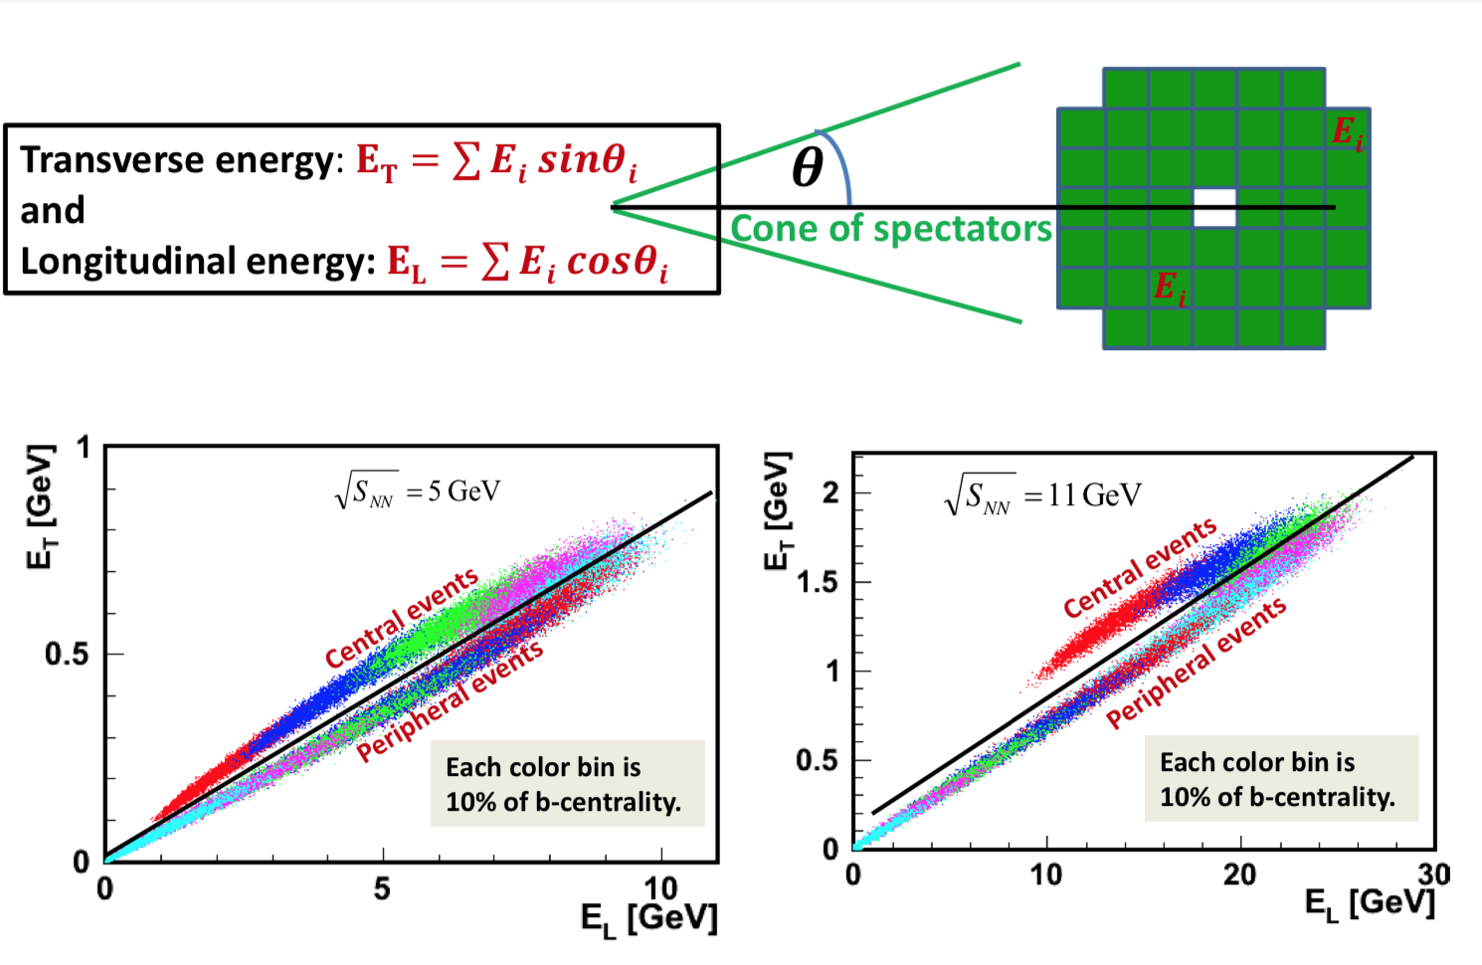
Approaches to determine “centrality” in Monte Carlo
FHCal response - suggested by INR team method of correlations between transverse and longitudinal energy deposition in calorimeters, see MPD Physics Seminar - https://indico.jinr.ru/event/1012/contributions/26/attachments/92/97/energy_distributions_FHCal.pdf
FHCal geometry is already in MpdRoot
We need manpower to implement this method to MpdRoot so that any analyzer would be able to get centrality measured by FHCal.

Slide 6
Approaches to determine “centrality” in Monte Carlo
Multiplicity in TPC - suggested by MEPHI/GSI/INR team method
see a number of reports, e.g. at MPD Physics seminar: https://indico.jinr.ru/event/1013/contributions/29/attachments/95/100/CentralityEstimationMPD.pdf
or PWG1 meeting: https://indico.jinr.ru/event/1129/
It has already been tested with MpdRoot to some extent (see https://git.jinr.ru/nica/mpdroot/-/blob/pro/macro/physical_analysis/Flow/Utilities/get_centrality.C )
Needed to be propagated as a common method to be able to call from MpdEvent

Slide 7
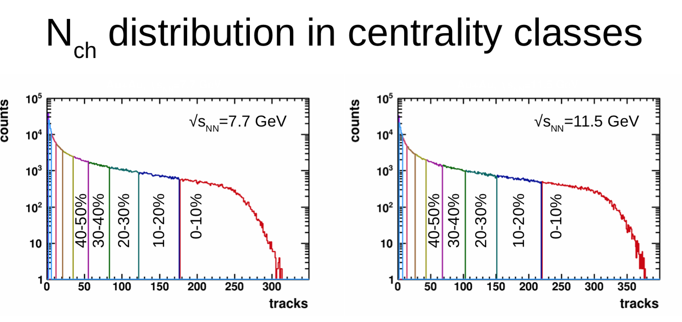
Approaches to determine “centrality” in Monte Carlo
Multiplicity in TPC - suggested by MEPHI/GSI/INR team method
see a number of reports, e.g. at MPD Physics seminar: https://indico.jinr.ru/event/1013/contributions/29/attachments/95/100/CentralityEstimationMPD.pdf
or PWG1 meeting: https://indico.jinr.ru/event/1129/
It has already been tested with MpdRoot to some extent (see https://git.jinr.ru/nica/mpdroot/-/blob/pro/macro/physical_analysis/Flow/Utilities/get_centrality.C )
Needed to be propagated as a common method to be able to call from MpdEvent

Slide 8
Tasks
We urgently need a common effort from INR, MEPHI and software development groups of MPD.
Once these methods are implemented within MpdRoot, we would need a manpower to test these approaches.

Slide 9
Example: centrality determination in ALICE
Public note “Centrality determination in heavy ion collisions” - http://cds.cern.ch/record/2636623

