Slide 1






The Transparent Nucleus
Unperturbed nucleon knockout measurements
in inverse kinematics with a 48 GeV/c Carbon beam
The BM@N Collaboration
May 12th, 2020

Slide 2
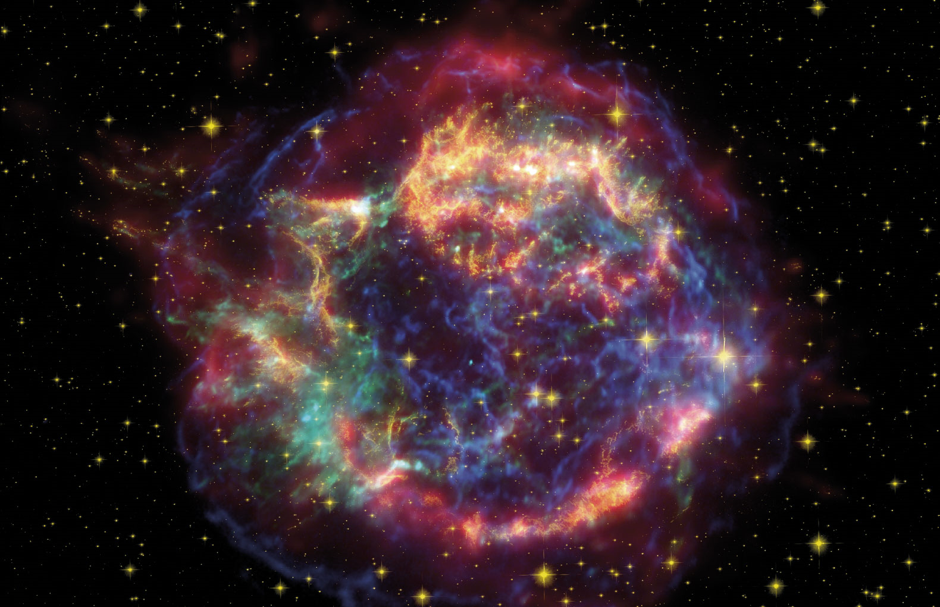
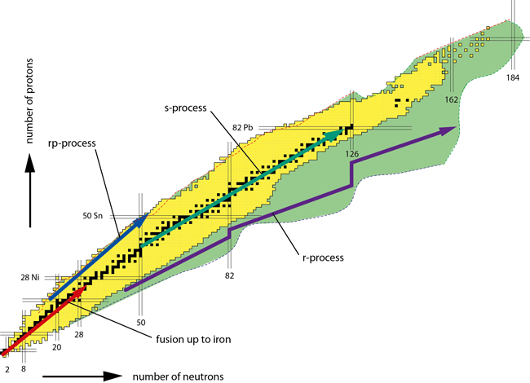
From QCD to the Stars
All visible matter produced in astrophysical scenario
Heavy elements: very neutron-rich environment

Slide 3
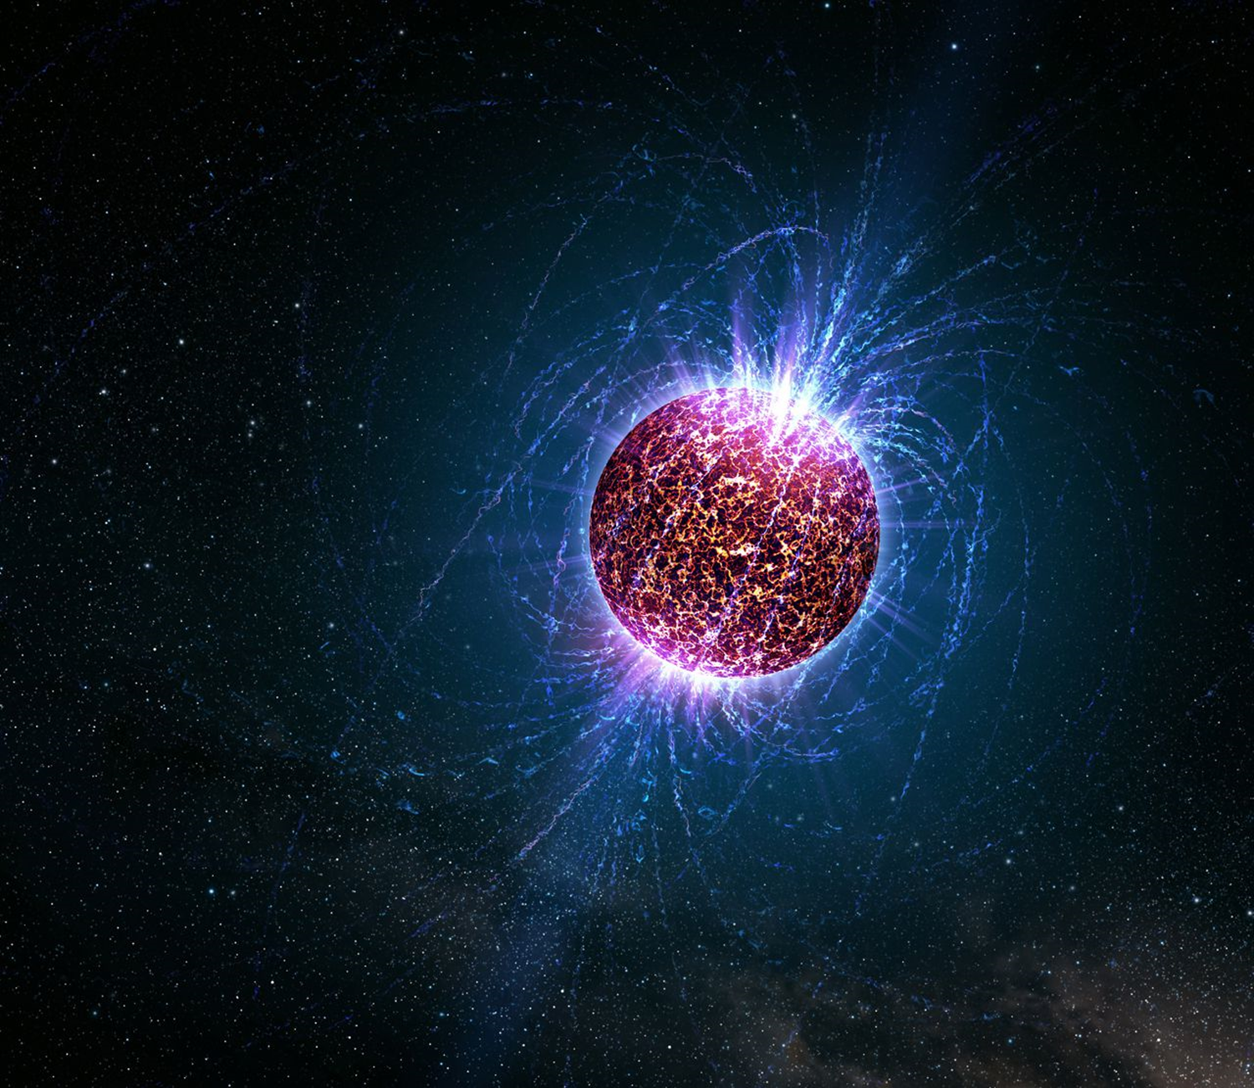
From QCD to the Stars
Extreme forms of matter in neutron stars:
ρ ~ ρ_{SRC} ~ 2-5 ρ₀

Slide 4
From QCD to the Stars
Information about
Nucleon-Nucleon Interaction and
Nuclear Structure
key input for understanding exotic nuclei and dense nuclear matter
Experiment
Theory
Rare-isotope beams in inverse kinematics
Probe single-nucleon removal
Model strongly-interacting quantum many-body system
Reaction Theory

Slide 5
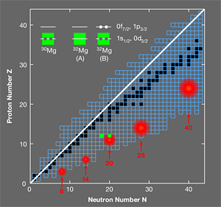
Properties of Exotic Nuclei
Independent-particle shell model works well only for nuclei close to
β stability
Nuclear structure changes dramatically with neutron-proton asymmetry
→ known magic numbers disappear
B.A. Brown, Physics 3, 104 (2010)

Slide 6
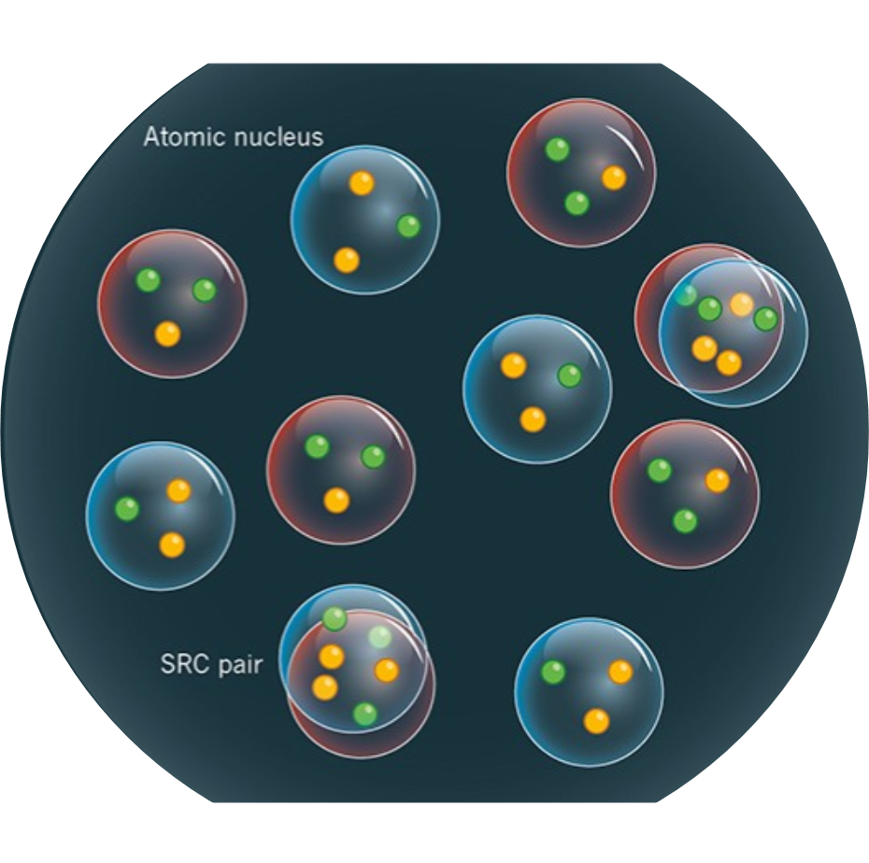
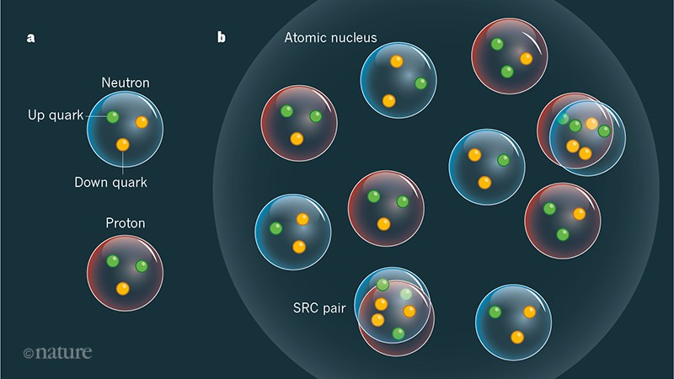
Study Single-Nucleon Momentum Distributions ?
- e⁻ scattering (stable nuclei)
or
- Nucleon knockout reactions
or …
→ Reconstruct initial nucleon
momentum from scattered
particles

Slide 7
Quasi-Free (p,pN) Scattering (QFS)
G. Jacob and Th.A.J. Maris, Rev. Mod. Phys. 38, 1 (1966):
QFS = Remove single nucleon moving in nucleus by proton
A(p,2p)A-1 scattering (100~1000 MeV)
Problem:
Initial and Final State Interactions
→ long-standing problem in nuclear physics

Slide 8
Initial and Final State Interactions (ISI / FSI)
(p,2p)
Initial and Final State Interactions
Incoming proton and
Outgoing protons
interact with other nucleons
→ disturb initial momentum
reconstruction
→ extra excitations of the nucleus
(break fragment apart)
→ eject additional particles (pions, …)

Slide 9
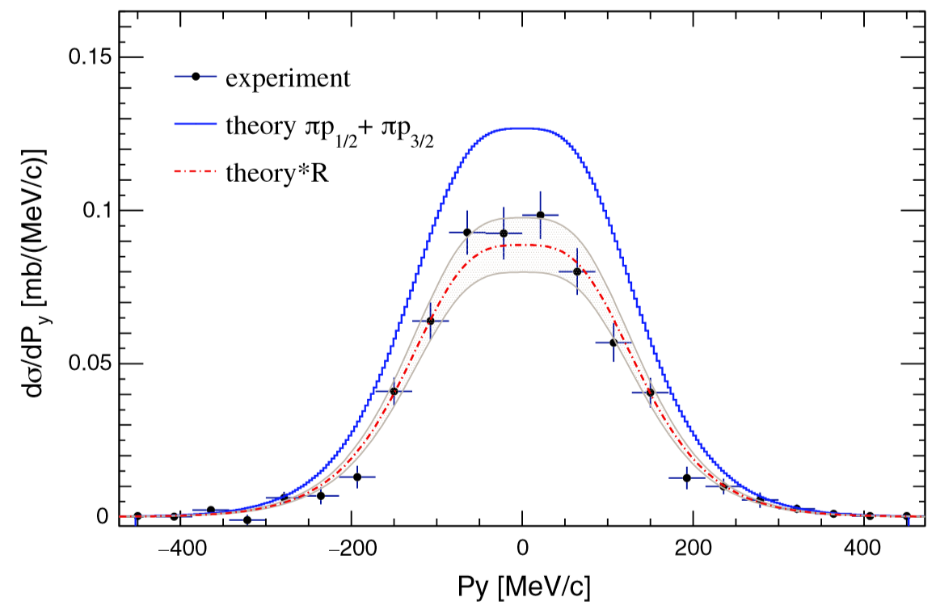
Momentum Distribution in Quasi-Free Scattering (QFS)
16O(p,2p) at 450MeV/u
select fragment final state
but not
distinguishing inelastic contributions
→ introduces model-dependence
L. Atar et al. (R3B Collab.), Phys. Rev. Lett 120 (2018)

Slide 10
Momentum Distributions in Quasi-Free Scattering (QFS)
16O(p,2p) at 450MeV/u
select fragment final state
but not
distinguishing inelastic contributions
→ introduces model-dependence
We show how to overcome those obstacles
in single-step nucleon-knockout QE reactions at high energies
L. Atar et al. (R3B Collab.), Phys. Rev. Lett 120 (2018)

Slide 11
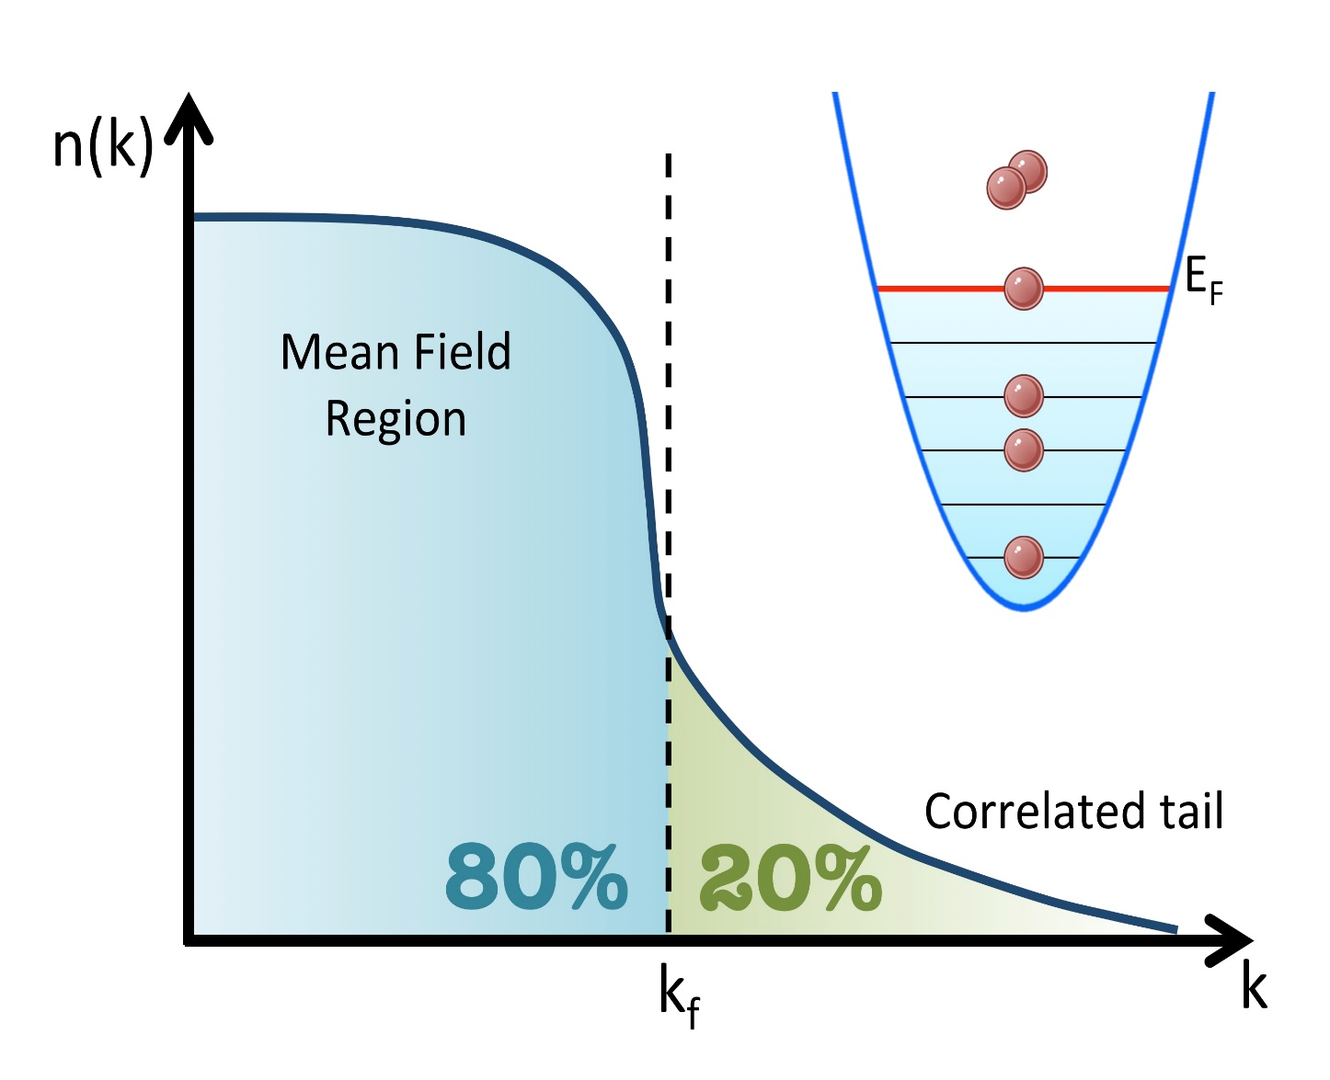
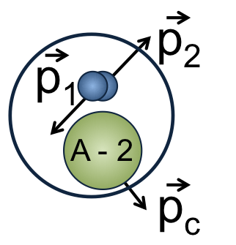
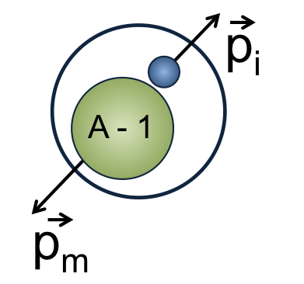
Probe full Momentum Distribution:
Meanfield + Short Range Correlations
R. Subedi et al., Science (2008) O. Hen et al., Science (2014)
M. Duer et al., Nature (2018)
Need high-energy probe
beyond long-range
shell-model interactions
Impacts energy balance
of protons and neutrons
→ how evolves with large
neutron-proton
asymmetry?
k_{F}

Slide 12
Our Pilot-Experiment (2018)
well known system: 12C
(p,2p) 90° c.m. scattering
high momentum: 4 GeV/c/u
inverse kinematics
→ extract momentum distribution
→ identify SRC signal in inverse kinematics

Slide 13
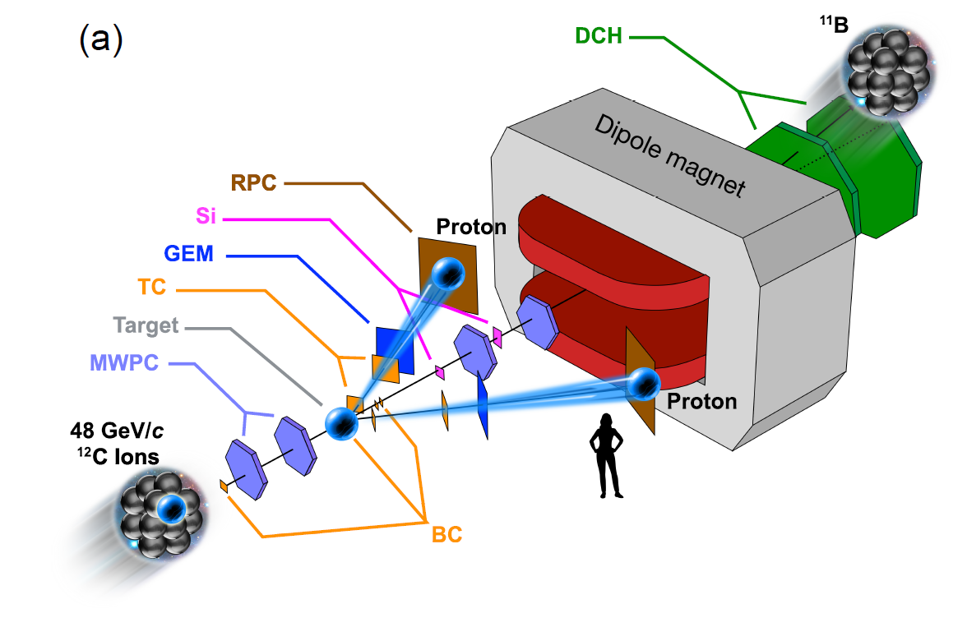
Experiment at BM@N
¹²C(p,2p)X
Two-Arm
Spectrometer

Slide 14
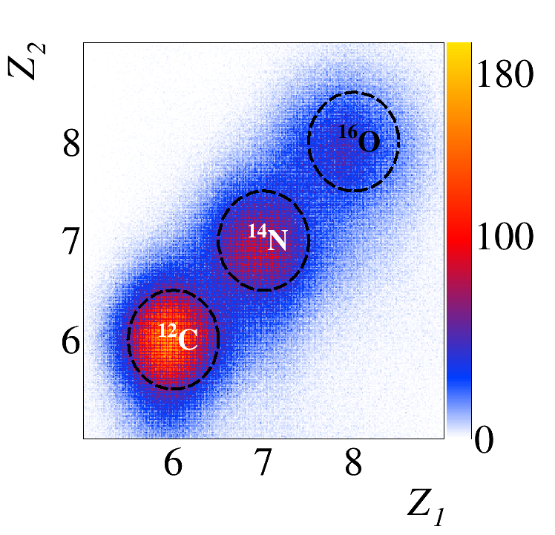
Experiment at BM@N
Incoming Particle ID (BC1 vs. BC2)

Slide 15
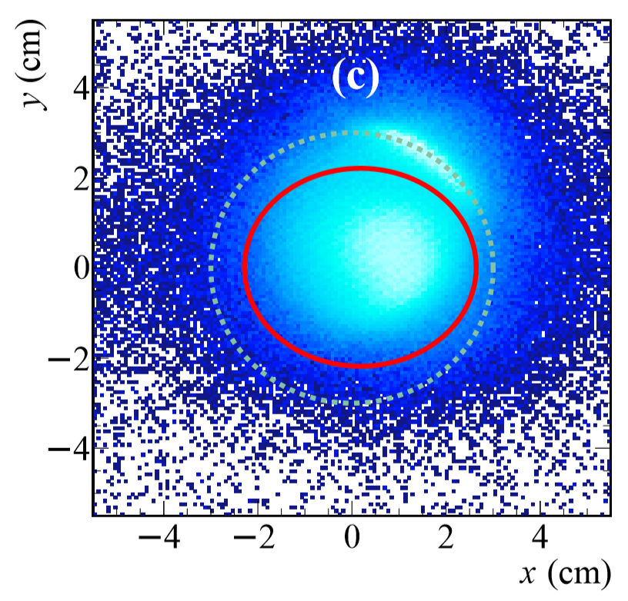
Incoming Beam Tracking
MWPC Pair upstream the target
Beam Profile

Slide 16
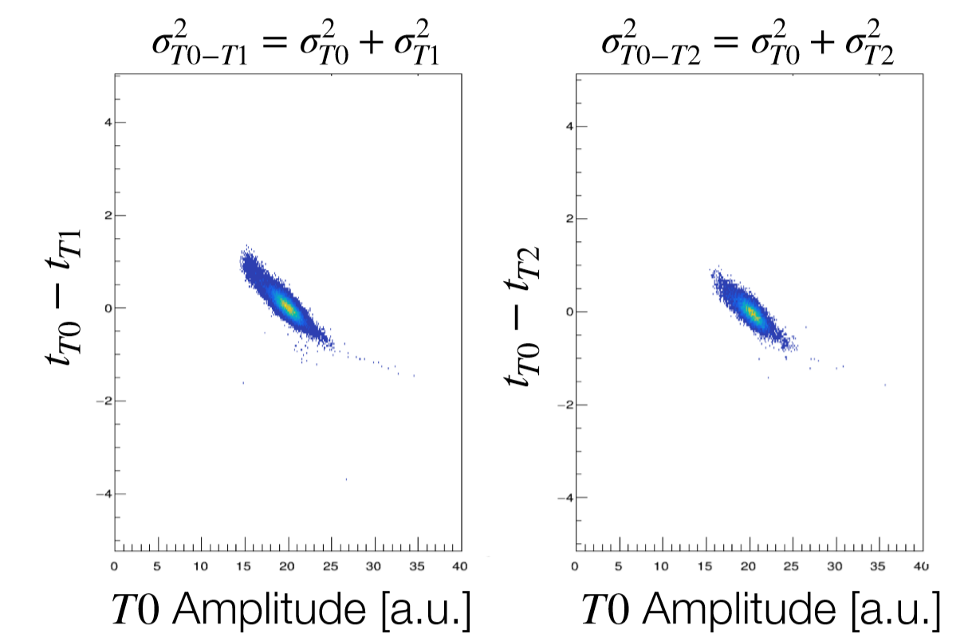
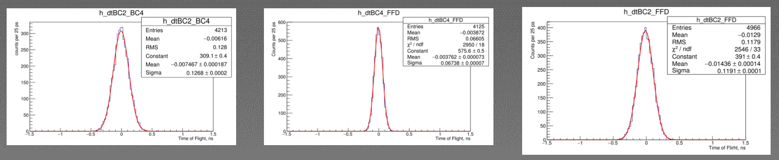
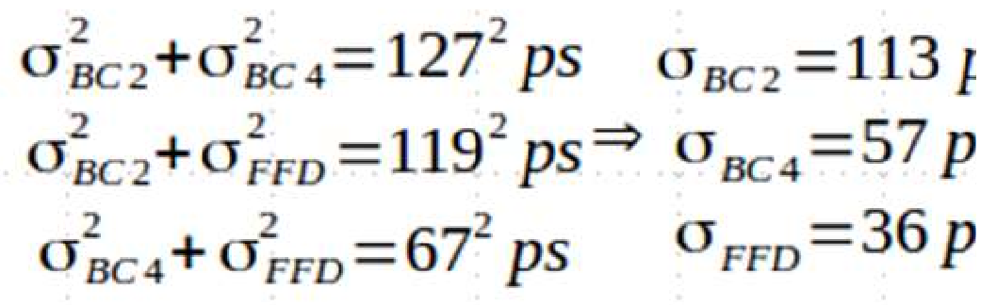
Start Timer BC2 (T0)
- Used two fast-timing beam counters with T0 in low-luminosity run
- Extract T0 resolution and time-walk correction →σ_{T0} ≈113 ps

Slide 17
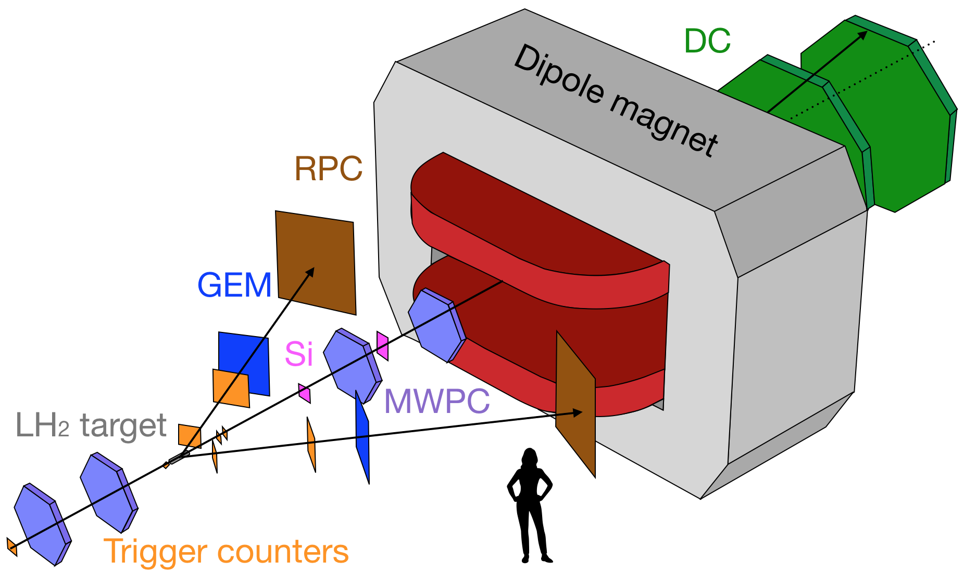
Two-Arm Spectrometer for Proton Momentum Measurement
90° c.m. scattering
→ large symmetric lab. angle scattering
GEM and RPC
→ linear tracks
Closest approach of 2 tracks
→ Vertex

Slide 18
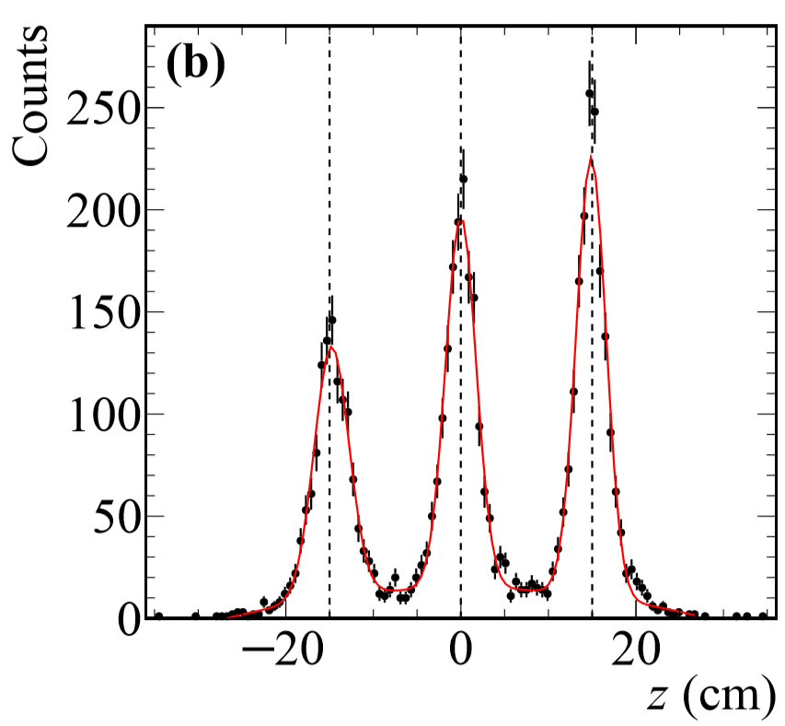
Reaction-Vertex Reconstruction
Confirm Calibration Procedure
with 3 lead targets
σ(z) = 1.8cm

Slide 19
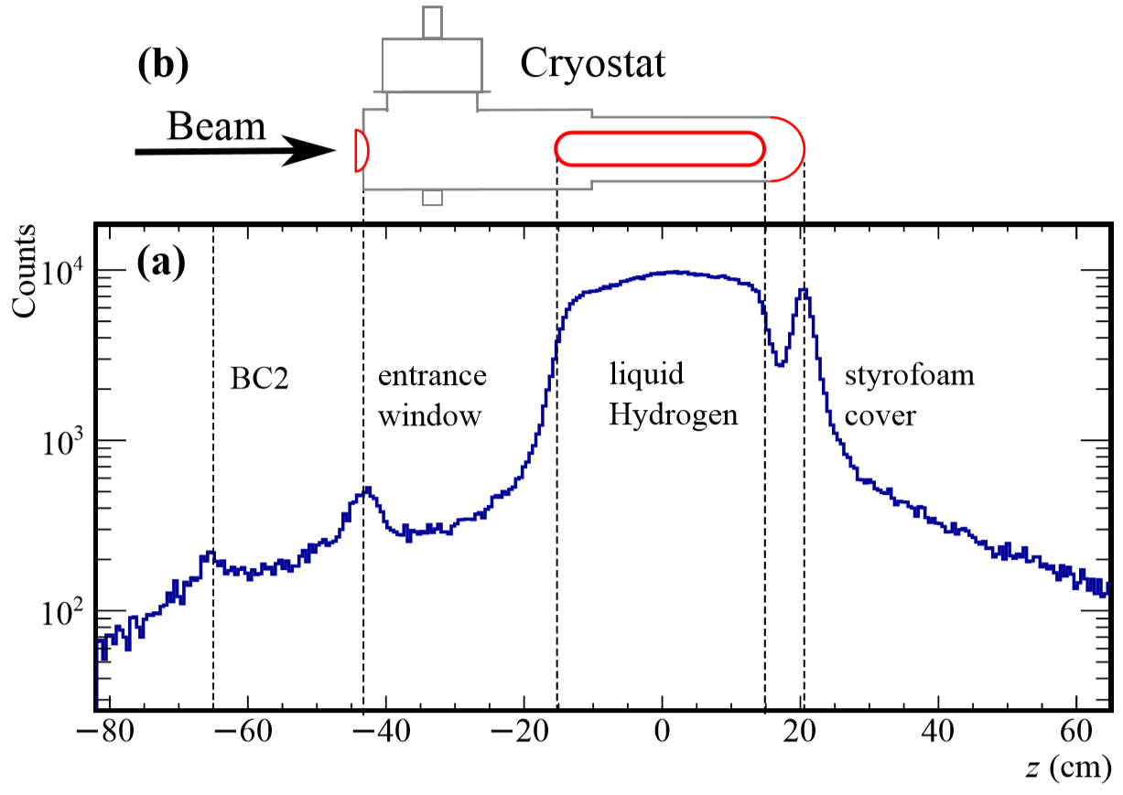
Reaction-Vertex Reconstruction
LH₂ Target Runs
Analysis
cut

Slide 20
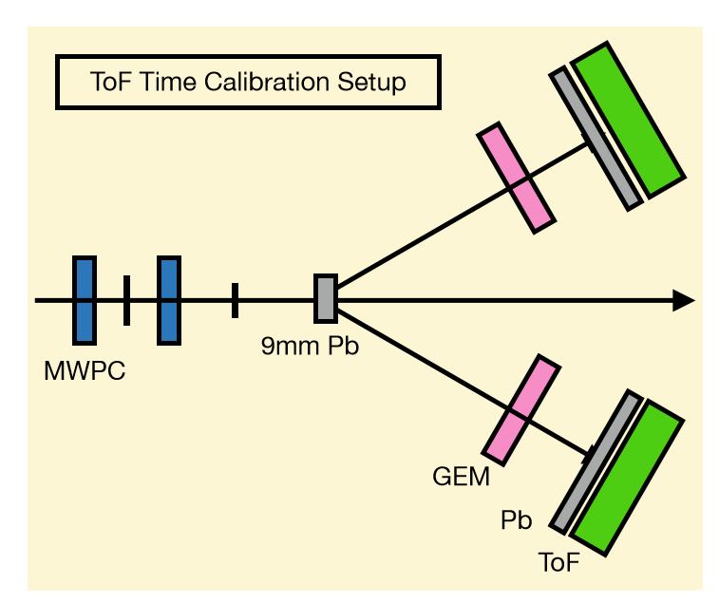
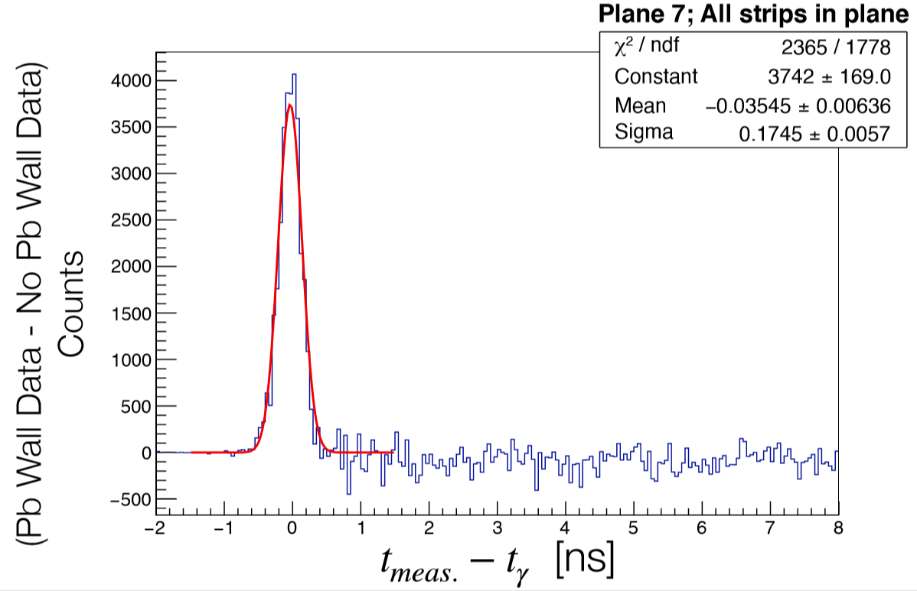
Two-Arm Spectrometer: ToF Calibration
- 9mm Pb target
data with and without Pb sheet in front of RPC
Extract ToF resolution using gamma ﬂux
σ = 175ps

Slide 21
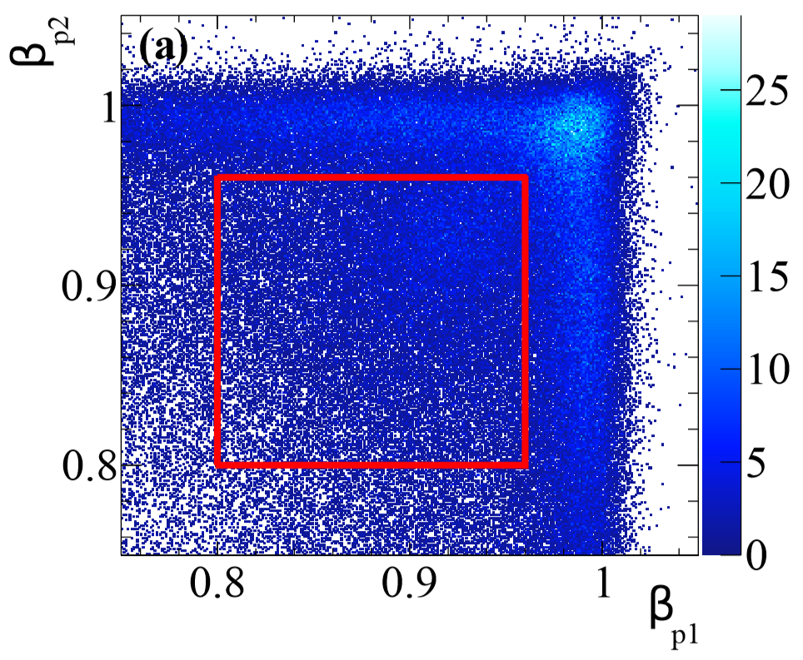
Proton Identification and Momentum
Reject very fast and slow particles:
1.25 GeV/c < p_{p} < 3.20 GeV/c
Vertex
Fight length
Time-of-flight
Momentum
(additional cuts follow to select quasielastic event)

Slide 22
Inclusive Reaction Channel (p,2p)
single incoming ¹²C
good vertex
velocity cut
(additional cuts to select quasi-elastic event)

Slide 23
Outgoing Particle ID
P/Z ~ Bending in Magnet

Slide 24
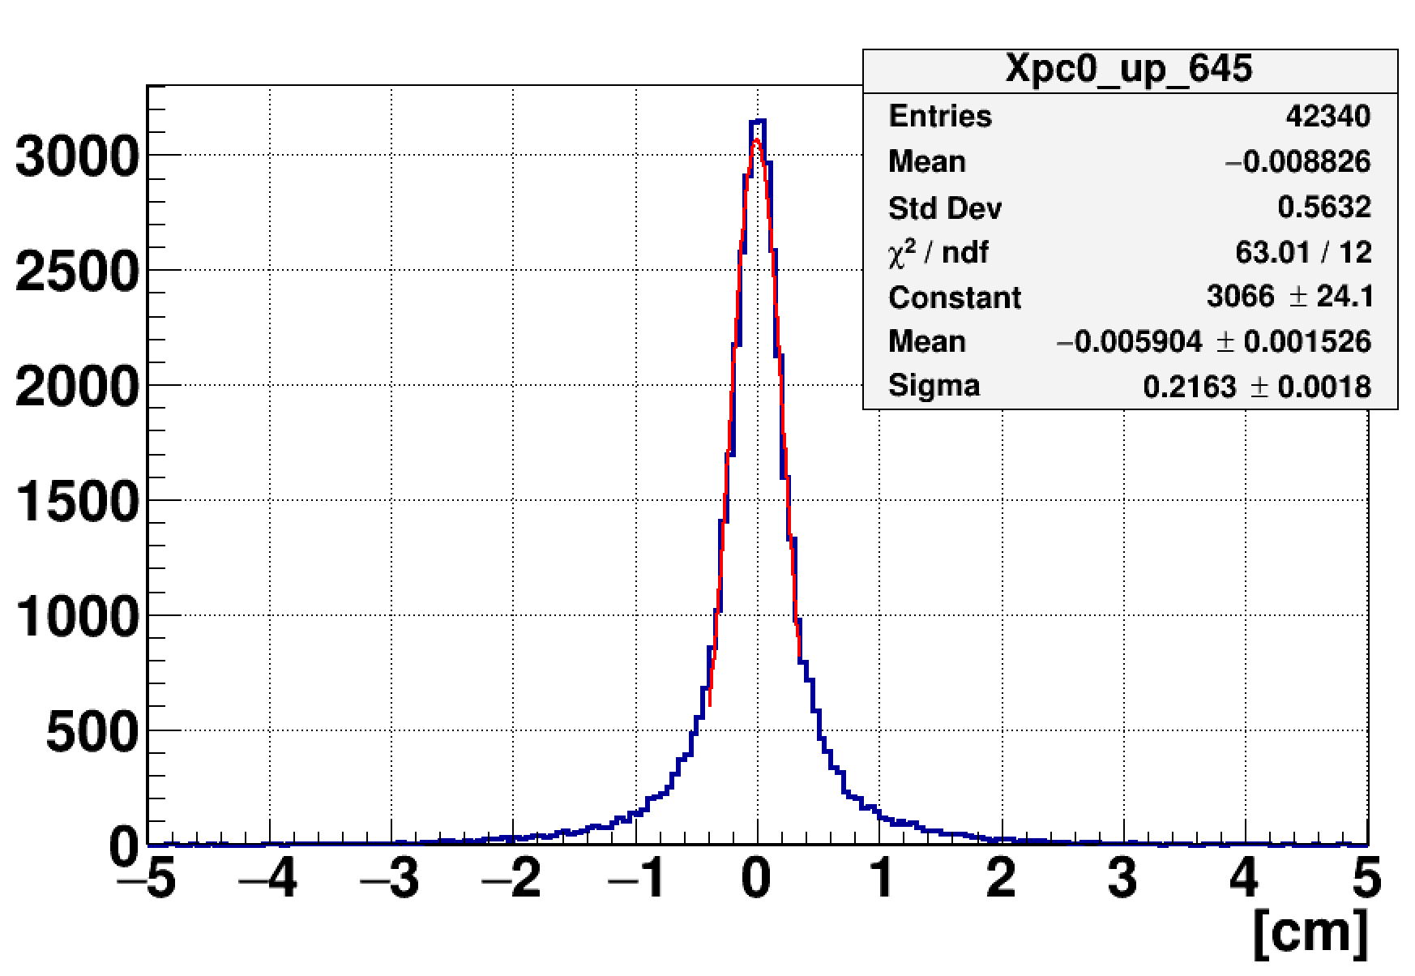
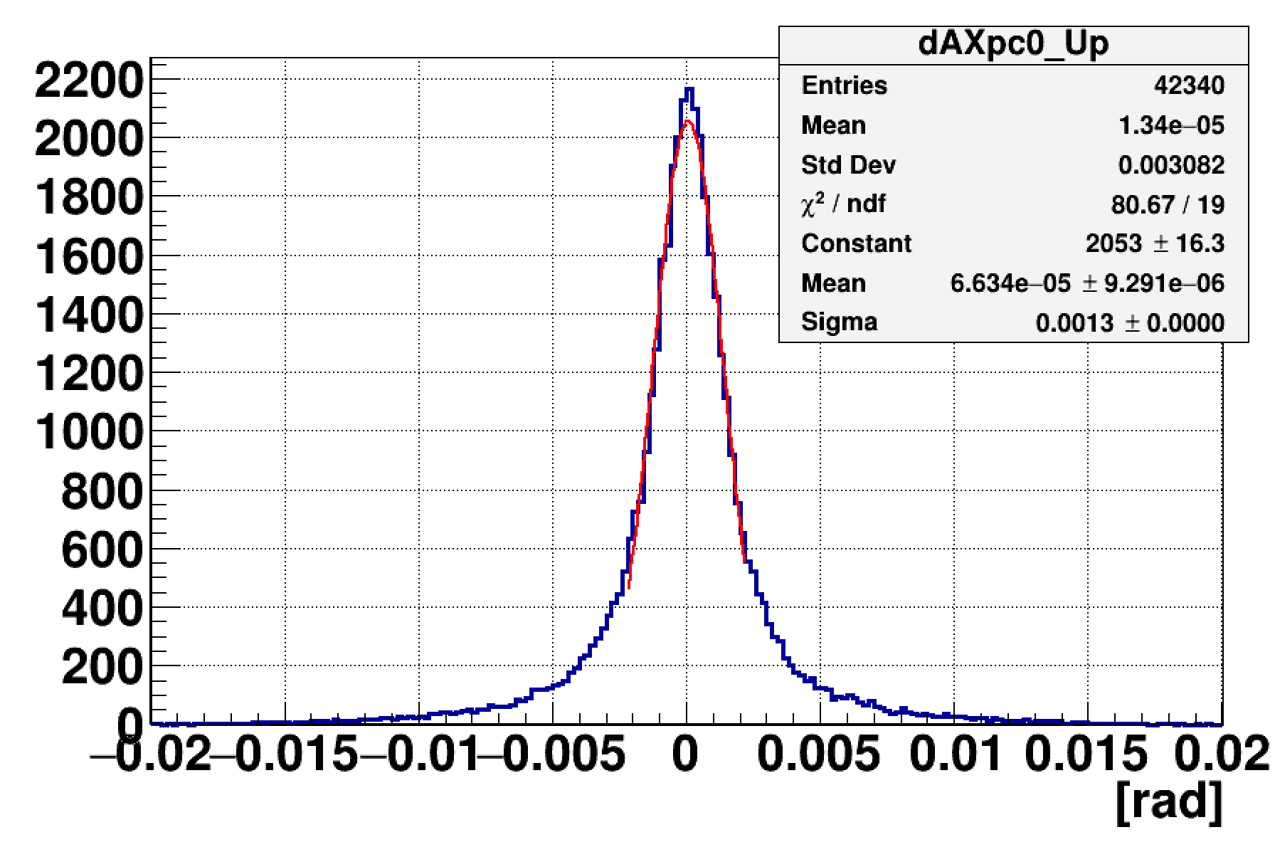


Fragment Tracking (Upstream the Magnet)
- Combine Si + MWPC (OR only Si OR only MWPC)
- detection efficiency of 98%
- defines the scattering angle (rel. to beam)
Pair0-Upstream Matching
dX
dtgX
$σ$= 2.2 mm
$σ$= 1.3 mrad
→ x_{up},y_{up},z_{up},α_{x},α_{y}

Slide 25
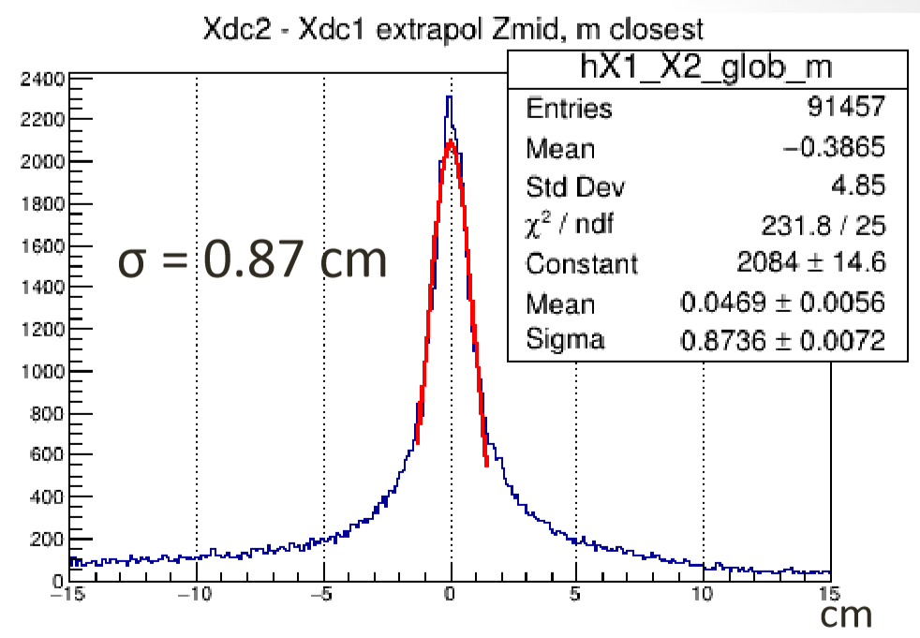
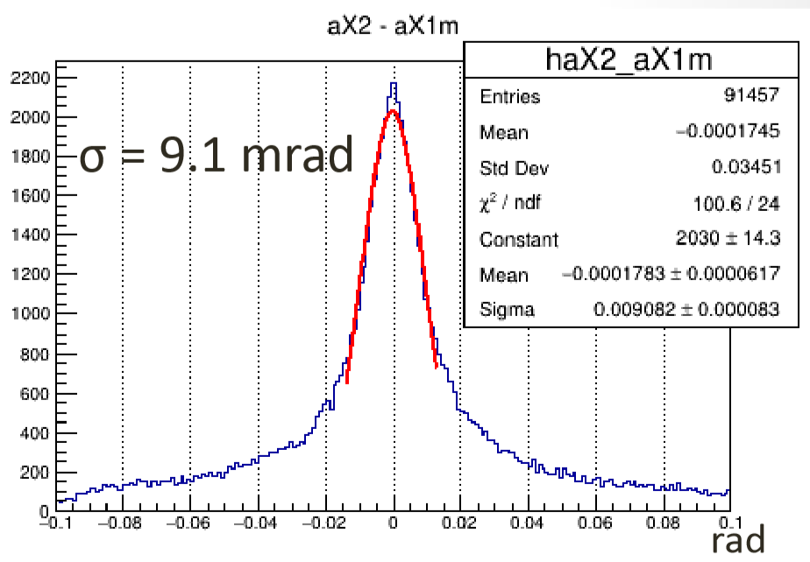
Fragment Tracking (Downstream the Magnet)
- Combine DCH1 + DCH2
- detection efficiency of 98%
- defines the bending angle (rel. to upstream)
DCH1-DCH2 Matching
→ x_{DCH},y_{DCH}, z_{DCH}, β_{x},β_{y}

Slide 26
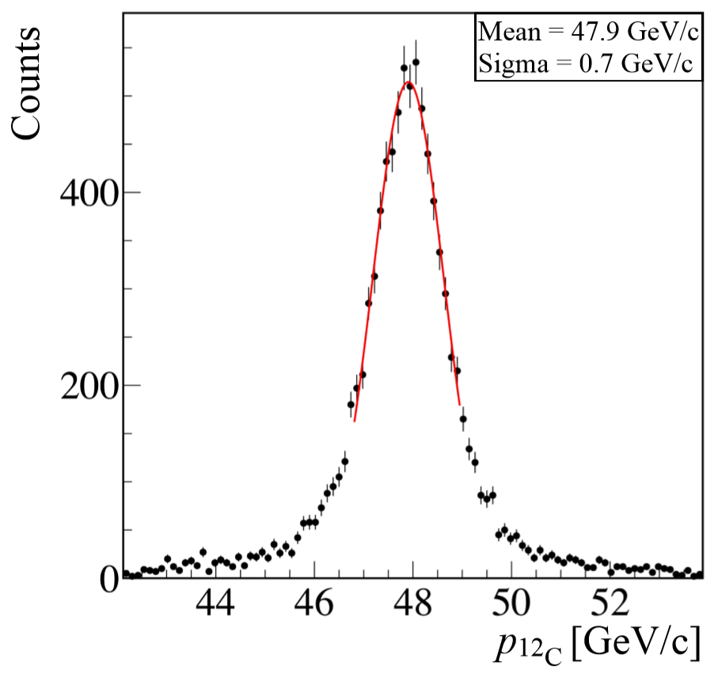
Fragment Momentum
P/Z ~ bending in magnet
Generate simulation-based
multi-dimensional fit function
(including energy-loss):
P/Z = f(x_{up},y_{up},z_{up},α_{x},α_{y},x_{DCH},y_{DCH}, z_{DCH}, β_{x},β_{y})
Tracking Efficiency: (50±5)%
Reconstructed Momentum for ¹²C in empty-target run
σ(P)/P = 1.5%

Slide 27
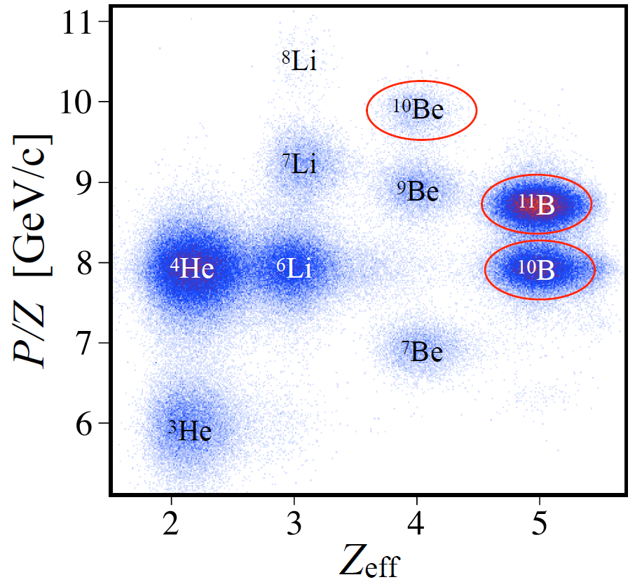

Outgoing Particle ID
Evaluated in multi-dimensional Fit
Total charge
BC3 & BC4

Slide 28
Exclusive Reaction Channel (p,2p)X
Inclusive +
single global track +
identified heavy fragment X
*global track = matched track between up- and downstram tracking detectors (for all their multiplicities)

Slide 29
Experiment at BM@N
¹²C(p,2p)X

Slide 30
Single Proton Knockout ¹²C(p,2p)
Extract the initial momentum of knocked-out proton:
No ISI/FSI
measured

Slide 31
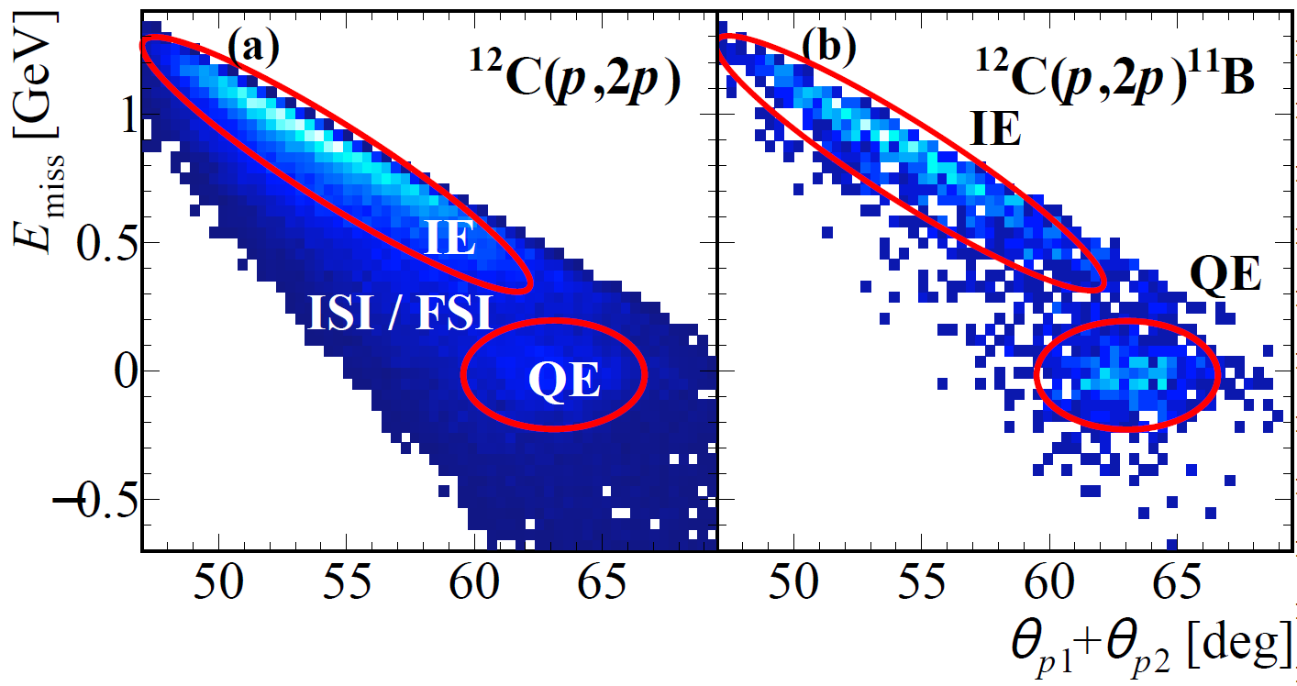
Single Proton Knockout: Inclusive ¹²C(p,2p)
contaminated by
Inelastic scattering (IE) and ISI / FSI

Slide 32
Single Proton Knockout: Exclusive ¹²C(p,2p)¹¹B
tagging the fragment removes ISI / FSI
select quasi-elastic scattering (bound 11B)
Preliminary BM@N Data

Slide 33
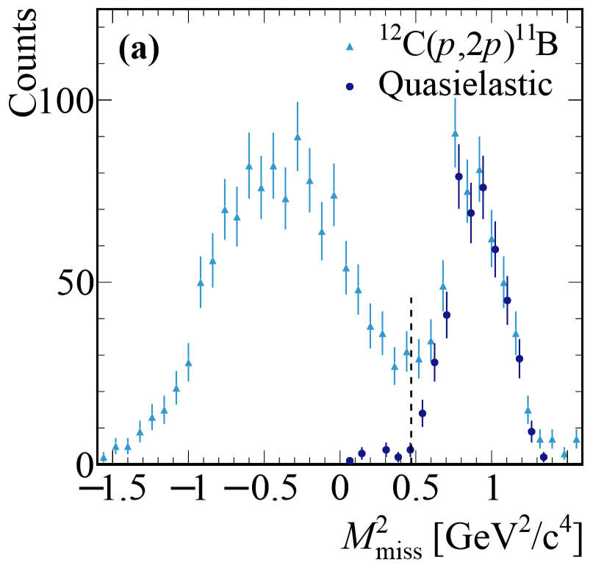
QE Single Proton Knockout ¹²C(p,2p)¹¹B
Missing mass confirms background-free proton knockout
Preliminary BM@N Data

Slide 34
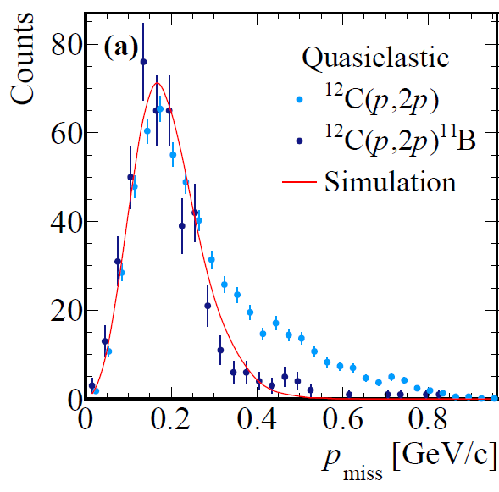
Probing the Meanfield Proton Momentum Distribution
Preliminary BM@N Data
Direct confirmation:
Fragment tagging
suppresses ISI / FSI
(¹²C p_{3/2}-shell)

Slide 35
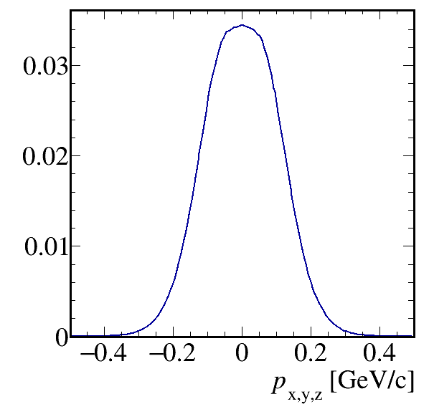
Single-Proton Knockout Simulation
Input:
¹²C p_{3/2}-shell distribution (C. Bertulani)
+ exp. pp differential cross section
Reaction kinematics
Acceptance+
Resolution+
Analysis cuts
Momentum distribution without ISI / FSI

Slide 36

Proton-Fragment Correlation: Confirm QFS scattering
Preliminary BM@N Data
Spectator Fragment:
p_{i} = - p_{11B}
→ back-to-back emission
Transverse opening angle

Slide 37
¹¹B Fragment Momentum
Spectator Fragment:
Initial proton momentum
can be reconstructed
from IE processes also
Preliminary BM@N Data

Slide 38
1. Results
Single-step proton knockout
selects QE channel
strongly suppresses ISI / FSI
by fragment tagging
extract initial momentum distribution
Fragmentation of residual:
  (10.5 ± 1.8)% to 10B
  ≤ 2% to 10Be
  ∼ 50% Z<4
Preliminary BM@N Data
„Ground-state properties of exotic nuclei can be extracted quantitatively by the use of fully exclusive (p,pN) knockout reactions in inverse kinematics at the high-energy radioactive beam facilities“

Slide 39
Hard Breakup of SRC Pairs
np pair
¹²C(p,2p) ¹⁰B
pp pair
¹²C(p,2p) ¹⁰Be
SRC Pair

Slide 40
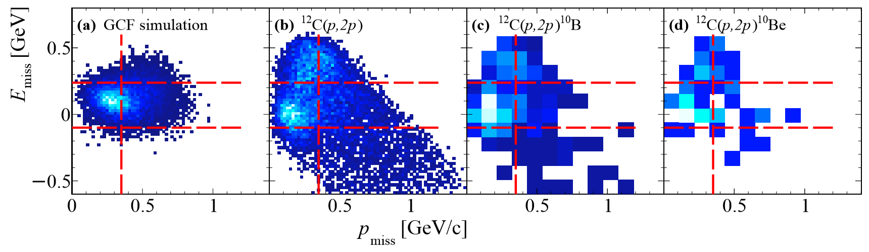
Selection of SRC
inclusive channel +
10B or 10Be +
p_{miss} > 350 MeV/c
GCF Simulation
Preliminary BM@N Data
Guide selection with the Simulation
in Generalized Contact Formalism
A. Schmidt et al., Nature (2020)

Slide 41
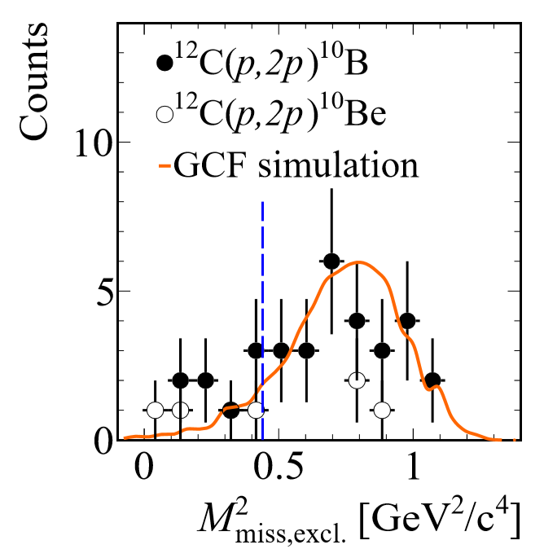
Selection of SRC
inclusive channel +
10B or 10Be +
p_{miss} > 350 MeV/c +
-110 < E_{miss} < 240 MeV +
in-plane opening angle > 63° +
Mmiss > 420 MeV²/c⁴
NEED PICTURE for angle with cut
Preliminary BM@N Data

Slide 42
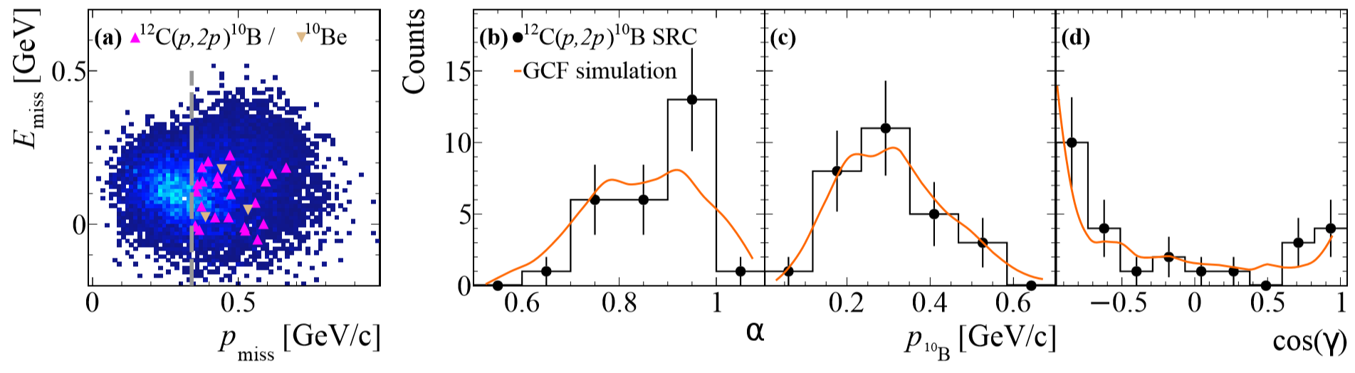
SRC Breakup
Preliminary BM@N Data
26 events with ¹⁰B
3 events with ¹⁰Be
→ np pair dominance
Possible contamination:
1. ¹¹B IE events?
Result in #¹⁰B ~ ¹⁰Be due to similar np / pp cross section
2. QE meanfield events with excited ¹¹B?
Estimated contribution of 5 (10B) and 2 (10Be) events

Slide 43

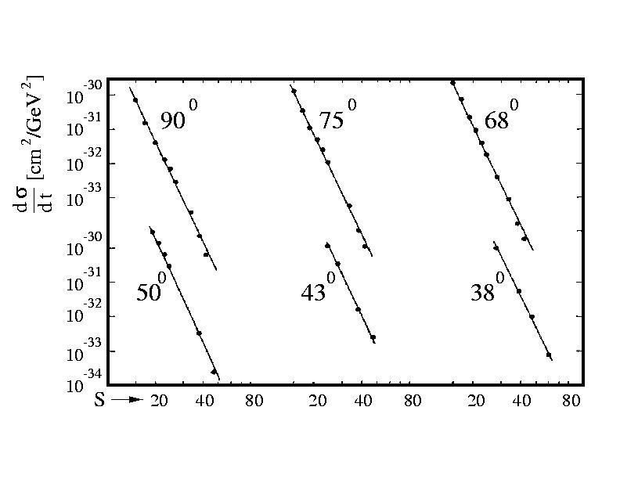
SRC Breakup
Preliminary BM@N Data
strong s-dependence of large-angle pp
elastic scattering cross-section

Slide 44
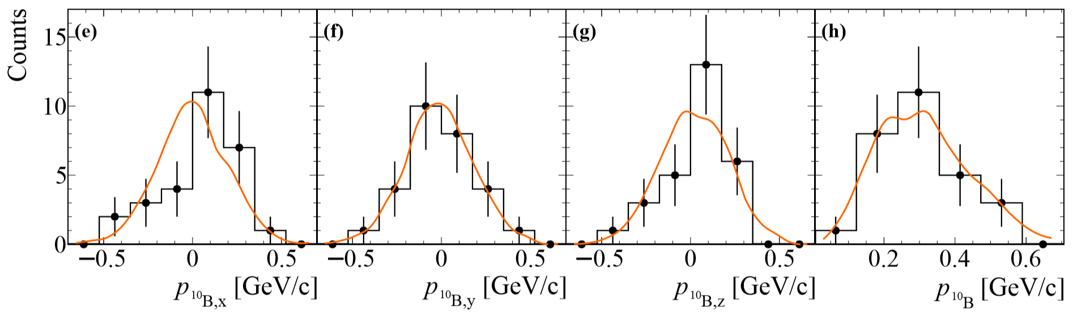
SRC Breakup
Fragment momentum balances pair c.m. motion (no ISI / FSI)
E. Cohen et al., PRL (2018)
Preliminary BM@N Data

Slide 45
SRC Breakup
Opening angle (p_{miss},¹⁰B)
No correlation.
Indicates scale separation between c.m. and large relative momentum
Preliminary BM@N Data

Slide 46
Summary
Our experiment demonstrates the ability to:
Extract initial single proton ground-state properties
Study Short-range correlations with
high-energy inverse kinematics scattering
Opening the door for new campaign to study SRC in unstable asymmetric nuclei
ERC SYG 2020 Proposal by E. Piasetzky, T. Aumann, O. Hen
passed 1st step of evaluation March 2020
We ask for approval to present the preliminary data at this critical time of the proposal evaluation

Slide 47
Thank You to the Collaborators
and for Your Attention

Slide 48
Appendix

