Slide 1
Report
On the concluding theme “Investigations of Condensed Matter by Modern Neutron Scattering Methods”
and
Proposal
For opening of the new theme “Investigations of Functional Materials and Nanosystems by Neutron Scattering Methods”
Theme Leaders: D.P. Kozlenko, V.L.Aksenov, А.М.Balagurov

Slide 2
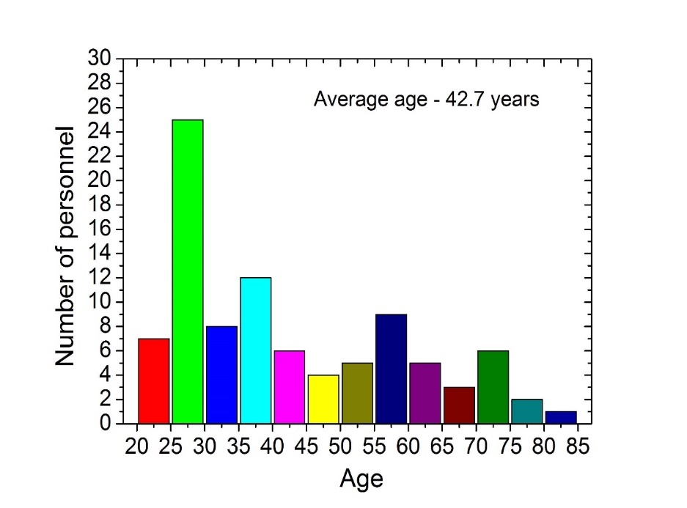
Department of Neutron Investigations of Condensed Matter, FLNP JINR
Sector 1 - Diffraction
Sector 2 – Neutron Optics
Group 1 – HRFD/FSD
Group 2 – DN-2
Group 3 – DN-12
Group 4 - SKAT
Group 1 – REMUR
Group 2 – REFLEX
Group 3 – GRAINS
Group YuMO
Group NERA
Staff number: 119
Main Staff: 51
Staff from Member states: 36
Part occupancy staff
(including students): 32
50 % of staff – younger than 45 years old

Slide 3
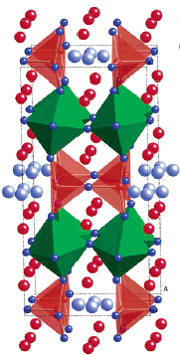
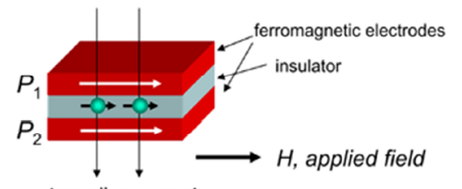
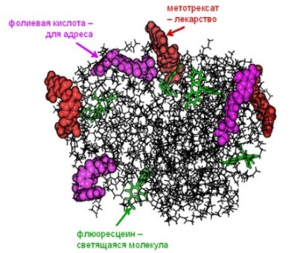
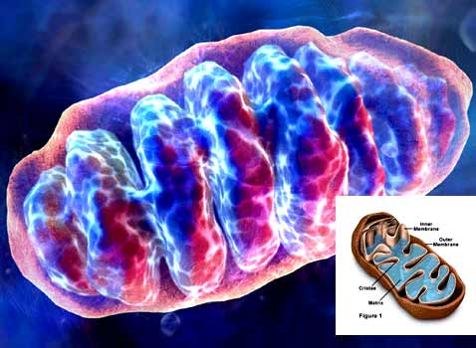
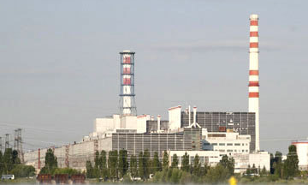
The priority directions of scientific research :
Physics and Chemistry of Novel Functional Materials;
Physics of Nanosystems and Nanoscale Phenomena;
Physics and Chemistry of Complex Liquids and Polymers;
Molecular Biology and Pharmacology;
Materials and Engineering Sciences.

Slide 4
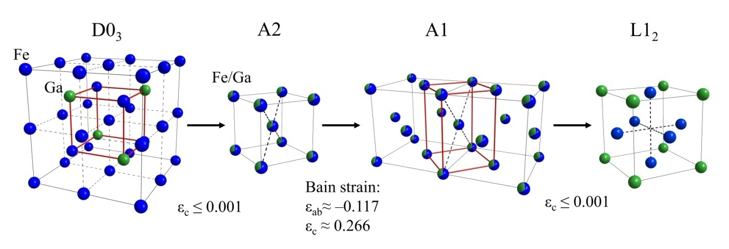
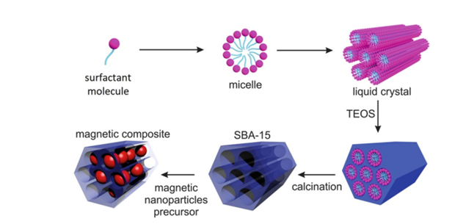
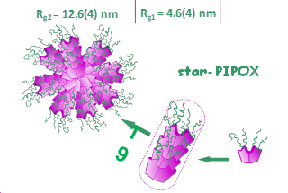
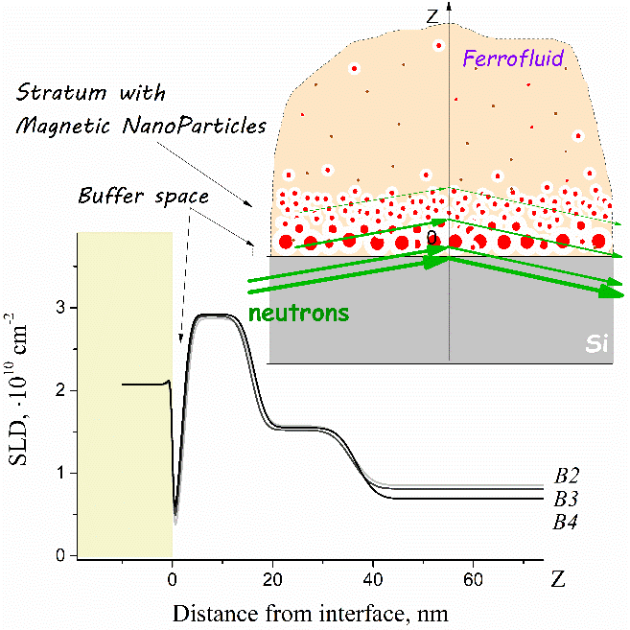
Summary of the important scientific results:
Determination of the structural, magnetic and electronic P-T phase diagram of magnetite Fe₃O₄;
Structural analysis of the phase transitions in giant magnetostrictive Fe-xGa alloys (x = 27.2 – 28 at. %) induced by isothermal annealing;
Determination of the structural organization of iron oxide nanoparticles in SBA-15 nanoporous silica;
Determination of the structural features of star-shaped poly(2-ethyl-2-oxazoline) and poly(2-isopropyl-2-oxazoline) with central thiacalix[4]arene fragments;
Analysis of the non-uniform external magnetic field effects on the adsorption of magnetic nanoparticles from ferrofluids on a flat interface;
Detailed activity report at https://indico.jinr.ru/event/1328/

Slide 5
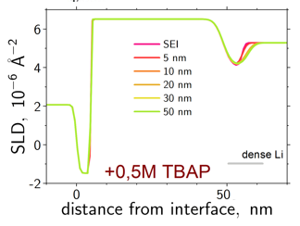
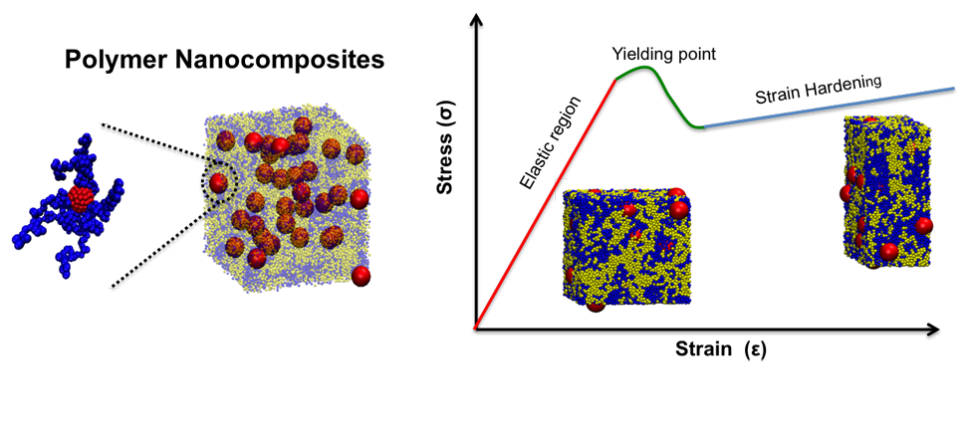
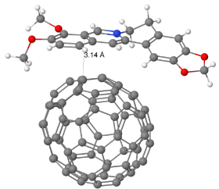
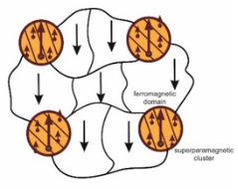
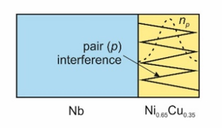
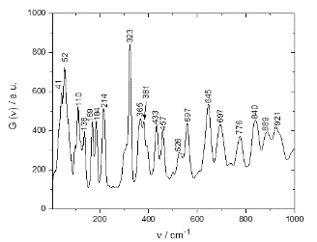

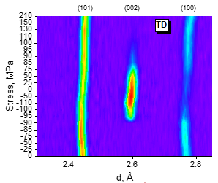
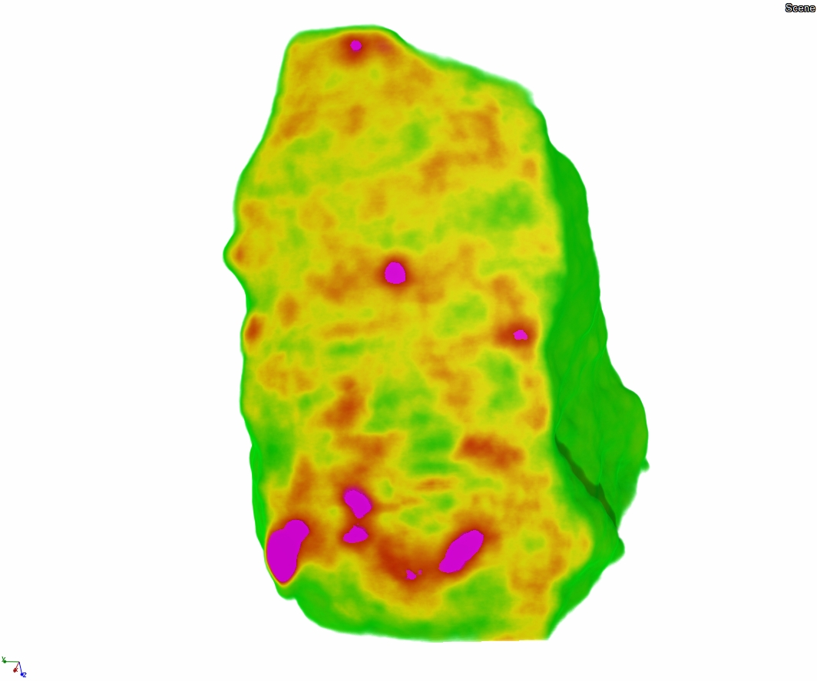
In-operando analysis of non-electroactive additive effects (tetrabutyl ammonium perchlorate) in Li-containing electrolyte on the formation of a solid-electrolyte interphase (SEI) in model electrochemical interfaces of ‘liquid electrolyte/solid electrode’ type;
Determination of the structural organization of C₆₀ and C₇₀ fullerenes in polystyrene nanocomposite thin films;
Determination of the structural features of the complexation processes between fullerenes and antitumor pharmacological ingredients;
Analysis of the properties of magnetic and superconducting states in layered Nb(70nm)/Ni_{0.65}Cu_{0.35}(6.5 nm) nanostructures;
Analysis of the vibrational spectra of Trans-1,3-, Cis-1,3-, Trans-1,2- and Cis-1,2-cyclohexanediol with general chemical formula C₆H₁₂O₂;
Determination of residual stresses in steels and magnesium alloys under applied load;
Analysis of the preferred crystallographic orientation of minerals in eclogites;
Analysis of the internal organization of cultural and natural heritage objects by means of neutron radiography and tomography.

Slide 6
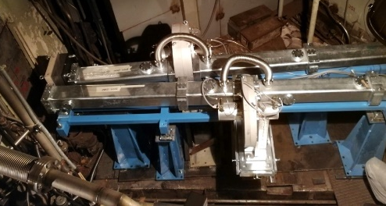
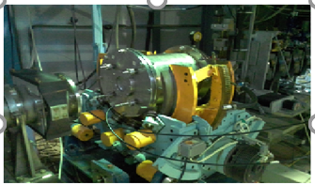
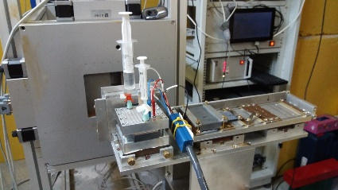
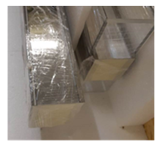
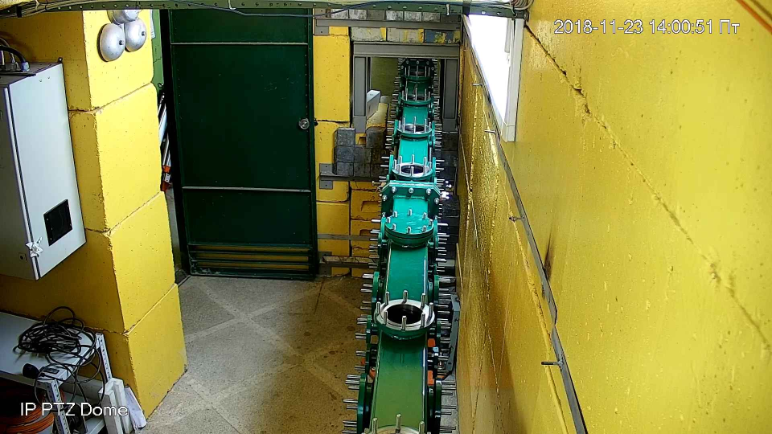
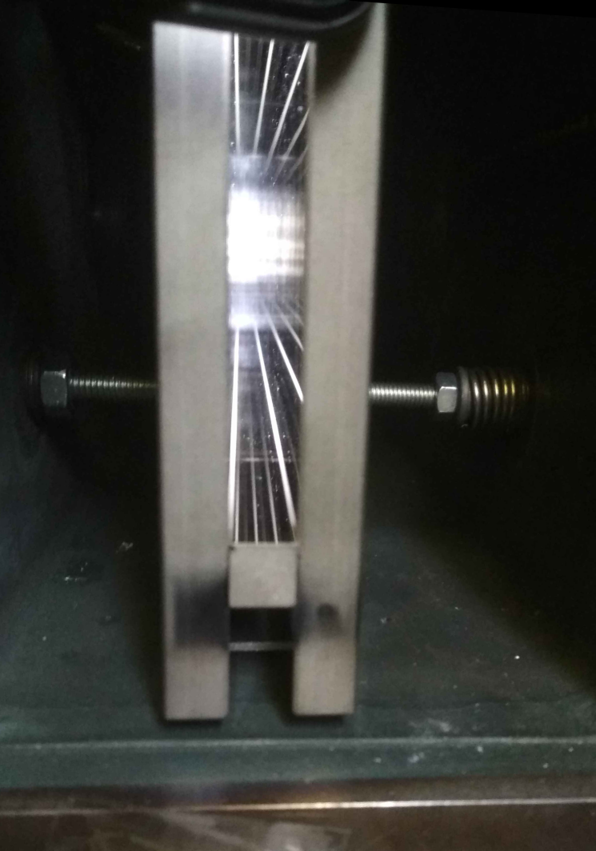
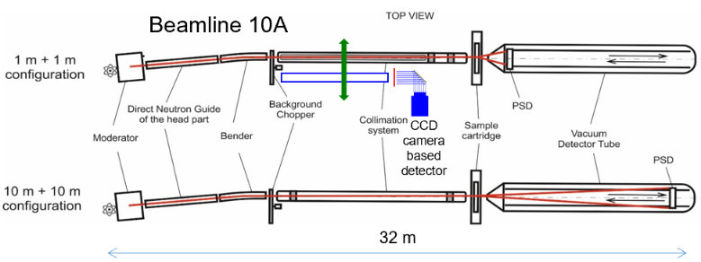
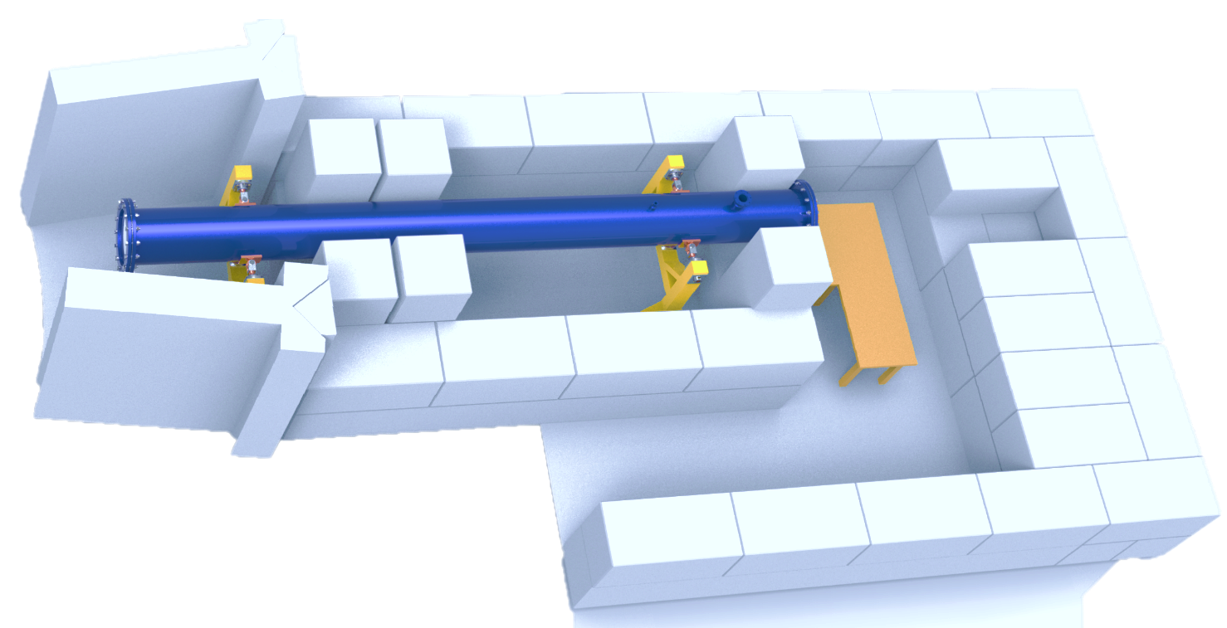
Summary of the most important methodical results:
Upgrade of the neutron splitting system at the 10 channel of IBR-2;
Development of the isotope identifying reflectometry at the REMUR reflectometer;
Modernization of the electrochemical cells for neutron reflectometry experiments;
Installation of the parabolic neutron focusing device (m = 5) at the NERA spectrometer;
Installation of the new mirror neutron guide (m = 2) at the FSS diffractometer at the 13 beamline of IBR-2;
Development of the elements of the neutron transportation system of the new small angle neutron scattering and imaging spectrometer to be installed at the 10A beamline;
Development, installation and putting into operation of the neutron radiography and tomography spectrometer at the stationary reactor WWR-K (INP, Kazakhstan).

Slide 7
Publications – 363
Conferences – 347
Patents - 5
JINR Prizes
2018
First prize in the field of experimental physics research “Correlation of structure and physical properties in ordered iron-based alloys”.
Authors: A. Balagurov, I. Bobrikov, S. Sumnikov, I. Golovin, V. Palacheva.
First prize in the field of applied research and technology “Structure and properties of aqueous solutions of C60 and C70 fullerenes for biological applications”.
Authors: E. Kyzyma, V. Petrenko, O. Ivankov, M. Avdeev, V. Aksenov, L. Bulavin, Yu. Prylutskyy.
2019
First prize in the field of applied research and technology “Application of neutron diffraction to study structural and microstructural transformations of Li-ion electrode materials during operation”.
Authors: I. Bobrikov, A. Balagurov, N. Samoylova, S. Sumnikov, O. Ivanshina, R. Vasin”.
Second prize in the field of applied research and technology “Neutron radiography and tomography at the pulsed high-flux IBR-2 reactor: development of the experimental facility and results of the interdisciplinary applied research”.
Authors: D. Kozlenko, S. Kichanov, A. Belushkin, E. Lukin, K. Nazarov, A. Rutkauskas, G. Bokuchava, B. Savenko, I. Saprikina.

Slide 8
User Programme Realization
2017 – 221 proposals; 203 accepted;
2018 – 131 proposals; 116 accepted;
2019 – 220 proposals; 196 accepted;
In average ~ 75 external visitors per year

Slide 9
Financial report (theme budget)
Planned | 2018, kUSD | 2019, kUSD | 2020, kUSD
Materials | 588.4 | 861 | 264
Equipment | 712.6 | 576 | 395.6
Research contracts | 70.0 | 58.0 | 20.0
International cooperation | 168.7 | 168.7 | 168.7
Information expenses | - | 20.0 | 15.0
Total | 1539.7 | 1683.7 | 863.3
Realization: | 95 % | 98 % | In progress
Additional financial sources – 500 kUSD per year, including:
Grants and programmes of PP of Poland, Slovak Republic, Czech Republic, Romania, Bulgaria,
BMBF-JINR Agreement,
Serbia_JINR Agreement,
RSA-JINR Agreement,
ARE-JINR Agreement,
RSF grants,
RFBR grants

Slide 10
Proposal for opening a new theme
“Investigations of Functional Materials and Nanosystems by Neutron Scattering Methods”
for the period 2021-2025
Theme Leaders: D.P. Kozlenko, V.L.Aksenov, А.М.Balagurov

Slide 11
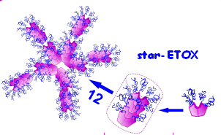
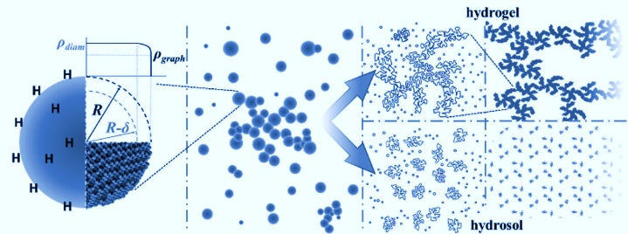
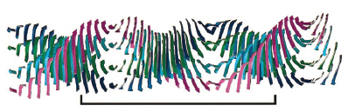
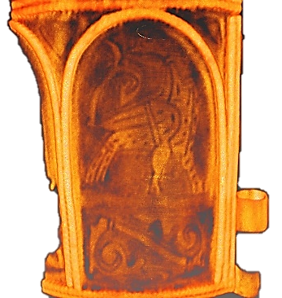
The priority research directions of the theme:
Condensed Matter Physics and Materials Science;
Physics of Nanosystems and Nanoscale Phenomena;
Physics of Complex Liquids and Polymers;
Biophysics and Pharmacology;
Applied Materials and Engineering Sciences.

Slide 12
Main scientific topics within priority research directions:
1.1 A study of structure and properties of novel inorganic and organic functional
materials,
1.2 A study of structural and magnetic properties of materials under extreme conditions,
1.3 A study of characteristics of physical and chemical processes in functional materials
in real time,
1.4 Computer modeling of physical and chemical properties of novel crystalline and
nanostructured materials;
2.1 A study of structural and magnetic properties of layered nanostructures;
2.2 A study of structural characteristics of carbon and silicon based nanomaterials,
2.3 A study of molecular dynamics of functional materials;
3.1 A study of structural characteristics of dispersed systems and complex liquids at
bulk and interface states,
3.2 Structural characterization of polymer materials;
4.1 A study of structural characteristics and functional properties of biological materials,
4.2 A study of structure and properties of lipid membranes and lipid complexes,
4.3 A study of structural characteristics and properties of biohybrid complexes;
5.1 A study of residual stresses and microstrains in constructional materials, industrial
products and earth rocks,
5.2 Neutron imaging of internal structure features of cultural and natural heritage
objects, constructional materials, industrial products,
5.3 A study of texture and physical properties of Earth’s rocks, minerals, and
constructional materials,
5.4 A study of radiation damage effects in condensed matter.

Slide 13
Expected Scientific Results:
Determination of characteristics of the atomic and magnetic structure of giant magnetostrictive alloys depending on thermodynamic and synthesis conditions, alloying additives and thermomechanical processing.
Determination of parameters of the atomic and magnetic structure of simple and complex oxides with a spinel-type structure under high pressure.
Determination of parameters of crystal, magnetic and electronic subsystems of multifunctional oxides based on cobalt, manganese, iron in the regions of spin, magnetic and metal-insulator phase transitions in a wide range of temperatures and pressures.
Study of structural mechanisms of the magnetoelectric effect in multiferroics.
Study of the effect of microstructure of electrodes with varying composition on charge-discharge processes in compact electric power sources. Clarification of structural mechanisms responsible for the capacity and lifetime of batteries. Selection of optimal discharge/charge modes during cycling.
Analysis of processes of deposition and intercalation of electrically active ions and their derivatives from liquid and solid electrolytes at electrochemical interfaces in compact electric power sources. A comparative study of characteristics of adsorption layers (density, thickness, homogeneity) at electrochemical interfaces for electrolytes and electrodes.
Study of phenomena and effects induced by the interaction of ferromagnetic and superconducting order parameters in complex structures with helicoidal magnetic ordering.
Investigation of structural stability of colloidal systems, including biomedical solutions, in bulk and at interfaces under various conditions. Determination of characteristics of adsorption layers at interfaces in case of loss of stability as a result of external influence of gradient electric and magnetic fields, as well as temperature effects. Study of the effect of aggregate formation in bulk on adsorption.
Investigation of the structure of advanced nanosystems based on composite carbon- and silicon-containing materials, including those based on fullerenes, nanodiamonds and their bioactive derivatives. Study of complex multicomponent systems.

Slide 14
Determination of structural characteristics of magnetic elastomers and carbosilane dendrimers, holding promise for technological applications.
Determination of structure and vibrational spectra of molecular complexes: ionic-molecular inclusive materials and complexes with electric charge transfer, structural and dynamic parameters of hydrogen bonds in bioactive materials.
Investigation of molecular mechanisms of protein interaction, dimerization and functional characteristics of supramolecular structures and molecular complexes. Study of regularities and relationships between structural characteristics and functions of proteins, protein complexes and membrane-protein aggregates. Analysis of the effect of composition and external parameters on the phase state of membranes.
Determination of structural characteristics and diffusion properties of lipid nanosystems for transport of drugs and nano-drugs.
Analysis of metamorphic, geodynamic and evolutionary processes in the lithosphere using data on textures of deep-seated and near-surface rocks. Investigation of relationships between seismic anisotropy of lithosphere rocks and textures of minerals, preferentially-oriented cracks and pores.
Nondestructive testing of residual internal stresses and microstrains in real industrial products and advanced structural materials induced by various technological processes (metal and heat treatment, welding, rolling, stamping, 3D printing, etc.).
Investigation of relationships between microstructure and thermomechanical properties of advanced functional and structural materials (high-strength steels, aluminum and magnesium alloys, composites, cermets, etc.), analysis of mechanical behavior of structural materials under external influences (load, temperature).
Analysis of internal structure and construction of 3D models of objects of cultural and natural heritage, industrial materials and products using neutron tomography and radiography data.
Clarification of mechanisms of radiation damage to solids, obtaining long-life operating data on radiation damage resistance of materials.

Slide 15

Methodical activities
Development of the instrumentation of the IBR-2 spectrometer complex.
Development of neutron scattering methods for interdisciplinary studies of nanosystems and materials.
The detailed plans of instrumentation development can be found at https://indico.jinr.ru/event/1328/
Additional materials,
Spectrometers development plan for 2021-2025
Project
1. Development of inverse geometry inelastic neutron scattering spectrometer at the IBR 2 reactor (2021-2023, project leader – Dr. D. Chudoba, separate presentation).

Slide 16
Expected methodical results:
Development and construction of elements of basic configuration of a small-angle scattering and imaging spectrometer on beamline 10.
Development and construction of elements of a neutron guide system for a new inverse geometry inelastic scattering spectrometer.
Development of neutron guide and detector system for the new DN-6 diffractometer for studies of microsamples, aimed at improving its technical parameters and expanding the available range of high pressures.
Improvement of technical parameters and expansion of experimental capabilities of the GRAINS multifunctional reflectometer (startup of a new neutron beam chopper, development of electrochemical and liquid cells for conducting experiments).
Modernization of the available IBR-2 spectrometers (HRFD, RTD, DN-12, YuMO, FSD, REFLEX, REMUR, SKAT, EPSILON) aimed at improving their technical characteristics (enhancement of luminosity, suppression of neutron background, improvement of data acquisition systems and expansion of experimental capabilities).
Development and construction of a prototype of a small-angle spin-echo scattering spectrometer on beamline 9.
Improvement of technical characteristics of the radiography and tomography spectrometer on beamline 14 (spatial resolution, radiation resistance of the detector system).
Upgrade of the FSS correlation spectrometer on beamline 13 and improvement of its technical parameters. Further development of the RTOF correlation method.
Development of neutron methods for condensed matter research, including spin-echo, neutron standing waves, neutron wave splitting, neutron magnetic resonance, radiography, tomography, and other techniques.
Development of neutron scattering methods for in-operando monitoring and study of electrochemical materials and interfaces.

Slide 17
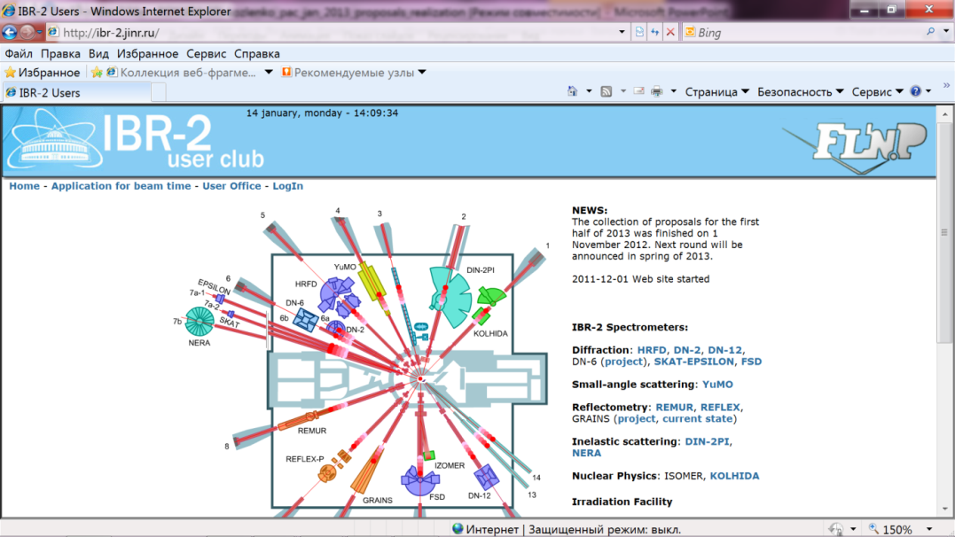
User Programme at IBR-2M Spectrometer Complex
Web-submission system: http://ibr-2.jinr.ru

Slide 18
Azerbaijan – IP ANAS (Baku)
Belarus – BSU, INP BSU, JISSSP NASB, NC PHEP BSU, PMI NASB, RIPChP BSU (Minsk )
Bulgaria - IMS BAS, INRNE BAS, ISSP BAS, IE BAS (Sofia)
Czech Republic – CTU, GPI ASCR, IG ASCR, IMMC ASCR, IP ASCR (Prague), NPI ASCR (Rez)
Arab Republic of Egypt – EAEA, CU (Cairo)
Finland - TRC (Espoo)
France - IBS, ILL (Grenoble), LAL (Orsay), LLB (Saclay)
Germany - HZB (Berlin), Univ. (Bayreuth), RUB (Bochum), TU (Darmstadt), TU (Dortmund), IZFP (Dresden), TU BAF (Freiburg), Univ. (Goettingen), MLU (Halle), DESY (Hamburg), FZJ (Julich), KIT (Karlsruhe), CAU, IFM-GEOMAR (Kiel), Univ. (Leipzig), Univ. (Rostock), MPI-FKF (Stuttgart)
Hungary – Wigner RCP (Budapest), US (Szeged)
Kazakhstan – INP (Almaty), RII (Rudny)
Japan – Shinshu Univ. (Nagano), Keio Univ. (Minato)
India - Amity U. (Pancheyon)
Latvia – ISSP UL, IPE (Riga)
Moldova – IC ASM (Chisinau)
Mongolia – IPT MAS (UlaanBaator)
Poland - INCT (Warsaw), FC JU, NINP PAS, AGH (Cracow), IP MCSU (Lublin), IP AMU (Poznan), ICh SUT, IP SUT (Szczecin), IPTCH WUT, UW (Wroclaw), UNCH (Siedlce), WPUT (Szczecin)
Romania - IFIN-HH, INCDIE ICPE-CA, INFM, ISS, UB (Bucharest), I.N.C.D.T.I.M., RA BC-N, UBB (Cluj-Napoca), UOC (Constanta), NIRDTP, UAIC (Iasi), SCN (Pitesti), LMF CFATR, UPT, UVT (Timisoara)
Russia - GС RAS, IC RAS, IGIC RAS, IMET RAS, IPCE RAS, ITEP, MEPhI, MITHT, MSU, NIKIET, PFUR, NRC KI, SINP MSU, VNIINM (Moscow), VNIISIMS (Alexandrov), ISSP RAS (Chernogolovka), RIAR (Dimitrovgrad), PNPI RAS (Gatchina), IP SB RAS (Krasnoyarsk), NNSU (Nizhny Novgorod), IPPE (Obninsk), GIDROPRESS (Podolsk), RIP RSU (Rostov-on-Don), IPTI RAS (St. Petersburg), SSPI (Sterlitamak), NPI TPU (Tomsk), HPPI RAS, INR RAS (Troitsk), TSU (Tula), IMP UB RAS (Yekaterinburg)
Serbia – INS “Vinca” (Belgrade), UNS (Novi Sad)
Republic of South Africa – NECSA (Pretoria)
Slovak Republic – CU (Bratislava), IEP (Kosice)
Switzerland - PSI (Villigen), ETH (Zurich)
Taiwan – NSRRC (Hsinchu)
Ukraine - IPMS NASU, NTSU (Kiev), IAP NASU (Sumy)
United Kingdom – RAL (Didcot)
Uzbekistan - INP UAS (Tashkent)

Slide 19
Planned budget of the theme
№№ p/p | Activities | Total Costs | Expenses per year, (kUSD)
 |  |  | 2021 | 2022 | 2023 | 2024 | 2025
1. | Development and construction of elements of basic configuration of small-angle scattering and imaging spectrometer on beamline 10. | 1290 | 350 | 290 | 250 | 200 | 200
2. | Development of new spectrometers (DN-6, GRAINS, tomography and radiography, FSS). | 2150 | 450 | 450 | 450 | 400 | 400
3. | Development and construction of elements of neutron guide system for a new inverse geometry inelastic scattering spectrometer. | 2750 | 500 | 500 | 500 | 650 | 600
4. | Modernization and reconstruction of existing spectrometers (HRFD, YuMO, RTD, DN-12, FSD, NERA, REMUR, REFLEX, SKAT, EPSILON). | 4560 | 750 | 870 | 920 | 950 | 1070
5. | Activities on development of neutron methods for investigation of nanosystems and materials. | 450 | 70 | 80 | 100 | 100 | 100
TOTAL |  | 11200 | 2120 | 2190 | 2220 | 2300 | 2370

Slide 20
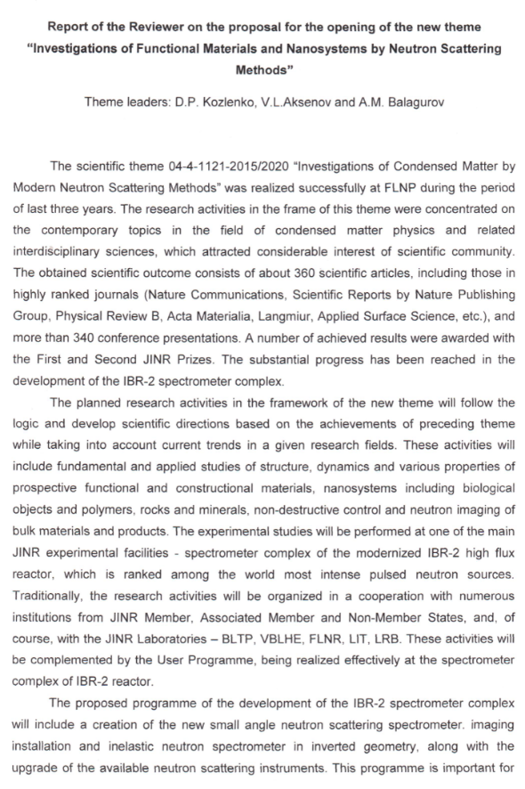
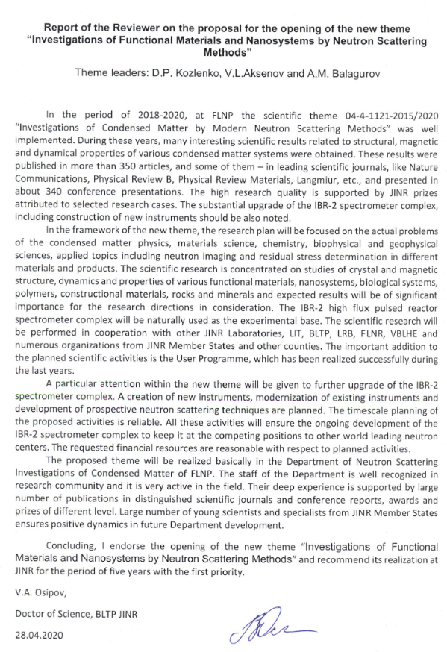
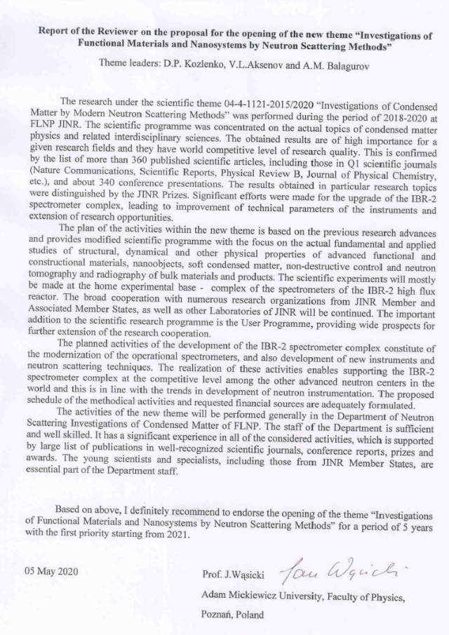
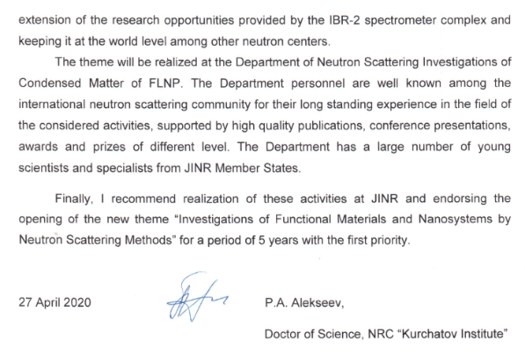
Referee reports
Prof. P.A.Alekseev
(RNC KI, Moscow)
Prof. V.A.Osipov (BLTP JINR)
Prof. J. Wąsicki (AMU, Poznan, Poland)

Slide 21
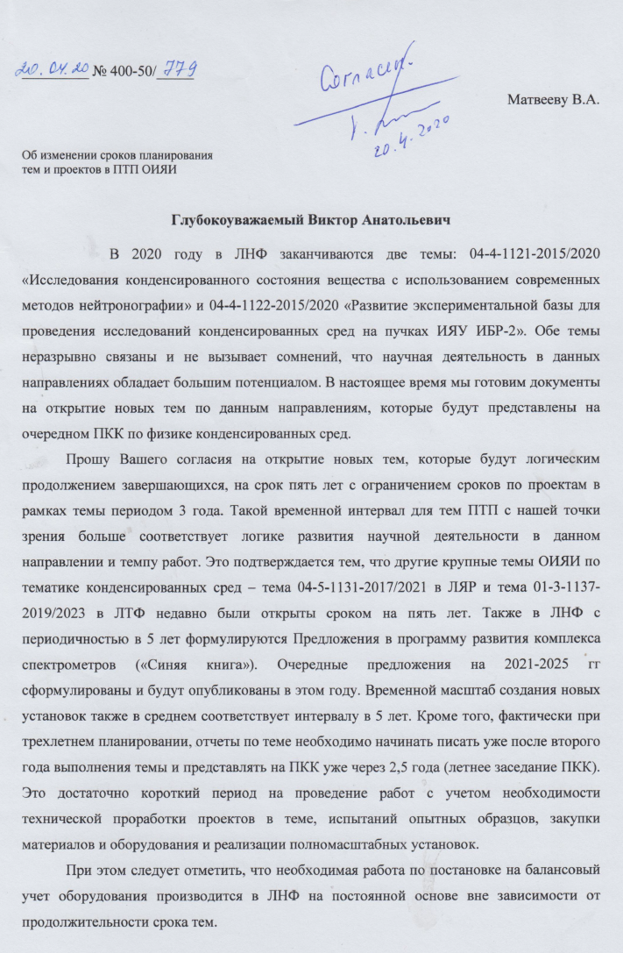
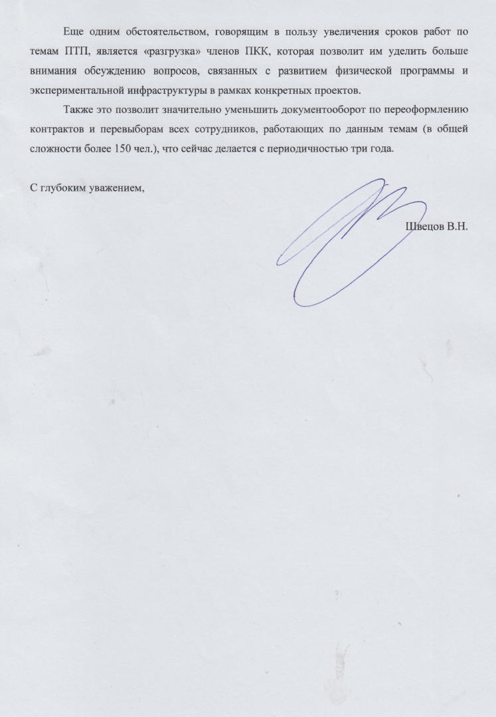

Slide 22
Thank You for Your Attention!

