Slide 1
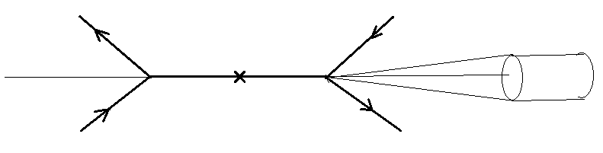

FTF model simulation of pp and dd interactions for estimation of SPD forward calorimeter load
V. Uzhinsky, A. Galoyan, S. Shimansky 13 May 2020
P out
P in
$$θ$$
P in
P out
R = 10 и 5 см
___________ l = 10 м ________
dd and pp interactions at Ecms =6 and 10 GeV are considered. 1 M events were simulated for each case. Using FTF model and SPDroot.
θ

Slide 2
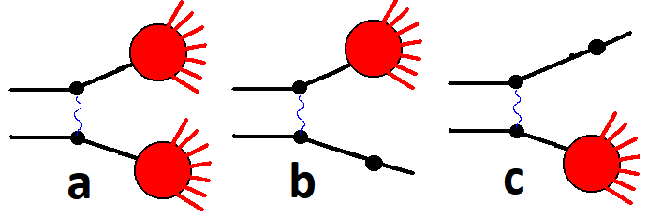
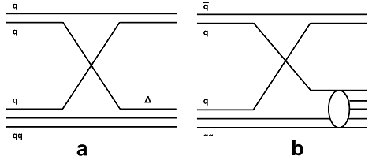
FTF model : basic assumptions
Fig. 1: Processes of string's creations considered in the FTF model.
B.Andersson et al. Nucl. Phys. B281 289 (1987)
B.Nilsson-Almquist, E.Stenlund, Comp. Phys. Comm. 43 387 (1987).
Fig. 2 Additional quark exchange processes in the FTF model.
String mass distribution
2

Slide 3
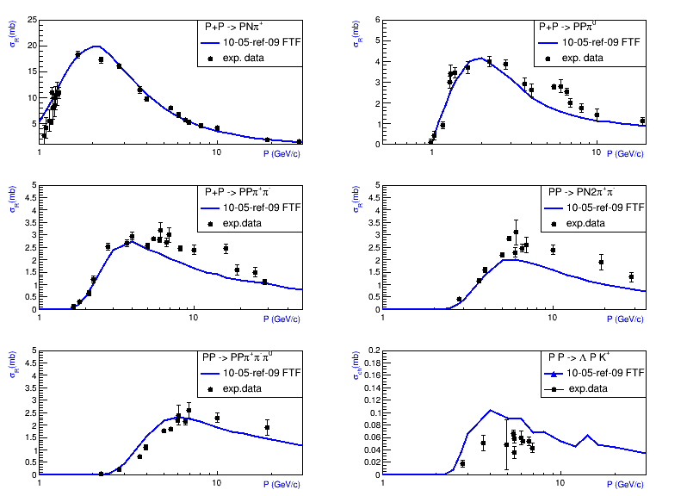
FTF model: PP channel cross sections (tuning)
Energy dependency
of single diffraction
cross section
Fig. 3 Channel cross sections of pp interactions. Points are experimental data gathered in [CERN-HERA] where one can find exact references on experimental papers. Lines are FTF model calculations.
3

Slide 4
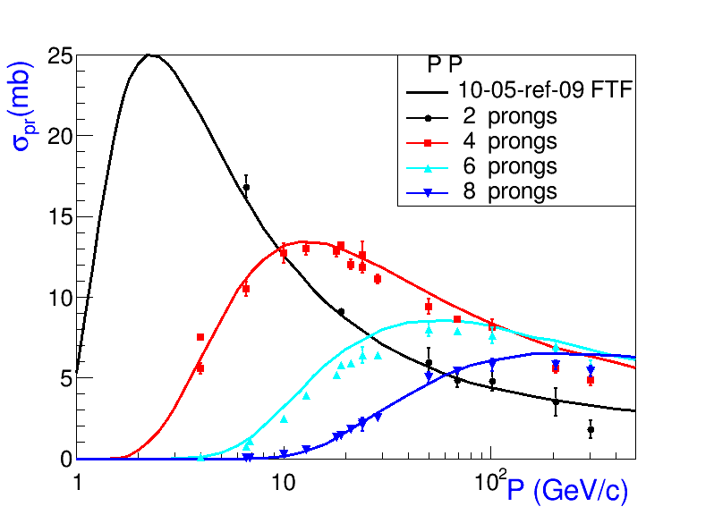
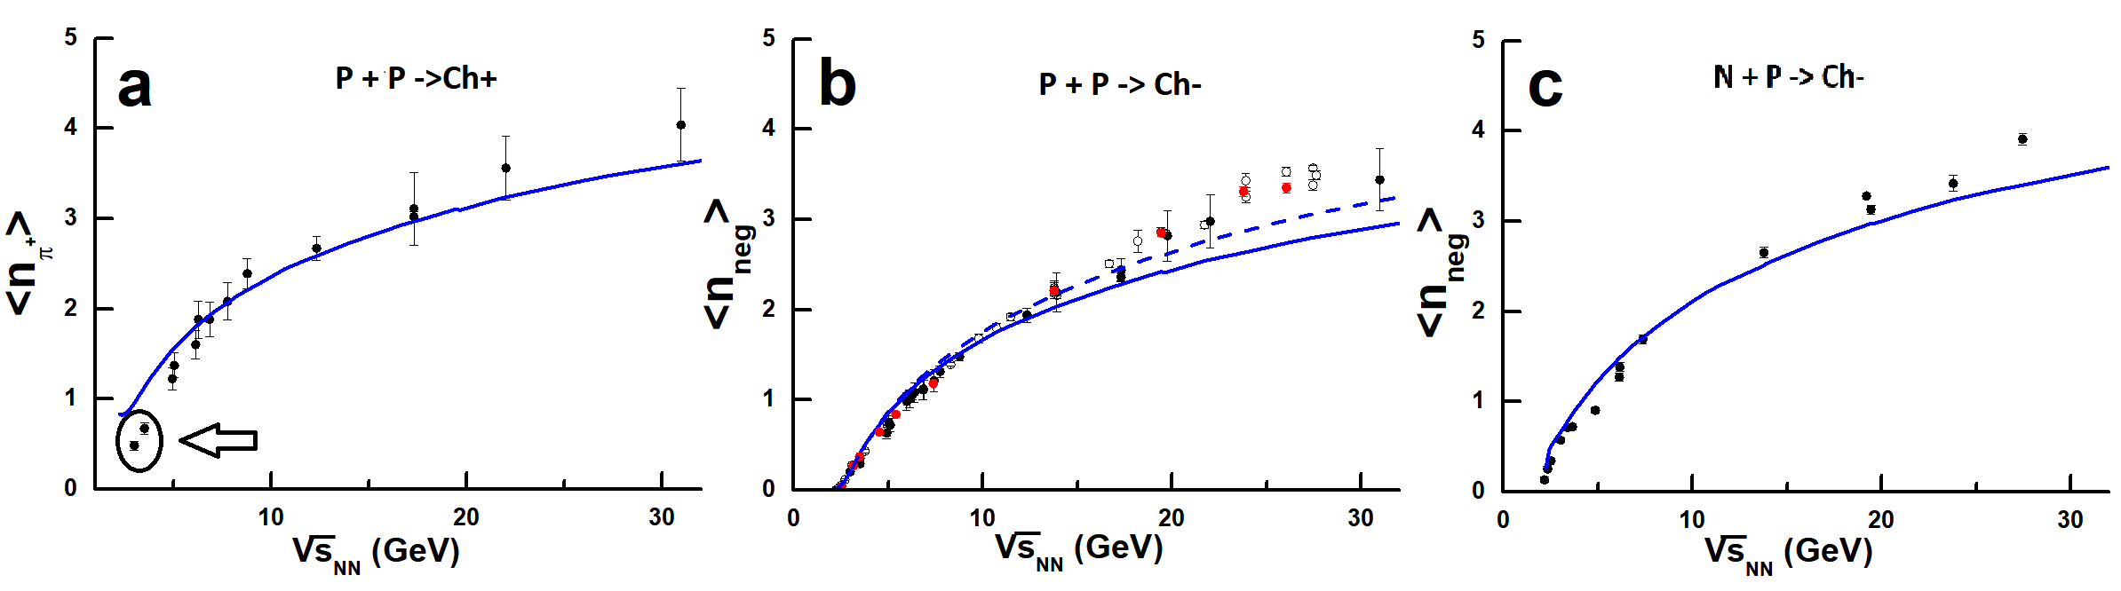
FTF model: topological cross sections of PP interactions
CERN-HERA
Topological cross sections
of pp interactions.
M:. Antinucci et al. Lett. al
Nuovo Cim. V. 6, No 4, 121 (1973)
Marek Gazdzicki, Dieter Roehrich
Z. Phys. C 65, 215-223 (1995)
Energy dependencies of Pi+ meson (a) and negative charged particles in pp (b) and pn (c) interactions.
4

Slide 5
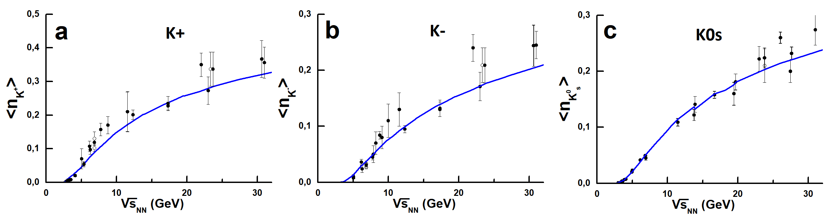
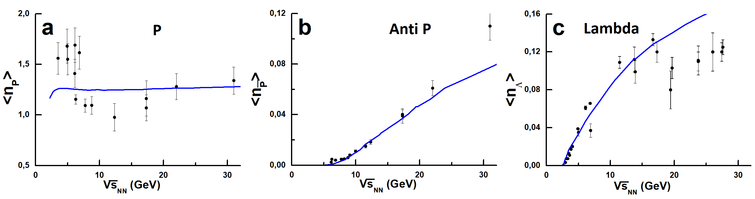
FTF model: production yields in PP interactions
Energy dependencies of multiplicities of K+, K-, and K0s mesons (a, b and c, respectively)
in pp interactions.
M:. Antinucci et al. Lett. al
Nuovo Cim. V. 6, No 4, 121 (1973)
Marek Gazdzicki, Dieter Roehrich
Z. Phys. C 65, 215-223 (1995)
Z. Phys. C 71, 55-63 (1996)
Energy dependencies of multiplicities of proton, antiproton and Lam- hyperons (a, b and c, respectively) in pp interactions.
5

Slide 6
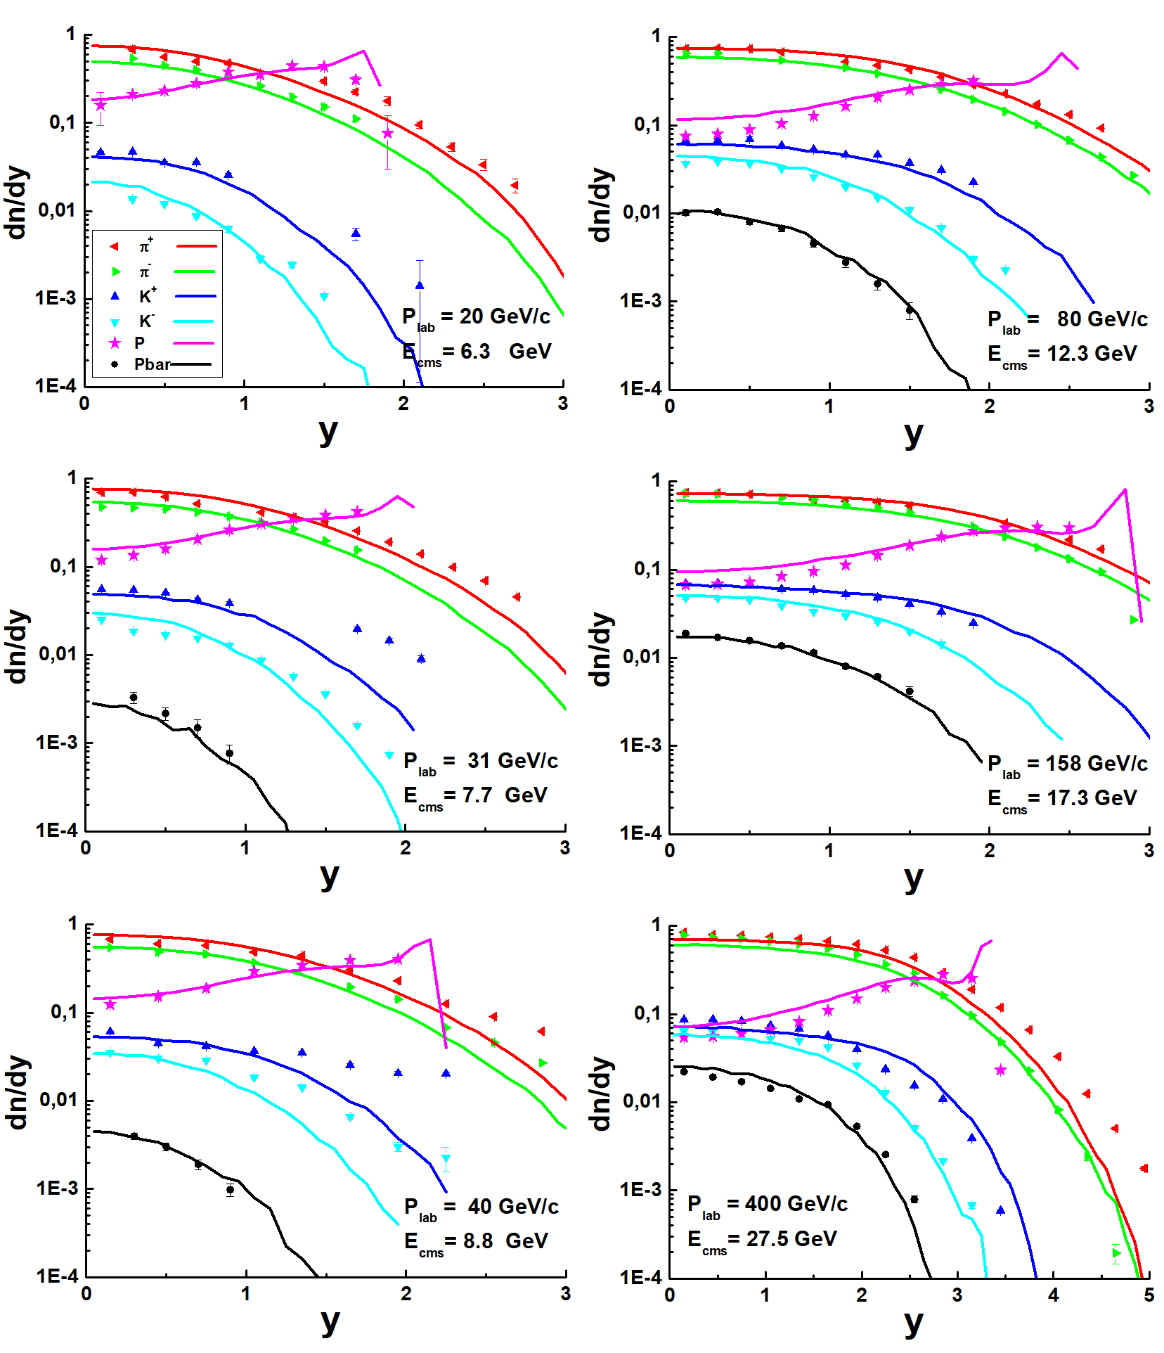
FTF model: rapidity distributions in PP interactions
Distributions of Pi and K mesons, protons, and anti-protons, on rapidity in
the center-of-mass system of pp interactions at Plab= 20, 31, 40, 80, 158
and 400 GeV/c. Points are experimental data [NA61] without statistical
errors only. Curves are FTF model calculations.
6

Slide 7
Physics of Particles and Nuclei Letters, 2020, Vol. 17, No. 2, pp. 142
A list of microscopic models on the market includes UrQMD [23], EPOS [24], PHSD [25], and PHQMD [26] generators. Despite of the fact that some models reproduce moderately well the energy dependence of hadron yields, none of the existing event generators can simultaneously describe total multiplicities, rapidity spectra, and transverse momentum distributions. In order to overcome this challenge we suggest a simple particle generator to obtain realistic hadron phase space distributions
The generator provides <n> particles of a particular sort per event followed
a predefined profile along rapidity (Gaussian for produced mesons or polynomial
for p, Λ) and thermally distributed along transverse momentum. The parameters <n>,
σ_{Gauss}, and T (slope) are taken from parameterizations discussed in Sections 3, 4.
That is all !!!
7

Slide 8
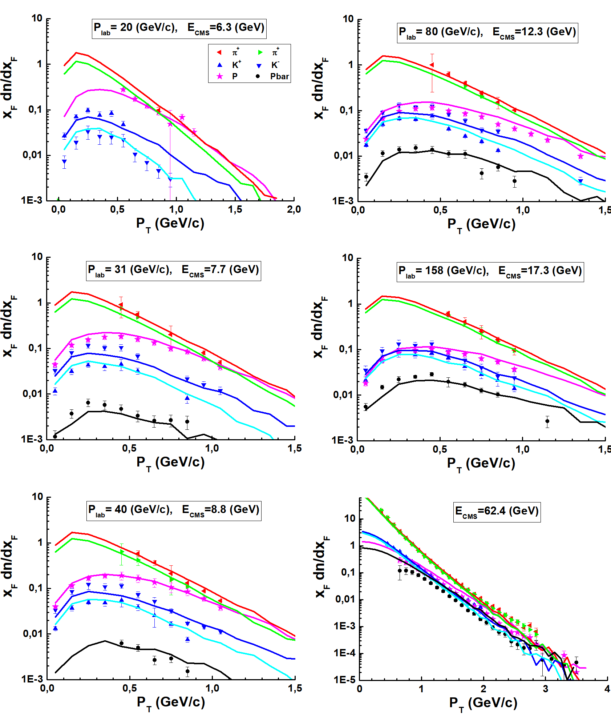
FTF model: Pt distributions in PP interactions
Exp. data by
NA61/SHINE
Collaboration
for Pi+-, K+-,
protons and
antiprotons
Pt distributions
of particles
with 0< y <0.2
+ Data by
Phenix (RHIC)
collaboration
8

Slide 9
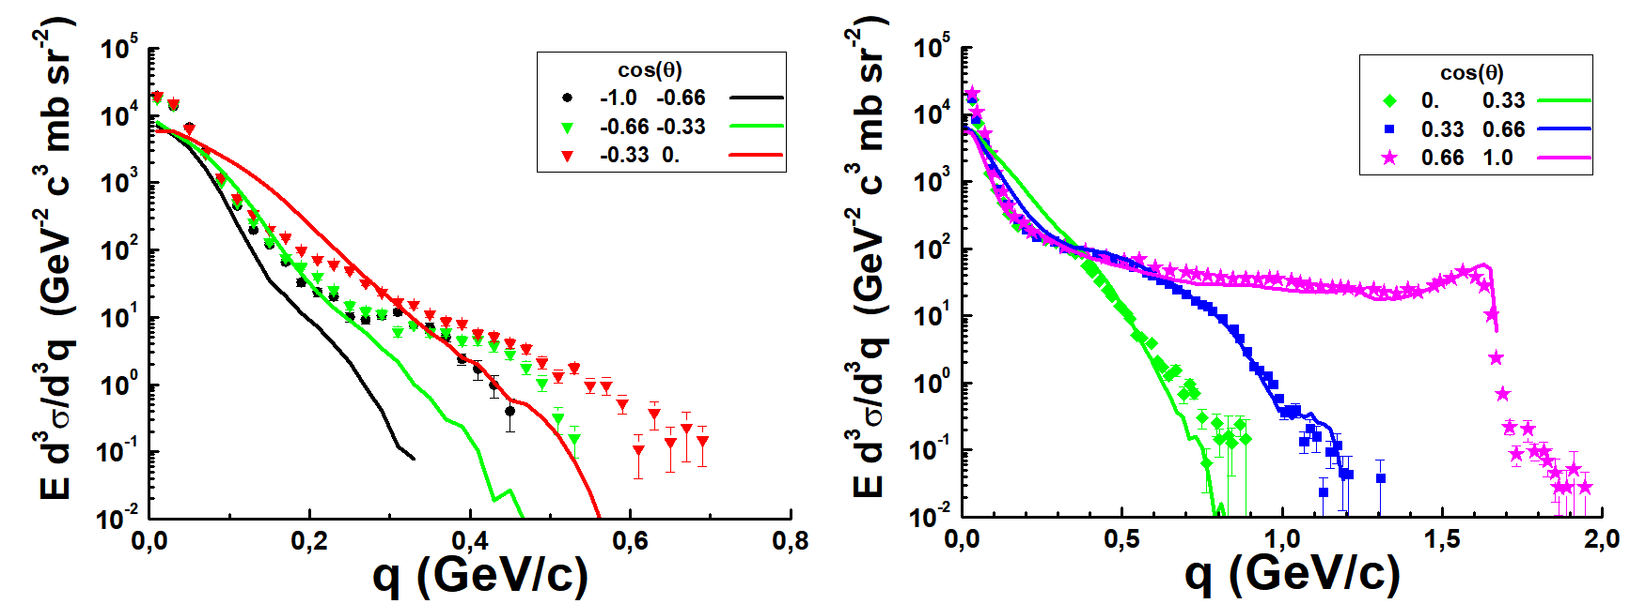
FTF model: pD interactions
1 – 0º
0.66 -- 49º
0.33 – 71º
0 -- 90º
-0.33 – 109º
-0.66 – 131º
-1 -- 180º
Z. Phys. A 357, 107 (1997)
9

Slide 10
FTF model: DD interactions
Our: Glauber Monte Carlo program for NICA/MPD and CBM experiments A. Galoyan and V. Uzhinsky Phys. Part. Nucl. Lett. 12 (2015) no.1, 166
1 million
events
10

Slide 11
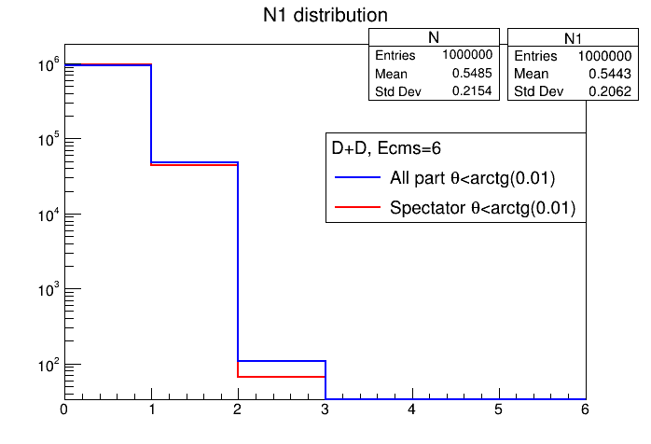
FTF model: DD interactions at Ecms=6 GeV
SPDroot
dd-interactions at √(S_{NN})=6 GeV
Multiplicity distribution of all particles falling into a cone
tg(θ) ≤ 0.01. й стороны.
The blue histogram is the number of all particles charged and neutral (p, n, π-
и К-mesons). The first blue step from 0 to 1 gives the number of events when
there are no particles in the forward cone. There are ~ 950 thousands (95 %).
11

Slide 12
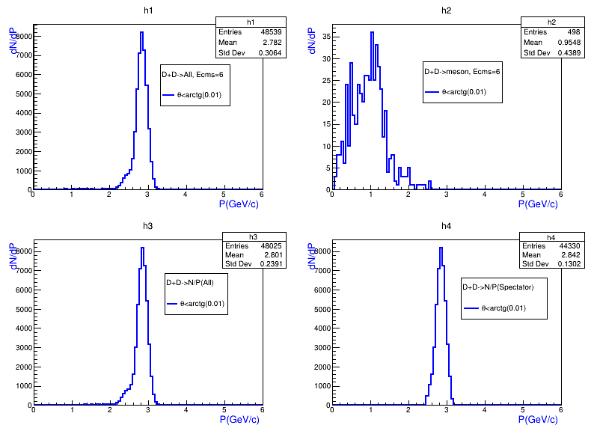
FTF model: DD interactions at Ecms=6 GeV
The particles falling into the cone tg(θ)<0.01, momentum distributions in CMS.
SPDroot
Всего в передний конус tg(θ) ≤ 0.01 попало 2059 частиц. Из них мезонов 475, нейтронов ~500, и протонов ~ 1070.
Top left figure shows that 48.5 thousands particles fall into the cone. Top right one shows
that there are only 498 mesons (498/48 539 ~= 1 %) among all these particles. Bottom left one -
the number of nucleons fall into the cone. There are 48025 particles. Bottom right figure -
44330 spectators falling into the cone among all particles. Total 44330/48539 = 91.3%.
12

Slide 13
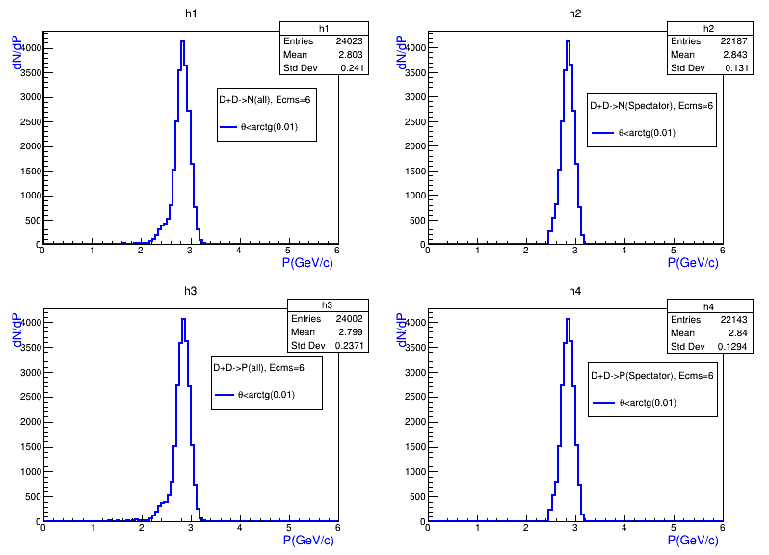
FTF model: DD interactions at Ecms=6 GeV
The neutrons fall into in the cone tg(θ) ≤ 0.01, momentum distribution in CMS..
Left figure (h1) shows all neutrons in the cone - 24023.
Right figure (h2) shows that among them there are 22187 spectator neutrons,
that is, 92.3% of neutrons in the cone. The number of spectator
neutrons of the total number of particles falling in the cone is 45.7% (22187/48539).
13

Slide 14
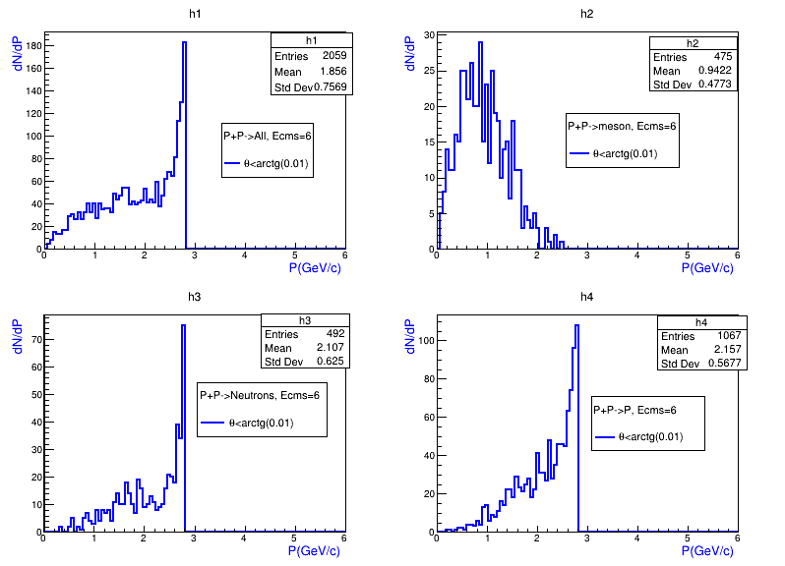
FTF model: PP interactions at Ecms=6 GeV
The particles falling into the cone tg(θ)<0.01, momentum distributions in CMS.
Всего в передний конус tg(θ) ≤ 0.01 попало 2059 частиц. Из них мезонов 475, нейтронов ~500, и протонов ~ 1070.
Forward cone tg(θ) ≤ 0.01 hit 2059 particles. There are 475 mesons, 500 neutrons and 1070 protons.
14

Slide 15
FTF model: DD interactions at Ecms=10 GeV
15

Slide 16
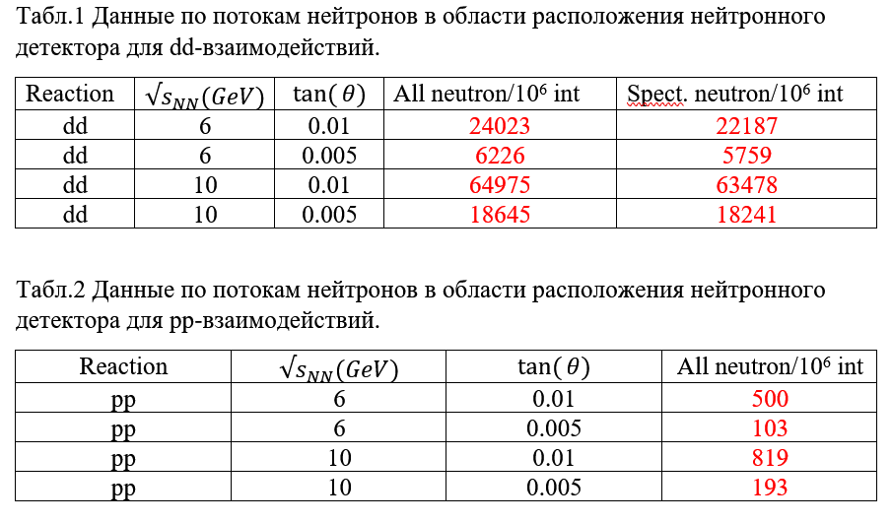
FTF model: DD- and PP-interactions, summary
The neutron fluxes in the region where the neutron detector is located for dd-interactions..
The neutron fluxes in the region where the neutron detector is located for pp-interactions..
The study shows that the occupation of neutron detectors from
particles coming directly from the interaction point is far from
crucial values.
16

