Slide 1


BM@N, Nuclotron, Collider, key milestones

Slide 2
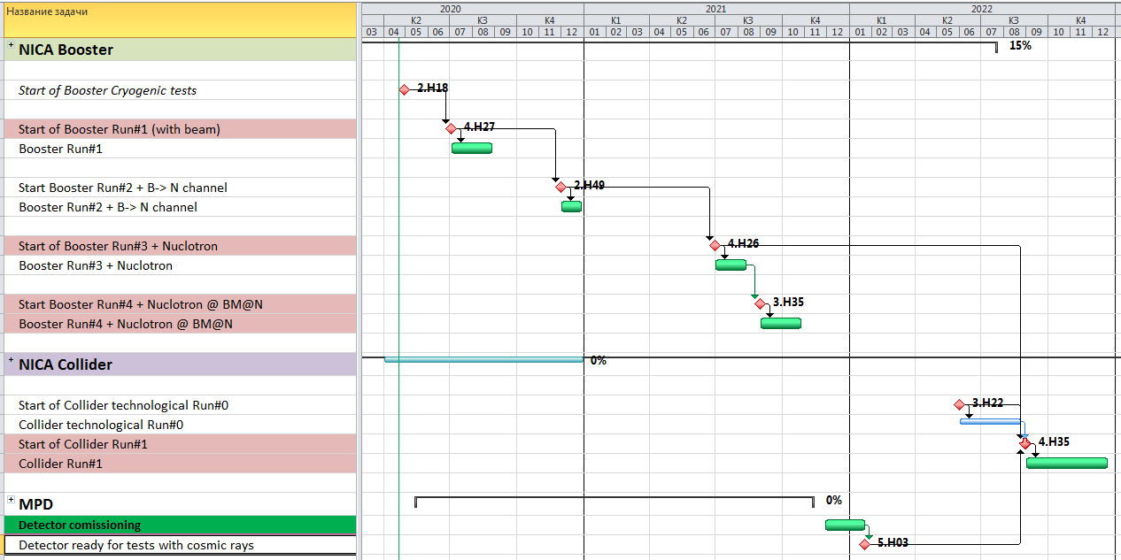
Key run-milestones
planned before COVID
2020
2021
2022
W35, 2021
2

Slide 3
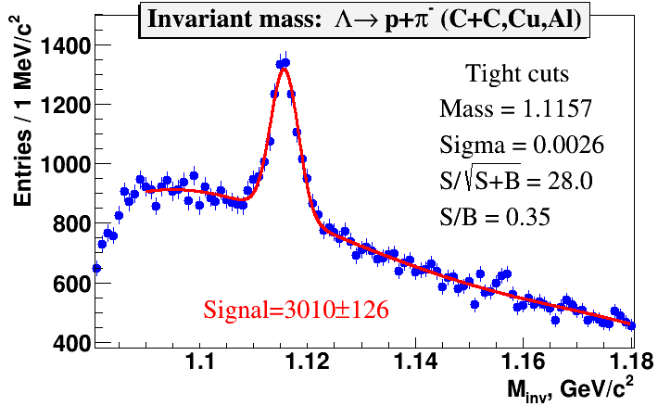
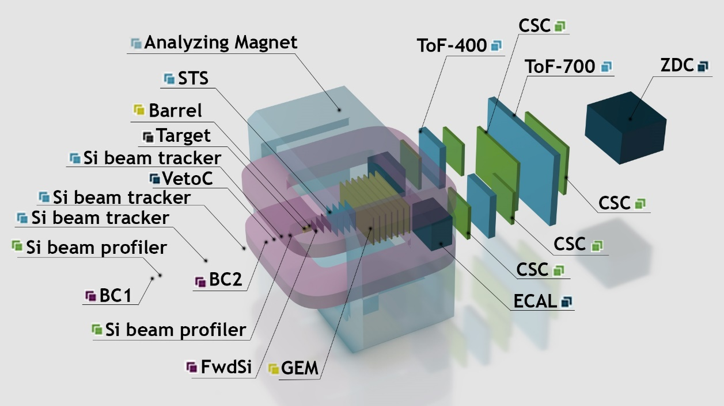
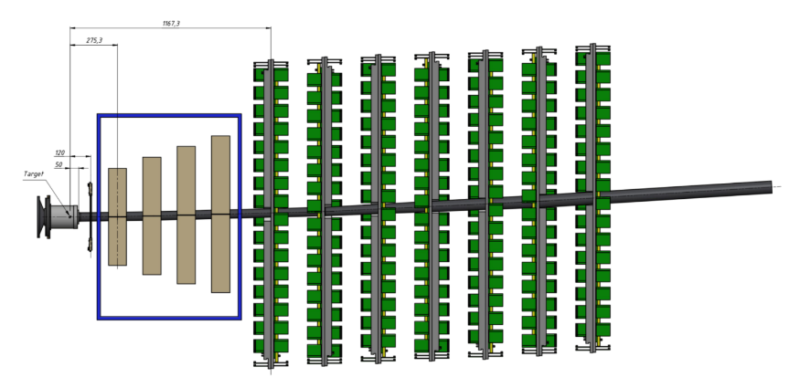
Baryonic Matter at Nuclotron (BM@N)
1st physics run:
March – April 2018:
targets: C, Al, Cu, Sn, Pb;
beams stat
      ¹²C⁶⁺ 4,0 -4,5 AGeV 20 M ev
      ⁴⁰Ar¹⁶⁺ 3,2 AGeV 130 M ev
      ⁸⁴Kr²⁶⁺ 2,3 AGeV 50 M ev
Year | 2017 | 2018 | 2021 | 2022 +
Beam | C | Ar,Kr, C | Kr,Xe | до Au
Intensity, Hz | 0.5M | 0.5M | 0.5M | 0.5M
Trig rate, Hz | 5k | 10k | 10k | 10k
Central tracker | 6 ½ plGEM | 6 ½ plGEM +3 pl. FwdSi | 7 pl. GEM + 3 pl. FwdSi | 7 pl. GEM + 3 pl. FwdSi + 4 pl. STS
Status | Tech. run | Tech + Phys run | Phys run, 1st stage | Phys run, 2nd stage

Slide 4

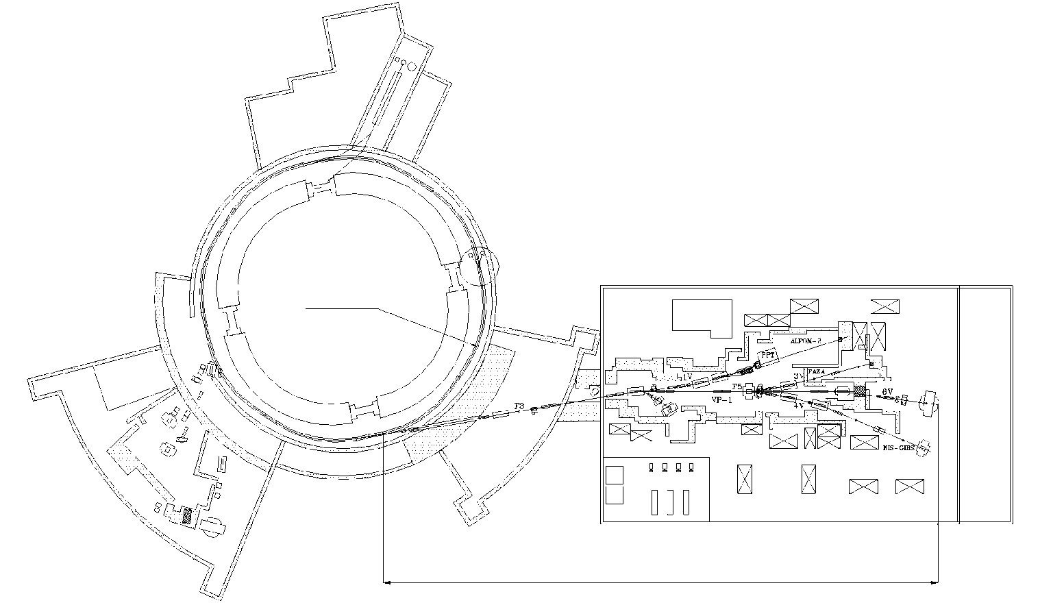
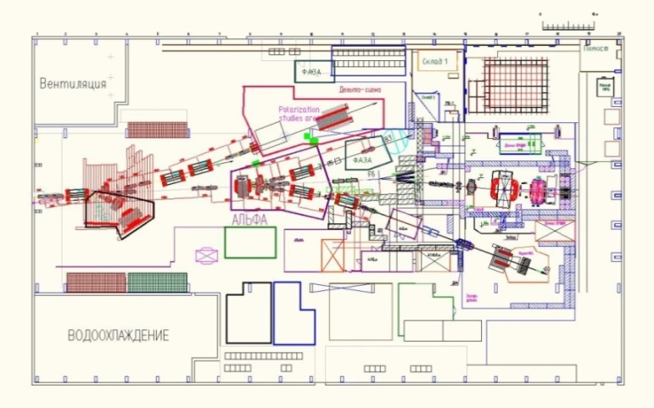

Nuclotron - BM@N beam line
►Upgrade of Nuclotron - BM@N transport channel for heavy ion program:
→ replace air intervals / foils with vacuum beam pipe along 160 m of BM@N transport line to get minimum dead material
►Replacement of transformers, power supplies and cables to power magnetic elements of the transport channel (need a new building to place transformers)
Procurement new PS and power distribution cabinets,
M7 2020
Prodction of control electronics for magnets’ PS => M2 2021
Commissioning of the system => Q3 2021
Nuclotron
~160 m
Building 205
BM@N
BM@N experiment

Slide 5
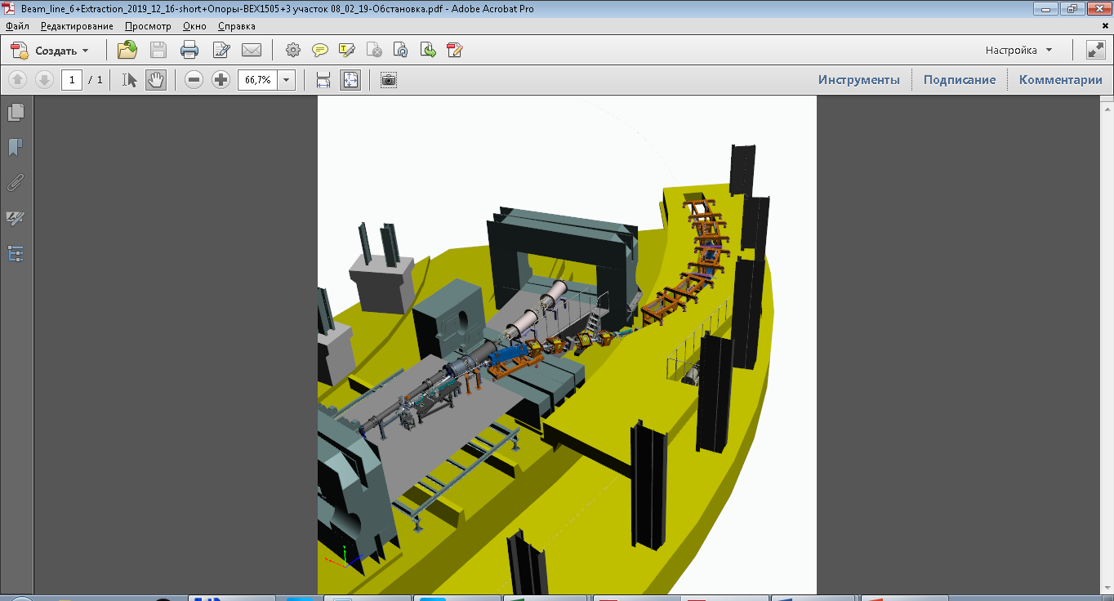
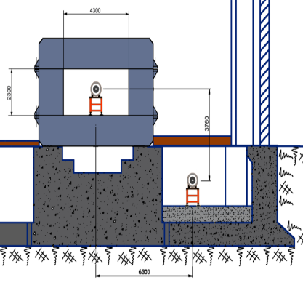
Booster-Nuclotron transfer channel
A.Tuzikov
production @ BINP
extraction elements - in the tunnel
channel elements
03.2020 > 10.2020
Assembly and testing
04.2020 > 12.2020
Booster
Nuclotron

Slide 6
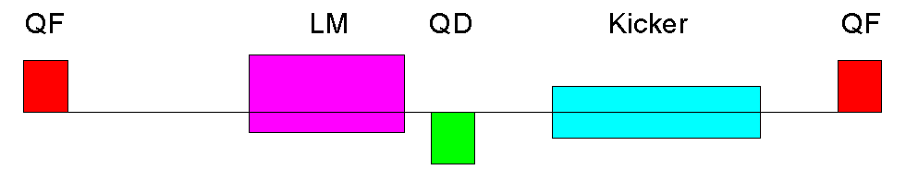
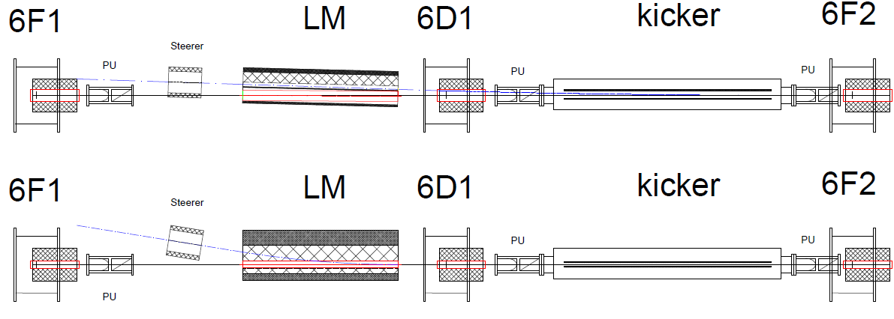
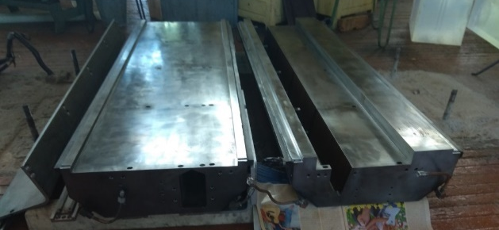
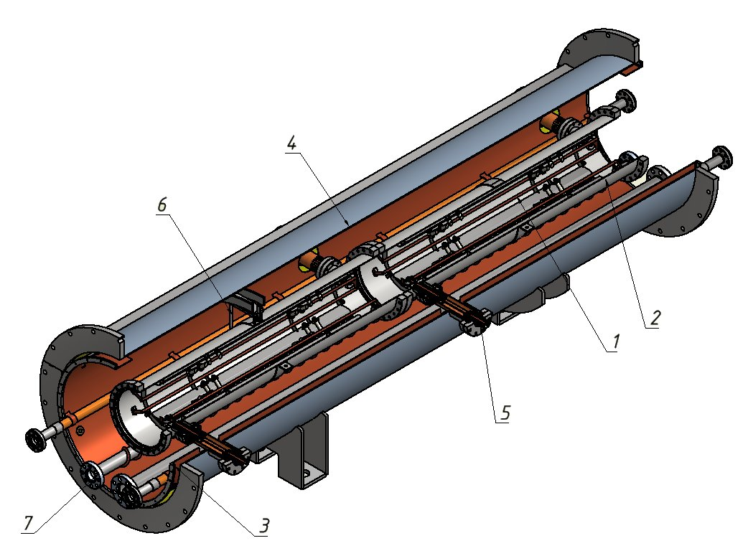
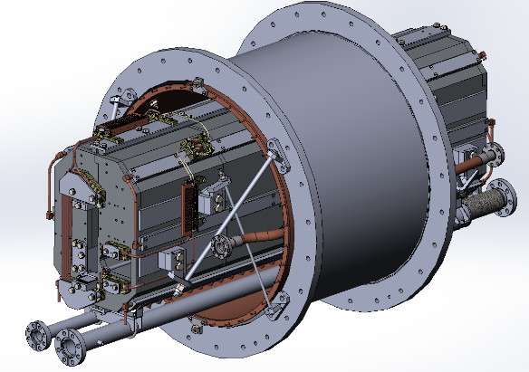
Nuclotron high energy beam injection system
Nuclotron
LM, kicker production => end 2020
PS prodction => mid 2021 (EVPU, BINP)
System launch => mid 2022

Slide 7
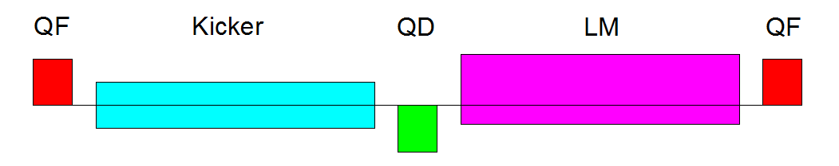
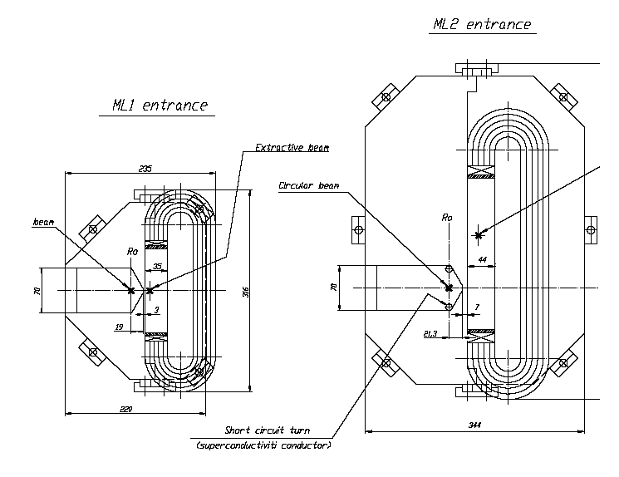
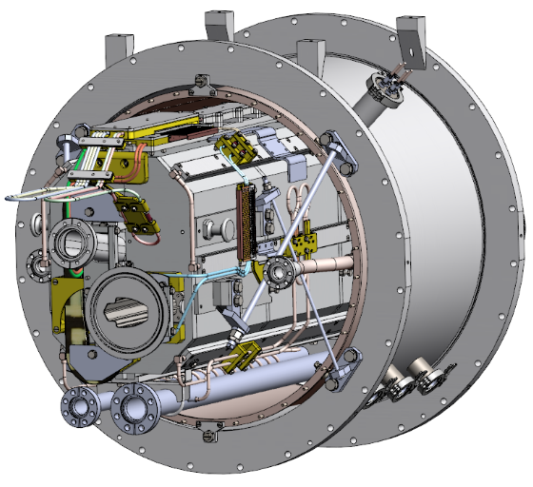
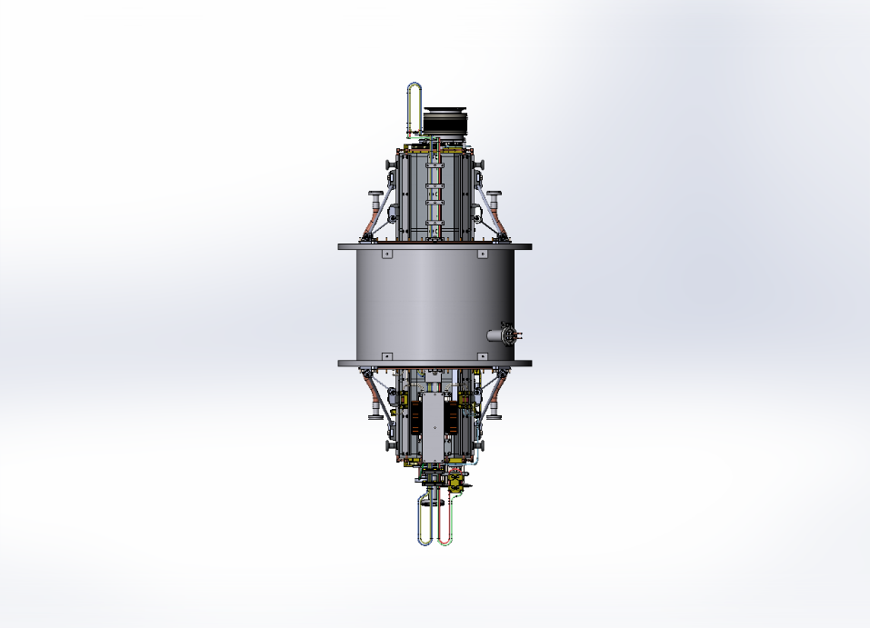
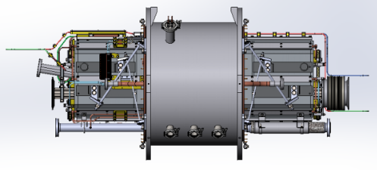
Nuclotron fast extraction system
Kicker + 2 sections Lambertson magnet
Nuclotron
Concept of the kicker and its power supplies has been developed.
Kicker prototype has been manufactured and tested.
Lambertson magnets are based on existing spare yokes for slow extraction system of Nuclotron.
Concept has been developed only.
design=> Q4 2020
production => Q3 2021
system launch => Q3 2022

Slide 8
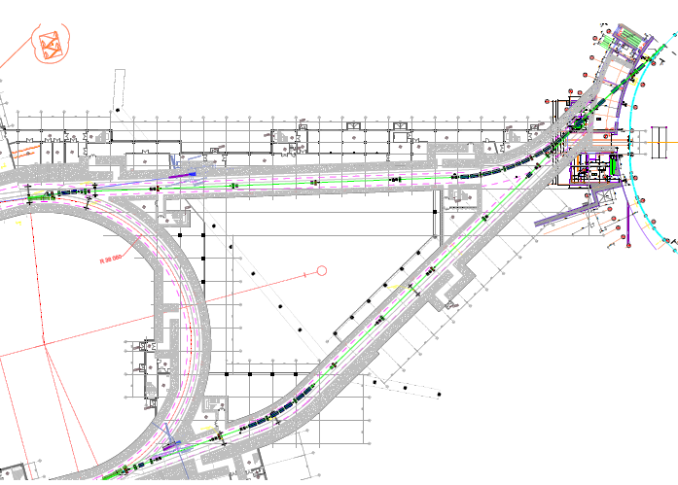
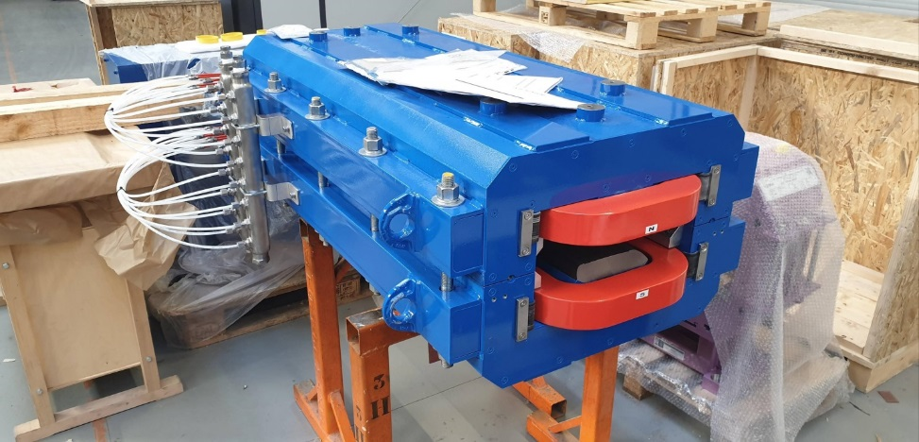
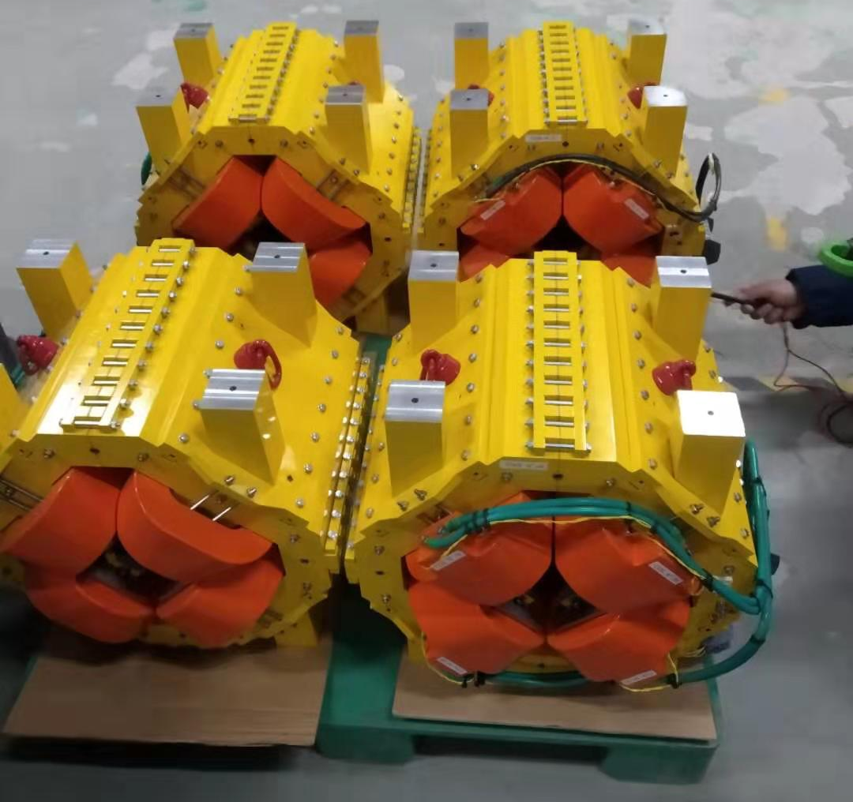
Nuclotron-Collider beam transport channel
A.Tuzikov
JINR has prepared a temporary storage in the Collider tunnel and ready to receive the channel magnets
delivery => Q4 2020
assembly=> Q4 2021
commissioning => Q2,Q3 2021

Slide 9
Magnetic system: design, production & testing of SC magnets
Collider
H.Khodzhibagiyan
 | total | % completion
Industry subcontracted items
Dipole magnet yokes | 80+1 | 100%
Arc quadrupole magnet yokes | 46 | 100%
Yokes of lens doublet on straight section | 12 | 5%
Corrector magnet yokes | 124+4 | 35%
Vertical bending dipole yokes | 8 | 12%
Final focus quadrupole magnet yokes | 12 | 12%
Dipole magnet beam pipe | 160 | 100%
Quadrupole magnet beam pipe | 92+24 | 20%
Beam position monitors | 92+24 | 5%
Vacuum shells of dipole magnet | 80+1 | 100%
Vacuum shells of quadrupole magnet | 46+12 | 80%
Vacuum shells of cryogenic by-pass | 4 | 2%
Vacuum shells of feed boxes | 2 | 5%
Vacuum shells for SC magnets interconnections | 182 | 30%
Vacuum shells’ bellows | 350 | 100%
SC magnet units’ supports | 81/58 | 70%

Slide 10
Magnetic system: design, production & testing of SC magnets
Collider
H.Khodzhibagiyan
 | total | % completion
JINR production items
Dipole magnet SC coil | 80+1 | 56%
Quadrupole magnet SC coil | 46+24 | 43%
Corrector magnet SC coil | 124+4 | 16%
Final focus quadrupole SC coil | 12 | 8%
Vertical bending magnet SC coil | 8 | 12%
Dipole magnet heat screen | 80+1 | 62%
Quadrupole magnet heat screen | 46+12 | 40%
SC magnets interconnections’ heat screen | 181 | 0%
Cryogenic by-pass heat screens | 2 | 0%
Heat screens for reference magnet & feed boxes | 2 | 0%
Temperature sensor @ cold | 900 | 100%

Slide 11
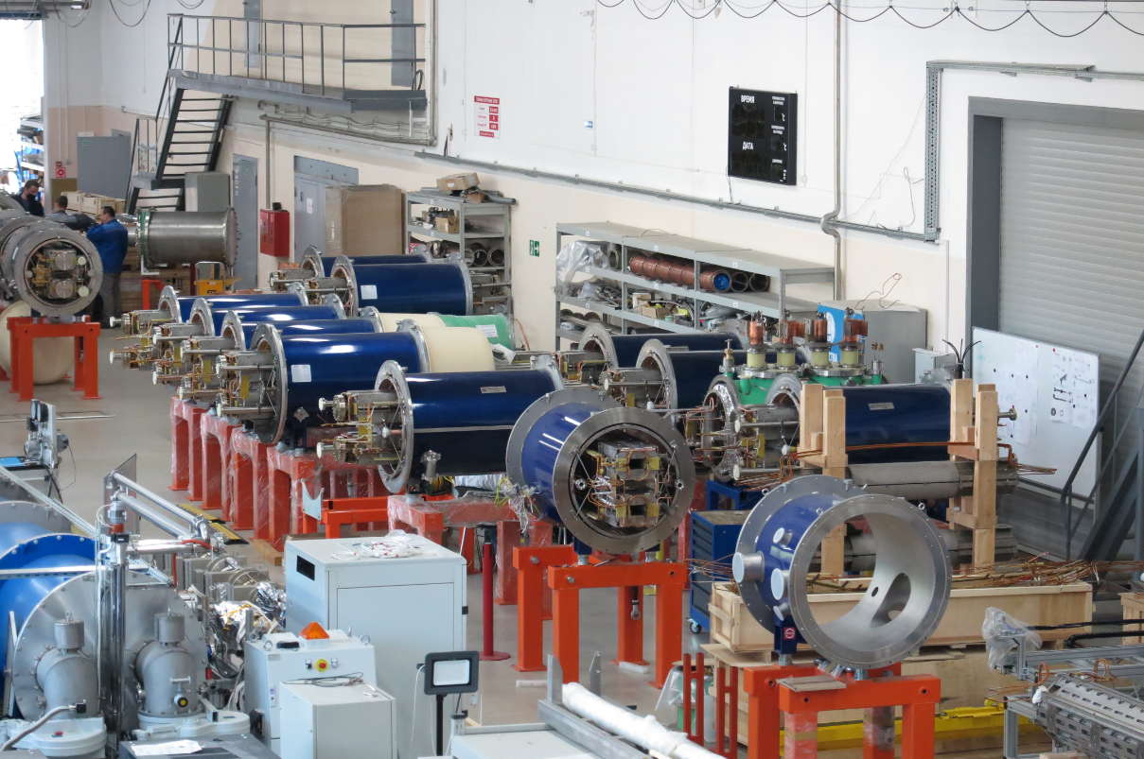
Magnetic system: assembly and testing of SC magnets
Collider
Cryogenic-tests per year:
2016 – 20
2017 – 60
2018 – 58
2019 – 76
to 25.05.2020 - 21
for today successfully passed cryogenic tests:
52 % - dipoles
0 quadrupoles
0 correctors
rate of the assembly and testing of SC magnets should be immediately increased by factor of 2 up to 150 per year

Slide 12
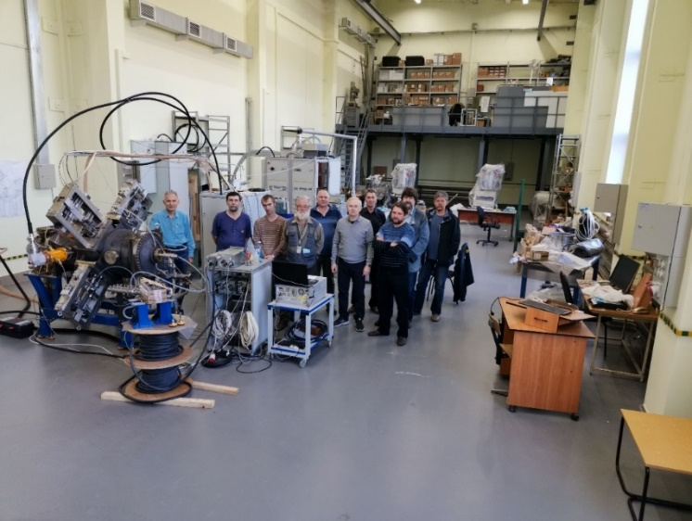
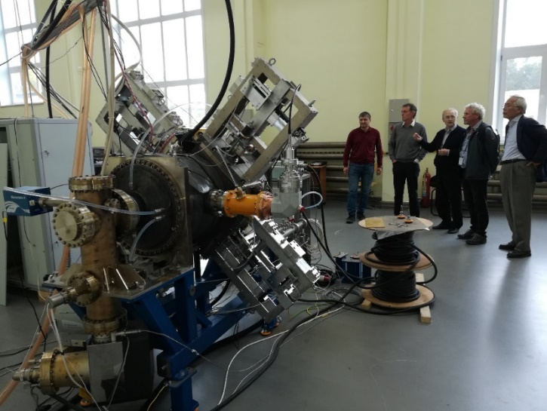
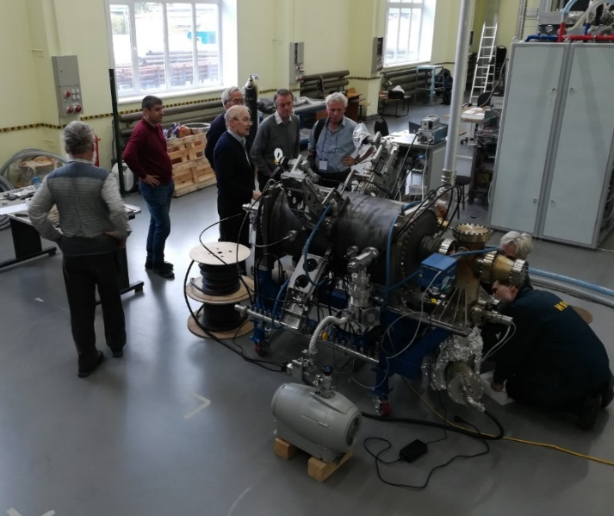
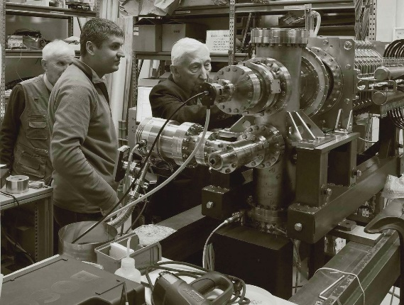
RF-systems
Collider
RF-1 @ JINR
RF-2 delivery Q4 2020/
Q2 2021
assembly => Q4 2021
E.Syresin
24.09.2019 RF-2 Visit of the NICA MAC members
23.09.2019 RF-2 and all the Team
RF-2 at friendly inspection
21.03.2019
24.09.2019 The same and RF-3
I. Meshkov

Slide 13
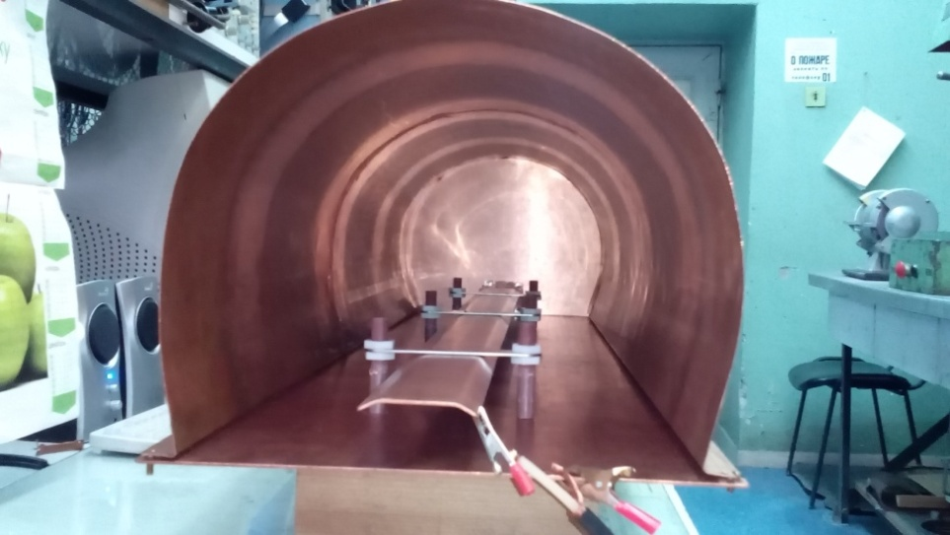
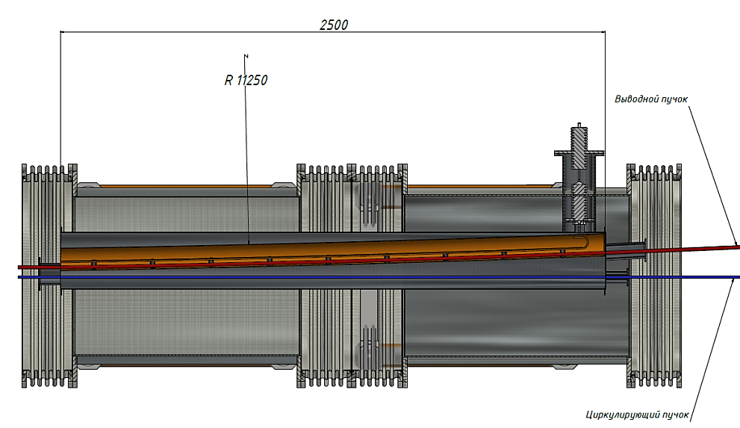
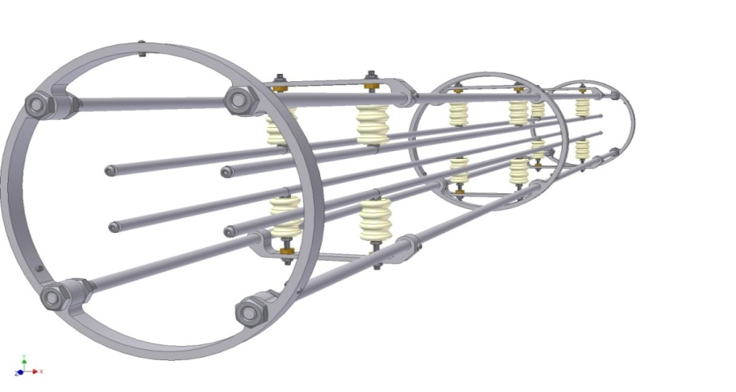
Injection & beam dump system
Collider
A.Tuzikov
Technical design development is in progress.
Concept of power supply has been developed.
Septum
Concept of the kicker and its power supplies is developed.
Effects of after-kicks to the stack are estimated. Concept of measures against after-kicks has been developed.
Kicker
Septum, Kicker, PS R@D => 2020
=> system production 2021
assembly => Q1,Q2 2022
commissioning => Q3 2022

Slide 14
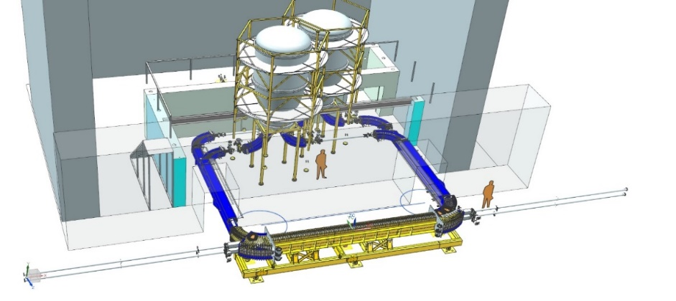
Collider cooling and beam feedback systems
Collider
High Voltage Electron Cooler (HV ECS) for the Collider
V.Reva, V.Parkhomchuk
under construction @ BINP
delivery to JINR - mid 2021
assembly and tests => end 2021
Stochastic cooling system
A.Sidorin, I.Gorelyshev, K.Osipov
concept prepared
Specification completion, PUs, Kickers, Electronics contraction => end 2020
production => end 2021
System assembly => mid 2022
Beam feedback system
concept started, design finishing => end 2020
2021,2022 production, delivery, assembly

Slide 15
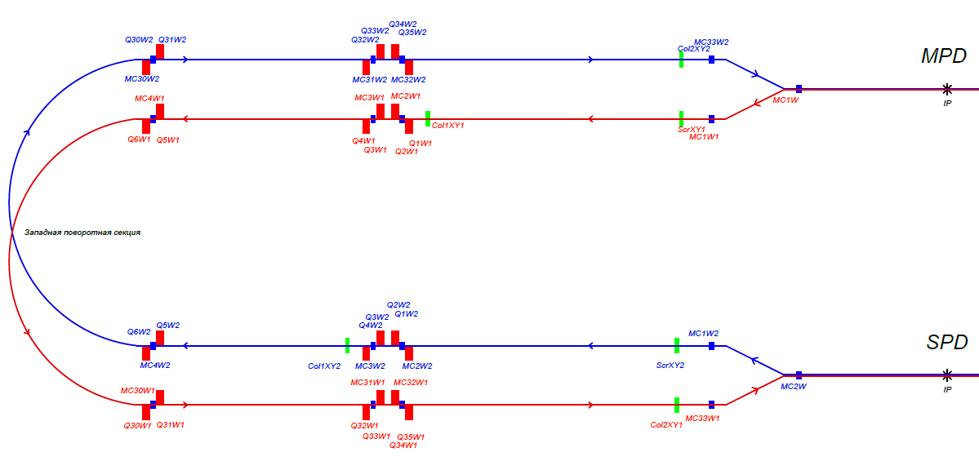
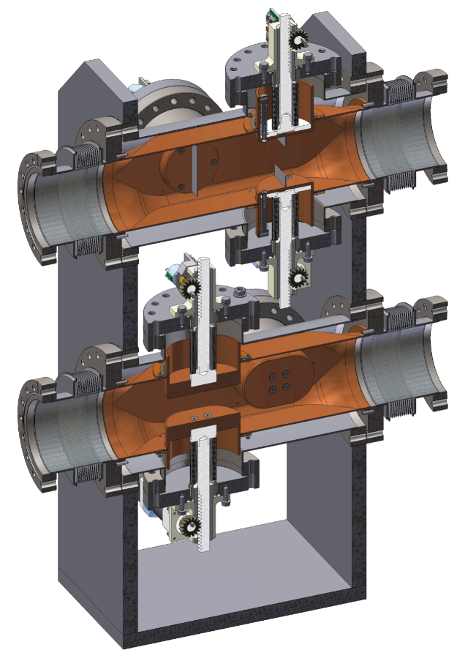
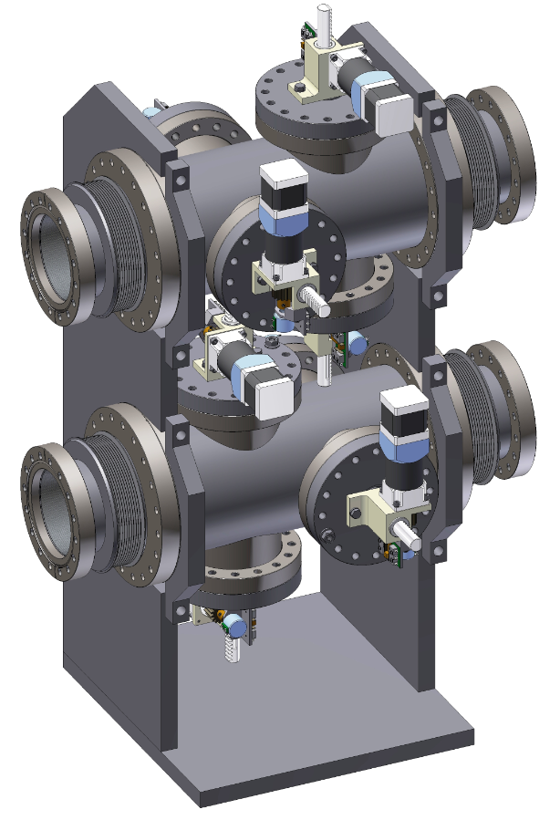
Beam collimation system
O.Kozlov
Collider
Concept completed,
design completed => Q3 2020
system’s elements production => Q3 2021
assembly => Q4 2021
ready for tests Q1 2022

Slide 16
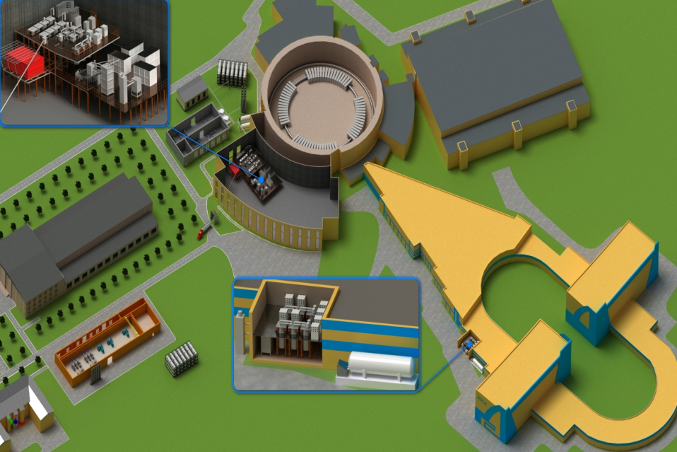
New Cryogenic Equipment of the NICA Complex
1000 m³ helium gasholder
completed W04, 2021
Central cryogenic plant (bld. 1B)
comiss W29, 2021
New compressor hall
constr completed W49, 2020
1000 m³ nitrogen gasholder
completed W49, 2020
Bld. 17
completed W52, 2021

Slide 17
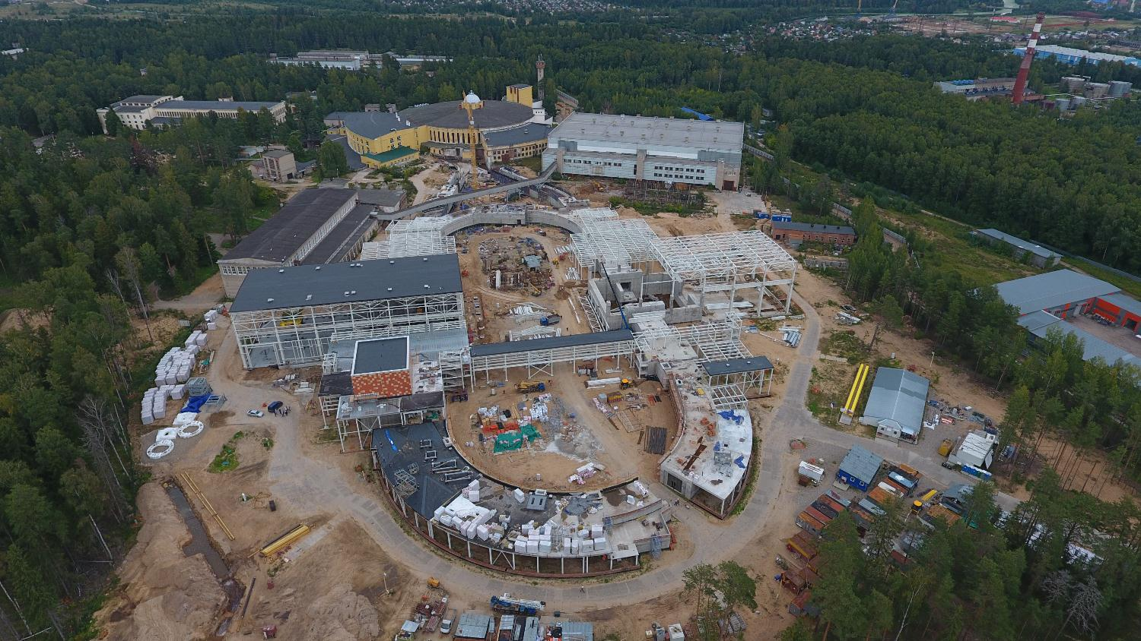
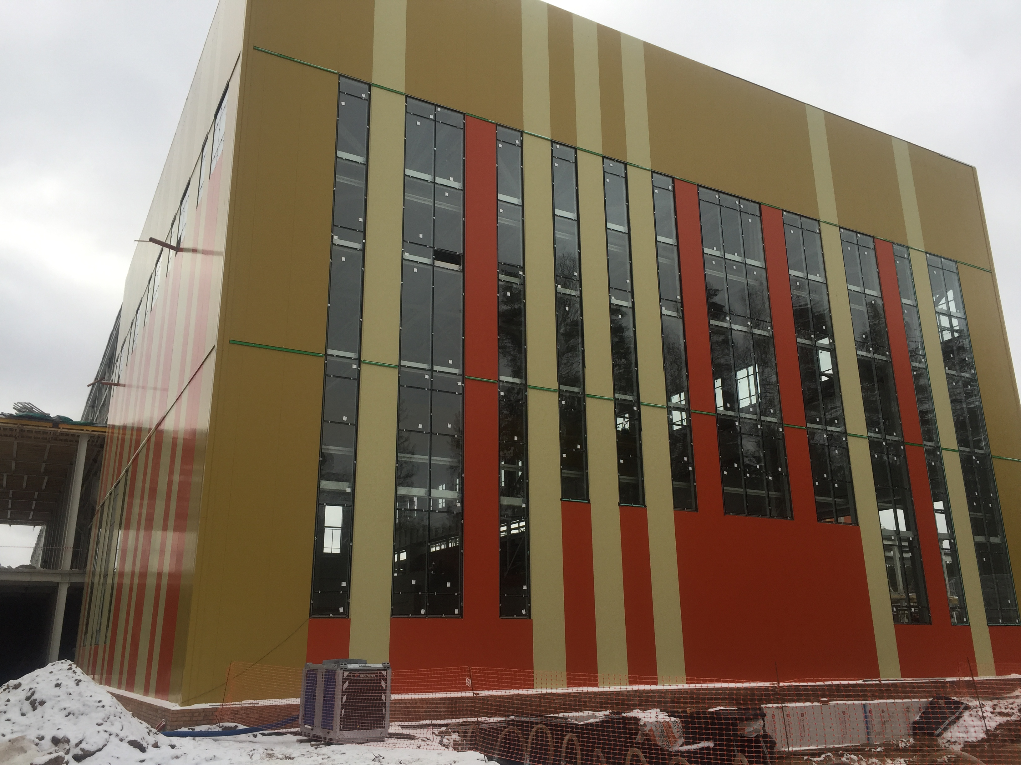
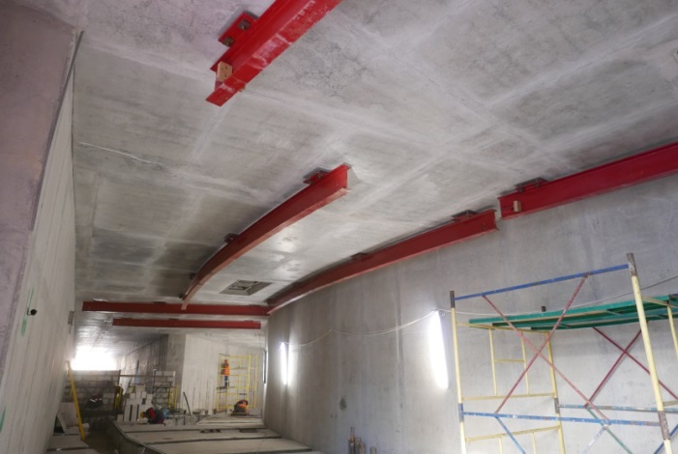
Collider building
LHEP electrical consumption
should be increased 2.5 times
construction of several electrical substations
+ engineering infrastructural works planned to 2020-2021
to be completed –2021
Aug2019
BM@N
SPD
MPD
tunnel arc
MPD
MPD
Notes:
The civil construction of the collider complex is going on in accordance with the plans. the MPD hall will be ready by the summer of 2018, and the entire complex will be completed in 2019.

Slide 18
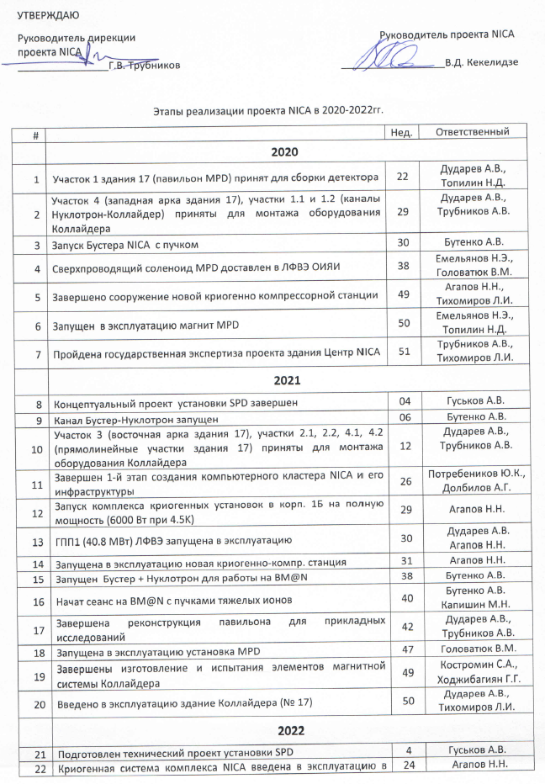
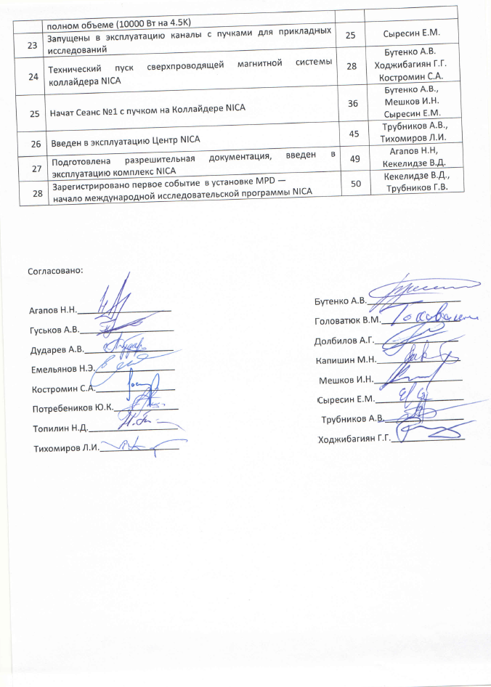
Key milestones
Overall project plan

Slide 19
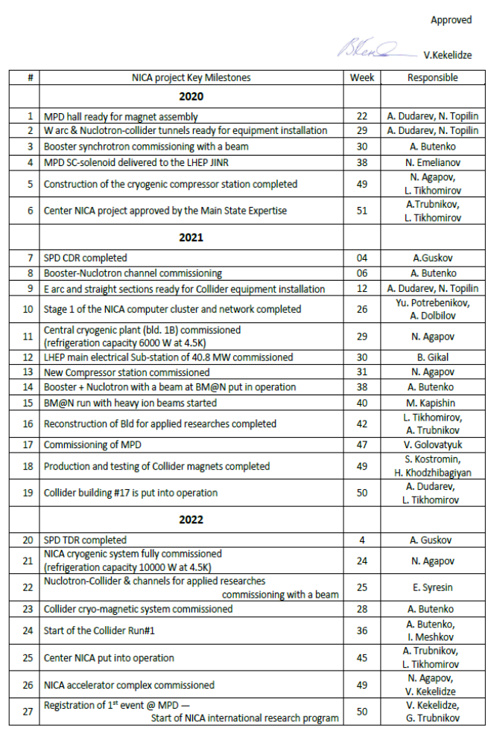
Key milestones
…main points
2020
Booster commissioning
construction cryogenic compressor station W49
2021
Booster – Nuclotron channel commissioning W06
LHEP electrical substation commissioning W49
BM@N run W40
MPD commissioning W47
2022
NICA cryogenic system fully commissioned W24
Start of Collider Run#1 W36

Slide 20
QA plan
NICA facility
Documents
  specifications
  Instructions
  Protocols
  Reports
Peoples (engineers)
Equipment (Labs)
Actions to ensure total quality
Serial magnets for Booster, Collider, SIS-100
  yokes
  SC-coils
  parts of magnets’ cooling systems
Vacuum shells, vacuum volumes
High vacuum volumes (beam pipes)
Other parts of cryostats
JINR-workshop made cryogenic equipment
Cryomagnetic-system of the Booster: assembly technology, testing program
Cryomagnetic-system of the Collider: assembly technology, testing program
NICA complex main cryogenic system
assembly technology, testing program
“selection” of subcontractors)
QA plan – need to be fulfilled

Slide 21
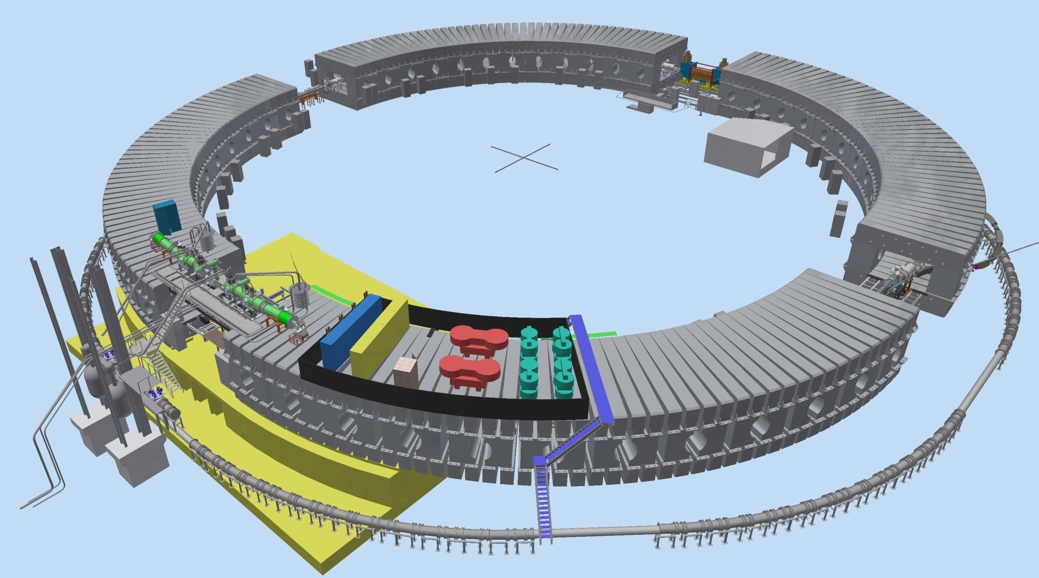
2020-milestone
Thank you for your attention!

