Slide 1

BEAM TRANSFER LINE NUCLOTRON-COLLIDER
AND INJECTION INTO COLLIDER
Tuzikov A.
on behalf of JINR team

Slide 2
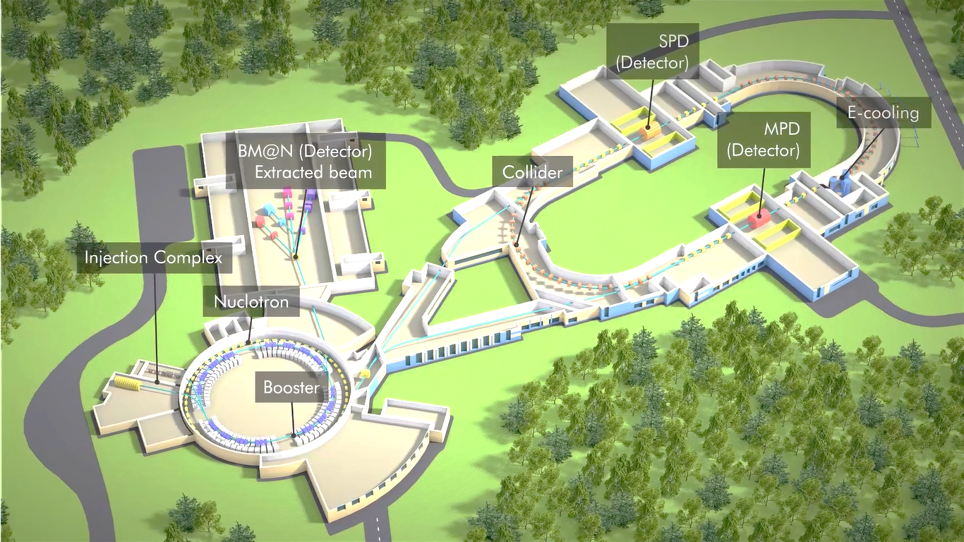
Beam transfer from Nuclotron to Collider
Goals
Accumulation of required intensity of ions (with help of barrier bucket system and beam cooling systems of Collider).
Commissioning: June 2022
Beam Parameters
Ions | Au⁷⁹⁺
Energy of ions, GeV/u | 1 ÷ 3.8
Magnetic rigidity of ions, T m | 14 ÷ 38.5
Ion number | 1∙10⁹
NICA MAC 2020

Slide 3
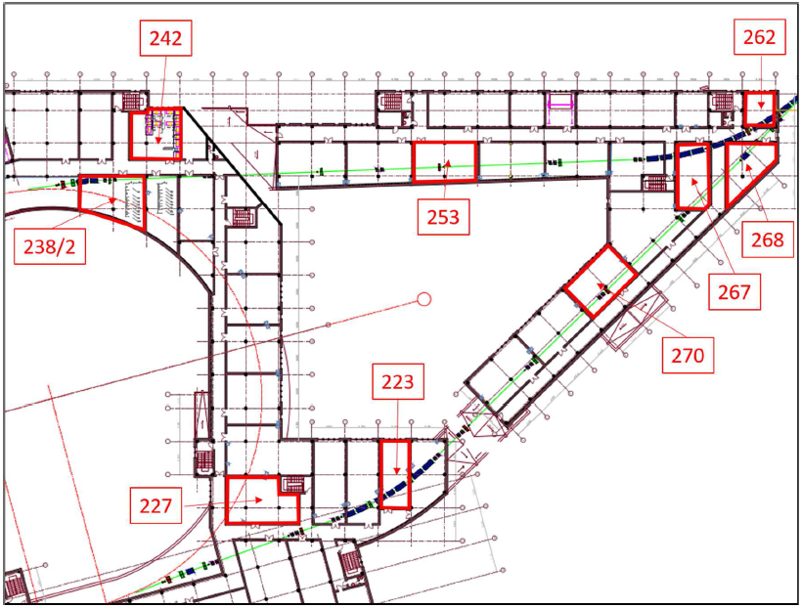
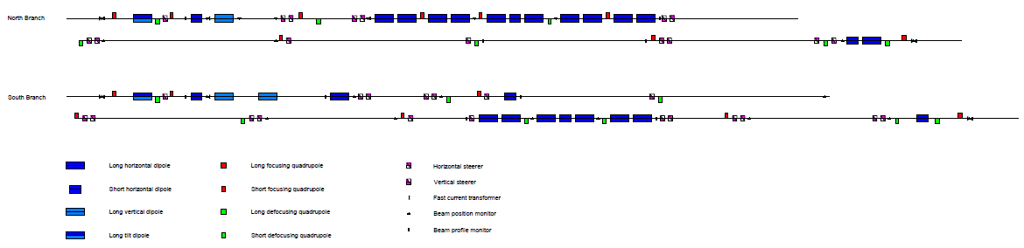
Nuclotron-Collider beam transport channel
Layout
Composition
NICA MAC 2020

Slide 4
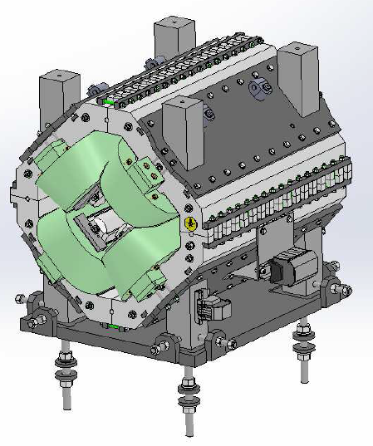
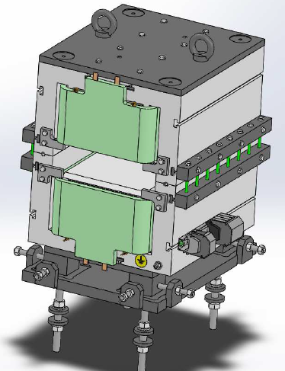
Nuclotron-Collider beam transport channel
Pulsed magnet elements
Magnetic element | Number | Effective length, m | Max. magnetic field (gradient), T (T/m)
Long dipole | 21 | 2 | 1.5
Short dipole | 6 | 1.2 | 1.5
Quadrupole Q10 | 22 | 0.353 | 31
Quadrupole Q15 | 6 | 0.519 | 31
Steerer | 33 | 0.466 | 0.114
Designed by SigmaPhi
NICA MAC 2020

Slide 5
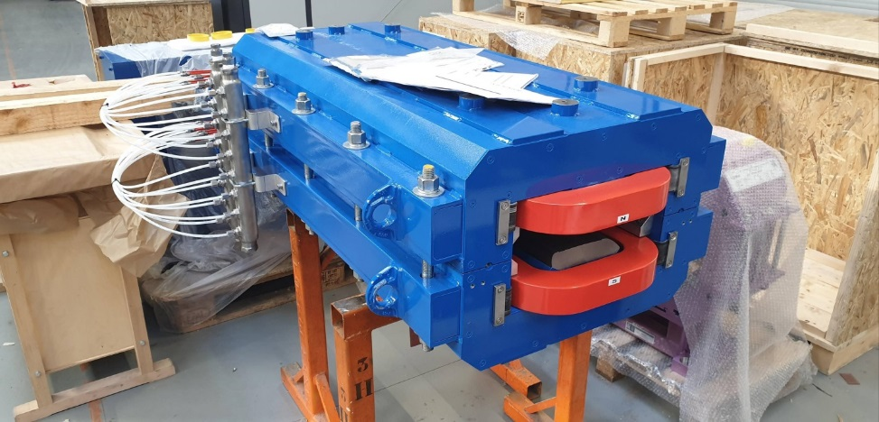
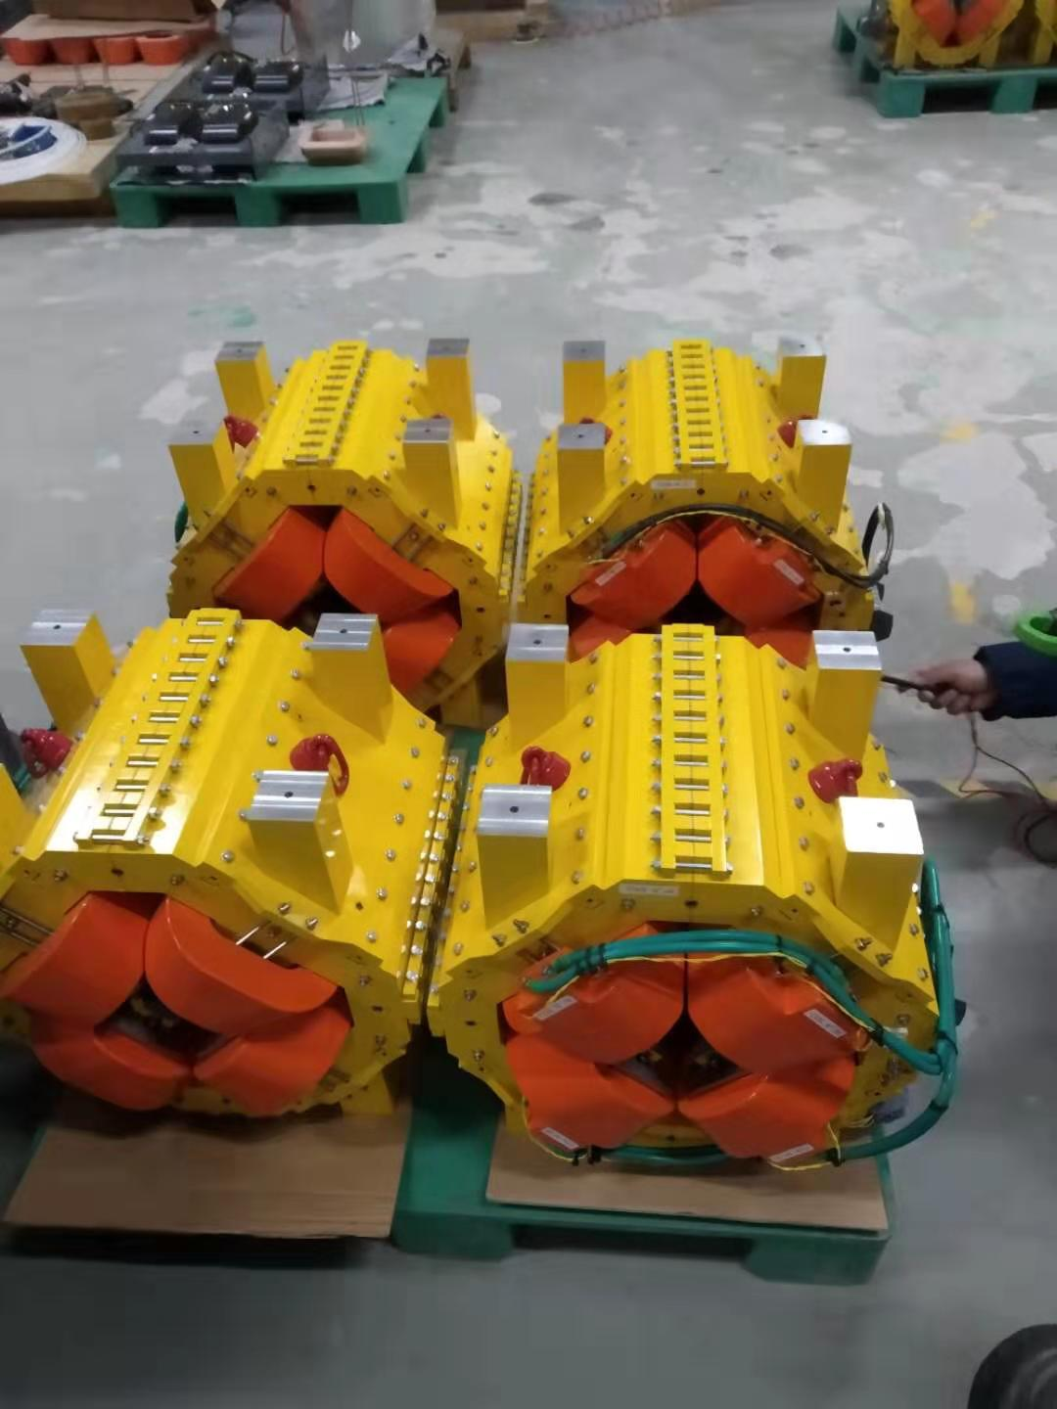
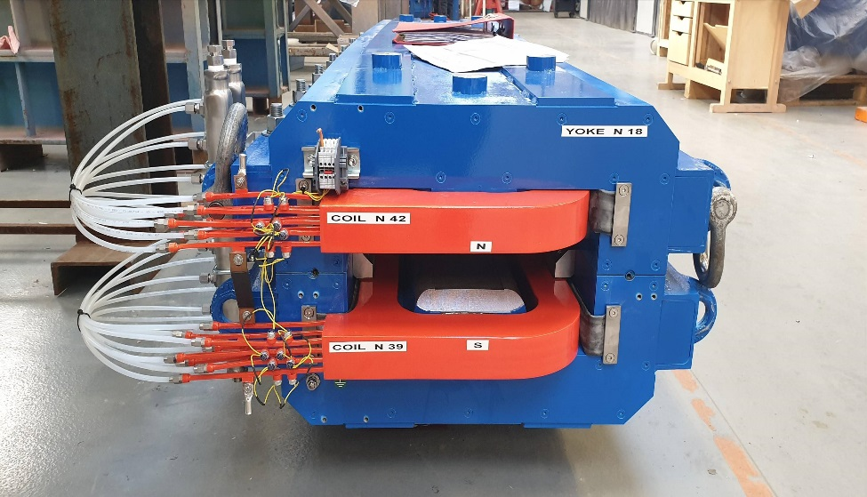
Nuclotron-Collider beam transport channel
Pulsed magnet elements
Manufactured by SigmaPhi
NICA MAC 2020

Slide 6
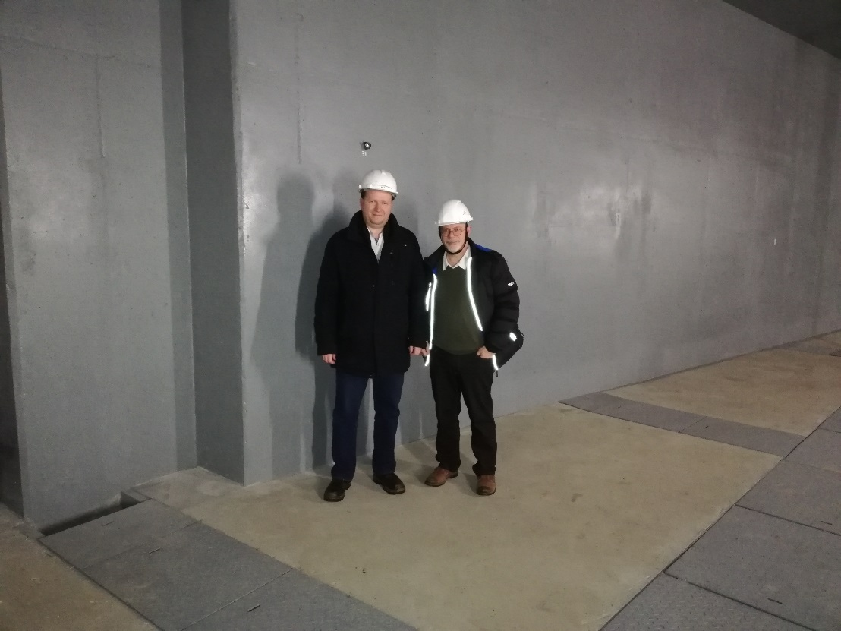
Nuclotron-Collider beam transport channel
Pulsed magnet elements
JINR has prepared a temporary storage in the Collider tunnel and ready to receive the channel magnets. But... Magnetic measurements were fulfilled in quasi-static modes for one magnet of each type only.
Ready for delivery to JINR
RISKS?
NICA MAC 2020

Slide 7
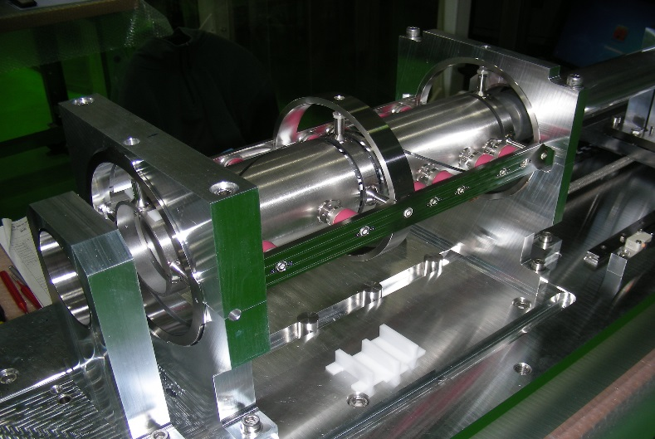
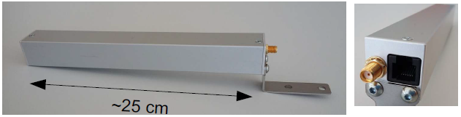
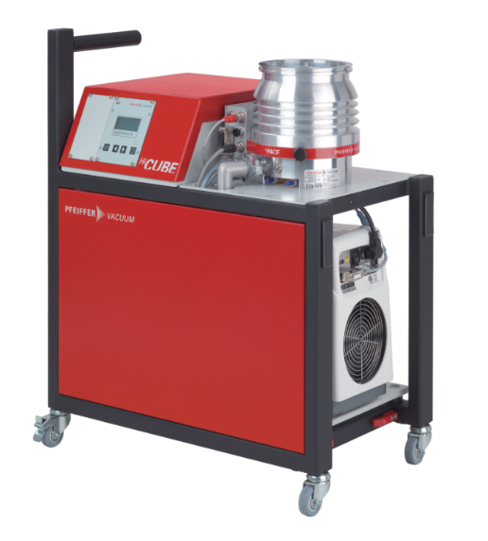
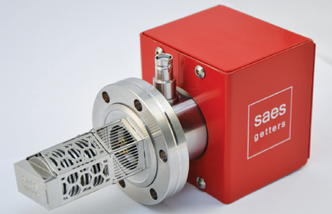
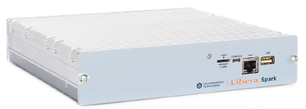
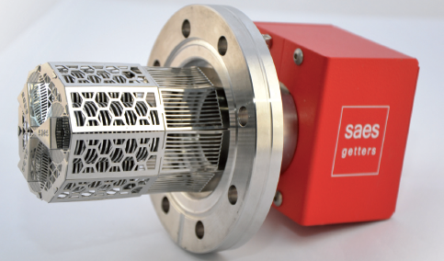
Nuclotron-Collider beam transport channel
Status of channel equipment
Power supplies are being re-designed in order to be based on components provided by Russian vendors.
Beam diagnostics is purchased and manufactured partially. Full sets of beam diagnostics electronics, fast current transformers, beam loss monitors are ready for delivery to JINR. The first set of 6 pick-us are already delivered.
Purchasing of vacuum equipment is near completion.
NICA MAC 2020

Slide 8
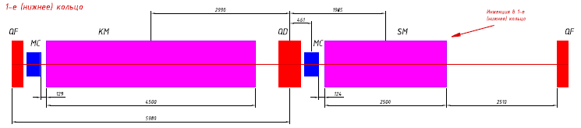
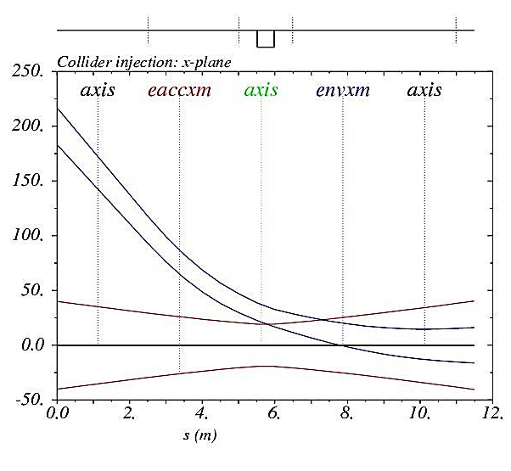
Collider injection system
Beam injection
NICA MAC 2020

Slide 9
Collider injection system
NICA MAC 2020
Design development is in progress

Slide 10
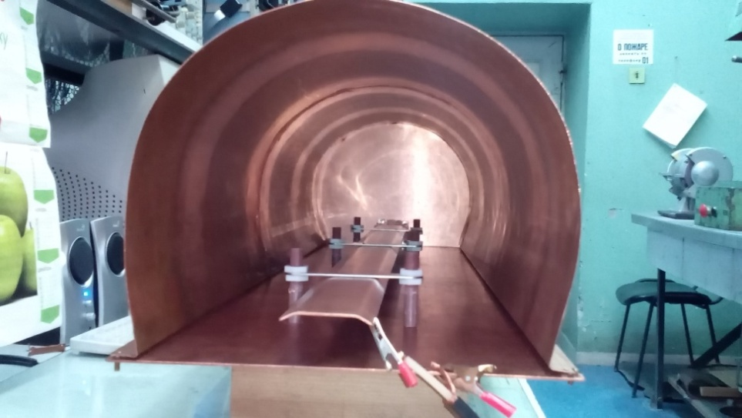
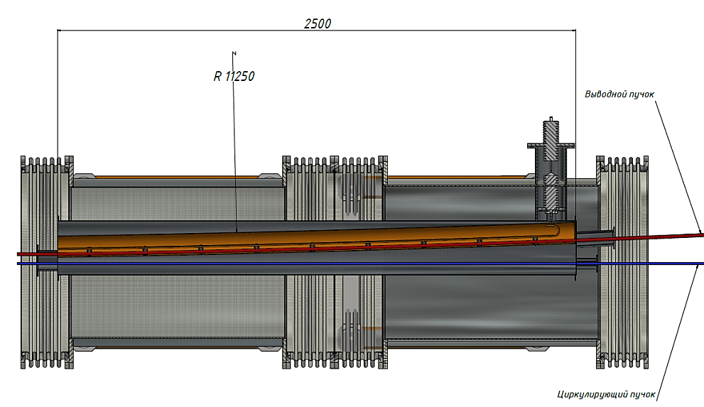
Collider injection system
Septum
Length, m | 2.5
Max magnetic field, T | 0.42
Gap, mm | 35
Septum thickness, mm | 3
Pulse shape | semisinusoidal
Pulse duration, μs | ~ 10
Technical design development is in progress. The main crucial items are low-inductive feedthroughs for current pulses of order 50 kA.
New design of power supply based on semi-conducting switches is being developed.
NICA MAC 2020
10

Slide 11
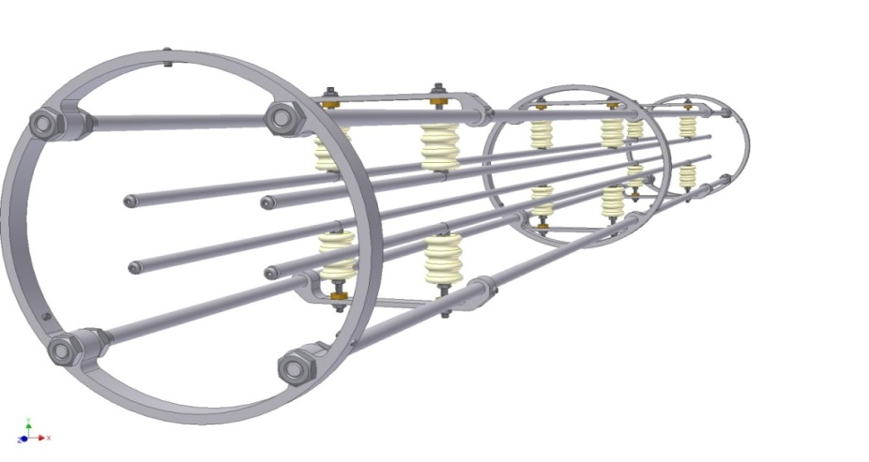
Collider injection system
Kicker
Length, m | 4
Max magnetic field, T | 0.1
Pulse duration, ns: rise plateau fall | 200 200 200
After-kick amplitude, plateau level | ≤1.5%
After-kick duration, ns | ≤160
Concept of the kicker and its power supplies is developed.
Concept of measures against after-kicks is developed.
Effects of after-kicks to the stack are estimated.
NICA MAC 2020

Slide 12
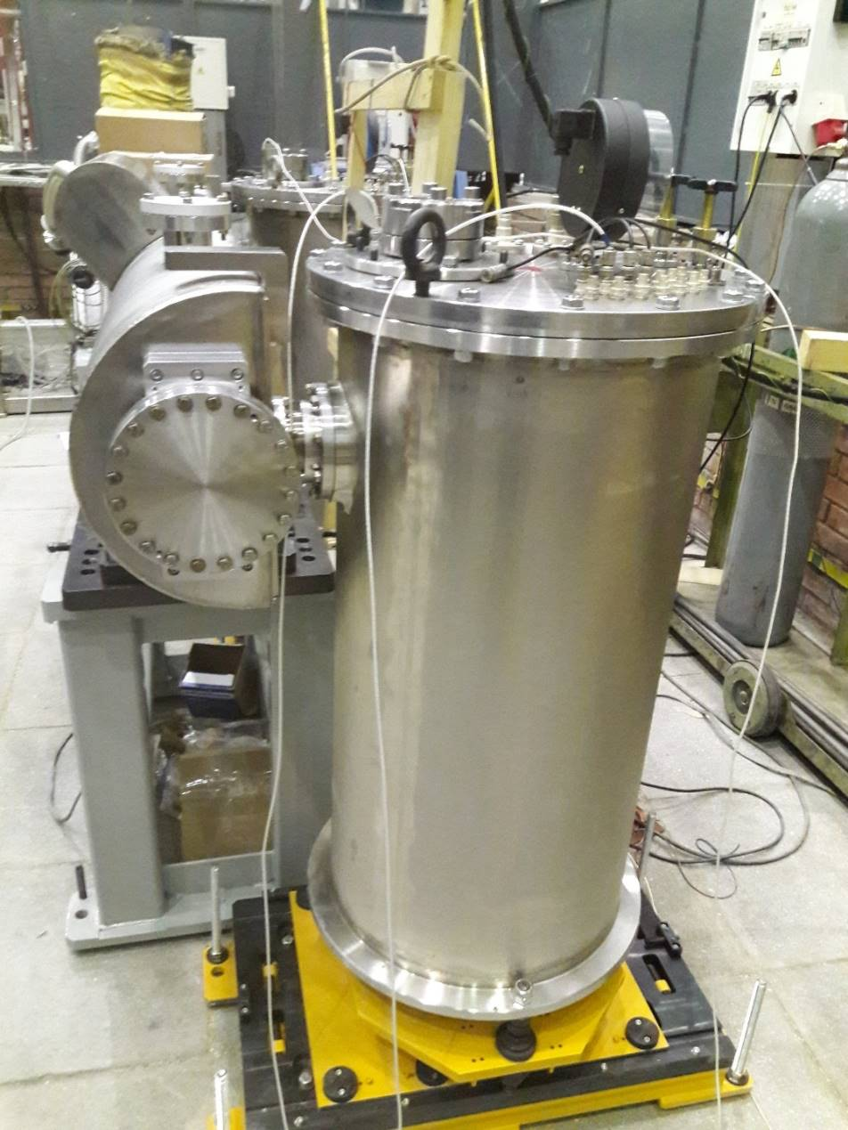
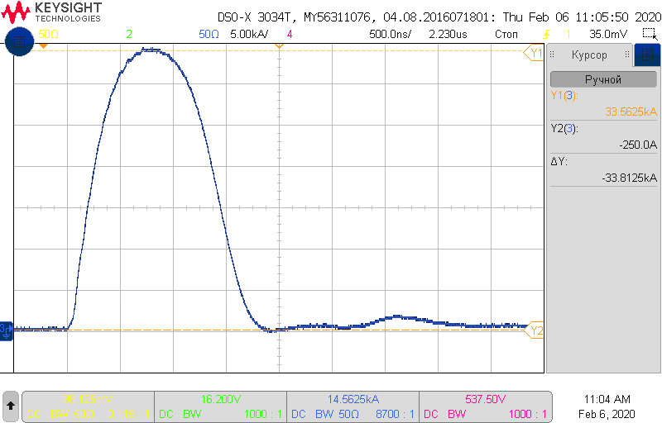
Collider injection system
Kicker of beam extraction system of Booster
Manufactured by BINP
NICA MAC 2020

Slide 13
Collider injection system
Kicker after-pulses
Suppression of after-pulses by damping circuit
NICA MAC 2020

Slide 14
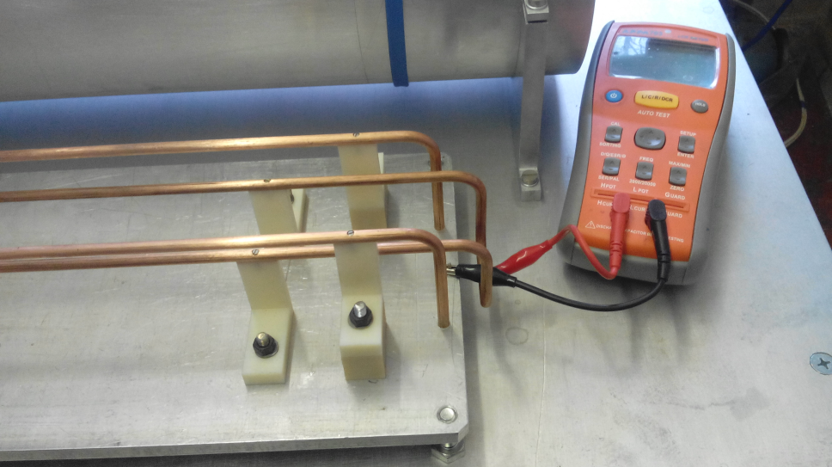
Collider injection system
Kicker subsystem
Disadvantages
Power supplies have a complicated circuit scheme.
High voltage on capacitors and other components of power supplies (up to 60 kV).
Many power supplies (8 PS per a kicker).
Possible alternative solutions
Suppression of a kicker after-pulse influence on a beam instead of a kicker after-pulse itself → simplification of power supplies
NICA MAC 2020

Slide 15
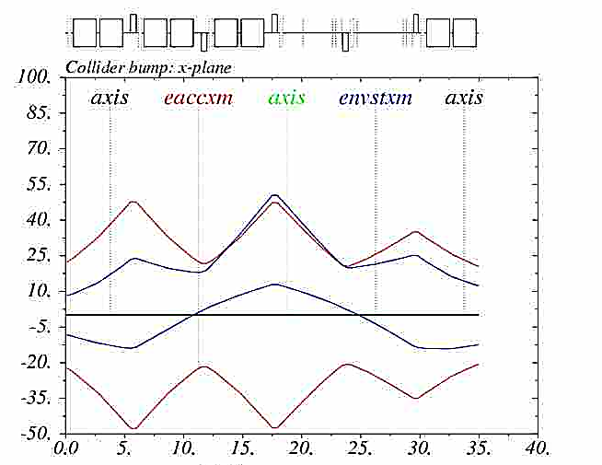
Collider injection system
Kicker subsystem
Possible alternative solutions
Revision of the beam injection concept → decrease of a kicker’ angle → lower current and voltage in PS
Local closed orbit bump
Hor. acceptance of the Collider stack – 20 π∙mm∙mrad
NICA MAC 2020

Slide 16
Collider injection system
Revisioned injection system (to be optimized)
Kicker
Length, m | 2 ÷ 4
Max magnetic field, T | 0.05 ÷ 0.12
Pulse duration, ns: rise plateau fall | 200 200 200
Bump dipoles
Powering | 1 additional PS per a pair of dipoles
Number of power supplies | 4
Max current, A | 150
Max bending angle, mrad | 1.2
NICA MAC 2020

Slide 17
THANK YOU FOR ATTENTION

