Slide 1
Stochastic cooling hardware
Sidorin A, Gorelishev I, Osipov K
JINR – 27-29.05.2020

Slide 2
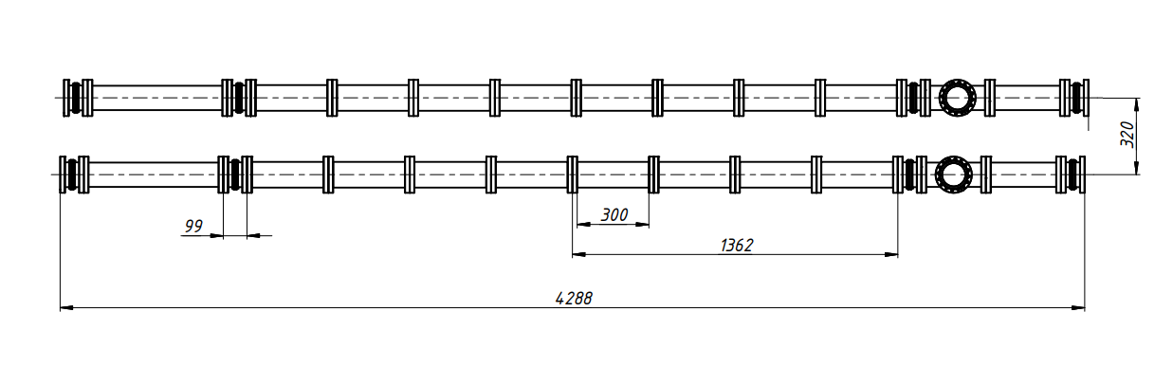
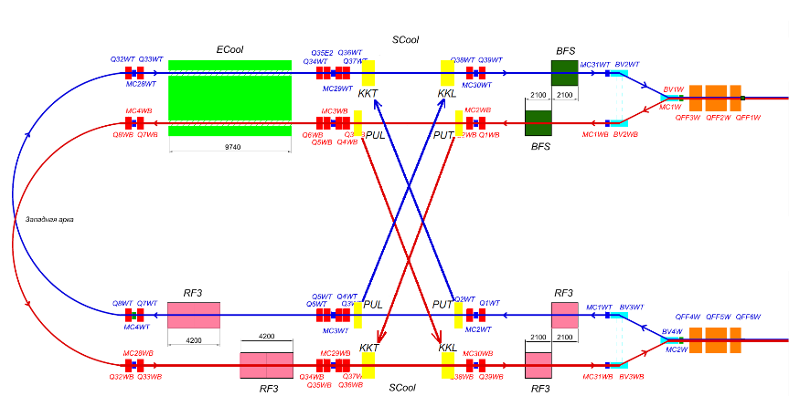
General requirements:
  Location - warm section of Collider.
  Ultra-high vacuum.
  High shunt impedance.
  Linear phase transfer function.

Slide 3
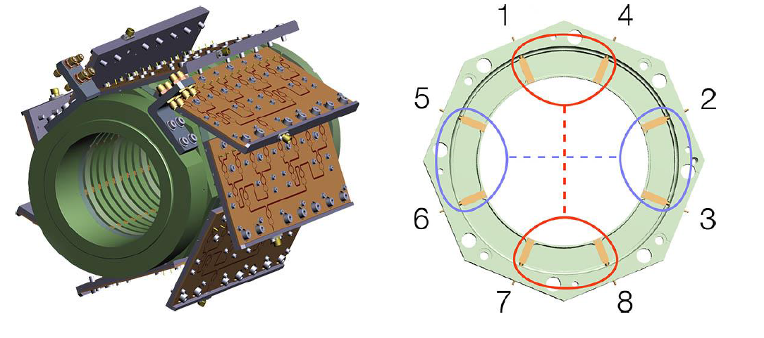
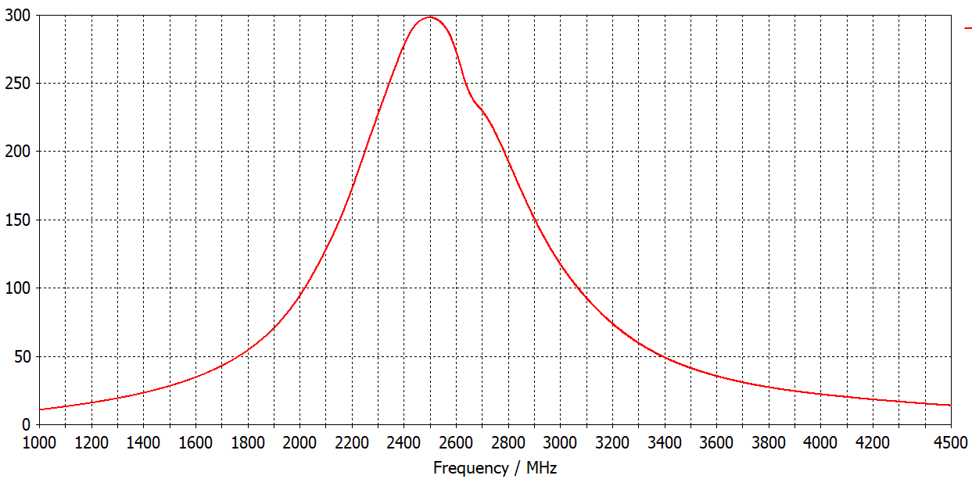
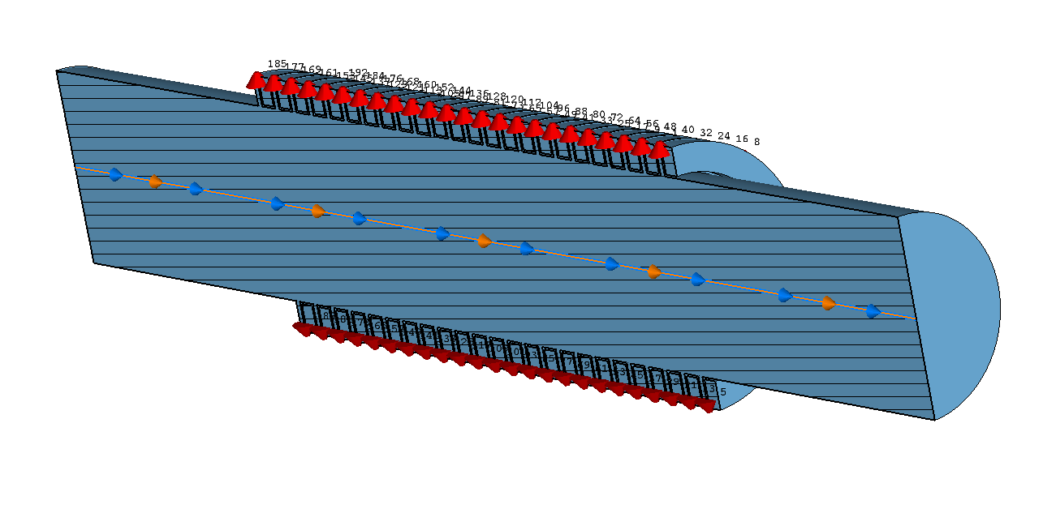
Initial Design – Ring-Slot coupler
Model and calculated shunt Impedance.
Ohm

Slide 4
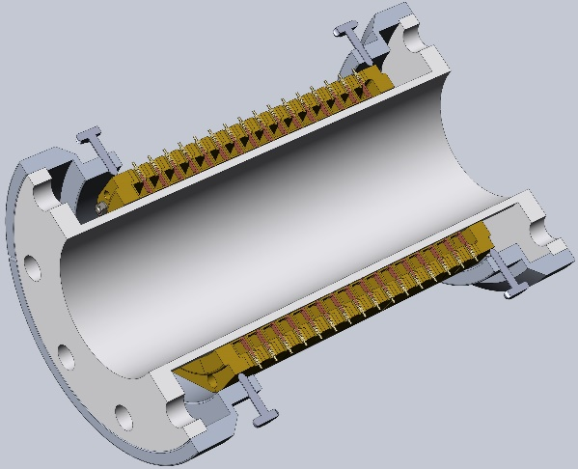
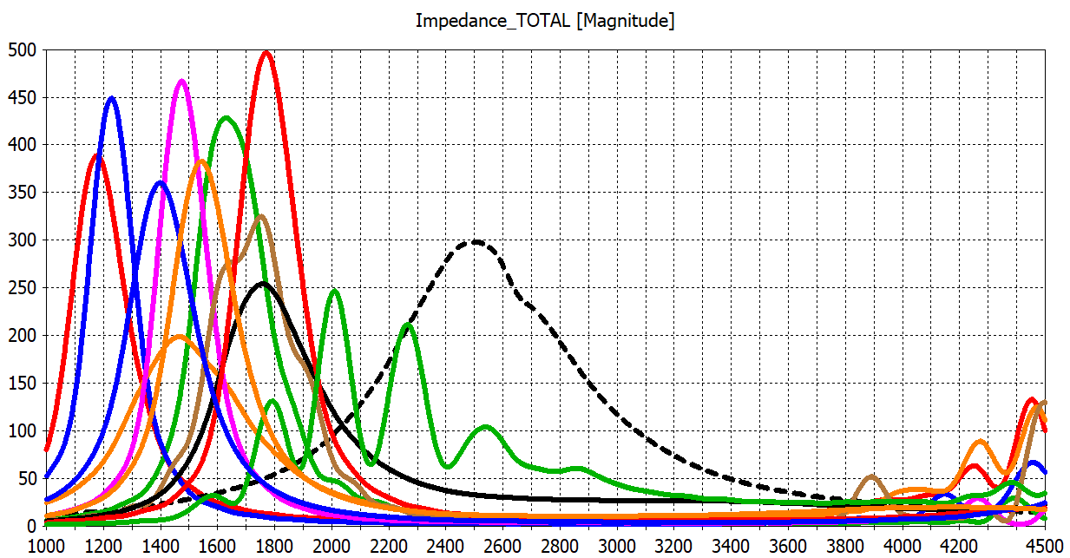
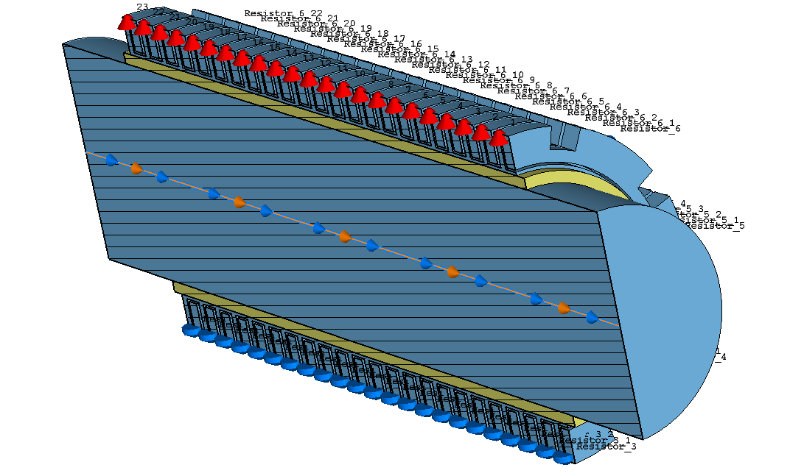
Using cylindrical ceramic insert is good in solving the problem of local sealing, but high ε of ceramic (Al2O3) moves frequency of structure down to 1-1.8 GHz and decrease the bandwidth.
Minimum thickness of the tube due to vacuum requirements - 5mm.
Modeling was done for different sets of parameters – rings number, rings size,
feeding line size etc.
So, reasonable parameters can not be reached in required bandwidth.
Initial curve
Ohm
MHz
Shunt impedance curves for different parameters of the model
Pickup/kicker model with ceramic tube

Slide 5
Bandwidth of the structure is much narrow than required band of 1-3 GHz.
But the physics of the stochastic cooling allows to divide a system bandwidth into several bands.
For each pickup and kicker of the SCS, 4 segments are allocated at the collider, so band can be divided into 4 sub bands.
It can be done in 2 ways:
1. Sub band dividing with one optical processing module and additional multiplexers
Prelaminar sub band dividing:
Sub band 1 – 1000-1320МHz
Sub band 2 – 1320-1740МHz
Sub band 3 – 1740-2300МHz
Sub band 4 – 2300-3000МHz
2. Sub band dividing with independent channels and optical processing modules for each channel.
Hardware to be developed:
Pickups and kickers.
Multiplexers.
Band filters.
Band equalizers.
RF decoupler.

Slide 6
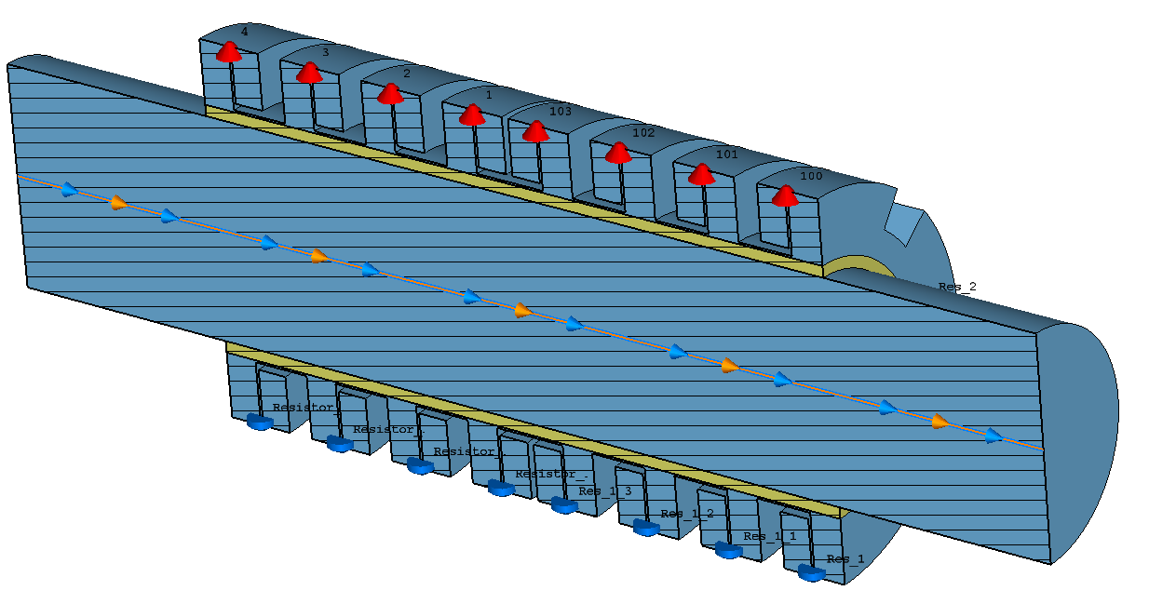
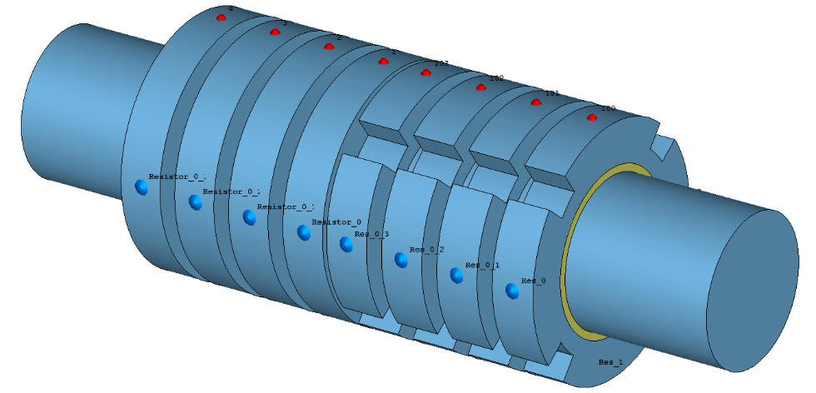
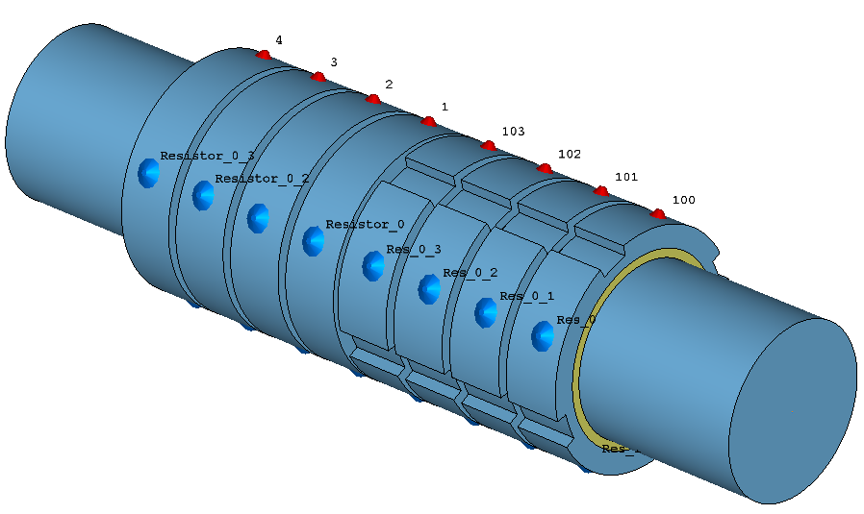
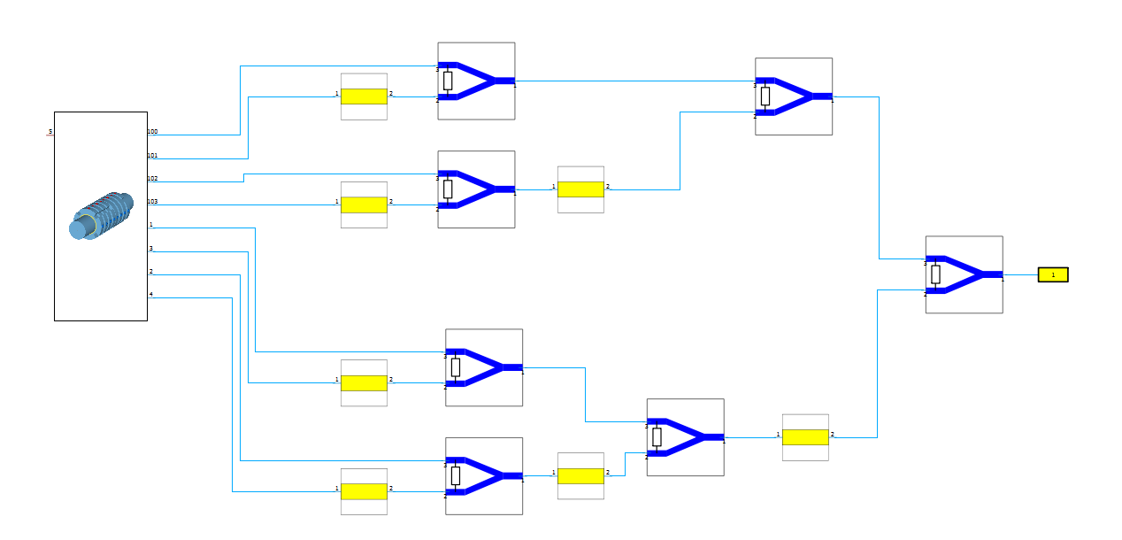
Result of sub band 1 and 2 design optimization: acceptable longitudinal impedance characteristics were obtained for just 8 rings and 4 ports per ring.
It allows to reduce losses on combining board.
Also it reduce total size of the structure due to reduction of combining board size and reduction of number of combining boards. So, It is possible to mount pickups and kickers parallel in available area.

Slide 7
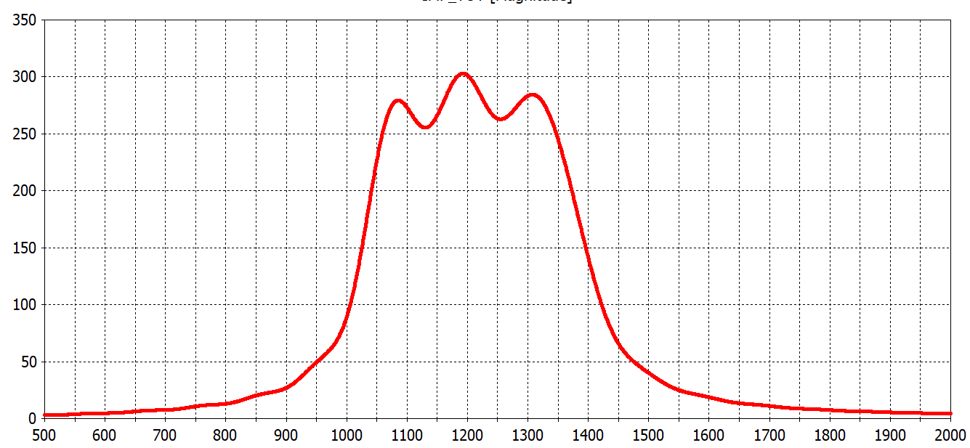
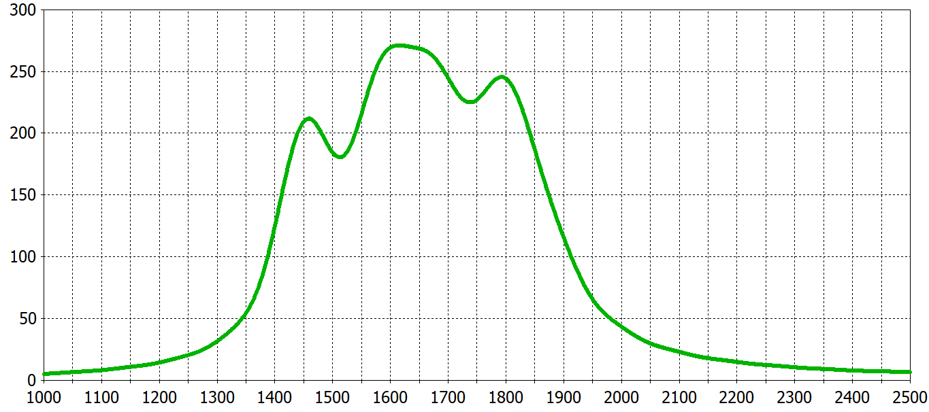
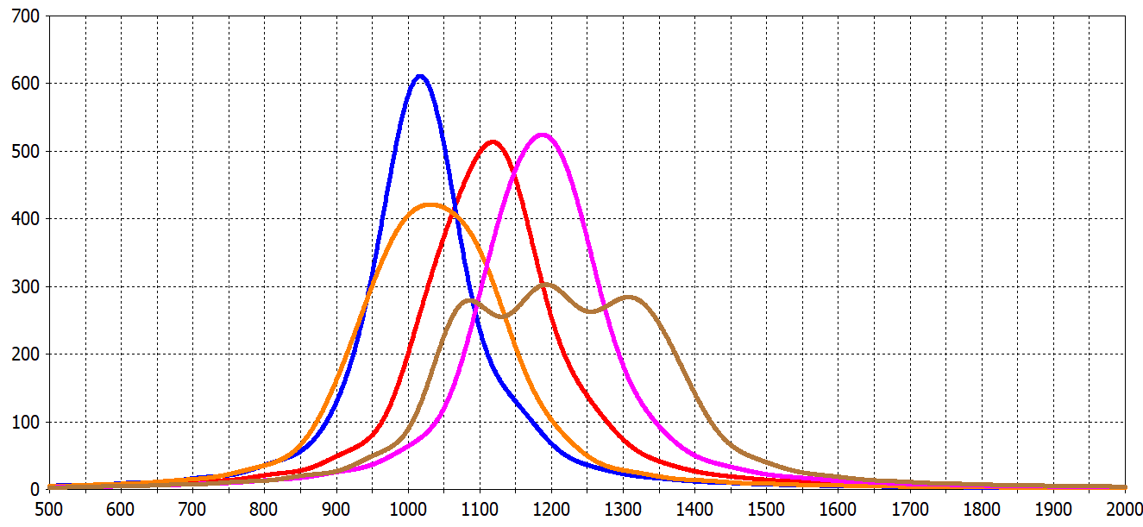
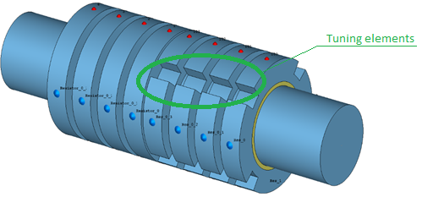
Ohm
Ohm
Optimized longitudinal shunt impedance sub band 1
MHz
Optimized longitudinal shunt impedance sub band 2
MHz
Ohm
MHz
Longitudinal shunt impedance sub band 1 for different sets of tuning elements

Slide 8
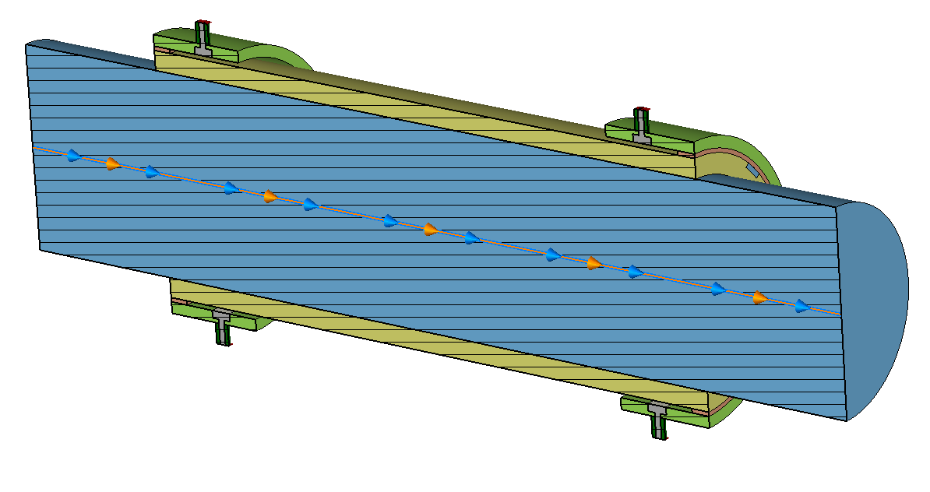
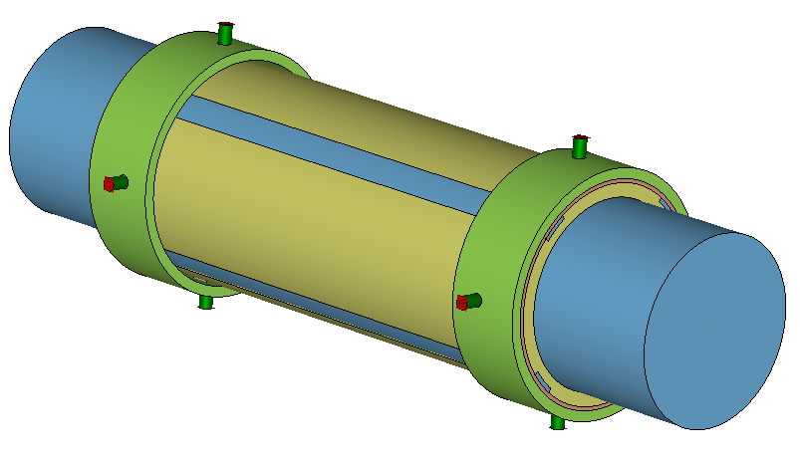
During the simulation of pickups, a strong influence of a ceramic pipe on the nature of signal propagation was found.
A ceramic pipe is a slowing structure and a surface wave is induced in it.
This effect does not allow to optimize ring-slot coupler in frequencies higher than 2GHz.
But it is possible to use a spurious wave “in our own interests”.
The main idea – to absorb an energy induced in ceramic pipe by a beam propagation along the pipe with only one sensor ring (not several ring as in ring-slot coupler).
Another sensor ring is installed in opposite side just to reduce standing wave amplitude and fed with matching loads.
Frequency range of the structure depends on the dielectric layer thickness (ceramic tube) and can easily be adjusted.
Acceptable results for longitudinal shunt impedance for sub bands 3 and 4 were achieved.

Slide 9
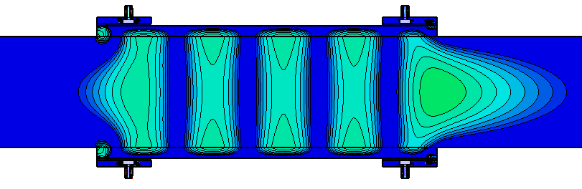
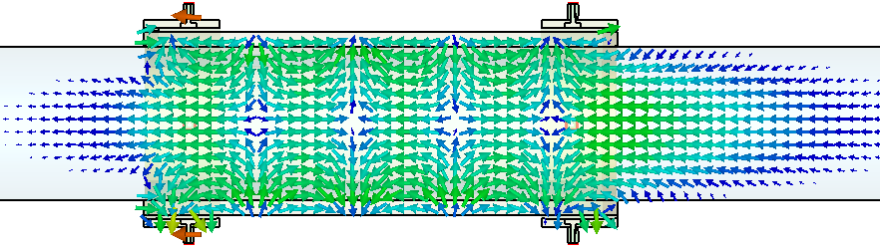
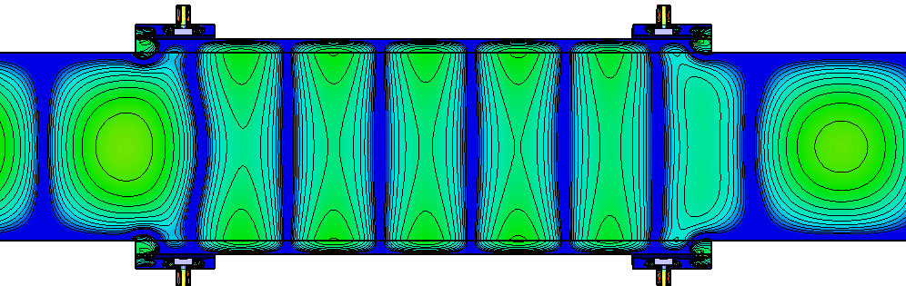
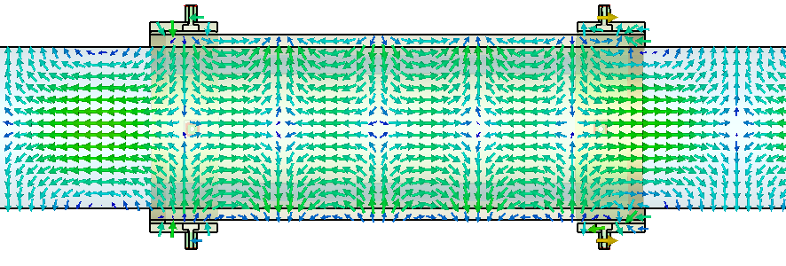
Kicker sub band 3 Z-term of E-field
Kicker sub band 3 E-field
Kicker sub band 4 Z-term of E-field
Kicker sub band 4 E-field

Slide 10
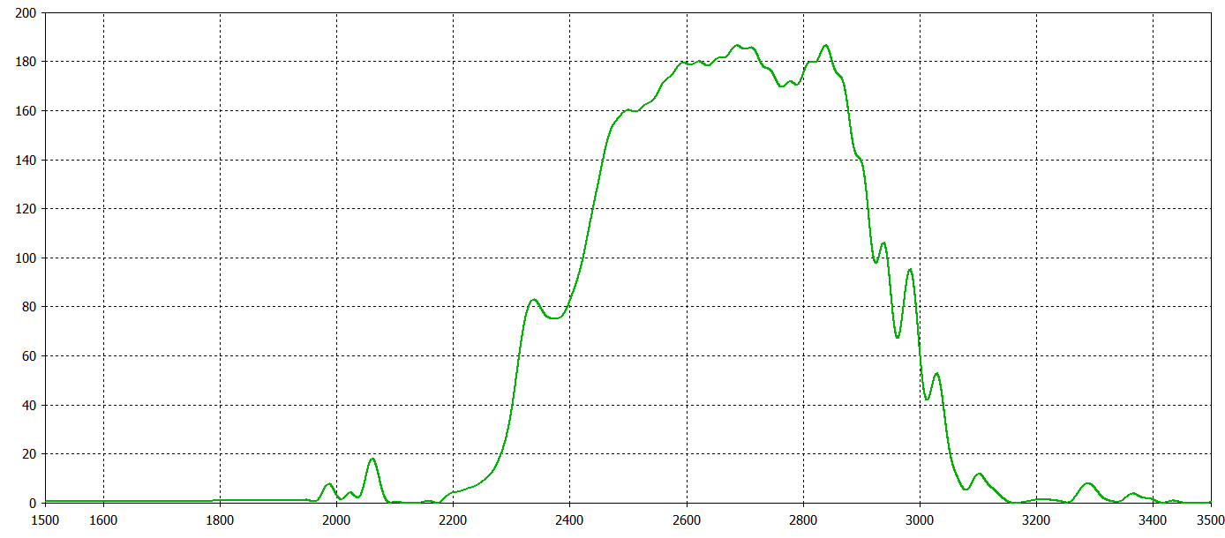
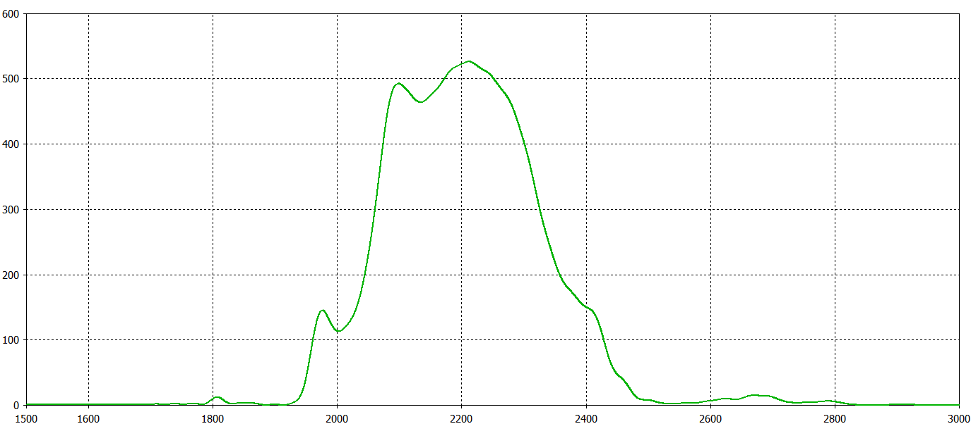
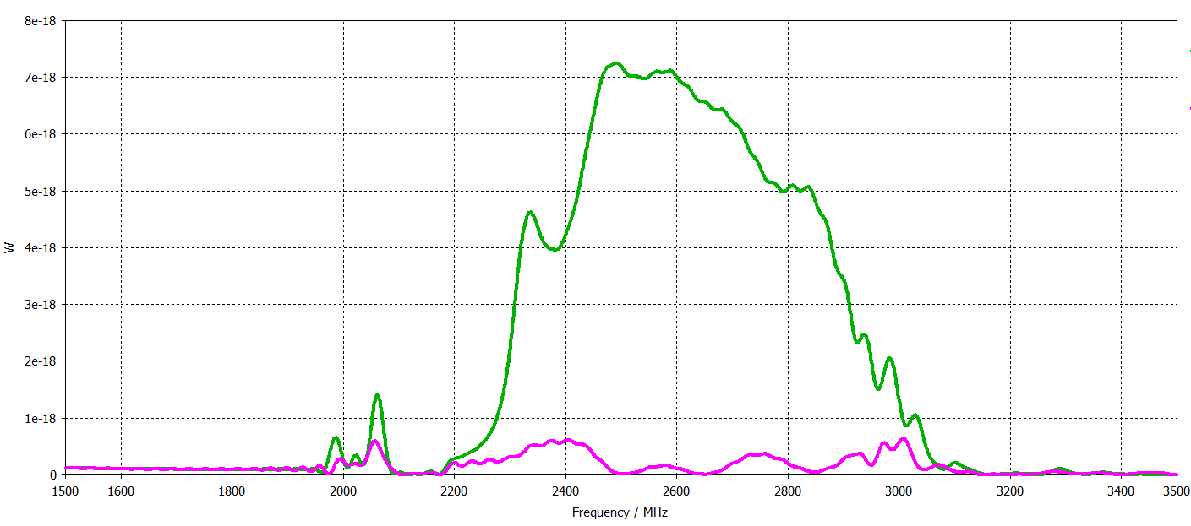
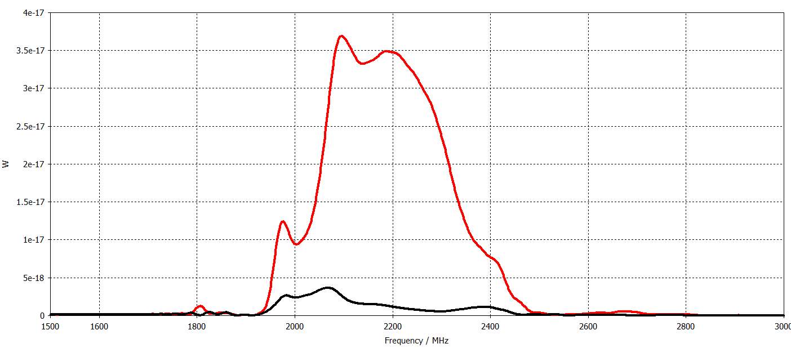
Ohm
Ohm
MHz
MHz
Optimized longitudinal shunt impedance sub band 4
Optimized longitudinal shunt impedance sub band 3
W
W
MHz
MHz
Power accepted in forward and backward rings for sub band 4
Power accepted in forward and backward rings for sub band 4

Slide 11
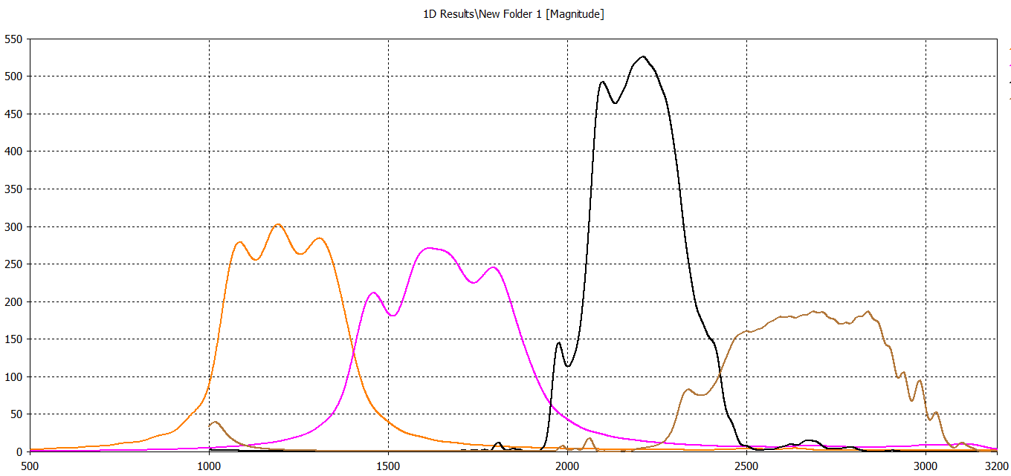
Ohm
Longitudinal shunt impedance for all bands.
MHz

Slide 12
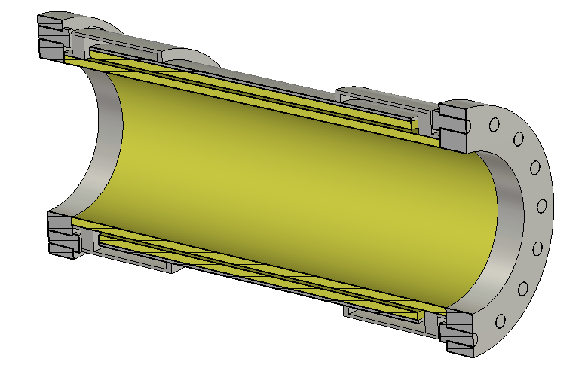
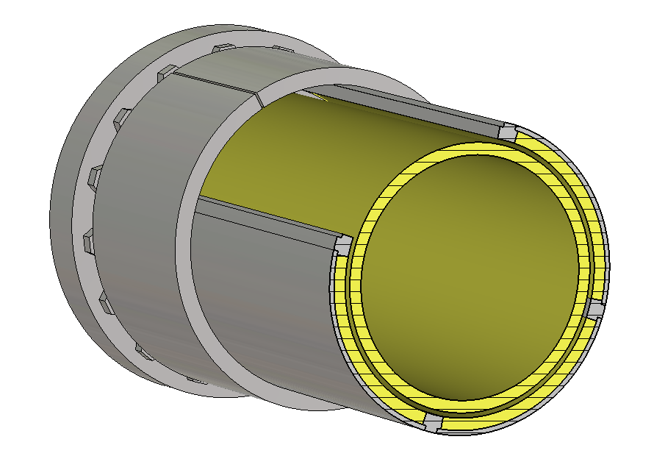
Practical realization
The design of sub band 1 and 2 pickups and kickers are supposed to be identical to the initial one.
Exception is reduced dimensions and simplification.
Besides, Tuning elements are supposed to be included.
The preliminary design of sub band 3 and 4 pickups and kickers is done.
It includes changeable dielectric inserts to control working frequency and other characteristics.
Pickups and kickers are decided to mount outside the sealing ceramic tube. So, it can be changed, or modified independently.
The design of sealing tube is now practically defined. Prototype of sealing tube is made and tested for vacuum conditions. So, all of it can be done in parallel of pickup and kicker experiments.
First practical experiments to confirm ne design characteristics are suppose to be done on Buster.
Sealing tube for it is made, tested for vacuum and ready to mount on Booster.
Design of sub band 3 and 4 pickup

