Slide 1
PERIODIC SOLUTIONS IN PROBLEMS OF ISOTHERMAL FILTRATION OF HYDROCARBON MIXTURES
V.M. Zaichenko, D.A. Molchanov, Yu.V. Pazyuk, V.N. Sokotushchenko, V.M. Torchinsky
JIHT, Moscow
this work is supported by RFBR (project № 17-08- 01270)

Slide 2




system of equations for the filtration of a 2-phase mixture in the one-dimensional case
- density, viscosity, pressure, and the velocity vectors

Slide 3
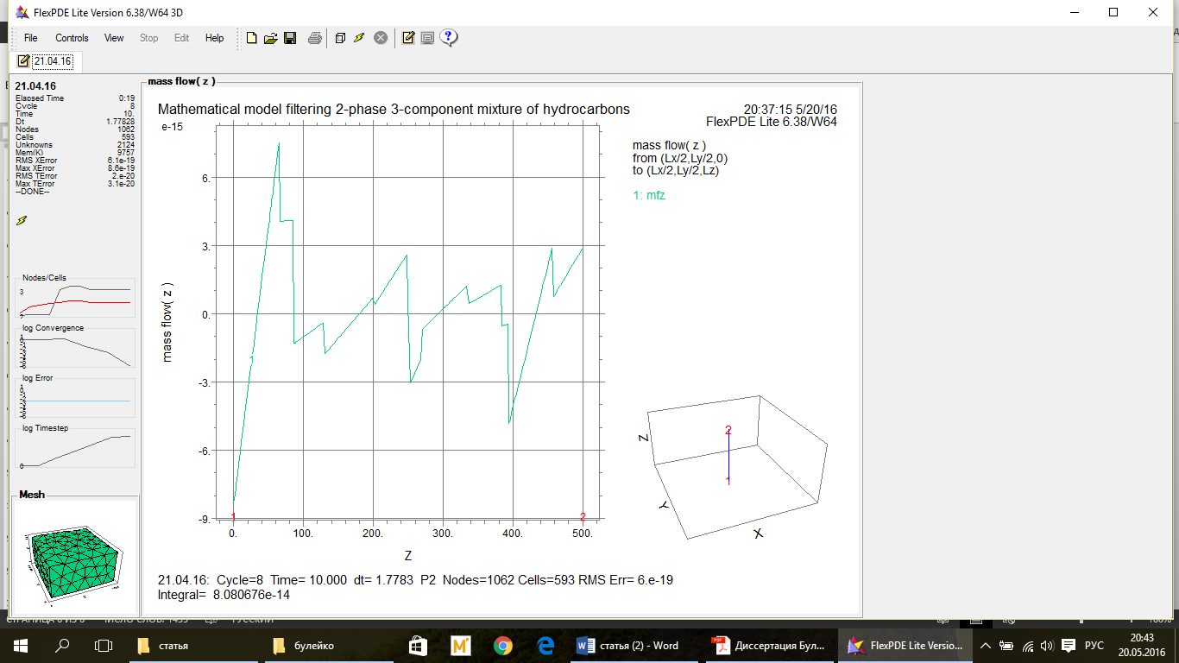
Mathematical modeling of filtering 2-phase
3-component mixture of hydrocarbons

Slide 4
THANKS FOR ATTENTION!

