Slide 1


Finite size effects in the thermodynamics of a free neutral scalar field on the lattice and in the continuum
A.S. Parvan
BLTP, JINR, Dubna
DFT, IFIN-HH, Bucharest

Slide 2
Free real scalar field in the path integral method
Partition function
Operators: Schrodinger representation
Classical action:
Classical Lagrangian density:
Partition function:
Field operator:
Conjugate field operator:
Hamiltonian operator:
Hamiltonian density:

Slide 3
The path integral method in one spatial dimension
Discretization of inverse temperature:
Discretization of the spatial volume:
4-dimensional lattice:
one spatial dimension:
The state vectors:
Orthogonality and completeness:
Field representation:
A.S.P., arXiv:1505.05838v3 [hep-ph]

Slide 4
Configuration space
Partition function:
Matrix element:
Hamiltonian:
Partition function:
Boundary conditions:

Slide 5
Configuration space
Integration over :
Reduction to the bilinear form:
Symmetric square matrix A of size :
A.S.P., arXiv:1505.05838v3 [hep-ph]

Slide 6
Partition function in configuration space
Integration over :
Partition function in the configuration space:
Recurrence relations:
- real symmetric square matrix
A.S.P., arXiv:1505.05838v3 [hep-ph]

Slide 7
Momentum space: Discrete Fourier transform
4-dimensional momentum space:
Some relations:
Discrete Fourier transform in one spatial dimension :
periodic
antiperiodic

Slide 8
Partition function in momentum space
Partition function in momentum space:
Matrix of the bilinear form for even and even for the real scalar field:
Jacobian matrix:
A.S.P., arXiv:1505.05838v3 [hep-ph]

Slide 9
Thermodynamic quantities in momentum space
Partition function in momentum space in 1-spatial dimension:
Generalization of the partition function in momentum space in 3-spatial dimensions:
Density of thermodynamic potential, energy density and pressure in 3-spatial dimensions :
J.Engels, F.Karsch, H.Satz, Nucl. Phys. B 205, 239 (1982)
A.S.P., arXiv:1505.05838v3 [hep-ph]

Slide 10
One-Side Limit for lattice quantities
Energy density, vacuum term and physical term:
Pressure, vacuum term and physical term:
Density of thermodynamic potential, vacuum term and physical term:

Slide 11
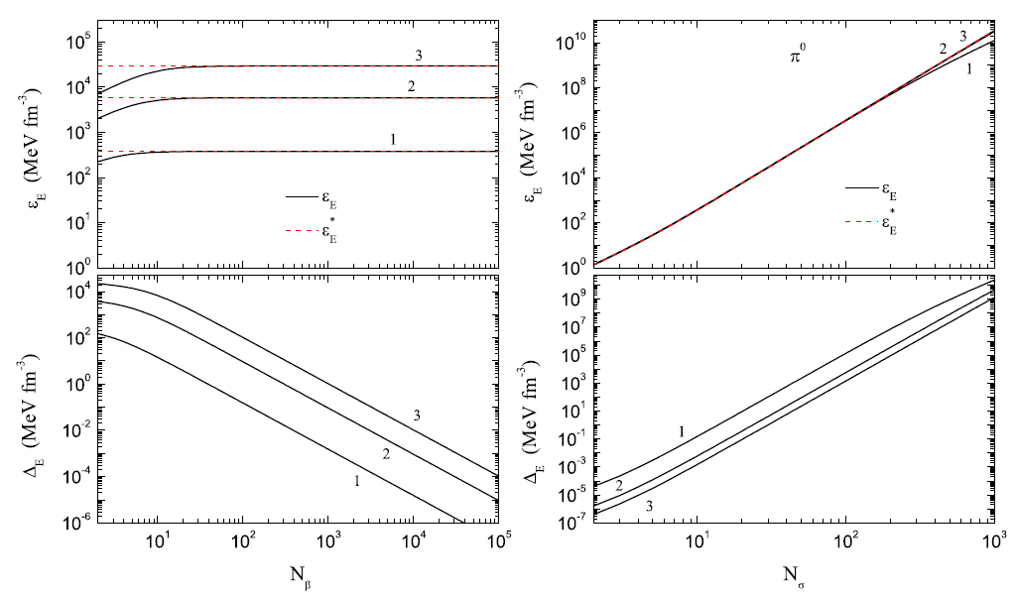
Energy density on a finite lattice
-limit at
-limit at

Slide 12
Continuum Limit
Energy density, vacuum term and physical term:
Pressure, vacuum term and physical term:
Density of thermodynamic potential, vacuum term and physical term:
Trace anomaly:
A.S.P., arXiv:1505.05838v3 [hep-ph]

Slide 13
Potential inhomogeneity and zeroth law of thermodynamics
1.) Thermodynamic potential is a homogeneous function of the first order with respect to V (a linear function):
Potential inhomogeneity:
Zeroth law of thermodynamics:
2.) Thermodynamic potential is an inhomogeneous function with respect to V (not a linear function):
Potential inhomogeneity:
Zeroth law of thermodynamics:
A.S.P., arXiv:1505.05838v3 [hep-ph]
-condition
-intensive
-additive
-condition
-intensive
-nonadditive
If the thermodynamic potential is an inhomogeneous function with respect to V (not a linear function) then it is
non-additive, potential inhomogeneity is not equal to zero and the zeroth law of thermodynamics is not satisfied

Slide 14
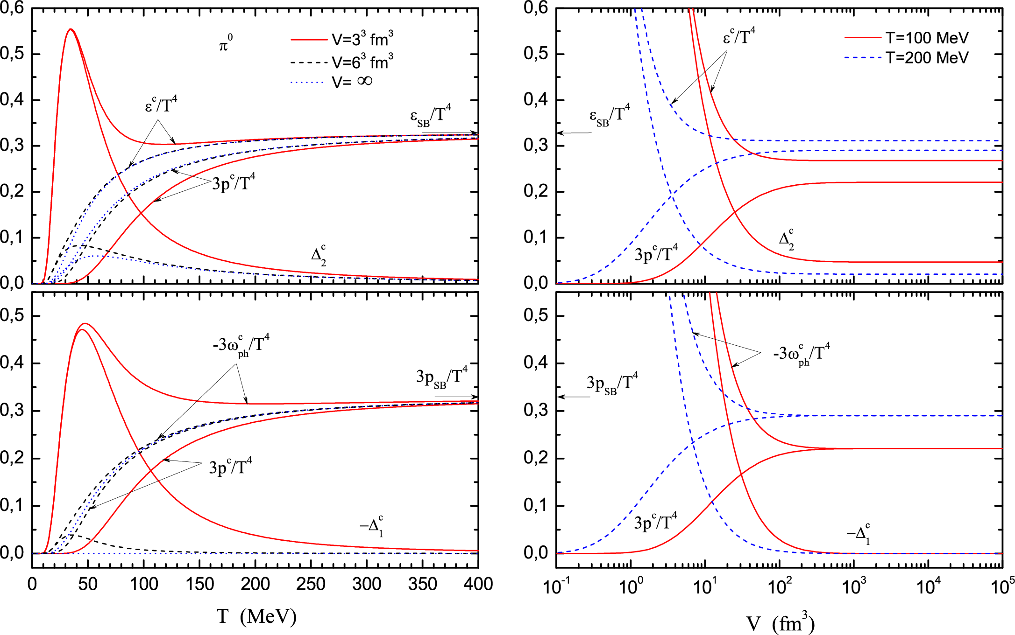
Continuum limit: Massive free real scalar field in a finite volume
-physical energy density
-physical pressure
-physical density of thermod. potential
-trace anomaly
-potential inhomogeneity

Slide 15
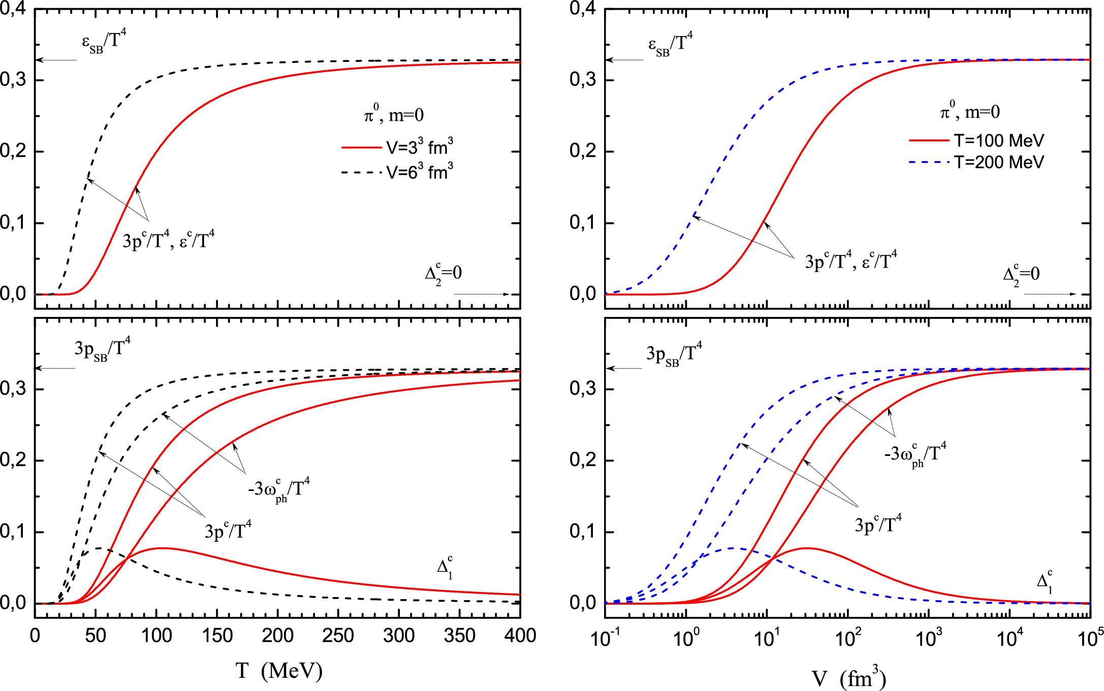
Continuum limit: Massless free real scalar field in a finite volume
(without zero-mode term)
-physical energy density
-physical pressure
-physical density of thermod. potential
-trace anomaly
-potential inhomogeneity

Slide 16
Vacuum quantities on a finite lattice
J.Engels, F.Karsch, H.Satz, Nucl. Phys. B 205, 239 (1982)
Vacuum terms on a finite lattice (summation over is changed to integration):
Vacuum terms in the continuum limit:

Slide 17
Physical quantities on a finite lattice
J.Engels, F.Karsch, H.Satz, Nucl. Phys. B 205, 239 (1982)
Physical terms on a finite lattice:
Trace anomaly on a finite lattice:
Physical terms in the continuum limit:
A.S.P., arXiv:1505.05838v3 [hep-ph]

Slide 18
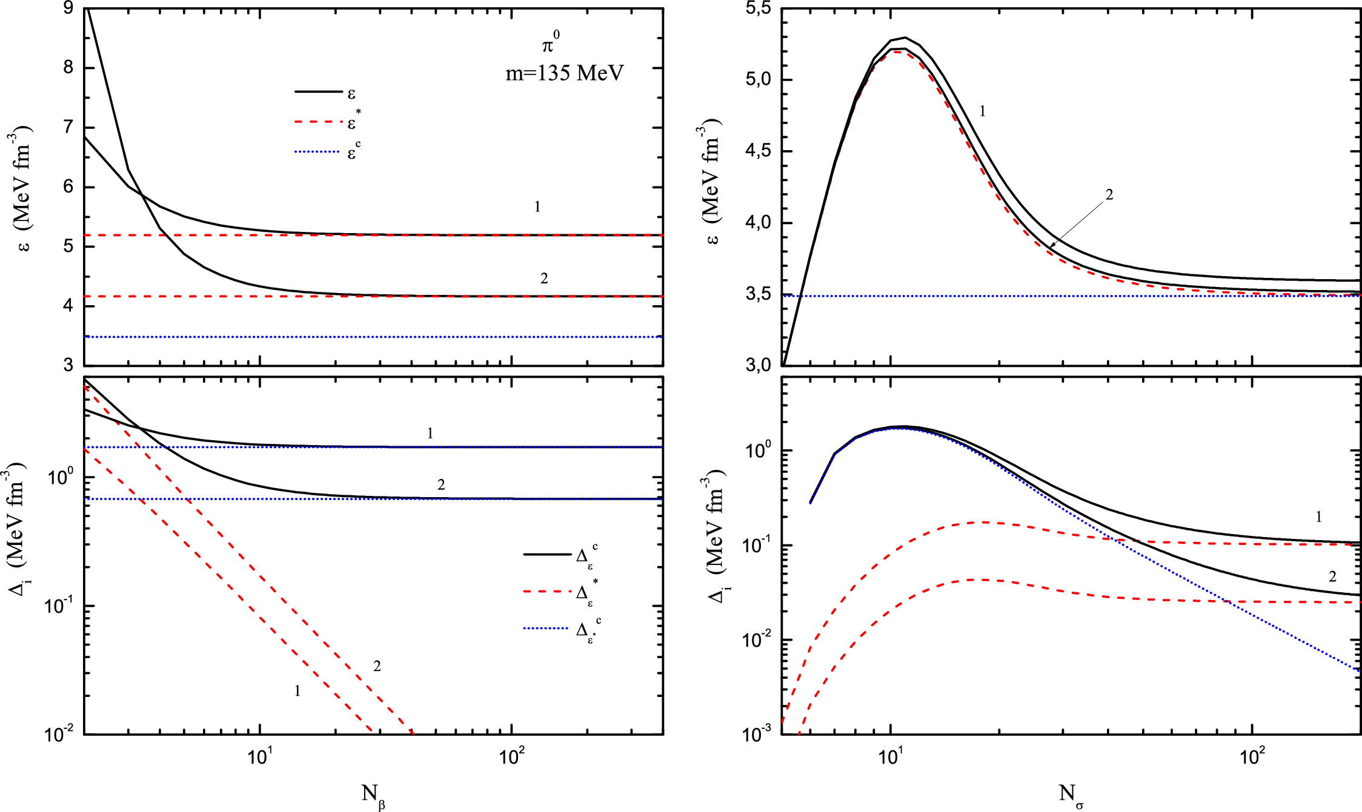
Physical energy density on a finite lattice
-limit at
-limit at

Slide 19
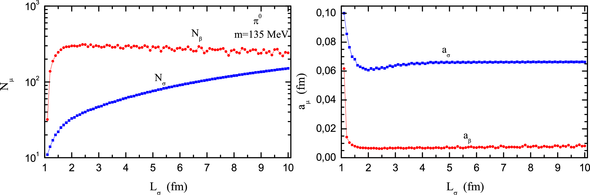
Approximation of the continuum limit for the scalar field
A.S.P., arXiv:1505.05838v1 [hep-ph]
is found from the condition
is found from the condition
Lattice Sizes
Spacings

Slide 20
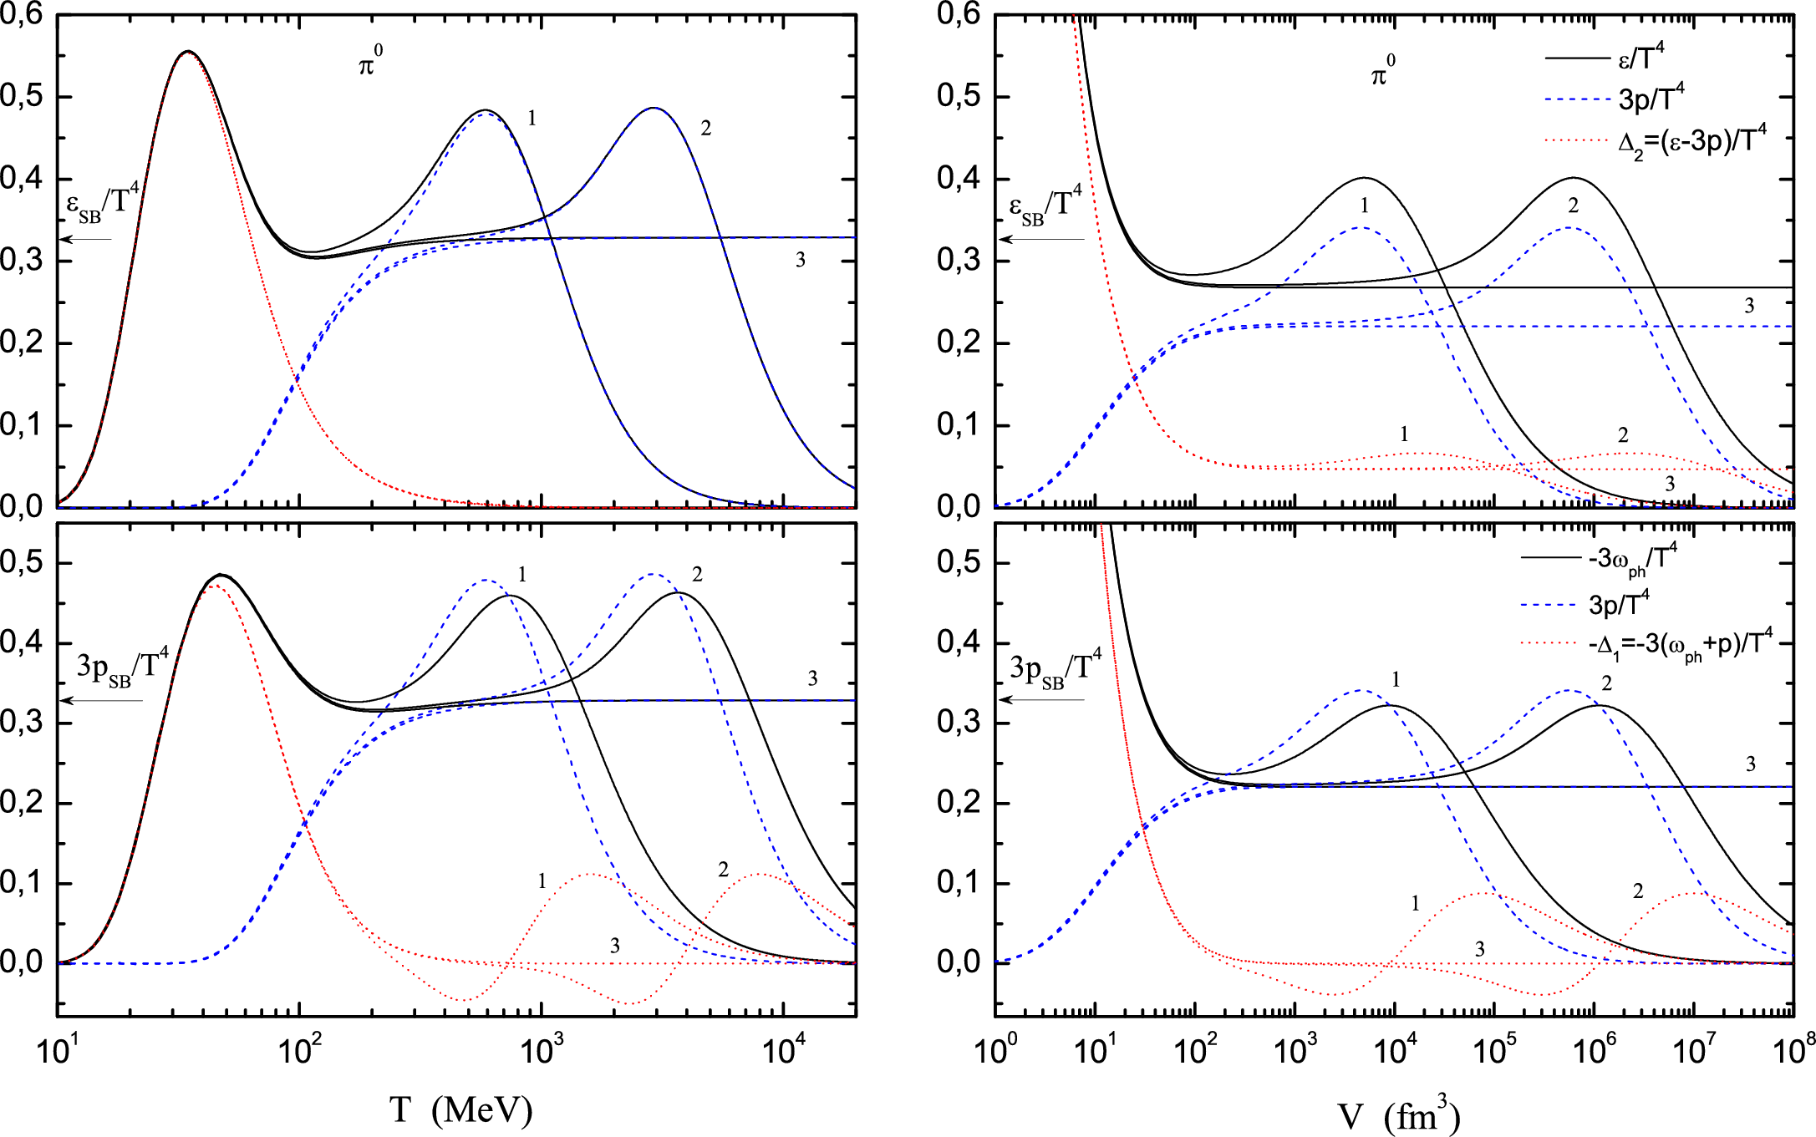
The exact lattice results for the massive scalar field
A.S.P., arXiv:1505.05838v3 [hep-ph]
-physical energy density
-physical pressure
-physical density of thermod. potential
-trace anomaly
-potential inhomogeneity

Slide 21
Conclusions
The exact analytical lattice results for the partition function of the free neutral scalar field in one spatial dimension in both the configuration and the momentum space were obtained in the framework of the path integral method.
The symmetric square matrices of the bilinear forms on the vector space of fields in both configuration space and momentum space were found explicitly.
The thermodynamic properties and the finite volume corrections to the thermodynamic quantities of the free real scalar field were studied.
We found that on the finite lattice the exact lattice results for the free massive neutral scalar field agree with the continuum limit only in the region of small values of temperature and volume.
However, at these temperatures and volumes the continuum physical quantities for both massive and massless scalar field deviate essentially from their thermodynamic limit values and recover them only at high temperatures or/and large volumes in the thermodynamic limit.

Slide 22
Thank you for your attention!

