Slide 1
Small-angle pp scattering
LPI team: V. Baskov, O. Dalkarov, A. L’vov, V. Poliansky
Aims:
Technical: a tool for measuring and monitoring luminosity
a) absolute scale, normalization
b) stability, relative measurements
2) Physics: studying the proton’s periphery (new effects??)
How to implement (EndCap)

Slide 2
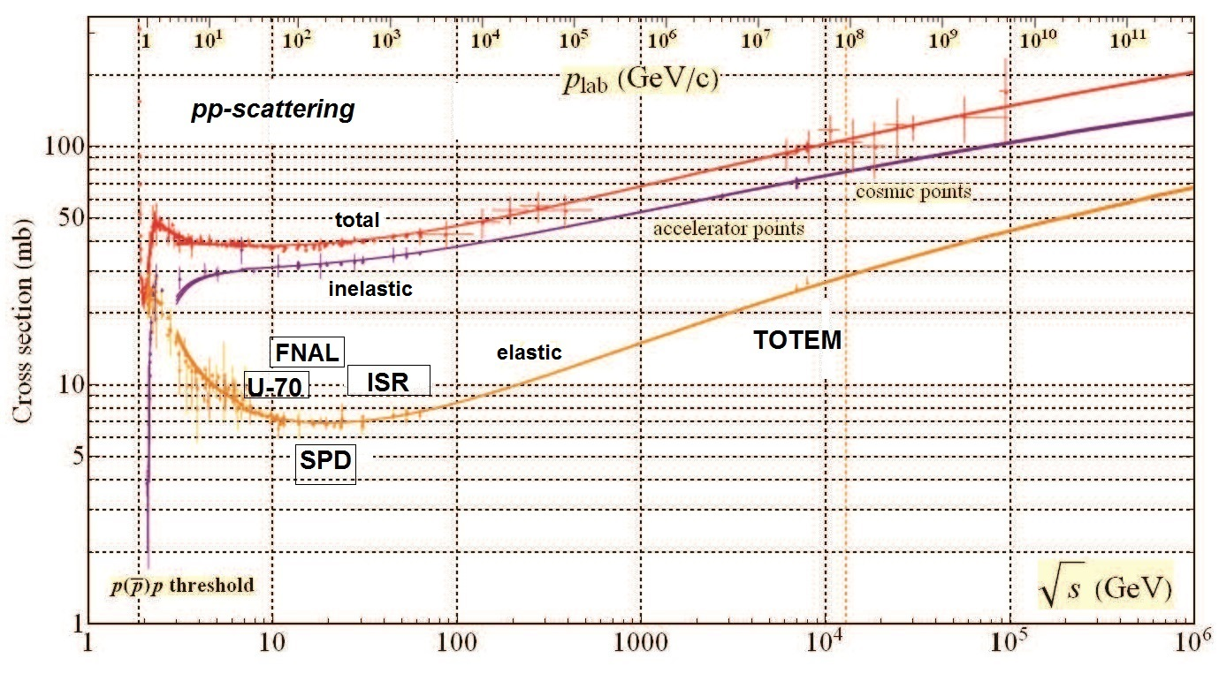
Data on the total cross section of high-energy pp interaction
Energy range of SPD is in between that of U-70 (Protvino), old FNAL and ISR
Registration of pp pairs in SPD can serve as a luminosity monitor of collisions
In the region of SPD, the most precise data are from U-70, ISR and FNAL.
Syst = 4%, 2-3%, 1-2%, resp.

Slide 3
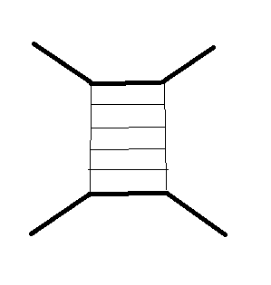
What do we learn from elastic reactions at low t ?
Probing particles with parton (reggeon) ladders.
dσ/dt = A exp(Bt)
Simple model: dσ/dt = A F_{p}²(t) F_{p}²(t) F_{qq}²(t)
F_{p}(t) = e.m. f-factor of the proton, r_{p} = 0.75 fm
F_{qq}(t) = f-factor of qq scattering
→ r_{q} = 0.5 fm
Further refinements are in models with Reggeons.
All impact parameters < 1 fm
But what’s about meson periphery? (like in EM processes)

Slide 4
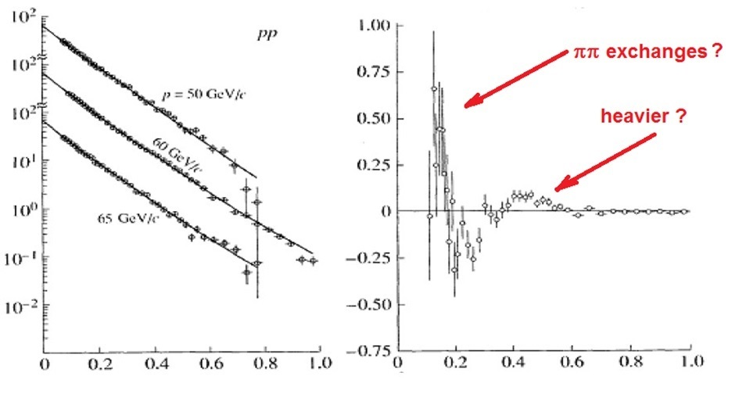
Differential cross sections of pp scattering (Protvino)
dσ/dt, mb/(GeV/c)²
(dσ/dt) – (dσ/dt)_{fit}, mb/(GeV/c)²
Diff. cross sections and deviations from the reference exponential form exp(Bt + Ct²) at √s ~ 11 GeV.
Such deviations were observed on repeated occasions at various machines and energies.
Diff. cross sections fitted with a squared exponential (left) and the difference between the 60 GeV data and their fitted values (right)
|t|, (GeV/c)²
Antipov et al. preprint 1976.
Denisov et al. Yad.Fiz. 79 (2016) 121.

Slide 5
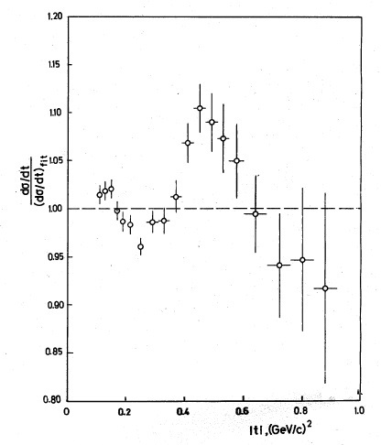
pp scattering (Protvino)
pp scattering, 60 GeV/c
Antipov et al. preprint 1976.

Slide 6
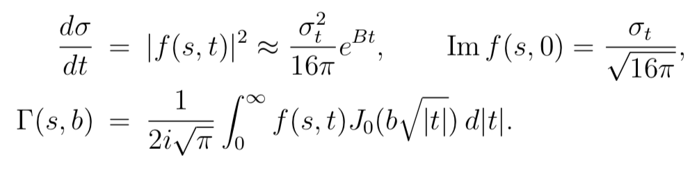
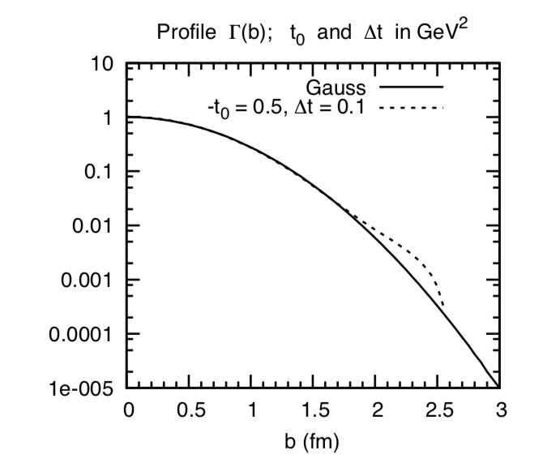
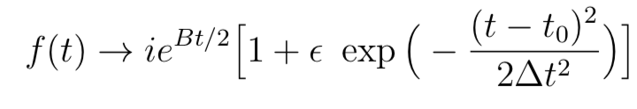
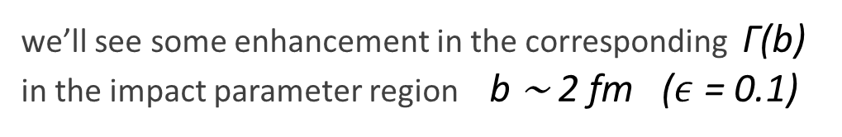
Impact parameter interpretation of the second peak ?
(just an estimate)
In the impact parameter space
Let’s assume f(t) ∝ ie ^{Bt/2} , therefore the corresponding
Γ(b) ∝ exp(−b²/2B)
If we add the local amplitude f (t) enhancement
at the point t = t₀ = -0.5 GeV ²
we’ll see some enhancement in the corresponding Γ(b)
in the impact parameter region b ∼ 2 fm ($ε$ = 0.1)

Slide 7
Impact parameter interpretation of the second peak ?
(just an estimate)
Data from U-70 indicate that another anomaly in the differential cross section exists at –t = 0.4 – 0.5 GeV² (>> 4m_{π}² ).
Perhaps it is relatied with heavier than pion exchanges existing in the proton structure (σ-meson??).
Physics of this phenomenon is a very good task for SPD experiment. In the range of –t ∼ 0.4 – 0.5 GeV² there is almost no data on the diffractive pp-scattering: the accuracy decreases when –t increases from 0.1 – 0.2 GeV² to 0.4 – 0.5 GeV².

Slide 8
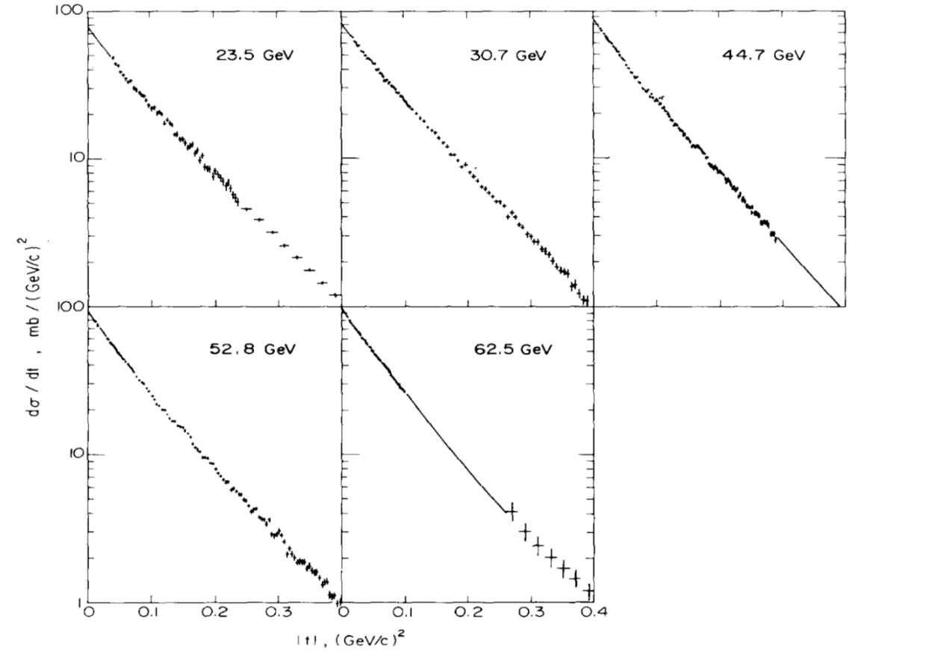
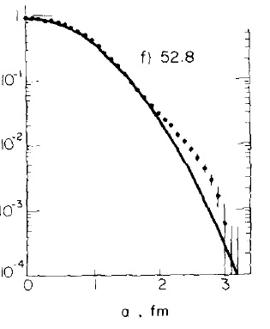
ISR data (pp collisions)
U. Amaldi, K.R. Schubert.
“Impact parameter interpretation of proton-proton scattering from a critical review of all ISR data ”.
Nucl. Ohys. B166 (1980) 301.

Slide 9
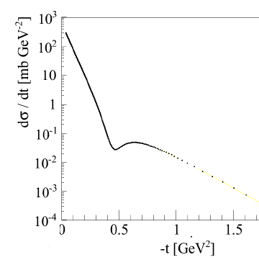
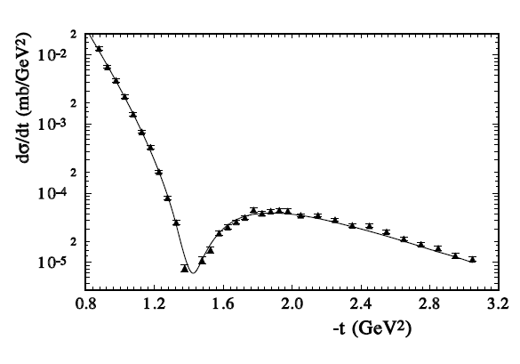
pp-scattering at very high energies
√s = 13 TeV (TOTEM 2018)
√s = 30 GeV (Selyugin 2017)

Slide 10
pp-scattering at very high energies
TOTEM data are very precise. In 2018 they have been extended to higher t.
Ref:
TOTEM Collab. (LHC), 2015
“Evidence for non-exponential elastic proton–proton differential cross-section at low |t | and √s = 8 TeV by TOTEM Collaboration”.
Nucl. Phys. B 899 (2015) 527.

Slide 11
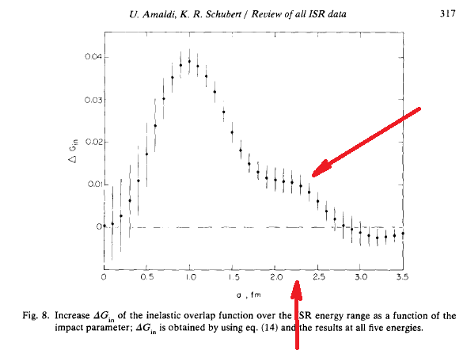
ISR data (pp collisions)
U. Amaldi, K.R. Schubert.
“Impact parameter interpretation of proton-proton scattering from a critical review of all ISR data ”.
Nucl. Ohys. B166 (1980) 301.

Slide 12
Cf. EM form factors of the proton
At the scale of a few per cent,
EM formafactors of the proton show irregularities at medium Q² below 1 GeV² (deviations from a simple dipole Ansatz).
Mainz A1 Collab. “Electric and magnetic form factors of the proton”. Phys. Rev. C90 (2014) 015206.

Slide 13
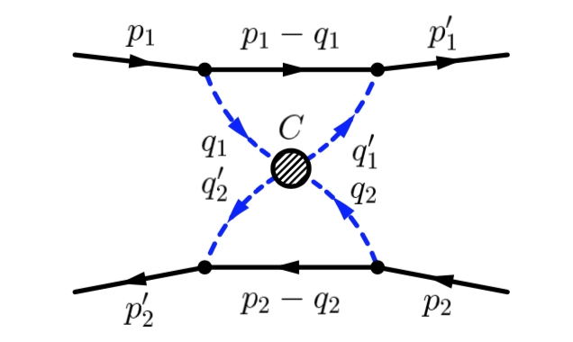
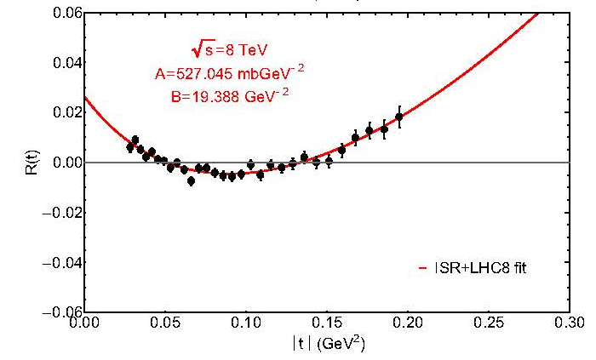
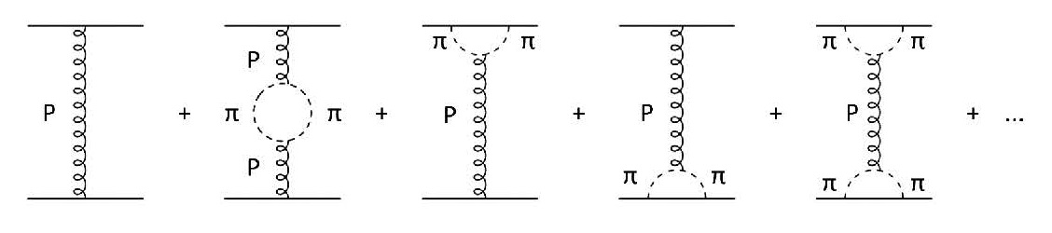
Two-pion effect at low t
Large impact distances suggest that exchanges with light particles (pions) are responsible for irregularities in the differential cross section at small t.
Jenkovszky: Two-pion exchanges explain irregularities in diffractive high-energy data up to LHC energies.
A. Anselm, V. Gribov. “Zero pion mass limit in interaction at very high energies”. Phys. Lett. 40B (1972) 487.
L. Jenkovszky et al. “Shape of proton and the pion cloud”. Eur. Phys. J A (2018) 54.
TOTEM
However, this concerns only very low -t ~ 0.1 GeV²

Slide 14
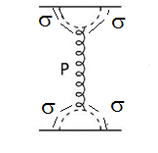
Other pion (?) effects at low t ??
Are there hard cores inside the nucleon,
next to the pion soft cloud?
Beyond Sullivan pion diagram?
Skyrme model is a possible tool to explore this question theoretically.
Electromagnetic probes are blind to such effects !
So, it would be interesting to establish experimentally using hadronic reactions (like pp scattering) whether such a core really exists.

Slide 15
Preliminary conclusion
Deviations from the Gaussian diffraction behavior of the differential cross section of elastic pp scatterimg are firmly established at very low –t ~ 0.1 GeV² (≈ 4m_{π}²),
both at medium and very high energies √s.
They are probably related with collisions of two pion clouds of the colliding protons.
At –t ~ 0.4-0.5 GeV² some smaller deviation are seen at medium energies in two experiments (p = 60 GeV/c at Protvino, √s = 58.5 GeV at ISR). Meanwhile they are not found in Fermilab measurements at p = 200 GeV/c reaching statistical accuracy compatible with that of U-70 and ISR.
Anyway, diffractive pp scattering at low t is an interesting subject, and it certainly deserves a detailed study at NICA SPD which is quite suitable for that (see below).

Slide 16
Diffractive pp-scattering @ SPD
L = 10³²
pp collisions 4 MHz (average in time)
pp elastic 0.7 MHz
pp elastic with –t>0.2 GeV² 95 kHz
proton’s detectors at Endcaps
Collision zone (luminosity distribution)
Blue line – with hourglass effect. D.f. = 2.8%
Ideal kinematics.
Collision point and angle (through coordinates)
Collision point through times:

Slide 17
Radial deviations of protons vs t
In order to cover
0.2 – 0.6 GeV²
R = 10-30 cm

Slide 18
Fluctuations (error in detectors, spread in beams):
Leading contribution to δθ and δt comes from angular divergence of colliding beams,
δt ~ 0.022 GeV² (we want to cover 0.3 – 0.5 GeV² )
Optimal (economic) step in ΔR = σ_{x’} D = 0.5 cm
that is sufficient for covering t with a small step.
Preliminary simulation is done.
It is important to remove (reduce) scattering of protons
(beryllium windows in tube, a socket [штаны] ??).
Implementation was not yet be discussed.

Slide 19
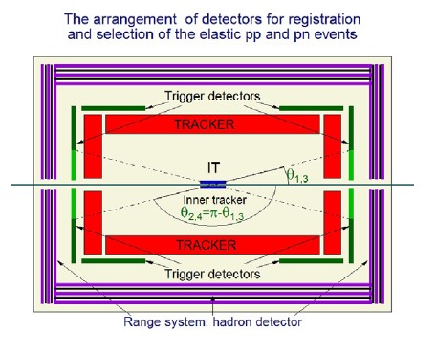
NICA-SPD-V Detectors for pp→pp

Slide 20
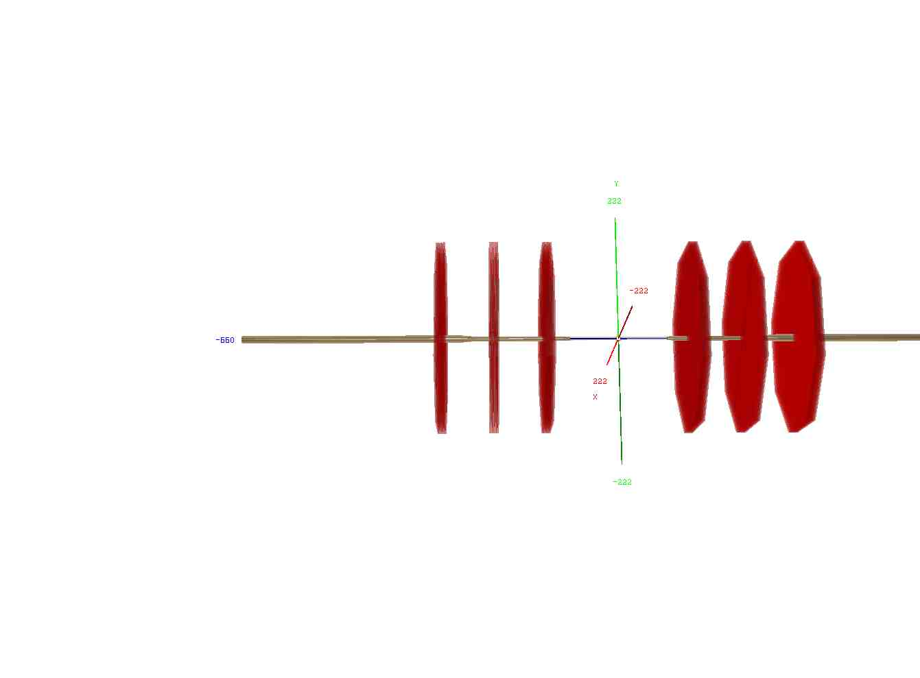
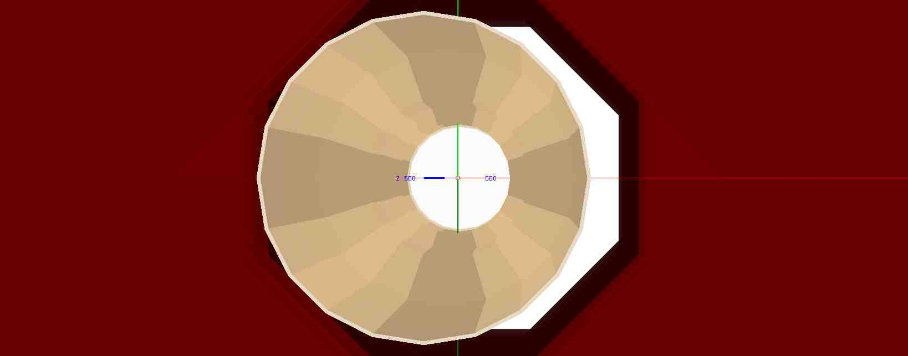
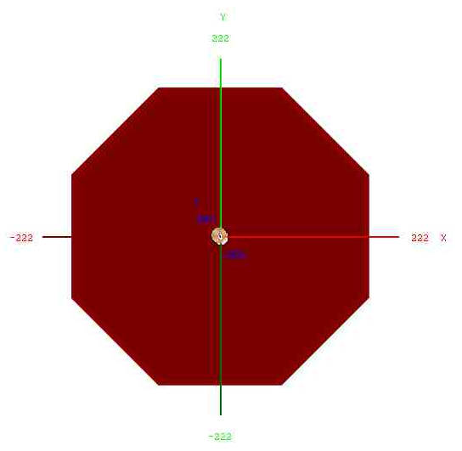
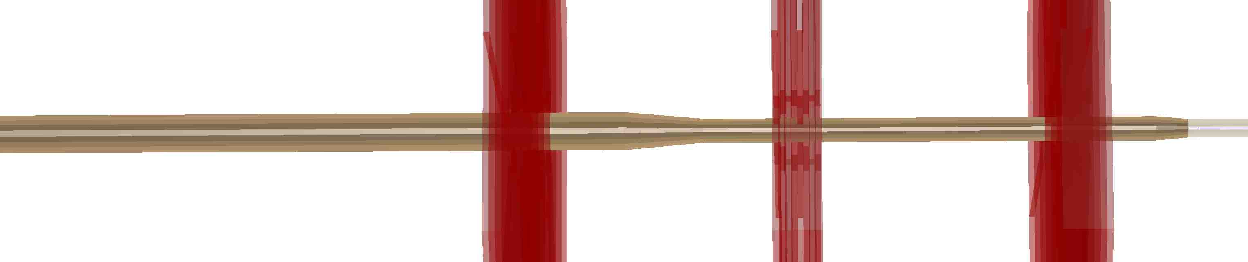
NICA-SPD-VI: Detectorts for small angle pp→pp scattering - End-Cap Trackers

Slide 21
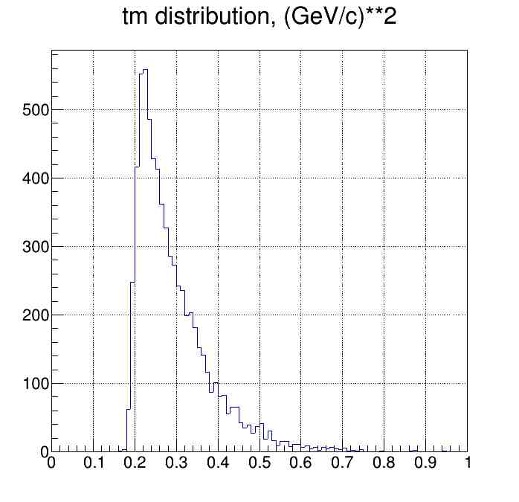
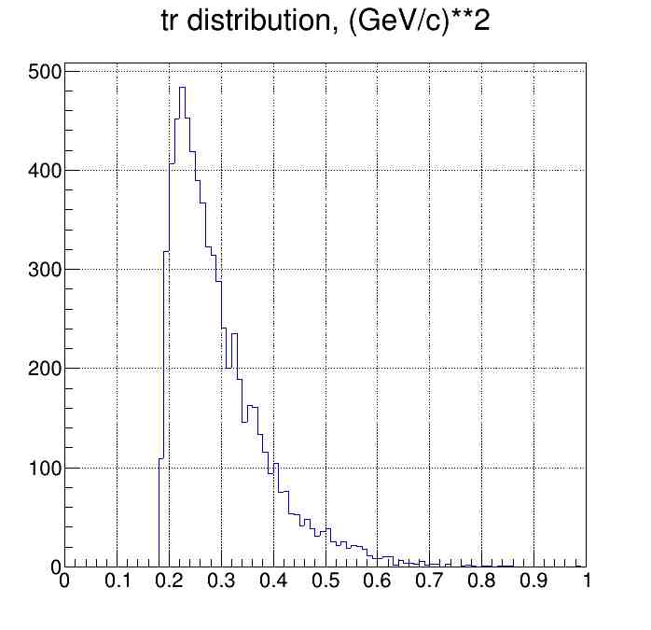
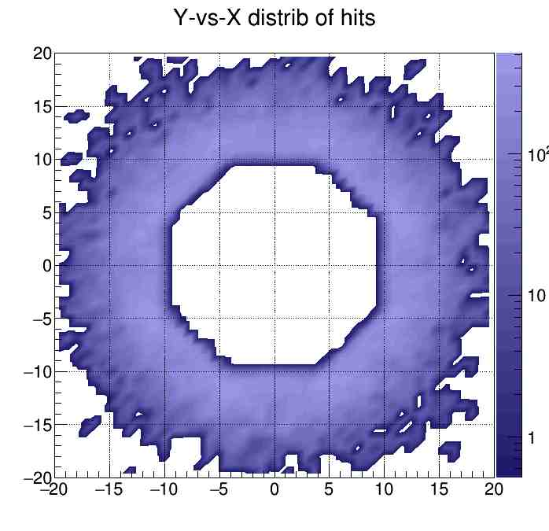
NICA-SPD-VI: Detectors for small angle pp→pp scattering - End-Cap Trackers

Slide 22
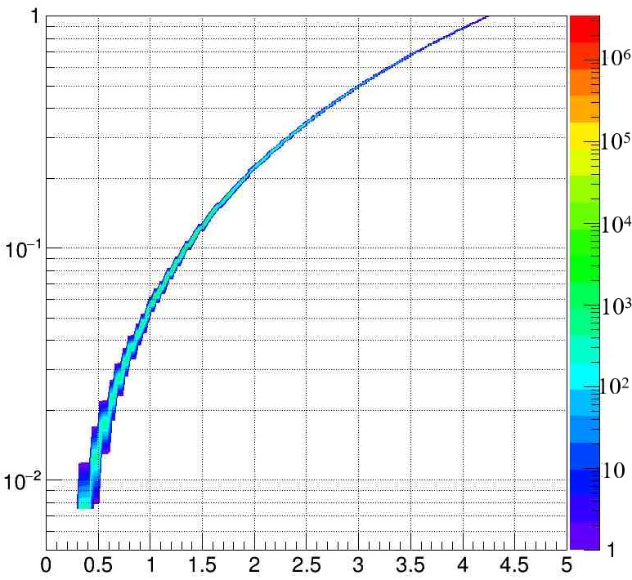
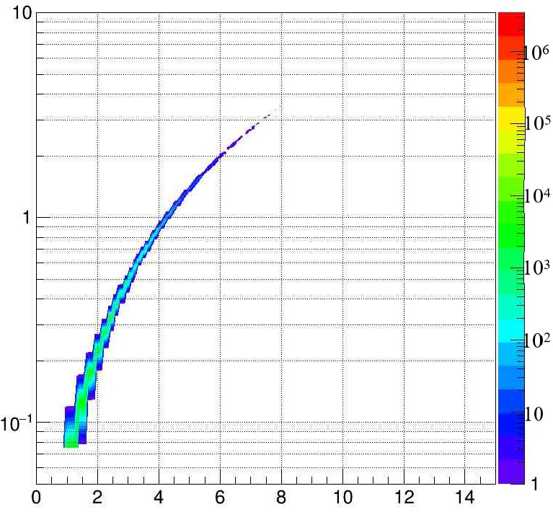
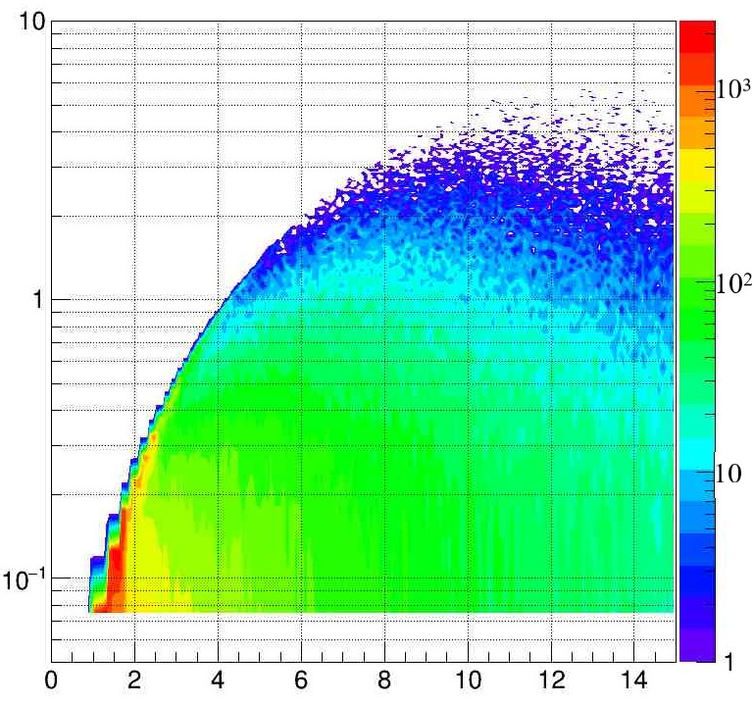
NICA-SPD-I pp: √s=27 GeV, 4 MHz event rate.
The pp relativistic collisions in the framework of the UrQMD-3.4 model:
|t_{proton}|, (GeV/c)²
√s=27 GeV; impact parameter b = 0–3 fm uniformly distributed, 4 Mevents.
|t_{proton}|, (GeV/c)²
Average (charged and neutral) particle multiplicity ~ 15.
|t_{proton}|, (GeV/c)²
pp→pp
pp→ c₁+ c₂+ … +c_{n}
n > 2
pp→pp
θ_{proton}, degrees
θ_{proton}, degrees
θ_{proton}, degrees

Slide 23
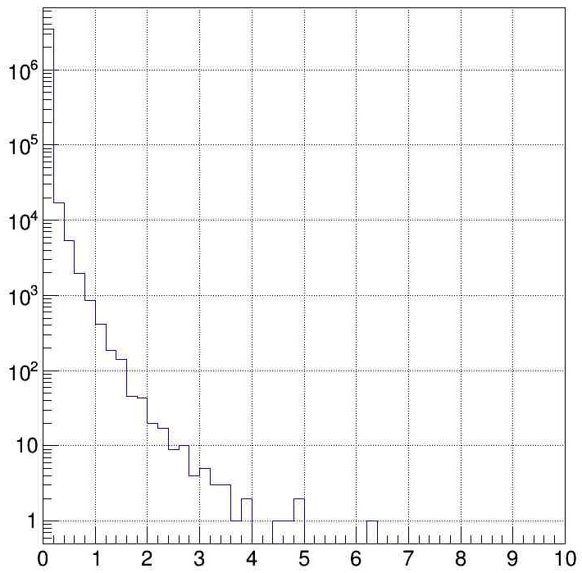
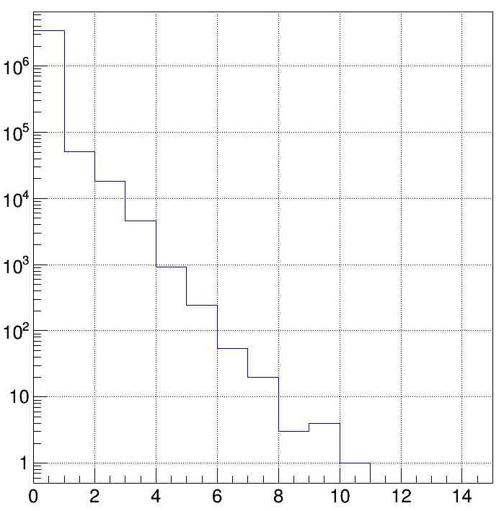
NICA-SPD-II pp: √s=27 GeV, 4 MHz event rate. UrQMD-3.4
pp→pp
dN/d|t_{proton}|, Events/(GeV/c)²
|t_{proton}|, (GeV/c)²
dN/dθ_{proton},, Events/degrees
θ_{proton}, degrees
|t_{proton}|, (GeV/c)²
θ_{proton}, degrees
θ_{proton}, degrees

Slide 24
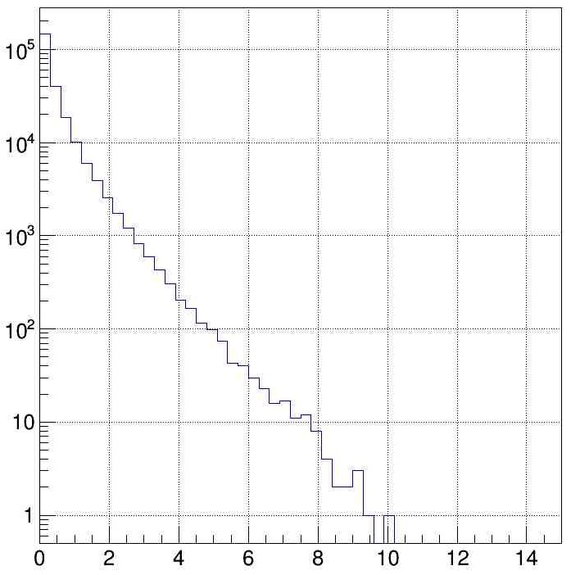
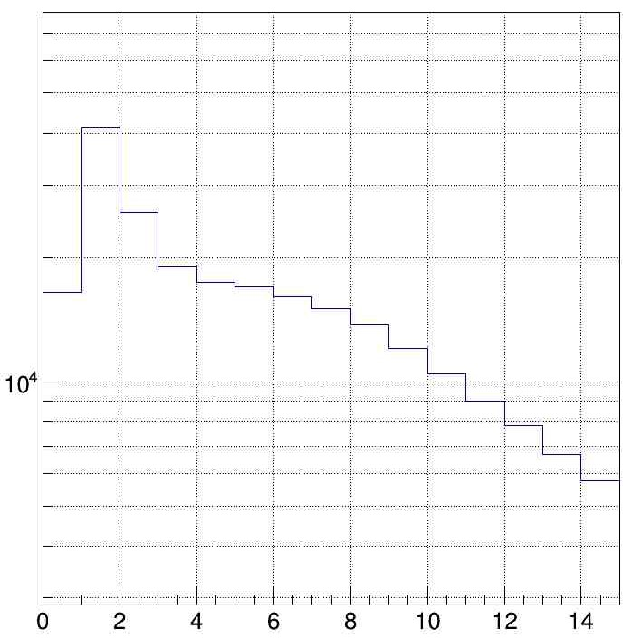
NICA-SPD-III pp: √s=27 GeV, 4 MHz event rate. UrQMD-3.4
pp→ c₁+ c₂+ … +c_{n}
n > 2
dN/d|t_{proton}|, Events/(GeV/c)²
|t_{proton}|, (GeV/c)²
dN/dθ_{proton},, Events/degrees
pp→pp
|t_{proton}|, (GeV/c)²
θ_{proton}, degrees
θ_{proton}, degrees

Slide 25
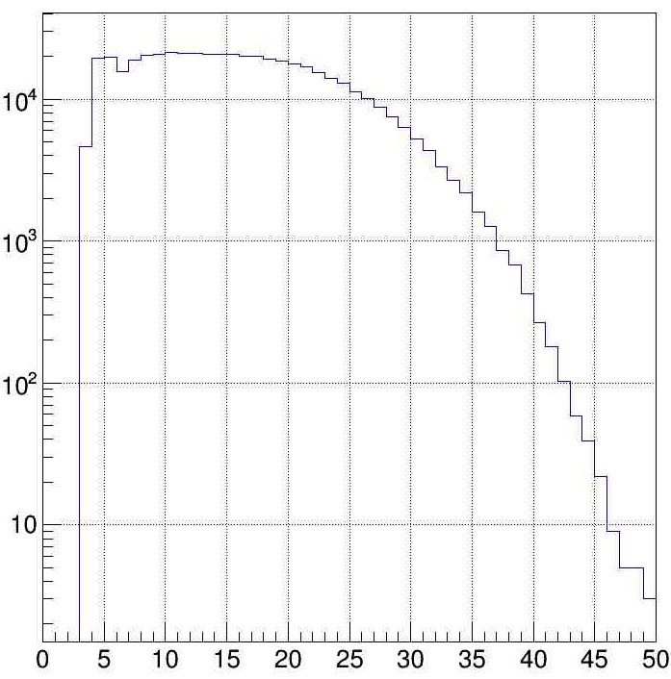
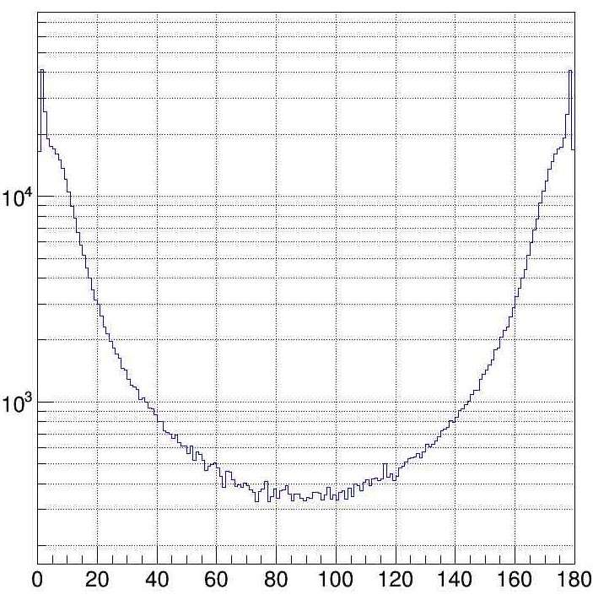
NICA-SPD-IV pp: √s=27 GeV, 4 MHz event rate. UrQMD-3.4
pp→ c₁+ c₂+ … +c_{n}
n > 2
Multiplicity
dN/dθ_{proton},, Events/degrees
Average (charged and neutral) particle multiplicity ~ 15.
Event rate ~ 0,117·4MHz
|t_{proton}|, (GeV/c)²
n_{particle}/event
θ_{proton}, degrees

Slide 26
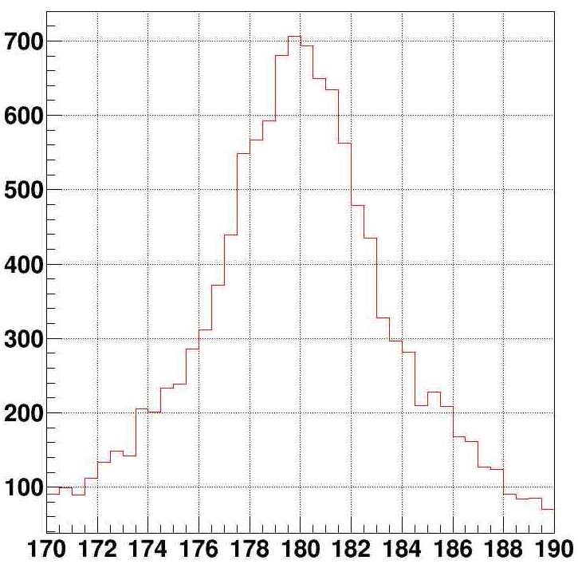
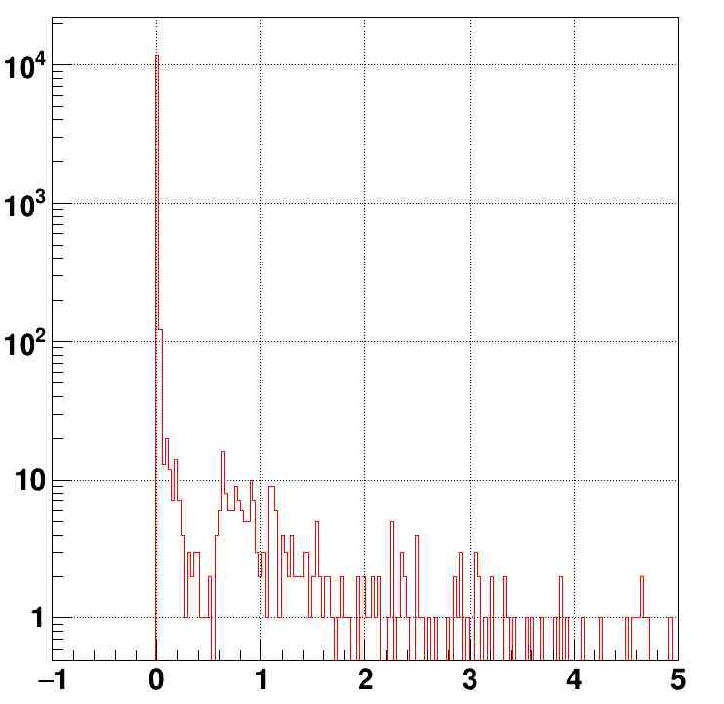
NICA-SPD pp: √s=27 GeV UrQMD-3.4-GEANT4
pp→ p + p + (propagation through a materials)
N_{events}
N_{events}
From the elastic kinematics :
two tracks,
|Θ_{p-forw} - Θ_{p-backw}| = 180 degr,
φ_{p-forw} - φ_{p-backw}|,= 180 degr,
|T_{p-forw} - T_{p-backw}|, = 0 ns.
Multiplicity
|φ_{p-forw} - φ_{p-backw}|, degr
²
|T_{p-forw} - T_{p-backw}|, ns
²

Slide 27
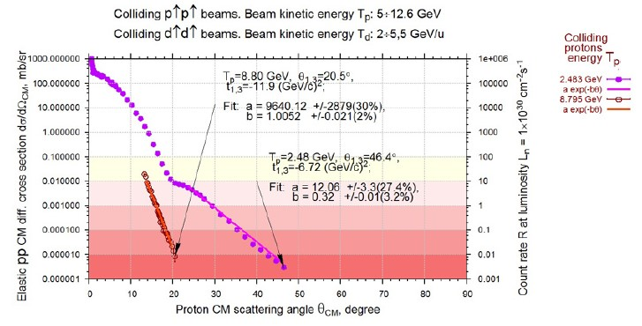
NICA-SPD-V Detectors for pp→pp

Slide 28
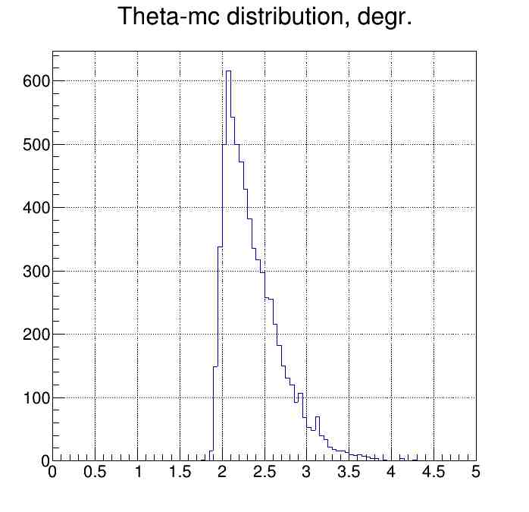
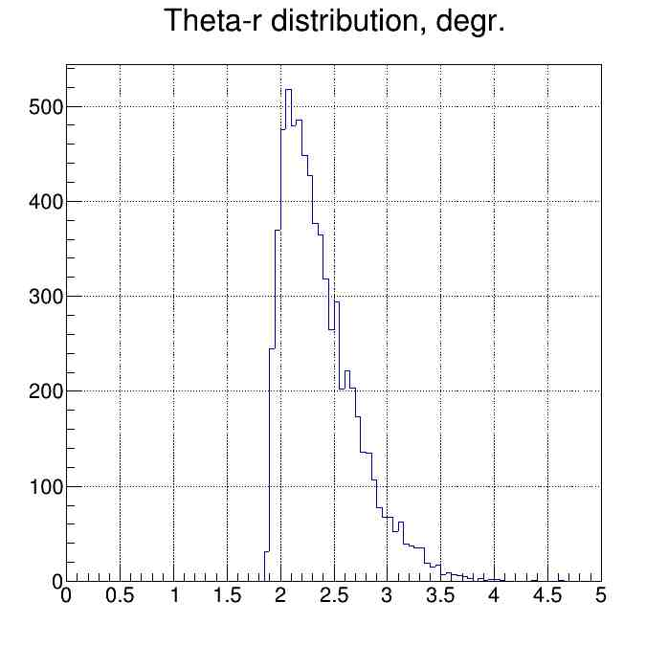
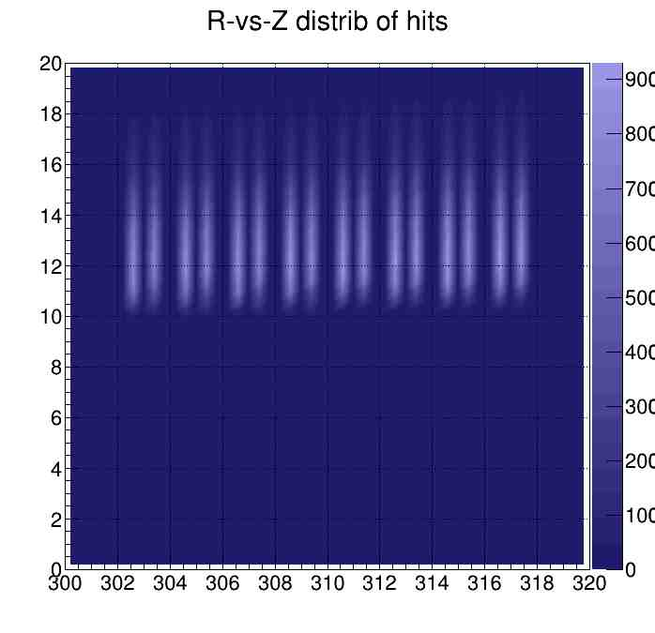
NICA-SPD-VI: Detectors for small angle pp→pp scattering - End-Cap Trackers

Slide 29
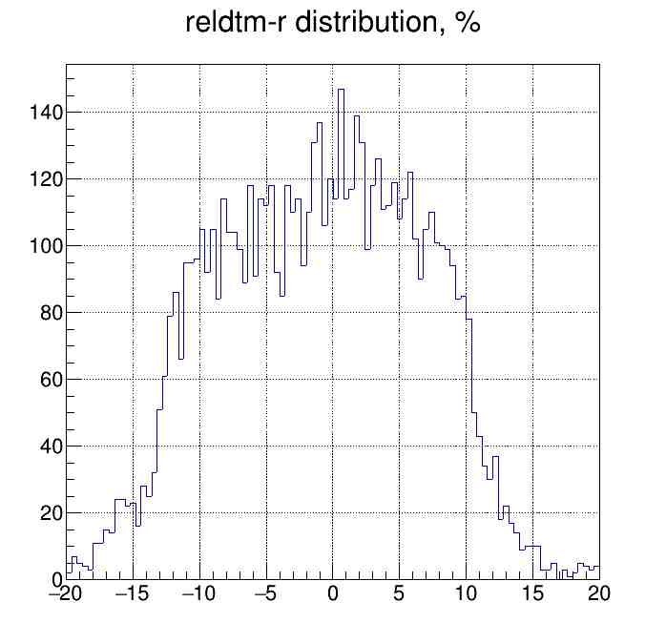
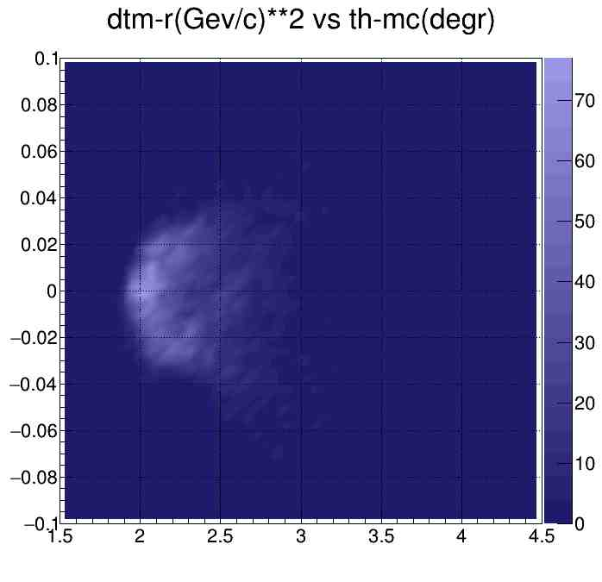
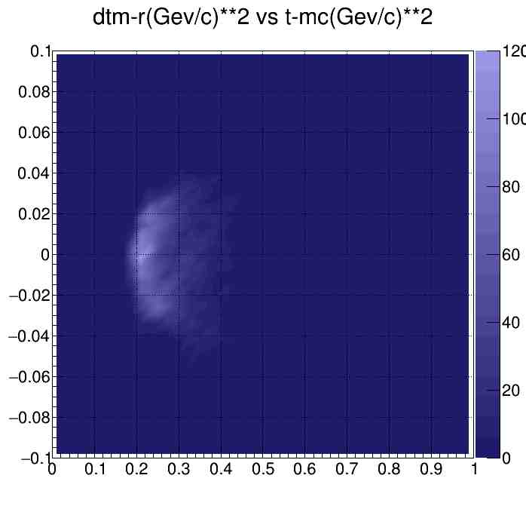
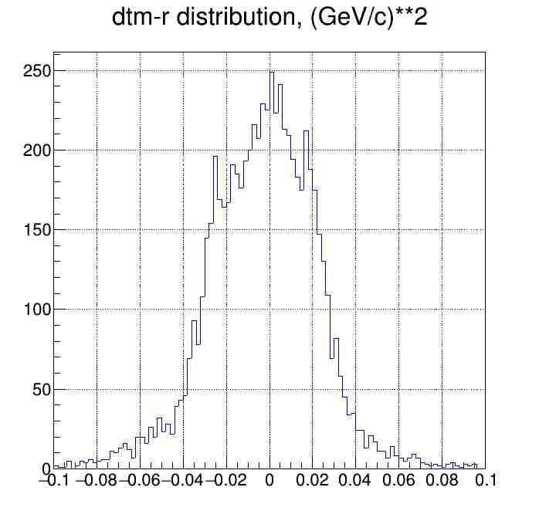
NICA-SPD-VI: Detectors for small angle pp→pp scattering - End-Cap Trackers

Slide 30
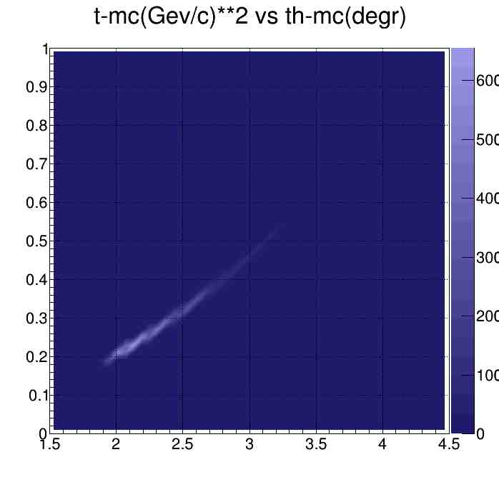
NICA-SPD-VI: Detectorts for small angle pp→pp scattering - End-Cap Trackers
Генератор событий упругого рассеяния pp→pp - PYTHIA 6
√s=26 GeV
Область взаимодействия пучков σ_{z}≈35 см, σ_{r}≈0.1 см
Расходимость пучков σ_{θ}≈0.0007 rad
Полное число pp→pp столкновений 10⁵
Число зарегистрированных событий ~ 7000

