Slide 1

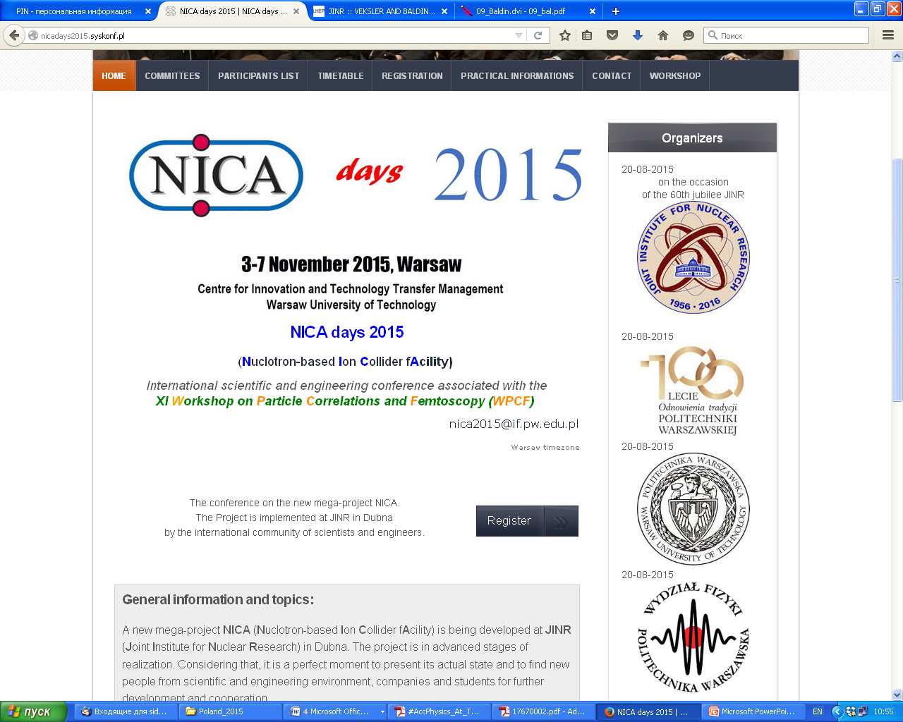
Programme Advisory Committee
for Condensed Matter Physics
(45th meeting, 19-20 January, 2017)
Prof V.Kantser
Review of PAC Recommendations presented by
Dr Oleg Belov
At 120th Session of the JINR Scientific Council
Dubna 22–23 September 2016

Slide 2
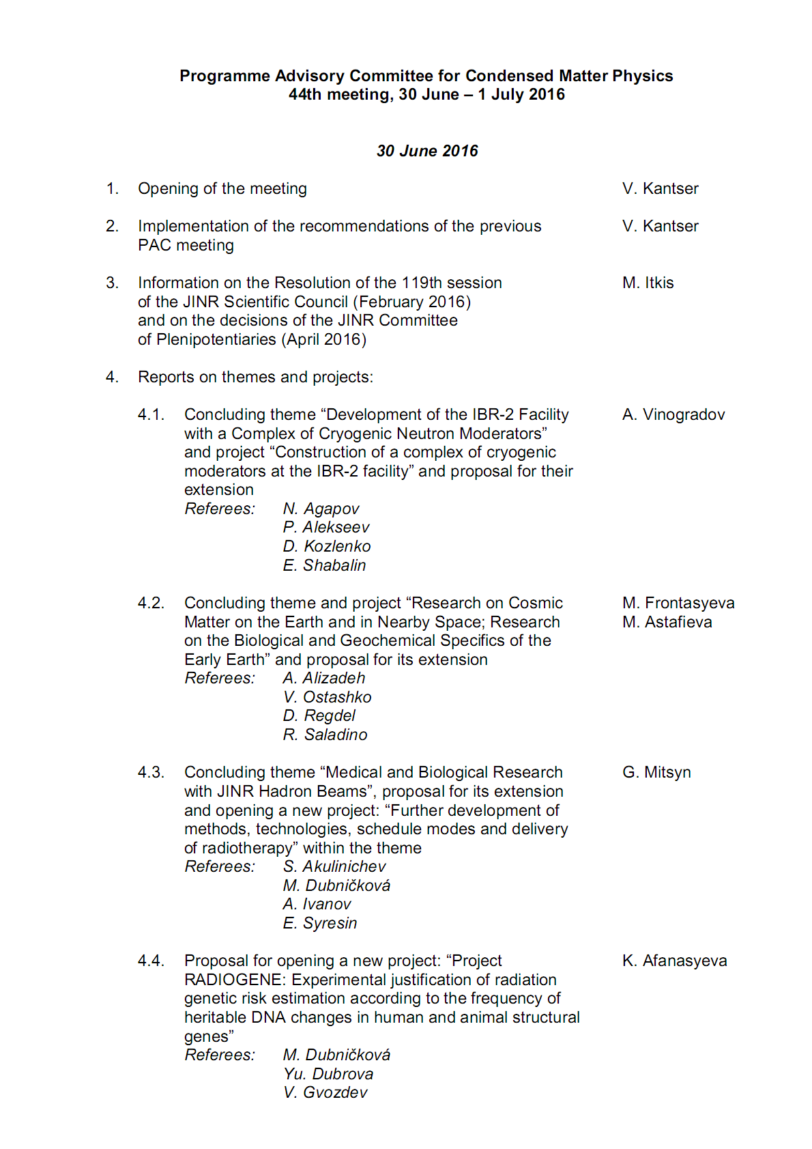
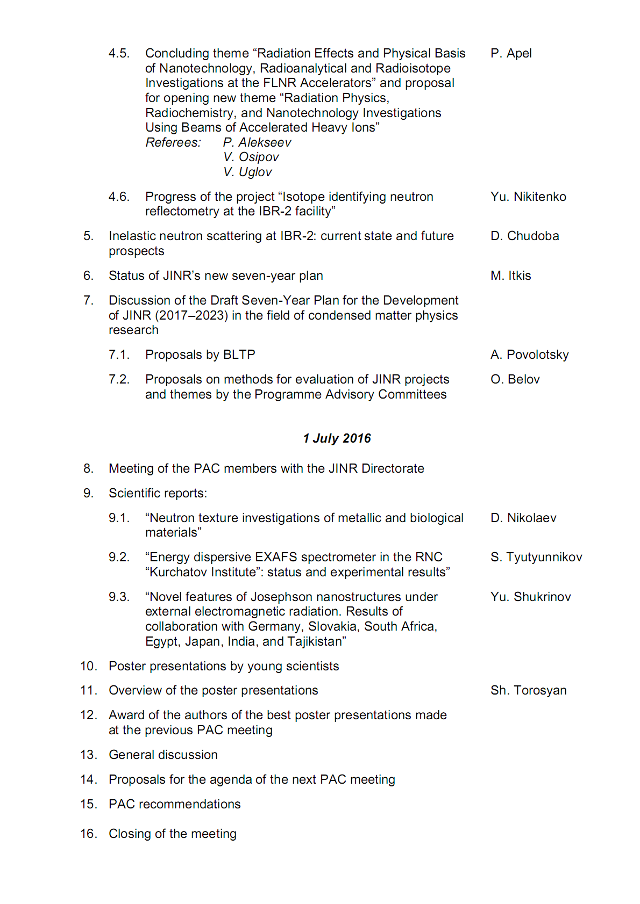
Agenda of the PAC meeting
Highlights of 44th PAC-CMP meeting:
Discussion of the draft of the 7-Year Plan for the development of JINR 2017–2023.
Reports on the concluding themes and projects.
Proposals on methods for evaluation of projects and themes by the PACs and the update of the PAC Regulation.

Slide 3
Information related to Seven-Year Plan
  The PAC informed SC that It heard with great interest the general overview of the status of JINR’s new seven-year plan presented by JINR Vice-Director M. Itkis.
  The PAC appreciates the recent add-ons to the draft of the Plan with respect to the version of September 2015. In particular, it welcomes the following changes:
  addition of the new “Introduction” chapter;
  the revised paragraph in the “Condensed Matter Physics” section addressing radiobiological and astrobiological research;
  the new chapter “Development of the Engineering Infrastructure”.

Slide 4
Information related to Seven-Year Plan
  As for the seven-year plan in general, the PAC suggests that this Plan should pose signs of flexibility to have a possibility to include new projects.
  Concerning the “Condensed Matter Physics” section of the Plan, the PAC considers this part to be slightly imbalanced between neutron scattering research and optical methods.
  The PAC took note of the latest proposals by BLTP presented by A. Povolotsky to the “Theory of Condensed Matter” section of the Plan.
  The PAC discussed the item “Study of nanosystems by the positron annihilation spectroscopy method” newly included in the “Condensed Matter Physics” section of the Plan; the PAC recommends adoption of this item. Concerning the LEPTA project related to this activity, the PAC recommends that its authors collect specific scientific proposals for experiments to be carried out at this facility and present them at a future PAC meeting.

Slide 5
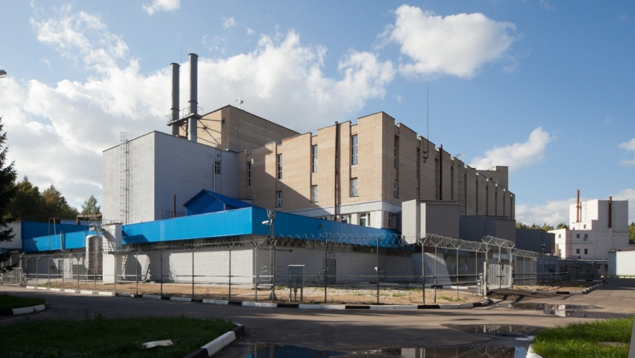
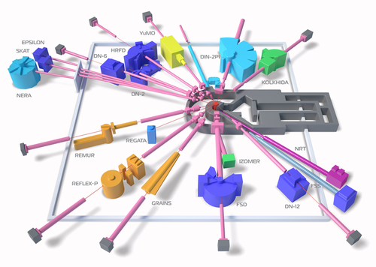
Information related to Development of the IBR-2 Facility with a Complex of Cryogenic Neutron Moderators
Delivered on the basis of dr A. Vinogradov report at PAC meeting
Implementation of the main tasks in 2014 – 2016
The IBR-2 facility is operated under the Rostekhnadzor license № GN-03-108-2871 issued on 30.04.2014. The period of license validity is 8 years until September 30, 2022.
Provision of physics research program on extracted neutron beams in a regular mode (W = 2 MW, f = 5 Hz).
 | Operation for physics experiments, hr | Number of shutdowns
2014 | 2492 – 9 cycles | 7
2015 | 2646 – 9 cycles | 2
2016 | 1300 (as of June 01, 2016) – 9 cycles are planned | 3
Notes:
The goal of construction of the complex of cryogenic moderators at the IBR-2 facility is of high scientific merit, which follows from the logic of the development of neutron centres whose activities mainly concern condensed matter physics studies.
The achievement of this task will increase the efficiency of experiments to study long-period structures of complex modern materials due to an increase in the flux of slow neutrons up to 20 times for 8 out of 14 FLNP spectrometers.

Slide 6

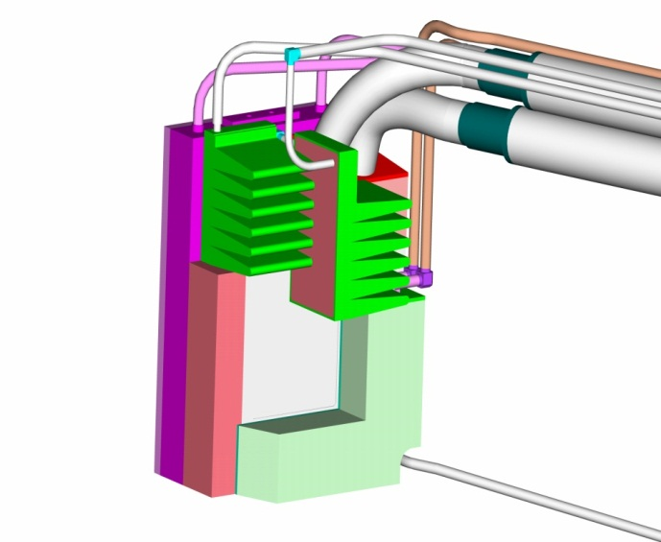
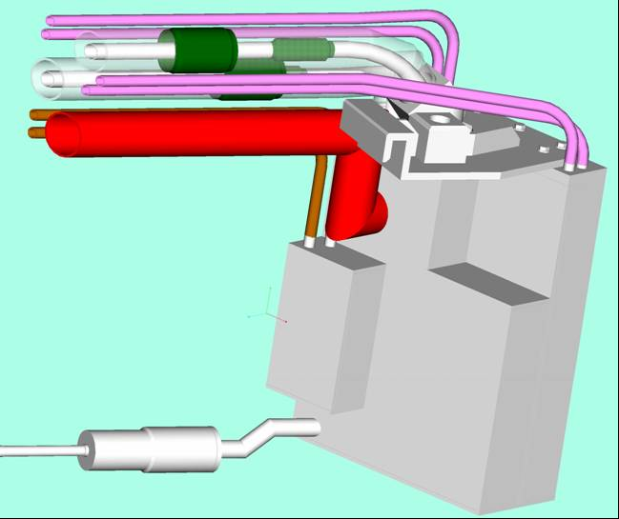
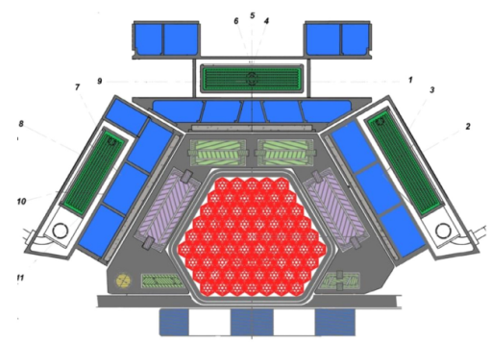
Construction of a complex of cryogenic moderators
at the IBR-2 facility
The PAC informed SC about its appreciation of the progress in construction of the complex of cryogenic moderators at the IBR-2 facility that will significantly increase the flux of cold neutrons enabling the implementation of an advanced physics research at the level of the leading neutron sources (ISIS, SNS, JSNS).
CM 201 (n-channels 1,4-6,9)
CM 202 (n-channels 7,8,10,11)
CM 203 (n-channels 2,3)
Notes:
The goal of construction of the complex of cryogenic moderators at the IBR-2 facility is of high scientific merit, which follows from the logic of the development of neutron centres whose activities mainly concern condensed matter physics studies.
The achievement of this task will increase the efficiency of experiments to study long-period structures of complex modern materials due to an increase in the flux of slow neutrons up to 20 times for 8 out of 14 FLNP spectrometers.

Slide 7
Construction of a complex of cryogenic moderators
at the IBR-2 facility
The reliability and efficiency of the technologies being used have been proved by successful three-year operation of the first out of the three cryogenic moderators — CM-202.
CM-202 (beamlines 7,8,10,11)
In 2015, CM-202 operated at power for physics experiments during two cycles for 9.4 and 10.4 days, respectively.
In the second half of 2016 work will be continued to consider promising variants of CM: with triphenyl-methane, replaceable working substance, etc.
CM-201 (inclined channel, beamlines 1,4,5,6,9)
Detailed plan of activities for CM-201 until the end of 2019 was prepared.
2017–2018 – completion of manufacturing of the moderator and equipment, adjustment at the workplace, cryogenic stand tests of CM-201.
2019 – preparation of CM 201 at the workplace (room 165), replacement of WM-301 with CM-201, start of operation in a cryogenic mode.

Slide 8
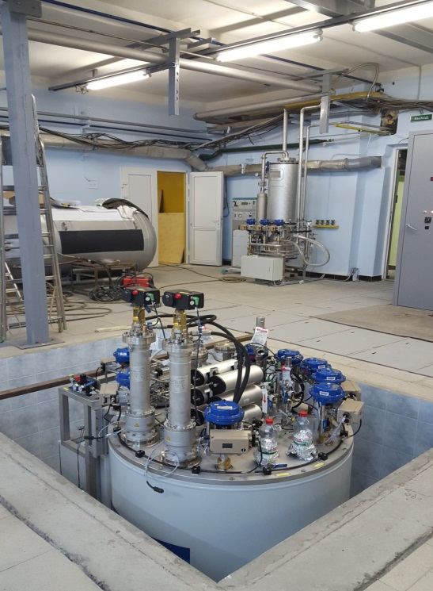
Construction of a complex of cryogenic moderators
at the IBR-2 facility
CM-203 (beamline 2)
Project design was done. Moderator cooling cryopipes were installed from rolling shield № 1 to a cryostat in experimental hall № 1. Continuation of work on CM-203 depends on the confirmation of the need for a cold moderator in the direction of beamline 2 and specification of users’ requirements. Realization of the CM-203 project is possible after 2020.
KGU 1200/10 by «Linde AG»
In November-December 2015 the equipment was delivered. Assembling, self test start-up and adjustment of the facility are successfully completed at the moment.
The facility will be put into regular operation through trials with the experimental test stand of CM-201 and in a pair “stand of CM-201 – CM-202» to test operation modes of KGU (working range of temperatures, refrigeration capacity) in IV quarter 2016.

Slide 9
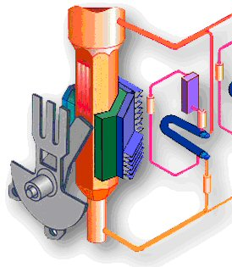
Next step in the cryogenic moderators facilities
Manufacturing of a reserve movable reflector for IBR-2
The PAC notes that by mid-2016 the available movable reflector has used 40% of its design service life.
Operation of the reflector is reliable; continuous monitoring and diagnostics of its state are provided.
However, to ensure a guaranteed operation of the reactor until the end of its service life the PAC finds it necessary to manufacture a reserve movable reflector of the same design within a short time (before 2019).
Movable
reflector

Slide 10

Manufacturing of a reserve movable reflector for IBR-2
The contract for the fabrication of the reserve movable reflector signed with JSC “Votkinsky Plant” for 2015–2018

Slide 11
General considerations concerning IBR-2
The PAC supports the activity towards ensuring the safe operation of the reactor as well as monitoring, diagnostics, and prognosis of its state. It will enable FLNP to match the methods of diagnostics used at IBR-2 with high and stringent modern requirements.
The planned modernization of monitoring and diagnostics systems will help to compensate the negative tendencies in the changes of reactor characteristics with time based on the analysis being conducted.

Slide 12
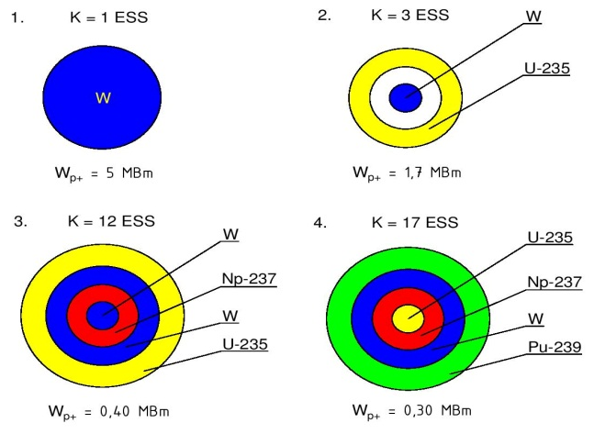
Some aspects about the future of neutron facilities
A concept of the JINR neutron source
beyond 2032
The PAC welcomes the FLNP’s intent to define the concept of the JINR neutron source beyond the year 2032 which may imply either the use of the existing facility or construction of a new one.
Some variants of a future n-source
TO DO NOTHING AFTER IBR-2 CLOSERE …absence of a competitive neutron source at JINR
NEW PULSE REACTOR …new fuel, …new building, …questions for safety
NEXT IBR-2 AFTER DEEP MODERNIZATION …replication, …may be old building, …but of little interest for users?
PROTON ACCELERATOR DRIVEN SUBCRITICAL REACTOR …new building …subcritical cascade core as a target …expensive …with much better use properties
© В.Л. Аксенов, А.М. Балагуров, Ю.Н. Пепелышев (2016)
Notes:
The PAC members are encouraged to take part in the elaboration of the concept based on either using the existing neutron facility or developing a new one. Before going into technical details of a new facility or upgrading the existing one, the PAC suggest performing an analysis of analogous setups available or planned to be developed first in Russia and then in the world.

Slide 13
Recommendation for SC. The PAC recommended extension of the theme “Development of the IBR-2 Facility with a Complex of Cryogenic Neutron Moderators” and the project “Construction of a complex of cryogenic moderators at the IBR-2 facility” until the end of 2019.

Slide 14
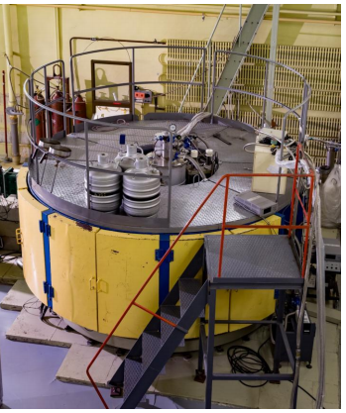
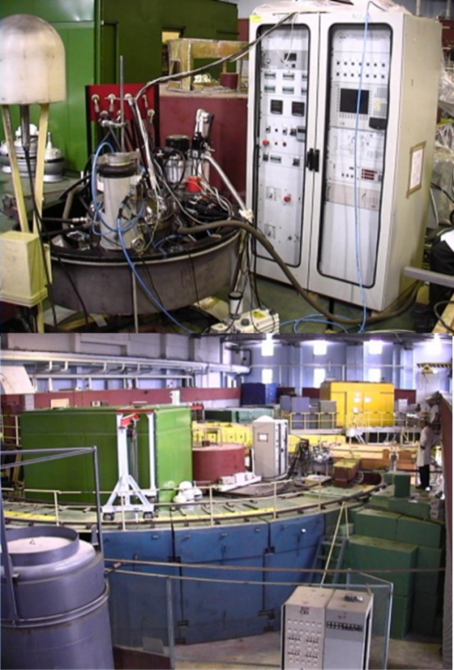
Inelastic neutron scattering at IBR-2
D. Chudoba
The PAC heard a report presented on the present status of the inelastic neutron scattering facilities operating at the IBR-2 reactor.
It notes that two spectrometers mentioned in the report are the only world-class inelastic neutron scattering instruments available for public domain research in Eastern Europe.
The PAC acknowledges the steady interest in the use of the NERA spectrometer that provides significant results and publications, which is largely the result of the previously performed upgrade of the spectrometer. The PAC supports further modernization of the spectrometer and recommends preparing an upgrade plan within the framework of a new project.
With regard to the DIN-2PI spectrometer, the PAC recommends that greater efforts be made to attract users to this facility, in particular to get higher neutron flux density at the sample position.
NERA
DIN-2PI

Slide 15
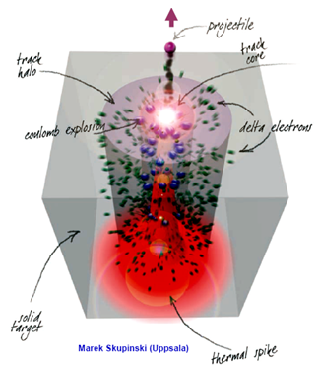
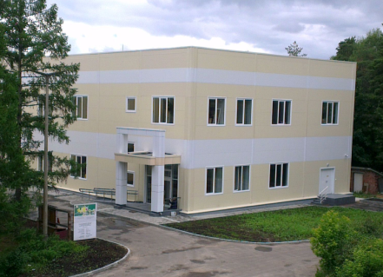
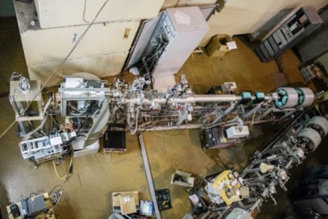
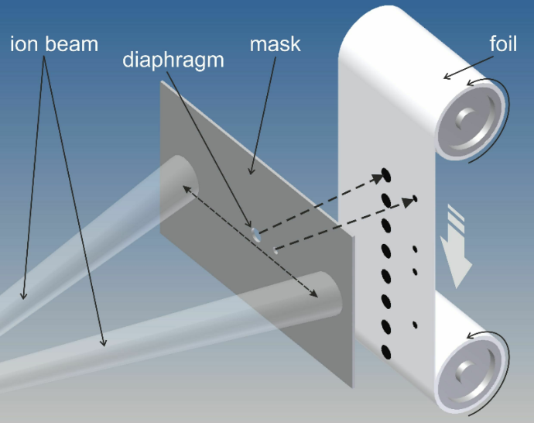
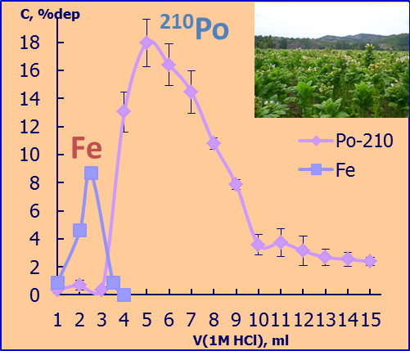
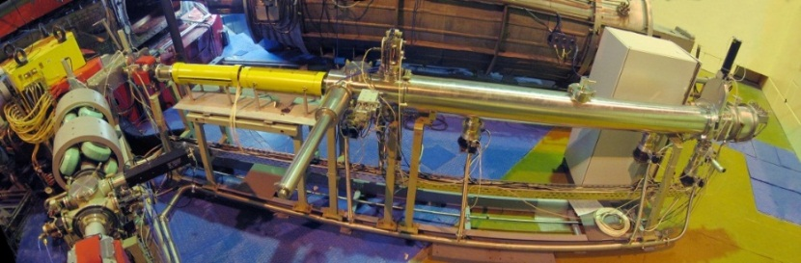
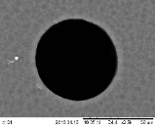
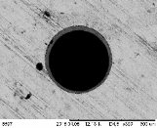
New them for investigations
Radiation Effects and Physical Basis
of Nanotechnology, Radioanalytical and Radioisotope Investigations at the FLNR Accelerators
On the basis of P. Apel presentation
Radiation stability of nanostructured ceramics and oxides irradiated with swift heavy ions
The PAC appreciates the broad spectrum of R&D studies already accomplished in 2009-2016 and the increasing number of publications
in highly ranked international journals.
Constructional materials with high radiation resistance
Nano- and microporous membranes
Radiochemistry and radioisotopes
Accelerators and irradiation facilities
New analytical laboratory (the Nanotechnology Centre)
The Nanocentre
laboratory building
Fabrication of single and oligo-pore membranes on the beam line of cyclotron IC100
Determination of ²¹⁰Po in environmental samples
Single-Event Effect testing of the electronics the FLNR cyclotrons. Main user: The Russian Space Agency (Roscosmos)

Slide 16
Given the successful completion of the theme “Radiation Effects and Physical Basis of Nanotechnology, Radioanalytical and Radioisotope Investigations at the FLNR Accelerators”, the PAC recommends its closure and opening the newly proposed theme “Radiation Physics, Radiochemistry, and Nanotechnology Investigations Using Beams of Accelerated Heavy Ions” until the end of 2021.

Slide 17
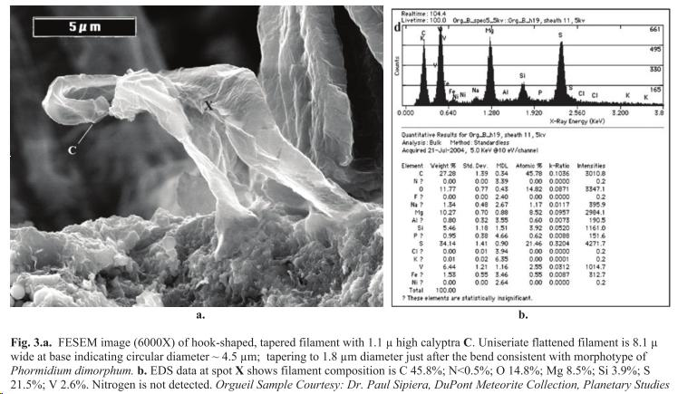
Research on Cosmic Matter on the Earth and in Nearby Space; Research
on the Biological and Geochemical Specifics of the Early Earth”
Theme extension on the basis of M. Frontasyeva and M. Astafieva presentation
The PAC took note of the report on this concluding theme and project and of the proposal for their extension.
To determine the elemental and structural composition of cosmic matter samples, the authors suggest using the multi-element neutron activation analysis on IBR-2 neutron beams, the neutron resonance capture with the pulsed neutron beam of the IREN facility as well as X-ray and neutron tomography. These techniques are actively applied at FLNP at a high scientific and technical level.
The project is a large and multidisciplinary collaboration between JINR (FLNP and LRB), the Russian Academy of Sciences and various research laboratories and institutions.
Neutron Activation Analysis at IBR-2 reactor
Recommendation. The PAC recommends extension of this theme and project until the end of 2019.
NAA (blue) + Mass Spectrometry (red)

Slide 18
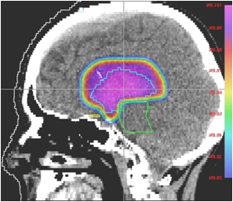
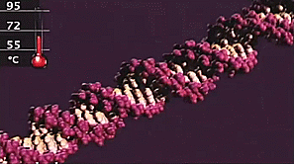
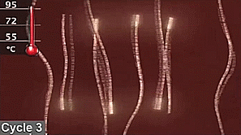
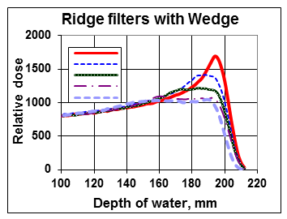
New theme for investigations
Medical and Biological Research with JINR Hadron Beams
G. Mitsyn, K. Afanasyeva
The PAC emphasizes the importance of the results achieved both in the field of clinical research on the proton radiotherapy and in radiobiology.
In Russia, this medical and technical complex is currently the unique centre
for proton therapy which is in operation and at the same time has acquired
considerable expertise in this field.
Project “Further development of methods, technologies, schedule modes and delivery of radiotherapy
Project “RADIOGENE: Experimental justification of radiation genetic risk estimation according to the frequency of heritable DNA changes in human and animal structural genes”
The PAC recommends closure of the theme “Medical and Biological Research with JINR Hadron Beams” and opening a new theme “Biomedical and Radiation-Genetic Studies Using Different Types of Ionizing Radiation” and a new project “Further development of methods, technologies, schedule modes and delivery of radiotherapy” until the end of 2019.
The PAC recommends opening the proposed RADIOGENE project within the scheduled period and with the requested financial support.

Slide 19
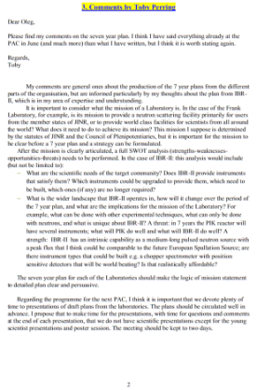
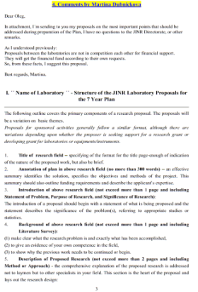
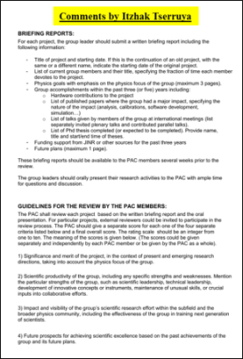
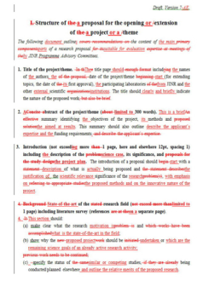
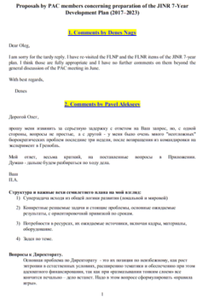
Proposals on methods for evaluation of projects
and themes by the PACs
The PAC was informed about the latest proposals on methods for the evaluation of JINR projects and themes by the PACs.
It appreciates the significant progress in developing the methodology previously delivered by this Committee to the JINR Directorate.
The PAC is pleased with the results of discussion of these proposals with the JINR Directorate and with members of two other PACs — for Particle Physics and for Nuclear Physics.
The PAC had a number of recommendations concerning the form of the proposals and methods of their examination.
Written comments by members of the PACs

Slide 20
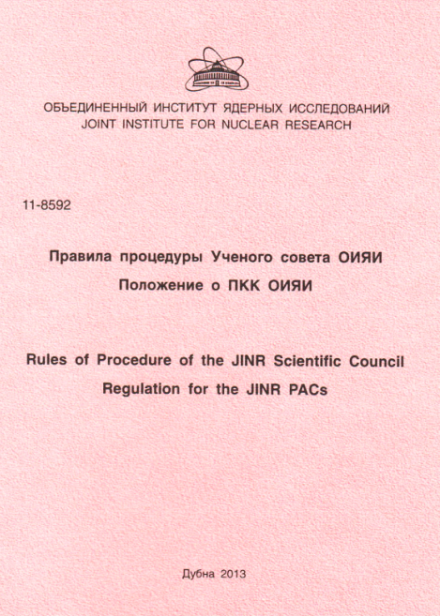
Updating the Regulation
for the JINR ProgrammeAdvisory Committees
The PAC finds elaboration of new methods for evaluation of JINR projects and themes useful in view of the current preparation of an update of the Regulation for the JINR PACs to be approved by the Scientific Council.
The PAC members were invited to submit their final proposals concerning methods of project evaluation and the new Regulation until the end of July 2016.
By now, the final comments of PAC members are collected and submitted to the JINR Directorate.
Regulation of the
JINR PACs

Slide 21
Scientific Reports
The PAC delivered information to SC concerning
scientific reports presented at June-July PAC meeting
The PAC took note of the following scientific reports in condensed matter physics and related fields::
“Neutron texture investigations of metallic and biological materials” by D. Nikolaev
“Energy dispersive EXAFS spectrometer in the RNC “Kurchatov Institute”: status and experimental results” by S. Tyutyunnikov
“Novel features of Josephson nanostructures under external electromagnetic radiation. Results of collaboration with Germany, Slovakia, South Africa, Egypt, Japan, India, and Tajikistan” by Yu. Shukrinov.

Slide 22
The PAC informed SC about the poster presentations by LIT and DLNP young scientists and selection of the best papers
The PAC is pleased with the quality of new scientific results achieved by LIT and DLNP young scientists in the field of condensed matter research and information technology and welcomes the concluding report by Sh. Torosyan.
The best selected poster:
“Analysis of small-angle synchrotron X-ray scattering experimental data from vesicular systems by means of the parallel asynchronous differential evolution method” presented by E. Zhabitskaya.
The PAC also noted two other high-quality posters:
“Parallel implementations of image reconstruction algorithms for X-ray microtomography” by M. Zuev
“Application of cloud technologies at JINR” by N. Kutovsky.
Recommendation. The PAC recommends the best selected poster “for presentation at the session of the Scientific Council.
Notes:
The PAC is pleased with the quality of new scientific results achieved by LIT and DLNP young scientists in the field of condensed matter research and information technology and welcomes the concluding report by Sh. Torosyan.

Slide 23
Junuary 2017 meeting of the PAC
The next meeting of the PAC for Condensed Matter Physics will be held
on 19–20 January 2017
Its tentative agenda will include:
information by the PAC Chairperson on the report at the next session of the Scientific Council, and the implementation of the recommendations of the current PAC meeting;
information by the JINR Directorate on the sessions of the Scientific Council
(September 2016) and of the Committee of Plenipotentiaries (November 2016);
reports and recommendations on themes and projects to be completed in 2017
and progress reports of ongoing projects and themes;
information by FLNP on the development of the IBR-2 facility;
status reports on the upgrades of FLNP instruments;
information about scientific meetings;
scientific reports;
poster session.

Slide 24
Thank you for your attention

