Slide 1
Development of modern education programs Project Report
Development of the open educational environment to support research priorities in nuclear physics New Project
Panebrattsev Yu.A.
Programme Advisory Committee for Condensed Matter Physics 19-20 January 2017, Dubna

Slide 2
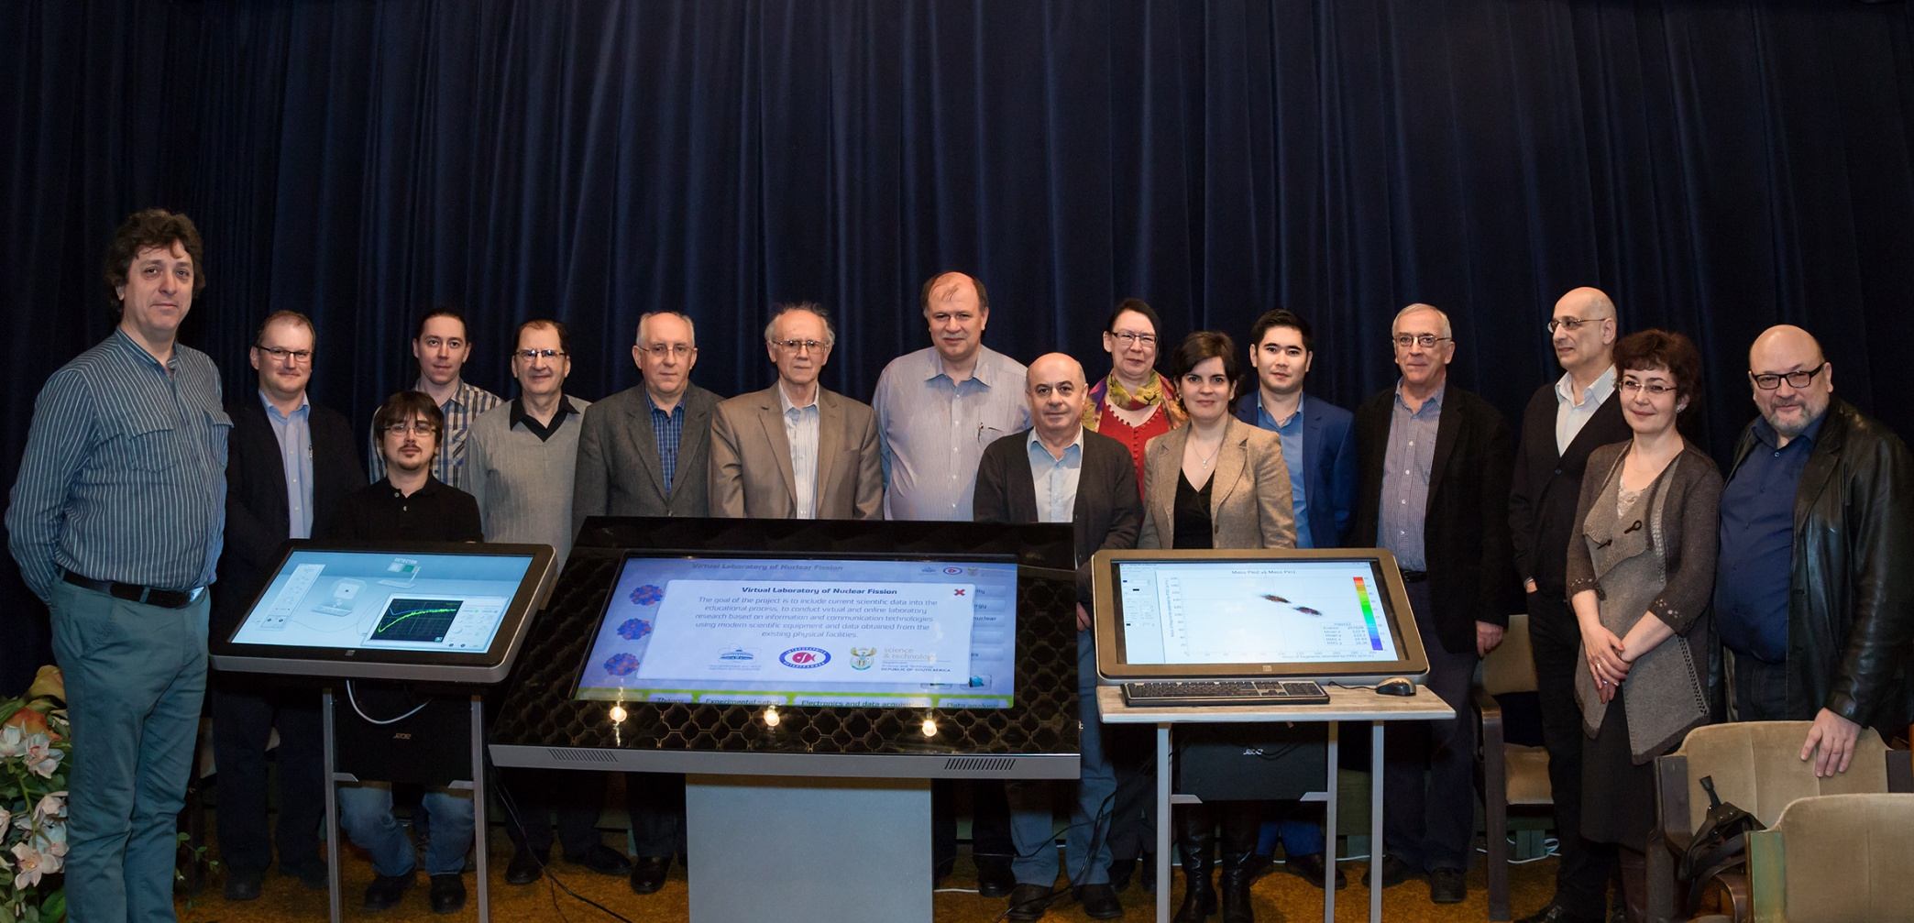
Development of modern education programs Project Report

Slide 3
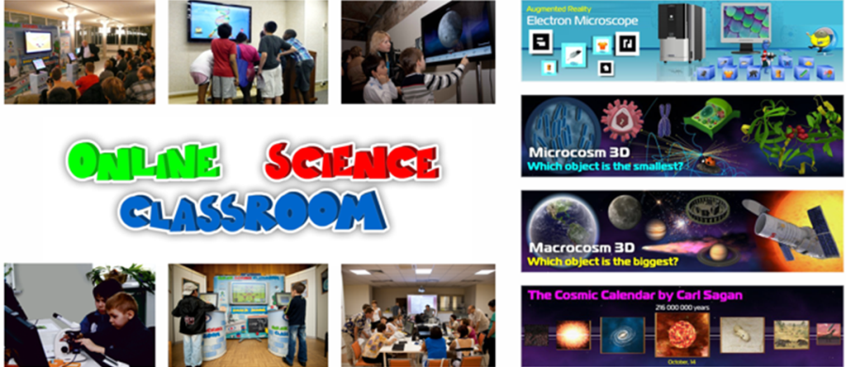
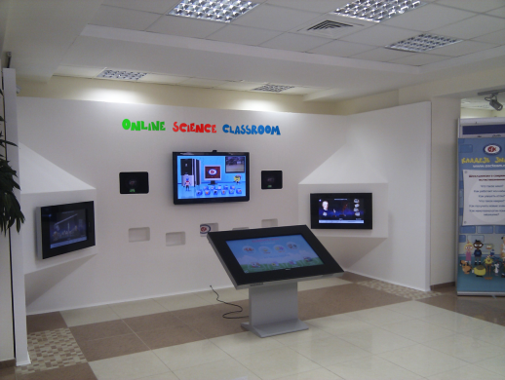
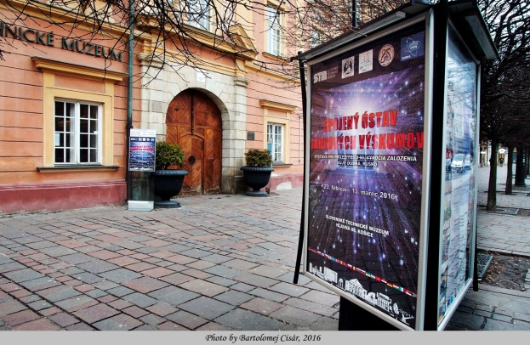
Development of modern education programs Project Report
1. Multimedia interactive modules of basic JINR facilities
2. Exhibitions. JINR Visit Centrum. JINR Museum

Slide 4
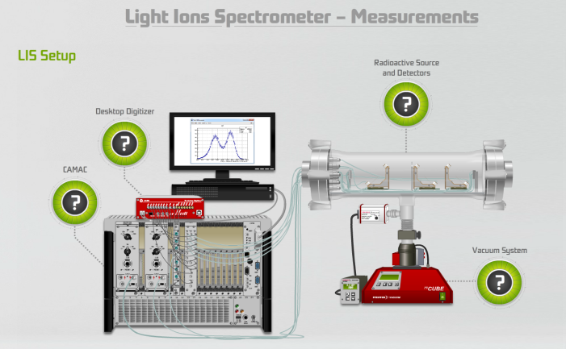
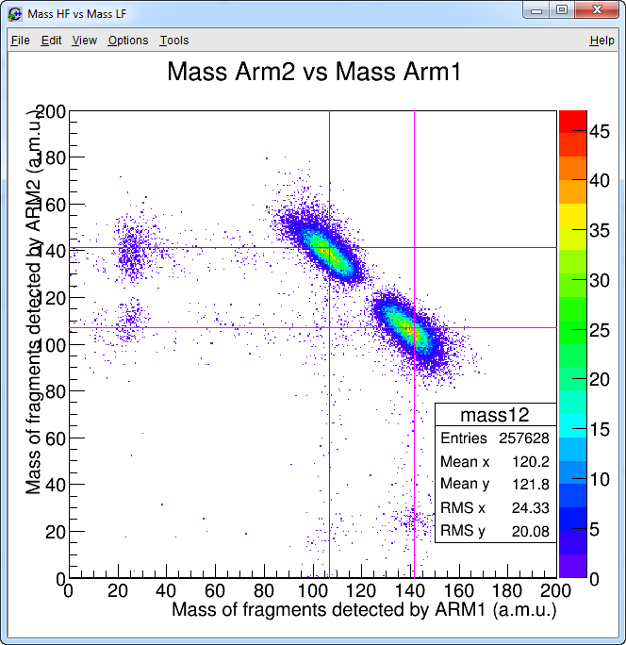
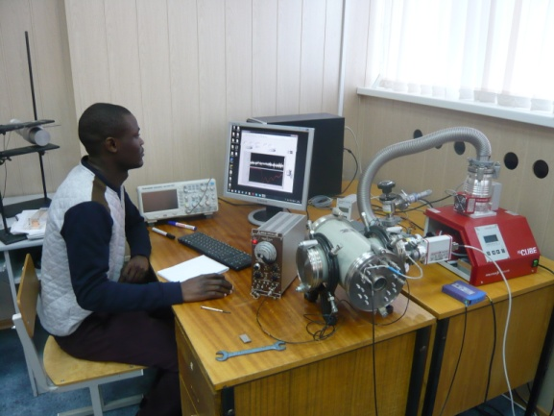
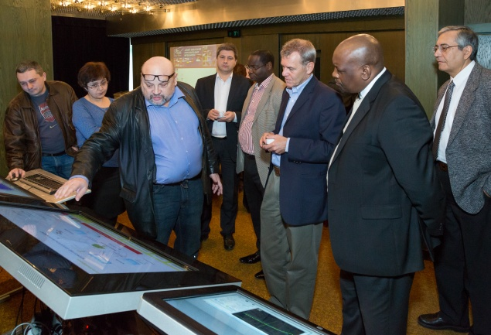
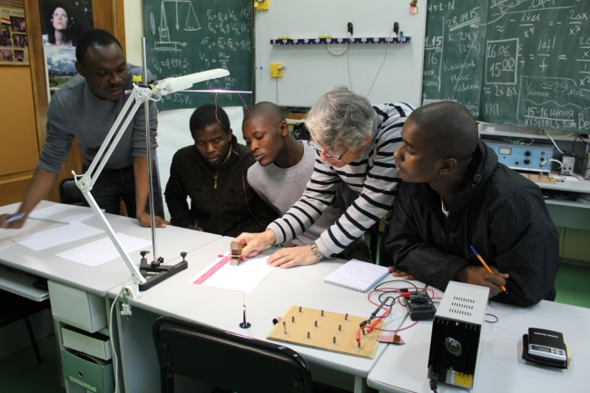
Development of modern education programs Project Report
3. Virtual Laboratory of Nuclear Fission

Slide 5
Development of the open educational environment to support research priorities in nuclear physics New Project
Project authors from JINR:
S.N. Balalykin, V.V. Belaga, E.I. Golubeva, D.V. Kamanin, K.V. Klygina, A.O. Komarova,
V.V. Korenkov, Yu.D. Orlova, M.P. Osmachko, S.Z. Pakuliak, Yu.A. Panebrattsev,
E.V. Potrebennikova, P.D. Semchukov, N.E. Sidorov, O.A. Smirnov, A.V. Strekalovsky,
T.G. Stroganova, R. Tsenov, N.I. Vorontsova, D.V. Zhuravleva.
Participating organizations: National Research Nuclear University MEPhI
Dubna University
Institute of Physics, Kazan Federal University
Faculty of Applied Mathematics and
Control Processes, St. Petersburg State University
Stellenbosch University, RSA
UNISA, RSA
Sofia University, Bulgaria
INRNE BAS, Bulgaria
"InterGraphics" LLC
University P. J. Safarika, Kosice, Slovakia

Slide 6
Project goals
Attract talented young people and highly qualified specialists to work at JINR
Use modern educational technologies to train specialists intending to work at JINR
Implement the results obtained at JINR in the educational process in the State Members of the Institute
Build brand awareness of JINR and the NICA project for a wider audience
Develop educational content at the level of the leading research centers

Slide 7
Project tasks
Develop online courses and new educational programs within the subject-matter of JINR projects on the basis of modern educational platforms
Creation and development of multimedia educational resources for the JINR laboratories’ websites
Provide informational and educational support of the megaproject NICA
Develop multimedia exhibits associated with the JINR subject-matter
Develop a professional nuclear physics web-resource “Nuclear Science and Technology”
Develop a e-learning tool "Virtual Laboratory of Nuclear Physics" intended for students

Slide 8
Multimedia educational resources for the JINR laboratories’ websites

Slide 9
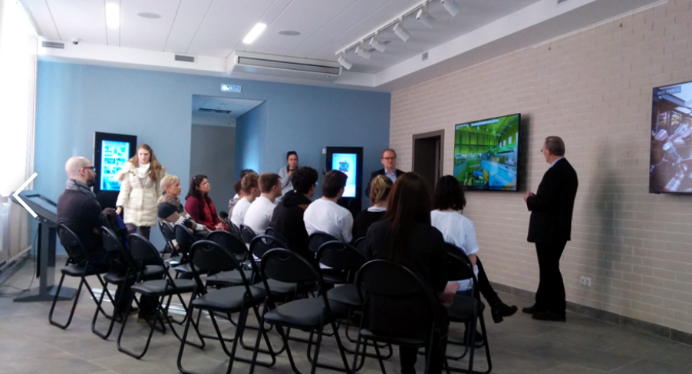
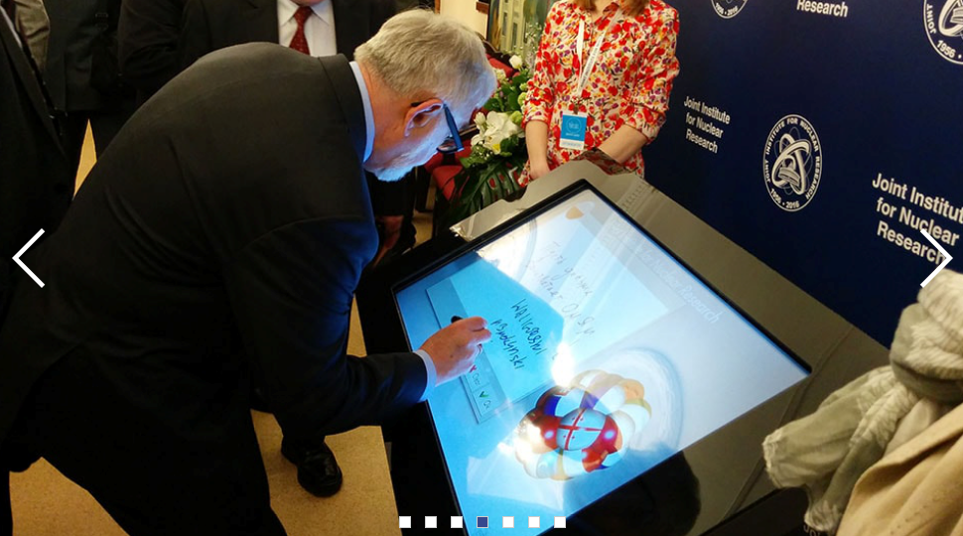
Science outreach activities
Exposition at JINR Visit Centrum
Exposition at Slovak Technical Museum
Kazan Federal University
Science Festival 0+ in Moscow
South Africa-Joint Institute for Nuclear Research 10th Collaboration Celebration & Ten-year Review Forum

Slide 10
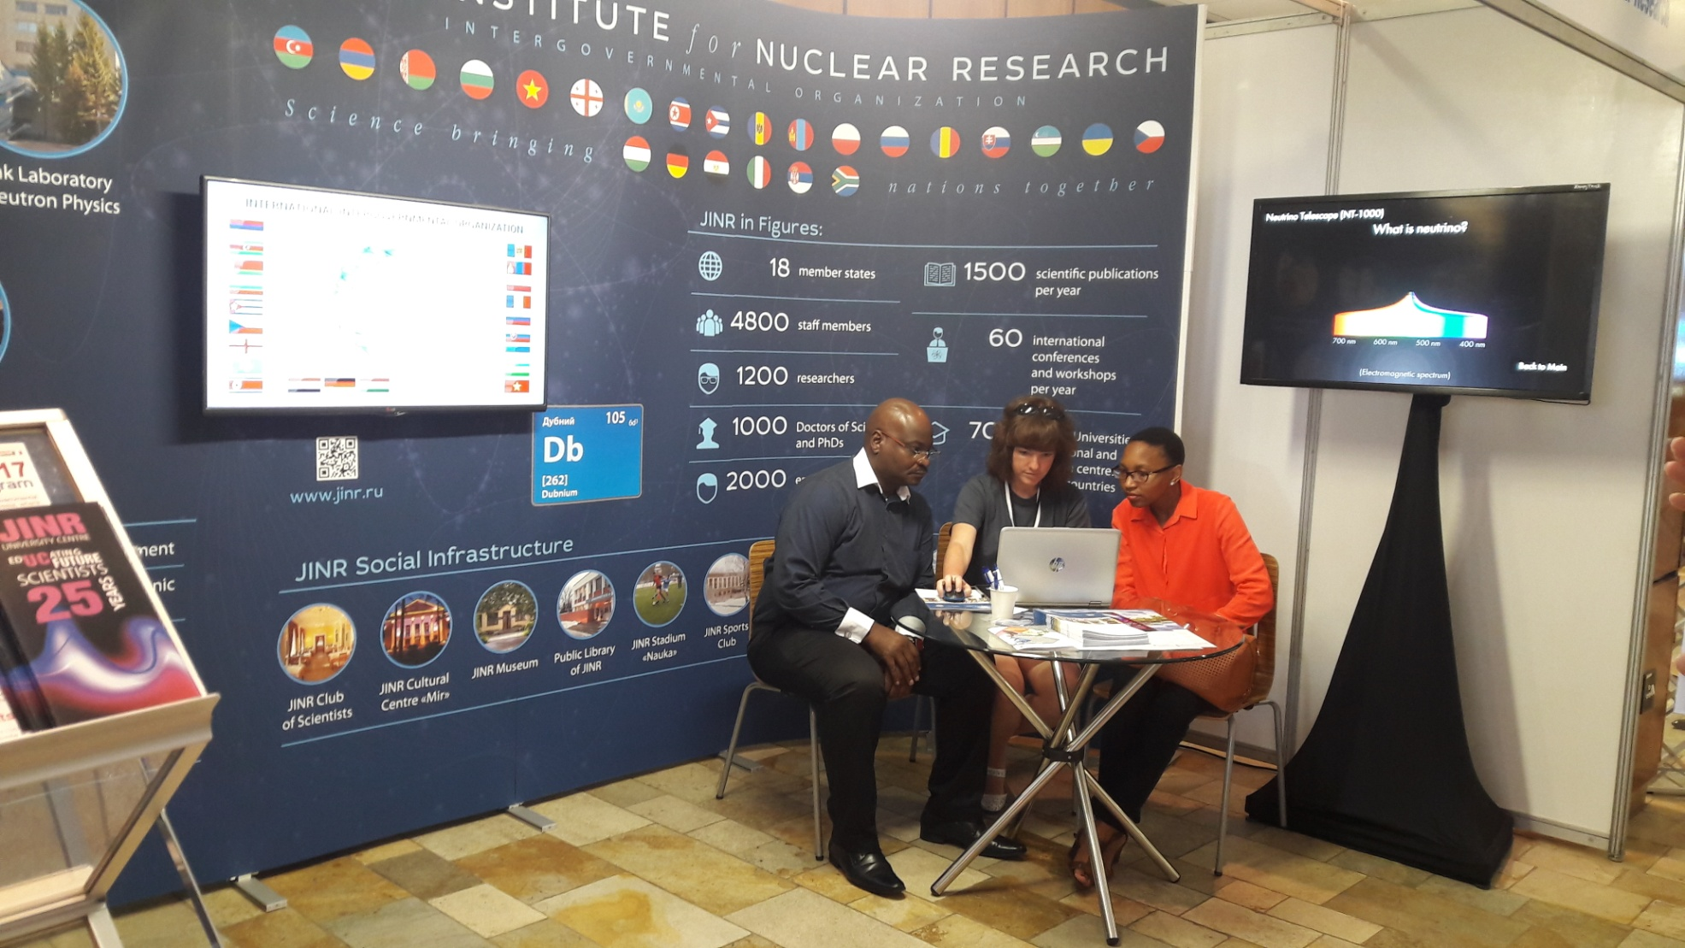
Multimedia exhibits related to the JINR subject-matter
Science Forum in South Africa

Slide 11
Online courses and new educational programs within the subject-matter of JINR projects on the basis of modern educational platforms

Slide 12
Blended learning model
NICA
certificate
Open informational educational environment

Slide 13
Online courses within the subject-matter of JINR projects
Physics: fundamental and applied research
Study of condensed matter using neutrons
Neutrino physics. Deep-water experiment Baikal
Heavy ion physics. Exotic nuclei. Radioactive beams
Synthesis of new superheavy elements
Heavy ion accelerator complexes
Cryogenic technologies and their use in accelerating technics
Information technologies for the NICA project
Medical and applied physics with heavy ion
GRID and distributed computing for Big Data
New generation networks and GRID-technology
Modern technologies of distributed computing systems
Modern technologies of Big Data system engineering
Data mining methods
Software engineering (in the development of Big Data systems)
Technologies of acquisition, storing and analyzing data in nuclear physics

Slide 14
Online courses and new educational programs within the subject-matter of JINR projects on the basis of modern educational platforms

Slide 15
NICA Project website: http://nica.jinr.ru
Informational and educational support of the megaproject NICA

Slide 16
Digital passport of the NICA Accelerator Complex
Informational and educational support of the megaproject NICA

Slide 17
Suggested list of online courses
Informational and educational support of the megaproject NICA
Basics of accelerator equipment
Experimental methods of nuclear physics
Storage and processing of experimental data
Introduction to the physics of relativistic nuclear collisions
Cryogenics in accelerators
Radiation medicine
Radiation materials science
Nuclear electronics
Physics with MPD detector

Slide 18
Development of online courses and new educational programs within the subject-matter of NICA project in collaboration with:
JINR specialists
University lecturers:
Dubna University
National Research Nuclear University MEPhI
AM&CP Faculty, St. Petersburg State University
Institute of Physics, Kazan Federal University
Institute of Nuclear Physics, Moscow State University
Moscow Institute of Physics and Technology
…

Slide 19
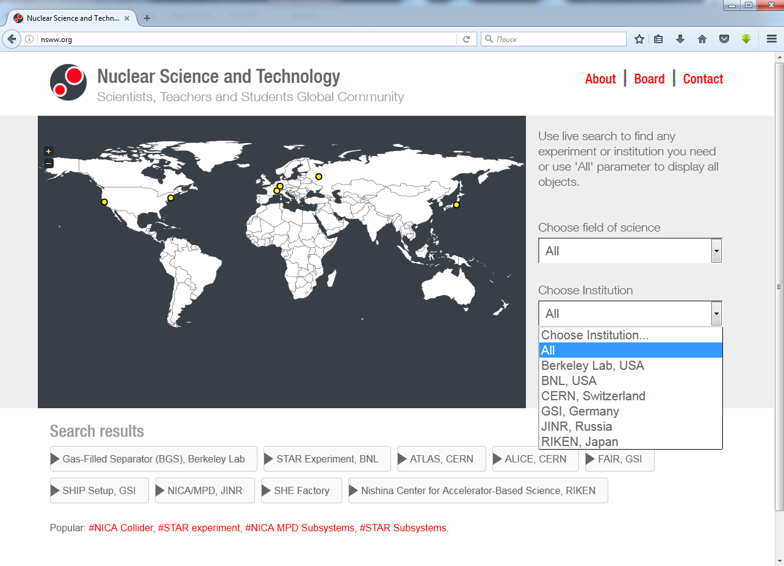
Professional nuclear physics web-resource “Nuclear Science and Technology”

Slide 20
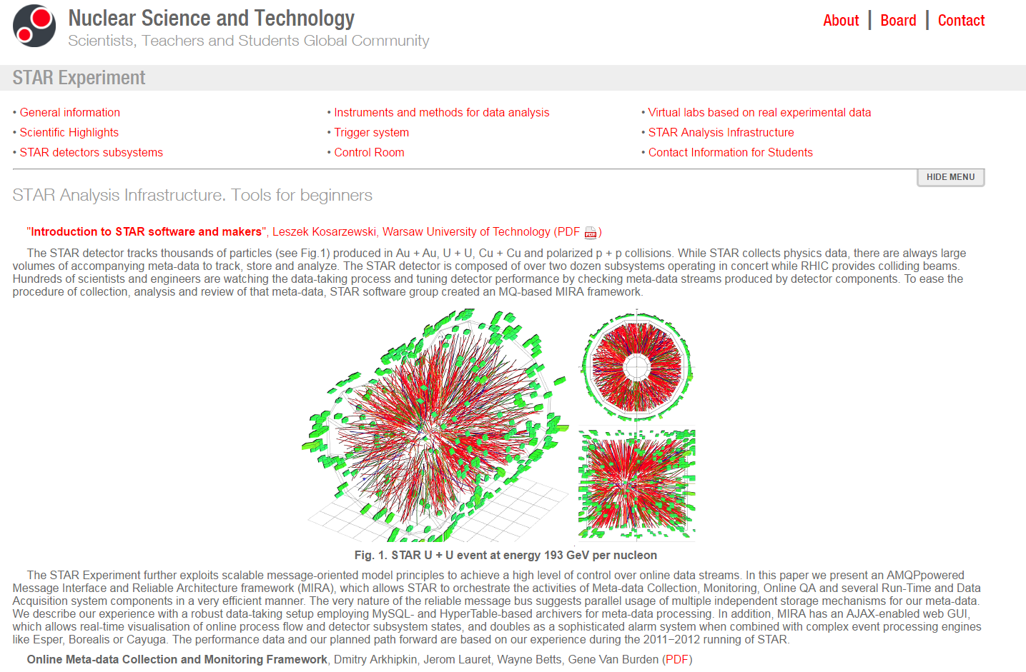
Modern detectors
Professional nuclear physics web-resource “Nuclear Science and Technology”
Data analysis

Slide 21
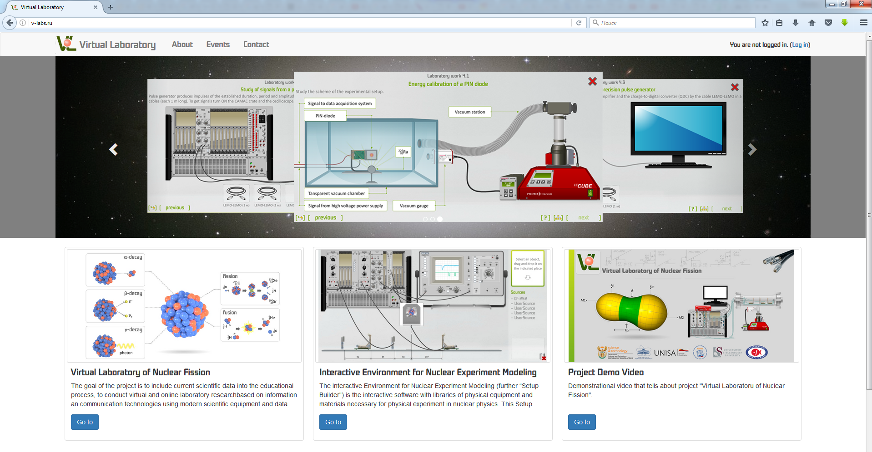
Educational online resource “Virtual Laboratory of Nuclear Physics”
2014–2016: Hardware-Software Complex “Virtual Laboratory of Nuclear Fission”
2017–2019:
– Development of the web-resource “Virtual Laboratory of Nuclear Physics”
– Development of the interactive environment for nuclear experiment modeling
– Integration of virtual laboratory to educational process of participating
universities
– Extension of practicum topics (gamma spectroscopy, neutron physics etc.)

Slide 22
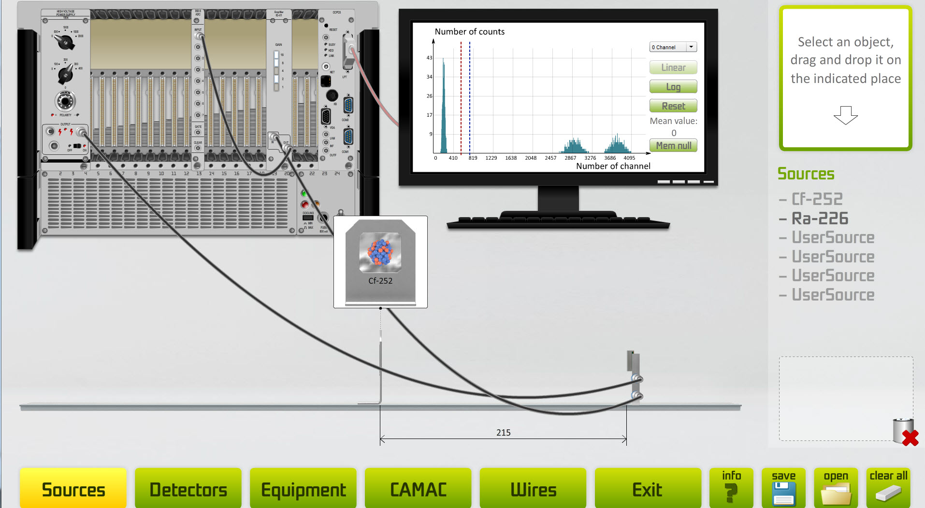
Interactive environment for nuclear experiment modeling

Slide 23
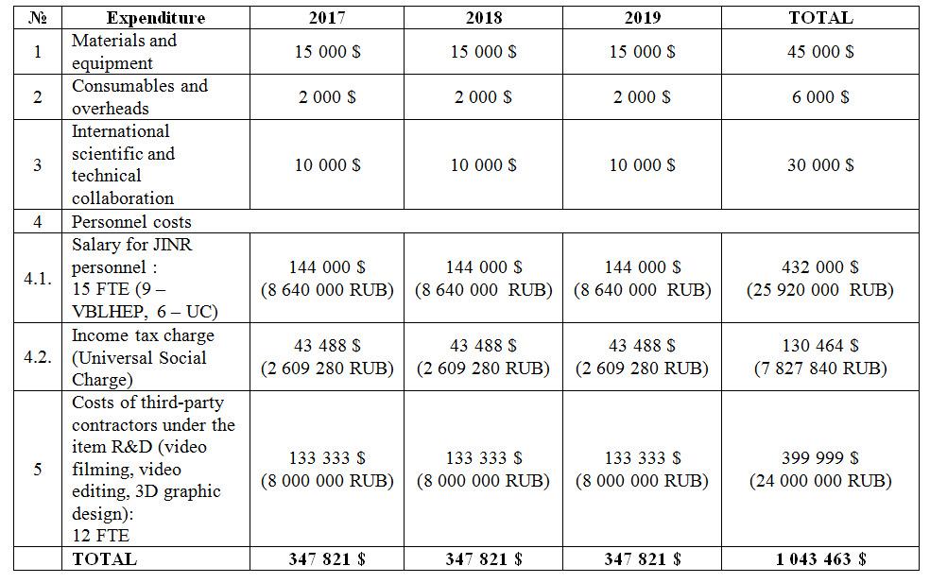
Explanatory note for budget of the project “Development of the open educational environment to support research priorities in nuclear physics”

Slide 24
Possible financing sources of the project
JINR UC budget theme: 1120
JINR infrastructure
VBLHEP budget theme: 1065 (NICA project)
VBLHEP budget theme: 1066 (STAR project)
Cooperation Programs with JINR Associated States
Grants of Plenipotentiaries of JINR Member States

