Slide 1
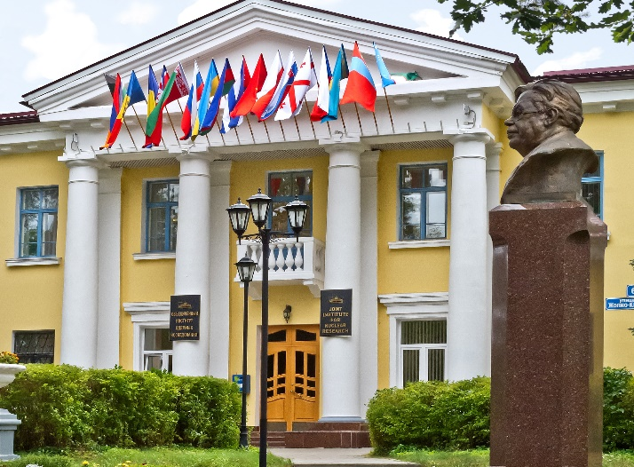
«ADVANCED MATERIALS INVESTIGATION BY MEANS OF NEUTRON SCATTERING METHODS»
STUDENT TRAINING
COURSE
27 August - 4 September 2016 JINR, Dubna
19.01.2017
PAC on Condensed Matter
Maria Balasoiu, Madalin Bunoiu, Rodica Vladoiu

Slide 2
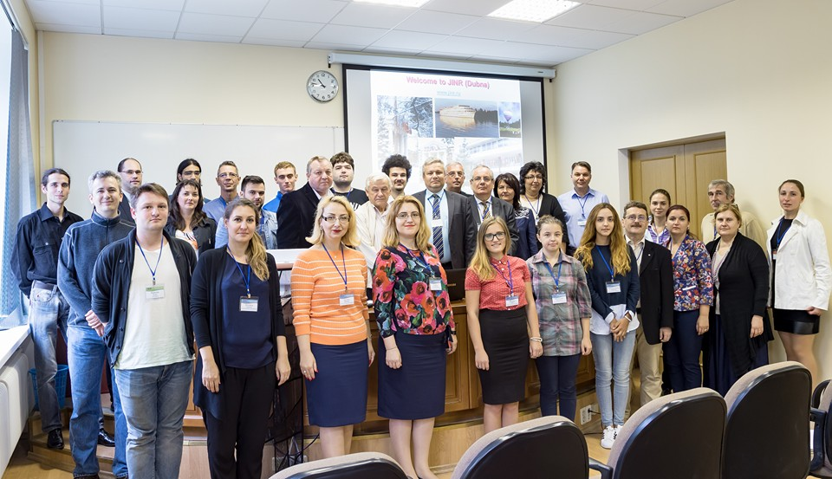
19.01.2017 PAC on Condensed Matter STUDENT TRAINING COURSE 27 August - 4 September 2016 JINR, Dubna
Between the 27-th of August and the 4-nd of September 2016, a group of professors and students of the Faculty of Physics from the West University of Timisoara and of the Faculty of Applied Sciences from Ovidius University of Constanta ROMANIA, attended the student training course “Advanced Materials Investigation by Means of Neutron Scattering Methods” organized at the Joint Institute for Nuclear Research (JINR), Dubna, RUSSIA.
Other participants:
Students performing the Summer practice in our Department from Dubna University;
Collaborators students from MEPHI (Moscow Research Nuclear University) and MSU (Lomonosov Moscow State University);
Young researchers from our Department.

Slide 3
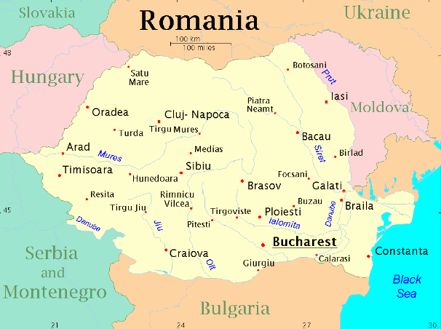
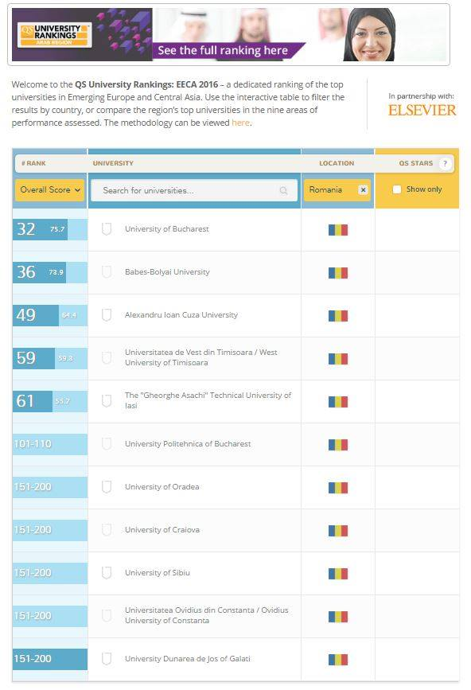
19.01.2017 PAC on Condensed Matter STUDENT TRAINING COURSE 27 August - 4 September 2016 JINR, Dubna
Universities Rankings in Emerging
Europe and Central Asia
top ~ 4 universities in Romania
top ~ 59 universities in EECA
It is a 72 years
old University
top ~11 universities in Romania
top ~ 200 universities in EECA
It is a 27 years old University

Slide 4
19.01.2017 PAC on Condensed Matter STUDENT TRAINING COURSE 27 August - 4 September 2016 JINR, Dubna

Slide 5
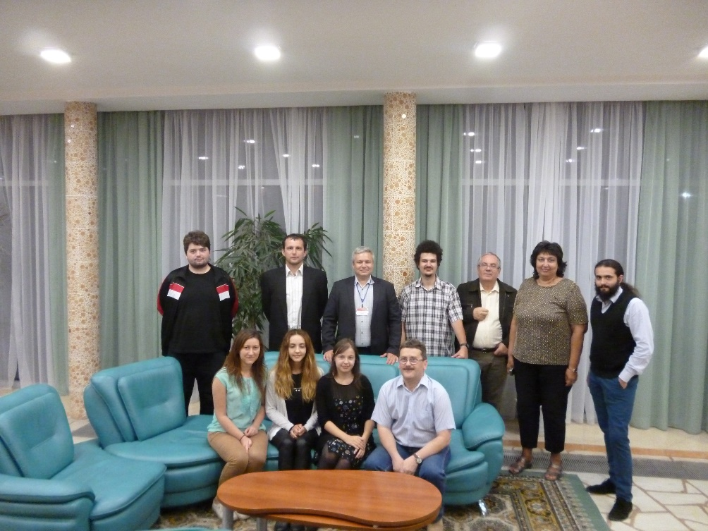
19.01.2017 PAC on Condensed Matter STUDENT TRAINING COURSE 27 August - 4 September 2016 JINR, Dubna
The delegation from the Faculty of Physics of the West University of Timisoara was comprised of the following members:
Prof. dr. Ioan BICA
Associate prof. dr.
Madalin Octavian BUNOIU
Lect. dr. Adrian Puiu NECULAE
5 Students:
Iulia Maria BEJENARIU , III B.Sc.
Mircea Lucian CORCODEL, I M.Sc.
Raluca Cristina HODOROG, III B.Sc.
Stefan Tiberiu KIS, II B.Sc.
Oana Cecilia STAMATOIU, I M.Sc.

Slide 6
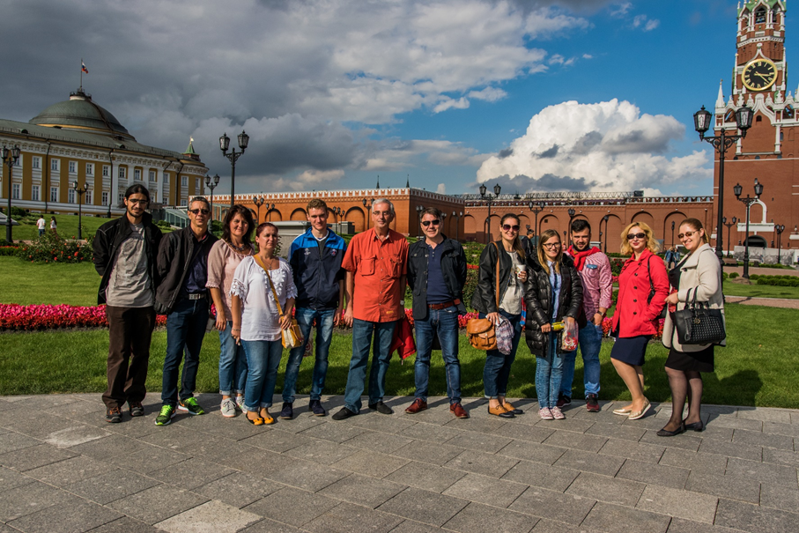
19.01.2017 PAC on Condensed Matter STUDENT TRAINING COURSE 27 August - 4 September 2016 JINR, Dubna
The delegation from the Faculty of Applied Sciences and Engineering was comprised of the following members:
Associate prof. dr. Marius BELC
Lecturer dr. Virginia Dinca-Balan
Lecturer dr. Aurelia Mandes
9 Students:
Nicolae HOBAN, III B.Sc.
Ilie Daniel PETCU, III B.Sc.
Adriana NANI, III B.Sc.
Alexandru Mihai MATEI , IV B.Sc
Nicoleta CIOCHINA, IV B.Sc.
Lucian Mihai CRACIUN, IV B.Sc.
Angelica PRENTU, I M.Sc.
Victoria POPA, I M.Sc.
Ionel CORNEA, I M.Sc.

Slide 7
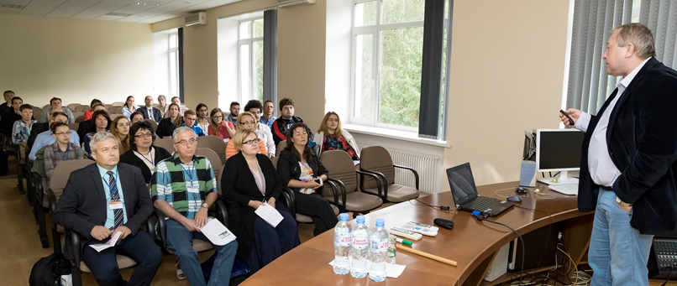
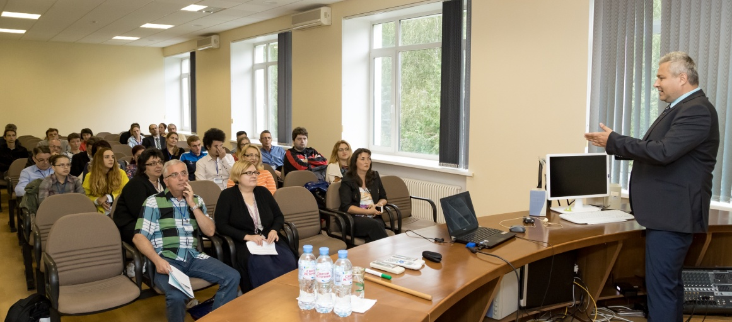
19.01.2017 PAC on Condensed Matter STUDENT TRAINING COURSE 27 August - 4 September 2016 JINR, Dubna
Opening of the student training course

Slide 8
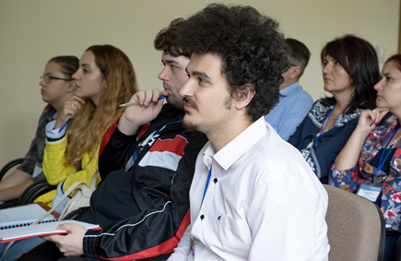
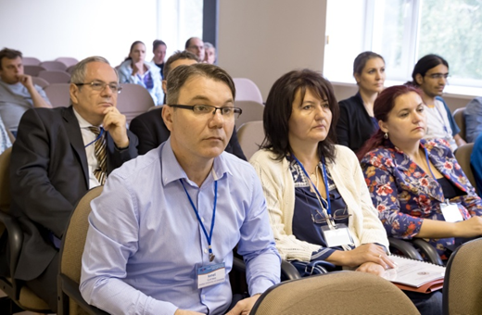
19.01.2017 PAC on Condensed Matter 9 Lectures STUDENT TRAINING COURSE 27 August - 4 September 2016 JINR, Dubna
Scientific program
Lecturers | Title of the lectures
OTILIA CULICOV | JINR opportunities for learning, employment and scientific collaboration
ANATOLY BALAGUROV | Neutron diffraction on pulsed sources
ROMAN VASIN | Neutron scattering in Earth sciences
DMITRY NIKOLAYEV | Introduction to texture analysis
SERGEY KICHANOV | The structural aspects of functional properties forming in materials: neutron studies
IVAN BOBRIKOV | Basics of diffraction data refinement
ALEXANDER KUKLIN | Determination of nanoparticles structure parameters using small angle scattering
NORBERT KUČERKA | Biophysical perspectives of membranes through the optics of neutrons
DOROTA CHUDOBA | Introduction to neutron inelastic scattering
MARIA BALASOIU | Small angle neutron scattering investigations of ferrofluids and magnetic elastomers

Slide 9
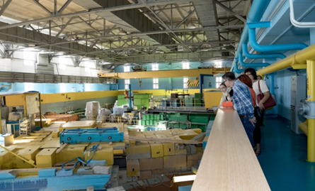
19.01.2017 PAC on Condensed Matter STUDENT TRAINING COURSE 27 August - 4 September 2016 JINR, Dubna
Practice works
Lecturers | Title of practice works
DOROTA HUDOBA ALEXANDER KUKLIN MAXIM RULEV ANTON RUTKAUSKAS CHRISTIAN SCHEFFZUK DMITRY NIKOLAYEV TATYANA LYCHAGINA | Visit to the reactor IBR-2 and YuMO, HRFD, DN-12, SKAT, EPSILON, NERA instruments
VITALY TURCHENKO | XRD Experimental work
ROMAN VASIN | Program MAUD
MARIA BALASOIU | Program FITTER
MAXIM RULEV | Chemical and biological laboratory visit

Slide 10
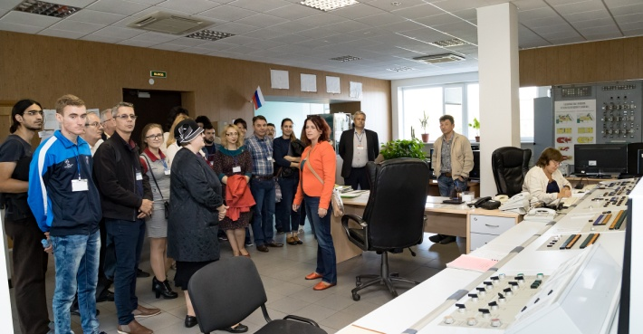
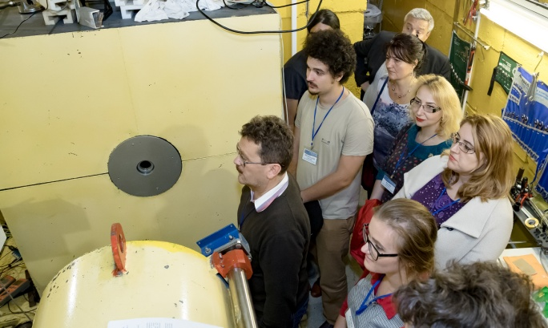
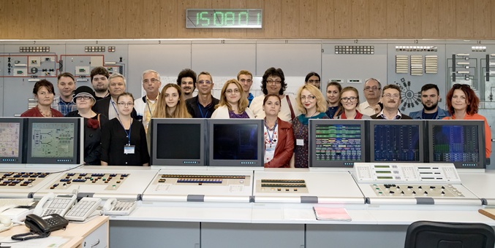
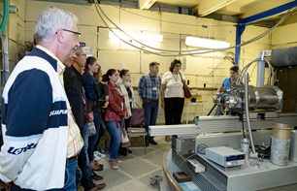
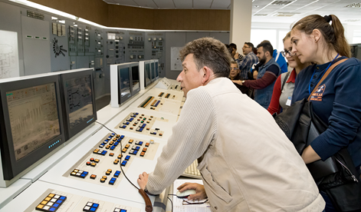
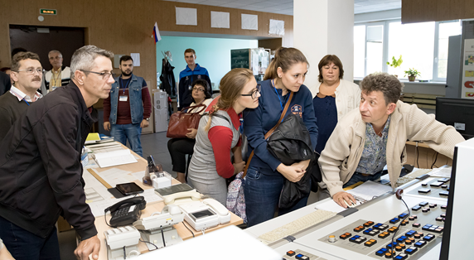
19.01.2017 PAC on Condensed Matter STUDENT TRAINING COURSE 27 August - 4 September 2016 JINR, Dubna
Visit to the reactor IBR-2 and presentation of YuMO, HRFD and DN-12 instruments

Slide 11
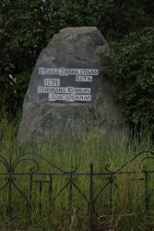
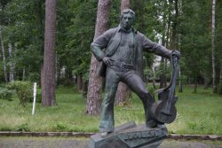
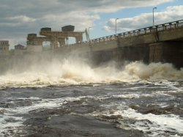
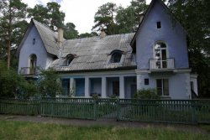
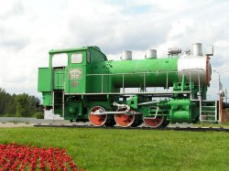
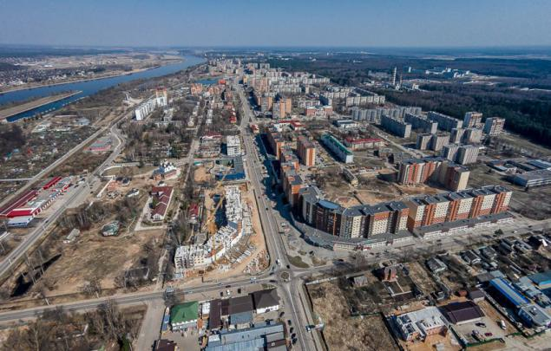
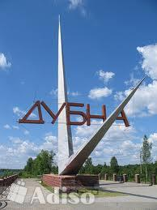
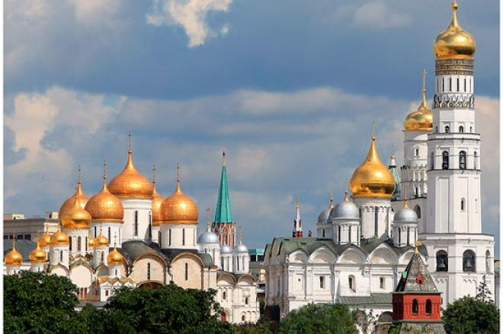
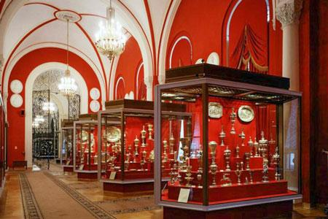
19.01.2017 PAC on Condensed Matter STUDENT TRAINING COURSE 27 August - 4 September 2016 JINR, Dubna
Cultural program
Excursion in Dubna of yesterday and today;
Excursion to Moscow –
Visit of Moscow Kremlin Museums

Slide 12
19.01.2017 PAC on Condensed Matter STUDENT TRAINING COURSE 27 August - 4 September 2016 JINR, Dubna
The FEEDBACK from the participants
The participants were very enthusiastic about everything they had learnt and seen, and suggested that such trennings should be held regularly in Dubna and Romania.

Slide 13
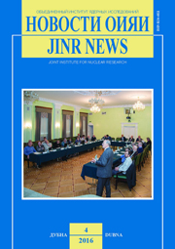
19.01.2017 PAC on Condensed Matter STUDENT TRAINING COURSE 27 August - 4 September 2016 JINR, Dubna
JINR News Bulletin №4 2016 - just have been issued

Slide 14
19.01.2017 PAC on Condensed Matter STUDENT TRAINING COURSE 27 August - 4 September 2016 JINR, Dubna
Acknowledgements
The event was organized with the financial support of the
Romanian Governmental Representative at JINR Grants and
JINR – Romania Cooperation Program Projects.
We acknowledge this support.
We warmly acknowledge also the support of JINR leadership staff, involved departments and colleagues.

Slide 15
19.01.2017 PAC on Condensed Matter STUDENT TRAINING COURSE 27 August - 4 September 2016 JINR, Dubna
Thank you for attention

