Slide 1
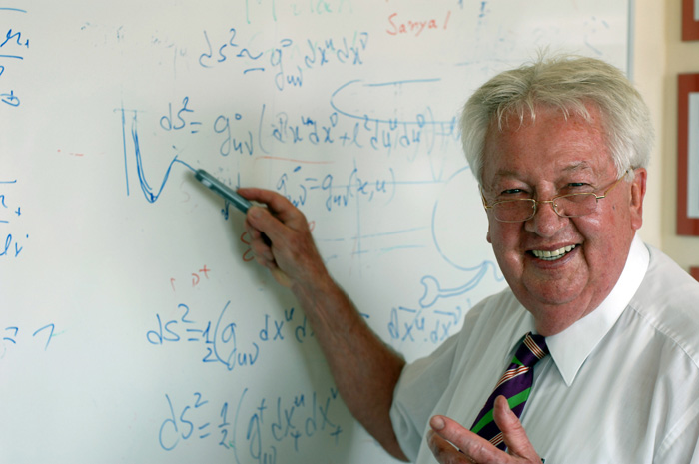
Walter Greiner
(29 October 1935 – 6 October 2016)

Slide 2
Independent members:
Christian Beck* - IPHC, Strasbourg, France
Sigurd Hofmann - GSI, Darmstadt, Germany
Guinyun Kim* - KNU (Kyungpook National University),
Daegu, South Korea
Alexey Korsheninnikov -Kurchatov Institute, Moscow, Russia
Marek Lewitowicz -GANIL, France
Vladimir Ostashko - INR,Kiev, Ukraine
Claude Petitjean - PSI, Villigen, Switzerland
Fabrice Piquemal - CENBG, Bordeaux, France
Adam Sobiczewski - INS, Warsaw, Poland
Ivan Štekl - IEAP CTU, Czech Republic
Emanuele Vardaci - UN, Naples, Italy
Zeblon Z. Vilakazi - University of the Witwatersrand,
Johannesburg, South Africa
*⁾ is not present at this meeting

Slide 3
Ex officio members appointed by the JINR:
Vadim Bednyakov -Director, DLNP
Sergey Dmitriev - Director, FLNR
Mikhail Itkis - Vice-Director, JINR
Valery Shvetsov - Director, FLNP
Tatiana Strizh - Deputy Director, LIT
Victor Voronov - Director, BLTP
.

Slide 4
