Slide 1

Main directions of research planned at JINR for 2017–2023
N.Russakovich PAC for NP Jan 25-th 2017

Slide 2
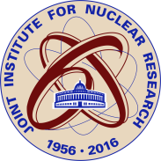
JINR is unique for its time-tested trinity of basic research, wide international cooperation, educational and multi-disciplinary approach. Research area of JINR includes particle physics, relativistic heavy ion physics, advanced physics of super heavy elements and exotic nuclei, precision nuclear spectroscopy, neutrino physics and astrophysics, IT and computing, fundamental neutron studies, theoretical and mathematical physics, condensed matter physics, biophysics and radio-biology, modern equipment and experimental technique.
Since JINR has been established, scientists from Asia, Africa and Latin America have been involved in its activity as well as European colleagues. And this particularly determines the scope and versatility, scientific interests and science policy of JINR.

Slide 3
A multi-disciplinary approach of the research program of the Institute is based on the traditional cooperation between the JINR departments, a continuous exchange of experience, equipment and ideas. This approach ties all directions of investigation by the single standard of values in the framework of the open international collaboration, promotion of which is in the fundamental principle of the Institute.
Due to the experience of the past years and logic of the development of the world science we can see that the success of the future of the Institute is in preservation and multiplication of its unique traditions, and in profitable combination of various scientific directions.

Slide 4
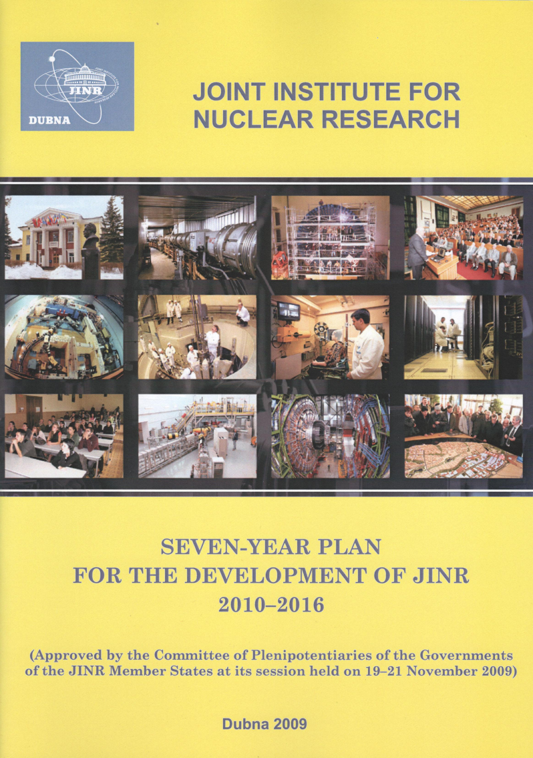
7-Year Plan (2010 – 2016)
The concept of the current Seven-Year Plan was focused on the concentration of resources to update the accelerator and reactor base of the Institute. The key elements of the qualitative improvement of the research infrastructure are the following basic facilities:
– heavy ion collider NICA (Nuclotron-based Ion Collider fAcility) for research in the field of physic of the hot and dense baryonic matter;
– cyclotron complex DRIBs-III (Dubna Radioactive Ion Beams) for the search for new superheavy elements of Mendeleev’s Periodic Table and for studies of the properties of radioactive and exotic neutron-rich nuclei;
– modernized reactor IBR-2M for research in condensed matter physics and particularly in the fields of nanoscience and nanotechnology.

Slide 5
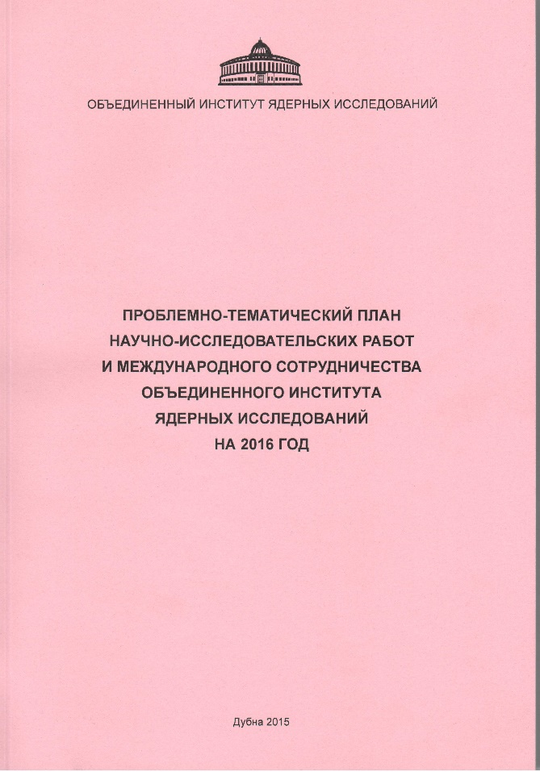
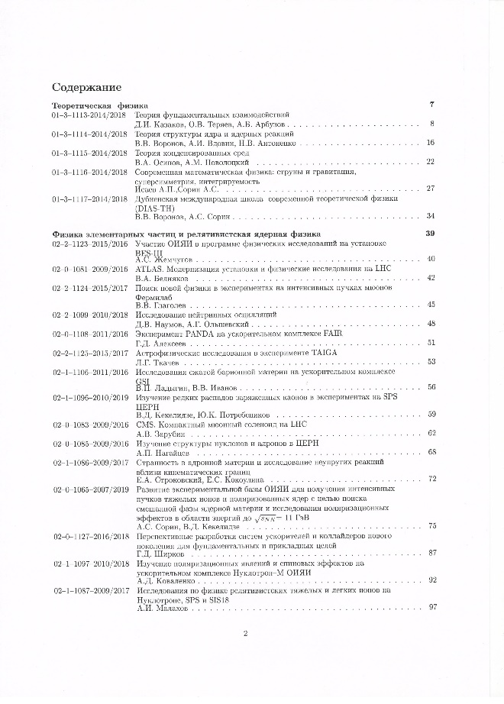
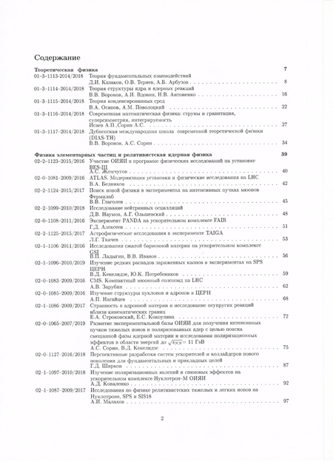
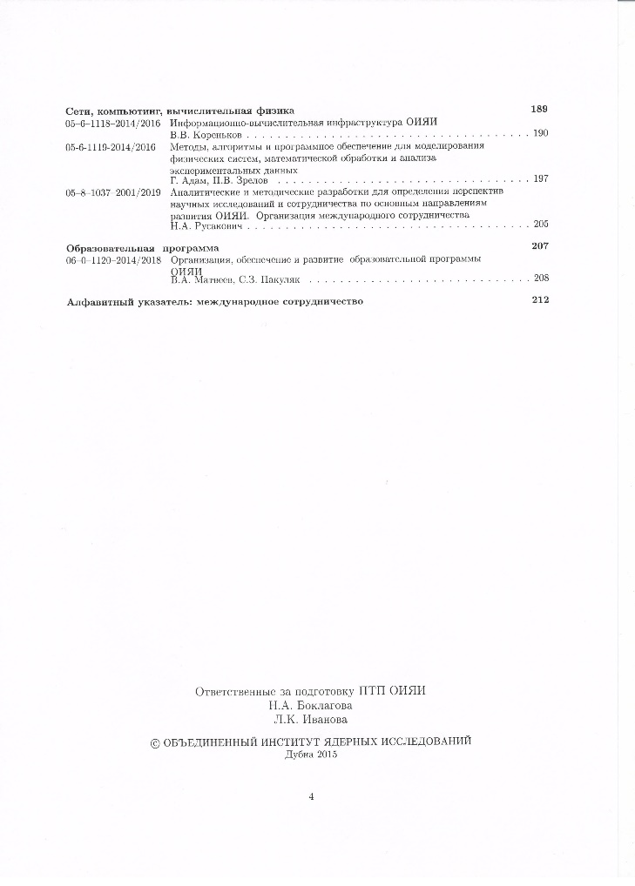
JINR’s Topical Plan (updated yearly)
Theory – 5
Particle Physics and Relativistic Ion Physics – 18
Nuclear Physics – 6
Condensed Matter Physics & Radiobiology – 9
IT, Networks, Computational Physics - 3
Educational Programs – 1
About 40 topics in total

Slide 6
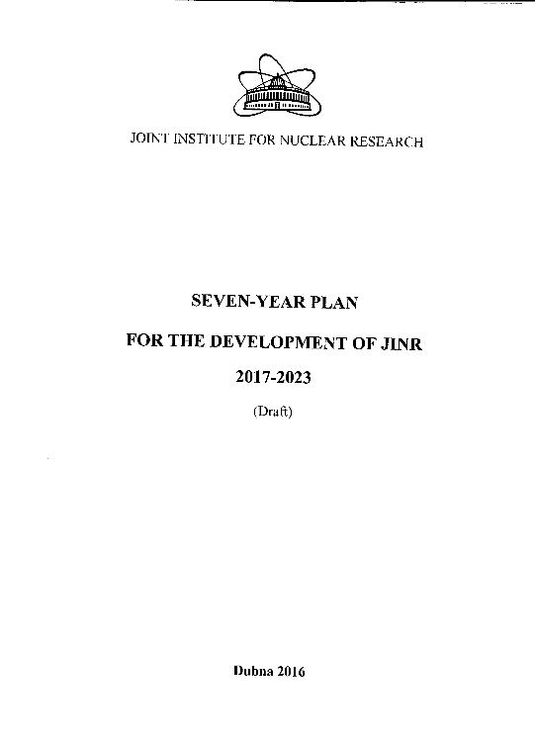

Content
-Introduction
-Development of the JINR facilities
-Physics:
Particle and relativistic heavy ion physics
Nuclear physics
Condensed matter physics
Theoretical physics
-Information Technologies
-Educational activities
-Engineering infrastructure
-Human resources and social policy
  - Innovations
- Finances

Slide 7
Major objectives of the plan for the development of JINR in the next 7-years period (2017-2023):
Focusing on the effective use of new and modernized basic facilities, built up under the current 7-years plan (IBR-2M, SHE factory);
New fixed target facility at NUCLOTRON BM@N (2017);
First stage of the NICA collider (2020);
Full scale Gigaton Volume Detector at the Baikal lake (2023);
Extension of the international cooperation around basic facilities of JINR, further integration of these facilities to European and worldwide research infrastructure;
- Attracting new countries to the JINR family;
Adjusting the general infrastructure and “modus operandi” of JINR accordingly to experience of best international research centers.

Slide 8
All basic parts of the NICA complex
are at the stages of fabrication or TDR approval.
The major milestones for the commissioning:
  accelerator complex
    start-up configuration – 2020
    the design configuration – 2023
  BM@N
    the I stage – 2017
    the II stage – 2019
  MPD
    the I stage – 2019
    upgraded (IT + end-cups) – 2023
  SPD project is under preparation
Notes:
Основные этапы создания комплекса NICA
в 2010 году утвержден проект NICA и завершен I этап модернизации Нуклотрона, начаты работы по ускорительному комплексу и многоцелевому детектору MPD (MultiPurpose Detector) , которые завершатся в 2019.
С 2012 года готовится эксперимент с фиксированной мишенью - детектор BM@N (I этап),первые результаты с которого ожидаются в 2017
- Идет подготовка проекта Spin Physics Detector (SPD)

Slide 9
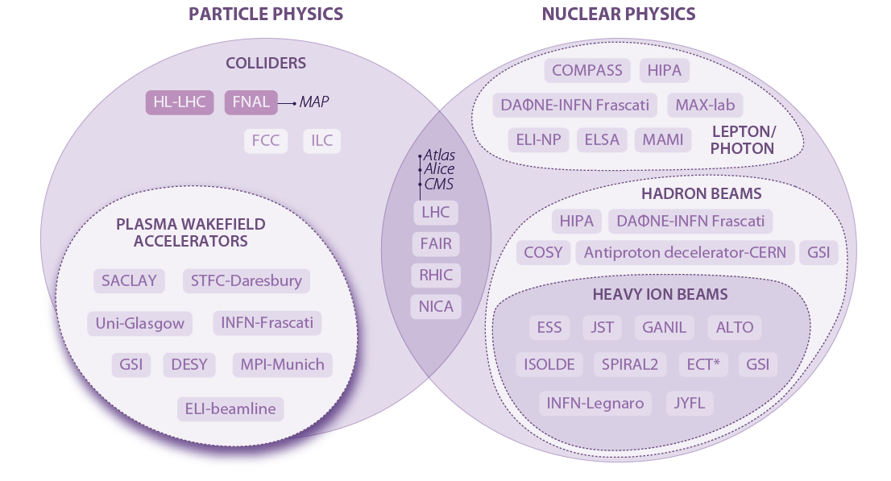
2016 update of the ESFRI Roadmap
Main Research Infrastructure in Particle and Nuclear Physics
NICA – Complementary Project

Slide 11
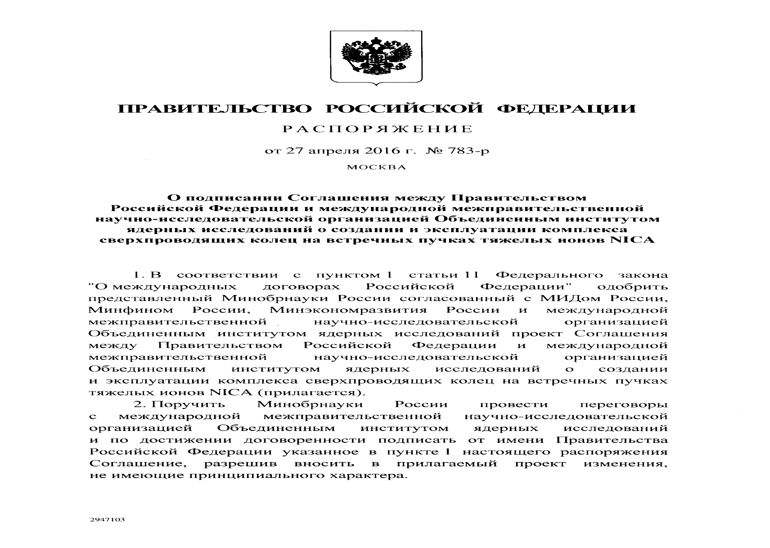
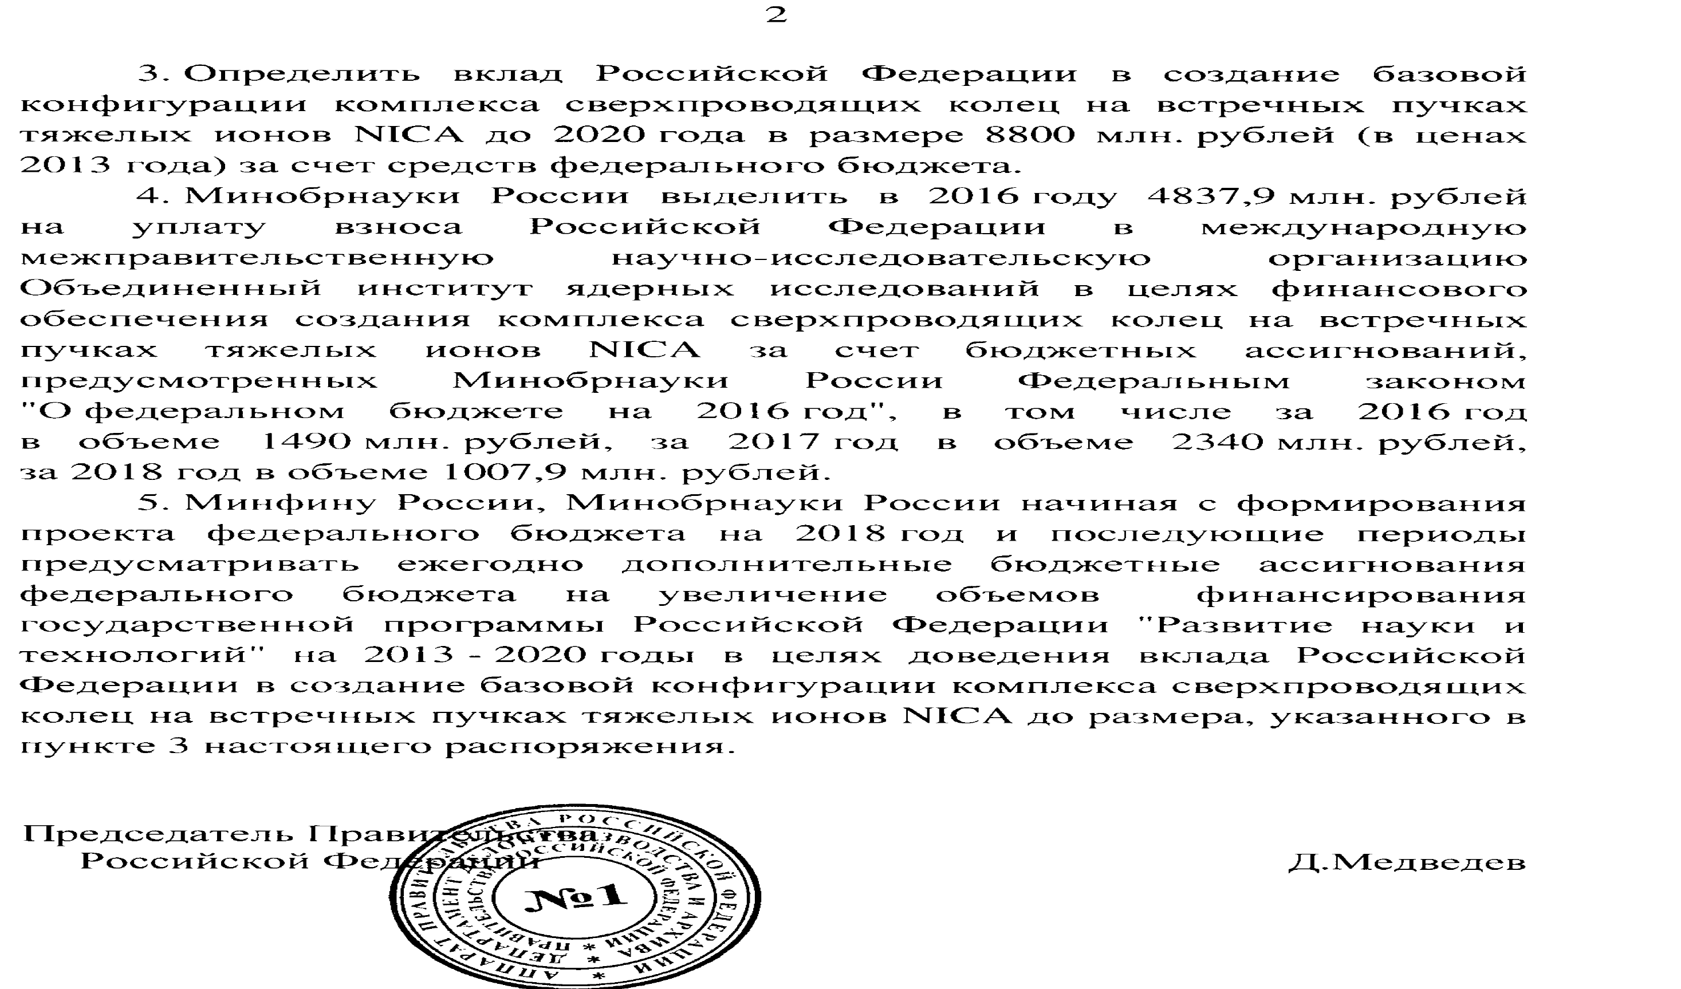
RF Government disposal

Slide 12
Objectives in the field of relativistic nuclear physics:
– Developing theoretical models and QCD methods in the region that will be available in the complementary NICA and FAIR projects,
– Establishing an effective interaction system between these two international projects in institutional, technological and research areas, developing regulations for joint data processing etc., formalizing this cooperation in the European context,
– Developing projects for relatively "distant" research prospects: spin physics, electron-ion collider, concurrent beams,
– Determining the scope and terms of use of opportunities that will be provided to users at the Nuclotron and, subsequently, at NICA. Establishing the User Policy. Disseminating broad information about these opportunities, establishing appropriate committees for the selection of projects.

Slide 13
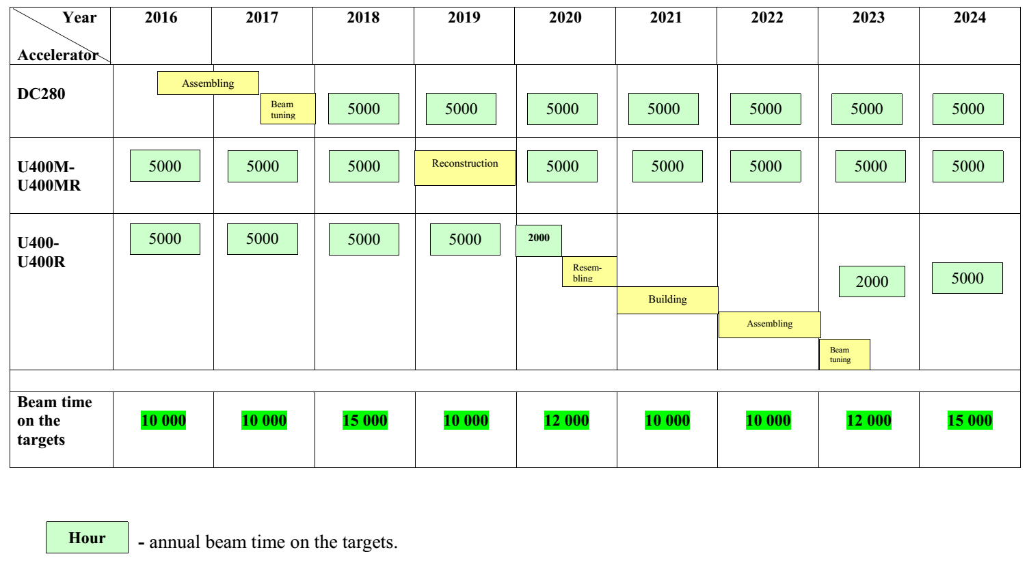
2016÷2024 years FLNR accelerators running, creation and modernization schedule

Slide 14
∑ = 105 700 k$

Slide 15
Objectives in the field of nuclear physics:
– In executing the plans for the seven-year period 2017-2023, the total amount of beam time at the FLNR accelerators will reach more than 15 thousand hours, which more than covers the needs in acceleration time for basic tasks (superheavy elements and exotic nuclei).
Therefore, it will become a possible (and, in fact, necessary) task to organize a system for attraction, selection and support of projects not regulated by the standard procedure of making the JINR Topical Plan. Addressing this task will require both organizational and technical solutions (e.g., creation of conditions for the temporary placement and maintenance of research facilities).
– Determining the scope and scale of JINR’s participation in the ELI project.

Slide 16
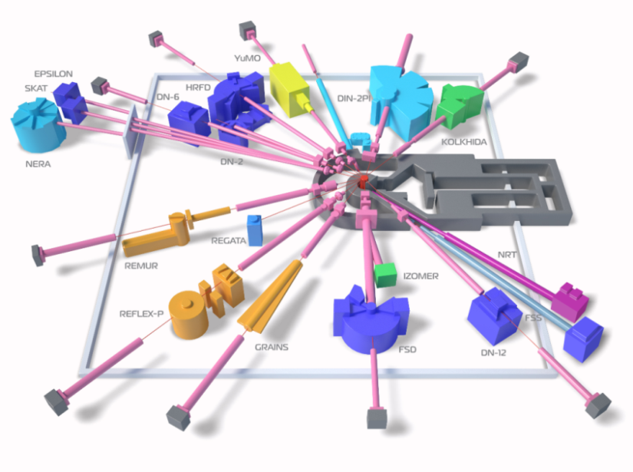
The IBR-2 pulsed neutron source
The programme of development of the IBR-2 reactor for 2017-2023 assumes:
Development and operation of the complex of cryogenic moderators.:
- commissioning of a new refrigerator for beam lines 4÷6.;
- development of the control and monitoring systems of the complex of cryogenic
moderators СМ-201, СМ-202, СМ-203;
2. Development and construction of a reserve movable reflector MR-3R.
3 Upgrade of the reactor technological equipment with expiring service life
(air heat exchangers, electromagnetic pumps, etc.).

Slide 17
IBR-2 USER PROGRAMME - 2015
197 proposals
19 countries

Slide 18
Programme of development of the spectrometer complex for IBR-2 will be aimed at:
Implementation of the final configuration and development of new spectrometers (DN-6, GRAINS, spectrometer of tomography and radiography, FSS).
Upgrade of the existing spectrometers aimed at improving their technical parameters, extending the experimental capabilities and ensuring trouble-free operation.
Creation of the basic configuration of a new small-angle scattering spectrometer.

Slide 19
∑ = 45 078 k$

Slide 20
Objectives in the field of condensed matter physics:
– The IBR-2 reactor is stable, the user programme is running. The challenge is to make this facility significant among other European neutron sources. For a qualitative increase of the role of JINR, it is necessary to develop and consistently implement a programme to create instruments with unique parameters not available at other neutron sources.
One should take into account that part of the powerful sources in Europe will be shut down in the next 10 years, and the demand for IBR will grow up.
– Long-term plan for possible future facility for CMP at JINR (after “natural” IBR-2 shut down, mid of 2030’s) has to be developed.

Slide 21
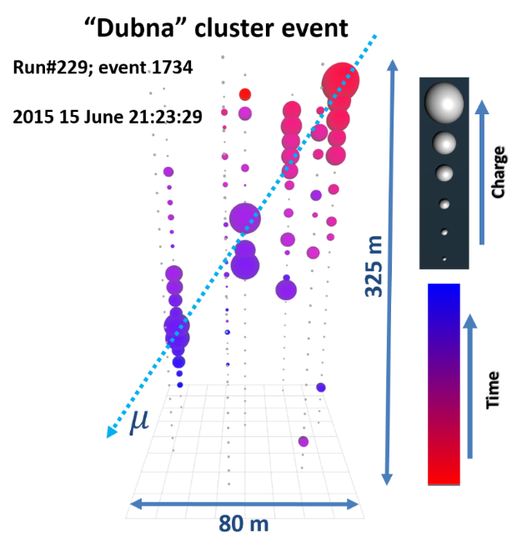
Baikal-GVD schedule
 | 2017 | 2018 | 2019 | 2020 | 2021 | 2022 | 2023
Clusters to install per year | 1 | 2 | 2 | 2 | 2 | 3 | 3
Clusters in the detector | 2 | 4 | 6 | 8 | 10 | 13 | 16
Optical Modules production per year | 600 | 600 | 600 | 600 | 900 | 900 | 900

Slide 22
∑ = 41 250 k$

Slide 23
Objectives in the field of neutrino physics and astrophysics:
– Establishing real cooperation between the Baikal GVD and other major experiments in this area (IceCube, KM3). Preparing the framework on exchange of data and algorithms, holding joint workshops, etc.,
– Defining the role of JINR in the implementation of the DUNE international project in the USA (jointly with CERN),
– Organizing JINR's participation in the SKA project (this refers, first of all, to the processing and storage of large amounts of data).

Slide 26
Provisional budgetary limit (sum of member fees)

Slide 28
Budget of the JINR: 2010-2016
М$
Plan
Actual Income
Notes:
Доходы бюджета ОИЯИ практически полностью формируются за счет взносов государств-членов. В соответствии с временной методикой взносы всех государств-членов на 2010-2016 годы увеличивались пропорционально величине роста расходов Института.
Уровень доходов бюджета планировался на основе плановых расходов бюджета ОИЯИ на 2010-2016 годы. Взносы государств-членов в 2010-2014 годах уплачивались практически полностью. Что касается 2015 года, то взнос Российской Федерации, доля которого составляет около 80% от суммы всех взносов, поступил в объеме, эквивалентном 98,9 тыс. долларов США (69 % от планового взноса), что было вызвано сложной экономической ситуацией в стране местопребывания Института. Заявка на выплату остатка средств по взносу РФ в ОИЯИ за 2015 год направлена в Министерство Финансов РФ, средства ожидаются к поступлению в бюджет в 2016 году.

Slide 29
Budgetary expectation for years 2017-2023
М$
Income
Member States contributions Yearly increase – 2,5% | 1 582,0
Expenses
Personnel | 615,0 | 42%
International Cooperation | 41,0 | 3%
Projects | 574,0 | 40%
Energy, Water etc | 55,0 | 4%
Operational Expenses | 160,0 | 11%
Intermediate Total | 1 445,0 | 100%
PP’s Grants and Joint Programs | 58,0
JINR’s Directorate Grants | 79,0
Grand Total | 1 582,0
29

Slide 30
Preliminary expectation of investments to Projects
М$
NICA | 211,4
DRIBs-III | 105,7
IBR-2 and spectrometers | 25,6
Neutrino Program | 55,5
IT | 17,7
Others | 48,0
Total investments | 463,9
Facilities M&O | 54,4
Infrastructure | 55,7
ВСЕГО | 574,0
30

Slide 31
Conclusions
JINR is keeping its multi-disciplinary approach for the next 7-years period.
2. The presented planning is based on the current vision of the JINR budget for years 2017-2023, proposed to the Committee of Plenipotentiaries by JINR Directorate and relies on the stable contributions of JINR’s Member States year by year. Security of the budget is of primary importance here.
3. Fresh young personnel (about 50+150 FTE) is highly required for services at SHE and NICA. The clear staff policy has to be implemented. Establishment of non-governmental pension fund at JINR has to be considered.

Slide 32

Thank You!

