Slide 1
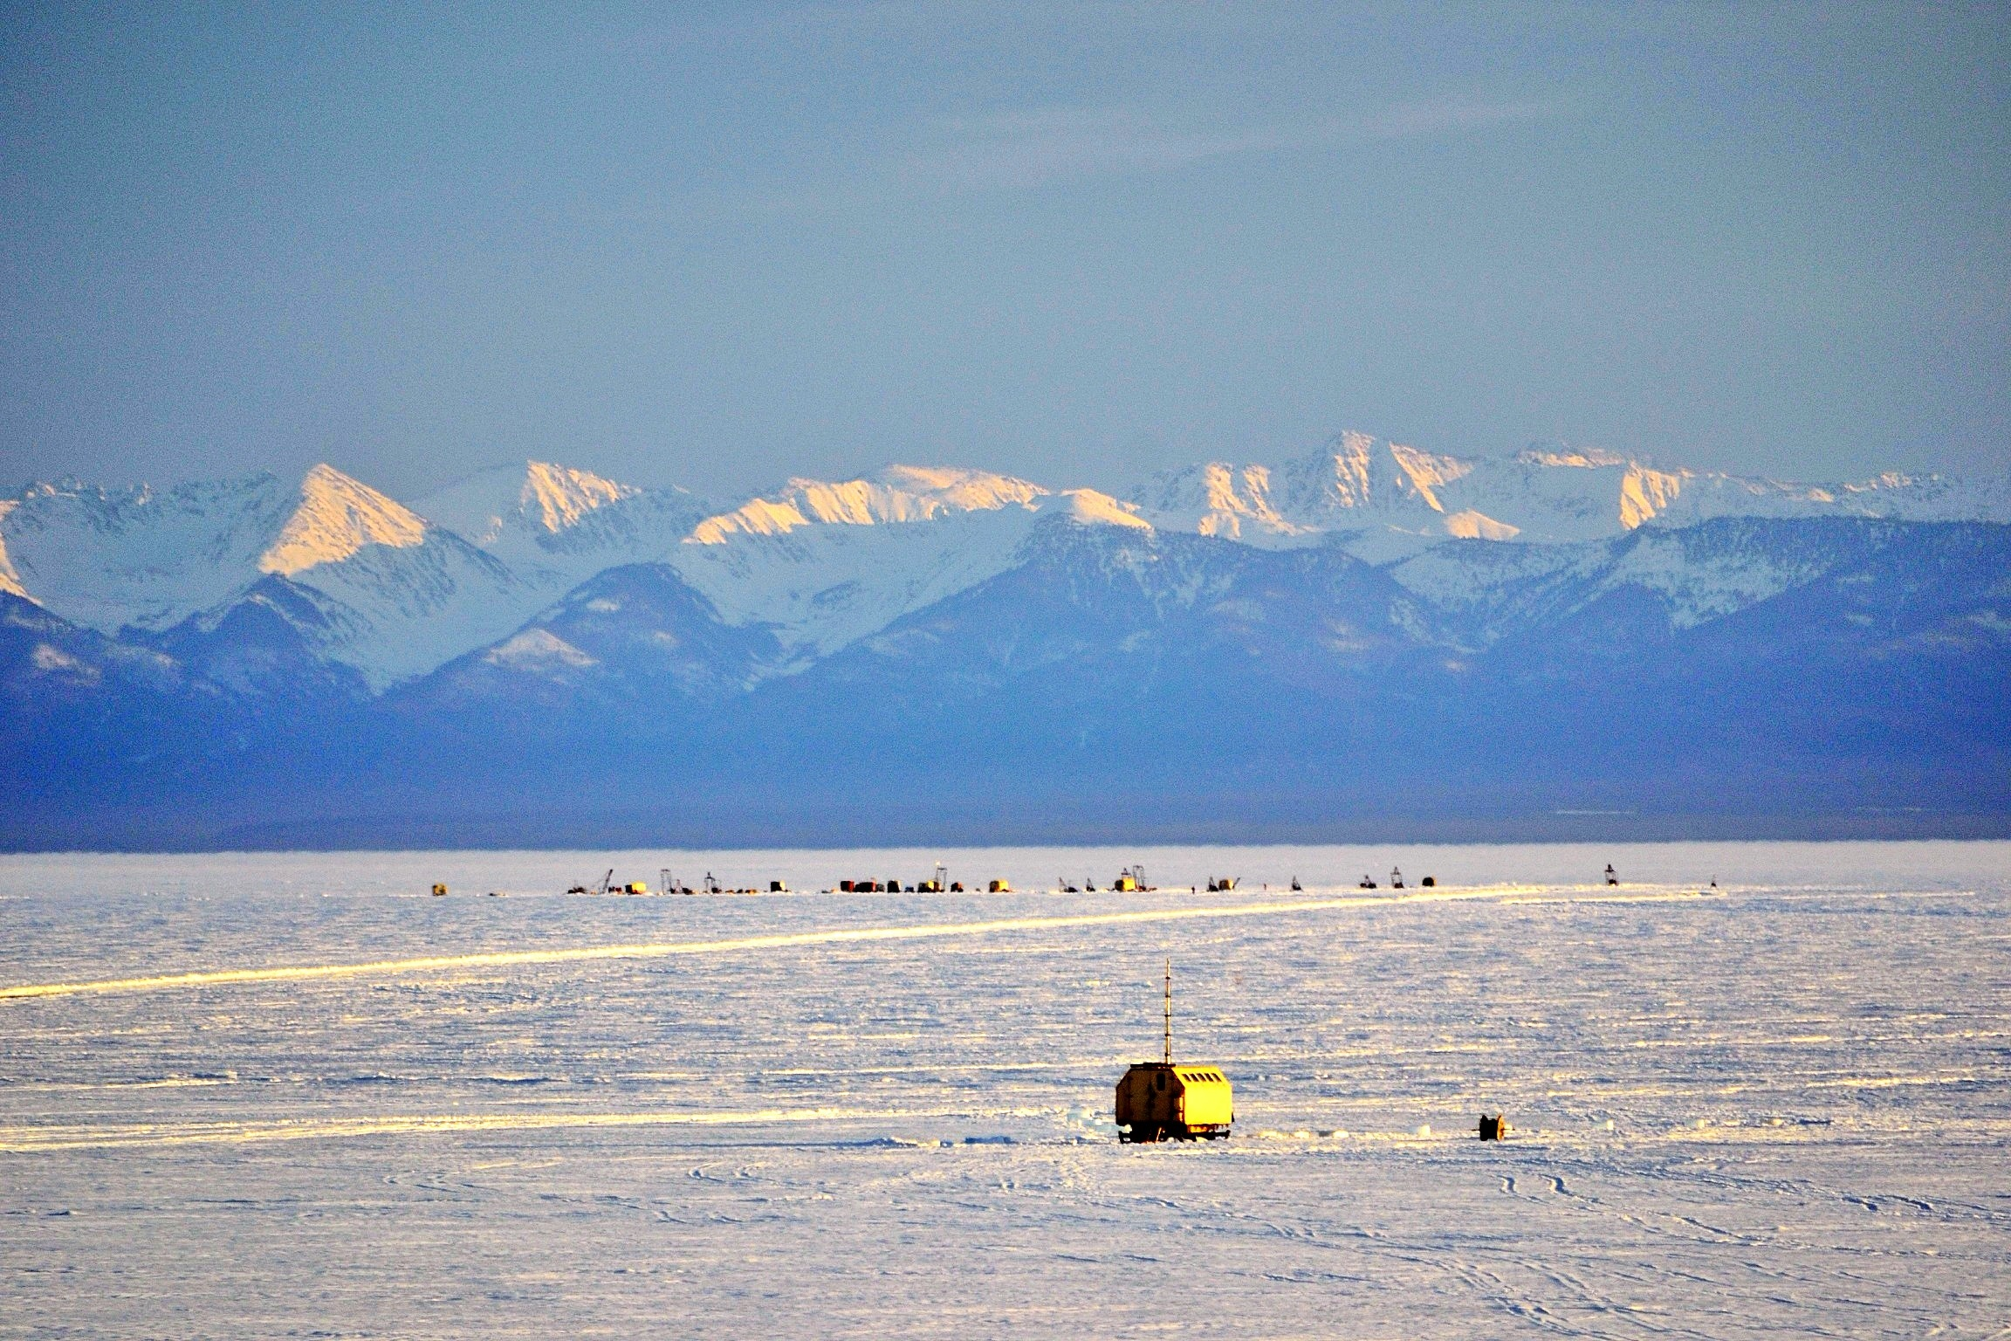
JINR neutrino program.
Baikal neutrino experiment: towards high-energy neutrino astronomy
Bair Shaybonov, LNP JINR
PAC for Nuclear Physics
25.01.2017

Slide 2
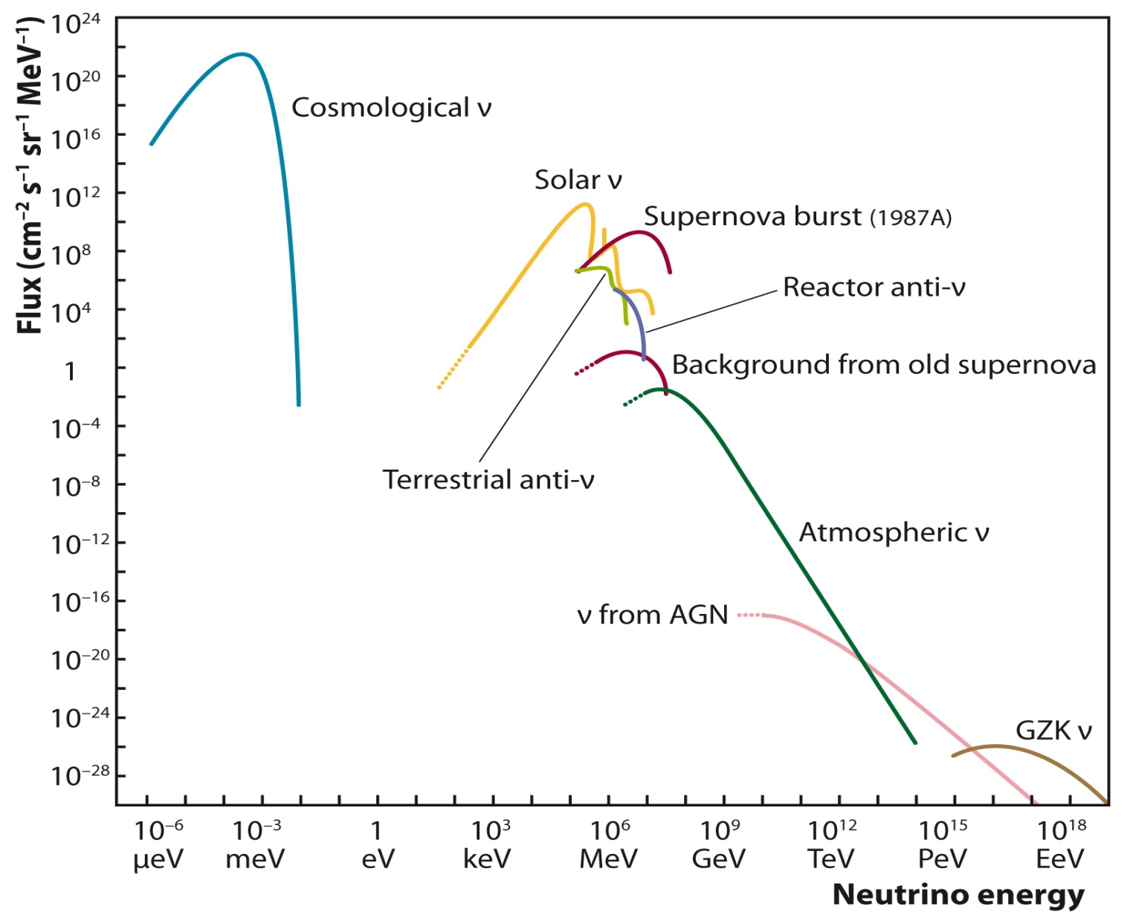
Neutrino sources

Slide 3
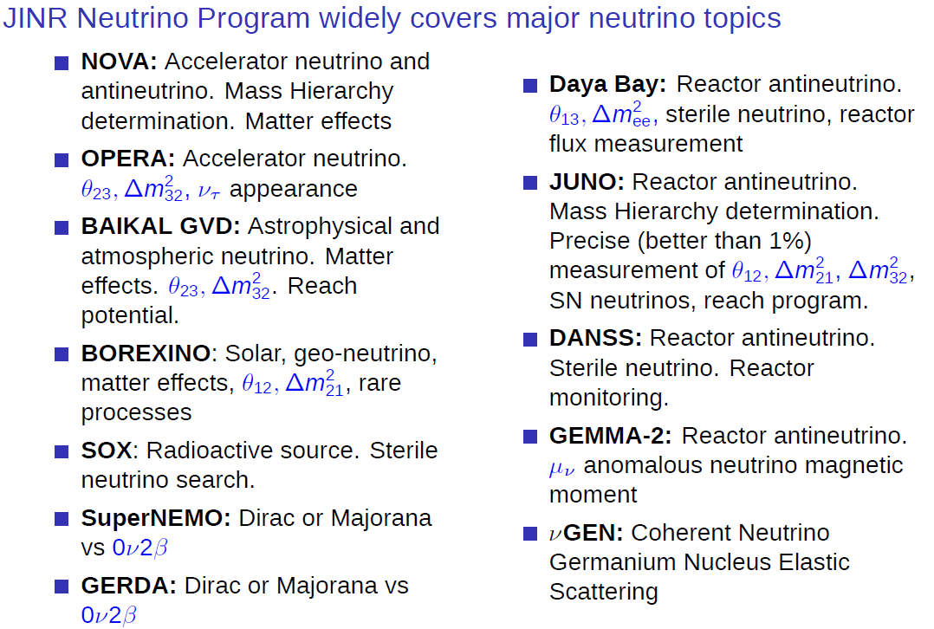

Slide 4
Baikal Collaboration
55 physicists and engineers
Institute for Nuclear Research, Moscow, Russia.
Joint Institute for Nuclear Research, Dubna, Russia.
Irkutsk State University, Irkutsk, Russia.
Skobeltsyn Institute of Nuclear Physics MSU, Moscow, Russia.
Nizhny Novgorod State Technical University, Russia.
Saint Petersburg State Marine University, Russia.
Institute of Experimental and Applied Physics, Czech Technical University, Prague, Czech Republic.
Comenius University, Bratislava, Slovakia.
EvoLogics, Berlin, Germany.

Slide 5
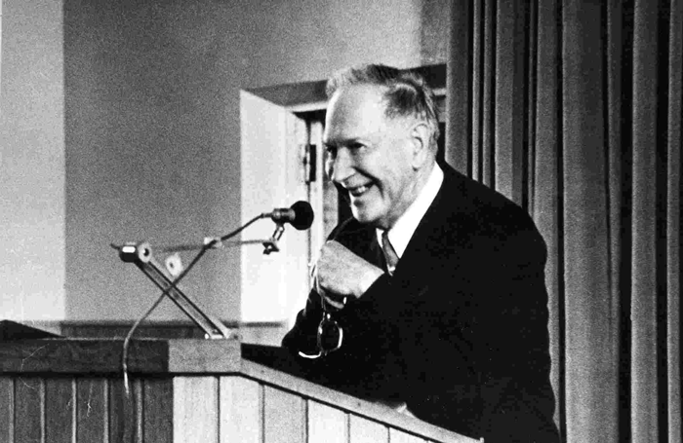
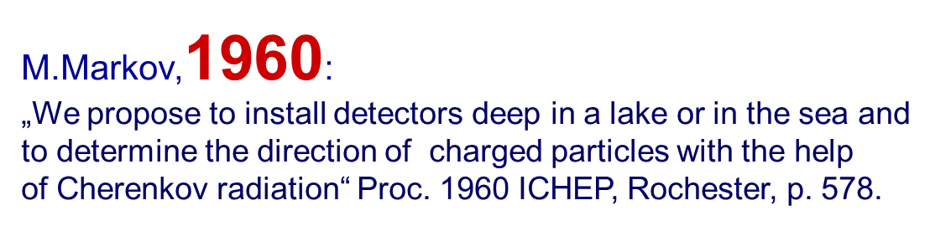

Slide 6
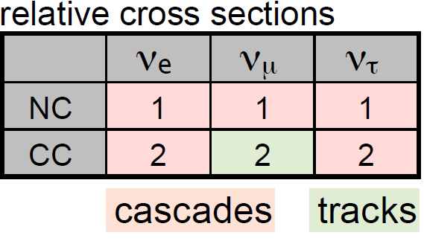











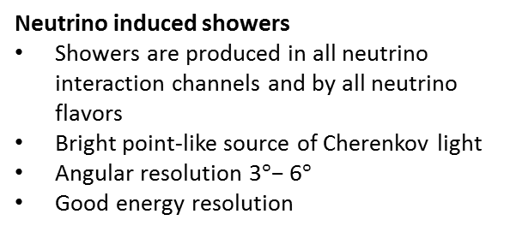
Neutrino detection principle
Neutrino induced muons
Long track in the detector
Good angular resolution 1◦
Neutrino interaction vertex can be located at several km from the detector
$$μ$$
Neutrino induced showers
Showers are produced in all neutrino interaction channels and by all neutrino flavors
Bright point-like source of Cherenkov light
Angular resolution $\text{3}°\text{− }\text{6}°$
Good energy resolution
$$μ$$
$$ν_{е, τ}$$
$$μ$$
10⁶ times larger
$$ν_{е,μ,τ}+N\underset{→}{NC}ν_{е,μ,τ}+N′$$
$$ν_{е, τ}+N\underset{→}{CC}е, τ+N′$$
$$μ$$
$${\overline{ν}}_{e}\left(6.3 PeV\right)+e^{−}→W− →hadrons$$
~1 km (200 GeV)
1:4.5
showers
$$ν_{μ}$$
3D array of photosensors
$$ν_{μ}+N\underset{→}{CC}μ+N′$$
muons
$$θ_{νμ}=1.5°/\sqrt{E_{ν}\left(ТэВ\right)}$$
Notes:
черенковское излучение

Slide 7
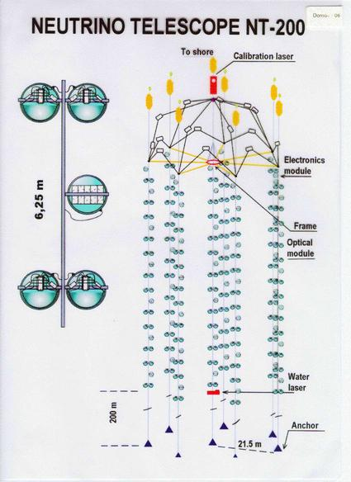
Pioneer detector NT-200: 1998
First fully reconstructed neutrino event by a detector installed in natural medium
First results with different stages of NT200
  Selection of first neutrino events
  Search for WIMP neutrinos from Earth
  Search for diffuse HE-neutrino flux
НТ-96
Fully reconstructed
neutrino event
(1996)

Slide 8
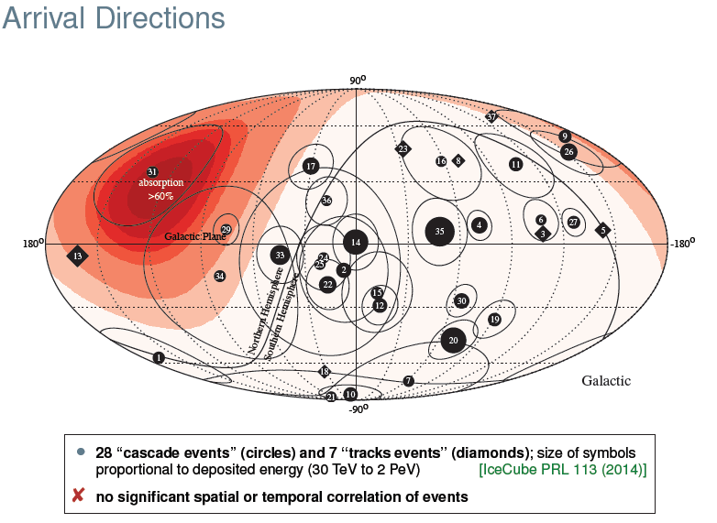
of IceCube astrophysical neutrinos
2013:

Slide 9

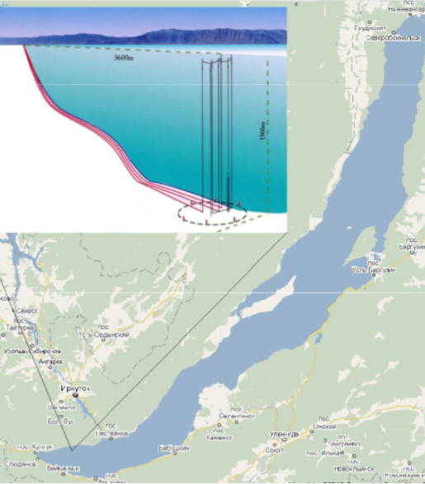
Baikal Site
Depth of 1366 m at only 3.6 km from shore
High deep water transparency (22 m) and low light scattering (30-50 m)
Fresh water
  simple mechanical constructions,
  no background from К⁴⁰
  no bioluminescence,
  chemiluminescence (1 photon background)
The most northern location allows observing neutrinos from the Galactic Center that propagate to the detector through the Earth 18 hours per day
Good infrastructure (railroad, power line)
Robust ice cover is an excellent deployment platform
  Simple deployment techniques

Slide 10


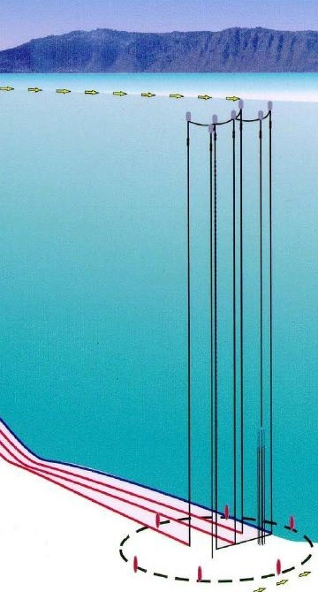
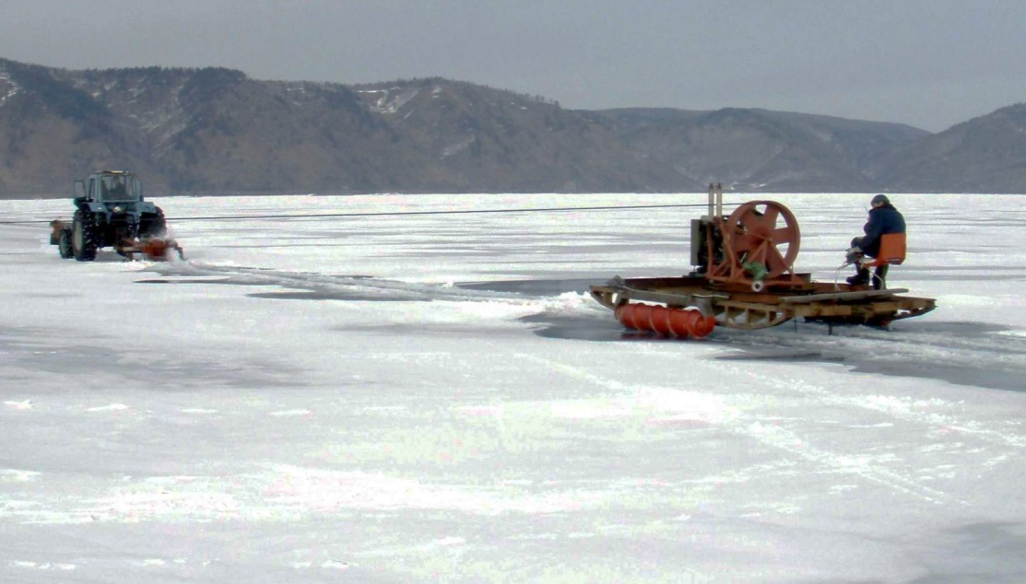

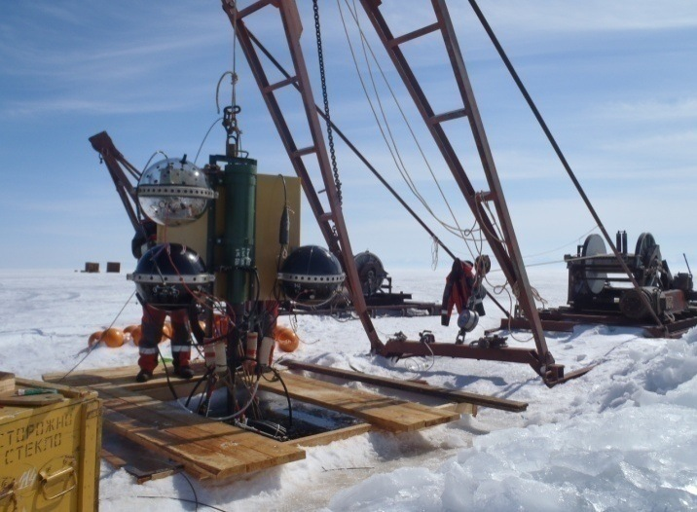
Detector deployment
Detector is easily accessible from the ice cover
Bed cable laying
Upper buoy is 25 m
below the surface
Detector deployment

Slide 11

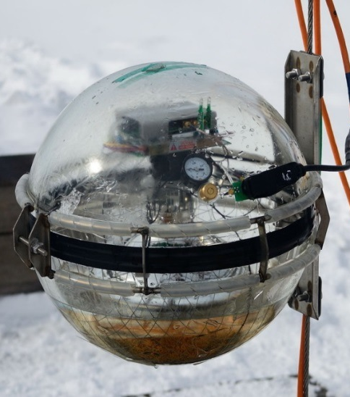
Optical Module
Optical module:
  10” Hamamatsu PMT R7081HQE, Qeff ≈ 0.35
  17” Glass pressure-resistant sphere VITROVEX
  Underwater 5-pin industrial SubConn connector
  OM electronics: amplifier, HV DC-DC, controller
  2 on-board LED flashers for calibration: 10⁸ p.e., 430 nm, 5 ns
  Mu-metal cage
  Elastic gel

Slide 12

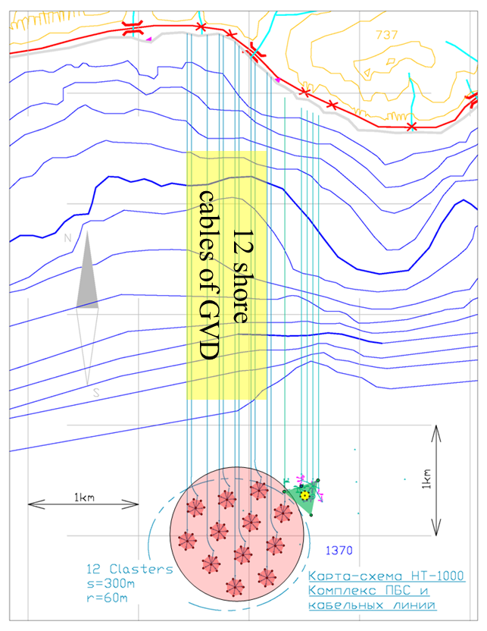
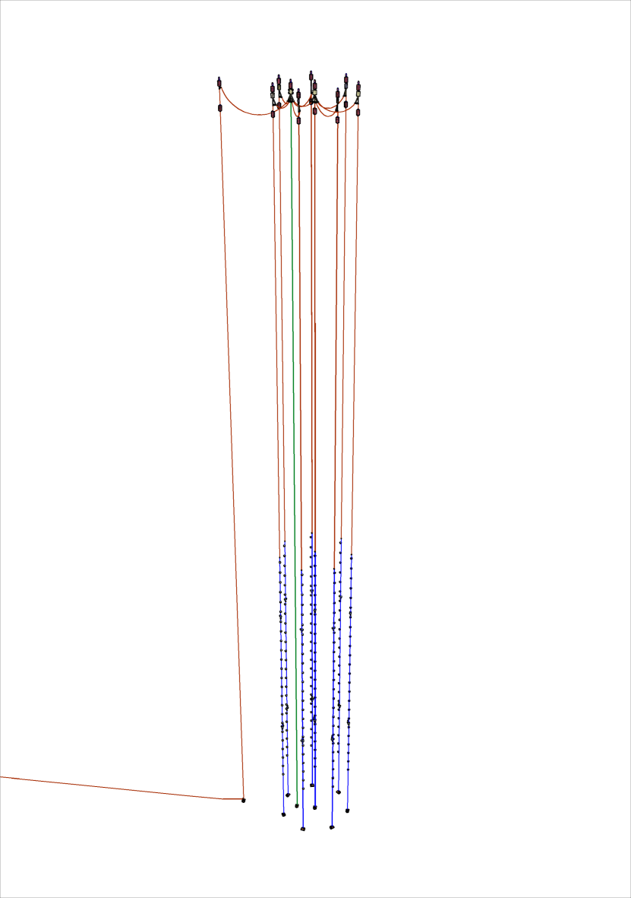
Baikal Gigaton Volume Detector
  2304 OMs
Two possible configurations (optimized for both muons and cascades):
  12 autonomous telescopes (clusters) at 300 m from each other with 350 m height (depths 925 – 1275 m). 192 OMs per cluster
  8 autonomous telescopes with a 525 m height (depths 750 - 1275 m). 288 OMs per cluster
  One bed cable for 2 clusters
4-6
Top view

Slide 13

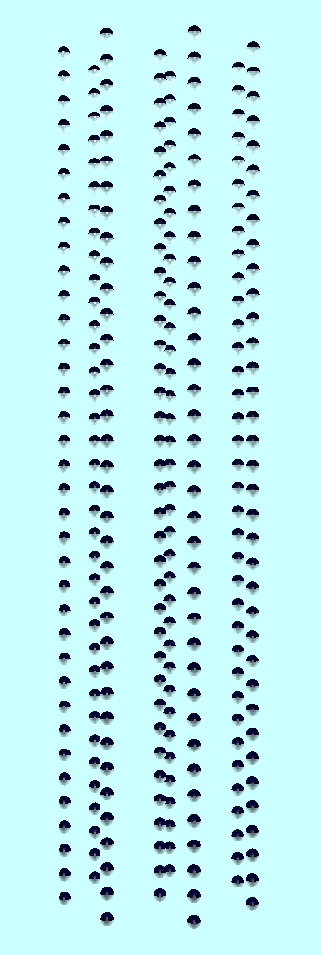
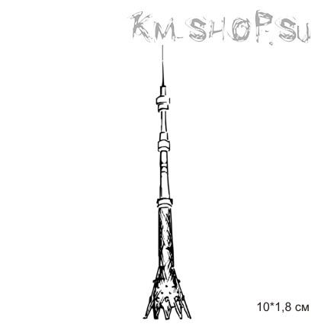
Future of the BAIKAL-GVD
~2300 OM (2020)
8 clusters
The Cluster
Taking data
since April 2016
750 m
300 m
NT-200(1998)
525 m
1250 m
~1 km
120 m
Notes:
Последовательное расширение НТ-36 (установки НТ-72, НТ-96, НТ-144) позволило в апреле 1998 года ввести в эксплуатацию установку НТ-200. Это первый в мире удачный опыт создания глубоководных установок такого масштаба. Еще до завершения строительства полного детектора были выделены первые события от нейтрино (НТ-36) и экспериментально показано, что детекторы подобного типа могут представлять собой нейтринные телескопы, восстанавливая по отклику установки направление прихода нейтрино (НТ-96).
Расширение установки в 2005 году на 36 фотоприемников (НТ200+), позволило увеличить в 4 раза эффективный объем установки в задаче поиска диффузных нейтрино.
Проект создания детектора BAIKAL-GVD (Gigaton Volume Detector) на озере Байкал является логическим продолжением и развитием исследований, проводимых в последние нескольких лет коллаборацией “Байкал”. Опыт постановки и эксплуатации НТ200/НТ200+ является надежной базой при создании нового детектора километрового масштаба.
В начале апреля 2015 года был запущен кластер «ДУБНА», который по размеру выше Эйфелевой башни. В апреле 2016 года будет запущен расширенный кластер, размеры которого будет уже превышать высоту останкинской телебашни.

Slide 14
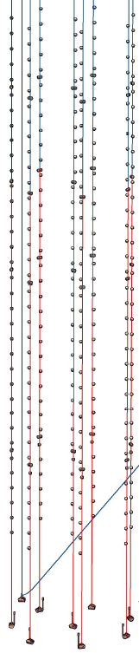
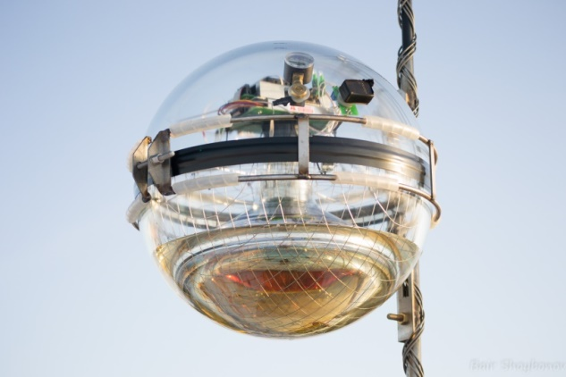
The Cluster 2016
Data taking since April 2016
288 OMs at 8 strings
  36 OMs per string, 15 m spacing
  depth 750 - 1275 m
  60 m between strings
Cluster DAQ center (30 m below surface)
  Trigger, power, data transfer systems of the cluster
Electro-optical cable to shore
Acoustic positioning system (4 beacons on each string)
3 calibration light beacons (matrix of LEDs)
  Interstring time calibration
525 m
120 m

Slide 15
Main Physics Goals
Galactic and extragalactic neutrino “point sources” in TeV – PeV energy range
Diffuse neutrino flux – energy spectrum, local and global anisotropy, flavor content
Transient sources (GRB, …)
Indirect search for Dark matter
Exotic particles – magnetic monopoles, Q-balls, …

Slide 16


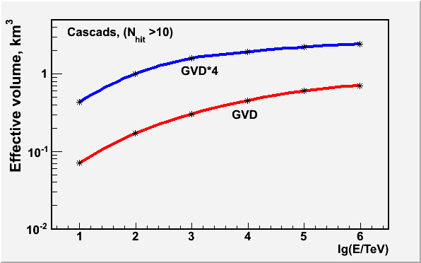
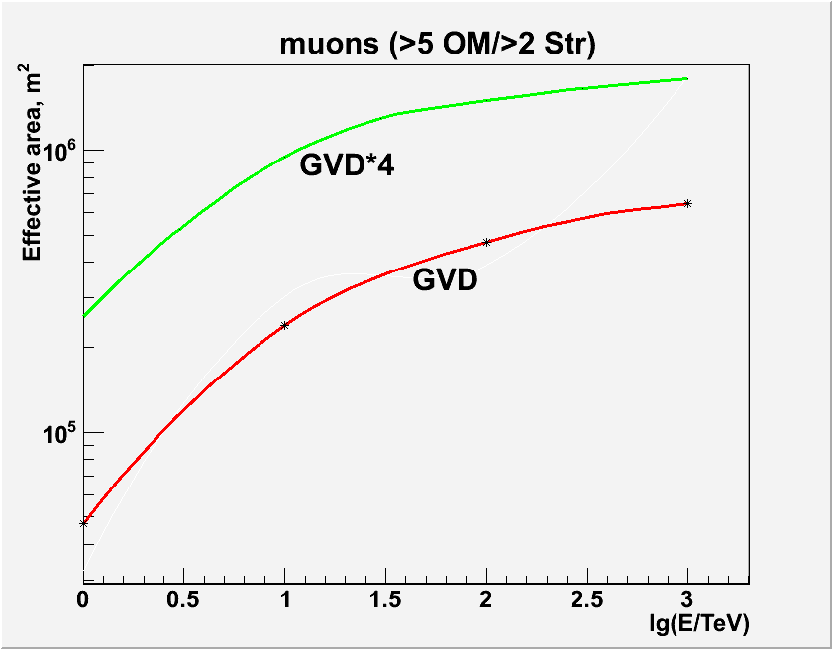


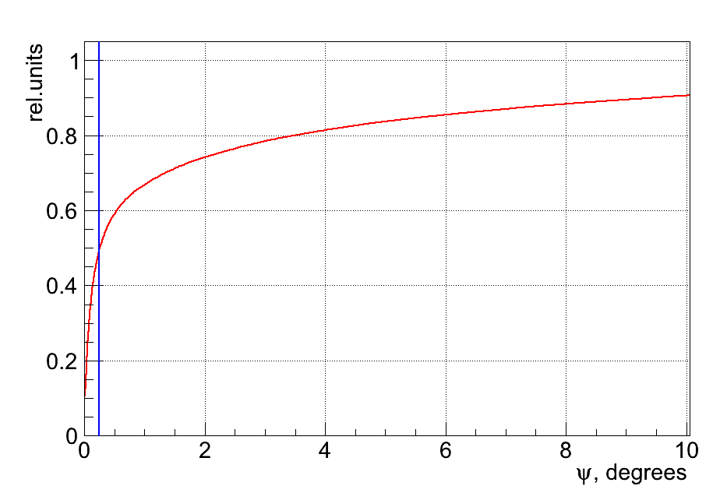
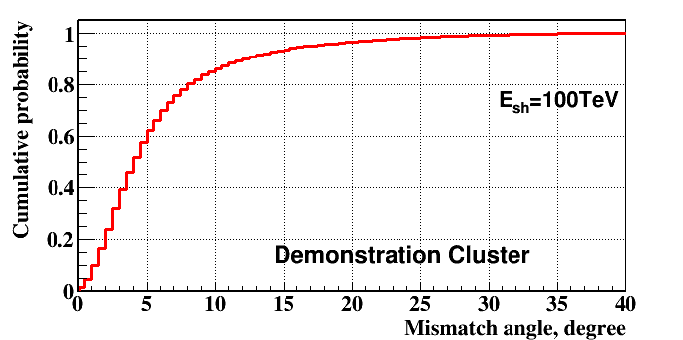
Baikal-GVD Performance
Effective area for muons E > 10 TeV: 0.2 - 0.6 km²
Effective volume for showers E > 100 TeV: ~0.2 - 0.6 km³
Nhit > 10
Angular resolution for muons: 0.25º
Angular resolution for showers: 3.5 - 5.5º

Slide 17
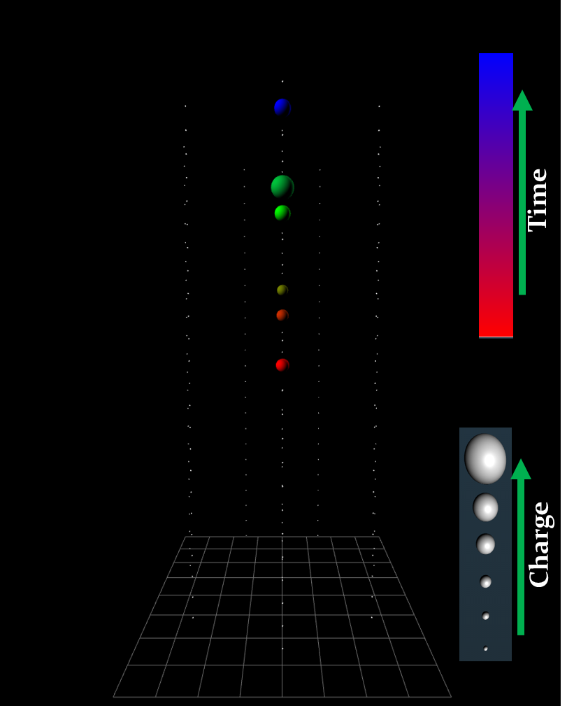
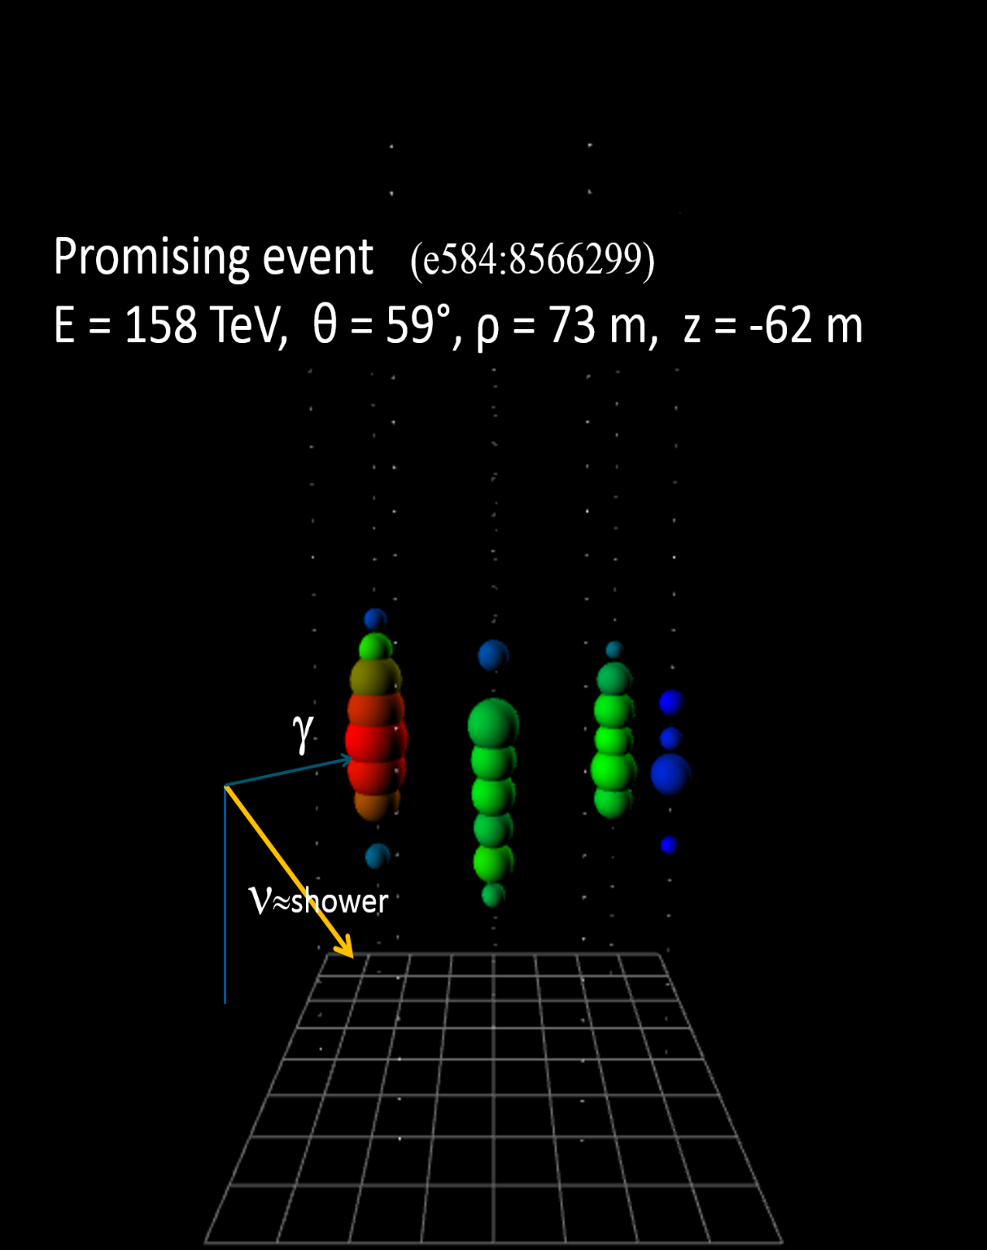
Cluster events
Upward going track event
Down going shower event
#11469229
Notes:
Примеры нейтринного (из-под горизонта) и каскадного событий, выделенные по данным кластера «Дубна».

Slide 18
Status of data analysis
Time and Amplitude calibration have been done
Raw data have been processed and events are prepared in automatic regime
Offline analysis software framework BARS is realized and widely used
Reconstruction and background rejection techniques are under development

Slide 19
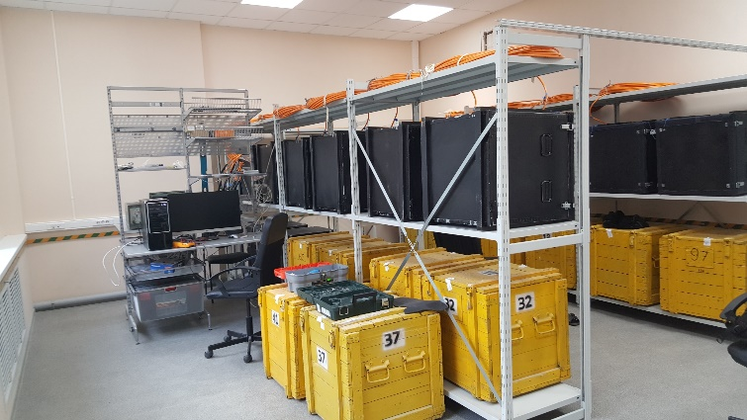
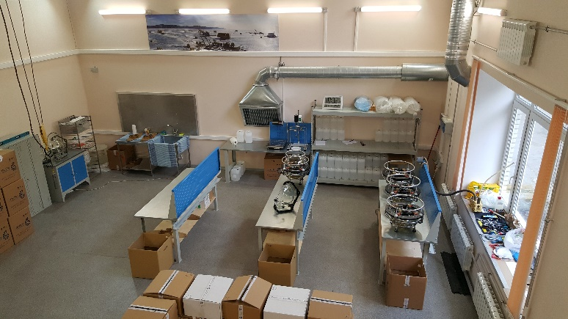
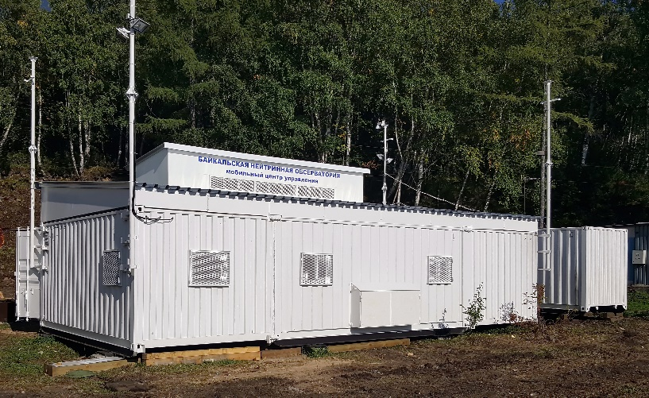
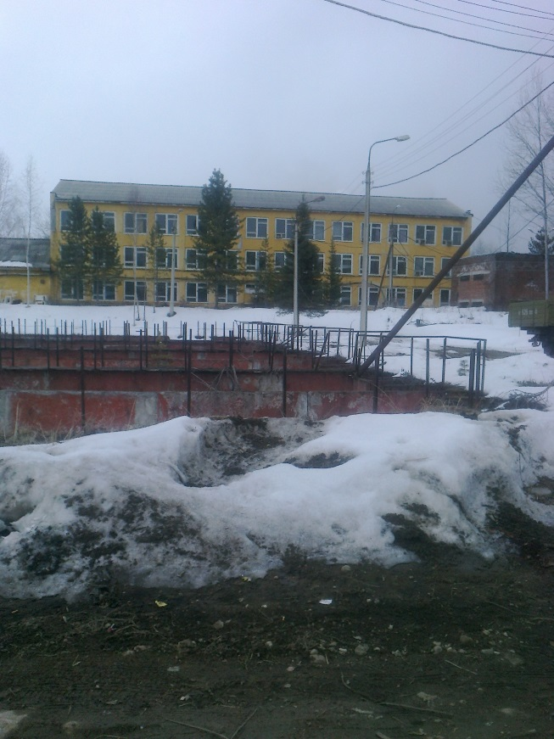
Infrastructure
New lab for long-term tests of the detector parts is operating in Dubna.
New OM production line started in Dubna.
The control center at the Baikal shore installed in August 2016.
The building in Baikalsk town is prepared as a local lab and OM storage
1
2
3
4

Slide 20
Baikal-GVD timeline
Cumulative number of clusters vs. year
Year | 2015 | 2016 | 2017 | 2018 | 2019 | 2020
Cluster 192 OMs | 1 192 | 1 192 | 3 576 | 5 960 | 7 1344 | 10 1920
Cluster 288 OMs | 2/3 192 | 1 288 | 2 576 | 4 1152 | 6 1728 | 8 2304

Slide 21
Conclusion
Baikal Collaboration has more than 30 years long an extensive positive experience on development, construction and operation of underwater facilities in lake Baikal
All elements and systems of the Baikal-GVD have been developed and tested in Lake Baikal.
The extended cluster with 288 OMs has started taking data since April 2016
Completion of the Baikal-GVD with 2304 OMs with about of 0.4 km³ effective volume for showers is expected in 2020

Slide 22
Thank you for attention!

