Slide 1
Web interactive 3D event display for MPD experiment at NICA collider
Alexander Krylov
Dubna/JINR
Email: avkrylov@jinr.ru

Slide 2
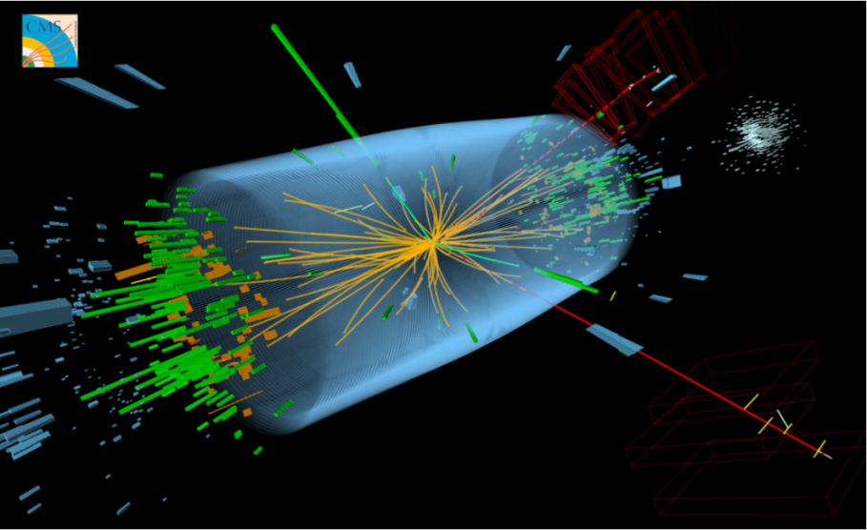
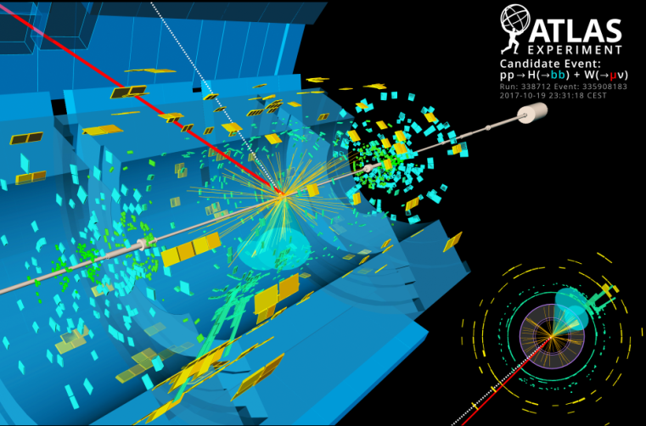
Event display in LHEP experiments
OpenGL based event displays
CMS (Frog)
ATLAS

Slide 3
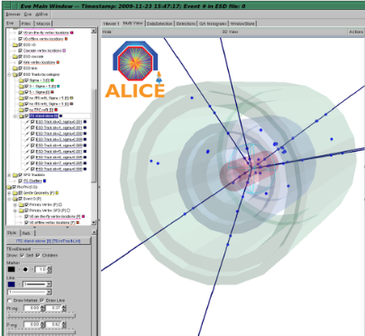
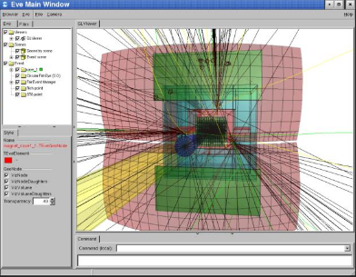
Event display in LHEP experiments
Root EVE (OpenGL) based event displays
CBM
Alice
Notes:
*Add advanteges and disadvantages*
Top picture from STAR, bottom left from ALICE, bottom right from CMS
Not sure what to add as a text maybe advantages and disadventages of ROOT based event display?
3

Slide 4
Technologies
JavaScript Engine V8
WebGL
ThreeJS library
NodeJS
React framework + Redux library
Notes:
4

Slide 5
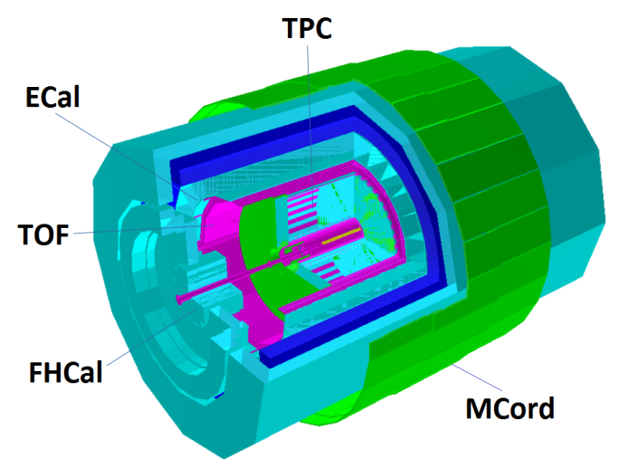
NICA — MPD experiment
First stage of MPD:
Time-Projection Chamber (TPC)
Time-Of-Flight detector (TOF)
Electromagnetic Calorimeter (ECal)
Forward Hadron Calorimeter (FHCal)
Muon detector (MCord)
1-st stage of Multi Purpose Detector (Geant geometry)

Slide 6
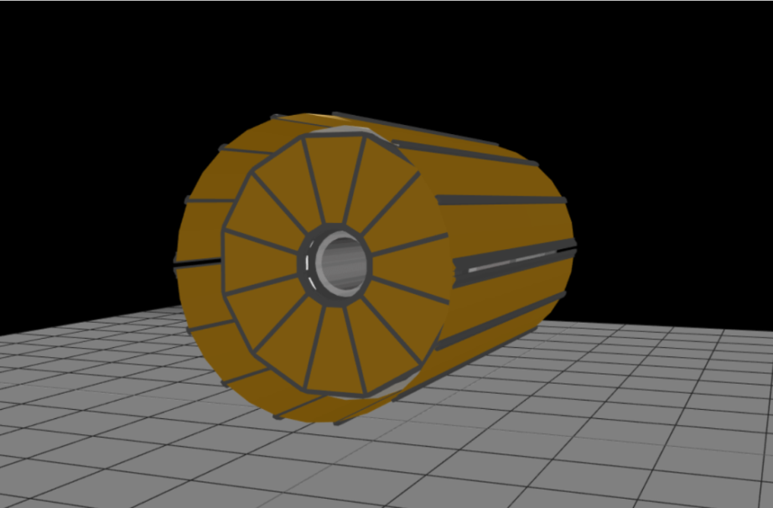
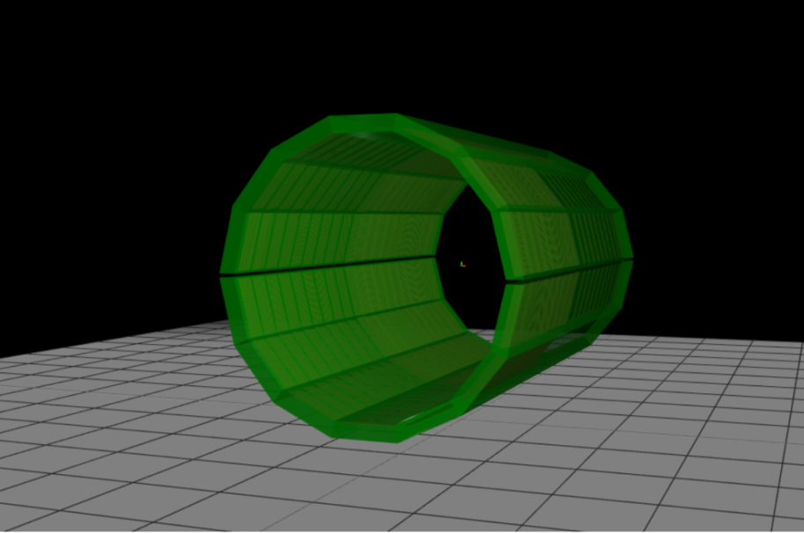
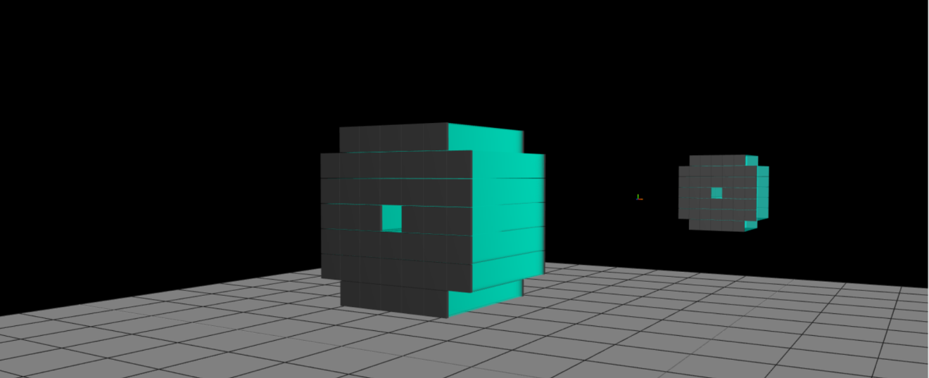
Detectors in Event Display
TPC
TOF
FHCal

Slide 7
TPC Elements
Notes:
7

Slide 8
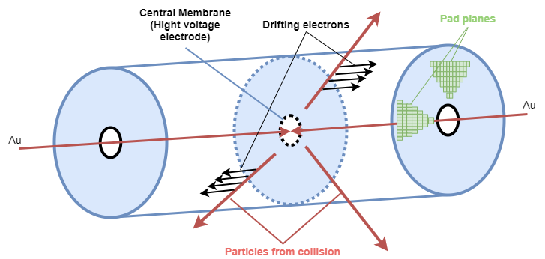
TPC working principle – data to visualize, MPD TPC parameters
3 types of data: Monte Carlo points, Reconstructed hits, pad signals
Length of the TPC | 340 cm
Length of the drift volume | 163 cm (each half)
Electric field strength | ~ 140 V
Magnetic field strength | 0.5 Tesla
Drift velocity | ~5.45cm/μs
Pad size | 5x12 mm² 5x18 mm²
Number of pads | ~ 97000
TPC workflow

Slide 9
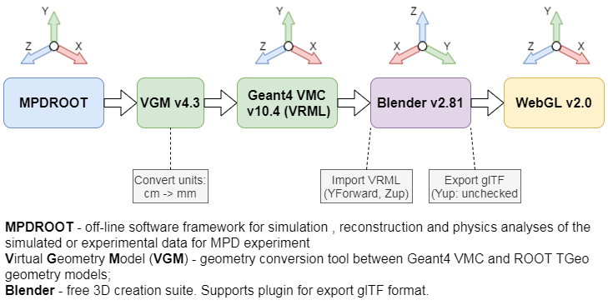
Geometry conversation scheme
VRML - Virtual Reality Modeling Language
glTF – Graphics Library Transmission Format
Notes:
*Change MPD ROOT v6.12 to MPDROOT*
9

Slide 10
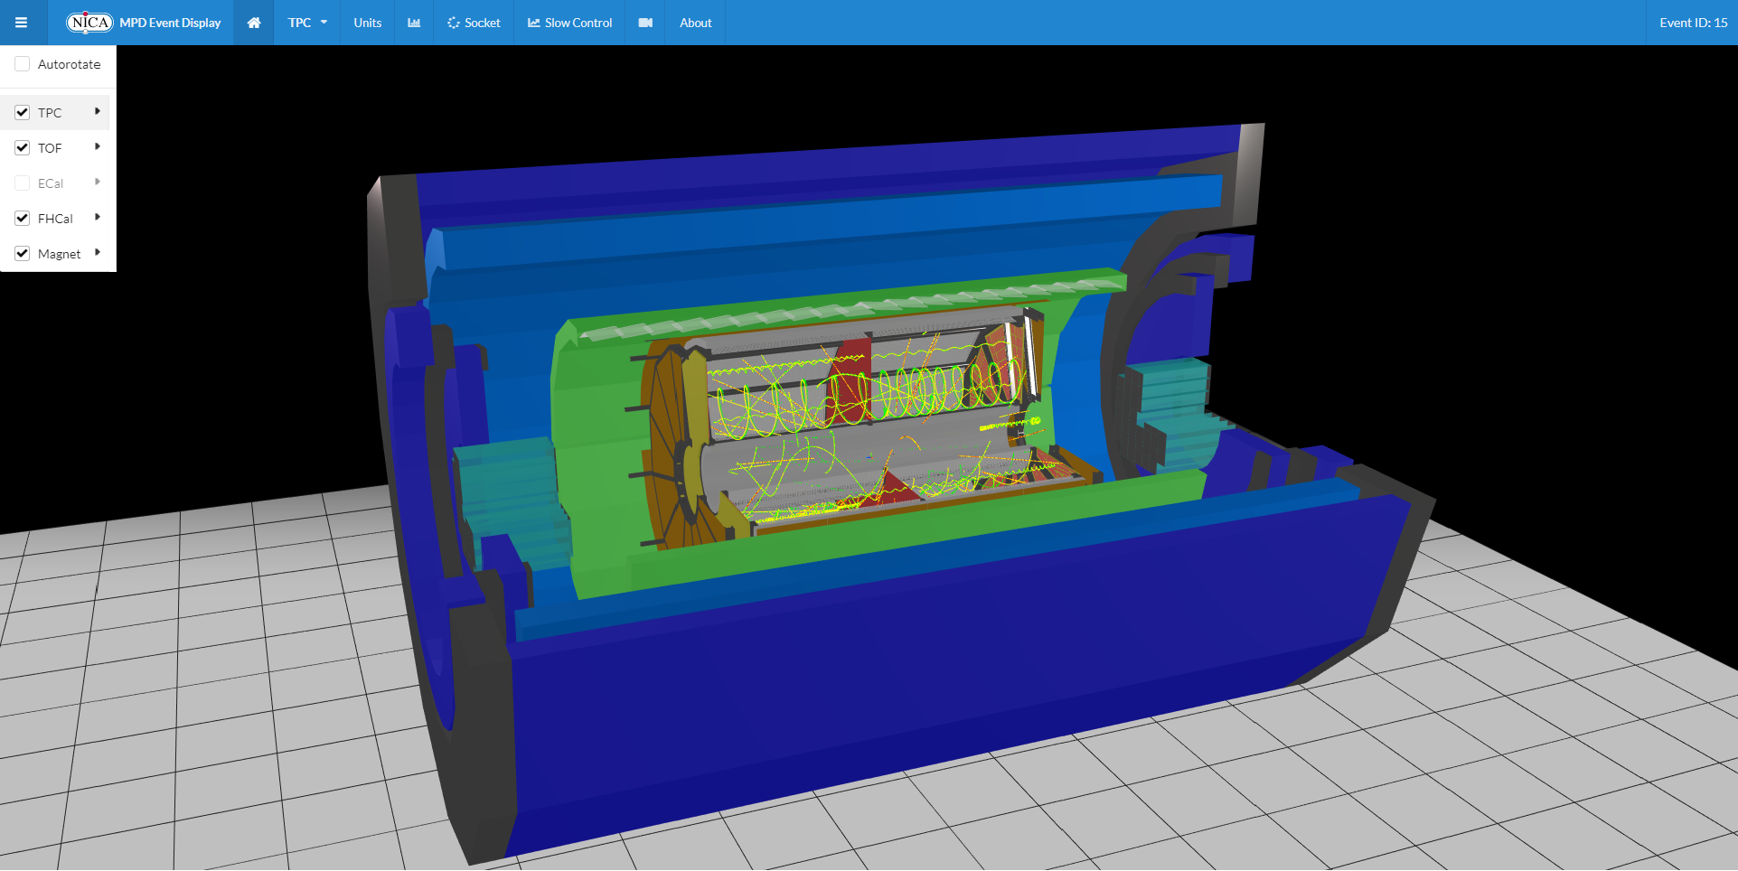
MPD Event Display
Notes:
*Add home event display screenshot or gif animation of all geometries*
10

Slide 11
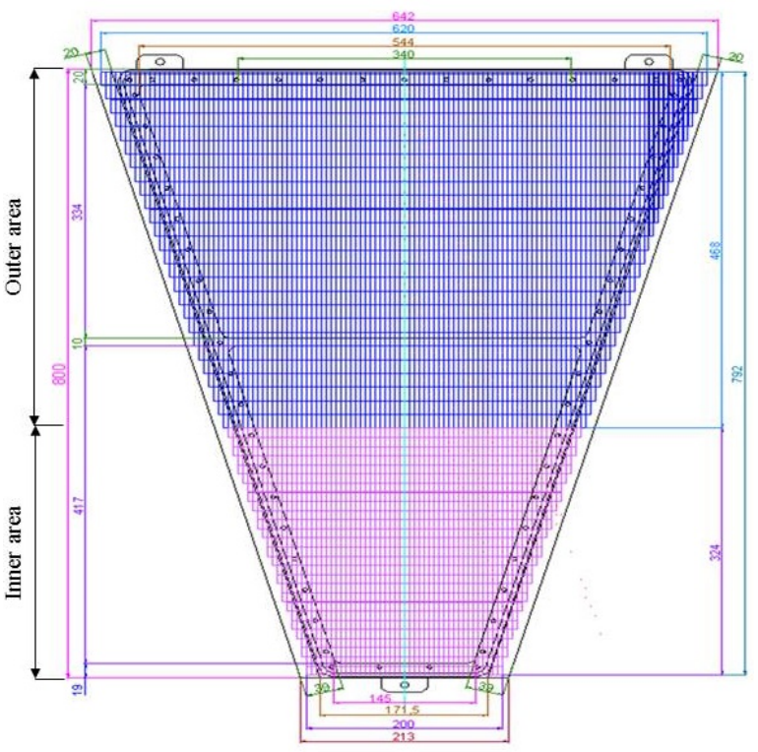
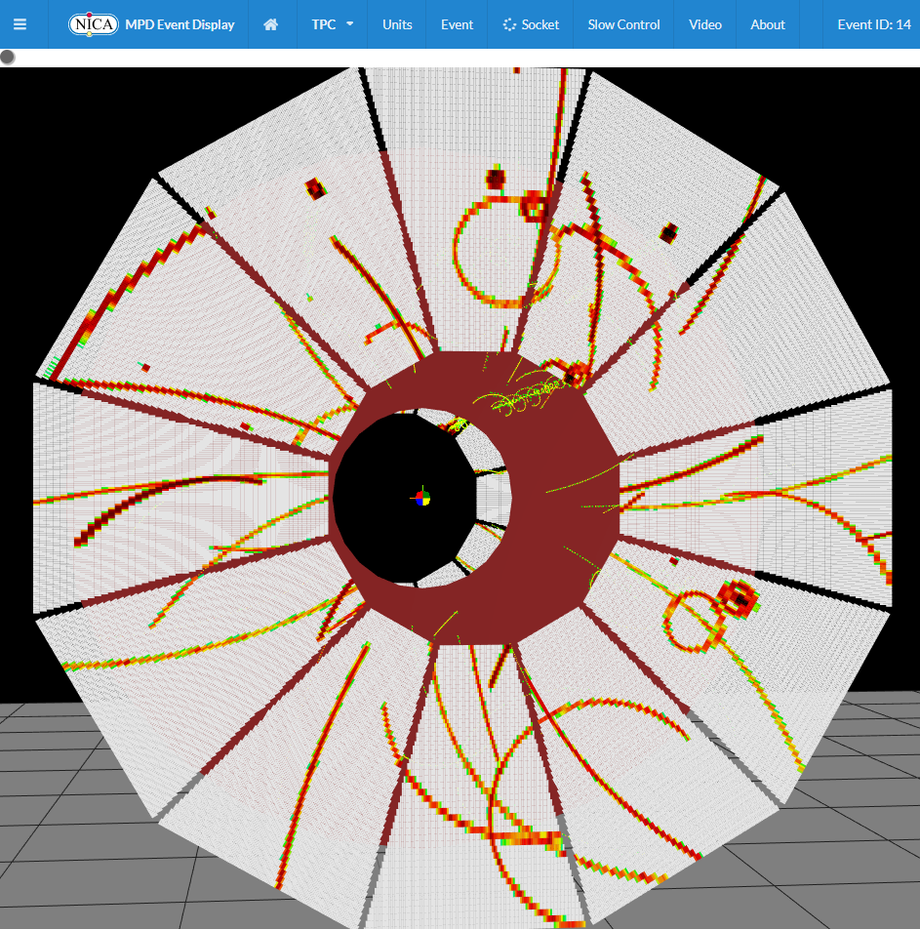
TPC Pads
Notes:
*Add number of polygons or number of volumes (~10^5)*
11

Slide 12
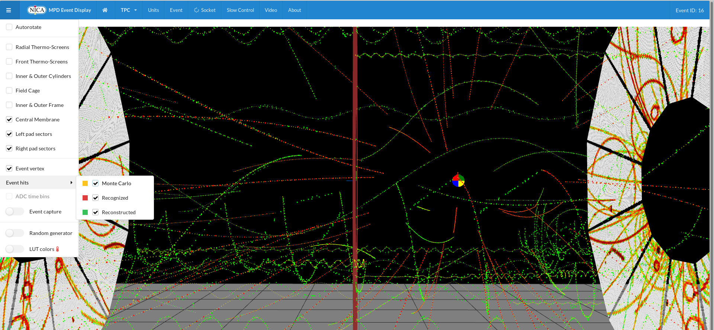
TPC tracking visualization in Event Display

Slide 13
Conclusion
Interactive web 3D event display for 1-st stage MPD experiment is ready to use and implemented into MPD software.
At the moment only TPC, TOF and FHCal geometries were added.
For TPC visualization of reconstructed hits, pad signals and tracks are available.
Event display for TPC is ready for testing with real response from TPC readout chamber.
Other detectors will be added soon.
Notes:
13

Slide 14
Thank you for your attention!
Development team:
O.Rogachevsky, V.Krylov, A.Krylov, A.Bychkov, V.Voronuk, A.Moshkin
The work is supported from RFBR grant №18-02-40102

