Slide 1



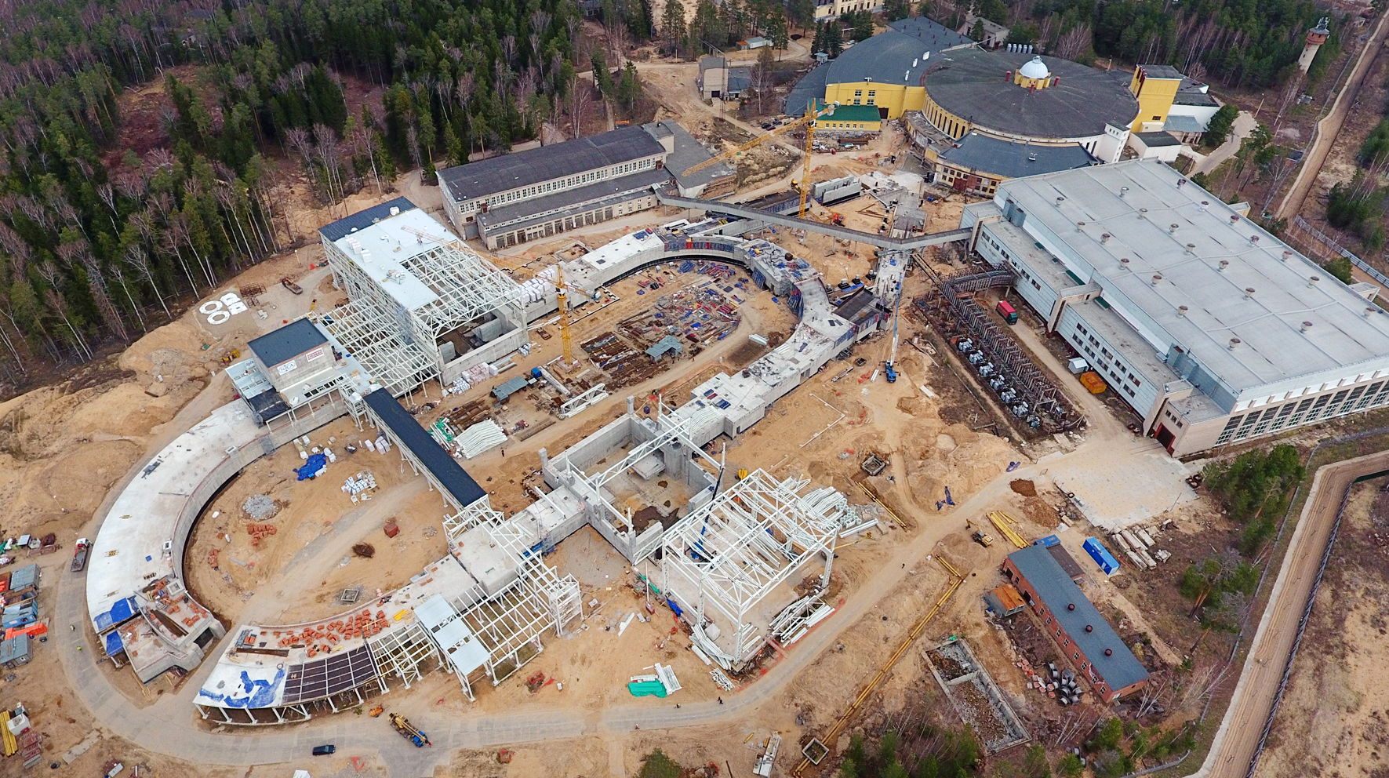
The Conference "RFBR Grants for NICA"
NICA Accelerator Complex
the Megaproject “Nuclotron-based Ion Collider fAcility”
Grigory Trubnikov
(with I.Meshkov, S.Kostromin, A.Butenko)
for the NICA Team
Joint Institute for Nuclear Research
Dubna, Russia, 20 Oct 2020

Slide 2
1. Goals for Experimental Research of the NICA Project
We intend to study extremely dense and hot baryonic matter
and wish to try to understand the nature of particle spin.
2. Stages of The NICA Accelerator Complex
Stage Ia: Heavy ion beam for fixed target experiment
“The Baryonic Matter at Nuclotron” (BM@N) 2021
Stage Ib: First heavy ion colliding beams at reduced luminosity
for the MPD test and very first experiments
Stage II: Heavy ion colliding beams of the design luminosity
for search for the Mixed Phase and New Physics
Stage III: Polarized p↑ & d↑ сolliding beams of the NICA Collider
Stage I 2022

Slide 3
2. Stages of The NICA Accelerator Complex: Summary
The last quad
December 23, 2019
Structure and Operation Regimes
Stage II 2024 - 2027
Linac HILac
KRION
Booster (25 Tm)
Storage of
(2 ÷ 4)×10⁹ ions,
acceleration
up to 580 MeV/u
Ion sources
Linac LU-20
Fixed Target Area
BM@N
2019
Stage Ia
Stripping (80%) ¹⁹⁷Au³¹⁺ => ¹⁹⁷Au⁷⁹⁺
Stage III
CDR in progress
Nuclotron (45 Tm)
Injection bunch
~ 2×10⁹ ions
acceleration up to
1 - 3.8 GeV/u
IP-2
Two SC collider rings
~ 2 x 22 injection cycles
22 bunches per ring
IP-1
Stages Ib and II

Slide 4
2. Stages of The NICA Accelerator Complex
Why do we need a booster-synchrotron?
1. The main reason: low charge state of ion generated in the injector chain KRION – HILAc (e.g. ¹⁹⁷Au⁷⁹⁺). Ion stripping to bare state requires sufficient ion energy. In NICA case it is 600 MeV/u.
The bare ion state allows one to accelerate them up to max. energy achievable at Nuclotron (3.8 GeV/u for Au nuclei).
2. The Booster allows us to store ions at injection energy (multiple injection).
Application of electron cooling at medium ion energy
(60 MeV/u for NICA booster that is well developed cooling technology) provides a small 6D emittance of the ion bunch at rather high its intensity.

Slide 5
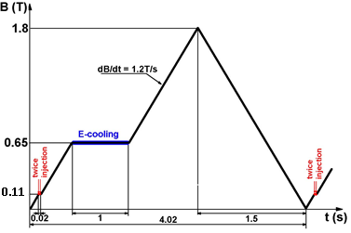
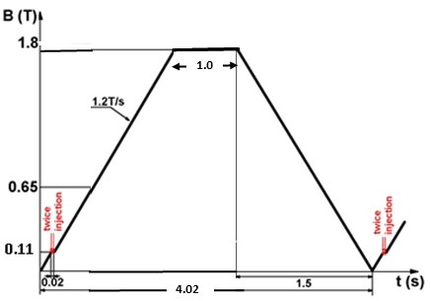
2. Stages of The NICA Accelerator Complex
Stage Ia
Booster: Bρ = 25.0 T⋅m
E_{max} = 0.6 GeV/u for ¹⁹⁷Au³¹⁺
Ion bunch max. intensity 2e9
Nuclotron: Bρ = 38.5 T⋅m, E_{max} = 3.8 GeV/u for ¹⁹⁷Au⁷⁹⁺,
Fixed target experiment Au×Au √s = 3.275 GeV/u
Ion bunch max. intensity 1e9
Average ion flux to the target 3.6e8 1/s
Booster cycle Nuclotron cycle at BM@N experiment
Slow extraction 1-10 sec.

Slide 6
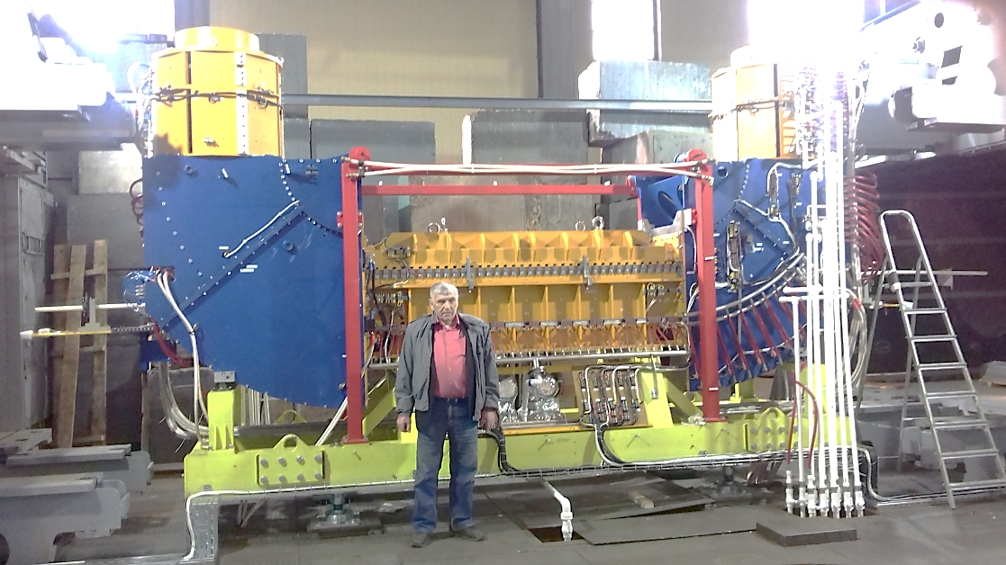
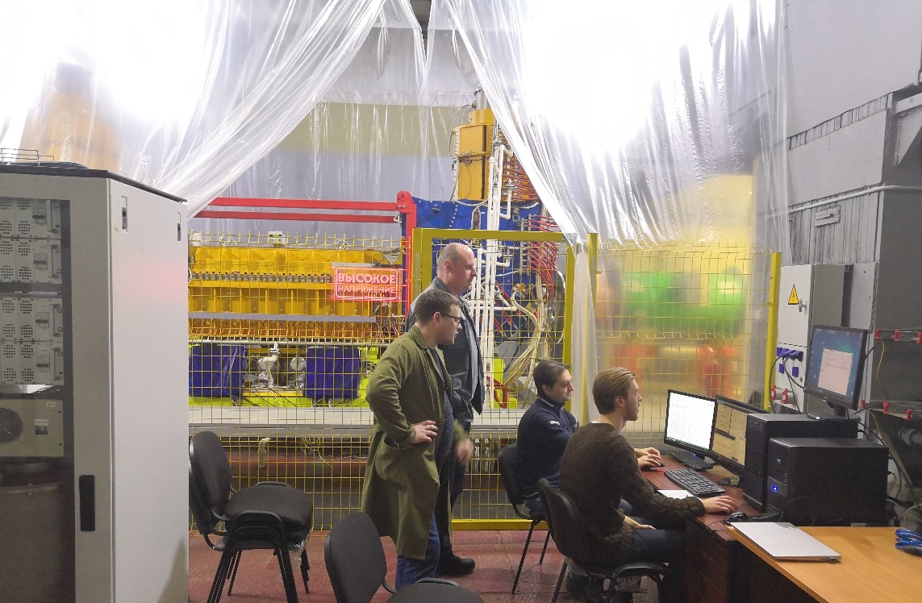
2. Stages of The NICA Accelerator Complex
Stage Ia
Electron cooling system at the Booster
Budker INP (Novosibirsk) is the Birthplace of the electron cooling method and well known “fabric” of electron coolers. E-coolers both for the Booster and for the Collider are designed and fabricated at BNP.
Parameter | Value
Ions to be cooled | p => ¹⁹⁷Au³¹⁺
Electron energy, keV | 1.5 – 50
Beam current, Amp | 0.2 – 1.0
Cooling section length, m | 1.9
Field ripples, ΔB/B on 15 cm | ≤ 3⋅10⁻⁵
NICA team studying e-cooler
V. Parkhomchuk – Father of e-coolers for NICA and for many other projects...

Slide 7
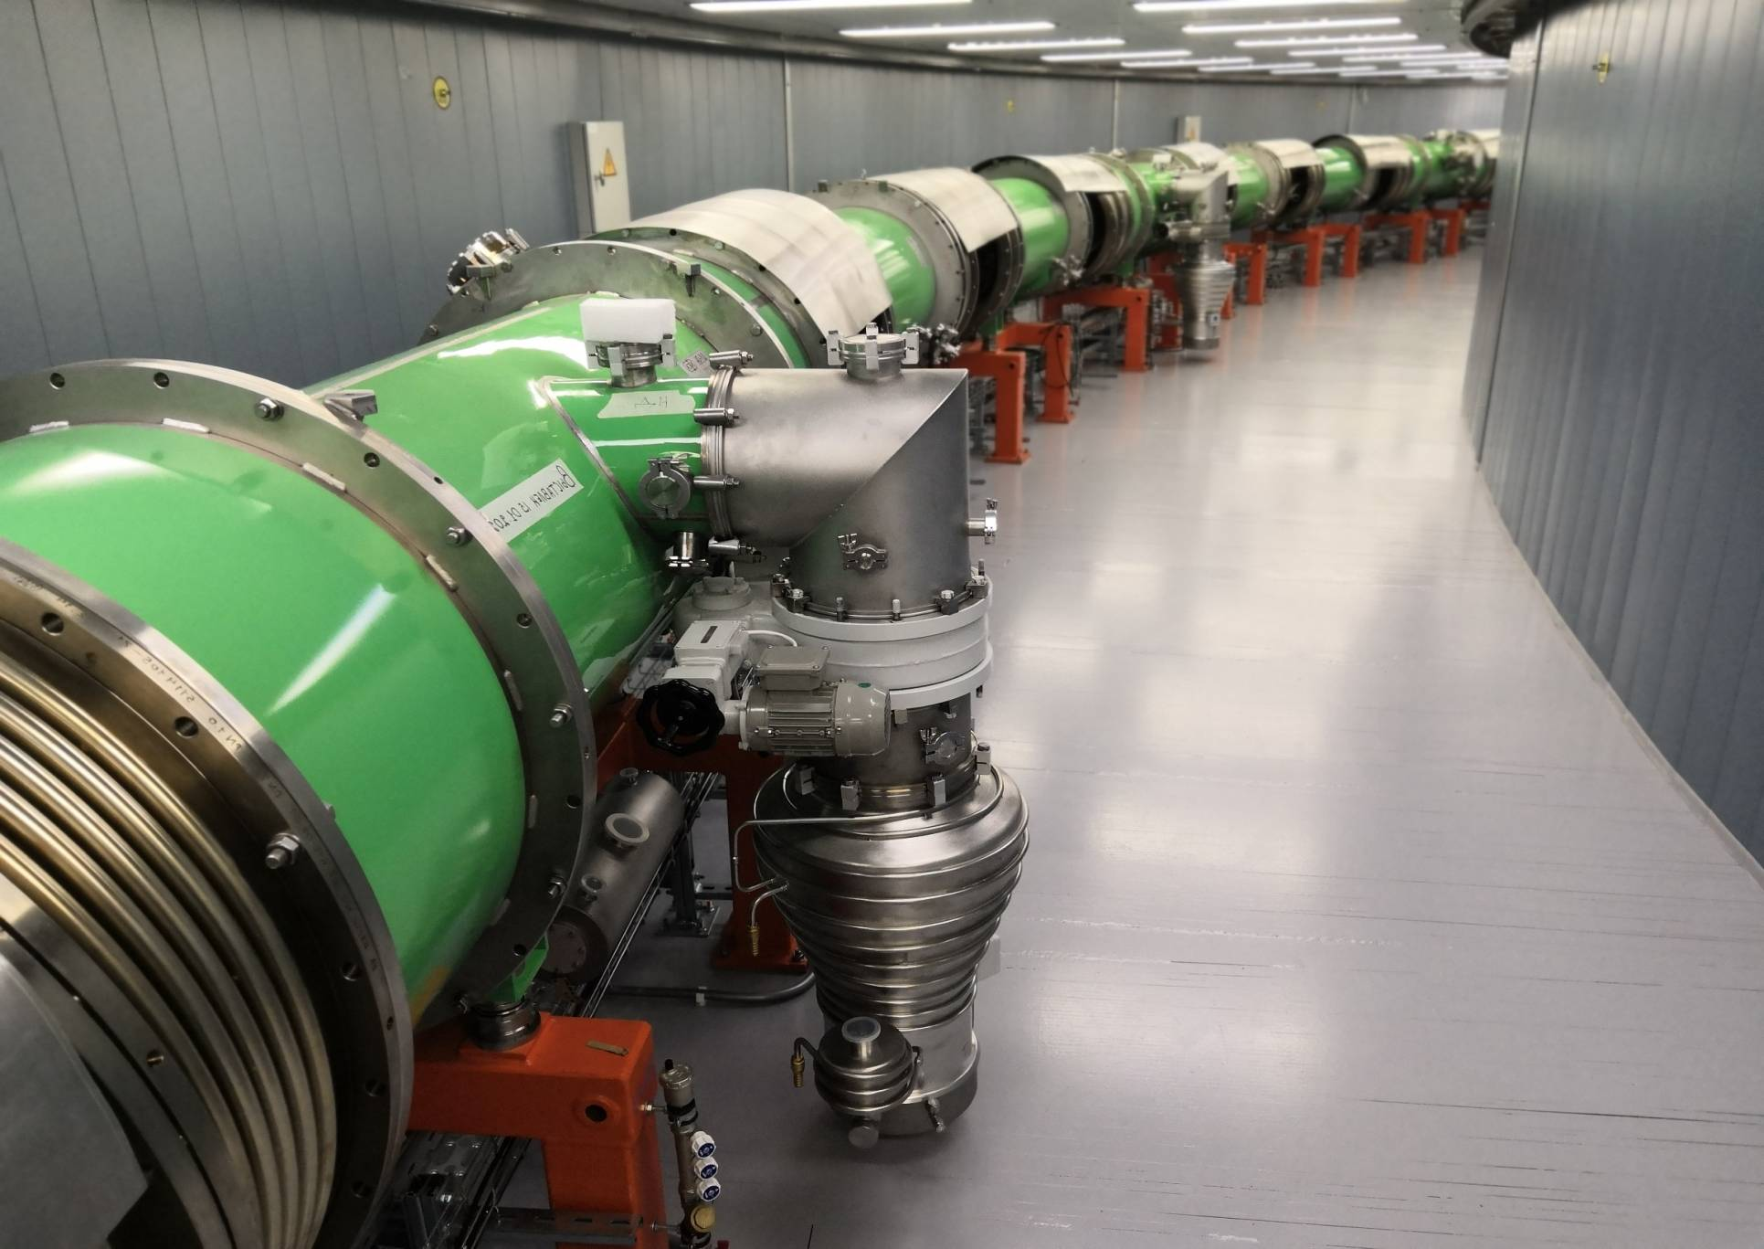
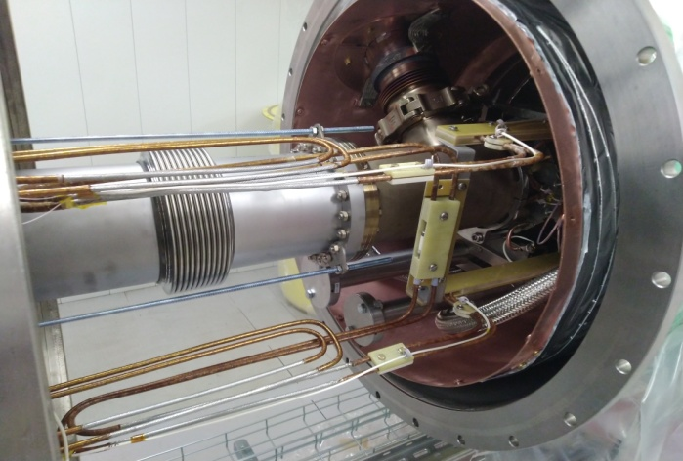
Booster sc-magnets system
all magnets in the tunel
95% connected
ring He-system
assembled 95%, tested 50%
beam pipe 55%
7

Slide 8
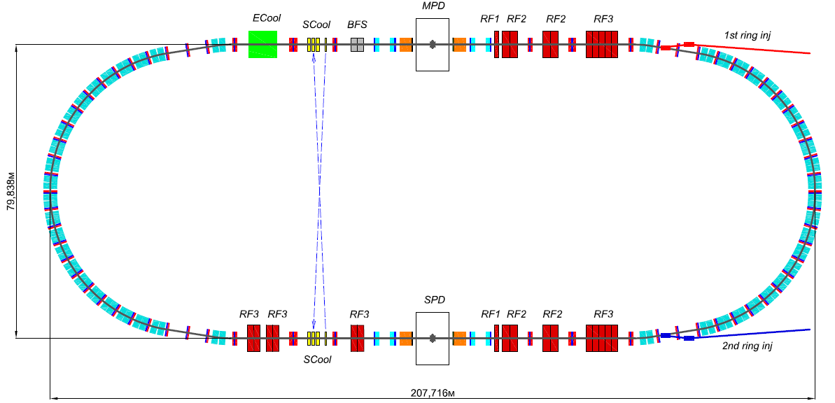
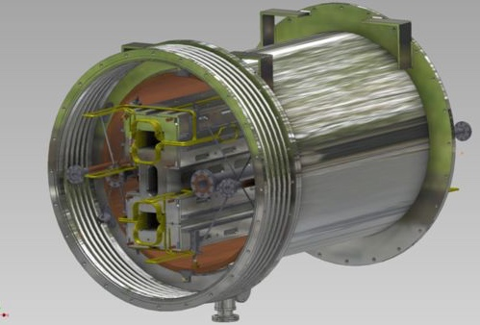
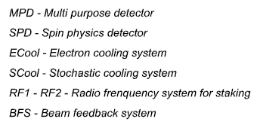
NICA Collider
8

Slide 9
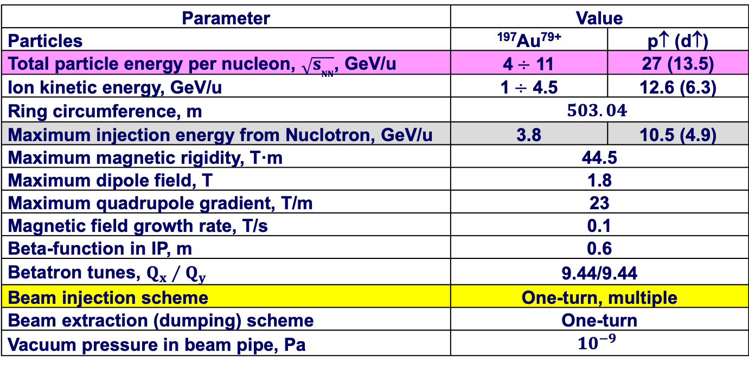
3. Strategy of The Project Luminosity Achievement
NICA Collider General Parameters
Parameter | Value
Particles | ¹⁹⁷Au⁷⁹⁺ | p↑ (d↑)
Total particle energy per nucleon, $\sqrt{s_{NN}}$, GeV/u | 4$÷$ 11 | 27 (13.5)
Ion kinetic energy, GeV/u | 1$÷$ 4.5 | 12.6 (6.3)
Ring circumference, m | $$503.04$$
Maximum injection energy from Nuclotron, GeV/u | 3.8 | 10.5 (4.9)
Maximum magnetic rigidity, T·m | 44.5
Maximum dipole field, T | 1.8
Maximum quadrupole gradient, T/m | 23
Magnetic field growth rate, T/s | 0.1
Beta-function in IP, m | 0.6
Betatron tunes, $Q_{x}⁄Q_{y}$ | 9.44/9.44
Beam injection scheme | One-turn, multiple
Beam extraction (dumping) scheme | One-turn
Vacuum pressure in beam pipe, Pa | $${10}^{−9}$$
Reducing beta-function at IP up to 0.35 m is possible and will be tested at commissioning
of the Collider. Working point Q_{x}/Q_{y} = 9.1/9.1 is foreseen as well.

Slide 10
3. Strategy of The Project Luminosity Achievement
To have a high luminosity we need:
1. An intense ion beam stored in the collider;
2. Application of electron and/or stochastic cooling at the beam storage;
3. Formation of a stored coasting beam of a small transverse emittance by the cooling application;
4. Formation of a bunched beam with the bunch length
σ_{b} ≤ 60 cm;
5. Application of the ring focusing structure with beta-function values at interaction points (IP) β* ≤ σ_{b} (to minimize so called hour-glass effect).
All the conditions are to be met in a collider.

Slide 11
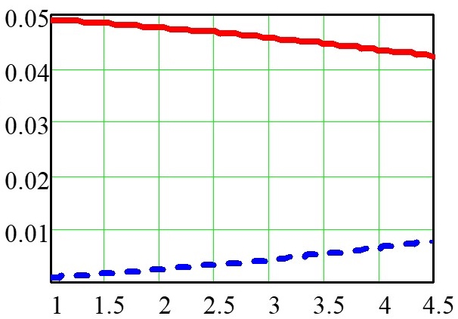
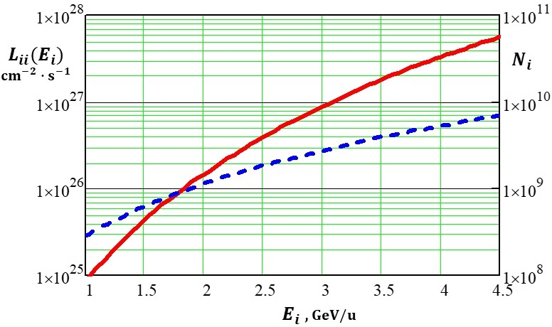
3. Strategy of The Project Luminosity Achievement
Space Charge Effects in the Collider [ЭЧАЯ 50 (2019) 776]
Two most serious effects:
1. Influence of own electromagnetic field of a bunch on its individual particles -
- so called Laslett effect, Δq betatron tune shift;
2. Influence of electromagnetic field of a bunch on particles of the colliding
(counterpropagating) bunch – so called “beam-beam effect”, ξ tune shift.
For the NICA Collider both effects both effects act differently on particle motion depending of their energy: at low energy the Laslett effect dominates, when at relatively high energy the beam-beam effect begin to play a visible role (Fig.1 below) .
Optimization of the Collider parameters can give us maximum luminosity (Fig. 2)
Dependence of the ion collider parameters with the bunched ¹⁹⁷Au⁷⁹⁺ beams; Δq_{max} = 0.05.
Δq(E_{i})
Δq(E_{i}) + ξ(E_{i}) ≤ 0.05
L_{ii}(E_{i})
N_{i}(E_{i})
ξ(E_{i})
E_{i} , GeV/u
E_{i} , GeV/u
Fig.1. Laslett parameter Δq (red curve) and the beam-beam parameter ξ (blue curve)
Fig.2. Collider luminosity L_{ii} (red curve) and the number of particles per bunch N_{i} (blue curve)

Slide 12
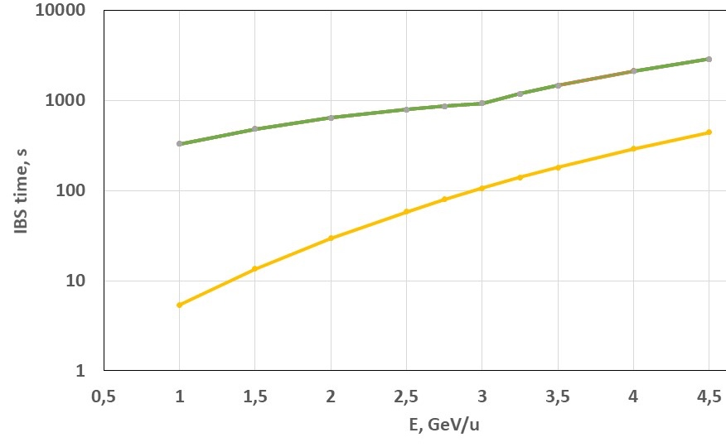
3. Strategy of The Project Luminosity Achievement
Intrabeam Scattering (IBS)
The problems:
- It increases 6D beam emittance that reduces the Collider luminosity,
- generates a beam halo that leads to ion loss and decreasing the beam lifetime.
In NICA Collider at design beam parameters IBS limited lifetime is as follows:
τ_{x} = τ_{y} = τ_{s}
Quasi-equilibrium beam
Parameters of quasi-quilibrium beam
Parameter | Value
Ion number per bunch, 1e9 | 0.3 – 2.8
Emittance, mm⋅mrad | 1.1
Bunch length, m | 0.6
Momentum spread, 1e-3 | 0.6 – 1.7
Betatron tune shift ΔQ | 0.04 – 0.05
Luminosity, cm⁻²⋅s⁻¹ , 1e27 | 0.01 – 0.9
IBS growth time, sec
Cooling time, sec
VVP Formula
Beam emittance growth under IBS action can be and must be suppressed by cooling – both electron and stochastic if τ_{cool} < τ_{IBS}.

Slide 13
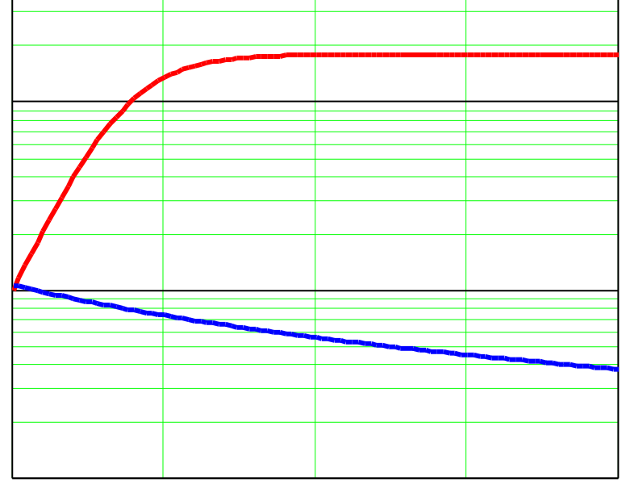
3. Strategy of The Project Luminosity Achievement
One More Statement (V. Parkhomchuk, BINP)
10
1
0.1
Luminosity, 10²⁷ cm⁻²∙ sec⁻¹
0 500 1000 1500 2000
Time, sec
What gives electron cooling to the NICA collider ??
Without cooling the ion beam grows in time and luminosity drops down
With cooling the ion beam shrinks and luminosity grows
We can increase luminosity by more than 20 times !!!
(equivalent of 20 NICA’s)

Slide 14
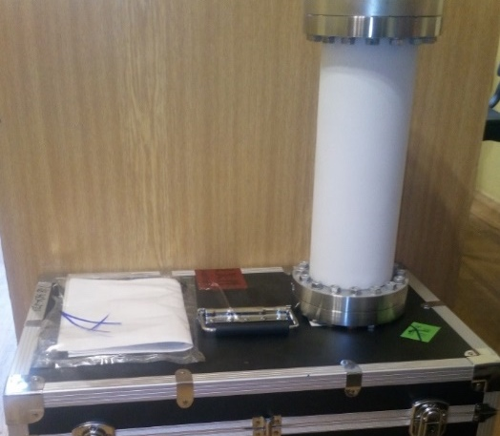
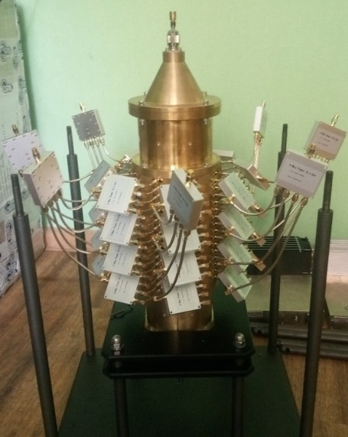
4. NICA Fabrication
Stochastic Cooling System (SCS) for the Collider
JINR – stages I and II
Parameters of the collider stochastic cooling system (stage I)
Parameter | Value
Energy range, GeV/u | 3.0 ÷ 4.5
Bandwidth, GHz | 0.7 ÷ 3.2
Gain range, dB | 84 ÷ 122 ± 0,5
Range of the delay, ps | 537 816 ÷ 544 453 ± 1
Average power of one SCS channel, W | 500
Prototype of Ceramic vacuum chamber for PU and kicker.
Basic structure – 16 rings
(development of FZJ)
Prototype of PU and kicker of SCS
(LHEP, June2019)
Fabrication at Kunshan Guoli
electronic tech. Co., Ltd (China)
Length – 200 mm
Commissioning 2022 (Stage I) – 2023 (stage II)

Slide 15
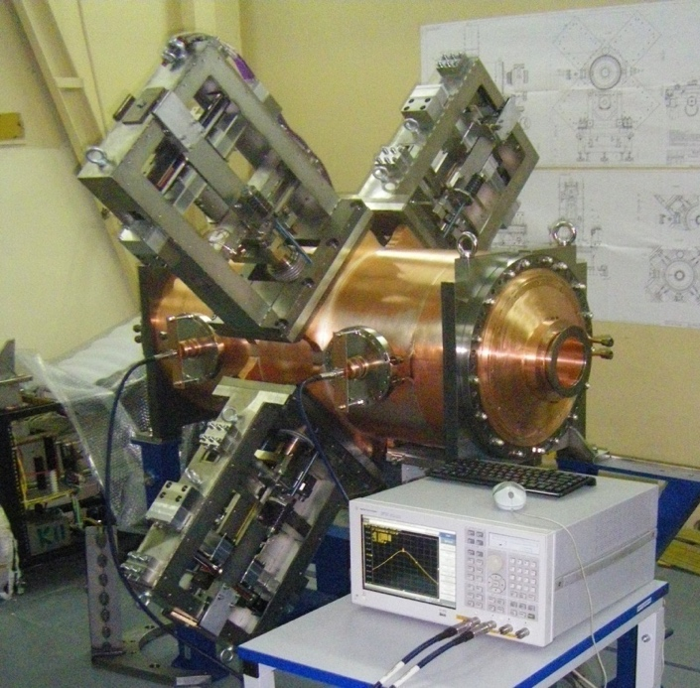
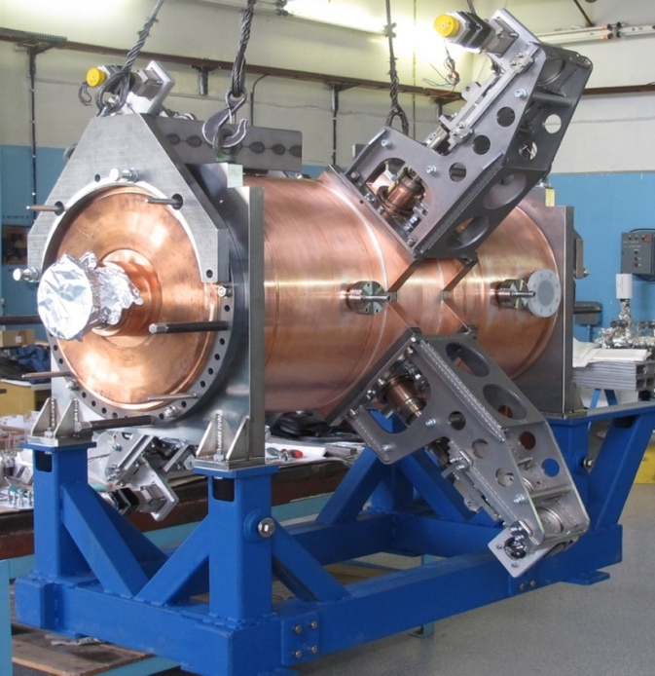
Challenge #1:
Low energy ultra-high intensity Collider
RF gymnastics:
From coasting beam to 22nd harmonics => 66th harmonics.
Cooling and stacking with RF1 barrier voltage (< 5 kV). Accumulation efficiency ~ 95%, about 110 - 120 injection pulses (55-60 to each ring) every 5 sec. Total accumulation time ~ 10 min.
Steps 2-3. Formation of the short ion bunches at presence of cooling: RF-2 (100 kV, 4 resonators) => RF-3 (1MV, 8 resonators).
Collider:
2 х 503 m SC rings in one cryostat, separated vertically
by 320 mm
Collider lattice:
FODO,
12 cells x 90⁰
each arc
Electron & stochastic beam cooling
RF-2 station
RF-3 station

Slide 16
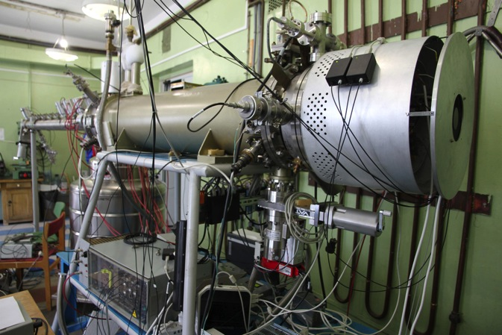
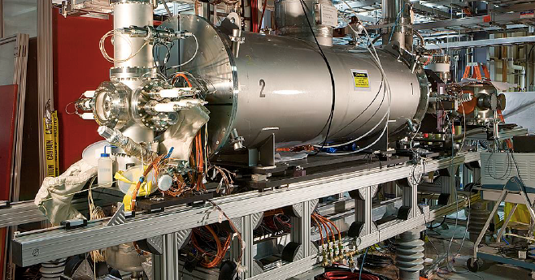
Challenge #2: Intense Heavy ion sources ESIS/EBIS type
JINR Krion-6T (ESIS) for NICA
B = 6 (5.4) T !!!
Ee = 25 keV
J_el (design) = 1000 A/cm²
Au³⁰⁺³²⁺ : 2.5*10⁹ ppp,
t_{ion} = 20 ms @ 50 Hz.
Frequency 0.6 – 10 Hz
Au (32+): 2.3*10⁹ ions/pp@5Hz
I_e = (7 –10) A
L_trap = 188 cm
E_e = (20 –24) kV
J_e= (300–500) A/cm2
BNL 5T EBIS (for RHIC and NSRL)

Slide 17
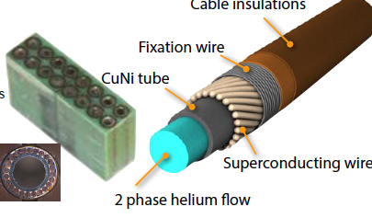
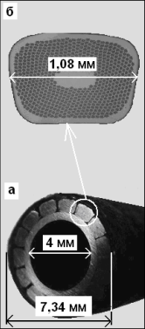
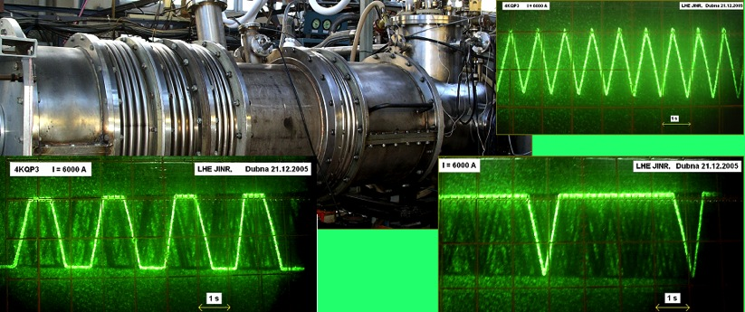
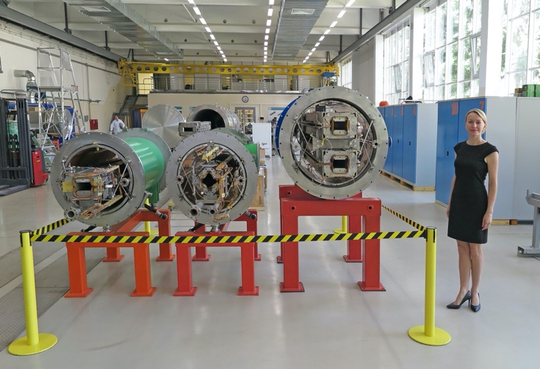
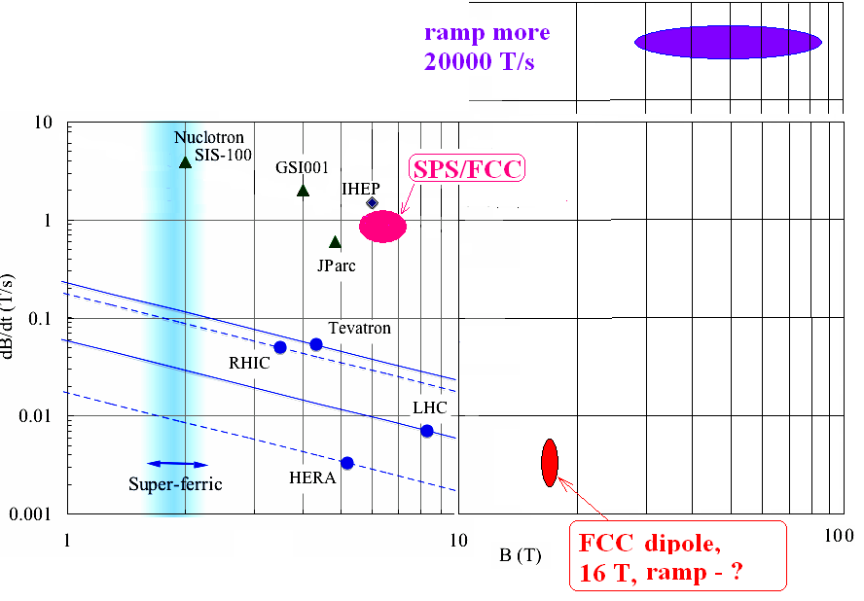
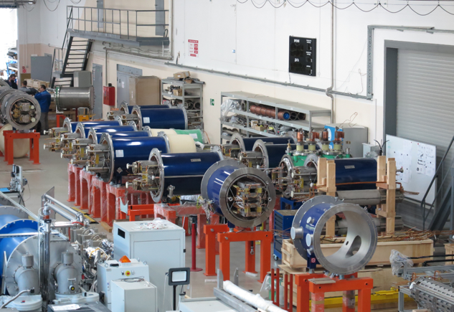
Challenge # 3: Unique SC magnets
(from fast-cycling mode to long plateu @ high field)
“Nuclotron cable” – hollow SC cable
NICA Booster and Collider, FAIR SIS-100, HIAF rings:
B ~2T, I=10–17 kA, Ramp rate – up to 4T/s@1Hz, Stored E ~0.4MJ
24/7 Factory for SC magnets
Very near future: fast (up to 4 T/s) ramped 4-6T dipoles and large aperture quadrupoles (FFL). Perspective -> 50 GeV (p)

Slide 18
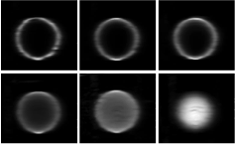
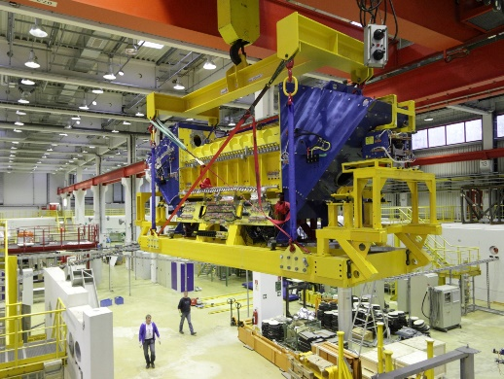
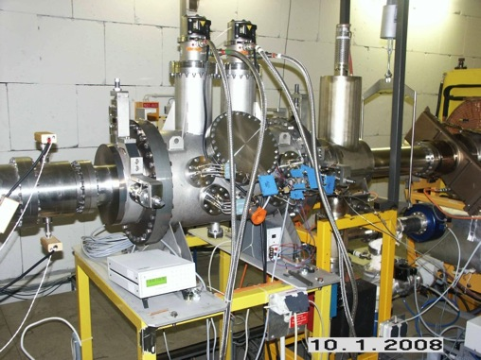
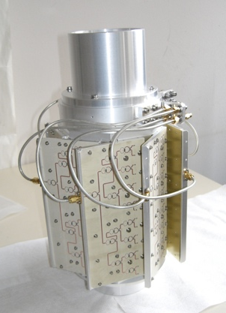
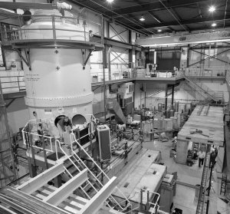
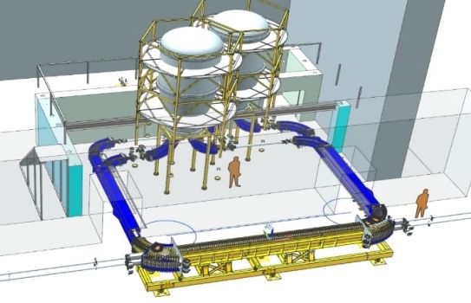
Challenge #4. Beam cooling systems: Electron and Stochastic
Ultra-high energy of electron beam
Use of cryogenic cathodes
Hollow electron beam
We are constructing stochastic cooling
system 2-4 GHz band and the slot-ring-coupler (designed and produced for Nuclotron at FZJ as prototype for NICA) collaborating strongly with FZJ (COSY, HESR) and FAIR, FNAL.
2 MeV cooler COSY FZJ
2.5MeV
cooler
NICA
S-cool slot-ring
coupler structure
FZ Juelich, COSY
To perform the horizontal and vertical cooling, we plan additionally ~ 10 Watt per each direction as the gain is 70~75 dB. Totally ~ 400 Watt is the required power.
TDR: 32 rings per each pick-up, and 64 rings per each kicker, ~ 400 rings for total system.
Challenge: advanced Notch-filter, accuracy of delay 1ps, effective 3D-cooling in 3⌯4.5GeV/u@ 300⌯700s, vacuum conditions for pick-up (warm section) 10⁻¹¹ Torr, simultaneous operation with beam accumulation
FNAL: 4 MeV Pelletron
Electron cooling: for booster – typical system, for collider – the most challenging in the world. JINR together with BINP. Electron Energy: 0.2-2.5 MeV, Electron current 0.1-1A, hollow beam, B=0.2T, cooling time in range 1⌯3 GeV/u ~ 10⌯300 sec
Main challenges: high voltage generation; power transmission to high potential; generation of magnetic guiding field.

Slide 19
4. NICA Stages
Two rings of the NICA Collider will be equipped with the following devises allowing to control parameters of the ion beams:
Device | Stage I (number per ring) | Stage II (number per ring)
RF-1 (ion storage and acceleration/deceleration) | 1 | 1
RF-2 (ion bunching) | 2 | 4
RF-3 (short bunch formation) | 0 | 8
HV Electron cooler | 1 beam | 1 beam
Stochastic cooling system | 1 channel (cooling of longitudinal degree of freedom) | 3 channels (3D cooling)
Feedback system | 1 channel (low frequency) | 1 channel (high frequency) ?

Slide 20
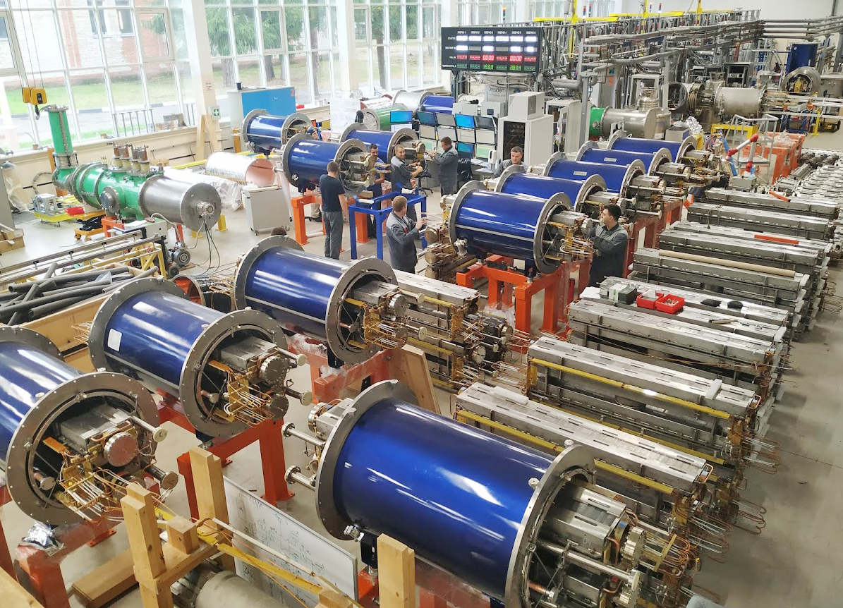
4. NICA Fabrication
Factory of the Miracles
August 2020

Slide 21
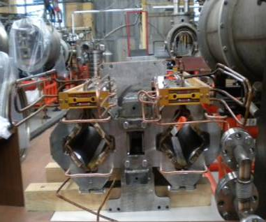
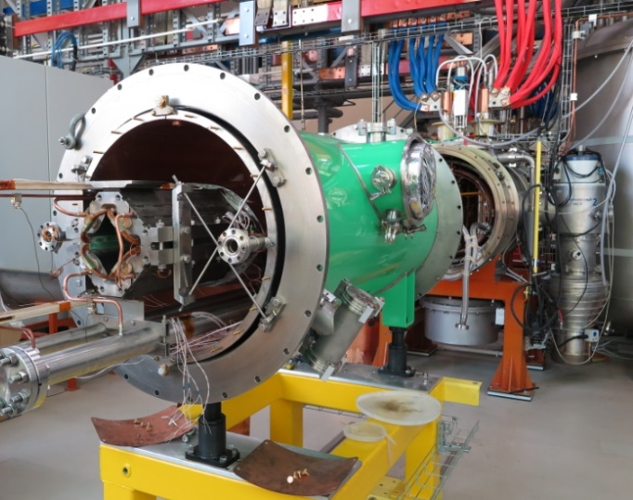
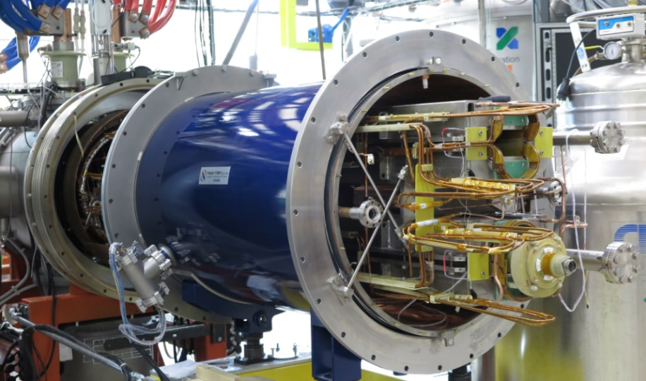
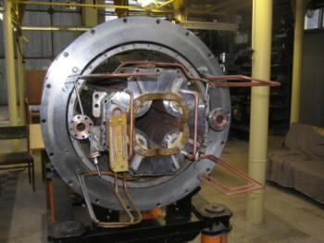
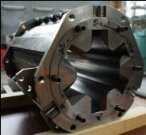
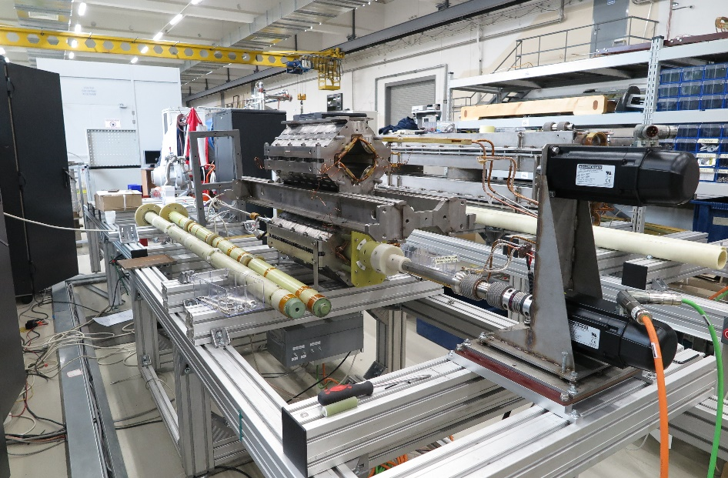
4. NICA Fabrication
Factory of the Miracles: ready samples
Booster dipole Collider dipole Collider quadrupole
Quadrupole & sextupole for SIS-100
Collider quadrupole ready for test

Slide 22
Facility components – status
2020
KRION
Linac HILac
KRION
Linac HILac
Ion sources
Booster (25 Tm)
1(2-3) single-turn injection,
storage of (2 ÷ 4)×10⁹ ions,
acceleration up to 100 MeV/u,
electron cooling, acceleration
up to 600 MeV/u
Ion sources
Booster (25 Tm)
1(2-3) single-turn injection,
storage of (2 ÷ 4)×10⁹ ions,
acceleration up to 100 MeV/u,
electron cooling, acceleration
up to 578 MeV/u
Linac LU-20
Linac LU-20
Fixed Target Area
Fixed Target Area
Slow resonance extraction
Stripping (80%) ¹⁹⁷Au³¹⁺ => ¹⁹⁷Au⁷⁹⁺
IP-2
Nuclotron (45 Tm)
injection of one bunch
of ≤ 2×10⁹ ions,
acceleration up to
1 - 4.5 GeV/u max.
Nuclotron (45 Tm)
injection of one bunch
of ≤ 2×10⁹ ions,
acceleration up to
1 - 4.5 GeV/u max.
Collider
L ≥ 10²⁷ см⁻²с⁻¹
IP-1
work in progress
early commissioning
commissioned / existing

Slide 23
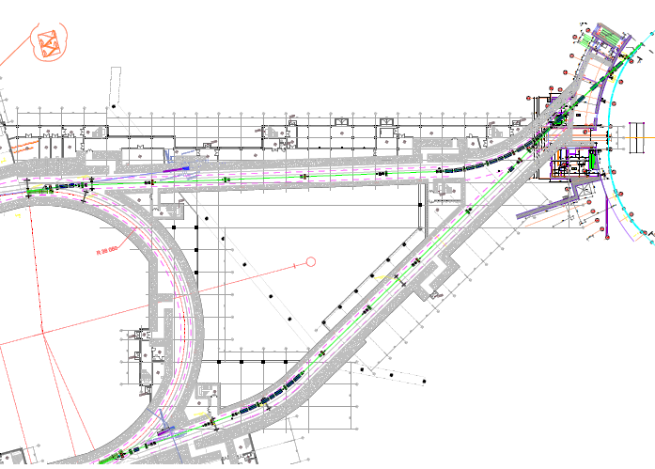
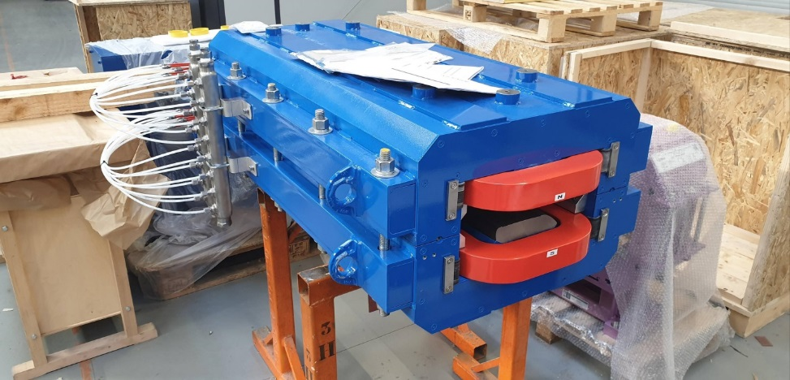
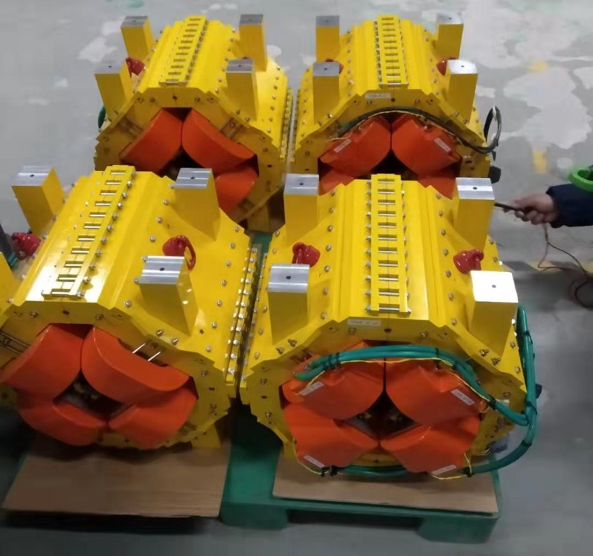
Nuclotron-Collider beam transport channel
A.Tuzikov
JINR has prepared a temporary storage in the Collider tunnel and ready to receive the channel magnets
delivery => Q4 2020
assembly=> Q4 2021
commissioning => Q2,Q3 2021

Slide 24
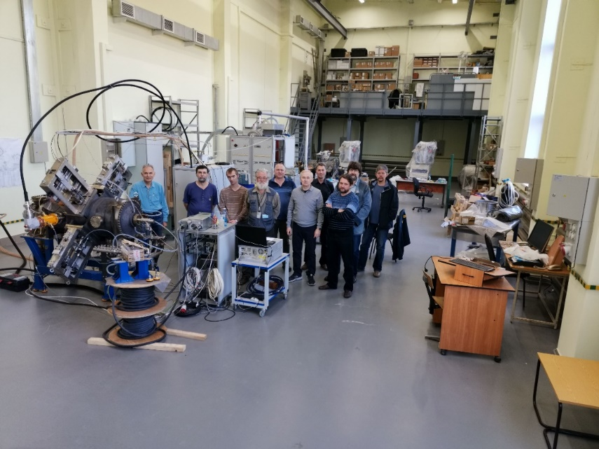
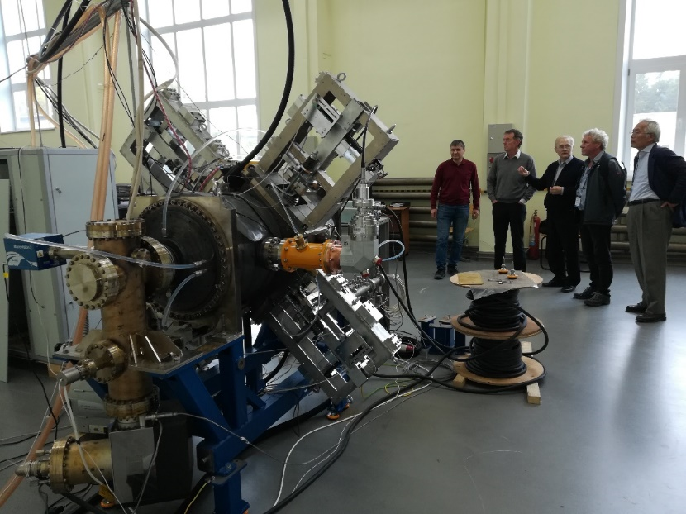
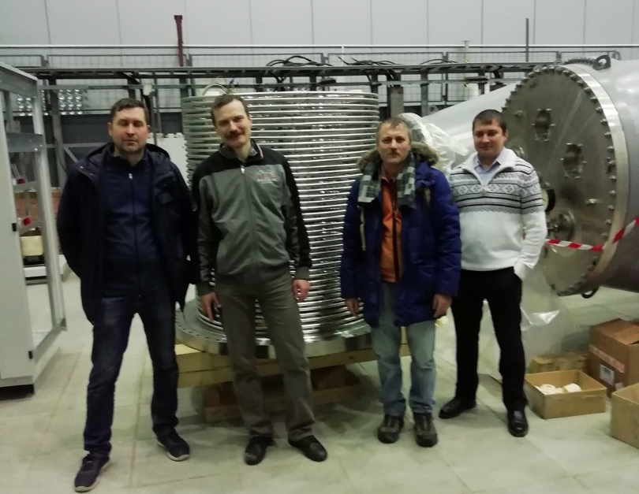
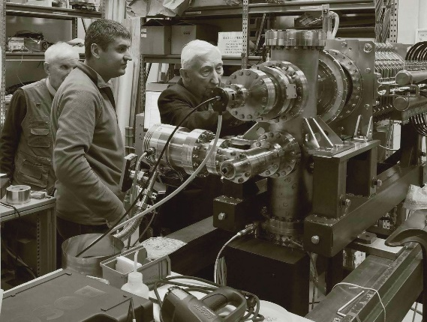
4. NICA Fabrication
RF Acceleration Systems for the Booster and the Collider:
Development by Budker INP - the main NICA collaborator
Harmonic systems RF2 and RF3, E-cooler for the Collider
24.09.2019 RF-2 Visit of the NICA MAC members
23.09.2019 RF-2 and all the Team
Acceleration system of HV E-cooler
Commissioning 2021
RF-1 at friendly inspection
21.03.2019

Slide 25
6. Expertise and Approval
of the NICA Accelerator Complex Project
Final Decision: JINR Committee for Plenipotentiaries
3rd level
JINR Scientific Council
1st level
Machine Advisory Committee for
the Project of NICA Accelerator Complex
1. I. Arkharov Bauman MSTU, RF
2. A. Feshchenko INR RAS, RF
3. S. Ivanov IHEP, RF
4. T. Katayama Nihon Univ., Japan
5. V. Lebedev FNAL, USA
6. E. Levichev Budker INP, RF
7. R. Scrivens CERN
8. Yu. Senichev MPEI, RF
9. A. Seryi Jlab, USA
10. R. Stassen FZJ, FRG
11. M. Steck GSI, FRG - Chairman
12. P. Zenkevich ITEP, RF
2nd level
Program Advisory Committee for Particle Physics
Steering Committee of the NICA Project:
NICA Accelerator Project:
Approved in 2011 and prolonged in 2015 until 2020 (2022)
NICA MAC
2008 – 2020
11 sessions
NICA DAC
2010 – 2020
8 sessions

Slide 26

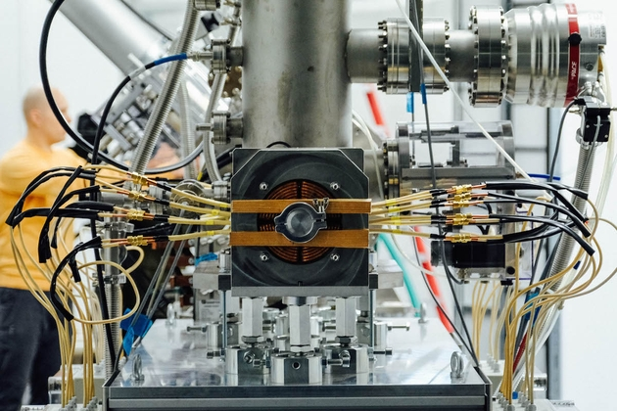
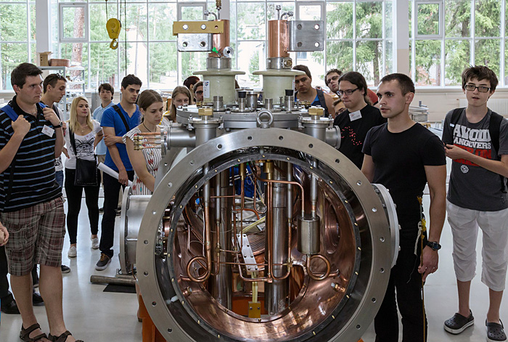
INNOVATIONS @ NICA
Innovative cluster:
Areas for an innovative and applied researches with use of linear accelerators and Nuclotron extracted beams;
Areas for an innovative and applied researches on the booster and Nuclotron beams;
Infrastructure cluster:
NICA user’s center;
IT complex for experimental data storage
and analysis;
Education field:
Areas equipped with use of modern
technologies for school, university
and special education (i.e. engineering, etc);

Slide 27
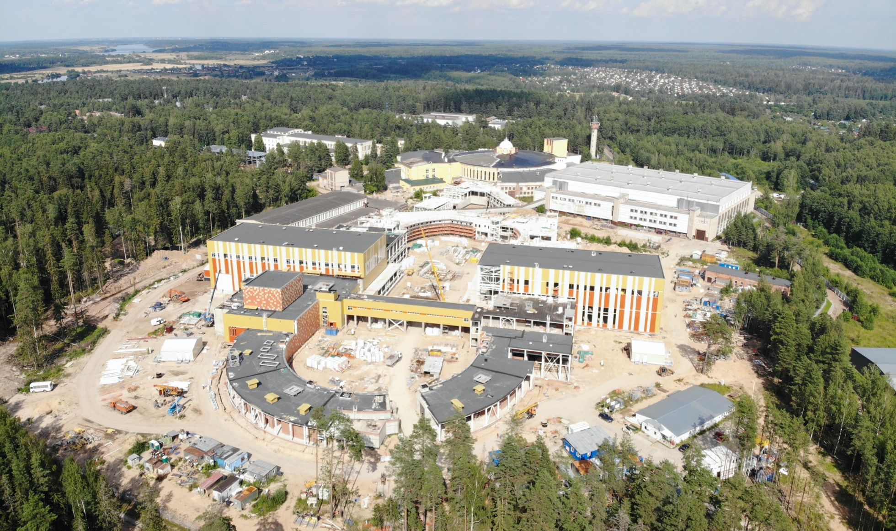


Collider building
to be completed –2021
BM@N
MPD
SPD
MPD
comissioning of builing =>
sub stages:
MPD - mid’20
collider magnets– beg‘21;
tunnel arc
Notes:
The civil construction of the collider complex is going on in accordance with the plans. the MPD hall will be ready by the summer of 2018, and the entire complex will be completed in 2019.

Slide 28
Thank you for your attention!

