Slide 1
Evaluation of prospects for hypernuclei studies with MPD at NICA
The Conference "RFBR Grants for NICA"
JINR, Dubna, Russia, 20-23 October 2020
J.Drnoyan, V.Kolesnikov, A.Mudrokh,
I.Rufanov, V.Vasendina, A.Zinchenko
for the MPD collaboration VBLHEP, JINR, Dubna, Russia
This work was supported by the Russian Foundation for Basic Research (RFBR): grant No. 18-02-40060

Slide 2
Outline
NICA project and MPD detector geometry
Hypernuclei in HIC
New track reconstruction performance
New dE/dx parameterization in TPC (Garfield++)
New PID performance in TPC & TOF
Realistic reconstruction of hypernuclei
Summary

Slide 3
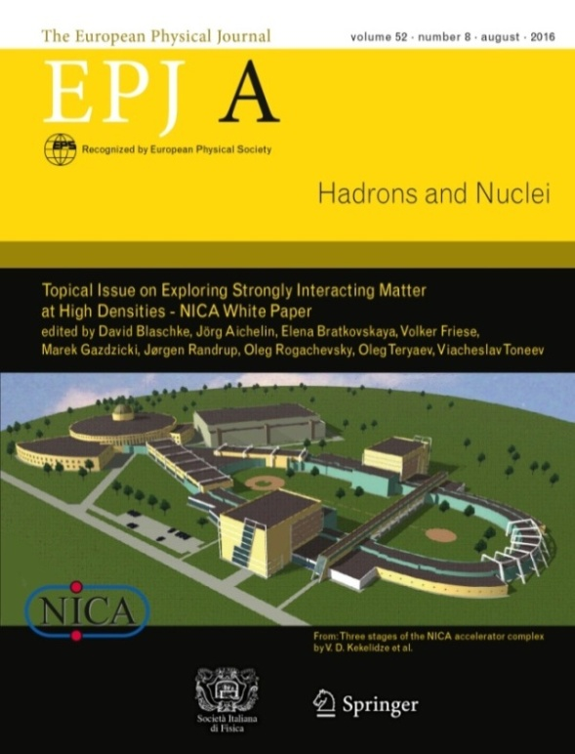
NICA complex and NICA physics
New flagship project at JINR (Dubna)
Based on the technological development of the Nuclotron facility
Optimal usage of the existing infrastructure
Modern facility incorporating new technological concepts
Experimental strategy: energy and system size scan to measure a variety of signals systematically changing collision parameters (energy, centrality, system size). Reference data (i.e. p+p) will be taken in the same experimental conditions
NICA parameters:
Beams: p, d, … ¹⁹⁷Au⁷⁹⁺
Collision energy: 4-11 GeV (nuclei)
Luminosity: 10²⁷ cm⁻²s⁻¹ (Au), 10³² cm⁻²s⁻¹ (p)
2 Interaction points: MPD and SPD
Fixed target: 1-6A GeV beams
Bulk properties, EOS: particle yields & spectra, ratios, femtoscopy, flow
In-Medium modification of hadron properties: dileptons and resonances
Deconfinement (chiral) phase transition at high r_{B}: strangeness, Chiral Magnetic (Vortical) effect
QCD Critical Point: event-by-event fluctuations and correlations
YN, YY interactions in nuclear matter: hypernuclei

Slide 4
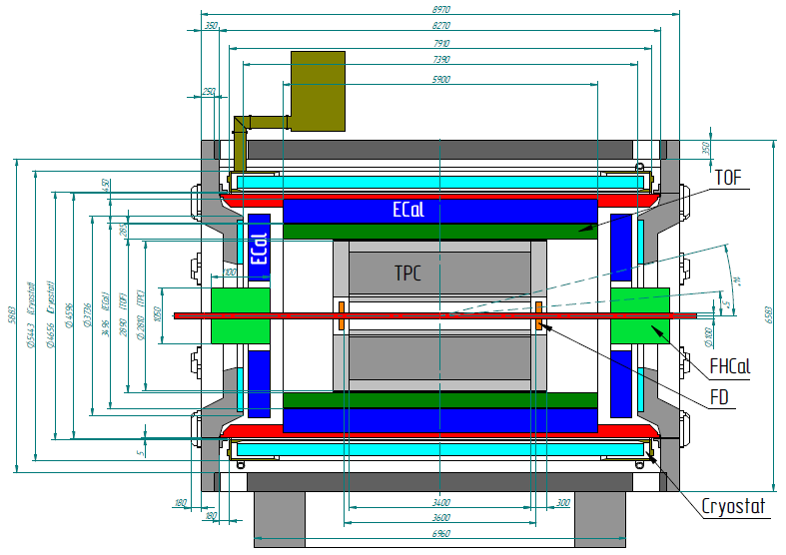
Multi-Purpose Detector @ NICA
To study hypernuclei, MPD detector must be able to detect and identify light nuclei in a wide rapidity range as well to have a good capability for precise secondary vertex reconstruction
Stage 1:
Magnet: 0.5 T superconductor
Tracking: TPC
Particle ID: TOF, ECal, TPC
T0, Triggering: FD
Centrality, Event plane: FHCal
Requirements to the apparatus:
Hermeticity, homogenous acceptance: 2π in azimuthal angle
Highly efficient 3-D track reconstruction, high resolution vertexing
Powerful PID: π/K up to 1.5 GeV/c, K/p up to 3 GeV/c, ECAL for γ, e
Careful event characterization: impact parameter & event plane reconstruction
Minimal dead time, event rate capability up to ~ 6 kHz

Slide 5
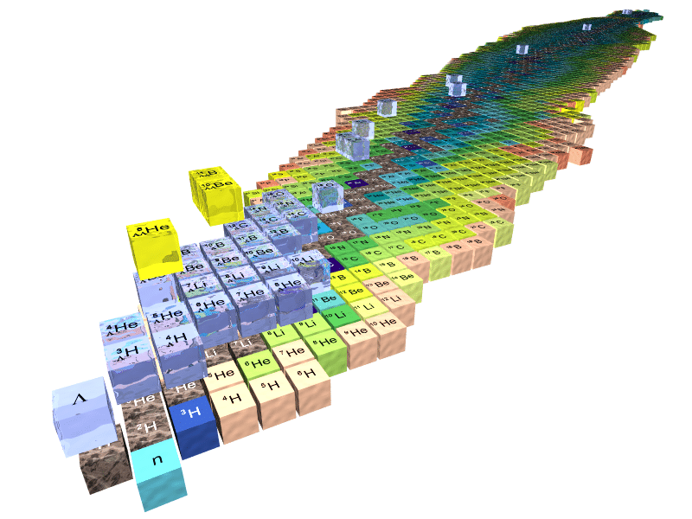
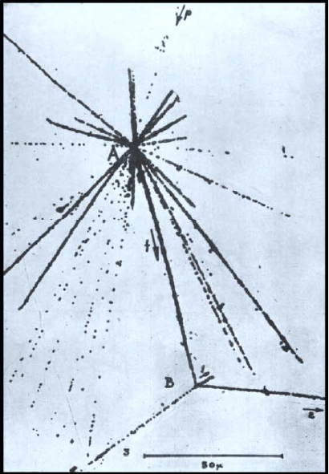
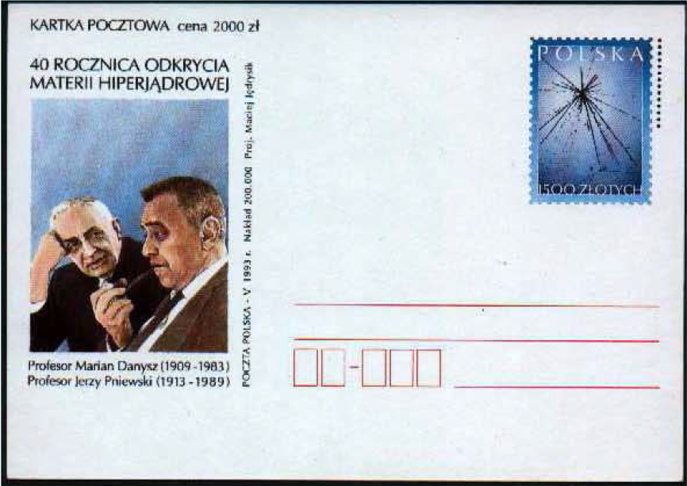
HIC: Hypermatter production
Hypernuclei – strange nuclear systems (S = -1, -2, …)
Contain one (or more) hyperons (Λ, Σ or Ξ) instead of a nucleon
Give access to the third dimension of the nuclear chart (strangeness)
Lifetimes close to free Λ (weak decay)
Precise information on YN interaction: nuclear EOS, astrophysics
Hypernuclei ground, excited states and life times: critical assessments for QCD calculations and model predictions
Production mechanism of bound states with hyperons: coalescence versus spectators-participants interactions, exotic states, dibaryons
No hyperon target available. No hyperon beam available.
However, YN and YY interaction can be investigated:
hypernuclei is micro-laboratory with protons, neutrons
and hyperon
Duality: Nuclear ↔ Particle Physics
Strangeness
The picture is taken from "IX International Conference on Hypernuclear and Strange Particle Physics" at Johannes Gutenberg-Universität Mainz.
The first hypernuclear measurement by Danysz and Pniewski
in 1952 from a cosmic ray emulsion event.

Slide 6
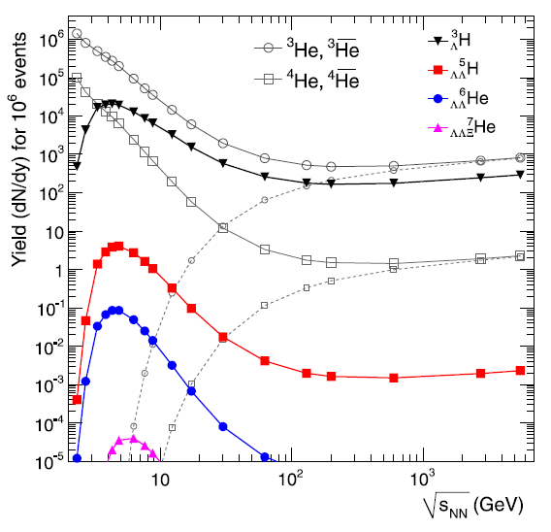
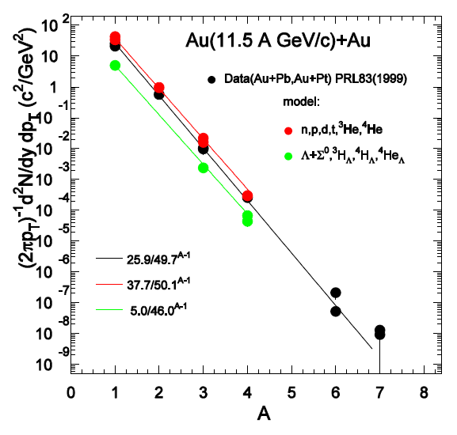
HIC: Multy-hypernuclear production
Statistical model:
A.Andronic, P.Braun-Munzinger,
J.Stachel, H.Stocker
Physics Letters B 697 (2011)
DCM-QGSM model:
K.Gudima, V.Toneev
Expected yields for Stage’2 (L=10²⁷ cm⁻²s⁻¹):
³_{Λ}H for MPD (10 weeks) @ 5 GeV: 9 . 10⁵
⁴_{Λ}He for MPD (10 weeks) @ 5 GeV: 1 . 10⁵
NICA energy range
In heavy-ion reactions: production of hypernuclei through coalescence of Λ with light fragments
Maximal yield predicted for √s_{NN} = 4-5 GeV (statistical model)
NICA energy range is ideally suited for the search of (double) hypernuclei

Slide 7
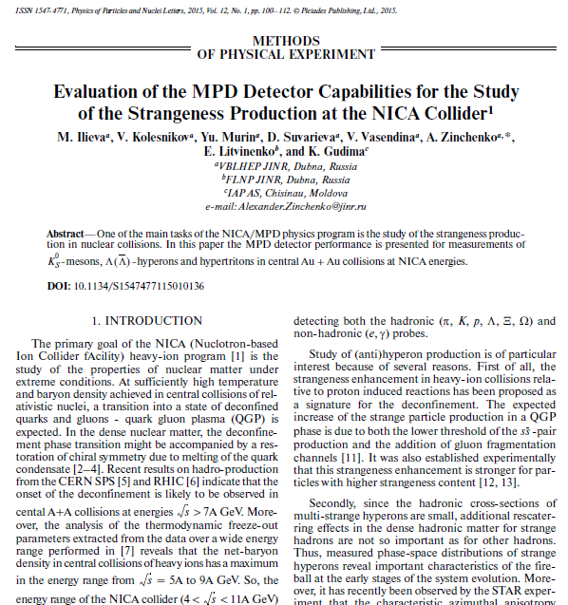
Main goal:
Realistic hypernuclei reconstruction with NEW realistic MPD performance
Software development:
Towards a realistic simulation of the MPD / NICA
Realistic description of the response of detectors, creation and configuration of algorithms for reconstruction of signals in detectors
Realistic track reconstruction procedure in TPC
Description of ionization losses in TPC gas based on Garfield ++ simulations that are consistent with STAR data
New realistic identification of electrons, hadrons and light nuclei in TPC and TOF software
Software requirements for hypernuclei simulation:
Qualitative reconstruction of the tracks of hadrons and light nuclei
Good recovery of primary and secondary vertex
High efficiency of identification of both hadrons and light nuclei
The first hypernuclei simulation with early version of MPD
and simplified track reconstruction in TPC

Slide 8
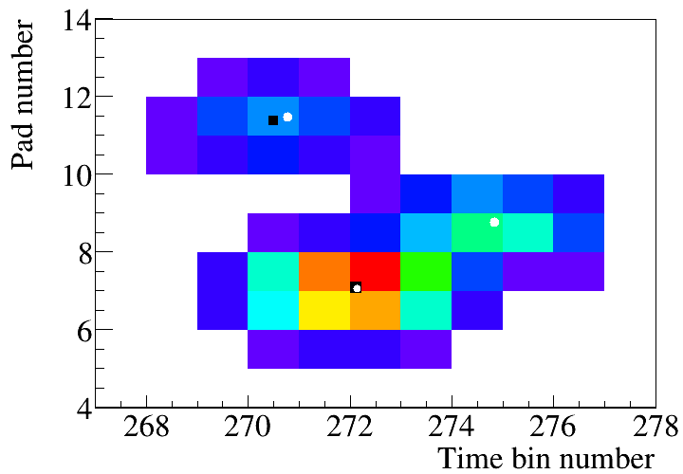
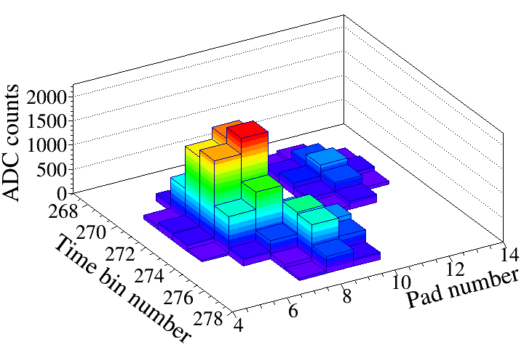
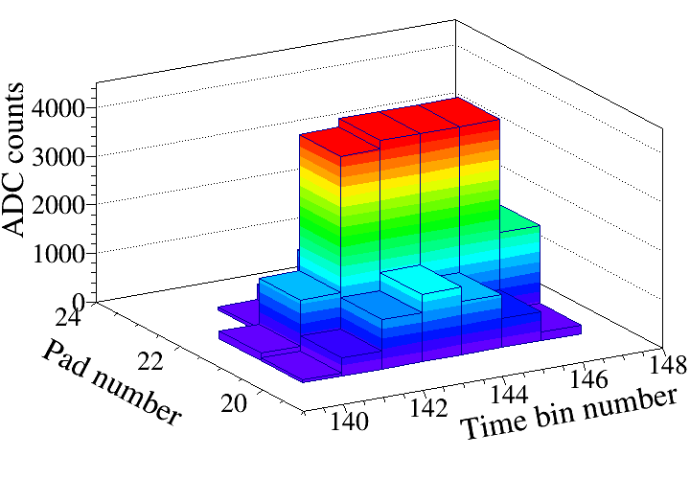
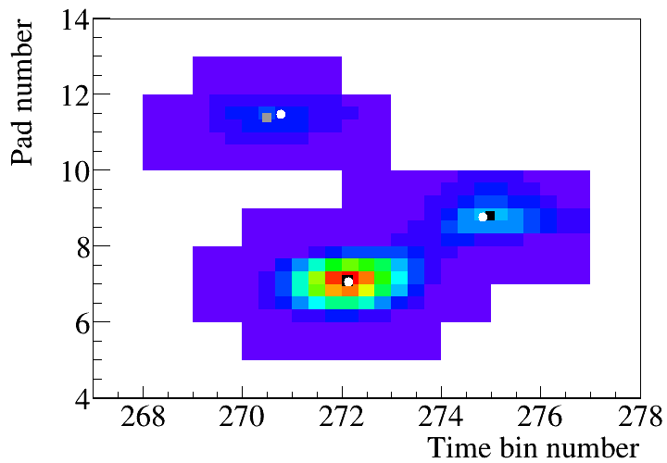
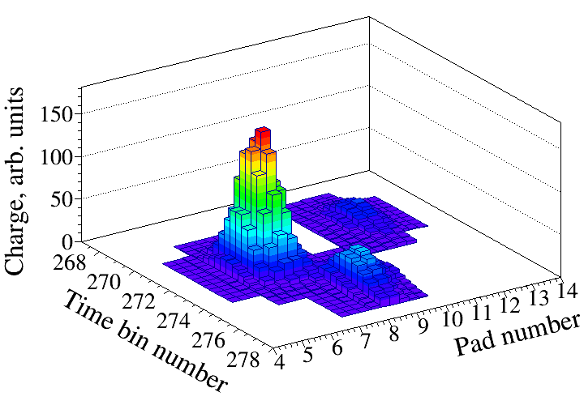
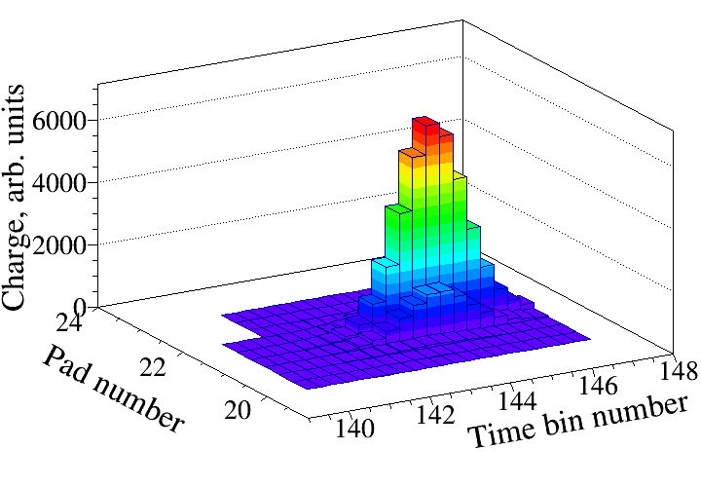
Cluster topologies and
Maximum Likelihood - Expectation Maximization procedure
2D and 3D views of a precluster of three tracks
3D view of a cluster with overflows
before
after MLEM
True hit coordinates - , Reconstructed hit coordinates - . On the top left plot one hit has not been reconstructed.
Bottom - 2D and 3D views of the same precluster after the MLEM procedure.
Top - ADC output: charge loss because of overflows;
Bottom - signal recovery using undistorted measurements from the tails after MLEM procedure.

Slide 9
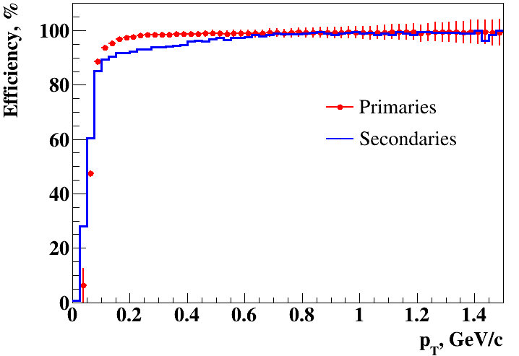
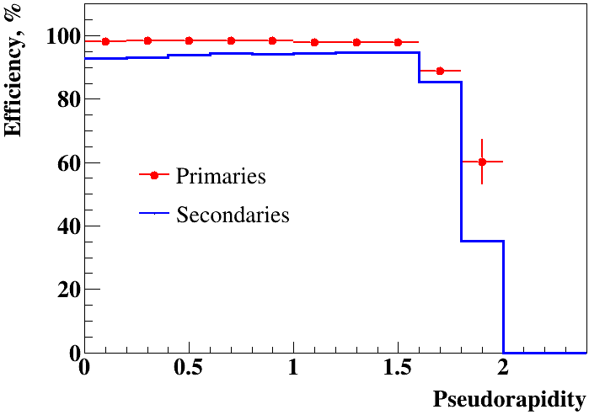
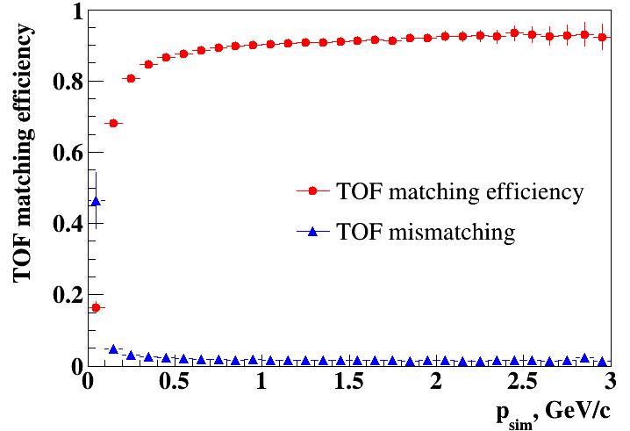
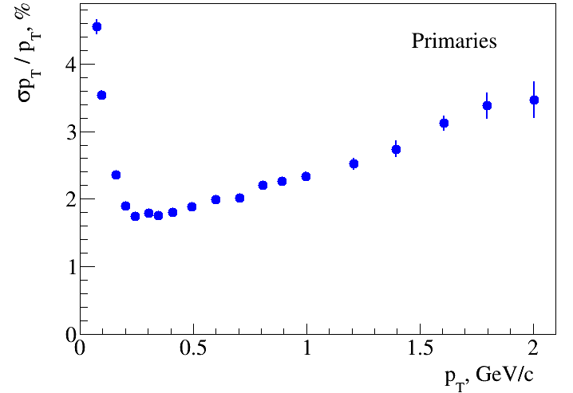
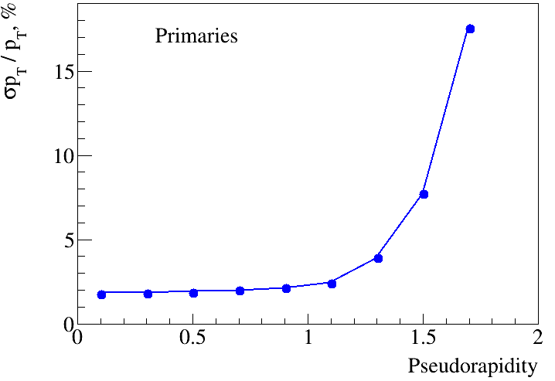
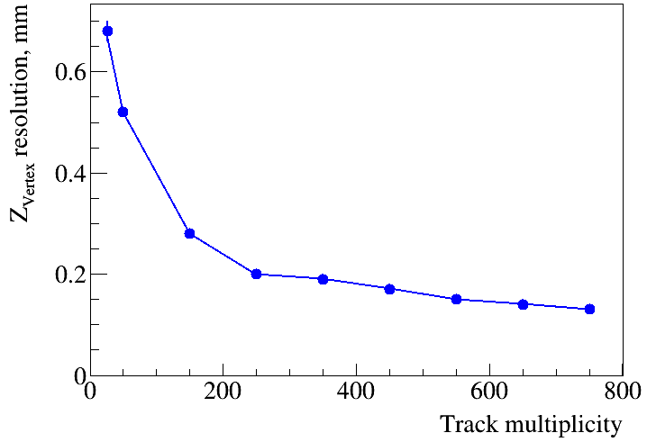
Realistic MPD simulation and reconstruction
TPC

Slide 10
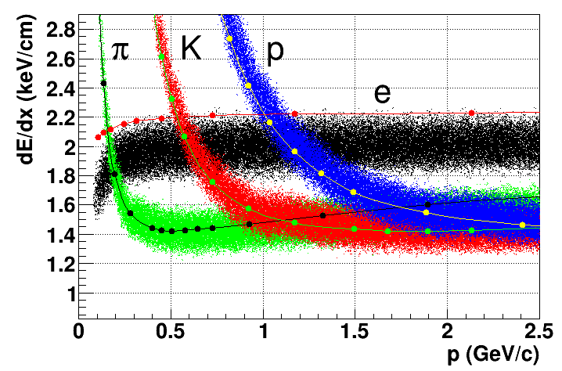
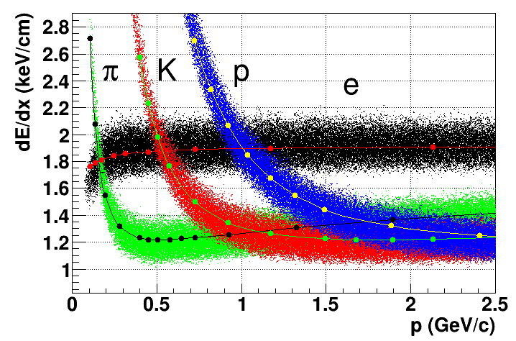
New dE/dx performance in TPC
old
new
More details in I.Rufatov`s talk
dE/dx vs momentum for TPC/MPD
Box generator (e, π, K, p);
Curves – STAR standard function
(Bicshel`s functions)
[NIM A558 (2006) 419-429]
 | ALICE | STAR | MPD
Gas | 85% Ne mix | P10 | P10
N rows x pitch (mm):
Inner pads | 64 x 7.5 mm | 13 x 12 mm | 26 x 12 mm
Outer pads | 64 x 10 mm | 32 x 20 mm | 27 x 18 mm
Outer-2 pads | 32 x 32 mm | – | –
P10 mixture – 90% Ar, 10% methane
Data vs MC with old parameterization dE/dx in GEANT3:
Essentially (~20%) underpredicts relativistic rise of the ionization energy loss as seen from comparison of pion and electron bands
Overpredicts energy loss at low momentum (protons at p<1 GeV/c)
Gives shifted momentum of intersections of electron and other particles bands
Gives distorted input for realistic PID
New dE/dx parametrization (Garfield++) in GEANT gives a good agreement with STAR data

Slide 11
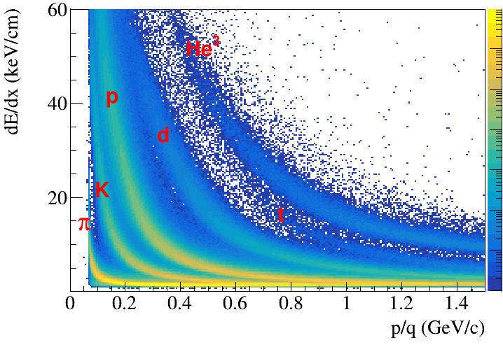
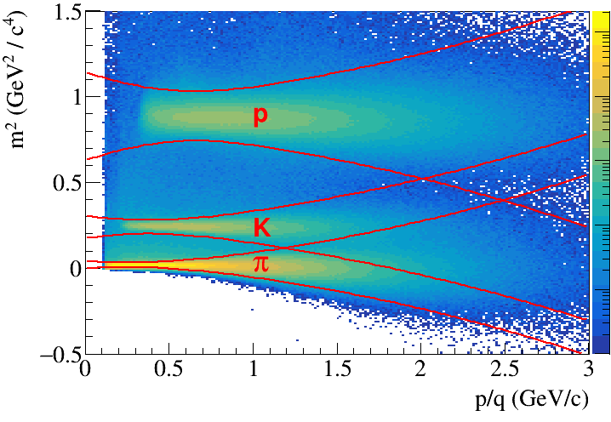
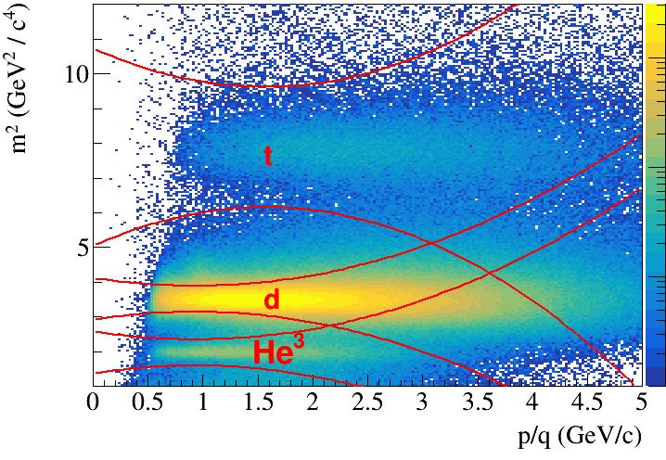
New PID performance in TPC & TOF
More details in A.Zinchenko`s talk
dE/dx vs momentum in TPC and
m² vs momentum in TOF
Selection criteria for events and identified tracks:
|Z_{PV}| < 50 cm
Primaries particles
N_{TPC_hits} ≥ 27
|η| < 1.3
Mass square calculated using the measurements of magnetic rigidity (p/q), time-of-flight (T) and trajectory length (L):

Slide 12
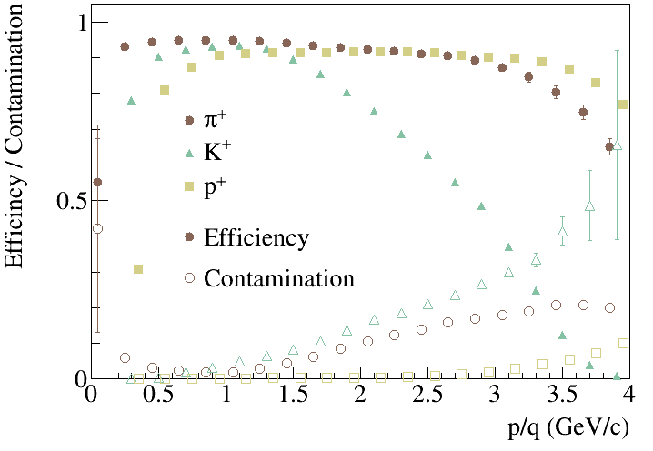
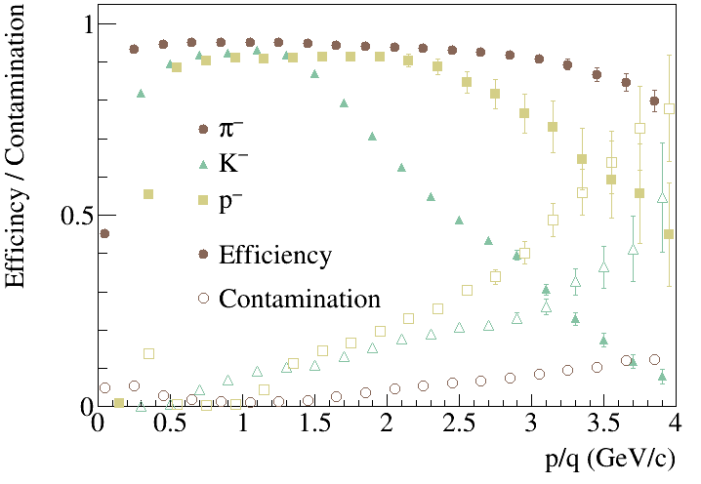
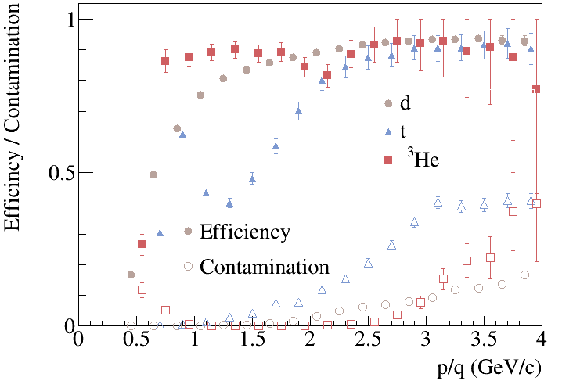
PID: Efficiency and Contamination
Primaries + secondaries (after GEANT) particles
Eff. $=\frac{\text{particles} \text{which} \text{are} \text{correctly} \text{identified}}{\text{all} \text{particles} \text{of} \text{a} \text{given} \text{species}\text{ (}\text{PDG}\text{)} }$
Cont. $=\frac{\text{particles} \text{which} \text{are} \text{falsely} \text{identified}}{\text{all} \text{identified} \text{particles} \text{of} \text{a} \text{given} \text{species} }$

Slide 13
Data set
Generators: DCM-QGSM, Au+Au @ 5 GeV, central, 0.9M events
Detectors: TPC and TOF
Cluster / hit reconstruction: precluster finder (group of adjacent pixels in time bin – pad space); hit finder (“peak-and-valley” algorithm either in time bin – pad space (for simple topologies) or in time-transverse coordinate pixel space after Bayesian unfolding (for more complicated topologies) )→ COG around local maxima
Track reconstruction: two-pass Kalman filter with track seeding using outer hits (1st pass) or leftover inner hits (2nd pass)
Track acceptance criterion: |η|< 1.3, N_{TPC_hits} ≥ 10 (for reconstructed tracks)
NEW energy loss simulation in gas TPC: with new parameterization in GEANT (Garfield++)
NEW PID: dE/dx in TPC & m² in TOF, N_{TPC_hits} ≥ 27 (for identified tracks)
Vertex reconstruction: Kalman filter based formalism working on MpdParticle objects

Slide 14
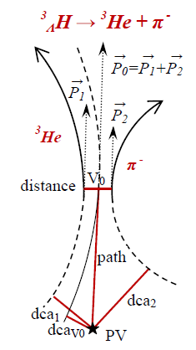
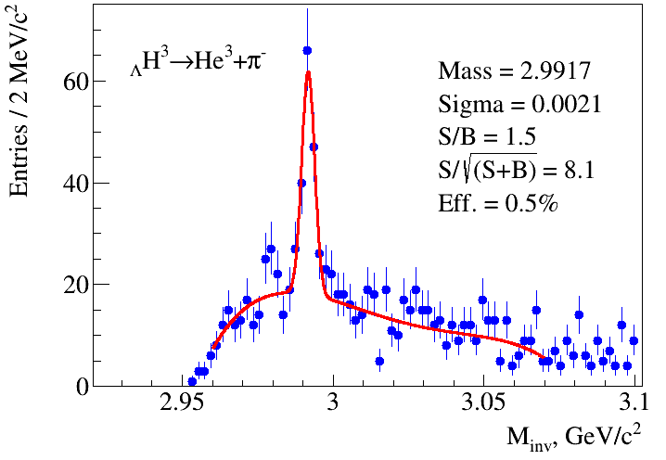
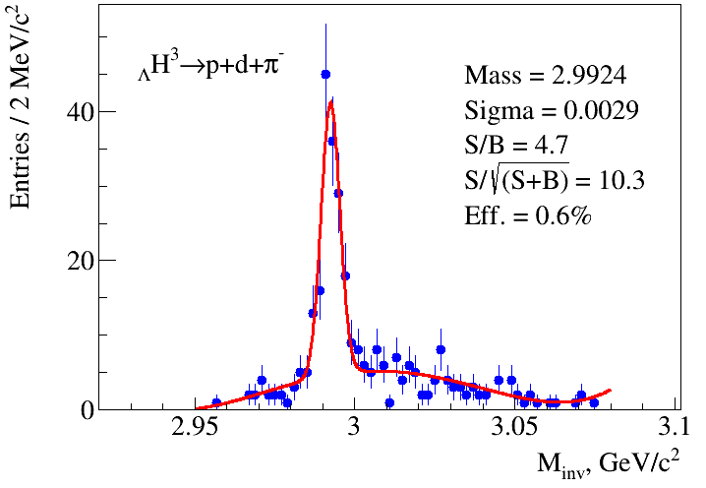
Hypertriton reconstruction
Efficiency = (reconstructed, identified and selected Hyp at |η| < 1.3) / (all generated Hyp after GEANT within 50 cm of PV) – includes branching ratios, detector acceptance and reconstruction efficiency
Decay channel | Branching ratio | Decay channel | Branching ratio
π – + ³He | 24.7% | π – + p + p + n | 1.5%
π ⁰ + ³H | 12.4% | π ⁰ + n + n + p | 0.8%
π – + p + d | 36.7% | d + n | 0.2%
π ⁰ + n + d | 18.4% | p + n + n | 1.5%
Mesonic decay of _{Λ}H³: Event topology
PV – primary vertex
V₀ – vertex of hyperon decay
dca – distance of the closest approach
path – decay length

Slide 15
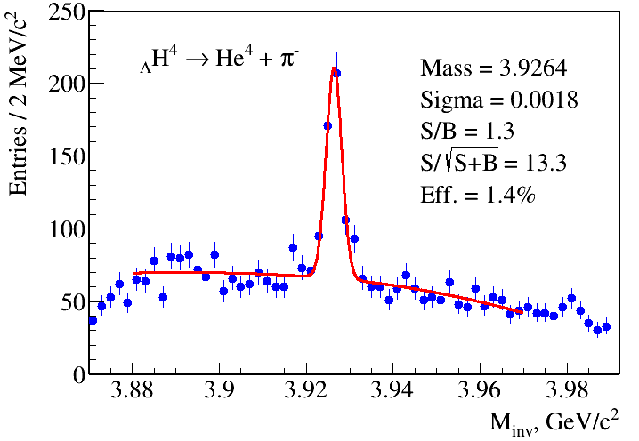
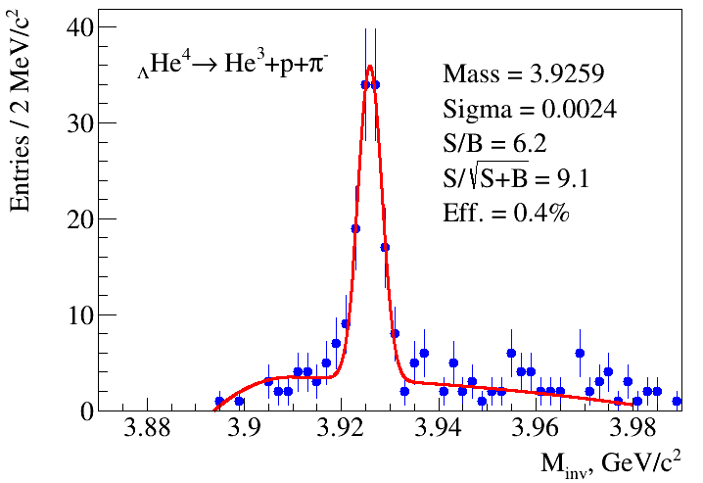
_{Λ}H⁴ and _{Λ}He⁴ reconstruction
Branching ratio: 75% Branching ratio: 32%
Signal embedding technique: The Monte Carlo event sample was enriched by signal particles (hypernuclei), distributed according to the y-p_{T} phase space given by the DCM-QGSM generator
Equivalent statistics: ~20M events for _{Λ}H⁴ and ~30M for _{Λ}He⁴

Slide 16
Summary
The updated MPD reconstruction and identification packages have been tested using hypernucleus as a testing tool
New method with Garfield++ package of track energy loss calculation in gas volume of TPC detector has been tested
For hadrons and light nuclei the new combined identification, based dE/dx in TPC and m² in TOF, has been tuned and tested
Clear peaks of _{Λ}H³, _{Λ}H⁴ and _{Λ}He⁴ in invariant mass spectrum have been obtained
The updated results on the yields of hypernuclei have largely confirmed the earlier, rather ideal, estimates and increased the level of reliability of the physical predictions underlying the physical program of the experiment.
The obtained results showed that even the starting version of the MPD setup (TPC+TOF) has good opportunities for studying hypernuclei.
Thank you for attention!

