Slide 1
What do anisotropic flow measurements can tell us about the matter created in the little bang at NICA?
Petr Parfenov¹, Vinh Ba Luong¹, Dim Idrisov¹, Nikolay Geraksiev^{2,3},
Arkadiy Taranenko¹, Alexey Povarov¹, Alexander Demanov¹, Anton Truttse¹
¹National Research Nuclear University MEPhI
²VBLHEP JINR
³FPT, Plovdiv University “Paisii Hilendarski”
For the MPD Collaboration
This work is supported by the RFBR according to the research project No. 18-02-40086
The Conference "RFBR Grants for NICA", 20-23 October 2020, Dubna, Russia
Notes:
1
1
1
1
1
1
1
Good afternoon! In this presentation, I would like to speak about The comparison of methods for elliptic flow future measurements with the MPD Experiment at NICA

Slide 2
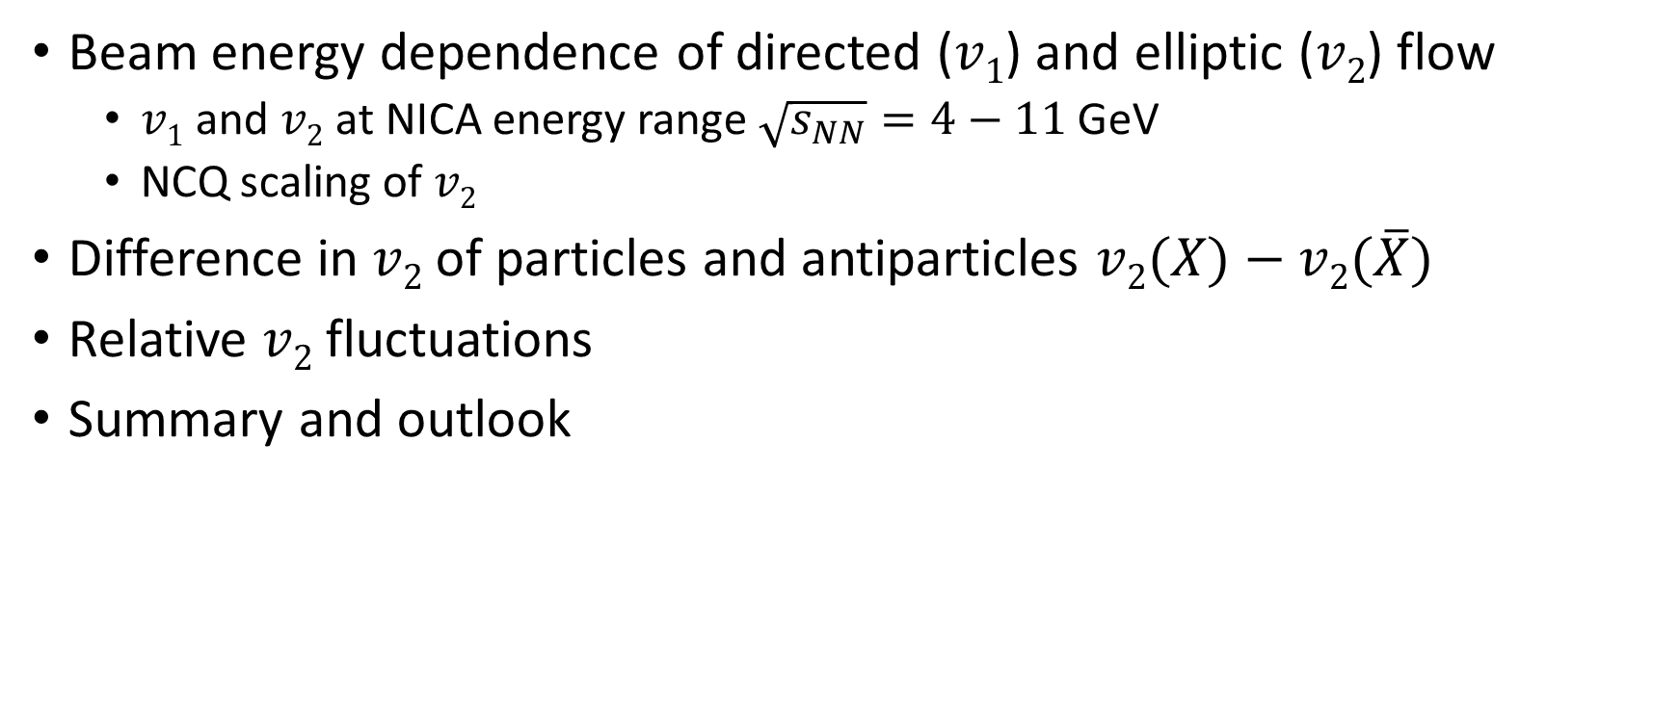
Outline
Beam energy dependence of directed ($v1$) and elliptic ($v2$) flow
  $v1$ and $v2$ at NICA energy range $\sqrt{s_{NN}}=4−11$ GeV
  NCQ scaling of $v2$
Difference in $v2$ of particles and antiparticles $v2(X)−v2(\overline{X})$
Relative $v2$ fluctuations
Summary and outlook

Slide 3
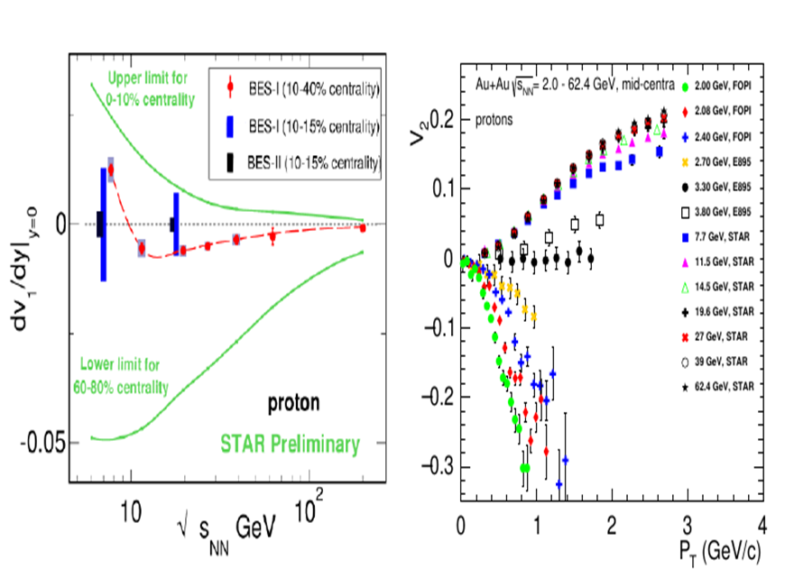
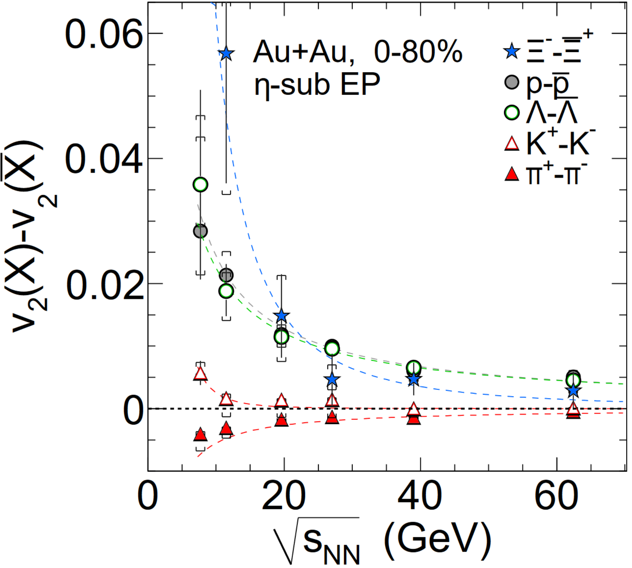



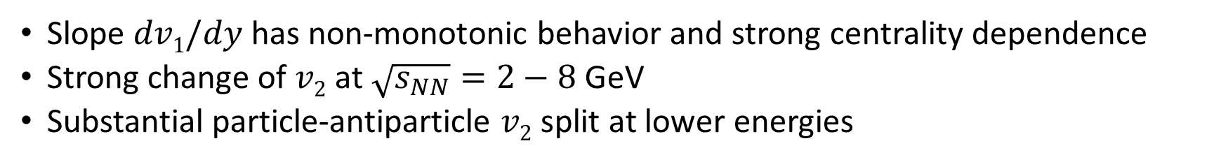
Beam energy dependence of anisotropic flow from RHIC to NICA
$v1$ – Directed flow
$v2$ – Elliptic flow
$v2$ of particles vs. antiparticles
Slope $dv1/dy$has non-monotonic behavior and strong centrality dependence
Strong change of $v2$ at $\sqrt{s_{NN}}=2−8$ GeV
Substantial particle-antiparticle $v2$ split at lower energies
Taranenko et. al. Phys. Part. Nuclei 51, 309–313 (2020)
RHIC BES. (STAR Collaboration) Phys. Rev. C 88 (2013) 14902

Slide 4
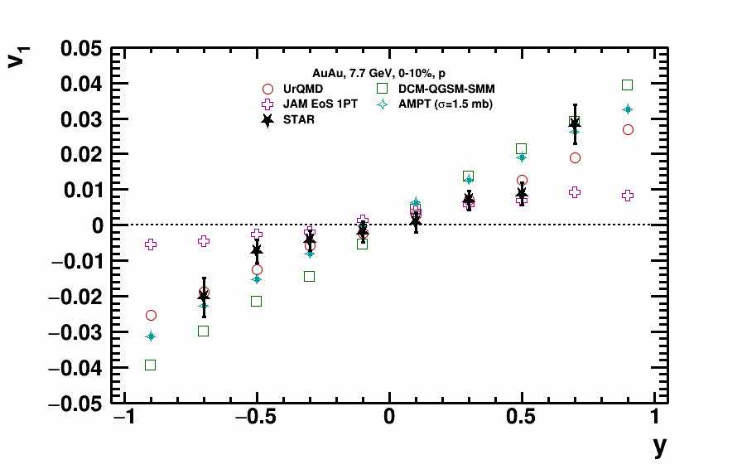
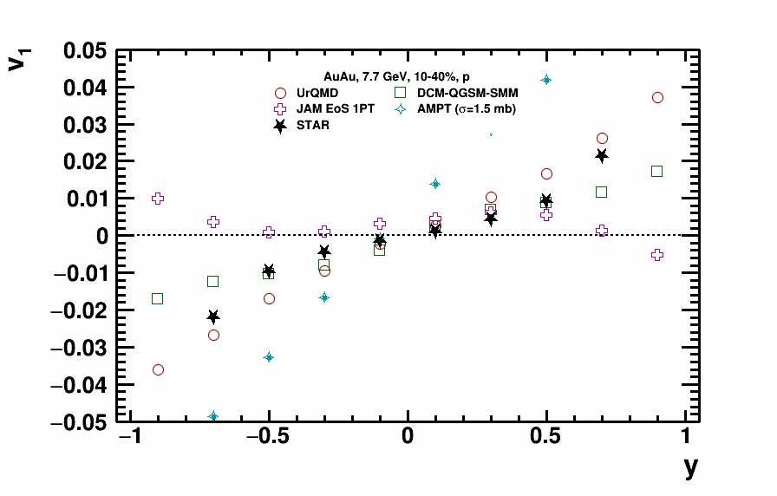
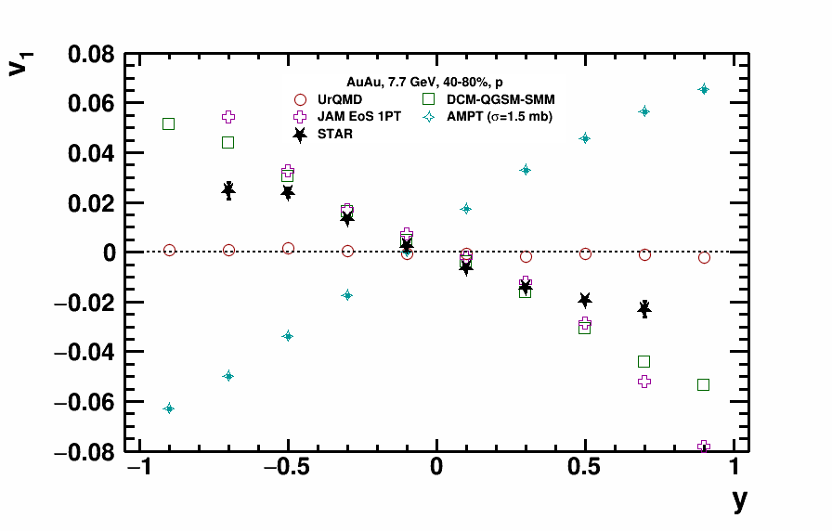
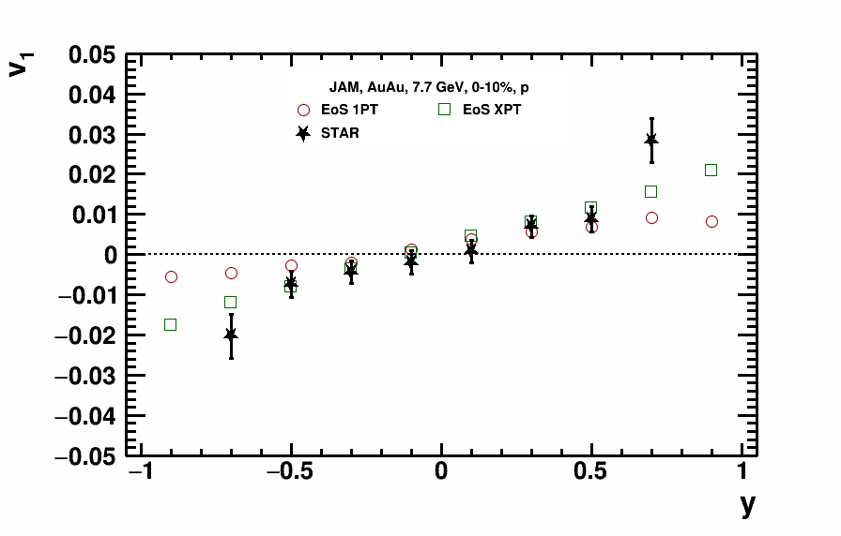
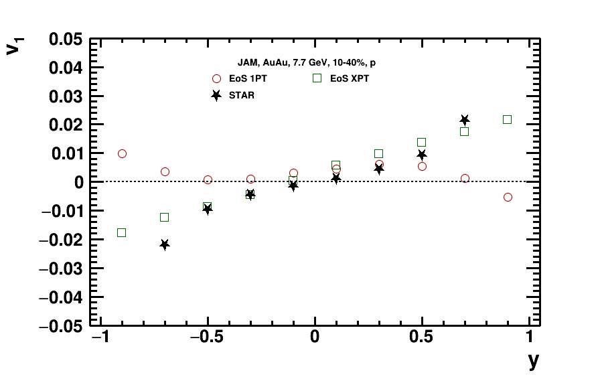
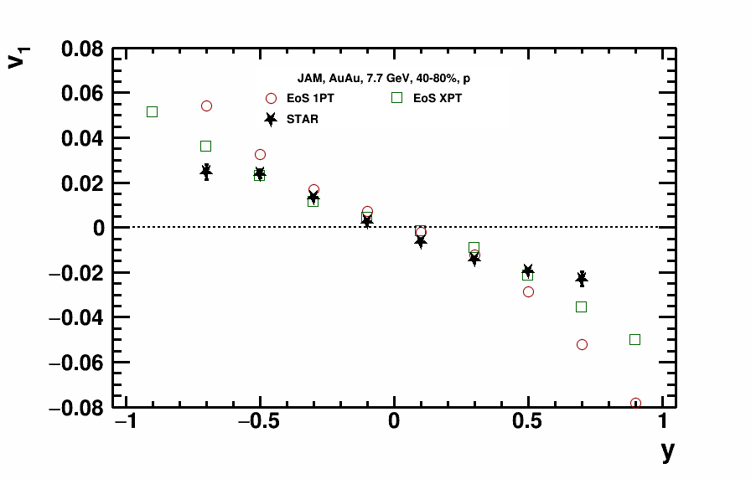
Model vs. data comparison for $v1(y)$
STAR data: Phys. Rev. Lett. 112 (2014) 162301
STAR data: Phys. Rev. Lett. 112 (2014) 162301
DCM-QGSM-SMM and JAM XPT have the better agreement with STAR published data
Slope $dv1/dy$changes dramatically with centrality for protons

Slide 5
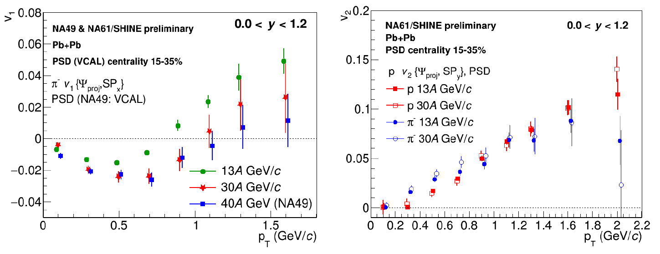
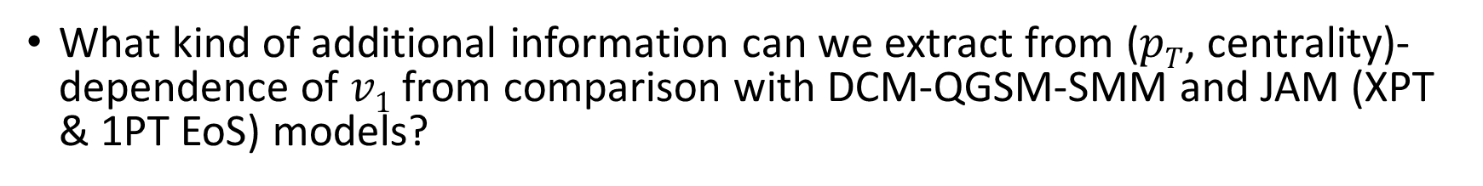
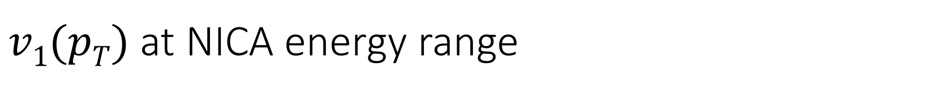
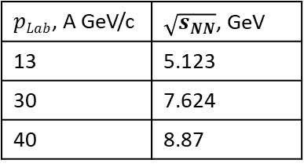
$v1(pT)$at NICA energy range
$pLab$, A GeV/c | $\sqrt{s_{NN}}$, GeV
13 | 5.123
30 | 7.624
40 | 8.87
NA61/SHINE: Golosov. O., Kashirin E. (ICPPA 2020)
What kind of additional information can we extract from ($pT$, centrality)-dependence of $v1$ from comparison with DCM-QGSM-SMM and JAM (XPT & 1PT EoS) models?

Slide 6
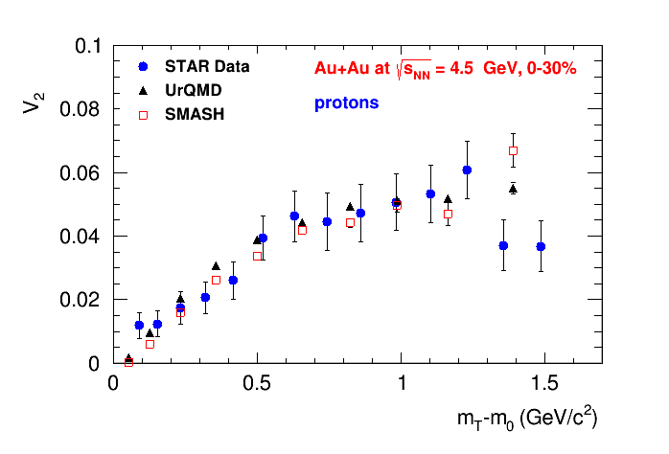
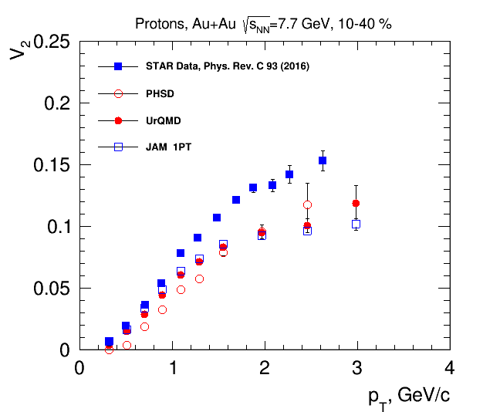
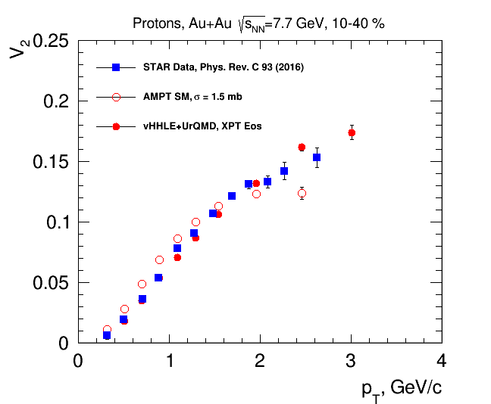
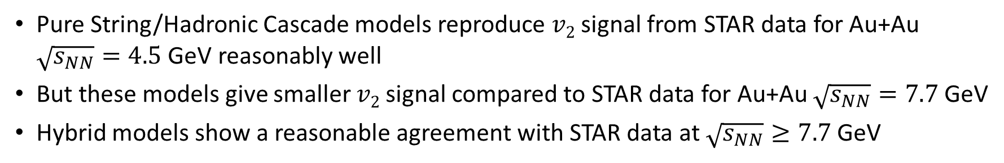
Elliptic flow at NICA energies
STAR Collaboration, arxiv.org/abs/2007.14005
Pure String/Hadronic Cascade models reproduce $v2$ signal from STAR data for Au+Au $\sqrt{s_{NN}}=4.5$ GeV reasonably well
But these models give smaller $v2$ signal compared to STAR data for Au+Au $\sqrt{s_{NN}}=7.7$ GeV
Hybrid models show a reasonable agreement with STAR data at $\sqrt{s_{NN}}≥7.7$ GeV

Slide 7
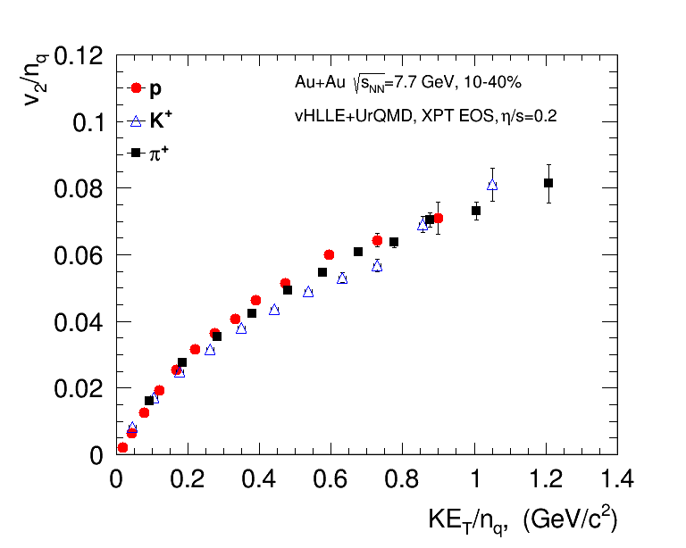
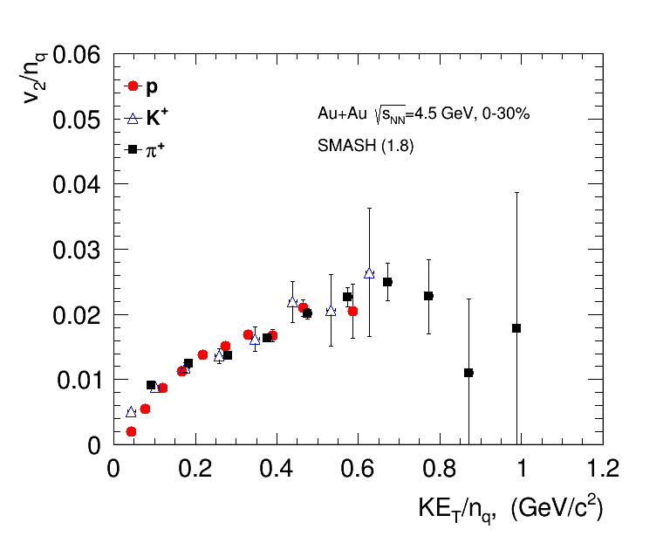
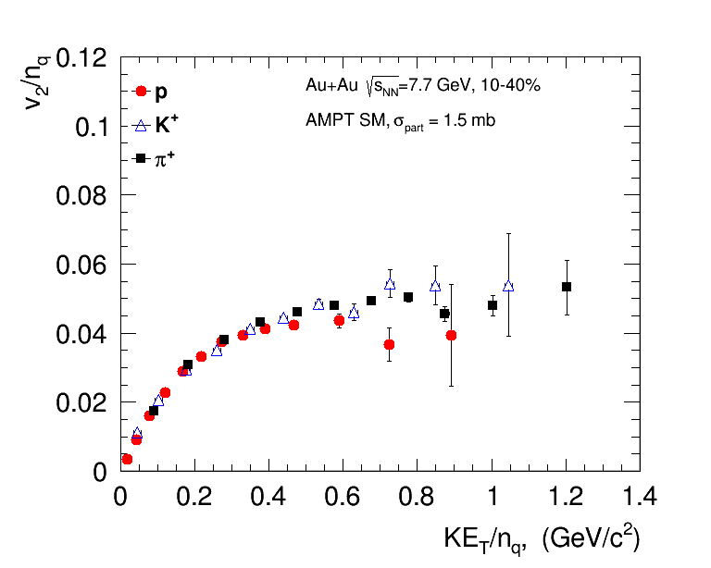
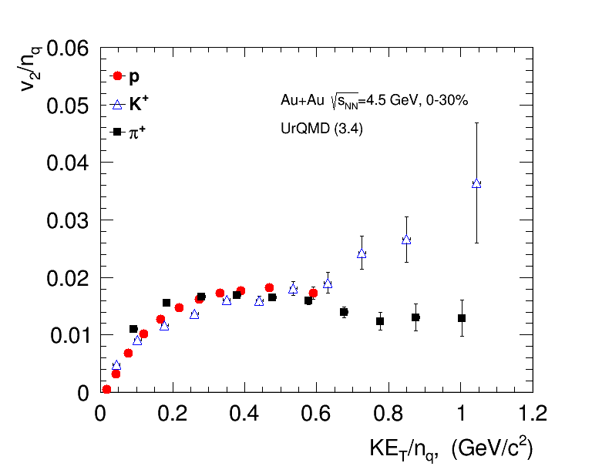
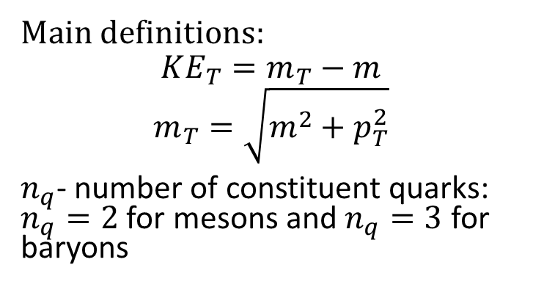
Elliptic flow: NCQ scaling
Main definitions:
$$KE_{T}=m_{T}−m$$
$$m_{T}=\sqrt{m^{2}+p_{T}^{2}}$$
$n_{q}$- number of constituent quarks: $n_{q}=2$ for mesons and $n_{q}=3$ for baryons
At RHIC: NCQ scaling = partonic collectivity
NCQ scaling holds both in hybrid (vHLLE+UrQMD, AMPT) and pure string/hadronic cascade (UrQMD, SMASH) models
  What is the origin of NCQ scaling?

Slide 8
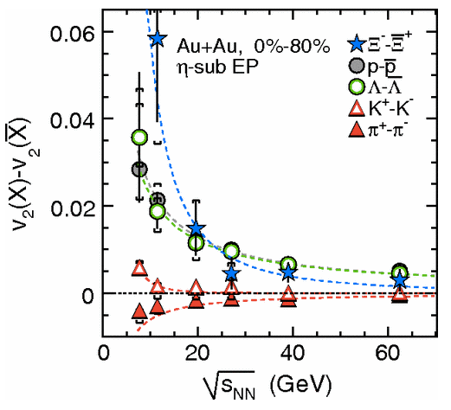
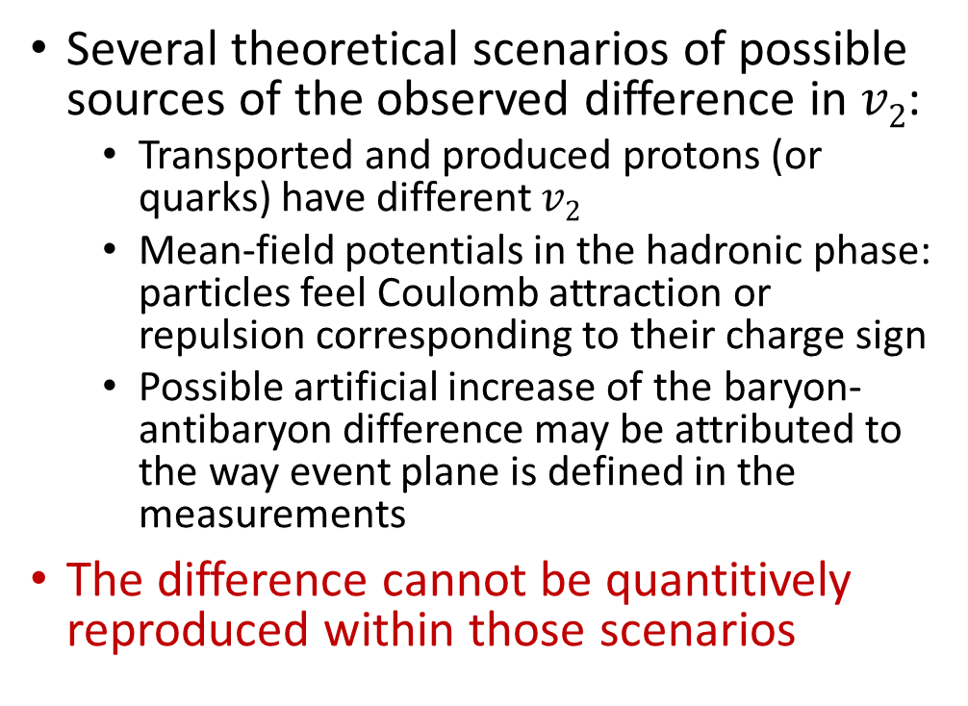
Difference in $v2$ between particles and antiparticles
RHIC BES. (STAR Collaboration) Phys. Rev. C 88 (2013) 14902
Several theoretical scenarios of possible sources of the observed difference in $v2$:
  Transported and produced protons (or quarks) have different $v2$
  Mean-field potentials in the hadronic phase: particles feel Coulomb attraction or repulsion corresponding to their charge sign
  Possible artificial increase of the baryon-antibaryon difference may be attributed to the way event plane is defined in the measurements
The difference cannot be quantitively reproduced within those scenarios

Slide 9
Difference in $v2$ between particles and antiparticles
Steinheimer, J. et al., Phys.Rev.C 86 (2012) 044903
The difference between might depend on the event plane (defined from protons or antiprotons; 1st or 2nd order harmonic) that is used in $v2$ measurements

Slide 10
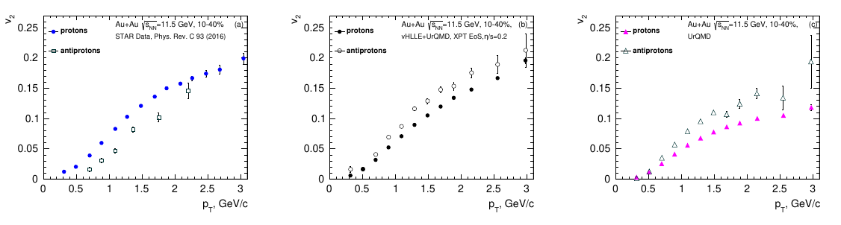

Elliptic flow: protons vs. antiprotons
Both vHLLE+UrQMD and UrQMD predict $v_{2}\left(p\right)<v_{2}\left(\overline{p}\right)$ but experimental data shows $v_{2}\left(p\right)>v_{2}\left(\overline{p}\right)$

Slide 11
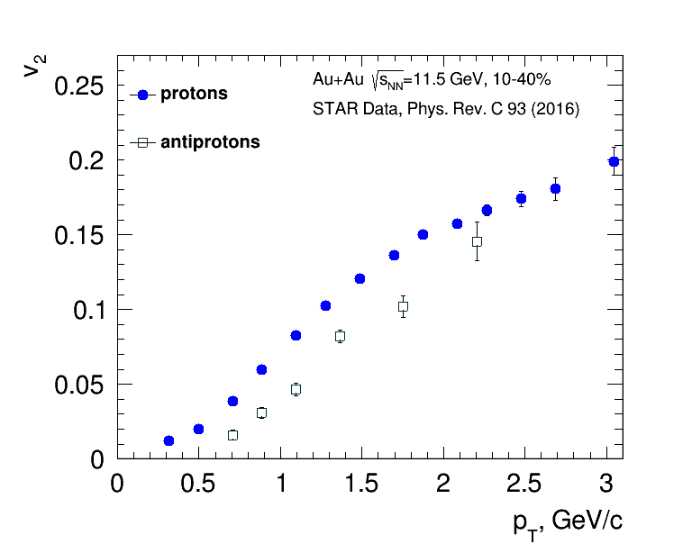
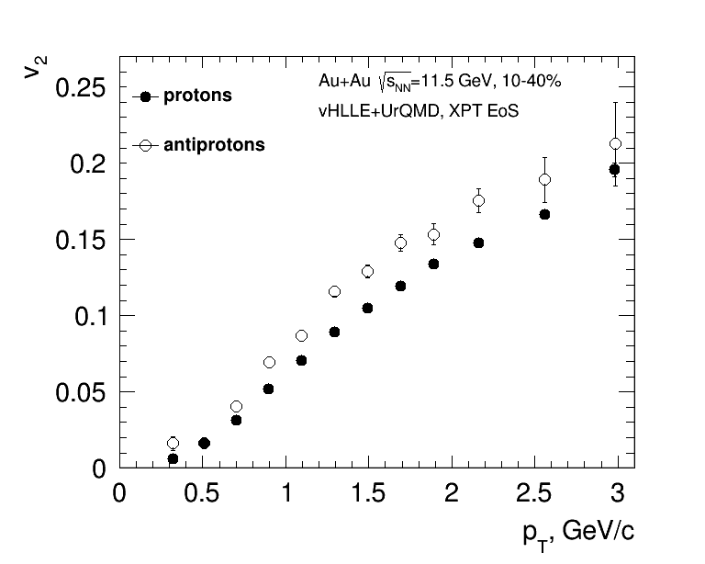
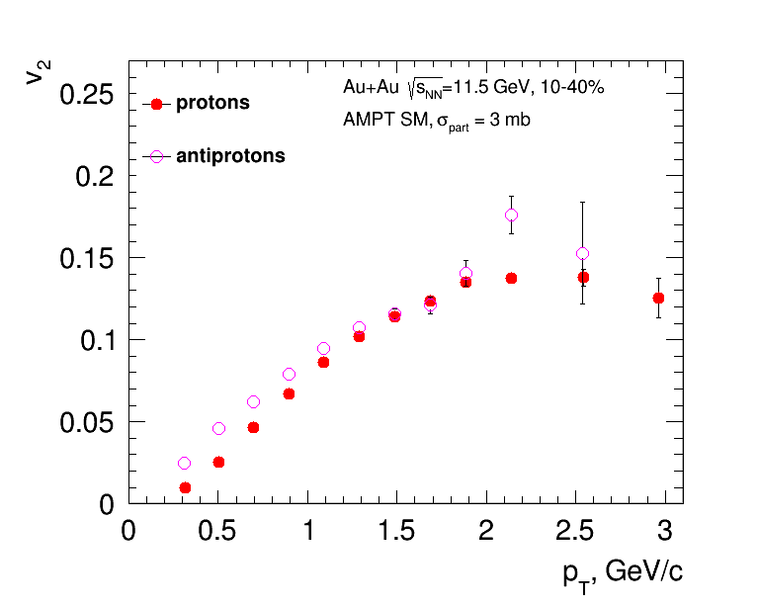
Elliptic flow: protons vs. antiprotons
The same trend is apparent in both vHLLE+UrQMD and AMPT
The effect is smaller in AMPT than in vHLLE+UrQMD and UrQMD

Slide 12
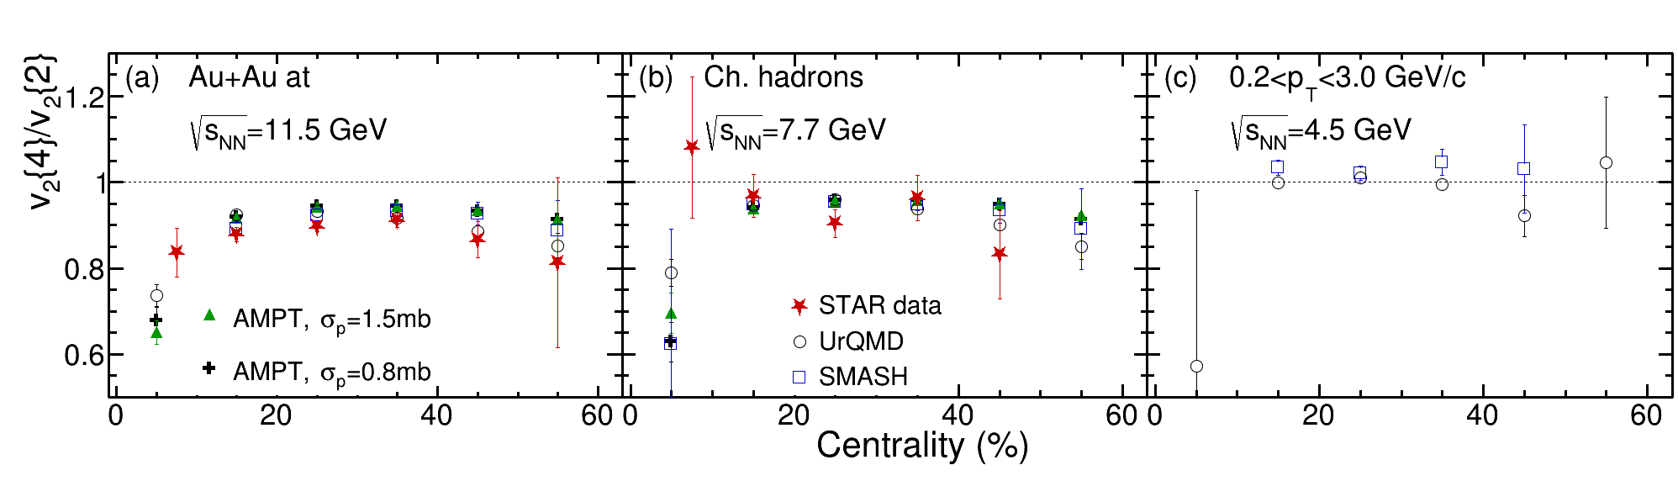
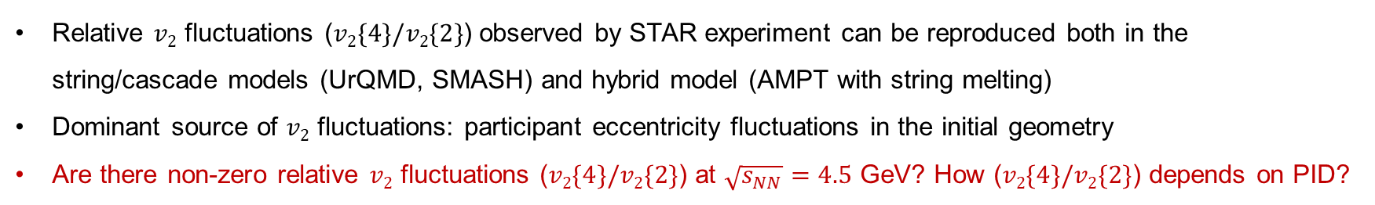
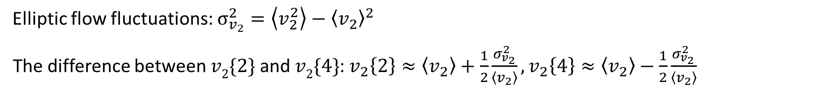
Relative elliptic flow fluctuations at 11.5, 7.7 and 4.5 GeV
Elliptic flow fluctuations: $σ_{v_{2}}^{2}=\left\langle v_{2}^{2}\right\rangle −{\left\langle v_{2}\right\rangle }^{2}$
The difference between $v2\{2\}$ and $v2\{4\}$: $v_{2}\left\{2\right\}≈\left\langle v_{2}\right\rangle +\frac{1}{2}\frac{σ_{v_{2}}^{2}}{\left\langle v_{2}\right\rangle },v_{2}\left\{4\right\}≈\left\langle v_{2}\right\rangle −\frac{1}{2}\frac{σ_{v_{2}}^{2}}{\left\langle v_{2}\right\rangle }$
Relative $v2$ fluctuations ($v2\{4\}/v2\{2\}$) observed by STAR experiment can be reproduced both in the string/cascade models (UrQMD, SMASH) and hybrid model (AMPT with string melting)
Dominant source of $v2$ fluctuations: participant eccentricity fluctuations in the initial geometry
Are there non-zero relative $v2$ fluctuations ($v2\{4\}/v2\{2\}$) at $\sqrt{s_{NN}}=4.5$ GeV? How ($v2\{4\}/v2\{2\}$) depends on PID?
12
Star data: L. Adamczyk et al. (STAR Collaboration). Phys. Rev. C 86, 054908 (2012))
Notes:
12
12
12
12
12
12
12
12
Different orders of cumulants do not have the same sensitivity to elliptic flow fluctuations.
In the figure, you can see the results of ALICE experiment, where red squares denote the second order cumulants and grey crosses -are the fourth order cumulants of elliptic flow
the difference between two- and multi-particle cumulants is due(ДЬЮ) to the fluctuations in the initial geometry.
In collisions, fluctuations can be expressed not only by the initial geometry, but also by the non-flow, formed by resonance decay or jet fragmentation.
And we can see that elliptic flow obtained by second order cumulants is more sensitive to nonflow than other higher order cumulants.

Slide 13
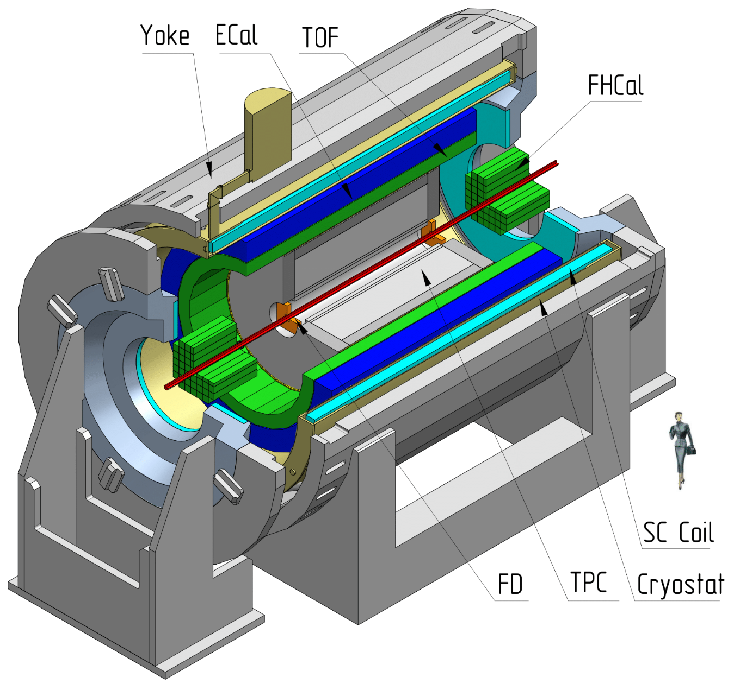
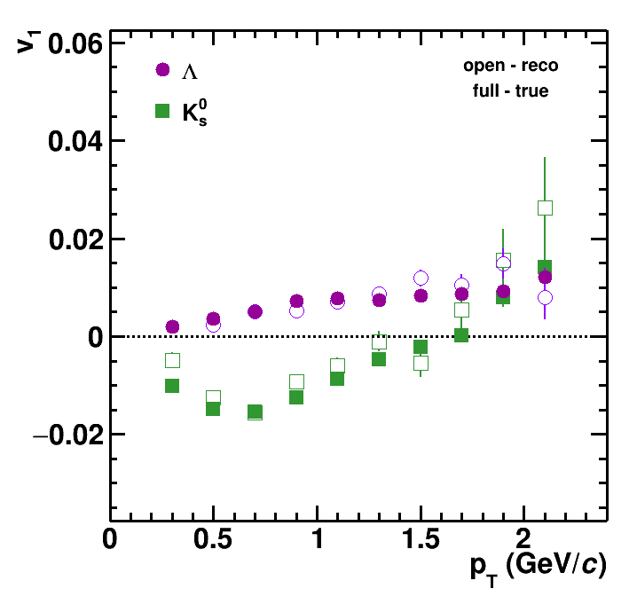
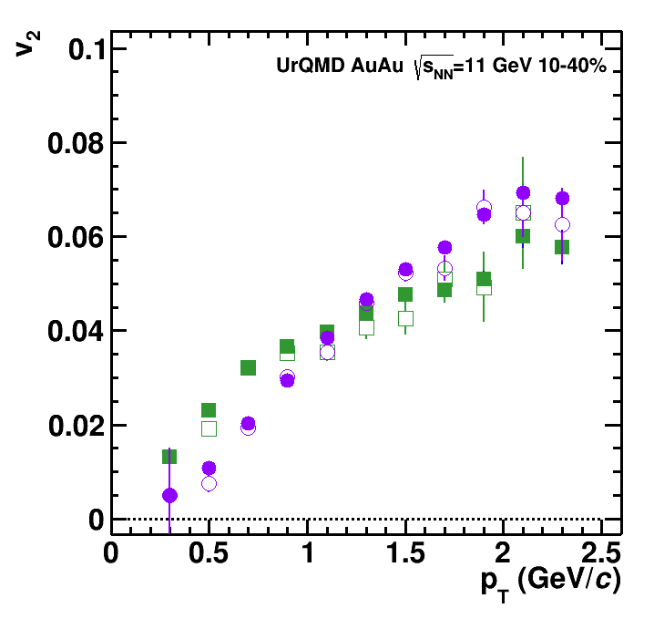
Flow measurements in MPD at NICA
To further investigate mentioned effects, framework for differential anisotropic flow measurements from realistically reconstructed data with high precision was implemented in the MPDROOT environment

Slide 14
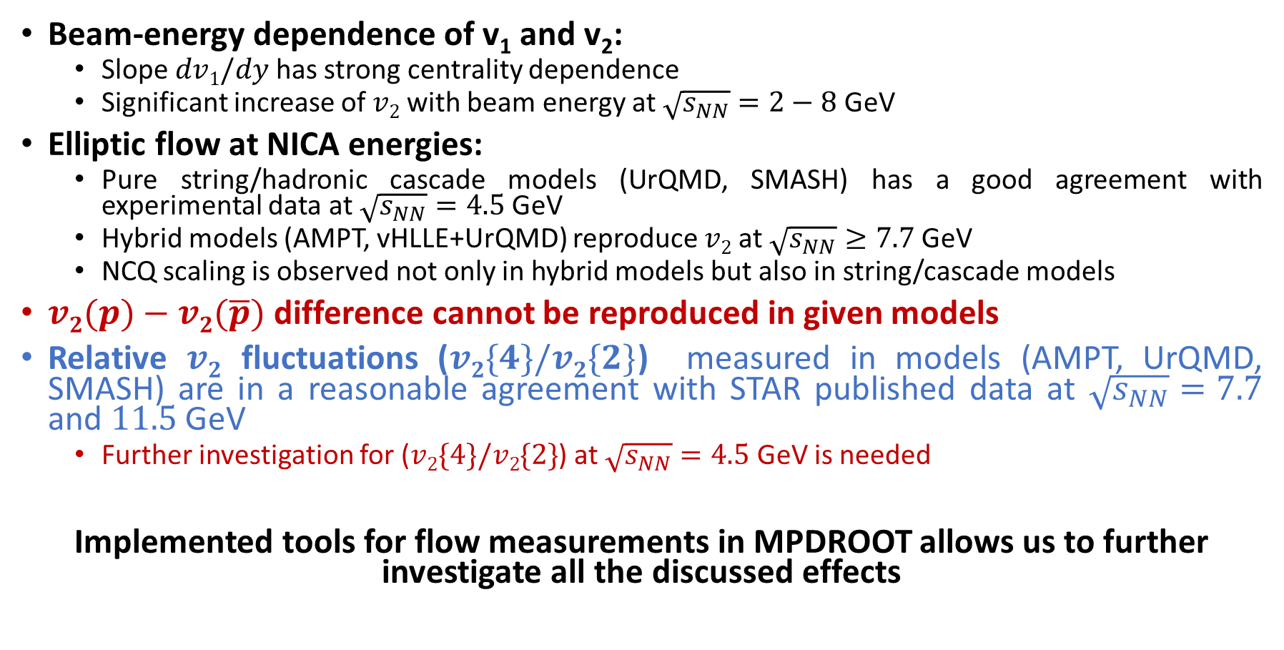
Summary and outlook
Beam-energy dependence of v₁ and v₂:
  Slope $dv1/dy$ has strong centrality dependence
  Significant increase of $v2$ with beam energy at $\sqrt{s_{NN}}=2−8$ GeV
Elliptic flow at NICA energies:
  Pure string/hadronic cascade models (UrQMD, SMASH) has a good agreement with experimental data at $\sqrt{s_{NN}}=4.5$ GeV
  Hybrid models (AMPT, vHLLE+UrQMD) reproduce $v2$ at $\sqrt{s_{NN}}≥7.7$ GeV
  NCQ scaling is observed not only in hybrid models but also in string/cascade models
$v2(p)−v2(\overline{p})$ difference cannot be reproduced in given models
Relative $v2$ fluctuations ($v2\{4\}/v2\{2\}$) measured in models (AMPT, UrQMD, SMASH) are in a reasonable agreement with STAR published data at $\sqrt{s_{NN}}=7.7$ and $11.5$ GeV
  Further investigation for ($v2\{4\}/v2\{2\}$) at $\sqrt{s_{NN}}=4.5$ GeV is needed
Implemented tools for flow measurements in MPDROOT allows us to further investigate all the discussed effects

Slide 15
Backup

Slide 16
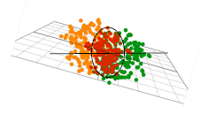
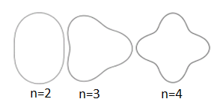

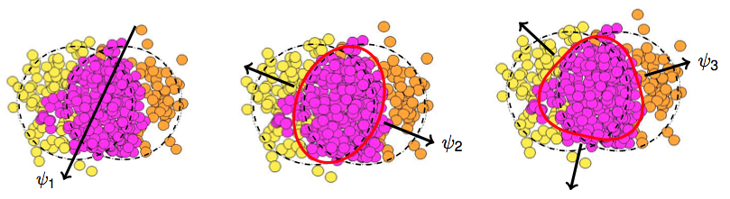
Anisotropic Collective Flow
Initial eccentricity (and its attendant fluctuations), ε_{n}, drives momentum anisotropy, v_{n}, with specific viscous modulation
v₁ - directed flow v₂ - elliptic flow v₃ - triangular flow

