Slide 1



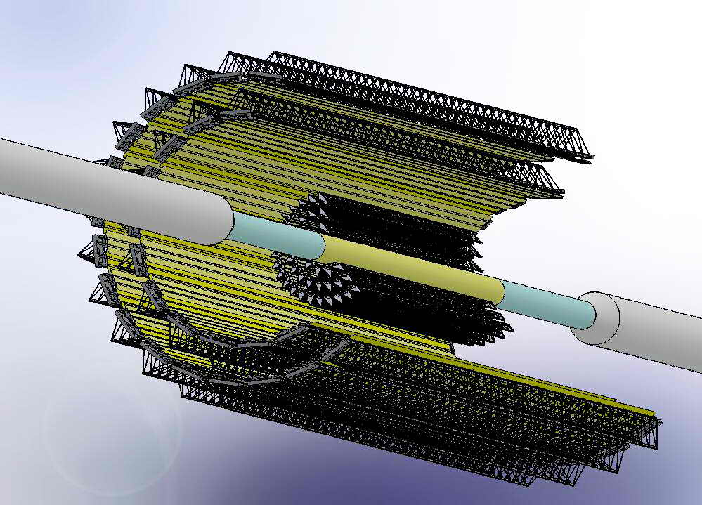
Progress in design and production of ultra-light mechanics for the MPD ITS and its integration scenario with the MPD TPC
Voronin A. L. voroninal@jinr.ru
Igolkin, S. N. Igolkin.sergey@gmail.com
Dubna October 23, 2020
RFBR research project No. 18-02-40119

Slide 2
The main areas of work in the production of mechanics.
1. Reproduction of the production technology of cold plates, creation of prototypes and their testing.
2. Production of supporting wheels for fixing the Outer Barrel of ITS.
3. The preparation for the production of ITS cage.

Slide 3
Mechanics of ITS optimal option for a 40 mm pipe.
Body length 1660mm. Outer diameter 495mm.
It consists of five coaxial layers of detector lines. The first three layers are located as close as possible to the beam pipe. These layers form a barrel that has an independent reference structure and it can be replaced with a different barrel depending on the diameter of the pipe used.

Slide 4
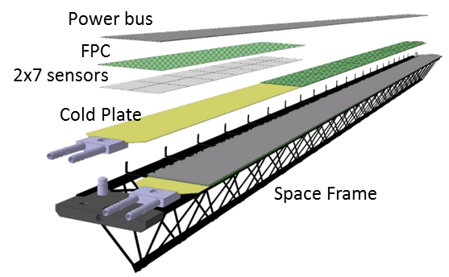
Detector’s Staves of OB layers 4 and 5
The 1540mm Staves of layers 4 and 5 have 2 cold plates (Half-Staves) with pixel detectors arranged in two rows on each Half-Stave. The total number of pixel chips on one Stave is 196. The total number of Staves in layers 4 and 5 is 42.

Slide 5
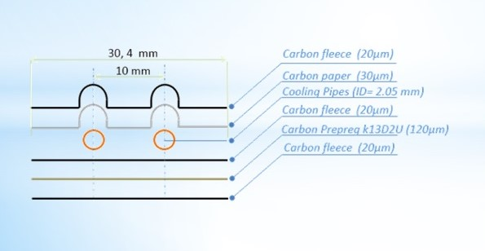
1. The production of the cold plates. The need for thermal testing of an analog of the source material.
At the moment, all the materials necessary for the production of cold plates are available, except for the K13D2U heat-conducting prepreg.
It was decided to replace it with the MJ55 prepreg, and conduct thermal tests to compare the characteristics of the following samples:
Cold plate using the K13D2U prepreg (ALICE-CERN).
Cold plate using MJ55 prepreg.
Cold plate using MJ55 prepreg and an additional heat-conducting layer of carbon paper.
Reference sample from CERN:
Weight: ~20.2 grams.
Length: 1504 mm.
The area of the working surface: ~48 cm².
Amount of heat removed: ~180 Watts.

Slide 6
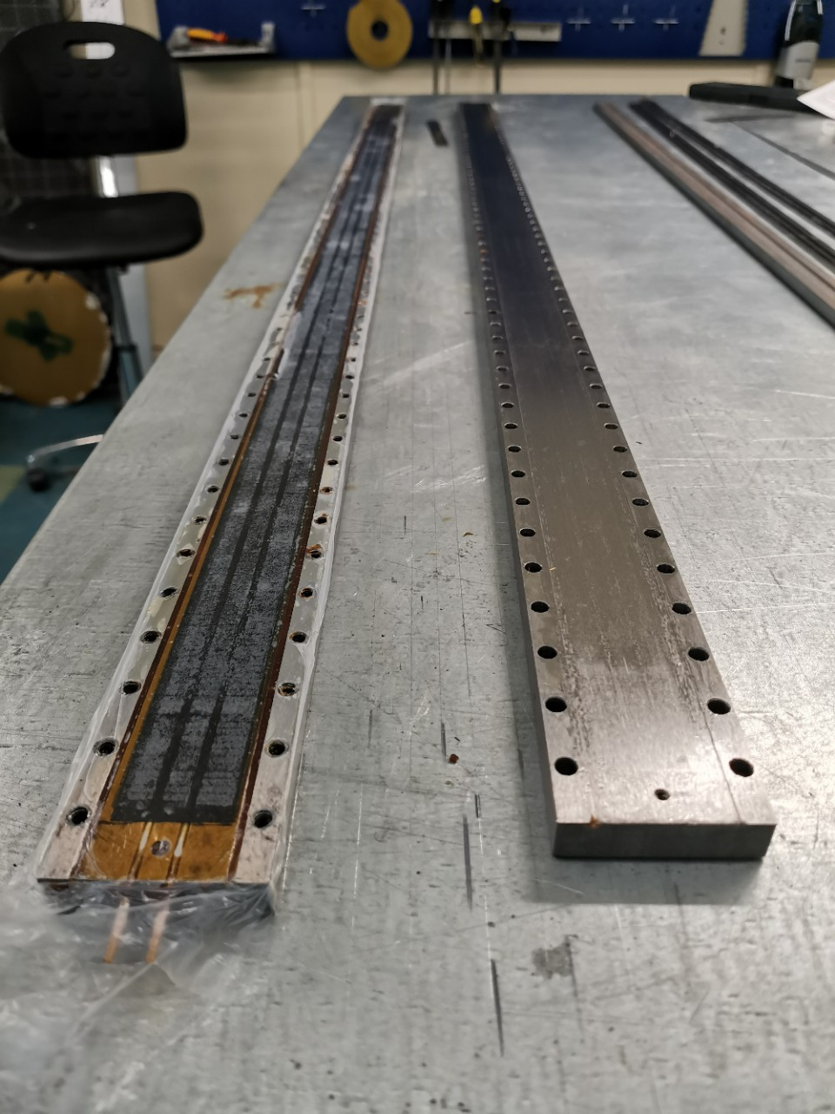
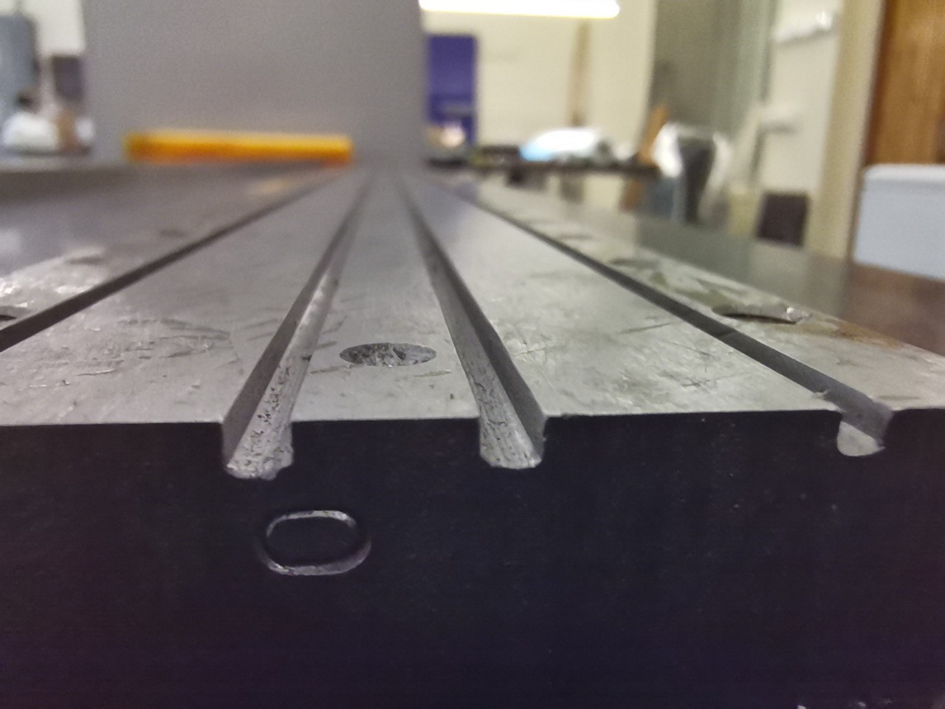
The Staves of outer layers #4 and #5 are a complete analog of the Staves from ALICE's OB Staves.
For the production of which the following equipment is available:
- Mold for forming OB supporting trusses (space frames) in St. Petersburg State University;
- Mold for forming OB cooling panels in JINR
Technological equipment for Assembly operations in production.

Slide 7
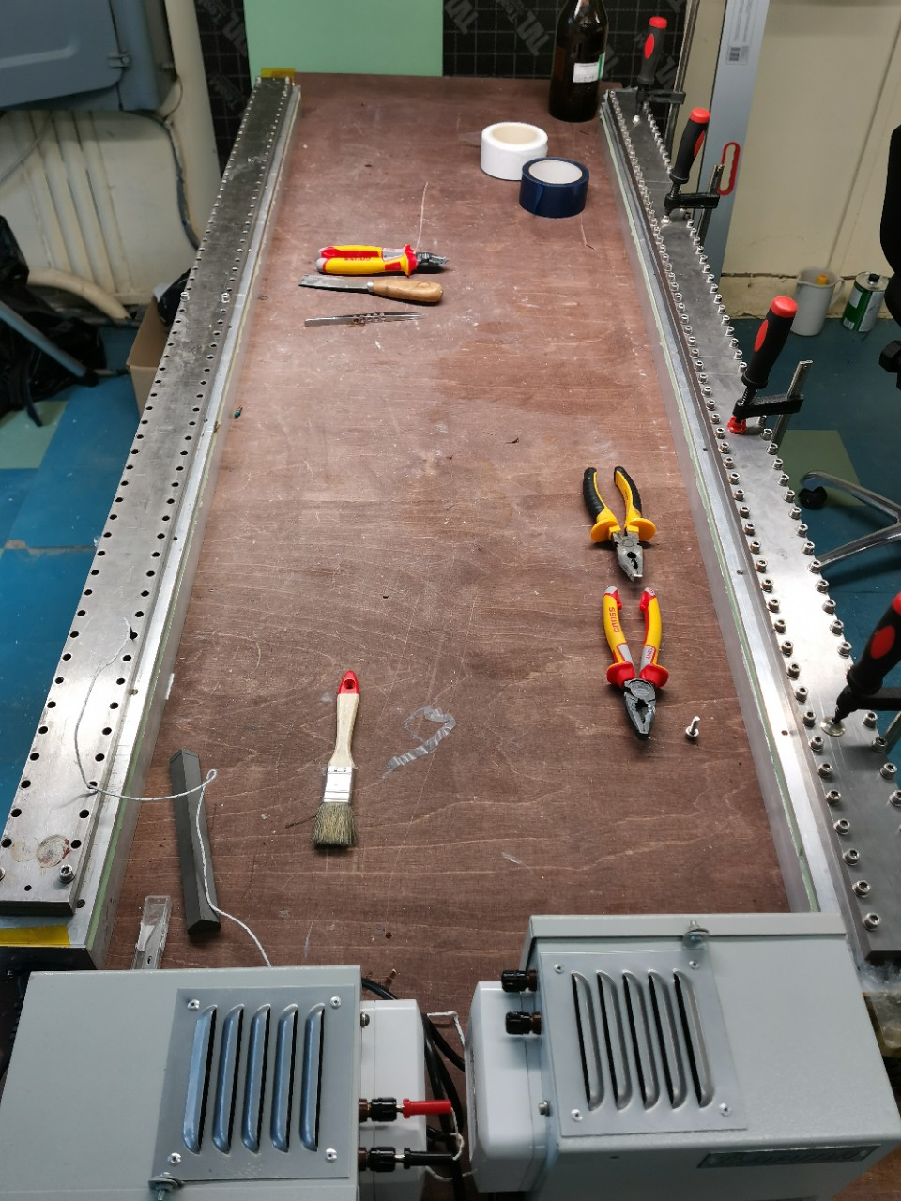
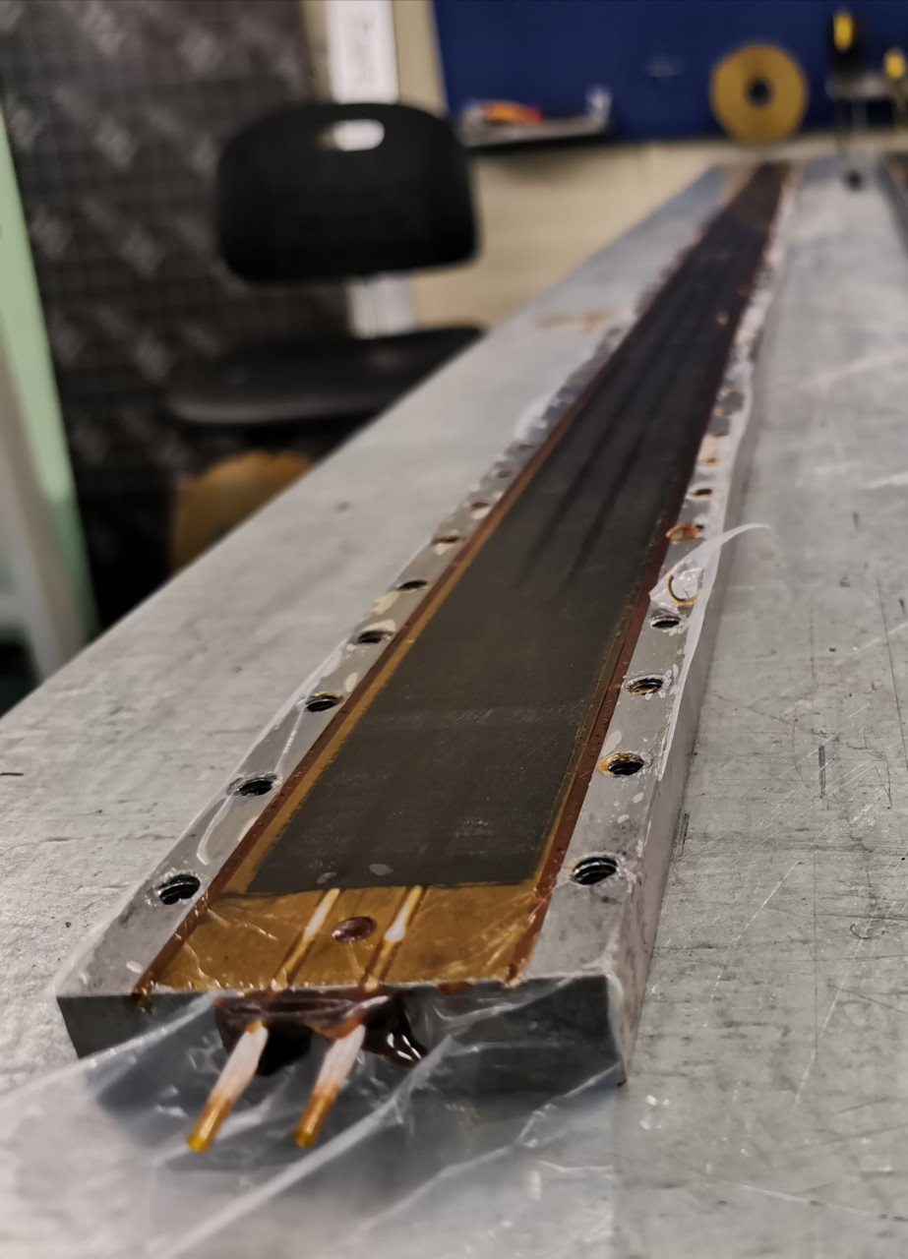
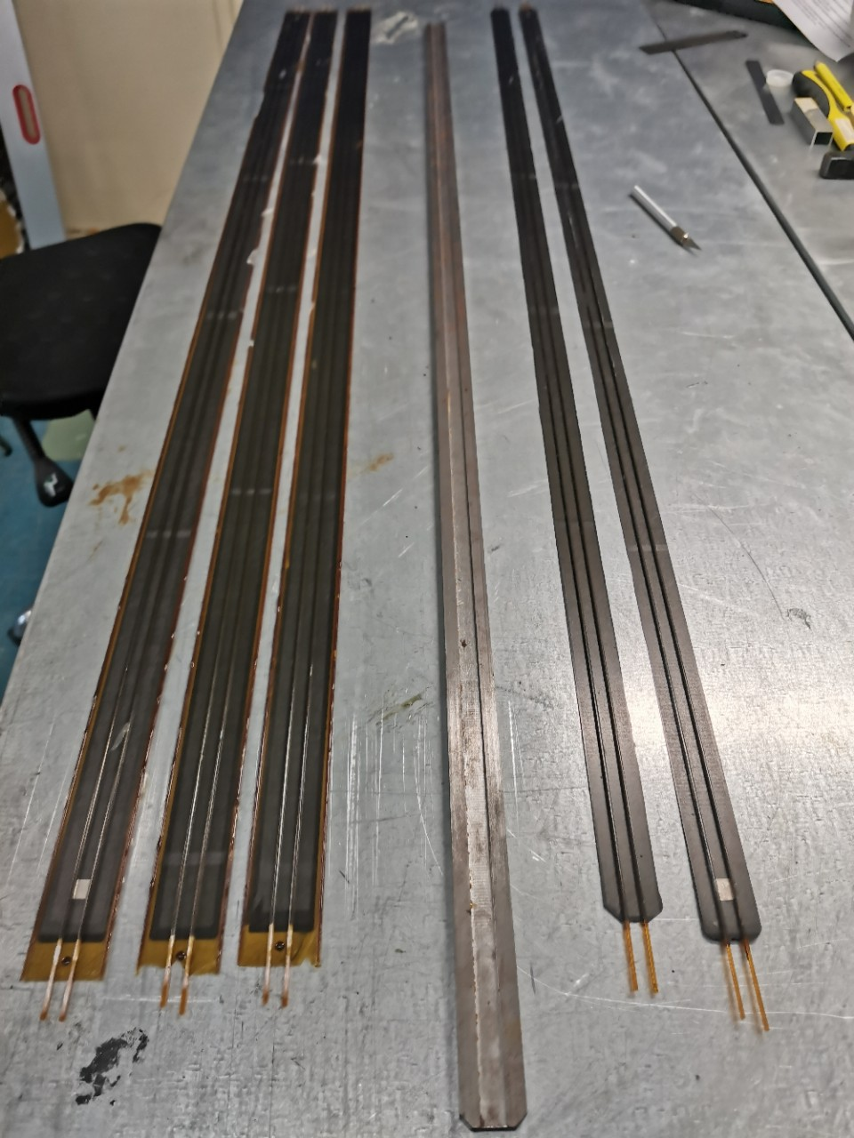
Preparation for conducting thermal tests.
This year, the laboratory is equipped with a production area that allows us to perform the entire cycle of work on the production of cold plates.
The following samples were produced for testing:
1. Cold plates using prepreg MJ55.
2. Cold plates using MJ55 prepreg and an additional heat-conducting layer of carbon paper.
The reference sample was brought from CERN.

Slide 8
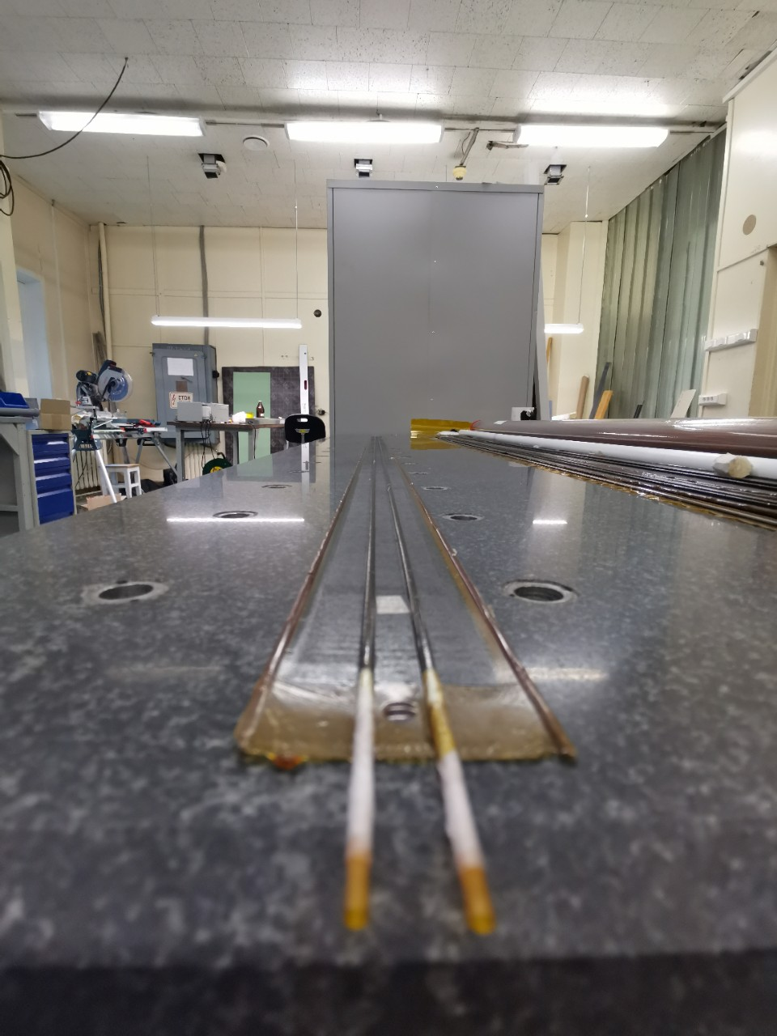
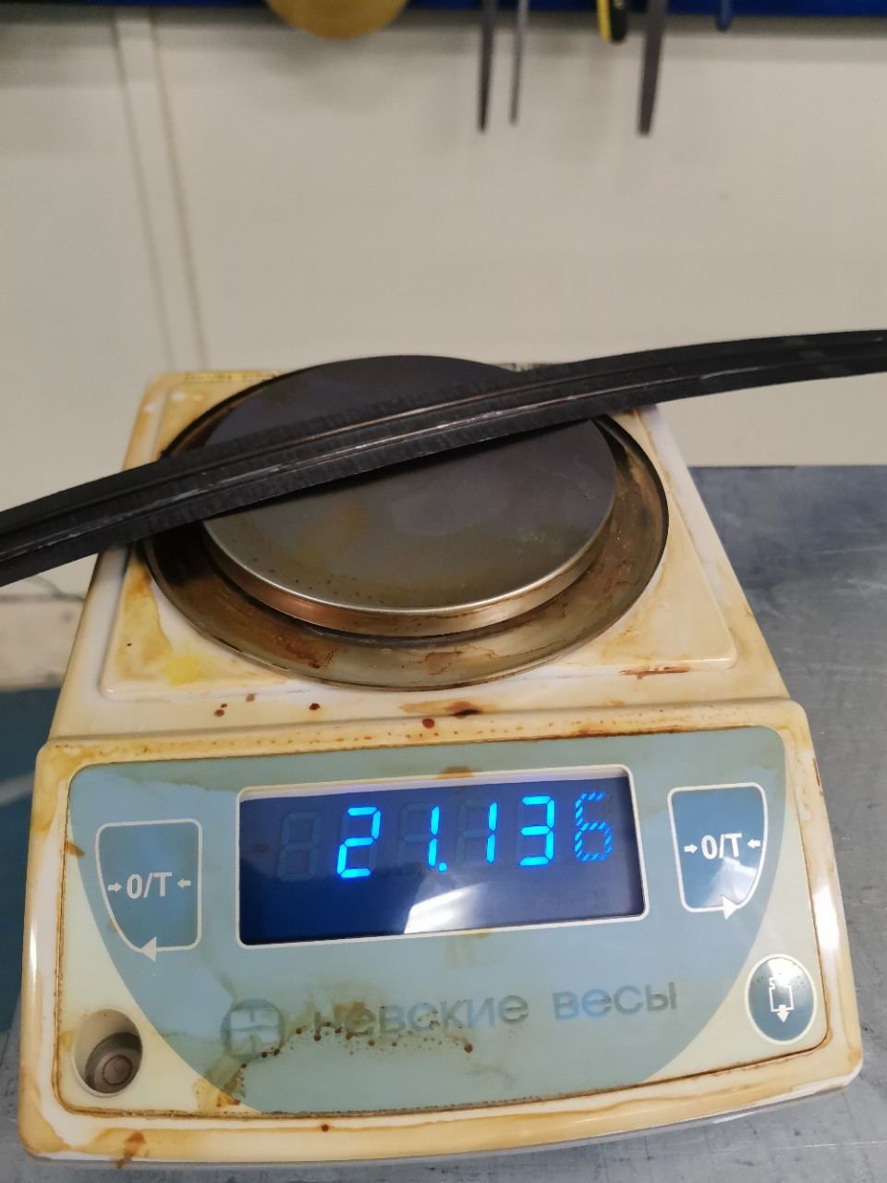
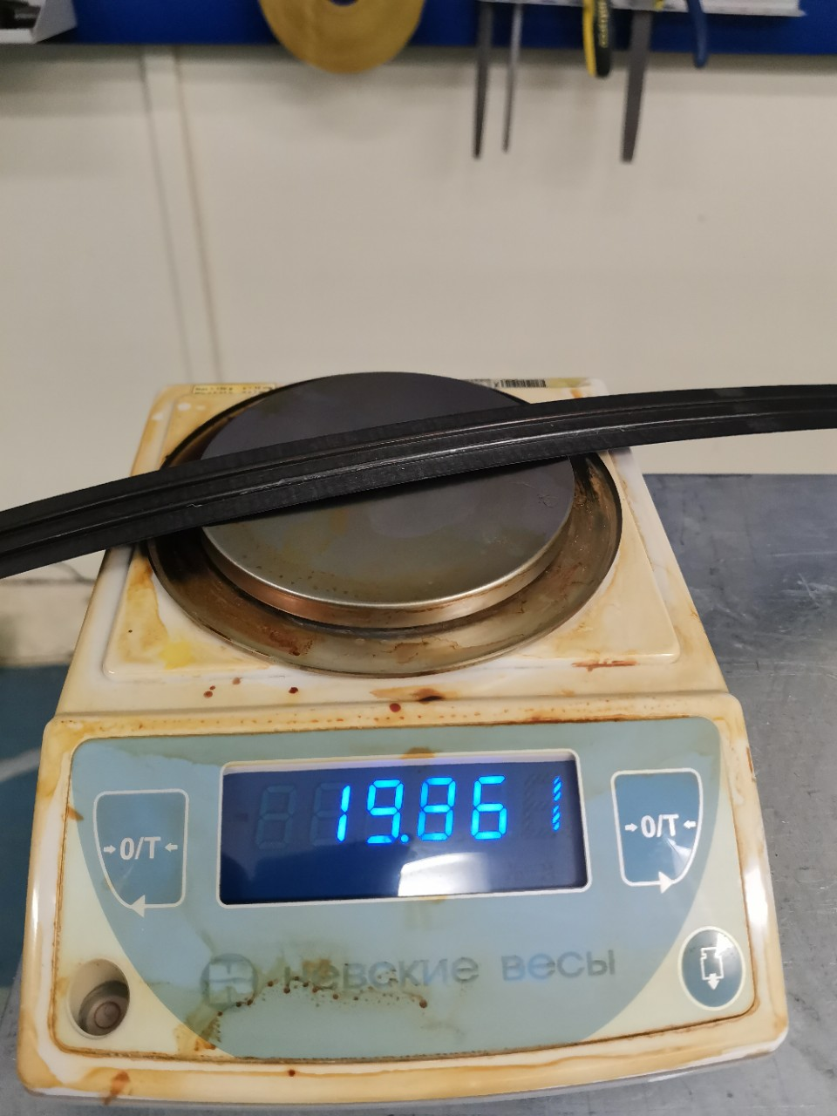
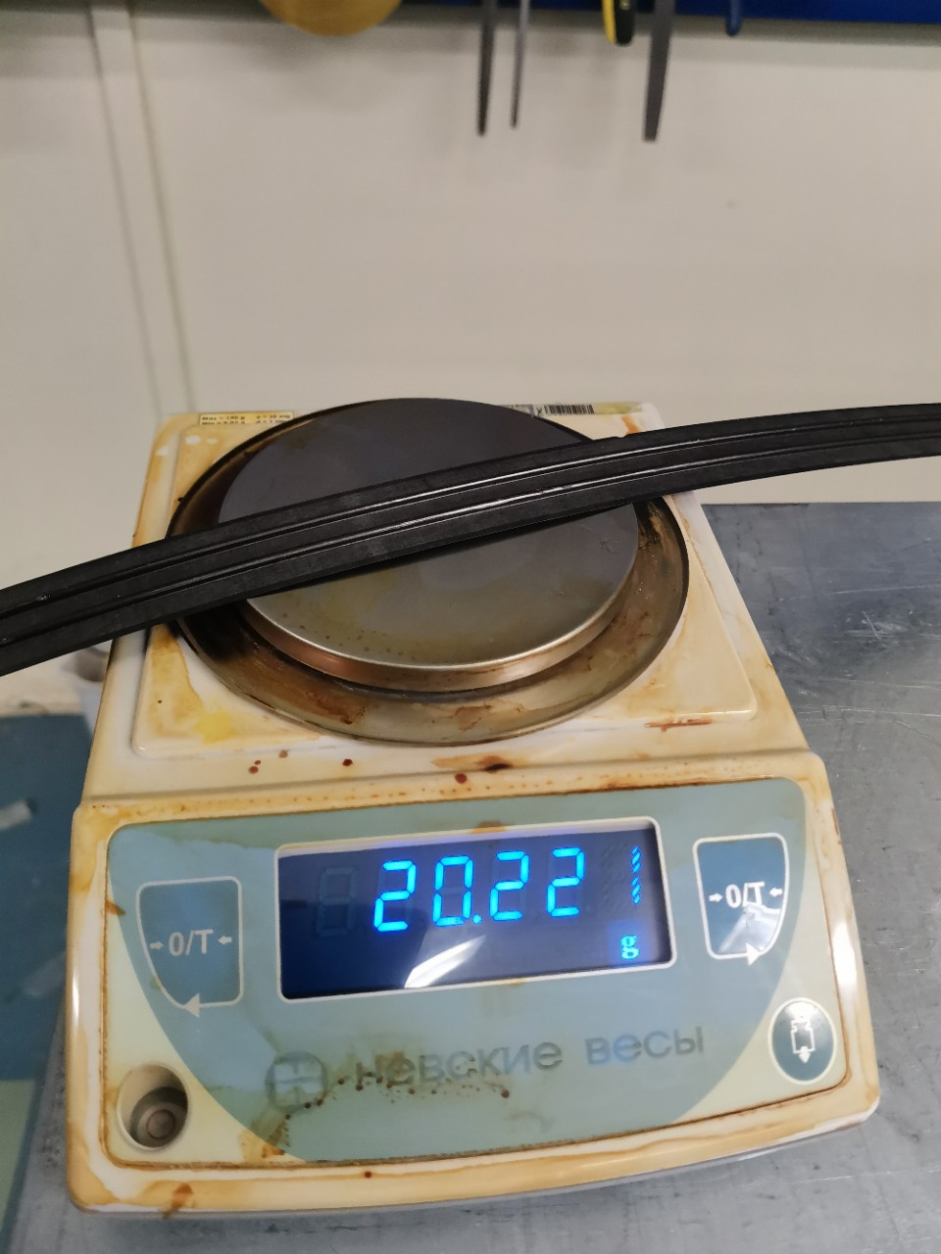
Mechanical performance tests were successfully passed - the cold plates is flat and smooth. Weight tests are also passed - the difference between the samples is 19.86 grams (MJ55) and 20.22 grams (Mj55 and carbon paper) .
MJ55 and carbon paper
MJ55
K13D2U

Slide 9
Thermal testing is planned to be performed by the end of October – beginning of November.
Mass production of our version of cold plates will be started if its thermal characteristics differ from the reference sample by less than 1-3 °C degrees.

Slide 10
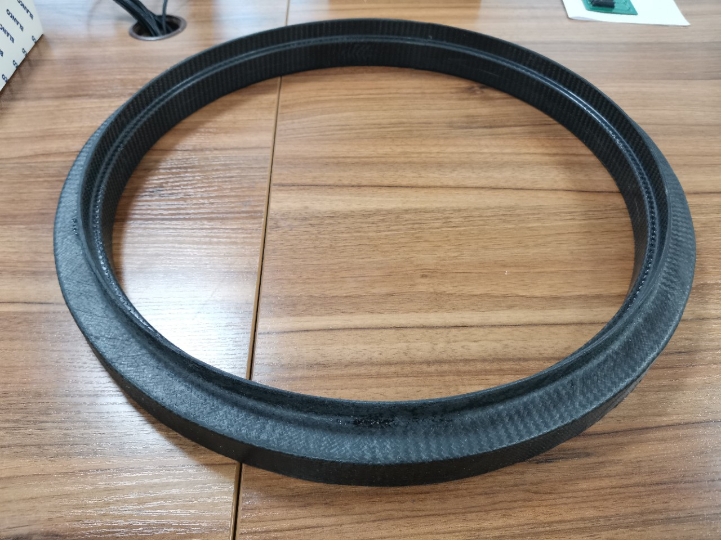
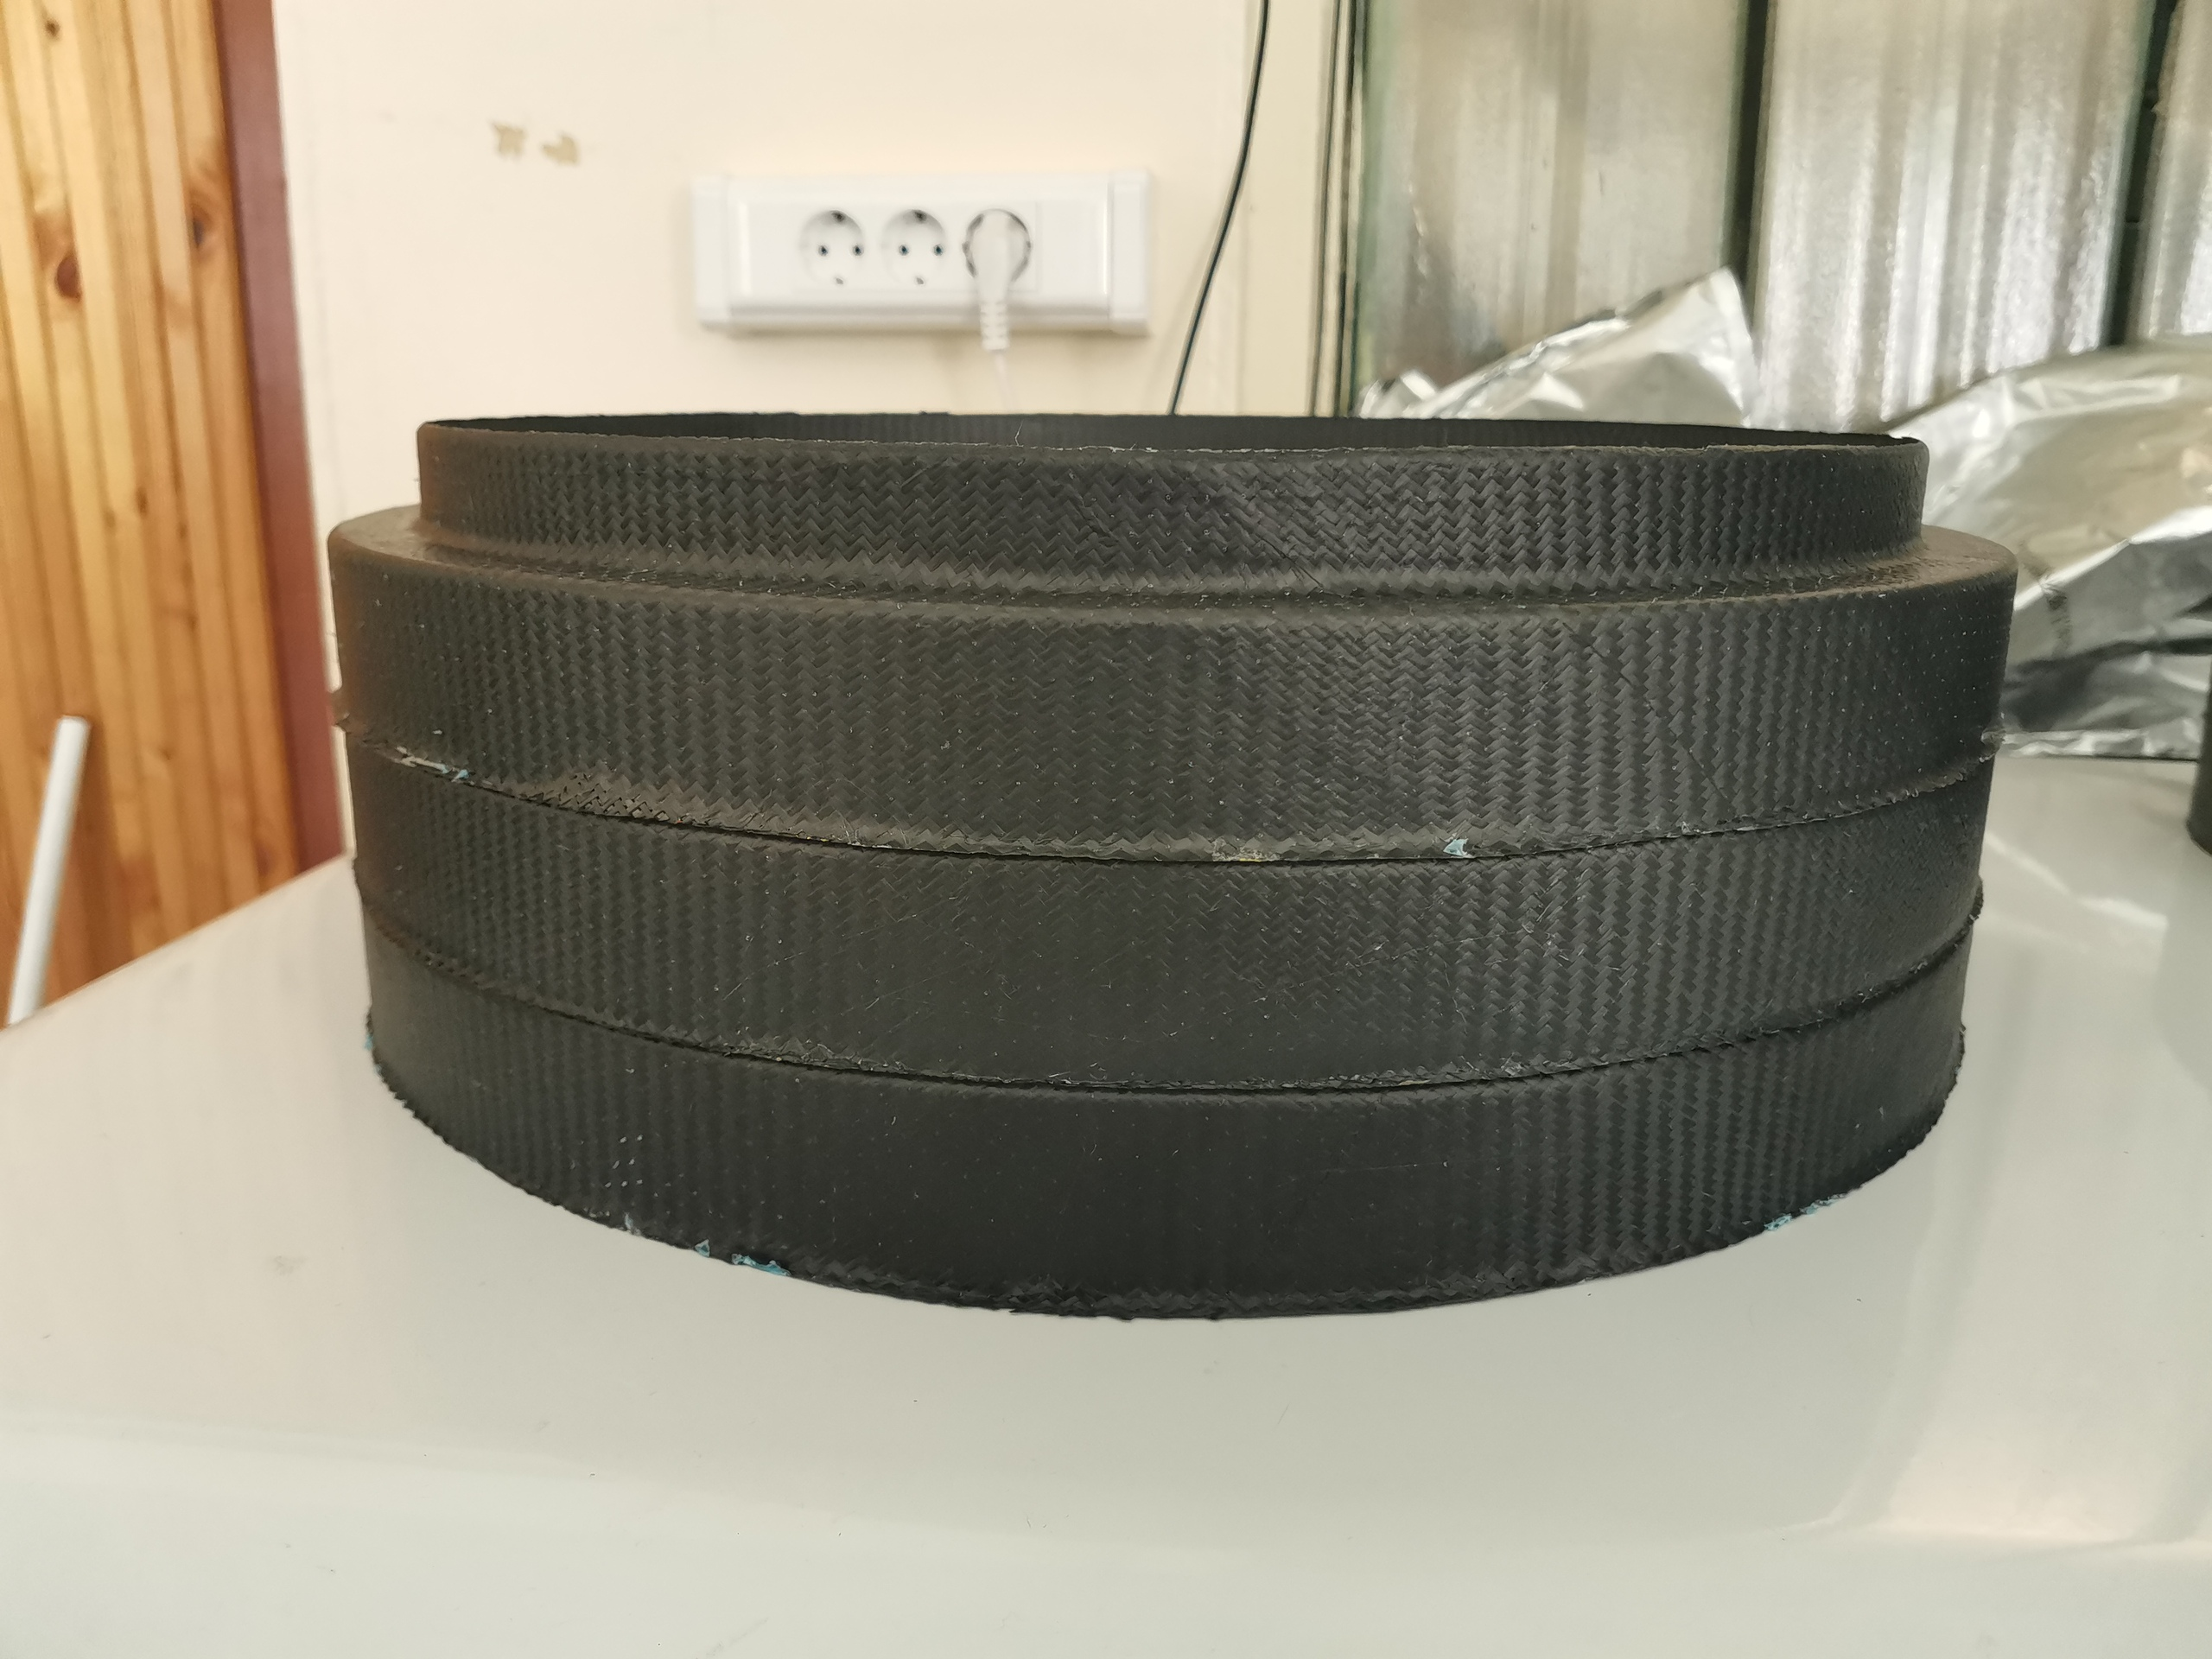
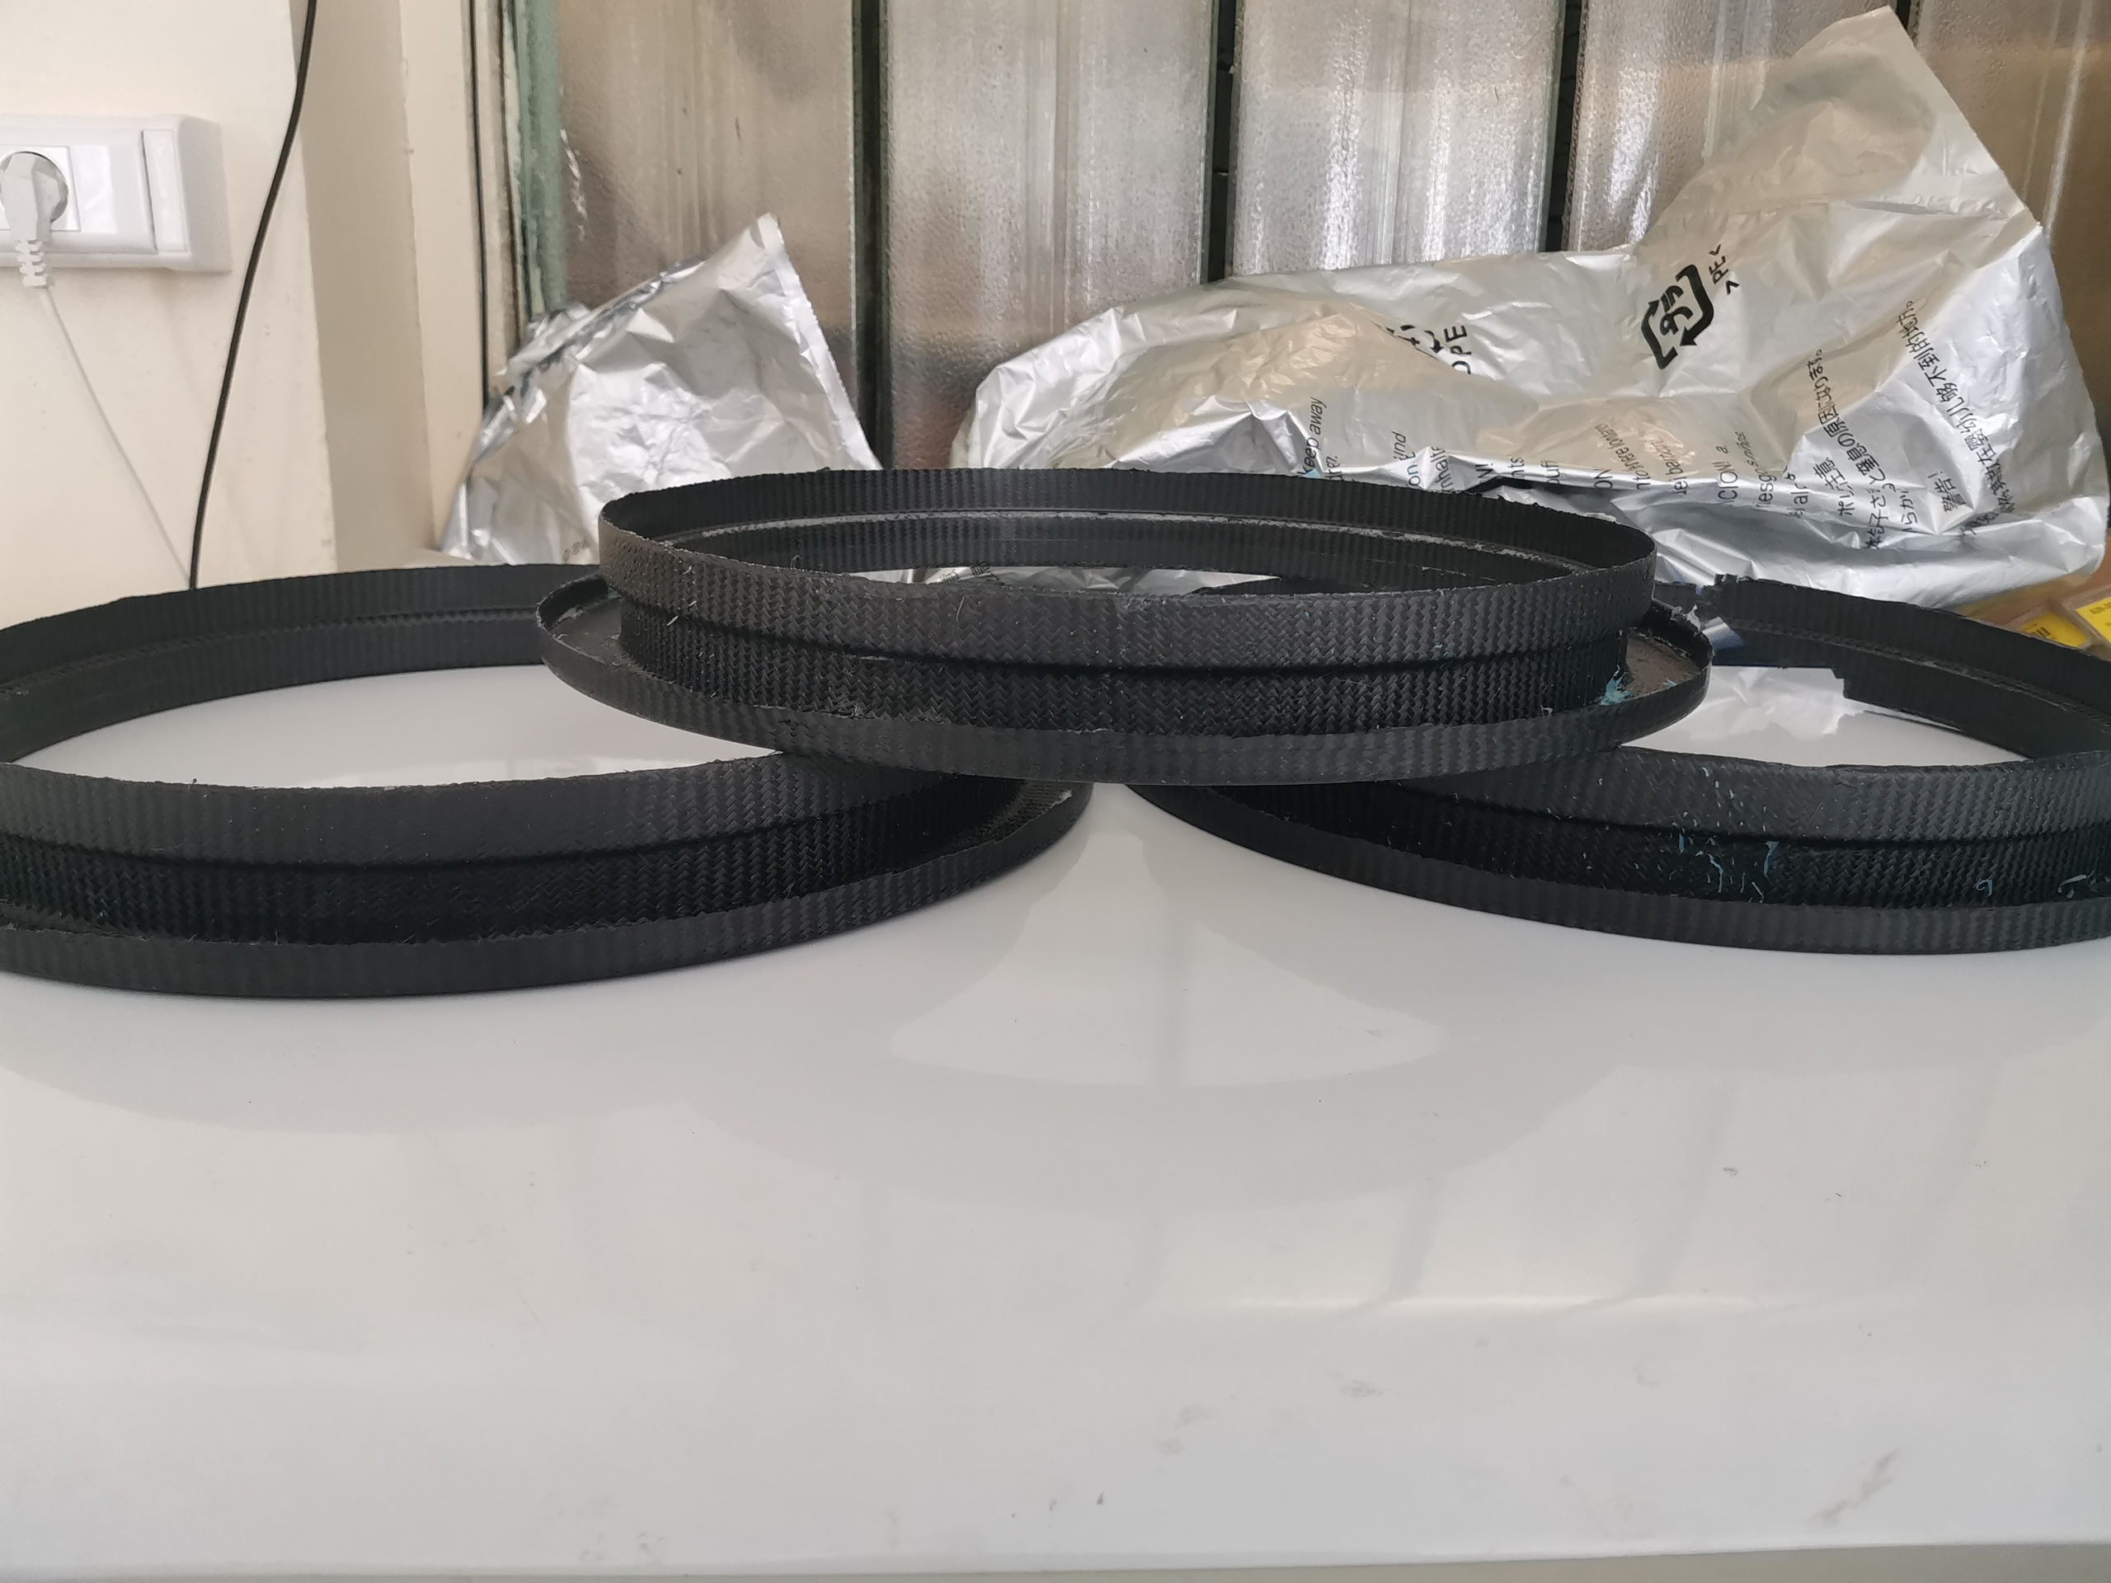
2. The production of supporting wheels for mounting the outer layers of ITS
To install layers 4 and 5 of ITS, it is necessary to produce carbon fiber supporting wheels by hot vacuum forming, each of which consists of two rings – internal and external. The rings are formed separately, and then glued together into a single piece for further processing.

Slide 11
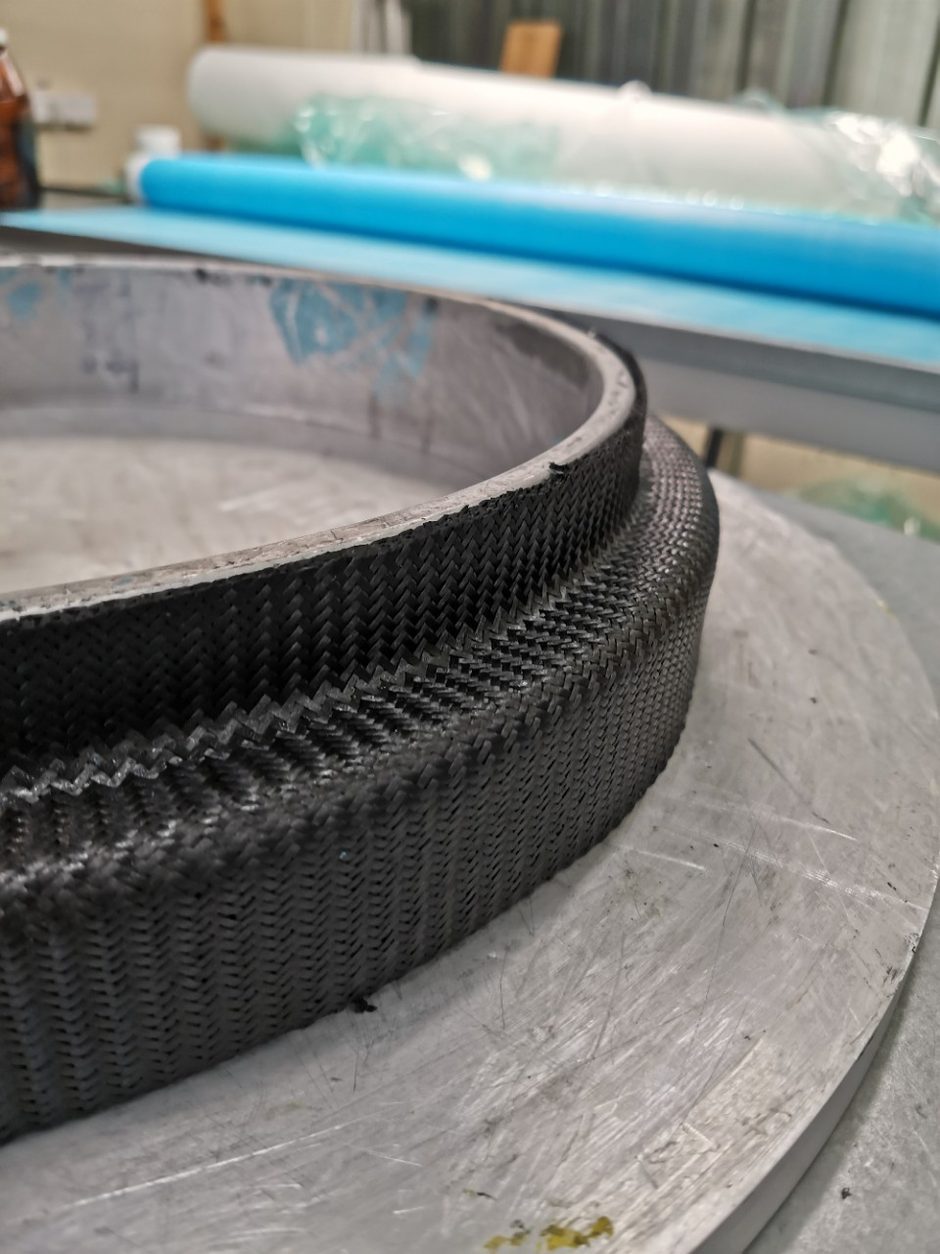
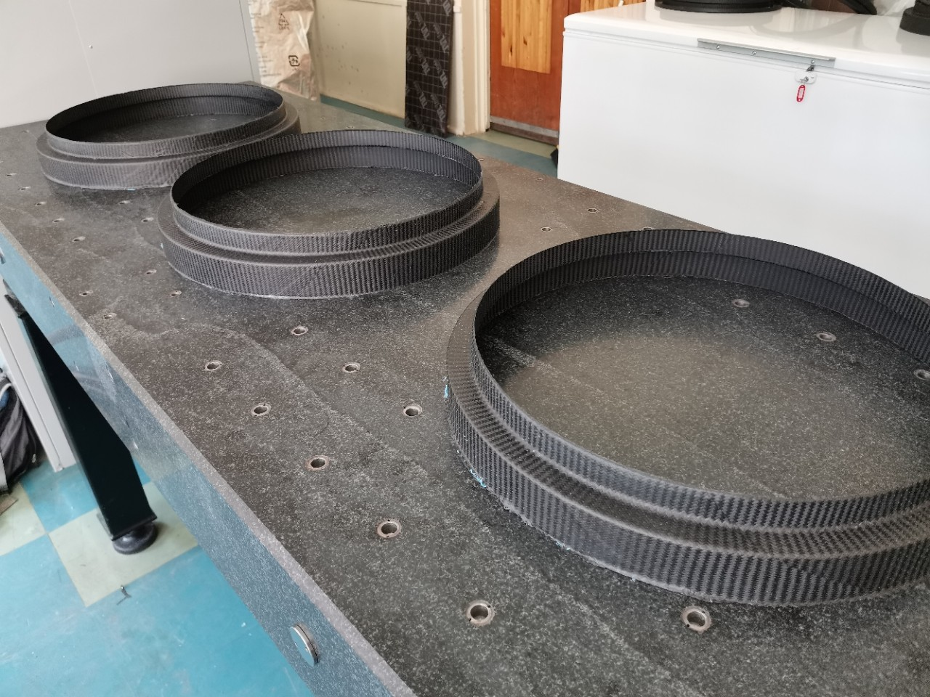
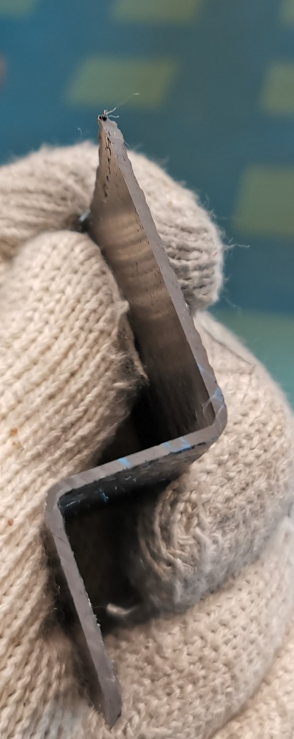
At the moment, the production technology of outer rings has been fully developed, and three products have been produced. The next stages are the production of inner rings, gluing supporting wheels, and processing them.

Slide 12
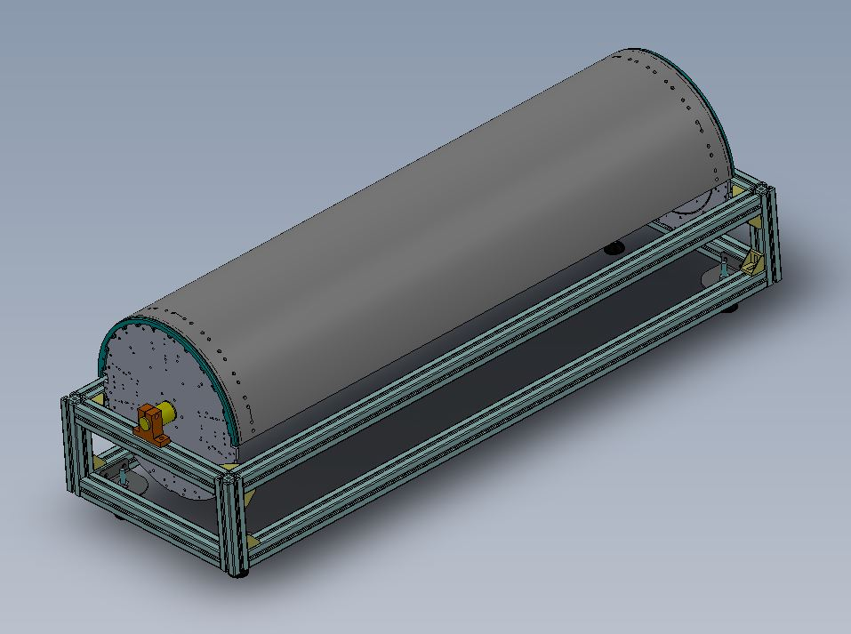
3. The preparation for the production of ITS cage.
All materials and accessories for manufacturing the cage are available. All drawings of parts are ready, and the parts themselves are in the manufacturing process. Production of the cage is planned for 2021.

Slide 13
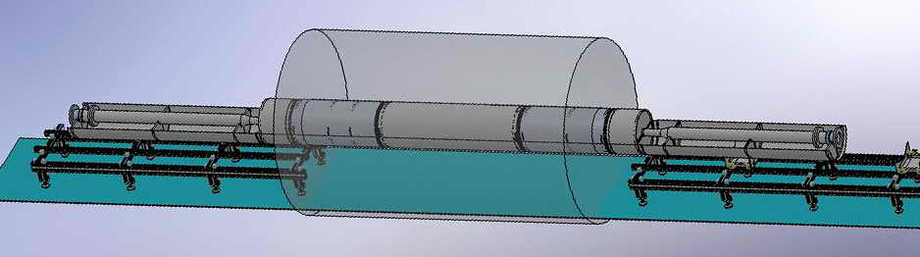
Conclusions:
By the end of 2020, jobs were prepared and production of prototypes and working products for the MPD ITS project was started. The main result will be the conclusions drawn from the tests of prototype cold plates and the launch of their mass production.
Plans for 2021 year:
Production of cold plates in the required quantity.
Manufacture supporting of wheels for the outer layers of ITS.
Manufacturing of the ITS cage.
The production of the layout of the tracker and mechanical testing.
Layout of internal device integration with TPC

Slide 14
Thanks for your attention!

