Slide 1
Development of the silicon tracking system for the BM@N experiment.
RFBR grant 18-02-40113
A. Baranov, N. Baranova, V. Elsha, P. Kharlamov, M. Korolev, V. Leontiev, M. Merkin, A. Sheremetiev

Slide 2
Outline
Central sensors
Main frame
Carbon C-frame and Al C-frame with cooling
FEB, FEB box, FEB connectivity
Cable routing
Plans
Laser setup for quality assurance of BM@N silicon tracking modules by P. Kharlamov
Progress in preparations for the BM@N STS ladder assembly by V. Elsha
Status of the BM@N STS module assembly by N. Sikhov

Slide 3
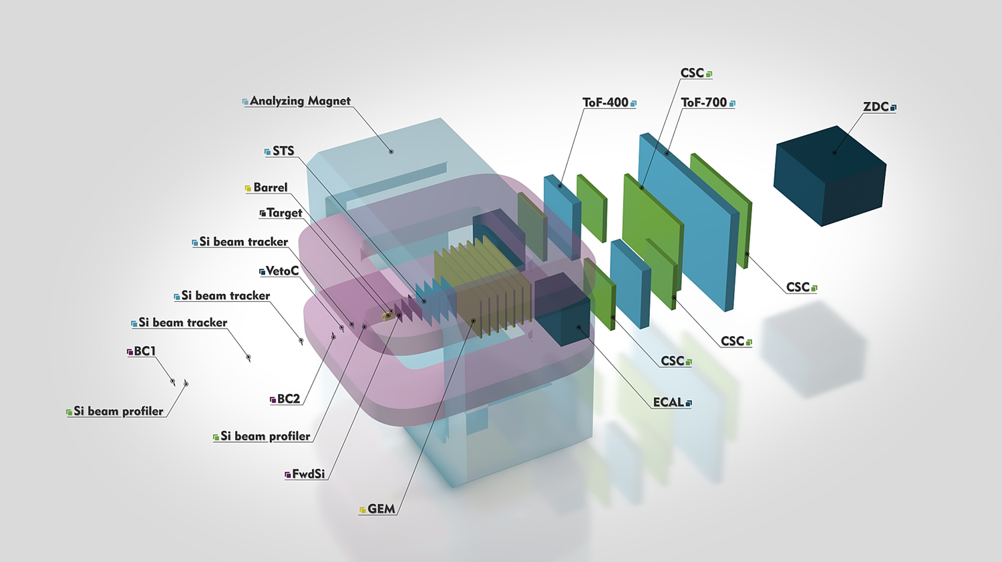
BM@N experiment

Slide 4
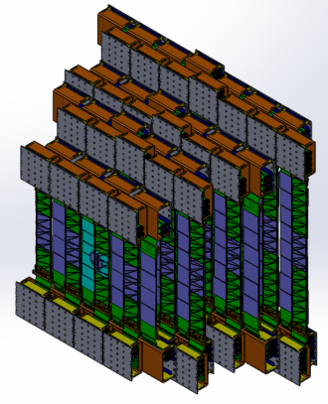
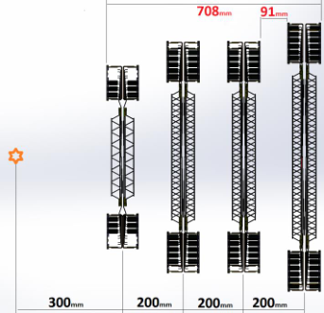
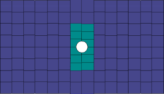

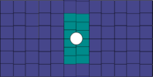

Layout of BM@N STS
Four stations are based on CBM-type modules with double-sided microstrip silicon sensors
Number of modules: 292
Number of channels: ~600k
Power consumption: ~15 kW

Slide 5
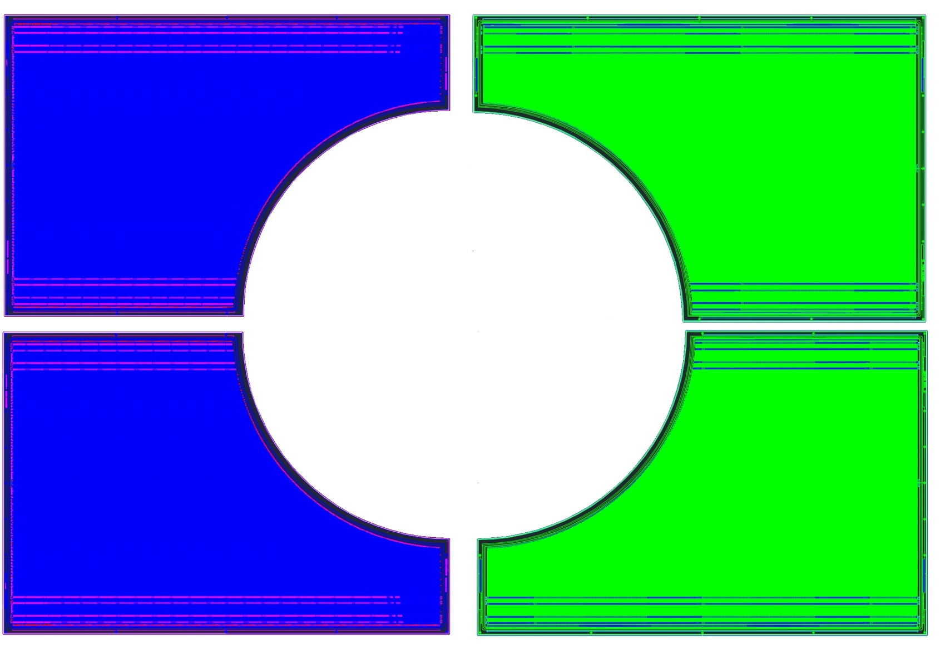
Central Sensors
P-side N-side
27 mm

Slide 6
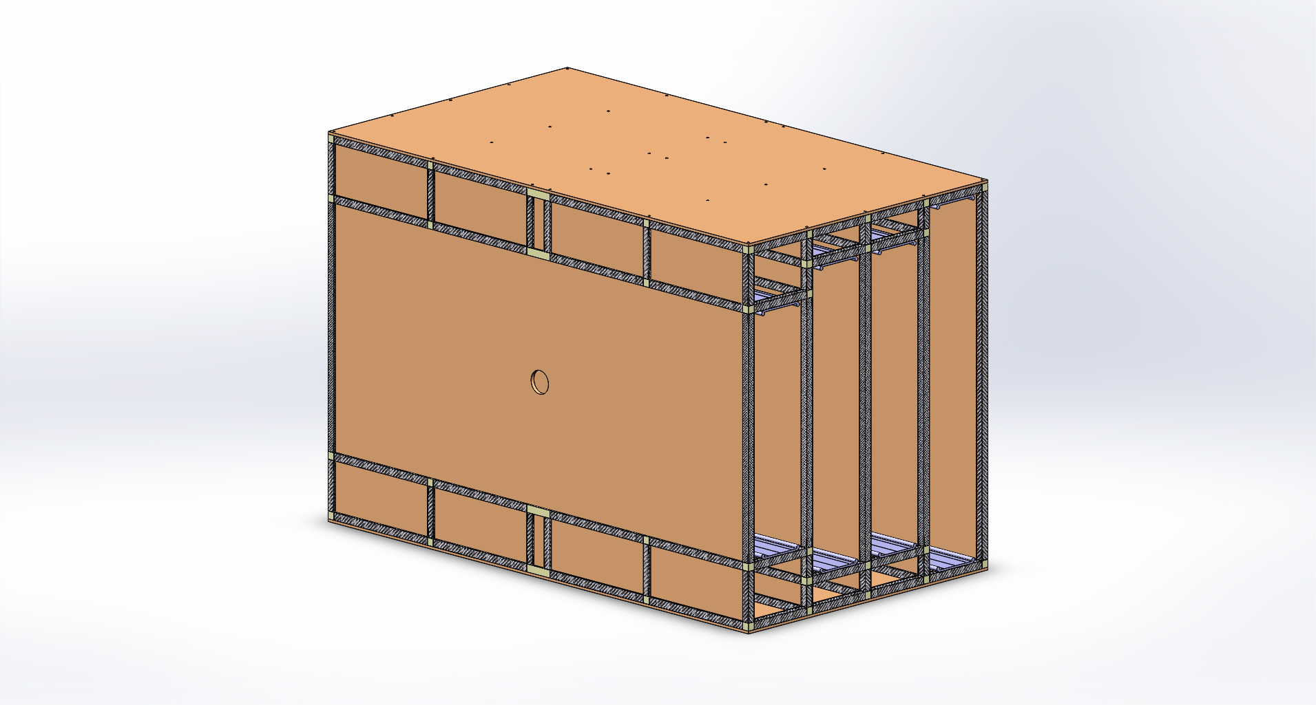
Mainframe

Slide 7
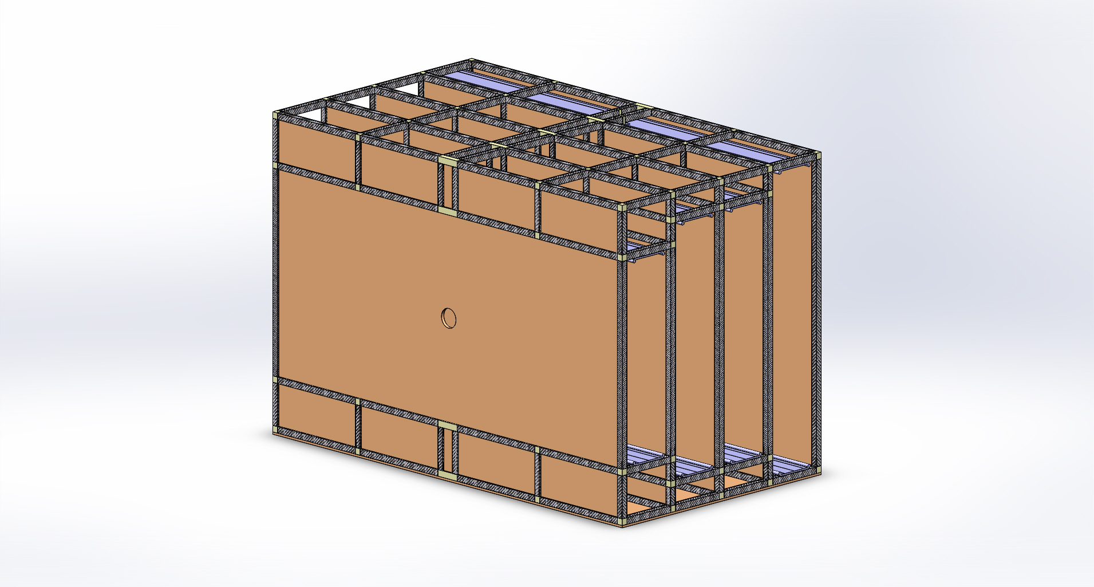
Mainframe

Slide 8
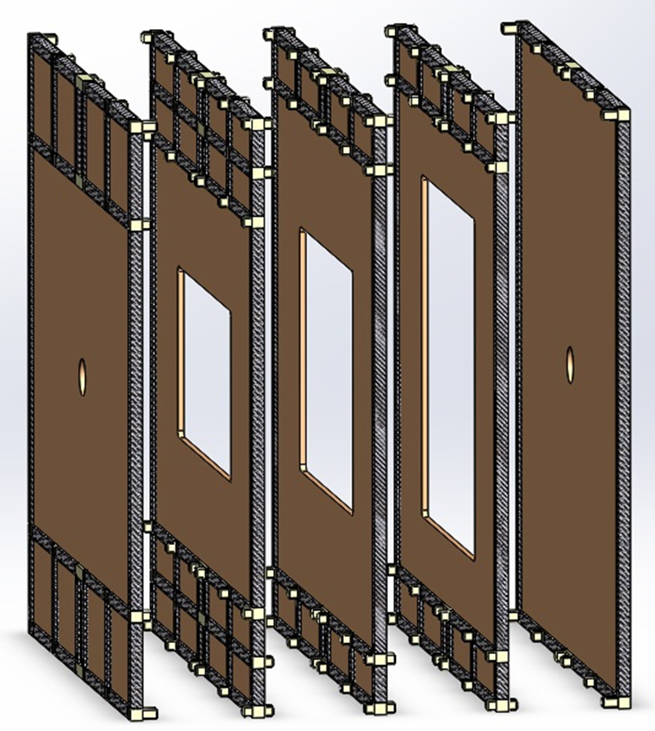
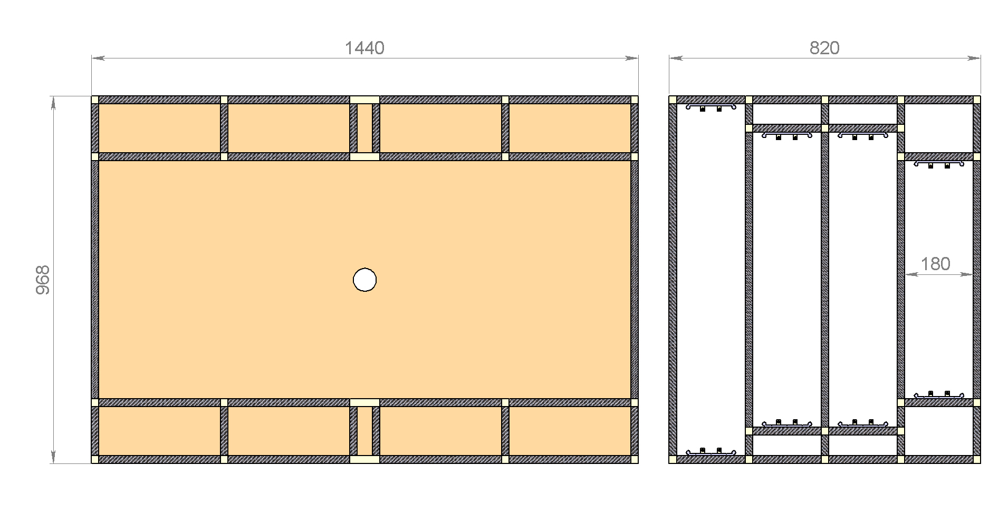
Mainframe details

Slide 9
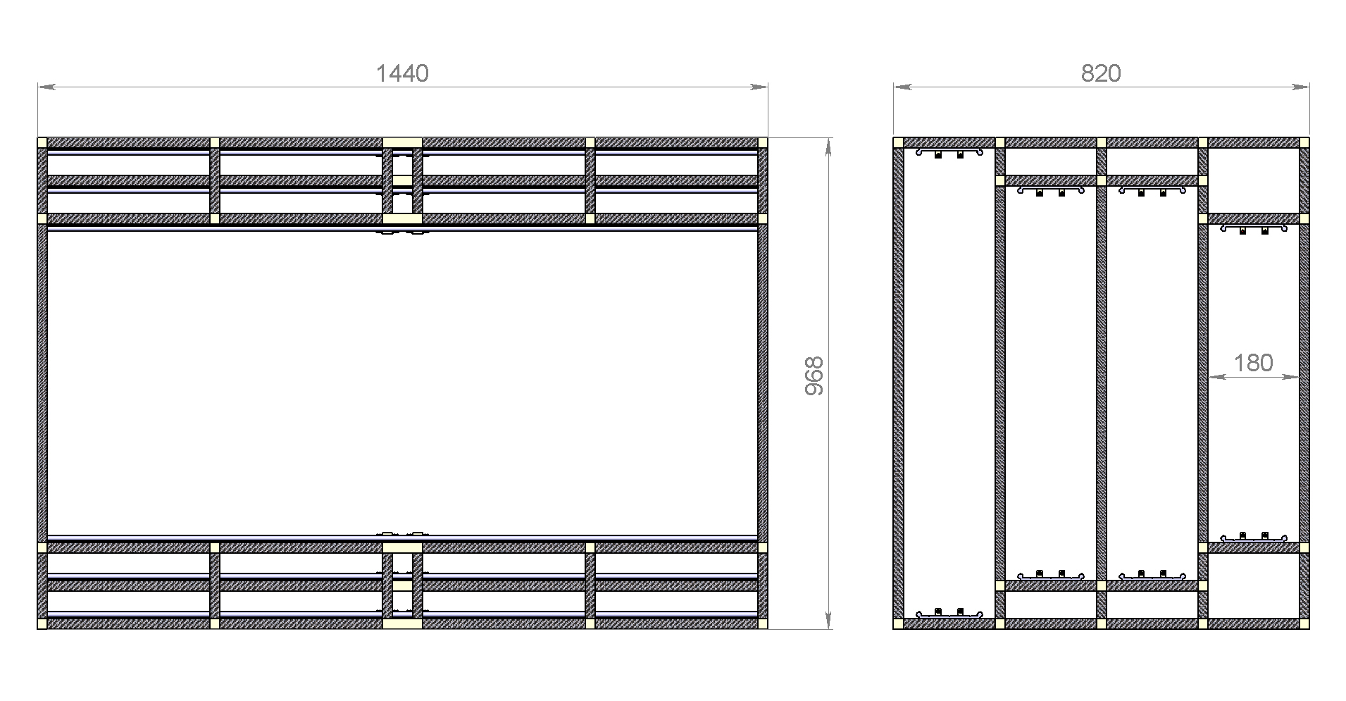
Mainframe

Slide 10
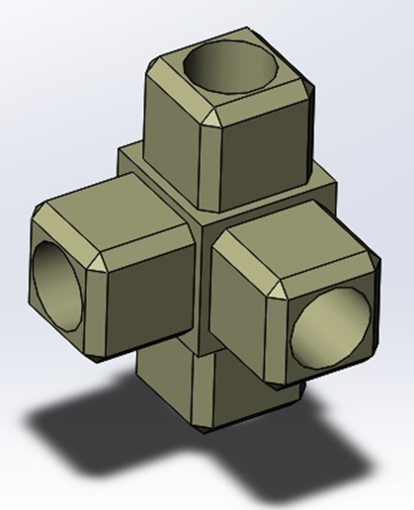
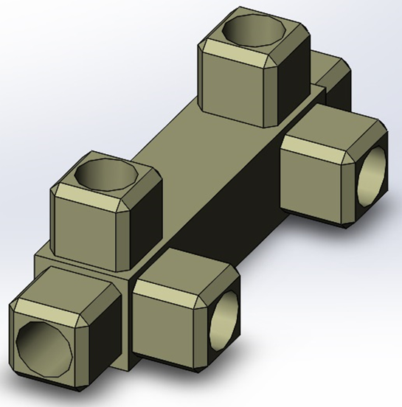
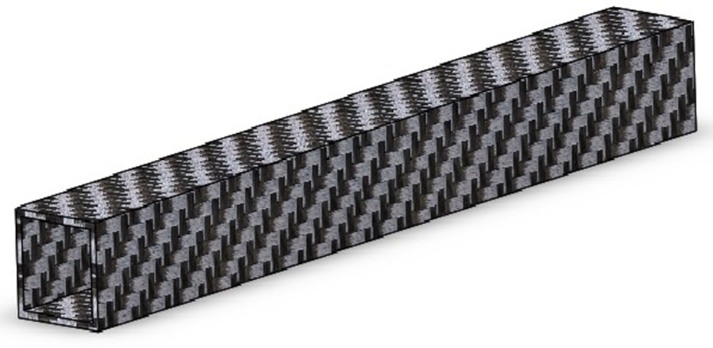
Mainframe details

Slide 11
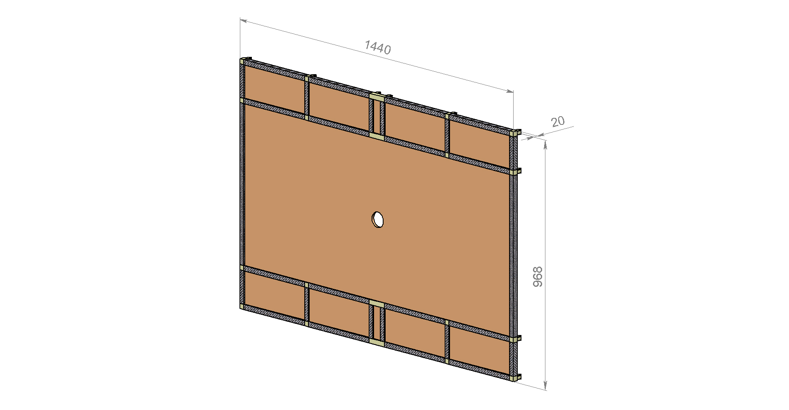
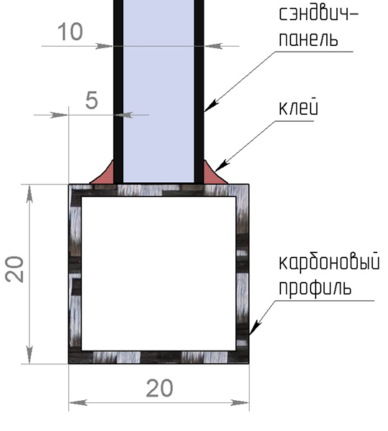
Mainframe details

Slide 12
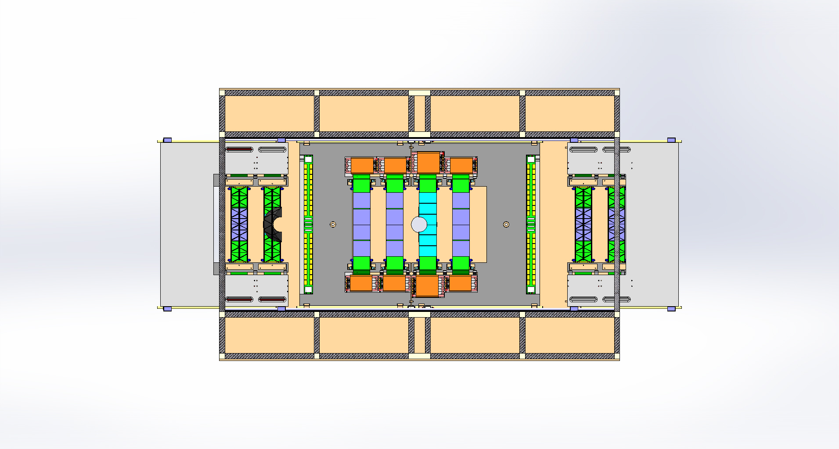
Station in Mainframe

Slide 13
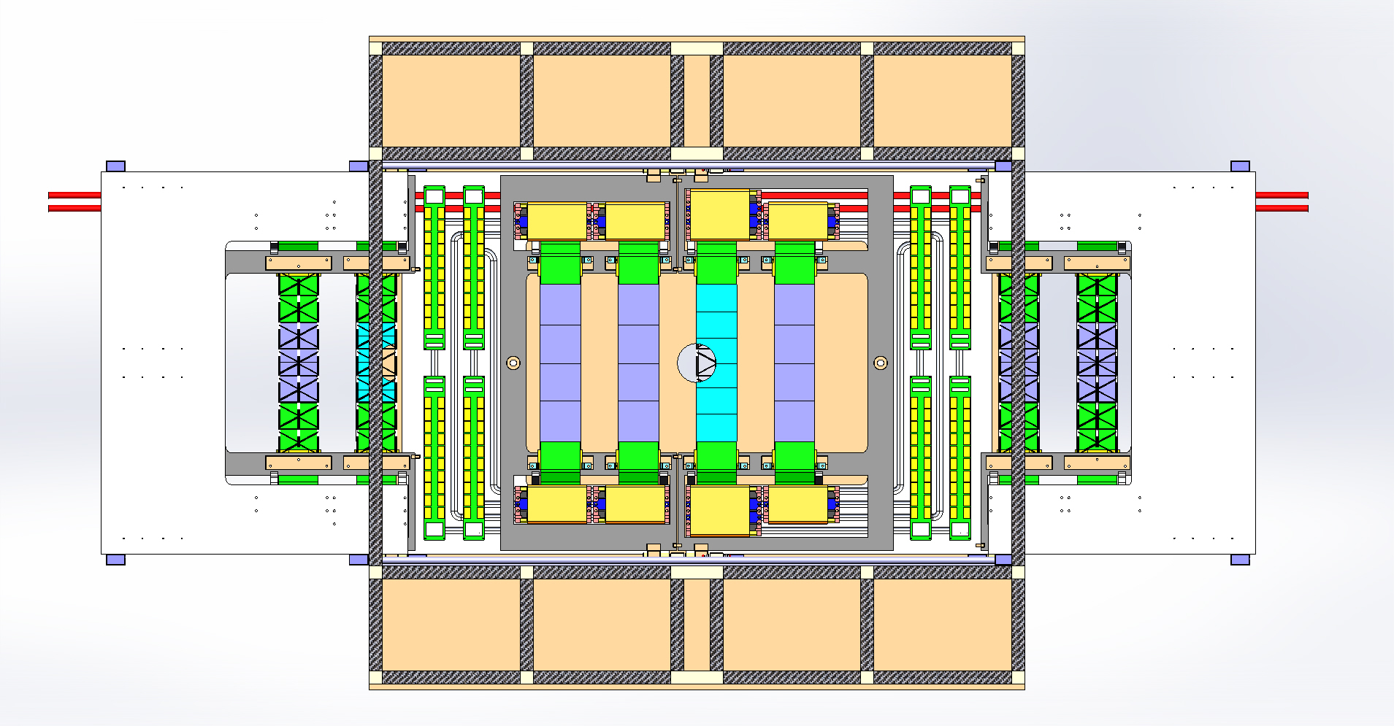
Station in Main frame

Slide 14
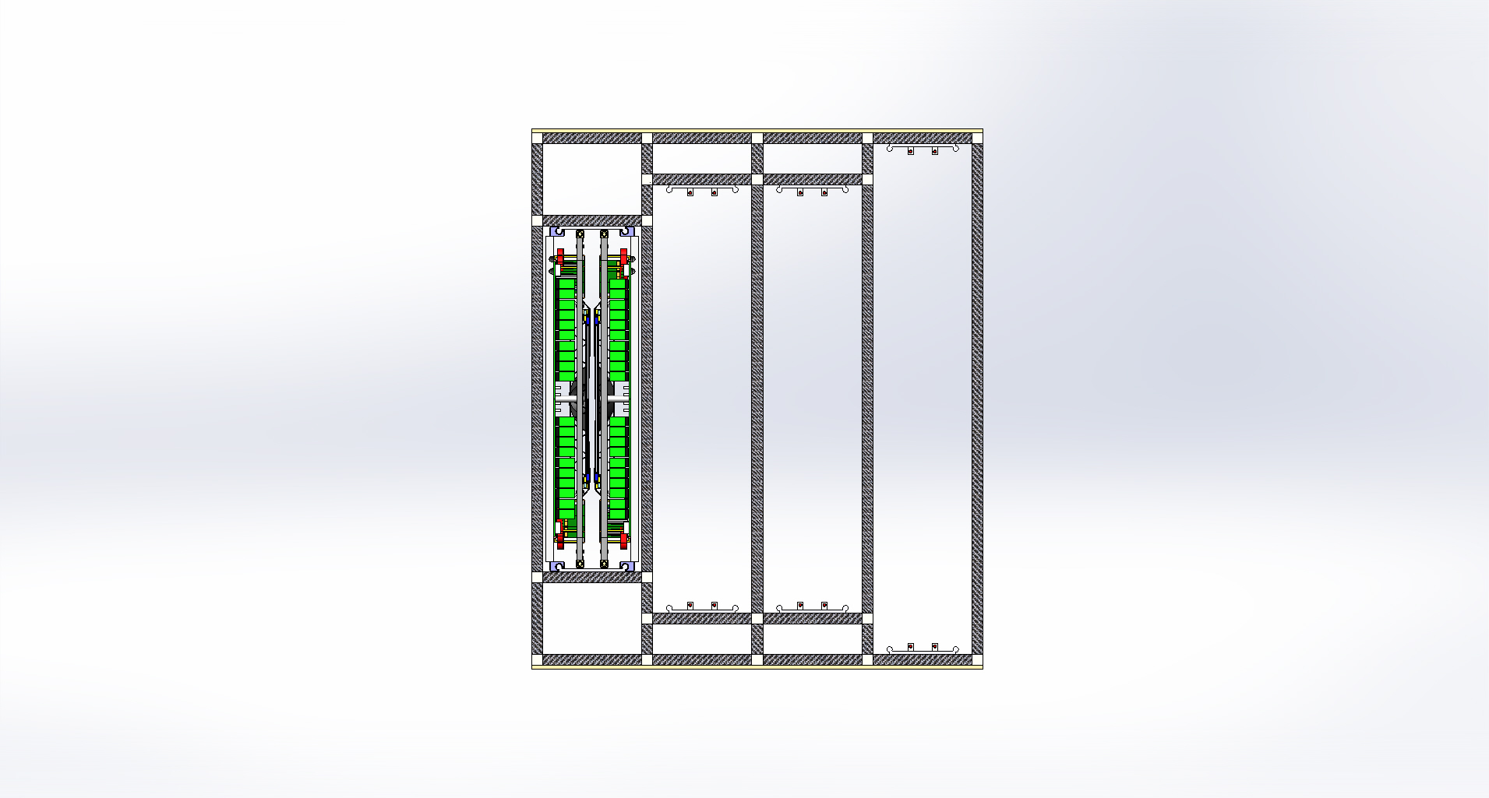
1-st station Main frame (side view)

Slide 15
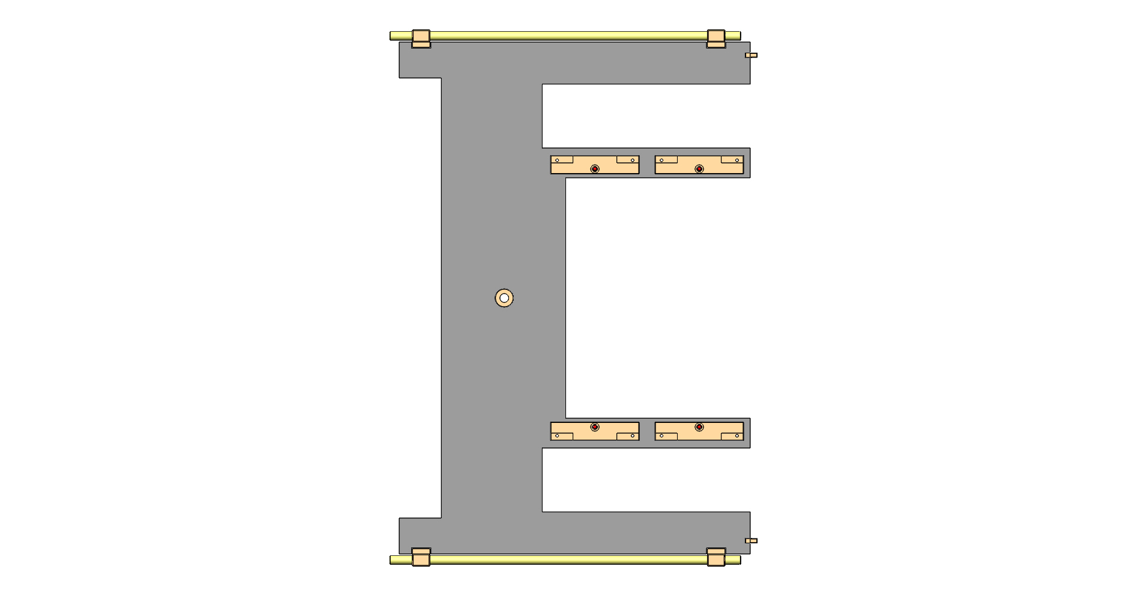
Carbon (sandwich panel) C-frame 1-st station

Slide 16
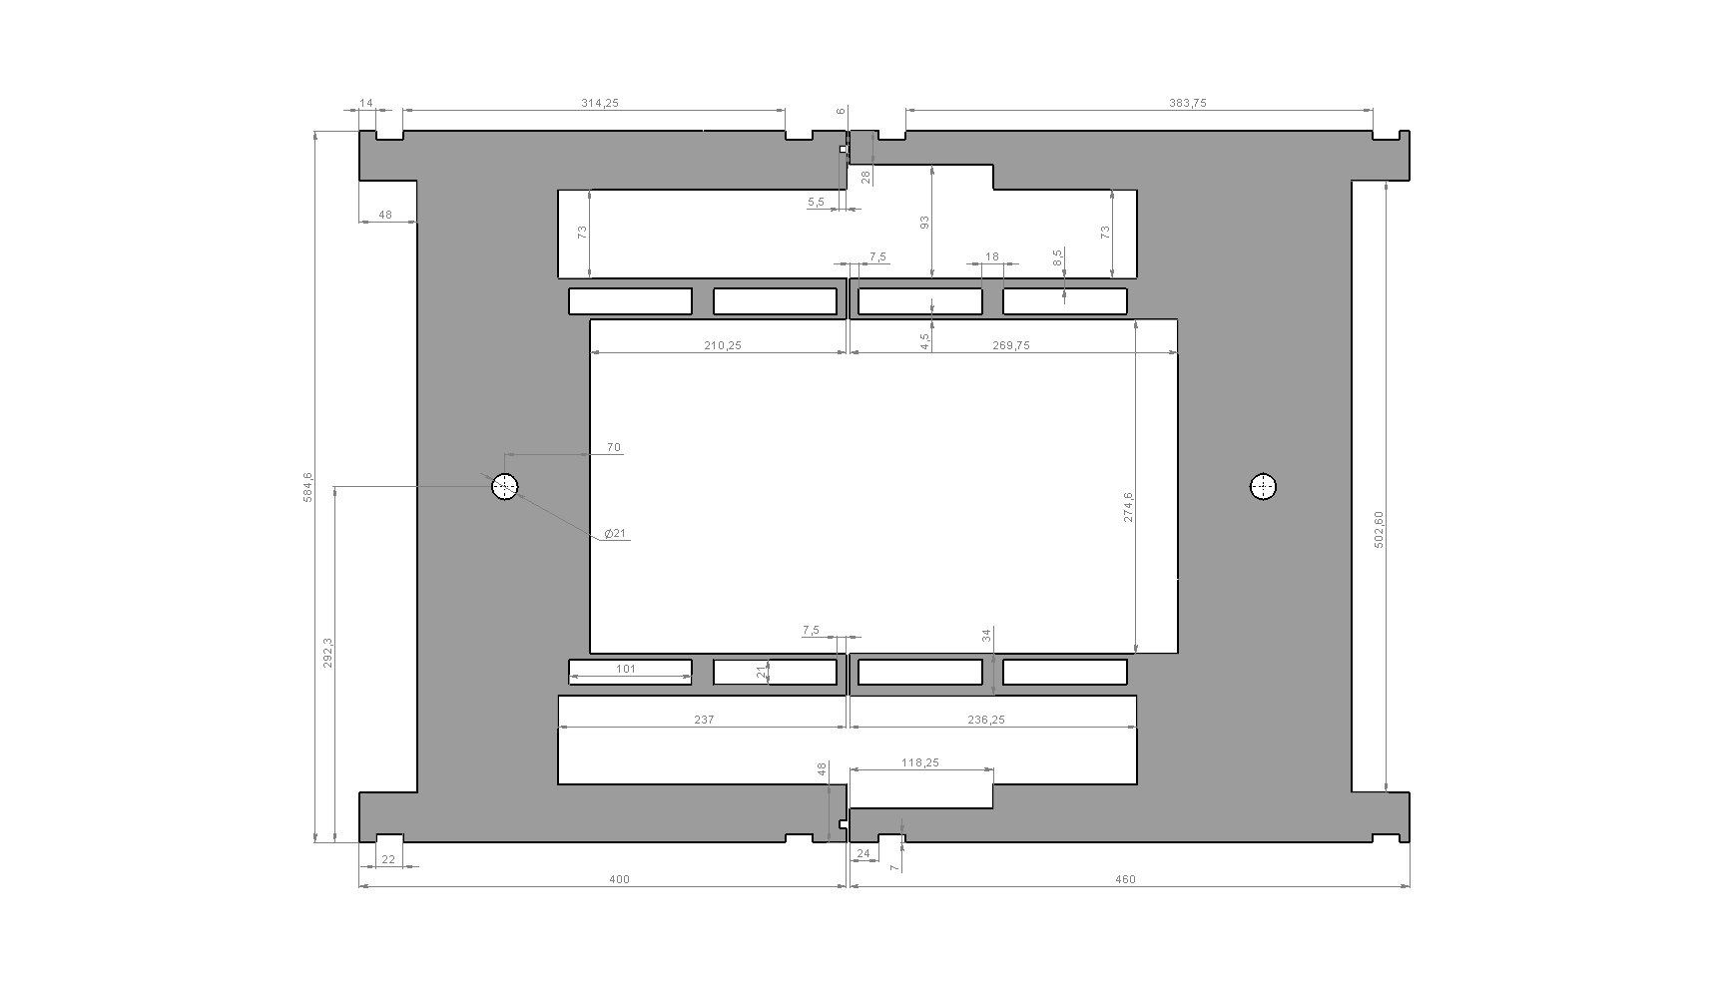
Carbon (sandwich panel) C-frames 1-st station

Slide 17
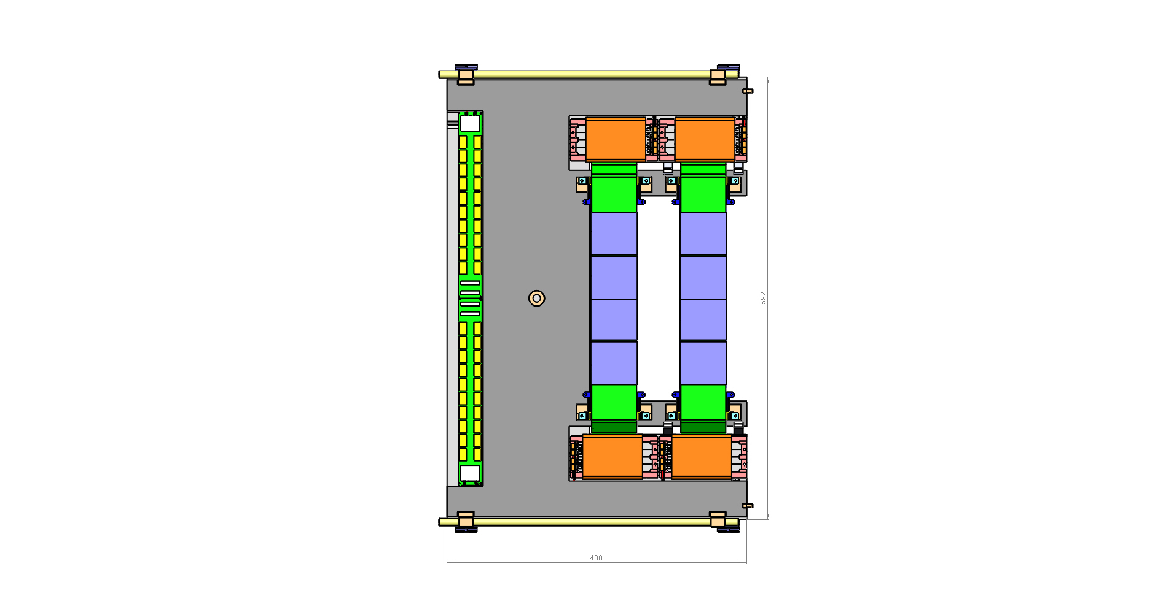
¼ of the 1-st station

Slide 18
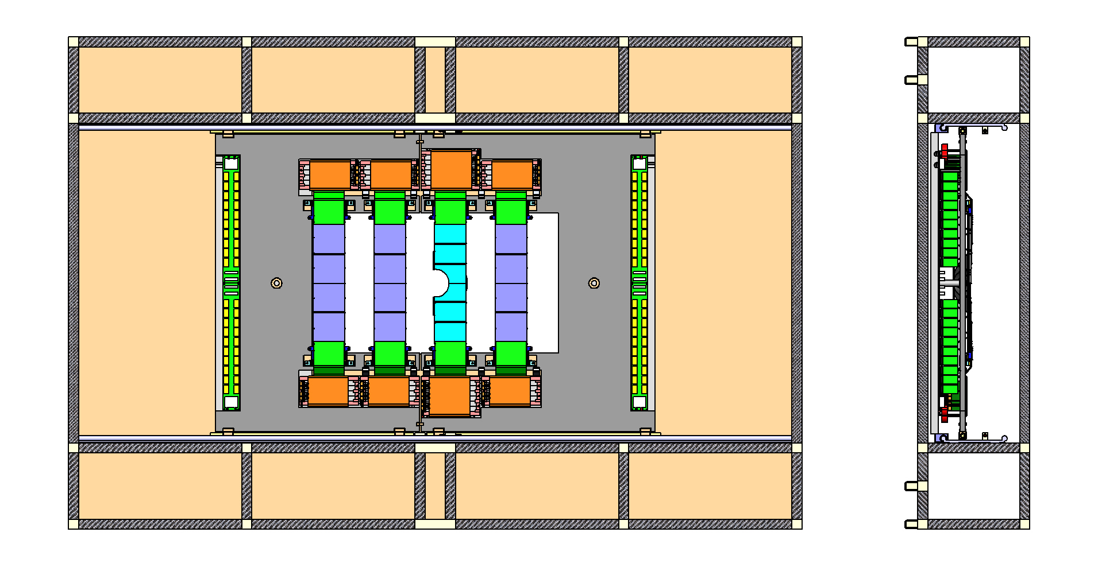
½ of the 1-st station in Main frame

Slide 19
Al c-frame and carbon c-frame

Slide 20
Al c-frame and carbon c-frame

Slide 21
Al c-frame and carbon c-frame

Slide 22
¼ of the 1-st station

Slide 23
The 1-st station in Main frame

Slide 24
Central Ladder for the 1-st station

Slide 25
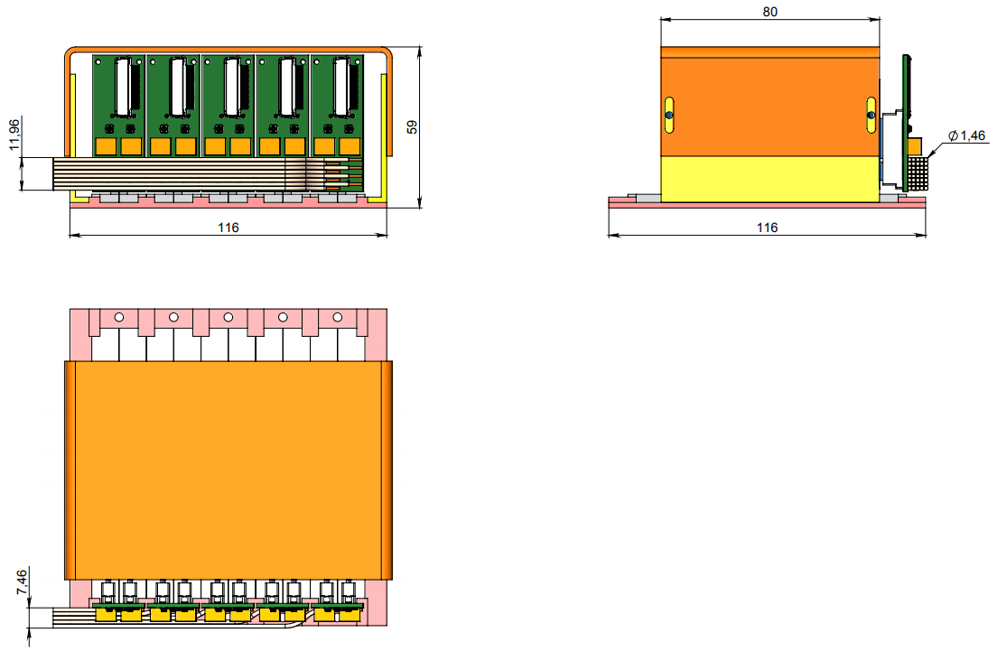
FEB box

Slide 26
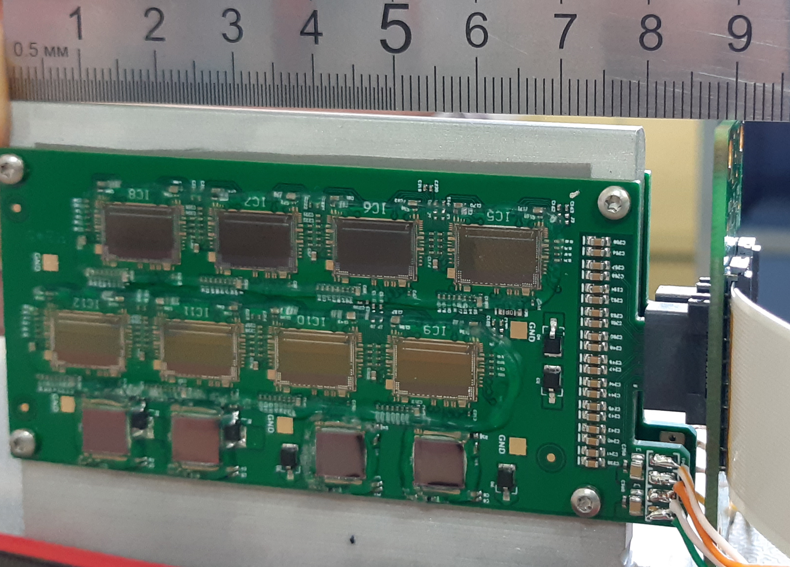
BM@N Front-end Boards
Features:
  Size: 87*40 mm²;
  Thickness with components: 3 mm;
  Edge-type connector with two pin groups: [ HV, LV ] & [ DATA ]
Advantages:
  Increased space for the cabling between FEB-boxes;
  90 bending of cables is not needed ;
  Easy connectivity with a FEB-panel;
  Low thickness of the board allows to increase thickness of the cooling fin for one FEB up to 3 mm.
Comparison of two FEB geometries
This part is connected with RFBR grant 18-02-40047
Prototypes of FEB with FEB-panel

Slide 27
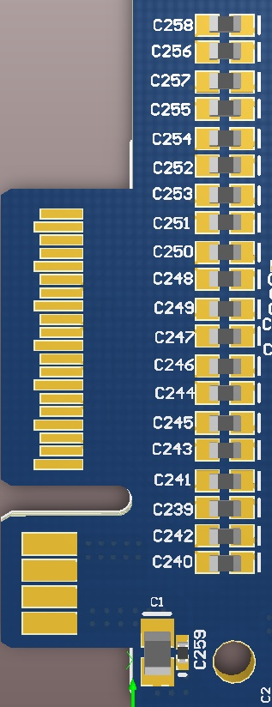
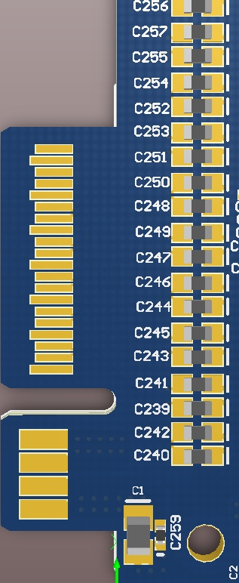
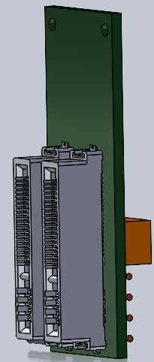
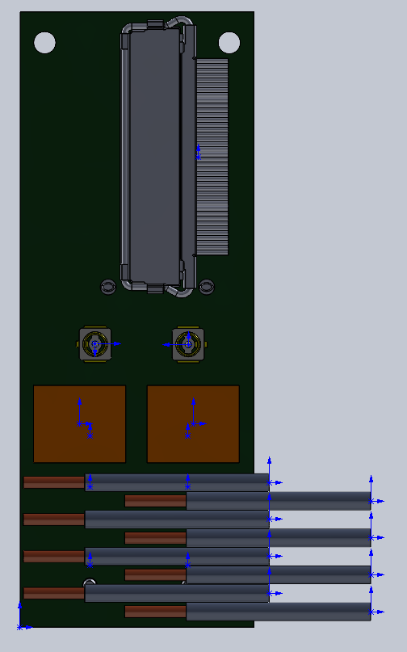
FEB connectivity
Data connector
AWG40 microcoax cables
IPEX Cabline connector
DATA PINS
DATA PINS
HV connectors
Sig. ret. Caps
POWER PINS
POWER PINS
20 AWG
power cables
2× FEBs
FEB panel

Slide 28
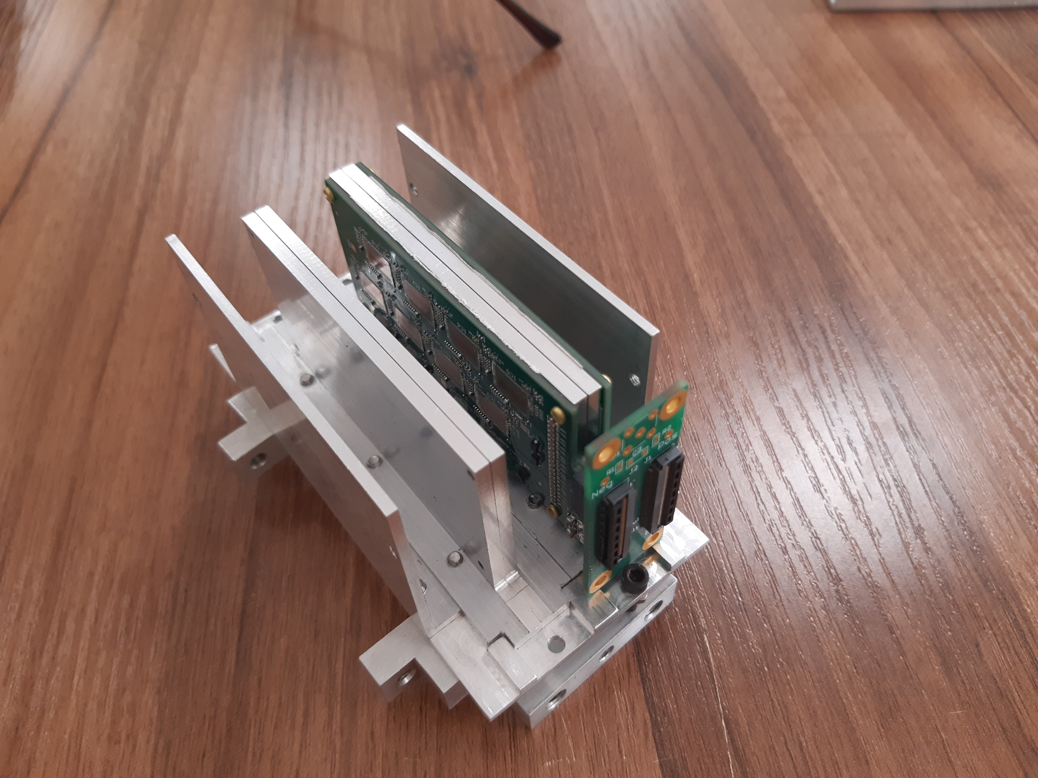
FEB box prototype

Slide 29
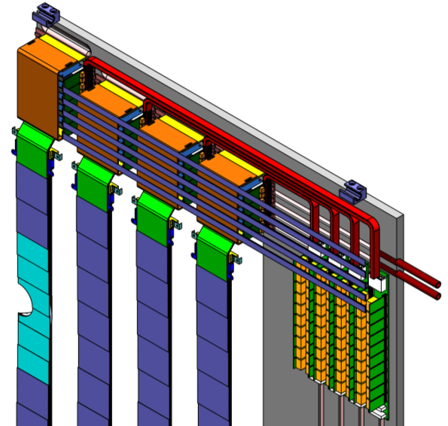
Cable routing
Power cables to POB
DATA cables to patch panel

Slide 30
Construction of the STS mechanics
Prototype tooling for mainframe production.
Mainframe prototype production.
Production of a prototype C-frames without cooling system for the 4-th station.
The goal is to test the possibility of positioning, evaluate accuracy.
Production of a prototype C-frame without cooling system for 1-st station.
The goal is to develop the assembly of ladders and its installation
on the C-frame. See Vladimir Elsha presentation today.

Slide 31
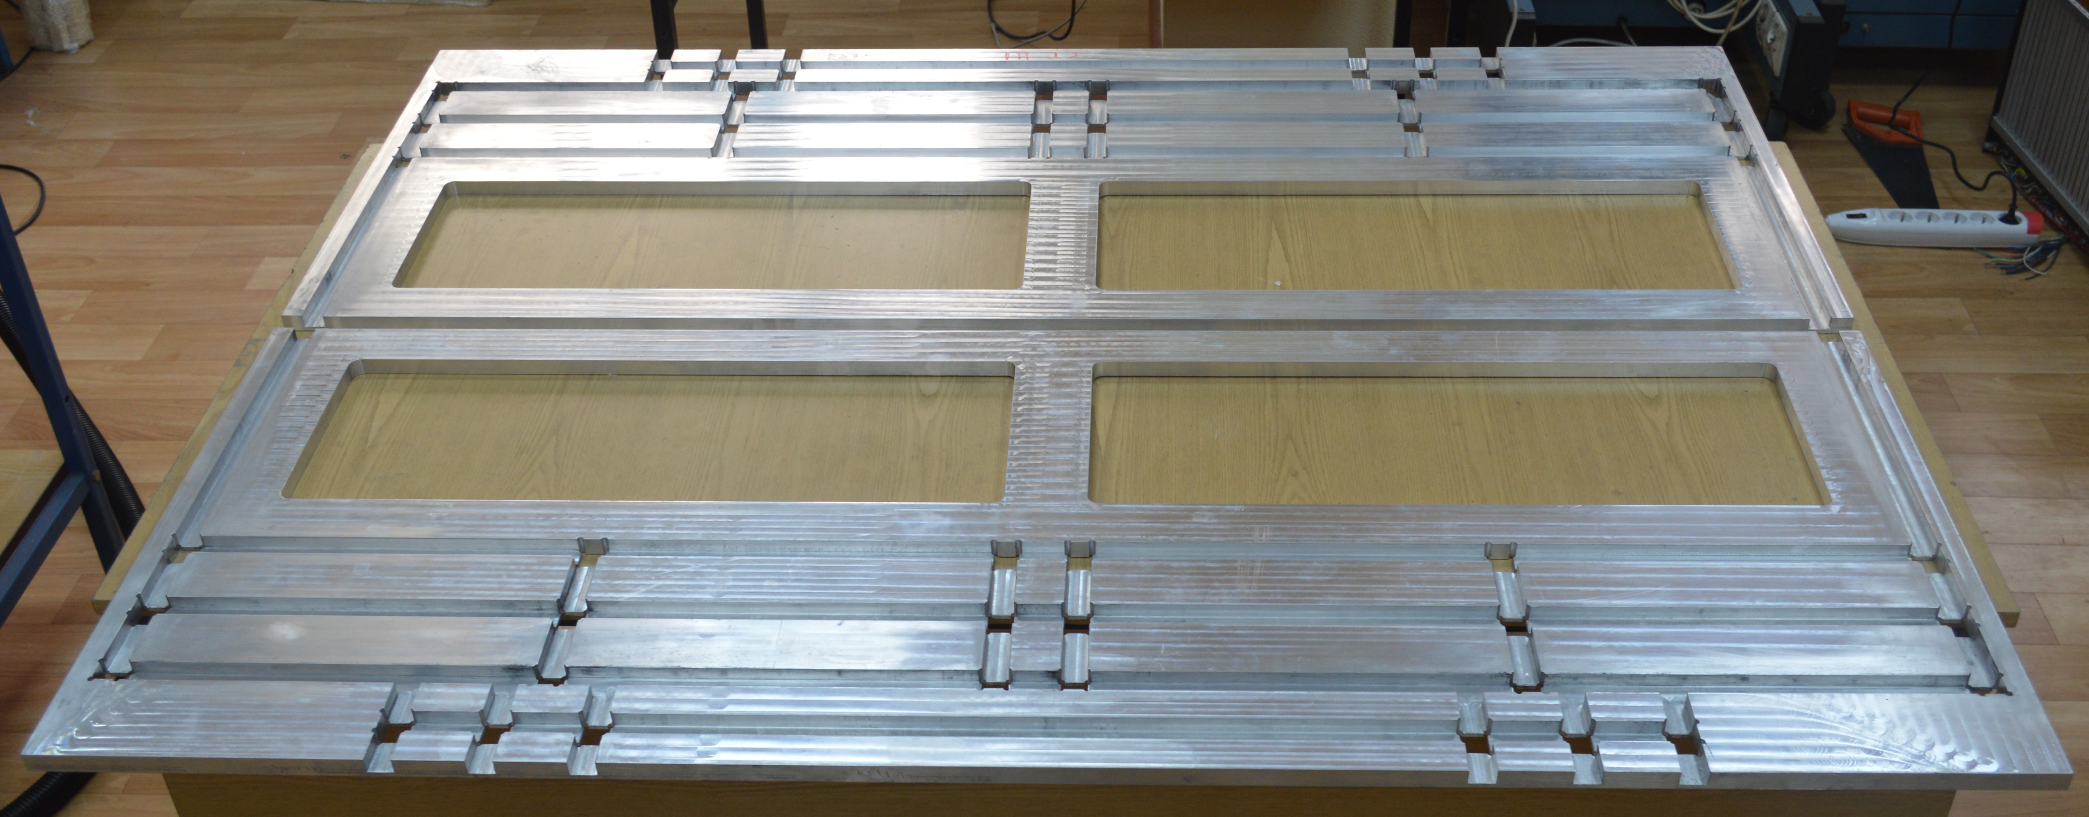
Mainframe assembly tool

Slide 32
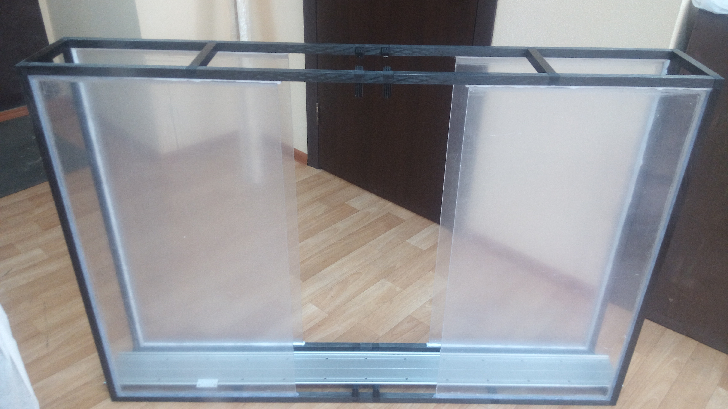
Mainframe prototype

Slide 33
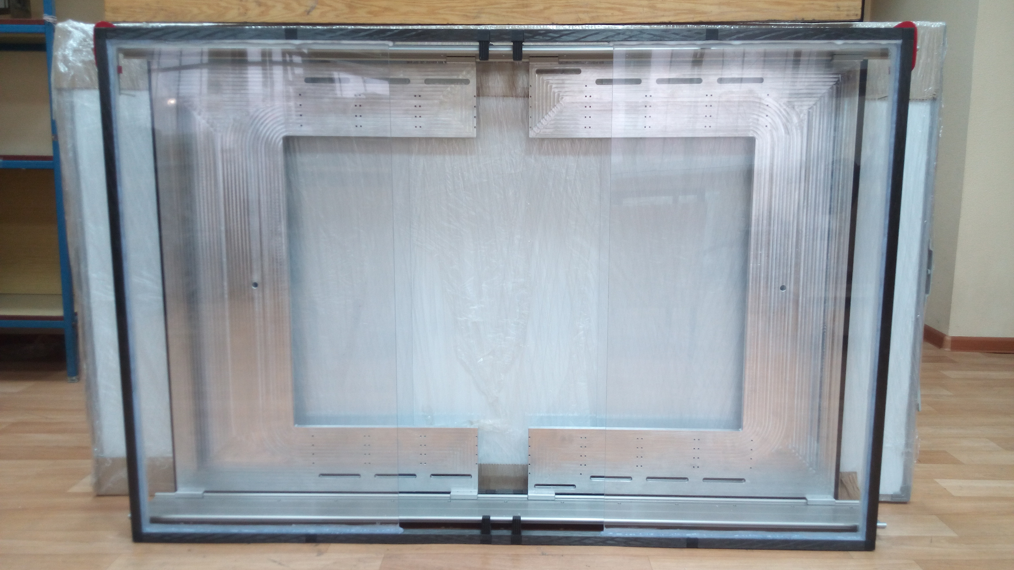
Mainframe with two Al C-frames

Slide 34
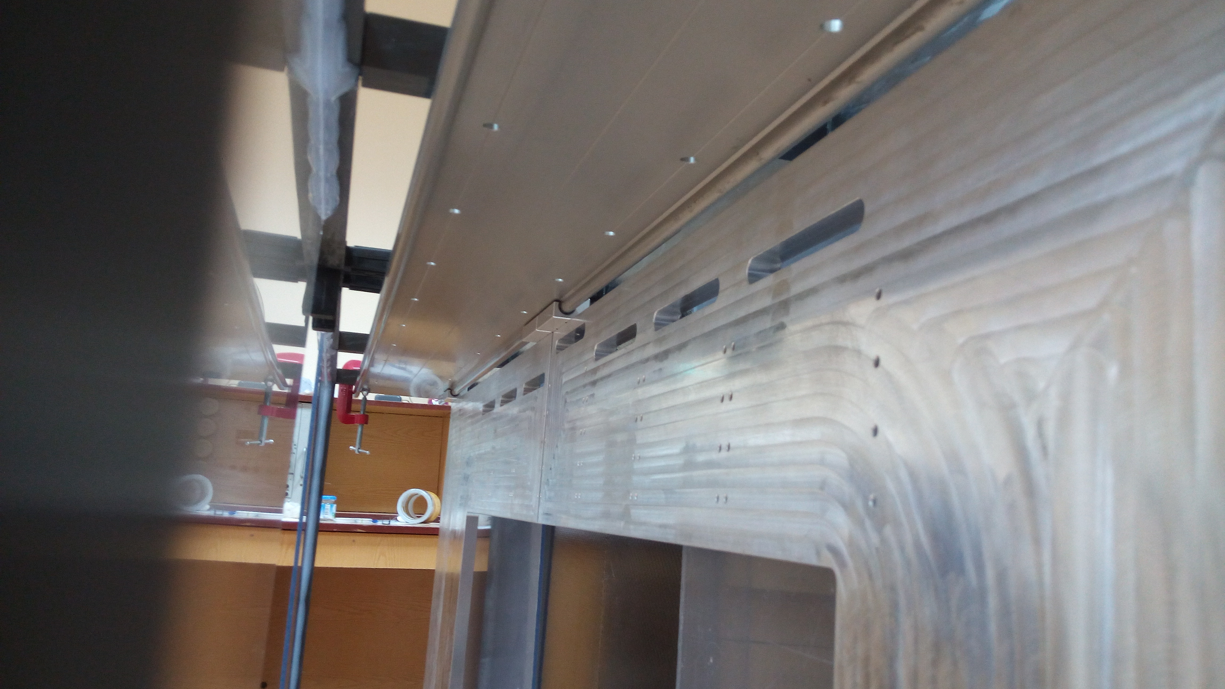
Mainframe, rails, Al C-frame with bearing - top

Slide 35
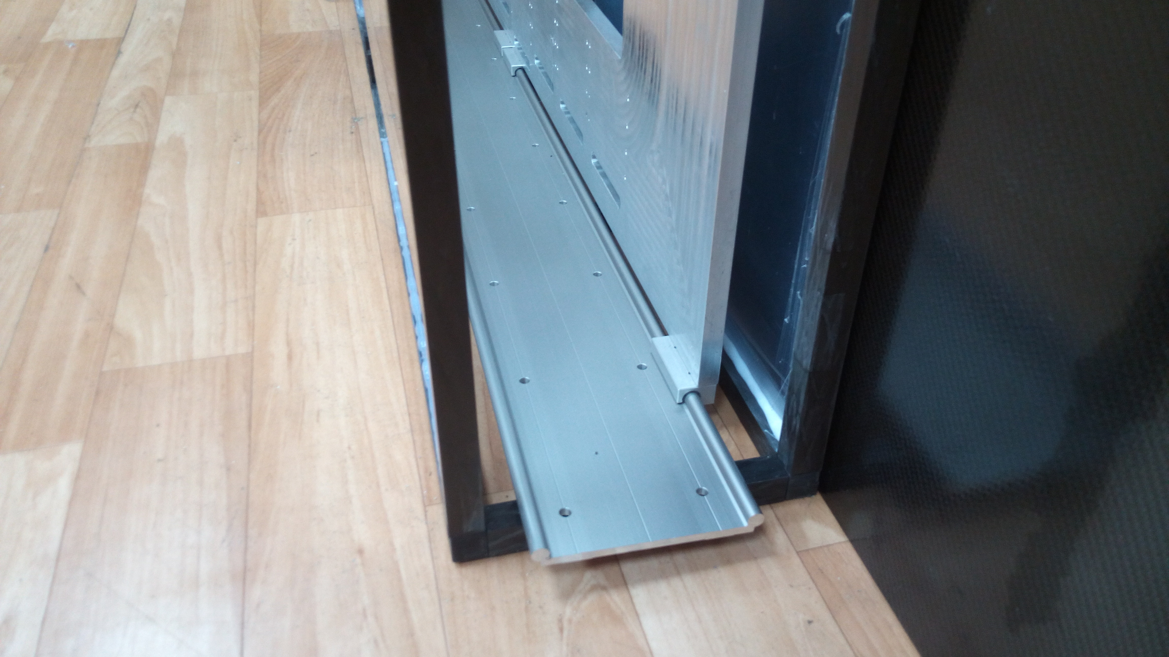
Mainframe, rails, Al C-frame with bearing - bottom

Slide 36
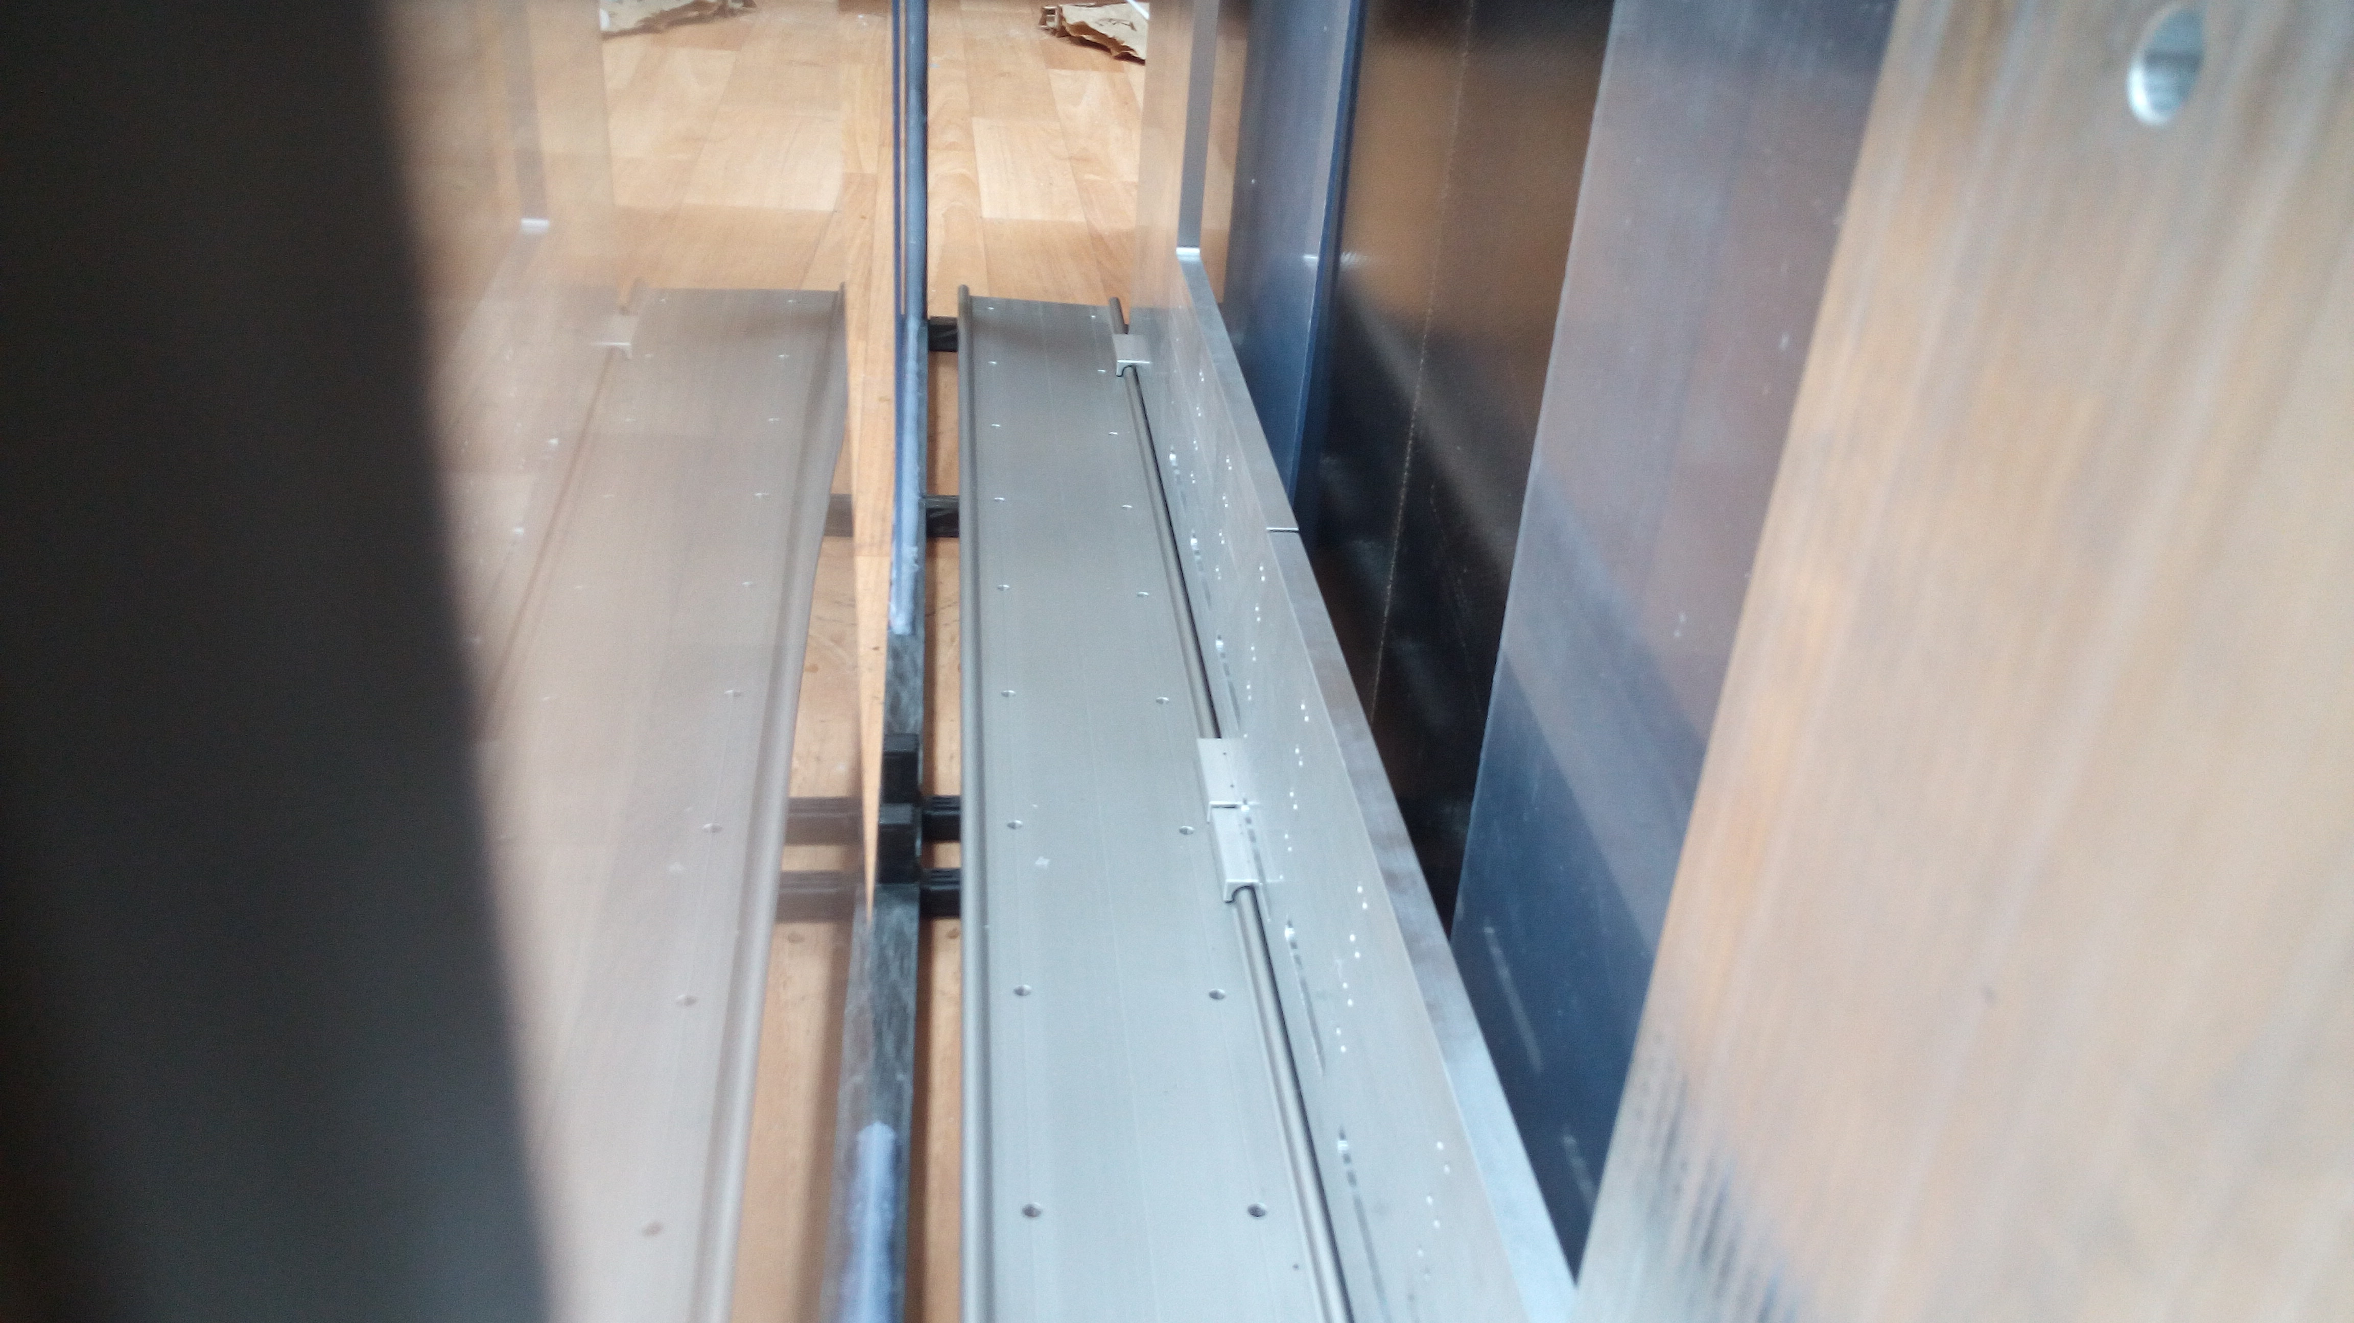
Mainframe, rails, Al C-frame with bearing - bottom

Slide 37
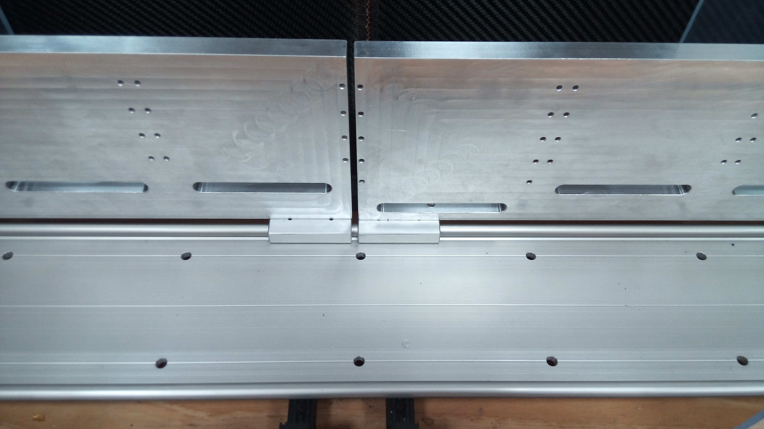
Al C-frames оn rails

Slide 38
From H.R.Schmidt

Slide 39
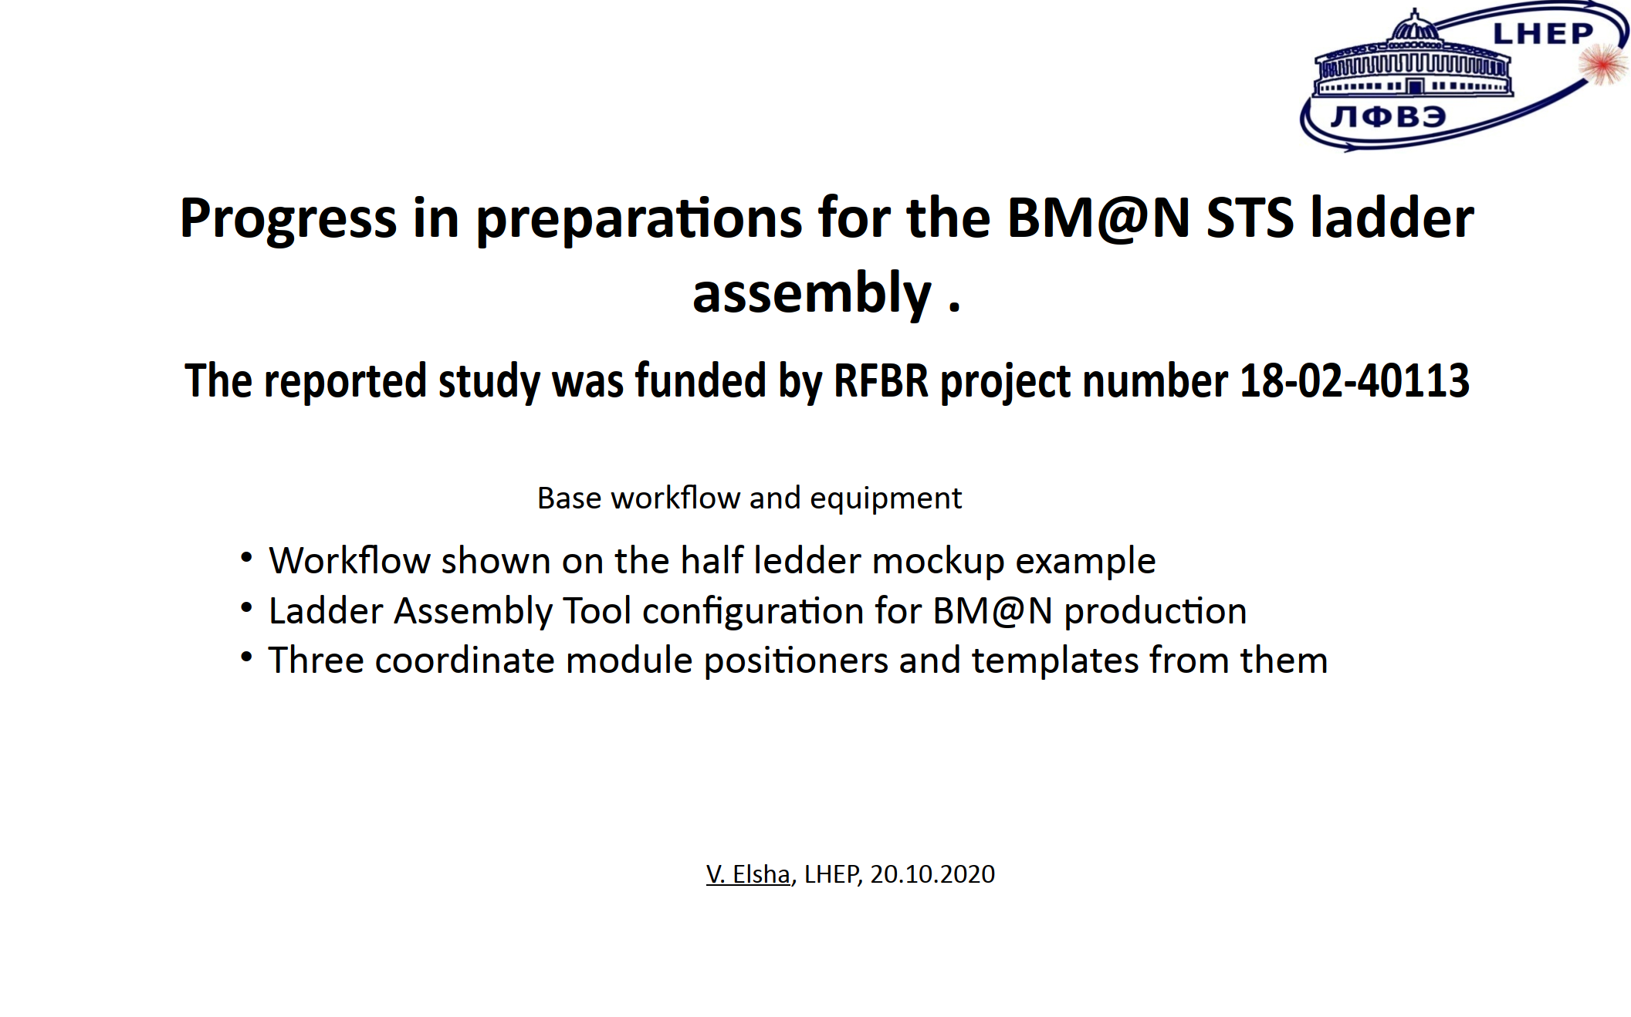

Slide 40
Laser setup for quality assurance of BM@N silicon tracking modules
The reported study was funded by RFBR project numbers 18-02-40113 and 19-32-90001
A. Baranov, N. Baranova, V. Elsha, P. Kharlamov, M. Korolev, V. Leontiev, M. Merkin, A. Sheremetiev

Slide 41
Status of the BM@N STS module assembly
N. Sukhov
The reported study was funded by RFBR project numbers 18-02-40047 and 18-02-40113

Slide 42
Thank you !

