Slide 1

Bonding Test Procedure Developed for the Assembly of BM@N STS modules
A.Kolozhvari, JINR, Oct.2020.
For CBM - BM@N - STS collaboration.
Supported by RFBR grant 18-02-40047
1
Notes:
1

Slide 2
Introduction. Some numbers.
The Silicon Tracking System (STS) of the BM@N experiment will include 292 double-sided silicon microstrip sensors.
The sensor has 1024 microstrips on each of its 2 sides.
Each side of the sensor will be readout with 8 STS/MUCH-XYTER 128-channels ASIC chips [1] situated on a corresponding front-end board.
The ASIC will be connected to the sensor with 2 microcables, each having 64 traces.
Production of such a system is a challenge !
Only for signal connections with microcables between the sensors and the ASICs 2x2x1024x292 = 1196032 bondings should be carried out.
2
Notes:
2

Slide 3
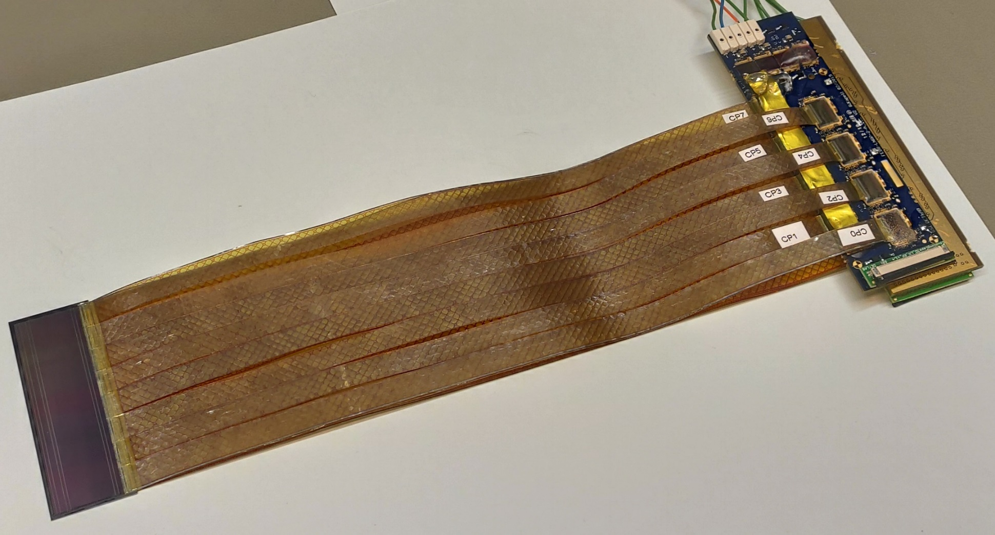
Module.
Collaboration with the CBM experiment at FAIR, GSI (Germany).
The modules assembly is being done at GSI and at JINR.
Exchange of materials,
components, and know-
how.
bonds
ASIC
The module includes:
A sensor
32 microcables
2 FEBs with 8 ASICs each.
Sensor 6x2 cm
bonds
microcables
Front-end boards
3

Slide 4
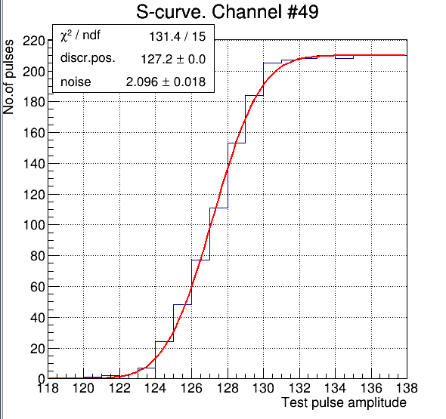
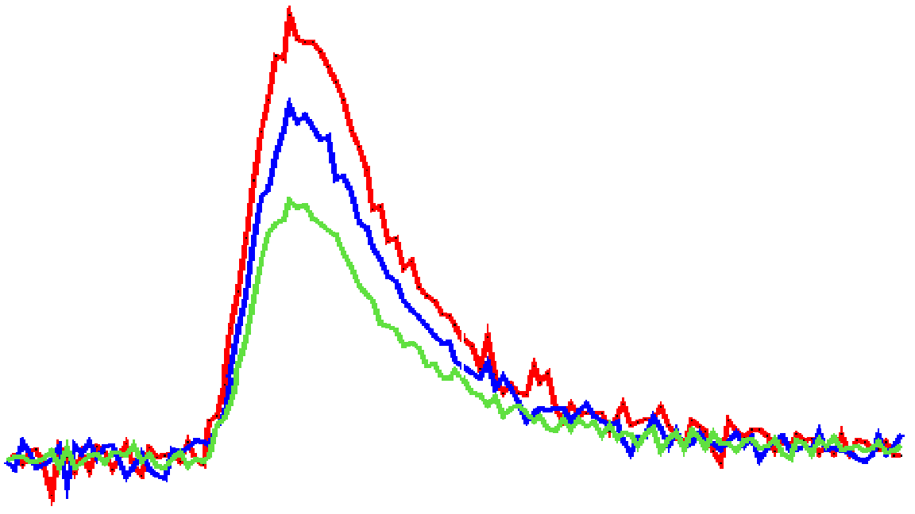
The Pogo-pin Noise Measurement Diagram
Signal amplitude
V₃
V₂
V₁
Compa-
rators
counters
thresholds
signal
Test pulse
V
microcable
analog
front end
counter
FMC-AFCK
IPbus
Intel
CPU
Read-out
Compa-
rator
UDP/IP
sensor
C_{sen}
C_{cab}
threshold
HDD

Slide 5
Tests of bondings with measurements of noise level at inputs of the ASIC’s channels [2].
The “BondingTest” program detects contacts between a microcable signal line, an ASIC’s frontend input, and a sensor’s microstrip for each channel.
It measures noise levels at input of a channel at different steps of the assembly process and compares
the results. It uses several functionalities implemented in the ASIC.
The noise level increases with the capacitance at the input. Therefore, after bonding of ASIC to a cable, and then a cable to a sensor, the capacitance, and the noise level, change in steps.
The noise level is determined from a fit of the error function to the data in measurement of the
S-curve.
The program stores the measured data on a disk. It may be used for the quality control.
The program runs under Linux OS. It is written in C++ and uses CERN Root, uHAL and Boost libraries and firmware configuration XML-files developed in WUT.
It uses AFCK with FMC board and pogo-pin hardware.
5

Slide 6
The Pogo-Pin Device

Slide 7
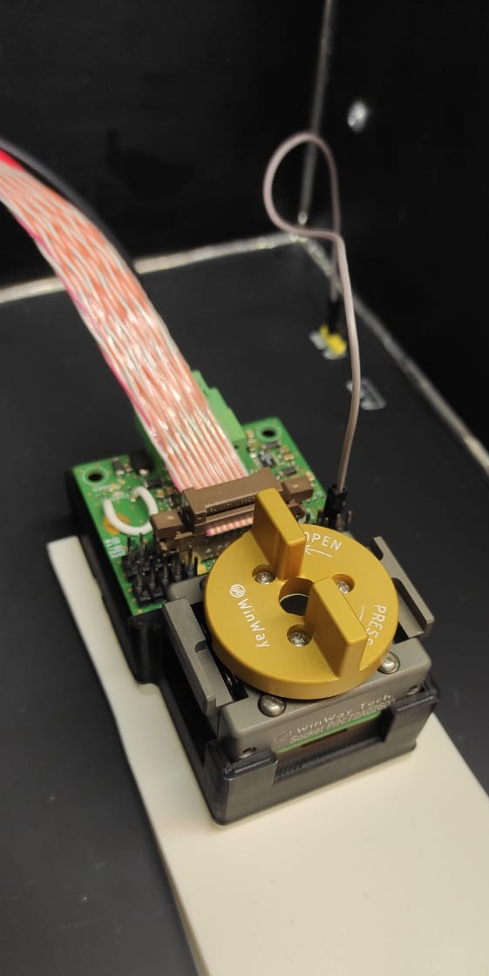
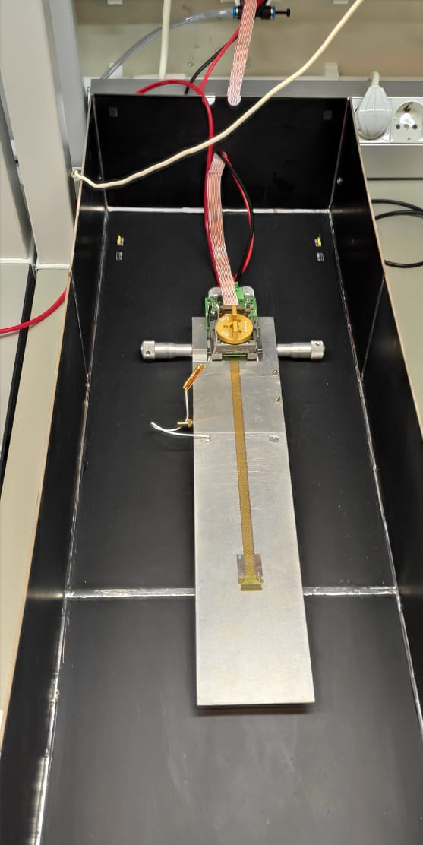
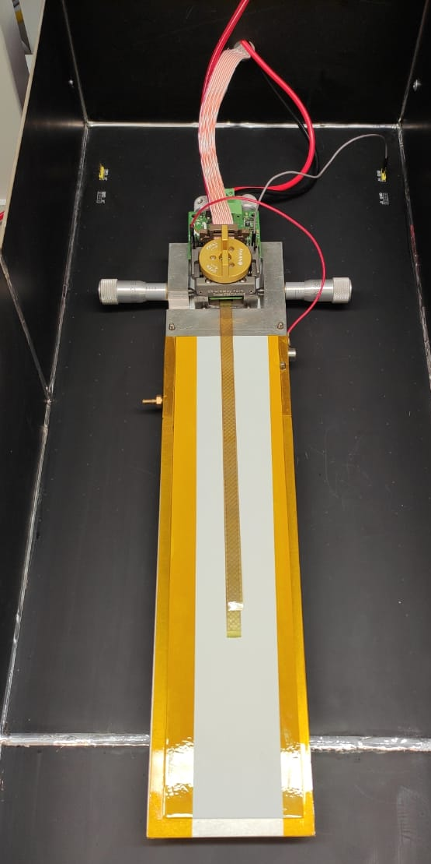
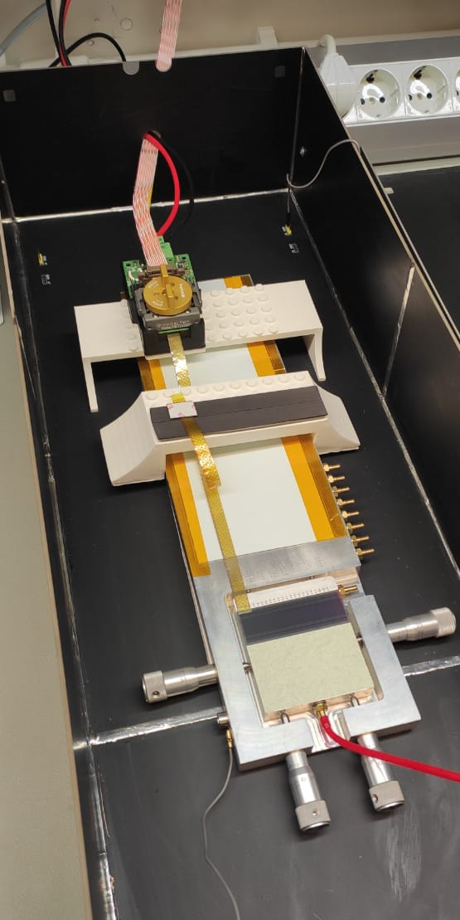

Measurements at the module assembly
“bare” ASIC – reference noise measurement
ASIC bonded to two microcables with technological pads on the loose ends
ASIC bonded to two mcrocables with the technological pads cut off
The first microcable bonded to the ASIC and to the sensor. The second microcable is bonded to the ASIC and its loose end is placed on a special pad
(a)
(b)
(c)
(d)

Slide 8
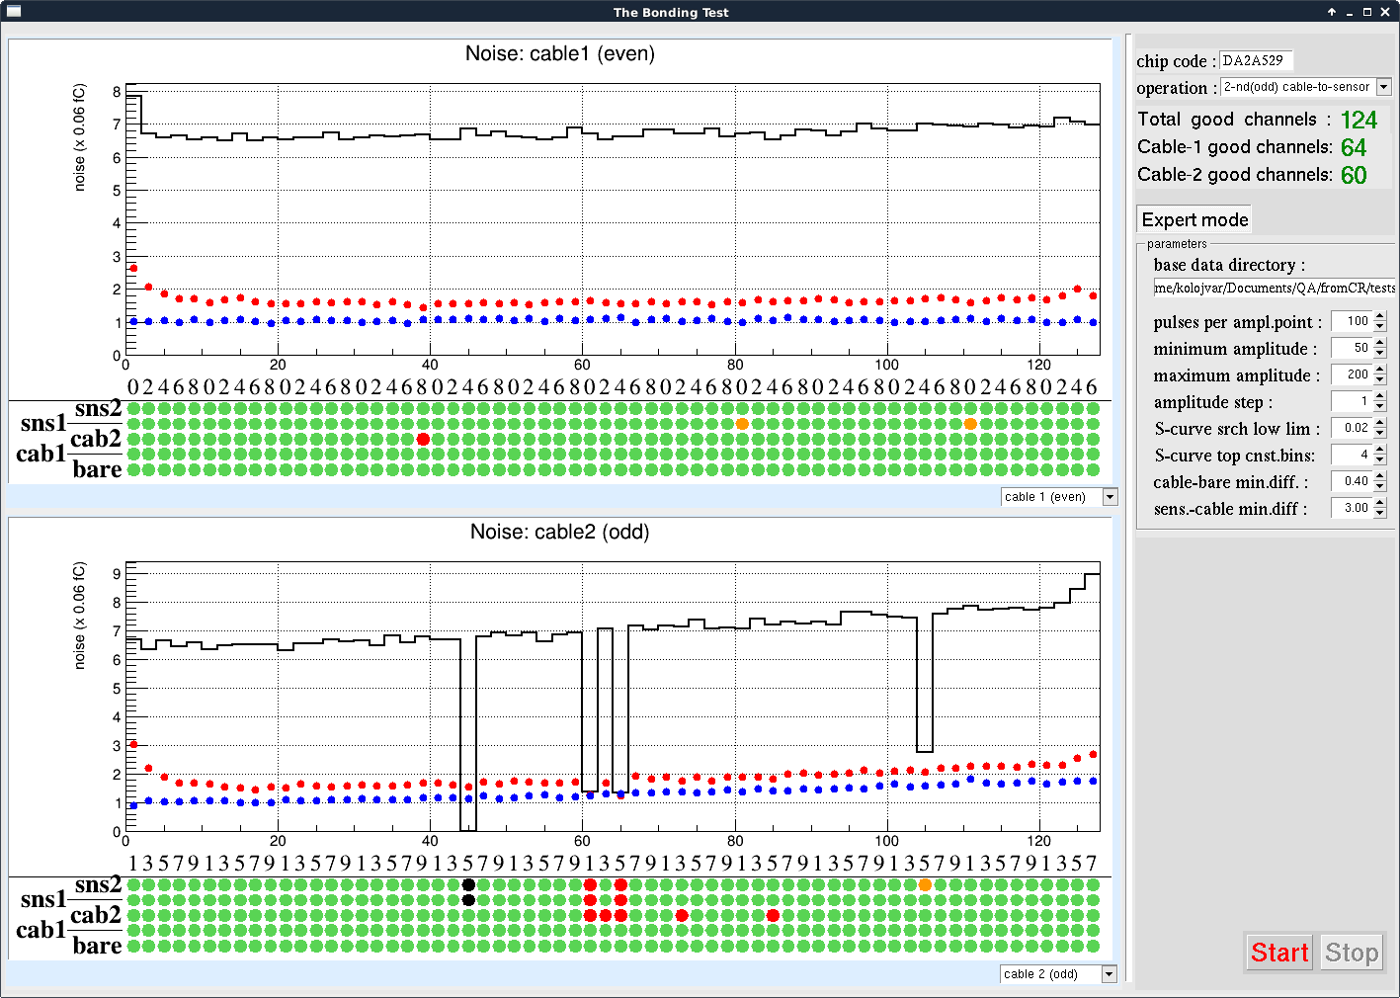
The operator's GUI
The QA colors:
Green : good
Black: dead channel
Blue: noise is too high
Red: no contact ASIC – cable
Orange: no contact cable – sensor
White: no information
8

Slide 9
Evolution of the channels states at the assembly operations
N-side
P-side
N-side

Slide 10
Conclusions.
The “BondingTest” is a useful, simple to use, quality assurance tool for the module assembly.
The data produced by the program can be fed into a general data bases of the CBM and/or BM&N detectors
Number and types of the tests performed in ``production mode'' should be optimized.
10

Slide 11
References:
K. Kasinski et al., Characterization of the STS/MUCH-XYTER2, a 128-channel time and amplitude measurement IC for gas and silicon microstrip sensors, Nucl. Inst and Meth.
A908 (2018) pp.225-235.
2. N. Sukhov et al., Development of bonding quality control for assembly of the silicon microstrip sensor modules, in CBM Progress Report 2018, Darmstadt, 2019, p.18.

Slide 12
That‘s all.
Thank you!

