Slide 2
Integration of geographically distributed heterogeneous resources for the MPD experiment with the DIRAC Interware
Supported by the RFBR special grant (“Megascience – NICA”), №18-02-40101
Speaker: Igor Pelevanyuk
22 October 2020

Slide 3
DIRAC: Igor Pelevanyk, Andrey Tsaregorodtzev MPD: Andrey Moshkin, Oleg Rogachevskiy Responsibles for resources: Cloud: Nikolay Kutovskiy Tier-1,Tier-2, EOS: Valery Mitsyn Govorun: Dmitry Podgainy LHEP cluster: Boris Schinov dCache: Vladimir Trofimov
Authors

Slide 4
NICA

Slide 5
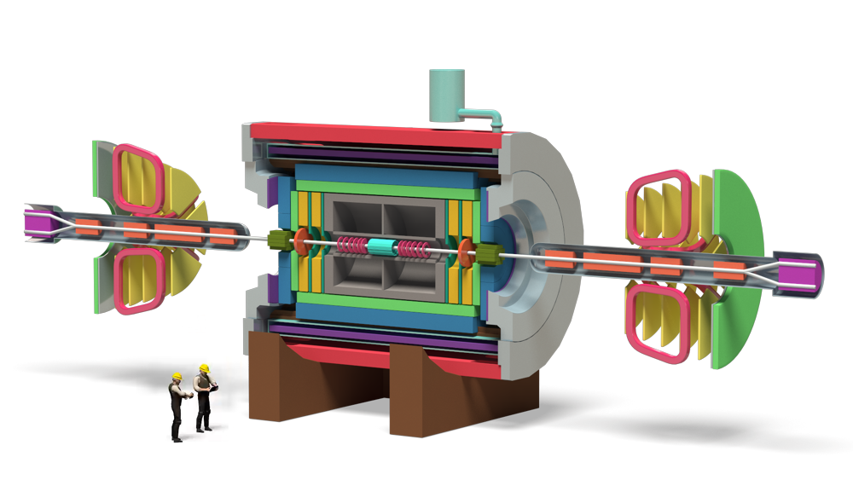
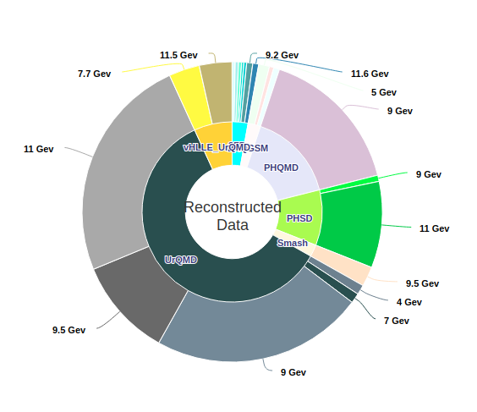
MPD MC generation
The MPD(Multi Purpose Detector) apparatus has been designed as a 4π spectrometer capable of detecting of charged hadrons, electrons and photons in heavy-ion collisions at high luminosity in the energy range of the NICA collider. To reach this goal, the detector will comprise a precise 3-D tracking system and a high-performance particle identification (PID) system based on the time-of-flight measurements and calorimetry.
Reconstructed Monte-Carlo events
MPD detector

Slide 6
MC generation math
In practice, to
generate 600M events
reconstruct 100M events
(size of reconstructed is around 1 MB)
You need to execute 500k jobs,
Each lasts for average 5.5 hours on one CPU core
(4-9 hours depending on the resource)
Notebook: ~80 years
Server(24cores): ~13 years
Cluster(10000 cores): ~ 11 days

Slide 7
MICC Resources
EOS
dCache
Storage
Disk, Tape
Protocol
local, root
GridFTP, root
local
local
Auth Storage
Kerb. , x509
x509
ceph key
HybriLIT
Auth Jobs
Kerb. x509
x509
SSO
HybriLIT
Job Submit.
Torque Grid
Grid
OpenNebula
Slurm
Component
Tier-2/CICC
Tier-1
Cloud
Govorun/HybriLIT
* This is a simplified slide to demonstrate complexity and variability of protocols and accesses approaches

Slide 8
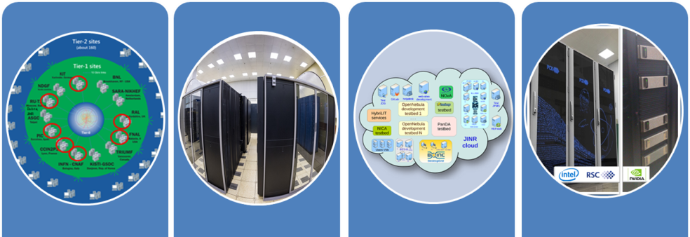
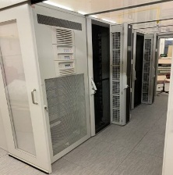
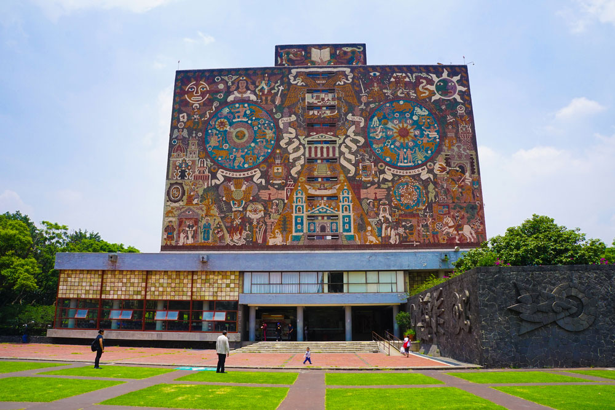
What was done in JINR
EOS
Tier-1
CICC/Tier-2
Clouds
Govorun
NICA Cluster
UNAM
Running
Running
Running
Running
Running
Running
The computing resources of the JINR Multifunctional Information and Computing Complex, clouds in JINR Member-States, cluster from Mexico University were combined using the DIRAC Interware.

Slide 9
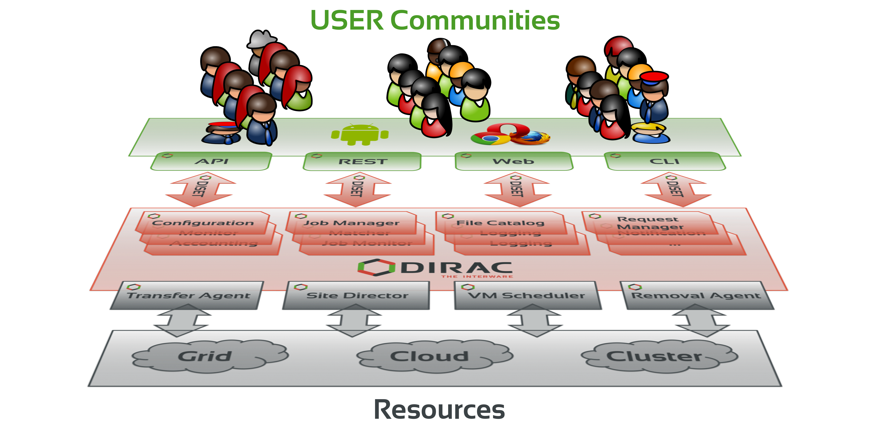
What is DIRAC?
DIRAC provides all the necessary components to build ad-hoc grid infrastructures interconnecting computing resources of different types, allowing interoperability and simplifying interfaces. This allows to speak about the DIRAC interware.
Web
CLI
API
REST

Slide 10
DIRAC provides
User Interface
API
Workload management
Data management
Integration tools
File Catalog
Meta-data management
Accounting

Slide 11
DIRAC standard job workflow
1. Initial configuration
2. Input data download
3. Processing
4. Output data upload
5.Finalization

Slide 12
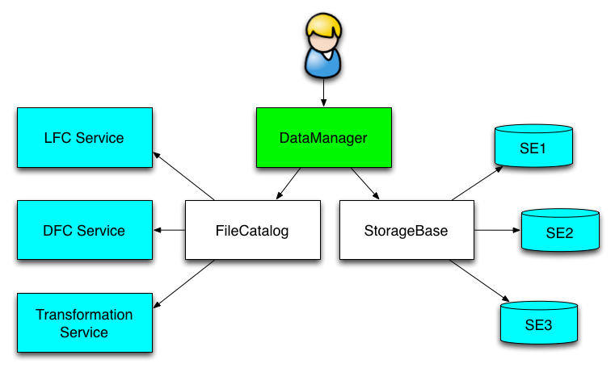
Data Management
DIRAC File Catalog(DFC) is maintaining a single global logical name space
A user sees it as a single catalog with additional features
DataManager is a single client interface for logical data operations
Upload file(example):
dirac-dms-add-file /mpd/vo/model/DQGSM/data.root ./data.roor EOS-MPD
Download file(example):
dirac-dms-get-file /mpd/vo/model/DQGSM/data.root

Slide 13
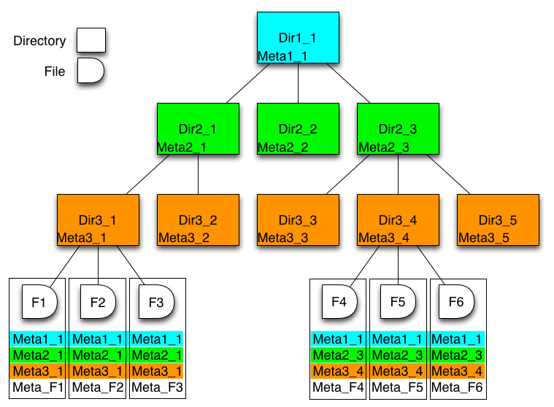
Meta Data
DFC also may host Metadata
User defined metadata
The same hierarchy for metadata as for the logical name space
Metadata associated with files and directories
Allow for efficient searches
Efficient Storage Usage reports
find /mpd/model LastAccess < 01-10-2020 GaussVersion=v1,v2 SE=EOS-MPD Name=*.raw

Slide 14
Disclaimer for further slides
Further statistics applied only for MPD centralized mass-production submitted only via DIRAC in JINR
Difference between resources mostly due to the fact that some resources integrated by DIRAC for longer time.
Computing power of different components mostly determined by quotas on the resources.

Slide 15
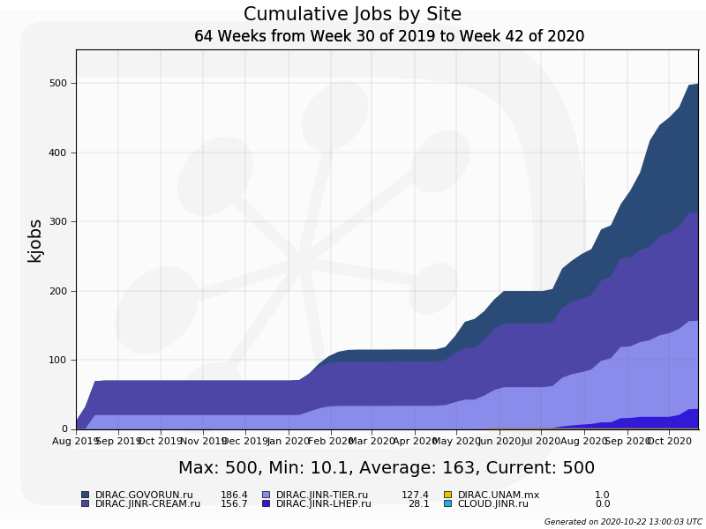
MPD Jobs Total
Half million jobs
Govorun
LHEP
(recently added)
Tier2
Tier1

Slide 16
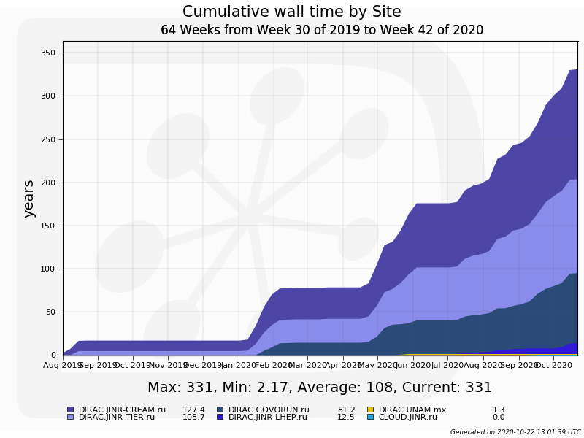
MPD Wall time
0.5M jobs
Each lasts 5,5 hours
Tier2
LHEP cluster
Tier1
Govorun

Slide 17
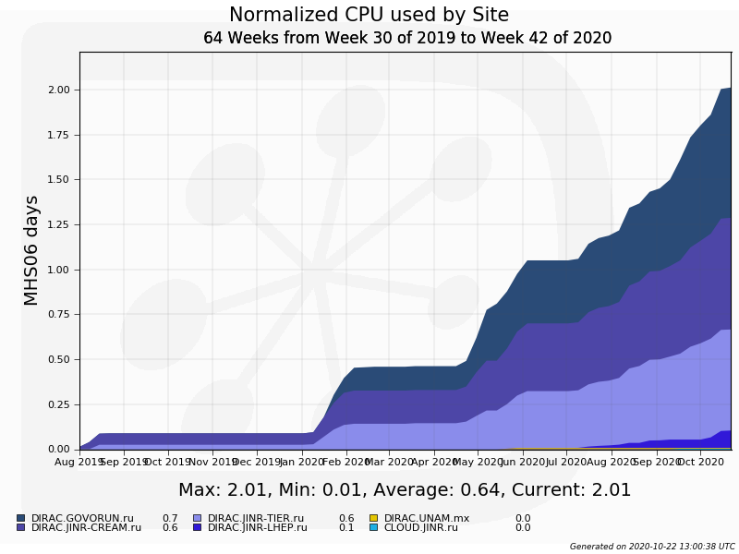
MPD Normalized time
Govorun
LHEP cluster
Tier2
Tier1

Slide 18
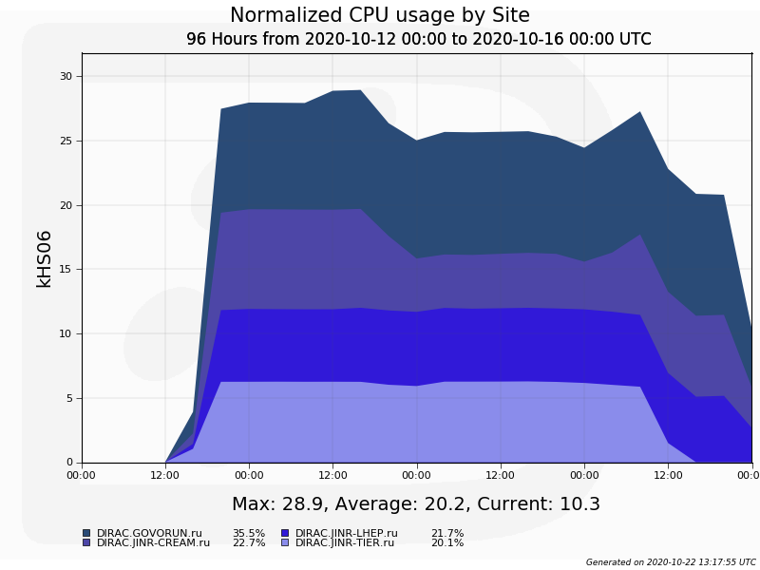
Computing power in DIRAC
Govorun
Tier2
LHEP cluster
Tier1

Slide 19
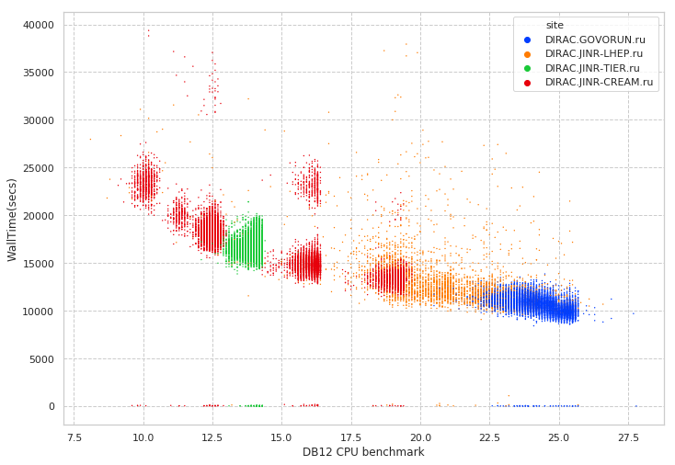
MPD plot - July
Tier1
Tier2
LHEP cluster
Govorun

Slide 20
Conclusion on MPD+DIRAC
Cooperation is the key.
640M events generated
130M events reconstructed
130TB data written to EOS disks(all registered in DIRAC FileCatalog)
Some resources are not presented in accounting:
JINR Cloud: strongly requires MPD code in CVMFS
UNAM Cluster: 1000 jobs completed as experiment. Network is week point.
Tapes over dCache tested. Mostly needed for RAW data from detector.
DIRAC accounting provide normalized accounting across all resources.

