Slide 1
Simulation of radiation damage to different neuronal structures with Geant4-DNA toolkit
Lkhagvaa Bayarchimeg¹,
Oleg Belov¹, Munkhbaatar Batmunkh^{1,2}, Oidov Lkhagva²
¹Laboratory of Radiation Biology, Joint Institute for Nuclear Research
²Division of Natural Sciences, National University of Mongolia
121st Session of the JINR Scientific Council, Dubna, 23-24 February 2017

Slide 2
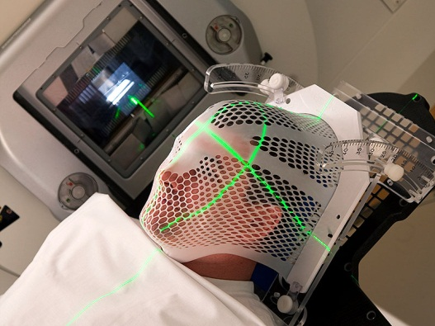
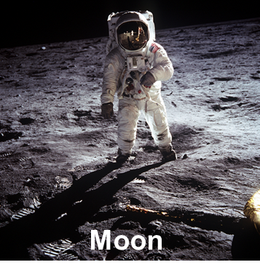
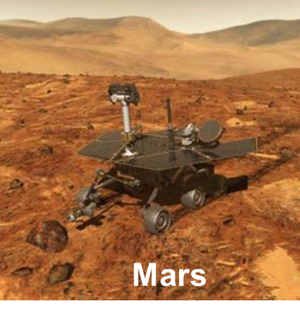
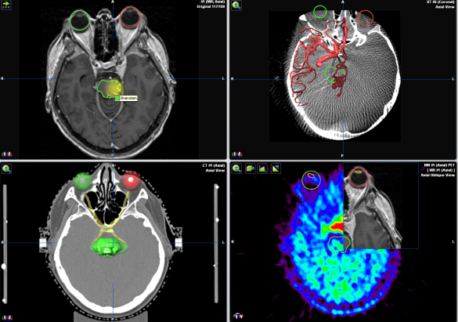
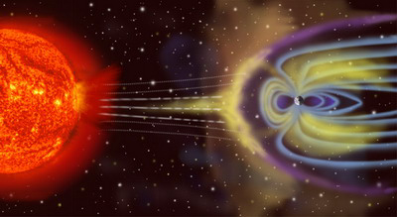
Introduction
Study of radiation damage to the central nervous system
Cranial radiation therapy
Space
radiobiology

Slide 3
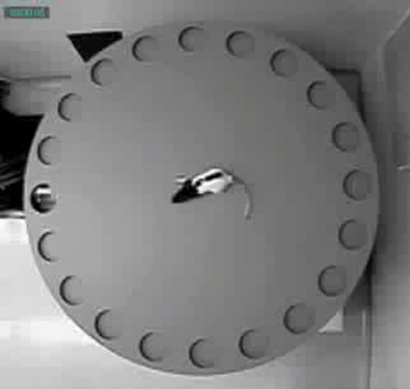
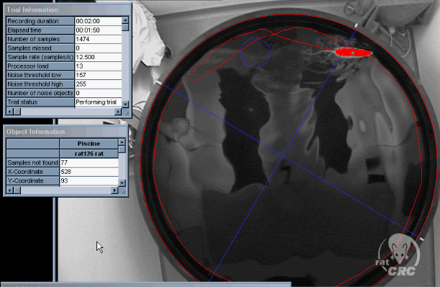
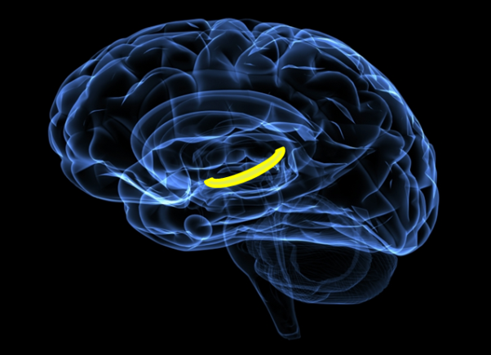
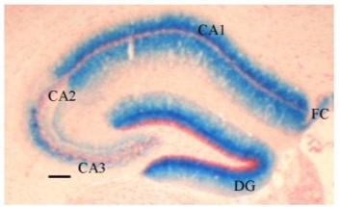
Introduction
Experiments with exposure of rodents to heavy ion beams revealed
Prolonged deficit in hippocampal-dependent learning and memory;
Neurochemical alterations in brain structures;
Impairment in the striatum-dependent operant response;
Electrophysiological alterations in the hippocampus…
Acute and late effects after exposures to heavy charged particles (⁵⁶Fe, ¹⁶O, …)
Hippocampus

Slide 4
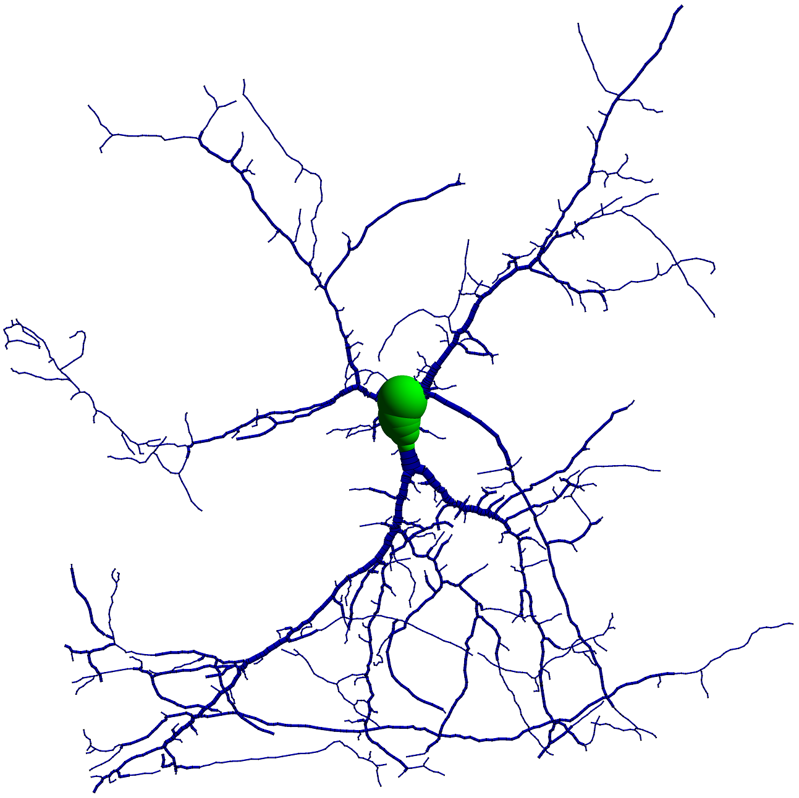
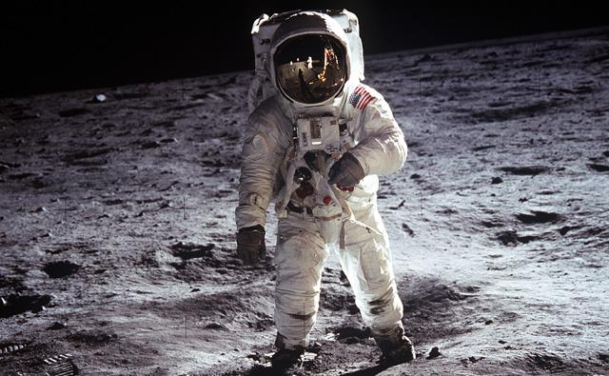
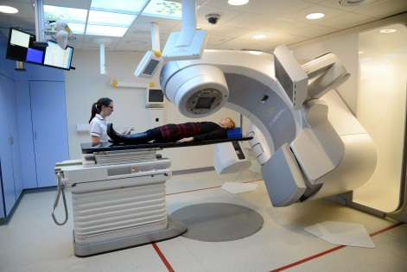
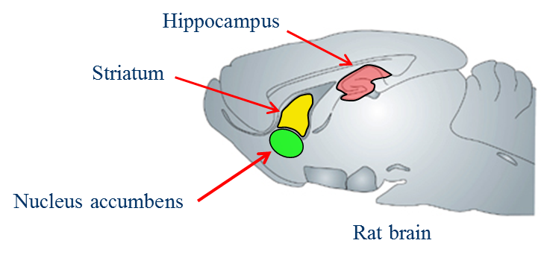
Simulation of radiation damage to neural cells
Radiation damage to the central nervous system (CNS) is a challenge.
Particle traversals to neurons are the initial events of radiation damage to CNS, leading further to a variety of cognitive impairments.
A neural cell is a complicate structure because of its intricate morphology.
Simulation of radiation transport in neural cells is of great interest.

Slide 5
Simulation tools

Slide 6
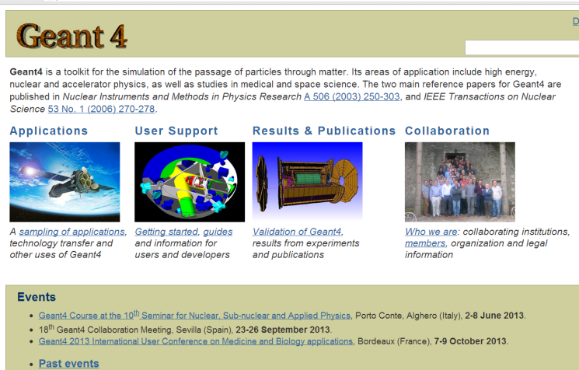
Track structure simulation with Geant4-DNA
GEANT4-DNA extension of the GEANT4 Monte Carlo code for modelling of radiation physical and chemical processes on the nanoscale
Time stages of radiation action
10⁻¹⁸ s
Physical stage
10 ⁻¹⁵ s
Physico-chemical stage
10 ⁻¹² s
Chemical stage
10 ⁻⁶ s
Bio-chemical stage
GEANT4 (code in C++) is user-friendly, possible to develop new applications.
Models of GEANT4-DNA processes based on numerous experimental data.
1 h
Biological stage

Slide 7
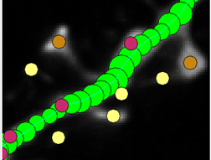
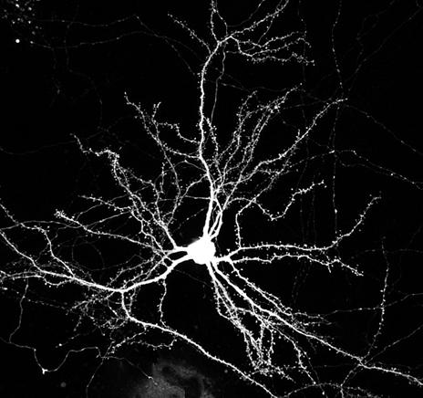
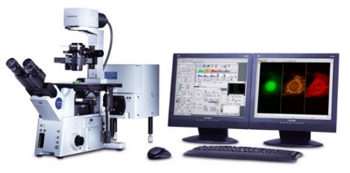
Geometrical model of a single neuron in Geant4
Reconstruction:
Tracing points (voxels)
GEANT4: A single pyramidal neuron
SWC File – standardized
neuromorphometric format:
n T x y z R P
…………………..,
51 3 -91.73 3.64 -2.25 0.24 50
52 3 -92.12 3.98 -1.91 0.29 51
…………………..,
Dentrictic trees: 2563 cylindrical compartment
3
Soma: 11 spherical compartment
4
Neurolucida (Glaser, 1990)
2
Available
Microscopy Images
1
Martone, 2003
The geometrical model of neuronal cells and receptor structure were constructed using experimental data on their molecule and cell morphologies.

Slide 8
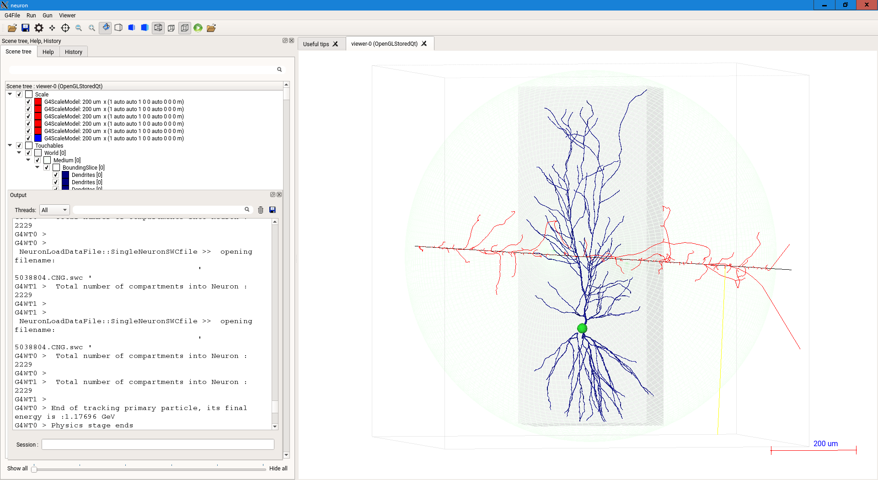
Simulation of particle track interaction with a single pyramidal neuron
Neuron model
290 MeV/u
carbon particle track
A single pyramidal neuron in the Geant4-DNA+GUI environment

Slide 9
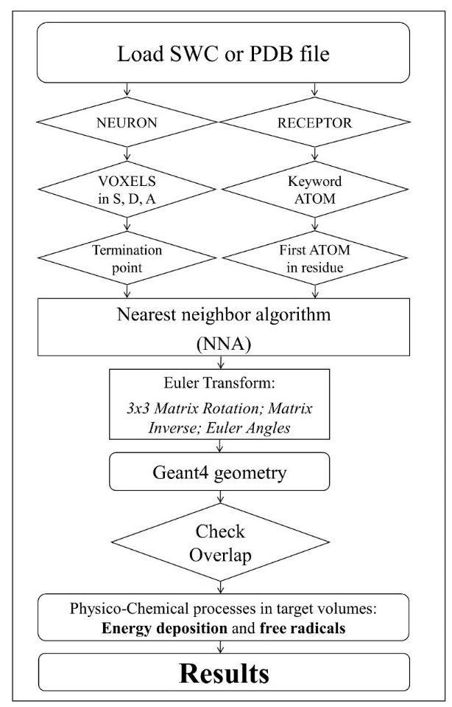
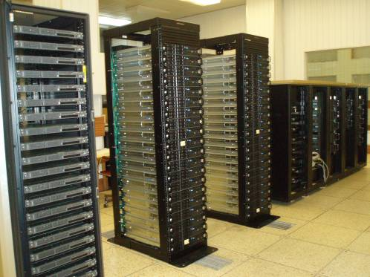
High-performance computations
Computation procedure
Scheme of simulation approach
HYBRILIT: heterogeneous cluster (LIT, JINR)
To build 3D neuron geometry (~ 10⁶ segments) as Geant4 parameterised volumes
Track structure simulation in large volume at nm scale; ~ 10⁷ particles as Multi-Threading mode multi-CPUs

Slide 10
Results

Slide 11
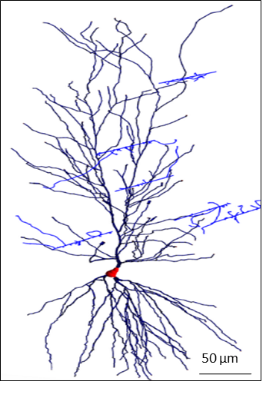
Distribution of energy deposition in a single pyramidal neuron
¹²C, 500 MeV/u, 1Gy
⁵⁶Fe, 1000 MeV/u, 1 Gy
M. Batmunkh, O. Belov, L. Bayarchimeg, O. Lhagva, N. Sweilam // J. Rad. Res. Appl. Sci . 2015. 8:498-507.
Distribution of energy deposition within a single pyramidal neuron. Energy deposition is indicated as a color-map and expressed in eV

Slide 12
Specific energy spectra in the single pyramidal neuron
n
a)
b)
Specific energy spectra in a single rat pyramidal neuron under exposure to ¹²C (a) and ⁵⁶Fe (b) ions

Slide 13
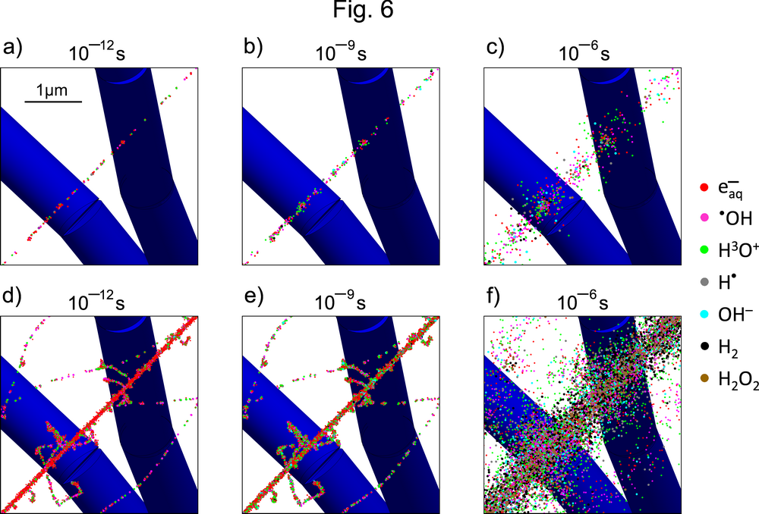
Distribution of free radicals in a single pyramidal neuron
30 MeV
⁺p particle track
1000 MeV/u ⁵⁶Fe particle
track
Track structure of a 30 MeV proton and 1000 MeV/u ⁵⁶Fe ion in dendritic branches of pyramidal neuron, as viewed at picosecond, nanosecond, and microsecond after exposure

Slide 14
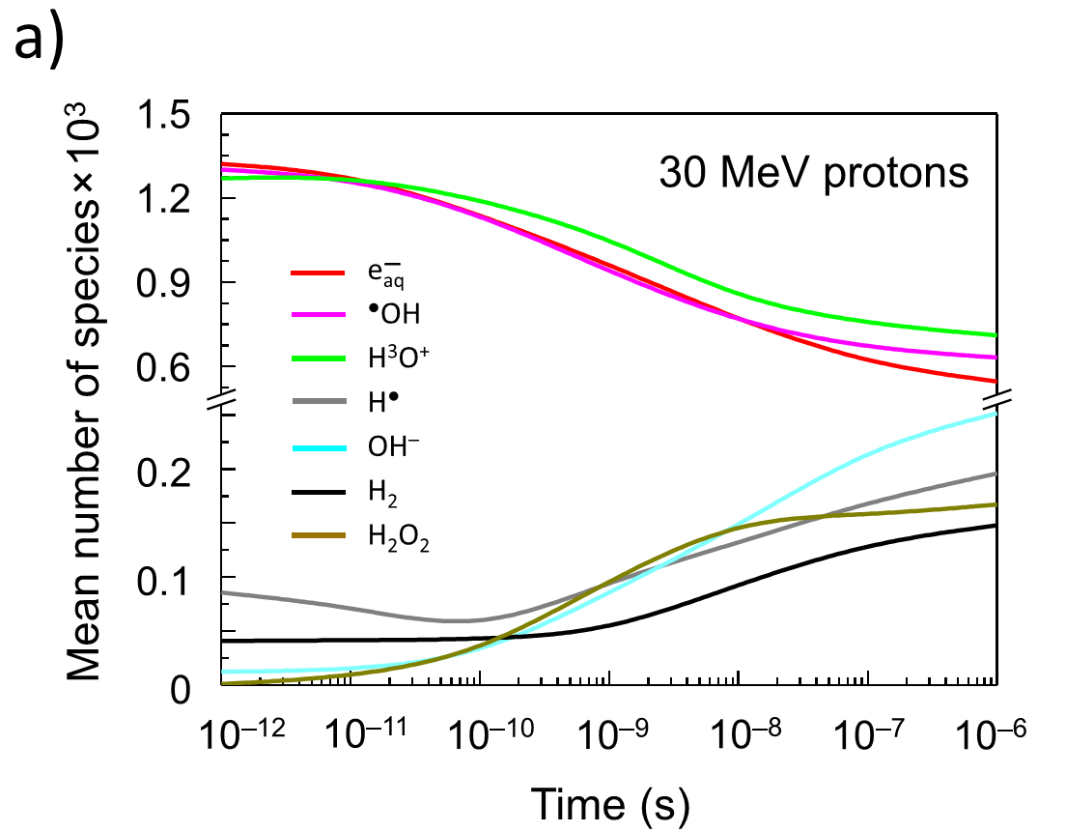
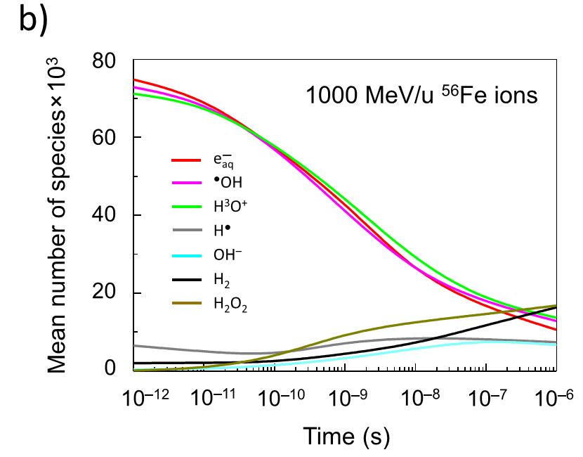
Number of free radicals in single pyramidal neuron
The time-dependent number of free radicals produced by single track of
30 MeV proton and 1000 MeV/u iron particles calculated per one neuron.

Slide 15
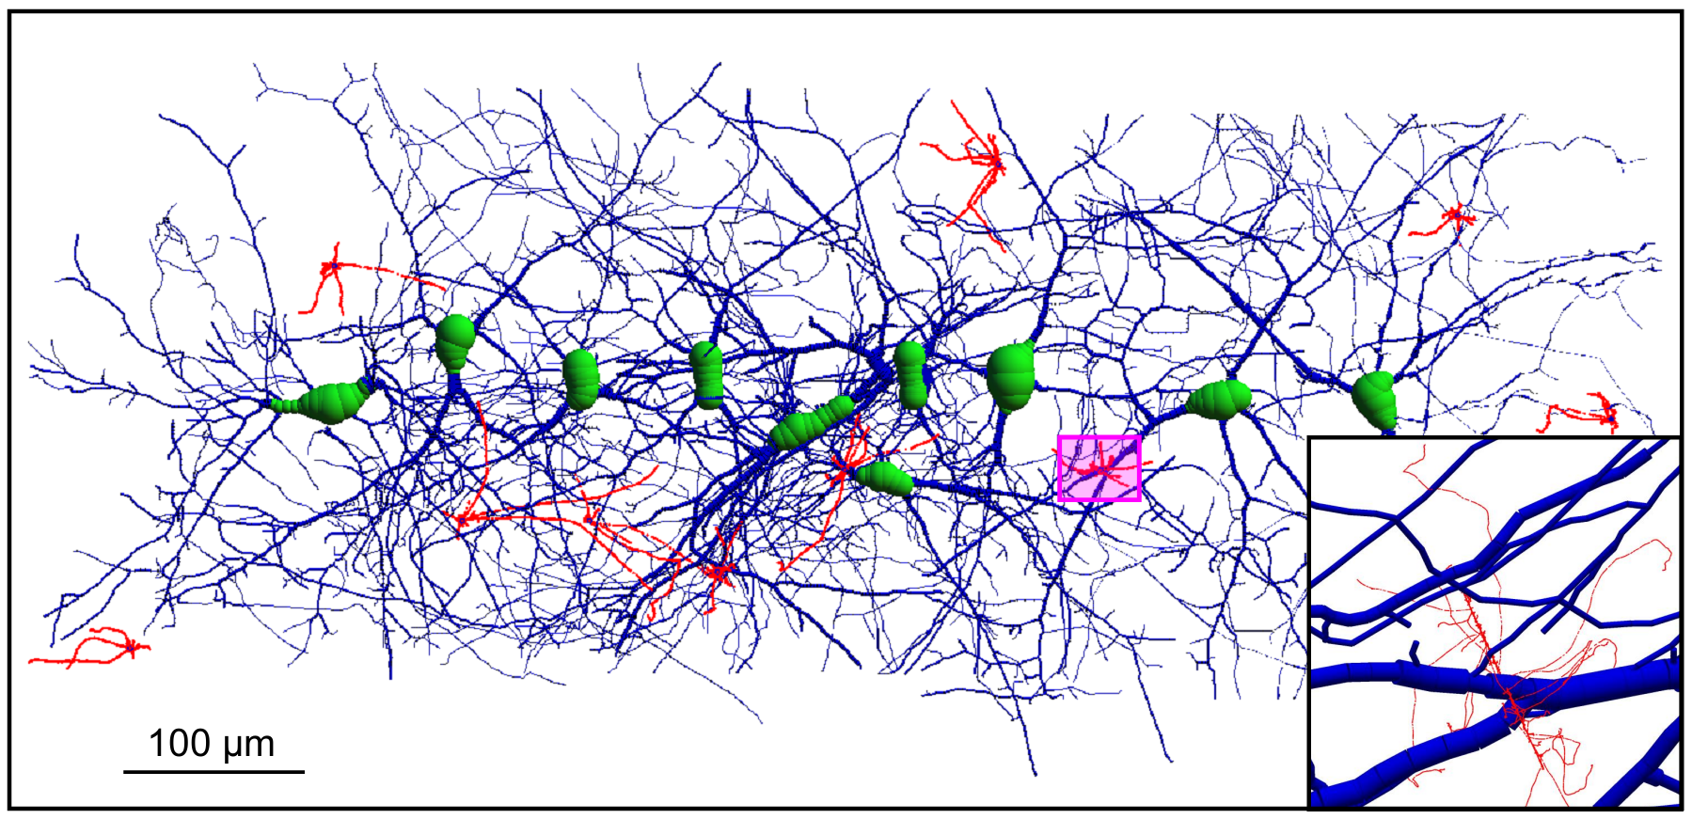
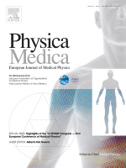
Dose distribution in a small neural network
Three-dimensional structure of the neural network composed of 10 cells which are traversed by several tracks of 1000 MeV/u ⁵⁶Fe particles. The segments of ⁵⁶Fe particle tracks are given in red colours.
96 spheres and 18082 small cylindrical compartments
O. Belov, M. Batmunkh, S. Incerti, O. Lkhagva // Physica Medica. 2016. 32:1510-1520.

Slide 16
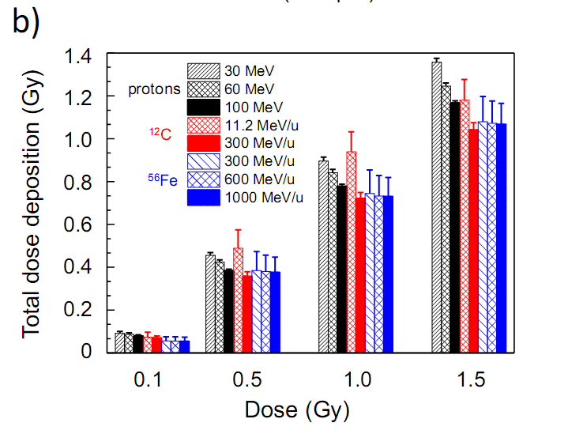
Dose deposition in a small neural network
Total dose deposition in the neural network with respect to the fluence dose

Slide 17
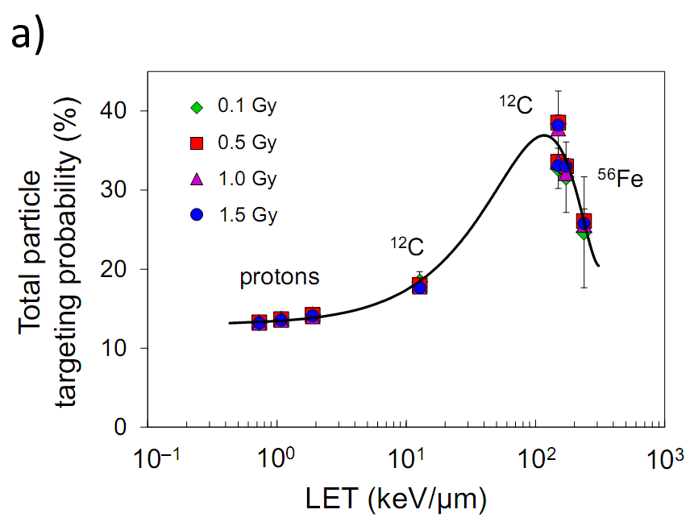
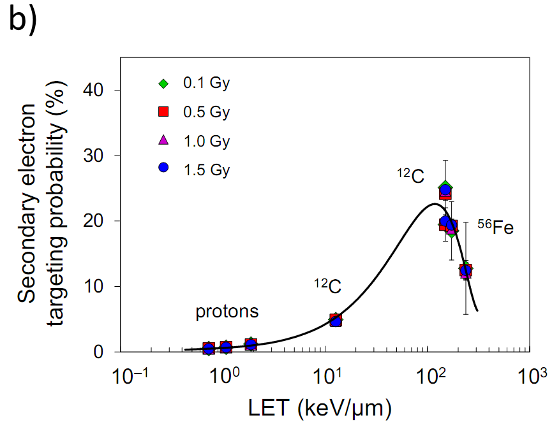
Probability of particle track traversal to the neural network
Total particle TP = primary particle TP + TP from secondary electron interactions
TP of only secondary electron interactions
The targeting probability plots characterizing the frequency of particle coincidence with neuron components in the neural network.

Slide 18
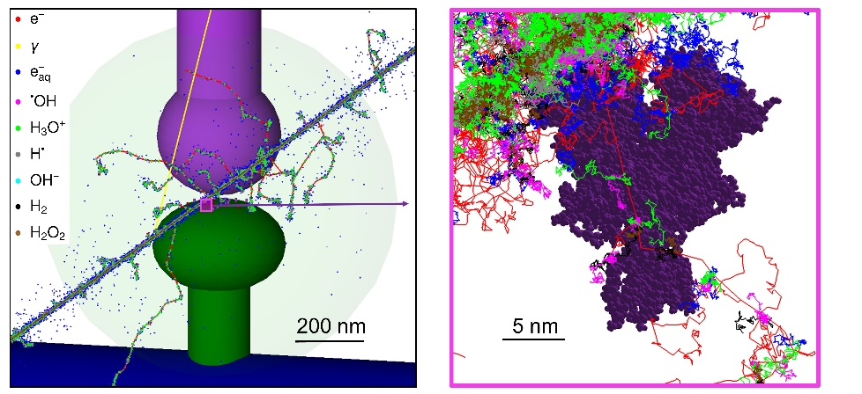
Simulation of radiation damage to synapses and receptors
Track structure of 100 MeV/u iron particles in synaptic receptors
V_{AMPA}=359.89 nm³
V_{NMDA}=429.85 nm³
The average values of energy deposition to NMDA and AMPA receptor exposed to 10000 tracks of ⁺p, ⁴He, ¹²C, ²⁸Si, and ⁵⁶Fe particles with same kinetic energy of 100 MeV/u.
L. Bayarchimeg, O.V. Belov, M. Batmunkh, O. Lkhagva
// Mongolian Journal of Physics. 2016. 2:470-474.

Slide 19
Conclusions
We have calculated microscopic energy deposition and yields of water radiolysis products in single neuron, a small neuronal network and synapse exposed to different radiations.
The present work demonstrates for the first time the possibilities of the general-purpose Geant4 toolkit for simulation of radiation effects in CNS.
It reports dependencies of the most important characteristics of radiation transport on particle LET and dose, it describes as well the time-evolution of particle tracks in the tested neural network with the special emphasis on modelling of water radiolysis chemistry.
Some of the obtained quantities cannot be measured experimentally in real neurons and, therefore, the data produced is of particular importance for understanding the earliest physico-chemical events leading to further functional changes in CNS.
Notes:
In order to study direct and indirect radiation damage to brain neurons, we have calculated microscopic energy deposition and free radicals in single neuron and small neural network and synaptic receptor under irradiation with different particles and energies.
CNS is so complex system. So some of obtained data, for example datas of physical and chemical interaction in neuron and neuronal system are can not be measured experimentally in real neurons. Therefore all obtained datas are particular importance for understanding the earliest physico-chemical-biological events leading to further functional changes in CNS.
Recently we have developed new example on this computation to be officially included to Geant4-DNA.
///Only: The estimation of the radiolytic yields in neuronal cells suggests that the observed enhancement in the levels of reactive oxygen species may potentially lead to oxidative damage
to neuronal components disrupting the normal communication between cells of the neural network.

Slide 20
Publications
O. Belov, M. Batmunkh, S. Incerti, O. Lkhagva. Radiation damage to neuronal cells: Simulating the energy deposition and water radiolysis in a small neural network // Physica Medica. 2016. 32:1510-1520.
L. Bayarchimeg, O.V. Belov, M. Batmunkh, O. Lkhagva. Modeling of synaptic receptors under irradiation with charged particles //Mongolian Journal of Physics. 2016. 2:470-474.
М. Batmunkh, O.V. Belov, L. Bayarchimeg, O. Lkhagva. Radiation effects in the central nervous system: Simulation technique and practical applications // Mongolian Journal of Physics. 2016. 2:317-323.
M. Batmunkh, O. Belov, L. Bayarchimeg, O. Lhagva, N. Sweilam. Estimation of the spatial energy deposition in CA1 pyramidal neurons under exposure to ¹²C and ⁵⁶Fe ion beams // J.Rad.Res.App.Sci. 2015. 8:498-507.
Thank you for your attention!

