Slide 1
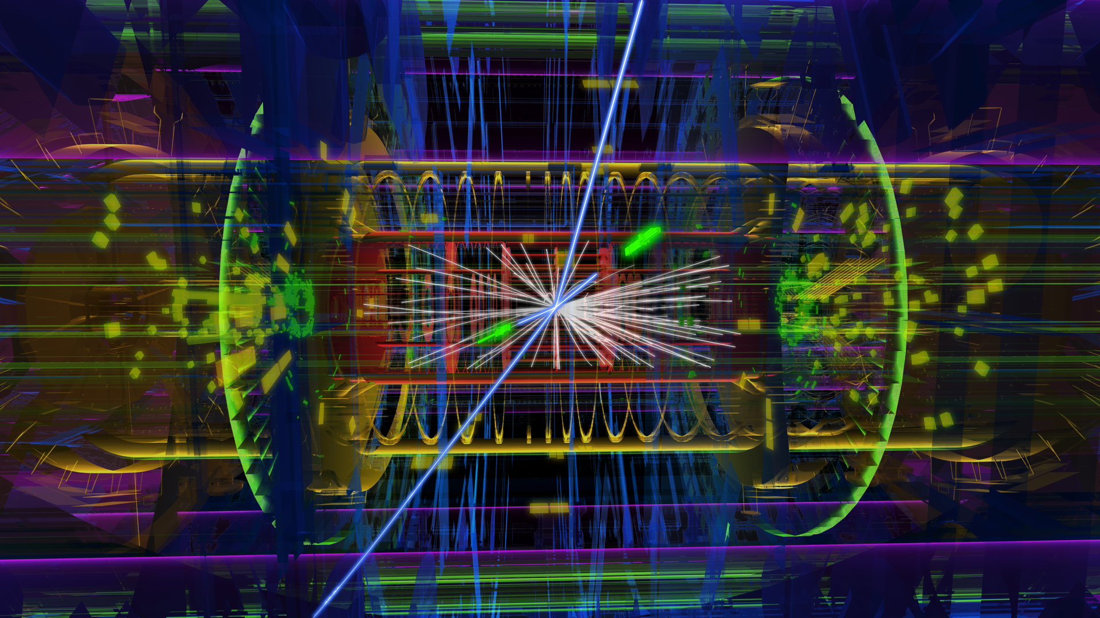

WLCG Status and Challenges
Dr. Markus Schulz
CERN
LHC Computing Project
NEC 2017

Slide 2
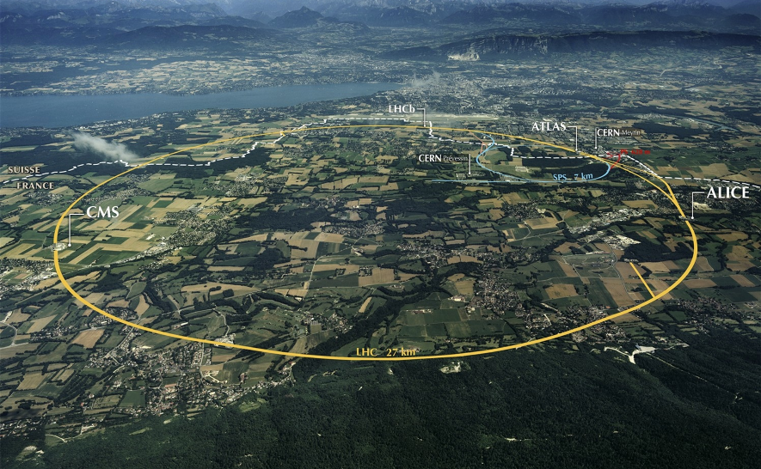
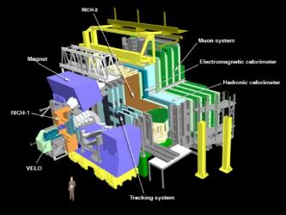
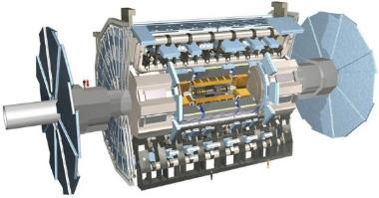
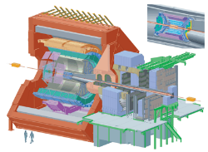
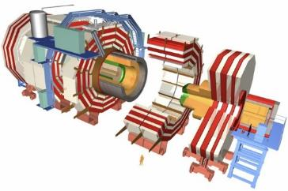
The Large Hadron Collider (LHC)
>1 GB/s
~700 MB/s
A new frontier in Energy & Data:
LHC experiments generate 50 PB/year
~10 GB/s
>1 GB/s
Notes:
Largest scientific apparatus ever build
27km around
2 general purpose detectors: Huge microscopes – to explore the very small – using a long lever arm
2 specialized detectors

Slide 3
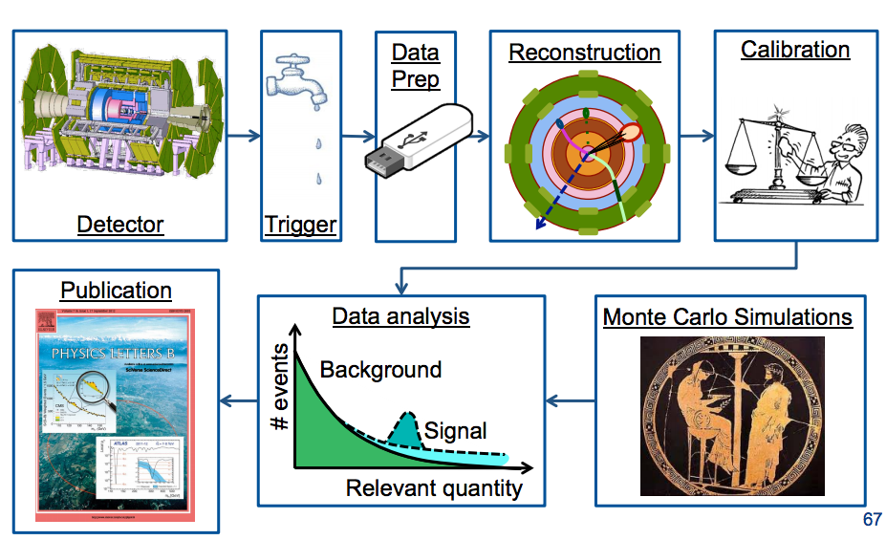
Processing
Online
Repeated from time to time
~50% of computing
Repeated very frequently
Anna Sfyrla CERN/ATLAS

Slide 4
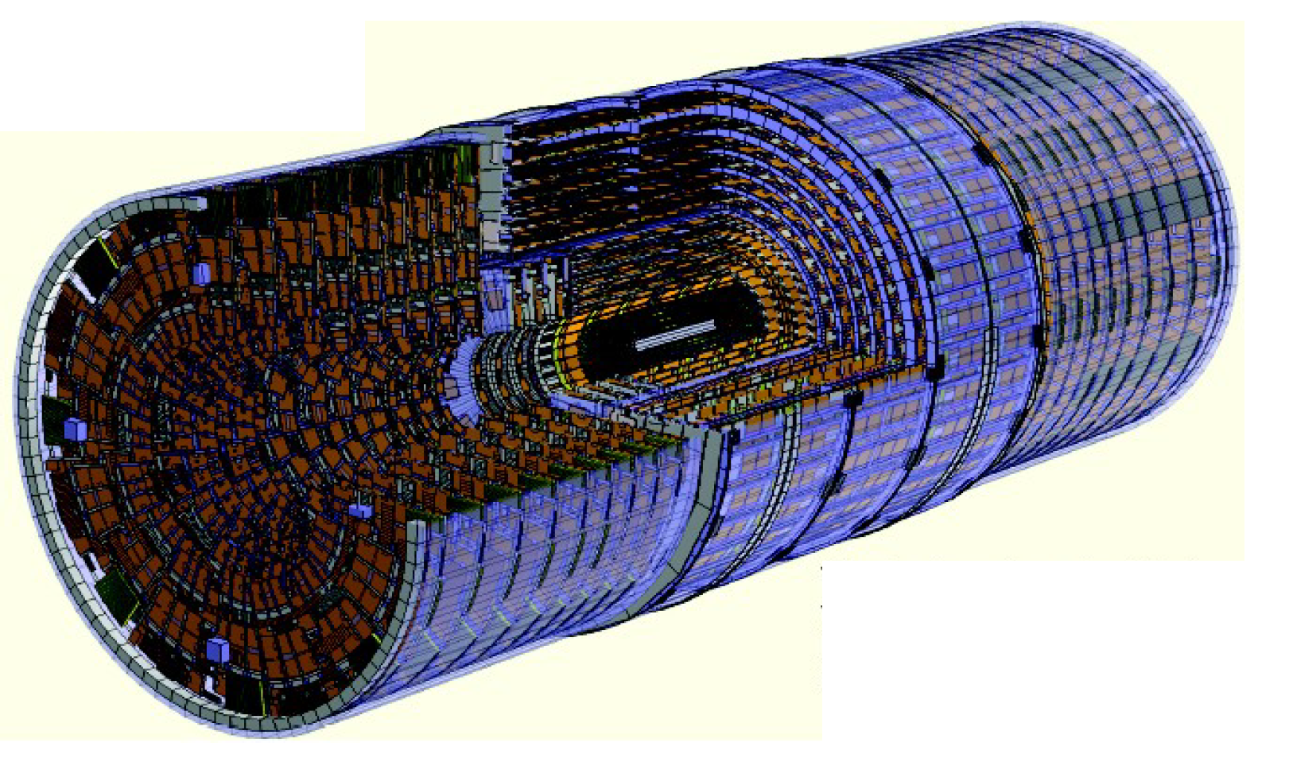
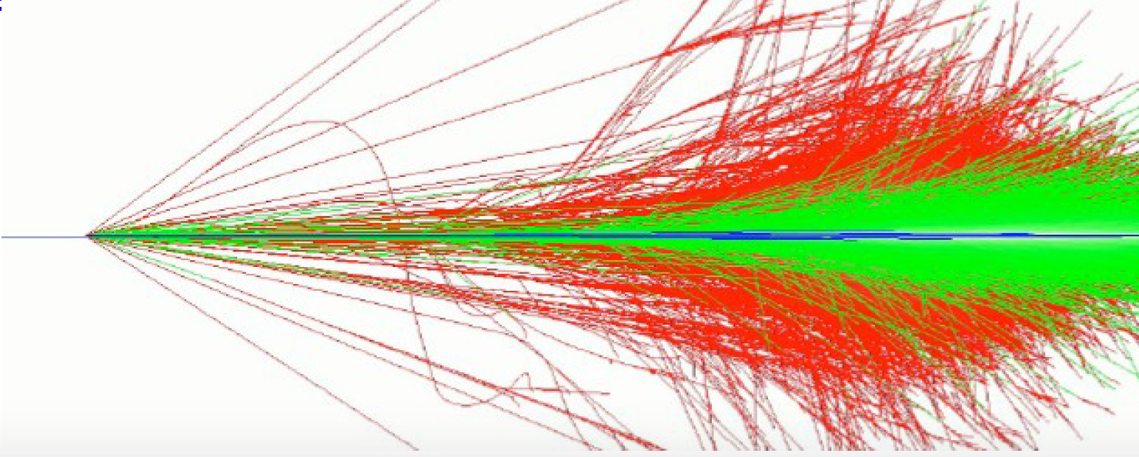
Simulation is complex at all levels
Detector Geometry
Physics Process
Detector Responds

Slide 5
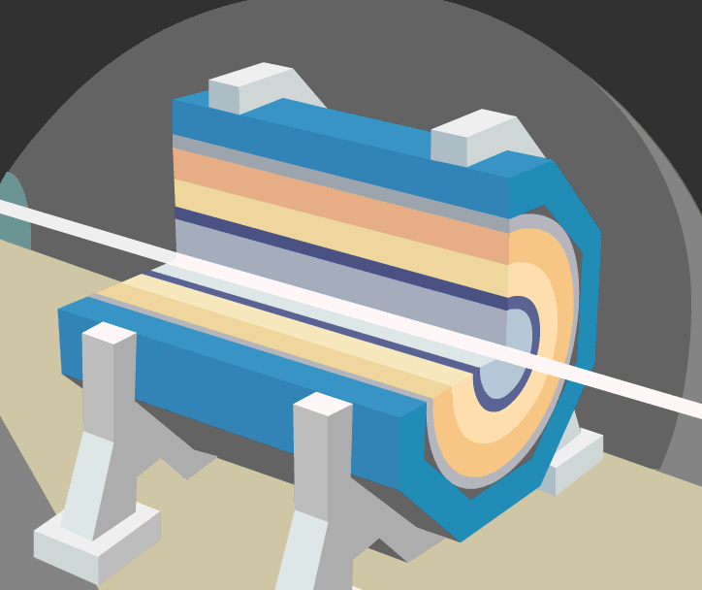
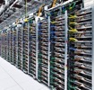

Data Analysis at the LHC
The process to transform raw data into useful physics datasets
This is a complicated series of steps at the LHC (Run2)
After HardwareTrigger (TB/s)
From Detector (1PB/s)
Derived Data (2 GB/s)
Derived Data (2 GB/s)
Analysis Selection
(100MB/s)
Data
Volume
Selected RAW (1 GB/s)
20k
cores
Processing and people
HLT
Reconstruction
Reprocessing
Organized Analysis
Final Selection
40k
cores
30k
cores
DAQ and Trigger (less than 200)
Operations
(less than100)
Analysis Users
(lMore than 1000)
Operations
(less than 100)
60k cores
Analysis Users
(lMore than 1000)
Notes:
Takes weeks and involves a big central operation team and large user community. Data is touched several times and by different sets of teams

Slide 6
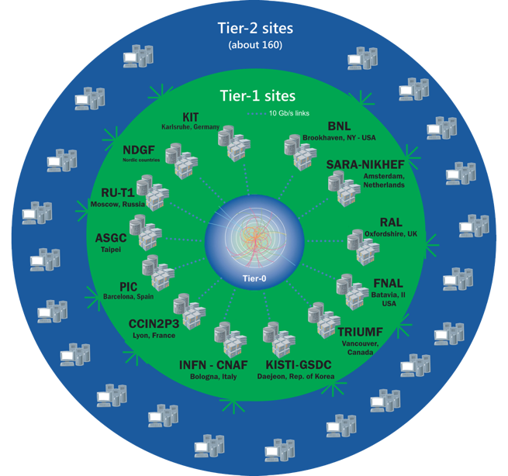
The Worldwide LHC Computing Grid
Tier-0
(CERN and Hungary):
data recording, reconstruction and distribution
~170 sites,
42 countries
~750k CPU cores
Tier-1: permanent storage, re-processing,
analysis
~1 EB of storage
> 2 million jobs/day
Tier-2: Simulation,
end-user analysis
10-100 Gb links
WLCG:
An International collaboration to distribute and analyse LHC data
Integrates computer centres worldwide that provide computing and storage resource into a single infrastructure accessible by all LHC physicists

Slide 7
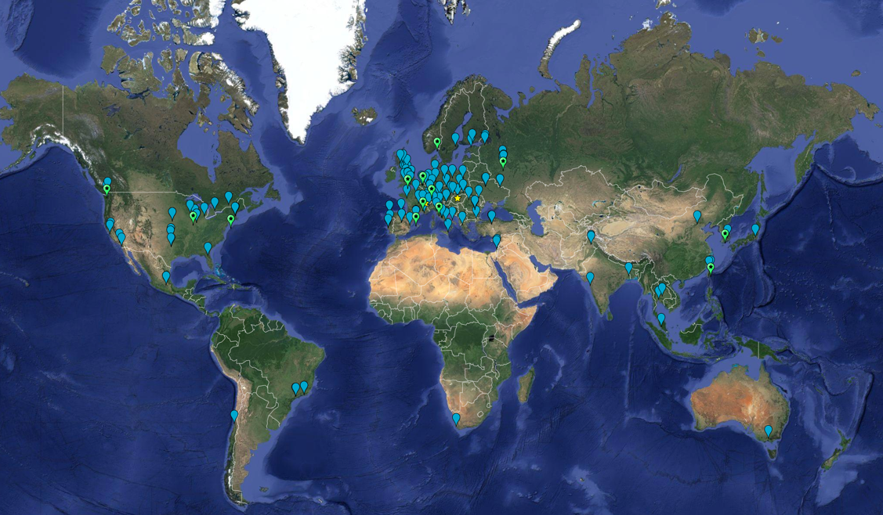
WLCG MoU Signatures
2017:
63 MoU’s
167 sites; 42 countries

Slide 8
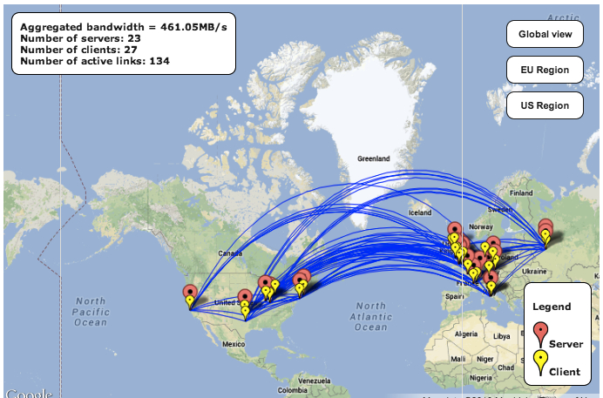
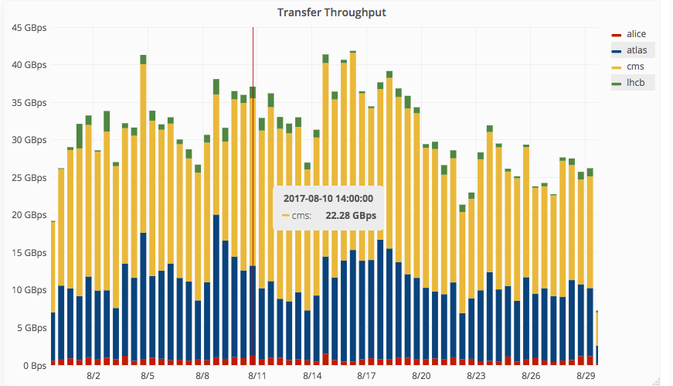
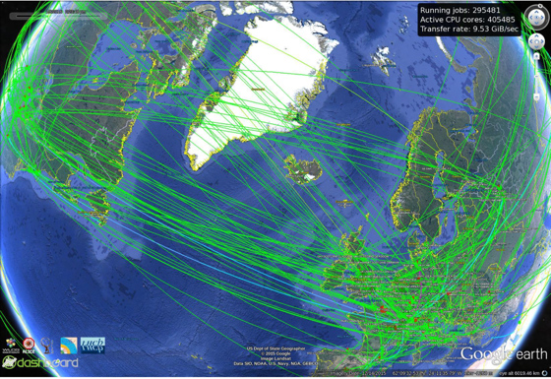
Data distribution
Global transfer rates increased to 30-40 GB/s
(>2 x Run1)
Federated Data
Increased performance everywhere:
Data acquisition >10PB / month
Data transfer rates > 35 GB/s globally
Regular transfers of >80 PB/month with ~100 PB/month during July-October
(many billions of files)
Notes:
Top plot: data acquired in May and June 2016 – new daily records for pp data: >400TB/day (but mostly driven by ALICE not doing compression in HLT)
Middle: global data transfer rates – again new peaks at up to 35 GB/s – Run 1 was ~15GB/s. 2015 was 25 GB/s; right plot is CPU used
Bottom: internal CERN traffic to/from all storage systems (Tape and disk pools) – sums are close to 100 GB/s!

Slide 9
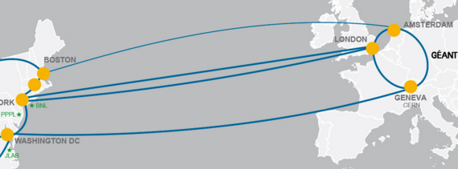
Networks
Optical Private Network
Support T0 – T1 transfers
& T1 – T1 traffic
Managed by LHC Tier 0 and Tier 1 sites
Up to 340 Gbps transatlantic

Slide 10
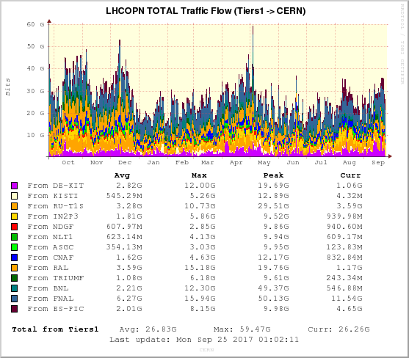
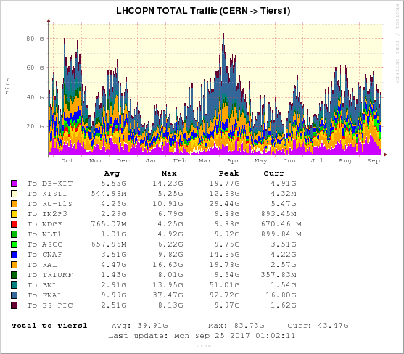

Slide 11
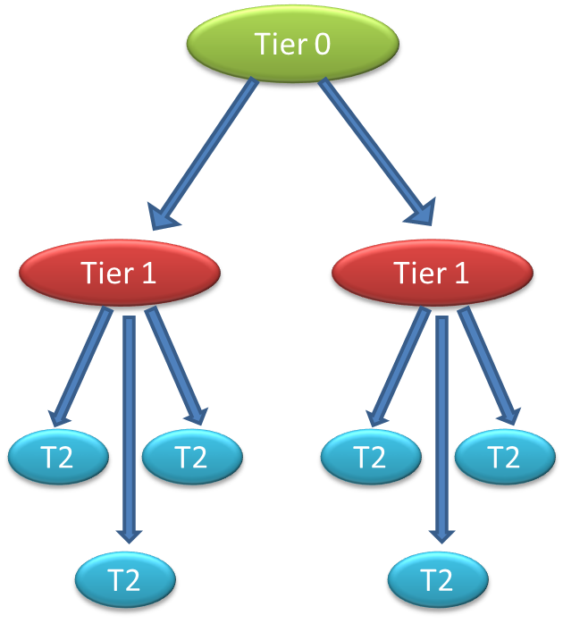
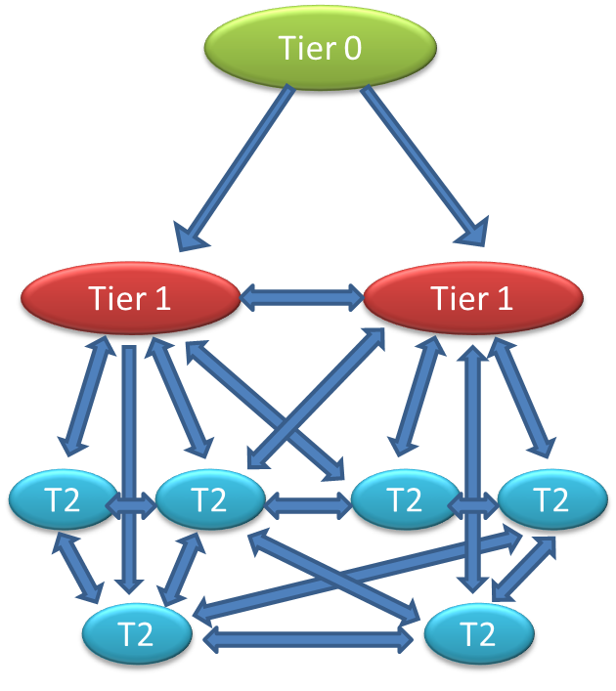
We evolved the Computing model
Evolution of computing models
FAX
AAA
http Fed.
Hierarchy
FTS-3
Mesh

Slide 12
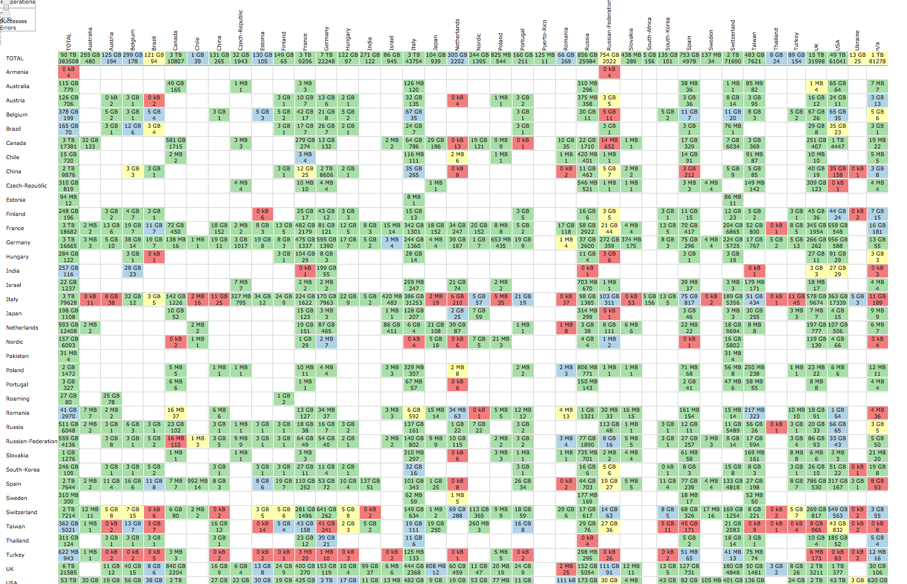
160 X 160 Problem

Slide 13
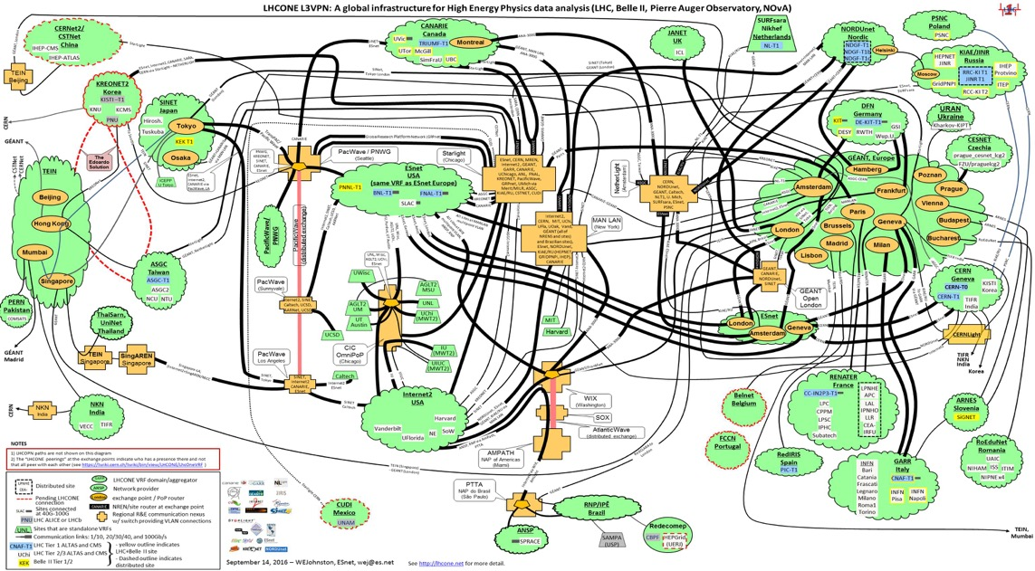


Asia
North America
Europe
LHCOne: Overlay network
Allows NREN’s to manage HEP traffic on general purpose network
Managed by NREN collaboration
South America

Slide 14
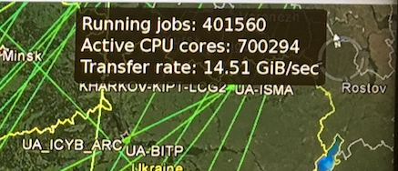
Worldwide computing
Peak delivery:
190M core-days/month
(~ 600k cores permanently)

Slide 15
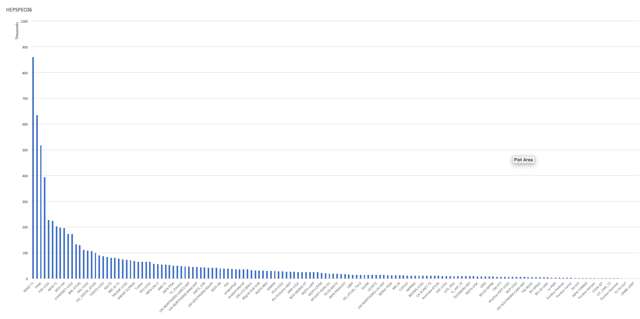
Distribution of Contributions
50%
15 sites
80%
47 sites
20%
110 sites
~T0

Slide 16
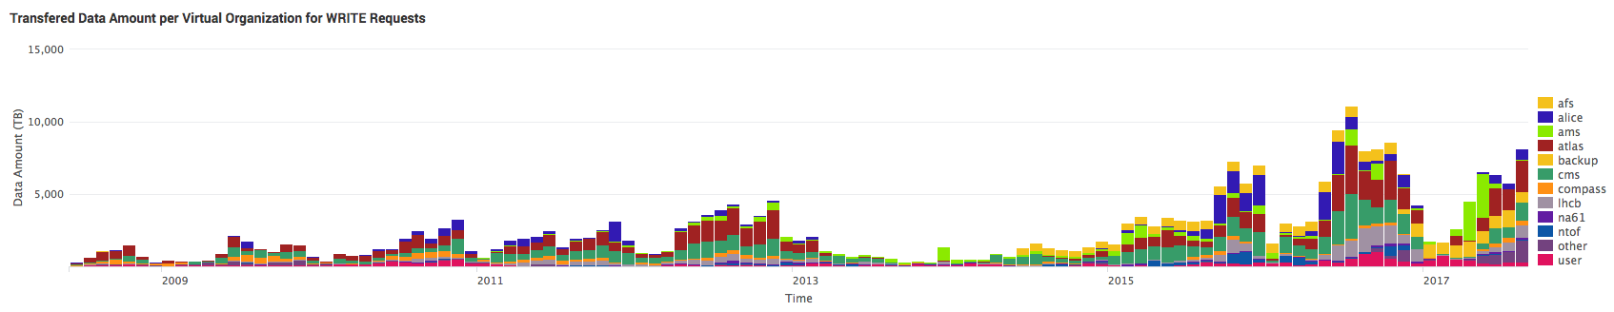
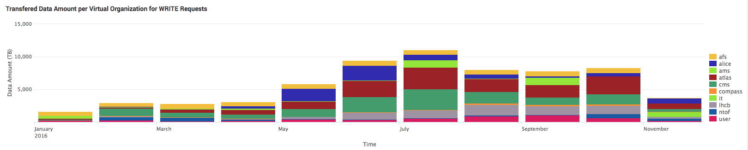
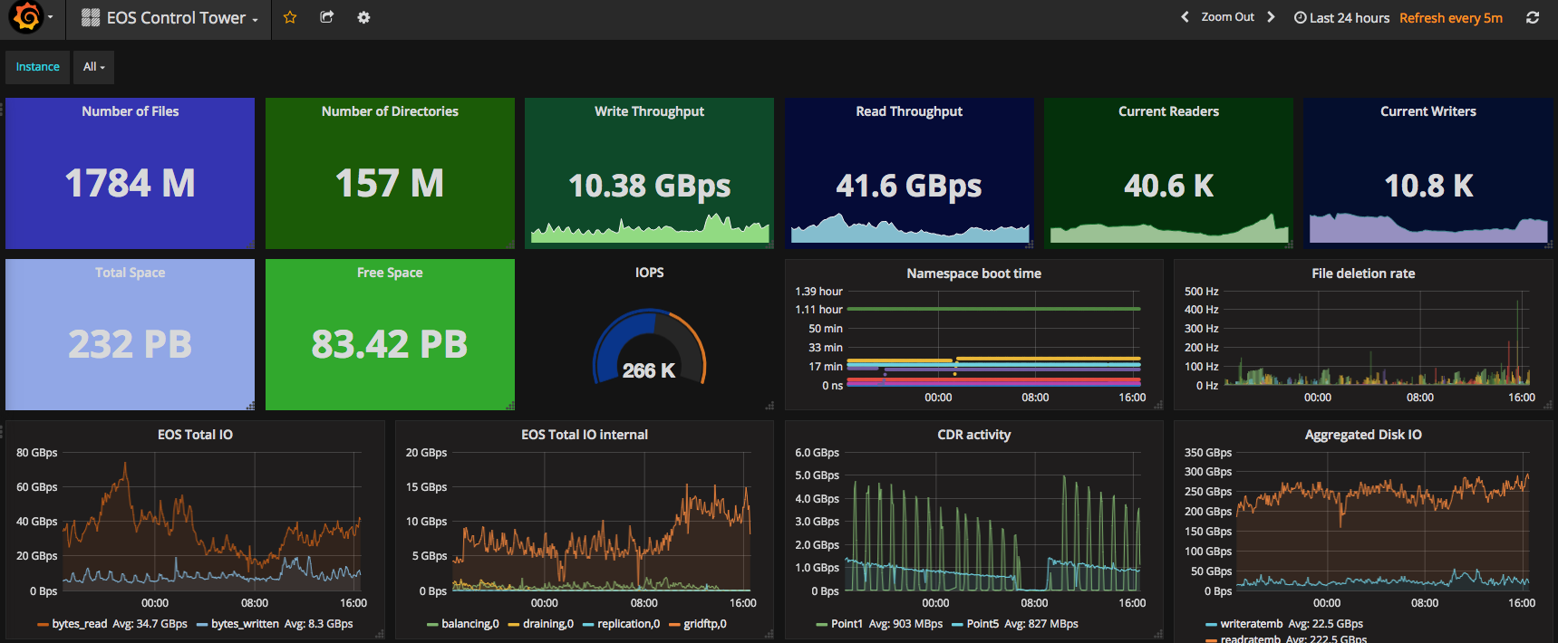
Data at the T0 (CERN)
ALICE: 7.6 PB
ATLAS: 17.4 PB
CMS: 16.0 PB
LHCb: 8.5 PB
2016: 49.4 PB LHC data/
58 PB all experiments/
73 PB total
11 PB in July 2016
200 PB on tape
>500 M files

Slide 17
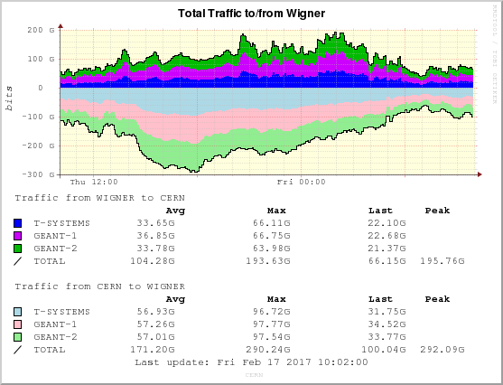
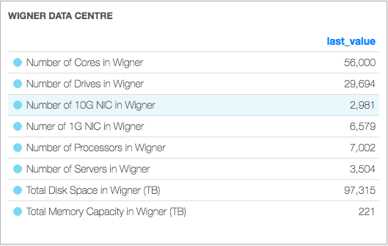
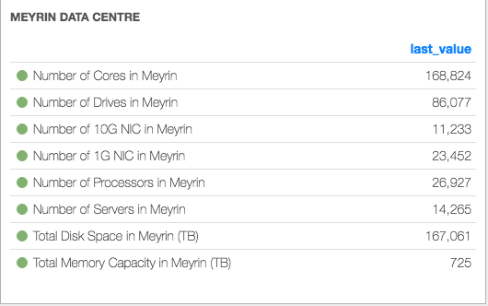
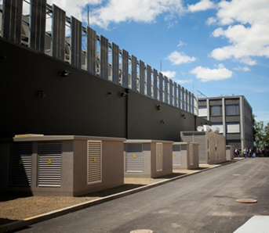
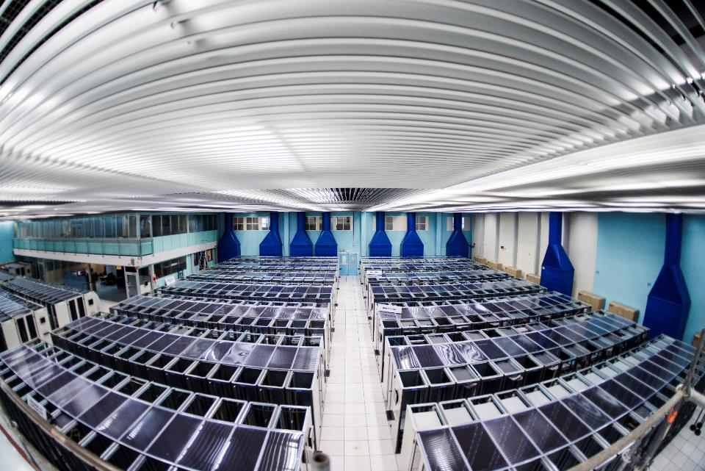
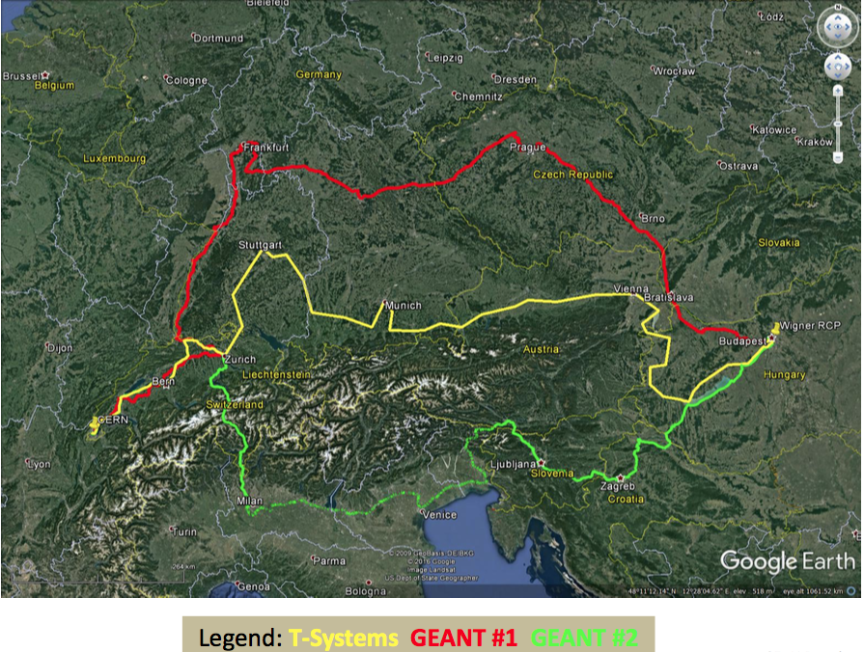
CERN Facilities today
2017-18/19
Upgrade internal networking capacity
Refresh tape infrastructure
2017:
325 k cores
250 PB raw disk

Slide 18





Provisioning services
Moving towards Elastic Hybrid IaaS model:
In house resources at full occupation
Elastic use of commercial & public clouds
  Assume “spot-market” style pricing
End Users
Experiment Pilot Factories
CI/CD
IT & Experiment Services
HTCondor
(LSF)
APIs
CLIs
GUIs
HPC/
Volunteer/
Opportunistic
Public Cloud
OpenStack Resource Provisioning
(>1 physical data centre)
Bare Metal and HPC
Containers
VMs

Slide 19
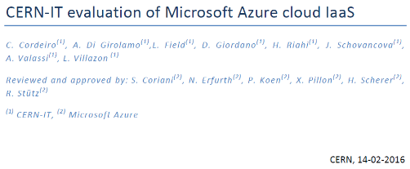
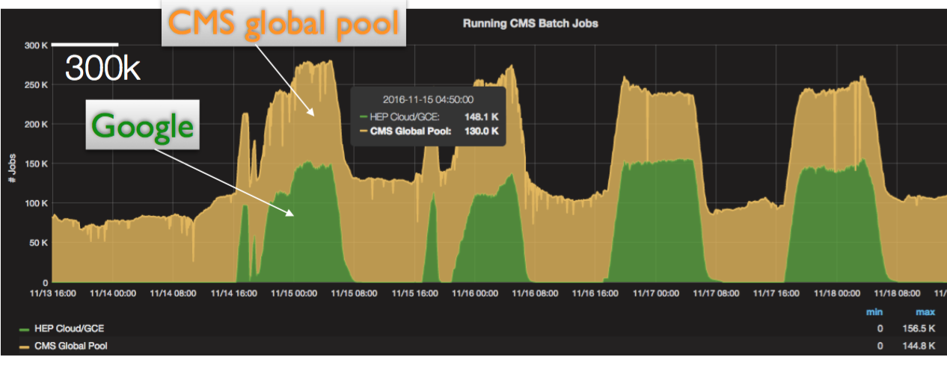
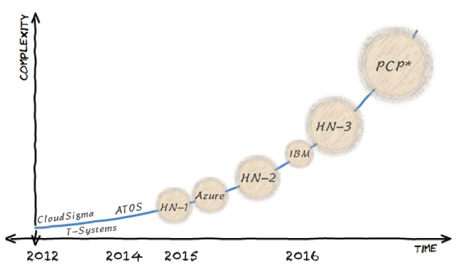
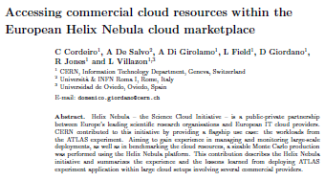





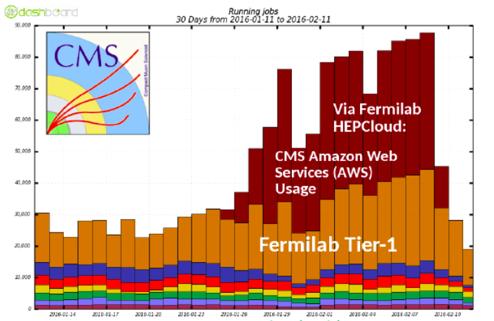
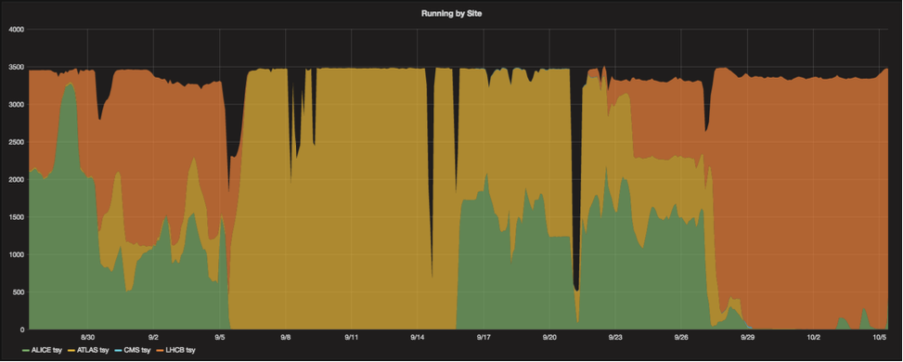
Commercial Clouds
Open Telekom Cloud
LHCb
ATLAS
ALICE

Slide 20

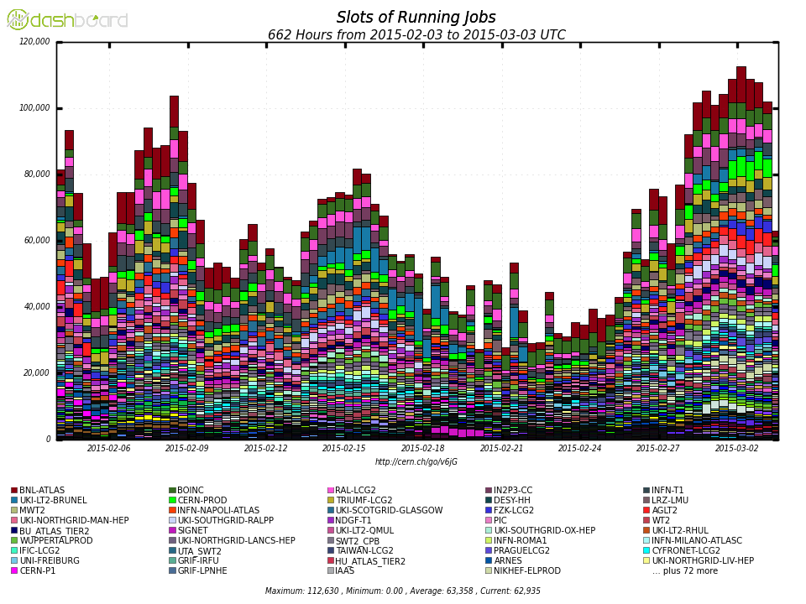
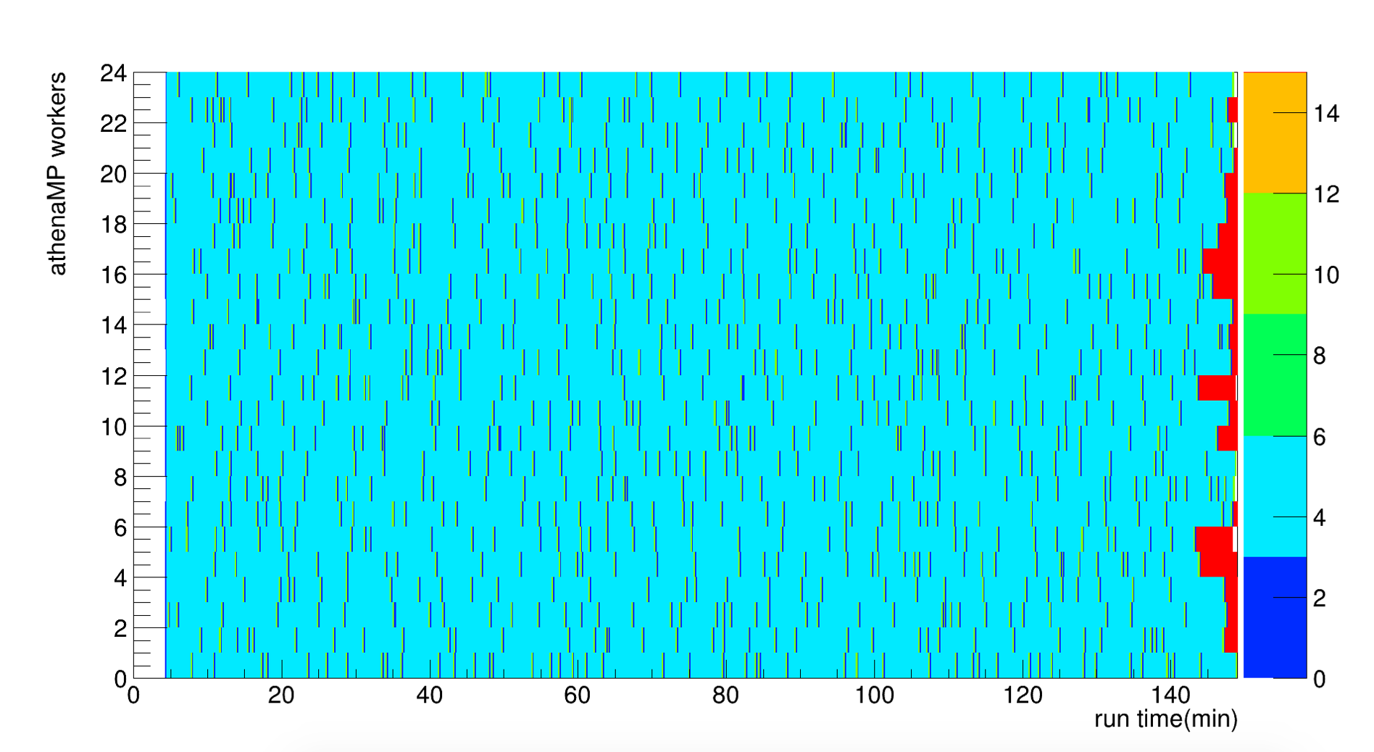
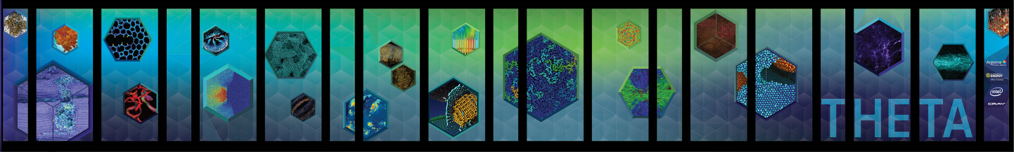
Other Resources for WLCG
High Performance Computing
  HPC shares
  HPC backfill
Opportunistic Resources
  Volunteer computing
    LHC@home (Boinc)

Slide 21
ATLAS@home Contribution
2nd largest simulation site
Running 4-5k parallel jobs
20M events simulated
5M CPU hours
http://atlasathome.cern.ch/atlas_job.php
21

Slide 22
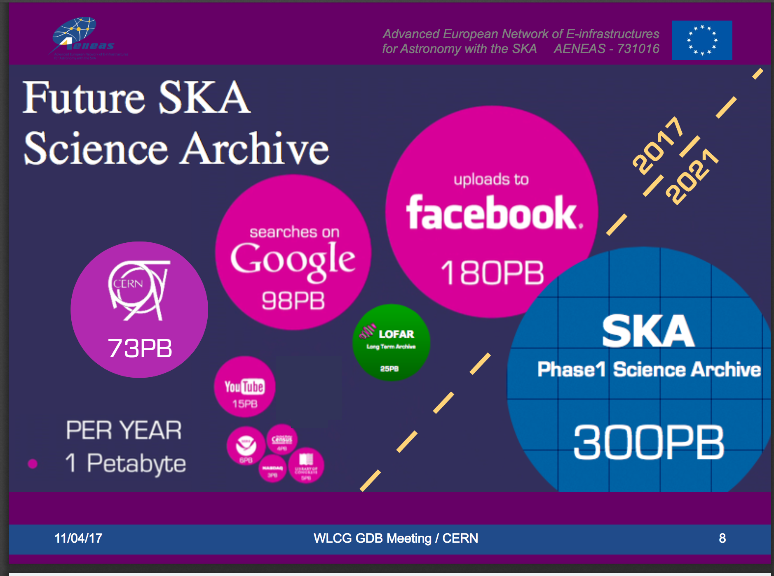
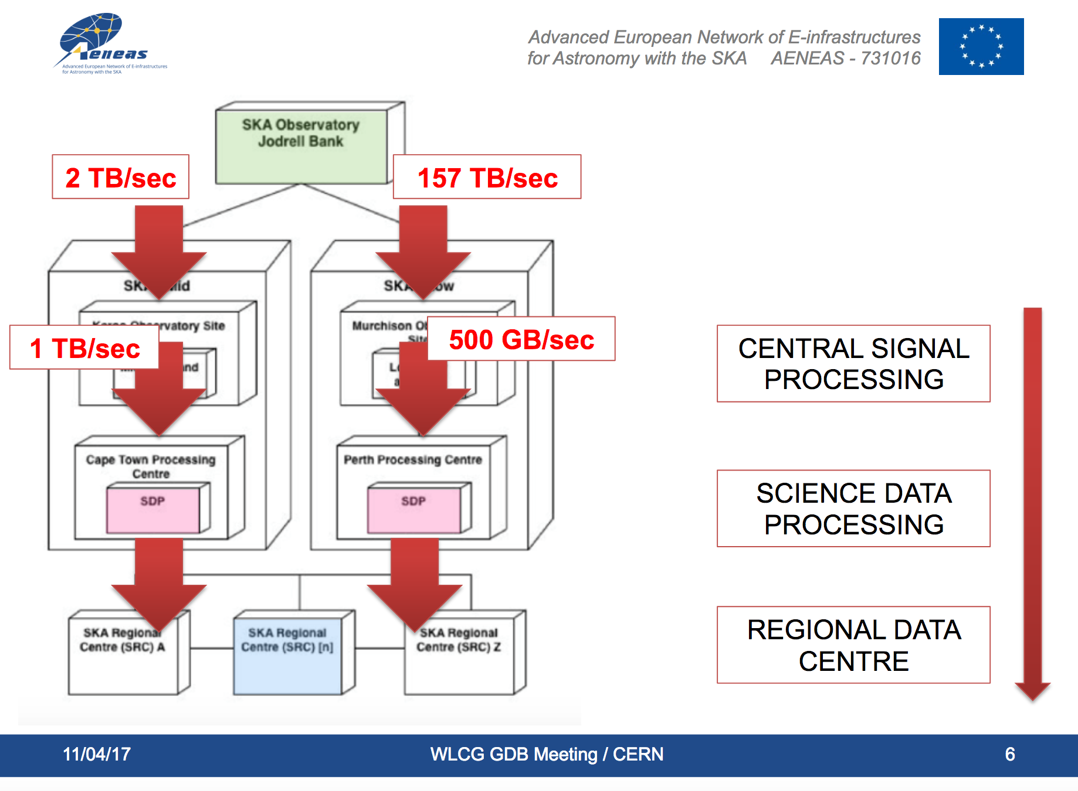
Collaboration beyond HEP
Example: SKA
  data rates and processing needs like WCG

Slide 23
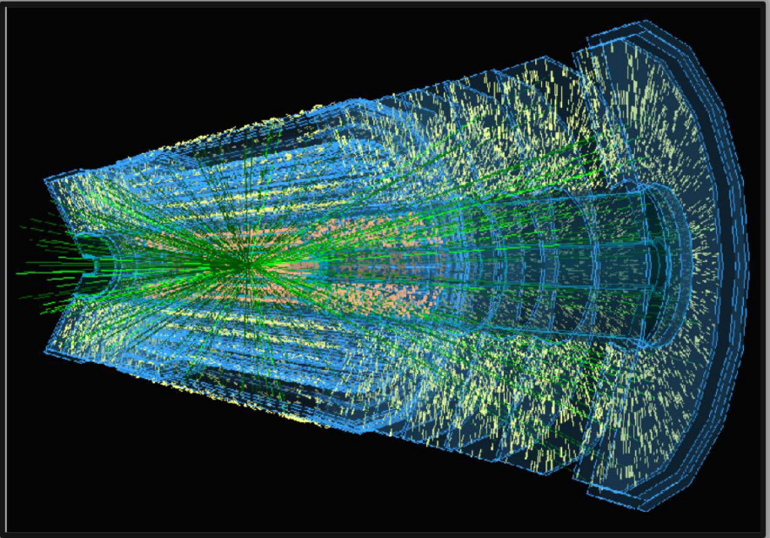
Future Challenges
High Luminosity LHC

Slide 24
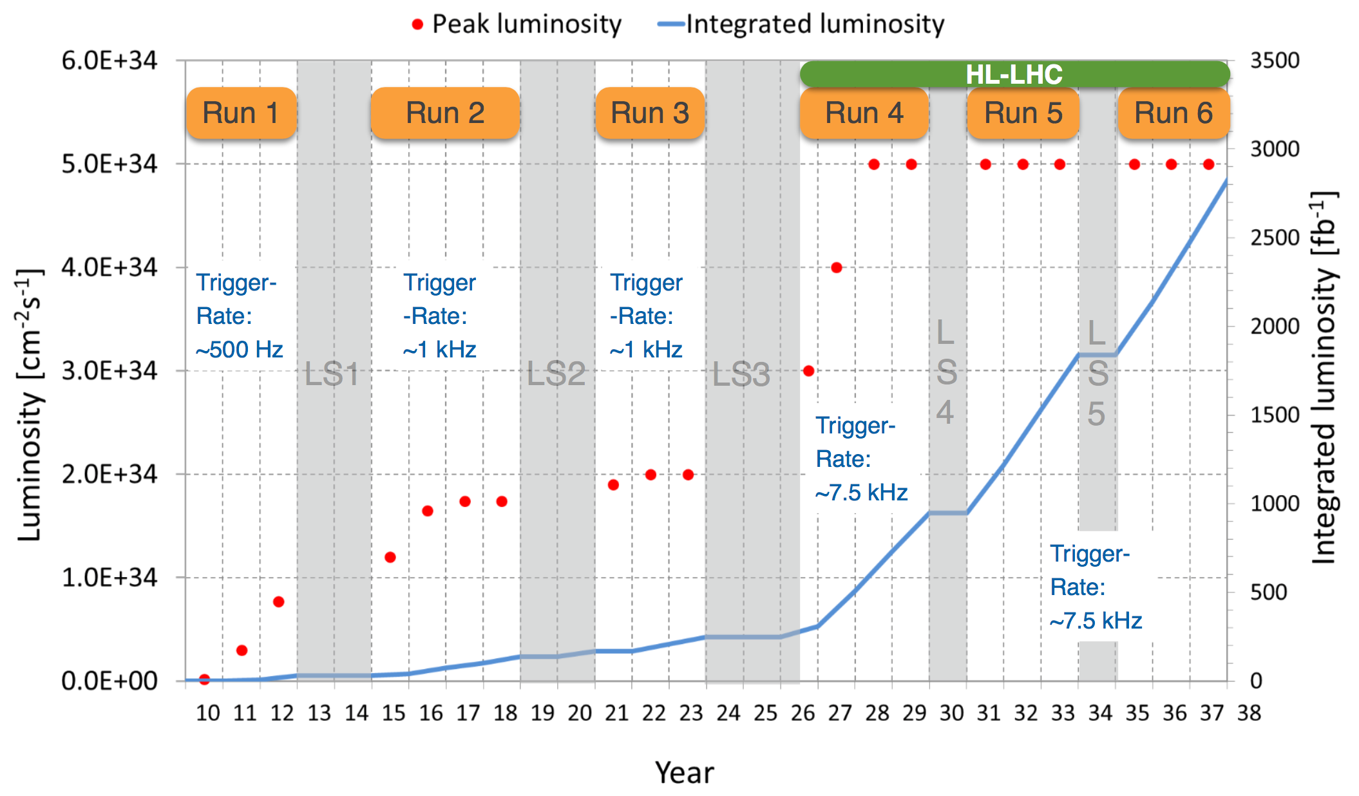
LHC Schedule
Run 3
Alice, LHCb upgrades
Run 4
ATLAS, CMS upgrades

Slide 25
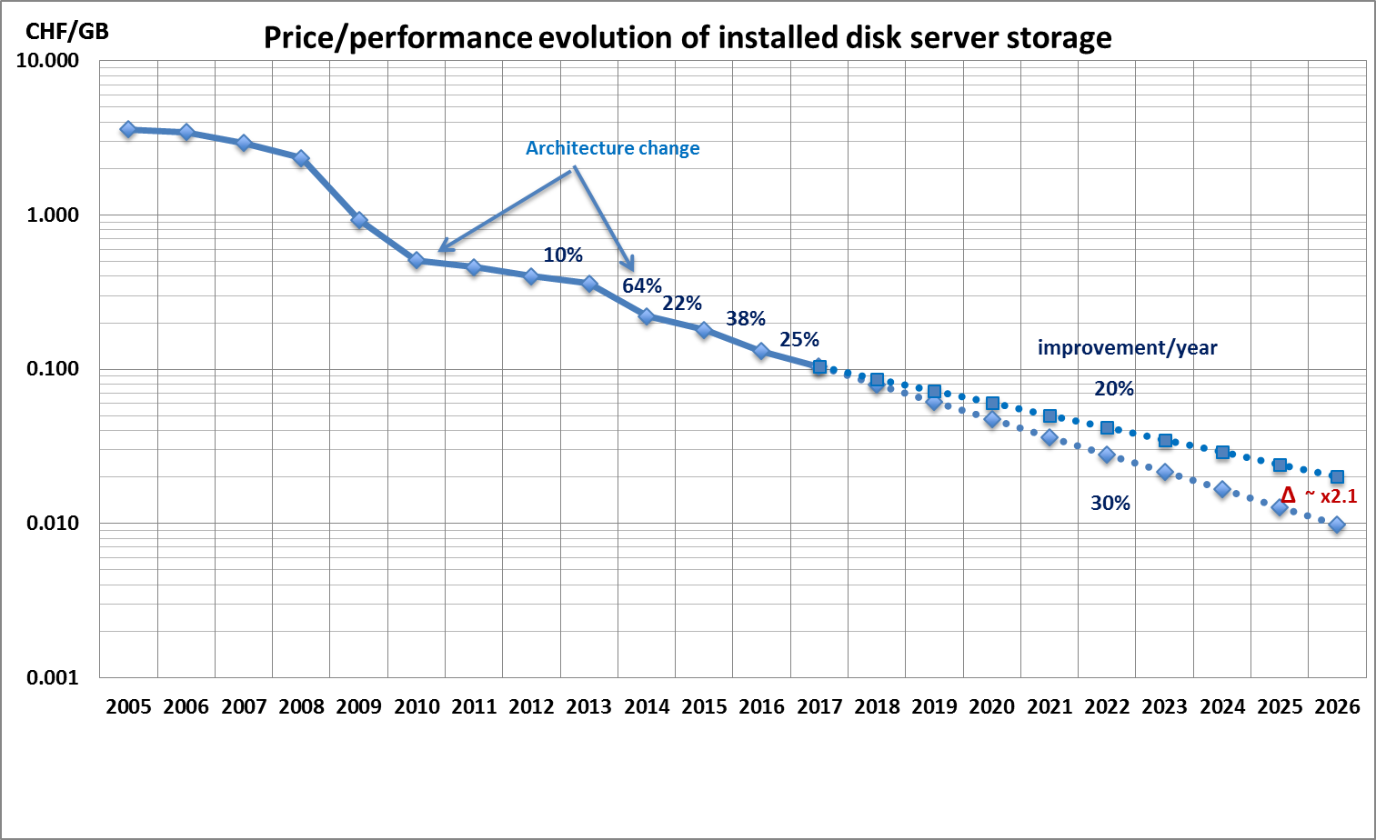
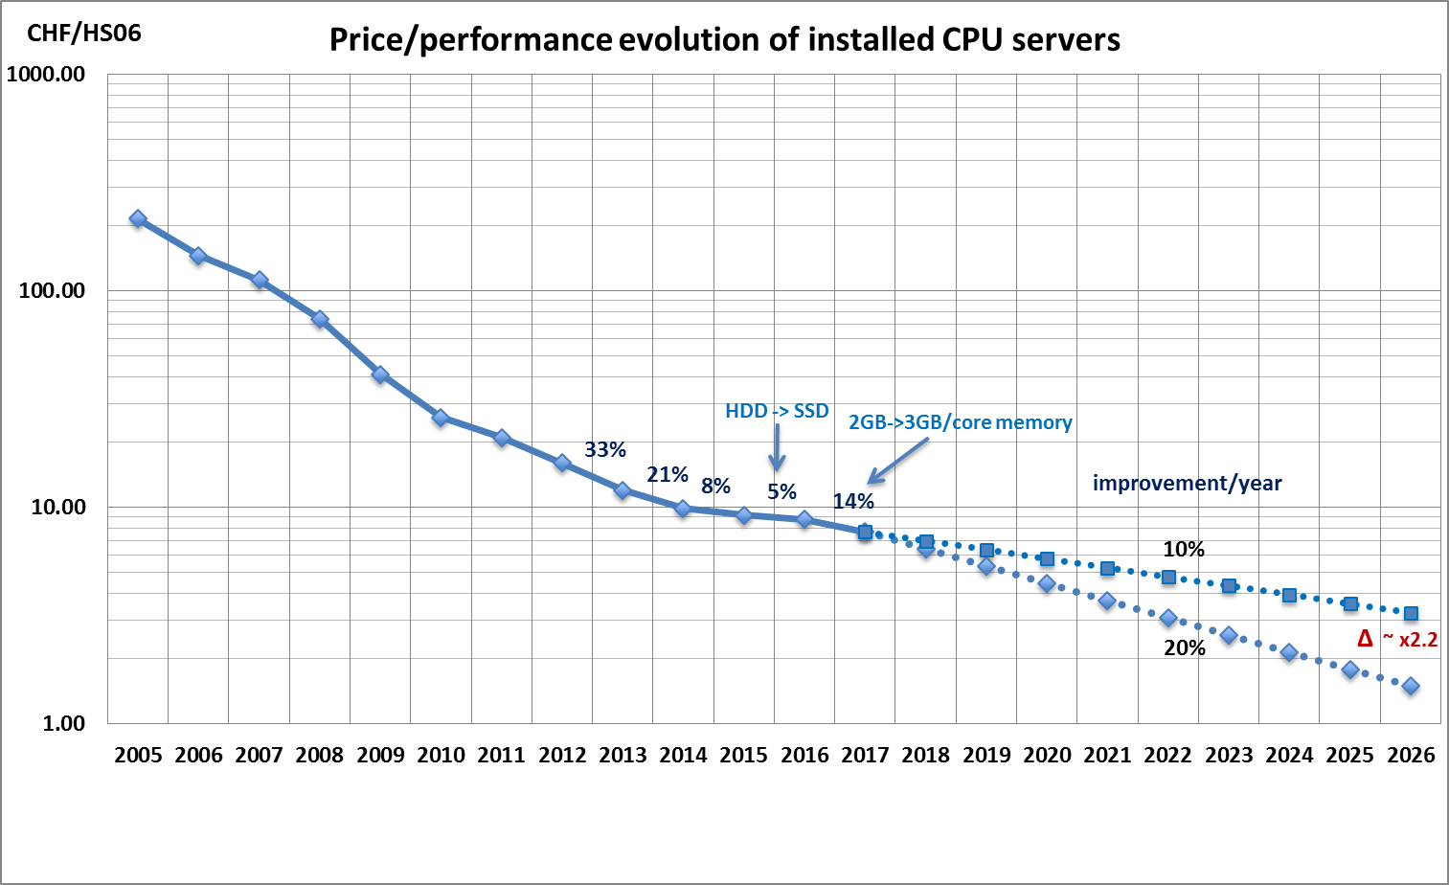
Future Challenges
2010
2011
2012
2013
2014
2015
2016
2017
2018
2019
2020
2021
2022
2023
2024
2025
…
2030?
…
First run
LS1
B
LS3
HL-LHC
Second run
LS2
Third run
FCC?
Data:
Raw 2016: 50 PB → 2027: 600 PB
Derived (1 copy): 2016: 80 PB → 2027: 900 PB
CPU:
x60 from 2016
Raw data volume for LHC increases exponentially and with it processing and analysis load
Technology at ~20%/year will bring x6-10 in 10-11 years
Estimates of resource needs at HL-LHC x10 above what is realistic to expect from technology with reasonably constant cost

Slide 26
Other Challenges
Advancement of processing at same cost slows down
Computing becomes more divers
  FPGAs
  GPUs
  HPCs
  Competing CPUs: Intel, ARM, Power
Machine learning requests for training resources
HL-LHC Physics requires more precise event generators
  Next to leading order, next to next to leading order
    Massive increase in complexity
.......

Slide 27
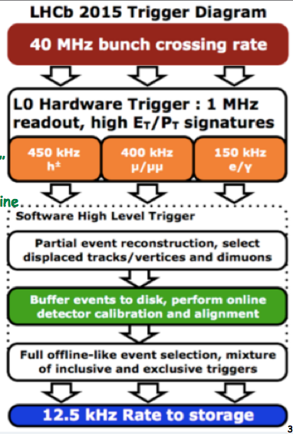


Run 3 needs for ALICE and LHCb
Data: 2016 times 7
  Each ~ 50 PB/year “raw” data
    LHCb will need ~80 PB/year disk
CPU
  x2 (ALICE), x4 (LHCb) increased offline need in

Slide 28
10-year challenges
HL-LHC will be a multi-Exabyte challenge
  Storage and compute needs x10 above what naïve technology extrapolation will bring
  Need to drive down costs: focus on performance, efficiency, operations, etc. ➔changes in computing and infrastructure models are necessary
But there is experience:
  ~15 years of grid development and successful operation for science
  WLCG has been operating a distributed DC for >5 years
  Large internet companies provide tools and experience that did not exist when we started WLCG
    Tools for managing interconnected DCs, cloud provisioning, etc.
  Starting to prototype federated structures for the future
  “Upgrade” of the software and computing models

Slide 29



Possible Model for future HEP computing infrastructure
Cloud users:
Analysis
Simulation resources
HEP Data cloud
Storage and compute
HEP Data lake
Storage and compute

Slide 30

Software
HSF Set up in response to recognition that software will be key to success for HL-LHC and the future

Slide 31
HSF Community White Paper
A Roadmap for HEP Software and Computing R&D for the 2020s
To identify and prioritize the software research and development investments required
The CWP will describe the community strategy and a roadmap for software and computing R&D in HEP for the 2020s.
Organised under the umbrella of the HSF.
  Charged by WLCG reaching out to other HEP experiments
NOT the project plan for the next decade!
http://hepsoftwarefoundation.org/activities/cwp.html

Slide 32
Working Groups
Careers, Staffing and Training WG
Computing Models, Facilities, and Distributed Computing WG
Conditions Database WG
Data Organization, Management and Access WG
Data Analysis and Interpretation WG
Data and Software Preservation WG
Detector Simulation WG
Event Processing Frameworks WG
Machine Learning WG
Physics Generators WG
Software Development, Deployment and Validation/Verification WG
Software Trigger and Event Reconstruction WG
Visualization WG

Slide 33

New analytics
Big Data tools
Machine/Deep learning

Slide 34

SWAN
Provides a web-based analysis facility – via notebooks
Transparent access to scalable back-end analysis infrastructure
  Clouds, Spark, Hadoop, ML, etc.
Performance is defined by the infrastructure
Provides the analysis portal in a “data cloud” or “data lake” model

Slide 35
Conclusions
WLCG has been successful in providing the global computing environment for physics at the LHC
Engagement and contributions of the worldwide community have been essential for that
LHC upgrades over the coming decade will give new challenges and opportunities
  Technology will change our computing models
We see a lot of potential synergy with other sciences: leadership in scientific big-data in the next decade

