Slide 1


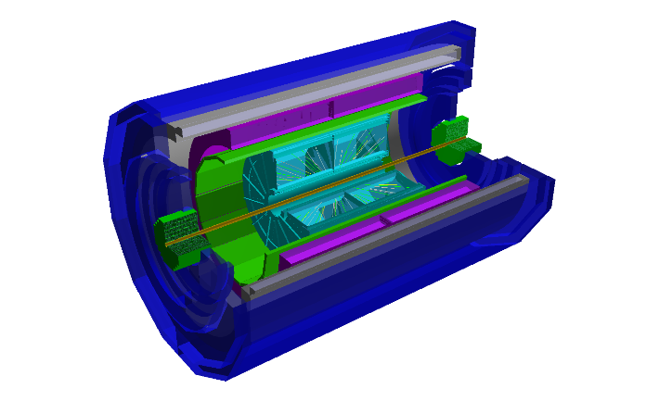
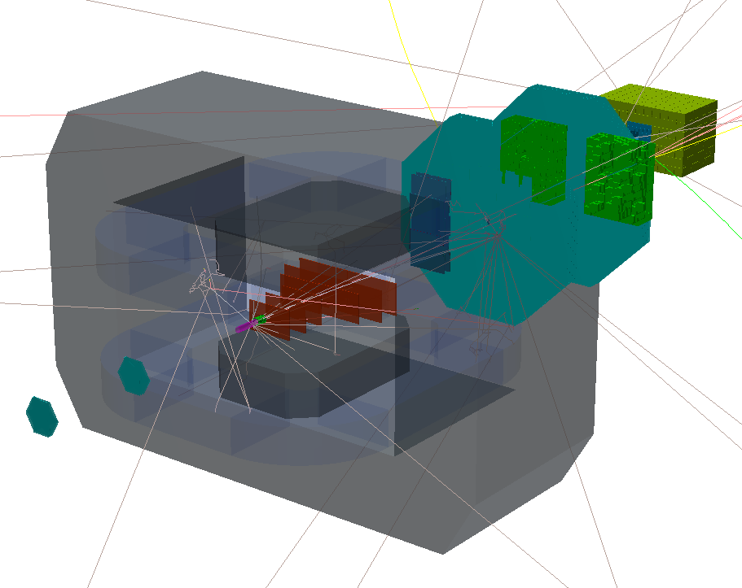
The development of Online Event Display using the ATLAS TDAQ for the NICA experiments
NEC’2017: XXVI International Symposium
on Nuclear Electronics & Computing
K. Gertsenberger, M. Mineev
Joint Institute for Nuclear Research
on behalf of the MPD&BM@N collaboration
28 September 2017

Slide 2
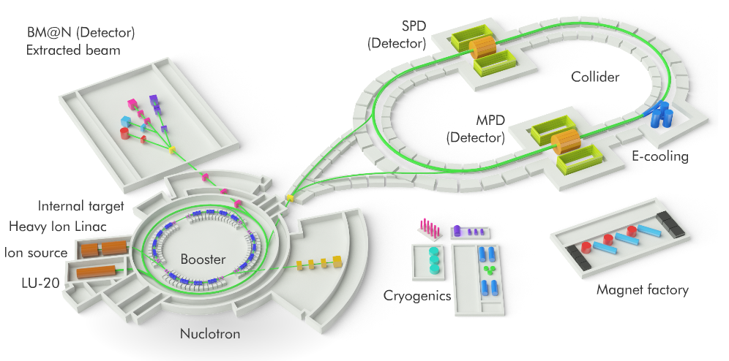


Nuclotron based Ion Collider fAcility
Beams: from $p, d^{↑}$to${Au}^{79+}$
Fixed target experiment: BM@N (2017)
2 interaction points: MPD (2020) & SPD
Luminosity: ${10}^{27}$(Au), ${10}^{32}$ (p) $cm^{−2}s^{−1}$
Collision energy: $\sqrt{S_{NN_{AU}}}$ = 4 – 11 Gev $E_{lab}$ = 1 – 6 AGev
Online Event Display for the NICA experiments

Slide 3
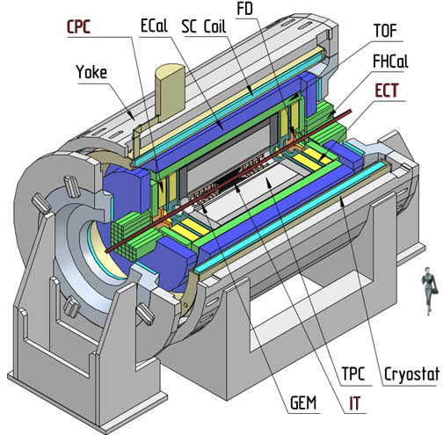
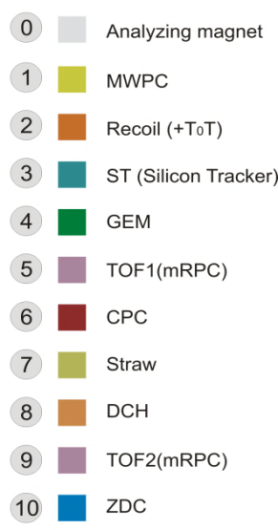
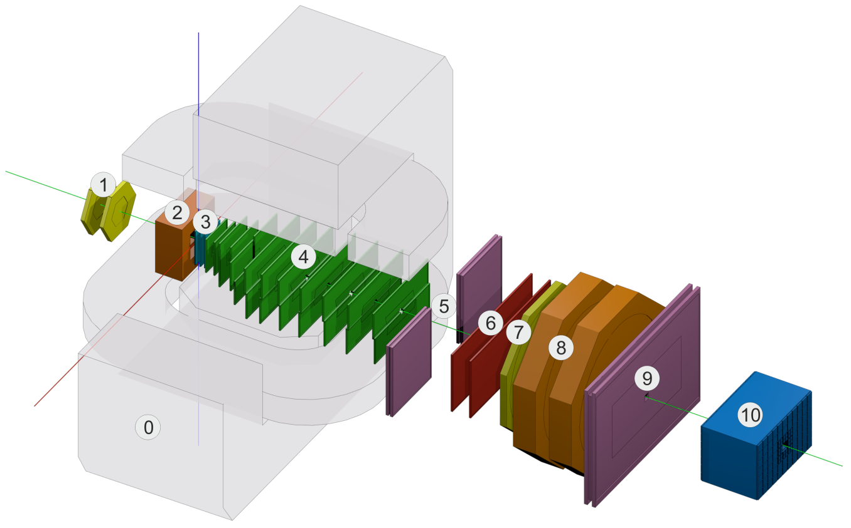
MPD and BM@N experiments at NICA
BM@N physics program:
strange/multi-strange hyperon and hypernuclei production at the threshold
hadron femtoscopy
short range correlations
event-by event fluctuations
in-medium modifications of strange & vector mesons in dense nuclear matter…
MPD physics program:
study of hot and dense baryonic matter at the energy range of max baryonic density
particle yields and spectra (π, K, p, Λ, Ξ ,Ω…)
femtoscopy involving π, K, p, Λ
collective flow for identified hadron species
electromagnetic probes (electrons, gammas)
di-Lepton precise study, Charm, Exotics…
Online Event Display for the NICA experiments

Slide 4
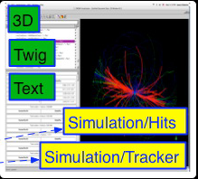
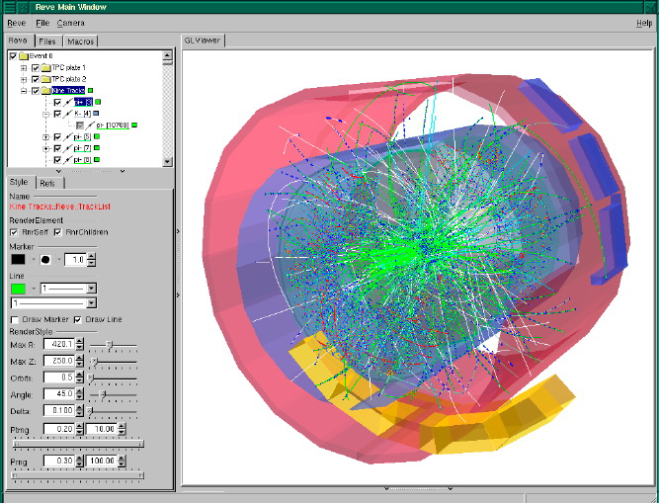
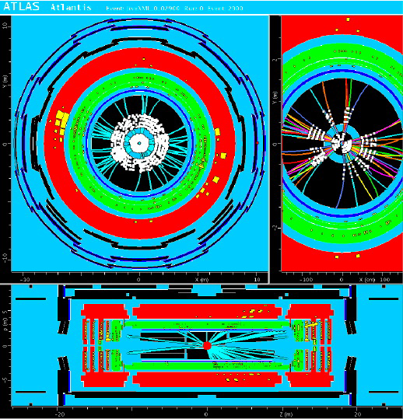
Event Display in the modern experiments
CMS (IGUANA)
ALICE (AliEVE)
ATLAS (Atlantis)
Online Event Display for the NICA experiments

Slide 5
Purposes of Event Display
design / offline stage = offline event display:
model and algorithm checking and debugging for developers
data reconstruction and analysis visualization for a better understanding of the detector and event structure
demonstration and presentation of works
run / online stage = online event display:
online visual presentation of the selective events during the experiment run – monitoring system
visual control and debugging of current events
Online Event Display for the NICA experiments

Slide 6
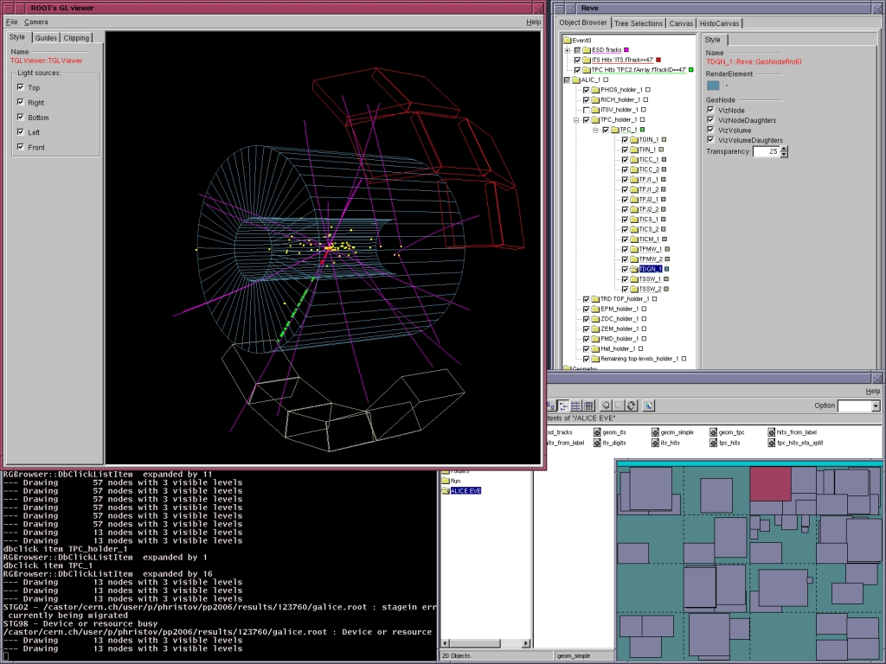
Event Display for the NICA experiments
is the same part of BmnRoot and MpdRoot environments which developed for event simulation, reconstruction and physical analysis of particle collisions in MPD and collisions with a fixed target registered by BM@N, and based on ROOT and FairRoot frameworks
uses Event Visualization Environment (EVE package):
included in the ROOT environment
graphically presents the events
by means of ROOT GUI and OpenGL
oriented on physical objects
visualization, such as raw data, clusters,
hits and tracks
Online Event Display for the NICA experiments

Slide 7
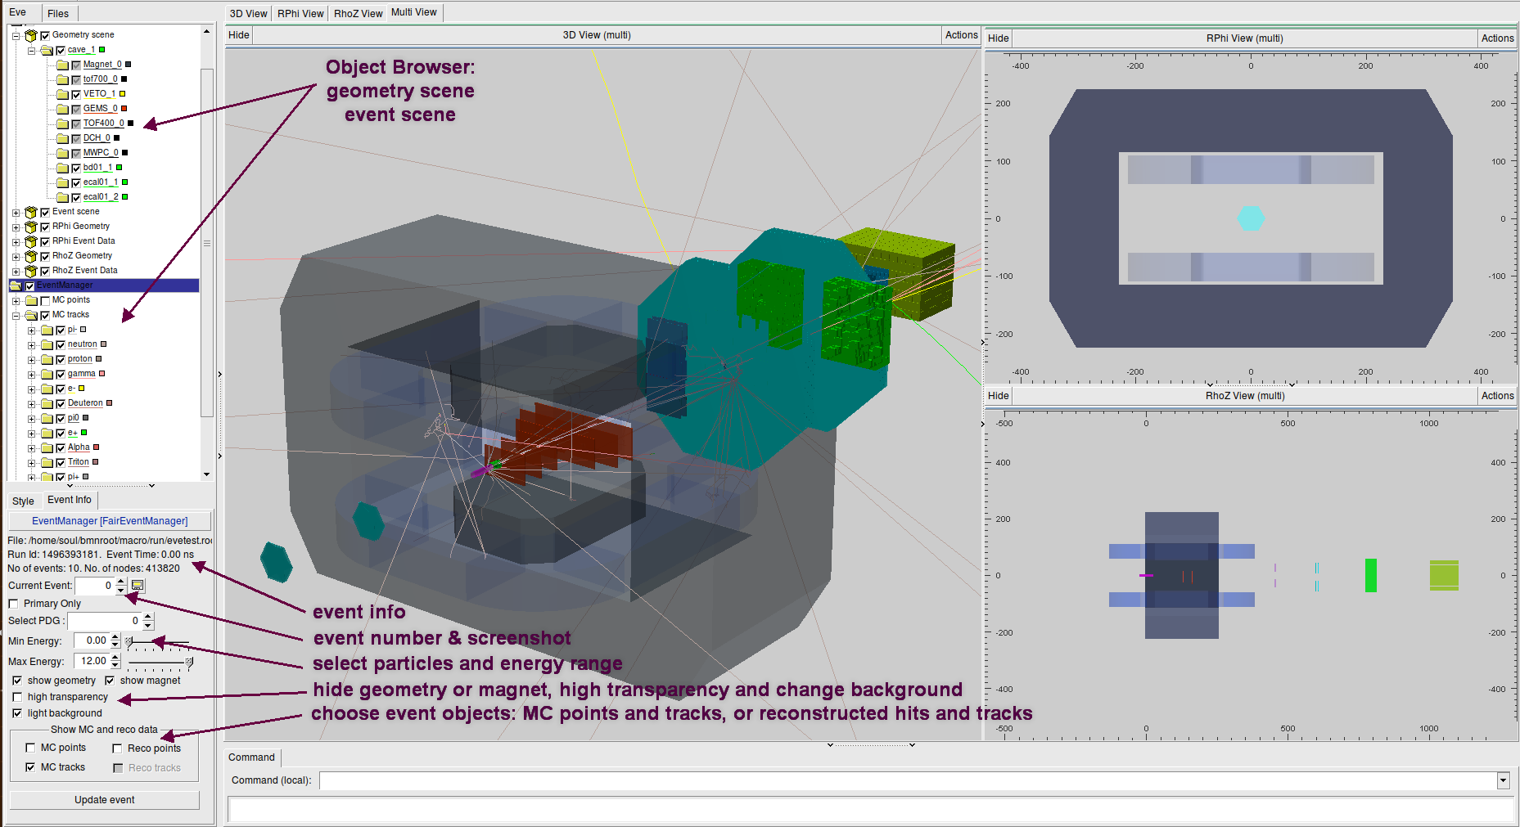
Event Display (views and projections)
The Event Display can show/hide setup geometry, simulated and reconstructed data: points, hits, tracks, calorimeter towers, select event to display, select particles with definite PDG codes, set energy range and many other visualization options.
Online Event Display for the NICA experiments

Slide 8
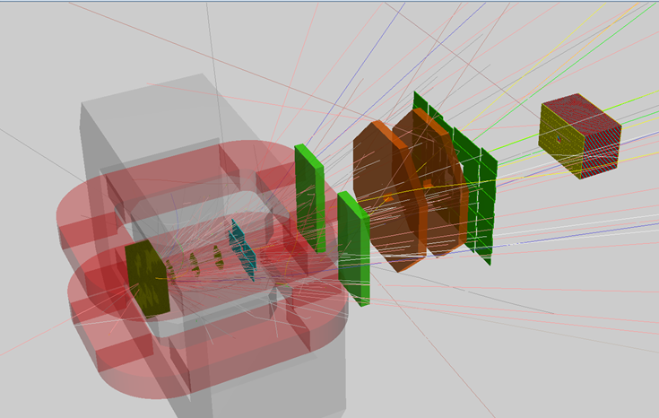

Simulation data for offline Event Display
UrQMD,
QGSM, Pythia…
event
generator
Geant 3/4
simulation
run_sim.C
evetest.root
detector geometry, MC data
visualization
reco data
eventdisplay.C
reconstruction
run_reco.C
dst.root
Au-Au $E_{lab}=4 GeV$
Online Event Display for the NICA experiments

Slide 9
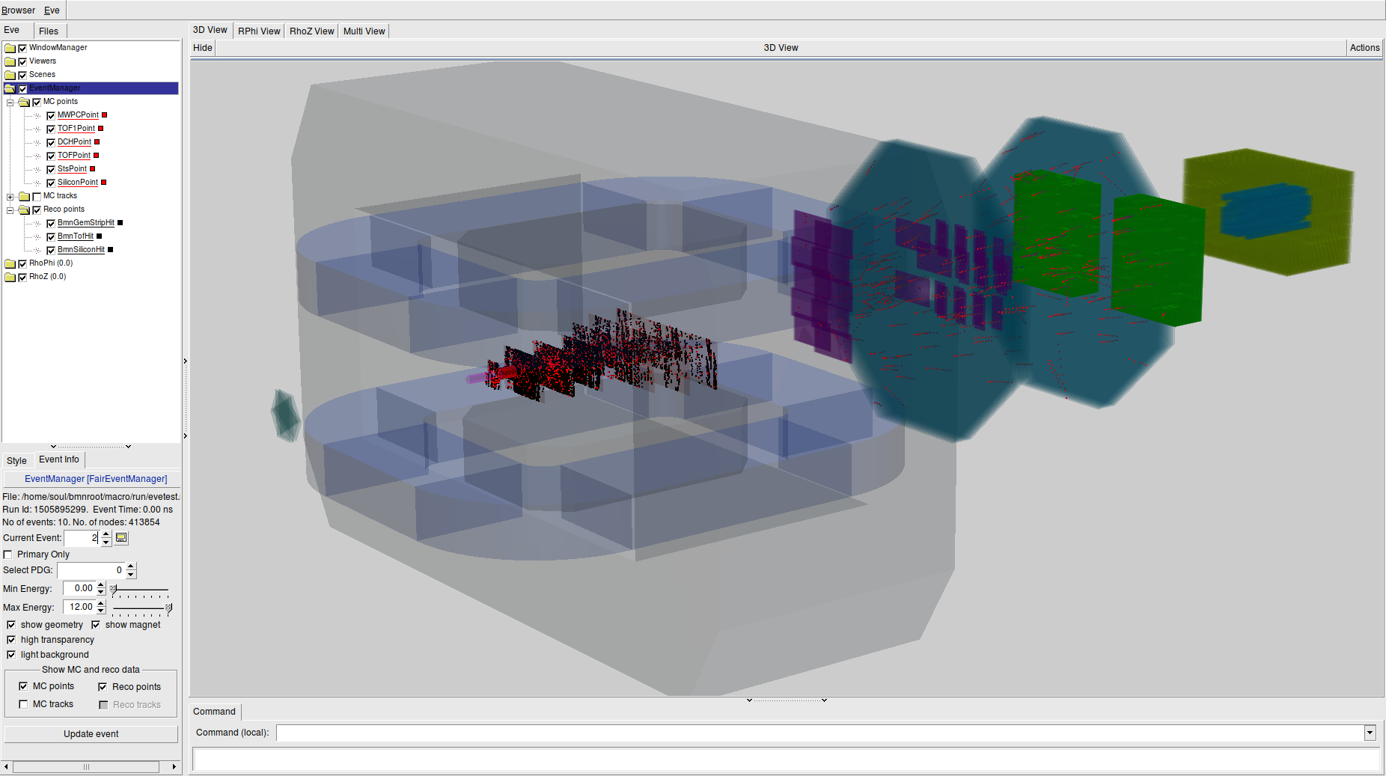

BM@N Event Display (MC and reco. points)
Au-Au E_{lab} = 4 GeV
Au-Au $E_{lab}=4 GeV$
Online Event Display for the NICA experiments

Slide 10
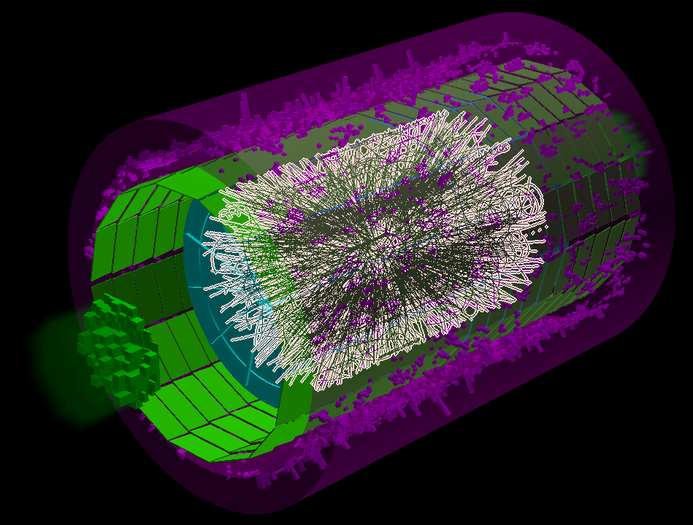
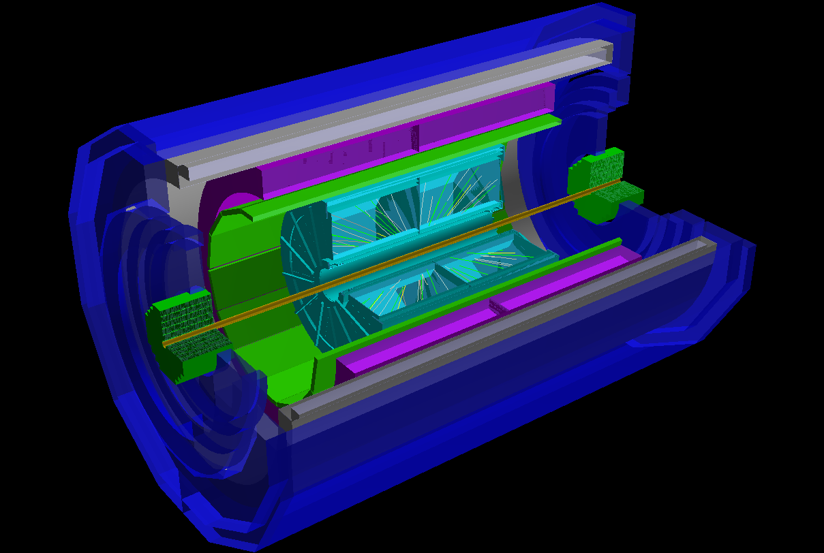


MPD Event display (MC and reco. tracks)
Event Display for simulated MPD event data:
MC tracks and EMC+FHCAL towers
Au-Au $\sqrt{S_{NN}}=11 GeV$
Event Display for reconstructed data:
TPC KalmanTracks
Au-Au √s_{NN} = 7 GeV
Au-Au $\sqrt{S_{NN}}=7 GeV$
Online Event Display for the NICA experiments

Slide 11

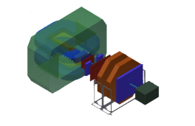
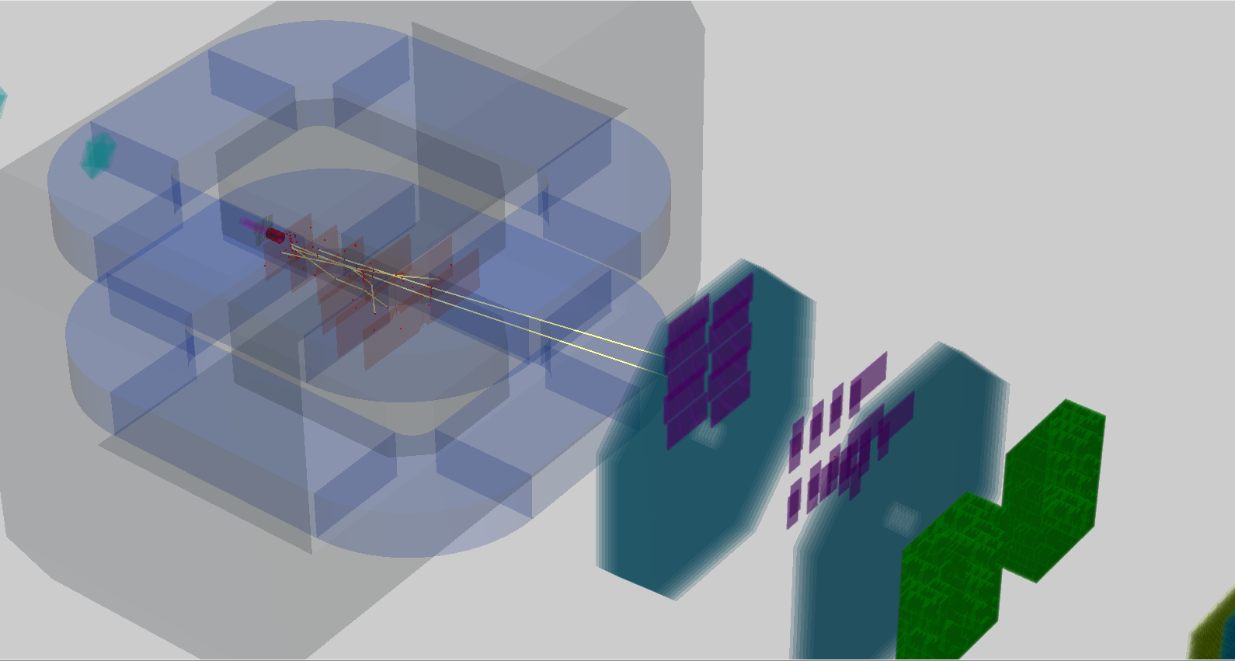

Experimental data for offline Event Display
raw (binary) data
in MPD format
digitizer
Unified Database
C-C $E_{lab}=3.5 GeV$
raw_run.data
detector
geometry
digits.root
clustering
visualization
reconstruction
eventdisplay.C
hits and tracks
dst.root
tracking
Online Event Display for the NICA experiments

Slide 12
Purposes of Event Display
design / offline stage = offline event display:
model and algorithm checking and debugging for developers
data reconstruction and analysis visualization for a better understanding of the detector and event structure
demonstration and presentation of works
run / online stage = online event display:
online visual presentation of the selective events during the experiment run – monitoring system
visual control and debugging of current events
Online Event Display for the NICA experiments

Slide 13

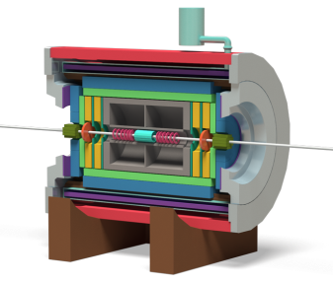

NICA DAQ Data Flow (Event Monitor)
FLP
First Level
Processor
Data Check Flow Control Formatting
EvB
Event
Builder
Buffering
Sorting
Distribution
Rootifier
ROOT Format
Mapping
Alignment
REC
Event
Reconstruction
PA
Physics
Analysis
HLT
High Level
L3 Trigger
RQ
Raw Data
Quality
Check
distributed cluster
TDS
Transient Data Storage
PDS
Permanent Data Storage
ATLAS TDAQ components
DRE
LDC
FT REC
Fast Event
Reconstruction
HIST
Online
Histograms
EvM
Event
Monitor
Database
￼
￼
DAQ
On-line
Processing
Off-line
Processing
matched from “MPD Data Acquisition System TDR”, MPD DAQ Collaboration
13

Slide 14
ATLAS TDAQ system
Online Event Display for the NICA experiments

Slide 15
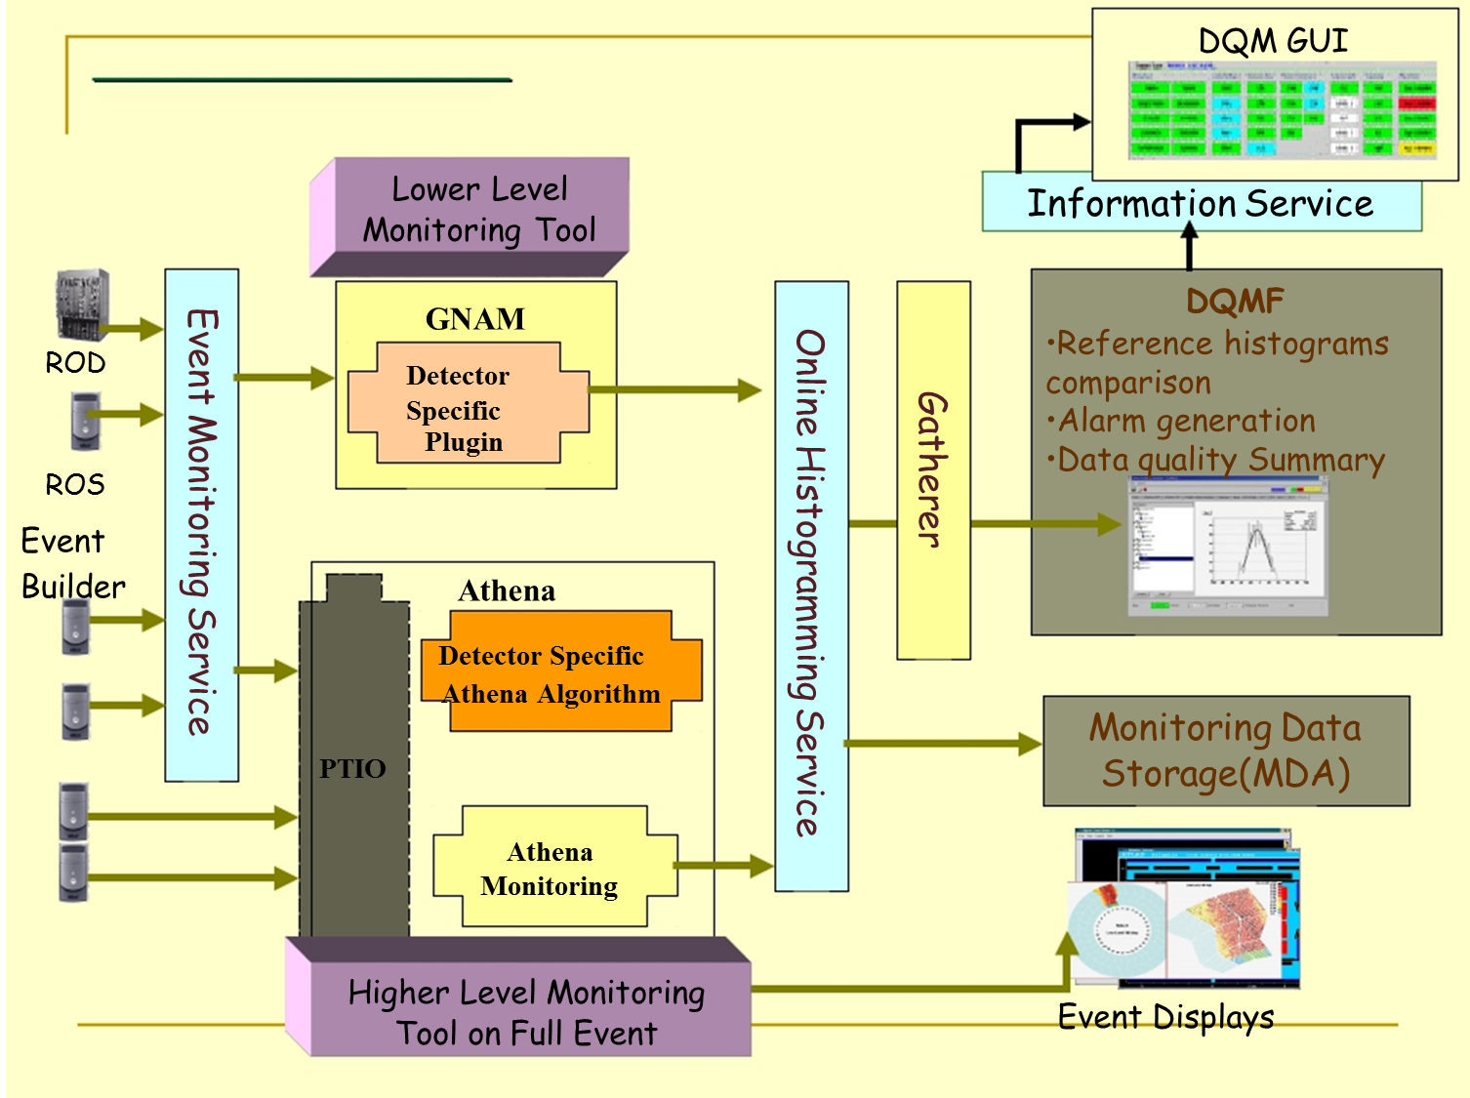
ATLAS TDAQ Online Monitoring
ATLAS TDAQ Online System:
specifies the required configuration, including program parameters
provides transfers between programs, deliver by subscription or request and save, if necessary, error messages and other requested information
consistently starts and shutdowns the entire run system
stores all required detector and run parameters
monitors the correctness of system operations
restarts, if possible, malfunctioning parts of the system
monitors the quality of incoming data
Online Event Display for the NICA experiments

Slide 16
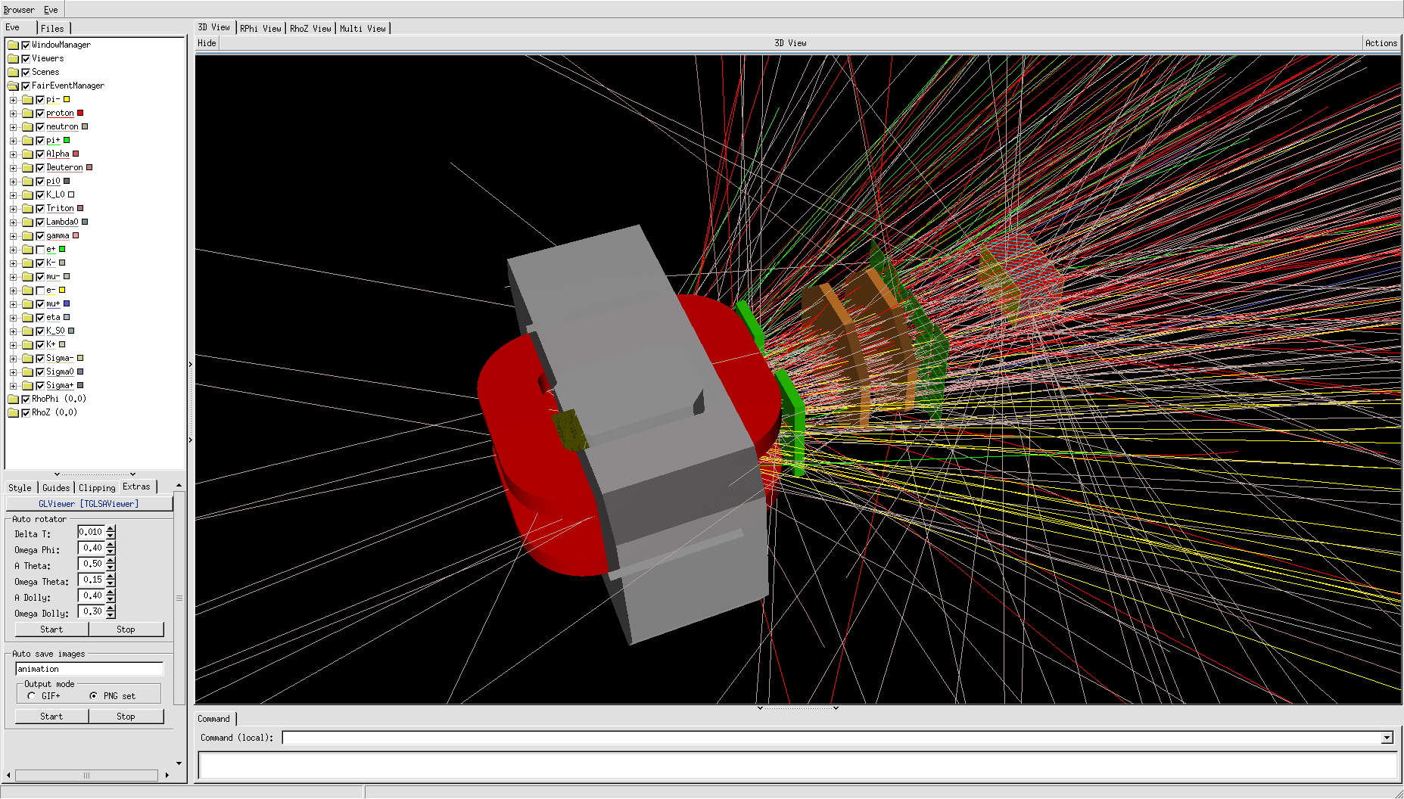
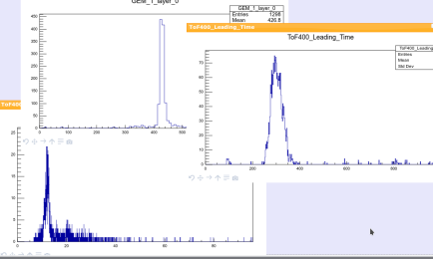
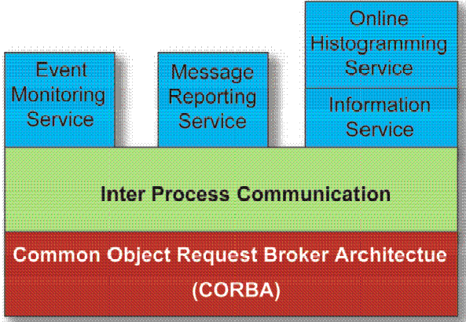
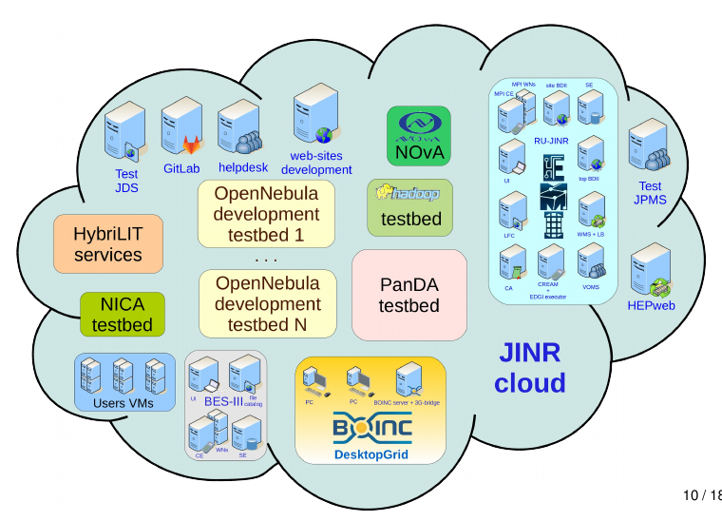
TDAQ for Online Event Display
Displays
Analysis
Archiving
Event Display
Information Monitors
Monitoring Data Archiving
Data Quality Monitoring
Histogram Presenter
Web Monitoring
Archive Browser
Raw Event Builder
first prototype was developed
in LIT JINR cloud
ATLAS TDAQ Online Components
Online Event Display for the NICA experiments

Slide 17
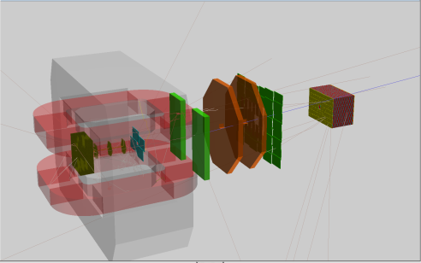


Remote monitoring with Online Event Display
BM@N DAQ system
Event Monitor
EvB
Event
Builder
TDS
Transient Data Storage
BmnRoot
Event Sampler
Event Distributor
BmnRoot
start_sampling
Event Monitoring Service
select
Event Provider
stop_sampling
Event Consumer
add_event
1000
next_event
Event Accumulator
Event Iterator
Inter Process Communication
Online Event Display for the NICA experiments

Slide 18
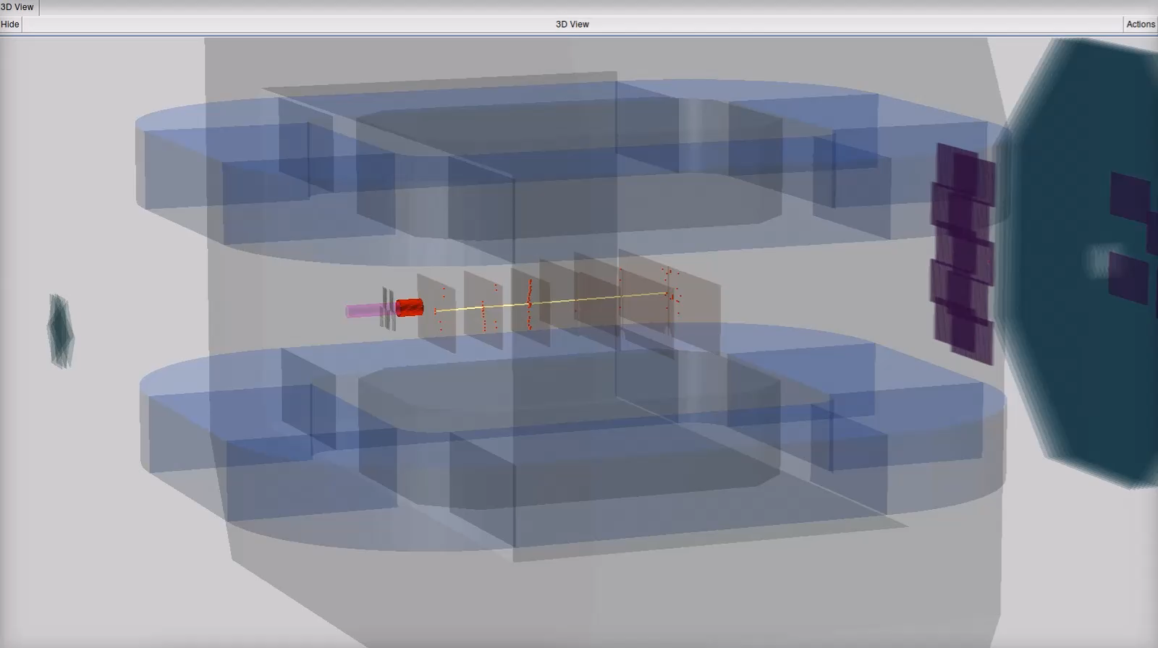

Experimental data for Online Event Display
DAQ storage
raw *.data
digitizer
BM@N geometry
run 1986
Unified Database
digits
TDAQ
EMS
digits
hits
fast
clustering
tracks
fast
tracking
C-C $E_{lab}=3.5 GeV$
Online Event Display
(GEM hits and tracks in run #1220)
Online Event Display for the NICA experiments

Slide 19
Conclusions
The EVE package of the ROOT environment was chosen for the Event Display to show detector geometries, simulated and reconstructed data.
Event Display classes and macro were developed for graphical presentations of the NICA experiments in offline as well as online mode and integrated into the BmnRoot and MpdRoot software.
ATLAS TDAQ components are used to transfer raw event data outside the DAQ system to visualize the NICA experiments on another machine with powerful graphic card. It can also be used for online histogramming and Web monitoring.
The Online Event Display was tested with raw data files from the DAQ storage system.
It is planned to use the Online Event Display for visual presentation of the selective BM@N events during the future experiment runs.
Online Event Display for the NICA experiments

Slide 20

NEC’2017: XXVI International Symposium
on Nuclear Electronics & Computing
Thank you for your attention!
More information: mpd.jinr.ru
email: gertsen@jinr.ru
28 September 2017
Online Event Display for the NICA experiments

