Slide 1
Service Reliability with the Cloud of Data Centers under Openstack
Petr Fedchenkov₁, Sergey Khoruzhnikov₁, Vladimir Grudinin₁, Oleg Sadov₁, Andrey Shevel_{1,2}, Arsen Kairkanov₁, Oleg Lazo₁, Anatoly Oreshkin₂
26th International Symposium on Nuclear Electronics and Computing — NEC'2017, 25 September – 29 September, 2017, Montenegro (Budva).
1
ITMO University, S.Petersburg (Russia)
2
National Research Centre "Kurchatov Institute"
PETERSBURG NUCLEAR PHYSICS INSTITUTE
Notes:
Добрый день, коллеги, меня зовут Федченков Петр. Я представляю группу разработчиков из университета ИТМО Санкт Петербург и института Курчатова. Сегодня я хотел бы представить доклад, посвященный Service Reliability with the Cloud of Data Centers under Openstack.
Good afternoon, colleagues. It is an honor to be here with you today. My name is Fedchenkov Petr. I represent a group of researchers from the ITMO University and the Kurchatov Institute St. Petersburg. Today I would like to present a report on Service Reliability with the Cloud of Data Centers under Openstack platform.

Slide 2
Outlook
Cloud of Data Centers with Openstack
Cloud Sevices
Cloud Networking
Software Defined Storage in cloud of Data Centers
PoC Testbed

Slide 3
Cloud of Data Centers (basic configuration)
Openstack umbrella
DC1
DC3
Control panel
aka Horizon
Control panel
aka Horizon
DC2
Control panel
aka Horizon
Cloud
Notes:
Распределённая система предполагай использование централизованного управления через контрольную панель, например Horizon для openstack. Несмотря на физическое выделение ресурсов в рамках конкретного ЦОДа, запрос может быть сгенерирован на любом из них. В случае недоступности одного из ЦОДов работоспособность других не должна быть затронута.
The distributed system assumes the use of centralized management through the control panel, for example Horizon for openstack. Despite the physical allocation of resources within a particular data center, a request can be generated on any of them. And all of DCs should run the command accordingly to request. In the case of the inaccessibility of one of the data centers, the operability of others should not be affected.

Slide 4
Cloud of Data Centers advantages
Improve reliability for services.
Possible scaling with adding new DCs to the cloud.
Centralized administrative functionality to some extent.

Slide 5
Cloud Services
Main cloud services:
Computing (VMs)
Storage: Software Defined Storage
Data transfer channels: Software Defined Network
Control channels (OpenVPN)
Regular channels (encrypted)
Quantum Key Distribution (QKD) channels
Notes:
Основными облачными службами являются стандартные средства вычислений(виртуальных машин), хранения,передачи данных.
Особенностью платформы является использование наряду с классическими вариантами шифрования каналов, шифрования каналов с использованием квантового генератора ключа
The main cloud services are standard tools for computing (virtual machines), storage, and data transfer.
The feature of our platform is using encryption of channels using a quantum key generator along with the classical options for encryption of channels. In such way we can improve degree of channel security to a new level. We have Alice and Bob for every channel between DCs

Slide 6
Network aspects on Georgaphically Distributed Software Defined Storage (GDSDS)
First of all we have to keep in mind the CAP theorem:
NOT possible to guarantee all below requirements at the same time:
Consistency
Availability
Partitioning

Slide 7
GDSDS
Important features:
Data storage and Data transfer
Reliability: data replication, erasure coding.
Reliability of long time data storage.
Security: Data encryption (quantum key distribution).
Network architecture (SDN).
Automatic storage deployment by user request.
Notes:
Возвращаясь к техническим характеристикам географически распределённых цодов, хочется отметить ряд важных возможностей которые можно разбить на несколько групп, а именно:
В аспекте хранения и передачи данных:
За счёт репликации данных и избыточного кодирования повышается надежность хранилища. За счёт компрессии снижается объём данных.
Веб портал разрабатываемой платформы позволяет автоматически разворачивать сетевую архитектуру с использованием квантовых каналов и архитектуру подсистемы хранения
Returning to the technical characteristics of geographically distributed Data centers, I want to note a number of important opportunities that can be divided into several groups, namely:
In the aspect of data storage and transmission:
Due to data replication and redundant coding, the reliability of the storage increases. Due to compression, the amount of data is reduced.
The web portal of the developed platform allows to automatically deploy the network architecture using quantum channels and the architecture of the storage subsystem
Storage deployment is performed upon user request. We use CEPH cluster in storage layer.

Slide 8
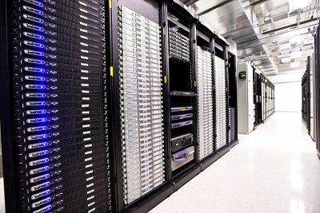
Possible allocation of instances of Virtual Storage
Client-1
Client-2
client=VM, desktop,
mobile device, etc
CEPH
Virtual Storage-1
CEPH
Virtual Storage-2
DC-1
DC-2
DC-3
Notes:
Использование кластера CEPH в качестве хранилища данных позволяет использовать распределенную архитектуру построения ЦОДов. Так, хранилище может быть распределено между отдельными ЦОДами и использовано клиентами вне зависимости от подключения к конкретному ЦОДу.
The use of a CEPH cluster as a data storage allows us to use a distributed data center architecture. So, the storage can be distributed between individual data centers and used by clients, regardless of the connection to a particular data center.

Slide 9
Service Reliability
It is distinguished two type of DC problems:
DC is completely down.
DC is up, however connectivity with other DCs is down.
Computing services:
When connectivity between DCs are down, the normal DCs operations might be continued in aspects not affected by the connectivity.
Storage:
With enough replicas the cloud might continue normal operations.

Slide 10
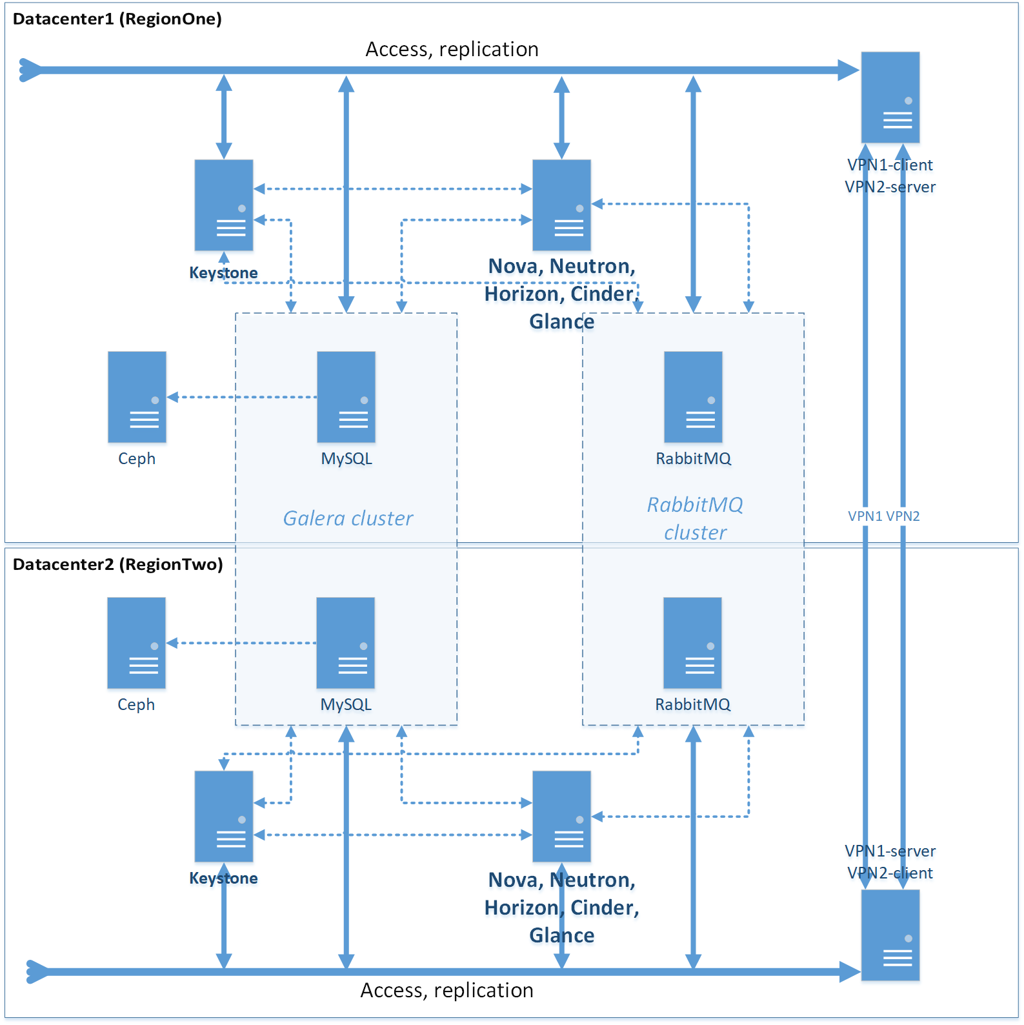
Testbed architecture of Common Keystone
Database for two DCs
Each DC runs under own Openstack with own region.
Created Galera cluster provides synch between different regions (DCs).
Each region (DC) has own address space.
Created RabbitMQ cluster provides command transfer between DCs.
Notes:
На данном слайде представлено развертывание платформы openstack на двух цодах. Каждый цод является с точки зрения разделения openstack отдельным регионом. Каждый регион предполагает наличие полного набора служб openstack с заданными адресами доступа. Мы используем адрес openvpn сервера в качестве адреса для доступа служб внутри цода. Подобный вариант позволяет пользоваться локальными службами в случае разрыва ассоциации. Для обеспечения единства управления необходимо использование кластера базы данных keystone и очереди сообщений. Благодаря единой базе данных, каждый из keystone может обращается к данным keystone другого региона
This slide shows the deployment of the openstack platform on two Data centers. Each Data center is in terms of dividing the openstack into a separate region. Each region assumes that there is a full set of openstack services with the specified access addresses. We use the openvpn address of the server as the address for accessing services inside the Data centers. This option allows you to use local services in the event of an association breakdown. To ensure unified management, you must use the keystone database cluster and the message queue. Thanks to a single database, each of the keystone can access the keystone data of another region.

Slide 11
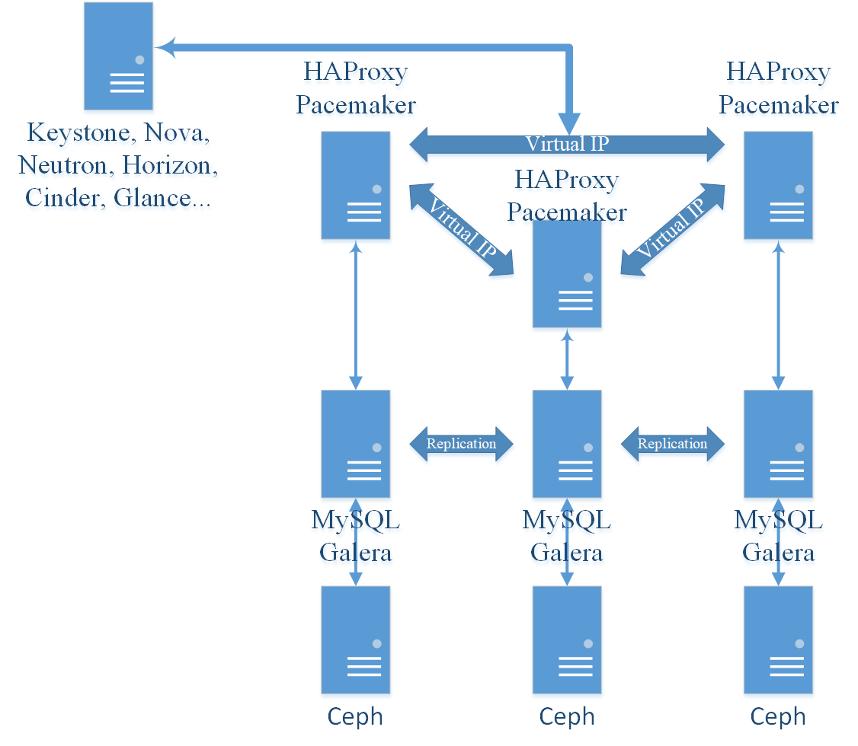
Three DCs testbed configuration
High Availability Proxy
Virtual IP for Keystone and DB access between regions
Pacemaker for service stability and checking
CEPH is used just as storage: different pools for different MySQL.
Notes:
В случае использования числа регионов больше двух, удобно использовать виртуальный ip адрес и модули Pacemaker и настроить платформу на взаимодействие через него. Haproxy может быть использован в данном случае не только для балансировки нагрузки, но и для обеспечения роутинга пакетов
In case of using a number of regions more than two, it is convenient to use virtual ip address and Pacemaker modules and configure the platform for interaction through it. Haproxy can be used in this case not only for load balancing, but also to ensure routing of packets

Slide 12
Basic testbed configuration
OpenVPN
server 1
OpenVPN
client 2
MySQL Galera
node 1
RabbitMQ
node 1
DC 1
VM
Horizon
With access to both Regions
Keystone
Region 1
Nova
Ceph
For DB, Cinder and Glance
Glance
Cinder
Neutron
Open VPN connection
Distance between host machines 43 km over common Internet
OpenVPN
server 2
OpenVPN
client 1
MySQL Galera
node 2
RabbitMQ
node 2
DC 2
VM
Horizon
With access to both Regions
Keystone
Region 2
Nova
Ceph
For DB, Cinder and Glance
Glance
Cinder
Neutron

Slide 13
Conclusion
In developed testbed is possible:
enter into Horizon DC1 , start and see running VMs and other resources of both regions (DCs) and vice versa.
shutdown DC1 and continue to use DC2 and vice versa.
use (with light modification by adding third DC in form of VM) Virtual IP to enter the most appropriate at time region (DC).
Experimental distributed CEPH cluster (as part of future GDSDS) is used in testbed. It is running more than two years. It passed through many updates, sudden power off, unplanned reboot, but no data corruption.

Slide 14
References
Justin Riley, John Noss, Wes Dillingham, James Cuff, Ignacio M. Llorente, "A High-Availability Cloud for Research Computing", Computer, vol. 50, issue 6 , pp. 92-95, 2017.
M. Nabi, M. Toeroe, F. Khendek, "Availability in the Cloud", J. Network and Computer Applications, vol. 60, pp. 54-67, 2016.

Slide 15
Time for questions & suggestions!

