Slide 1
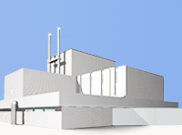
Data acquisition systems on neutron spectrometers of the IBR-2 reactor
Frank Laboratory of Neutron Physics, JINR
Andrey Bogdzel, Andrey Churakov, Feodosiy Levchanovsky, Andrey Kirilov, Vladimir Kruglov, Sergey Kulikov, Michail Korobchenko, Elena Litvinenko, Svetlana Murashkevich, Vladimir Drozdov, Valentin Prikhodko, Valery Zhuravlev
Presenters
Vladimir Drozdov, FLNP JINR
NEC’2017
Notes:
My report is a brief review on data acquisition systems developed and currently used on neutron spectrometers of the IBR-2 reactor in FLNP.

Slide 2
Neutron instrumentation at the IBR-2
2
NEC’2017
Notes:
This slide shows neutron instrumentation at IBR-2.
The IBR-2 reactor is equipped with a unique complex of neutron spectrometers allowing a wide range of studies.
At present, 18 spectrometers operate, or are in the final stage of development at the reactor. Fourteen are used for condensed matter research, two for nuclear physics research, one for radiation material science, and one for neutron activation analysis.
Success and effectiveness of the performed research largely depends on the quality of Instrumentation technology, Automation systems and the computing infrastructure of the laboratory.

Slide 3
Development of DAQ for IBR-2 spectrometers over the past 15 years
Before the reactor upgrade, the data acquisition and storage systems as well as the experiment control systems were based on the VME standard of electronics
The next generation data collection system is developed on the basis of new electronic modules that connected directly to the PC by PCI and USB interfaces
3
NEC’2017
Notes:
In my Laboratory, since its foundation, four generations of data acquisition and automation systems, on neutron spectrometers have been created. The systems have always used an up-to-date electronics and computing infrastructure.
General approach to developing new data acquisition systems for our spectrometers is to use and develop unified blocks, unified standards and unified software.
As a result, systems installed on different spectrometers have a unified structure.
Such unification can be realized because the main method is the time-of-flight method for measuring the energy of the detected neutrons. Also, scintillation, gas or position sensitive detectors are used as detectors in all spectrometer set ups.
Data from different spectrometers can also be presented in a unified form as histograms or spectra of neutrons scattered on the studied sample under various experimental conditions and recorded by a multi-element detector system and a PSD.
In the last 15 years two generations of DAQ systems have been developed in our Department.

Slide 4
The FSD automation system structure
4
NEC’2017
Notes:
This can be illustrated on the example of construction and development of data acquisition and automation systems for the Fourier Stress Diffractometer (FSD) located on channel 11a.
The FSD is a TOF-diffractometer with a fast Fourier chopper for modulation of the intensity of the neutron beam. The FSD uses the Reverse Time of Flight, that is RTOF, method for data acquisition and calculation high-resolution spectra. At present, three similar spectrometers operate on the IBR-2 reactor. Measurements with FSD have been carried out since 2001.
The slide shows the structure of the data acquisition system based on the VME standard at the time.
The input blocks of detector electronics and the discriminators are in the NIM crate near the detector system. The TOF encoders are in the CAMAC crate. The digital signal processing units and blocks of histogram memory are in the VME crate with an embedded system computer. They all are located in the counting room over the detectors.
For such DAQ systems our department developed two types of processor blocks in the VME standard for spectra acquisition in the high and low resolution modes. The RTOF correlator for high resolution mode uses a signal processor for correlation processing of received signals and accumulation of high-resolution spectra.
The second processor module PRO of the data acquisition system was responsible for temporary storage of raw data for each reactor cycle, data format conversion, time-of-flight corrections (time focusing) calculation of position codes in linear and two-coordinate PSDs and histogram memory addresses, and also for monitoring the reactor and spectrometer parameters.

Slide 5
High-resolution spectra acquisition by DSP RTOF analyzer
5
NEC’2017
Notes:
This slide illustrates high-resolution spectra acquisition by RTOF analyzer based on VME –DSP-RTOF correlator blocks.
Earlier, on the FSD spectrometer we used 4 parallel-working RTOF correlators to process 4 total detector signals collected from four sections of a multi-element detector system.
Each correlator unit provided calculation of the mutually correlated function of three signals such as reactor pulse, chopper pic-up signal, and one total signal of the detector section. The resulting high-resolution spectrum was accumulated in the operation memory of each block and was read out by VME-PC at the end of each measuring cycle of the chopper.

Slide 6
FSD VMEbus -DAQ with VME-PCI interface
6
NEC’2017
Notes:
This photo shows a VMEbus-DAQ crate with the above said RTOF analyzer and a low resolution subsystem based on the DSP unit PRO as it was in operation on the Fourier Stress Diffractometer for a long time.
At that time, the first version of the SONIX control software running under the OS9 operation system on the system processor unit and located in the same VME crate, was also developed. This software package provided a unified graphical user interface including both experiment control and visualization of data from all the detectors used.
At the same time, it was possible to work via the network through a PC operating in the remote X-terminal mode.
Later, in all our VME-DAQ crates the single-board VME-computer module, was replaced with an external PC by connecting a VMEbus, through PCI interface adapter to the PC.
In this case, the PC performs the VME-computer function, and the Sonix control complex is replaced with Sonix + with the Windows operating system instead of OS-9.

Slide 7
Development of Spectrometers - New DAQ Requirements
Improve measuring methods
Increase the number of specified and observed parameters
Increase the number and complexity of detectors
Higher requirements for precision
Make possible remote control
7
NEC’2017
Notes:
Slides 7-8.
The slides list new challenges for DAQ due to spectrometer development
Development of new projects of spectrometers and new detector systems incorporating PSDs, higher requirements for increased accuracy of measurements together with requirements for accumulation of larger amounts of raw data transmitted on-line, demand developing of new systems and data acquisition units.
The new projects also assume improvement or development of experiment automation systems including upgrading of the sample environment, development of the SONIX software package, and modernization of the information and computing structure.

Slide 8
Detector System Development - New DAQ Requirements
Increase the number of detector system channels used for data aquisition from one measurement cycle
Transition from 1D-PSDs to 2D-PSDs
Rreal-time raw data aquisition in the list mode.
Increase data stream and transmission channel bandwidth
Improve time resolution in the TOF mode
8
NEC’2017

Slide 9
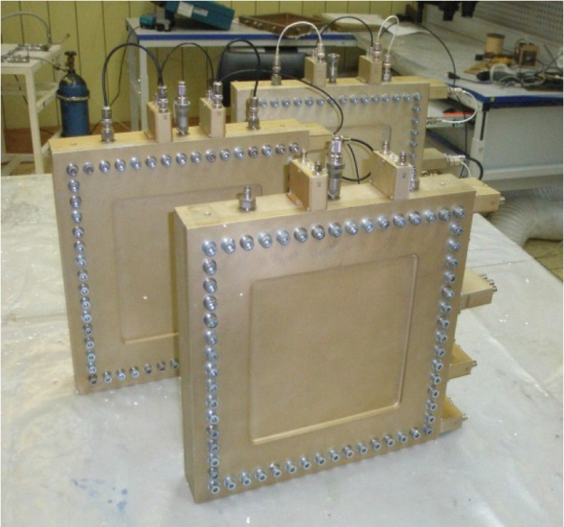
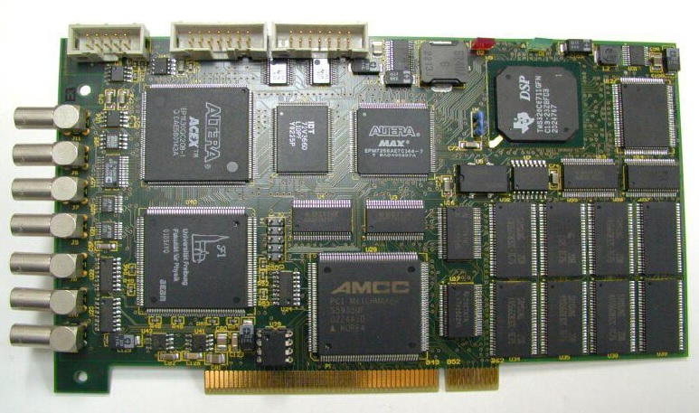
DAQ for 2D PSD
De-Li-DAQ-1
MWPC 2D-PSD
9
NEC’2017
Notes:
The slide shows the block that satisfies the new requirements.
The block of the new DAQ system with modules directly connected to computer interfaces is the De-Li-DAQ-1 module with a PCI interface designed to collect and accumulate data from one- and two-coordinate PSDs based on multiwire proportional chambers with delay line readout.
The module is built on the basis of TDC, DSP, FPGA and RAM and allows implementation of algorithms for receiving and processing data from PSDs and accumulating 3-dimensional X-Y-TOF spectra as well as transferring raw data in the list-mode mode at a rate up to eight hundred thousand events / s

Slide 10
DAQ System Structure with DeLiDAQ2 and MPD-240 blocks
1D PSD
DeLiDAQ2
A/D
Adapter
2D ПЧД
2D PSD
USB2.0/3.0
DeLiDAQ2
A/D
Adapter
РС
MPD-240
Adapter
POINT DET.s.
Neutron DETECTORS
Ethernet
Amp.-DISCRIMINATORS
FIBER
DAQ BLOCKs
10
NEC’2017
Notes:
Later it was decided to use remote connection of data acquisition modules via serial fiber link and USB interface.
During the reactor shutdown for modernization, work on modernization of spectrometers and data acquisition systems was carried out. The blocks in the VME standard were replaced with data acquisition blocks with a serial fiber interface, and new multi-channel blocks of discriminators were developed. In the new DAQ system architecture, detector electronics and data acquisition units can be located in one NIM crate located near the detector system. To connect DAQ units to a computer in the new architecture, a USB interface was chosen and an adapter unit for remote connection of modules with a serial fiber-optic interface was developed.
So, two new blocks were designed. One is MPD-240 with a discriminator block to operate with an array of point detectors. The second is DeLiDAQ-2D to operate with PSDs.
The DAQ System Structure with DeLiDAQ2 and MPD-240 blocks is shown in the slide

Slide 11
Main features of MPD-240 DAQ
1. Electronics provide data acquisition from all types of multi-point detector systems of neutron spectrometers on IBR-2M reactor
2. Maximum number of detector elements is 240
3. Maximum detection rate is 8 x 10⁶ events/s
4. Frequency of time sampling = 62.5 MHz (16ns), ~ 1ppm
11
NEC’2017
Notes:
Slides 11- 13.
Main features of MPD-240 DAQ
The MPD system is built of two types of modules: digital modules capable of acquisition and storing data from up to 240 point-detector elements and from up to eight 32-channel discriminator modules for detection, discrimination, conversion, and transmission of signals from detector preamplifiers to the MPD digital module.
MPD DAQ provides
First, data acquisition from all types of multi-point detector systems of neutron spectrometers on IBR-2M reactor
Second,. Maximum number of detector elements is 240
Third, Maximum detection rate is 8 million events per second
Fourth. Frequency of time sampling is 62.5 MHz corresponding to 16ns of time-step-resolution, with stability of one ppm.

Slide 12
Main features of MPD-240 DAQ (cont.-d)
5. Events are recorded in absolute time of experiment, max. exposure time=4.5 x 10⁶ s (length of time counter = 48 b)
6. Registration of service signals with the same accuracy as that of detector elements: start of reactor, start / end of time window, end of exposure, etc
7. Registration of additional 6 external signals (falling and rising edges): for example PICK-UP Fourier signal of the diffractometer
8. Histogram memory (64MB) for visualization and on-line monitoring of data acquision (256 x 64K)
12
NEC’2017
Notes:
Fifth Events are recorded in absolute time of experiment with maximum exposure time of 4.5 million seconds determined by 48- bit length of the time counter .
Sixth Registration of service signals with the same accuracy as that of detector elements such as start of reactor, start/end of time window, end of exposure, etc.
Seventh, Registration of additional 6 external signals by falling and rising edges: for example PICK-UP Fourier chopper signal of the diffractometer
Eighth, Histogram memory of 64MB for visualization and on-line monitoring of data acquision.

Slide 13
Additional MPD DAQ features
- Mask register for selecting input detector signals
- Program specified thresholds of detector signals in discriminators (bus I2C);
- Simultaneous transmission of histogramming data and «raw» data in the list mode to the computer
- «time focusing» due to individual time channel width for each detector element
- In-built test generator (debugging and fast testing of system operability)
13
NEC’2017
Notes:
Also, MPD DAQ provides
- Mask register for selecting input detector signals,
- program-controlled thresholds of detector signals in discriminator modules using I2C bus connection of the MPD module with the discriminator modules
- Simultaneous transmission of histogramming data and «raw» data in the list mode, to the computer
- «time focusing» due to individual time channel width for each detector element
- In-built test generator for debugging and fast testing of system operability.

Slide 14
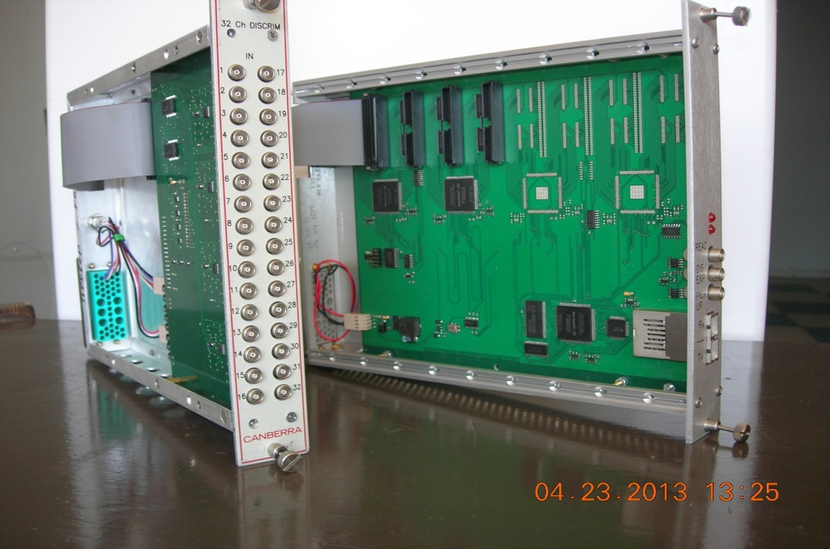
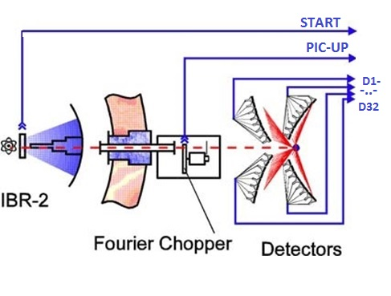
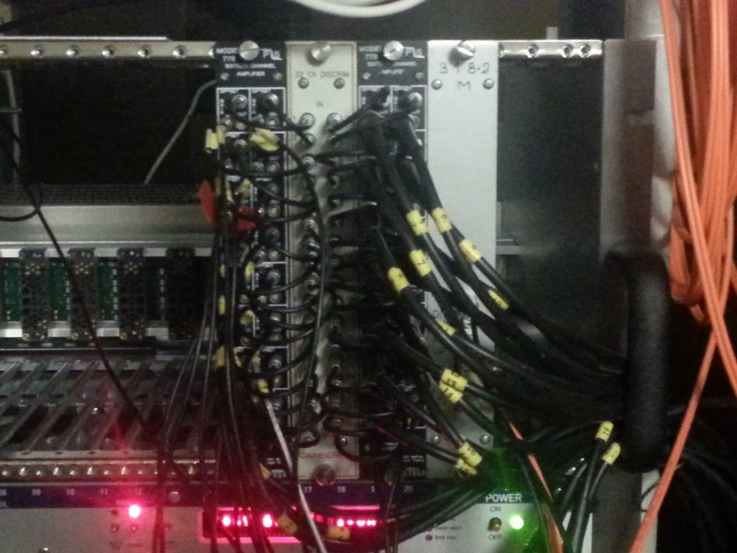
MPD-240 DAQ on FSD
14
NEC’2017
Notes:
This slide shows how the MPD-240 DAQ is used on FSD for high resolution data acquisition.
The MPD-240 unit was also developed taking into account the replacement of the old VME-DAQ system for the high-resolution Fourier diffractometer. In this case, the MPD-240 system must provide, during on-line measurements, transmission of raw data from reactor pulse, chopper pick-up signal, and from an array of detector elements for their subsequent off-line processing. To input the data from reactor pulse and pick-up signals, there are made additional inputs on the front and back panels of the unit. To input detector signals, one 32-channel discriminator module is used. This MPD-240 data acquisition n system is now used on three Fourier diffractometers, HRFD, FSD, and FSS.

Slide 15
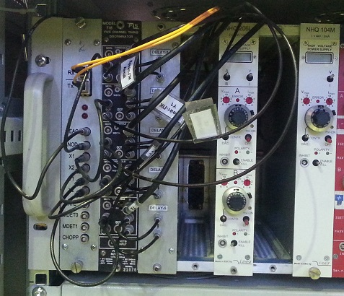
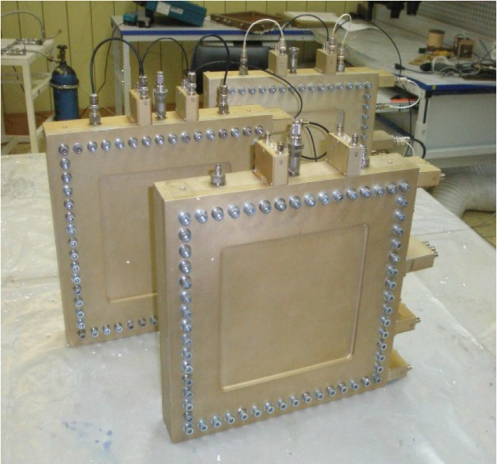
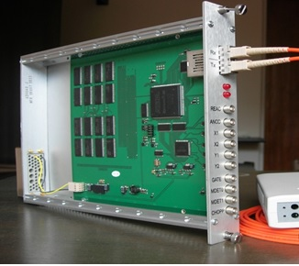
DeLiDAQ2- DAQ for 2D PSD
DeLiDAQ-2D
15
NEC’2017
Notes:
Slide 15 (De-Li-DAQ-2D for 2D-PSD)
A unified electronic module of new generation, De-Li-DAQ-2D, to replace De-Li-DAQ-1 was developed to collect and store data from one- and two-coordinate PSDs based on multiwire proportional chambers with information reading from delay lines.
The new De-Li-DAQ-2D module
includes an eight-channel integrated circuit of time-to-digital converter (TDC-GPX), IC of FPGA with about 6K logic elements, 1 GB of histogram memory, which is sufficient for storing 512 × 512 × 1024 of 32-bit words of 3-dimensional X-Y-TOF spectra, and a high-speed serial fiber interface to link with a personal computer by external USB adapter .

Slide 16
Main features of the DeLiDAQ-2D
DAQ system for MWPCs with delay line readout
Flexible configuration for 1D or 2D PSDs;
TDC resolution– 80ps.
Real time data filtering and event recognition
Maximum detection rate is 1 million events/sec
16
NEC’2017
Notes:
Slide 16.
Main features of De-Li-DAQ-2D DAQ (For 1D and 2D position-sensitive detectors)
Удовлетворяет требованиям, предъявляемыv к электронике считывания данных с ПЧД на основе линий задержек
DAQ system for MWPCs with delay line readout method.
Satisfies the requirements for the electronics for read out data from the PSD with delay line readout method
Гибкая настройка для работы с 1D или 2D ПЧД;
Преобразователи TDC с разрешением – 80ps.
Отбор и фильтрация данных в реальном времени используя алгоритмы реализуемы программируемой логикой;
Поток регистрируемых событий</= 10**6 /sec;

Slide 17
Main features of the DeLiDAQ-2D (cont.-d)
RAM memory of 1GB for accumulation 3D histogram
2 monitor detector inputs
3 events pile-up reconstruction (overlapping)
neutron loss counters for dead time calculation
embedded test generator of detector signals
1 Gb serial fiber optic interface
NIM standard module (+6V, 0.8A)
17
NEC’2017

Slide 18
SONIX⁺ viewing of DeLiDAQ2 data from 2D-PSD
18
NEC’2017

Slide 19
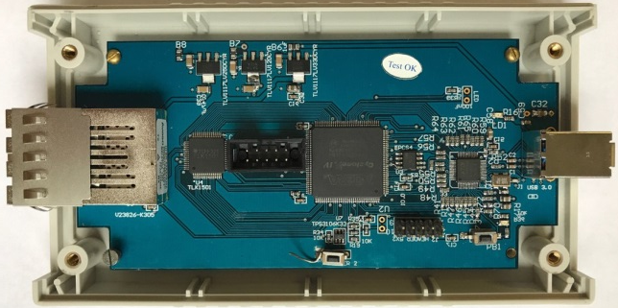
FLINK Upgrade
USB3.0
USB2.0
19
NEC’2017

Slide 20
Conclusions
In general, the characteristics of the created data acquisition systems for the spectrometer complex meet all modern requirements, which is a key to successful implementation of the research program at the IBR-2M reactor.
The authors are grateful to their colleagues in the Condensed Matter and Spectrometers Complex Departments of Frank Laboratory, who made a significant contribution to the creation and implementation of the systems reviewed in this report.
20
NEC’2017

Slide 21
Thanks for your attention
21
NEC’2017

