Slide 1
BM@N carbon beam pipe
M. Janda¹, F. Lopot¹, M. Rachac¹
P. Chudoba², A. Kugler², V. Kushpil²
¹Faculty of Mechanical Engineering of the Czech Technical University
²Nuclear physics institute, The Czech Academy of Sciences
chudoba@ujf.cas.cz
October 21, 2020

Slide 2
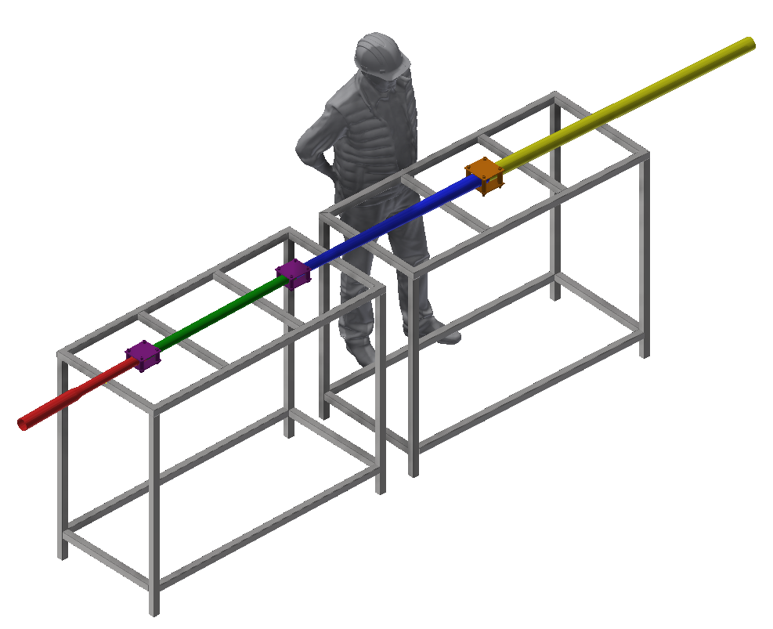
Updated BP design
4.
All of the pipes (1.-4.) are detachable
Ends of the pipes are redesigned as required
Mounting tools (a,b) for easier assembling are added
b
3.
detachable
2.
a
a
1.
detachable

Slide 3
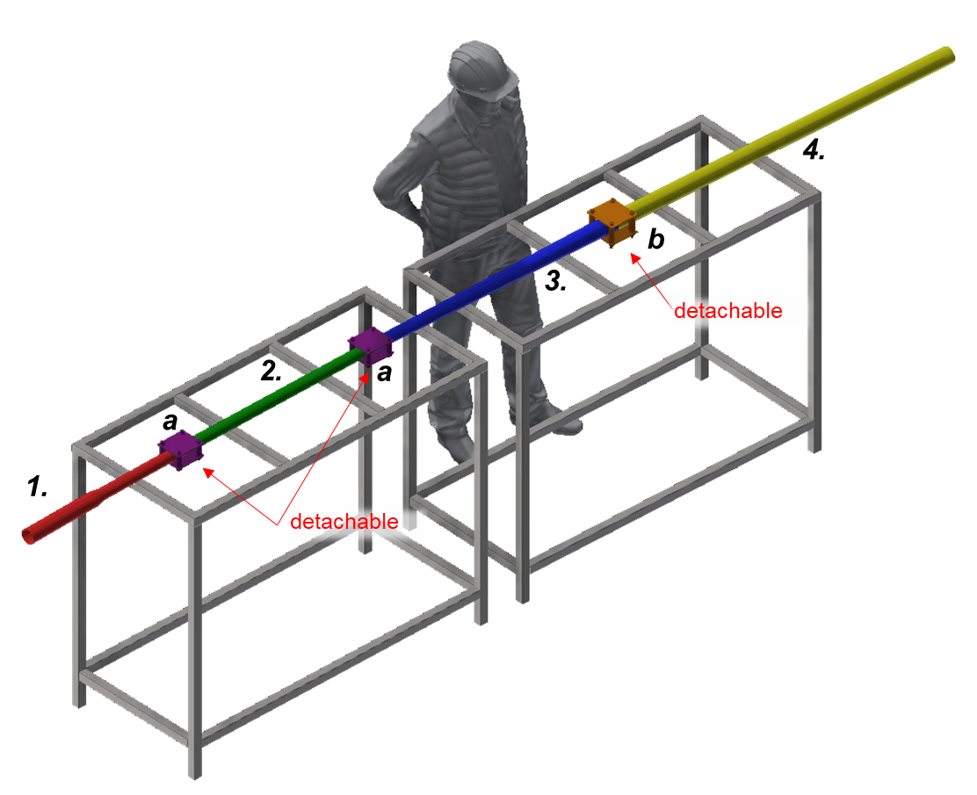
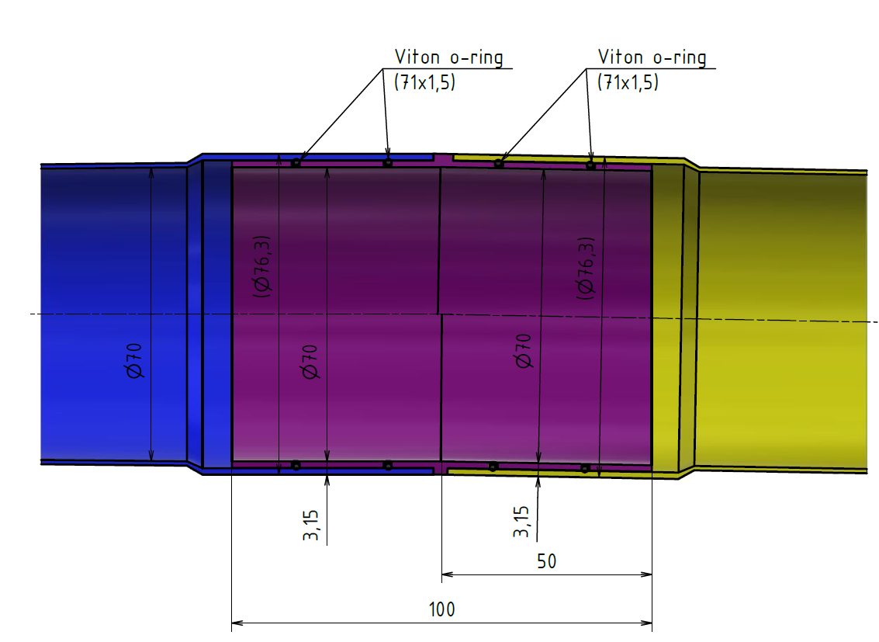
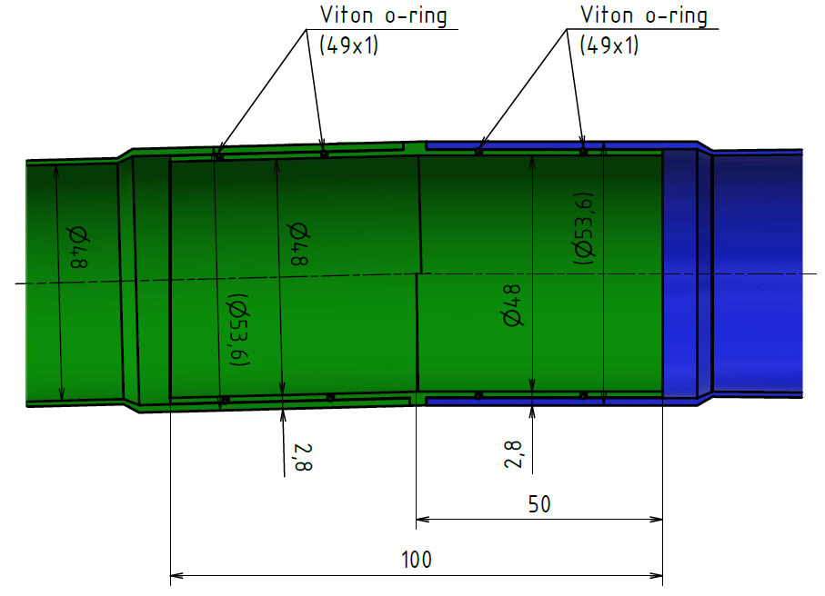
Updated BP design
Mounting tools for easier assembling were added
Wall thicknesses are as low as possible (2.8 mm and 3.15 mm)
The length of these walls is not more than 100 mm

Slide 4
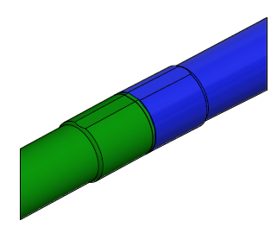
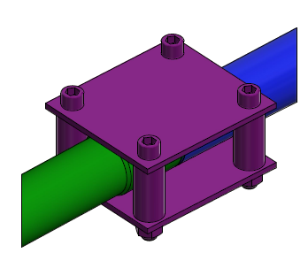
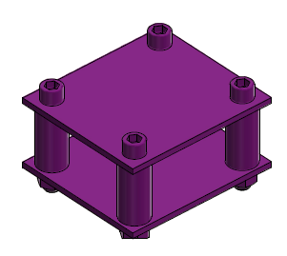
Updated BP design
Ends of the pipes are redesigned as required
To find the exact pipes position a special pipe end shapes are developed
Mounting tools are developed for precise and simple installation
Special pipe shape
Simple and precise instalation
Mounting tool

Slide 5
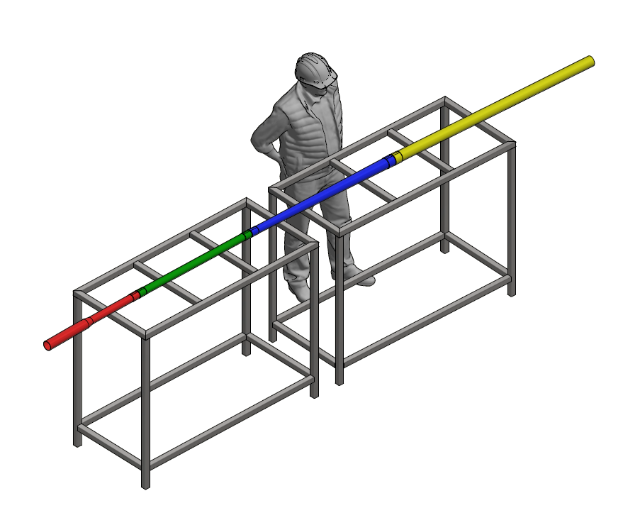
Updated BP design
From my point of view, this is the final design version
If you have any comments or questions, do not hesitate to contact marek.rachac@gmail.com

