Slide 1



GEM/CSC tracking system status
Andrei Galavanov on behalf of BM@N Collaboration
6th Collaboration Meeting of the BM@N Experiment at the NICA Facility, 26.10.2020

Slide 2
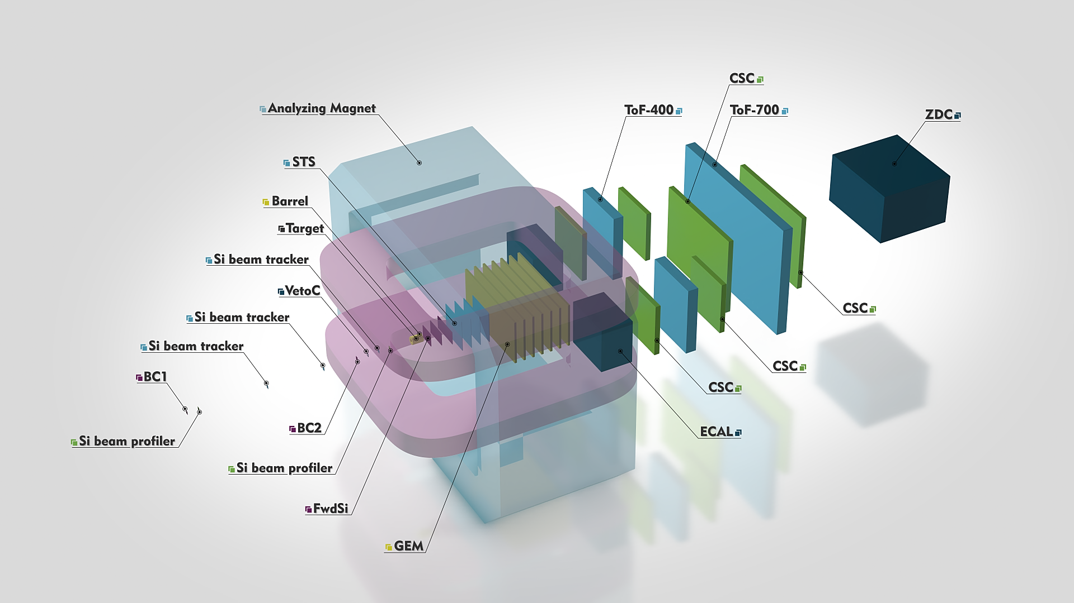
BM@N experiment
CSC 1×1 m²
CSC 2×1,5 m²
7 GEM planes
CSC 1×1 m²

Slide 3
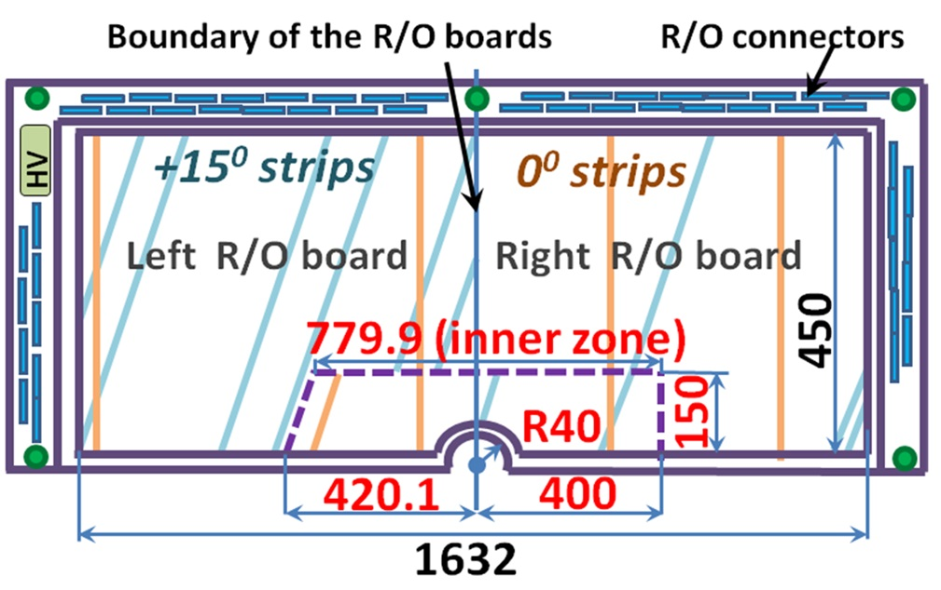
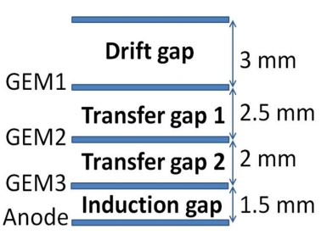
BM@N GEM detectors
Now we have:
7 detectors 1632 × 450 mm²
7 detectors 1632 × 390 mm²
2 spare detectors will be produced in 2021
0.16
0.8
0.8
0.68
Schematic cross section of the BM@N triple GEM detector

Slide 4
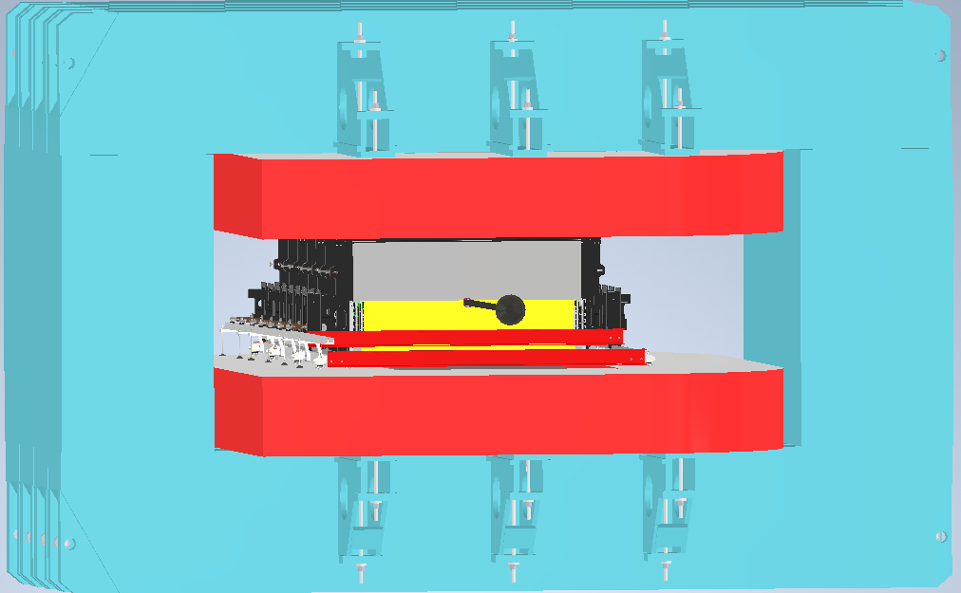
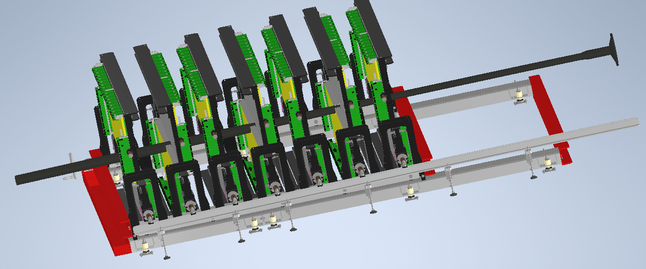
Full planes configuration inside the SP-41 magnet
Active area of
the GEM tracking system ~ 9.5 m²
Space for installation and alignment
is limited by the aperture of our magnet
10.2020 – finish of development
of the mechanics for GEM planes
precise installation inside the magnet.
2021 – mechanics production, installation of the GEM planes.
Development of the mechanics design for GEM planes precise installation inside the magnet was done by “Pelcom” (Dubna). Final cross-checks of the design are performed by BM@N chief engineer and our group.
A tender procedure will be initiated to select a manufacturer of support mechanics.

Slide 5
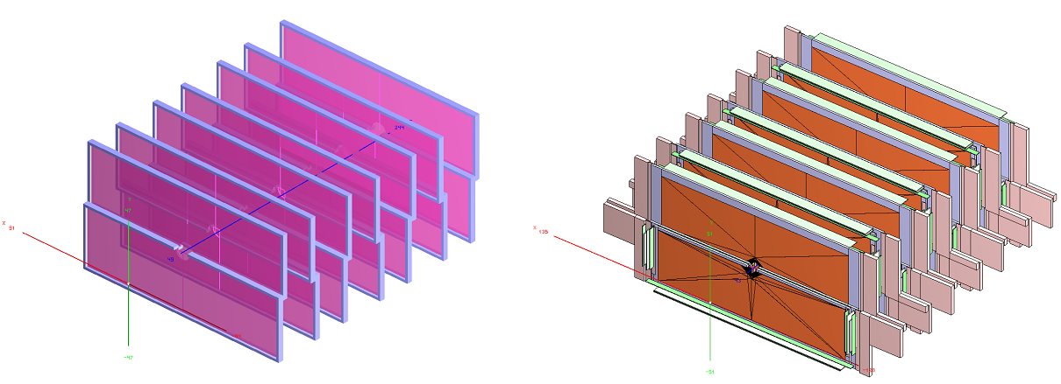
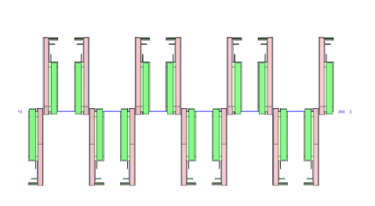
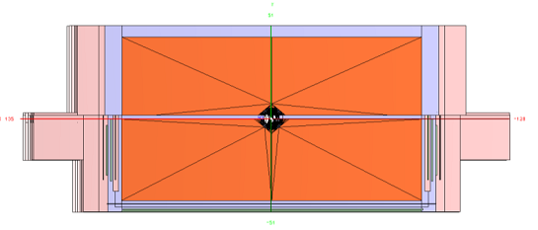
Full configuration of the GEM central tracking system
Detailed geometry of GEM planes for heavy ion beam runs (Left panel: GEM active areas,
right panel: GEM planes with mechanical support frames and FEE electronics)
XY projection
ZY projection

Slide 6
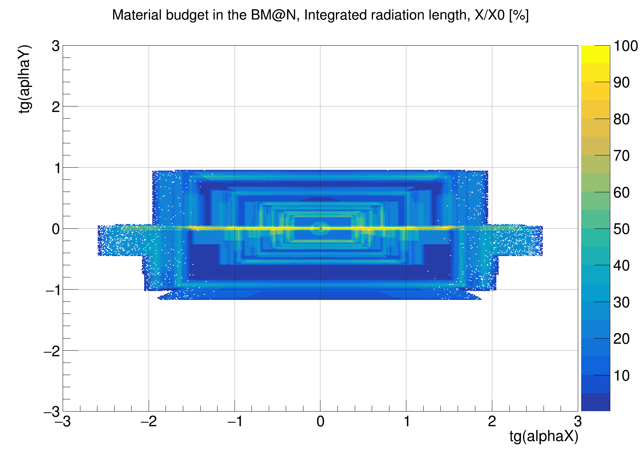
Material budget of the GEM central tracking system
full configuration

Slide 7
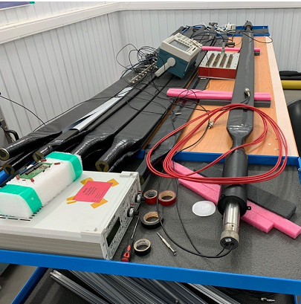
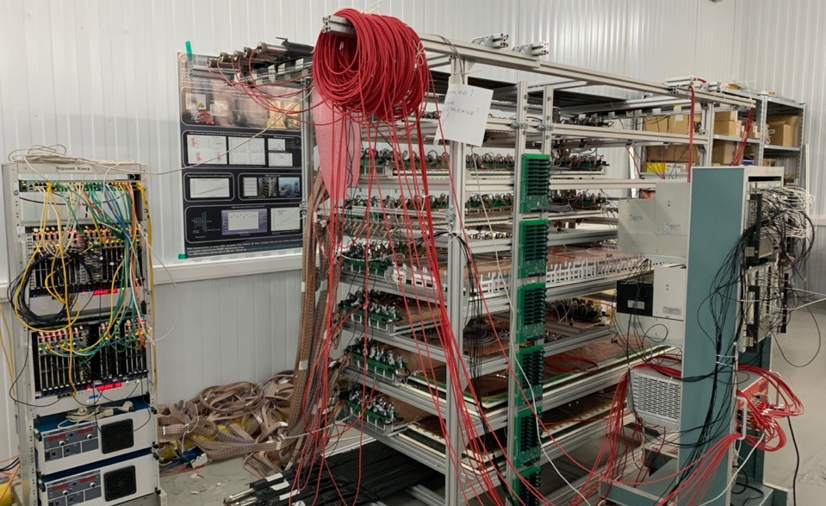
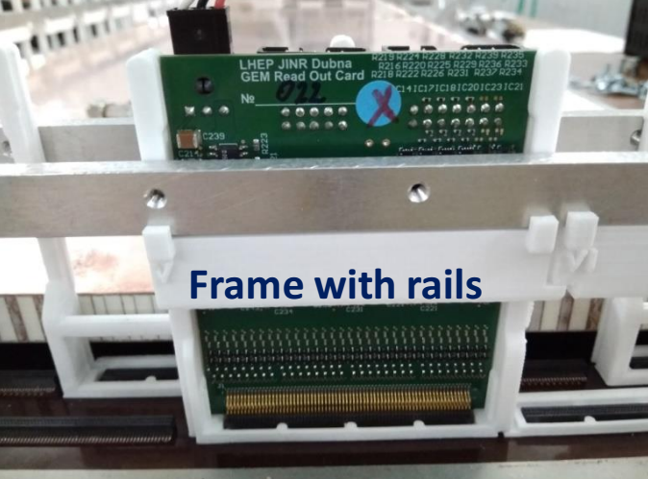
Assembly of the stand for long-term GEM tests
Trigger system – ten 10*200 cm²
scintillation detectors
First stage – tests of 1632*390 mm² detectors,
right now
Second stage – tests of 1632*450 mm² detectors
Frames for FEE
electronics

Slide 8
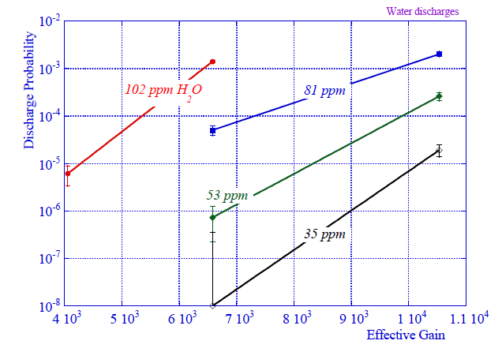
Gas system
Gas system requirements :
stable flow and mixture parameters;
7 independent channels to each GEM-plane;
reducing and control oxygen and moisture impurities in gas mixture;
Gas cylinders
Multichannel gas mixer
H₂0 and 0₂ filter
H₂0 and 0₂ analyzer
Distribution panel
GEM plane
H₂0 and 0₂ analyzer
Oil gate
For one channel
We tested GE oxy.IQ for oxygen analyze and GE dew.IQ+ GE IQ.probe for moisture analyze.
Problem – moisture analyzers have no coincidences in measuring
Discharge probability on alphas as a function of moisture level in the gas. COMPASS

Slide 9
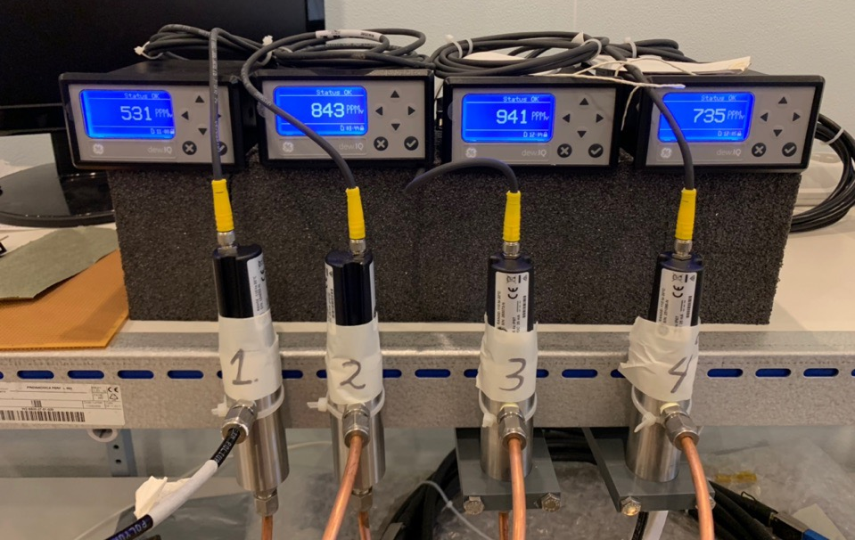
Tests of the moisture analyzers
Tests of the oxygen analyzer have shown coincidence of the sensors readings on the level 1-5 ppm.
Tests of the moisture analyzer have shown coincidence of the sensors reading on the level 100-300 ppm.
Now we have a discussion with technical support of the official distributor about this situation.
Sensor 1 and 2 – old, last calibration in 2017; sensor 3 and 4 – new, calibration in 2020.

Slide 10
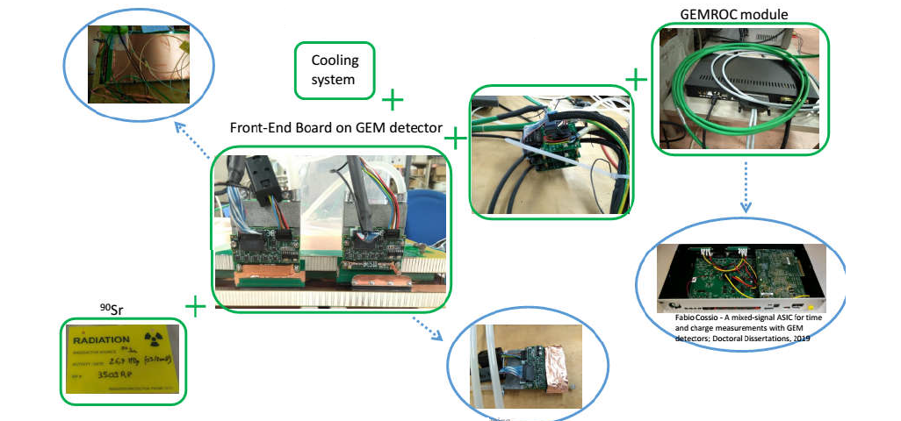
Development of new FEE for high intensity heavy ion beams
First run of TIGER FEE on the BM@N GEM detector was performed at CERN at the end of 2019. Next tests were planned on March 2020 at JINR, but were put forward.
Kintex7 based 128ch GEM evaluation board was designed for VMM3a tests.
Evaluation board is produced, the firmware is under development

Slide 11
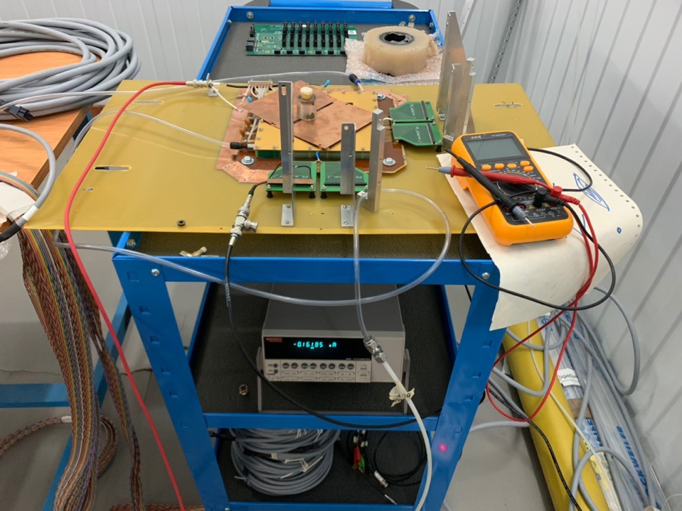
Small GEM for tests of the new FEE
10×10 cm² GEM
Fe-55 ionization source
Picoampermeter
Keithley 6485

Slide 12
Schematic view of CSC
1
1
Anode wires geometry
Honeycomb
Anode wires. Step 2,5 mm Diam. 30 mkm
Hanger system
1077,5
8
Anode wires
Sensitive area
1129
Spacer
1065
568,5
560,5
Spacer
Support wires for anode wires
Beam
1
Cathode 1
Cathode 1
Wire isolated with teflon
3,8 mm
Anode wires
Front-end electronics for cathode strips
3,8 mm
0,8 mm
Tightening capron loop
8
Cathode 2
Cathode 2

Slide 13
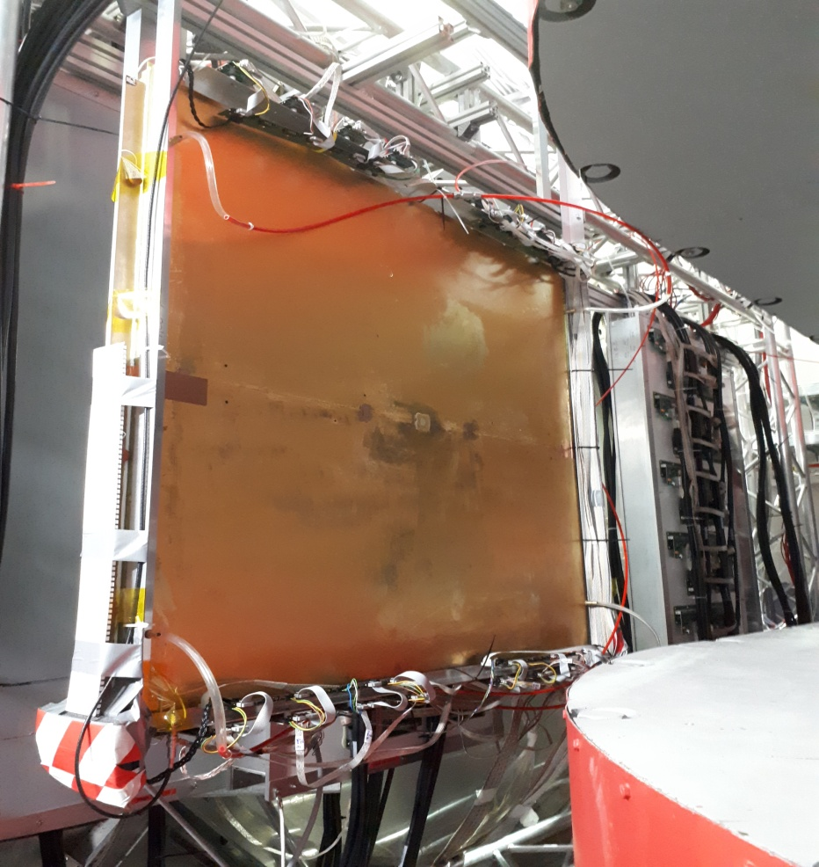
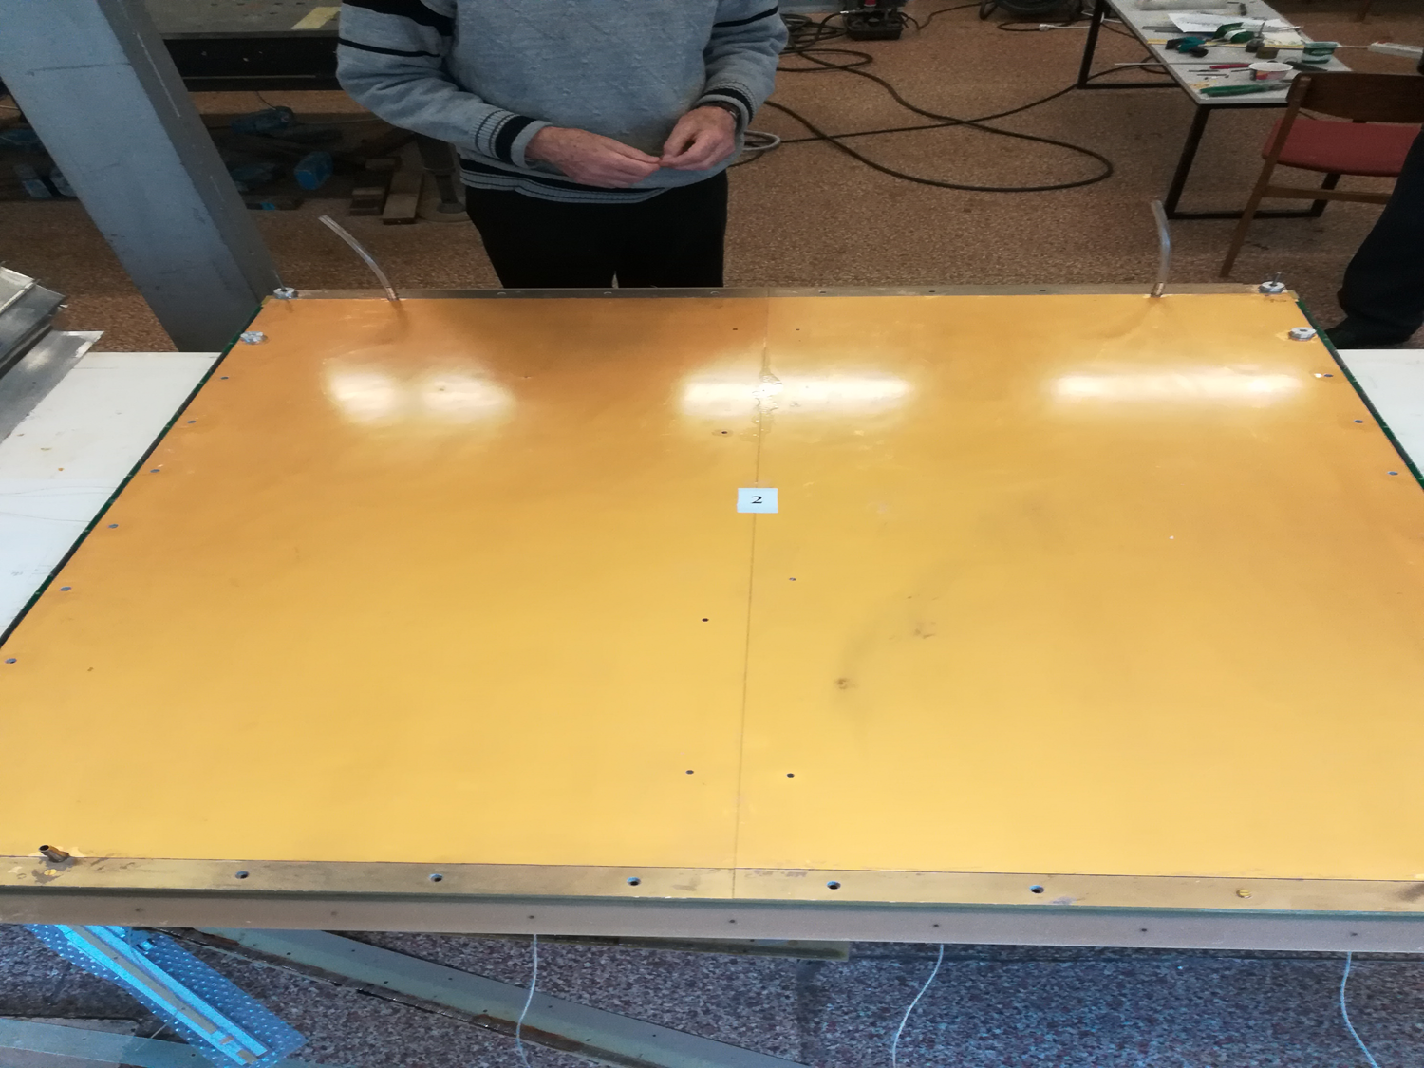
CSC 1 × 1 m²
1 chamber was produced and integrated into the BM@N setup at 2018.
3 chambers are finished on 99%.
Remaining works:
Sealing all chambers;
Equip mount elements.
Necessary timing ~ 2 week.

Slide 14
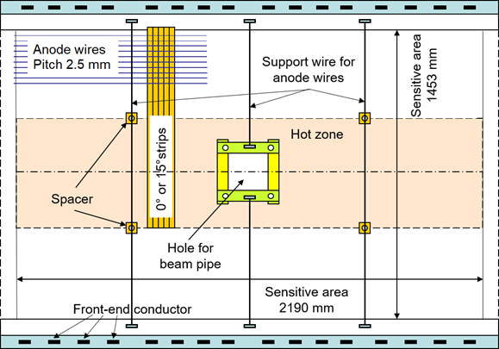
CSC 2 × 1.5 m²
Design of the cathode planes is finished, producing of the cathode planes will be finished at the end of November;
Production of the inner frames and another parts of detectors – end of November;
Preparation of the assembly table – November 2020.
Problem – fume hood and ventilation system at the assembly building.

Slide 15
Conclusions
GEM:
7 detectors 1632×450 mm² and 7 detector 1632×390 mm² are produced;
2 spare detectors are waiting for the assembly at CERN;
Mechanics for GEM-planes inside the magnet is developed;
The tender procedure will be initiated to select a manufacturer of support mechanics by the end of the year;
Assembling the stand for testing the GEM-detectors with cosmic rays is finished;
Tests of 1632*390 mm² detectors with cosmic rays in progress.
CSC:
1 chamber of the size 1×1 m² is produced;
3 chamber of the size 1×1 m² will be produced in this two weeks;
Preparatory work for 2×1.5 m² chambers is underway: cathode planes in production, another parts of detectors in production or already done.

Slide 16
Back up slide

Slide 17
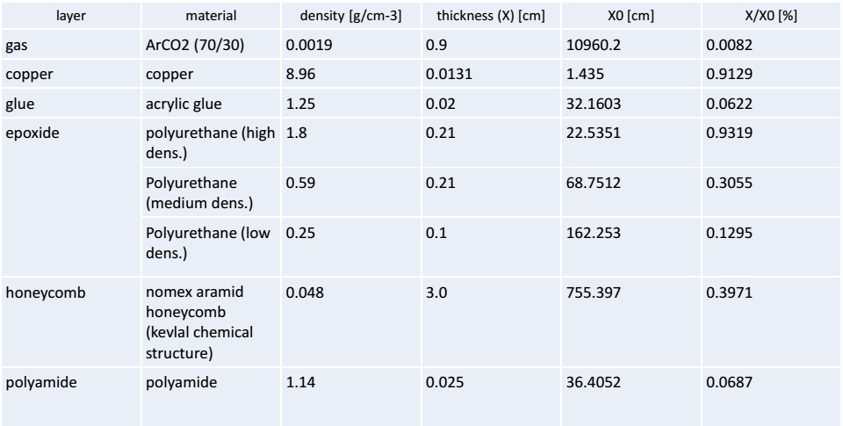
Material budget of one Gem detector

