Slide 1
ELECTRON CLOUDS IN NICA
A.V. Philippov for NICA team Veksler and Baldin Laboratory of High Energy Physics
Joint Institute for Nuclear Research, Dubna, Russia
NICA Machine Advisory Committee
meeting at Joint Institute for Nuclear Research, Dubna, Russia
May, 22-23, 2017

Slide 2
ABSTRACT
First calculation of electron-cloud (e-cloud) build-up in NICA was done in 2008. Since NICA CDR publishing in 2009, the Collider concept has undergone significant changes [1], therefore the old results revise for a new concept is given in this talk. New simulations were performed with last ECLOUD code, version 4.b [2].

Slide 3
OUTLINE
1 A brief review of e-cloud build-up
1.1 Condition of e-cloud build-up
1.2 Problem statement and input parameters for NICA
1.3 Tune shift relative e-cloud effect
2 Calculation results
3 Conclusion
4 References

Slide 4
1 A BRIEF REVIEW OF E-CLOUD BUILD-UP
The circulating beam particles can produce electrons due to different mechanisms, e.g. residual gas ionization in the vacuum chamber. This “primary” electrons are attracted by the passing particle bunch and can be accelerated to energies up to several hundreds of eV (for NICA this value 50 ÷ 300 eV).
When an electron with this energy impacts the wall, “secondary electrons” are likely to be emitted. The secondaries have energies up to few tens of eV and, if they impact the wall with these energies, they are either absorbed or elastically reflected but cannot produce any secondary. On the other hand, if they survive until the passage of the following bunch they can in turn be accelerated, projected onto the wall and produce secondaries. This can trigger an avalanche multiplication effect which builds up the e-cloud during the passage of an entire bunch train.

Slide 5
1.1 CONDITION OF E-CLOUD BUILD-UP
The criteria for electron cloud build-up can be formulated in the following way [3]. The necessary condition for e-cloud build-up is
$$N_{b}>\frac{β^{2}R^{2}}{Zr_{e}S_{b}},S_{b}=\frac{C}{n_{b}}.$$
Here $N_{b}$ is the number of ions per bunch; $βc$ is the ion velocity; $R$ is the vacuum chamber radius; $Z$ is the ion charge; $r_{e}$ is the classic electron radius; $S_{b}$ is the interbunch distance; $C$ is the circumference, and $n_{b}$ is the number of bunches.
The sufficient condition (acceleration of secondary electrons in the bunch electric field up to energy $ΔW$ sufficient for kicking out of the chamber wall more than one electron) is the following:
$$N_{b}>\frac{βR}{Zr_{e}}\sqrt{\frac{ΔW}{2m_{e}c^{2}}.}$$
The combination of the necessary and sufficient condition for two energy values sufficient for kicking out of the chamber wall more than one electron is shown next slide.

Slide 6
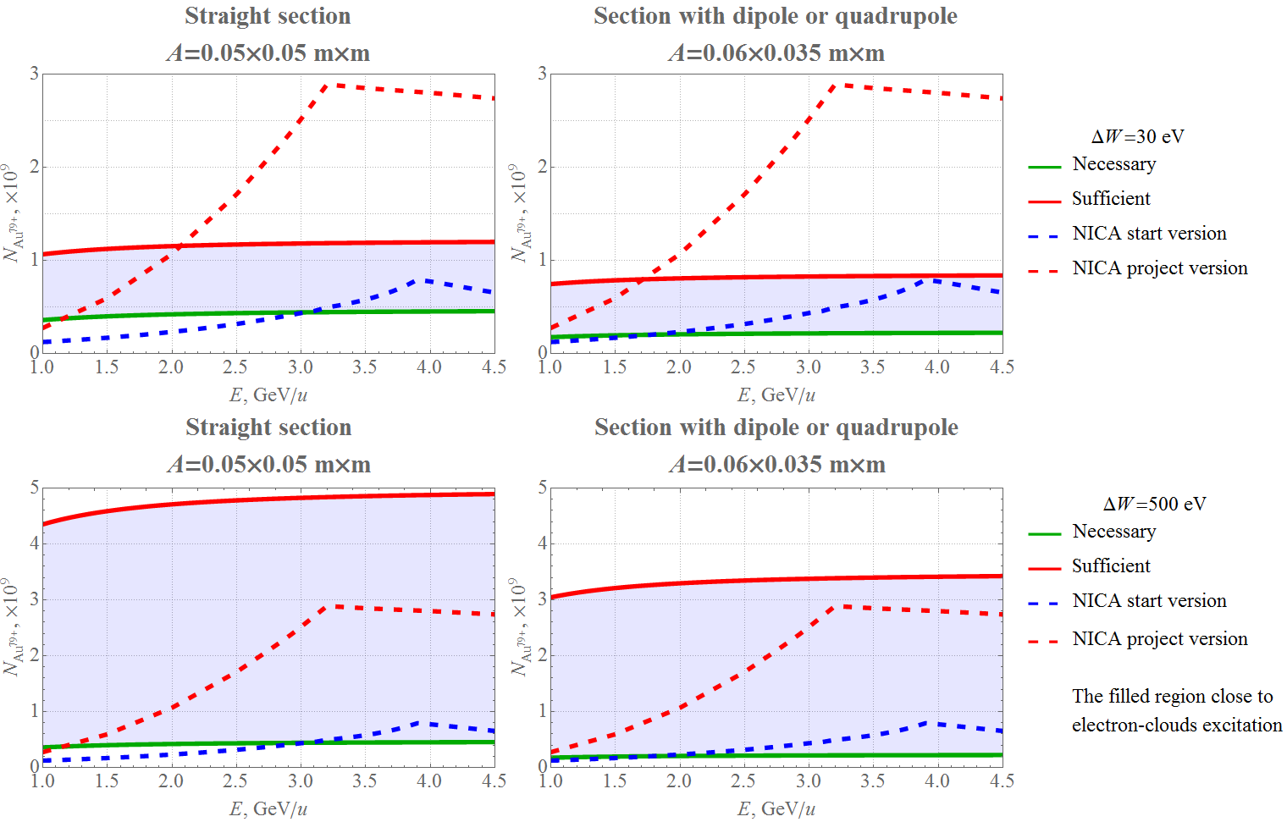
1.1 CONDITION OF E-CLOUD BUILD-UP (Cont.)

Slide 7
1.2 PROBLEM STATEMENT AND INPUT PARAMETERS FOR NICA
Thus, such above estimates show that NICA parameters are close to excite e-cloud build-up:
in start NICA version up to 2 GeV/u in dipole and up to 3 GeV/u in straight section
in project version in all energy range
Therefore numerical simulations have been fulfilled. For this case the last ECLOUD code, version 4.b [2] was used for performing simulation of e-cloud build-up for NICA.
Next slide the input parameters for ECLOUD program is given. All other parameters necessary for the calculation were used on recommendation of program developers [2].

Slide 8
1.2 PROBLEM STATEMENT AND INPUT PARAMETERS FOR NICA (Cont.)
List of the NICA parameters used in the ECLOUD simulation
Ion type ¹⁹⁷Au⁷⁹⁺
Number of bunches 22
Ring circumference, m 503.04
Bunch spacing, m 22.87
RMS beam emittance x/y, π mm∙mrad 1.1/1 ÷ 0.7 varied with energy
RMS bunch length, m 0.6
Bending magnet field/quadrupole gradient, T/T/m 1.8/23.1
Length of dipole/quadrupole/straight section, m 1.94/0.47/15
Aperture dipole/quadrupole/straight section, m×m 0.06×0.035/0.05×0.05
Total residual gas ionization cross-section, Mb 1276 ÷ 1186 varied with energy
Total gas pressure, nTorr 0.01
List of the varied parameters
Energy, GeV/u 1 ÷ 4.5 varied step 0.5
Number of particles per bunch 5∙10⁸ ÷ 5∙10⁹ varied step 5∙10⁸
Secondary emission yield 1.1 ÷ 1.9 varied step 0.1

Slide 9
1.3 TUNE SHIFT RELATIVE E-CLOUD EFFECT
A bunch passing each turn through a static e-cloud with uniform spatial density $ρ_{e}$, experiences a coherent tune shift $ΔQ_{x/y}^{EC}$ [4]:
$$ΔQ_{x/y}^{EC}=ρ_{e}\frac{r_{p}Z}{γA}\frac{\overline{β_{x/y}}h_{x/y}L}{h_{x}+h_{y}}.$$
Here $r_{p}$ is the classical proton radius; $Z$ is the nuclear number, $A$ is the atomic number; $\overline{β_{x/y}}$ is the average beta functions; $h_{x/y}$ are the vacuum chamber semi-axes; $L$ is the sections length with e-cloud, and $γ$ is the Lorentz factor.
Note here that for NICA $∆Q^{SC}≤0.05$ in all energy range, and this value was used below like norm factor for estimation the critical secondary emission yield (SEY) in ratio ${ΔQ_{x/y}^{EC}}/{ΔQ^{SC}}$.

Slide 10
2 CALCULATION RESULTS

Slide 11
2 CALCULATION RESULTS (Cont.)

Slide 12
2 CALCULATION RESULTS (Cont.)

Slide 13
3 CONCLUSION
The presented estimation results based on [3] show that NICA parameters are close to excitation of e-clouds build-up:
in start NICA version up to 2 GeV/u in dipole and up to 3 GeV/u in straight section
in project version in all energy range
For the project values of vacuum chamber dimensions, residual gas pressure, magnitudes of dipoles magnetic field, quadrupole lenses gradient and its lengths the calculations of e-cloud build-up in a wide energy and intensity range of bare gold nuclei beam, and SEY coefficients was performed by using the last ECLOUD code version 4.b
The analysis of the results shown that e-cloud effect most probably occurs in dipoles magnet, but choice SEY value less that 1.3 keeps stable NICA working regime in wide energy and intensity range (slide 11)
Unexplainable behavior of the e-cloud effect in dipoles for SEY more that 1.5 was observed (slide 11), probably it’s related to some computational defects, and requires a more detailed studies, possibly by using another programs
Also more detailed study require the IP straight section due to expected there a small aperture

Slide 14
4 REFERENCES
[1] Technical Design Report of the NICA acceleration complex. JINR. 2015
[2] G. Rumolo and F. Zimmermann. CERN-SL-Note-2002-016 (AP)
[3] I.N. Meshkov, et al. Phys. Part. Nuclei Lett. (2011) 8 1087
[4] W. Fischer, et al. BNL-79227-2007-CP

Slide 15
Thank you for attention and welcome your questions

