Slide 1
EСal Status
Dubna
October 2020

Slide 2
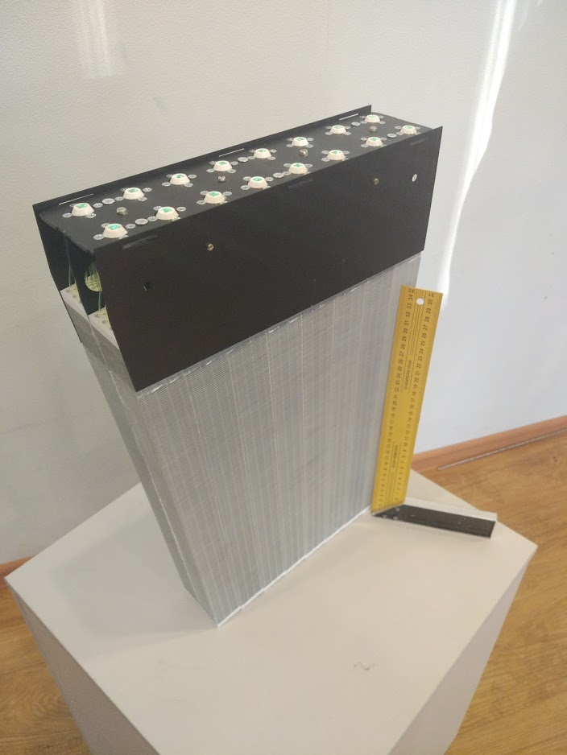
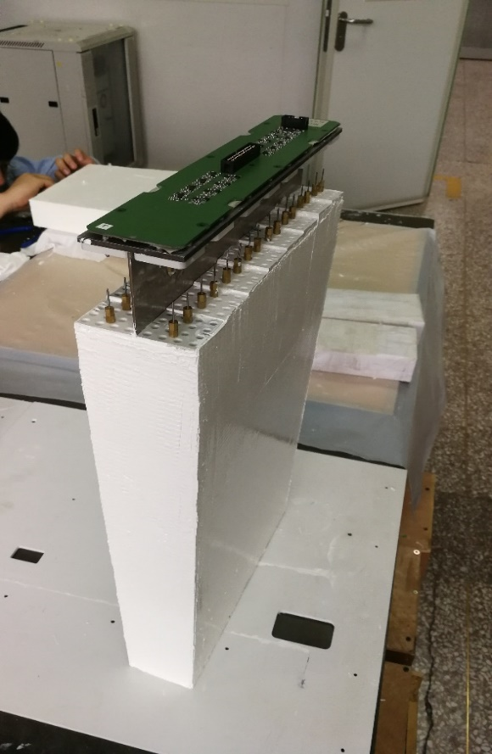
Modules production
Protvino
Production started
To the April 2021 - 440 modules
ТЕНЗОР
Production started
To the April 2021 - 250 modules
8 sectors out of 25
2

Slide 3
Modules production
China production site
Institutes：
Tsinghua University (60%)
Huzhou University
Shandong University (20%)
Fudan University (10%)
University of South China (10%)
China Contribution
Modules production (25%)
Analog boards (HV + amp.) production (50%)
If so! 16 sectors could be assembled
3

Slide 4
Modules production

Slide 5
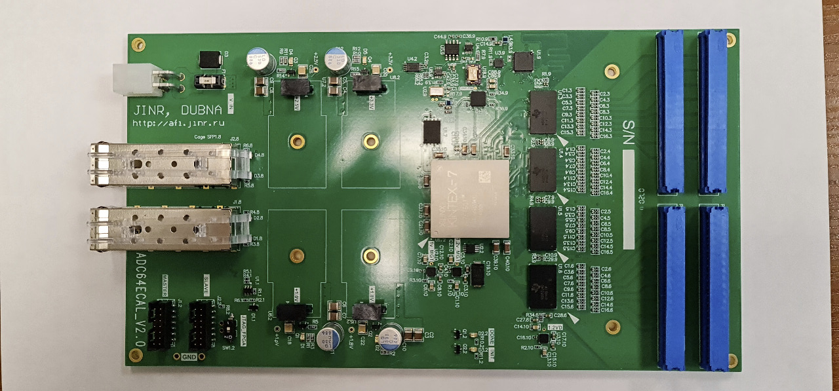
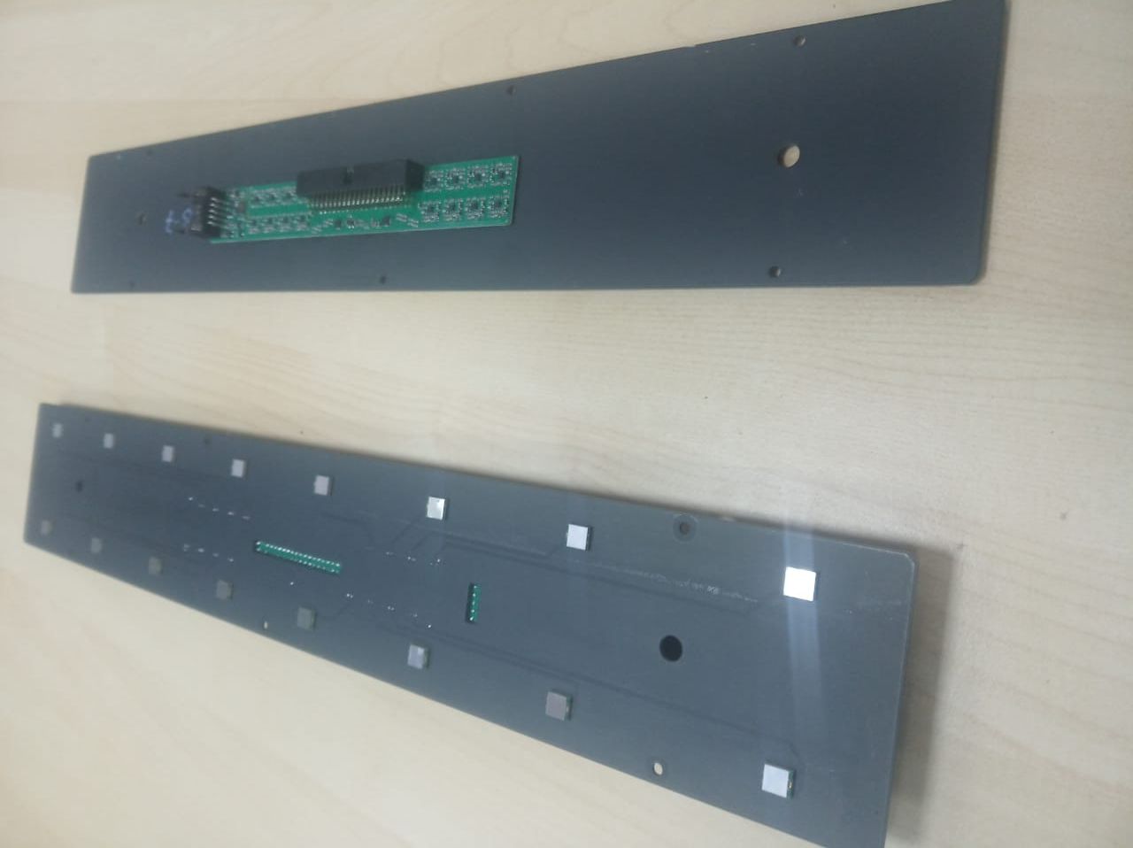
Electronics
ADC64 - 192 boards
for 8 sectors in production
HV+amplifier+SlowControl – 800 boards
for 8 sectors in production
Production plans will be corrected when China production rate will be demonstrated

Slide 6
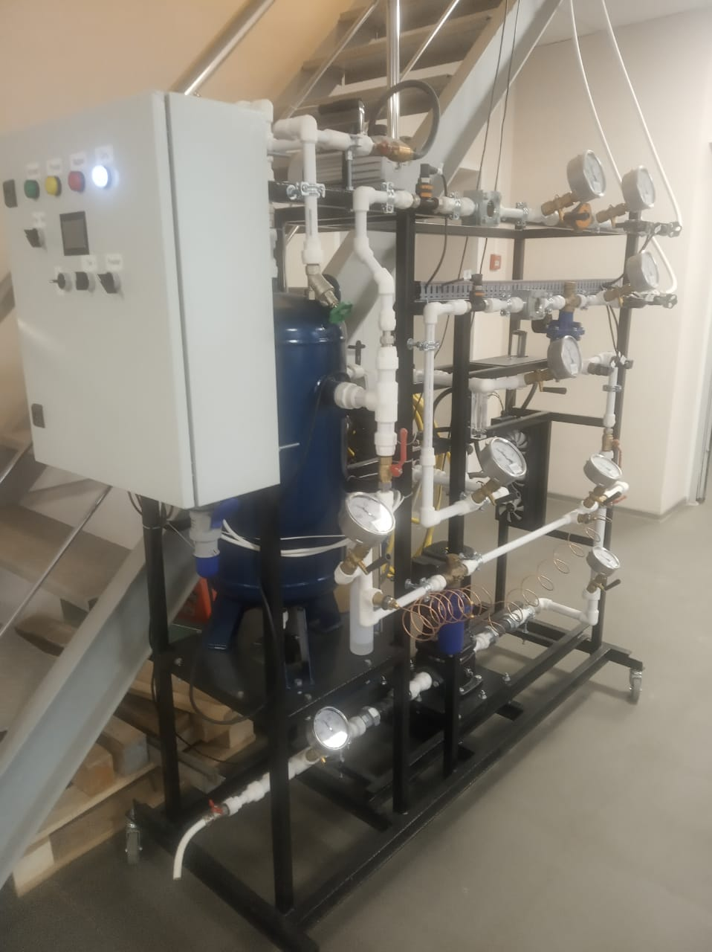
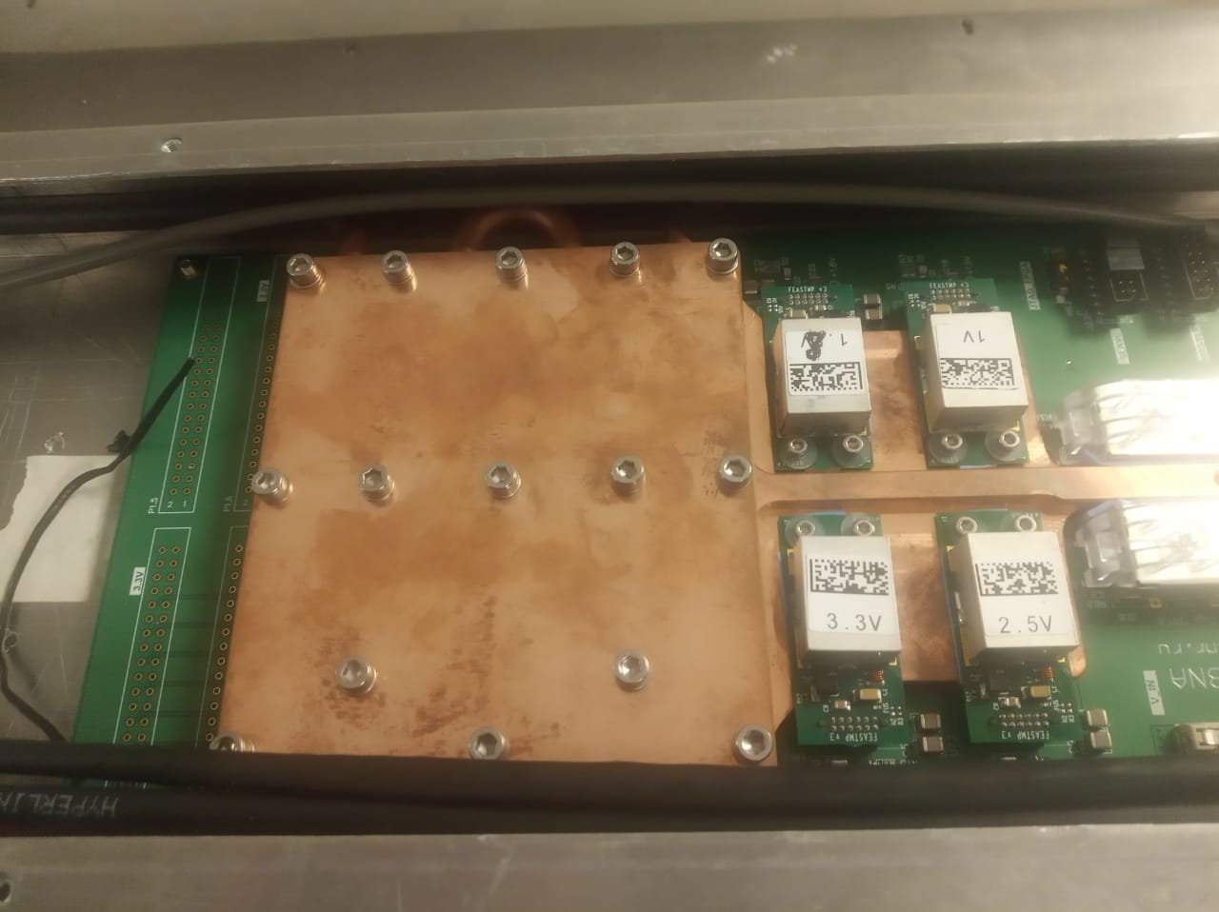
Cooling system for ADC64
Vacuum pump station
Internal part – cold insertion mounted inside barrel
In production

Slide 7
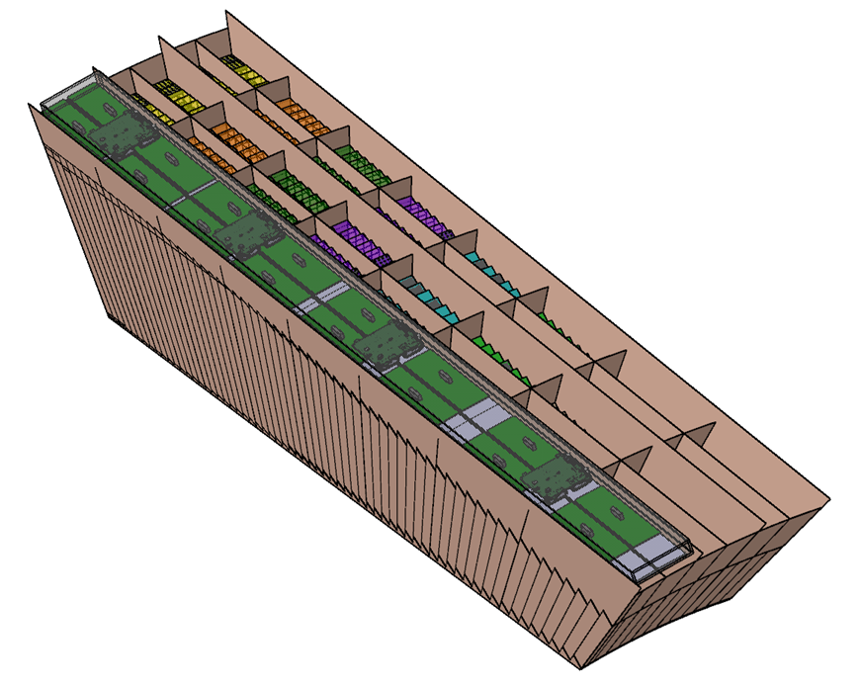
Slipway to assembly half sector
In production
Ready - end 2020
Half-sector Container
in production
First container arriving end 2020

Slide 8
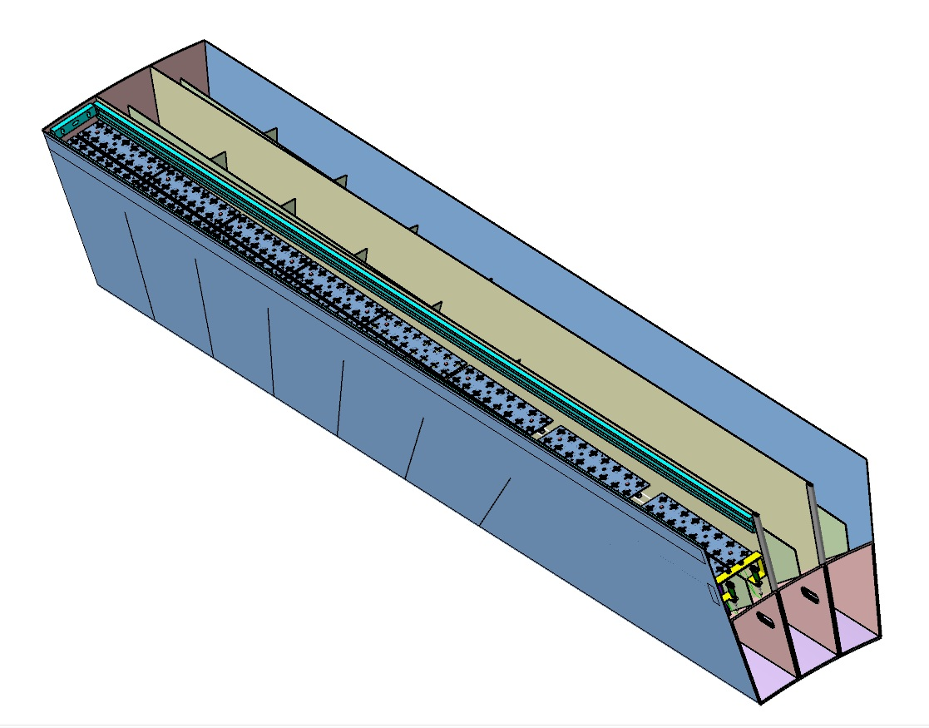
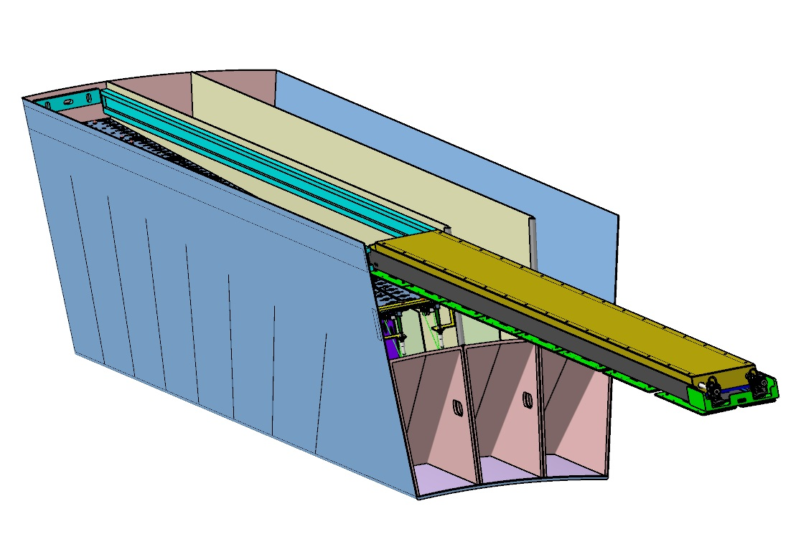
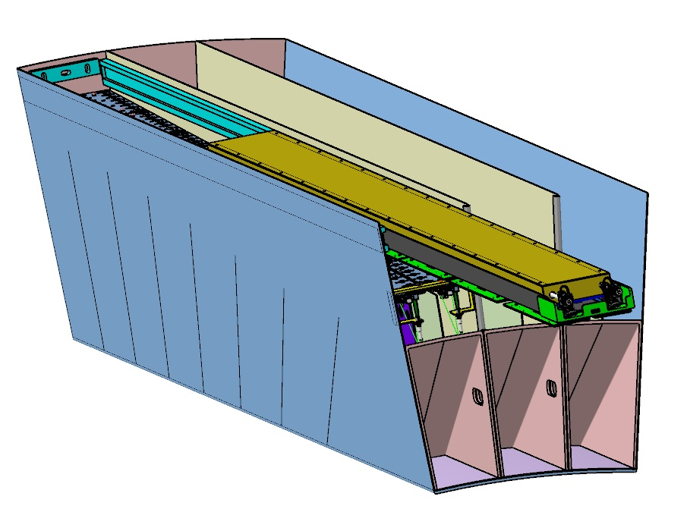
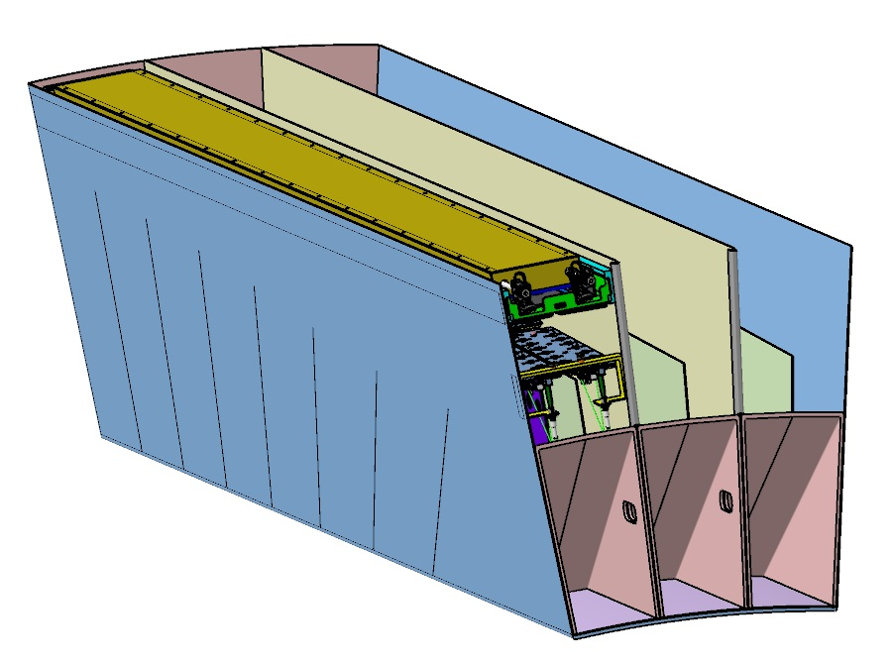
Movable electronics box

Slide 9
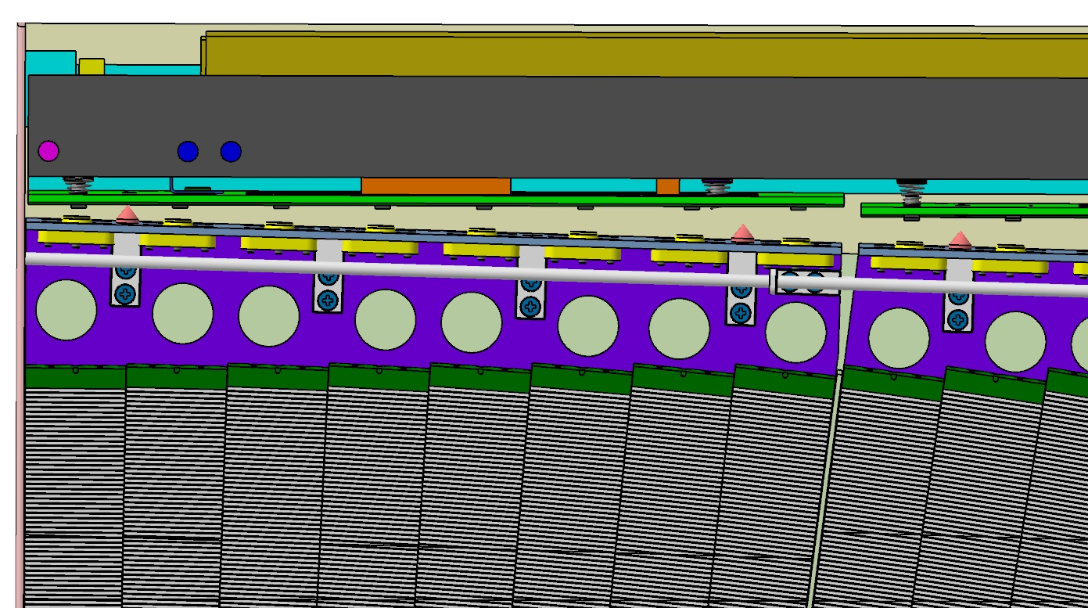
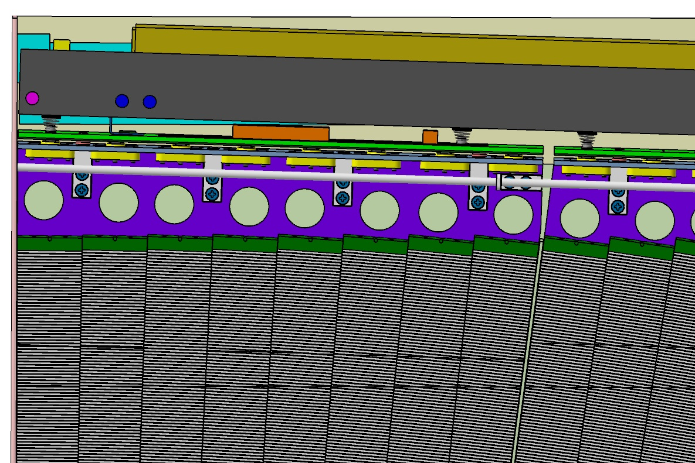
Movable electronics box

Slide 10
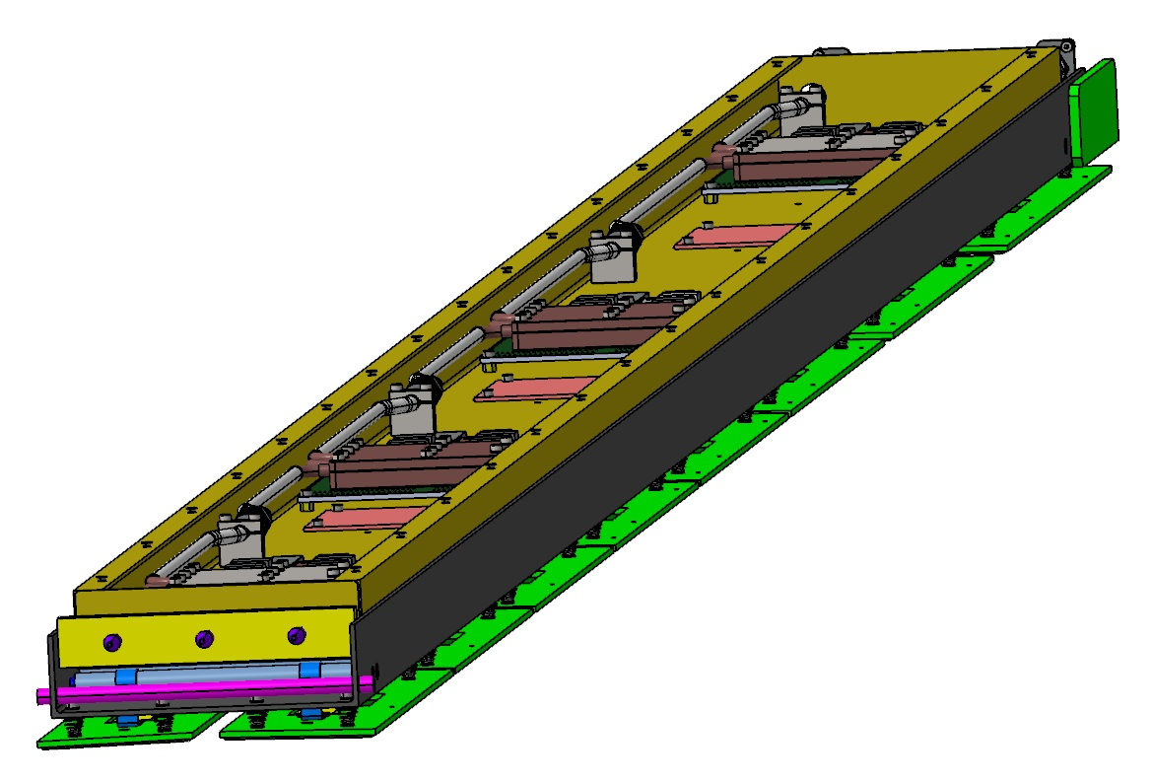
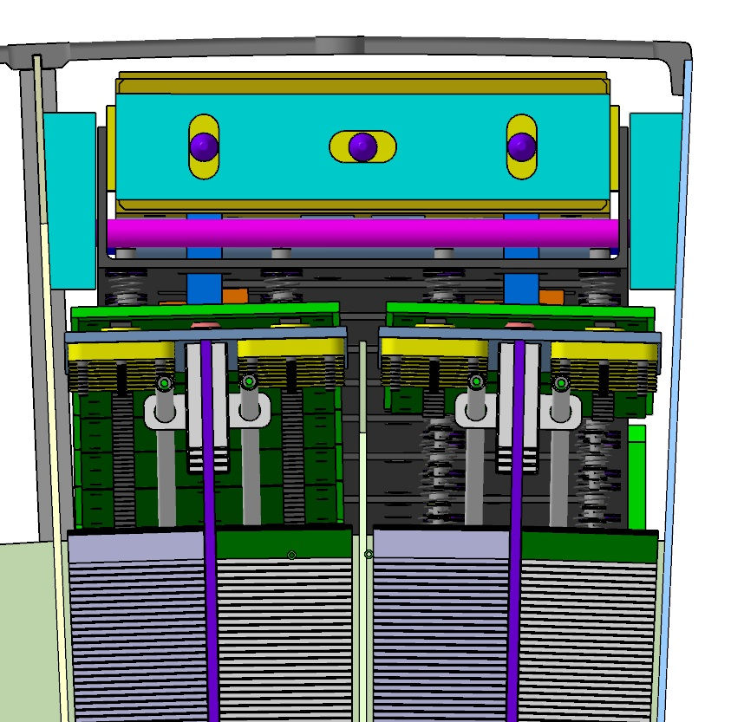
Movable electronics box

Slide 11
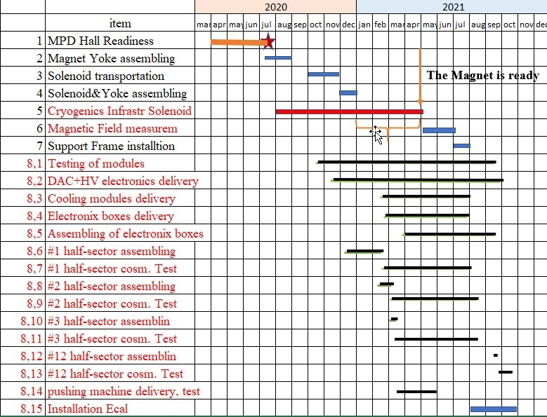
Assembly Time line
8
8

Slide 12
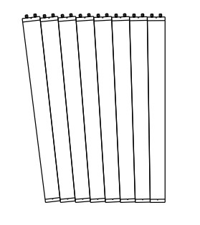
Calibration
Cosmic muons may be used to equalize signals from all channels
Longitudinal muons
Transverse muons
Side view
Front view
Self trigger mode of ADC64
used to register “longitudinal” or
“transverse” muons
Or
Direct but low efficient method
About 1 week to collect enough events
in each channel
2. Not direct - Require some assumptions
High statistics – 10 hors is enough

Slide 13
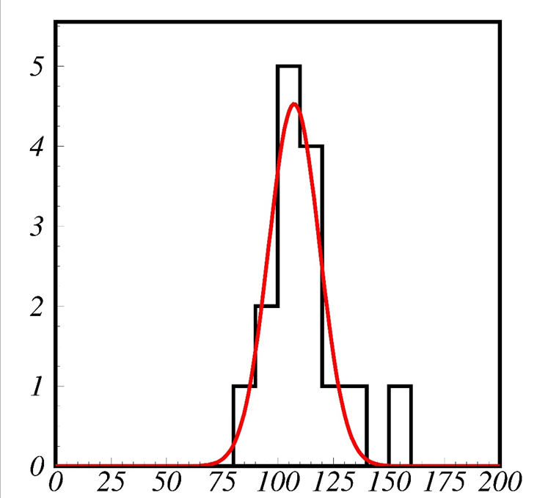
Transverse muons
Correction factor distribution
For selected muons distributions of signals for
the 16 channels of one module
Standard deviation from average is below 10%

Slide 14
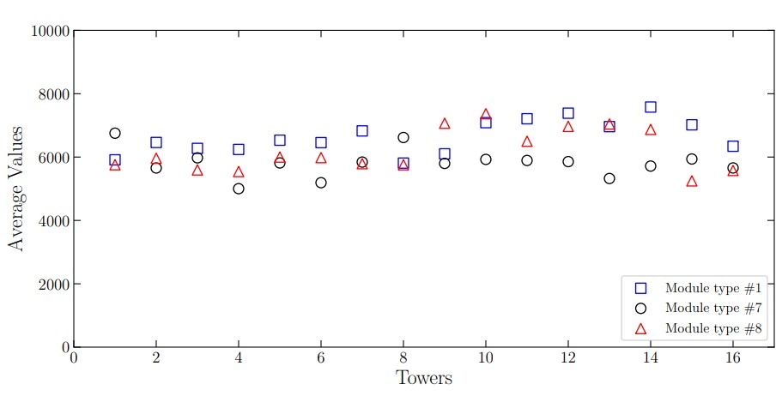
Transverse muons
Results based on the pilot
modules and will be repeated
Comparison of the modules with different geometry

Slide 15
Longitudinal muons
25
15
5
t°(deg)
HV (v)
62.0
61.6
61.2
ADC
counts
64000
K=0.065 v/deg
60000
56000
52000
0 20 40 60 80 100

Slide 16
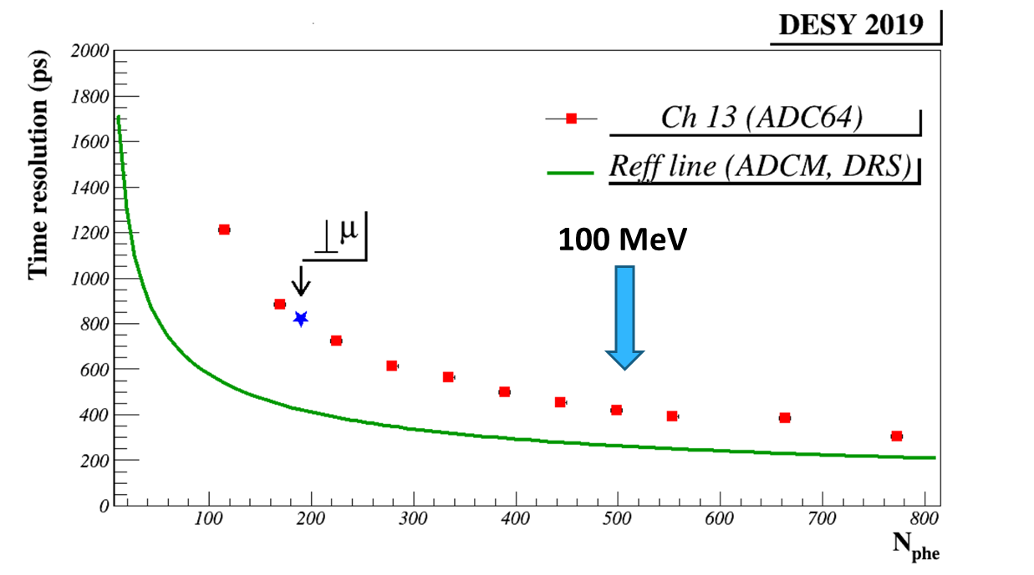
Time resolution
with transverse
muons
σ/$\sqrt{2}=$750 psec
Δt=t_{i}-t_{j}
t₁
t₂
t₃
t₄
t₅
t₆
t₇
t₈
17 MeV
50 MeV e⁻
2019
2020

Slide 17
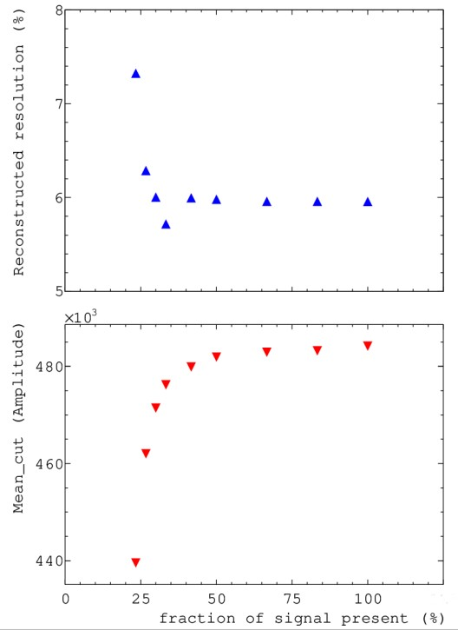
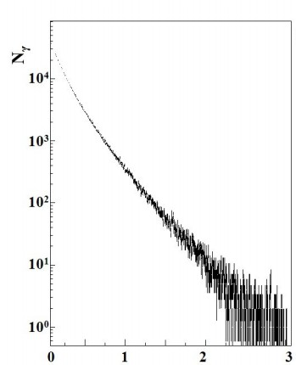
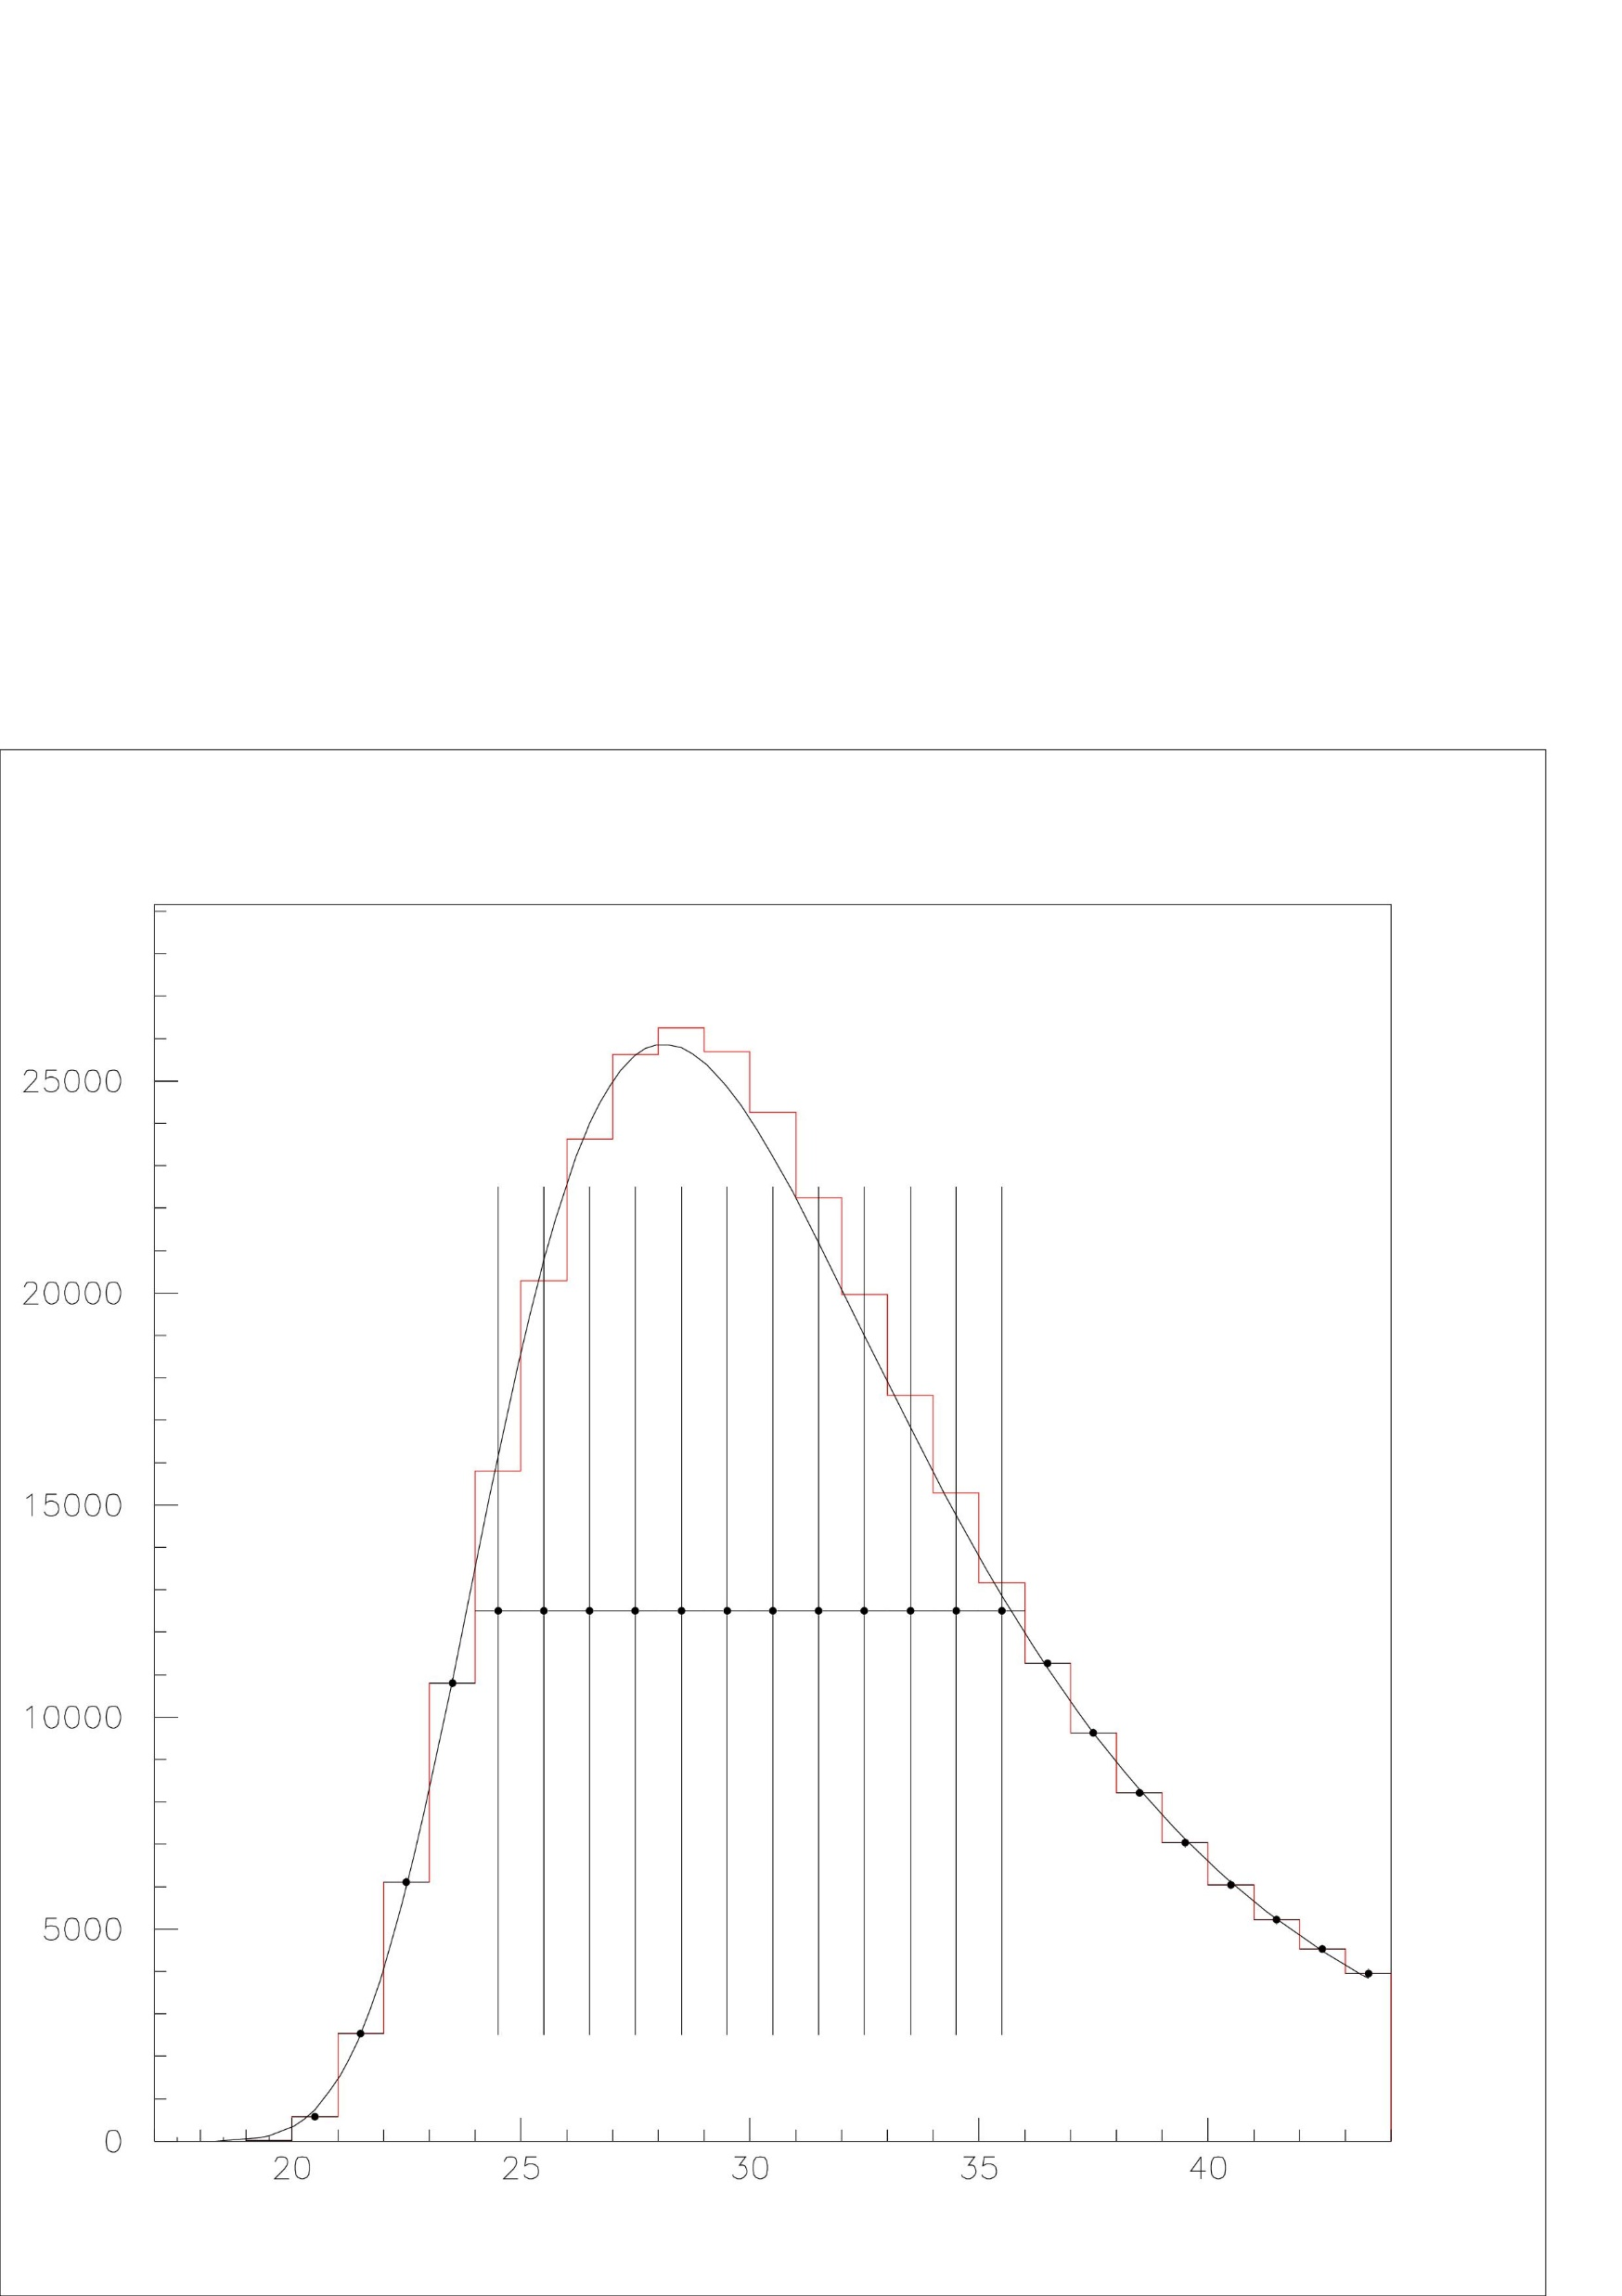
DAQ dynamic range
1,6 GeV Electrons form DESY
ADC64 limit
0,4%
GeV

Slide 18
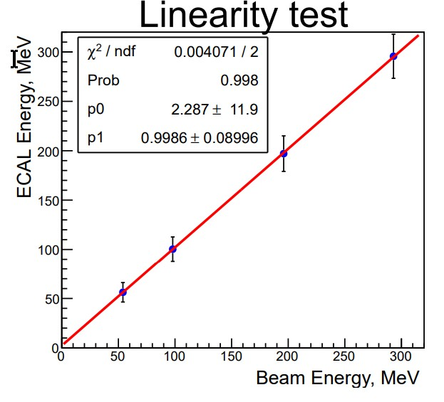
Beam test –Troick 2019

Slide 19
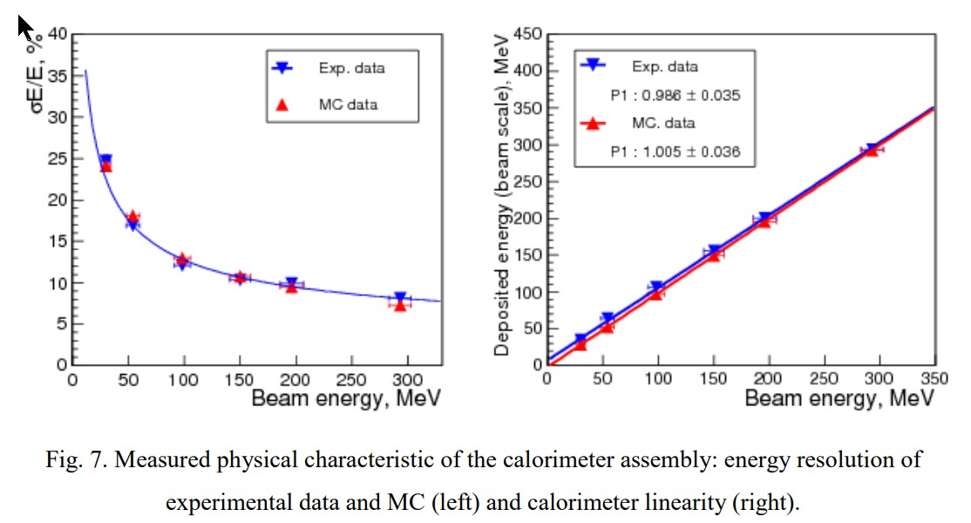
Processed by ITEP group
!

Slide 20
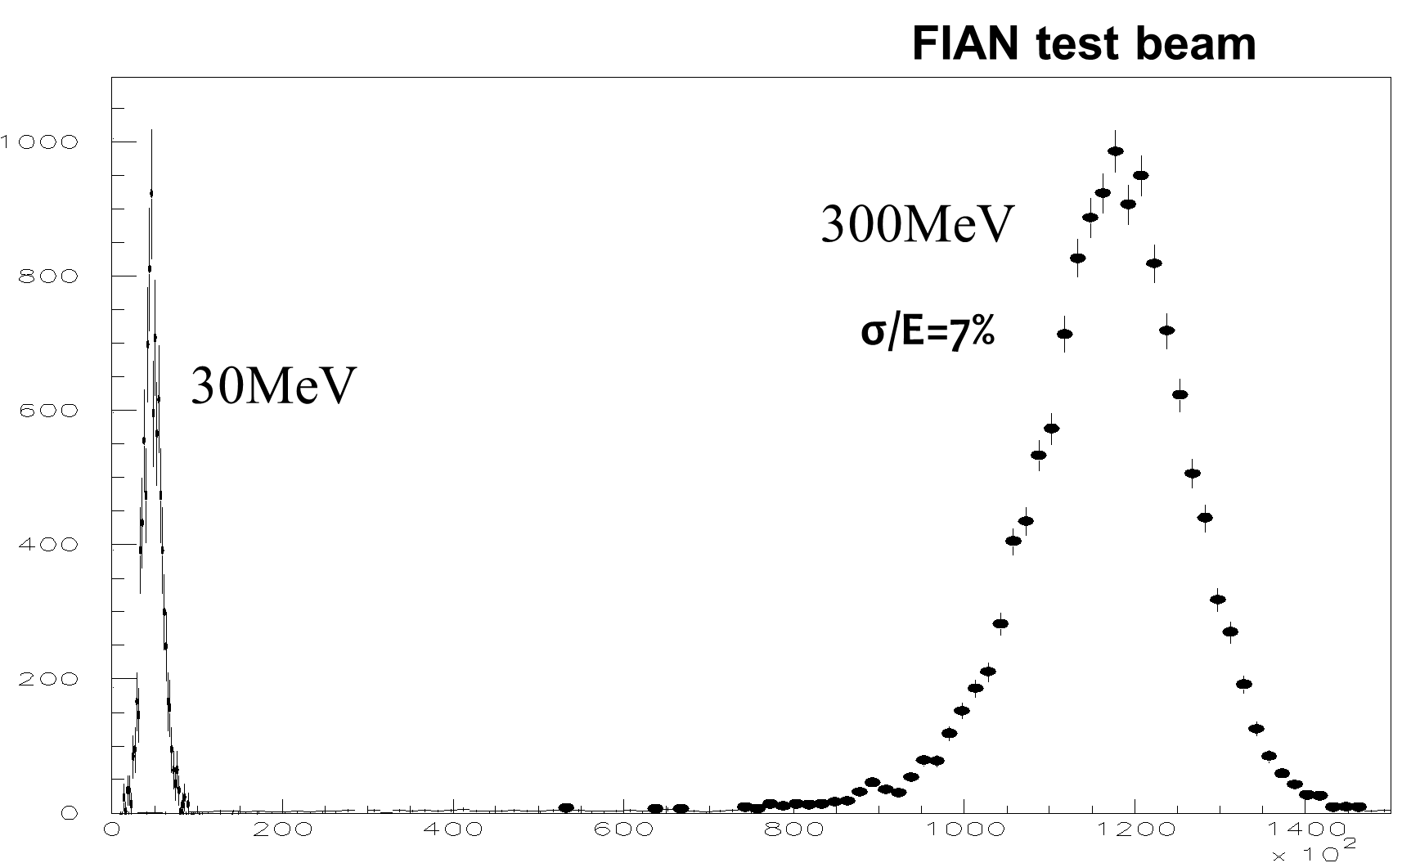
Beam test –Troick 2019

Slide 21
1. Production
Modules production started in Russia. About 700 modules must be produced before autumn 2021.
China is ready to start production in the few production areas.
16 sectors out of 25 may be ready to the first run
Electronics boards are in production
Cooling system is designed, built and tested. Production of cold insertions is started
Carbon made supporting frame is in the production
Sectors assembling procedure is under development
Design of movable electronic system is not yet finished. Test of elements are going on
Assembling can start autumn 2020.
2. Tests
Tests of produced modules are going on by means of cosmic muons. Few test on the electron beam are expected when beam become available
Procedure of modules mass tests and calibration is developed
Time resolution for extremely low signals is studied and found in agreement with previous expectations
Increase of dynamic range of electronics is proposed

