Slide 1
Centralized Monte-Carlo productions
"MPD Collaboration Meeting "
29.10.2020
Dubna
Moshkin Andrey*, Rogachevsky Oleg, Pelevanyuk Igor
for MPD collaboration
(*) amoshkin@jinr.ru

Slide 2
https://mpdforum.jinr.ru/c/MCProd

Slide 3
Available resources

Slide 4
Available resources(1)
NICA offline cluster 250 cores(limit for users)
GOVORUN 184-470 cores
Tier1 445 cores
Tier2 485 cores
Clouds 70 cores
UNAM 100 cores
Up to 2 000 000 reconstructed events per day in the last production.

Slide 5
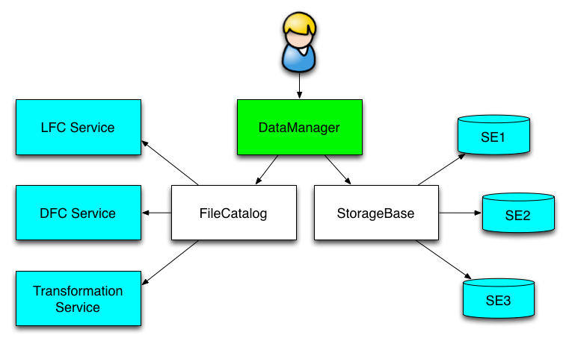
Dirac as the centralized data storage service
DIRAC File Catalog(DFC) is maintaining a single global logical name space
A user sees it as a single catalog with additional features
DataManager is a single client interface for logical data operations
Upload file(example):
dirac-dms-add-file /mpd/vo/model/DQGSM/data.root ./data.root EOS-MPD
Download file(example):
dirac-dms-get-file /mpd/vo/model/DQGSM/data.root

Slide 6
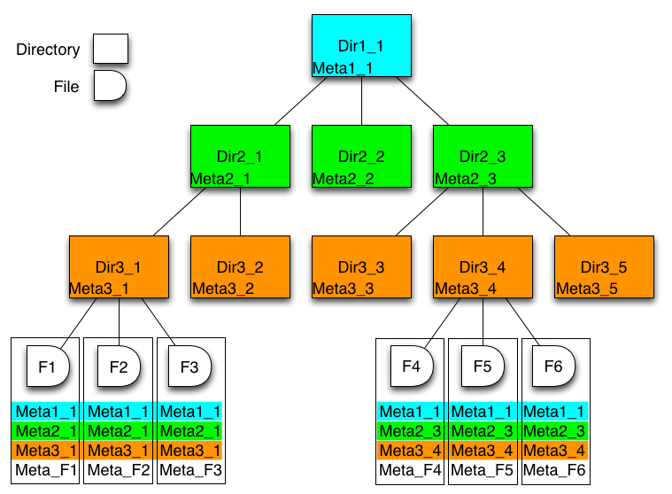
Meta Data
DFC also may host Metadata
User defined metadata
The same hierarchy for metadata as for the logical name space
Metadata associated with files and directories
Allow for efficient searches
Efficient Storage Usage reports
find /mpd/model LastAccess < 01-10-2020 coll=AuAu PWG=pwg3 ECM=11.5 mplabel=10 Name=*.mcDst.root

Slide 7
Dirac file catalog

Slide 8
DIRAC standard job workflow
1. Initial configuration
2. Input data download
3. Processing
4. Output data upload
5.Finalization

Slide 9
Task example
#!/bin/sh
./dirac-set-app-status “Ini"
export XrdSecGSISRVNAMES=eos.jinr.ru
dirac-dms-get-file /mpd.nica.jinr/vo/mpd/sim/inputfiles_BiBi-9GeV-mp07-20-pwg3/runMC.C
dirac-dms-get-file /mpd.nica.jinr/vo/mpd/sim/inputfiles/dirac-set-app-status
chmod +x dirac-set-app-status
dirac-dms-get-file /mpd.nica.jinr/vo/mpd/sim/inputfiles_BiBi-9GeV-mp07-20-pwg3/reco.C
dirac-dms-get-file /mpd.nica.jinr/vo/mpd/sim/inputfiles_BiBi-9GeV-mp07-20-pwg3/BiBi_ecm9GeV_EoS_Hg_0-14fm_1000ev_9849.mcDst.root
./dirac-set-app-status "Processing-Step1“
. /cvmfs/nica.jinr.ru/sl6/mpdroot/dev/mpdroot_config.sh
root -l -q -b runMC.C\(\"BiBi_ecm9GeV_EoS_Hg_0-14fm_1000ev_9849.mcDst.root\",\"urqmd-BiBi-09.0GeV-0-14fm-eos0-250-9849-0.dst.root\",0,250,kFALSE,0\)
./dirac-set-app-status "Processing-Step2"
root -l -q -b reco.C\(\"urqmd-BiBi-09.0GeV-0-14fm-eos0-250-9849-0.dst.root\",\"urqmd-BiBi-09.0GeV-0-14fm-eos0-250-9849-0.reco.root\",0,250,\"local\"\)
./dirac-set-app-status "OutputDataUpload"
dirac-dms-add-file -f /mpd.nica.jinr/vo/mpd/data/exp/dst-BiBi-09GeV-mp07-20-pwg3-250ev/BiBi/09.0GeV-0-14fm/UrQMD/BiBi-09GeV-mp07-20-pwg3-250ev-4/urqmd-BiBi-09.0GeV-0-14fm-eos0-250-9849-0.reco.root urqmd-BiBi-09.0GeV-0-14fm-eos0-250-9849-0.reco.root JINR-EOS-MPD
./dirac-set-app-status "Finalization"
rm -rf *.*

Slide 10
Run scripts
#!/usr/bin/env python
import sys
from DIRAC import exit as DIRACExit
from DIRAC.Core.Base import Script
Script.parseCommandLine(ignoreErrors=False)
from DIRAC.Interfaces.API.Job import Job
from DIRAC.Interfaces.API.Dirac import Dirac
SITE = 'DIRAC.GOVORUN.ru'
dirac = Dirac()
import os
directory = '.'
files = os.listdir(directory)
scripts = filter(lambda x: x.endswith('.sh'), files)
for script in scripts:
J = Job()
J.setExecutable(script, arguments="")
J.setDestination(SITE)
J.setTag( ['high_ram'] )
result = dirac.submitJob(J)
DIRACExit(1)

Slide 11
Dirac job monitor

Slide 12
/cvmfs usage
git tag -a mp10 9fceb02 -m “Mass Production 10“
/cvmfs/nica.jinr.ru/sl6/mpdroot
/cvmfs/nica.jinr.ru/centos/mpdroot
/cvmfs is not yet available on NIСA and UNAM clusters.

Slide 13
Mass production storages:
Main storage, integrated in Dirac File Catalog, size 250 TB
/eos/eos.jinr.ru/nica/mpd/dirac/mpd.nica.jinr/vo/mpd/data/
LHEP mirror, will be integrated in Dirac File Catalog, size 150 TB
/eos/nica/mpd/sim/data/
Data produced not from Mass production requests
/zfs/store6.hydra.local/mpddata/data/ , size 85 TB
/eos/hybrilit.jinr.ru/nica/ , size 100 TB
dCache(LIT type robot), tested
WebUI: http://mpdroot.jinr.ru -> SOFTWARE -> DataBases -> MPD DataBase

Slide 14
Mass production DataBase(1)

Slide 15
Mass production DataBase(2)

Slide 16
Mass production DataBase(3)

Slide 17
MPD mass production 2020 summary :
Generator | PWG | Coll. | $$\sqrt{s}$$ | # of events(${10}^{6}$) | Reco
UrQMD | PWG4 | AuAu | 11 | 15 | +
 |  | BiBi | 9 | 10 | +
 |  |  | 9.46 | 10 | +
 | PWG2 | AuAu | 11 | 10 | +
 | PWG3 | AuAu | 7.7 | 10 | +
 |  | BiBi | 7.7 | 10 | +
 |  |  | 9 | 10 | +
PHQMD | PWG2 | BiBi | 8.8 | 15 | +
vHLLE-UrQMD | PWG3 | BiBi | 11.5 | 15 | +
 |  | AuAu | 11.5 | 15 | +
Smash | PWG1 | BiBi | 9.46 | 10 | +
 |  | ArAr | 4/7/9/11 | 20/20/20/20 | -
 |  | AuAu | 4/7/9/11 | 20/20/20/20 | -
 |  | XeXe | 4/7/9/11 | 20/20/20/20 | -
 |  | CC | 4/7/9/11 | 20/20/20/20 | -
 |  | pp | 4/7/9/11 | 50/50/50/50 | -
Total |  |  |  | 650 | 130

Slide 18
Conclusion
10 mass productions request were done.
610M events generated + 40M taken from P. Batyuk.
130M events reconstructed
~132TB data written to EOS disks(all registered in DIRAC FileCatalog)
UNAM Cluster: 1000 jobs completed as experiment. Network is week point.
Tapes over dCache tested. Mostly needed for RAW data from detector.
Using multiple clusters allows us to choose the optimal cluster structure.

Slide 19
Recommendations for using the NICA cluster
Do not use /weekly for long-term storage of files - quickly transfer them to EOS!
Do not copy file from /weekly to /eos, use /tmp or /toEos on ncx104, /weekly->/toEos->/eos more than 10 times faster then /weekly->/eos
Run Your jobs from /tmp, and use /tmp as data output for small file (size of /tmp ~220 GB) as data output for big files please use /weekly
Don’t forget clean working folders in /tmp and /weekly after using
http://mpdroot.jinr.ru/howto-work-with-nica-cluster/

Slide 20
Plans:
Make an application on the Dirac portal for launching productions by users.
A version of the web application based on the Dirac console client has been developed, but is not suitable for security reasons.

Slide 21
Thanks for:
Schinov B.
Dolbilov A.
Podgainy D.
Zuev M.
Belyakov D.
Mitsyn V.
Balashov N.
Kutovsky N.
Luciano Diaz

Slide 22
Thanks for attention
31

