Slide 1






VI-th Collaboration Meeting of the MPD Experiment at the NICA Facility
October 28-30, 2020
ECal Module Production in China
Chendi Shen
Department of Engineering Physics, Tsinghua University

Slide 2
Contents
1
  Mass Production Plan
2
  Module Production in THU
3
  Beam Test and Calibration
4
  Summary

Slide 3
Contents
1
  Mass Production Plan
2
  Module Production in THU
3
  Beam Test and Calibration
4
  Summary

Slide 4
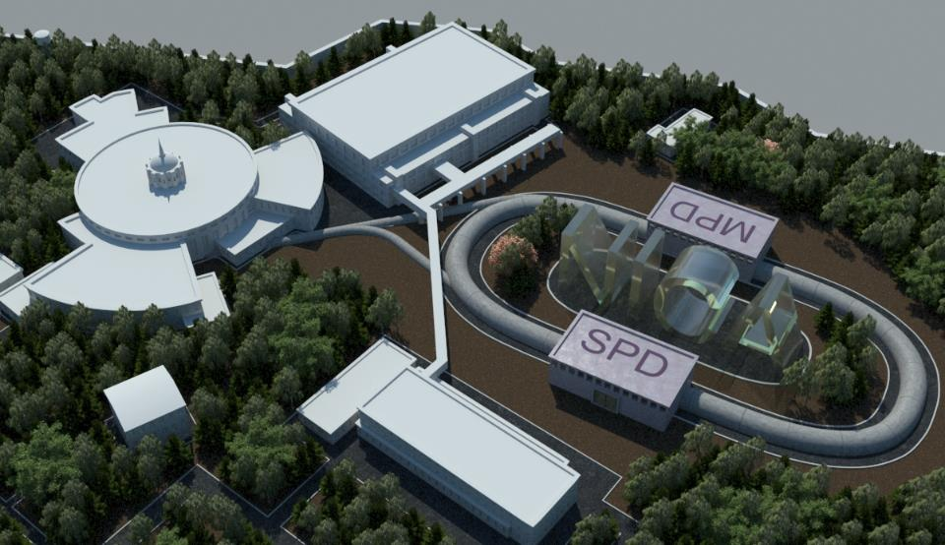
1
  NICA/MPD
KRION-6T+HILac (3MeV/u)
Accelertor complex LHEP
PS and
LU-20 (5MeV/u)
Experiments
with fixed targets
bld. 205
existing
BM@N
In preparation
SPD
Transfer lines
Collider NICA
(√s_{NN} = 4-11 GeV, C=503 m)
Booster
(600 MeV/u)
NUCLOTRON 0.6-4.5 GeV/u
MPD
MultiPurpose
Detector - MPD
The Multi Purpose Detector (MPD) is one of the detectors at NICA collider, which is optimized for the study on properties of hot and dense matter in heavy-ion collisions and, in particular, the search for a manifestation of possible deconfinement and/or chiral symmetry restoration phase transitions, critical end-point and mixed quark-hadron phase.

Slide 5
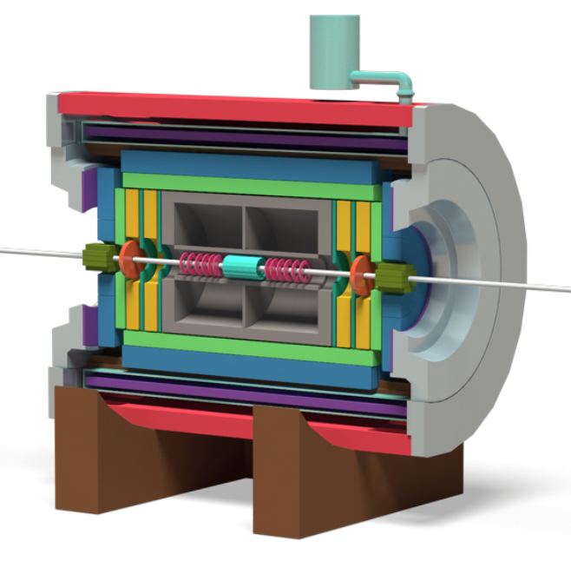
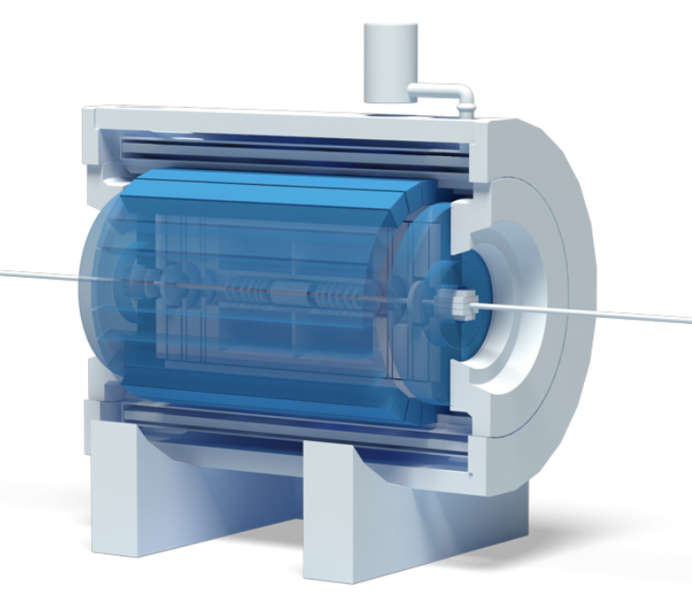
1
  NICA/MPD
MPD: Multi-Purpose Detector
4π spectrometer capable
Total charged particle multiplicity : 1000+
Beams from р to Au
L : 10²⁷ (Au), 10³² (р)[см⁻²с⁻¹]
√ S_{NN} : 4-11 GeV
High Luminosity : 6 kHz
Central Detector
ECal
Notes:
左图为mpd中心探测器的完整结构，有图蓝色部分为电磁量能器，mpd探测器的具体性能特点列举如下。

Slide 6
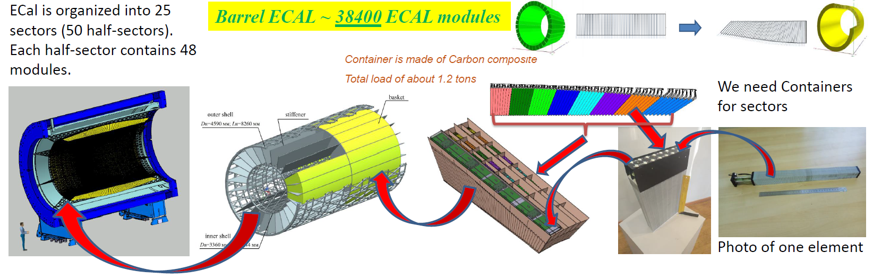
1
  MPD ECal Production
Barrel ECal ~ 38400 ECal towers
1 half-sector
1 module
1 tower

Slide 7
1
  China MOST MPD ECal project
Hardware:
1) Construction of 8 sectors ECal prototype. Energy resolution is 5%/√E, spatial resolution is 5mm
2) Production of FEE PCB
3) R&D on fast readout electronics, time resolution is less than 150ps
Software and simulation
Budget: 4.8M USD
Schedule: 2020.6-2024.5
Institutes: Tsinghua University, Shandong University, Fudan University, University of South China, Huzhou University

Slide 8

1
  Production in China
Tsinghua University (60%)
Shandong University (20%)
Beijing
Qingdao
Fudan University (10%)
Shanghai
Hengyang
University of South China (10%)

Slide 9
1
  Production in China
In the first stage (2020-2022), 8 sectors will be produced in China
8 sectors=16 half sectors=768 modules=12288 towers
1
2
3
4
5
6
7
8
Modules produced in each institutes
 | 1 | 2 | 3 | 4 | 5 | 6 | 7 | 8 | Total
THU |  |  |  | 76 | 96 | 96 | 96 | 96 | 460
SDU |  | 38 | 96 | 20 |  |  |  |  | 154
FDU | 19 | 58 |  |  |  |  |  |  | 77
USC | 77 |  |  |  |  |  |  |  | 77

Slide 10
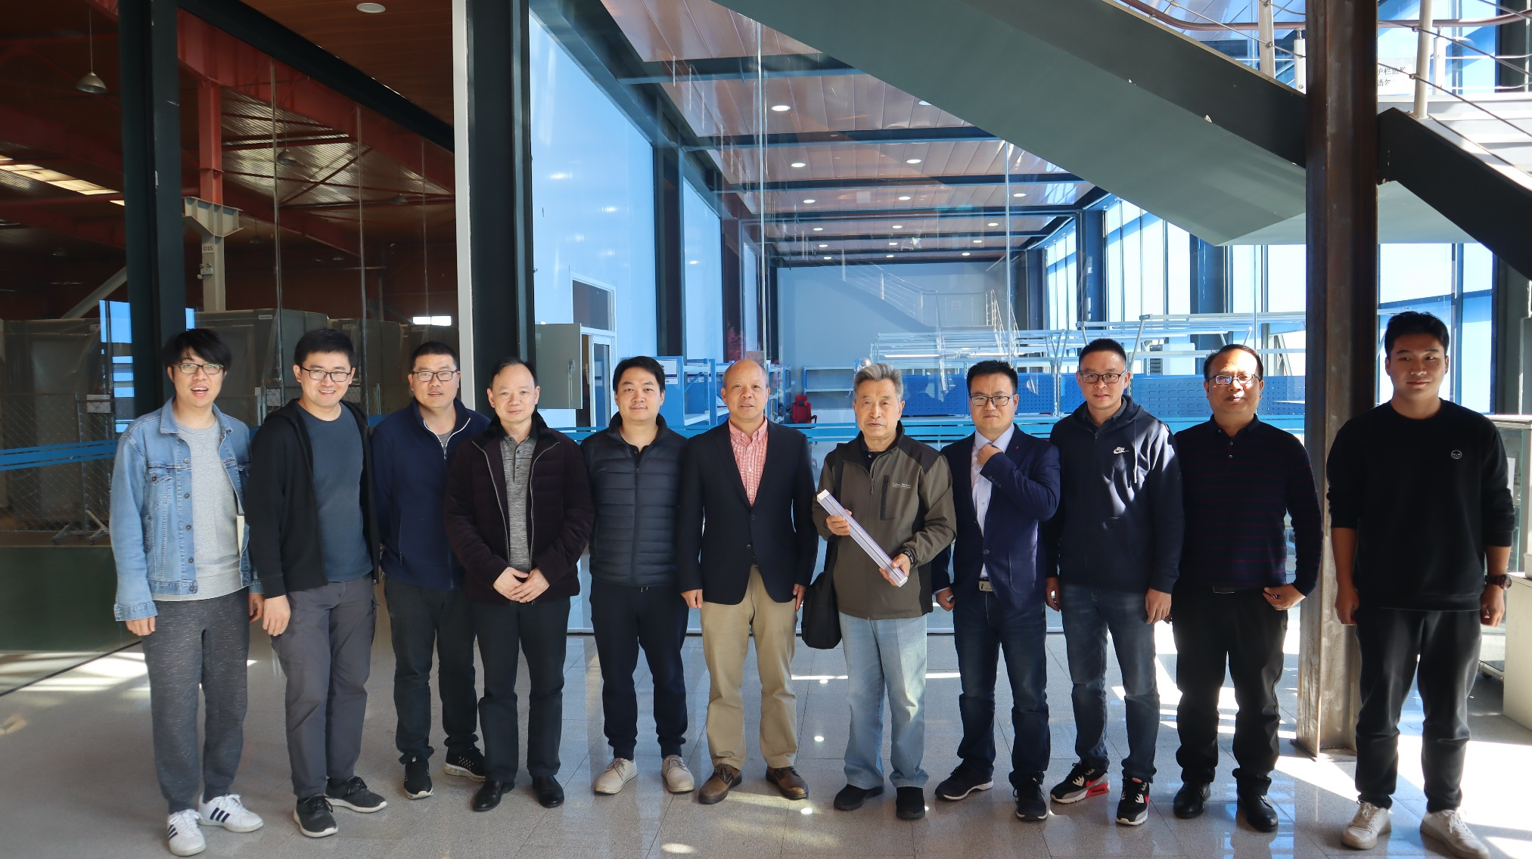
1
  Production in China
same material
same standard
same procedure
same QA and QC
Four institutions have discussed and unified the process flow of ECal module production

Slide 11
 | 2020.10 | 2020.11 | 2020.12 | 2021.01 | 2021.02 | 2021.03
Lead painting
Steel wire & nut production
Aluminum plate production
Tooling production
WLSF purchase
CNC purchase
Scintillator and plastic shipment
Tower assembly
Tower pressurization
Tower milling
Tower gluing
Half-module milling
Module gluing
WLSF milling & painting
WLSF insertion & gluing
Module wrapping
Module test

Slide 12
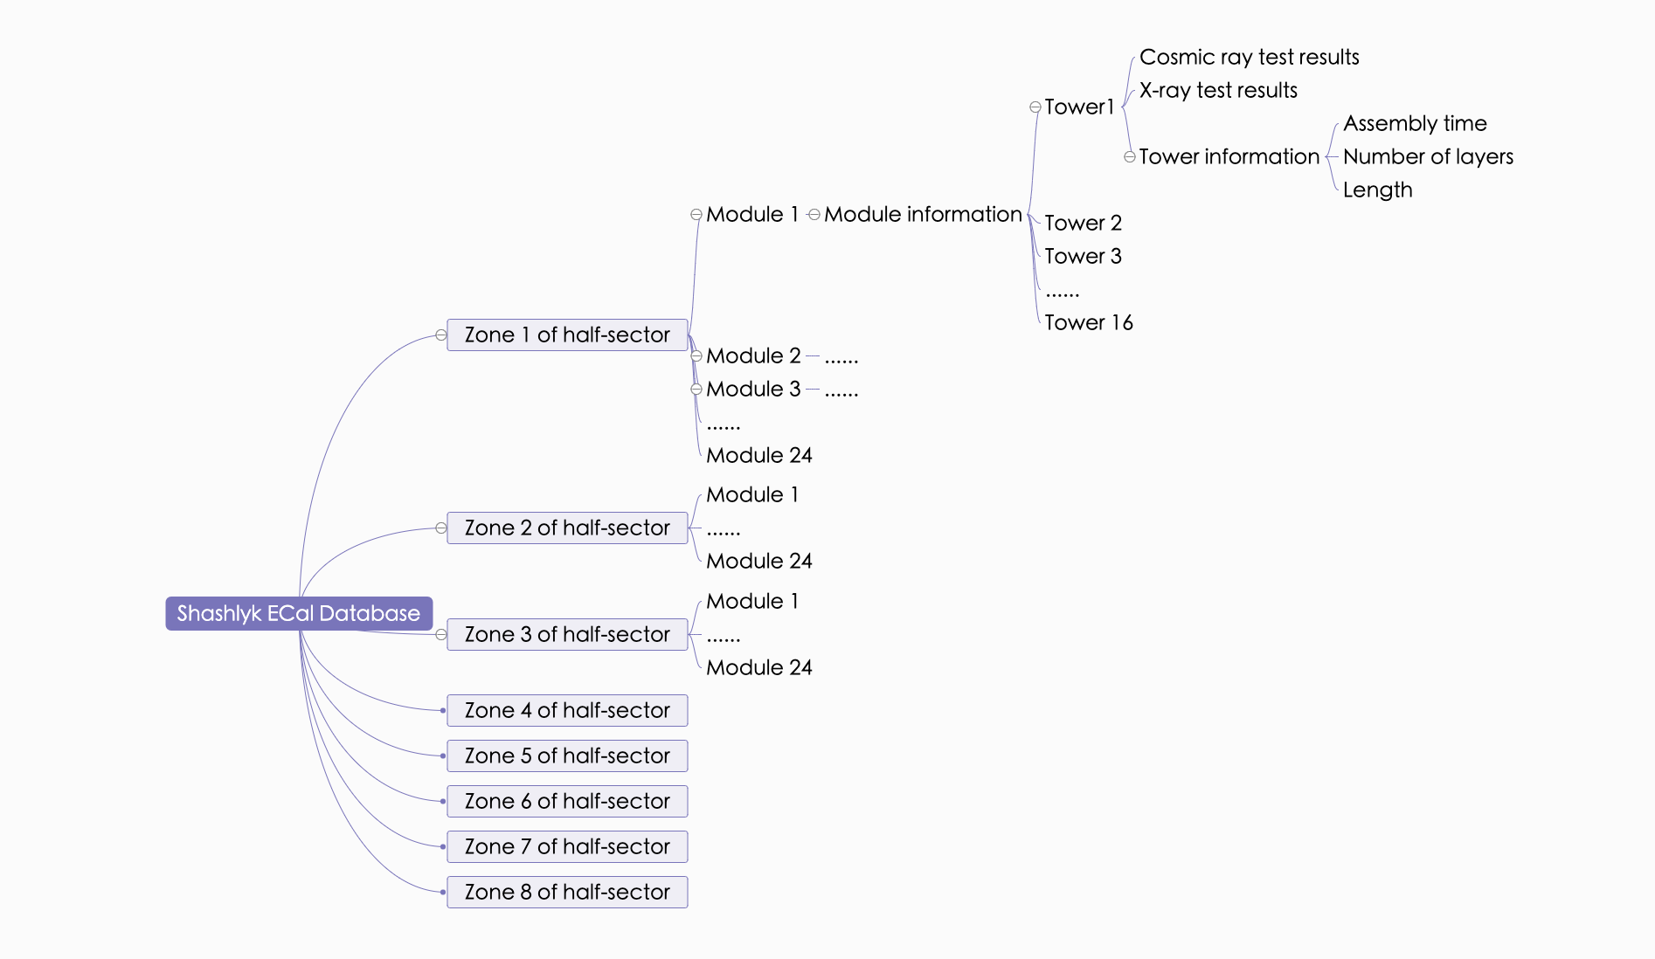


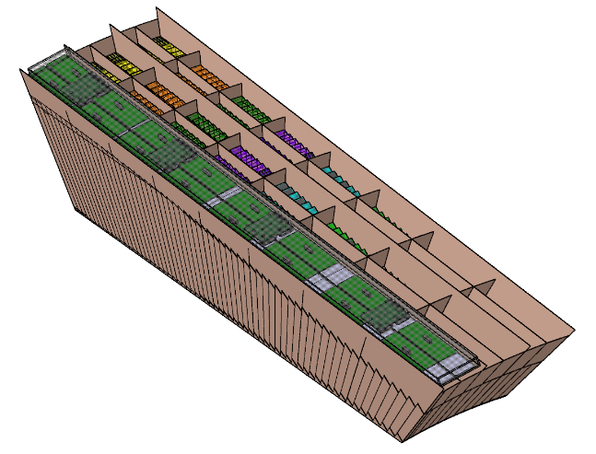

Storage allocation of ECal data
1
  Database
A notebook
QR Code
Notes:
The data backup will be stored on our Tsinghua University server, the first is the total folder
Its subdirectories are sectors of eight different regions
Next are modules of the same model and different numbers. Our plan is to make 24 modules in each region by March.

Slide 13
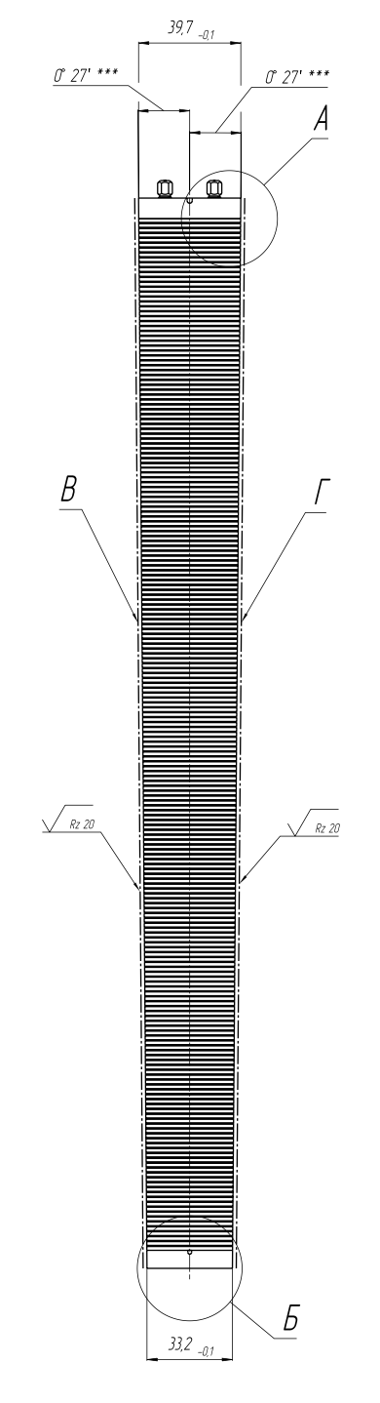
Tower Information ——Four parameters
1
  Database
？Assembly time
？
？
？Length
？Number of layers
Cosmic ray test results | Waveform / Wave data / Peak / Integral
X-ray test results | Waveform / Wave data / Peak / Integral
Notes:
3.Since the cosmic ray test takes too long, we will randomly sample for testing. But we will test each tower in the X-ray test.

Slide 14
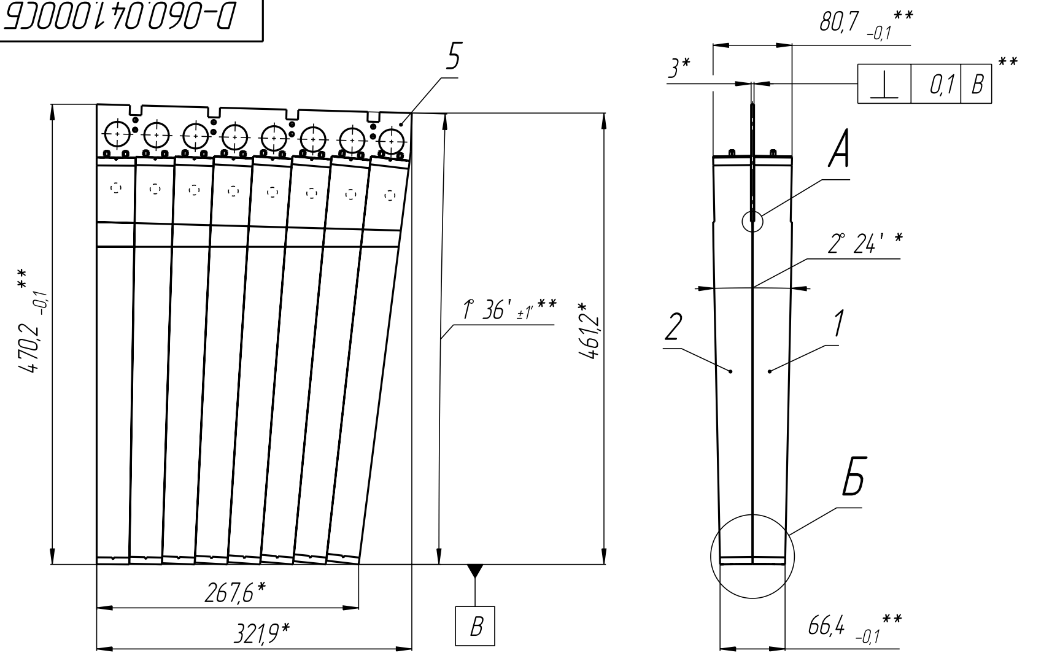
Module Information ——Seven parameters
1
  Database
？Assembly time
？
？
？
？
？
？
Cosmic ray test results | Waveform / Wave data / Peak / Integral
X-ray test results | Waveform / Wave data / Peak / Integral
Notes:
2.The length of the four edges, the thickness of the top and bottom, and the assembly time.
We want to add the X-ray test results, but regarding whether X-ray can play a role in quality inspection, we are now conducting relevant experiments.

Slide 15
Contents
1
  Mass Production Plan
2
  Module Production in THU
3
  Beam Test and Calibration
4
  Summary

Slide 16
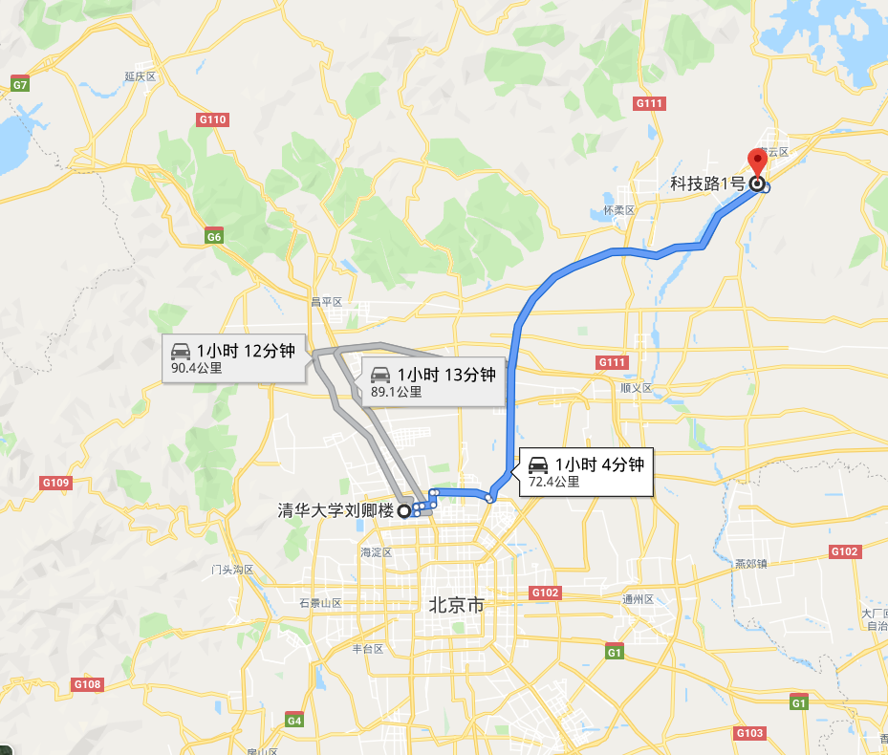
2
  Production Site (THU)
NUCTECH
NUCTECH Company
The company is ~80km away from Tsinghua University. This is very convenient for testing and transportation of modules
THU

Slide 17
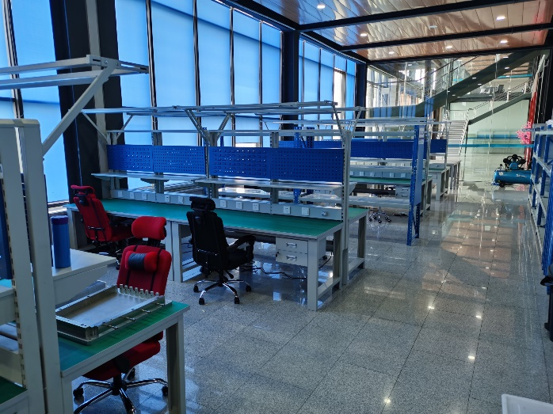
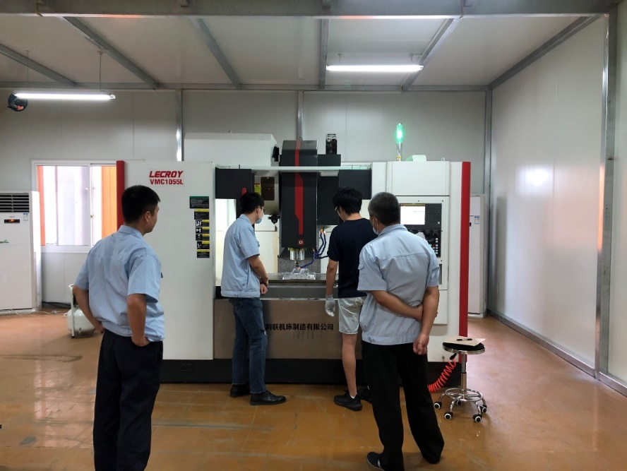
2
  Production Site
Assembling area
(two floors)
400m² in total
Gate
Cutting area
(3 milling machine or more)
Gate
Notes:
The lower left corner is the model diagram of the NICA，MPD

Slide 18
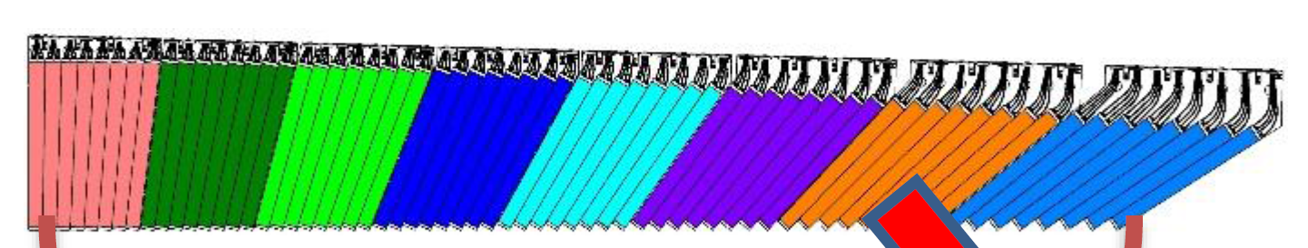
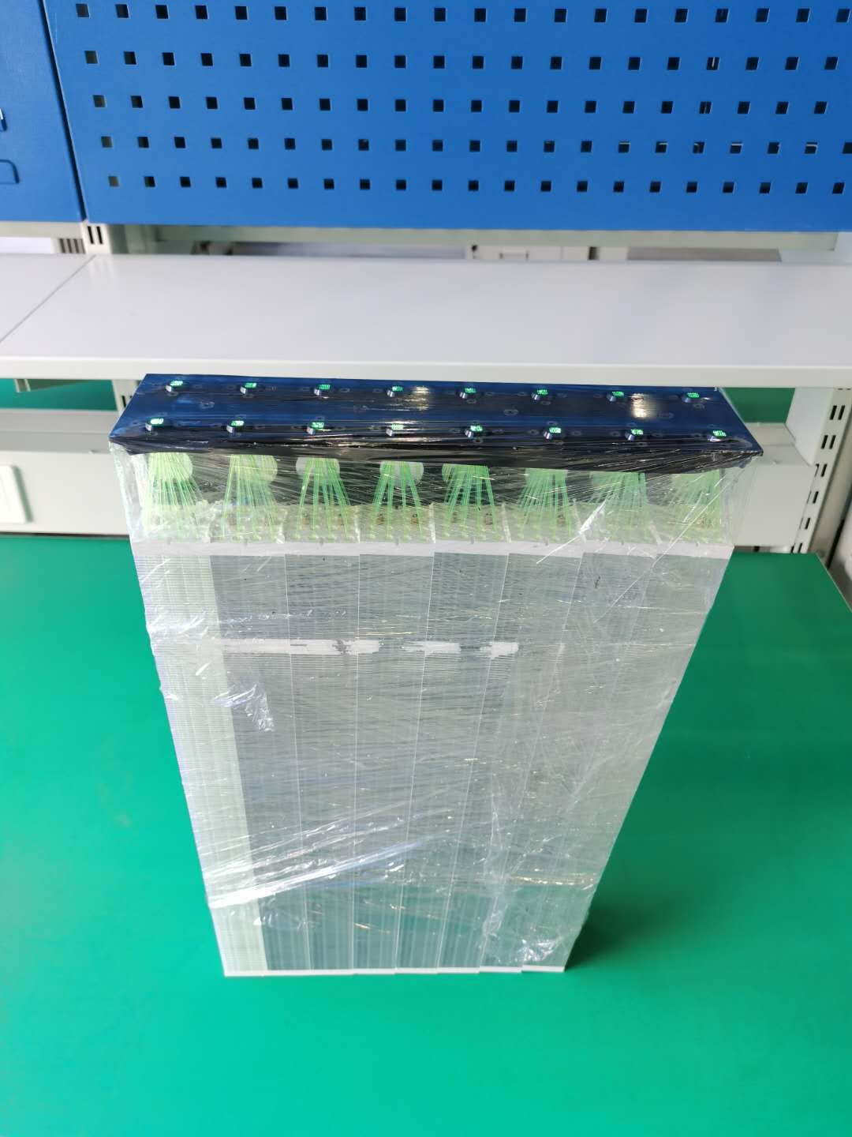
2
  Module Production in THU
Up to now, two modules have been produced in THU, the angle of which is the smallest.
After measurement, the size of the module has met the design requirements. This means that THU has fully mastered the process flow of Module production.
Next, the performance of the two prototypes will be tested after getting the electronics.
Produced in 2020

Slide 19
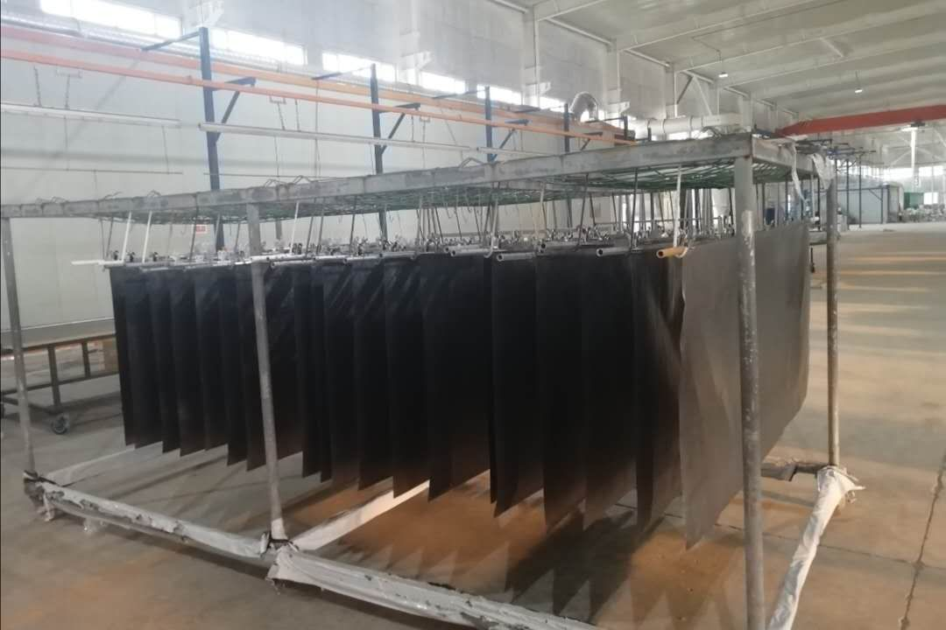
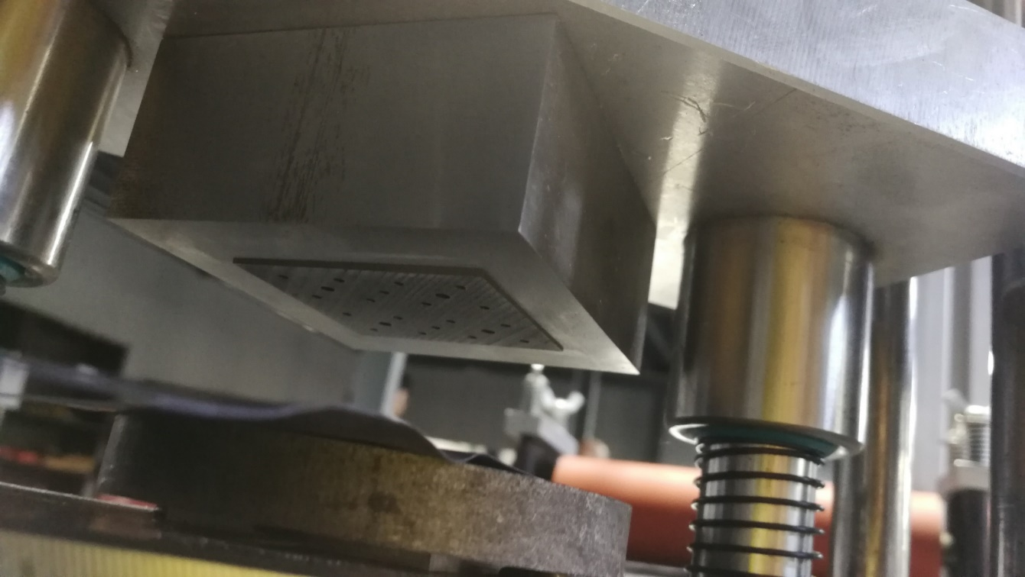
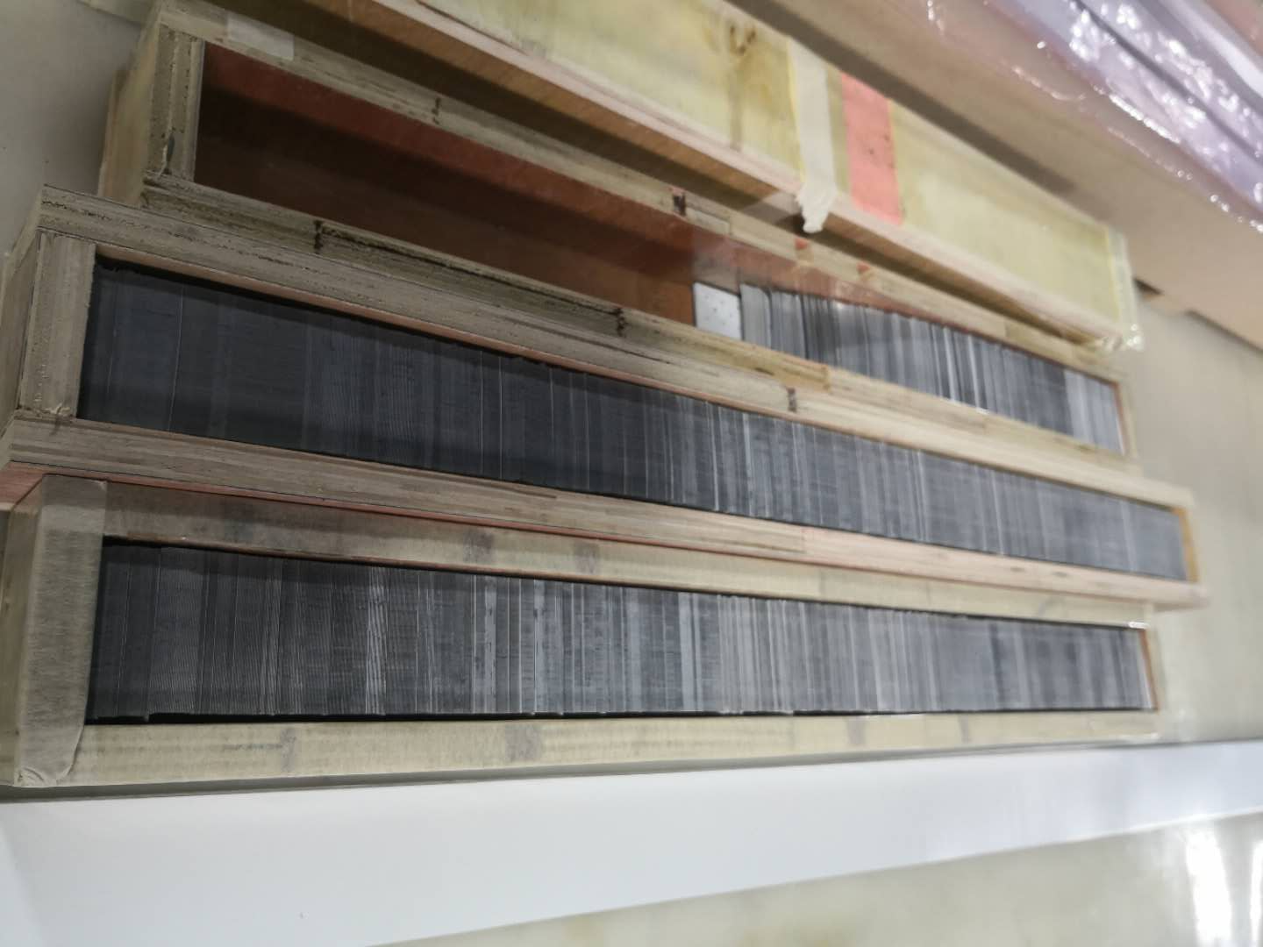
2
  Lead painting & cutting
Step1. Powder painting on the whole lead (large area).
Step2. Cutting lead into a circle with a width of 5cm.
Step3. Punching with automatic machine.
Thickness uniformity is very good by this method.
Notes:
1.Assembling a tower by using 220 alternating layers of lead and scintillator plates in the mold, pulled together with one loops of a steel string. Strings are ﬁxed by the two tension screws.
2.Sixteen towers are pressed with a special machine.
3.Sixteen towers are cut at a small angle and bonded into one module with two rows (each row consists of 8 towers).
4.The end of ﬁbers are glued in bunches and connected with SiPM separately.
5. Cut and polished the ﬁbers, connecting the PCB plate with SiPM detector and wrapped with shading paper

Slide 20
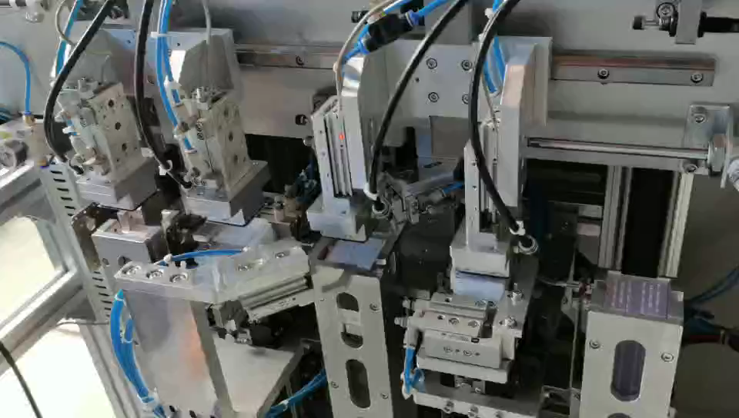
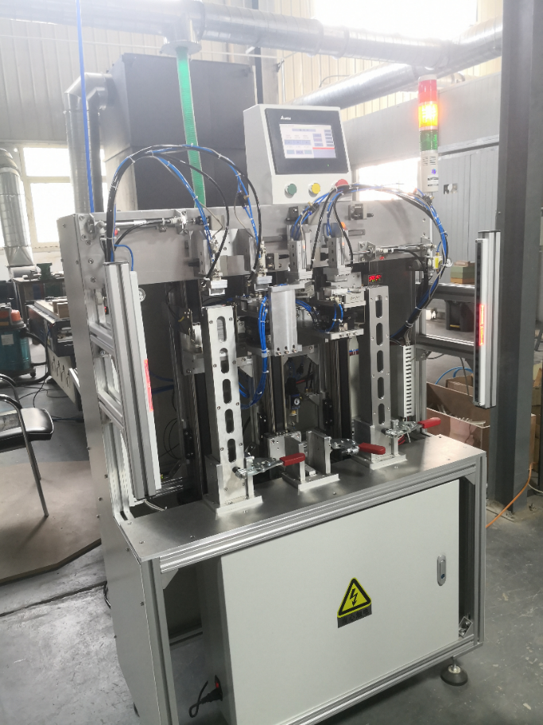
2
  Automatic tower assembly
Assemble a tower in 20 min.
Fully automatic.
Completed the assembly of 32 towers within 2 days
MPD-ECal tower automatic assembly robot

Slide 21
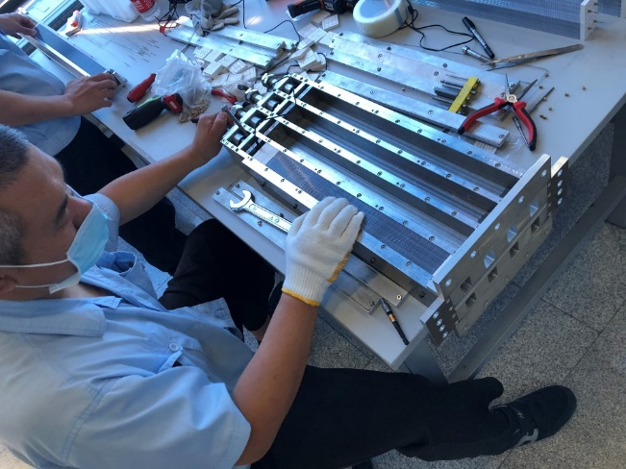
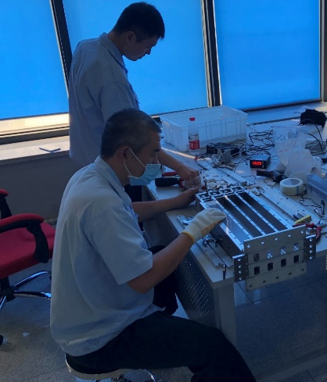
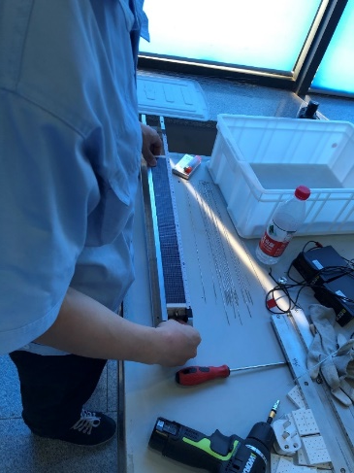
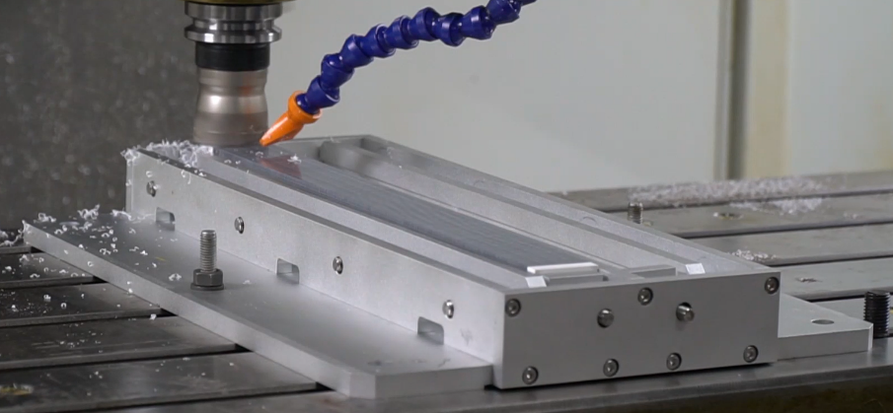
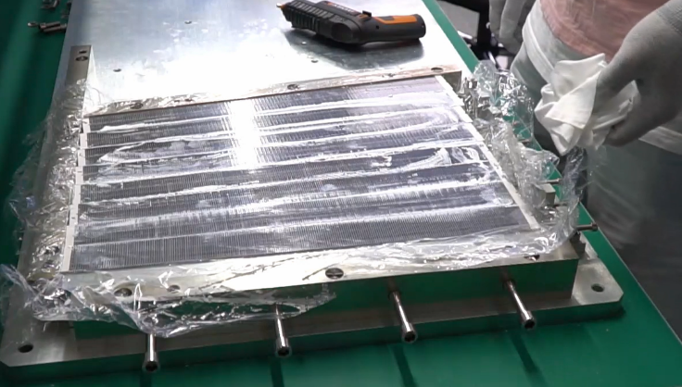
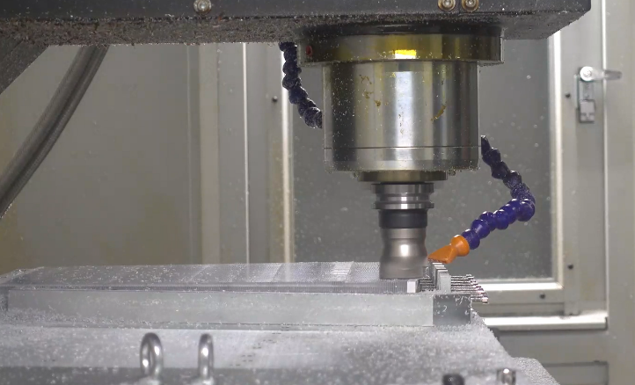
2
  process flow of module production (1)
Photo taken in 2020
Pre-pressure
Adjust length
Pressure transmission
Tower milling
Half-module gluing
Half-module milling

Slide 22
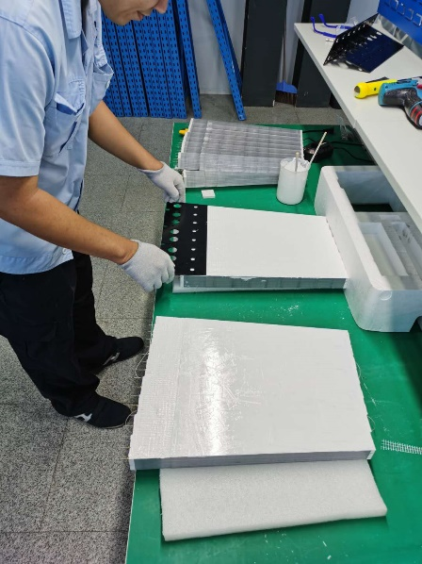
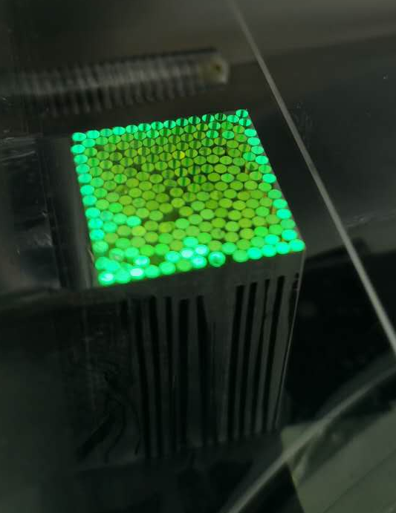
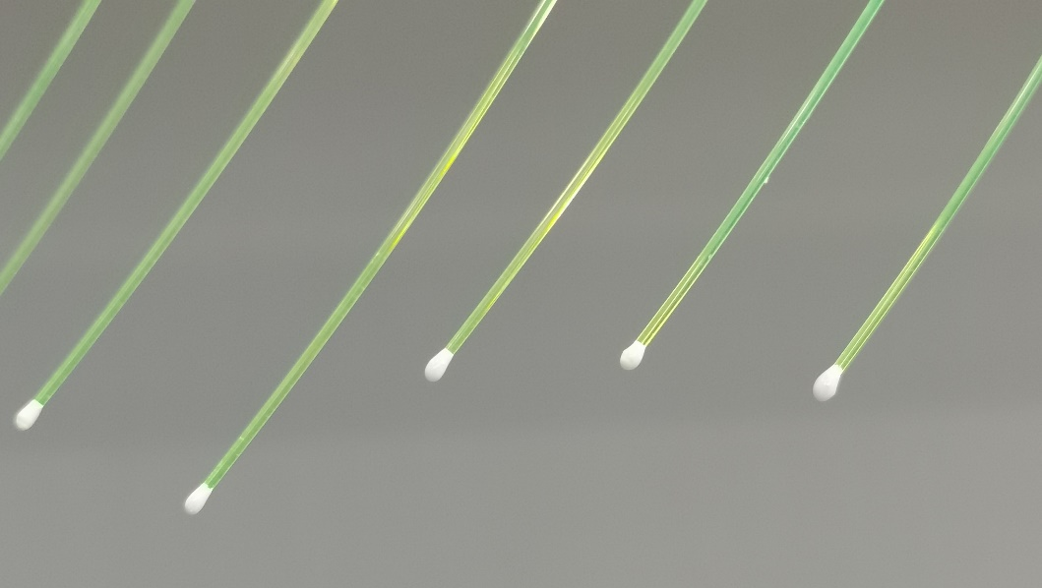
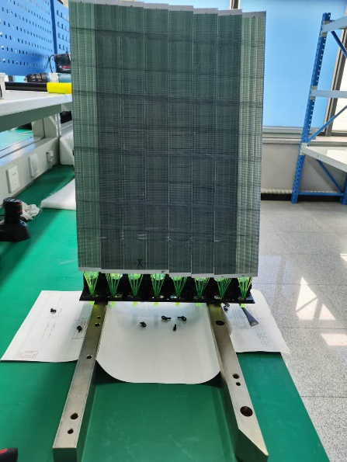
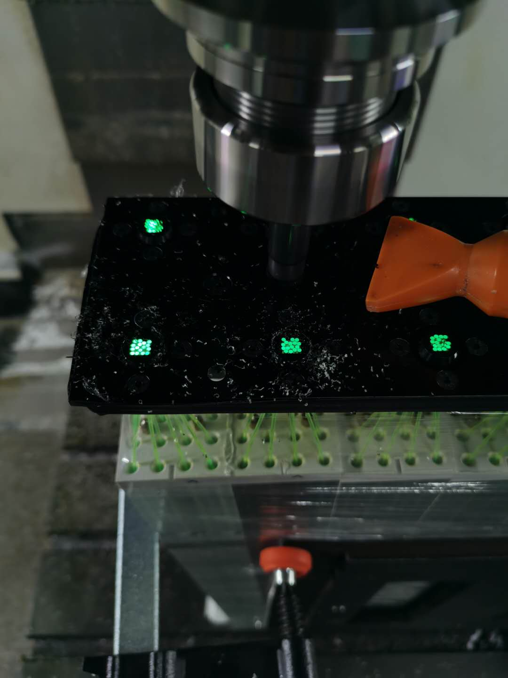
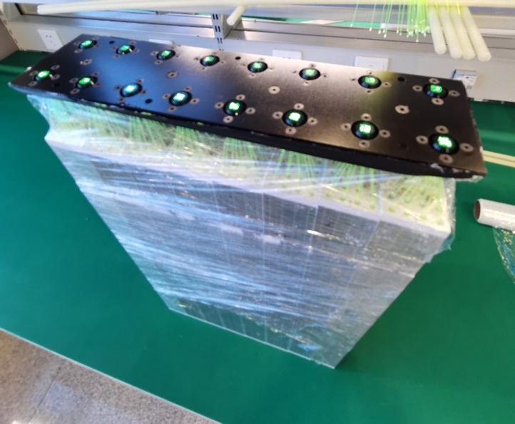
2
  process flow of module production (2)
Photo taken in 2020
Module gluing
WLSF cutting (A bundle)
WLSF painting
Fiber insertion & gluing
WLSF milling (diamond cutter)
finished

Slide 23
Contents
1
  Mass Production Plan
2
  Module Production in THU
3
  Beam Test and Calibration
4
  Summary

Slide 24
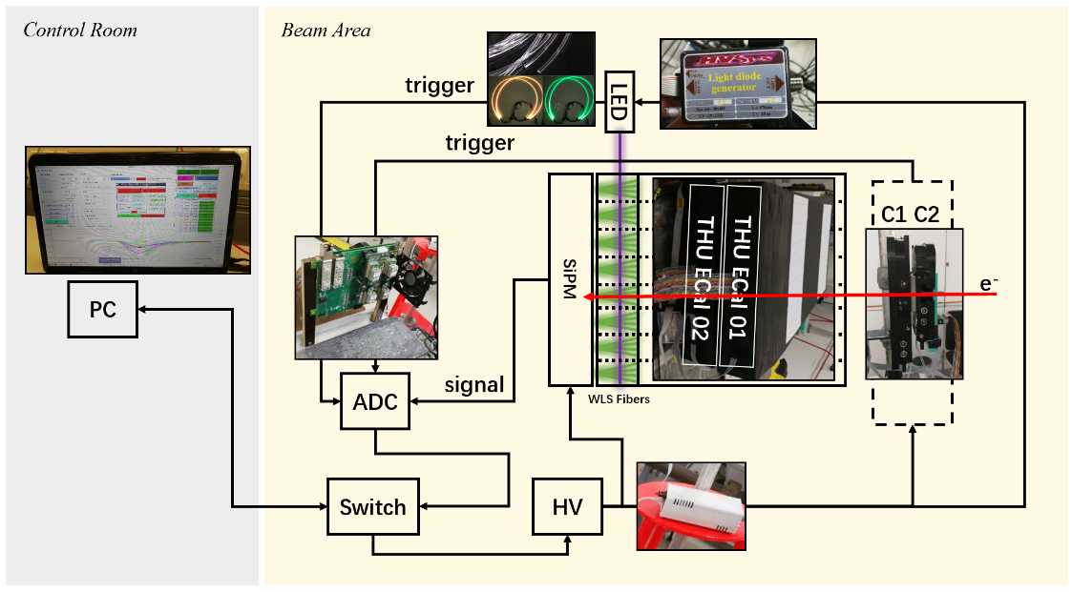
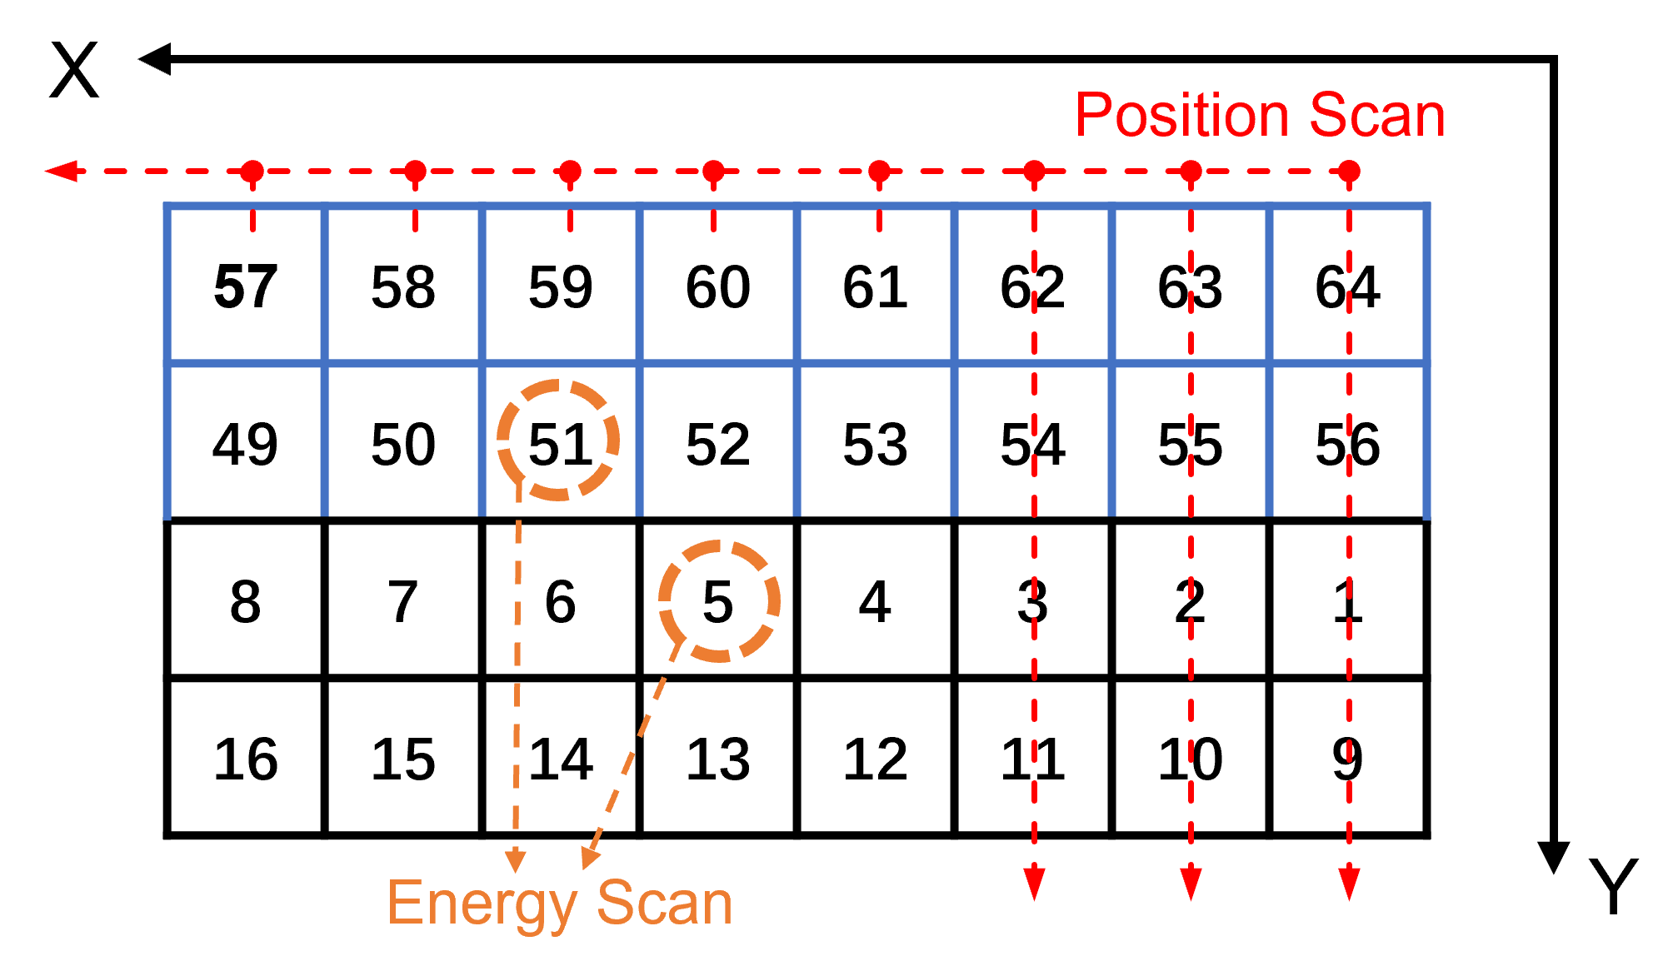
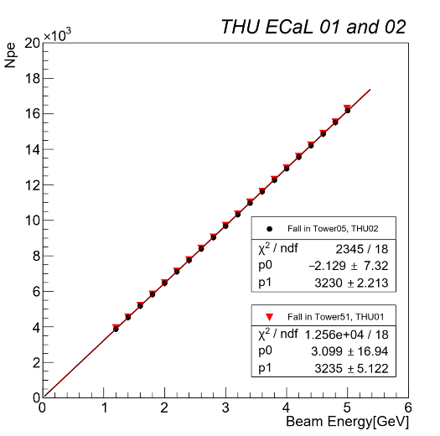
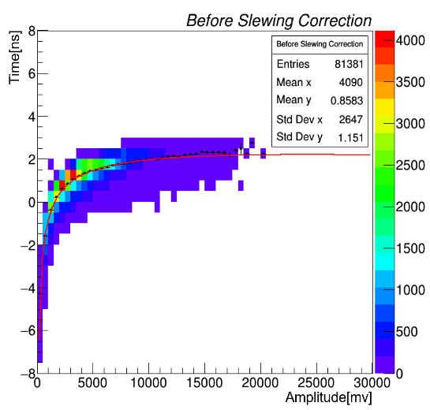
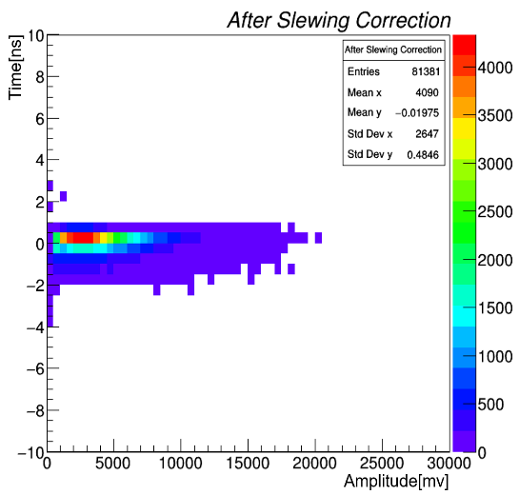
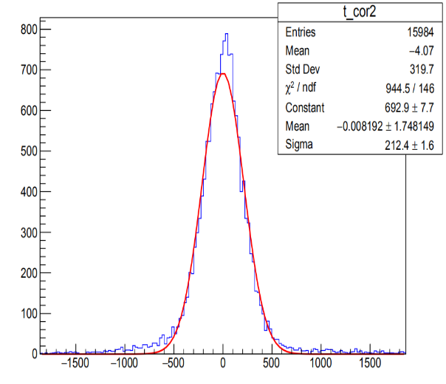
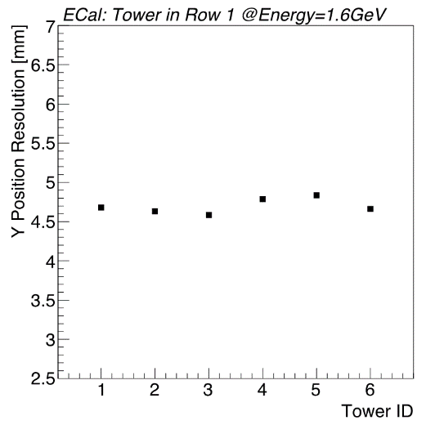
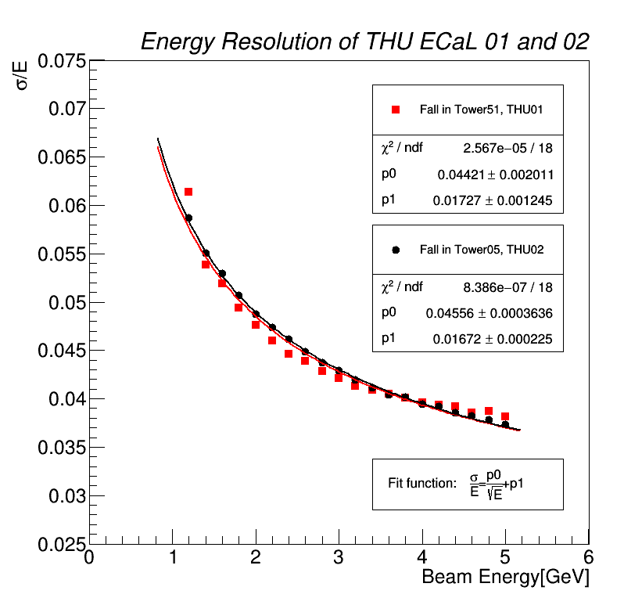
DESY, Electron beams.
3
  Beam test
Beam test set up
Position & Energy scanning
Energy linearity
Time
Time resolution
Spatial resolution
Energy resolution
Notes:
On August 2018, two prototype modules of the ECal, each consisting of 16 towers, were taken to the DESY for beam test in Hamburg, Germany. The two prototypes modules named THU ECal 01 and 02 were installed on the x, y-moving table.
The experimental set up of this beam time，The two ECal prototype positioned in the x, y-moving table which can be remotely controlled in control room with a precision of 0.4 mm. One of a trigger of the experimental setup used the coincidence of 2 scintillator counters – C one, C two. The other used the LED and illuminating fiber as a monitoring system to monitor the stability of the entire test. Amplitude information obtained by SiPM conversion of light was measured by 32-bit charge sensitive ADC modules 076D-3170 over 16ns gate. The high voltage system which controlled by the switch provided high voltage for the different plug-ins of the entire experiment. The final data is collected on the computer through the switch.
Each tower of the prototype was defined with a number(1-16, 49-64).
Eight columns were scanned along the x-axis direction, and each position was scanned every 5 mm for a total of 264 position points, each time at the center of each column, for the purpose of correction.
.
Lateral energy scanning, longitudinal energy scanning of energy from 1.0 to 5.0 GeV for tower 51 and tower 05 and step Length: 0.2 GeV
time information scanning were performed.
We use the time scan results of dubna. After the slewing correction of this function, we can see that the relationship of time & amplitude becomes irrelevant.
The final time resolution. 212ps, less than the required 1ns.
The spatial resolution is around 4.7 mm @1.6GeV by using Center of Gravity (COG) algorithm
The energy resolution of the two is finally obtained, one is 4% and the other is 4.5%, all of them Less than the required 5%

Slide 25
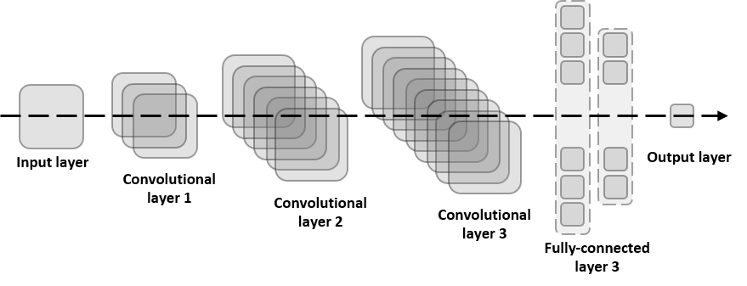
Convolutional Neural Network
3
  Beam test
Neural network and machine learning are powerful tools for solving non-linear problems.
In 1998, CMS ECal has tried the fully-connected neural networks. Results are similar to the COG(Center of Gravity algorithm).
A more general and powerful convolutional neural network(CNN) was designed, train and validate the network with recently developed hardware and technologies.
Energy resolution is obtained after with CNN.
Convolutional
neural network
(CNN):
Notes:
We also implement a new reconstruction method based on the neural network and machine learning. The neural network and machine learning are powerful tools for solving non-linear problems in all kinds of the field. As early as 1998, CMS has tried to apply fully-connected neural networks to the reconstruction algorithm of its ECal., However, due to the simple structure of the network and the difficulty of the training, the performance of this new method is just as good as the traditional charge center of gravity. We designed a more general and powerful convolutional neural network(CNN), train and validate the network with recently developed hardware and technologies.
The performance is indeed better than the center of gravity. This plot shows the structure of the CNN, it consits of an input layer, which is the largest tower and its 8 nearest neighbors, an output layer which is the estimated position, and 3 convolutional layers and fully connected layers. The goal of the CNN layers is to extract the information from the input data and estimate for the output.
CNN works better than the traditional method.

Slide 26
Cut the Energy Spread of accelerator– 5%
3
  Beam test
E_{test}: test value
  The mean of the spectrum
E_{true} : truth value
  Energy spread 5%
P(E_{test}E_{true})>P(E_{test})P(E_{true})
Tower 05: 4.93% < 5%
Tower 51: 4.69% < 5%
@1GeV
Notes:
We define the mean value of the energy distribution obtained by the traditional method as E test, and the 5% energy broadening as E true, and it is a Gaussian distribution that is positively correlated with the energy resolution.
Therefore, in the energy resolution obtained by the traditional method, I deconvolved a Gaussian distribution with a sigma of 5%. After the cut of this step, the subsequent energy resolution is obtained. The energy resolution is 4.93% and 4.69% at 1GeV.

Slide 27
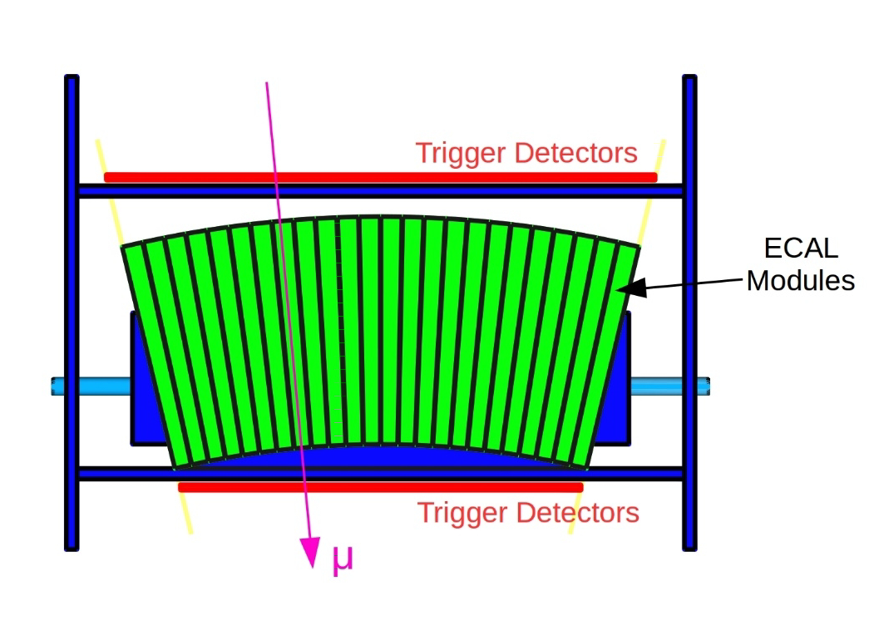
3
  Cosmic ray Calibration
40cm x 40cm
2D readout MRPC
for Tracking
Select examples of cosmic rays that completely pass through the tower
Measure the cosmic spectra
fast test method. This method can calibrate 3 modules at the same time

Slide 28
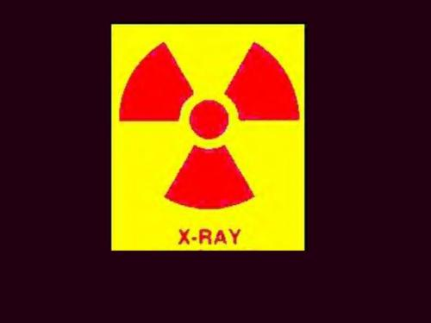
3
  X ray test
Detected the tower with obvious abnormal light output
Voltage of Output signal
X Ray Tower Scan
Tower
Fixed irradiation range
Test speed is very fast, 30s/tower

Slide 29
Contents
1
  Mass Production Plan
2
  Module Production in THU
3
  Beam Test and Calibration
4
  Summary

Slide 30
Summary
Chinese group has completely mastered the production process of MPD-ECal.
THU has produced 2 modules at the end of October 2020.
Preparations for mass production have started, and mass production will officially start in November 2020.
The module test system is under construction.
There are still some issues to be confirmed
  Connection method of electronic board?
  How to fix the module into the basket?

Slide 31
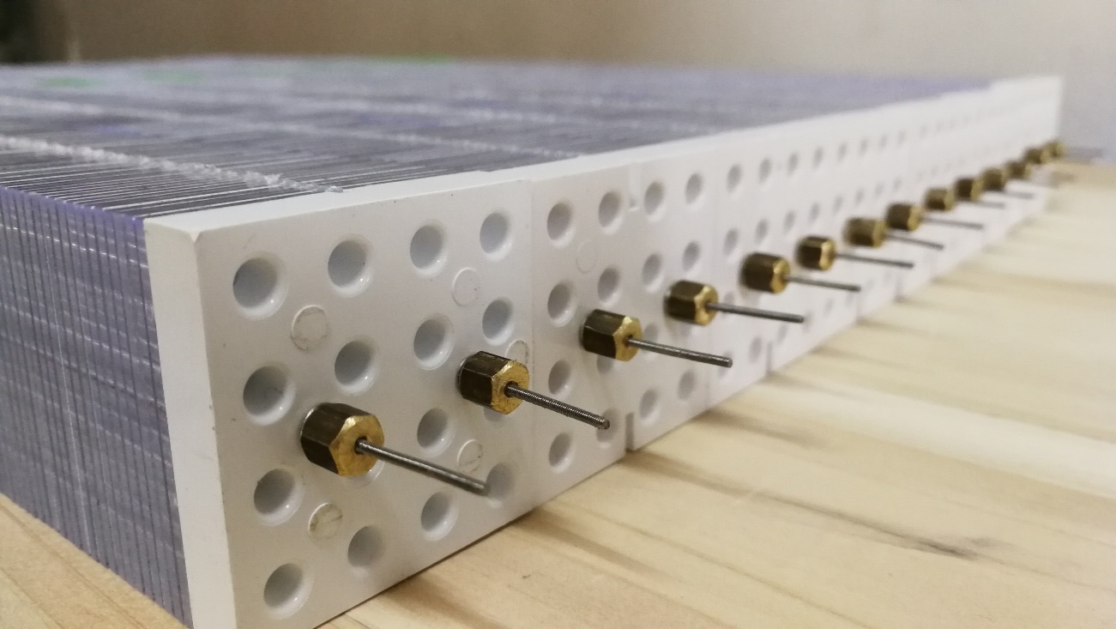
Thanks for your attention
Chendi Shen
Department of Engineering Physics, Tsinghua University

