Slide 1
Approaches in centrality measurements of heavy ion collisions with forward calorimeters at MPD/NICA facility
Volkov Vadim
INR RAS
17/09/2020
PWG1

Slide 2
Overview
Can FHCal measure the centrality with spectators?
FHCal detects not only energies but the space distribution of energies!
A few methods for centrality determination are discussed:
a) Correlations of transverse and longitudinal energy components,
b) 2D-fit of FHCal energy distributions,
c) Subtraction of pion energy contamination and evaluation of spectator’s energy.
Tools:
Simulations in MpdRoot;
Au-Au at ;
Two, LA-QGSM and DCM-SMM fragmentation models are used and compared.

Slide 3
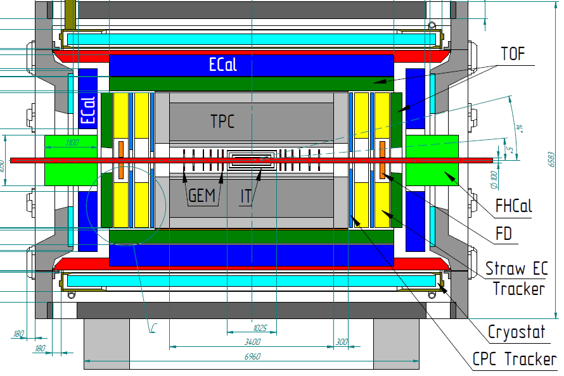
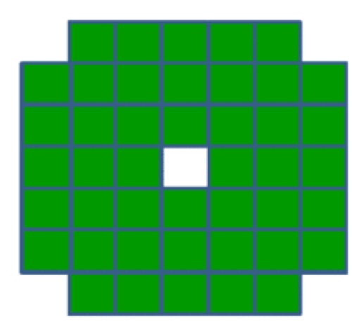
FHCal@MPD
The main purpose of the FHCal is to detect spectators and to provide an experimental measurement of a heavy-ion collision centrality and orientation of its reaction plane.
There is an ambiguity in FHCal energy deposition for central/peripheral events due to the fragments (bound spectators) leak into beam hole.
FHCal measures not only spectator’s but also pion’s energies.
Two upstream/downstream parts
44 individual modules
ambiguity
Non-spectator’s contributions
Beam hole

Slide 4
Energy depositions in FHCal for different models
LA-QGSM
DCM-SMM
Transverse energy distributions are wider for central events and narrower for the peripheral collisions.
Non-spectator’s contributions
Energy depositions are quite different for different fragmentation models.
Results would depend on the fragmentation model.
FHCal detects not only the spectators but also the produced particles and wounded nucleons from participant region.
LA-QGSM
Impact parameter b<= 6
Impact parameter b>6
This feature can be used for the separation of central/peripheral events.

Slide 5
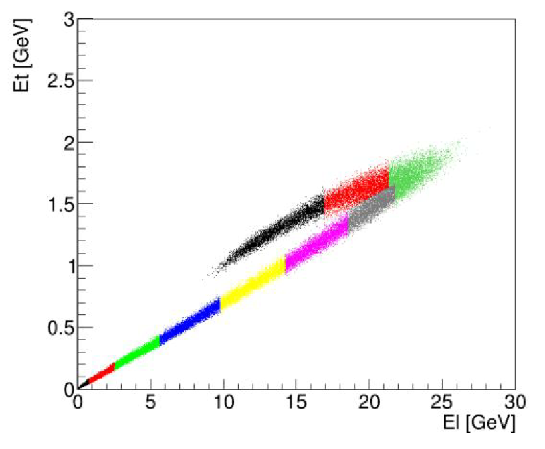
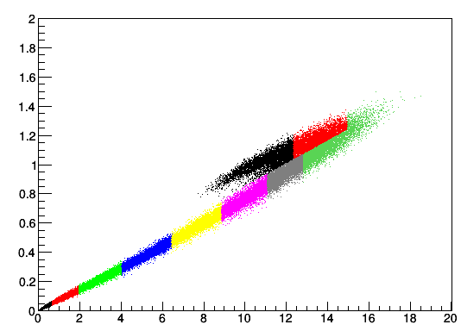
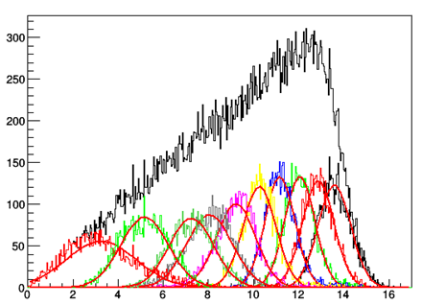
Correlation between transverse and longitudinal energies in FHCal
LA-QGSM and DCM-SMM models for √S = 11 AGeV are used.
The E_{T} and E_{L} energies are transverse and longitudinal energies: respectively.
The (E_{T} -E_{L} ) histograms are divided into ten parts, 10% of events in each part, 10%-clusters are separated from one another by perpendiculars to the envelope.
b-distributions for each centrality bin are fitted by Gauss.
The separation of central and peripheral events with DCM-SMM model is clearly worse.
LA-QGSM
DCM-SMM
central events
central events
peripheral events
peripheral events
Each color bin is 10% fractions of the total number of events.
Each color bin is 10% fractions of the total number of events.
counts
DCM-SMM
New approaches are needed
Impact parameters [fm]
Dependence of resolution of impact parameter on centrality

Slide 6
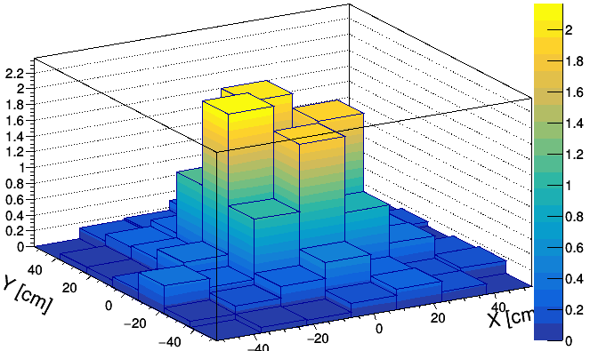
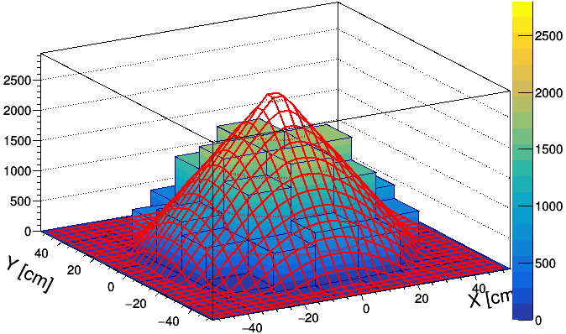
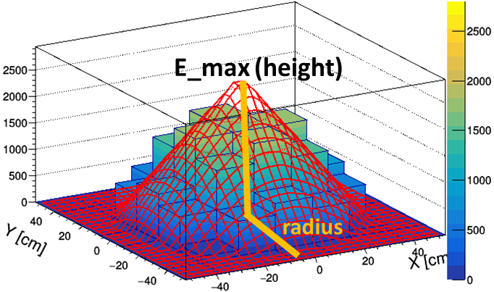
2D-linear fit method (linear approach)
Energy distribution in FHCal modules
Single event
Fitted event
E [GeV]
E [MeV]
In this method the space energy distribution in FHCal modules is used.
The energy in the histogram is uniformly distributed in FHCal modules according to the polar angle.
The histogram is fitted by a symmetrical cone (linear approximation).
Weight of each bin is proportional of the energy deposited in corresponding FHCal module.
This fit provides the new observables: radius, height of the cone. Volume of cone corresponds to the reconstructed energy (E_{rec}).

Slide 7
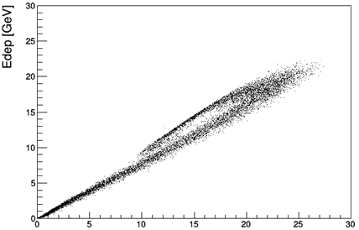
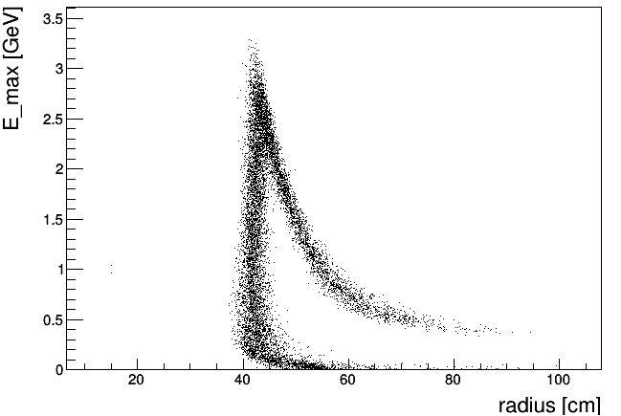
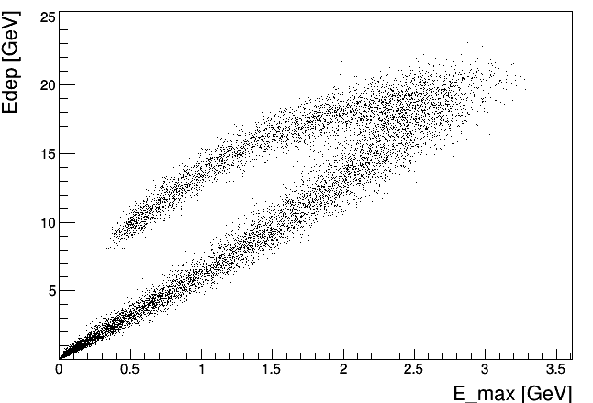
Correlation between obtained fit parameters. LA-QGSM
Initially we have experimental energy deposition E_{dep} in FHCal.
Experimental energy deposition vs reconstructed energy from the fitted event
Maximum energy in central bin vs radius
central events
E_max (height)
E [MeV]
peripheral events
E_{rec} [GeV]
radius
Experimental energy deposition vs maximum energy in central bin
After linear fit we have:
E_{rec} is reconstructed energy (volume of cone);
E_{max} – maximum energy in central bin (in FHCal hole);
Radius of spectator spot at FHCal is defined by the scattering spot of spectators.
central events
peripheral events
This correlation can be used for the centrality determination

Slide 8
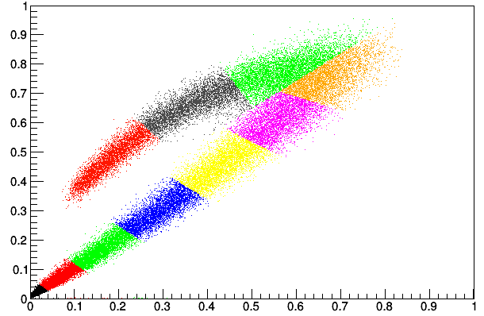
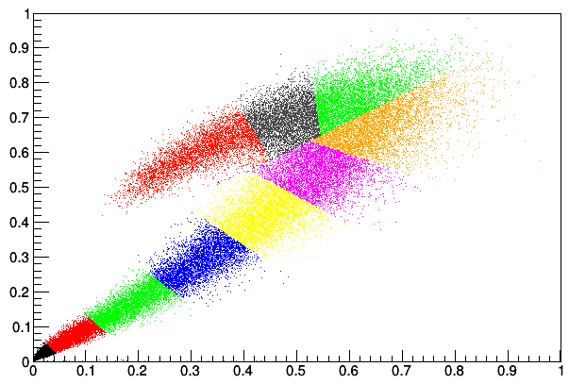
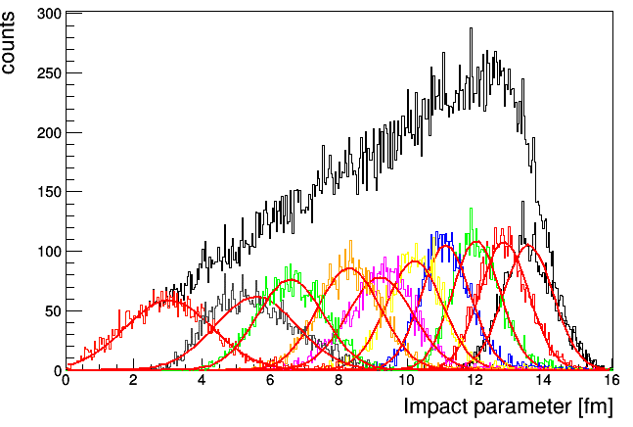
Centrality resolution for E_{dep} vs E_{max}
Edep [a.u]
LA-QGSM
E_{max} [a.u]
Edep [a.u]
DCM-SMM
Dependence of resolution of impact parameter on centrality
DCM-SMM
E_{max} [a.u]

Slide 9
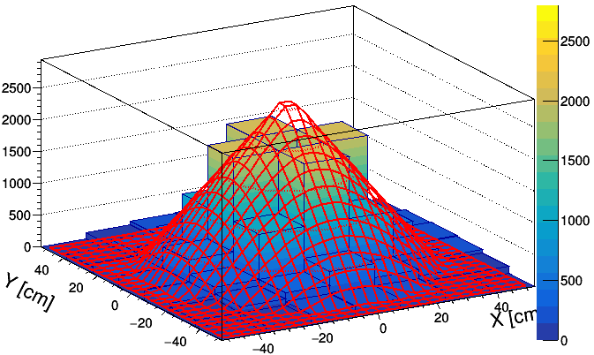
2D linear fit method (with subtraction of pion contribution)
Single event
Fitted and uniformly distributed event
Experimental energy deposition vs reconstructed energy from the fitted event
E [GeV]
E [MeV]
central events
peripheral events
Pion contribution
E_{rec} [GeV]
Narrow cone radius indicates that the outer FHCal modules detect the pions mainly, while the spectators are detected by inner modules.
Energy in outer modules can be regarded as pure non-spectator (pion) contribution.
Let’s try to evaluate pion contribution in full FHCal.

Slide 10
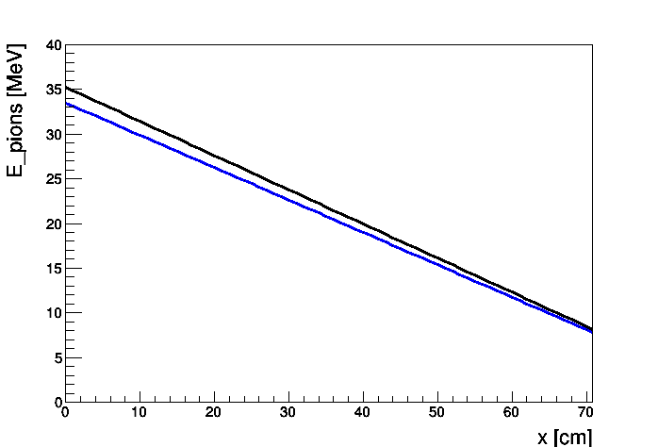
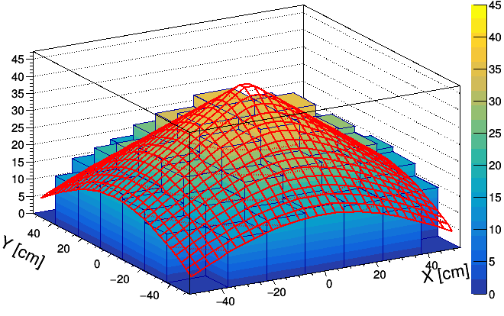
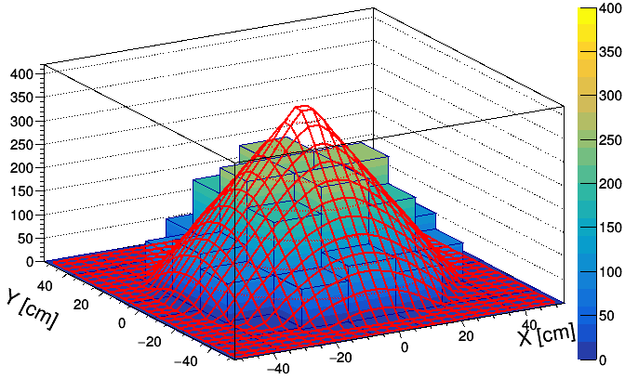
Evaluation of pion energy contribution
Pion energy distribution
Pion energy distribution
LA-QGSM
2D-case
1D-case
E [MeV]
y=kx+b
DCM-SMM
y=-kx+b
b
Pion contribution is subtracted
Linear fit with y=kx+b background,
b is known from outer FHCal modules,
k is taken from simulation and quite similar for LA-QGSM and DCM-SMM models
The ratio of edge and central energies is almost the same for different models (2.4609 for LA-QGSM, 2.45876 for DCM-SMM)
E [MeV]

Slide 11
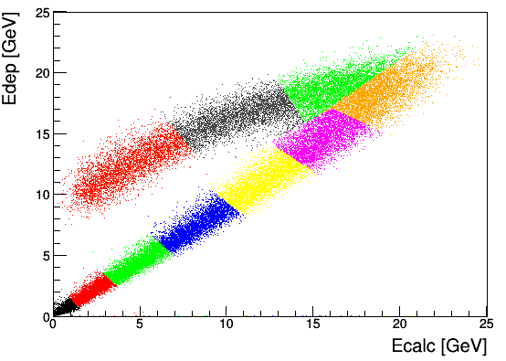
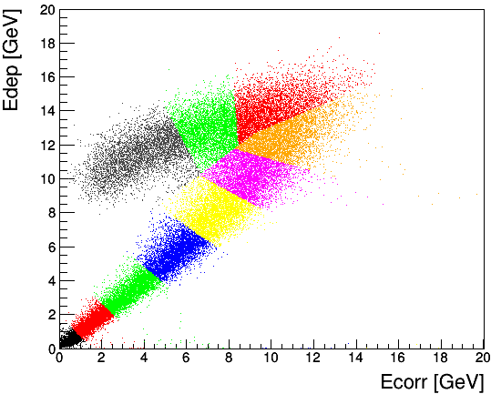
Centrality resolution for E_{dep} vs E_{rec}
(after subtraction of pion contribution)
LA-QGSM
E_{rec} is a volume of a cone
E [MeV]
E_{rec} [GeV]
Dependence of resolution of impact parameter on centrality
DCM-SMM
E_{rec} [GeV]
Dependence of impact parameter on centrality

Slide 12
Comparison of results from different methods
Dependence of resolution of impact parameter on centrality
LA-QGSM
DCM-SMM
Application of linear fit method improves the resolution for the most central events;
DCM-SMM model provides worse results comparing to LA-QGSM one.

Slide 13
Conclusion
The ability of FHCal to measure the collision centrality was considered.
Only the spectators for the centrality reconstruction were used.
Three methods for the centrality determination have been demonstrated:
Transverse-longitudinal energies correlation;
2D-linear fit method;
2D-linear fit with pion contribution subtraction method.
A few new observables were introduced for the centrality determination.
The usage of the introduced observables allows to determine the centrality more accurately, especially for the DCM-SMM model.
DCM-SMM model provides worse centrality resolution because this model has much more heavy fragments which escape in FHCal beam hole.
The subtraction of the pion contribution makes possible to measure the energy of free (protons/neutrons) spectators.
Number of free spectators can be estimated more accurately. It can be used for the centrality measurements.

Slide 14
Thank you for your attention!
This work was supported by the RFBR 18-02-40065 mega grant

Slide 15
BACKUPS

Slide 16
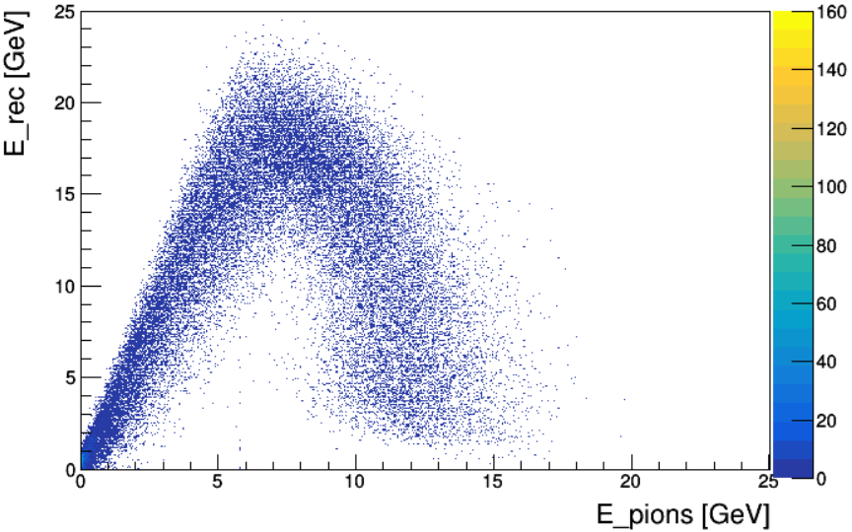
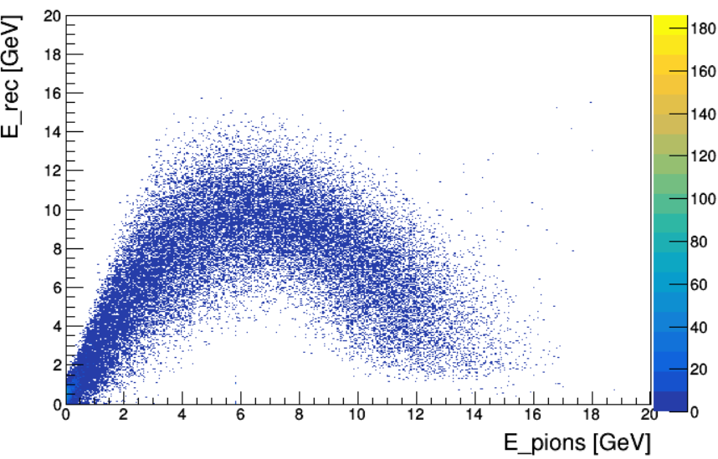
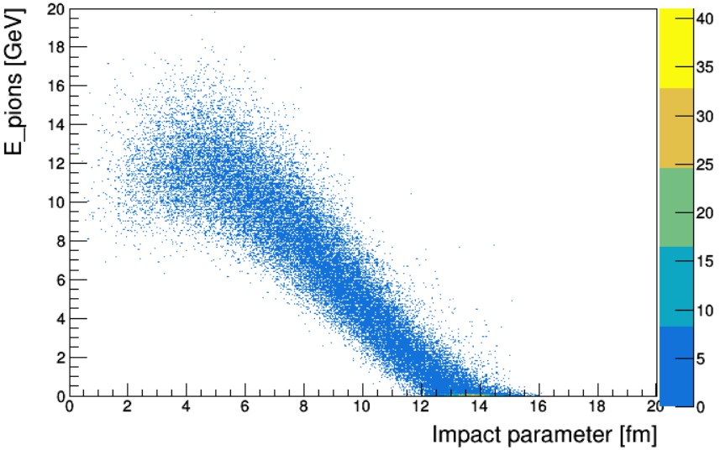
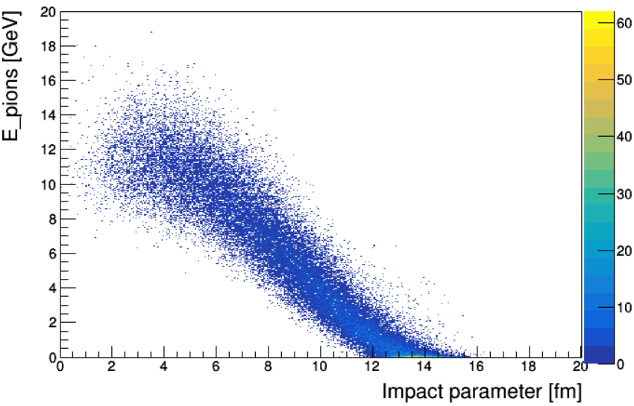
Energy deposition can be decomposed in two components: energy of free spectators and non-spectators energy
LA-QGSM
DCM-SMM
By using the subtraction of the non-spectator’s contribution, the energy deposition can be decomposed into two components.
E_dep
Free spectators energy (E_rec)
Non-spectators energy (E_pions)
LA-QGSM
DCM-SMM
Both energies can be used for centrality determination.

Slide 17
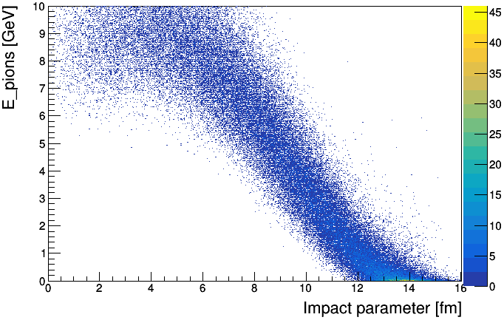
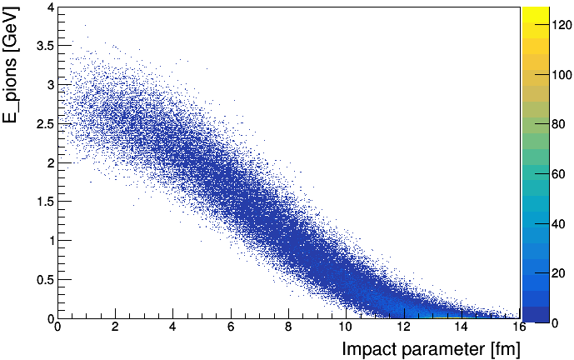
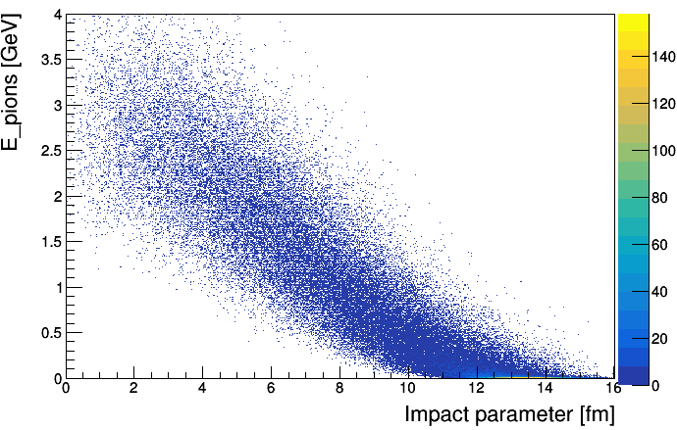
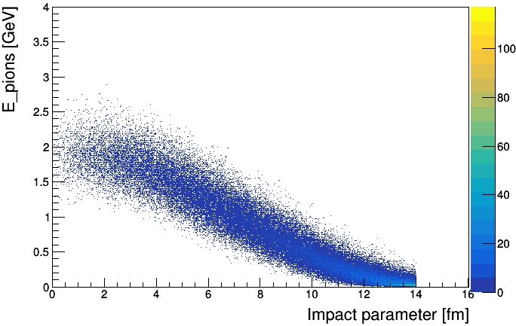
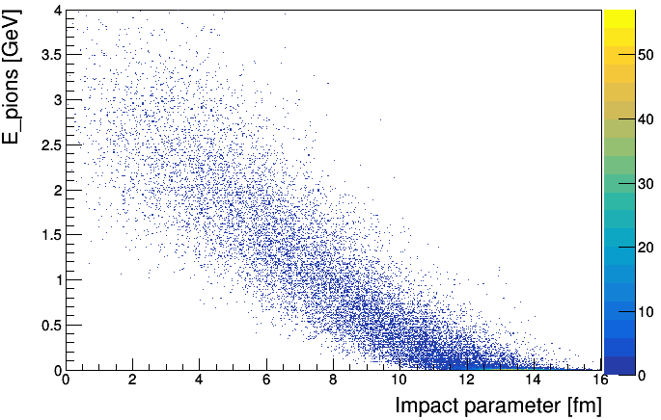
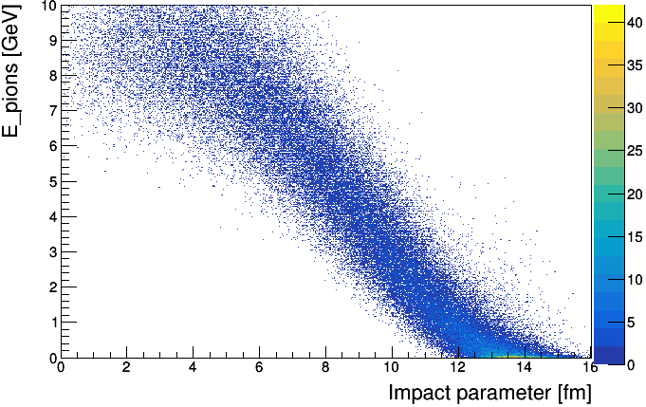
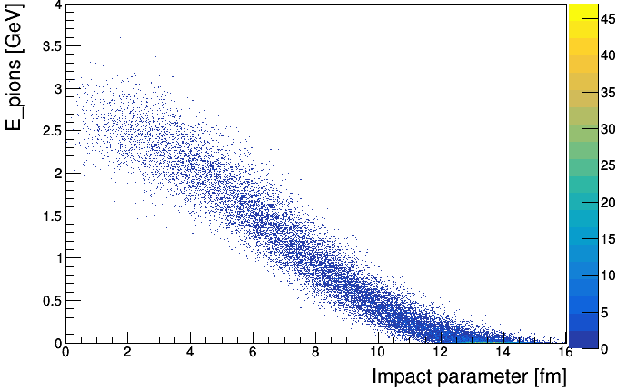
E_pions vs Imp
LA-QGSM
LA-QGSM
LA-QGSM
URQMD
only pions
reconstructed
reconstructed pions
only pions
DCM-SMM
DCM-SMM
DCM-SMM
only pions
reconstructed
reconstructed pions
only pions

Slide 18
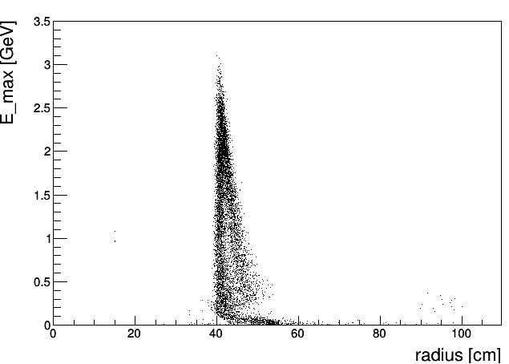
Comparison
LA-QGSM 11 GeV
FULL
MINUS BACKGROUND

Slide 19
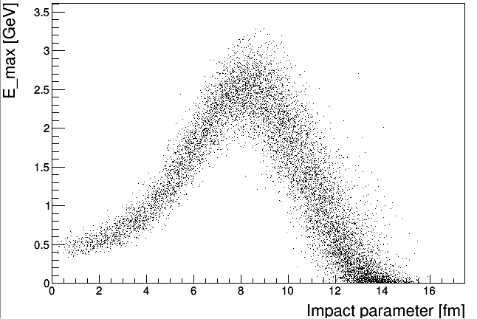
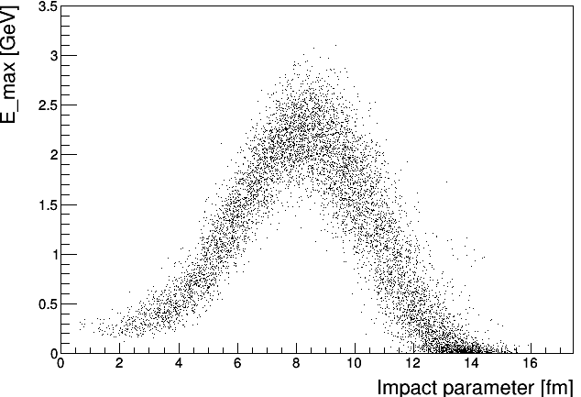
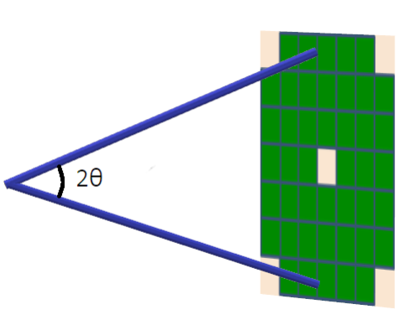
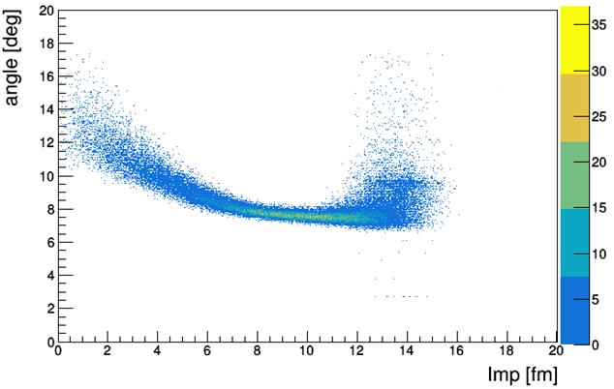
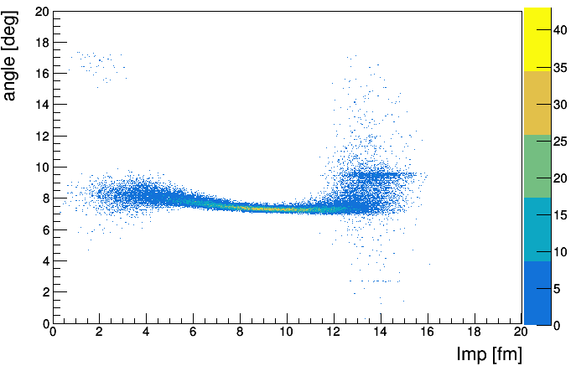
LA-QGSM 11 GeV
Energy in the central bin vs impact parameter
FULL
MINUS BACKGROUND
radius
After subtracting the pion contribution, the energies for the central events become less
Spectators scattering angle vs impact parameter

Slide 20
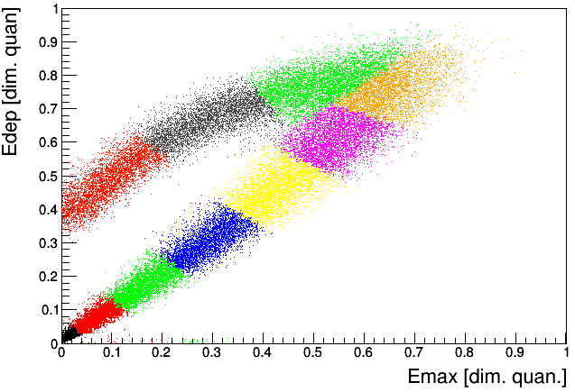
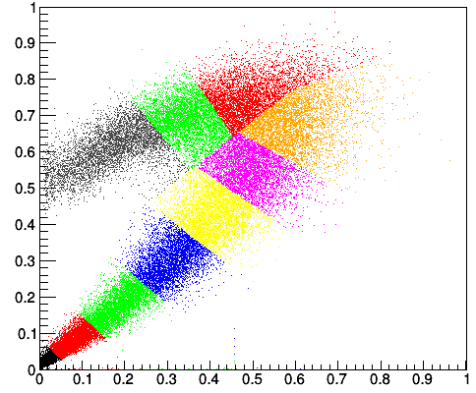
Centrality resolution for E_{dep} vs E_{max}
(after subtraction of pion contribution) backup
Edep [a.u]
LA-QGSM
E_{max} [a.u]
Dependence of resolution of impact parameter on centrality
Edep [a.u]
DCM-SMM
E_{max} [a.u]
Dependence of impact parameter on centrality

Slide 21
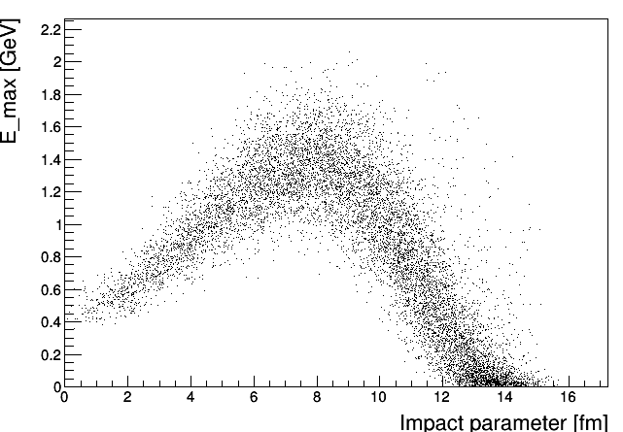
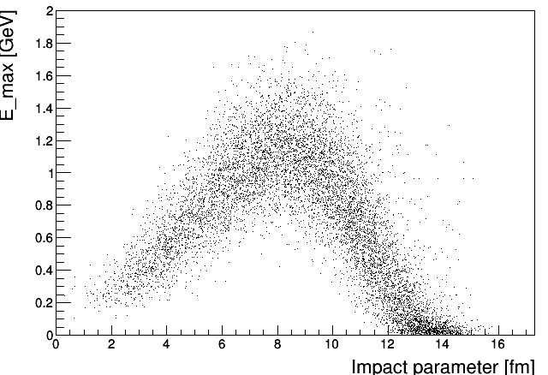
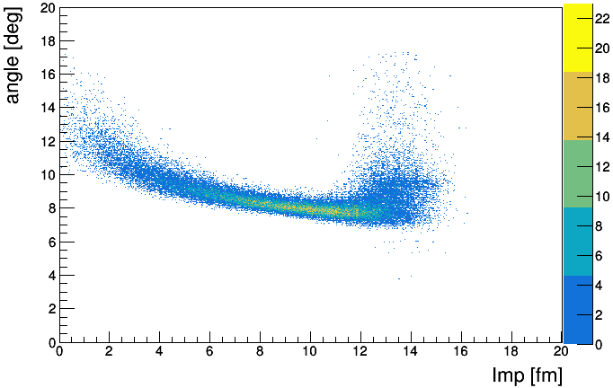
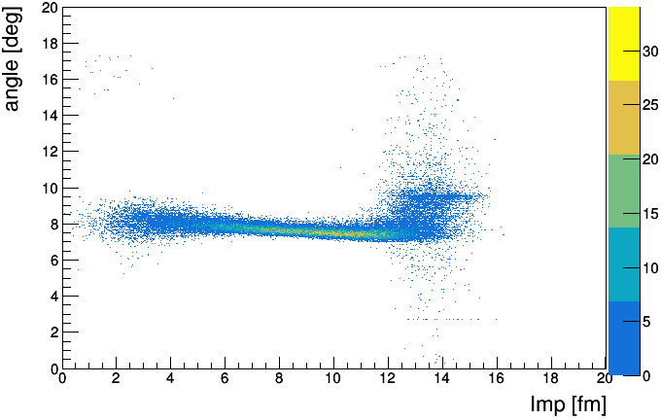
Comparison
DCM-SMM 11 GeV бэкап
FULL
MINUS BACKGROUND
Energy in the central bin vs impact parameter
FULL
MINUS BACKGROUND
Spectators scattering angle vs impact parameter

Slide 22
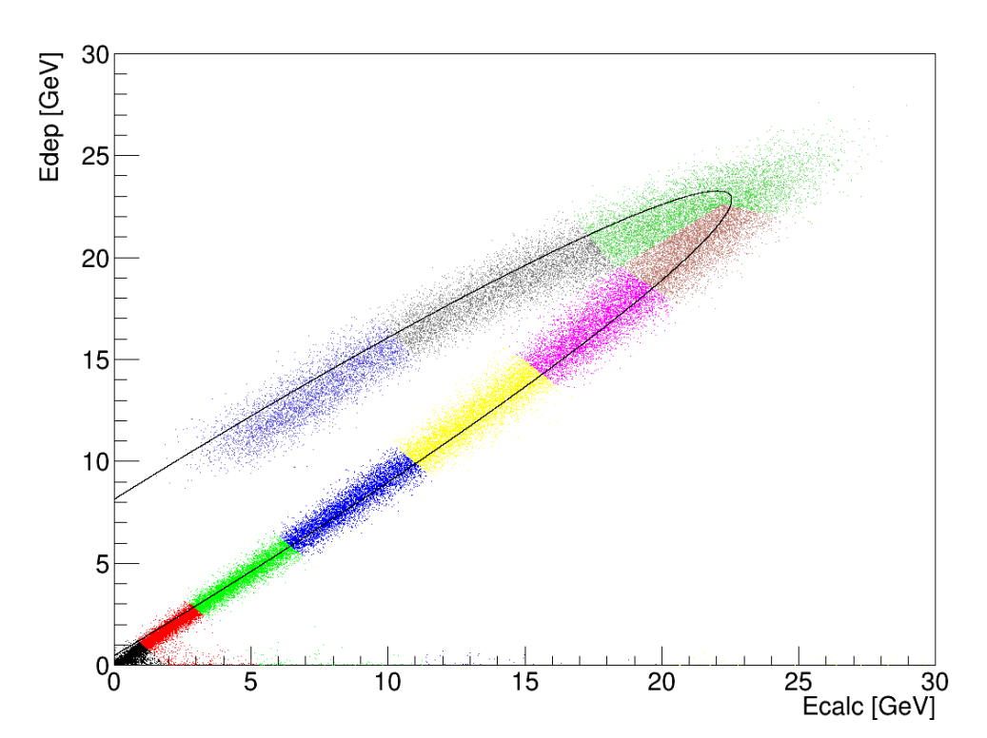
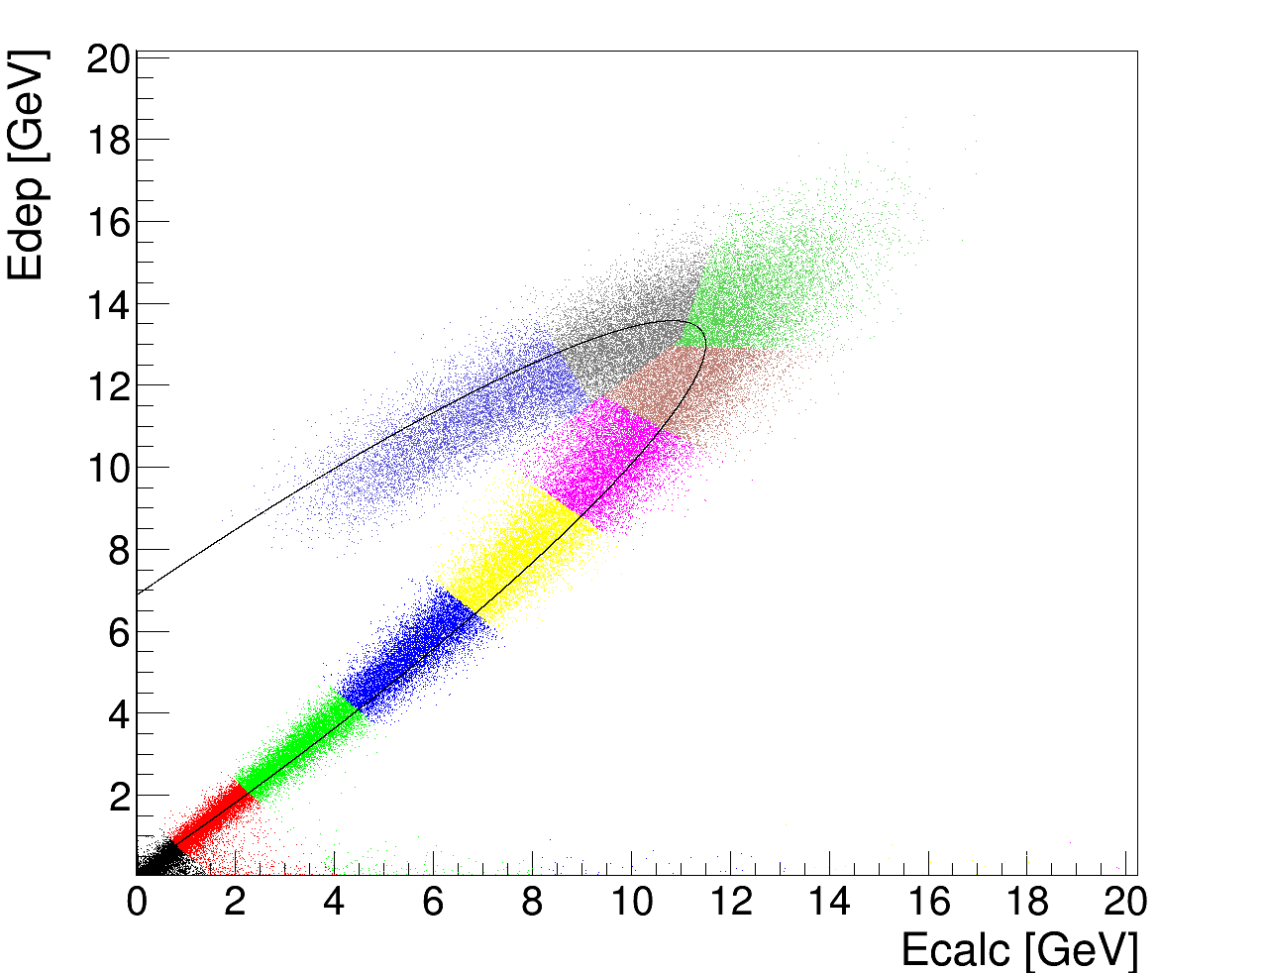
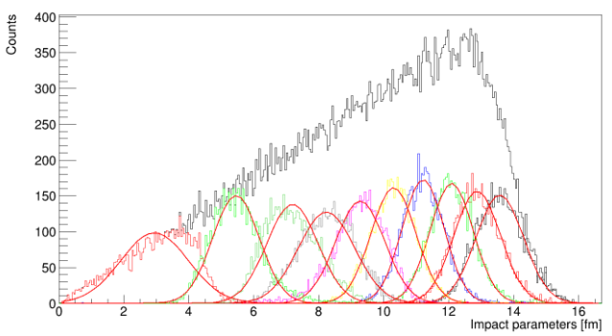
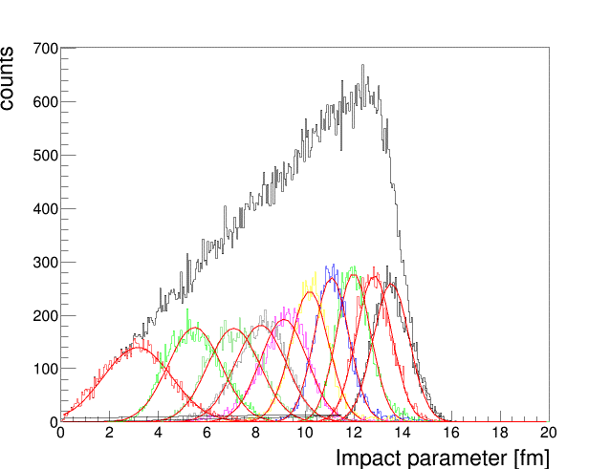
5 GeV example for LA-QGSM and DCM-SMM models
LA-QGSM
DCM-SMM
Each color bin is 10% fractions of the total number of events.
E_{rec}
E_{rec}

Slide 23
LA-QGSM and DCM-SMM models comparison for 5 GeV Erec Edep
DCM-SMM
LA-QGSM
Dependence of impact parameter on centrality
Dependence of resolution of impact parameter on centrality

Slide 24
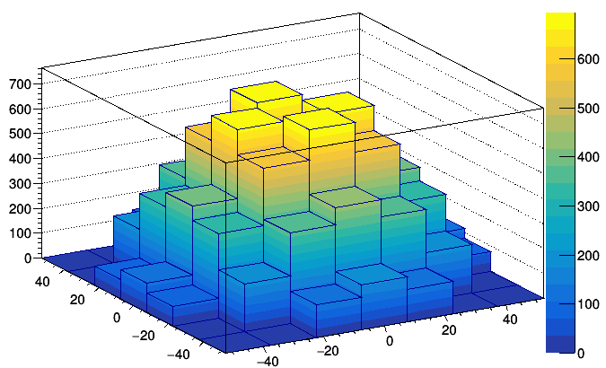
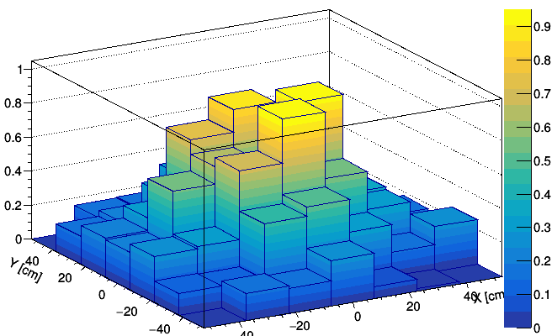
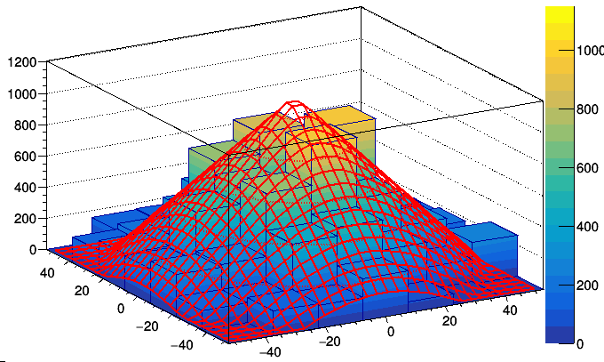
2D fit method LA-QGSM 11 GeV
Initial event
Fitted Initial event
Fitted event
Processed event (background subtracted)
Pion background from event

Slide 25
Correlation between transverse and longitudinal energies in FHCal DCM-SMM 11 GeV backup
Et [GeV]
counts
The separation of central and peripheral events with this model is clearly worse.
This approach is not suited for DCM-SMM model
DCM-SMM
DCM-SMM
Each color bin is 10% fractions of the total number of events.
El [GeV]
Impact parameters [fm]
DCM-SMM
LA-QGSM
New approaches are needed

Slide 26
2d fit method results LA-QGSM 11 GeV backup

