Slide 1
Measurements of spectators with Forward Hadron Calorimeter in MPD/NICA experiment
A.Ivashkin
(Institute for Nuclear Research RAS, Moscow)
This work was supported by RFBR according to the research project No 18-02-40065
The Conference "RFBR Grants for NICA"
20-23 October 2020

Slide 2
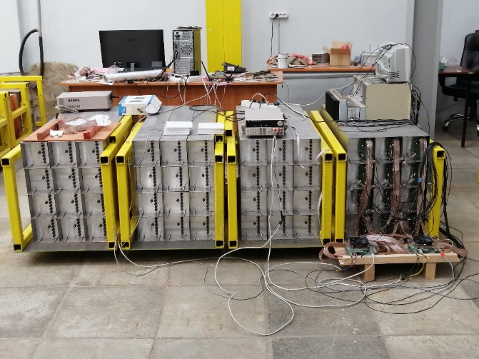
RFBR grant tasks
Detector tasks:
Physic’s tasks:
Software for FHCal readout.
Signal processing.
FHCal modules characterization.
Software for energy calibration.
FHCal centrality trigger.
Detector Control System.
Simulation and software for study of spectators matter.
Geometry of ion collisions:
event plane,
centrality.
Properties of spectators:
energy depositions,
scattering angles.
All tasks are associated with the FHCal performance, data quality and physic’s performance.
FHCal is unique detector dedicated for the measurements of spectators at MPD/NICA

Slide 3
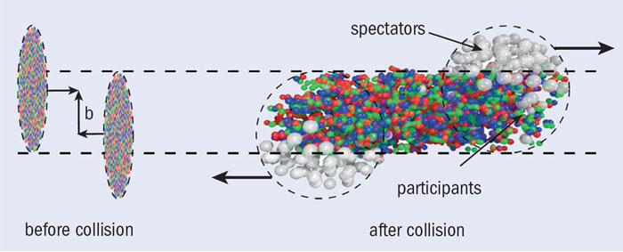
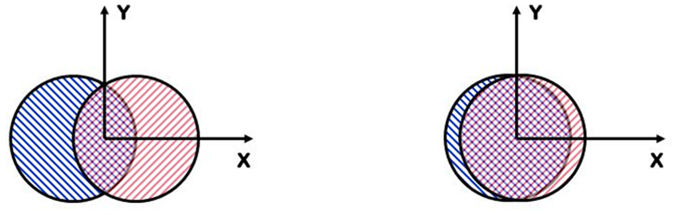
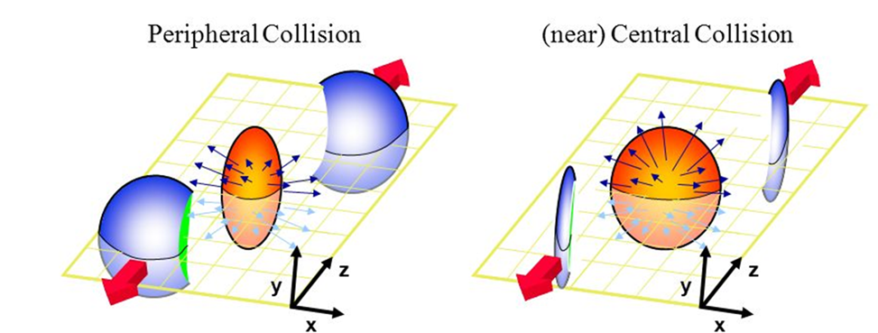
Spectators in ion collisions.
Spectators – non-interacting projectile nuclear fragments.
spectators
Reaction plane:
plane of b and Z (beam).
Spectators are effective tool in the measurements of centrality and the reaction plane of collisions.
Spectators are sensitive to the fragmentation models.
Can spectators be an additional probe of the fireball?

Slide 4
Detector tasks
Software for FHCal readout.
Signal processing.
FHCal modules characterization.
Software for energy calibration.
FHCal centrality trigger.
Detector Control System.

Slide 5
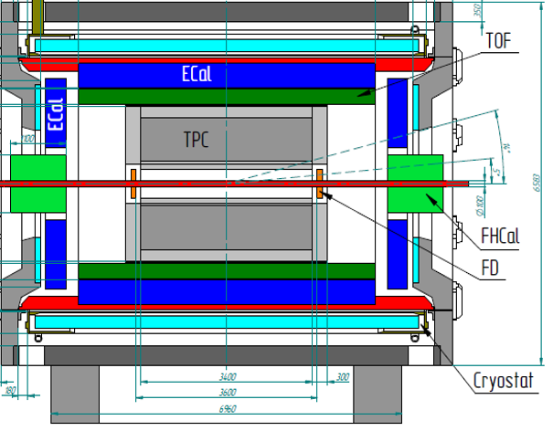
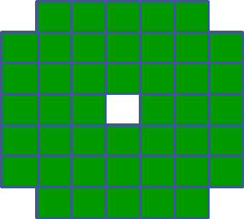
FHCal as a dedicated detector of spectators in MPD
FHCal modules
FHCal
FHCAL consists of 2x44 modules.
~1x1 m² each part.
Beam hole 15x15 cm².
Lead/scintillator sampling calorimeter.
Longitudinal segmentation;
Light readout- WLS-fibers;
7 sections/photodetectors in each module.
Two arms of hadron calorimeter at opposite sides in forward regions.
At the distance 3.2 meters from the interaction point.
Available acceptance corresponds to pseudorapidity 2.0<η <5.0

Slide 6
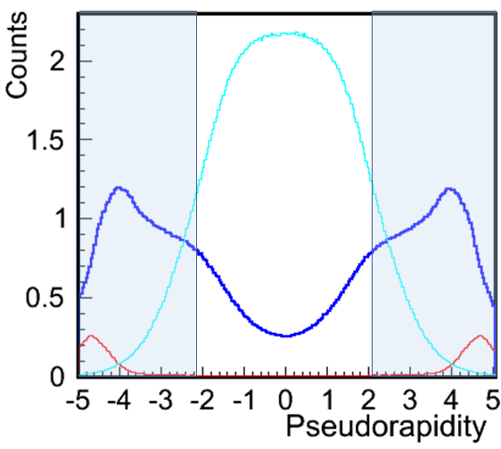
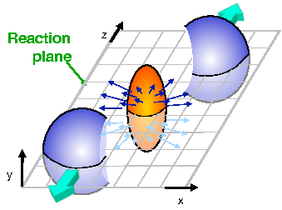
FHCal features
Pions
Protons + neutrons
Fragments
FHCal acceptance
Event plane
FHCal detects the energy of spectators;
FHCal detects the space distribution of the spectators;
FHCal detects the produced particles in forward region.
Spectator spot
Since FHCal has a beam hole, most of the bound spectators escape in this hole.
Mainly, free spectators (protons and neutrons) deposit energy in FHCal.

Slide 7
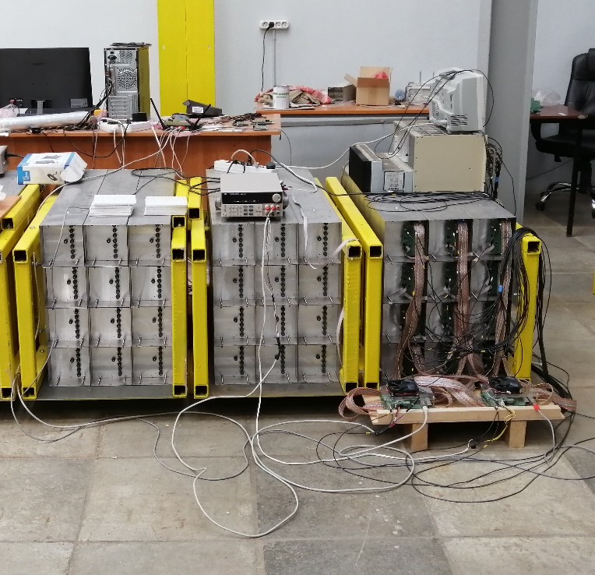
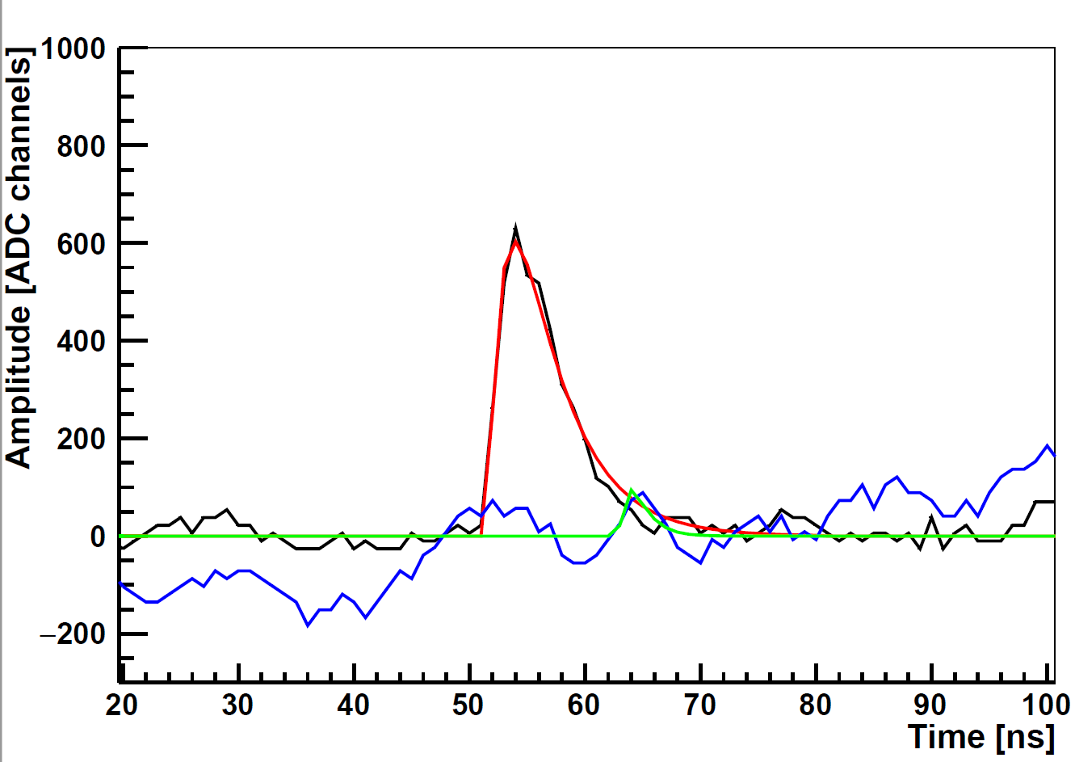

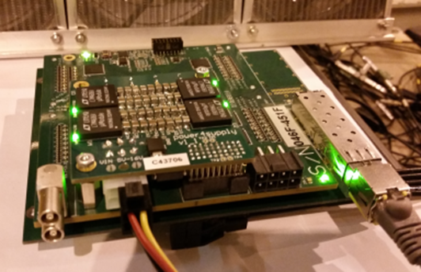
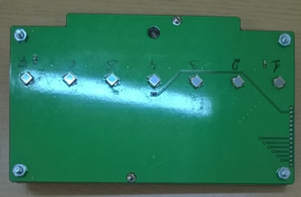
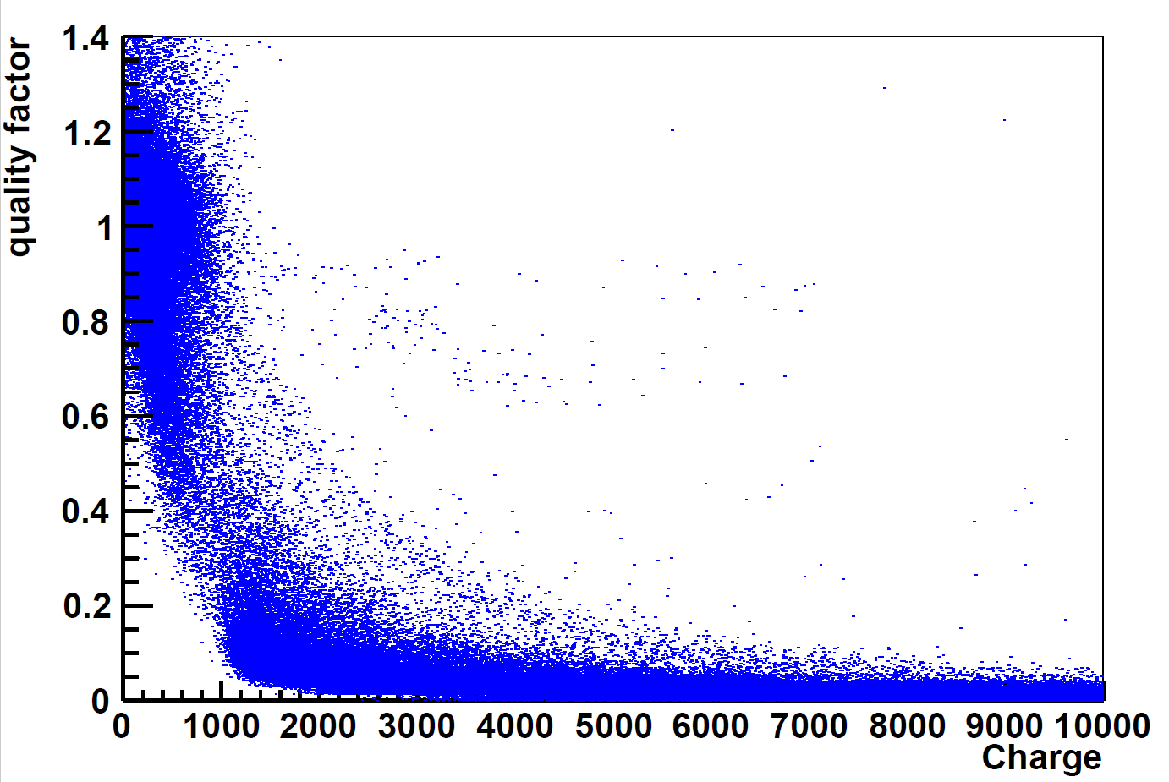
FHCal signal processing
Shape of digitized signal.
Fit function:
Prony method of fit
Good signal
Bad signal
The readout electronics: FPGA based 64 channel ADC64 board, 62.5MS/s (AFI Electronics, JINR).
noise
MPPC: new type
S14160-3010PS
size – 3x3 mm²;
pixel -10x10 µm²;
PDE~18%.

Slide 8
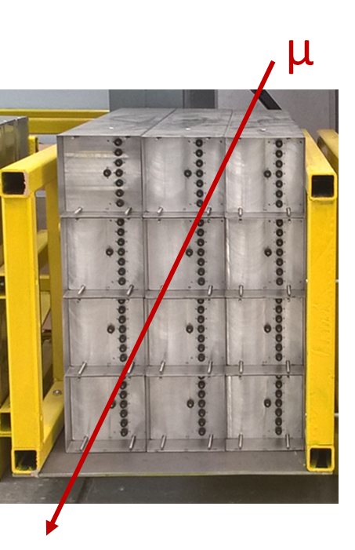
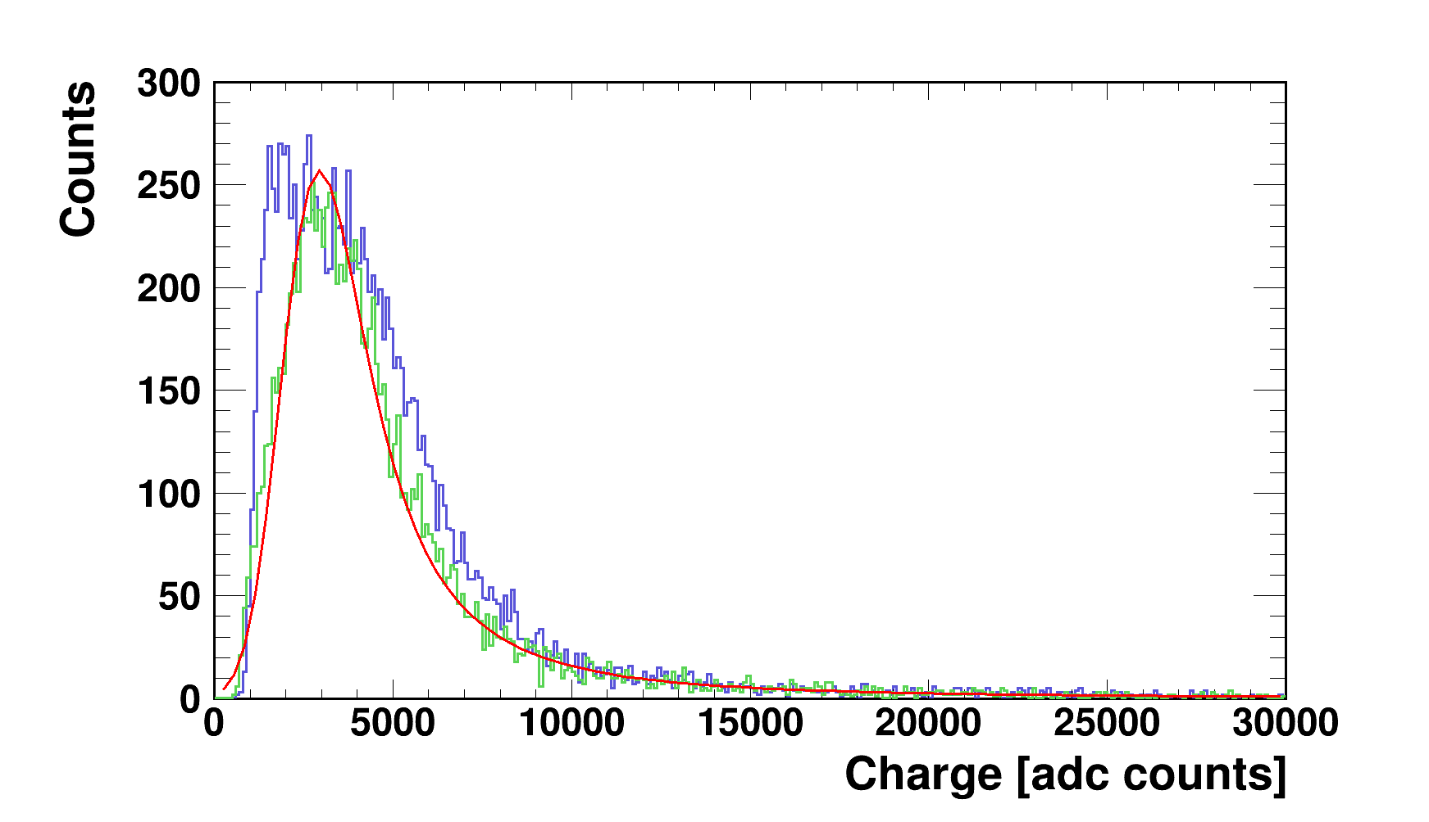
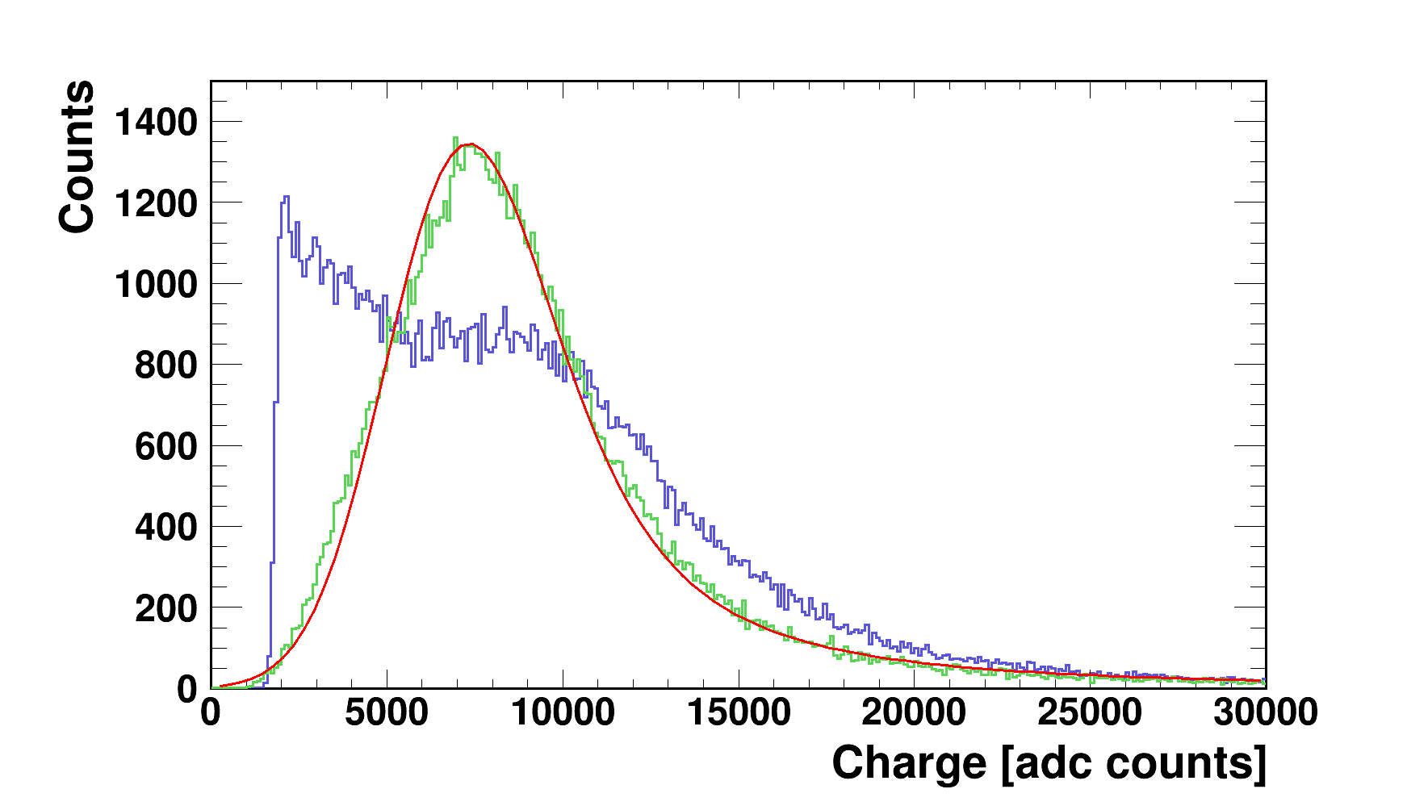
FHCal modules characterization with cosmic muons
Tasks:
Tests of different SiPM’s;
Tests of FEE;
Development of methods of the energy calibration;
Control of the light yield of the modules;
Energy threshold for the FHCal trigger.
Response of FHCal modules to cosmic muons with different types of MPPC.
Previous MPPC type
New MPPC type
Raw spectrum
Corrected to pass length in scintillators.
MPPC: S12572-010P
pixel -10x10 µm²;
PDE~12%;
G~10⁵.
MPPC: S14160-3010PS
pixel -10x10 µm²;
PDE~18%;
G~1.8x10⁵.

Slide 9
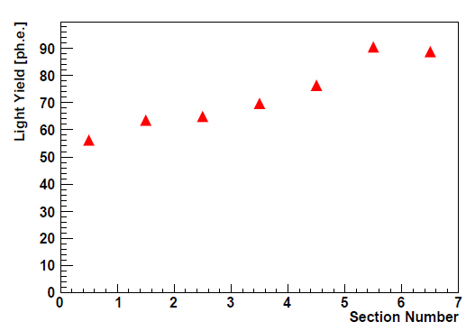
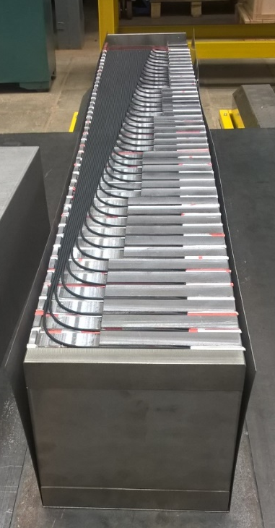
Calibration and light yield of FHCal modules
Clear amplitude spectra from cosmic muons allow the energy calibration in self-triggering mode (without external muon trigger).
This is due to high light yield in the longitudinal sections in modules.
New MPPC type
~5 MeV
Average light yield for MIP’s in longitudinal sections.
Light yield depends on WLS-fiber length.
Light drops for ~40% for 1m fiber.

Slide 10
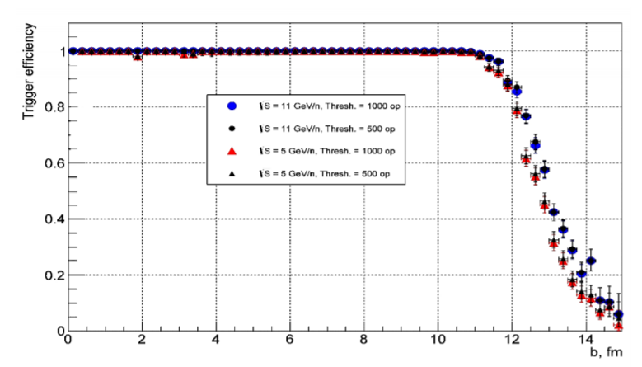
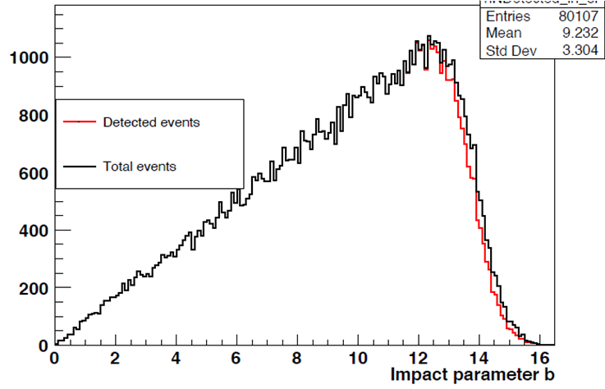
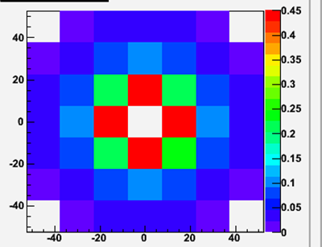
FHCal in trigger
Problem: FFD trigger efficiency drops for peripheral collisions.
Is it possible to arrange minimum bias trigger?
FFD Trigger Efficiency
FHCal detects the energies practically from all events, including the most peripheral ones.
Detected events – if the energy deposition in each central module exceeds 5 MeV.
5 MeV in each central module
In peripheral collision the energies are mainly deposited in central modules.

Slide 11
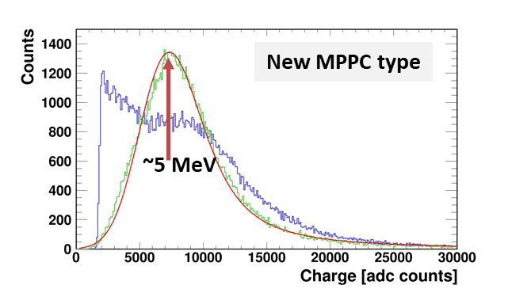
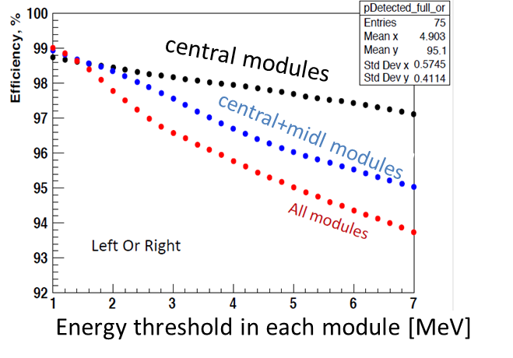
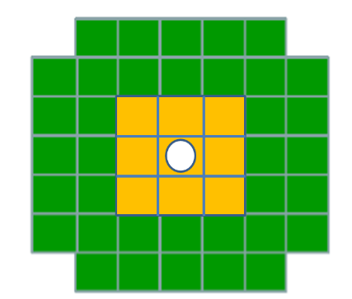
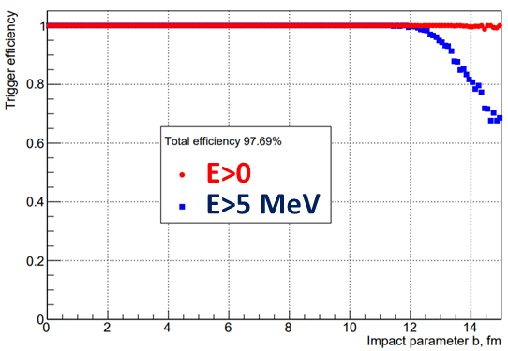
FHCal in trigger - 2
Spectrum from cosmic muons.
5 MeV is rather reasonable threshold for a single FHCal module with new photodiodes.
Dependence of trigger efficiency on the energy threshold and on the number of modules.
Events with energy deposition in each central module > 5 MeV.
Total trigger efficiency ~97.7%.

Slide 12
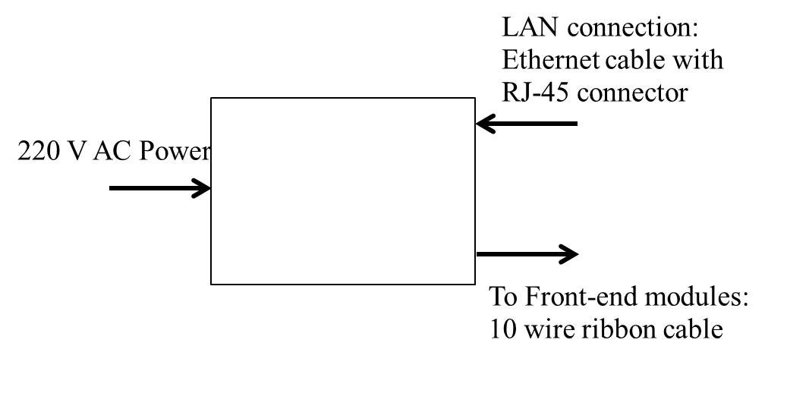
Detector Control System for FHCal
LAN
RS485
General
Slow Control
FHCal New Slow
Control (proxy)
System Module
FEE
FEE
FEE
System Module
FEE
Database
FEE
Hardware:
System Module (HV sys. Co.)
FEE
Control of HV at photodetectors (MPPC’s);
Temperature control of photodetectors;
Compensation of temperature drift of MPPC gain;
Monitoring of MPPC gain with stabilized light source.
Software:
Test version (full functionality) is ready.
New (advanced) python version in development.
  Proxy mode: let other software read FHCal transparently
  Provide TANGO bindings
  Faster operation with multiple System Modules

Slide 13
Physic’s tasks
Simulation and software for study of spectators matter.
Geometry of ion collisions:
event plane,
centrality.
Properties of spectators:
energy depositions,
scattering angles.

Slide 14
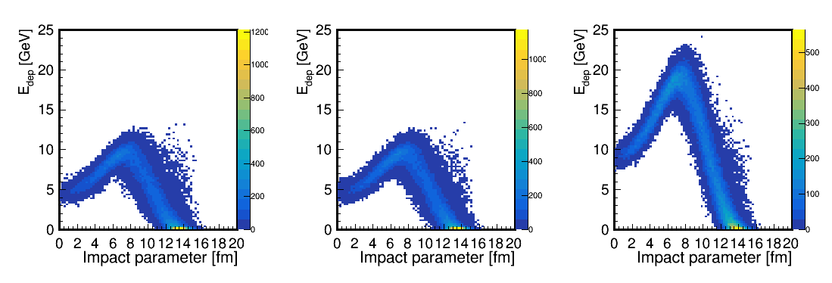
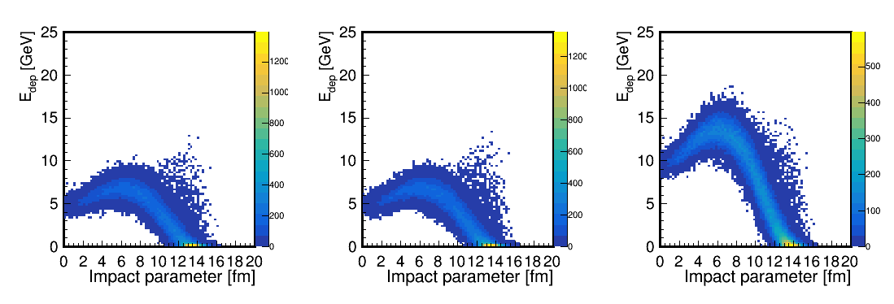
Fragmentation models/generators
Depending on fragmentation model, simulated energy deposition in FHCal can be quite different.
LA-QGSM
DCM-SMM
Non-spectator’s contributions
LA-QGSM: S. G. Mashnik, K. K. Gudima, R. E. Prael, A. J. Sierk, M. I. Baznat, N. V. Mokhov, CEM03.03 and LAQGSM03.03 Event Generators for the MCNP6, MCNPX, and MARS15 Transport Codes,
arxiv:0805.0751 [nucl-th] (2008)
For DCM-SMM, the maximum energy deposition in FHCal is about 30% less due to the larger number of intermediate fragments (effect of beam hole).
DCM-SMM: M. Baznat, A. Botvina, G. Musulmanbekov, V. Toneev & V. Zhezher Monte-Carlo Generator of Heavy Ion Collisions DCM-SMM, Phys. Part. Nuclei Lett. 17, 303–324 (2020). https://doi.org/10.1134/S1547477120030024
A few models must be compared!

Slide 15
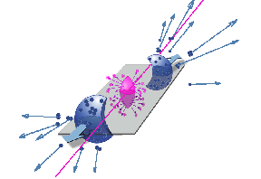
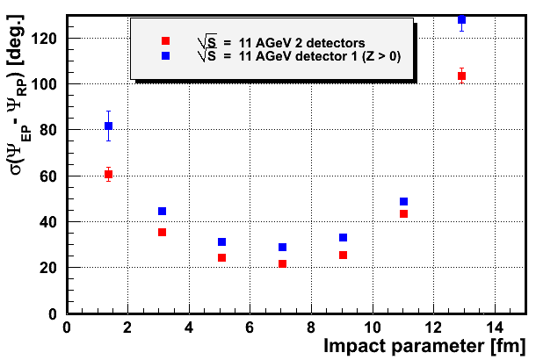
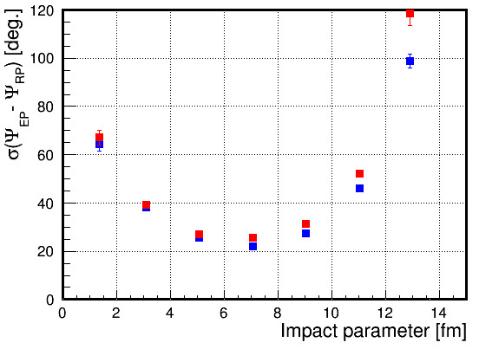
Reconstruction of the event plane with spectators
From energy and space distribution of spectators one can determine the event plane as an experimental estimate of the reaction plane.
E_{i} , (x_{i} ,y_{i}) – energy and coordinates of i-module.
spectators
Event plane in first FHCal part:
Event plane in both FHCal parts:
Resolution: difference between true reaction plane and reconstructed event plane.
(LA-QGSM)
(DCM-SMM)
Detection of all types of the spectators (protons, neutrons) for both colliding nuclei would ensure the outstanding ~20⁰ angular resolution of the event plane!

Slide 16
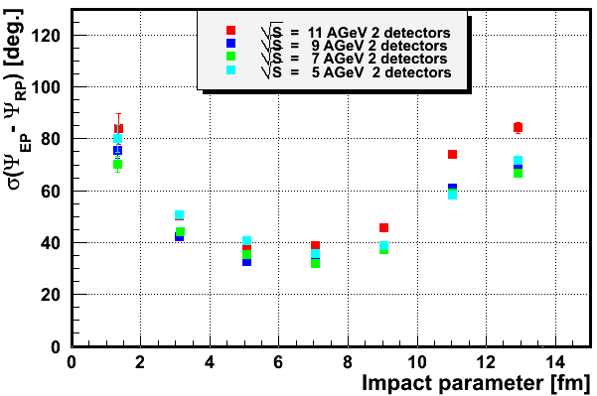
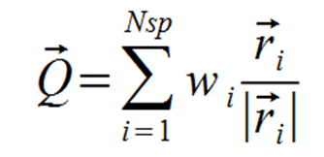
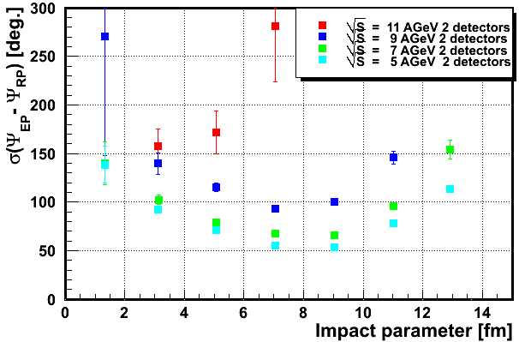
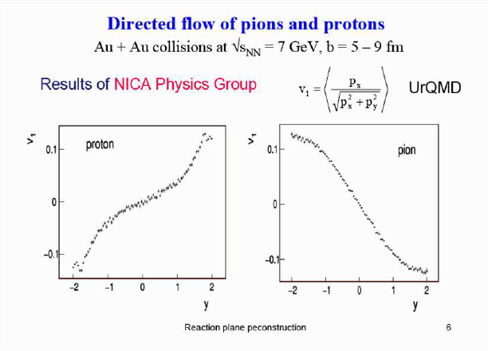
Resolution of the event plane for only charged particles
Only charged spectators (protons and fragments)
All charged particles (including pions)
Weight w_{i}=1.
The best resolution of event plane is about 30⁰-40⁰ in case of charged spectators only.
For all charged particles (including pions) the resolution is 60⁰ and larger.
It is a factor of 3 and more worse comparing to FHCal option.
The resolution degradation is due to the fact that protons and pions have an opposite signs of v₁ flow.
Detection of energies of all spectators ensures the best angular resolution.
Hadron calorimeter is the best option!

Slide 17
Centrality. Problem with beam hole in FHCAL.
For hermetical calorimeter the energy deposition of spectators has monotonic dependence on impact parameter.
It is not true in real situation.
Bound fragments have small transverse (Fermi) momentum and escape into beam hole.
LA-QGSM
Energy deposition in FHCal can not resolve the central and peripheral events.
New observables are needful to resolve ambiguity in energy deposition of the central and peripheral events.
The space information about the spectator hit points can be used additionally to the detected energy.
One can construct a few such observables.

Slide 18
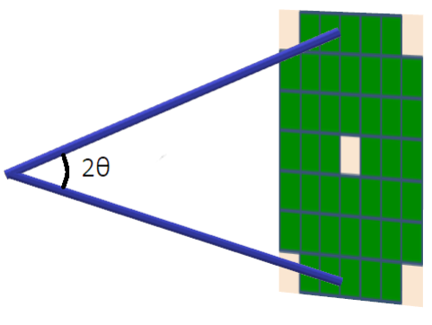
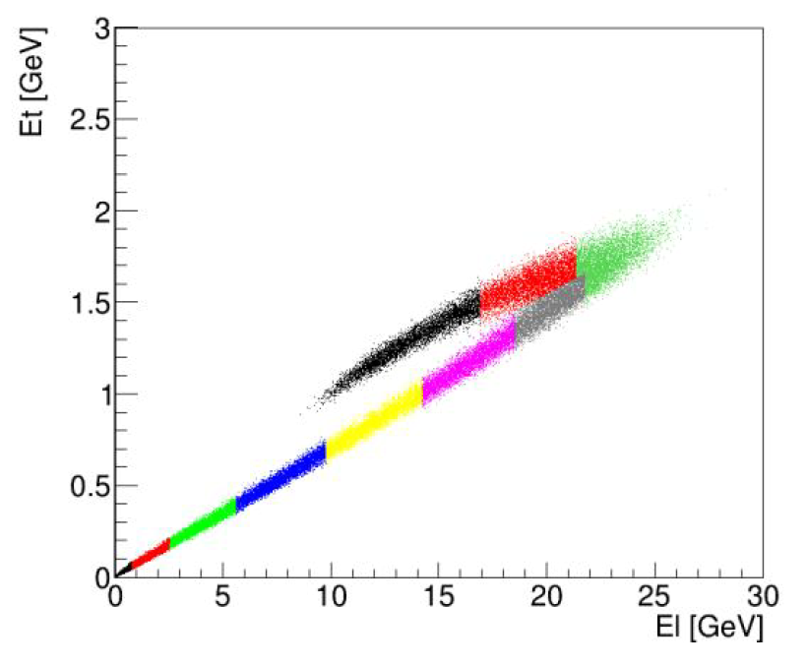
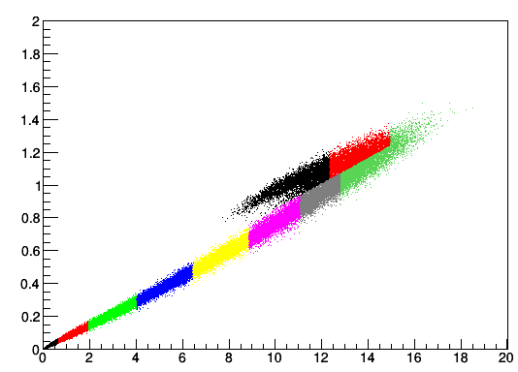
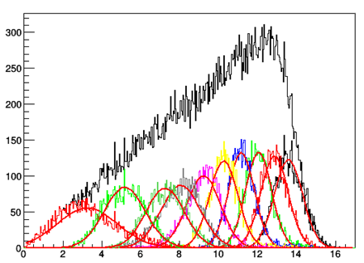
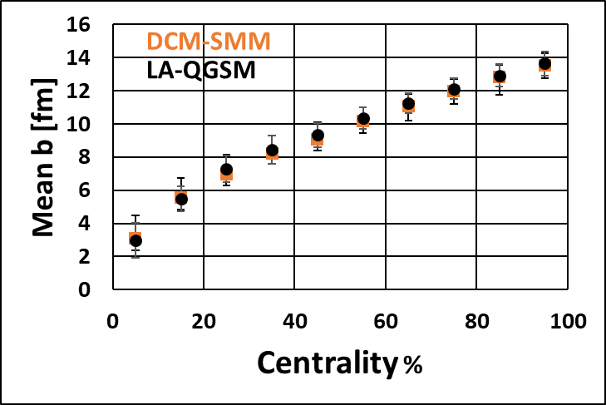
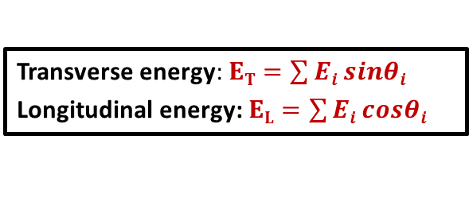





($ET$, $EL$) observables in FHCal for the centrality measurement
Transverse energy: $ET=\sum{Ei sinθi}$
Longitudinal energy: $EL=\sum{Ei cosθi}$
$$Ei$$
interaction point
Each color bin is 10% fractions of the total number of events.
$ET [$GeV]
Each color bin is 10% fractions of the total number of events.
LA-QGSM
$ET [$GeV]
Each color bin is 10% fractions of the total number of events.
DCM-SMM
$EL [$GeV]
$EL [$GeV]
counts
DCM-SMM
For DCM-SMM model the identification of central events is not suitable.
New approaches are needed!
Impact parameter [fm]
18

Slide 19
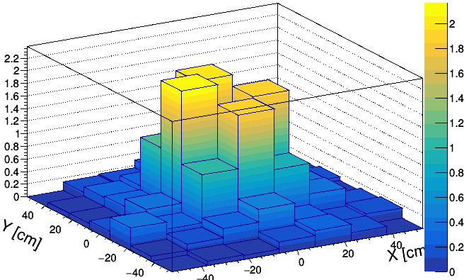
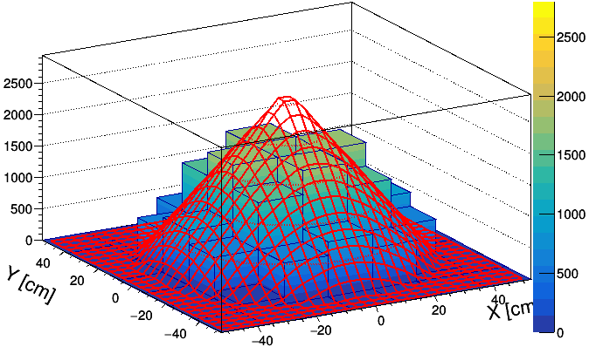
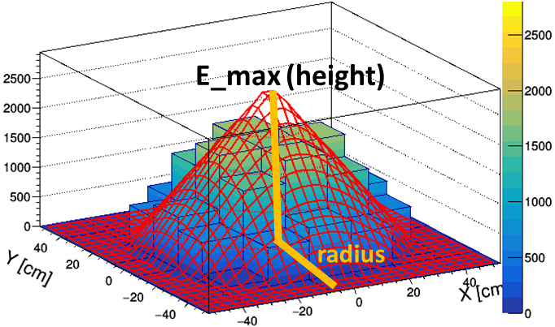
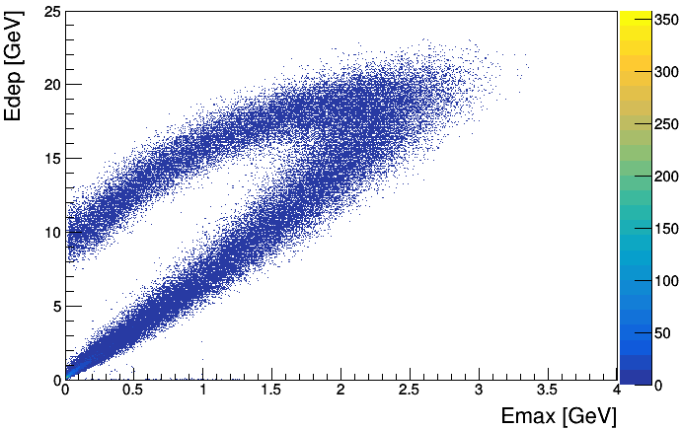
Centrality: 2D-fit of energy distributions (linear approach)
In this method the space energy distribution in FHCal modules is used.
The histogram is fitted by a symmetrical cone (linear approximation).
Weight of each bin is proportional of the energy deposited in corresponding FHCal module.
Energy distribution in FHCal modules
Single event
Fitted event
Initially we have experimental energy deposition E_{dep} in FHCal.
E [GeV]
E [MeV]
Energy deposition vs maximum energy in FHCal center
After linear fit we have:
E_{fit} is reconstructed energy (volume of cone);
E_{max} – maximum energy in central bin (in FHCal hole);
Radius is defined by the scattering angle of spectators.
central events
peripheral events
This correlation can be used for the centrality determination.
LA-QGSM

Slide 20
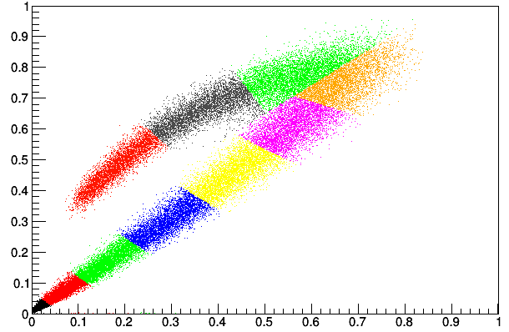
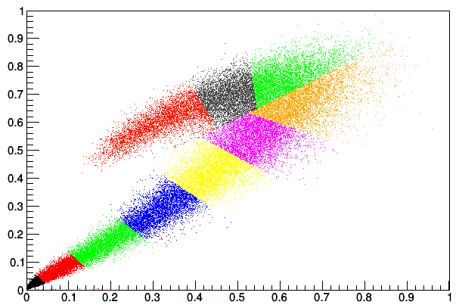
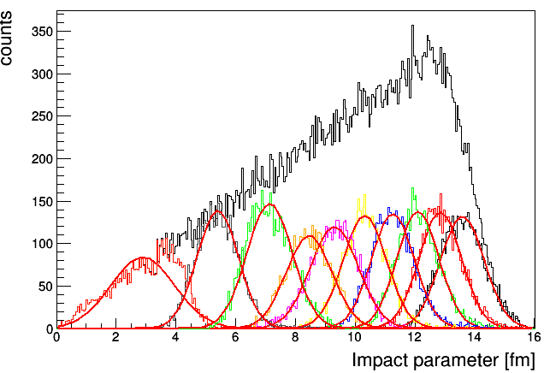
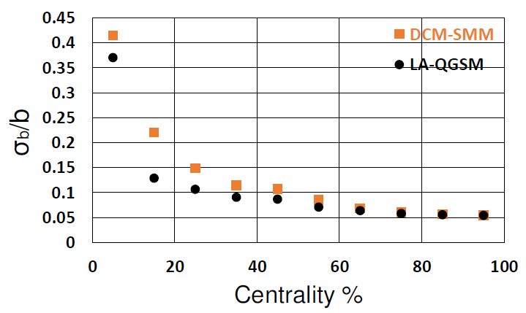
Centrality resolution for E_{dep} vs E_{max}
Each color bin is 10% fractions of the total number of events.
LA-QGSM
DCM-SMM
Edep [a.u]
Edep [a.u]
E_max [a.u]
E_max [a.u]
Energy deposition vs maximum energy in FHCal center
DCM-SMM
The accuracy of centrality determination depends on fragmentation model.
Real data can be quite different!

Slide 21
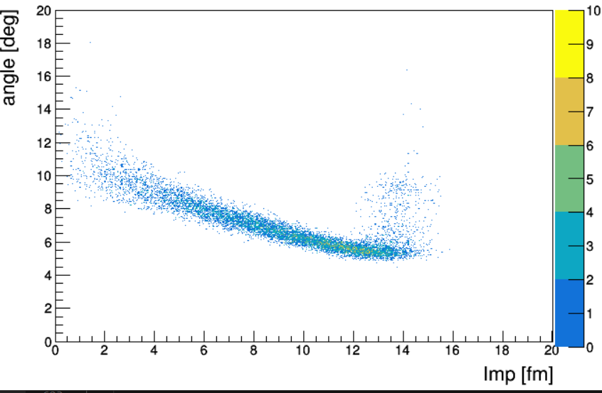

Scattering angles of spectators
Can spectator’s scattering angle be sensitive to the fireball?
E [MeV]
Interaction point
2θ
Interaction point
Radius of spectator’s spot is provided by fit.
Free spectators (protons&neutrons)
Full event
(pion contamination)
Scattering angle [deg]
LA-QGSM model
Scattering angle [deg]
Impact parameter [fm]
Impact parameter [fm]
According to the models, the size of the spectator’s spot (scattering angle) depends on the impact parameter. It reflects the spectator’s transverse momenta obtained from fireball.
Can it be used to probe the fireball properties?

Slide 22



Reconstruction of energy of spectators
Energy depositions in FHCal strongly depends on the composition of the free and bound spectators.
Most of bound spectators escape in beam hole, while free spectators deposit energy in FHCal.
E_fit is a volume of a cone
Subtracting the pion energy contribution from the FHCal full energy one can obtain the energy of spectators which is sensitive to the fragmentation model.
E [MeV]
LA-QGSM
DCM-SMM
A. O. Svetlichnyi and I. A. Pshenichnov,
Formation of Free and Bound Spectator Nucleons in Hadronic Interactions between Relativistic Nuclei, Bulletin of the Russian Academy of Sciences: Physics, 2020, Vol. 84, No. 8, pp. 911–91
Composition of free and bound spectators depends on centrality and can be used for the centrality determination.

Slide 23
Publication activity
A. Ivashkin, D. Finogeev, M. Golubeva et al., Compact segmented hadron calorimeter for detection of low energy spectators at MPD/NICA facility, Nuclear Inst. and Methods in Physics Research, A (2019), https://doi.org/10.1016/j.nima.2019.05.081.
Nikolay Karpushkin, Fedor Guber, and Alexander Ivashkin, Application of the Prony least squares method for fitting signal waveforms measured by sampling ADC, AIP Conference Proceedings 2163, 030006 (2019); https://doi.org/10.1063/1.5130092
Alexander O. Strizhak, and Alexander P. Ivashkin, Test of modules for Forward Hadron
Calorimeter at MPD/NICA facility, AIP Conference Proceedings 2163, 030013 (2019);
https://doi.org/10.1063/1.5130099
A. Ivashkin, D. Finogeev, M. Golubeva et al., Determination of geometry of heavy ion collisions with
forward hadron calorimeter (FHCal) at MPD/NICA, EPJ Web of Conferences 204, 0 (2019);
https://doi.org/10.1051/epjconf /201920407002
A. Ivashkin, M. Golubeva, F.Guber et al., Amplitude parameters of modules for hadron calorimeter
at MPD/NICA, Journal of Instrumentation, Volume 15, June 2020
https://doi.org/10.1088/1748-0221/15/06/C06044

Slide 24
Future plans:
Further development of FHCal readout;
Integration of FHCal to MPD setup;
Implementation of FHCal calibration procedure in MPDRoot environment;
Development of methods for collision centrality determination;
Search for new observables to characterize the properties of spectators;
Subtraction of the energy contributions in FHCal from non-spectator particles;
Test and comparisons of different fragmentation models.

Slide 25
Thank you!

