Slide 1
Investigation of initial states and development of methods for their analysis in proton and nuclear collisions at energies of the NICA collider.
Draft -02
Grigory Feofilov
V.Fock Institute for Physics, Laboratory of Ultra-High Energy Physics, Saint-Petersburg State University
The Conference "RFBR Grants for NICA"
https://indico.jinr.ru/event/1469/timetable/#all.detailed
Wednesday, 21.10.2020 , 11:00-11:35
Job is supported by RFBR grant #18-02-40097
Notes:
1

Slide 2
Layout
Introduction. Initial states in AA collisions
PART 1
Methods of analysis of initial states in pp and AA collisions
PART 2
Results of model simulations
PART 3
Fast Beam-Beam Collisions counters (FBBC) for NICA
Conclusions and plans ???

Slide 3
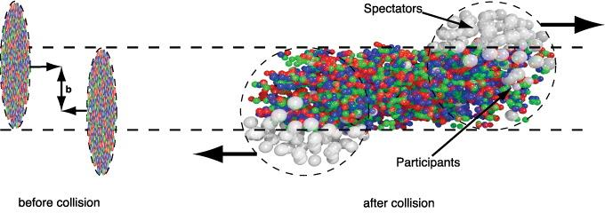
Some terminology and definitions
Impact parameter – b
• Nucleon-participants (𝑁𝑝𝑎𝑟𝑡) – nucleons collided at least once
• Nucleon-spectators (𝑁𝑠𝑝𝑒𝑐 = 2𝐴 − 𝑁𝑝𝑎𝑟𝑡) nucleons
which didn’t interact
• Number of nucleon-nucleon collisions (𝑁𝑐𝑜𝑙𝑙)
• Multiplicity of charged particles (𝑁𝑐h)

Slide 4
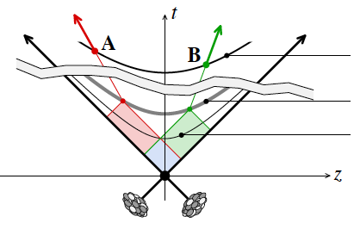
Some terminology and definitions
Stages of AA collision
detection
freeze out
Centrality of collision and Initial conditions
used in selection of classes of events
Proxies for the impact parameter b:
Multiplicity of charged particles
Nucleon-participants (𝑁𝑝𝑎𝑟𝑡)
Transverse energy (E_{T})
latest correlation
A.Dumitru et al., arXiv: 0804.3858
The initial state of collision is defined
by the collision centrality and dynamics
Fluctuations and Long-range correlations
Notes:
“ the large scale fluctuations
seen in the cosmological microwave background (CMB) and in the mass density
perturbations that result in galaxies.”

Slide 5
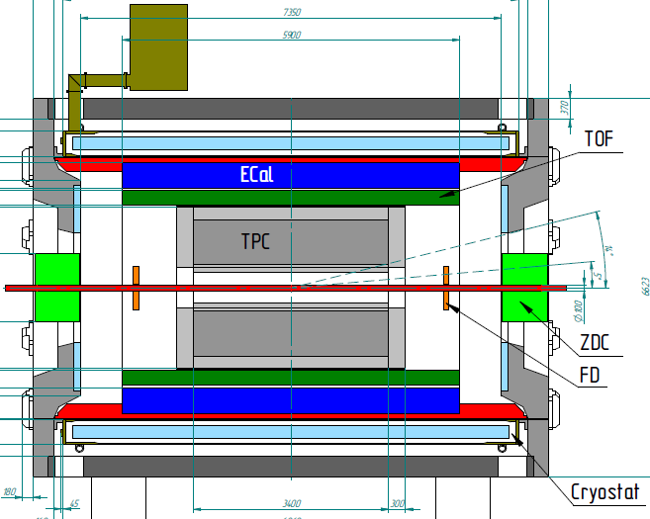
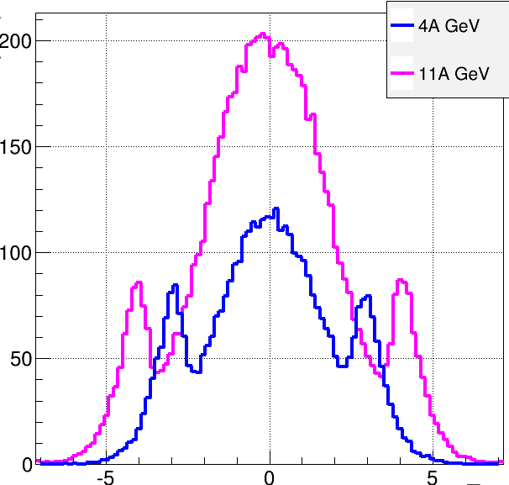
Multi-Purpose Detector (MPD)
stage I: TPC, TOF, ECAL, FHCal, FFD
stage II ( 2023): + ITS + EndCap (CPC, Straw, TOF, ECAL)
stage II
acceptance
URQMD
charged
b<11 fm
11 A GeV
4 A GeV
dN/dη
TPC
CPC
TOF
ECal
FFD
FHCal
FHCal
FFD
η
Selection of classes of events:
FFD, FHCal, Ecal, FFD… +Beam-Beam collisions counters
Notes:
The MPD will be put in operation at two stages. At the first one the barrel part will be equipped with major tracking detector TPC, TOF end ECAL. FHC and FD will be operational as well.
At the second stage the detector will be supplemented with IT and end cap subdetectors.

Slide 6
Initial conditions of multiparticle production
Task 1)
To measure, event-by-event, in pA and A+A collisions,
under well defined initial conditions, the following :
Event charge particle multiplicity
Event mean transverse momentum (p_{T})
Event transverse energy (E_{T})
Particle types and ratios
Event net charge
Number of nucleon-participants
(N_{part})
Event-plane and flow harmonics, etc.
A.Dumitru et al., arXiv: 0804.3858
initial state of collision is defined by
the collision centrality and dynamics

Slide 7
Initial conditions of multiparticle production
Task 2)
To get at the next step of analysis
the mean values of observables for carefully selected classes of events (-- i.e. for classes of well defined initial conditions) :
Mean charged particles density at midrapidity (<dN_{ch}/dη _{|η=0}>) for a given class of selected events
Pseudorapidity distribution (dN_{ch}/dη),
Total mean multiplicity (N_{ch})
Mean transverse momentum (<p_{T}>) and
Mean event transverse energy (<E_{T}>)
Mean values of particle ratios
PWG1: Global Observables
-

Slide 8
Initial conditions of multiparticle production
Task 3)
To define criteria for selection of classes of events (classes of well defined initial conditions).
Different estimators of centrality of A+A collision could be considered as a proxy for the impact parameter b:
-- Spectator nucleons (N_{s}) and number of nucleons-particpants(N_{part});
-- Event transverse energy (E_{T});
-- Multiplicity.
Selection of classes of events is very important for further studies of fluctuations and various correlations of observables, for studies of flow harmonics, light and heavy flavor yields, event shape engineering etc.
Nevertheless, the trivial fluctuations of the initial conditions could be large.
These “volume” fluctuations should be eliminated or taken into account in the event selection procedure
--- …..
PWG1: Global Observables
-

Slide 9
In the given report:
We consider 3 main directions of study:
1) Theoretical analysis of pp and AA collisions at NICA energies
-- modified Glauber approach to estimates of N_{coll in} AA collisions
-- quark-gluon strings formation and hadronisation
2) Model simulations using available event-generators and analysis of impact parameter distributions, classes of events and fluctuations of observables in AA collisions at NICA energies
— test of strongly intensive observables
---application of Identity method in separation of tracks of different particles
---…..
3) Development of a new concept of event-selection and beam-beam collisions monitoring

Slide 10
.
PART 1

Slide 11
Modified Glauber Model [1] for Au+Au collisions at NICA energies
The fixed portion (1-k) of momentum in the center of mass system[1] is lost by nucleon in each inelastic collision
Losses are due to the production of charged and neutral particles
Parameter k is defined by fitting the available experimental data on charged-particle multiplicity yields in AA collisions
Modified Glauber Model (MGM) calculations for Au+Au collisions at NICA energies (red lines – new results [A.Seryakov,G.Feofilov])
[1] G. Feofilov, A. Ivanov, Journal of Physics G CS, 5, (2005) 230-237.

Slide 12
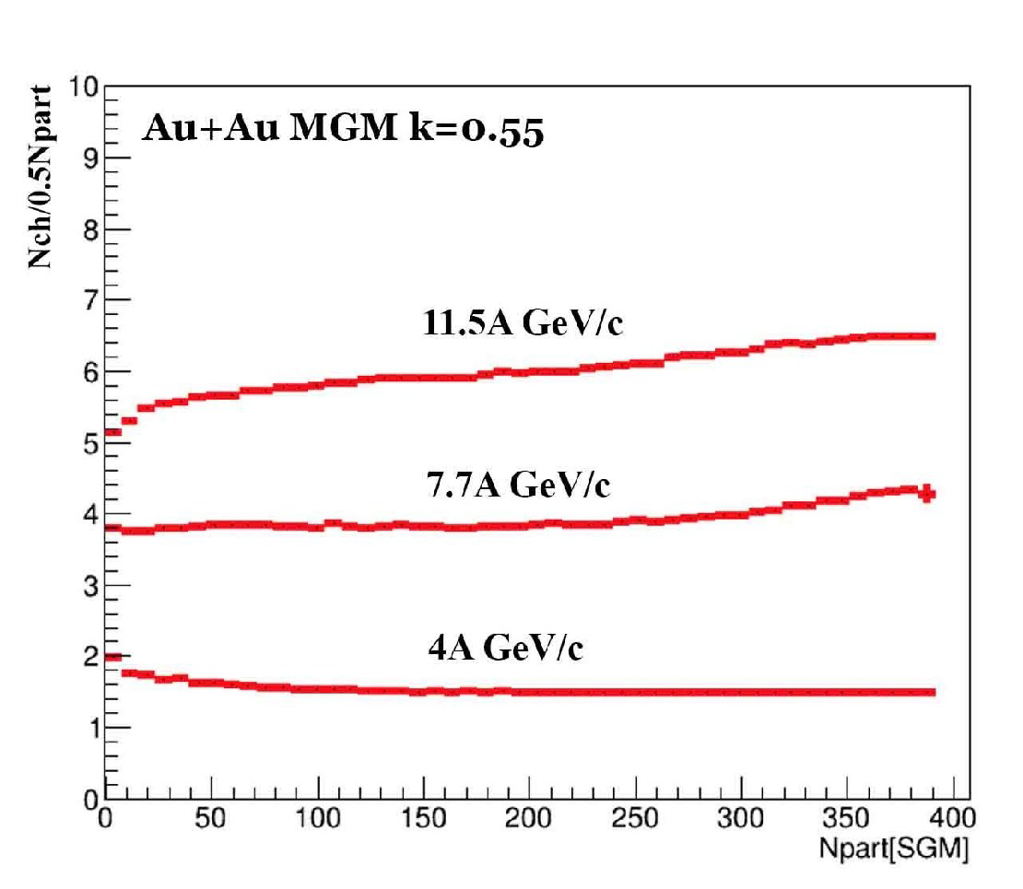
Modified Glauber approach (MGM) to estimates of N_{coll in} AA collisions
Total multiplicity of charged particles, normalized by the N_{part} vs. N_{part}
- our predictions for Au-Au collisions
for NICA energies calculations using the MGM with a momentum loss coefficient k = 0.55.

Slide 13
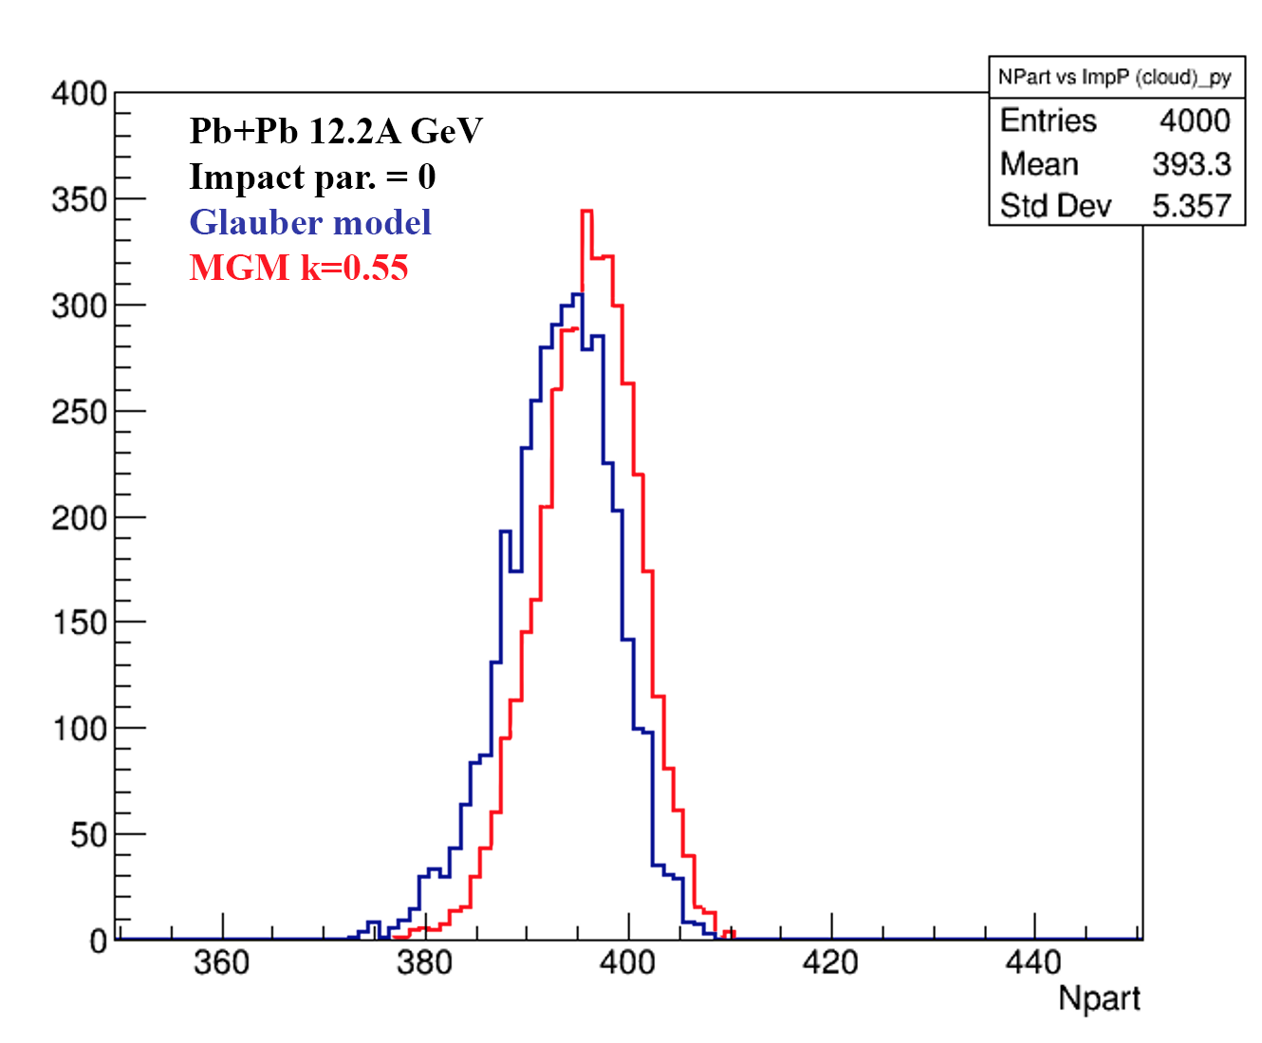
MGM and Standard Glauber for Au+Au collisions at NICA energies: mean values and fluctuations in N_{coll} and N_{part}
Glauber model and MGM calculations of N_{part} (left) and N_{coll} (right) for b=0 Au+Au collisions at NICA energies (red lines – new results [A.Seryakov,G.Feofilov])
Account of energy-momentum conservation in multiparticle production process decreases considerably values of N_{coll}

Slide 14
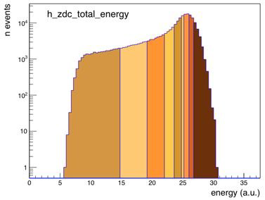
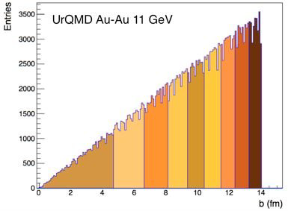
MC (SMASH and UrQMD) simulations of impact parameter distributions in Au--Au
Distribution of events generated in SMASH by impact parameter b: solid line - min. bias events, broken line - all
generated events.
Event classes (10% wide) in the range 0-90%, received by dividing the distribution of UrQMD events into 9 classes by the impact parameter (left) and energy distribution in the FHCal calorimeter (right).

Slide 15
Conclusions to PART 1
Predictions of the modified Glauber model
with the account of momentum and energy conservation in multiparticle production show considerable difference in such quantity as number on binary nucleon-nucleon collisions N_{coll} widely used in data analisys. This fact is under investigations and will be accounted for the MPD data event classes applications.

Slide 16
.
PART 2

Slide 17
Energy dependence of different processes in pp collisions
Dependence of the total scattering cross section for proton-proton
collisions and the contribution of individual processes to it. Generator Model Data SMASH events.

Slide 18
MC SMASH simulations— Strongly intensive variables
Σ [nF, nB] as a function of the distance between the pseudo-rapidity windows Δη, calculated for inelastic p + p interactions in the SMASH v.1.6 event generator for five energies: 4, 8, 11, 17.3 and 200 GeV. The width of the pseudo-rapidity windows is δη = 0.2. For each energy a million events were generated. Statistical error calculated by the subsample method.

Slide 19
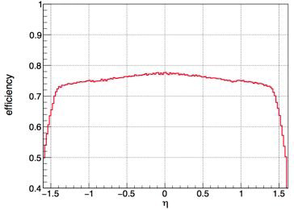
UrQMD simulations and reconstruction
Left: distribution of particles (sim) and reconstructed tracks (rec) over
pseudo-rapidity in UrQMD simulations (left).
Right: registration efficiency tracks as a function of pseudorapidity, for the pT range (0.1, 2.0 GeV / s).
Preliminary estimates based on simulated MPD datasets, located in the zfs storage.

Slide 20
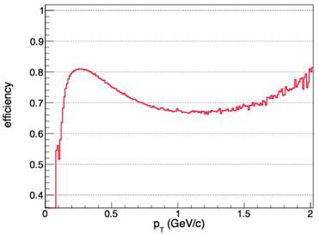
UrQMD simulations and reconstruction
Left: distribution of particles (sim) and reconstructed tracks (rec) over
transverse momentum (pT) in UrQMD simulations (left).
Right: efficiency registration of tracks as a function of pT (in the range | η | <1.6).
Conclusions to PART 2?

Slide 21
MC SMASH Σ [nF, nB] simulations for AA collisions
. Σ [nF, nB] as a function of the distance between the pseudo-rapidity windows Δη, calculated for inelastic p + p interactions (1M events), central (b = 0 fm) C + C (300k events), Cu + Cu (30k events) and Au + Au (5k events) collisions in event generator SMASH v.1.6 for an energy of 4 GeV per nucleon pair.
Width pseudo-rapidity windows δη = 0.8 For each energy 1mln events. The statistical error is calculated using the subsample method.

Slide 22
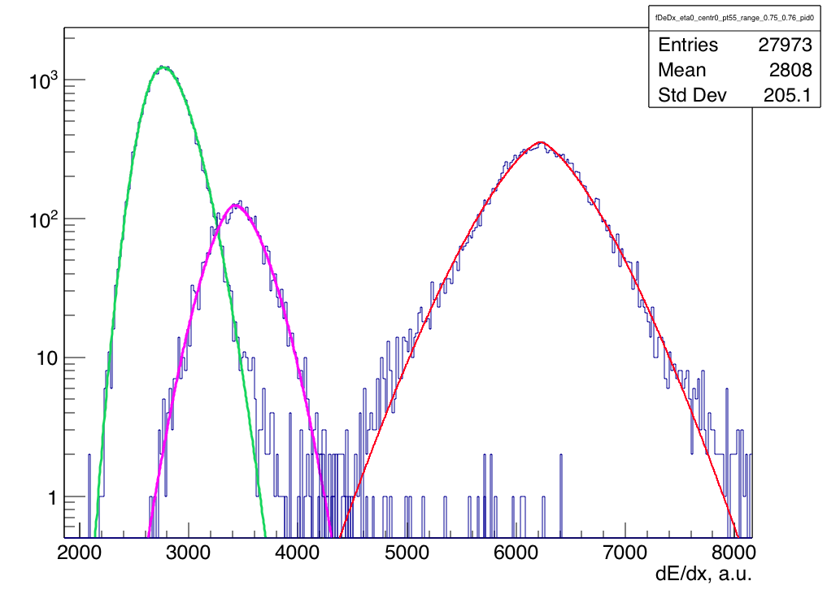
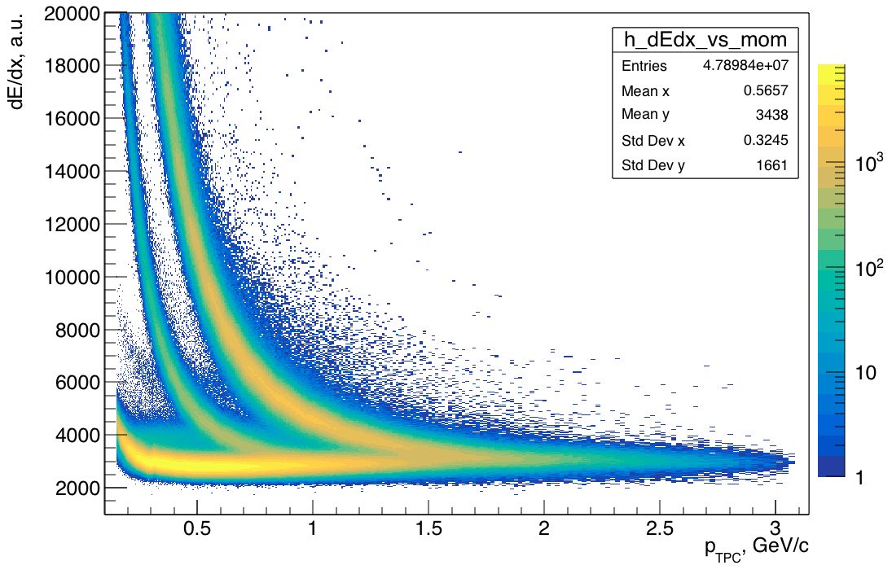
Identity Method for moments of particle distributions with MPD
The idea: Identity Method eliminates the effect of particle mis-identification using these probabilities, and allows for the calculation of pure and mixed moments of multiplicity distributions.
arxiv.1103.2887, arxiv.1106.4473, arxiv.1204.6632, arxiv:1807.06370
Example: momentum slice 0.75-0.76 GeV/c:
Fits: Generalized Gauss
pions
kaons
protons
First moments
Moments corrected with the IM can be used for:
Fluctuations of particle yields in full acceptance (e.g. net-proton)
Forward-Backward correlations of identified particles
etc.

Slide 23
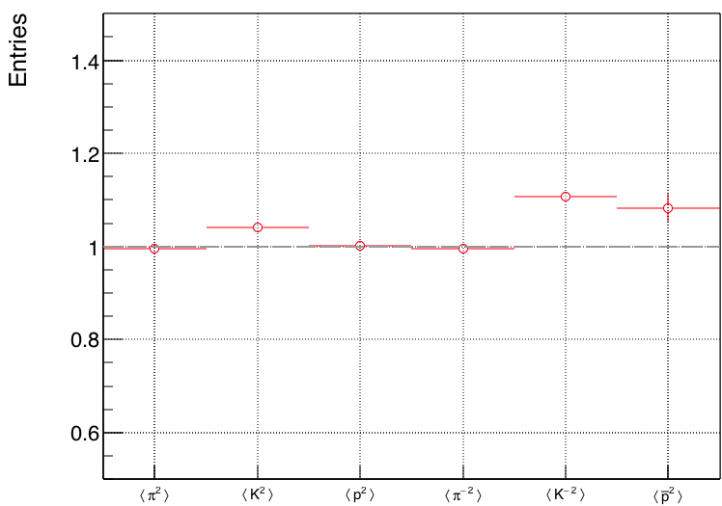
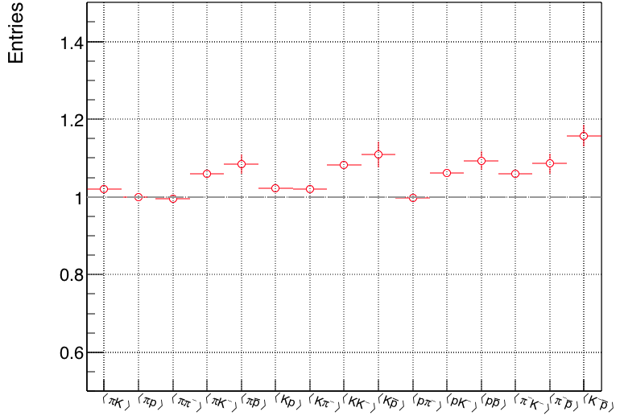
Identity Method: ratio to the truth moments
SMASH events + GEANT + reco, BiBi @ 9.46 GeV
centrality 0-20% (by mult. in TPC)
|η|<1, p in 0.3–1.2 GeV/c
Second moments
Mixed moments
Ratio IM / truth
Ratio IM / truth
Reasonable quality is achieved in these first tests
Room for improvement:
dE/dx fits
Increased statistics
(Reported at PWG3 today)

Slide 24
Conclusions to PART 2
The application of Identity methods is checked at NICA energies using MC event-generators data. It is shown to be useful in particle identification in AA collisions at MPD/NICA
It is shown that application of strongly intensive variables at NICA energies in the acceptance of the MPD could have a discriminative power in the analysis of data. In particular, besides the elimination of trivial volume fluctuations it shows sensitivity to formation of new types of particle-emitting sources

Slide 25
.
PART 3

Slide 26
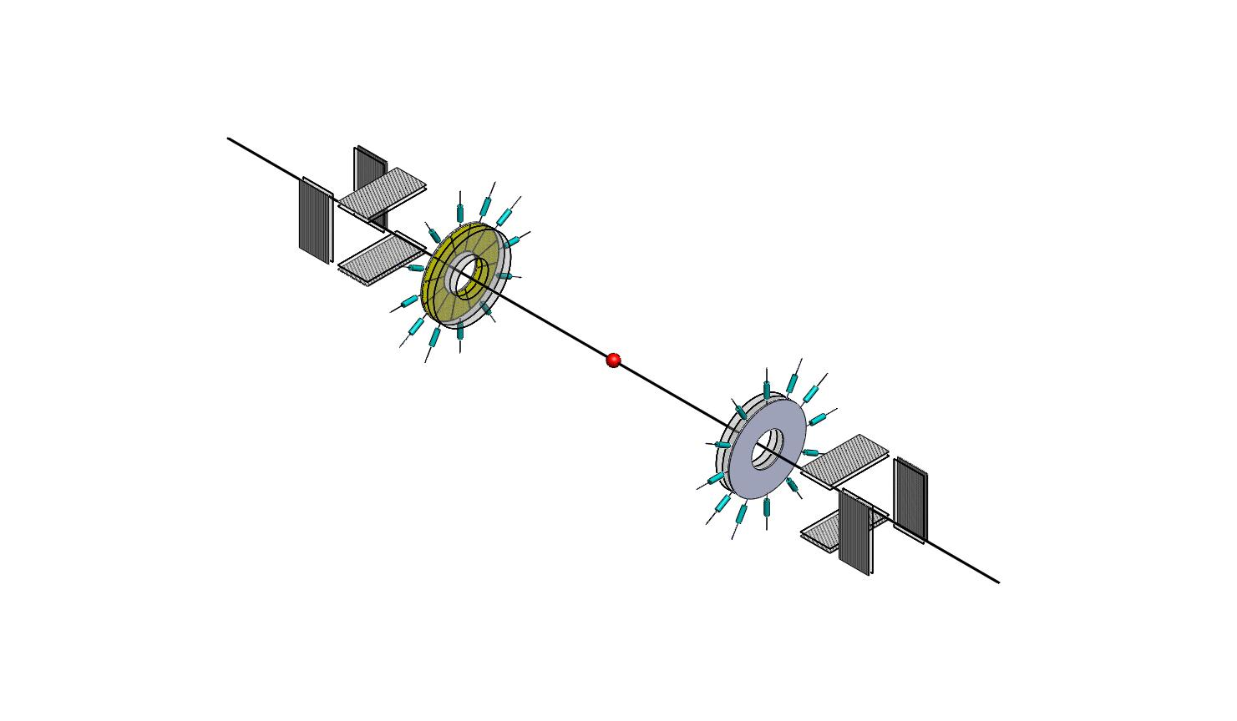
MCP-based solutions for Beam Position Monitor (BPM) and Fast Beam-Beam Collisions counters (FBBC) for NICA
(1) Fast monitoring of the beam position and profile (FBP) (2) The event-by-event fast monitoring of beam-beam collisions (FBBC)
NIMA62154
DOI: 10.1016/j.nima.2019.04.108

Slide 27
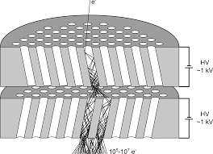
Micro Channel Plates (MCPs) as a MIP detector [1,2]
Active target-converter
MCP-Amplifier
Readout anodes
[1]A.Baldin,G.Feofilov,F.F.Valiev et al.
Microchannel plates as a detector for 800 MeV/c charged pions
and protons. // JINR Rapid Communications. 1991. No 4/50/-91. p.27-36.
[2] A.A.Baldin, G.Feofilov,Yu.Gavrilov, A.Tsvinev,F.Valiev,
Proposals for a new type of microchannel-plate-based vertex detector// NIM A323. 1992. p. 439-444.

Slide 28
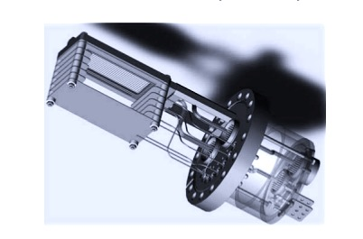
First test results of the beam profile
Monitoring
MCP-based device for fast monitoring of the beam profile (FBP) at the NUCLOTRON [1]
[1] A.Baldin, A.Berlev, I.Kudashkin, A.Fedorov, Space-time characteristics of the circulating beams, Letters to ECHAIA, 2014, vol.11, №2 (186), p.209-218

Slide 29
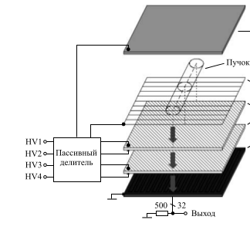
Beam Position Monitor (BPM) [1].
Anode
Gating grid
MCP-1
MCP-2
Strip readout
Beam
[1] A.Baldin, A.Berlev, I.Kudashkin, A.Fedorov, Letters to ECHAIA, 2014, vol.11, №2 (186), p.209-218

Slide 30
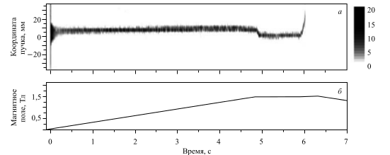
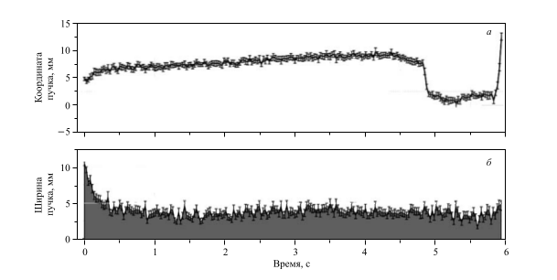
Space-time characteristics of the circulating beams
TESTS AT NUCLOTRON, JINR
Example of the deutron beam
position measurements
by using the residual gas
interaction MCP-based detector
at the NUCLOTRON.
The energy of deutron beams
was= 4GeV,
beam intensity -10⁸,
Vacuum 10⁻⁸ Torrr.[1]
[1] A.Baldin, A.Berlev, I.Kudashkin, A.Fedorov, Letters to ECHAIA, 2014, vol.11, №2 (186), p.209-218
Notes:
МКП детектор на выводе пучка из Нуклотрона
Собранный ранее, новый детектор на МКП (49Х64мм, 32канала, разрешение 2мм. ) был смонтирован в специально изготовленную камеру, установленную на выводе пучка между шибером и выходной мембраной.
Установка была успешно испытана на отсутствие течей, подключена к регистрирующей системе, проверена на работоспособность и настроена на существующий уровень электрических помех.
В течении всего сеанса проводилась регистрация данных детектора в различных режимах его работы с целью детального изучения его возможностей и недостатков.
В результате проведённых измерений было выявлено следующее:
- подтверждена принципиальная возможность использования МКП детектора в качестве неразрушающего профилометра на выведенном пучке.
- выявлены недостатки в конструкции детектора, систем регистрации и отображения в условиях его конкретного специфического расположения в зоне повышенного фона рассеяния. Эти недостатки будут устранены или минимизированы при модернизации существующего и (или) изготовлении новых детекторов.

Slide 31
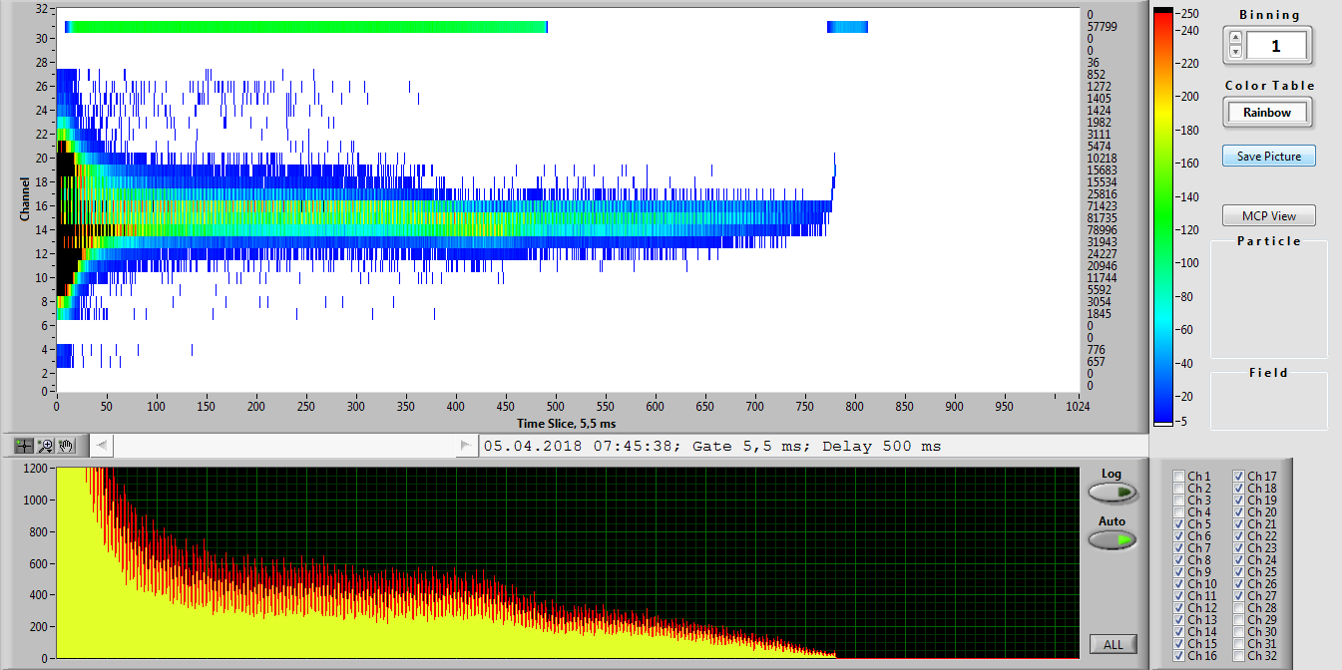
Space-time characteristics of the circulating beams
TESTS AT NUCLOTRON, JINR in February-April 2018
Dynamic profile of an accelerated krypton beam inside the NUCLOTRON accelerator ring (Vertical readings of the upper pattern in mm).
Example of the Kr beam position measurements at the NUCLOTRON. The energy of beams was 3.5GeV , beam intensity --10⁶, vacuum { 10⁻⁸ Torrr. Time Slice = 5,5 ms. Y scale has 3 mm channel bin width.
Notes:
Работы проделанные в рамках сеанса февраль-апрель 2018.
МКП детекторы на 7-м прямолинейном участке кольца Нуклотрона в районе станции внутренних мишеней.
Накоплен богатый методический материал по работе детектора на основе МКП, расположенного внутри кольца Нуклотрона на теплом прямолинейном промежутке в районе станции внутренних мишеней. Информация о пространственно временном расположении пучка в ускорителе передавалась в on-line режиме на пульт Нуклотрона и пульт линейного ускорителя. Детектор был запущен в начале работы с пучками углерода и выключен 05.05.2018 в 20:00 Детектор успешно проработал весь сеанс. Обеспечено круглосуточное, непрерывное предоставление информации в графическом виде в режиме on-line на пульт Нуклотрона и пульт линейного ускорителя ЛУ-20.

Slide 32
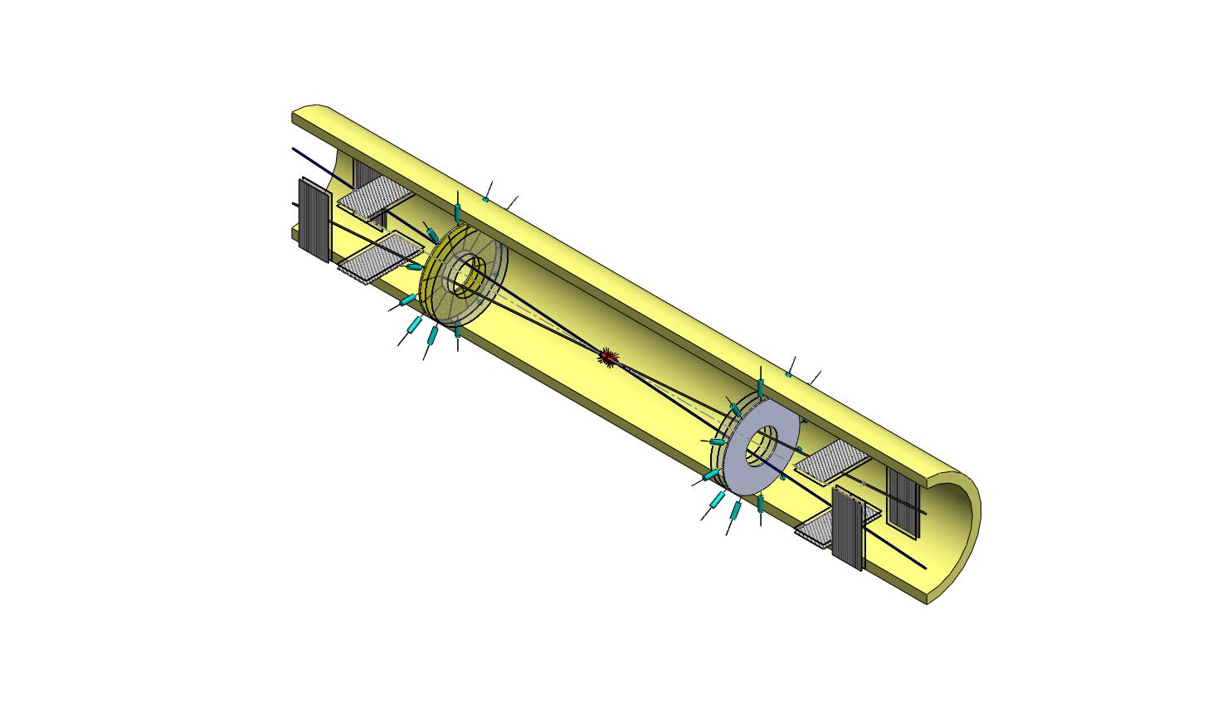
Fast Beam-Beam Collisions monitoring (FBBC)
(1) fast monitoring of the beam profile (FBP) (2) The event-by-event fast monitoring of beam-beam collisions
FBP
FBBC
FBBC
FBP
NIMA62154
DOI: 10.1016/j.nima.2019.04.108

Slide 34
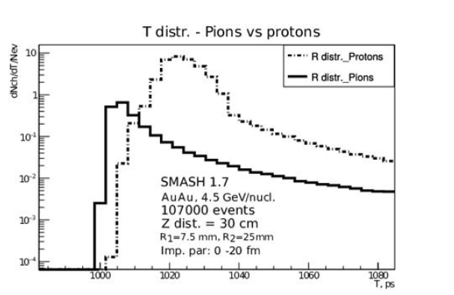

Slide 35
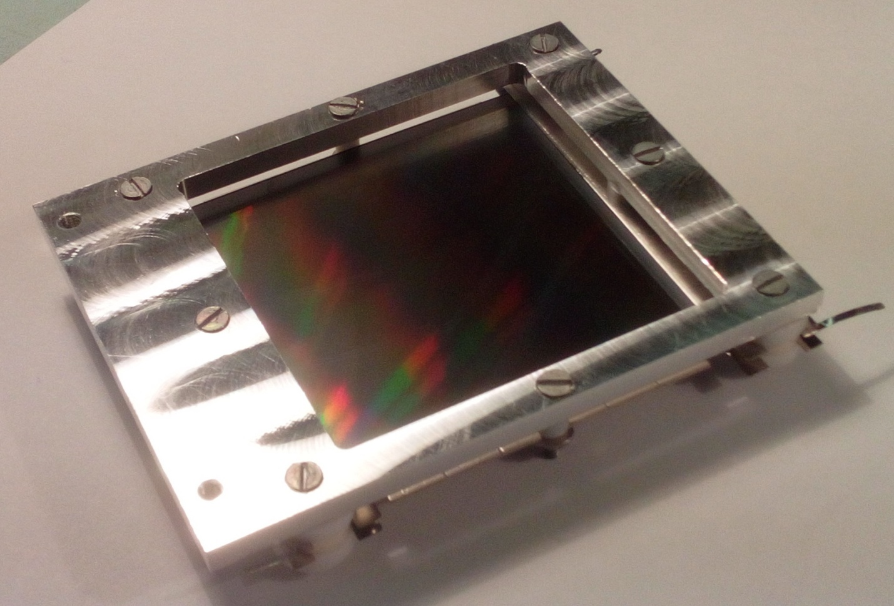
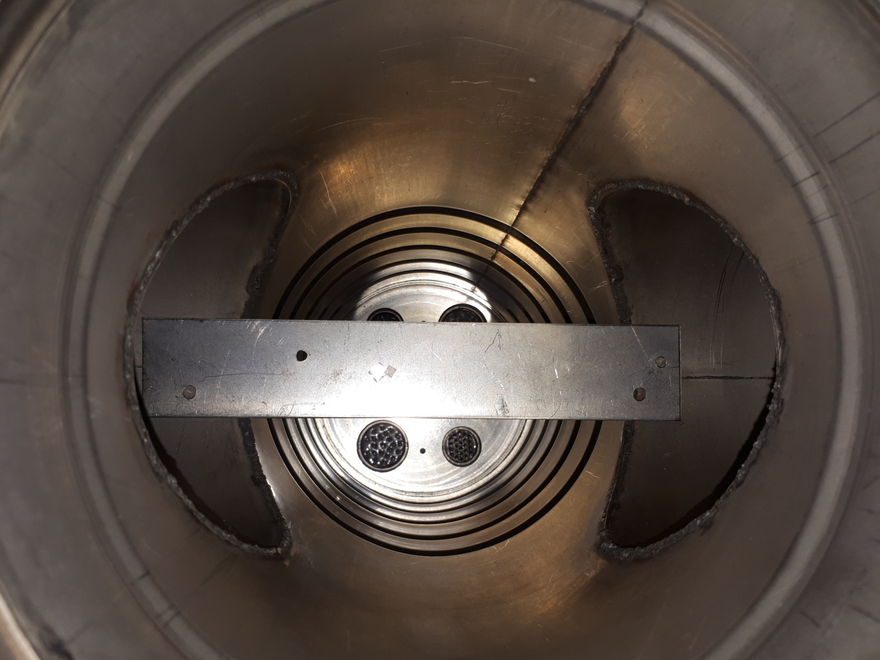
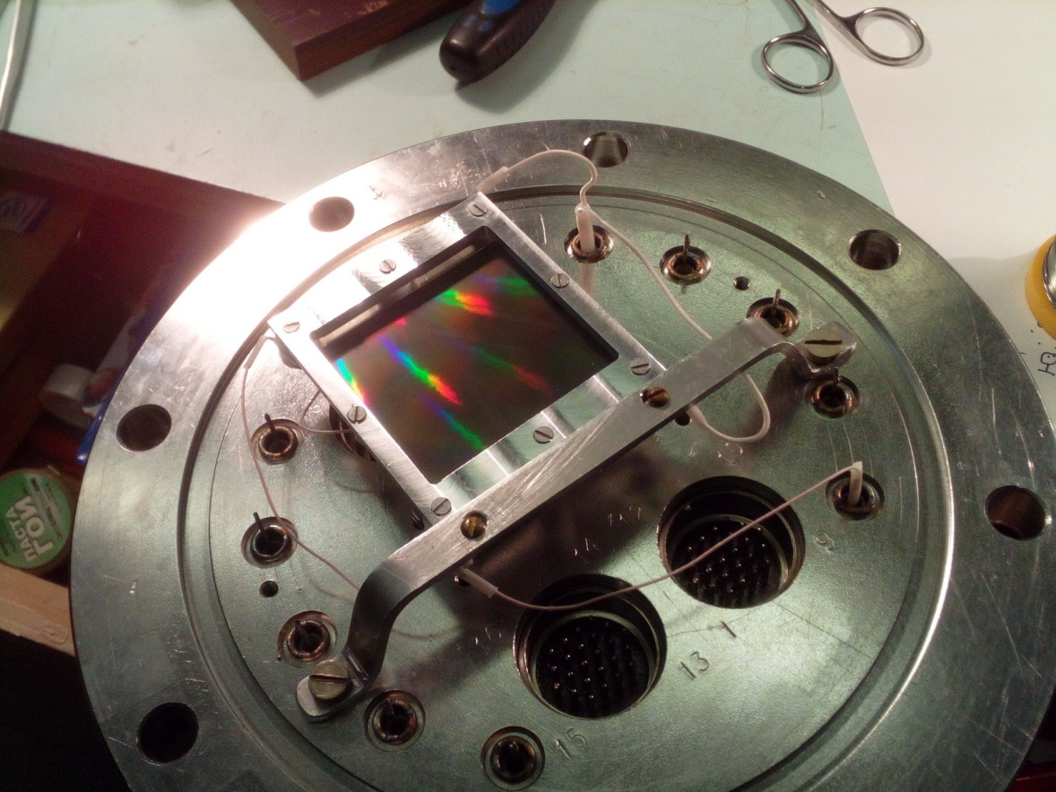
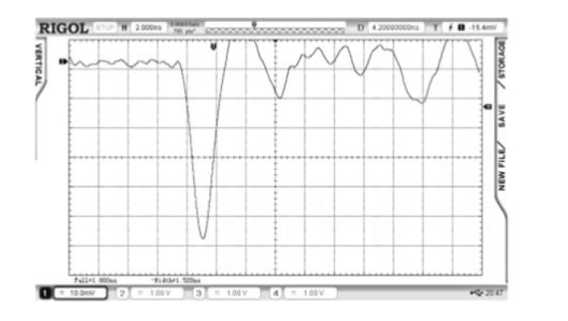
For Test set-ups at JINR and SPbSU
for Micro Channel Plates
MCPs: 43x63, 6mkm channel
https://baspik.com/eng/products/mkp/
²⁴¹Am
The ultra-high vacuum (UHV) compatibility and low-mass compact design.

Slide 36
Conclusions to PART 3
Compact beam-beam collisions (BBC) monitor is proposed for NICA beams at the MPD and future SPD installations.
The high timing resolution allows, for each event of collision, the event-selection in the Interaction Region, beam-gas collision suppression, fast precise trigger signal.
The work on new centrality selection criteria base on the TOF separation of pions and protons with this BBC is in progress

Slide 37
BACK-UP SLIDES

Slide 38
1) Theoretical analysis of pp and AA collisions at NICA energies-- quark-gluon strings formation and hadronisation
???

Slide 39
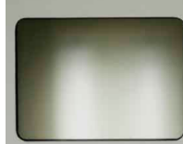
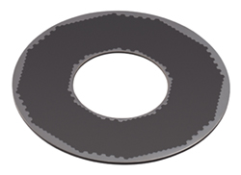
Micro Channel Plates
OPTIONS:
High resolution rectangular 43x63 mm² MCPs
with 6-15 µm - channel diameter -- could be used for the BPM
2) Sector type MCPs with the multipad isochronous readout
of the MCP array--could be used for the FBBC
3) MCP 56-15ch 12-15 with 15 µm - channel diameter
--could be considered for a very compact FBBC
placed inside the vacuum beam pipe
(Dimensions: 24 mm center hole and
the outer diameteris 60 mm)
OPTIONS:
VTC "BASPIK" detectors with a gap clearance between MCPs (with separated power supply). https://baspik.com/eng/news/456/
This unique feature helps to get amplification gain factor above 1×10⁷

Slide 40
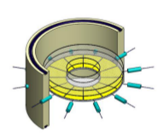
Fast Beam-Beam Collisions monitoring (FBBC) conceptual design
Compact module of the Fast Beam-Beam Collision Monitor (FBBC) based on the circular MCP chevron setup.
Sector cathode readout pads and two MCP set-ups are embedded
into a vacuum flange with hermetic 50 Ohm signal and HV feedthroughs.

Slide 41
Micro Channel Plates (MCPs)
as a MIP detector
[1]A.Baldin,G.Feofilov,F.F.Valiev et al. ,”Microchannel plates as a detector for 800 MeV/c charged pions and protons.” // JINR Rapid Communications. 1991. No 4/50/-91. p.27-36.
[2] A.A.Baldin, G.Feofilov,Yu.Gavrilov, A.Tsvinev,F.Valiev, “Proposals for a new type of microchannel-plate-based vertex detector”, // NIM A323. 1992. p. 439-444.
…
[3]V.Bondila, L.Efimov D.Hatzifotiadou, G.Feofilov, V.Kondratiev, V.Lyapin, J.Nysten, P.Otiougova, T.A.Tulina, W.H.Trzaska, F.Tsimbal, L.Vinogradov, C.Williams, Results of in-beam tests of an MCP-based vacuum sector prototype of the T0/centrality detector for ALICE, NIM A, Volume 478, Issues 1–2, 1 February 2002, Pages 220-224.
…
[4] G. Feofilov, V. Kondratev, O. Stolyarov, T. Tulina, F. Valiev, and L. Vinogradov, Development and Tests of MCP Based Timing and Multiplicity Detector for MIPs, ISSN 1547-4771, Physics of Particles and Nuclei Letters, 2017, Vol. 14, No. 1, pp. 150–159. © Pleiades Publishing, Ltd., 2017.

