Slide 1
DLNP Science and Technology Council
10 December 2020, Dubna
Elections for the position of the head of the electron cooling sector
Applicant: Krzysztof Siemek

Slide 2
Development of experimental techniques and applied research with slow monochromatic positron beams (PAS)
DLNP Science and Technology Council
10 December 2020, Dubna
Project leaders: K. Siemek^{a),b)} ,A.G.Kobets^{a),c)}
Scientific leader: I.N.Meshkov^{a)}
^{a)} Dzhelepov Laboratory of Nuclear Problems of Nuclear Problems JINR, Joliot-Curie 6, 141980 Dubna, Moscow region, Russia
^{b)} Institute of Nuclear Physics PAS, E. Radzikowskiego 152, 31-342 Krakow, Poland
^{c)} Institute of Electrophysics and Radiation Technologies, NAS of Ukraine, Chernyshevsky St. 28, 61002 Kharkov, Ukraine
Aim: Creation of a modern positron annihilation research laboratory for structural characterization of solids.

Slide 3
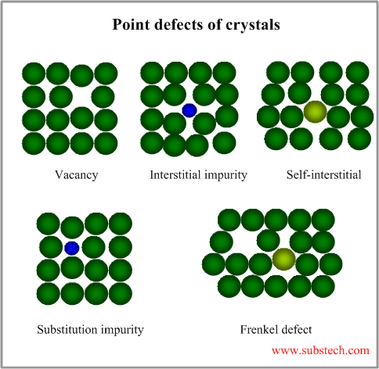
Positron annihilation spectroscopy (PAS)
Positron annihilation spectroscopy (PAS) is a suitable tool for studying changes in the material structure. It is a sensitive method for the detection of open-volume defects such as vacancies, vacancy clusters, dislocations etc.
PAS techniques:
angular correlations of gamma quanta
Doppler Broadening spectroscopy (DBS)
positron annihilation lifetime spectroscopy (PALS)
Possibilities:
defect characterization on the atomic scale
investigations of non-equilibrium defects created by irradiation or plastic deformation
studies of defect interactions
investigations of thermal stability of defects and defect recovery with increasing temperature

Slide 4
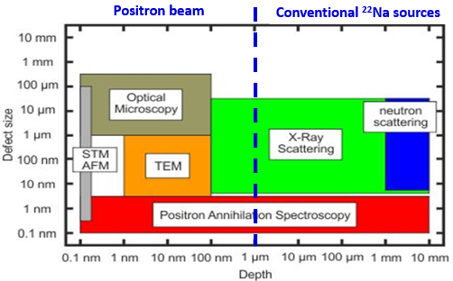
Measurements possibilities at DLNP
Doppler Broadening spectroscopy (DBS)
Doppler Broadening spectroscopy (DBS)
positron annihilation lifetime spectroscopy (PALS)

Slide 5
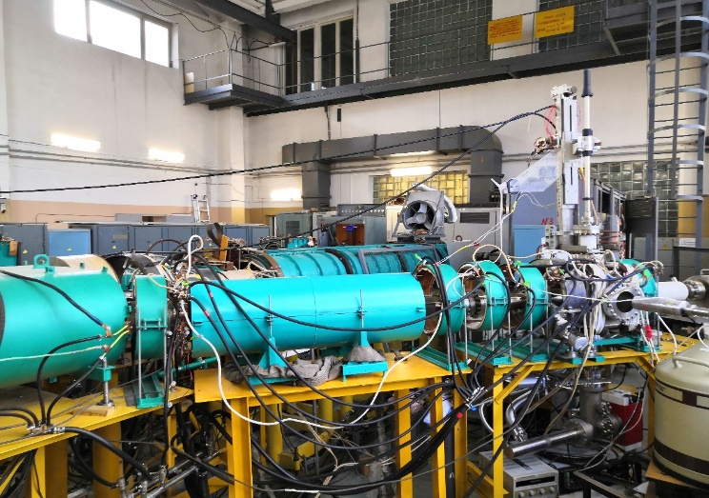
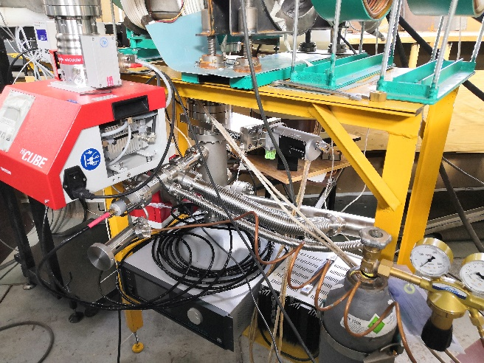
Project progress and plans
Realized in 2018-2020:
The slow positron specialized channel
construction was completed
The new method of ordered flux was invented
A system of reactive ion etching was developed
Equipment for the Coincidence Doppler Spectroscopy method was gathered
Experimental research was conducted in several areas
Plans:
Implementation of method of ordered flux
Continuation of experimental research

Slide 6
Current investigations
Studies of the destructive process:
Studies of materials for usage in IV type nuclear reactors - Institute of Nuclear Physics PAS, Cracow [dr. P.Horodek], University of Szczecin [prof. K.Czerski], JINR [dr. V. A. Skuratov, dr M.N. Mirzayev, dr E.P.Popov];
Studies on high irradiation resistivity materials, nanostructuration –PTU Tomsk [dr R. Laptev];
Cavitation, wear, corrosion process- Institute of Nuclear Physics PAS, Cracow [prof. J.Dryzek], Northern Arctic Federal University, Arkhangelsk [dr. M.Eseev];
Studies of modification of materials:
Surface modification by ion implantation in semiconductors and MOS structures – JINR, UMCS Lublin [dr M.Kulik];
Surface modification of zeolite ZSM-5 by irradiation - CNT Hochiminh [dr Luu Anh Tuyen];
Study of defects in optical materials - IGM SB RAS and NSU, Novosibirsk [dr. L.I. Isaenko, dr. A. P. Yelisseyev], JINR [dr. A.V Belushkin];
The role of defects in magnetic properties in BaTiO₃ nanopowders - STU, Voronezh [prof. L.Korotkov,];
Mechanical modification of materials – sandblasting, hydrostatic extrusion, surface modification attrition techniques -Institute of Nuclear Physics PAS, Cracow [dr. P.Horodek, dr. E.Dryzek], AGH University, Cracow [dr. M. Wróbel], Rzeszów University of Technology [dr. W. Nowak].

