Slide 1


LXX International conference NUCLEUS – 2020
Saint Petersburg, Russia, 11-17 October 2020
Perspectives of strangeness study
at NICA/MPD
from realistic Monte Carlo simulation
  J. Drnoyan, V. Kolesnikov,
  A. Mudrokh, V. Vasendina, A. Zinchenko
  for the MPD collaboration VBLHEP, JINR, Dubna, Russia

Slide 2

Outline
MPD/NICA project: niche, tasks and observables
NICA Complex: parameters
MPD detector performance: geometry, tracking, PID
Hyperon analysis: signals, phase space, p_{T} -spectra
Summary

Slide 3
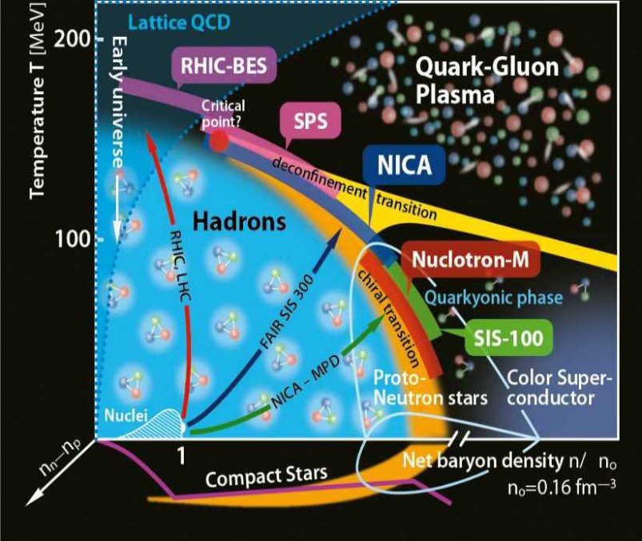
NICA niche in HIC and Strangeness production
Excitation function of hadrons, including strangeness (yields, spectra, and ratios)
Nuclear matter EOS, in-medium effects, and chemical equilibration can be probed
Hyperons sensitive to early stage and phase transformations in QCD medium
Non-monotonic strangeness-to-entropy ratio seen in heaviest systems (phase transformation?)
NICA (μB = [320-850] MeV) - highest net baryon density
Non-trivial energy dependence of multiple probes: strangeness production, flow, hyperon polarization
High luminosity guarantees sufficient event rate for rare probes (hypernuclei and multistrangeness)

Slide 4

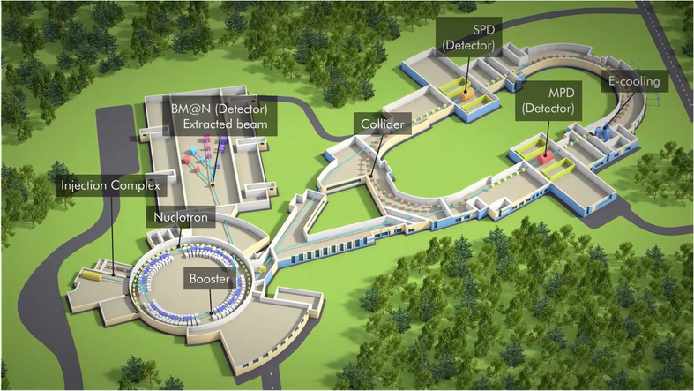
NICA Complex in Dubna
New flagship project at JINR (Dubna)
Based on the technological development
of the Nuclotron facility
Optimal usage of the existing infrastructure
Modern facility incorporating new
technological concepts
NICA parameters:
Beams: p, d, ...¹⁹⁷Au⁷⁹⁺
Collision energy: 4-11 GeV (nuclei)
Luminosity: 10²⁷ cm⁻²s⁻¹ (Au), 10³² cm⁻²s⁻¹ (p)
2 Interaction points: MPD and SPD
Fixed target: 1-6A GeV beams (BM@N)

Slide 5
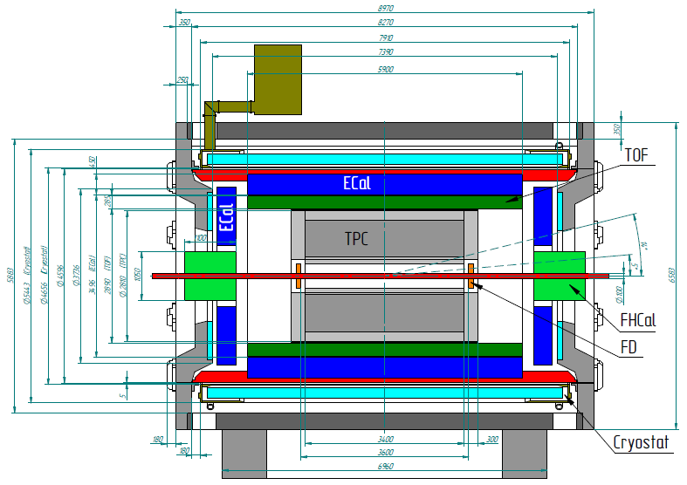
Multi-Purpose Detector @ NICA
Hermeticity, homogenous acceptance: 2π in azimuthal angle
Highly efficient 3-D track reconstruction (|η|<1.8), high resolution vertexing
Powerful PID: π/K up to 1.5 GeV/c, K/p up to 3 GeV/c, ECal for γ, e
Careful event characterization: impact parameter & event plane reconstruction
Minimal dead time, event rate capability up to ~ 6 kHz
Magnet: 0.5 T superconductor
Tracking: TPC, ECT, IT
Particle ID: TOF, ECal, TPC
T0, Triggering: FD
Centrality, Event plane: FHCal
MPD Collaboration:
11 Countries
505 participants
38 Institutes and JINR
Au+Au collision in MPD

Slide 6
Main goal
Configuring and testing the updated reconstruction and identification package.
Hyperons are a convenient tool for this purpose. They are characterized by a small cross-section of interaction with the nuclear medium, and, consequently, carry information about the early stages of the emergence of nuclear matter.
Changes since the previous hyperon analysis:
New MPD geometry
Realistic detector response
Realistic track reconstruction in TPC, improved separation of tracks
New PID in TPC and TOF
Tuning of the low-p_{T} reconstruction

Slide 7
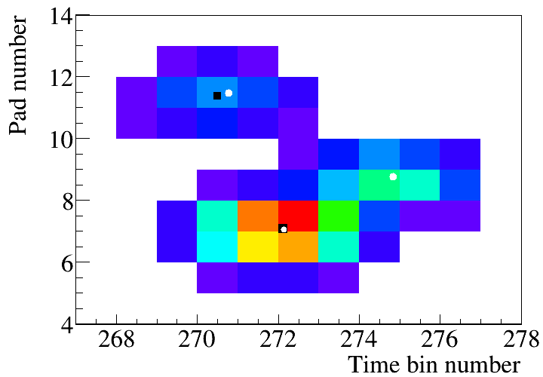
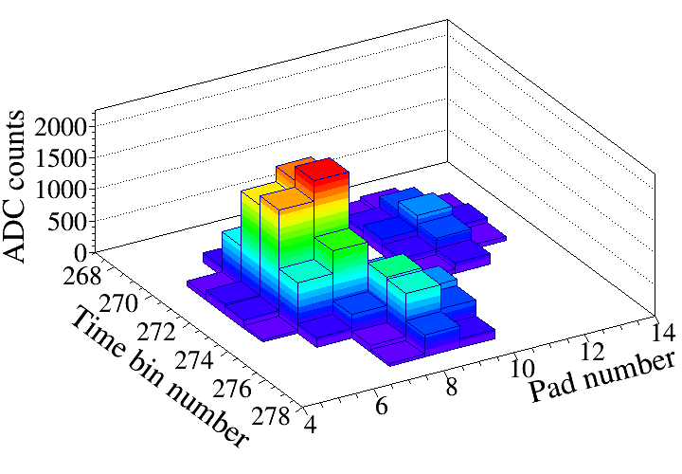
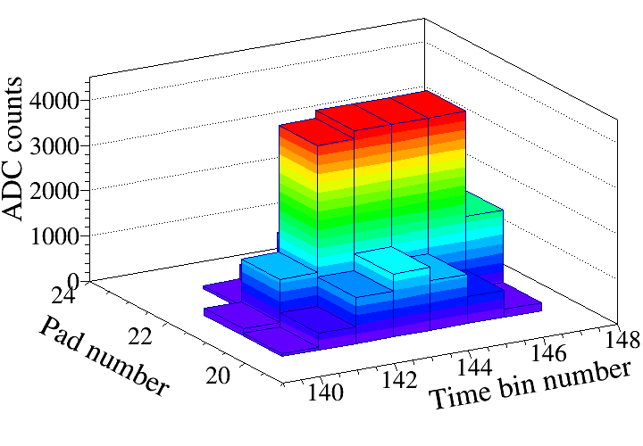
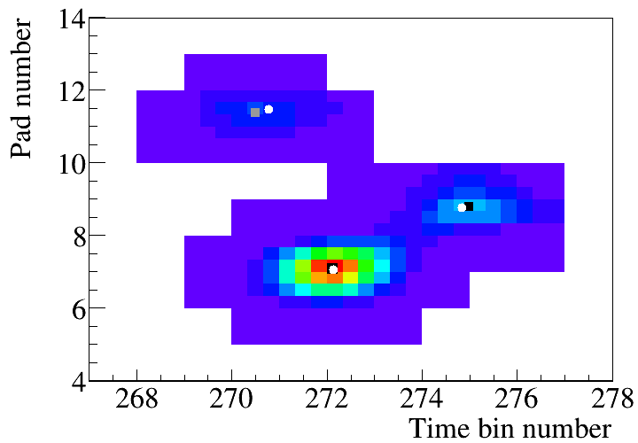
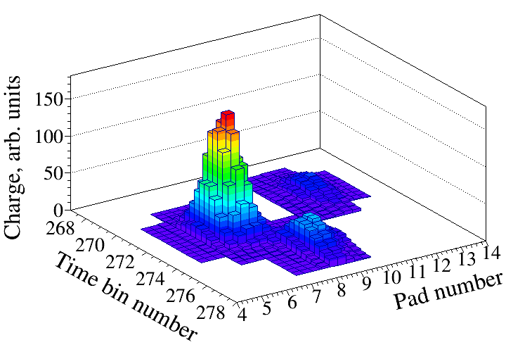
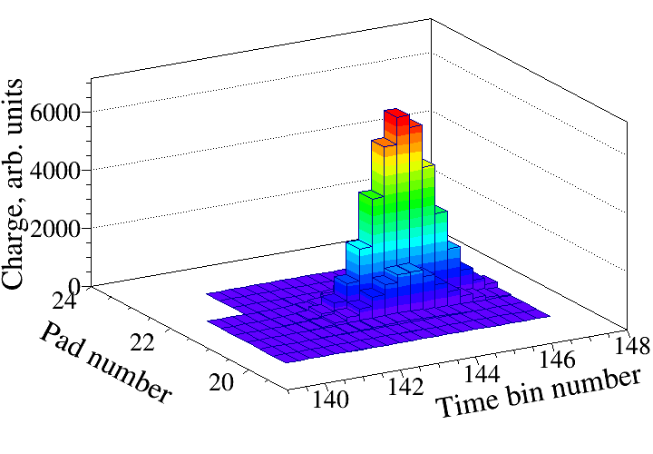
Cluster topologies and
Maximum Likelihood - Expectation Maximization procedure
2D and 3D views of a precluster of three tracks
3D view of a cluster with overflows
before
after MLEM
True hit coordinates - , Reconstructed hit coordinates - . On the top left plot one hit has not been reconstructed.
Bottom - 2D and 3D views of the same precluster after the MLEM procedure.
Top - ADC output: charge loss because of overflows;
Bottom - signal recovery using undistorted measurements from the tails after MLEM procedure.

Slide 8
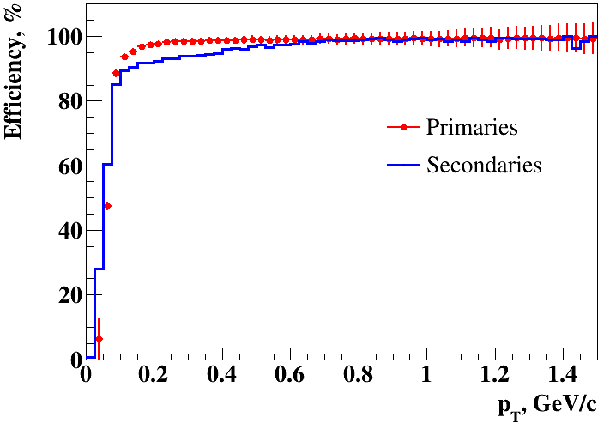
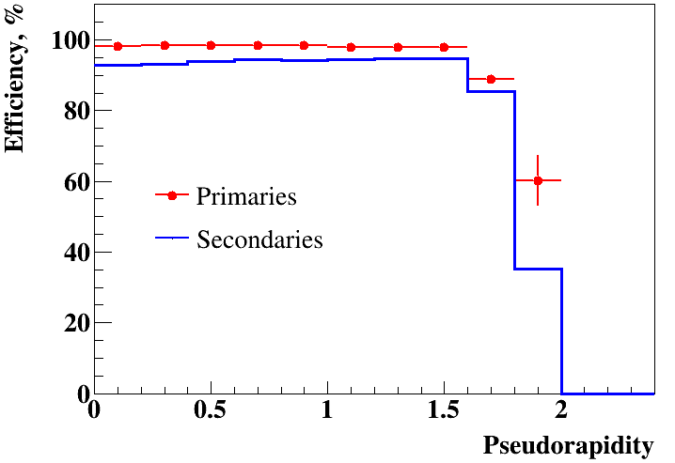
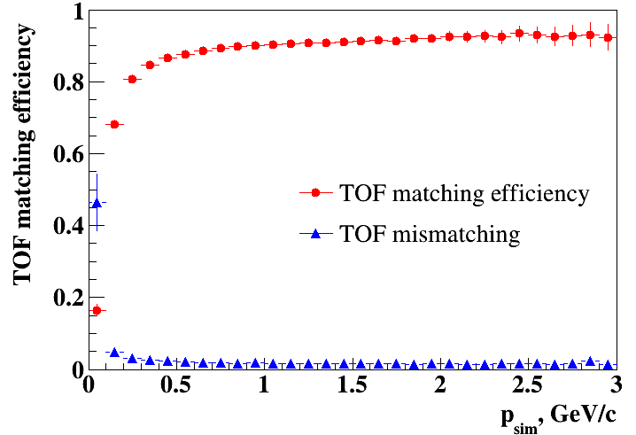
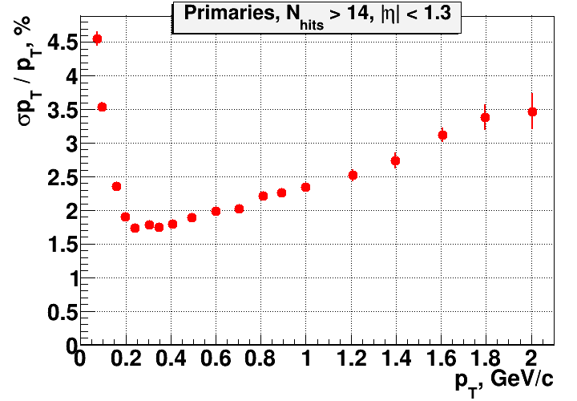
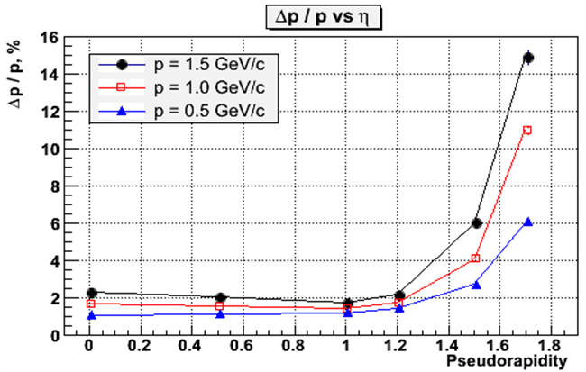
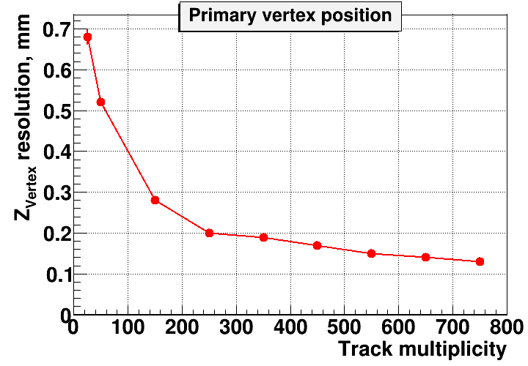
Realistic MPD simulation and reconstruction
Based on realistic event simulation within the MPDRoot framework
TPC

Slide 9
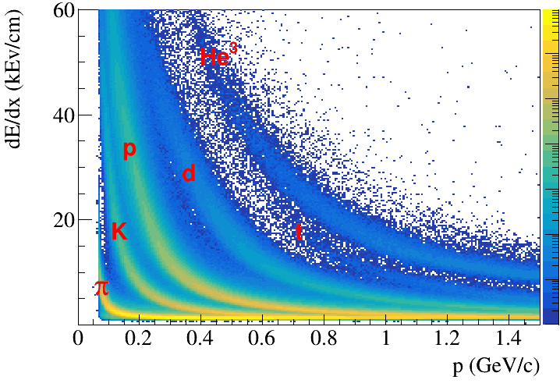
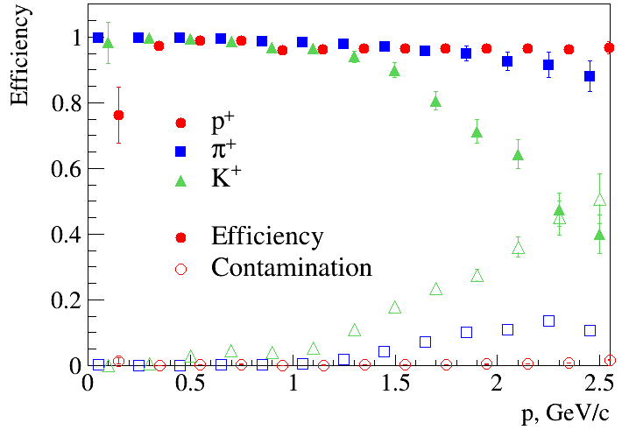
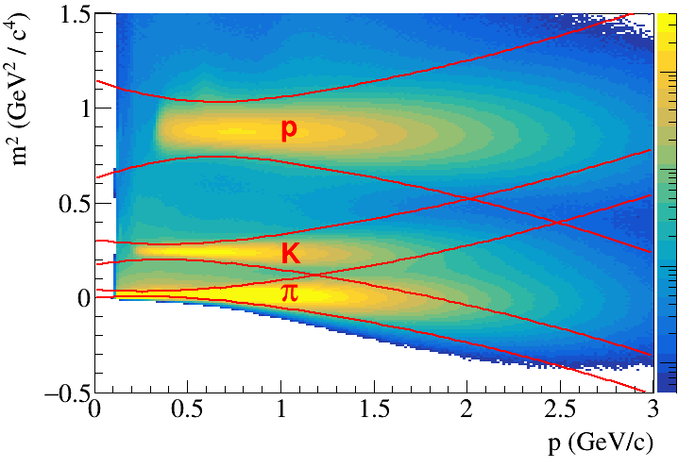
PID performance at MPD (TPC+TOF)
dE/dx vs momentum in TPC
Combined PID for primary positive tracks
(dE/dx in TPC + m² in TOF):
efficiency and contamination
m² vs momentum in TOF
Mass square calculated using the measurements of momentum (p)
time-of-flight (T)
trajectory length (L):
Selection criteria for events and tracks:
|Z_{PV}| < 50 cm
Primary particles
N_{TPC_hits} ≥ 27
|η| < 1.3

Slide 10
Data set
Generators: PHSD, Au+Au @ 11 GeV, min. bias, 8M events (~6 hours of running time at starting
luminosity - 1/20 of design value)
Detectors: start version of MPD with up-to-date TPC & TOF
Cluster / hit reconstruction: precluster finder (group of adjacent pixels in time bin – pad space) ; hit
finder (“peak-and-valley” algorithm either in time bin – pad space (for simple topologies) or in time-
transverse coordinate pixel space after Bayesian unfolding (for more complicated topologies) ) →
COG around local maxima
Track reconstruction: two-pass Kalman filter with track seeding using outer hits (1st pass) or
leftover inner hits (2nd pass)
Track acceptance criterion: |η|< 1.3, N_{hits} ≥ 10
Particle Identification: dE/dx in TPC & m² in TOF
Vertex reconstruction: Kalman filter based formalism working on MpdParticle objects

Slide 11
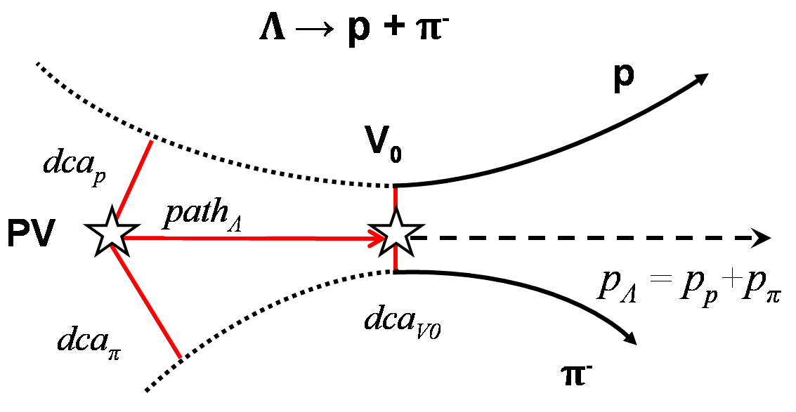
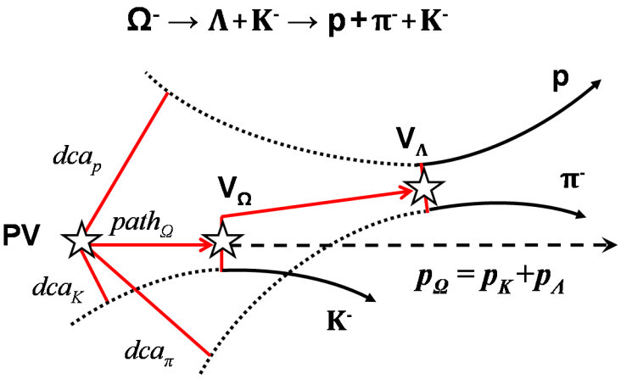
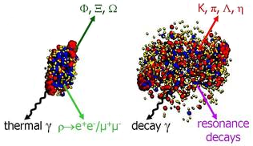
Physics Motivation and Analysis Goals
Analysis Goals:
Secondary Vertex Reconstruction algorithms development for multistrangeness analysis
Optimization of selection criteria in p_{T} and centrality
Analysis macros for invariant spectra reconstruction
Estimates of MPD efficiency and expected event rates
Analysis Method: Secondary Vertex Finding Technique
Event topology:
PV – primary vertex
V₀ – vertex of hyperon decay
dca – distance of the closest approach
path – decay length
Efficiency = (reconstructed, identified and selected Hyp at |η| < 1.3) /
(all generated Hyp after GEANT, radius ≤ 50 cm from PV) – includes branching ratios, detector acceptance and reconstruction efficiency

Slide 12
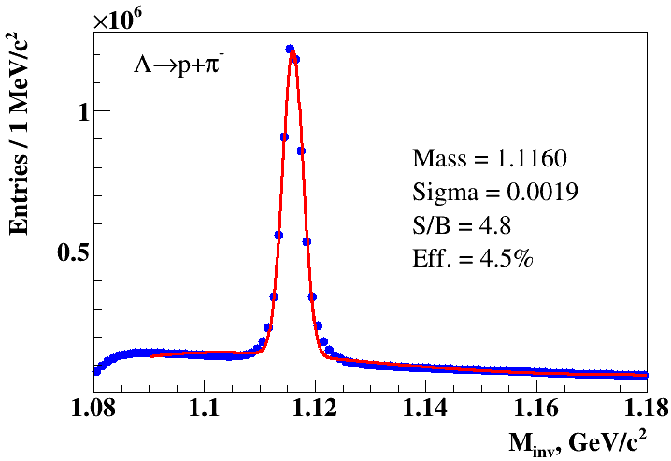
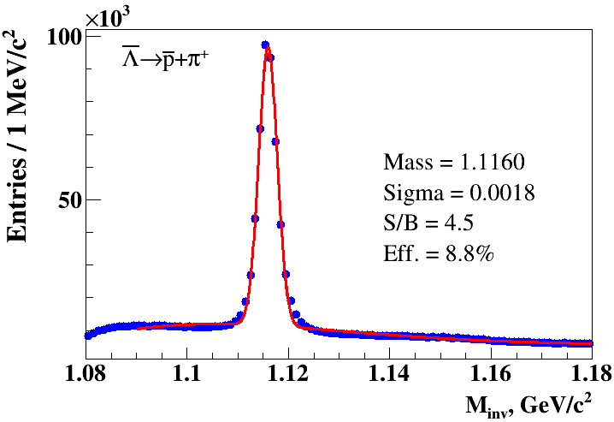
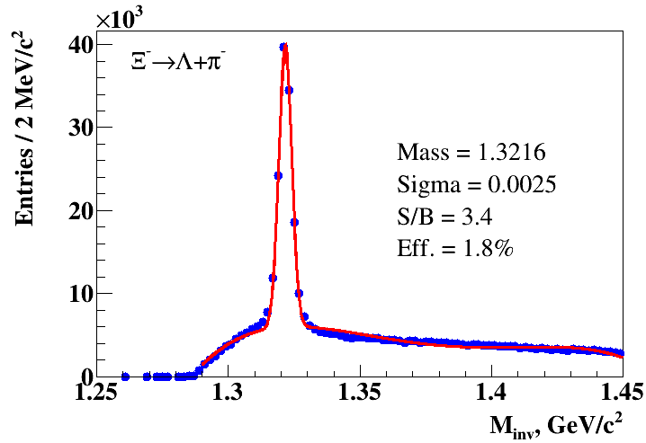
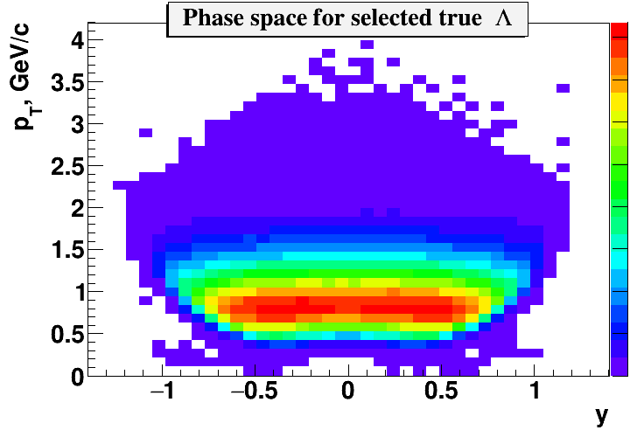
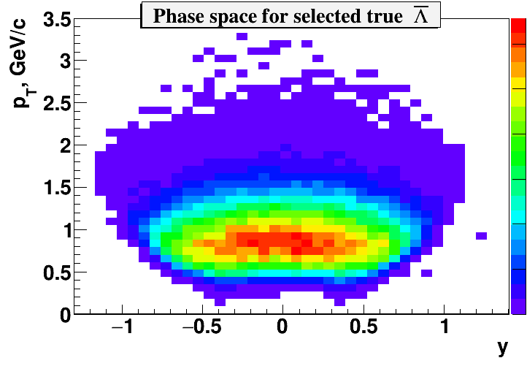
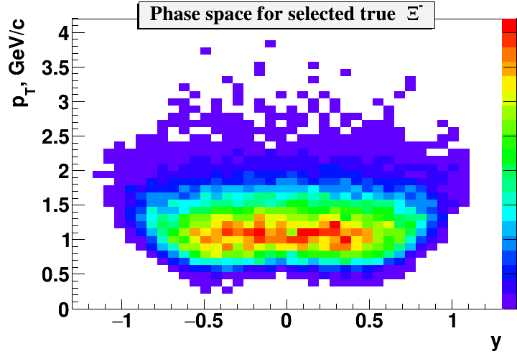
Λ, Λ, Ξ⁻ reconstruction and Phase space
Eff. (for |y|<0.5) =10.4% Eff. (for |y|<0.5) =14.1% Eff. (for |y|<0.5) =3.6%

Slide 13
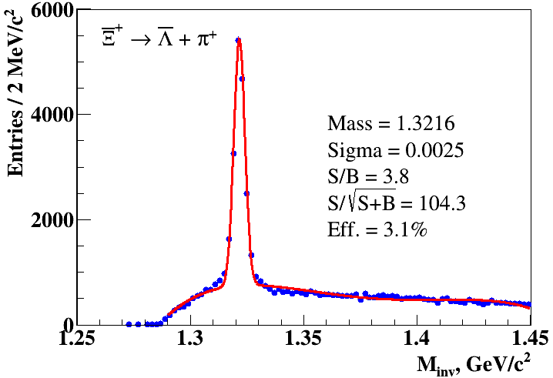
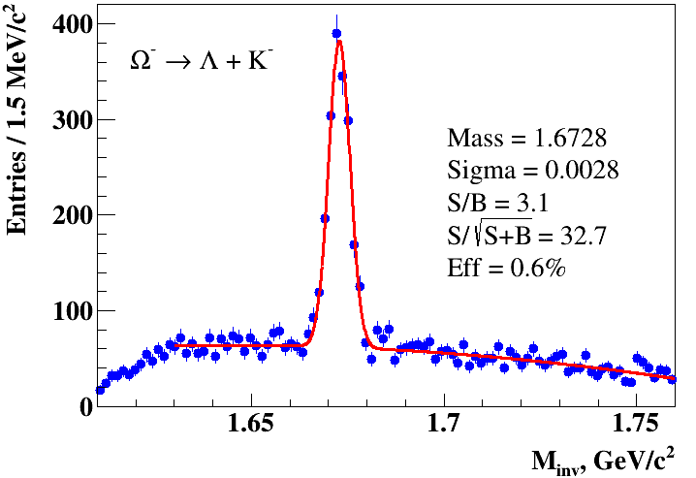
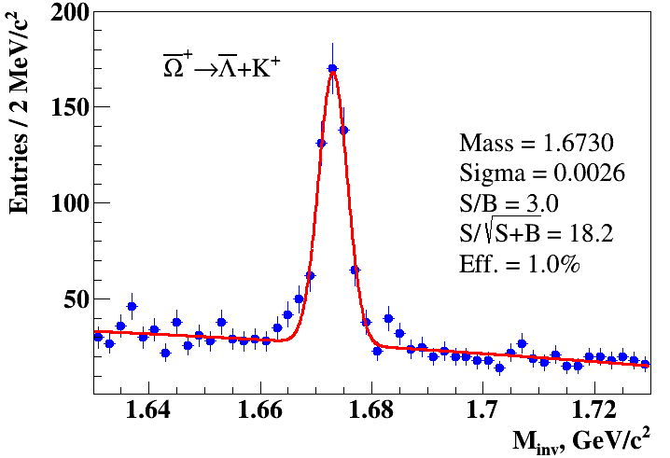
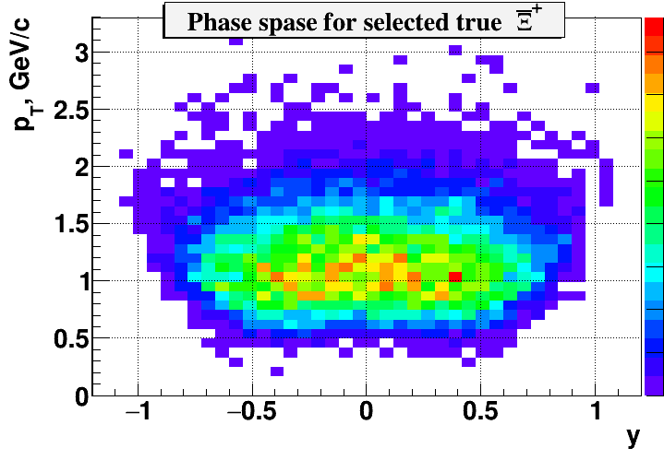
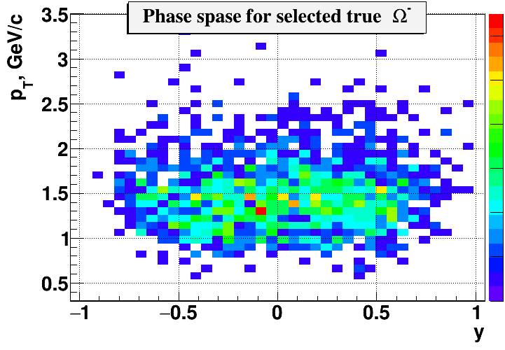
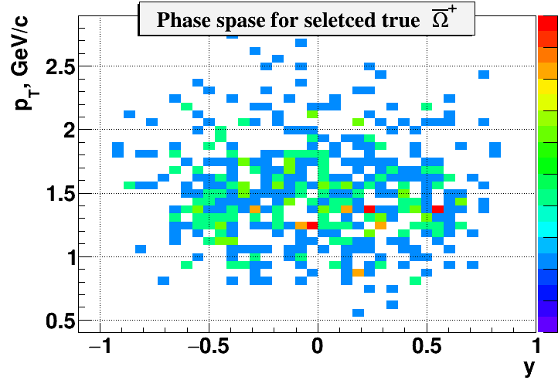
Ξ⁺, Ω⁻, Ω⁺ reconstruction and Phase space
Eff. (for |y|<0.5) =4.7% Eff. (for |y|<0.5) =1.1% Eff. (for |y|<0.5) =1.5%

Slide 14
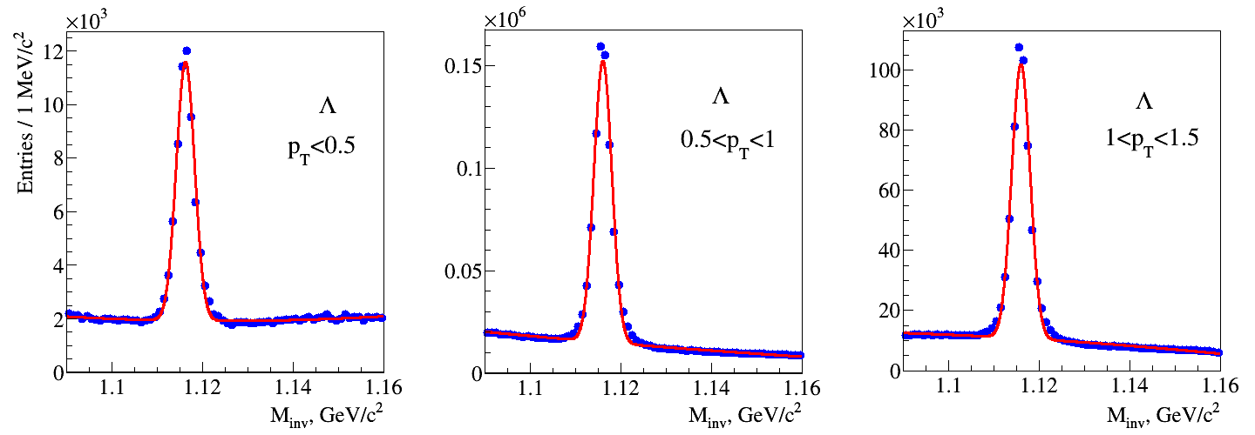
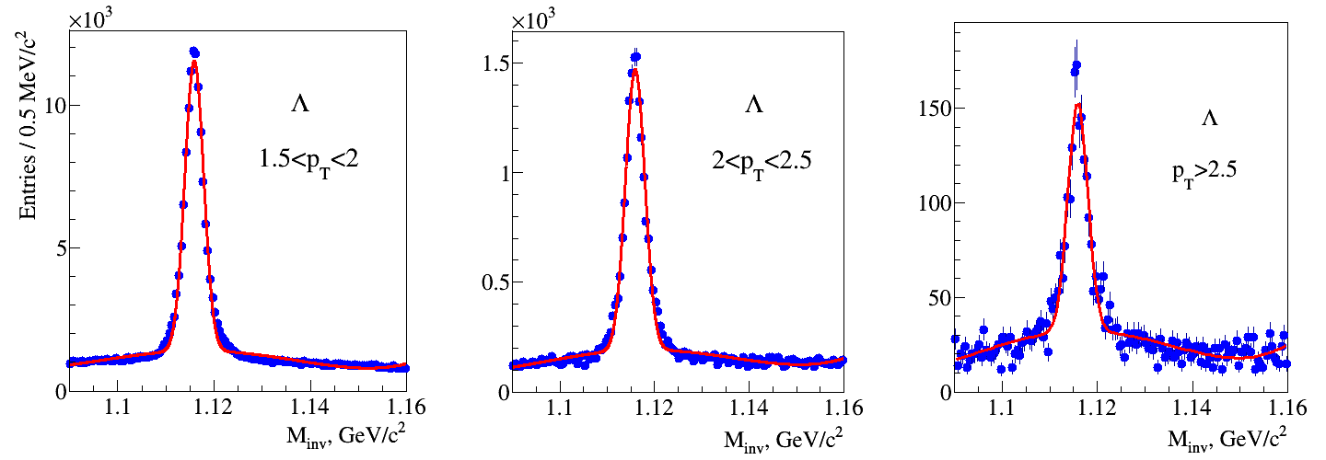
p_{T} dependence of Λ for all centralities

Slide 15
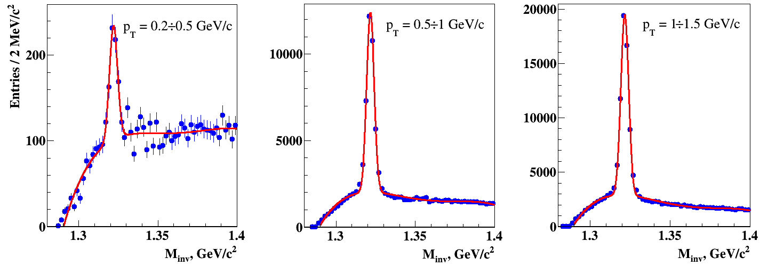
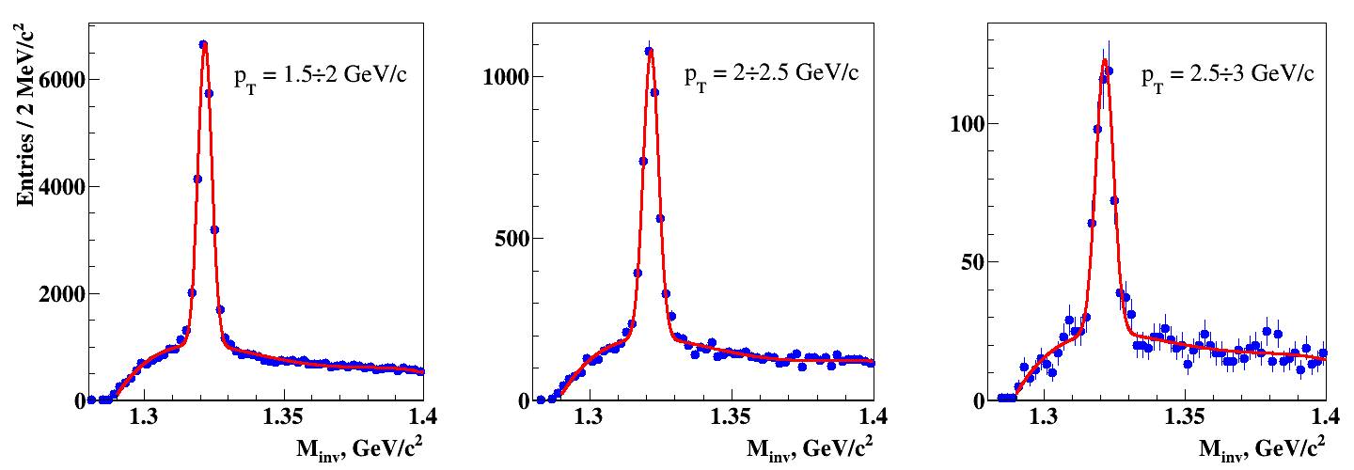
p_{T} dependence of Ξ⁻ for all centralities

Slide 16
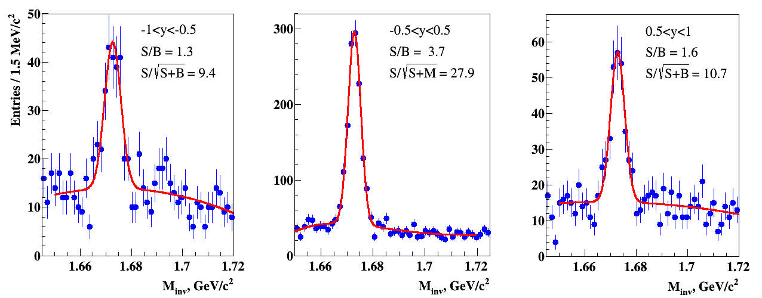
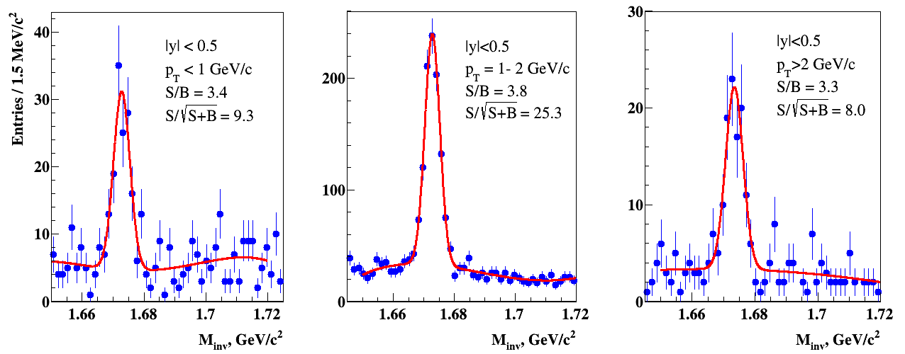
Ω⁻ hyperon: y & p_{T} dependence

Slide 17
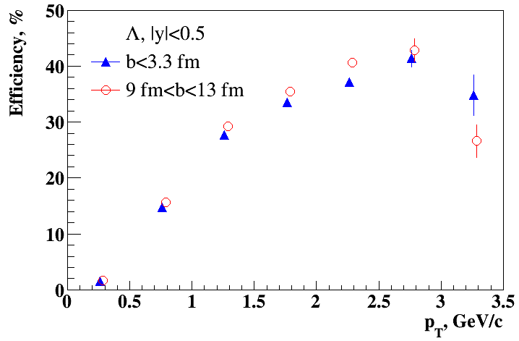
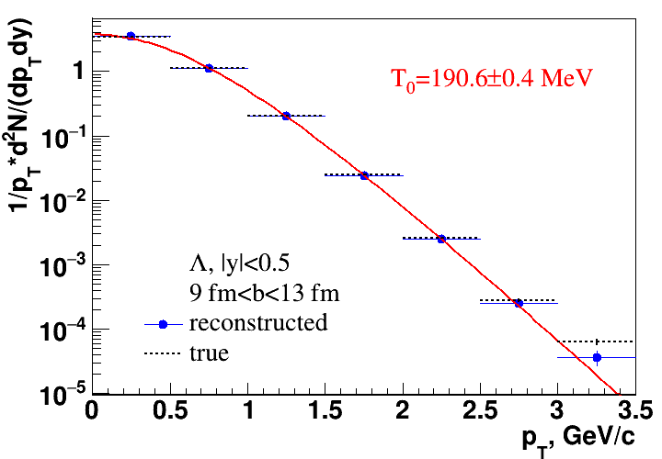
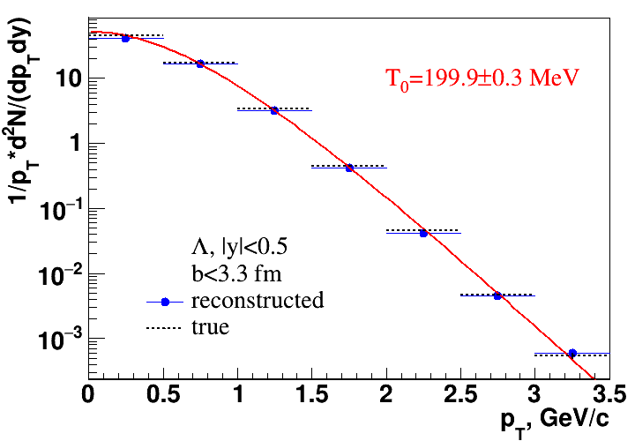
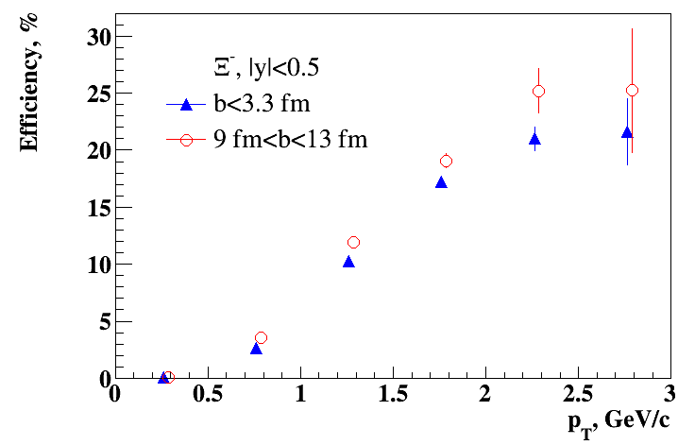
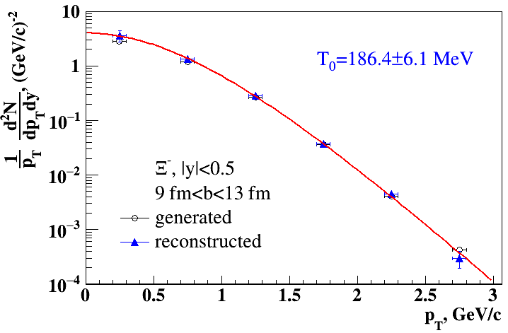
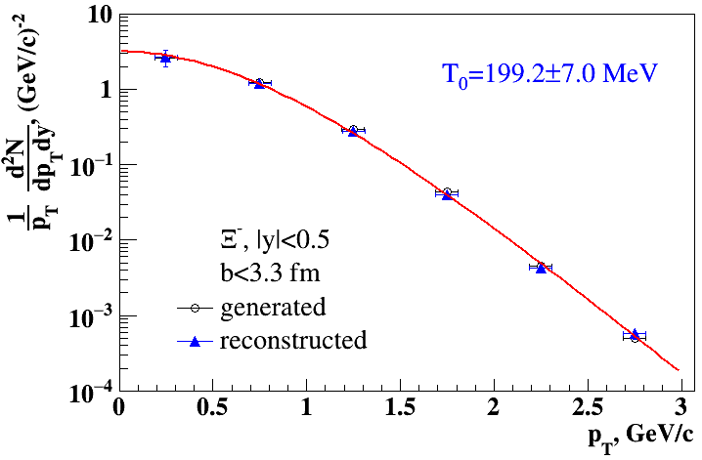
Λ & Ξ⁻ reconstruction: efficiency and p_{T} spectra
Efficiency of true Hyp in p_{T} and b bins for |y|<0.5: (reco & select Hyp) / (all gen Hyp)
Reconstructed invariant p_{T} spectrum: fit of selected Hyp in each bin
(Gauss ± 3σ) / Eff.
T₀ ~ 191 MeV
T₀ ~ 200 MeV
T₀ ~ 186 MeV
T₀ ~ 199 MeV

Slide 18
Summary and Acknowledgments
The updated MPD reconstruction and identification packages have been tested using multistrange hyperons as a testing tool
Clear peaks of Λ, antiΛ, Ξ⁻, Ξ⁺, Ω⁻, Ω⁺ hyperons in invariant mass spectrum have been obtained and the phase space of the hyperons presented
The invariant mass spectra of Λ, Ξ⁻, Ω⁻ for different p_{T} bins presented
Efficiency for Λ and Ξ⁻ as a function of transverse momentum for the most central and the most peripheral collisions obtained for |y|<0.5
Invariant p_{T} spectra of Λ, Ξ⁻ reconstructed and fitted to the statistical model expression to yield values of the effective temperature of the fireball
This work was supported by the Russian Foundation for Basic Research (RFBR): grant No. 18-02-40060
Thank you for attention!

