Slide 1
PROJECT:
“R&D on the ALICE Photon Spectrometer Upgrade
(JINR participation)”
Report on results of 2019-2020
A.VODOPYANOV
for JINR-PHOS (ALICE) team
NTS JINR, 15/10/2020

Slide 2

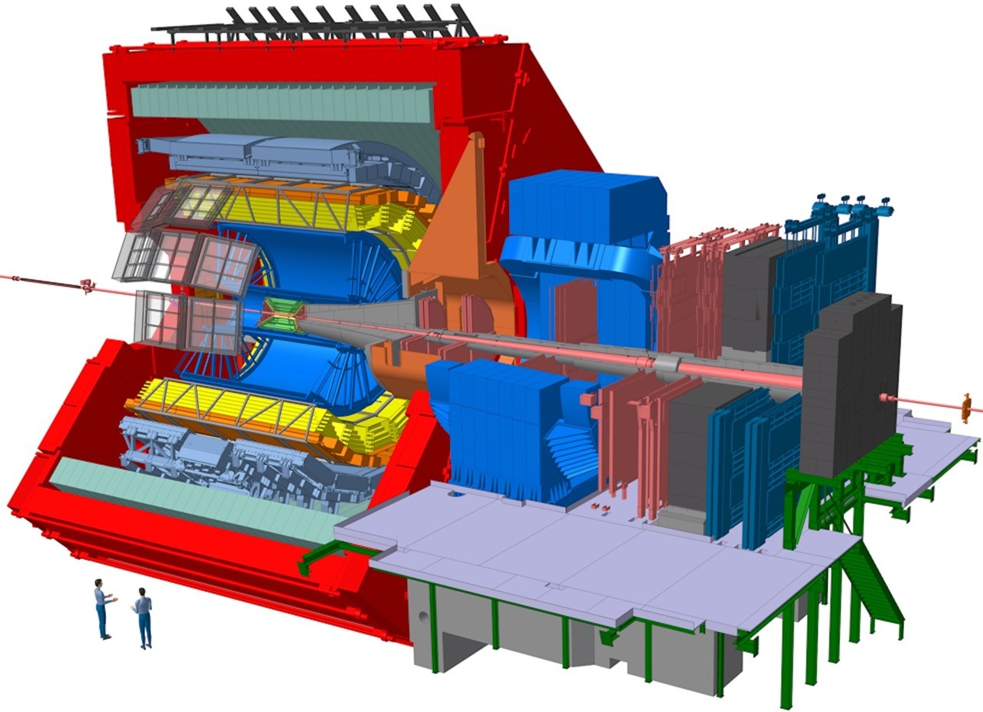
A Large Ion Collider Experiment
• New Inner Tracking System (ITS)
– MAPS: improved resolution,
less material, faster readout
• New Muon Forward Tracker (MFT)
– vertex tracker at forward rapidity
• New TPC Readout Chambers
– 4-GEM detectors
• New trigger detectors (FIT, AD)
– + centrality, event plane
• Upgraded read-out for TOF, TRD,
MUON, ZDC, EMCal, PHOS,
integrated Online-Offline system (O²)
– record minimum-bias Pb-Pb data
at 50 kHz (currently <1 kHz)
FA | ALICE RRB | 25 April 2018
37

Slide 3
Upgrade of the Photon Spectrometer readout system:
PHOS in ALICE: PbW04 crystals (22 x 22 x 180 mm);
HAMAMATSU S8664-55 5x5 mm APD, low noise CSR working temperature -25 C°, temperature stability -0.1 C°
PURPOSE of Upgrade
Considerable improvement of the measurement performance and reliability of the PHOS.
Consists of the development of new photodetector and readout card.
Current electronics has a number of shortcomings:
low time resolution, which is computed off-line;
outdated element base(ALTRO – chip); not on the market;
energy dynamic range and loading characteristic does not match current capabilities of LHC and ALICE.

Slide 4

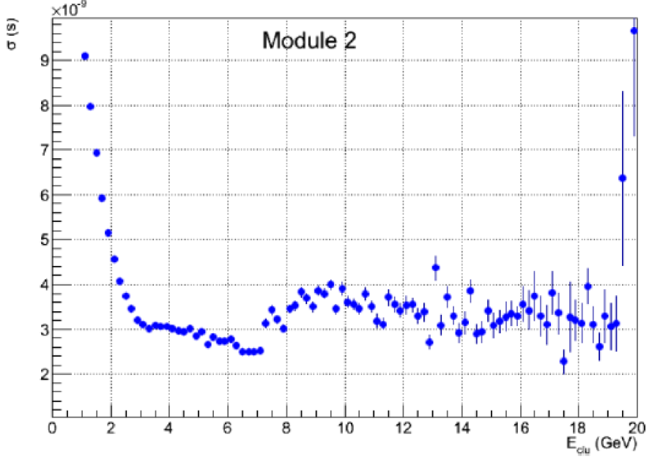
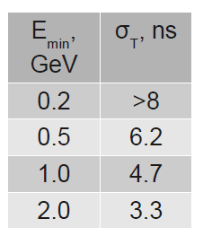
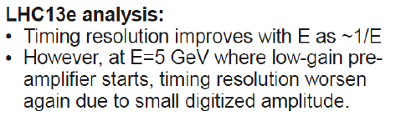

Slide 5
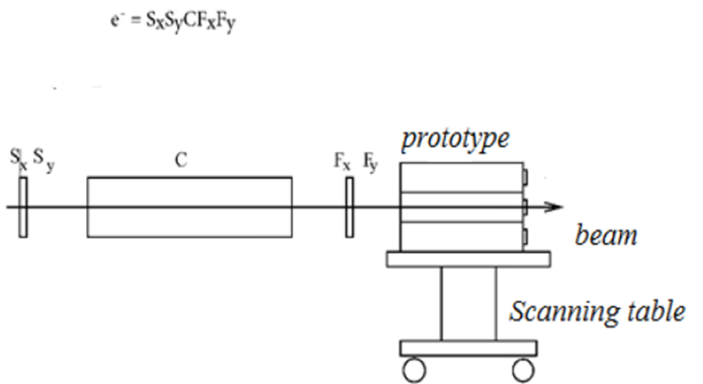
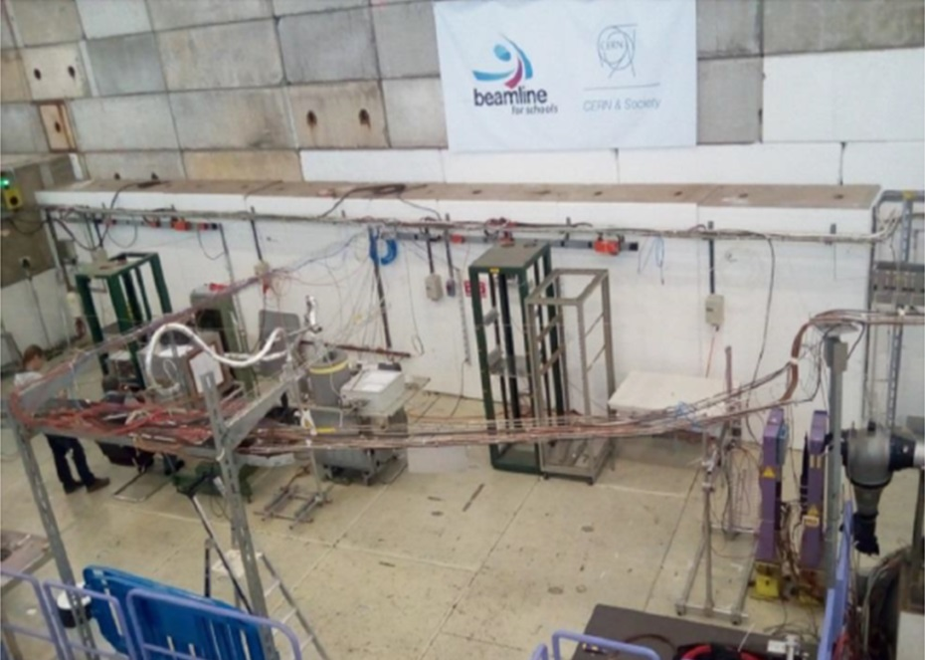
Secondary beam
Tests: 2012 – T10 – 15 days
2014 – T10 – 14 days
2015 – T10 – 14 days
2016 – T9 – 14 days, H6 - 5days
2017 – T9 – 14 days
2018 – T9 – 14 days, October 1-14
T9 – 1 – 10 GeV/c, East Hall, PS
T10 – 1 – 6 GeV/c, East Hall, PS,
H6 – 10 - 110 GeV/c, North Area - SPS
The measurements were done at Т=-25⁰ С and at Т=+18⁰ C
Experiment Set-up

Slide 6
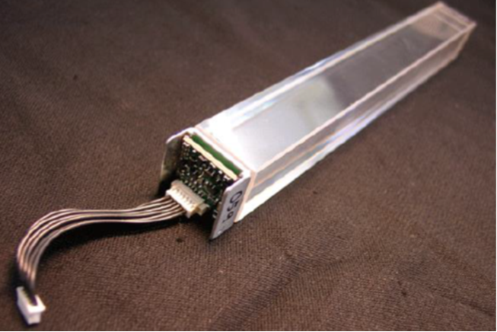
Detector components. Photodetectors
SiPM+APD
APD
S8664-55
S8664-1010
SiPMS12572-015C
APD
SiPM
Detector:
- Crystal PWO(PbWO₄) 22x22x180 mm³
- Assembly of photodetector and charge-sensitive-preamplifier;
HAMAMATSU Photodetectors
- Avalanche photodiodes (APD)S8664-55,1010
- Silicon photomultipliers (SiPM) MPPC
(multi pixel photon counter) of various types,
Microcells from 15 to 100 μm.
- Matrixes 2x2 of SiPM with microcell of 15μm
(6x6 mm² sensitive area)

Slide 7
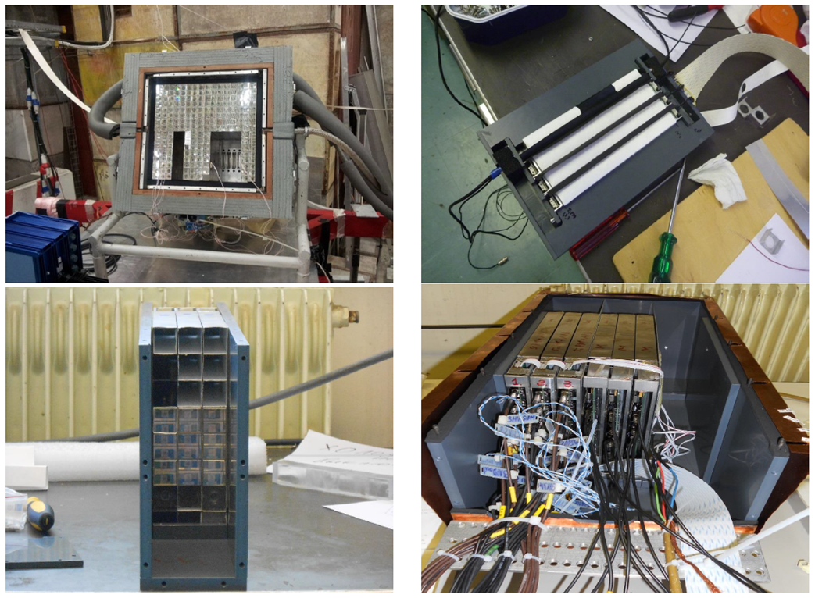
3 x 3 Prototypes. Single channels

Slide 8
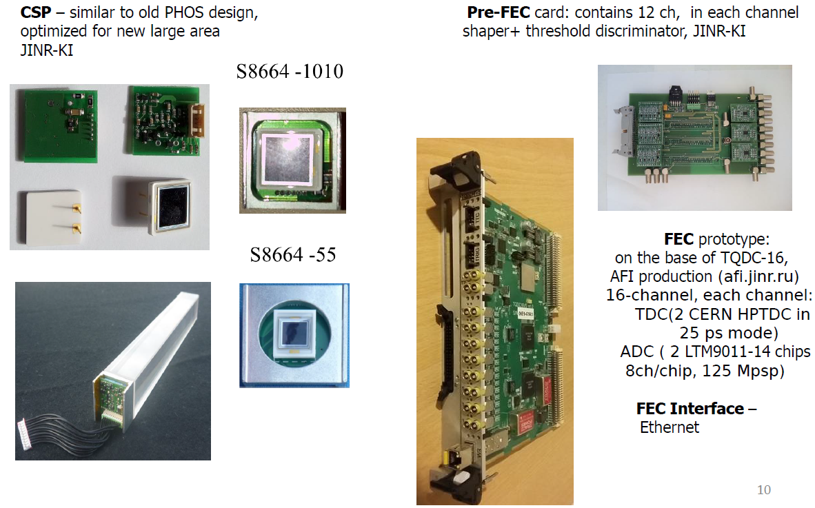
ALICE/PHOS T9 test in 2017
Measurement w/ APD 10×10 mm and FEC prototype

Slide 9
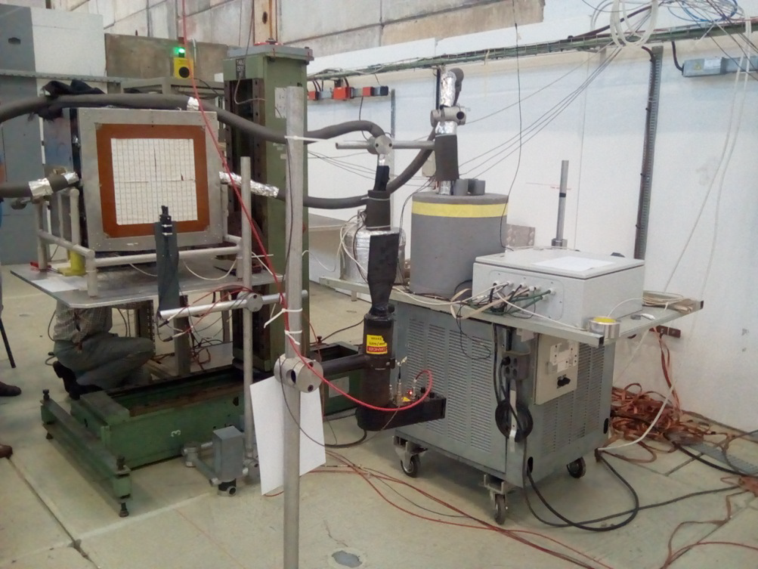
ALICE/PHOS T9 test in 2017
ALICE/PHOS T9 test in 2017
Beam requirements:
electrons(positrons), momenta : 1 - -10 GeV GeV/c, spot size ~ cm, "electron" target as much time as possible.

Slide 10
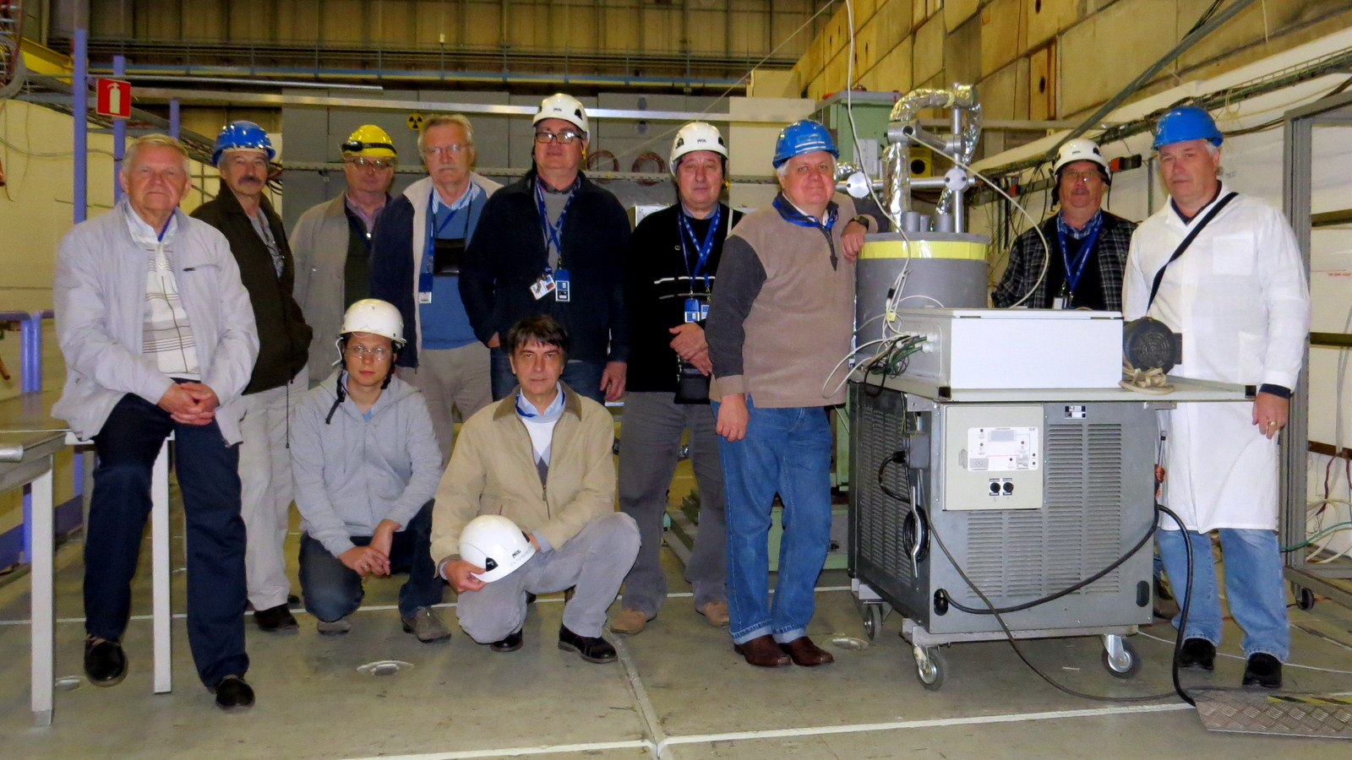
ALICE/PHOS T9 test in 2018

Slide 11
Outcome of the previous studies:
Photo detector:
The replacing avalanche photodiodes (APDs) with a window size of 5x5 mm², which are currently used, on APDs 10x10 mm², will allow operation at a temperature of + 17 °÷18 °C and stop cooling the detector to -25 degrees while maintaining energy resolution values. Time resolution at deposited energy 1 GeV is better than 500 psec.
Front-End Electronics:
The test of the FEC-8 prototype was very successful. Excellent energy resolution was obtained. The new FEC-32 measuring card must be designed and constructed using modern element base. It should be acquainted with ALICE DCS and DAC systems.

Slide 12
MOTIVATION:
PHOS measuring electronics cards need to be upgraded for the following reasons:
- an increase in the dynamic range of energies up to 200 GeV,
- increase in the count rate in the measuring channels,
- the need to measure more accurately the time of flight,
- aging of the element base.

Slide 13
The planned result of the project in 2019-2020
A prototype FEC-32 card with a new element base would be developed and tested on the bench, taking into account the inclusion in DCS and DAQ ALICE.
A pre-production sample of the FEC-32 would be manufactured.
A set of documentation for serial production of the FEC-32 card will be prepared.

Slide 14
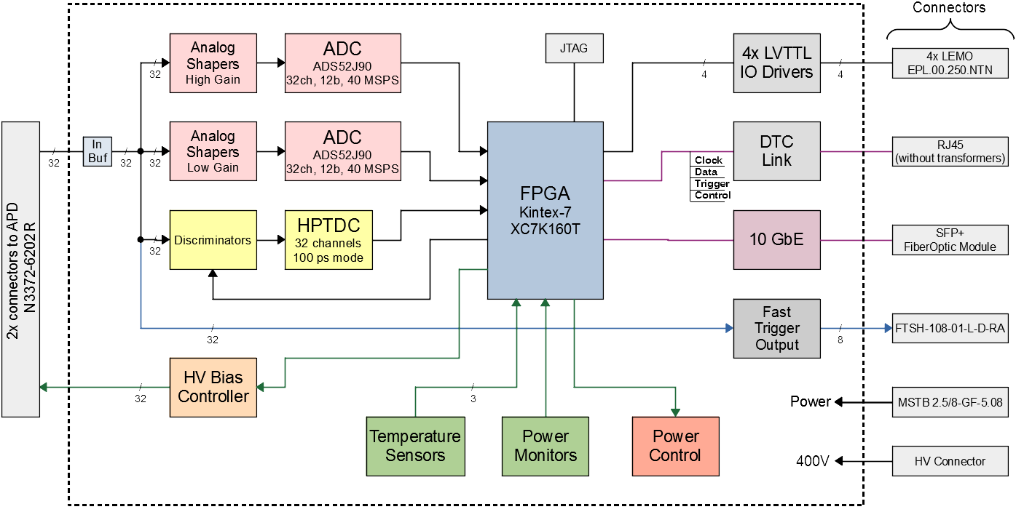
Block diagram of the developed PHOS card

Slide 15
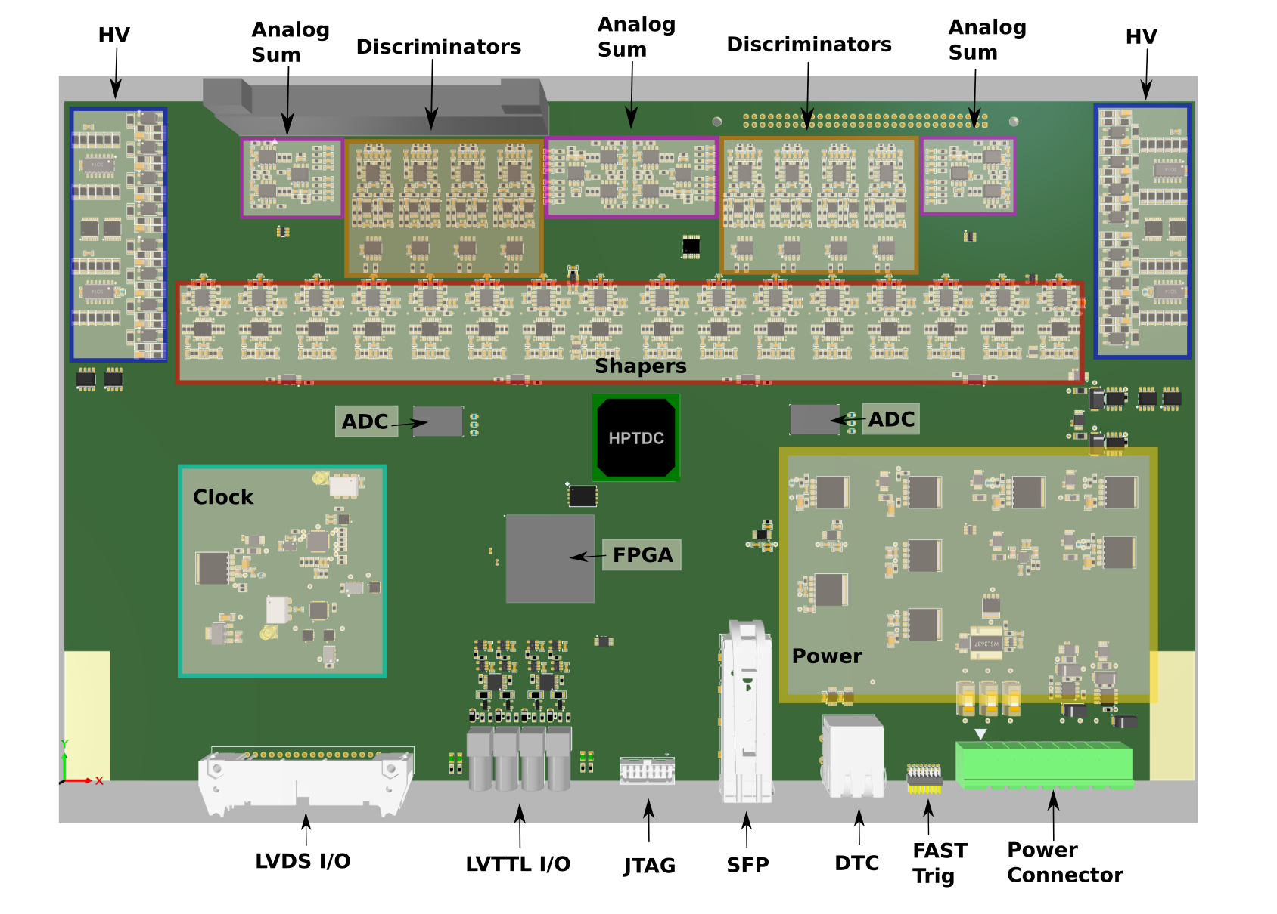
Photo of 32 channel card

Slide 16
Technical Specifications:
- 32 input channels;
- energy measurement in the range 5 MeV - 200 GeV;
- ADC capacity is 12 bits, signal sampling rate is 40 MSPS;
- measuring the time of flight by the Start-Stop method with an error not worse than 100 ps;
- individual adjustment of the bias voltage of avalanche photodiodes;
- individual adjustment of thresholds in the timing channels;
- formation of a trigger signal for the PHOS trigger system;
- control of electrical and temperature parameters of the card according to the ALICE-DCS standard - reading data according to the ALICE-DAQ standard.

Slide 17
ОДОБРИТЬ ОТЧЕТ ПО ПРОЕКТУ
“R&D on the ALICE Photon Spectrometer Upgrade
(JINR participation)”

Slide 18
Thank you for your attention
Спасибо за внимание

