Slide 1
Simulation of stand MiniSPD on Geant4
Elina Kasyanova
15.10.2020

Slide 2
Purpose of my work
Run a simulation of the stand MiniSPD on of cosmic rays particles (μ, e, p)
with different energies
2

Slide 3
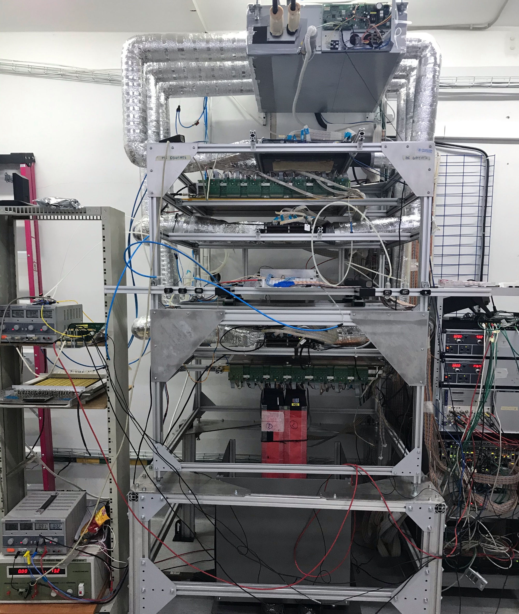
Stand MiniSPD
The purpose of the stand is testing straw-station
and collaboration of all detectors
[Temur Enik (temur.enik@cern.ch)]
• two GEM detectors
three silicon detectors
two straw detectors
Trigger system:
• three scintillators
Calorimeter - 396 mm
Lead - 375 mm
Stand (aluminum)
Stand (steel)
MiniSPD project is an international collaboration
3

Slide 4
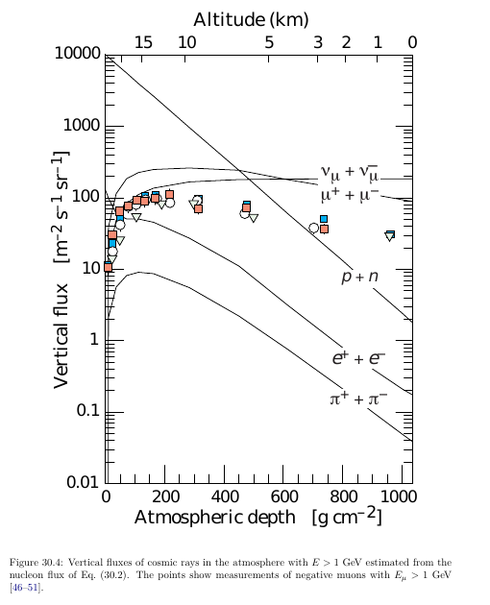
Сosmic rays
Testing on cosmic rays
Muons are the most numerous charged particles at sea level.
The mean energy of muons at the ground is ≈ 4 GeV.
4

Slide 5
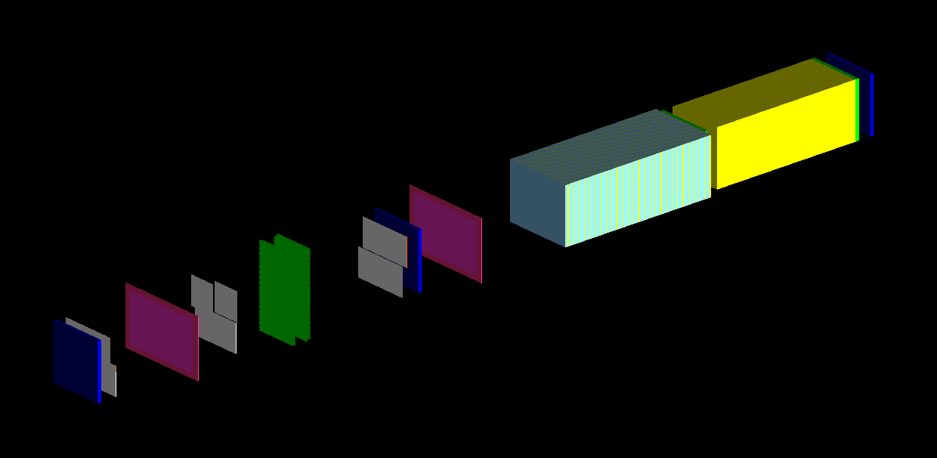
Simulation of stand MiniSPD
Git.Jinr: https://git.jinr.ru/aivanov/MiniSPD.git
Steel stand
Stand Al
GEM N2
Scintillator N3
Lead
SI N3
GEM N1
SI N2
Calorimeter
SI N1
Scintillator N2
Straw stations
Scintillator N1
Simulation of Stand MiniSPD
the position of the detectors based on the last alignment (22.05.2020)
(The first simulation was made by Artem Ivanov)
5

Slide 6
Quantity of materials of stand MiniSPD
Stand steel
0.9 mm ArCo2
12 mk Outer Kapton
Stand Al
GEM
7 mk Glue
2.3 mm Carbon
Straw
40 mk Inner kapton
1.5 mm scintillator
Gas ArCo2
Calorimeter (220 slices)
0.3 mm Pb
30 mk Tungsten wire
0.25 mm FRA4 top
3 mm PMM
Scintillator
5 mm scintillator
Silicon
0.3 mm Silicon
2 mm PLA Plastic
0.25 mm FRA4 bottom
6

Slide 7
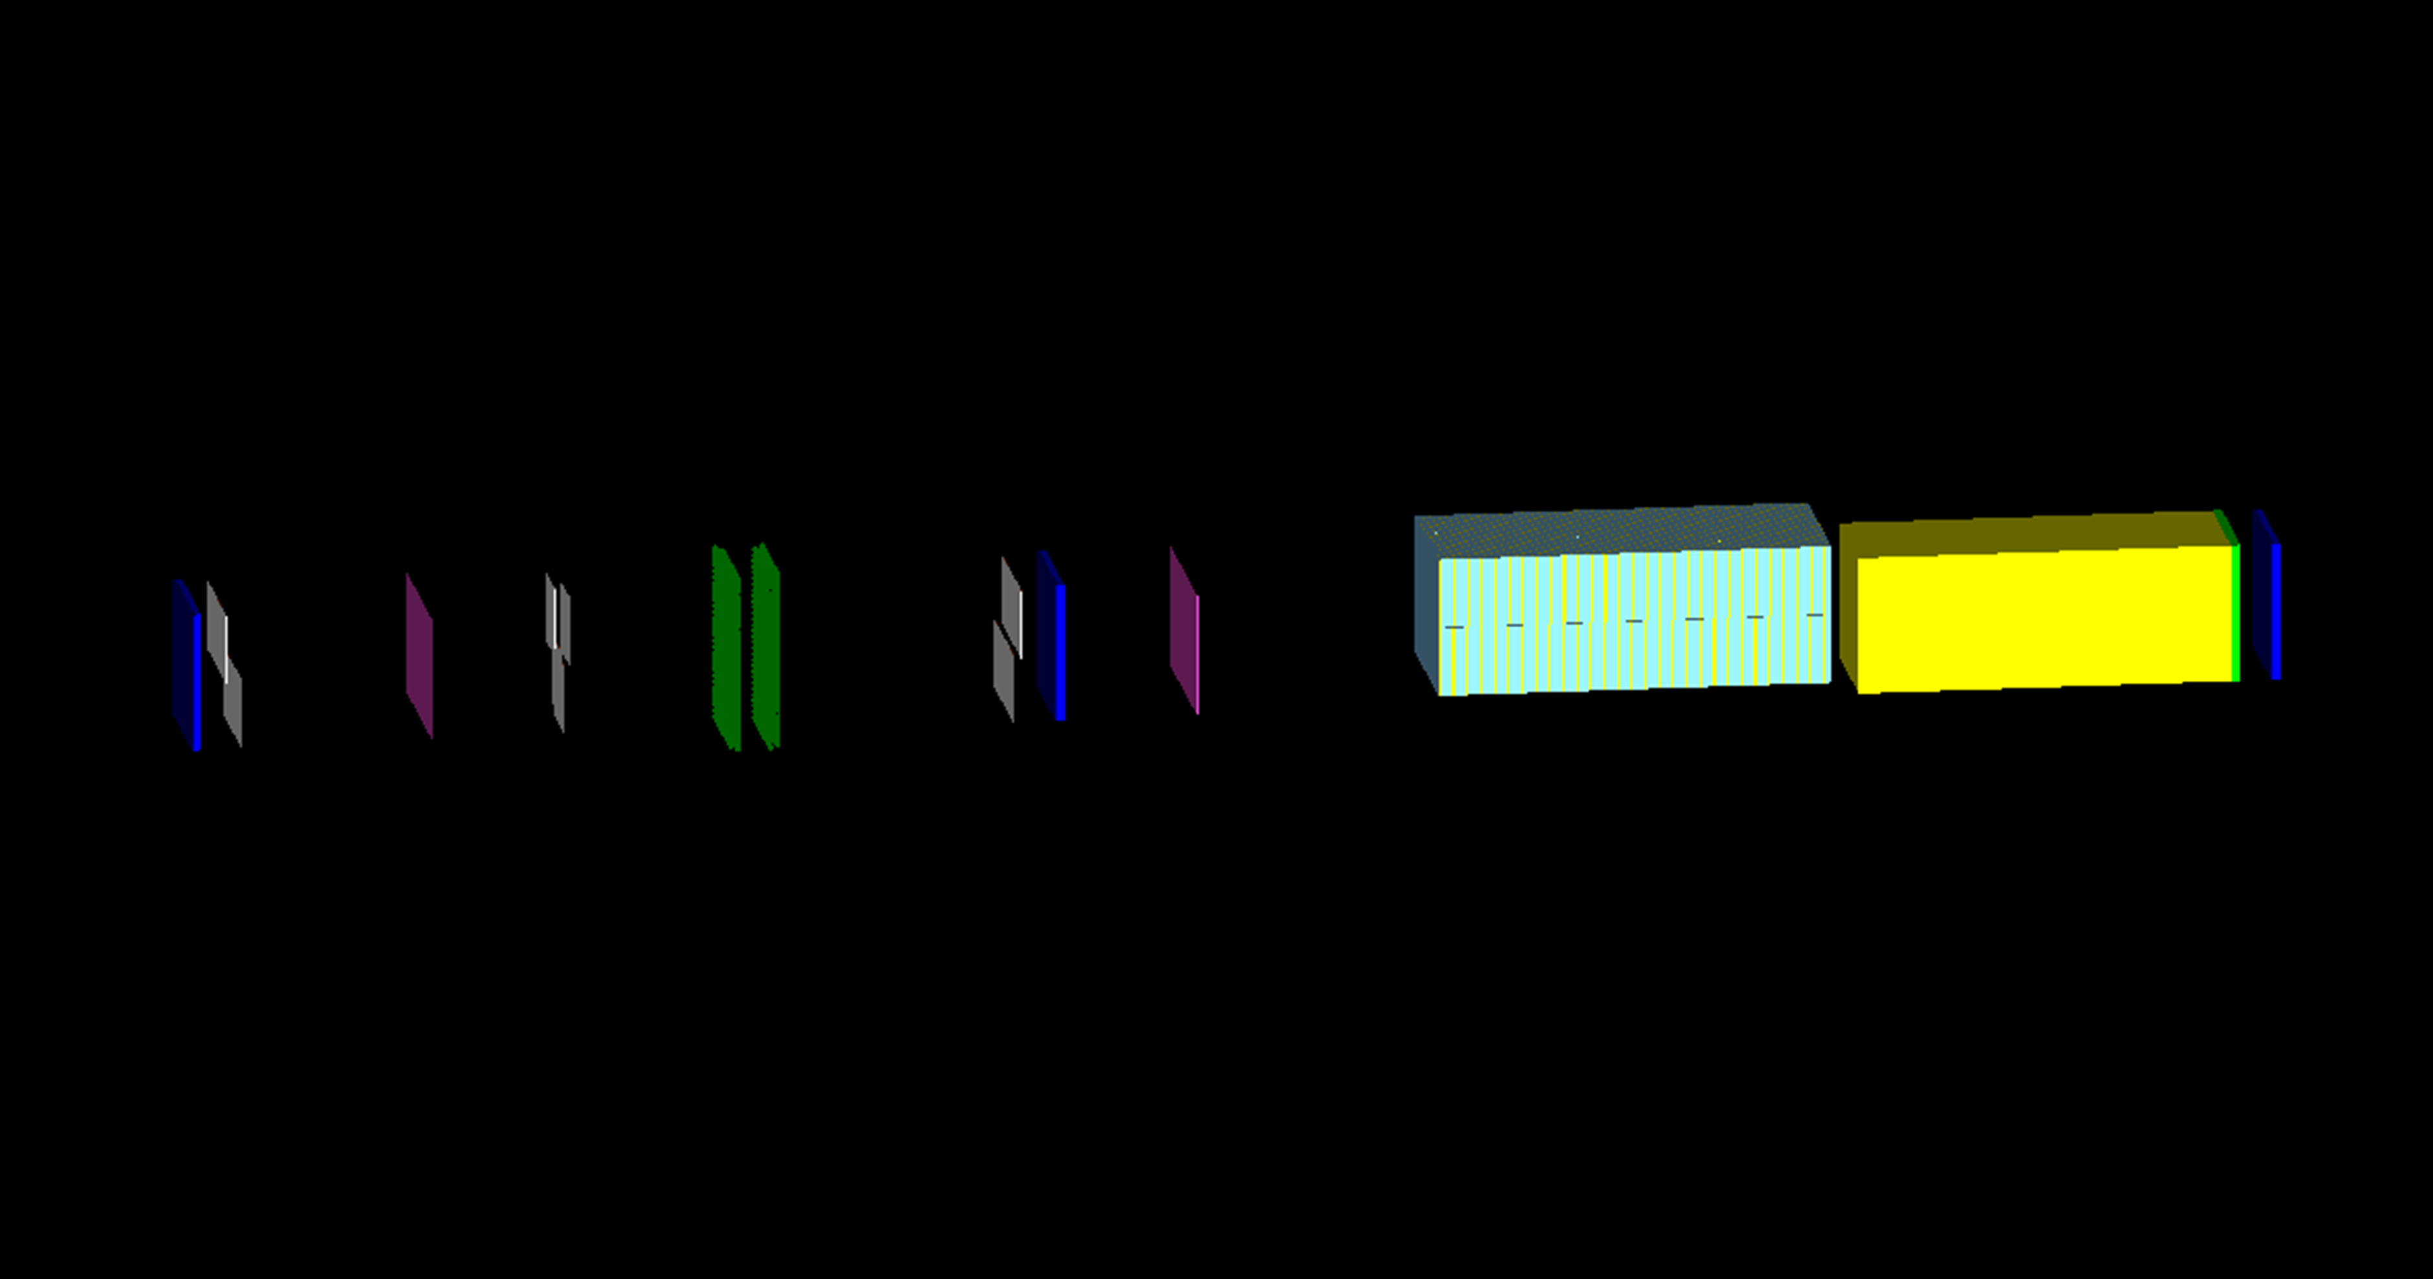
Simulation of stand MiniSPD on time 15.10.2020
Starting conditions
Stand Al
Stand steel
SI N2
SI N3
GEM N2
SI N1
GEM N1
Calorimeter
Lead
Scintillator N3
Straw stations
Scintillator N2
Scintillator N1
Simulation settings:
10 000 events
PV (10, 10, -80) mm
point source
• e-, μ-, proton
100 MeV, 1, 10, 100 GeV
• material of World volume – Air
7

Slide 8
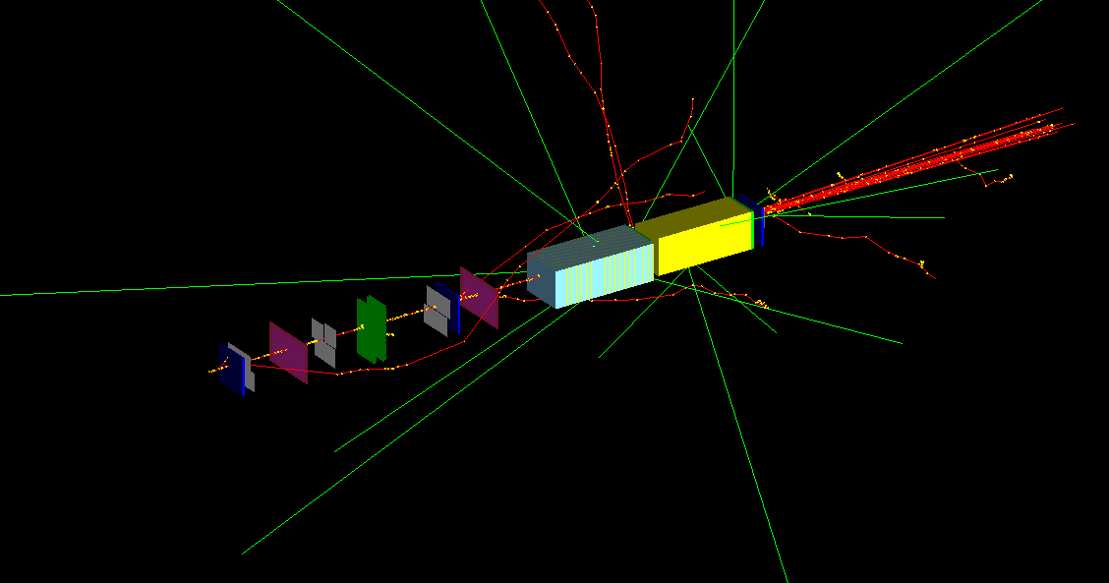
Simulation of stand MiniSPD
μ- beam (10000 particles) with energy of 1 GeV
8

Slide 9
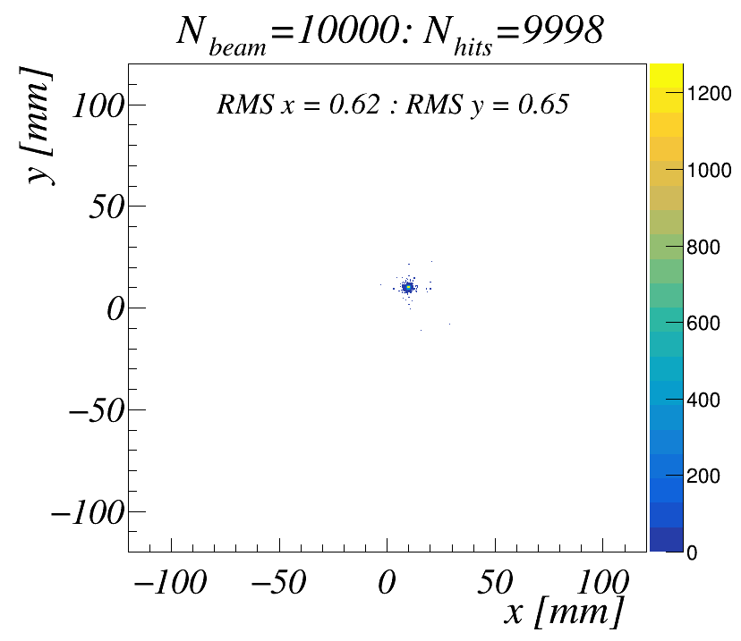
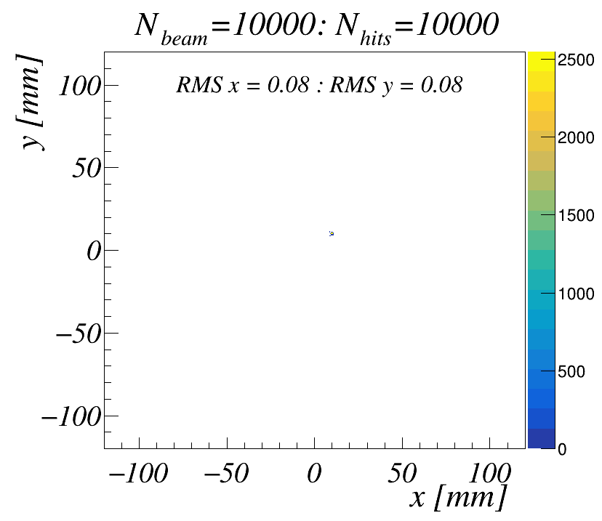
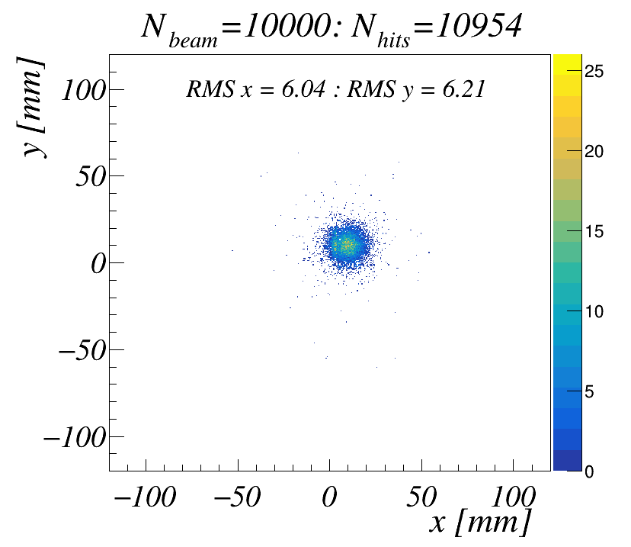
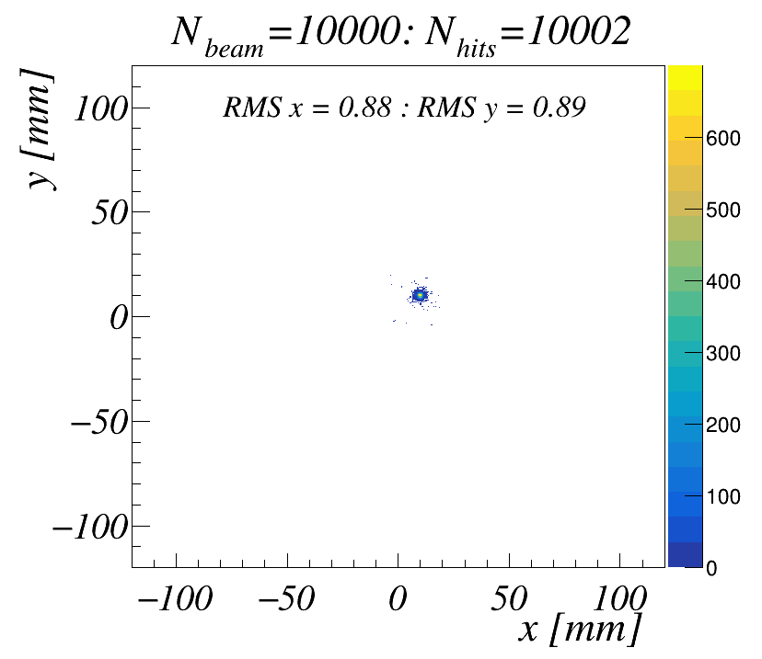
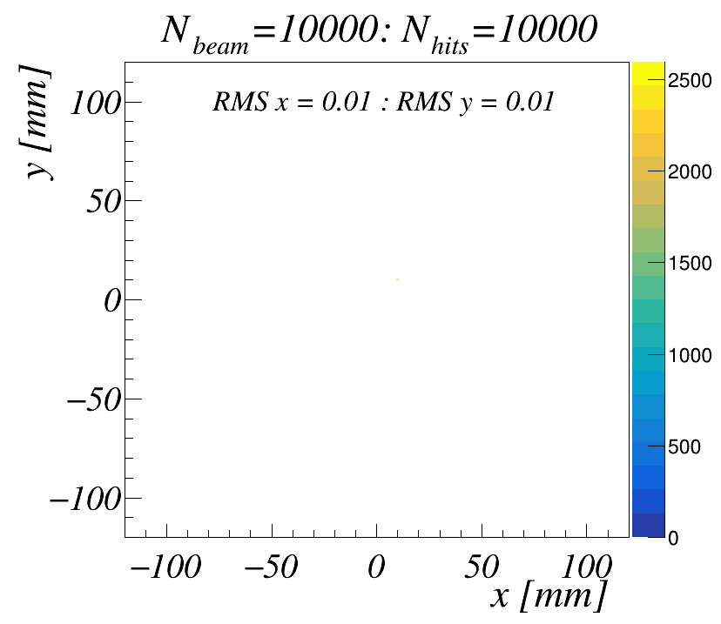
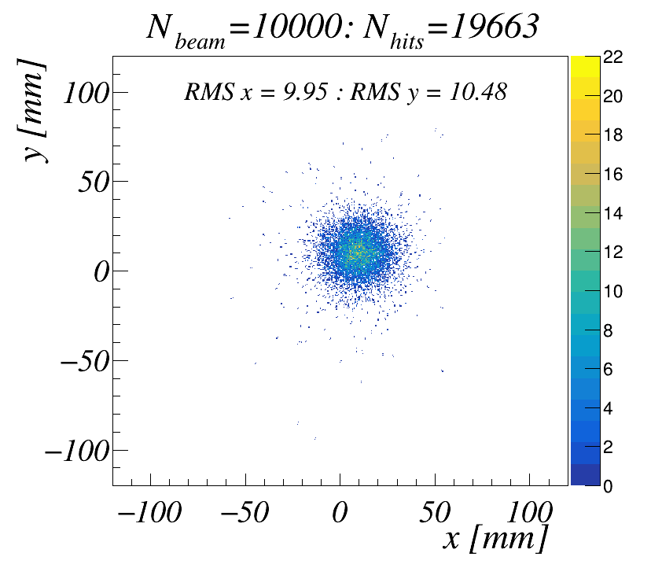
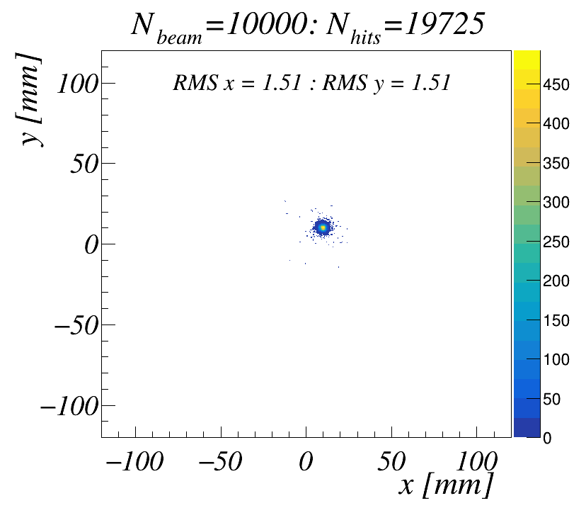
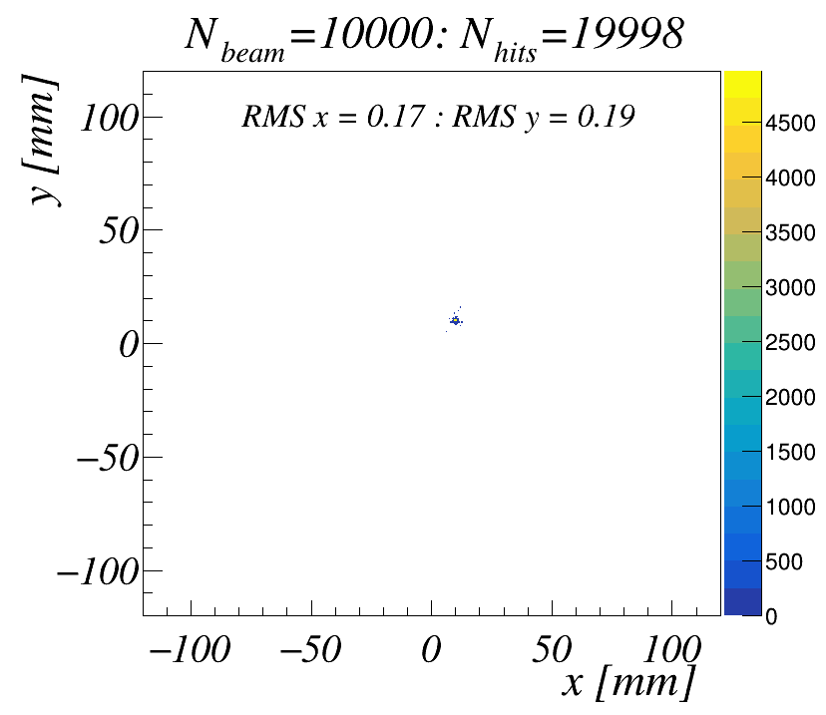
μ- beams
100MeV
1 GeV
10 GeV
100 GeV
SI N1
SI N2
Straw
SI N3
9

Slide 10
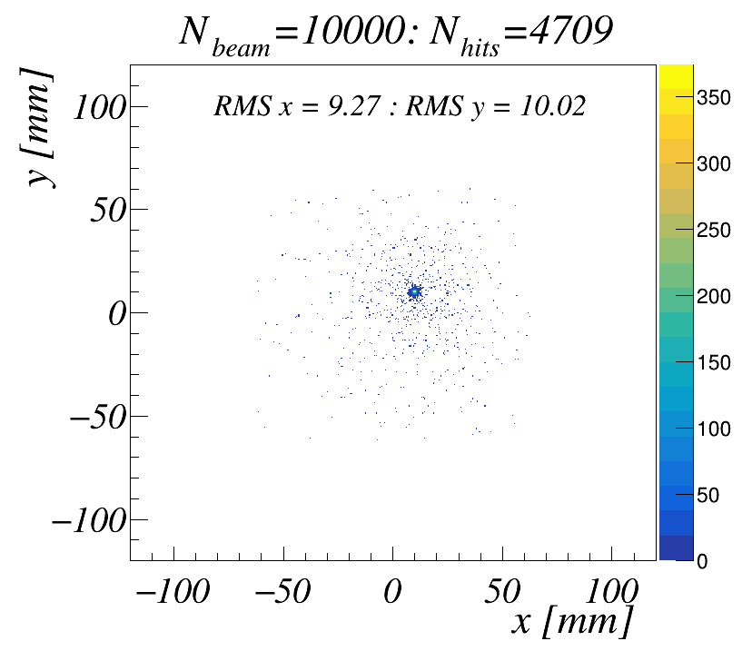
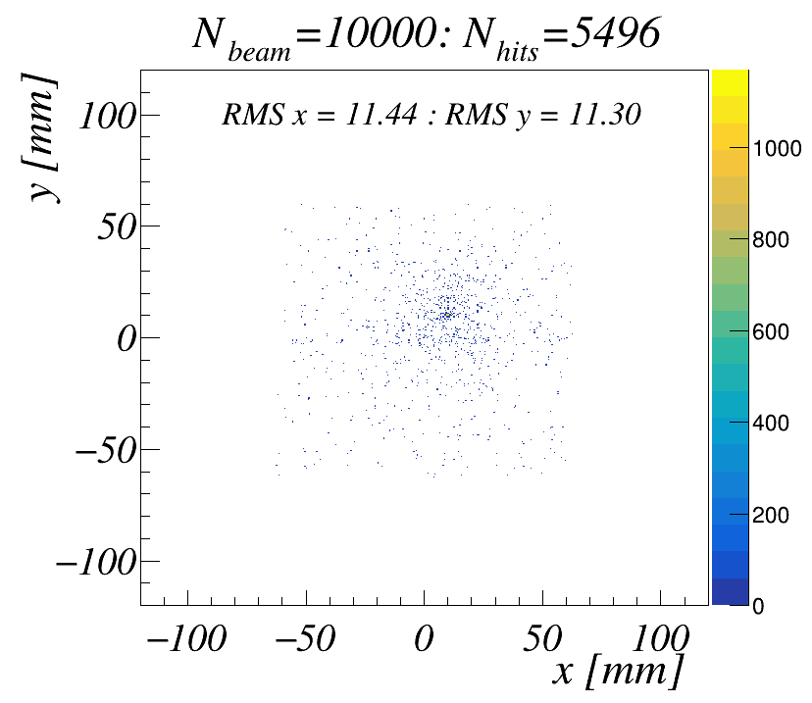
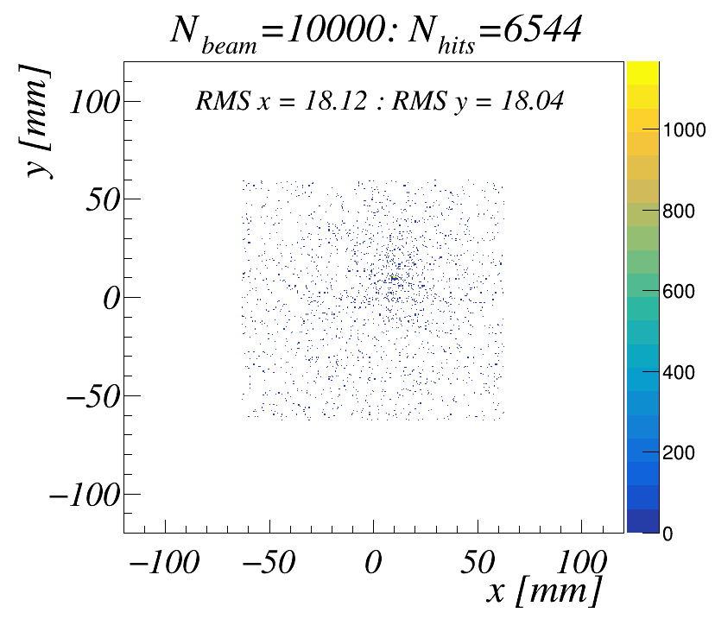
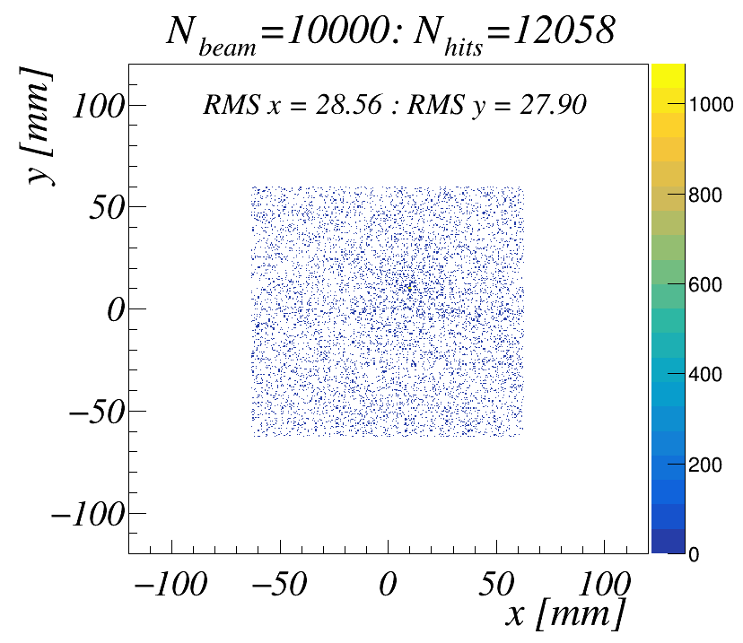
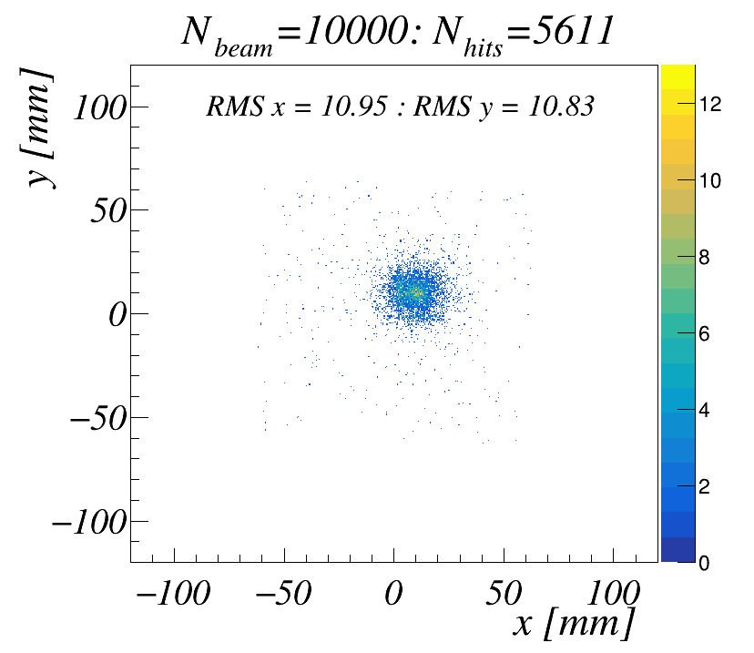
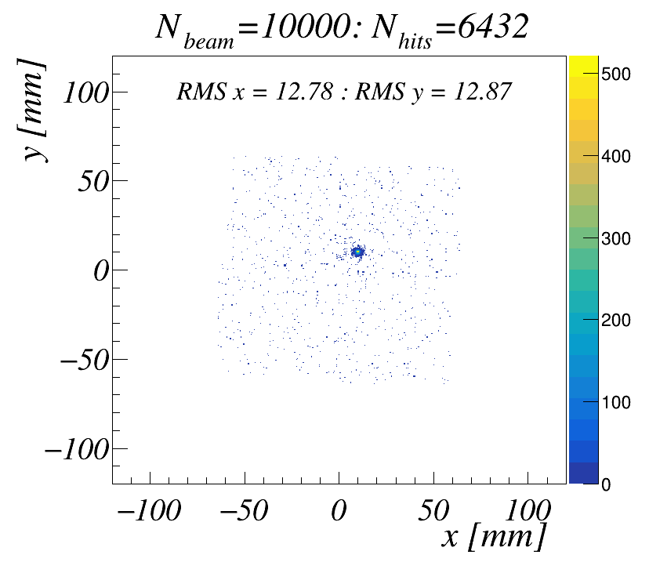
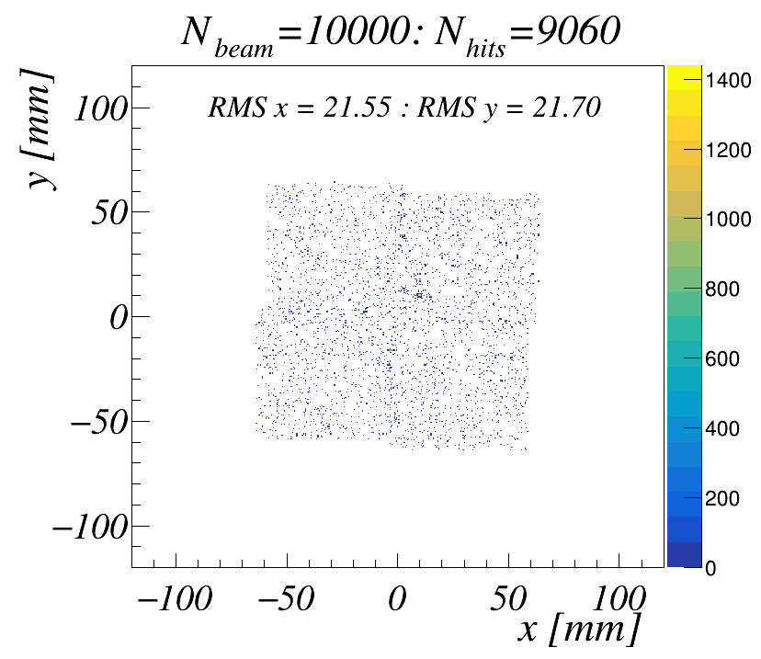
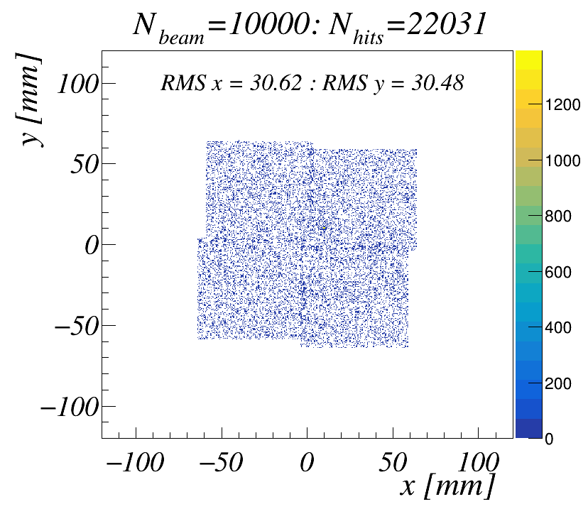
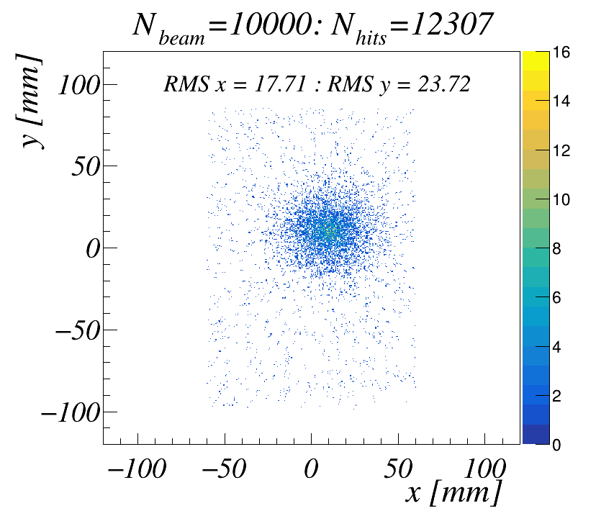
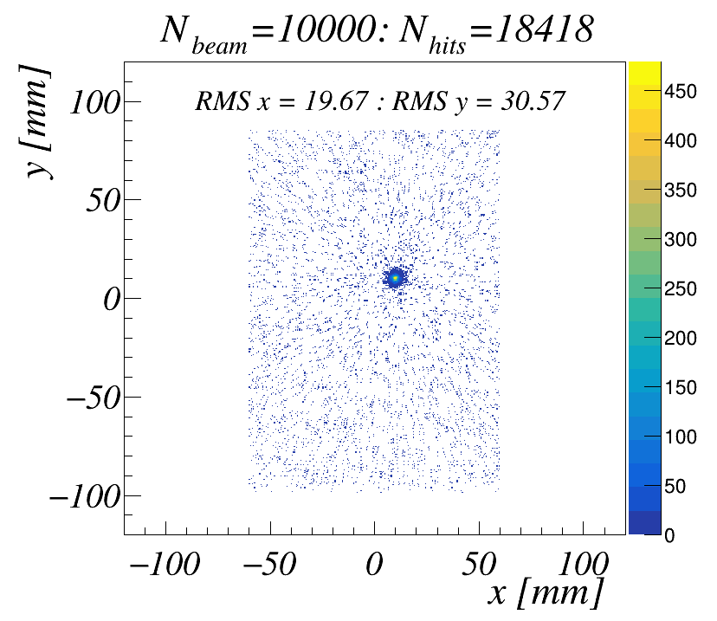
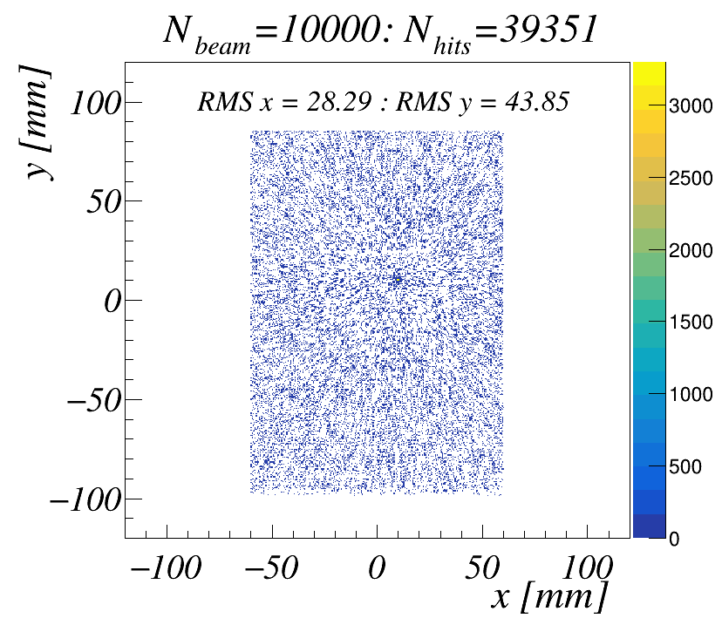
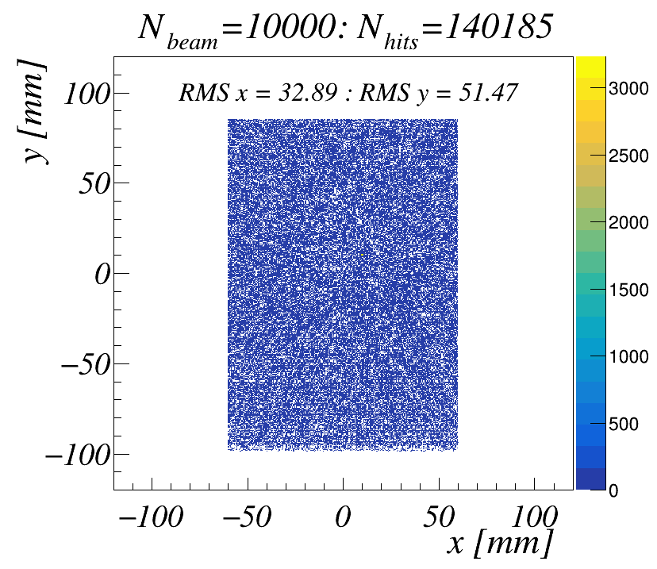
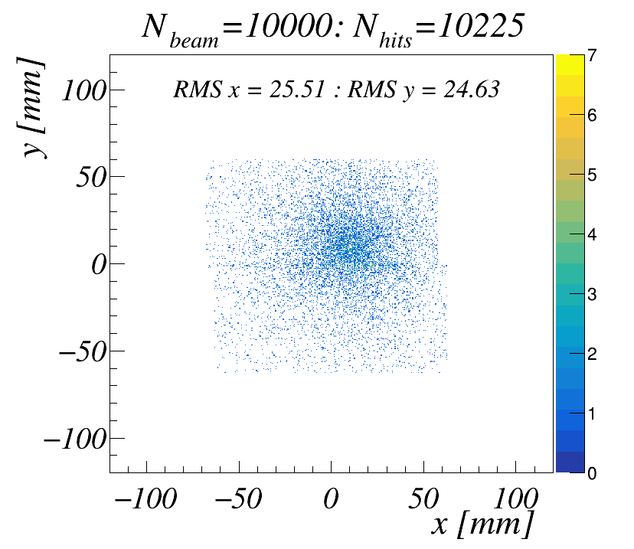
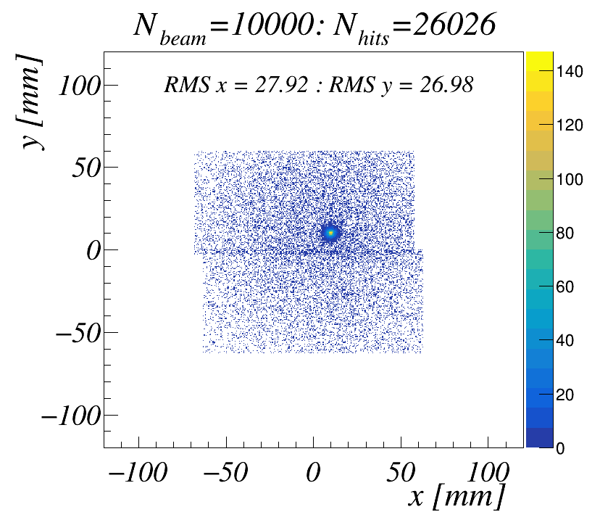
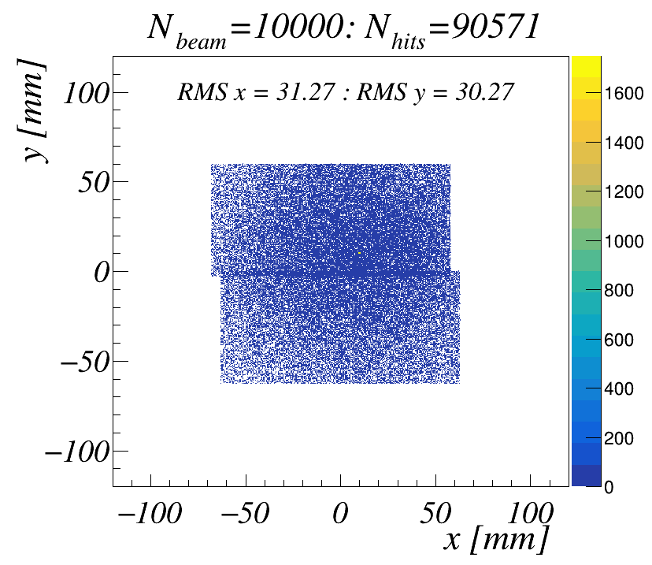
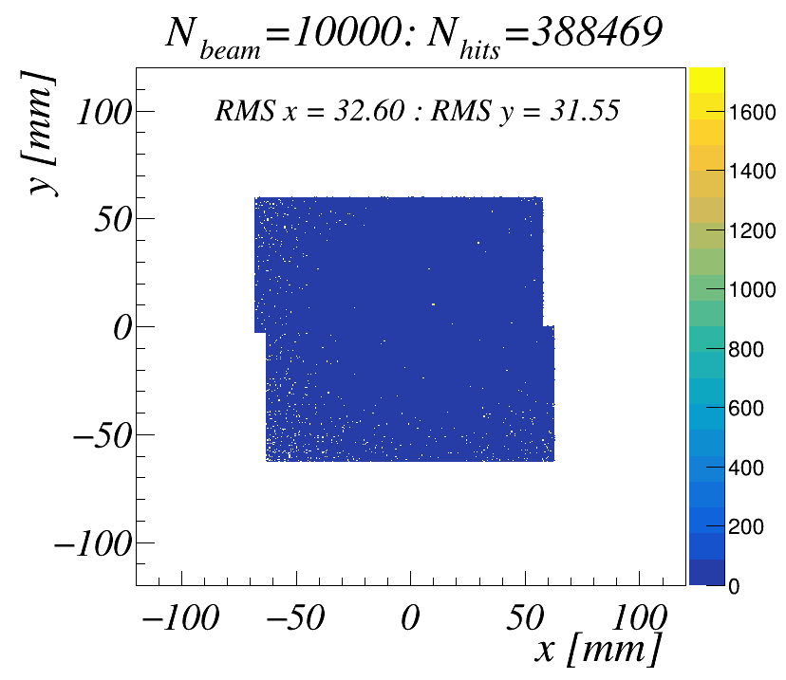
e- beams
( + shower e+e-)
100MeV
1 GeV
10 GeV
100 GeV
SI N1
SI N2
Straw
SI N3
10

Slide 11
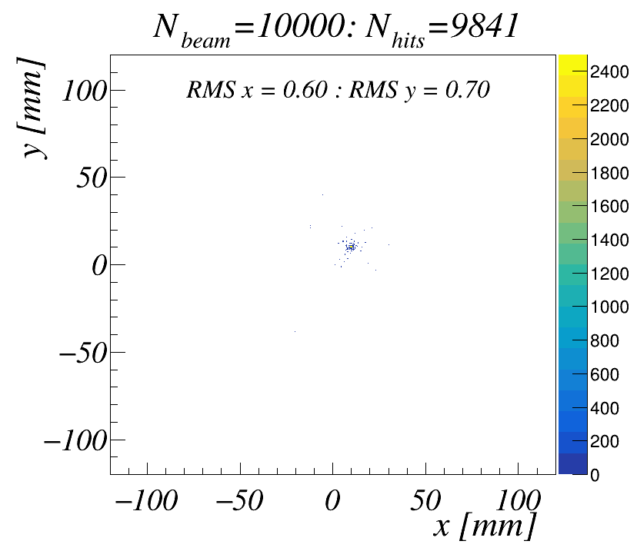
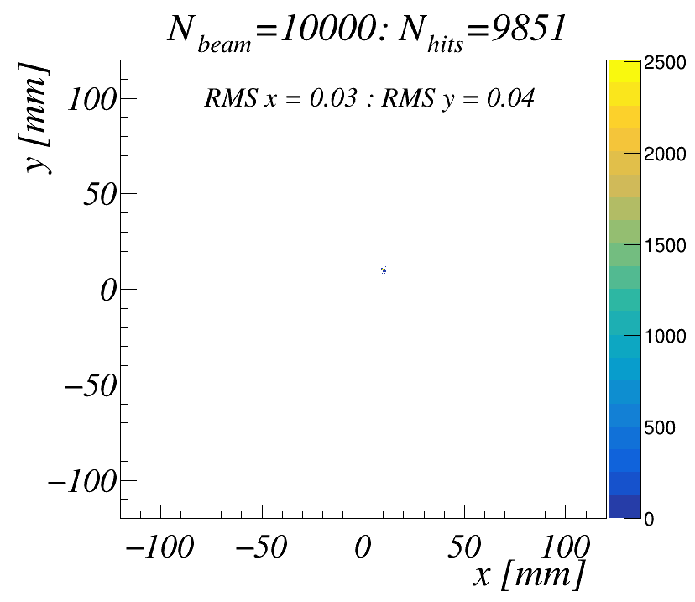
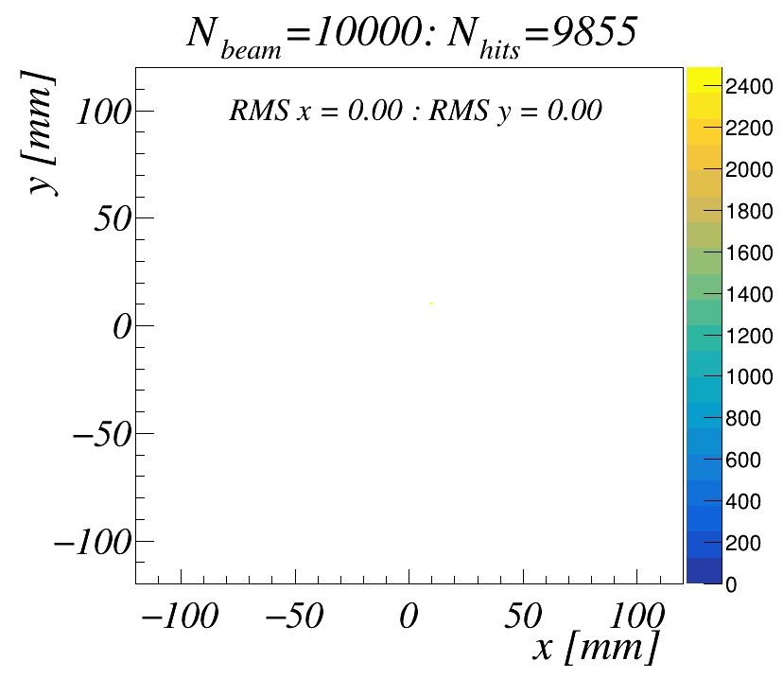
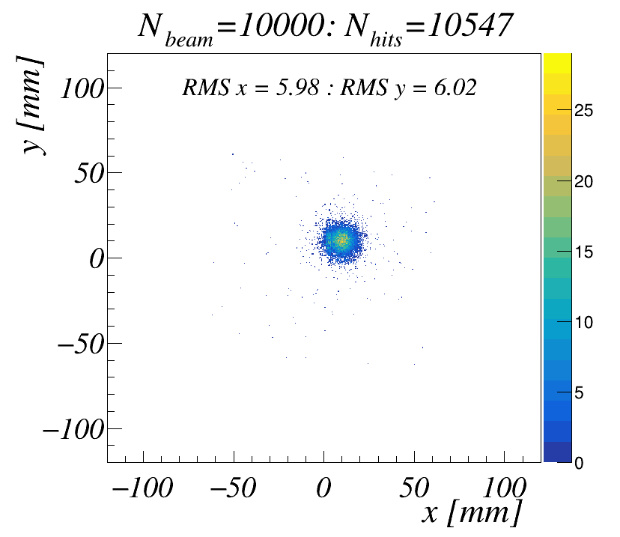
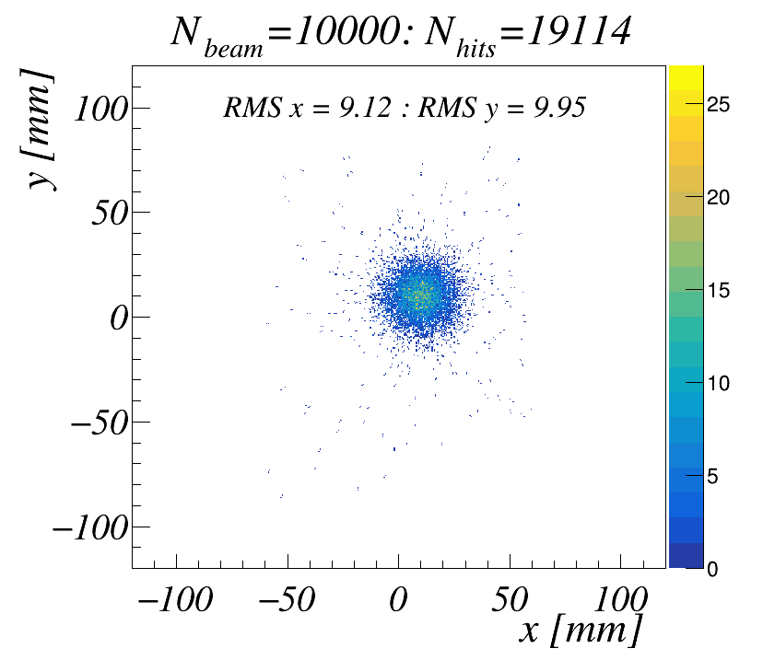
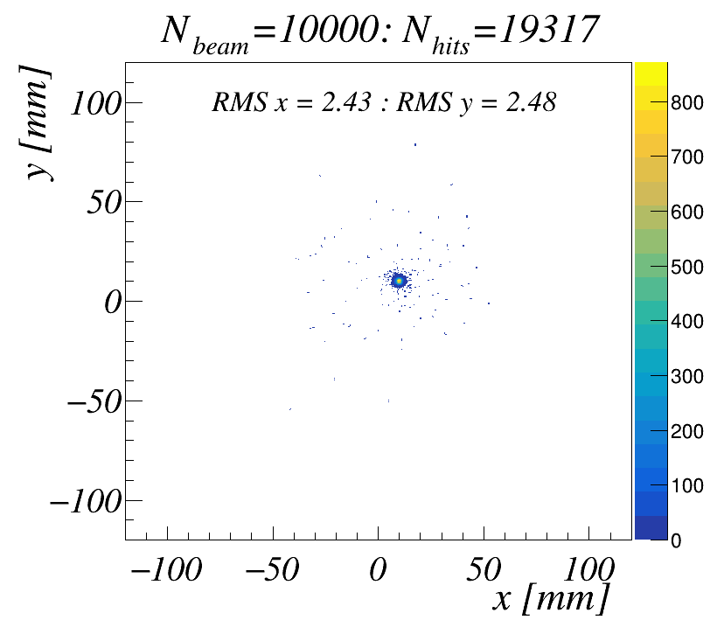
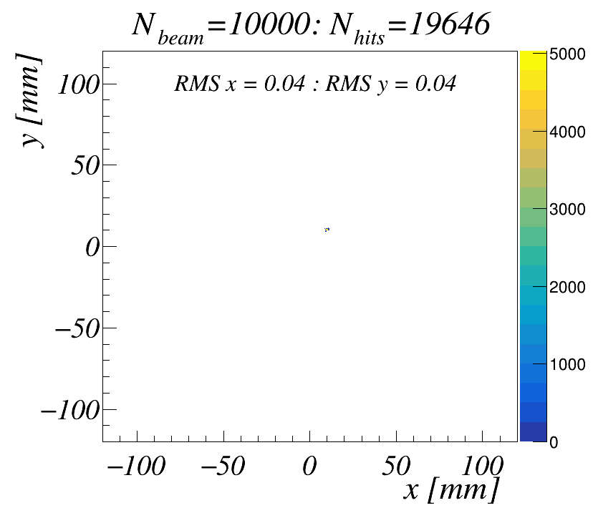
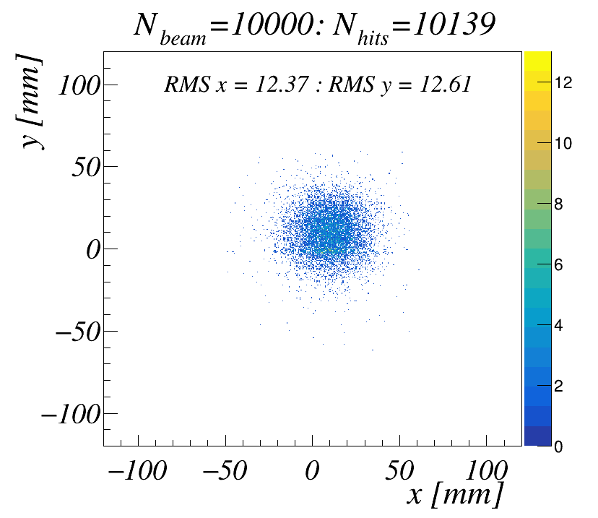
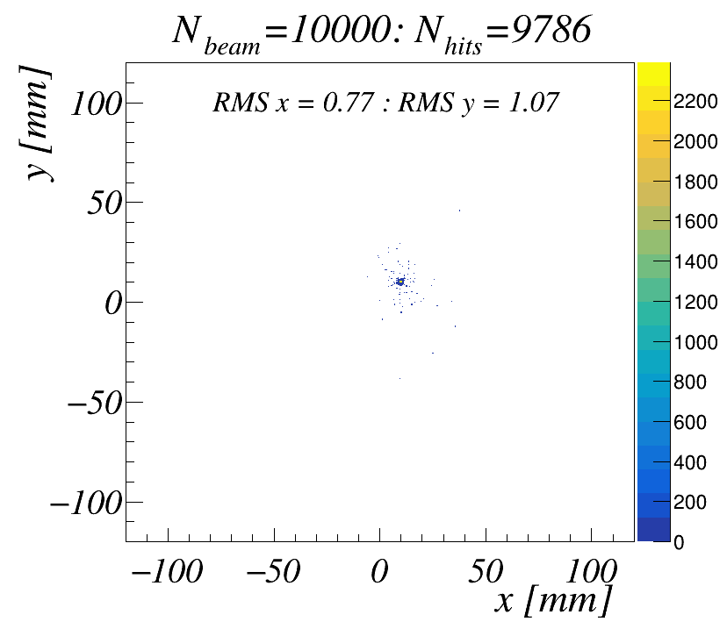
proton beams
100MeV
1 GeV
10 GeV
100 GeV
SI N1
SI N2
Straw
SI N3
11

Slide 12
Planned in the near future
• Take into account the cosmic ray flux angular distributions.
• Include RS simulation
12

Slide 13
Thank you for your attention !

