Slide 1
Appearance miniSPD
Detectors
Climate control
Gas system
DAQ
Detector power systems

Slide 2
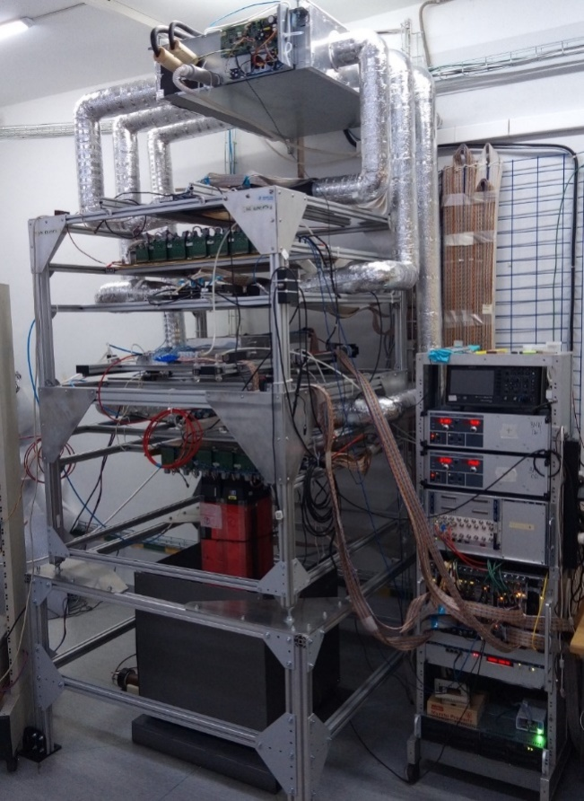
Functional structure of the stand

Slide 3
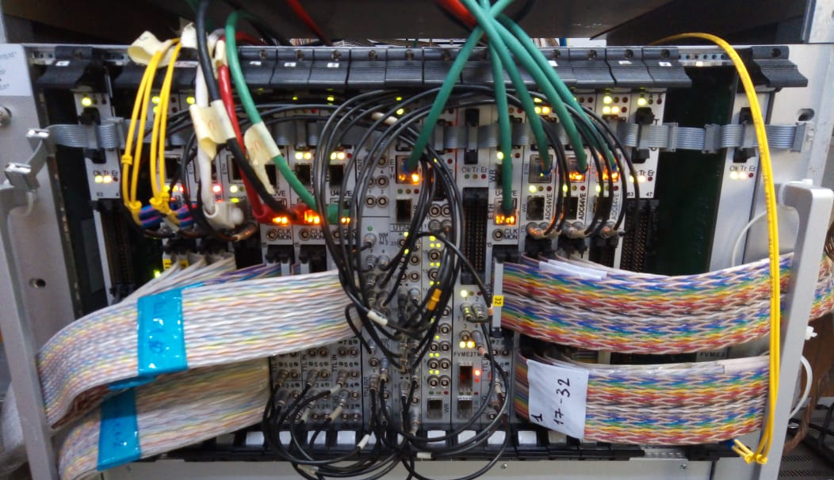
DAQ crate

Slide 4
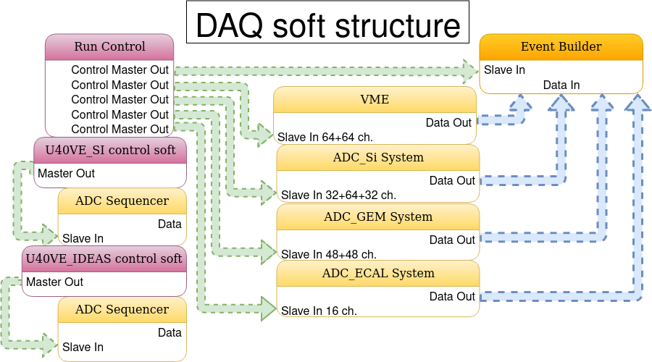

Slide 5
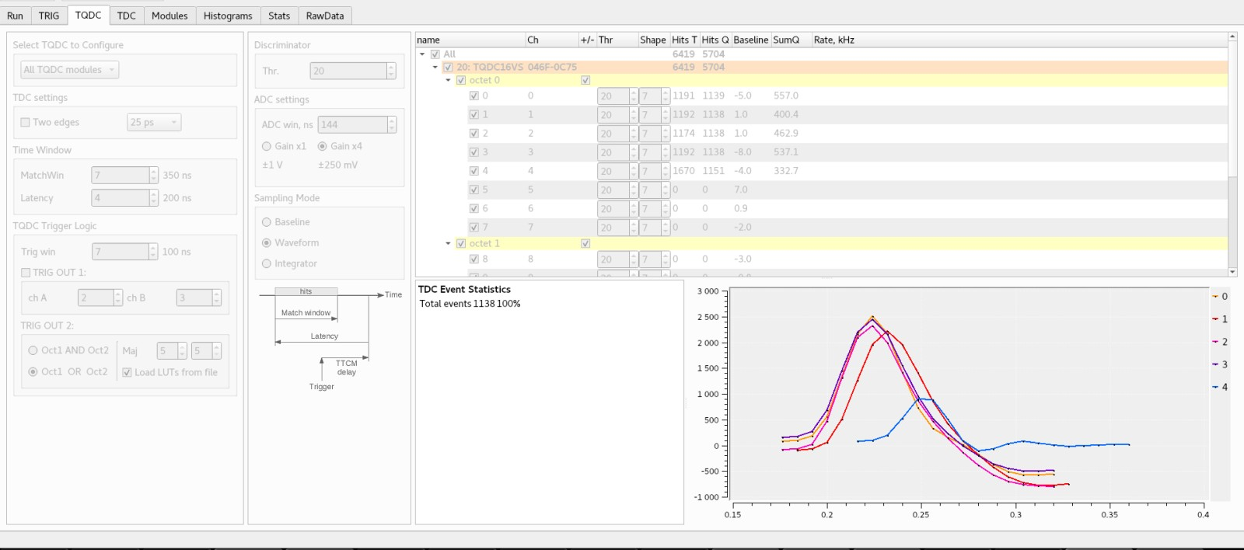
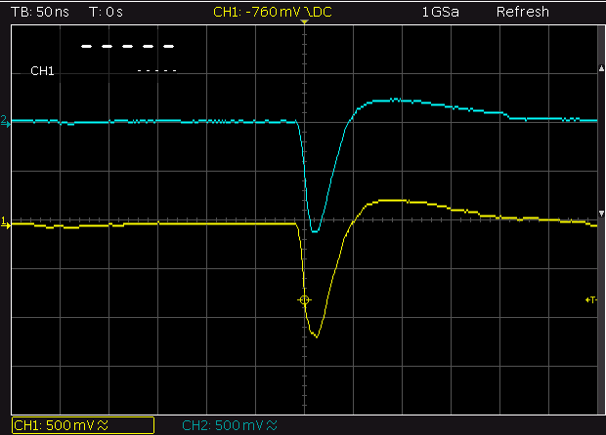
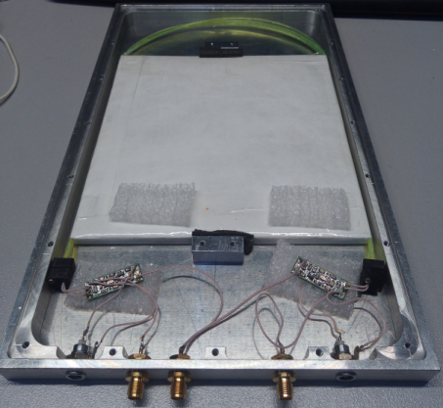
Trigger
- 2 Scintillators ( (SiPm 4ch)
- 16 channels, 50 Ohm
- 1 Scintillator (Pmt 1ch)
- TDC: time-stamping, 25ps bin size
- TQDC
- Amplitude (charge) measurement: 10/14 bit, 80 MS/s ADC
- On-board trigger matching logic

Slide 6
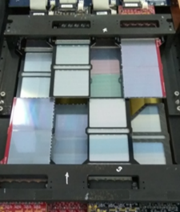
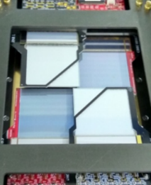
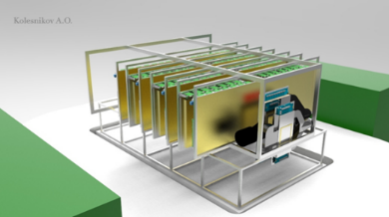
BM@N Silicon detector module design
Positions of Forward and Vertex Silicon Detector at BM@N technical run March 2018
[M.Kapishin , Status of Baryonic Matter at Nuclotron, October 2018]
ASIC VATAGP7.1 (5 chips on each side of module)
Number of CSA: 128 channels
Dynamic range: $±$30 fC
Peaking time (slow/fast shaper): 500 ns/ 50ns
Noise (ENC): 70e +12e/pF (typ.)
Voltage supply: +1.5 V, -2.0 V
Gain from input to output buffer: 16.5 µA/fC
Output Serial analog multiplexer clock speed: 3.9 MHz
Power dissipation per channel: 2.2 mW
Size: 63x63x0,3 mm³ (on 4” – FZ-Si wafers)
Topology: double sided microstrip (DSSD)
(DC coupling)
Pitch p⁺ strips: 95 μm;
Pitch n⁺ strips 103 μm;
Stereo angle between p⁺/n⁺ strips: 2.5⁰
Number of strips/DSSD: 640 (p⁺)$×614$(n⁺)
Number of strips/module: 640 (p⁺)$×640$(n⁺)
Pitch Adapter (n+) side
sapphire plates with Si-epitaxial layer Silicon On Insulator (SOI)
Number of channels: 640
Value of poly-Si resistors: $≈$ 1 MΩ
Value of integrated capacitors: $≈$ 120 pF
Capacitor working voltage: 100 V
Capacitor breakdown voltage: >150 V

Slide 7
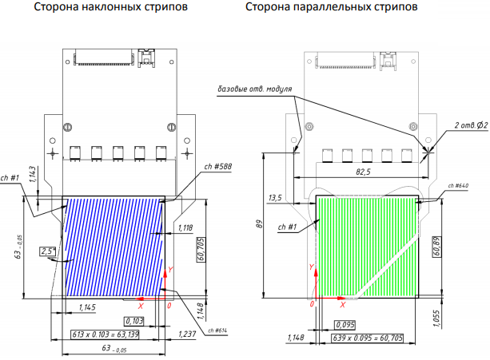
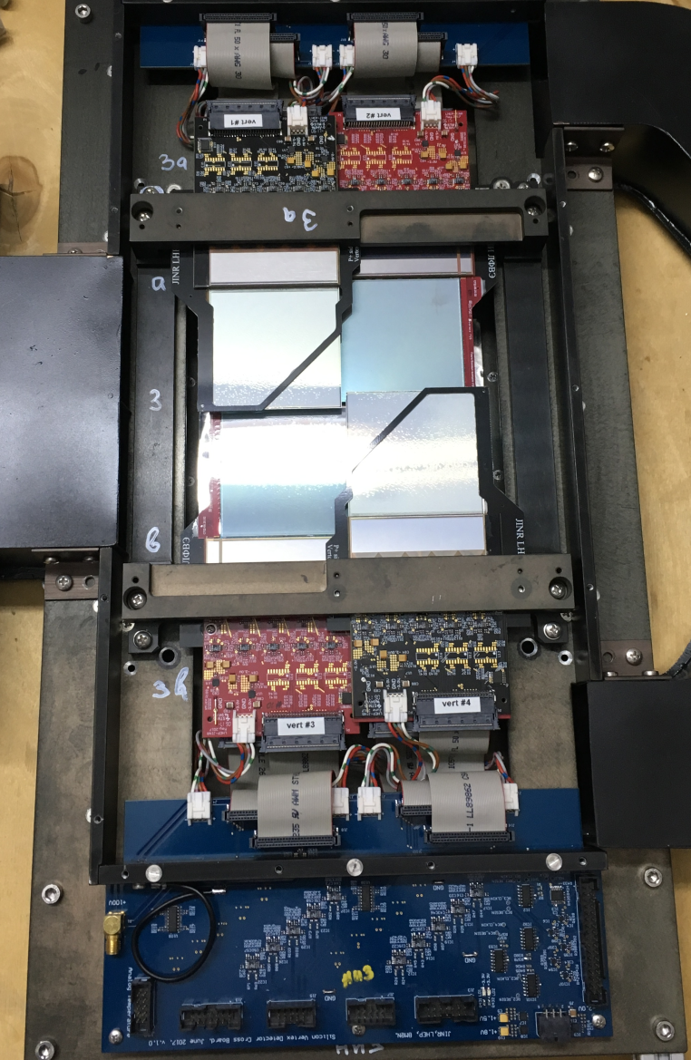
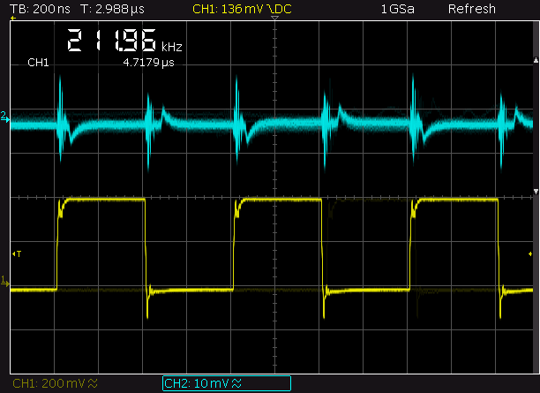
Silicon detector

Slide 8
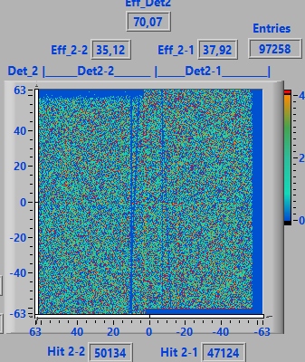
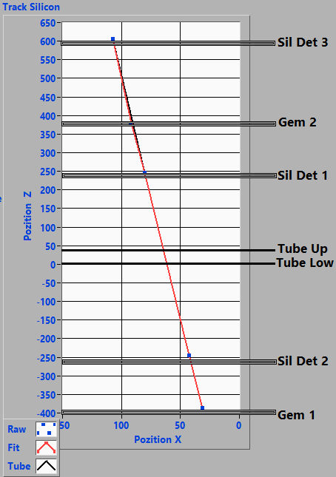
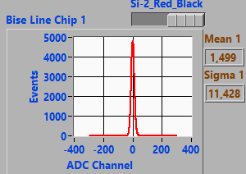
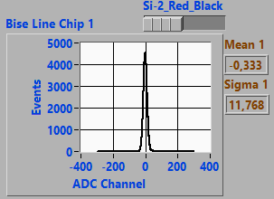
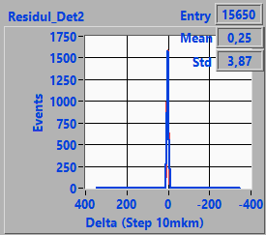
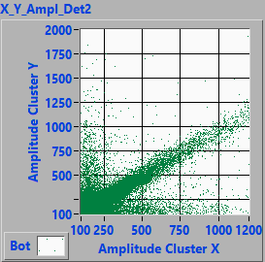
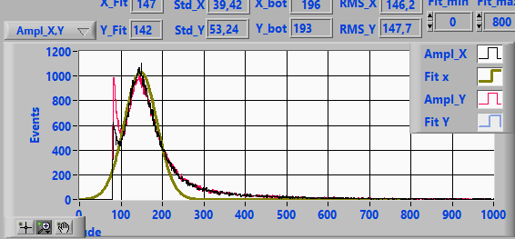
Silicon detector

Slide 9
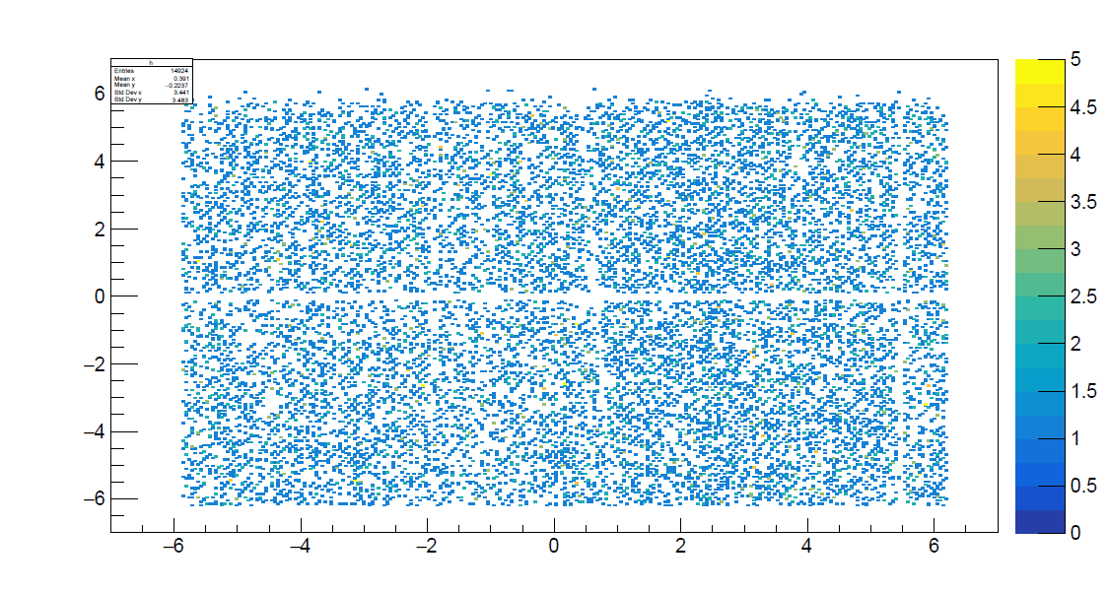
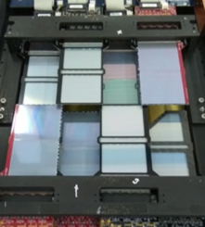
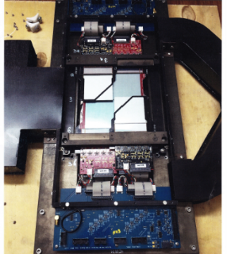
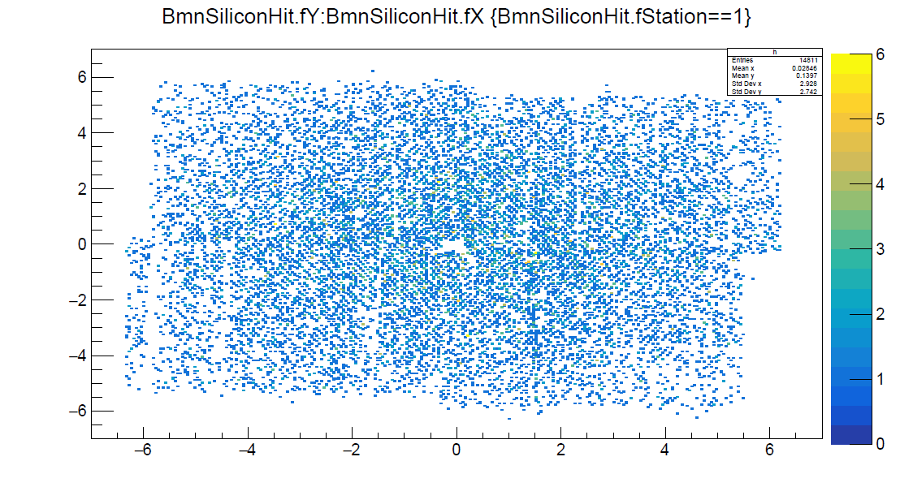
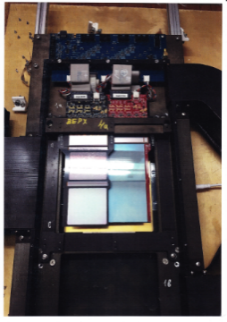
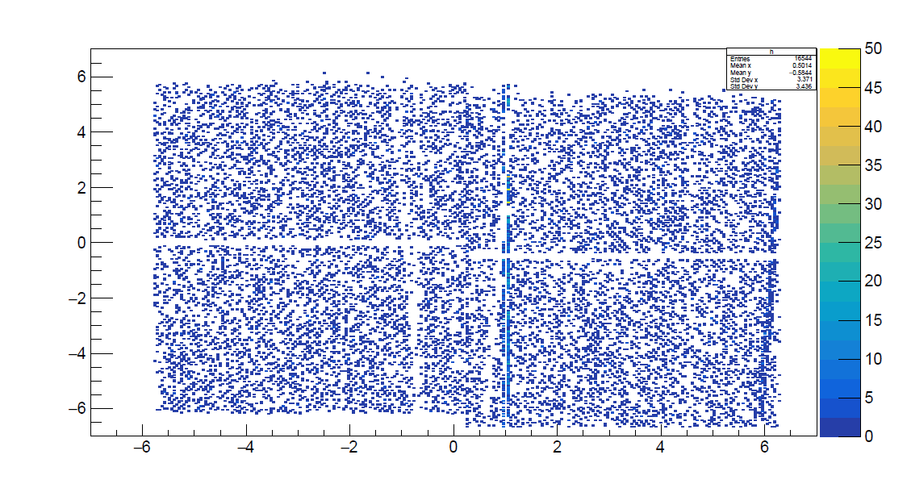
Events reconstruction
hitY,
cm
Hits plots in BM@N Si-modules;
Reconstructed track in muon stand (based on bmnroot framework);
c) BM@N Silicon modules;
hitX, cm
hitY,
cm
hitX, cm
hitY,
cm
a)
b)
c)
hitX, cm

Slide 10
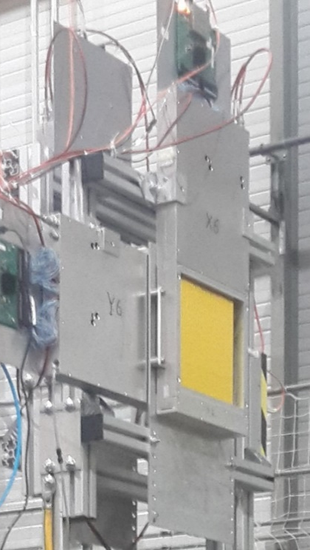
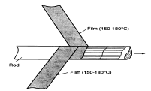
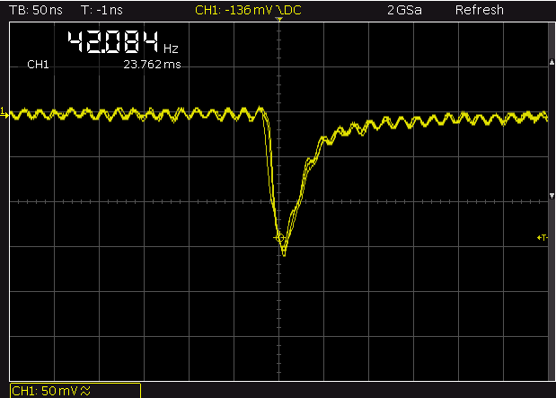
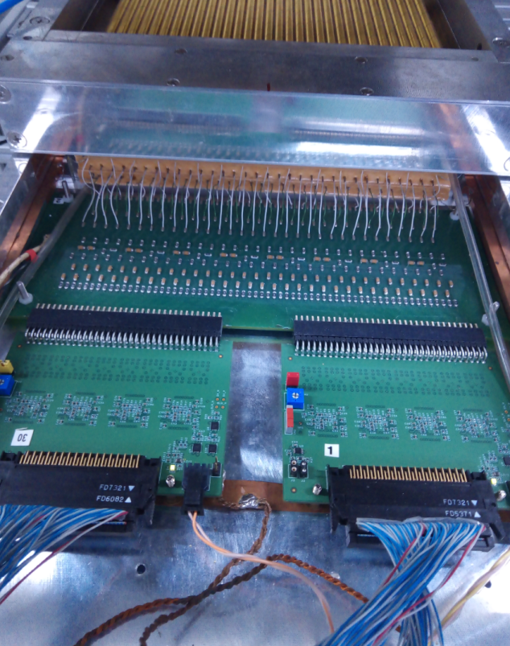
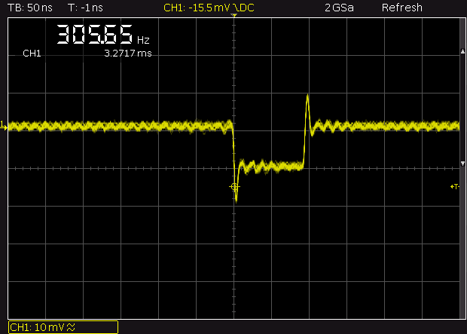
STRAW
Straw winding. Two film strips are wound around the mandrel
2 station
straw tube with 6mm diameter, in the centre a 30mrm diameter gold-plated tungsten wire
Length straw 20 cm
Precision measurement of 0.2 mm
6mm

Slide 11
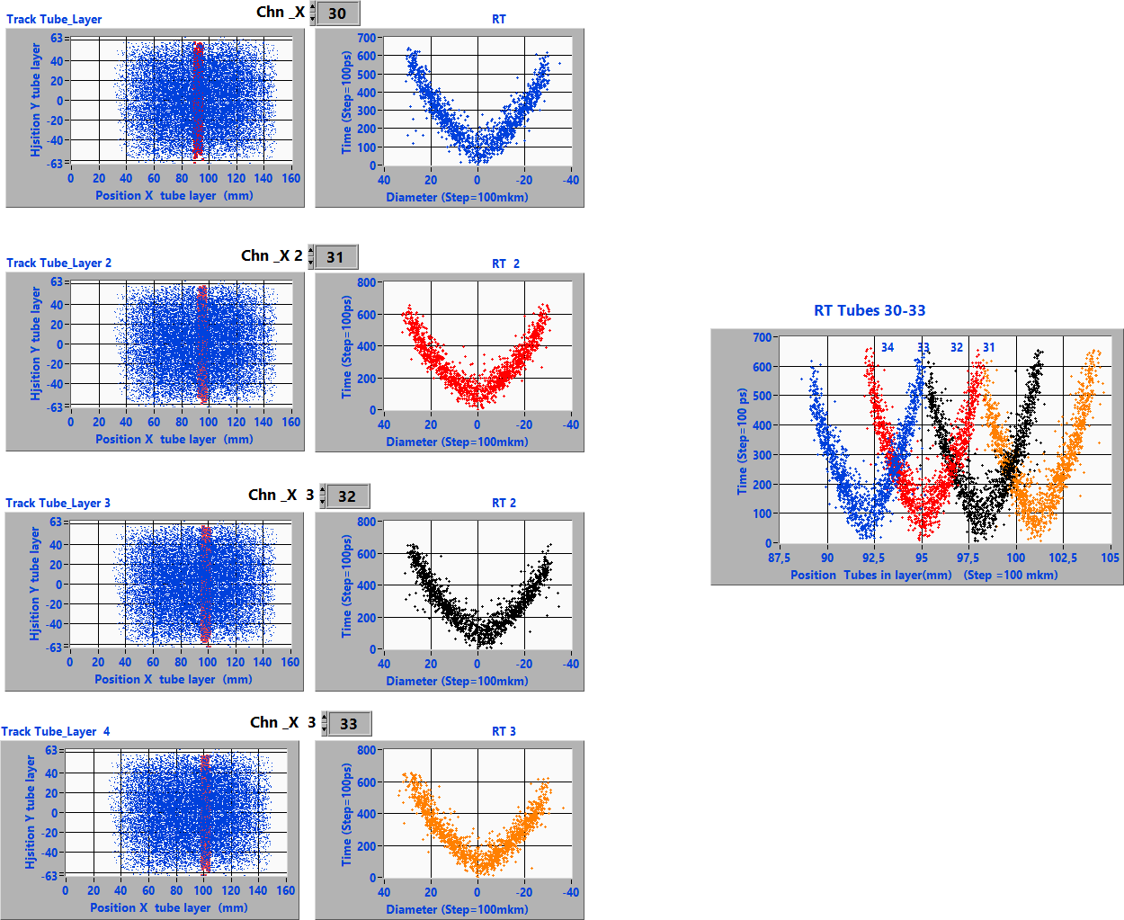
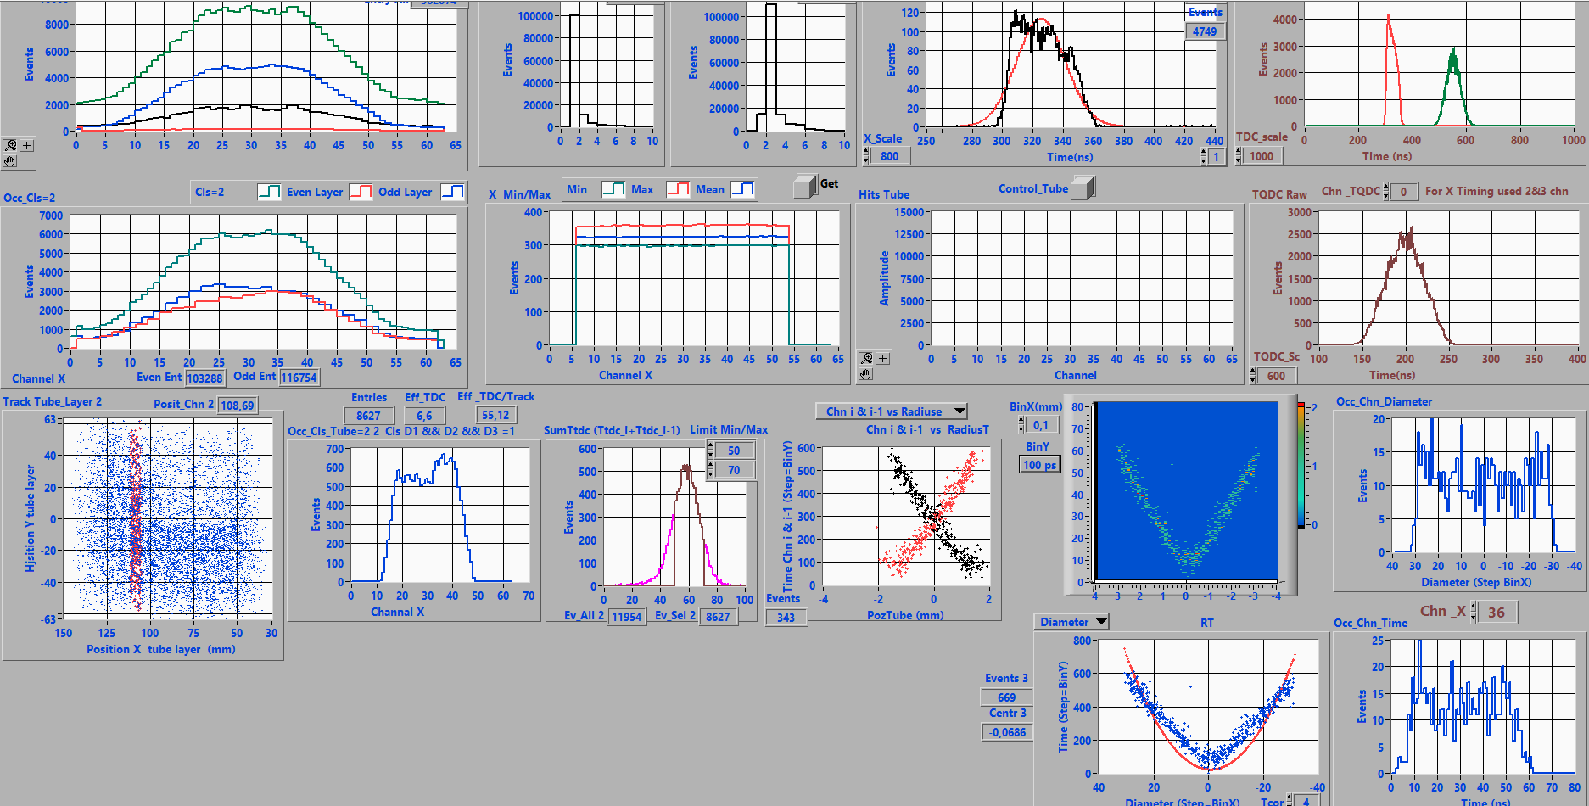
STRAW data monitoring
The r(t) relation (isochrone relation or “V-shape”) for straw tubes 30-33

Slide 12
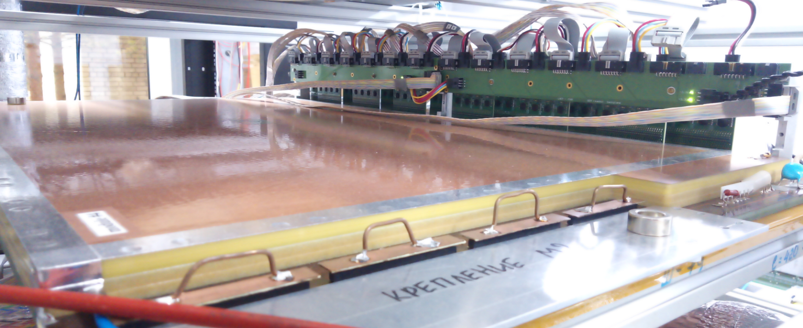
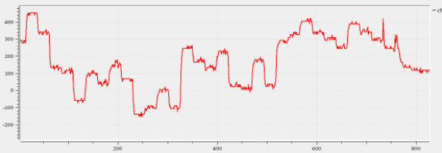
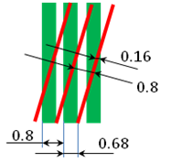
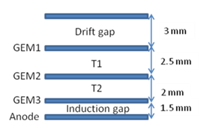
GEM

Slide 13
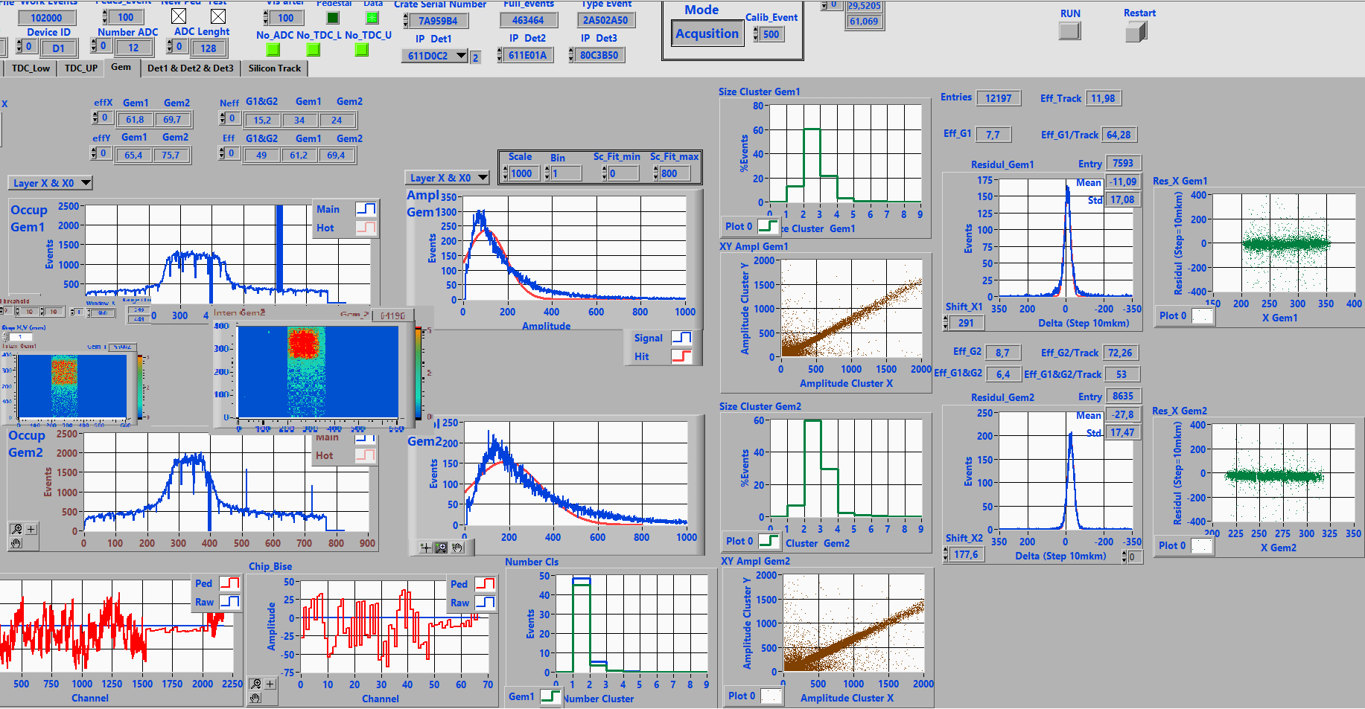
GEM data monitoring

Slide 14
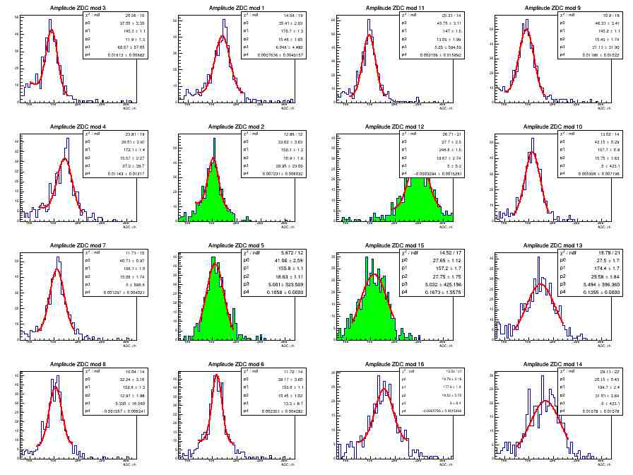
ECAL
ECAL MIP spectra in corresponding cells (top view)

Slide 15
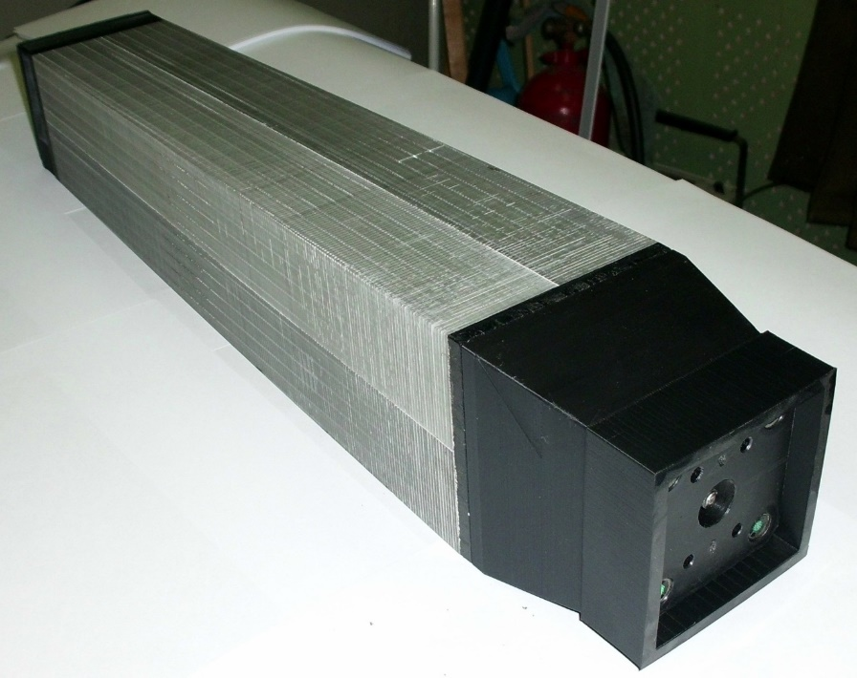
ECAL
ECAL module (110x110 mm²)design
Module consist of 4 cells 55x55x440 mm³:
220 Layers Lead and Scintillator
1.5 mm – Scintilator
0.3 mm - Lead

Slide 16
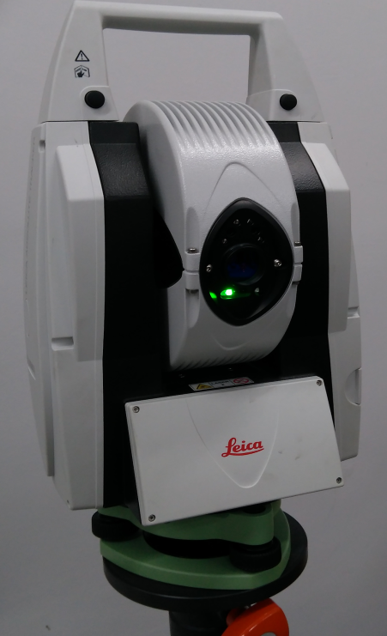
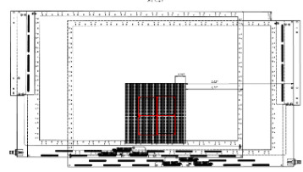
Alignment

Slide 17
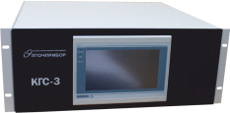
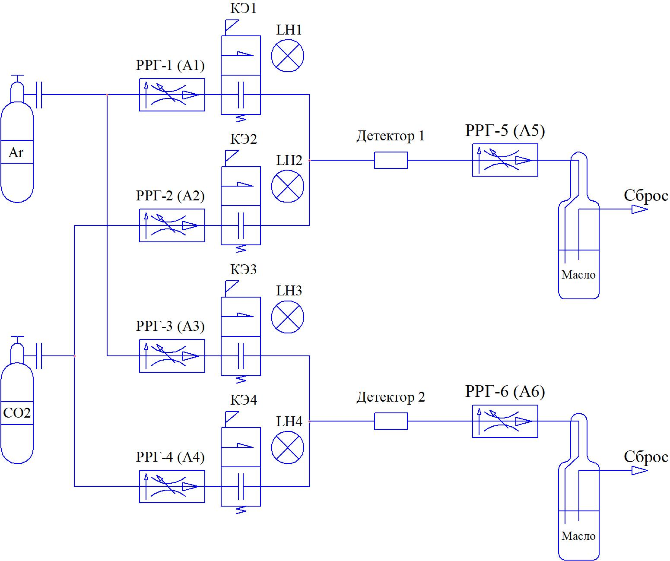
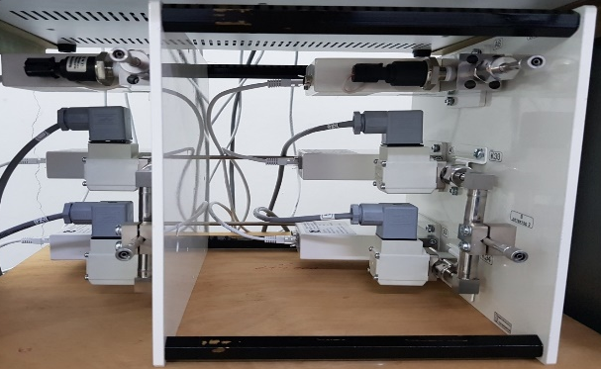
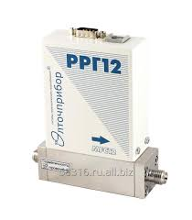
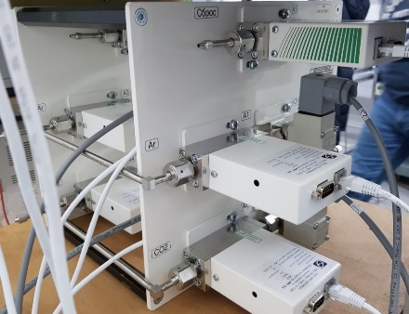
Gas supply system

Slide 18
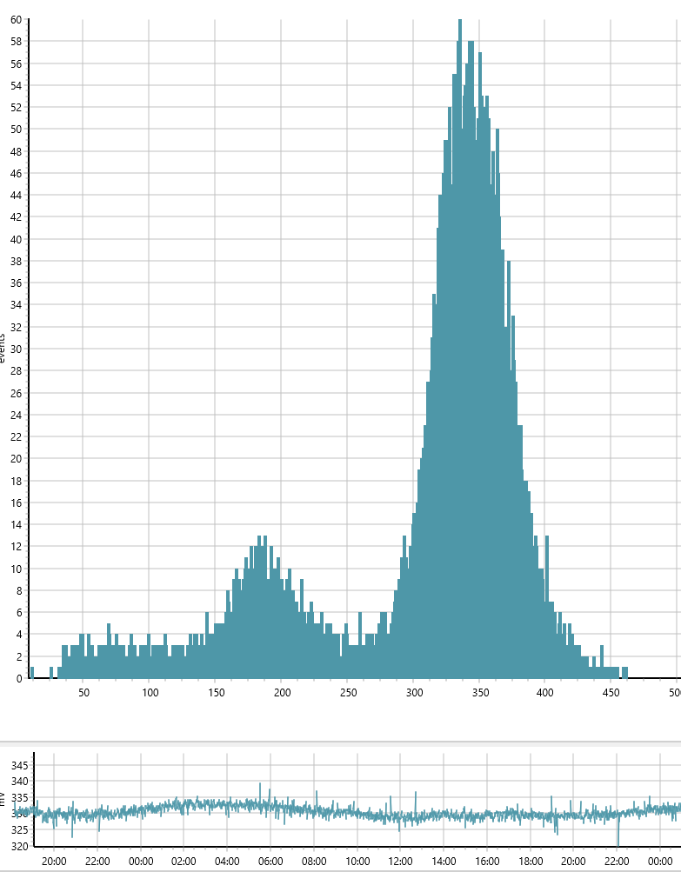
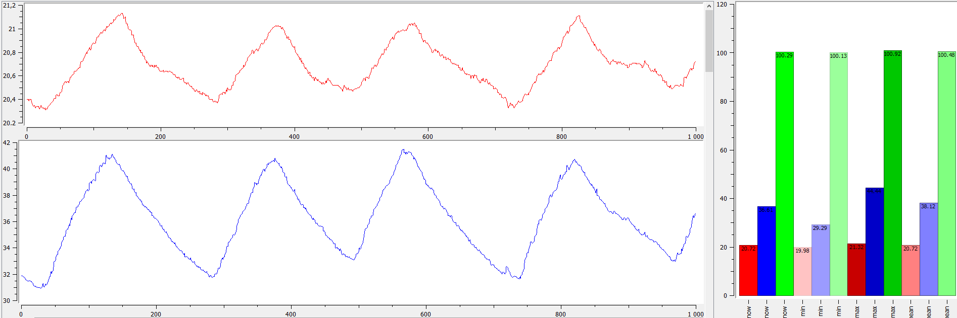
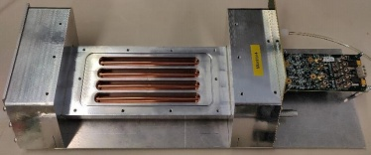
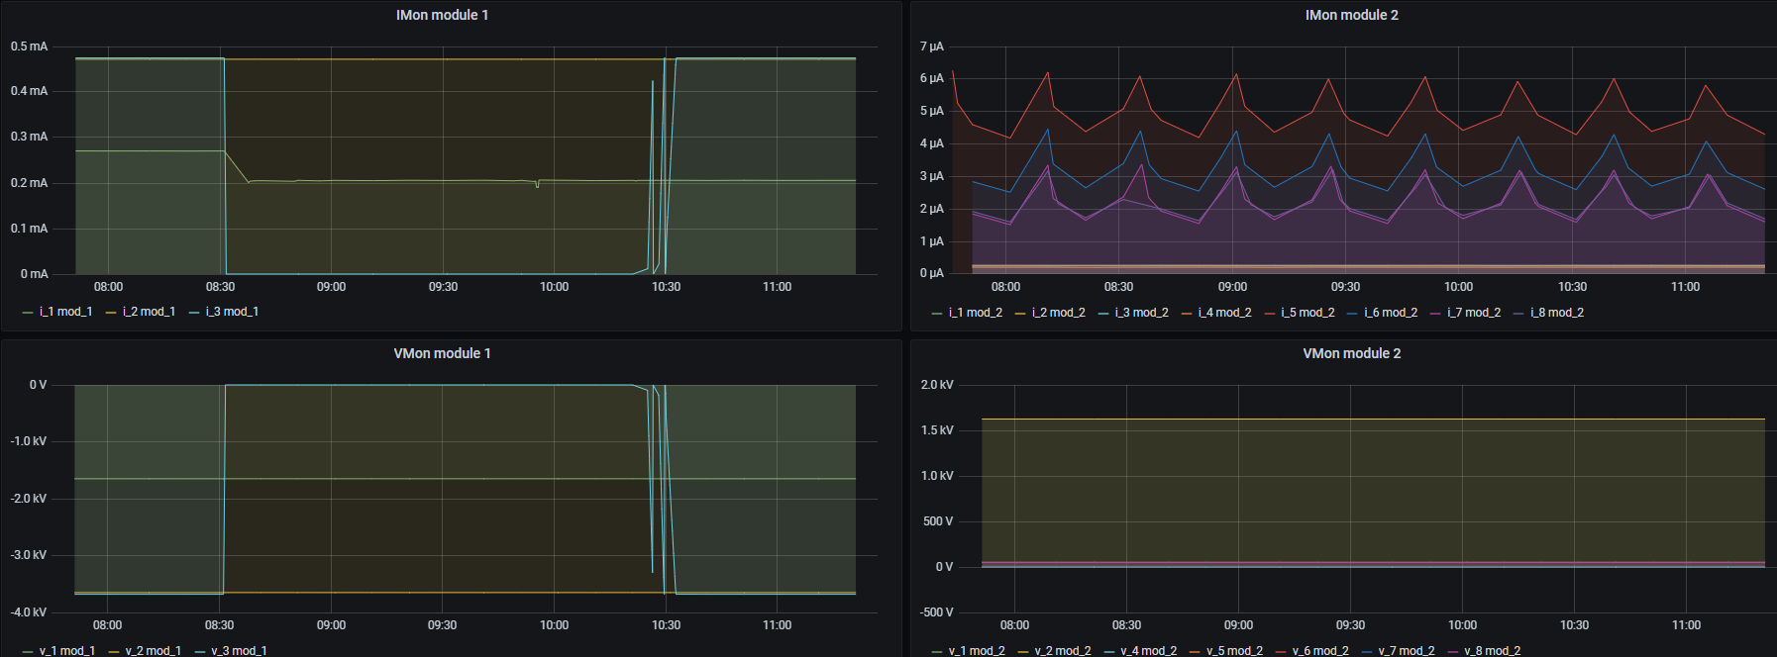
Slow control
TQDC16

Slide 19
Geant4
MiniSPD: $μ^{−}$ - 100 MeV
MiniSPD: $μ^{−}$ - 1 GeV
MiniSPD: $μ^{−}$ - 10 GeV
MiniSPD: $μ^{−}$ - 100 GeV
10

