Slide 1
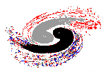



Institute of High Energy Physics
Where to find exotics?
Qiang Zhao
Institute of High Energy Physics, CAS
and Theoretical Physics Center for Science Facilities (TPCSF), CAS
zhaoq@ihep.ac.cn
The 11th APCTP-BLTP JINR-PINP NRC KI-SPbSU Joint Workshop ”Modern Problems in Nuclear and Elementary Particle Physics”, July 24-29, 2017, St. Petersburg

Slide 2
Outline
Hadrons beyond the conventional quark model and criteria for exotics signals
Do not forget the nearby S-wave thresholds
Put together pieces of the “jigsaw puzzle” for QCD exotics?
Prospects

Slide 3
1. Hadrons beyond the conventional QM and…
Exotic hadrons
convential hadron
Hybrid
Glueball
Tetraquark
(q‾q)
(qqq)
Pentaquark
Hadronic molecule
Proton
u
π
d
u
d
Neutron
Evidence for QCD exotic states is a missing piece of knowledge about the Nature of strong QCD.
d
u
Deuteron: p-n molecule

Slide 4
Exotics of Type-I:
J^{PC} are not allowed by Q‾Q configurations
States in natural spin-parity: if P=(−1)^{L+1} =(−1)^{J} , then S=1 and hence CP=(−1)^{(L+S)+(L+1)} =+1.
Mesons with natural spin-parity but CP= −1 will be forbidden:
0⁺⁻, 1⁻⁺, 2⁺⁻, 3⁻⁺, …
L
+
Natural: 0⁺⁺, 1⁻⁻, 2⁺⁺, 3⁻⁻, …
Unnatural: ( 0⁻⁻), 1⁺⁺, 2⁻⁻,3⁺⁺, …
−
S=1
L
+
Unnatural: 0⁻⁺, 1⁺⁻, 2⁻⁺, 3⁺⁻, …
−
S=0

Slide 5

Exotics of Type-II:
J^{PC} are the same as Q‾Q configurations
‾qq SU(3) flavor nonet: ‾3⊗3 =1⊕8
S
J^{PC} = 0⁻⁺
K⁰ (‾sd)
K⁺ (‾su)
+1
I₃
–1
+1
π– (‾ud)
π⁰, η, η′
π⁺(‾du)
−1
K⁻(‾us)
‾K⁰ (‾ds)

Slide 6
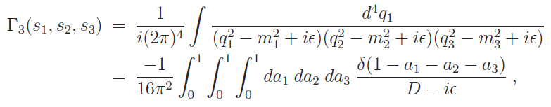
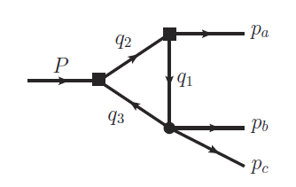



Exotics of Type-III:
Peak structures caused by kinematic effects, in particular, by triangle singularity.
The ATS occurs when all the three internal particles can be simultaneously on shell. It corresponds to
for all j=1,2,3.
L. D. Landau, Nucl. Phys. 13, 181 (1959);
J.J. Wu, X.-H. Liu, Q. Zhao, B.-S. Zou, Phys. Rev. Lett. 108, 081003 (2012);
Q. Wang, C. Hanhart, Q. Zhao, Phys. Rev. Lett. 111, 132003 (2013); Phys. Lett. B 725, 106 (2013)
X.-H. Liu, M. Oka and Q. Zhao, PLB753, 297(2016);
F.-K. Guo, C. Hanhart, U.-G. Meissner, Q. Wang, Q. Zhao, B.-S. Zou, arXiv:1705.00141[hep-ph], to appear in Rev. Mod. Phys.

Slide 7
Some long-standing but crucial questions:
Do we have evidence for exotic hadrons?
Yes! X(3872), Zc(3900), Y(4260), Pc(4450)…
Do we have indisputable evidence for exotic hadrons?
Yes/No ?!
Do we have efficient and sufficient criteria for identifying exotic hadrons?
No simple Yes/No ! Difficult!
Where to look for exotic hadrons?
We need to know how “exotic” those “exotics” are!

Slide 8
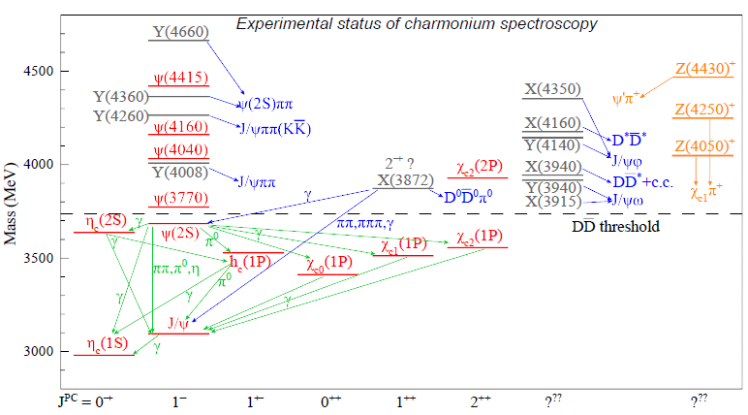
Heavy flavor states: Charmonia and charmonium-like states, i.e. X, Y, Z’s.
Zc(4200)
Zc(4020)
Zc(3900)
(I): Zc(3900), Zc(4020), Z(4430) …
(II): Y(4260), Y(4360), X(3872) …

Slide 9
Expected and unexpected: Do not forget the nearby S-wave thresholds!
Most of the ground states and states below open-flavor threshold are well established.
A large number of excited states, i.e. XYZ states, cannot be accommodated by the conventional quark model, while a large fraction of these states appear to be correlated with the nearby S-wave open thresholds.
Lattice QCD are still unable to provide a full quantitative description of the hadron spectroscopy.

Slide 10
S wave thresholds and effects on the lineshapes

Slide 11
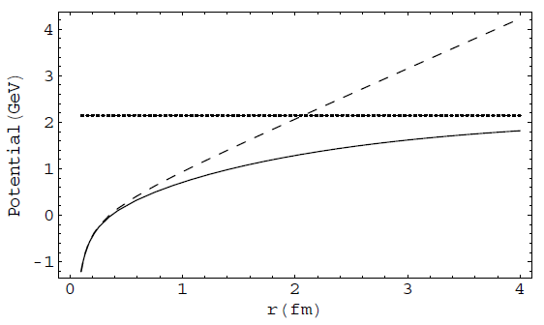
How the potential QM is broken down
V(r) = −κ/r + σ r
Linear conf.
‾qq creation
Coulomb
Color screening effects? String breaking effects?
The effect of vacuum polarization due to dynamical quark pair creation may be manifested by the strong coupling to open thresholds and compensated by that of the hadron loops, i.e. coupled-channel effects.
E. Eichten et al., PRD17, 3090 (1987)
B.-Q. Li and K.-T. Chao, Phys. Rev. D79, 094004 (2009);
T. Barnes and E. Swanson, Phys.Rev. C77, 055206 (2008)

Slide 12




Typical processes where the open threshold coupled channels can play a role
Y.J. Zhang et al, PRL(2009);
X. Liu, B. Zhang, X.Q. Li, PLB(2009)
Q. Wang et al. PRD(2012), PLB(2012)
“ρπ puzzle”
X.-H. Liu et al, PRD81, 014017(2010);
X. Liu et al, PRD81, 074006(2010)
Q. Wang et al, PRD2012
G. Li and Q. Zhao, PRD(2011)074005
F.K. Guo, C. Hanhart, G. Li, U.-G. Meiβner and Q. Zhao, PRD82, 034025 (2010); PRD83, 034013 (2011)
F.K. Guo and Ulf-G Meiβner, PRL108(2012)112002
The mass shift in charmonia and charmed mesons, E.Eichten et al., PRD17(1987)3090
X.-G. Wu and Q. Zhao, PRD85, 034040 (2012)

Slide 13
Weinberg’s Compositeness Theorem
Weinberg (1963); Morgan et al. (1992); Baru, Hanhart et al. (2003); G.-Y. Chen, W.-S. Huo, Q. Zhao (2013) ...
= Probability to find the hadronic molecule component in the physical state A
The effective coupling g_{eff} encodes the structure information and can be extracted model-independently from experiment.

Slide 14
3. How to put together pieces of the “jigsaw puzzle” for QCD exotics?
-- So far Y(4260) has been the mostly studied state with the largest data samples in e+e- annihilations.

Slide 15
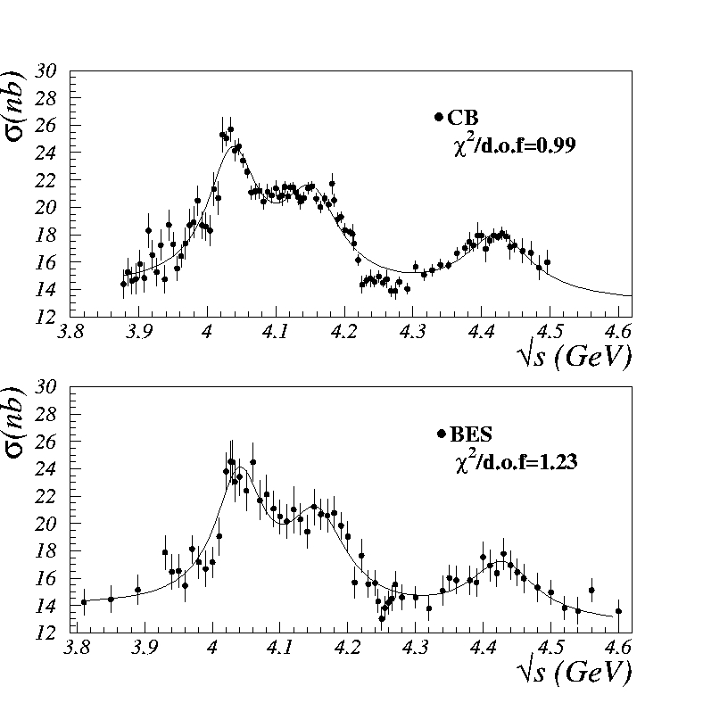
Absence of Y(4260) in inclusive and two-body open charm exclusive decays
ψ(3770), 1D
ψ(4040), 3S
X(3900) ?
ψ(4160), 2D
ψ(4415), 4S
σ(e⁺e⁻ → hadrons)
Y(4260)
Y(4260)
Y(4260)
e+e- → D‾D
Belle PRD77, 011103(2008).

Slide 16
Observation of Y(4260) in J/ψ ππ spectrum
Cited > 640 times!
PRD77, 011105 (2008)
Belle

Slide 17
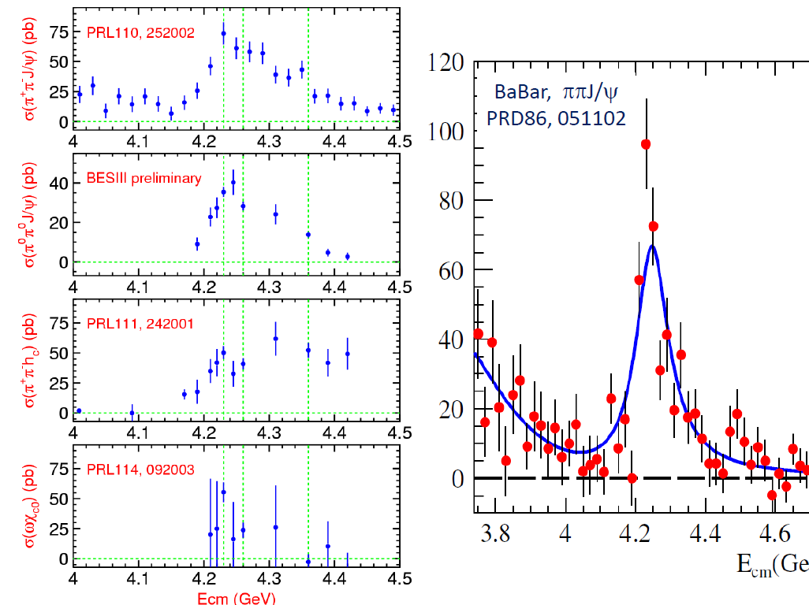
BESIII, arXiv:1611.01317 [hep-ex]
BESIII, arXiv:1610.07044 [hep-ex]
Gao, et al., 1703.10351[hep-ex]

Slide 18

X.Y. Gao, C.P. Shen and C.Z. Yuan, 1703.10351[hep-ex]

Slide 19
BESIII, 1704.08033[hep-ex]

Slide 20
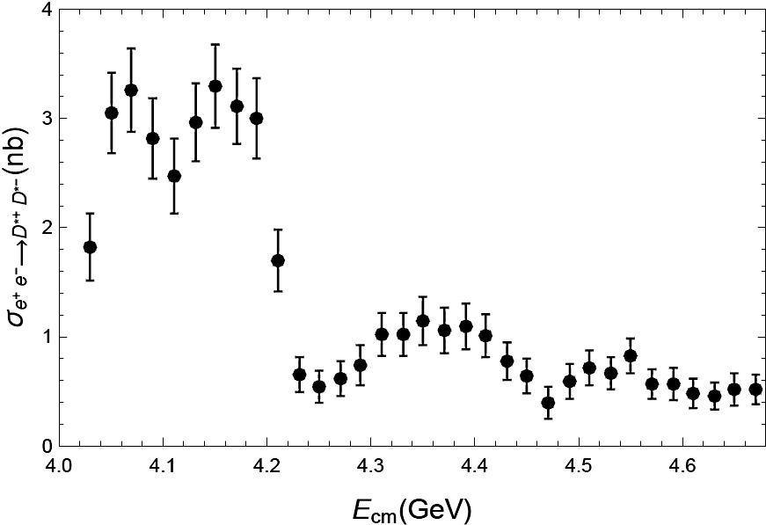
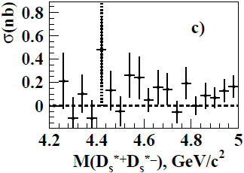


What’s the contribution of Y(4260) to open charm channels?
$e^{+}e^{−}→D^{∗}{\overline{D}}^{∗}$
$$e^{+}e^{−}→D_{s}^{∗}{\overline{D}}_{s}^{∗}$$
PRL 98 (2007) 092001
PRD 83, 011101 (2011)

Slide 21
Mass of Y(4260): ~ 4.22 GeV
Total width of Y(4260): 50~80 MeV
BESIII, 1705.06853[hep-ex]

Slide 22
Possible interpretations for the nature of Y(4260)
Hybrid state, F.E.Close and P.R.Page, PLB28(2005)215; S.L.Zhu, PLB625(2005)212; E. Kou and O. Pene, PLB631(2005)164
Radial excitation of a diquark-antidiquark state analogous to X(3872), L.Maiani, F.Piccinini, A.D. Polosa and V. Riquer, PRD71(2005)014028
D₁ D molecular state, G.J. Ding, PRD79(2009)014001; F. Close and C. Downum, PRL102(2009)242003; A.A. Filin, A. Romanov, C. Hanhart, Yu.S. Kalashnikova, U.G. Meissner and A.V. Nefediev, PRL105(2010)019101
Strongly couple to Χ_{c0}ω, M. Shi, D. L. Yao and H.Q. Zheng, hep-ph/1301.4004
Hadro-quarkonium, M. Voloshin
Inference effects, X. Liu et al
……

Slide 23
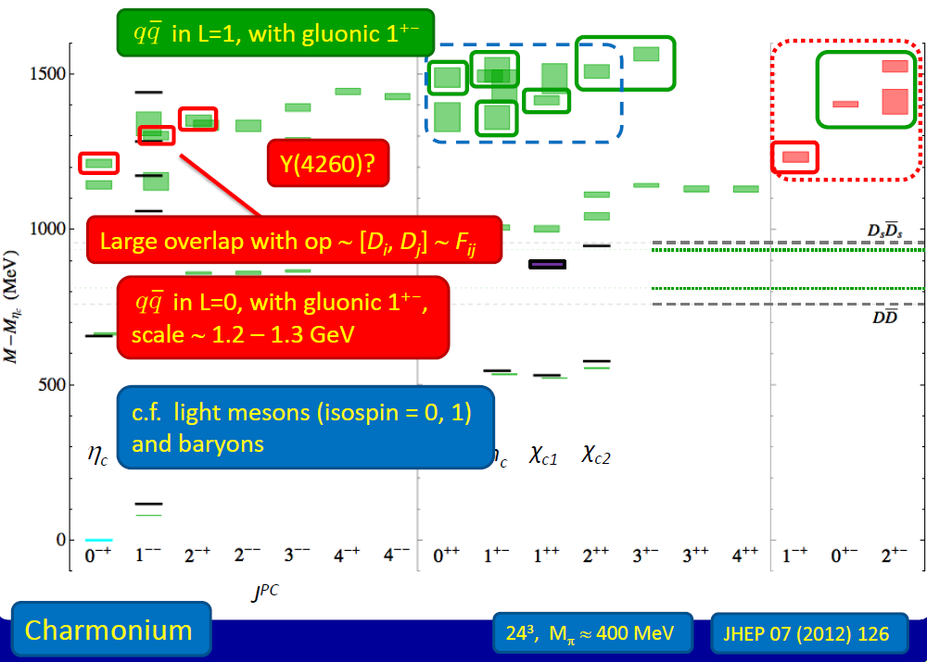
C. Thomas, talk at Charm 2013

Slide 24
e⁺
π
Y(4260)
π
e⁻
Zc
J/ψ
The mass of the charged charmonium-like structure Zc(3900) is about 3.899 GeV, close to DD* threshold!
It could be an opportunity for understanding the mysterious Y(4260).
BESIII, PRL110, 252001 (2013) [arXiv:1303.5949 [hep-ex]]

Slide 25
Belle, PRL110, 252002 (2013) [arXiv:1304.0121v1 [hep-ex]]
Xiao et al., PLB (2013), arXiv:1304.3036v1 [hep-ex]

Slide 26

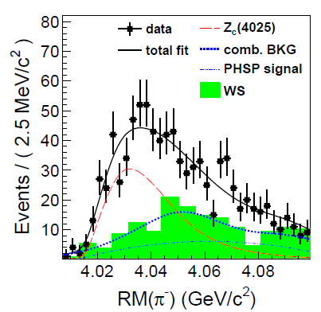


BESIII Collaboration, arXiv:1308.2760 [hep-ex]

Slide 27

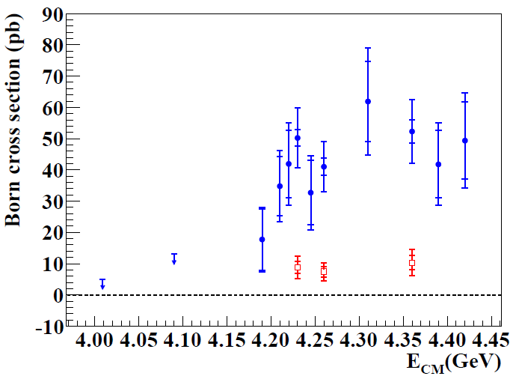
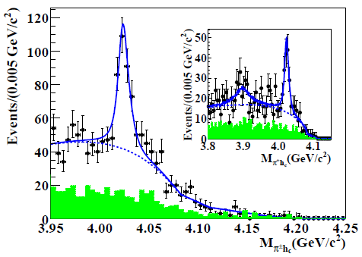

Zc(4020)
Zc(3900)?
Y(4260)
m(Zc(4020)) =
Γ(Zc(4020)) =
Both Zc(4025) and Zc(4020) are close to the ‾D*D* threshold. They could be the same state.
BESIII Collaboration, arXiv:1309.1896 [hep-ex]

Slide 28

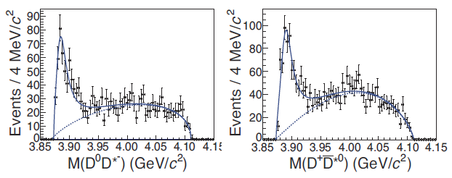
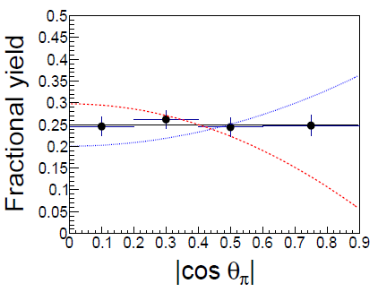
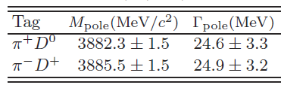
Zc(3900)?
Direct determination of the spin-parity!
J^{P} = 1⁻
J^{P} = 1⁺
J^{P} = 0⁻
BESIII Collaboration, arXiv:1310.1163 [hep-ex]

Slide 29
BESIII, PRL110, 252001 (2013) [arXiv:1303.5949 [hep-ex]]
Theoretical interpretations:
Hadro-quarkonium (M. Voloshin et al.)
Tetraquark (L. Maiani et al.)
Born-Oppenheimer tetraquark (E. Braaten)
CUSP effects from hadron loops (X. Liu et al.)
Hadronic molecule produced in a singularity condition (Q. Wang, C. Hanhart, Q.Z.)
… …
How these states are formed?
Why they mostly appear near “thresholds”?
What are the dominant decay channels of Zc and Zc’ ?
What observables are sensitive to the structure of such threshold states?
How to distinguish various proposed scenarios?
… …

Slide 30
The first S-wave open charm threshold in vector channel
e⁺
π
Y(4260)
π
ψ(4415)
e⁻
Y(4360)
D*‾D₁
Zc(3900)
J/ψ
Charmonium spectrum
Y(4260)
D‾D₁
At least 4 quarks !
ψ(4160)
π
ψ(4040)
Zc(3900)
D‾D*
ψ(3770)
D‾D
ψ′(3686)
π
J/ψ
J^{PC} = 1⁻⁻

Slide 31
Y(4260) could be a hadronic molecule made of DD₁(2420)
Y(4260)
D (c‾q), J^{P}=0⁻;
D*(c‾q), J^{P}=1⁻;
D₁ (c‾q), J^{P}=1⁺.
DD*π
DD₁(2420)
W= 4020 MeV
W= 4289 MeV
“threshold states” as hadronic molecular states
D₁(2420)
D₁
D*
Y(4260), 1⁻⁻
Y(4260)
π
‾D(1868)
‾D
‾D₀
Q. Wang, C. Hanhart, QZ, PRL111, 132003 (2013); PLB(2013)

Slide 32
The signature of Y(4260) could be revealed by the associated Zc(3900) near the DD* threshold via “triangle singularity”!
[J.-J. Wu, X.-H. Liu, B.-S. Zou, and Q. Zhao, PRL108, 081003 (2012)]
D1
π
D*
D
π
J/ψ (hc)
Zc(3900), I,J^{P}= 1, 1⁺
D*
J/ψ
+
‾D
π
M(Zc) ≅ M(D) + M(D*) = 3.876 GeV
A systematic study of the singularity regions in e+e- → J/psi pipi, hc pipi, χ_{c0} ω and DD*pi is necessary.

Slide 33






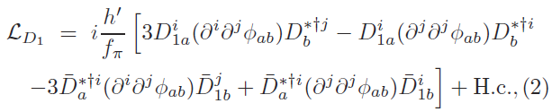
Lagrangians in the NREFT
Y(4260)D₁D coupling:
Zc(3900)DD* coupling:
D₁D*pi coupling:
Q. Wang, C. Hanhart, QZ, PRL111, 132003 (2013); PLB(2013)
Q. Wang et al., PRD89, 034001 (2014); M. Cleven et al., PRD90, 074039 (2014);
W. Qin et al., PRD94, 054035 (2016)

Slide 34

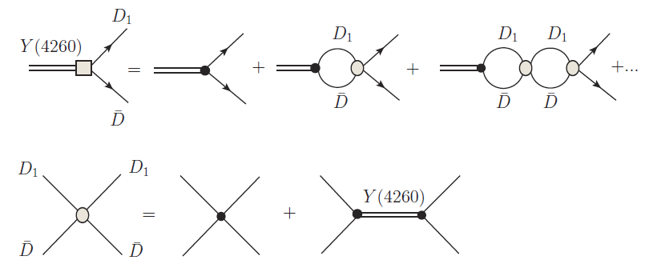
Define the molecular component of Y(4260)
HQSS breaking is implicated

Slide 35
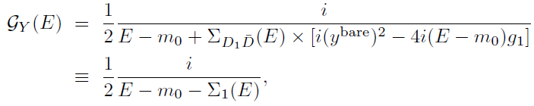




The propagator of Y(4260)

Slide 36




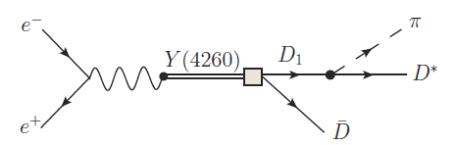

Y(4260) is dominated by molecular component but also contains a charmonium component as a compact structure.

Slide 37


Y(4260) production via its ‾cc component
Bare coupling to photon via VMD:
e⁺
Y(4260)
e⁻
Coupling renormalization:
Upper limit given by assuming D1 total width saturated by its decays into D*π:

Slide 38


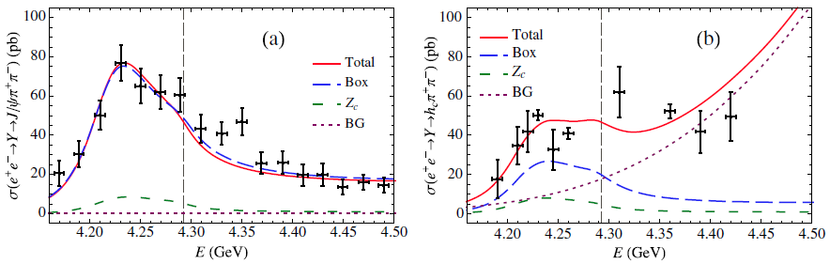
DD₁
DD₁
The presence of DD₁ threshold causes asymmetric lineshape in J/psi pipi channel and non-trivial lineshape of the hc pipi channel.
More information from other exclusive channel via the cross section lineshape measurement
M. Cleven, Q. Wang, C. Hanhart, U.-G. Meissner, and Q. Zhao, 1310.2190; PRD90, 074039 (2014)

Slide 39
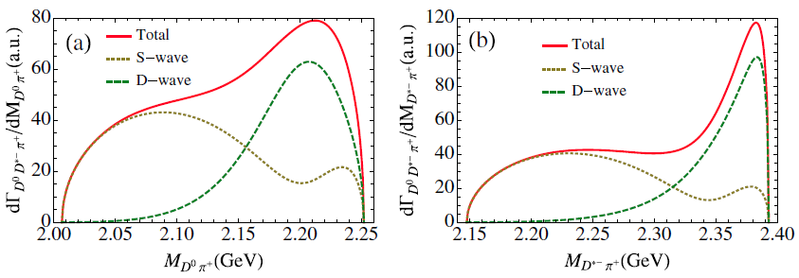
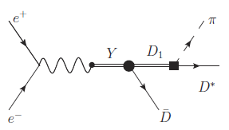
Invariant mass spectra for Dπ, D*π, and ‾DD*
Signature for D₁(2420) via the tree diagram.
The Zc(3900) could have a pole below the DD* threshold.

Slide 40
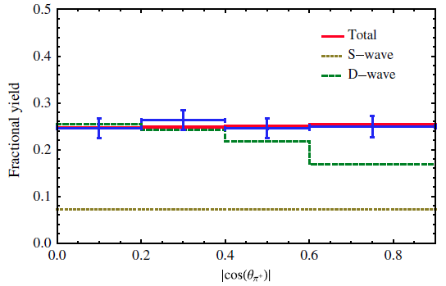
Angular distribution analysis
π⁺
BESIII (2013)
θ_{π}⁺
e⁺
e⁻
D
θ_{πD}
D*
The dominance of D wave at the Zc peak can compromise with the angular distribution.

Slide 41
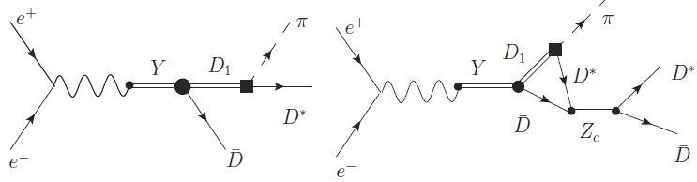
If a hadronic molecule component exists: the DD*pi should have a non-trivial lineshape!
Data from Belle
D₁D

Slide 42
Small cross section for e+e- → Y(4260) → χ_{c0} ω
Threshold enhancement generated by rescatterings of DD₁.
M. Cleven and Q.Z., EPJC(2016)

Slide 43
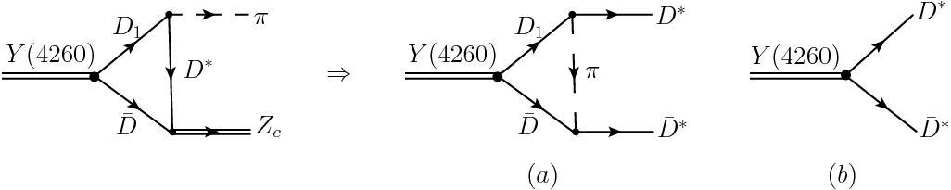

Challenge from e+e- → Y(4260) →$D^{∗}{\overline{D}}^{∗}$, ${Ds}^{∗}{\overline{D}s}^{∗}$
Feynman diagrams for the transition amplitudes
$ψ_{1}$, $ψ_{2}$and $ψ_{3}$ denote$ψ$(4040),$ψ$(4160) and$ψ$(4415), respectively.

Slide 44
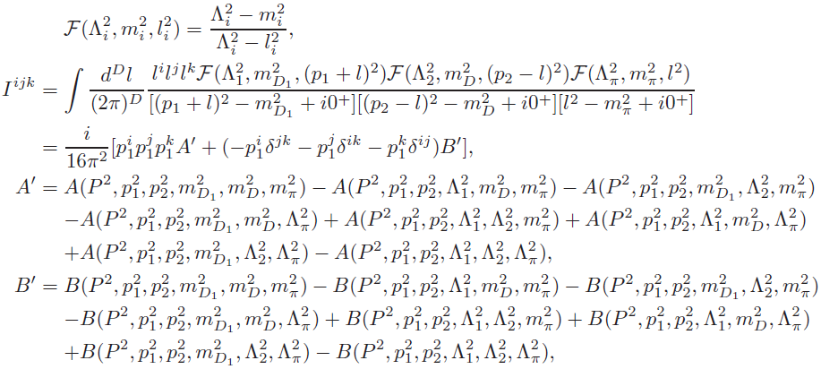
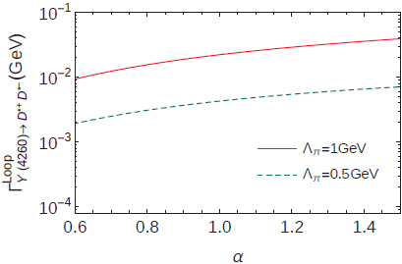
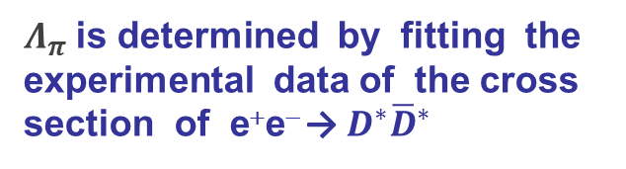
Monopole form factor
$Λ_{π}$is determined by fitting the experimental data of the cross section of e⁺e⁻ → $D^{∗}{\overline{D}}^{∗}$

Slide 46
4. Prospects from different scenarios
Theoretical models for XYZ states:
Hadro-quarkonium (Voloshin)
Tetraquark (Maiani, Polosa, et al.)
Born-Oppenheimer tetraquark (Braaten)
Hadron loop CUSP (Bugg, Swanson, Liu, et al.)
Hadronic molecule produced in a singularity condition for hadron loops
See e.g. M. Cleven, F.-K. Guo, C. Hanhart, Q. Wang, Q.Z., PRD(2015); arXiv:1505.01771 [hep-ph]

Slide 47
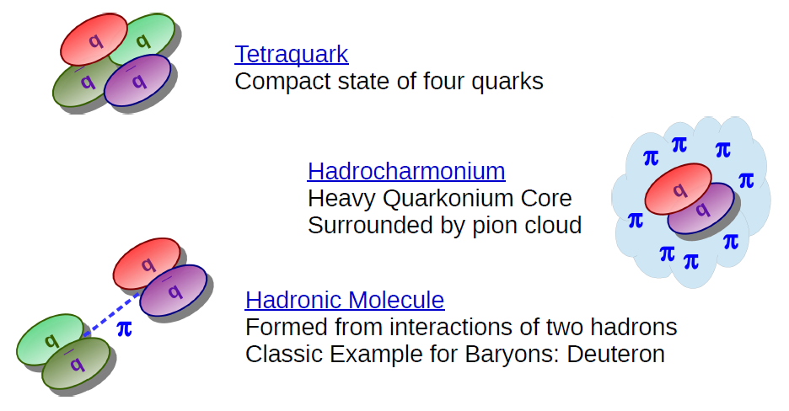
In the heavy quark spin symmetry (HQSS) limit these models have different predictions for the spectrum.
Slide from talk by M. Cleven

Slide 48



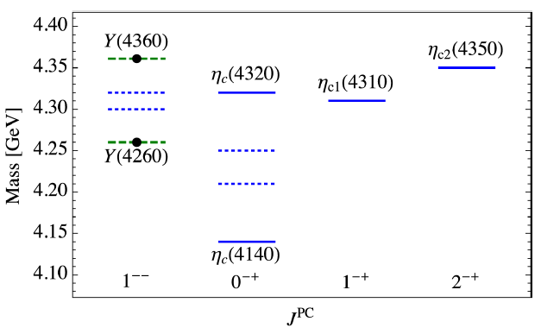
Hadro-quarkonium states (Voloshin)
Heavy spin doublets: (h_{c}, χ_{cJ}), (ψ, η_{c})
Possible decay channel: η_{c}ππ, χ_{cJ}ππ
Exotic quantum number: J^{PC}=1⁻⁺
Two η_{c} states
M. Cleven, F.-K. Guo, C. Hanhart, Q. Wang, Q.Z., PRD92, 014005 (2015); arXiv:1505.01771 [hep-ph]

Slide 49
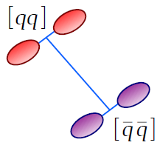

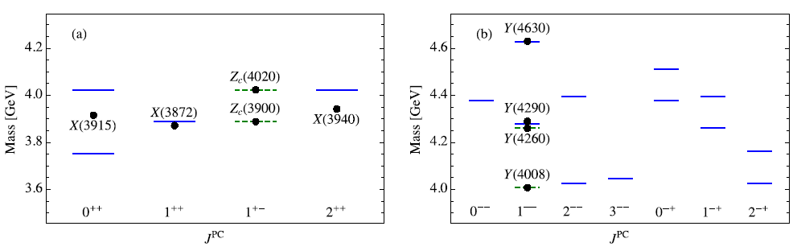
Tetraquark states (Maiani et al.)
The mass of a tetraquark is given by
For a state with given J, the mass can be estimated:
S wave
P wave
Extremely rich spectrum is predicted!

Slide 50
No Y(4008) observed!
BESIII, arXiv:1611.01317 [hep-ex]

Slide 51
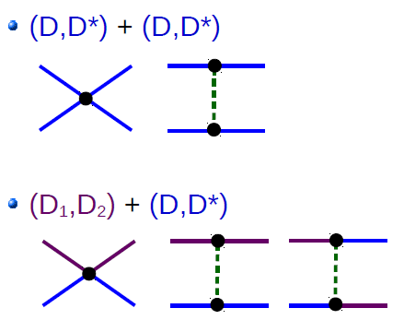
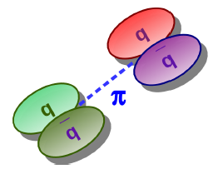

Hadronic molecules (Cleven et al.)
J^{PC} =0⁺⁺, 1⁺⁺, 1⁺⁻, 2⁺⁺
J^{PC} =1⁻⁻, 1⁻⁺
Long-range pion exchange;
Isoscalar and isovector may not bind simultaneously;
M. Cleven, F.- K. Guo, C. Hanhart, Q. Wang and Q. Zhao, PRD 92, 014005 (2015);
Q. Wang, PRD 89, 114013 (2014)

Slide 52
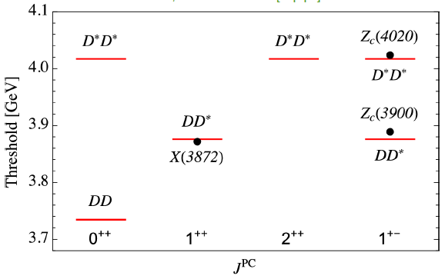
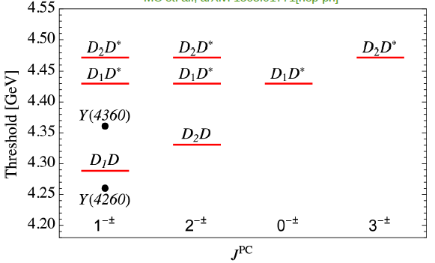
S wave – S wave
S wave – P wave
States appear at S-wave thresholds;
The J=3 state has significantly higher mass than for tetraquarks;
Only one J^{PC}=0⁻⁺ state is predicted;
Scalar state of ‾DD may not exist;
Exotic partners of J^{PC}= 1⁻⁻;
……

Slide 53
5. Summary
Huge puzzling questions on charmonium-like states!
Theory:
Self-consistent method
Systematic analysis of various processes
Better understanding of threshold structures
Experiment:
Detailed lineshape measurements
Angular distributions of exclusive channels
→ Large data sample with detailed energy scan
→ Reliable extraction of dynamic information

Slide 54
The Seventh Asia-Pacific Conference on Few-Body Problems in Physics (APFB 2017), Aug. 25 (Fri.) – 29 (Tue.), 2017, Guilin, China

Slide 55
Institute of High Energy Physics
Thanks for your attention!

Slide 56
Light hadrons:‾qq SU(3) flavor nonet: ‾3⊗3 =1⊕8
f₀(1500) ?
a₁(1420)?
η(1405) ?
Still there exist a lot of puzzling questions!

Slide 57
Scalar puzzle (II): Scalars below 1 GeV
Tetraquark states? Meson molecules?
J^{P} = 0⁺
‾qq ‾q²q²
‾qq tensor nonet
a₀(980) ‾uu -‾dd, [‾us‾su -‾ds‾sd ]
f’₂(1525) ‾ss
f₀(980) ‾ss , [‾su‾us +‾sd‾ds ]
K₂(1430) ‾sd
κ(800) ‾sd , [‾su‾ud ]
a₂(1320) ‾uu -‾dd
f₂(1270) ‾uu +‾dd
f₀(600) ‾uu +‾dd, [‾ud‾du ]
Pay less price to create a 0⁻ q‾q pair instead of orbitally excite a q‾q?
Hadronic molecules? – The dynamically generated scalars DON’T know the short-distance quark structures.
See recent review by J. Pelaez, arXiv:1510.00653 [hep-ph]

Slide 58
Jaffe’s diquark-antidiquark states? Or dynamically generated states by meson-meson scatterings?
d
d
u
u
u
u
d
d
Which picture is favored by Nature?
What are their implications of the whole hadron spectroscopy?
What is the role played by open thresholds? – Long-ranged dynamics should be taken into account.

