Slide 1
Exotic Glueballs
Hee-Jung Lee
(Chungbuk Nat’l Univ.)
Collaborators :
N. I. Kochelev (JINR)
A. V. Pimikov, P. Zhang (IMP, China)
Notes:
EPJA(2006), PLB 642 (2006) 358, hep-ph/0702225

Slide 2
In this talk
Exotic hadrons?
Review of the QCD sum rule
Review of the light scalar meson nonet as the exotic meson
Exotic glueballs within the QCD sum rule
Discussion

Slide 3
Exotic Hadrons?
Hadrons of quantum numbers which are not expected from the conventional quark model for hadrons (Baryons of 3 quarks, mesons of quark and antiquark).
- Examples : mesons of J^{PC}=0⁻⁻, 1⁻⁺
Hadrons which are expected to have more quark content than the conventional hadrons have.
- Example : tetraquark states for the light scalar
mesons
P=-(-1)^{L}, C=(-1)^{L+S}

Slide 4
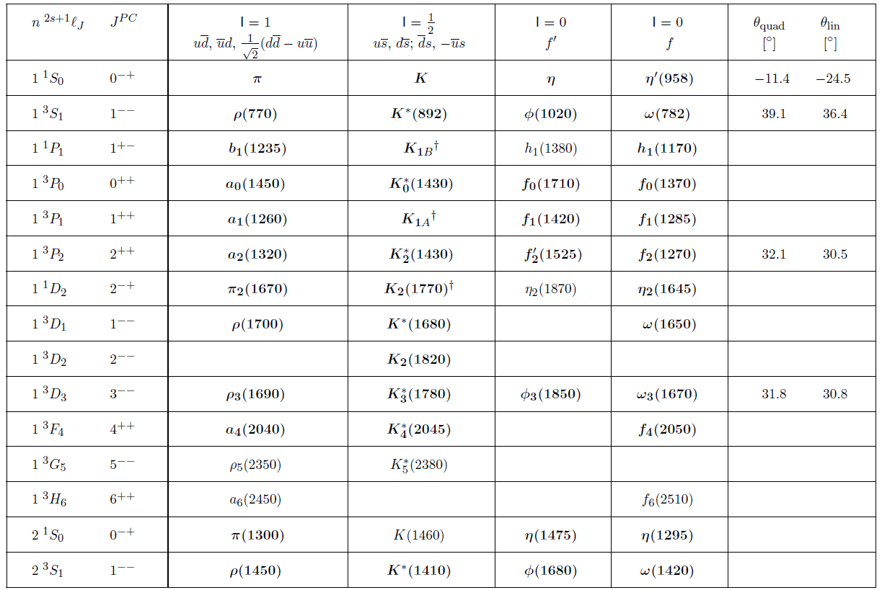
PDG 2016

Slide 5
QCD sum rule (SR)
Correlator of the interpolating current with the quantum number of the hadron under consideration
Calculating it in deeply Euclidean region by the perturbative OPE
Condensates from the
nonperturbative vacuum
Nonperturbative QCD Vacuum

Slide 6
is related to physical region by the dispersion relation
Narrow resonance approx. in the phen. side
Quark-hadron duality

Slide 7
Borel transform makes the contributions from the continuum suppressed exponentially.
QCD sum rules :
: Borel Mass
LHS(M) :
Must be POSITIVE

Slide 8
Mass of Particle can be determined by
Generally, including all contributions from OPE, the mass must be independent on the Borel mass, if the current is appropriate to the hadron.
Actually, we cannot do it. Up to a certain energy dimension operators, mass plateau appears in some region of the Borel mass.
Borel window
Borel window must be opened in .

Slide 9
Light scalar meson nonet
Members :
Large decay widths :
Refs. : PDG, Chin. Phys. C, 38(2014) 09001
Notes:
PDG 2008, sigma mass : 400~1200, sigma width :600~1000, PDG 2014, sigma mass : 400~550MeV, PDG 2014 f0(980), a0(980) mass : 990+-20, 980+-20

Slide 10
interpretation
L=1
With ideal mixing : for P=+1
(?1)Decays of : fraction of ?
Amsler et al,
Phys. Rep.
384(2004)61
Notes:
a0->eta pi (dom), f0->pi pi (dom), k->K pi, sigma->pi pi

Slide 11
(?2) Mass degeneracy in
1. From number of strange quarks
2. gives 400MeV more mass :
from the mass formula in a quark model
(Kochelev, H.-J. Lee, Vento, PLB 594 (2004) 87),
for example :

Slide 12
interpretation
One gluon exchange & instanton :
strongest attraction in two quarks of : scalar (S) diquark
in two antiquarks of : S antidiquark
-Jaffe & Wilczek, Shuryak & Zahed
In flavor space :
Explicitly
Notes:
Heff~-\lam*\lam \sig*\sig, Heff|\bar(3)_F,\bar(3)_C,1_s>=-8|\bar(3)_F,\bar(3)_C,1_s>, Heff|\bar(3)_F,6_C,3_s>=-4/3|\bar(3)_F,6_C,3_s>
Heff|6_F,\bar(3)_C,3_s>=+8/3|6_F,\bar(3)_C,3_s>, Heff|6_F,6_C,1_s>=+4|6_F,6_C,1_s>

Slide 13
In terms of S diquark & S antidiquark : L=0
Number of strange quark :
Strange quark component in :
: Inverted mass spectrum

Slide 14
SRs for light scalar nonet
Interpolating currents : energy dim.=6
After Borel transform :
Energy dimension of the correlator =10

Slide 15
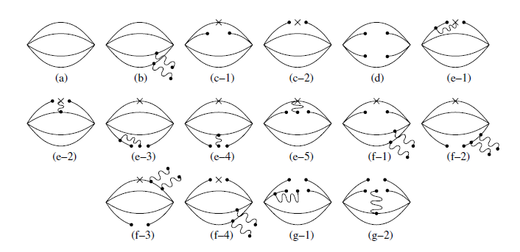
QCD SR : and up to
Continuum contributions :
Physical Borel region is around 1GeV :
operators up to dim=8 would be important

Slide 16
LHS of SRs with scalar Diquark

Slide 17
What we have seen…
SRs up to d=6 ops. :
- Multiquark system has large energy dim. :
SRs up to d=6 ops. could not be enough.
Large negative contribution from d=8 ops. :
destroys consistency of SRs.
Effect from Instanton?

Slide 18
Any possibility for keeping consistency of SRs?
Generally, five types of relativistic currents :
General interpolating currents :
Chen et al., Phys.Lett.B650:369-372,2007
Notes:
CQM : constituent quark model

Slide 19
SR for f0(500) again
‘t Hooft instanton induced interaction for u,d :
Fierz trans.

Slide 20
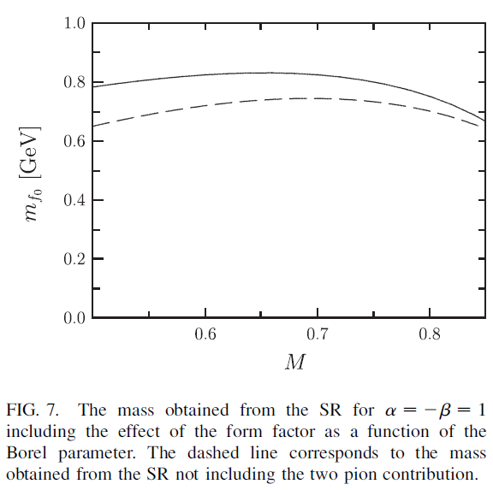
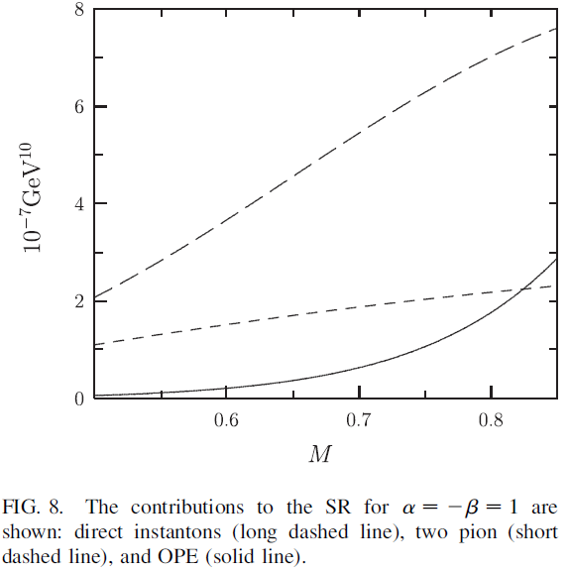
Including instanton effects, for a=-b=1, there can be stable result!
Notes:
Mass ~ 800MeV

Slide 21
Exotic Glueballs
Glueballs, bound states of gluons, are predicted by QCD and have been studied for a long time.
There has been no clear experimental evidence.
Theoretically, the glueballs of the two or three gluons with the quantum numbers, 0⁻⁺, 0⁺⁺, 2⁺⁺
have been studied mainly.
Masses of 0⁻⁺, 0⁺⁺ glueballs of two gluons from the QCD SR :
- Mathieu, Kochelev, Vento, IJMP(2009)

Slide 22
These glueballs could couple to the conventional mesons of 0⁻⁺, 0⁺⁺.
If glueballs of the exotic quantum numbers exist, those glueballs will not couple to the conventional mesons.
One candidate for such kinds of the exotic glueballs is the glueball with of three gluons.
This fact could be one of difficulties in
searching the glueballs in experiments!

Slide 23
glueball within QCD SR
Current of three gluons
- Under the charge conjugation and the parity
- Current will have a form, depending on O_{i} ,

Slide 24
First attempt : Qiao and Tang, PRL (2014)
- Current :
- It is checked that the imaginary part of the correlator within OPE is NEGATIVE. So??
- LHS of SR becomes NEGATIVE : No bound states in these kinds of three gluons.
This discussion will be appeared on PRL comm.

Slide 25
Our analysis : PRD (2017)
New current :
- Leading part is

Slide 26
Various contributions to :
- 6 types of correlators are appeared.
- Example :
- Diagrammatic representations :

Slide 27
Correaltor within OPE :
: POSITIVE Imaginary part.
: No Im., for J=0
: Negative Im.
:By Hyp. Vac. Dom.

Slide 28
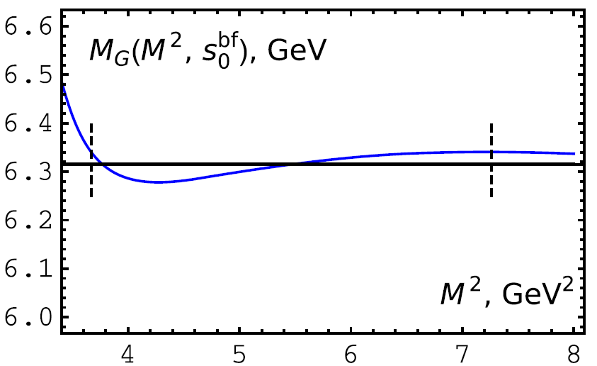
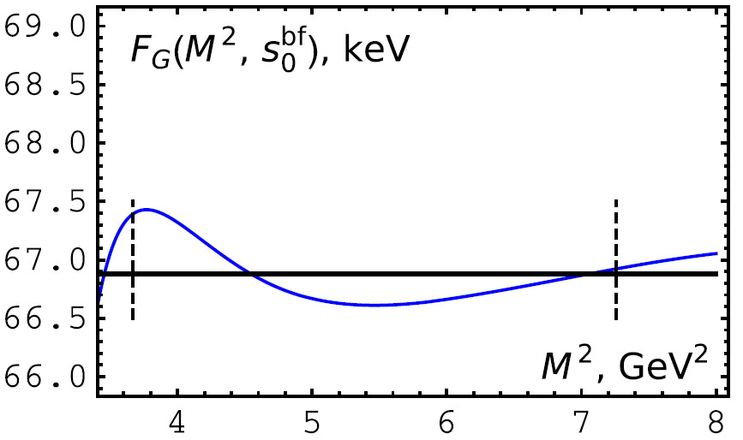
Mass and Decay constanat :
- with
From lattice, Gregory JHEP(2012) :

Slide 29
Discussion
We reviewed that f0(500) could be the bound state of the diquark-antidiquark. It was also discussed that interactions between the diquarks and antidiquarks played an important role in QCD sum rule analysis.
We showed that the exotic 0⁻⁻ glueball could be understood within the QCD sum rule.
- Will this exotic glueball not couple to the exotic meson? :
0⁻⁻ tetraquark has mass ~1.6GeV (Huang et al, PRD(17))
- It looks that we were lucky to find a good current for it.
- So, it is necessary for us to construct the current by
more systematic way as in the case of f0(500) :
under the progress.
Thank you!

Slide 31
