Slide 1
b-s anomaly in covariant quark model
Issadykov Aidos
in collaboration with:
Mikhail A. Ivanov &
Bratislava group

Slide 2
b-s anomaly
В_{d}→K* 𝜇⁺𝜇⁻
В_{s}→ $φ$𝜇⁺𝜇⁻
В_{s}→𝜇⁺𝜇⁻
up to 3,7 σ
up to 3,1 σ
up to 5 σ !
2015*

Slide 3
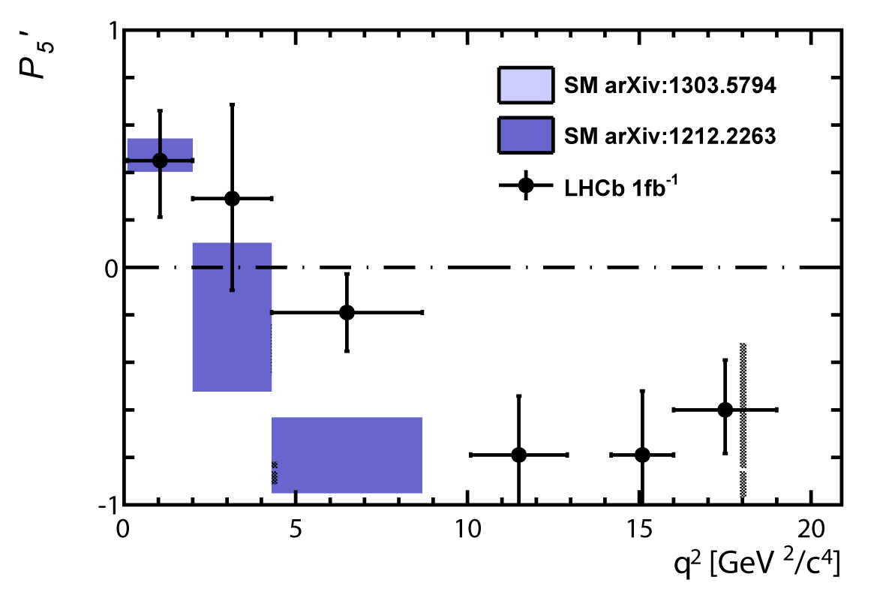
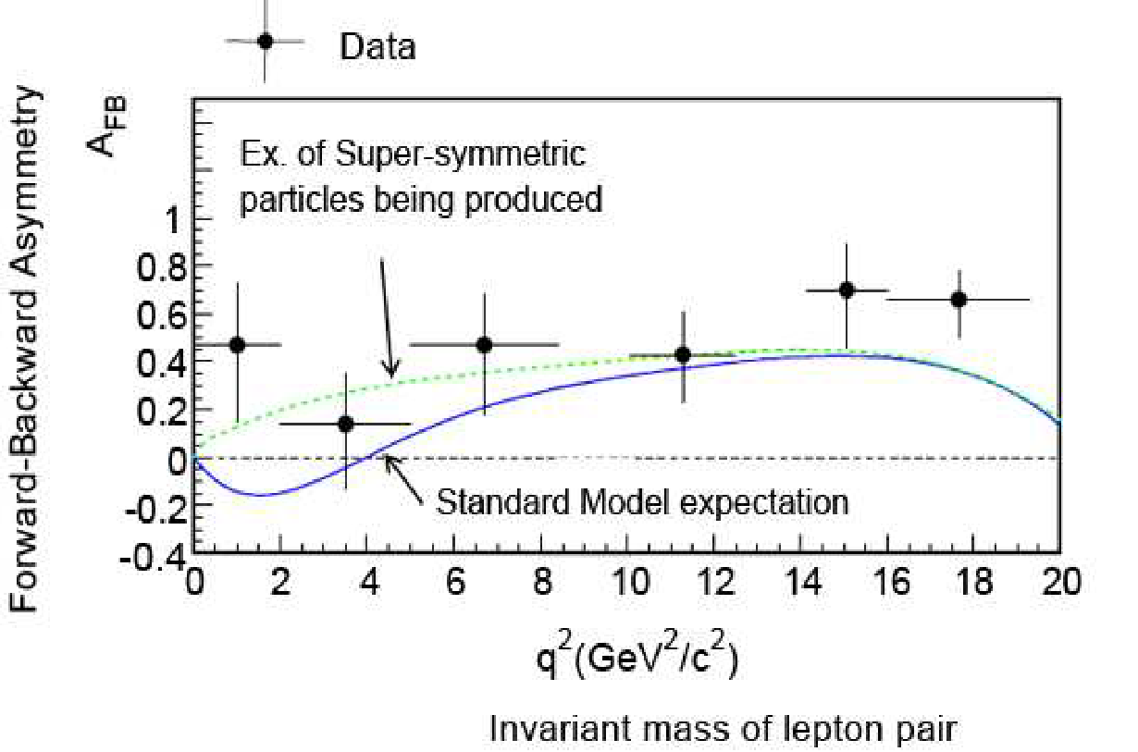
THE LHCB COLLABORATION REPORT IN 2013
3.7 σ
~ 3 σ

Slide 4
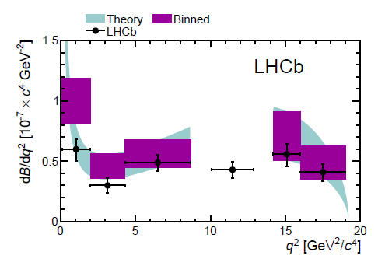
В→K*(K𝜋) 𝜇⁺𝜇⁻
В→K*(K𝜋)𝜇⁺𝜇⁻
Exp/SM = 3.7σ
New Physics ??
*

Slide 5
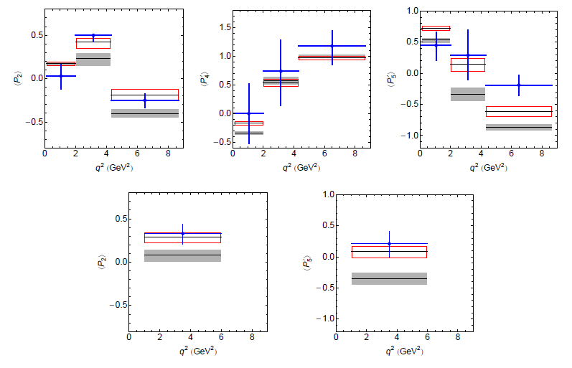
В→K*(892)
*

Slide 6
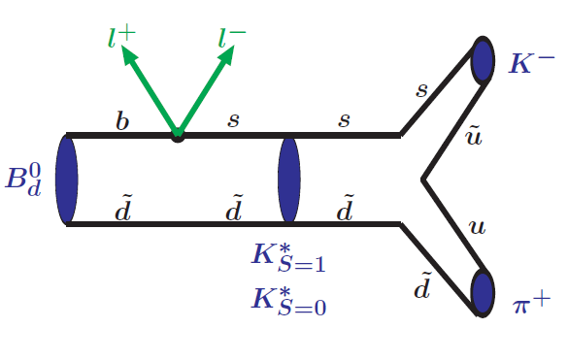
В→K*(→ K𝜋) + ℓ⁺ℓ⁻

Slide 7
b → s ℓ⁺ ℓ⁻

Slide 8
SCALAR MESONS
*http://pdglive.lbl.gov/

Slide 9
COVARIANT QUARK MODEL

Slide 10
COMPOSITENESS CONDITION IN COVARIANT QUARK MODEL

Slide 11
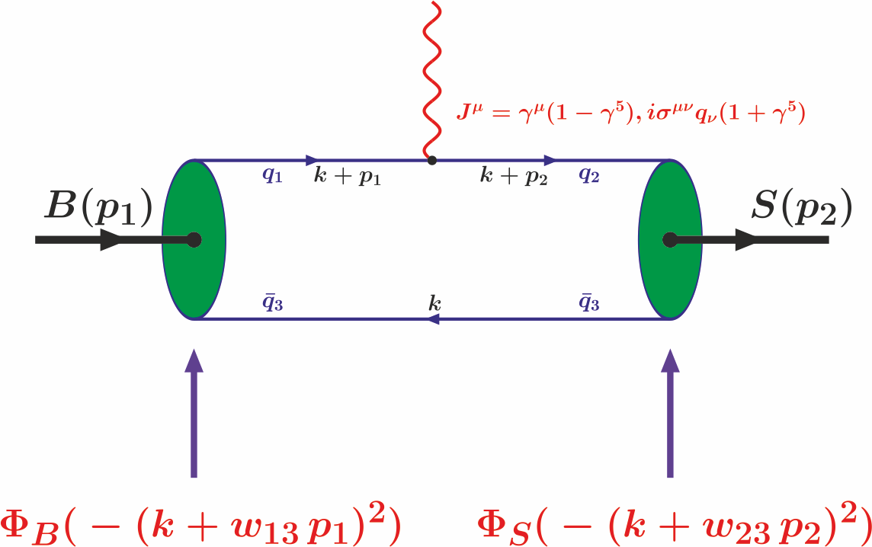
B-S TRANSITION DIAGRAM

Slide 12
B-S TRANSITION MATRIX ELEMENTS

Slide 13
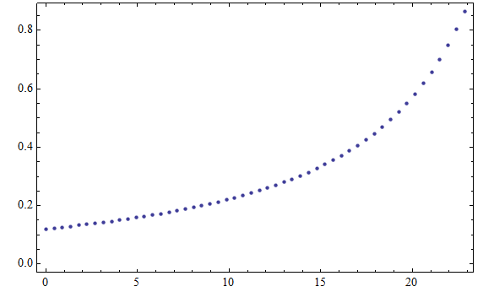
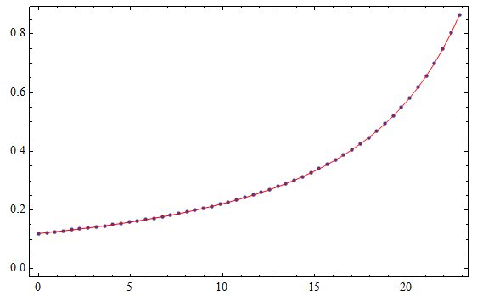
FORM FACTORS OF B-S TRANSITION

Slide 14
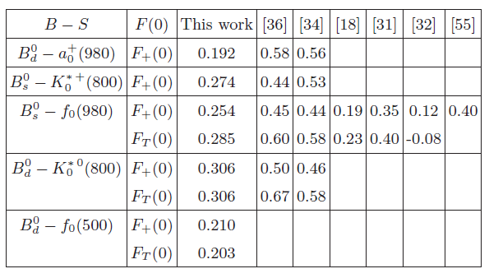
FORM FACTORS OF B-S TRANSITION

Slide 15
BRANCHING RATIOS

Slide 16
S-WAVE AND P-WAVE CONTRIBUTIONS IN THE NARROW WIDTH-LIMIT AND K-π LINE SHAPES PARAMETRIZATION
*

Slide 17
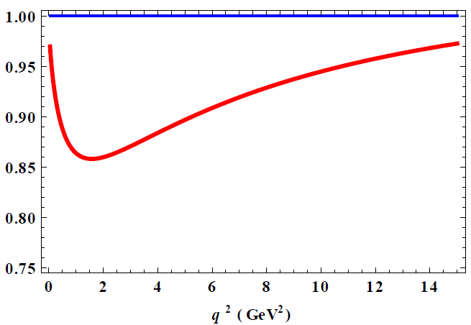
Impact of scalar K* mseon В→K*(→ K𝜋) + ℓ⁺ℓ⁻
14 %
~ 6 %

Slide 18
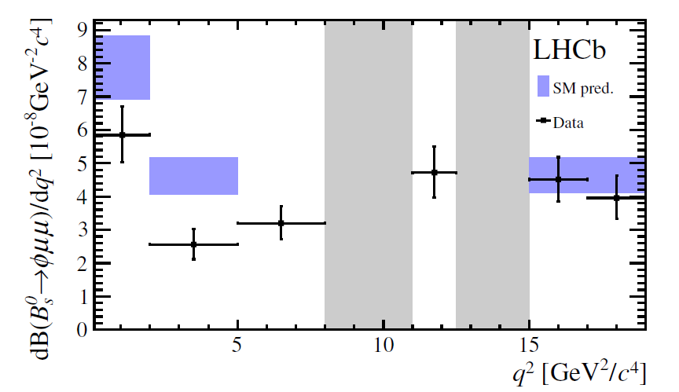
*

Slide 19
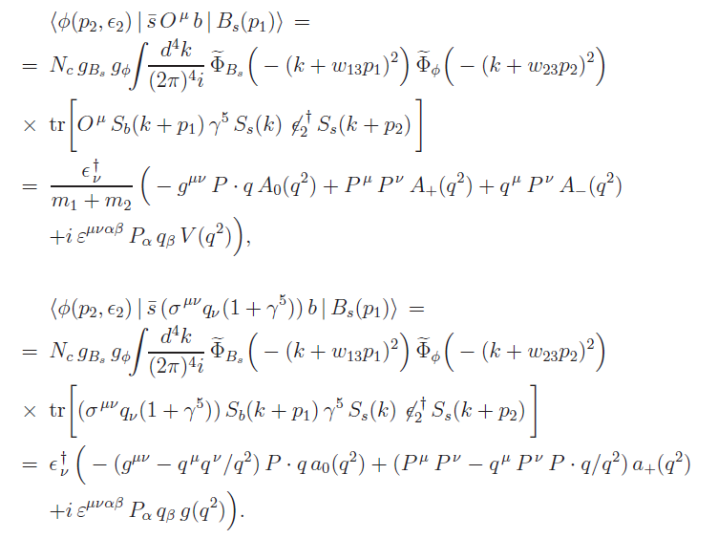
Form factors of the transition

Slide 20
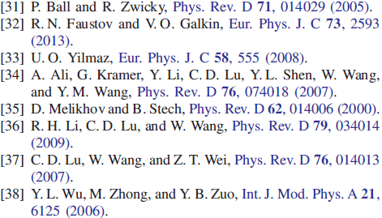
Form factors of the transition
*

Slide 21
THE VALUES OF BRANCHING FRACTIONS
*

Slide 22
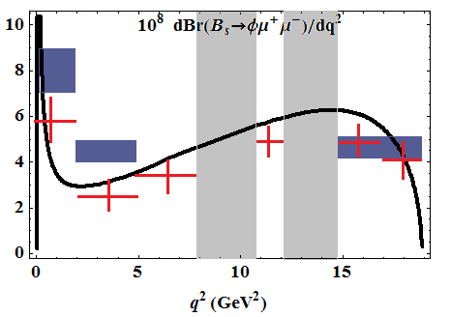
Branching ratio distribution

Slide 23
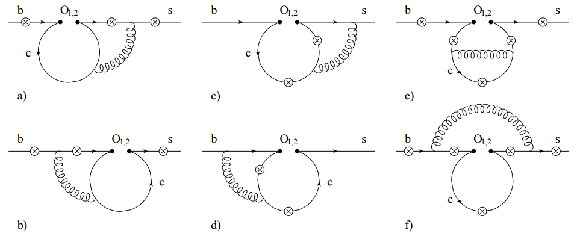
cc-resonance contributions

Slide 24
Two-loop corrections and cc-resonance contr.
Modify C₇^{eff} and С₉^{eff}
Condition:
q² /m_{b}² < < 1
q² / (4m_{c} )² < < 1
Areas of correction:
1.1 < q² < 5.5 ГэВ²
8.8 < q² < 22 ГэВ²

Slide 25
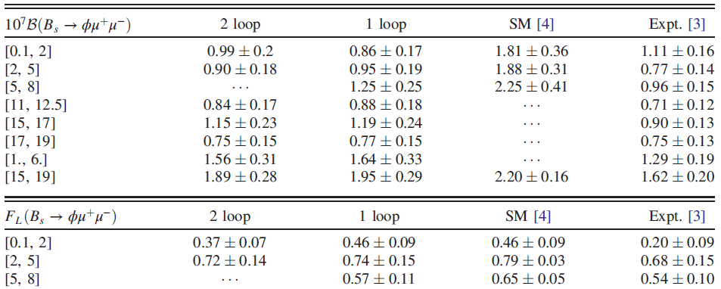
The values of angular observables and branching ratio

Slide 26
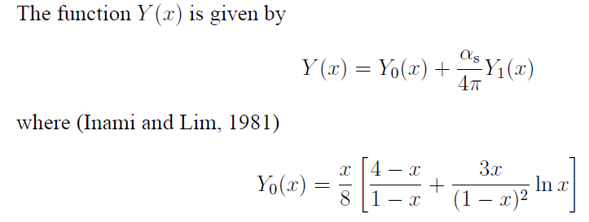
$$B_{s}→μμ$$
*

Slide 27
$$B_{s}→μμ$$

Slide 28
$$B_{s}→μμ$$
SM expectation:
2013 LHCb:
5 σ
2015 CMS & LHCb:
6.2 σ
March 2017 LHCb:
7.8 σ

Slide 29
Summary
В_{d}→K* 𝜇⁺𝜇⁻
В_{s}→ $φ$𝜇⁺𝜇⁻
В_{s}→𝜇⁺𝜇⁻
There might be smth.
The biggest discrepancy - 1.9σ
Exp. data is still updating

Slide 30
Thank you for attention

Slide 31
Backup slides

Slide 32
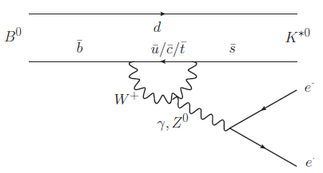
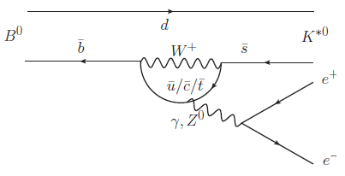
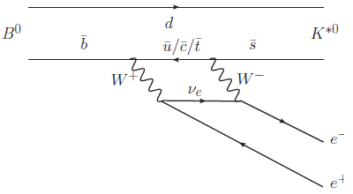
В→K*₀ℓ⁺ℓ⁻ and В→K*ℓ⁺ℓ⁻
*

Slide 33
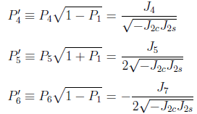
THE ANGULAR DECAY OBSERVABLES

Slide 34
NLL ORDER AND NNLL CORRECTIONS
Next-to-leading logarithmic order:
~ ~0
Next-to-next-to-leading logarithmic corrections:
< < 1
< < 1

Slide 35
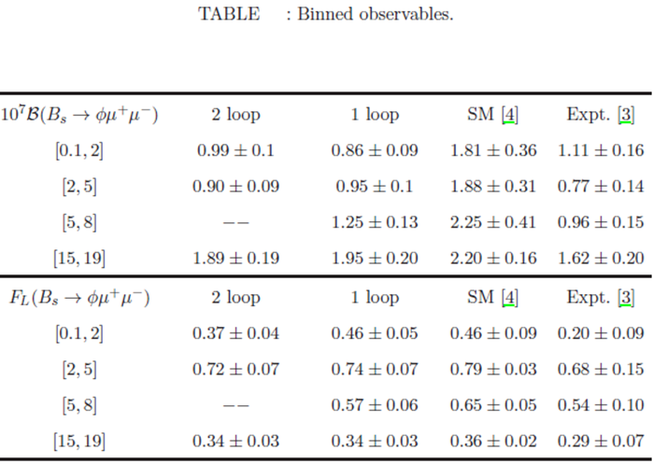
ANGULAR OBSERVABLES AND DIFFERENTIAL BRANCHING

Slide 36
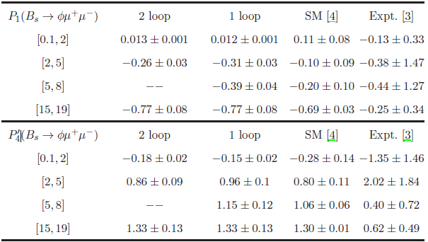
ANGULAR OBSERVABLES AND DIFFERENTIAL BRANCHING

Slide 37
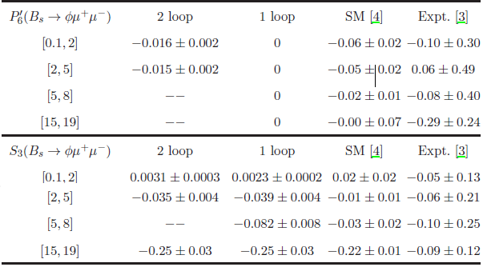
ANGULAR OBSERVABLES AND DIFFERENTIAL BRANCHING

Slide 38
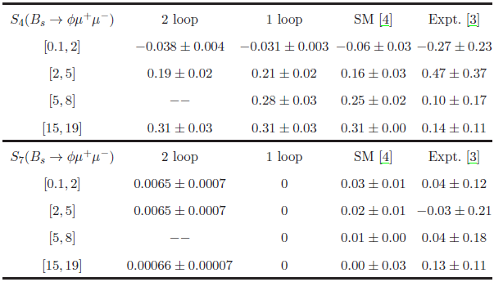
ANGULAR OBSERVABLES AND DIFFERENTIAL BRANCHING

Slide 39
MODEL PARAMETERS
The fitted values of the size parameter Λ in GeV

