Slide 1

QCD-Evolution
of Nuclear Structure Functions Large X:
EMC-effect and Cumulative Processes
Victor Kim
Petersburg Nuclear Physics Institute NRC KI, Gatchina
St. Petersburg Polytechnic University
1

Slide 2
Outline:
Evolution of nuclear structure functions
EMC-effect: ratio of nuclear structure functions
Cumulative processes
Flucton model: hard nuclear quark sea at large X
Summary
2
HS’11, Tatranska Strba, June 30, 2011
Notes:
2

Slide 3
Cold Superdense Baryon Matter
Quarkyonic state?
L.McLerran & L.McLerran & R. Pisarski (2007)
V. Braguta et al. (2016), …

Slide 4
Perturbative QCD: hard process factorization
Two cornerstones of perturbative QCD
for hard process description:
factorization of hard processes
GLAPD-evolution

Slide 5
Deep inelastic scattering (DIS)
Bjorken limit: s -> ∞ , Q² -> ∞
Bjorken scaling violation due to GLAPD-evolution

Slide 6
Deep inelastic scattering (DIS): structure functions
Bjorken limit: s -> ∞ , Q² -> ∞
Bjorken scaling violation due to GLAPD-evolution

Slide 7
Deep inelastic process (DIS): parton sum rules
Momentum sum rule:
all partons (quarks, antiquarks and gluons)
carry proton’s momentum
Quarks in proton: baryon number conservation

Slide 8
Hard processes in QCD
Perturbative QCD for hard processes
Q²/s = x – fixed, s ➔ ∞ (Bjorken limit)
➔
- Factorization of hard and soft contributions
in leading twist
A.Efremov & A.Radyushkin (78-81)
A.Mueller, J.Collins, D.Soper, G. Sterman, …
σ_{HARD} = σ_{parton} ✕ F(x, Q²) + (1/Q²)
- GLAPD Q²-evolution
V.Gribov & L.Lipatov (71-72), G.Altarelli & G.Parisi (77), Yu.Dokshitzer (77)

Slide 9
Structure functions of free nucleon and nucleus:
deep inelastic scattering
Factorization of hard and soft contributions
for DIS on free nucleon and nucleus:
σ_{HARD} = σ_{parton} ✕ F_{N}(x, Q²) + (1/Q²)
σ_{HARD} = σ_{parton} ✕ F_{A}(x, Q²) + (1/Q²)
factorization does not depend on type of target !

Slide 10
Nuclear structure function:
deep inelastic scattering

Slide 11
Nuclear structure functions:
GLAPD-evolution (RG-evolution) for NonSinglet

Slide 12
Nuclear structure functions:
GLAPD-evolution (RG-evolution) for Singlet

Slide 13
Nuclear structure functions:
GLAPD-evolution (RG-evolution) equations

Slide 14
EMC-ratio for nuclear structure functions
EMC Coll. (1983)
BCDMS Coll. (1987)
SLAC (1987)

Slide 15
Nuclear structure functions: nucleon distribution
L. Llewvvelyn Smith (1983)

Slide 16
Nuclear structure functions: nucleon distribution
A.Efremov, A.Kaidalov, VK, G.Lykasov & N.Slavin (1988)
F₂-ratio (Singlet):
xF₃-ratio (NonSinglet):

Slide 17
EMC-effect in Deutron: JLAB

Slide 18
EMC x-slope: R_{2N}(A/D)-dependence
L. Weinsten et al (2011)
J. Arrington et al (2013)

Slide 19
EMC effect: momentum “repumping”:
from valence to sea quarks
BCDMS (1987)

Slide 20
Nuclear structure functions at large X:
multiquark fluctons
A. Kaidalov, A.Efremov, VK, G.Lykasov, N.Slavin (1988)
- Hard quark sea at X > 1: S_{A}(x) ~ S_{N} (x) + Δ_{A} V_{A}(x)
Flucton fragmentation based on quark-gluon strings model
Nuclear structure functions at large X
in LO and NLO with TMC and higher twists
VK (1991,2017)

Slide 21
Nuclear structure function at X > 1
JLAB CLAS Coll., K. Egiyan (06)

Slide 22
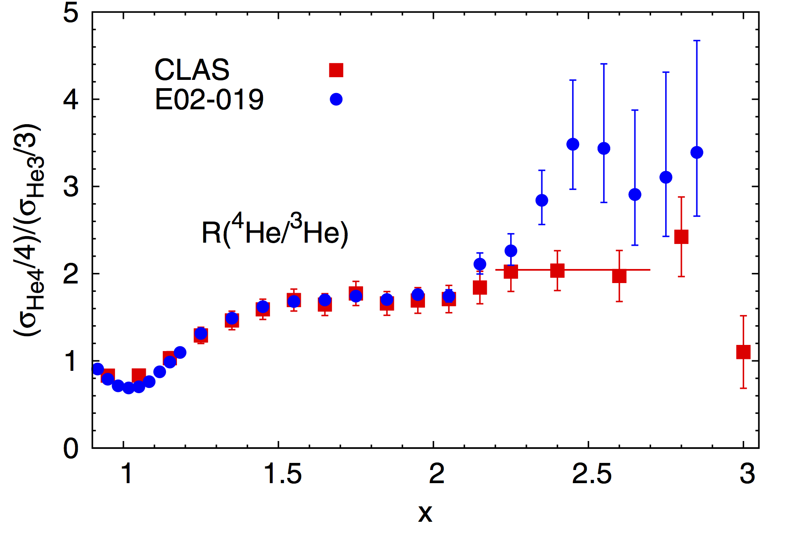
Nuclear structure function at X > 1
JLAB E02-019 (2012), <Q2> = 2.9 GeV²
JLAB CLAS (2006) – no IS corrections, <Q2> = 1.6 GeV²

Slide 23
Cumulative Processes:
generic definition:
processes beyond one free-nucleon kinematics
- fixed nucleus target: backward particle production
data: G.Leksin et al. (57), M.Mescheryakov et al. (57), …
- nucleus projectile fragmentation:
particles with momentum > momentum per nucleon
scaling: A.Baldin (1971), data: V.Stavinsky et al. (1971)
Efremov’s classification: hot and cold models
Hot models:
rescattering, resonances, fireballs, final state interaction, …
V. Kopeliovich, M.Braun & V. Vechernin, …
Cold models:
fluctons, short-range nucleon correlations, multiquark bags, …
D. Blokhintsev, V. Lukyanov, A. Efremov, V. Burov, A. Titov, L. Kaptari,
L. Frankfurt, M. Strikman, A. Kaidalov, VK, G. Lykasov, …

Slide 24
Cumulative Processes: definition
Cold models -> definition:
Nuclear processes beyond one free-nucleon kinematics
scaling property
->
Cumulative processes:
scaling nuclear processes with X > 1

Slide 25
Cumulative processes: projectile particles
slope, T₀
Exp(-T/T₀)
E₀ , GeV
Energy of projectile E₀

Slide 26
Cumulative Processes: scaling properties
How to distinguish “hot” and “cold” models?
-----------------------------------------------------------------------------------------------------
“Hot” models:
rescattering, resonances, fireballs, final state interaction, …
may “ingnite” hot medium, etc. ->
dependence on projectile hadron/nucleus
nonlocal interactions ->
no scaling properties !
-----------------------------------------------------------------------------------------------------
“Cold” models:
fluctons, short-range nucleon correlations, multiquark bags, …
local interactions ->
scaling properties !
nuclear parton struction function

Slide 27
Cumulative processes: backward particles
Exp(-T/T₀)
Ed³σ/d³p
Kinetic energy T, MeV
1 – evaporation
2 – cumulative

Slide 28
Cumulative proceess: superscaling !
Ed³σ/d³p
A.Efremov, A.Kaidalov, VK,
G.Lykasov, N.Slavin (1988)
prediction for
pure “sea” particles:
K⁻
antiproton
equal slopes:
superscaling !
ITEP data:
Leksin et al. (1989)
X

Slide 29
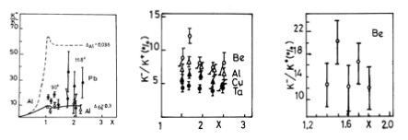
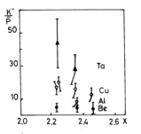
Cumulative processes:
hard “collective” nuclear sea at X > 1
hard “collective” quark sea in nuclei confirmed by data
V. Stavinsky et al. (82) Yu. Kiselev et al. (89) L. Zolin et al. (92)

Slide 30
Cumulative processes:
Carbon beam @ IHEP NRC KI (Protvino)
beam: C¹² 20 GeV/N forward fragmentation
fixed targets: C¹², Pb²⁰⁷
FODS-2, Bogolyubsky et al. (Baldin Conf, 2016)

Slide 31
Cumulative processes at NICA:
Cold Superdense Baryon Matter
Cumulative
X > 5
L.McLerran & L.McLerran & R. Pisarski (07)
Lattice: quarkyonic at ρ > 5ρ₀ V. Braguta et al. (16)

Slide 32
Cumulative processes at NICA:
Cold Superdense Baryon Matter
How cumulative particle production will shed light on
Cold Superdensed Baryon Matter?
Cumulative process at NICA:
an estimate for BM@N experiment would reach X>5
Cumulative particle production and observables
A. Andrianov, M. Braun, VK, V. Vechernin et al.
A.Stavinsky, S.Shimansky et. al.
(PNPI, ITEP, SPbU,SPbPU&JINR)
in progress
MC event generator HARDPING with nuclei
Ya.Berdnikov, VK et al.

Slide 33
Cold Dense Baryon Matter: 2-nucleon correlations
JLAB: np-pair dominance in NN-correlations in C¹² - Pb²⁰⁷
R.Subedi et al. (2008,2014)

Slide 34
Summary
■ Evolution of nuclear structure functions at large X
■ Multiquark fluctons:
EMC effect
Cumulative processes
Cronin effect
■ Flucton model and Cold Superdense Baryon Matter:
phase transition?
chemical potential?
isoscalar dominance?
quarkyonic phase?

