Slide 1
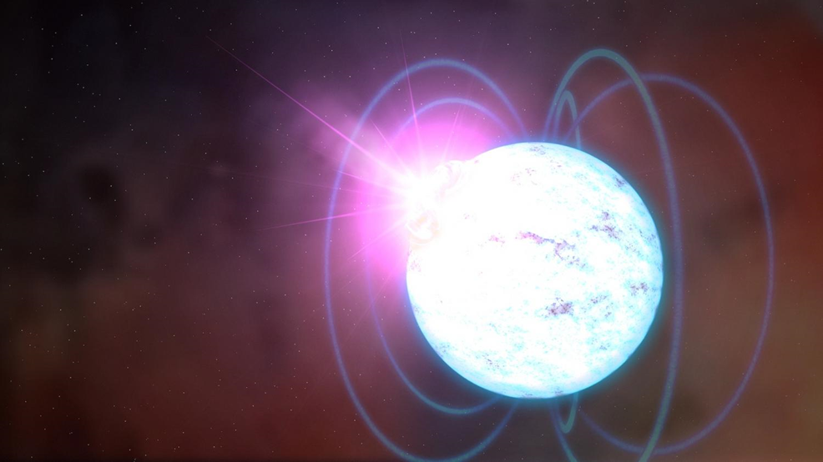
Particle Production in the Strong Magnetic Field (SMaF)
Myung-Ki Cheoun
Astro Nuclear Physics Group
Soongsil University, Seoul, Korea
http://ssanp.ssu.ac.kr
11th APCTP-BLTP JINR-PNPI NRC KI-SPbU Joint Workshop "Modern problems in nuclear and elementary particle physics“
24-28 July, 2017, Petergof, St. Petesburg, Russia

Slide 2

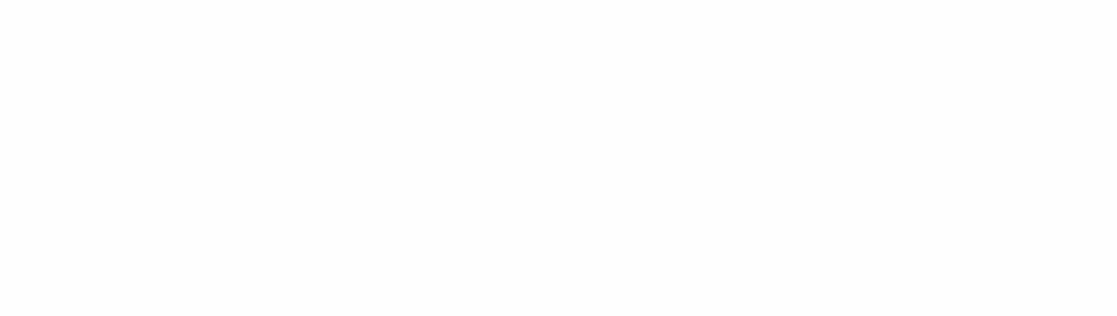
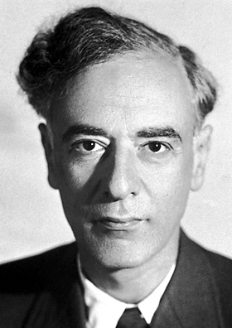
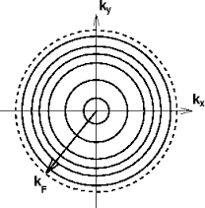
Contents
0. Introduction
1. Strong Magnetic Field (SMaF) in Dense Matter
1-1. Equation of States in Neutron Stars
1-2. Pulsar Kick of Neutron Stars
1-3. Spin Deceleration of Neutron Stars
2. Particle Production by SMaF via Landau Quantization in Astrophysics
2-1. Quantum Field Approach
2-2. Pion production in SMaF
3. Particle production and Magnetar Cooling
3-1. Axion production in Magnetar
3-2. Pair neutrino production in Magnetar
4. Summary and Conclusions
MKC et.al, PRC 82, 025804 (2010); PRC 83, 018802 (2011); JCAP 10, 21 (2013)
PRD 86 (2012) 123003 ; PRD 83 (2011) 081303(R),
PRC 89 (2014) 035801; PRD 90 (2014) 0637302…
PRD 91 (2015) 123007, PLB 757 (2016) 125
Notes:
Last two parts, which are actually topics of our Soongsil group. But

Slide 3
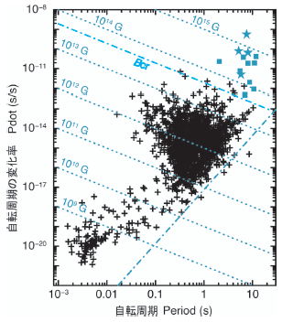
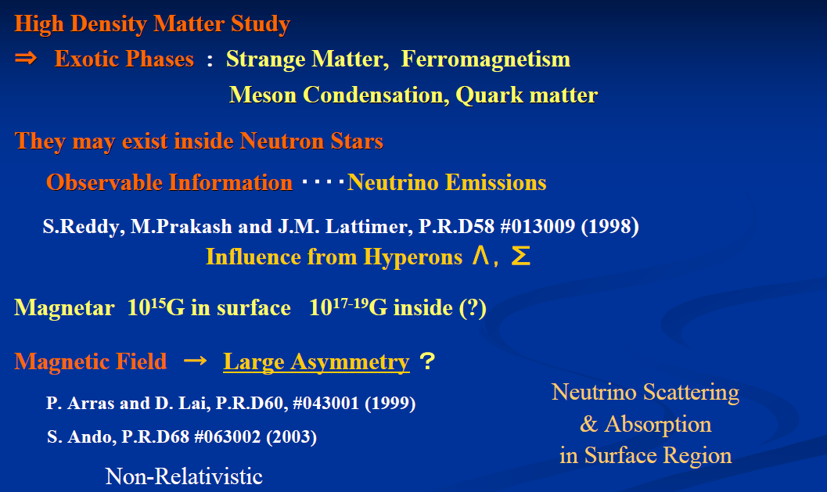
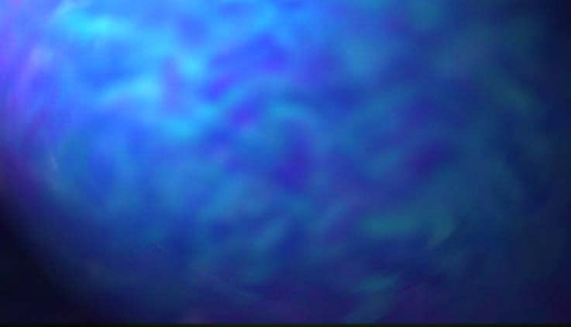

Introduction
Neutron Star for dense matter physics
SGR,AXP
…
, EM and GR waves
Courtesy by T. Maruyama

Slide 4
Tsuyoshi Miyatsu, Myung-Ki Cheoun (SoongSil U.), Koichi Saito (Tokyo U. of Sci., Noda Campus).
Published in Astrophys.J. 813 (2015) no.2, 135

Slide 5

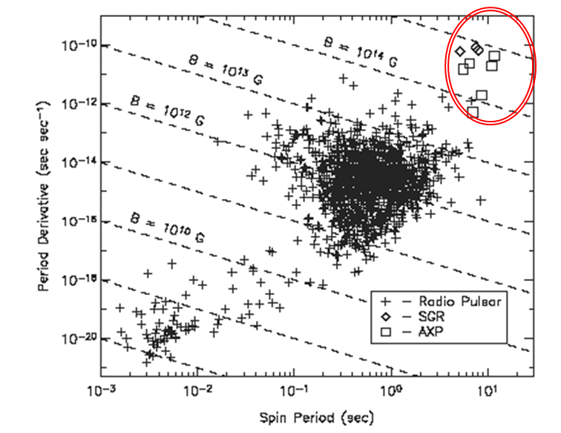
Magnetar Neutron-Star with Strong Magnetic-Field
Introduction
Magnetar and SMaF
http://www.space.com/21347-strange-magnetar-neutron-star-glitch.html
B.C.Duncan & C.Thompson ApJL 392, L9 (1992)
S.Merghetti, A&AR 15, 225 (2008)
Very Strong Magnetic Field
B ～ 10¹⁵ G (surface)
B ～ 10^{17－19} G (insides)
Normal Neutron Star B ～ 10^{12 －13} G
2) Long Spin Period
P = 2 ～ 12 s
Losing Ang. Mom. very Rapidly
Strong Magnetic Field
disappear about 10,000 years

Slide 6
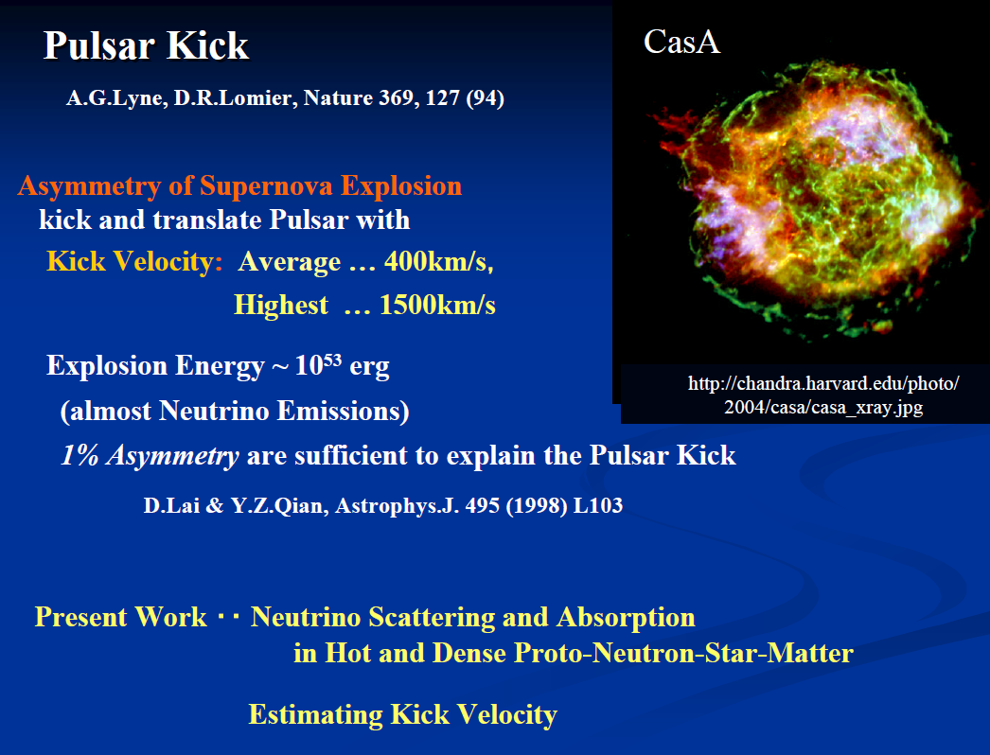
SMaF in NS
Pulsar Kick and Spin deceleration

Slide 7
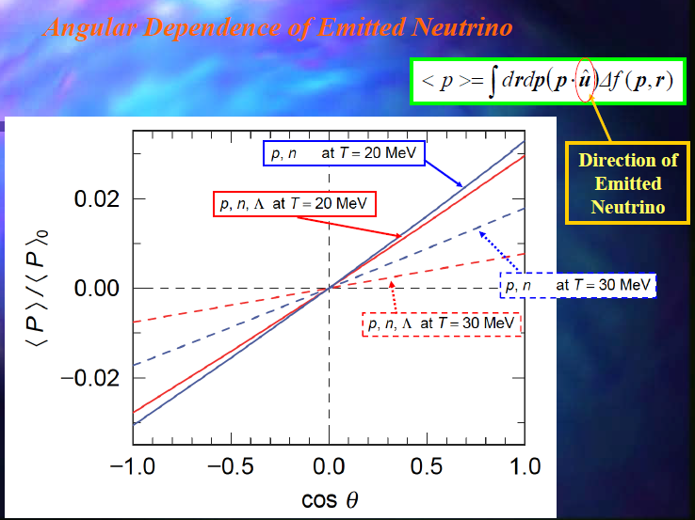

SMaF in NS
Angular Dependence of emitted neutrinos

Slide 8
Neutrino Propagation
Neutrinos
propagate on the straight lines
2) Neutrino are created and absorbed at all positions on the lines
Mean-Free Path
: σ_{ab}/V
θ
\

Slide 9

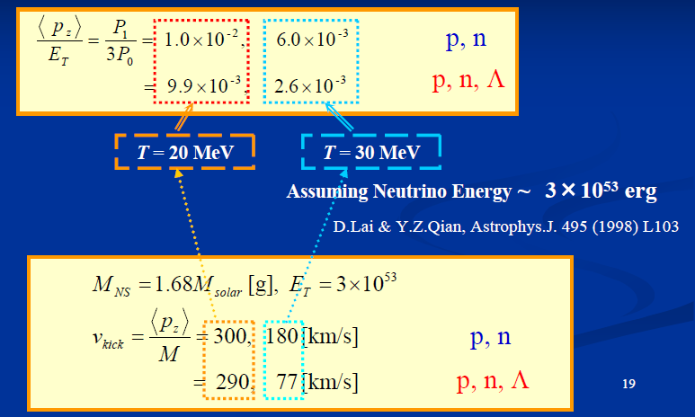
SMaF in NS
Pulsar Kick Velocity of Neutron Star

Slide 10
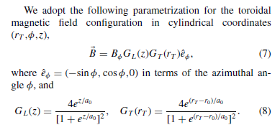

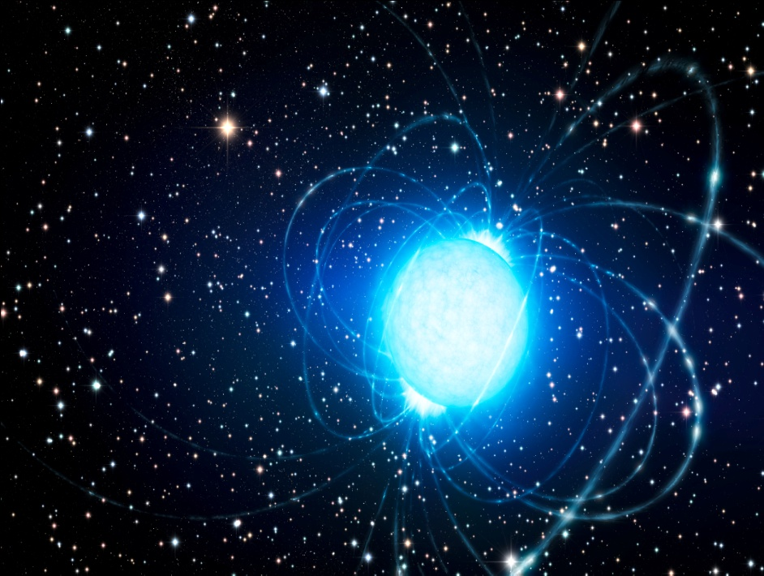
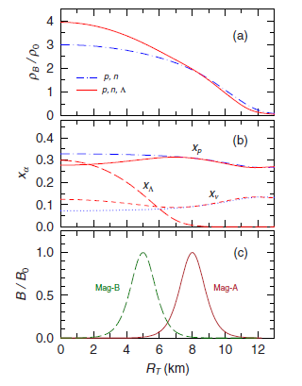
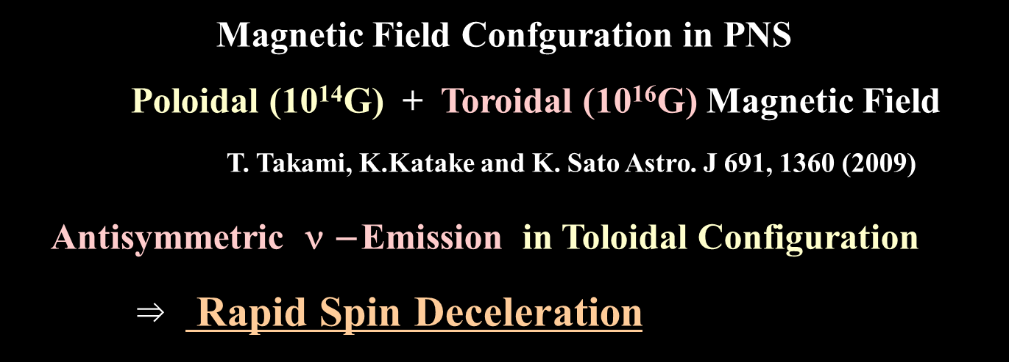
SMaF in NS
Spin Deceleration in Toroidal Magnetic Field

Slide 11
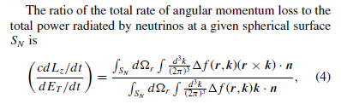
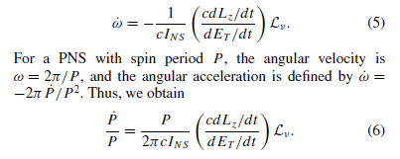
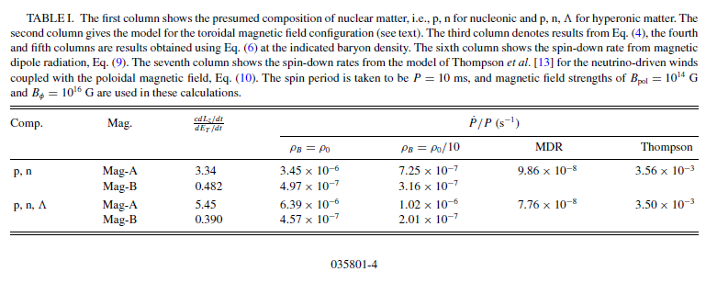
SMaF in NS
Toroidal Magnetic Field

Slide 12
SMaF ⇒ Affect neutrino scattering and absorption in dense matter
TM et al., PRD83, 081303(R) (‘11) , PRD86,123003 (‘12), PRC89, 035801 ‘(14)
Asymmetry of Neutrino Absorption
4.2 % at ρ_{B}=ρ_{0,} 2.2 % at ρ_{B}=3ρ₀ when T = 20 MeV and B = 10¹⁷G
Poloidal Magnetic Field Configuration → Kick Velocity
v_{kick} ≈ 500 －600 [km/s] when T = 20 MeV and B = 2×10¹⁷G
Toroidal Magnetic Field Cation → Spin-Down Rate of PNS
Spin-Down Ratio P-dot/P ≈ 10⁻⁶ ～ 10⁻⁷ (1/s) for Asym. ν –Emit
≈ 10⁻⁸ (1/s) for MDR
Perturbation calculation－＞ Non-perturbation including Landau quantization is necessary for further discussions of SMaF physics

Slide 13
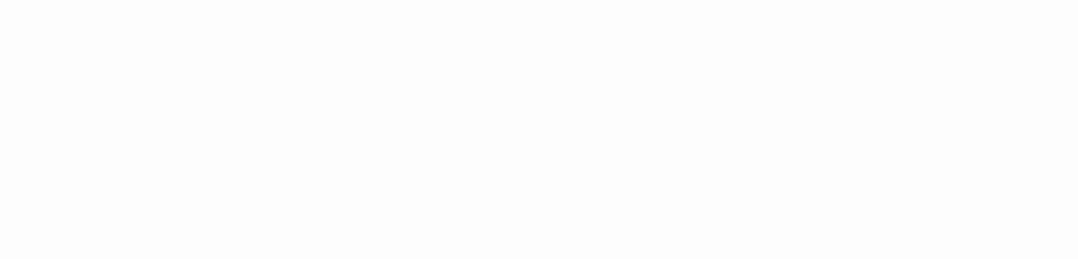
Contents
0. Introduction
1. Strong Magnetic Field (SMaF) in Dense Matter
1-1. Equation of States in Neutron Stars
1-2. Pulsar Kick of Neutron Stars
1-3. Spin Deceleration of Neutron Stars
2. Particle Production by SMaF via Landau Quantization in Astrophysics
2-1. Quantum Field Approach
2-2. Pion production in SMaF
3. Particle production and Magnetar Cooling
3-1. Axion production in Magnetar
3-2. Pair neutrino production in Magnetar
4. Summary and Conclusions
MKC et.al, PRC 82, 025804 (2010); PRC 83, 018802 (2011); JCAP 10, 21 (2013)
PRD 86 (2012) 123003 ; PRD 83 (2011) 081303(R),
PRC 89 (2014) 035801; PRD 90 (2014) 0637302…
PRD 91 (2015) 123007, PLB 757 (2016) 125
Notes:
Last two parts, which are actually topics of our Soongsil group. But

Slide 14
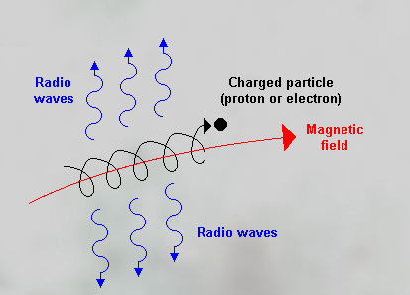


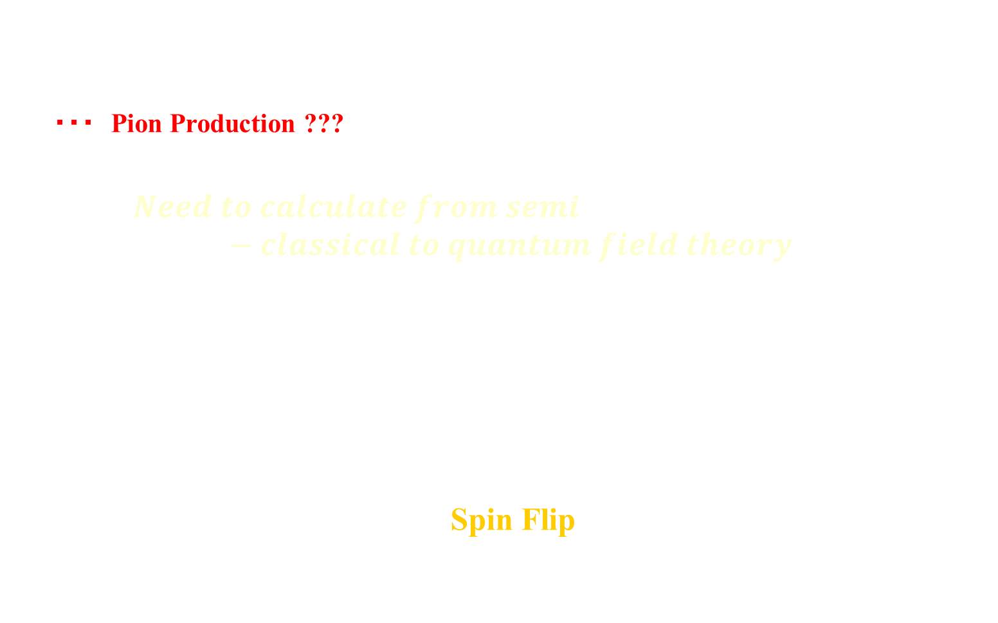
Beyond Synchrotron Radiation
1GeV～1TeV of proton
⇒ Synchrotron Radiation
・・・ Pion Production ???
$(Strong Force > E.Mag. Force)$
$$Need to calculate from semi−classical to quantum field theory$$
Ref: V.L.Ginzburg et al., UsFiN 87, 65, ARA&A 3, 297 (1965)
T.Kajino et al., ApJ 782, 70 (2014)
However, Scalar particle (not PS particle)
PV coupling source term
$q⊥B$ Spin Flip process is dominant?
Anomalous Magnetic Moment ⇒ Tensor field kinematics

Slide 15

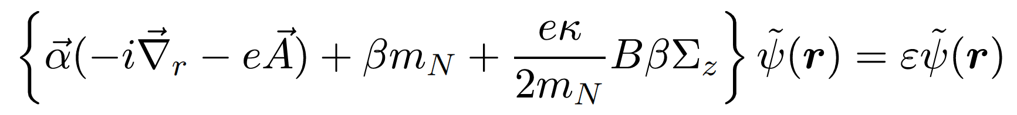

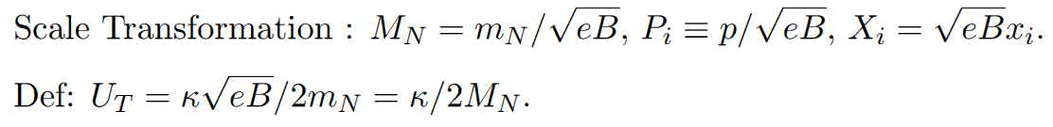
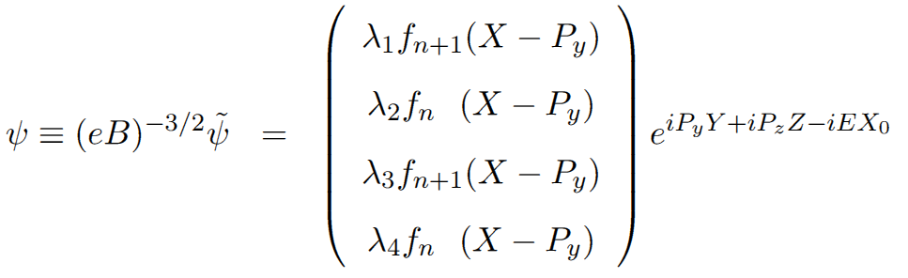
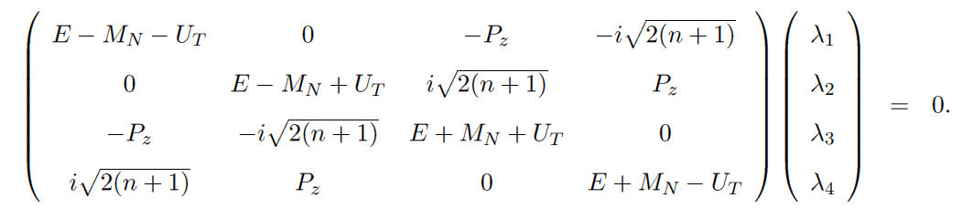
Particle Prod. in SMaF
Formalism I
Magnetic Field :
Tensor type mean field of ANM
Dirac Eq.
Wave
Function
Dirac
Spinor

Slide 16
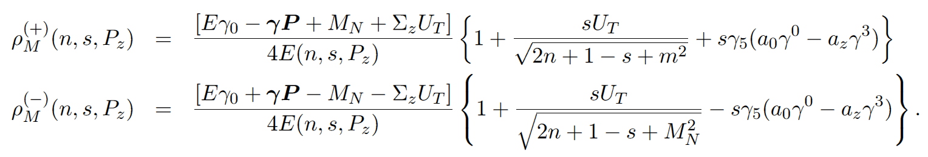
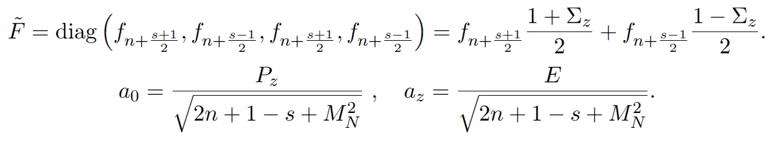
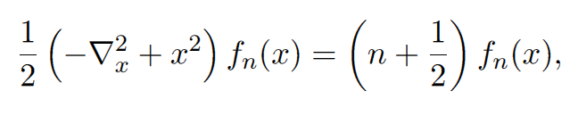
Particle Prod. in SMaF
Formalism II
Green Functional (Proton)
P = (0, －P_{T}, P_{z})

Slide 17
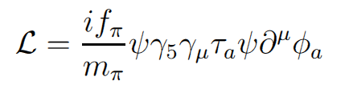
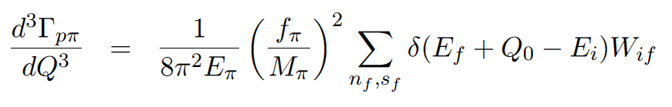
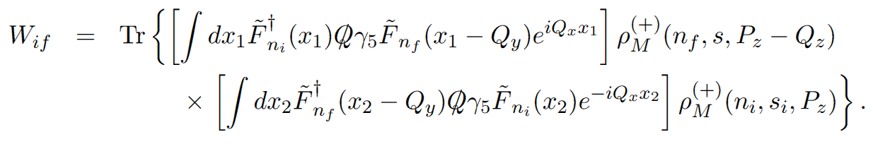
Decay Width of p to p + π ⁰ by Proton Green function
Particle Prod. in SMaF
Pion Production
πN interaction
Pion Momentum

Slide 18
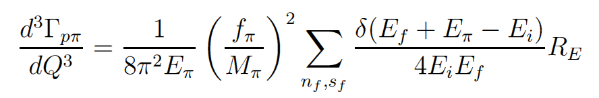
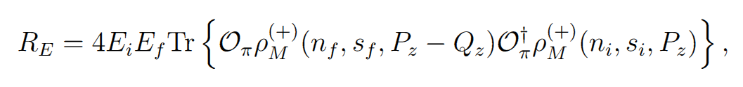
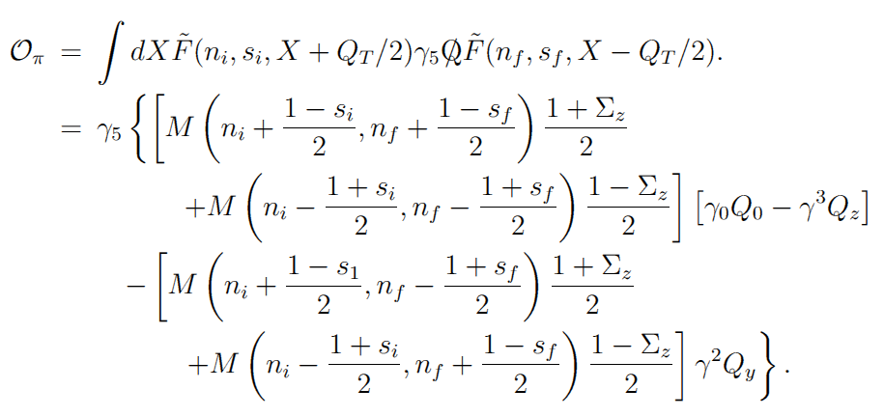
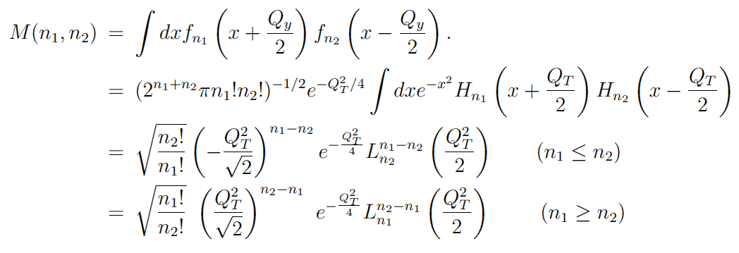
Decay Width of p to p + π ⁰
Particle Prod. in SMaF
Pion Production
18

Slide 19
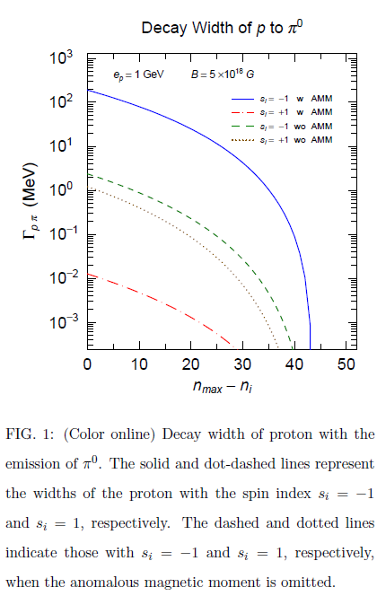
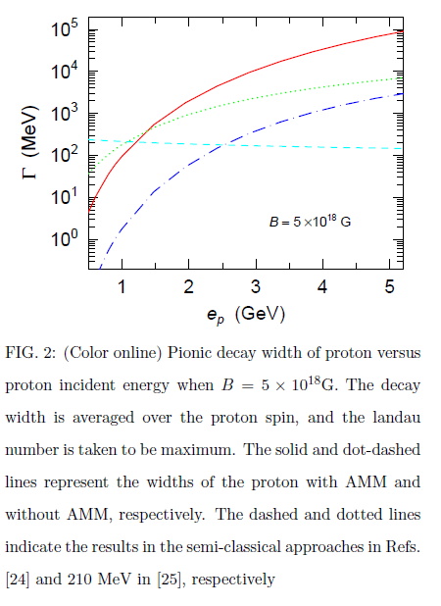
§3 Results of π⁰ Production
Particle Prod. in SMaF
Pion Production
Decay Width
W/O AＭN

Slide 20
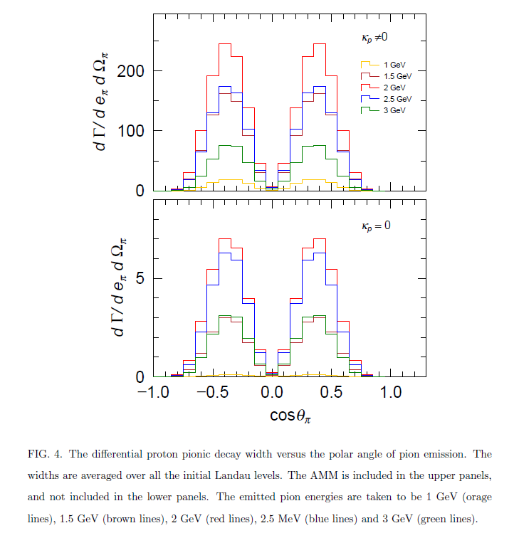
Particle Prod. in SMaF
Pion Production

Slide 21
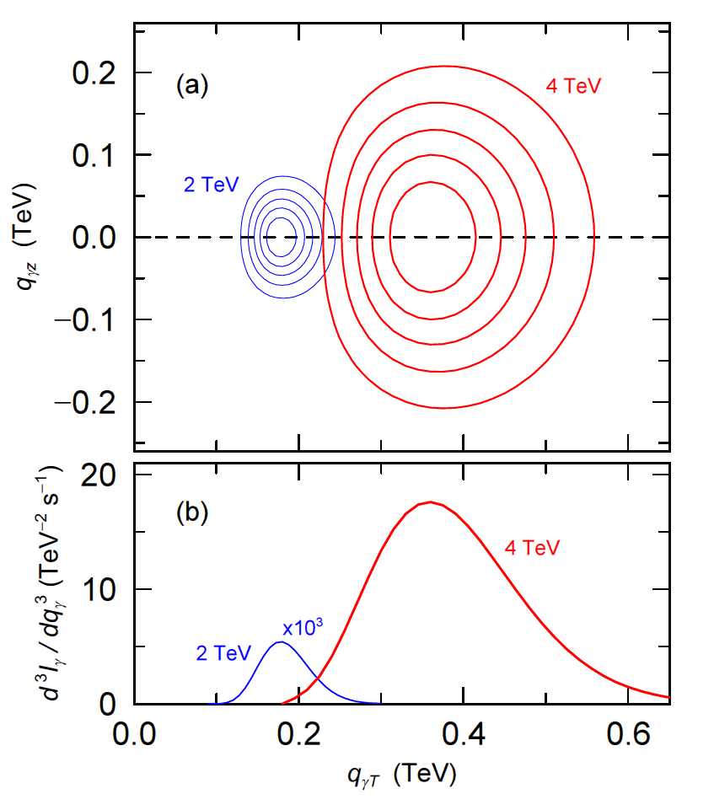
Particle Prod. in SMaF
Pion Production
π⁰ emission from Proton Transition between two Landau Levels
Quantum Calculation gives Momentum Distribution of Emitted Particles
( PRD91, 123007 (15), PLB757, 125 (16) )
Quantum >> Semi-Classical,
SMaF carries Large Momentum Transfer

Slide 22
Summary of Pion Emission
Emission of π⁰ ： QFT calculation・・・Transitions among Landau levels
By the Spin-Flip in the transition, PS π can be emitted.
In semi-classical approach, Pion can be emitted ？
Anomalous Magnetic Moment (AMN) mainly contribute. Decay (Emission) rates are increased !!!
If we take eB →0 limit, Decay (Emission) rate is very small !!
ANM → Tensor Field which changes kinematics
s = +1 (Attractive） K.E. becomes small、 p_{z}：small
s = －1 (Repulsive） K.E. becomes large p_{z}：large
Spin Flip +1 → －1 Large transition energy
－1 → + 1 Small transition energy
Final π goes to equator region

Slide 23
Contents
0. Introduction
1. Strong Magnetic Field (SMaF) in Dense Matter
1-1. Equation of States in Neutron Stars
1-2. Pulsar Kick of Neutron Stars
1-3. Spin Deceleration of Neutron Stars
2. Particle Production by SMaF via Landau Quantization in Astrophysics
2-1. Quantum Field Approach
2-2. Pion production in SMaF
3. Particle production and Magnetar Cooling
3-1. Axion production in Magnetar
3-2. Pair neutrino production in Magnetar
4. Summary and Conclusions
MKC et.al, PRC 82, 025804 (2010); PRC 83, 018802 (2011); JCAP 10, 21 (2013)
PRD 86 (2012) 123003 ; PRD 83 (2011) 081303(R),
PRC 89 (2014) 035801; PRD 90 (2014) 0637302…
PRD 91 (2015) 123007, PLB 757 (2016) 125
Notes:
Last two parts, which are actually topics of our Soongsil group. But

Slide 24
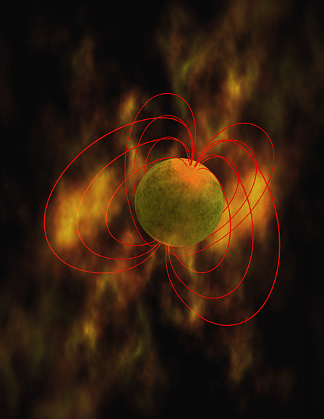
Magnetar & SMaF
Magnetar Cooling
1. High Temperature
Heating Source ?
Magnetic Energy
-> Thermal Energy
2. Emitting High Energy Photons
Soft Gamma Repeater (SGR)
Anomalous Xray pulsar (AXP)
3. Mechanism of Energy Conversion
Radiation & Heating ?
Magnetar
Zone
T ≈300 － 700eV Magnetar
T ≈ 10 － 150eV normal NS
A. D. Kaminker et al. MNRAS 2009;395:2257-2267
http://www.pd.infn.it/astro/pers/aspen2009/presentations/yakovlev.pdf
http://commons.wikimedia.org

Slide 25

Introduction
Magnetar & SMaF
Magnetar Cooling
Magnetar Cooling
Direct Urca $n →p{+e}^{−}+\overline{υ}$
Proton Fraction $x_{p}>\frac{1}{9}$ (k_{n} < k_{p} + k_{e} : Fermi Mom. )
Neutrino Luminosity $L∝T^{6}$
2) Modified Urca $n+B→p+B{+e}^{−}+\overline{ν}$
Neutrino Luminosity $L∝T^{8}$
3) Neutrino-antineutrino pair production
$e^{−}+B→e^{−}+B+\text{ν}\text{ +}\overline{ \text{ν}}$ (Crust, Low Density Region)
4) Axion Cooling and $B+B′→B+B′+X$
（Dark Matter)

Slide 26
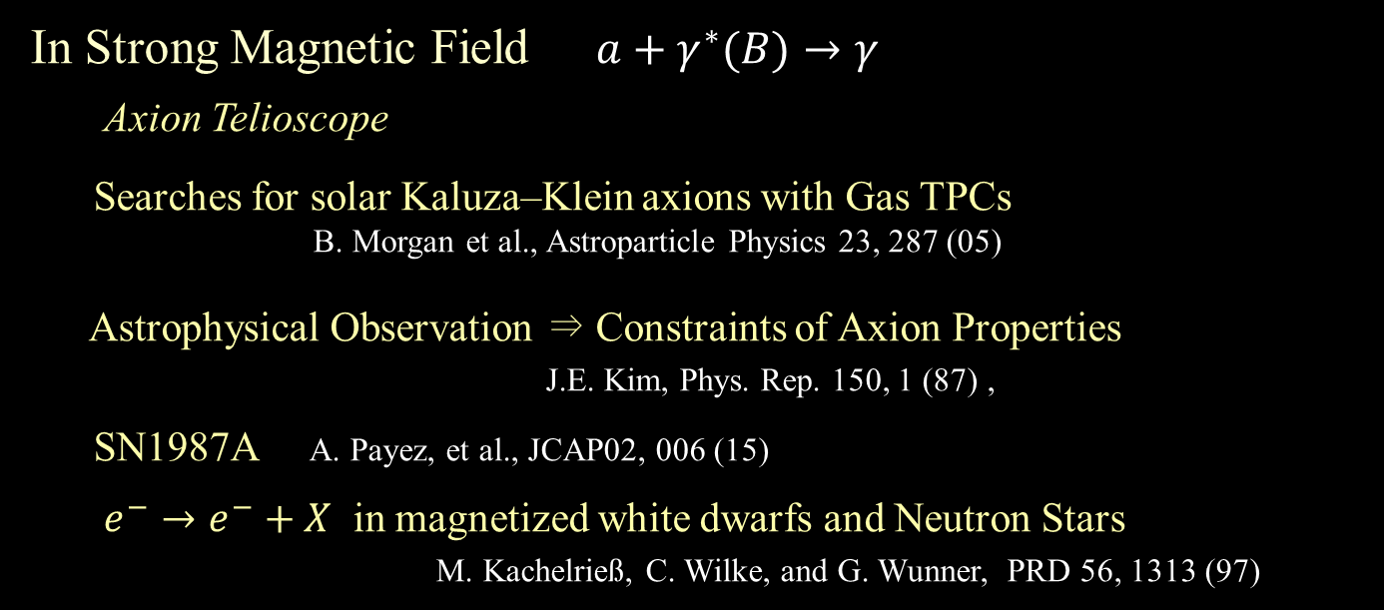
Axion Cooling
Magnetar & SMaF
Axion cooling in Magnetar
Axion ： Hypothetical Particle postulated by the Peccei–Quinn theory
Solution to the strong CP-violation problem of QCD
R. D. Peccei and H. R. Quinn, PRL 38, 1440 (1977); PRD16, 1791 (1977).
Possible Component of Cold Dark Matter.
F. Wilczek, PRL 40, 279 (1978).
In Strong Magnetic Field $a+γ^{∗}(B)→γ$
Axion Telioscope
Searches for solar Kaluza–Klein axions with Gas TPCs
B. Morgan et al., Astroparticle Physics 23, 287 (05)
Astrophysical Observation ⇒ Constraints of Axion Properties
J.E. Kim, Phys. Rep. 150, 1 (87) ,
SN1987A A. Payez, et al., JCAP02, 006 (15)
$e^{−}→e^{−}+X$ in magnetized white dwarfs and Neutron Stars
M. Kachelrieß, C. Wilke, and G. Wunner, PRD 56, 1313 (97)

Slide 27
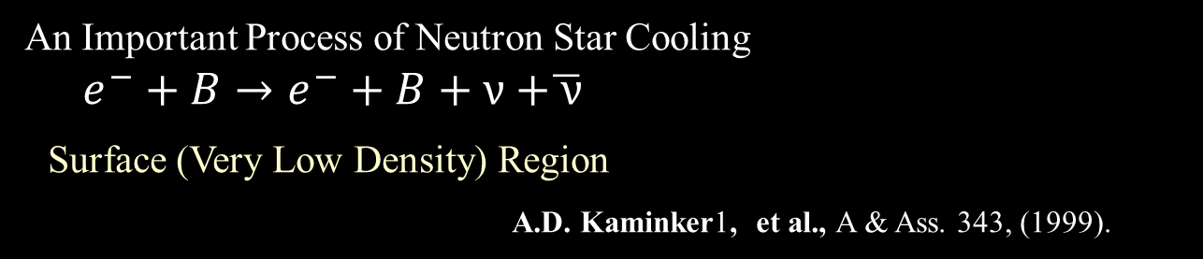




The Present Work ν$\overline{\text{ν}}$ - pair & Axion Production
Magnetar & SMaF
New Magnetar Cooling Process
Special Cooling Processes of Magnetar
An Important Process of Neutron Star Cooling
$e^{−}+B→e^{−}+B+\text{ν}\text{ +}\overline{ \text{ν}}$
Surface (Very Low Density) Region
A.D. Kaminker1, et al., A & Ass. 343, (1999).
In Strong Magnetic Field
$e^{−} \left(p\right)→e^{−}\left(p\right)+\text{ν}\text{ +}\overline{ \text{ν}}$ or a
Transition Between Different Landau Level States
$e^{−}$, p
$\text{ν} \overline{\text{ν}}$, a
Ultra Strong Mag. Fld.
$p→p+\text{ν}\text{ +}\overline{ \text{ν}}$
E.N.E. van Dalen, et al.
A &A. 360, 549 (2000)
Landau Level

Slide 28
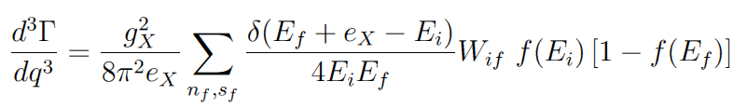
Decay Width
Magnetar & SMaF
Energy levels by SMaF in Magnetar
Low Temperature Expansion ( T < < 1 )
Emitted Particle Energy ~ T (Temperature)
Unavailable!
Landau Level Transition Energy is kept to be a few MeV
In Strong Mag. Fld. (e_{i} – e_{f}) ≫T , f(e_{i}) ~(1－f(e_{f})) ≪1
We cannot use the approximation

Slide 29
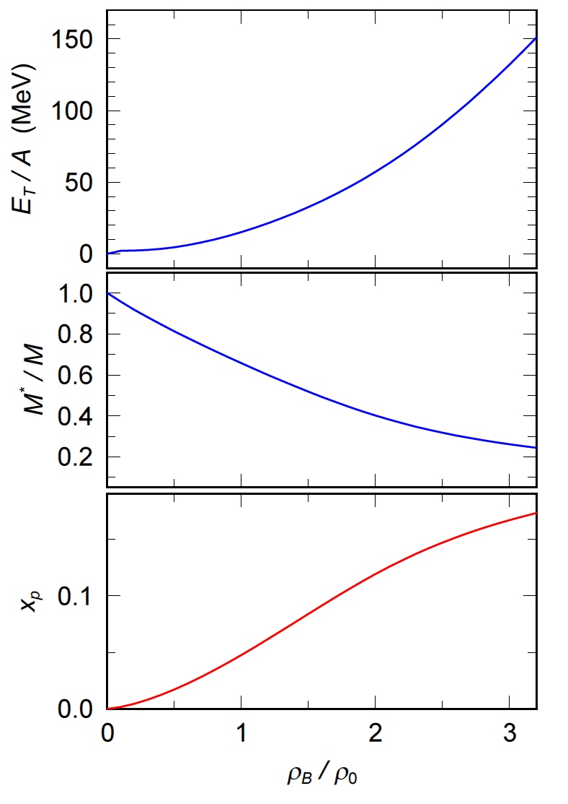
Magnetar & SMaF
EOS and Magnetar
29
EOS of Neutron-Star-Matter
in RMF N, e, σ, ω, ρ
Axion–N, e Coupling
1/100 of Max. Value
N. Iwamoto, PRL53, 1198 (84)

Slide 30
Magnetar & SMaF
Magnetar Cooling
30
Green Functionl (Proton and electron)
P = (0, －P_{T}, P_{z})

Slide 31
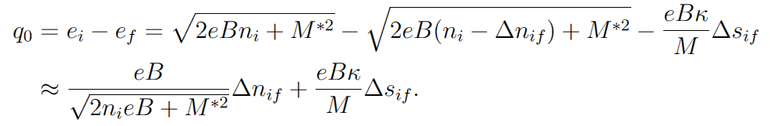

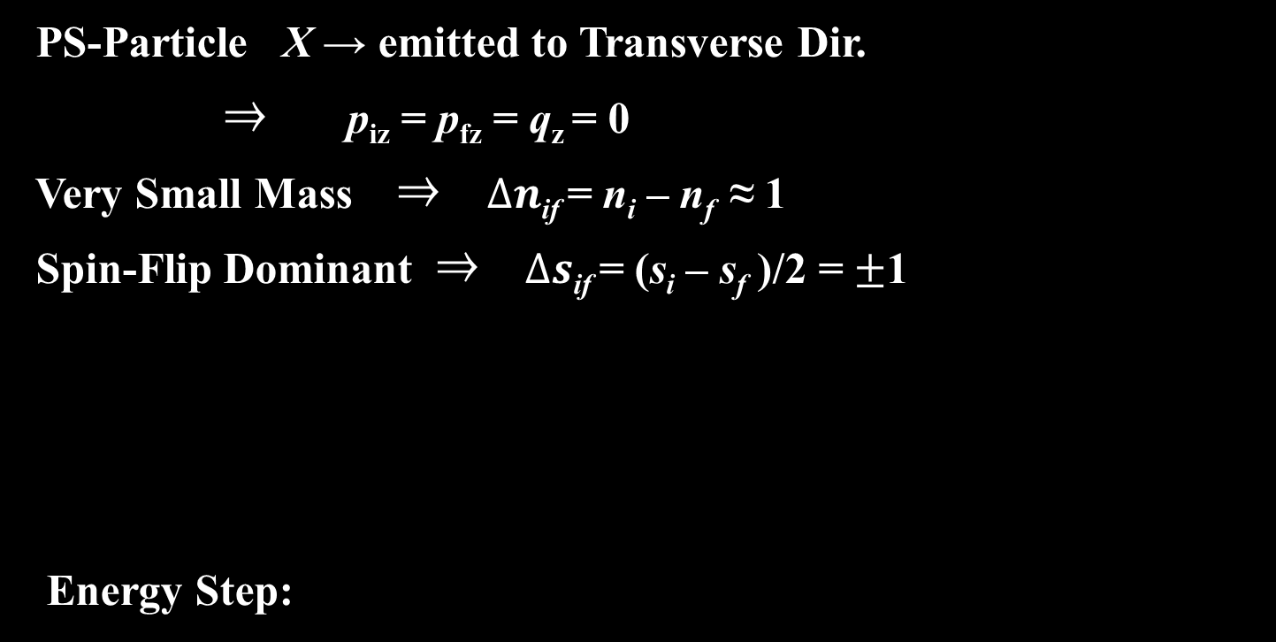
Magnetar & SMaF
Axion Production in Proton transition
PS-Particle X → emitted to Transverse Dir.
⇒ p_{iz} = p_{fz} = q_{z} = 0
Very Small Mass ⇒ $Δn$_{if} = n_{i} – n_{f} ≈ 1
Spin-Flip Dominant ⇒ $Δs$_{if} = (s_{i} – s_{f} )/2 = $±$1
Energy Step:

Slide 32
Temperature Dependence of Axion Luminosity
Magnetar & SMaF
Axion Luminosity from Magnetar
Axion–N, e Coupling
1/100 of Max. Value
N. Iwamoto, PRL53, 1198 (84)
(keV)

Slide 33

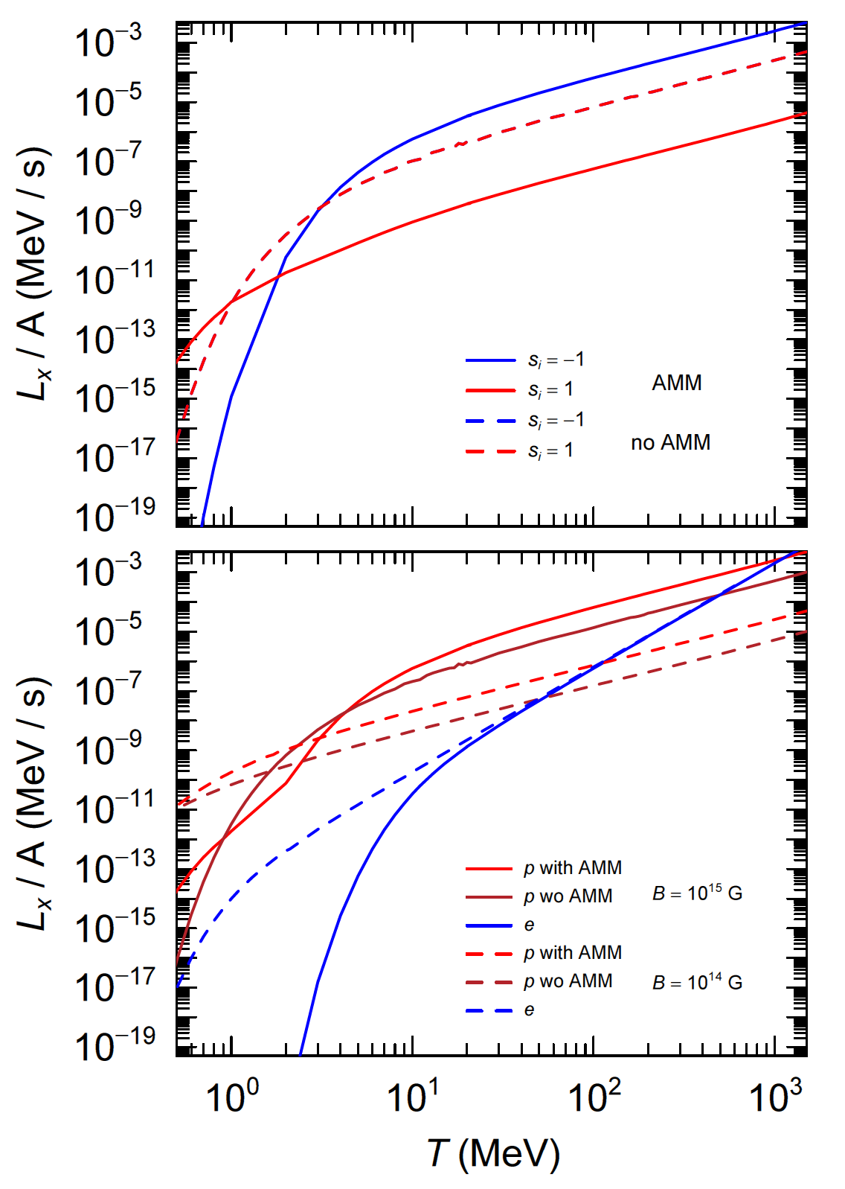
Energy-Interval

Slide 34
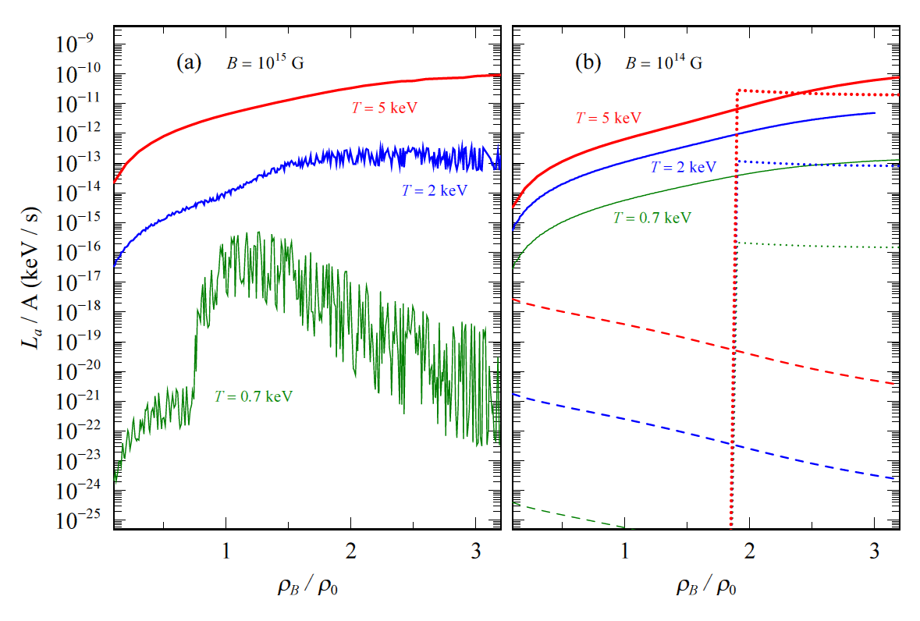
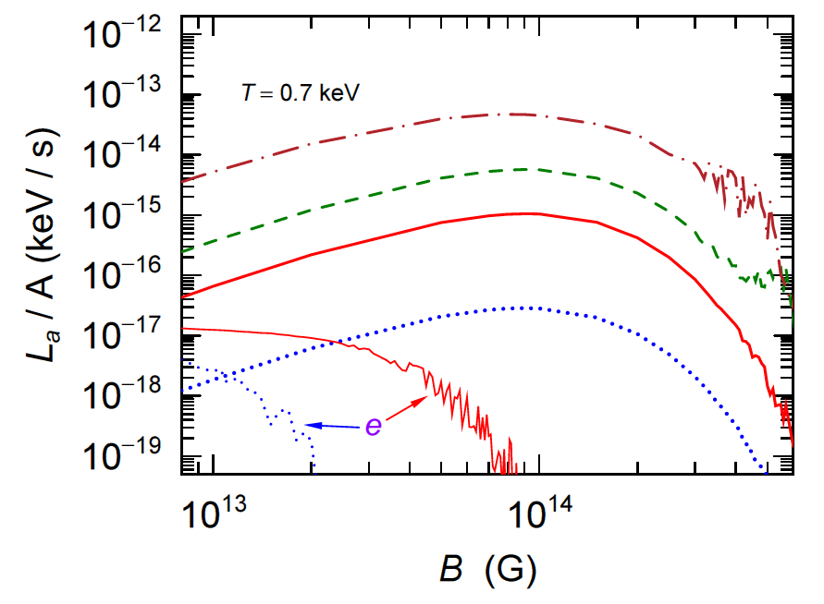
Density Dependence of Axion Luminosity
Magnetar & SMaF
Axion Luminosity from Magnetar
DU
MU
SMaF Dep.

Slide 35


Summary of Axion Production
Axion Luminosity $L_{X}$ $∝T^{a}$ a ≈ 1.6 when T > 10 keV
Low Temperature Expansion
f(E) [ 1－ f(E) ] ⇒ Narrow Peak Energy Level with Width T …. Region A
N + N → N+N+X ⇒ $L_{X}$ $∝T^{6}$ A.Sedrakian, PRD 93, 065044 (16)
Neutrino Luminosity a = 6 (DU), = 8 (MU)
Present Calculation
Very Low Temp. ( T < 5 keV) Energy Shift $Δe >T$
Both Initial and Final States do not locate in Region A
Discrete Energy Levels affect Strength Distribution
$$X+γ^{∗}(B)→γ$$
Are all Axions emitted to outside of Magnetar?

Slide 36


Magnetar & SMaF
Pair Neutrino Production
Magnetic Field :
Dirac Equation
IInteraction
I

Slide 37



Magnetar & SMaF
Pair Neutrino Production
Only Electron
Proton Contributions
are much Smaller
Cal. can be performed above 1-5 keV
Fitting $L/V=cT^{a}$
MU
MU
MU
Preliminary
Modified Urca (MU)).
D.G.Yakolev, K.P.,Levenfish
A&A 297, 717 (95)

Slide 38


Magnetar & SMaF
Magnetar Cooling by axion and neutrino
ν$\overline{\text{ν}}$ - Pair Production
Low Temperature ( T < 1 keV) ←
Extrapolating from High Temperature Results
ν$\overline{\text{ν}}$ - Pair Energy Loss >> MU & DU 10 ^{19－20}
$L_{υ\overline{ν}}$ $∝T^{a}$ a = 0.65 － 1.02 : This Work = 6 (DU), = 8 (MU)
High Temp. Region, T > 600 keV ( B>10¹⁶ G) , (Core Region),
A.M. Beloborodov and X.Li, arxiv;1605.090077
Contribution of Our Model is comparable to that in DU & MU
Smaller Magnetic Field suppress Production Rate
B ~ 10¹⁴ G
Transitions between two states with different Landau Levels
are important in Strong Magnetic Field
$T≪\sqrt{eB}$

Slide 39
Extrapolate Results at T = 700 eV (realistic Temp.)
Magnetar & SMaF
Magnetar Cooling by axion and neutrino
Preliminary
 | 0.1 ρ₀ |  | 0.5 ρ₀ |  | ρ₀
B | 10¹⁵G | 2x 0¹⁵G | 10¹⁵G | 10⁶⁵G | 10¹⁵G | 10⁶⁵G
a Power of T | 1.08 (e) 0.43 (p) | 0.64 | 1.02 | 0.93 | 1.01 | 0.77
L_{νν} (keV/s) at T=0.7keV | 9.0x10^{－5} (e) 2.6x10^{－15} (p) | 5.7x10^{－4} | 2.2x10^{－5} | 8.7x10^{－4} | 4.8x10^{－5} | 1.2x10^{－3}
MU | 1.0x10^{－25} |  | 1.0x10^{－25} |  | 5.6x10^{－26}

Slide 40

Axion vs. ν$\overline{\text{ν}}$ - Pairs
Magnetar & SMaF
Magnetar Cooling by axion and neutrino
$L_{υ\overline{ν}}$ $∝T^{a}$ a : different Values, T ≪ e_{i} －e_{f} T≫ e_{i}－ e_{f}
1. Axion ： Very Small Mass ⇒ n_{i}ーn_{f} ≈ 1
Δe is much smaller for Proton
Proton Contribution is much Larger than Electron One
2. ν$\overline{\text{ν}}$ - Pairs : Invariant Mass is not fixed
Smaller Particle Mass makes Larger Invariant Mass
Electron ⇒ Much Larger Phase Space in Final State
⇒ n_{i}ーn_{f} > 1
Electron Contribution is much Larger Proton

Slide 41


Summary of neutrino pair production
1. Laudau Levels are introduced into Calculations
of Particle Producyions in Strong Magnetic Flield
2. ν$\overline{\text{ν}}$ - Pair & Axion Production are mainly from transition of electron (proton) between different Landau numbers when T < 10 keV
3. ν$\overline{\text{ν}}$ - Pair and Axion Energy Loss >> MU & DU
$L_{υ\overline{ν}}$ $∝T^{a}$ a = 1 : This Work (ν$\overline{\text{ν}}$) = 6 (DU), = 8 (MU)
4. Transitions between two states with different Landau levels
are important in Strong Magnetic Field when energy difference is larger than temperature.
$T<\sqrt{eB}$

Slide 42
Summary and Conclusion for SMaF Physics
We calculated neutrino transport inside PNS, which shows an asymmetry with respect to the magnetic field direction in a magnetar.
The asymmetry turns out to be a source of pulsar kicks of neutron stars.
For the spin deceleration of neutron star, we also considered toroidal magnetic field, in which we also found the asymmetry leading to the spin deceleration.
Additional mechanisms for cooling process are shown to affect the cooling of magnetar as well as neutron stars.
In the Universe, we need more deep understanding of strong magnetic field (SMaF) physics, for example, Landau quantization and polarization of particle propagation inside neutron stars. It may lead to new mechanism of cosmic particles (pion, neutrino … emission) as well as the cooling process.

Slide 43
Collaborators
Eunja Ha, Y. S. Kwon, Ki-Seok Choi, T. Miyatsu, M. Kusakabe,
Jaewon Shin, Gil-Seok Yang, C-Y. Ryu (Soongsil University) ….
Hungchong Kim (Kookmin Univ.), K. S. Kim (Korea Aerospace Univ.), W. So (Kangwon Univ.), C. Hyun (Daegu Univ.)…
K. Tsushima (IIP, Brazil), K. Saito (TSU)
G. Mathews (Notre Dame), Baha Ballantekin (Wisconsin),
Alex Brown (MSU), H. Sagawa (RIKEN)
T. Kajino (NAOJ), Ko Nakamura (Waseda)
T. Maruyama (Nihon Univ.), T. Hayakawa (JAEA), S. Chiba (TIT)…
C. Deliduman, P. Yamac (Turkey)
A. Faessler (Tuebinen), F. Simkovic (Dubna, Bratislava Univ.)…

Slide 44

Thanks for
your attention !!

