Slide 1

11th APCTP-BLTP JINR-PINP NRC KI-SPbSU Joint Workshop
"Modern problems in nuclear and elementary particle physics"
Petergof , Russia, 23-29 July 2017
Assessment of neutron star EoS by gravitational wave detectors
Hyun Kyu Lee
Hanyang University
July 14-19, 2013 , Russia, Irkutsk Region, Bolshiye Koty

Slide 2
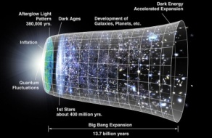
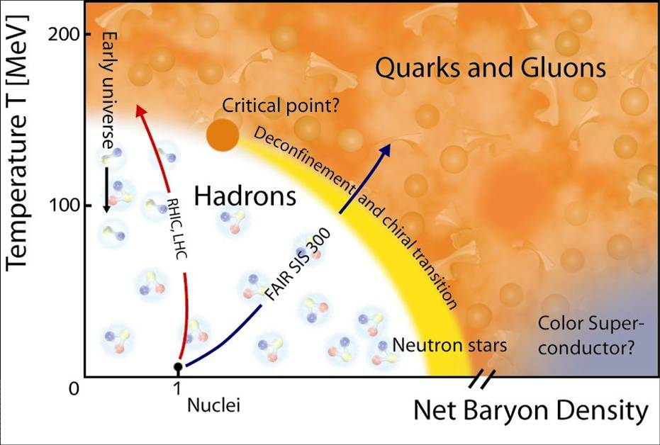
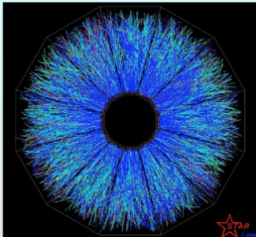
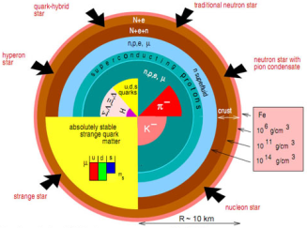
I. Introduction
Temperature frontier
Density frontier
Notes:
High baryon number density beyond n_0, Unexplored area either theoretically or experimentally.
High energy density, or high temperature, field theoretical method,
Lattice calculation, RHIC, LHC, : early Universe

Slide 3
A. Dense hadronic matter (DHM)
- Nuclei, Fe ,
normal nuclear density n₀ = 0.16/fm³
- Heavy ion collision
RHIC, LHC, RIKEN, FAIR, FRIB, RAON
- Neutron star(NS) core
- Merger remnant
binary neutron star merger

Slide 4
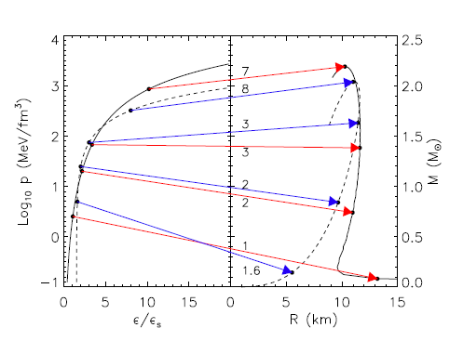
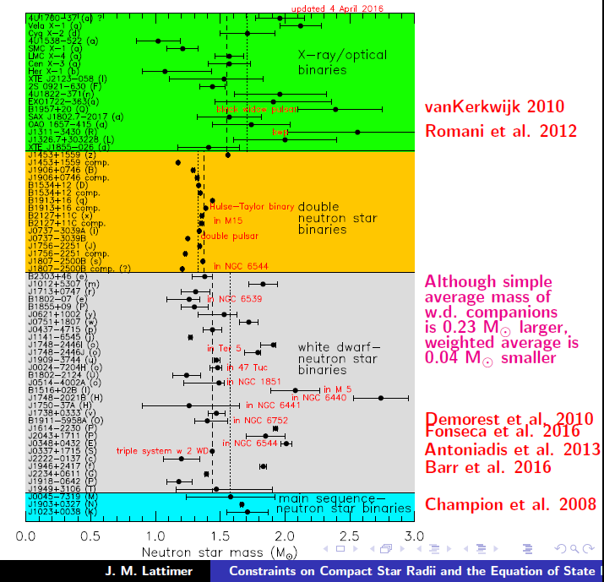
- Core density of neutron stars
Lattimer, arXiv: 1305.3510

Slide 5

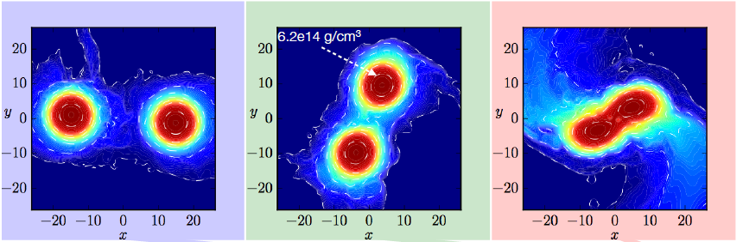
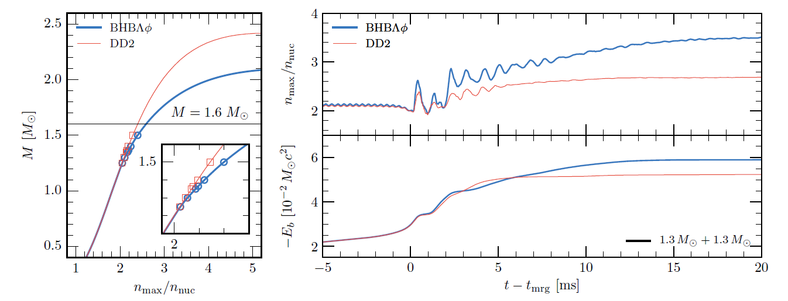
- Binary Neutron Star Merger Remnant
cosmic collider
n > 2 n₀
Radice et al. arXiv:1612.06429v2

Slide 6
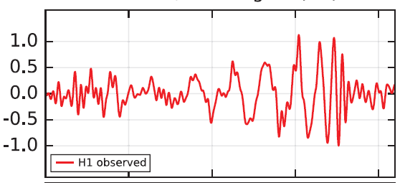
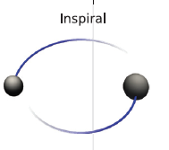



B. Gravitational waves from binary merger
- Mass

Slide 7
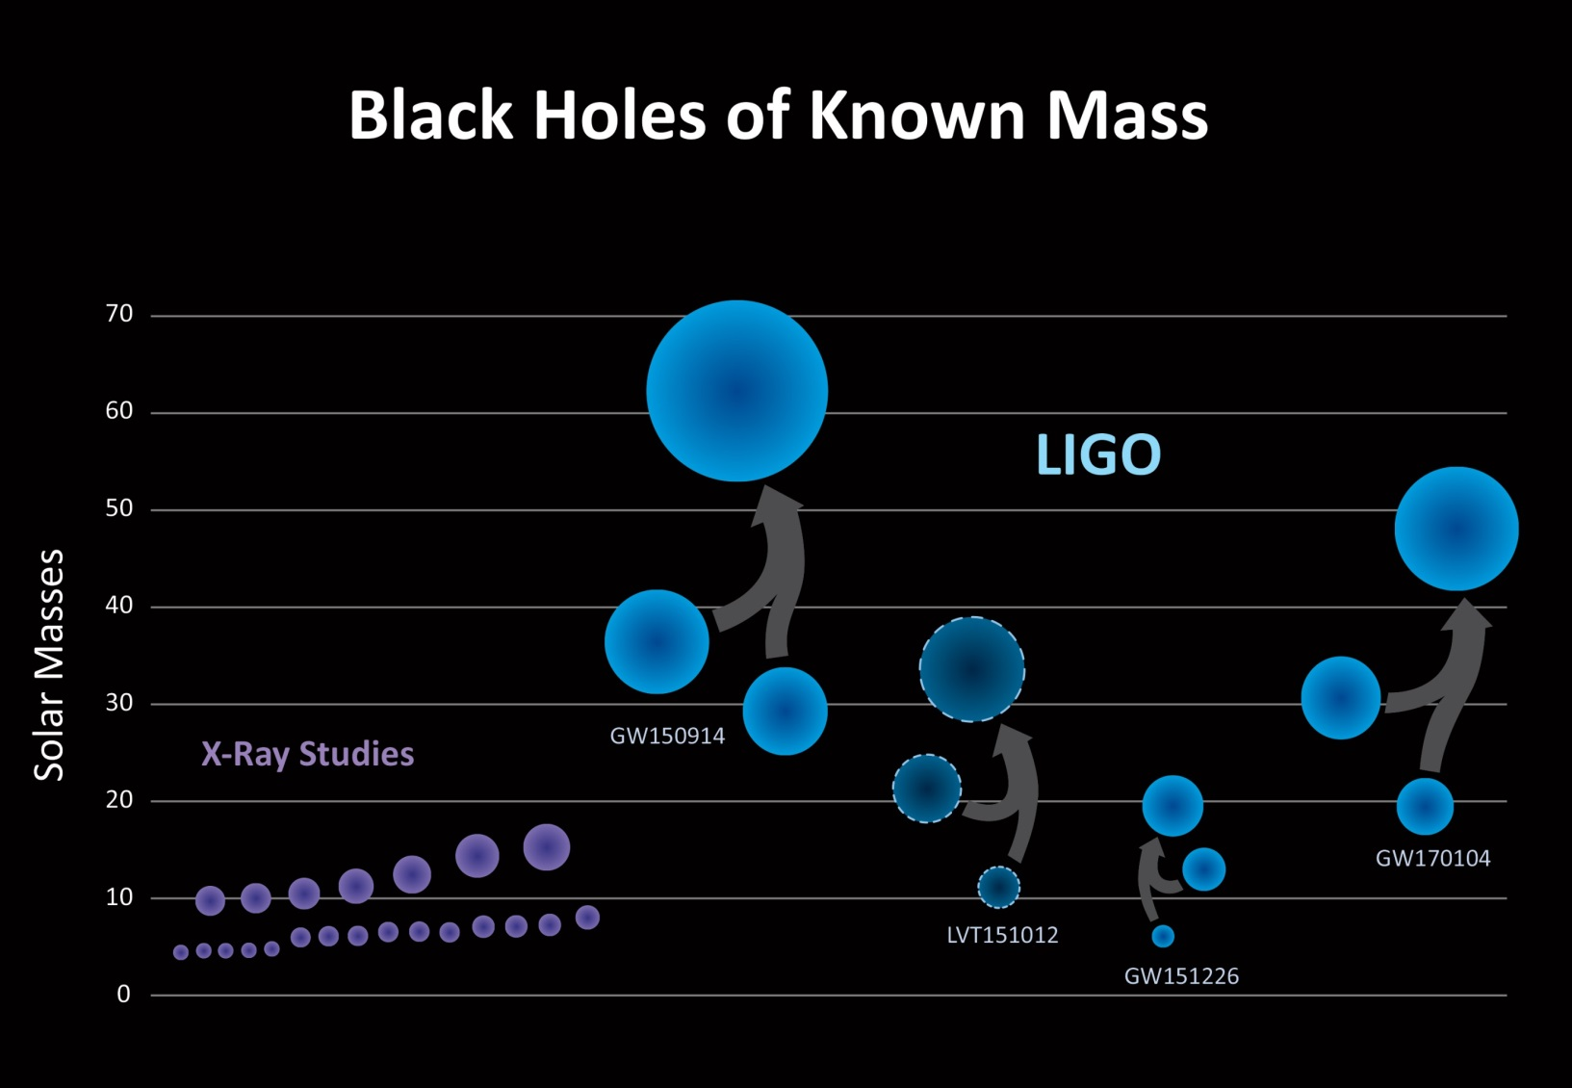

Slide 8
- Tidal deformation

Slide 9
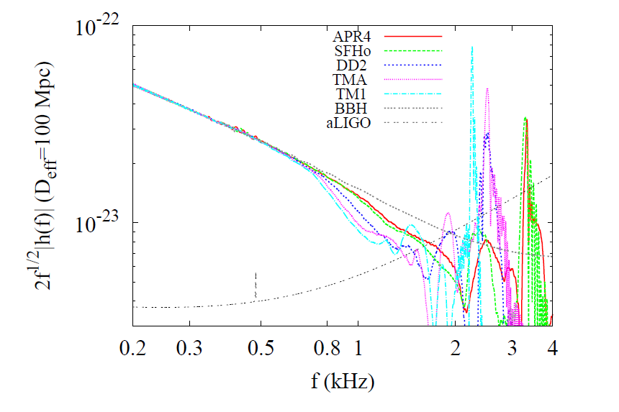

- Remnant oscillation :
l=m=2 quadrupole structure

Slide 10
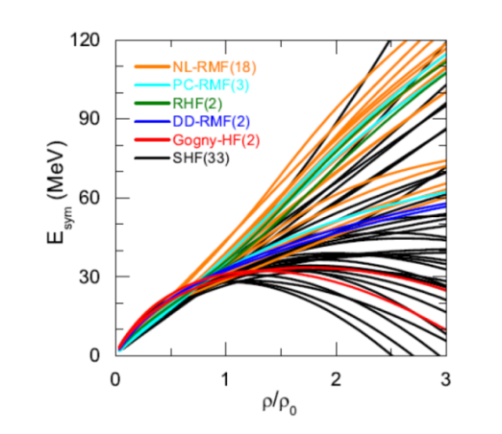
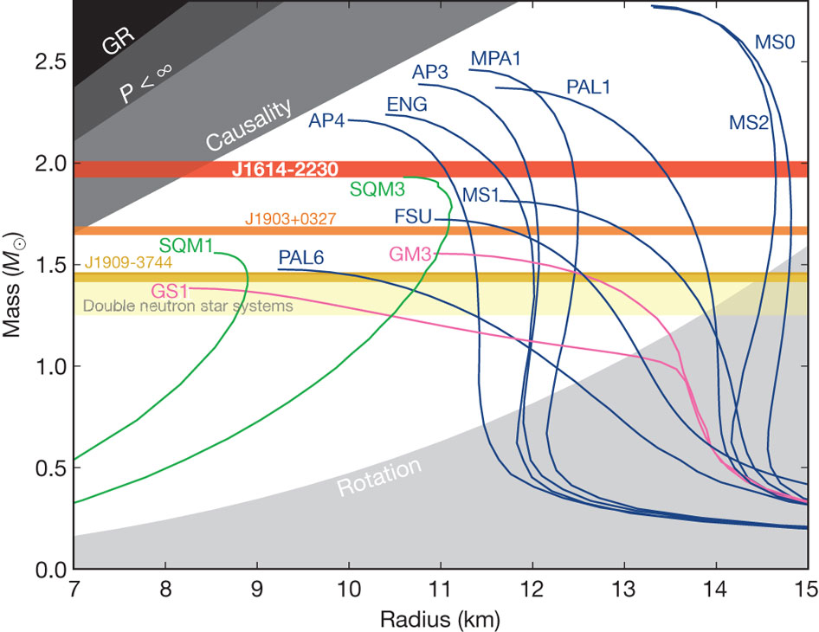
II. Equation of state of dense hadronic matter
Simple extrapolation from low density nuclear matter ?
Symmetry Energy
Mass -Radius
Deformation parameter
Chen, 1506.09057

Slide 11

Equation of state,
a. Interactions between nucleon and additional degree of freedoms
b. Composition of nuclear matter
leptons: electrons, muons
strange hadrons: kaon, hyperons
vector mesons: rho, omega
dilatons, ….
quarks,
→ Hadronic matter

Slide 12

c. Symmetries
1. Chiral symmetry → pions
2. Hidden local symmetry →
vector mesons as gauge bosons
3. Scale symmetry → scalar meson
4. Flavor SU(2) symmetry →
iso-doublet nucleon
unexpected emergent symmetries ??

Slide 13

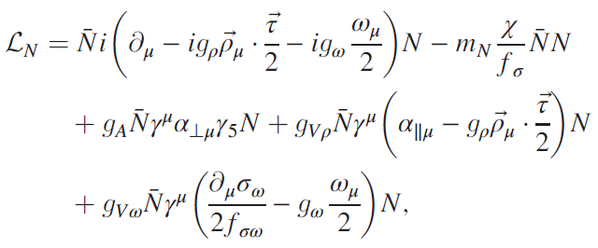
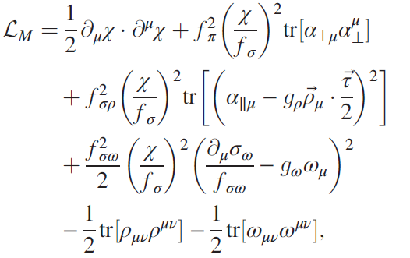

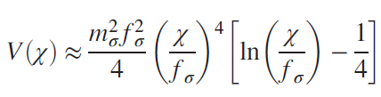
A. Scale-invariant hidden local symmetric effective theory
W.-G. Paeng, T. Kuo, HKL, Y.-L. Ma, M. Rho, arXiv: 1704.02775 (PRD in press, PKLMR)

Slide 14


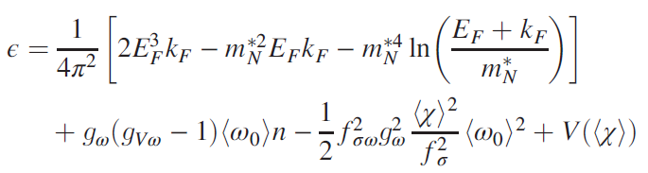



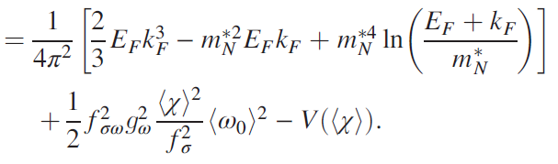

Trace of energy momentum tensor
- nucleon mass is introduced in a scale symmetric way !

Slide 15

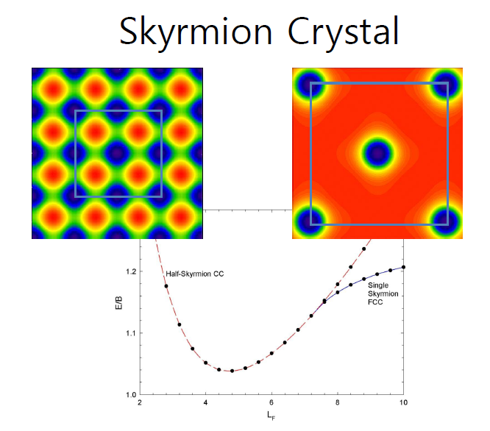
B. Hint from skyrmions on the lattice:
nucleon as skyrmion (toplogical soliton) in pionic lagrangian
baryonic matter : skyrmion on the lattice
Half skyrmion phase
skyrmions → half skyrmions on lattice
Goldhaber and Manton(1987);
B.Y. Park, V.Vento, H.J.Lee et al. (2003), …

Slide 16
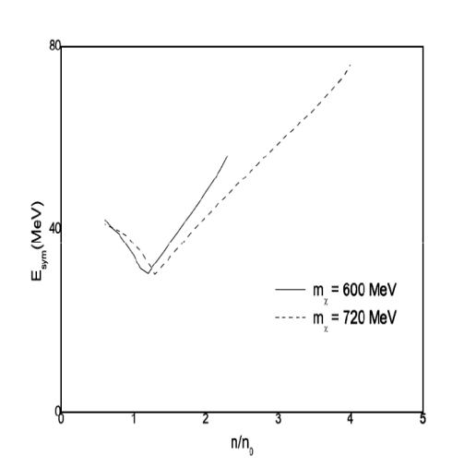

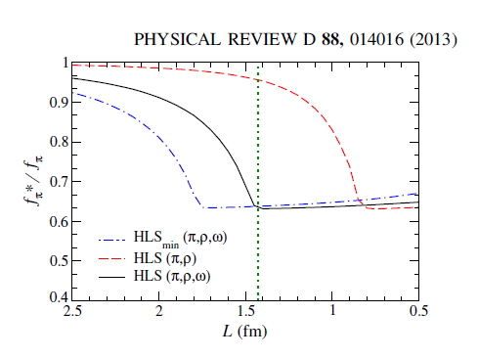

1. Change of symmetry energy
HKL, Park and Rho, PRC 83,025206(2011)
2. homogeneous dilaton condensation
→ density independent

Slide 17

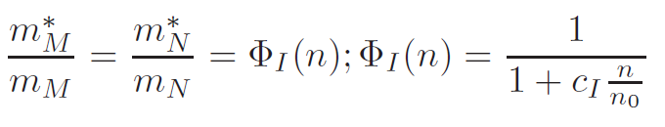

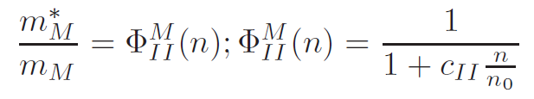

C. Implementation of half skyrmion into nuclear matter:
equation of state using V_{low-k}
old BR scaling at low density
new scaling at higher density

Slide 18
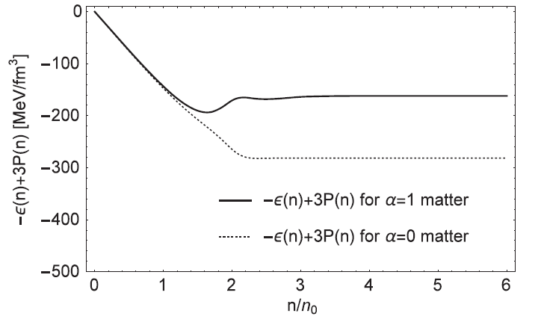
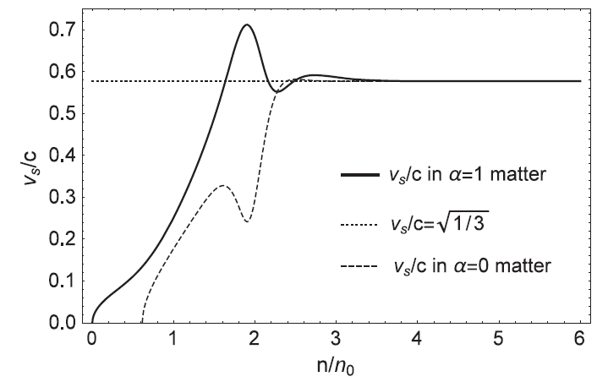
D. Results
Sound velocity v → 1/3 c
Precursor of scale symmetry restoration ?

Slide 19
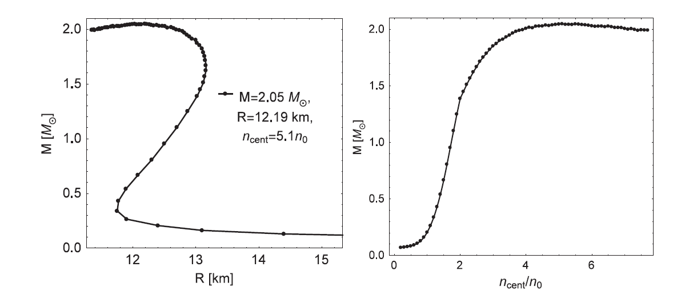
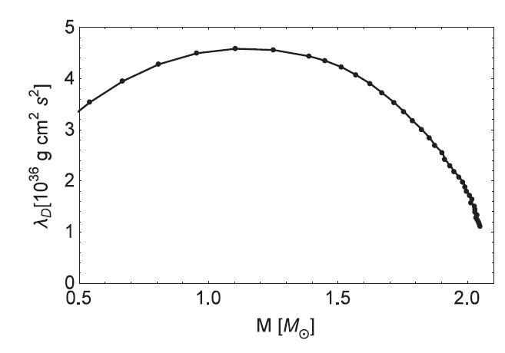
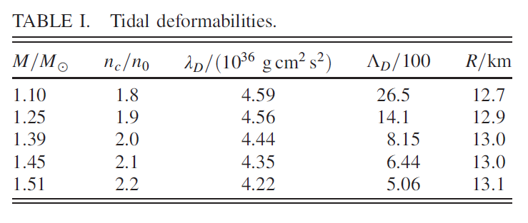
Mass- radius and central density
Tidal deformation

Slide 20
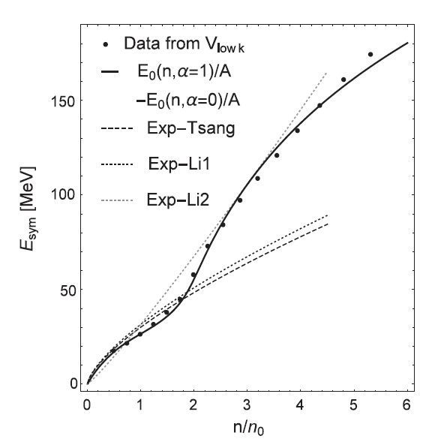
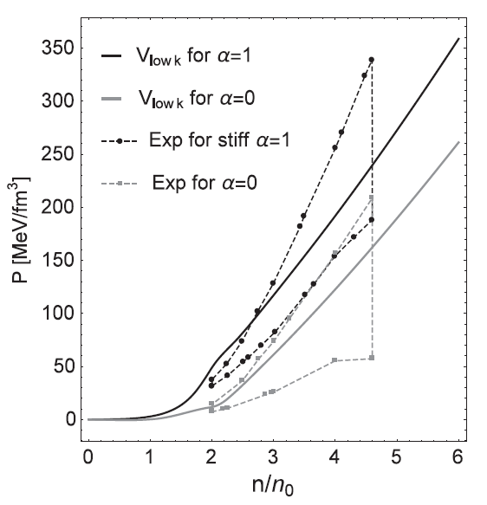
Pressure and symmetry energy
Stiffer at lower density upto n ~ 2 n_0
→ bigger radius, larger Lambda

Slide 21
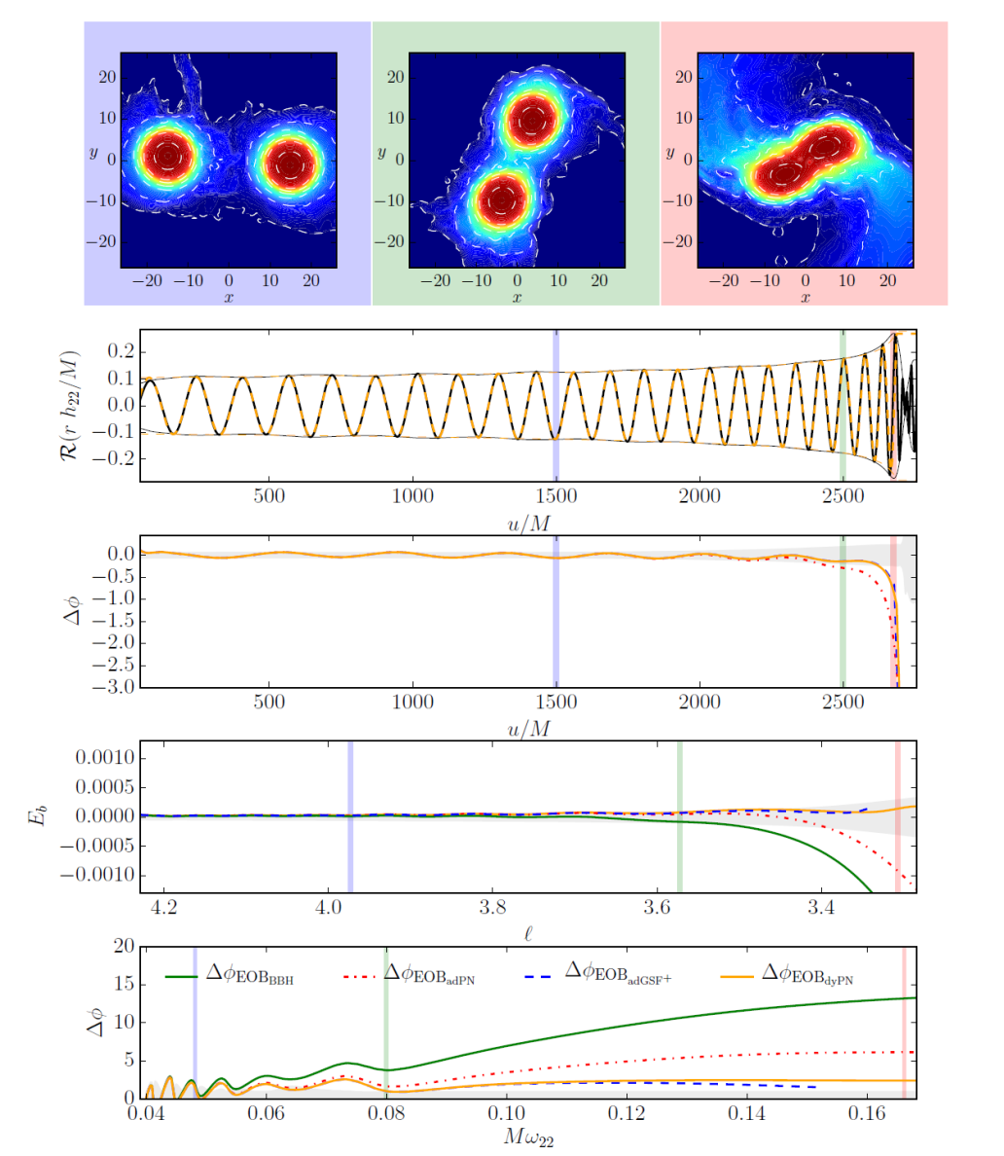
III. EoS and gravitational waves

Slide 22
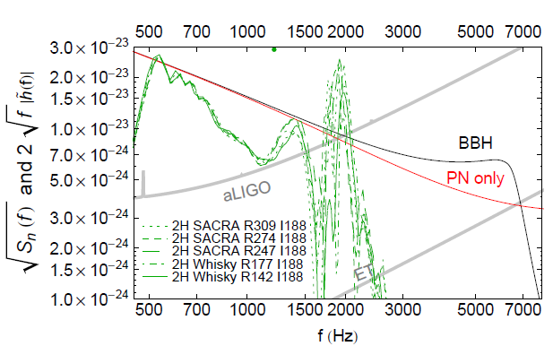
Read et al., arXiv:1306.4065

Slide 23
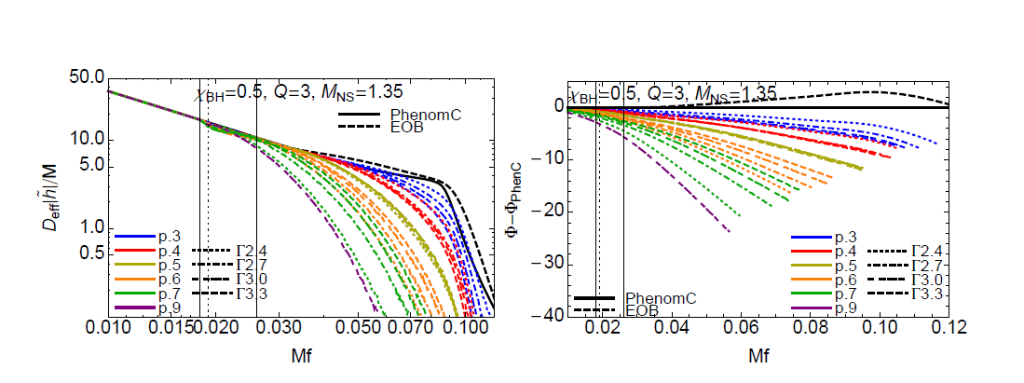
A. Tidal deformation
Lackey et al. PRD 89, 043009(2014)

Slide 24
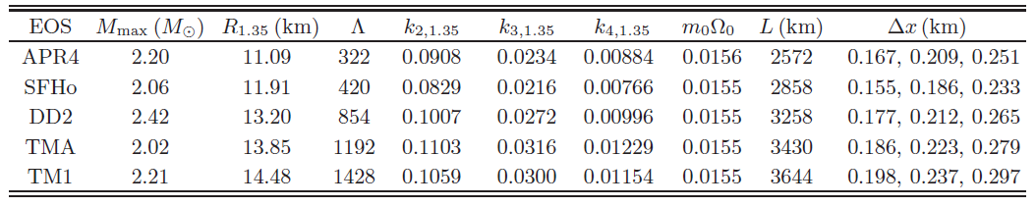
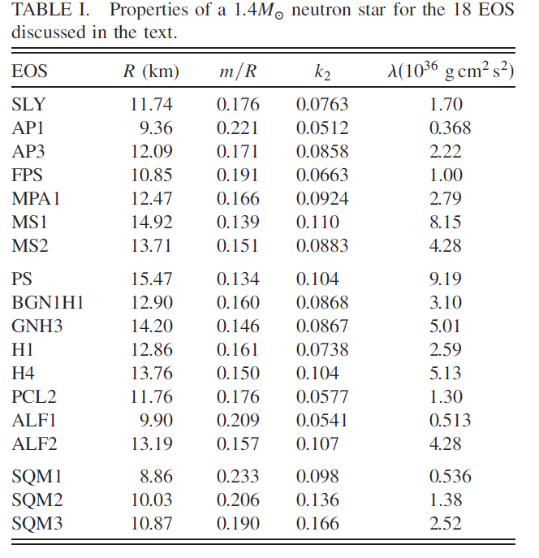
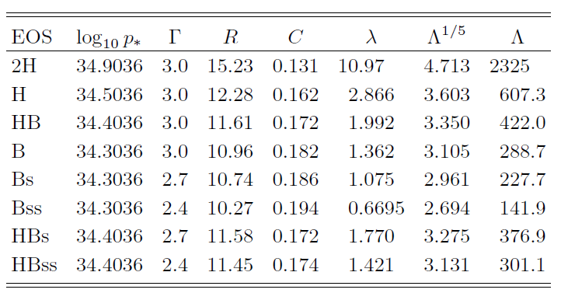

Slide 25

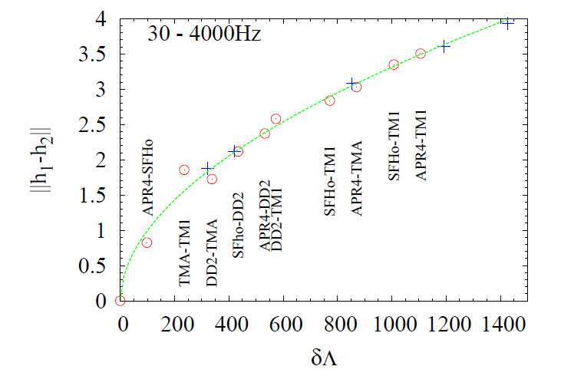
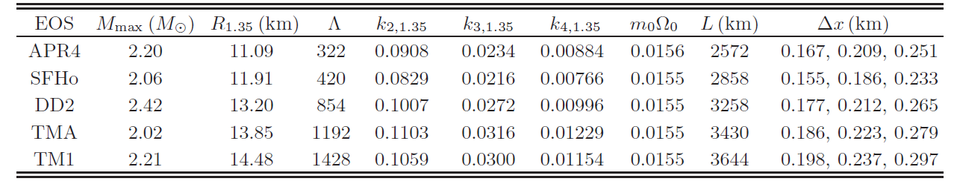

distinguishability
Hotokezaka et al. , 1603.01286

Slide 26

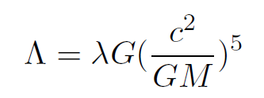



(a)1607.03235 (b)PKLMR
(a)
(b)
Distinguishable!!

Slide 27
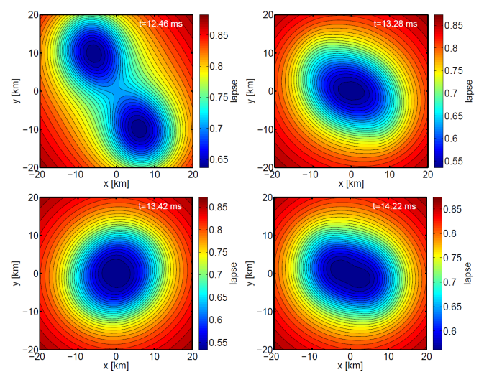

B. Peak frequency:
Remnant oscillation :
l=m=2 quadrupole structure
stiff soft

Slide 28
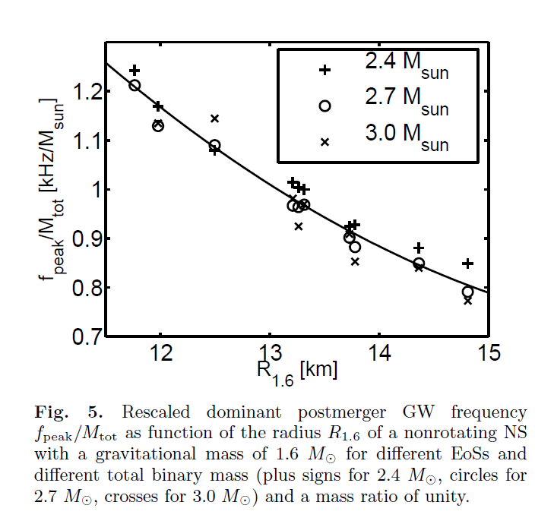
Scaling: f_{peak} vs radius
Bauswein, Stergioulas, Janka, arXiv: 1508.05492
soft stiff
Peak frequency of PKLMR
R_{1.6} = 13.15 km, f_{peak} = 0.99 M_{tot}

Slide 29

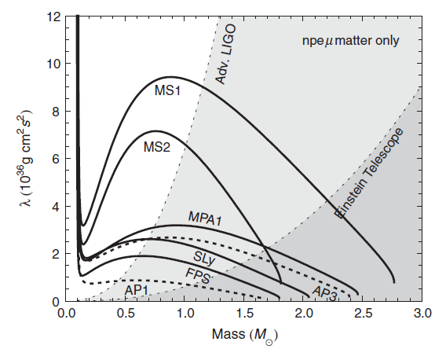
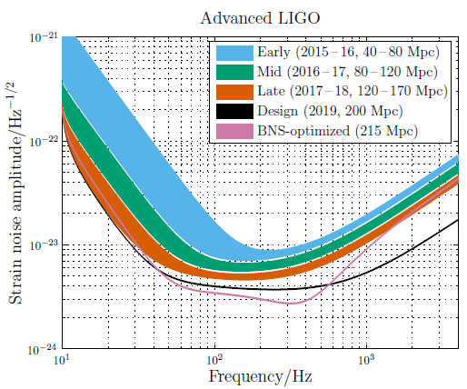
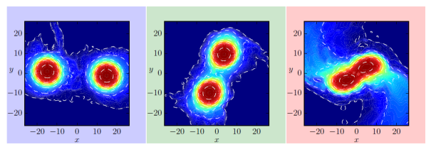
IV. Discussion
Characteristic features of equation of state
Mass -Radius
Deformation parameter
Symmetry Energy
?
Observational opportunities in gravitational wave detections at advanced LIGO –Virgo networks(2016 → )
inspiral -merger

Slide 30
