Slide 1
Nuclear Astrophysics with RI Beams at
RAON and RIKEN
The 11th APCTP-BLTP… workshop
St. Petersburg, Russia
July 25, 2017
Kevin I. Hahn
Ewha Womans University
Seoul, Korea

Slide 2
Outline
Nuclear astrophysics @ RAON
  RAON (the RI accelerator in Korea)
  KoBRA
Nuclear astrophysics @ RIKEN
  Experiments on the rp-process @ RIKEN
  Selected experiments at CNS
Summary

Slide 3
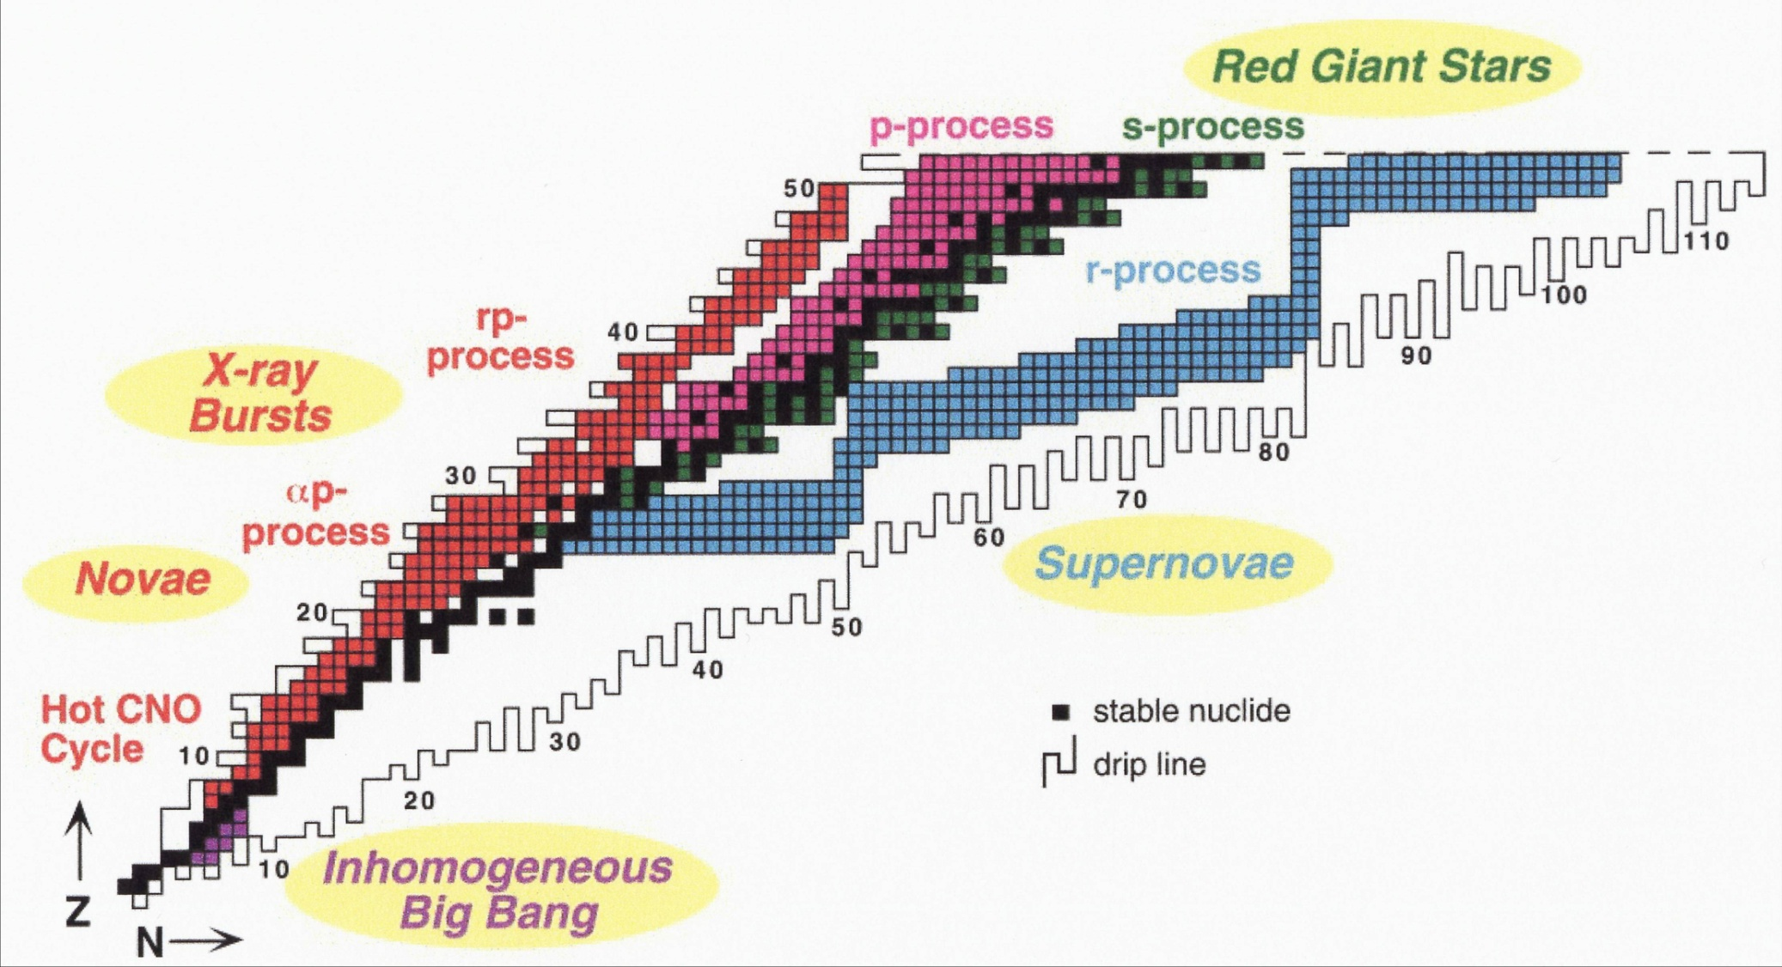
M.S. Smith and K.E. Rehm,
Ann. Rev. Nucl. Part. Sci, 51 (2001)
293
2,771
3,064
NNDC (BNL, 2000)
In many cosmic phenomena, radioactive nuclei play an influential role, hence the need for Radioactive Ion Beams / Rare Isotope Beams

Slide 4
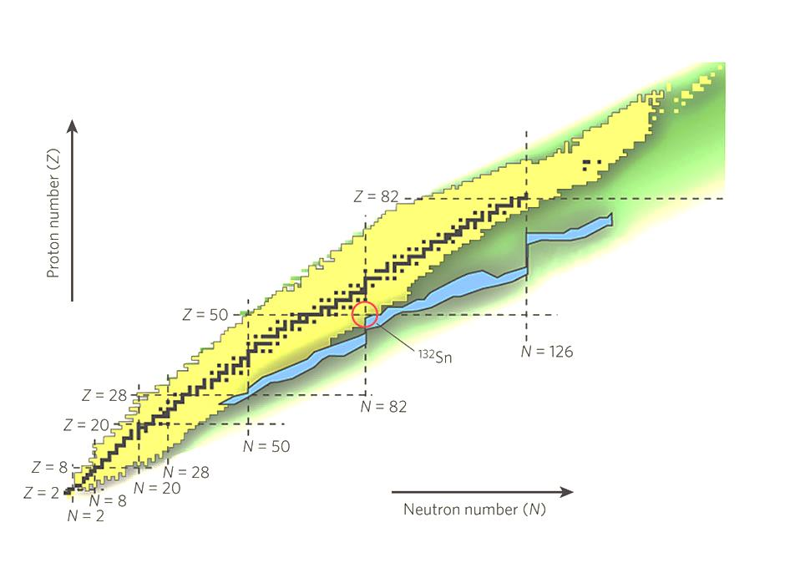
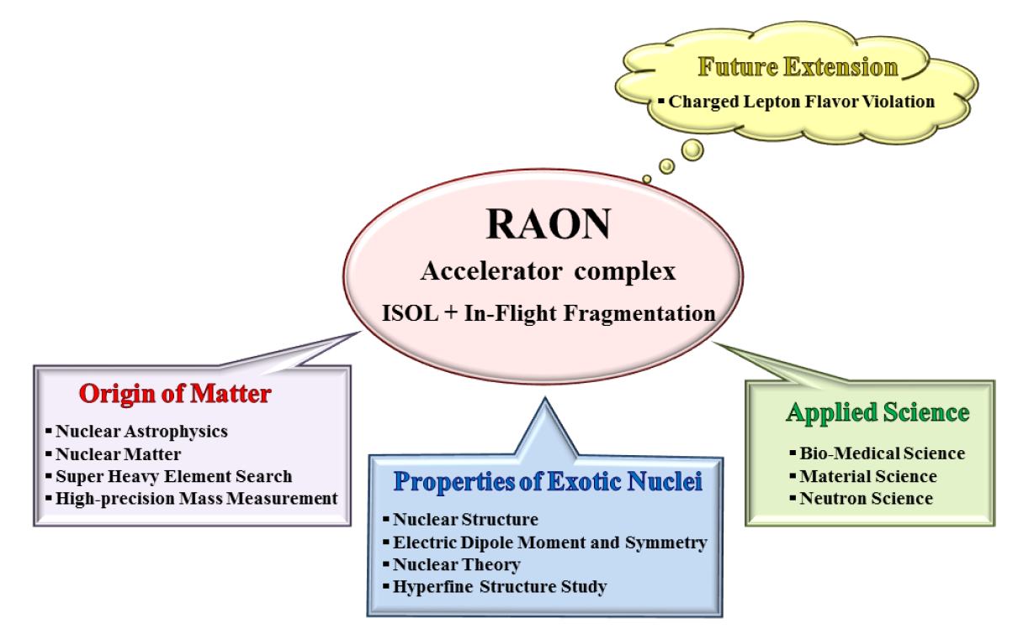
Rare Isotope Science Project (RISP)
Goal: To build a heavy ion accelerator complex RAON,
for rare isotope science research in Korea.
* RAON - Rare isotope Accelerator complex for ON-line experiments
All the following slides related to RAON are from Dr. S.C. Jeong
Budget: US$ 1.44 B (1 B$~1T Won)
- accelerators and experimental apparatus : 0.46 B$
- civil engineering & conventional facilities : 0.98 B$ (incl. construction site purchase)
(recently approved in June 2014)
Period: 2011.12 ~ 2021.12 (10.1 years)
Also shown by C. H. Lee yesterday

Slide 5
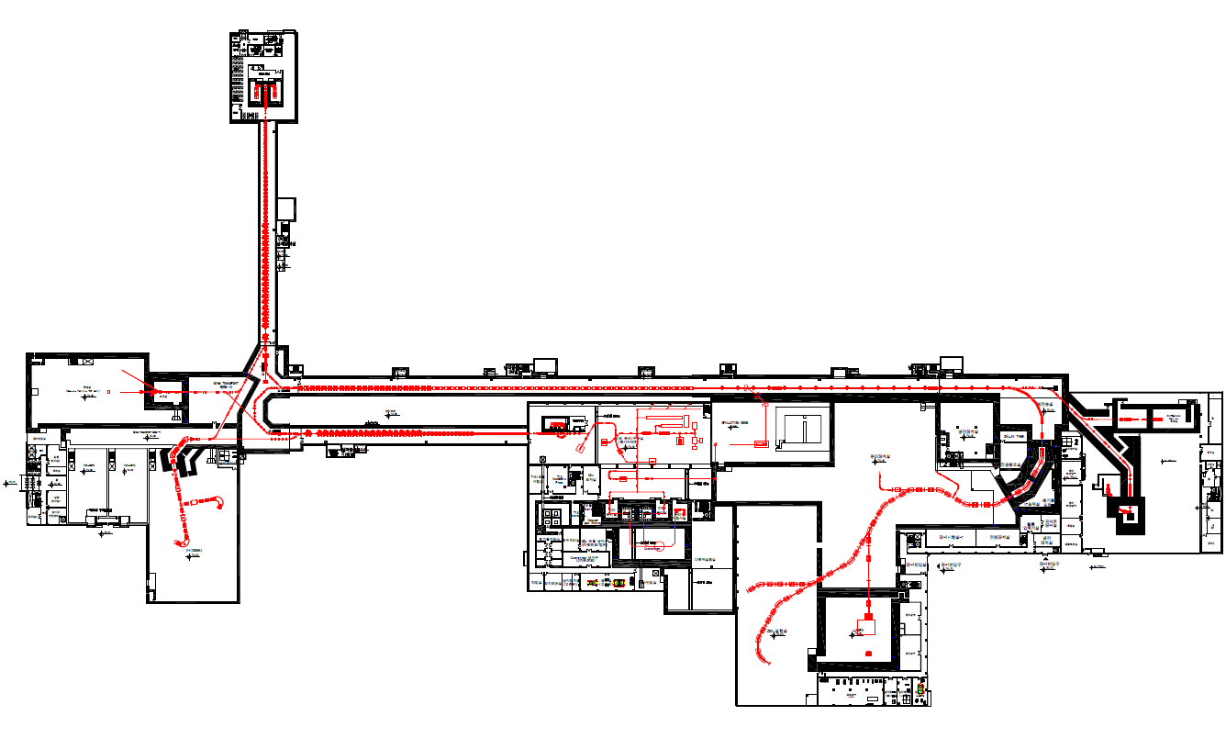
RAON Concept
: Accelerator complex for producing rare isotope beams
High intensity RI beams by ISOL & IF
  ISOL : direct fission of ²³⁸U by a 70MeV-proton cyclotron ~ 10¹⁴ f/s
  IF by 200MeV/u, 8.3pμA ²³⁸U by a 400kW-superconducting LINAC
High quality neutron-rich RI beams
  ¹³²Sn with up to ~250MeV/u, up to ~10⁸ pps
More exotic RI beams by ISOL+IF
Injector
SCL1
NDPS
BIS &
muSR
SCL2
HPMMS
& CLS
SCL3
Cyclotron
IF (high E)
KOBRA
ISOL
LAMPS

Slide 6

Lineup of RIB production & separation
ISOL→IF
SCL1
: ISOL→SCL3→SCL2→IF
SCL2
: ISOL→SCL3→KOBRA
SCL3
IF→Re-Acc
(future upgrade)
: IF→stopped beam→SCL
U-18.5MeV/u
70MeV-p
U-200MeV/u
KOBRA (low E IF)
ISOL
IF (high E)
Driver
SCL3 or SCL1
Cyclotron
SCL3→2 or SCL1→2
Post Acc
SCL3 or SCL3→2
Production mechanism
Direct reactions
- (p,d), (³He,n) etc
, MNT
p induced U fission
PF, U fission
Available RIB energy
< tens of MeV/u
> a few of keV/u
< hundreds of MeV/u
6

Slide 7
Expected RIBs at RAON in nuclear landscape
Stable ~300
Known ~2700
Unknown ~7000
IF
ISOL
KOBRA
ISOL+IF
RAON will provide access to unexplored regions of the nuclear chart !
RAON will be a powerful RIBs’ supplier to users globally
→ More exotic, More intense, and More various RIBs

Slide 8
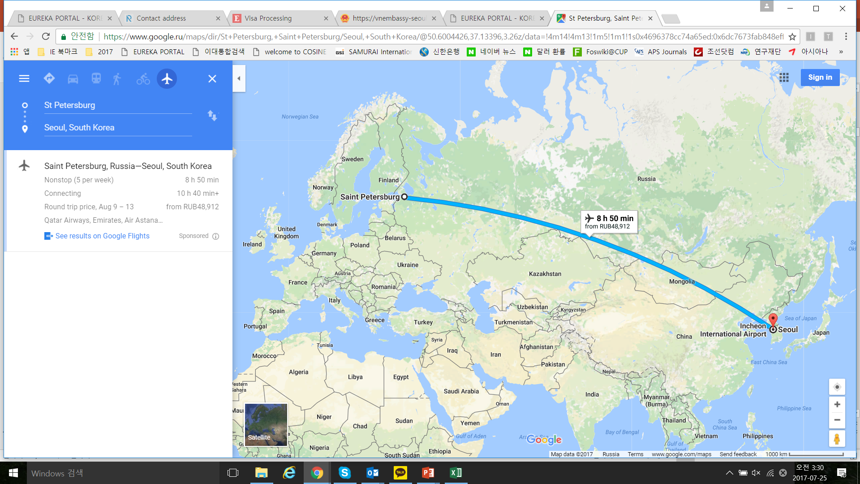
RAON Site :
~160km

Slide 9
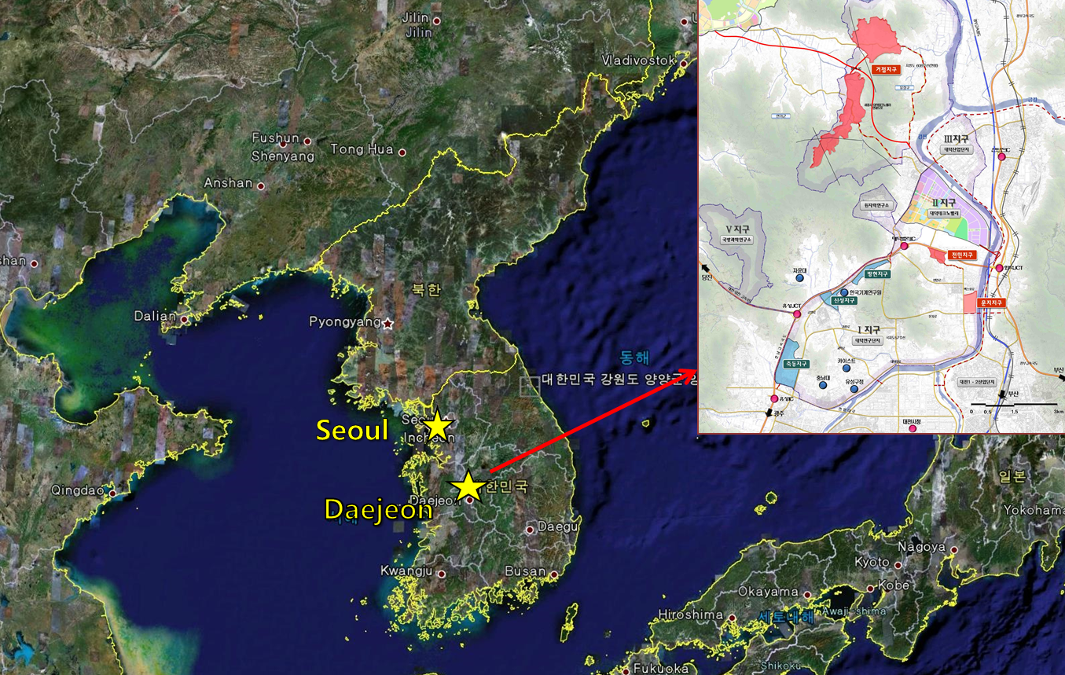
RAON Site :
Sindong in Daejeon
~160km

Slide 10
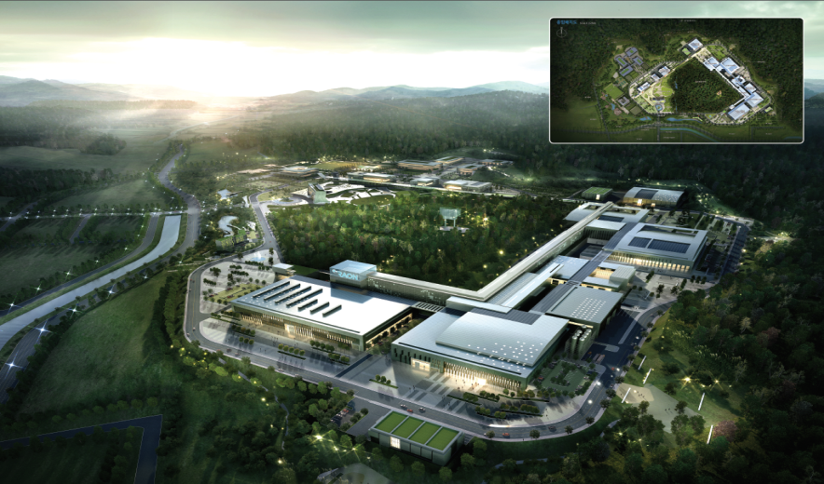
Bird’s eye view of the RISP Facility
Basic design was finished in Dec. 2015
A construction company was selected in Sept. 6, 2016. i
Area (Lot/Bldg): 952,066 m² / 130,257 m²

Slide 11
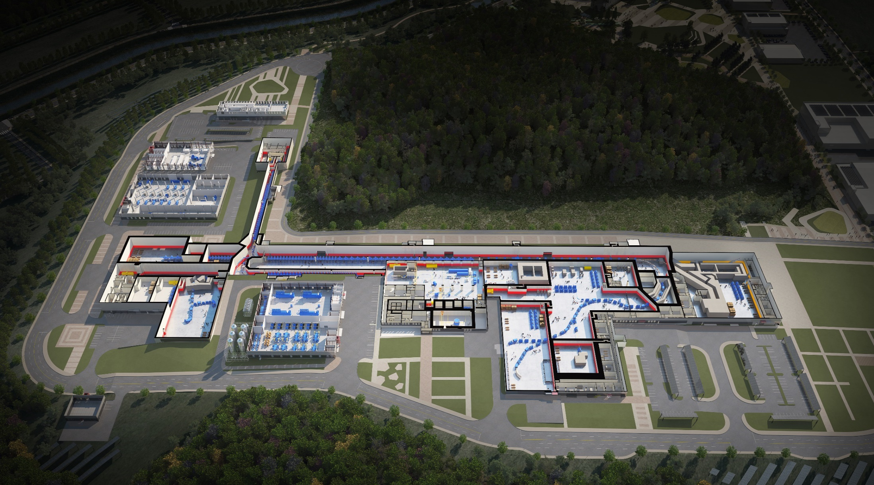
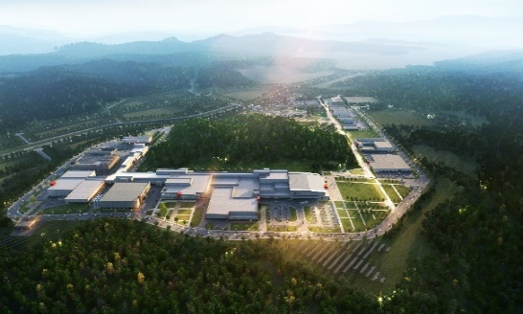
RAON layout
Control
Center
Utility
ECR IS
SCL1
ISOL System
HPMMS/
CLS
IF System
SCL3
SCL2
BIS
μSR
NDPS
KOBRA
Cyclotron
HRS
LAMPS

Slide 12
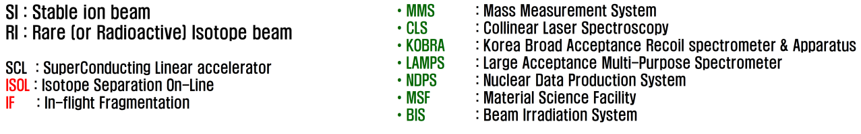
Layout of RAON
Injector1
SCL1
NDPS
BIS &
muSR
SCL2
Injector3
SCL3
HPMMS
& CLS
Cyclotron
IF (high E)
KOBRA
ISOL
Cyclotron, ISOL, SCL3, KOBRA, MMS, CLS
SCL2, IF, LAMPS
LAMPS
SCL1, NDPS, MSF, BIS

Slide 13
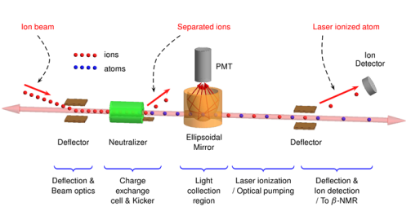
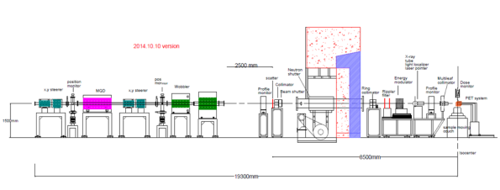
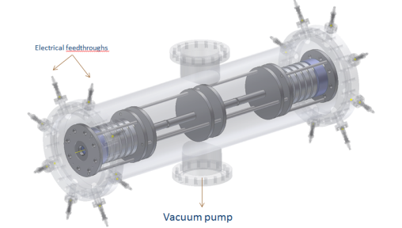
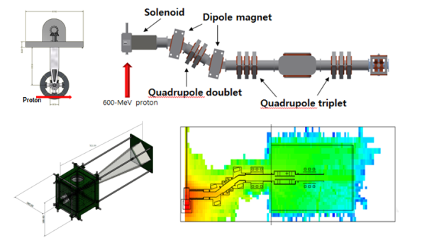
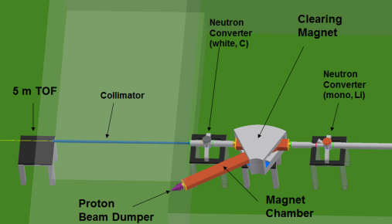
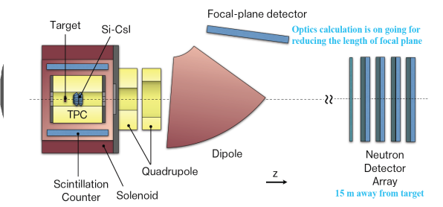
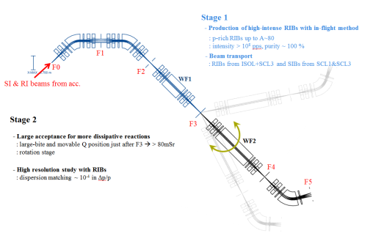
Experimental Systems
HI >200MeV/u
CLS
Bio-medical facility
High Energy Exp. II
P-600MeV
HPMMS
μSR
~keV/u
Very-low Energy Exp.
High Energy Exp. I
p, d, Li <P-88MeV/u
Neutron Facility
> U-200 MeV/u
LAMPS
> U-18.5MeV/u
KOBRA
Low Energy Exp.

Slide 14

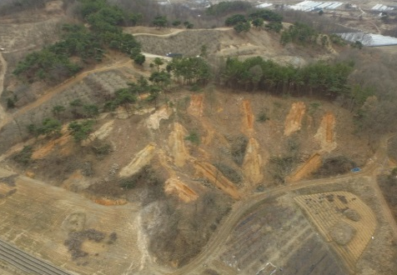
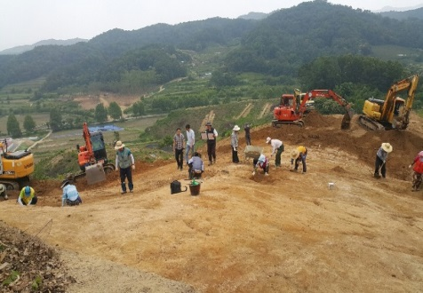
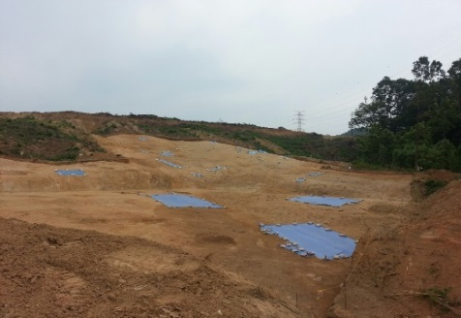
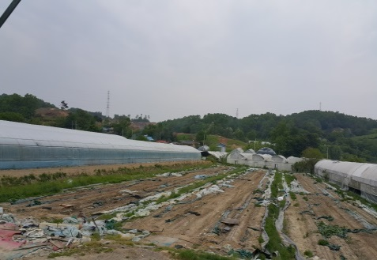
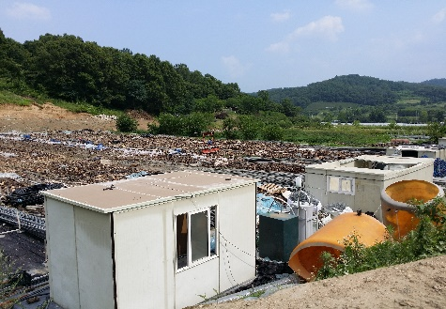
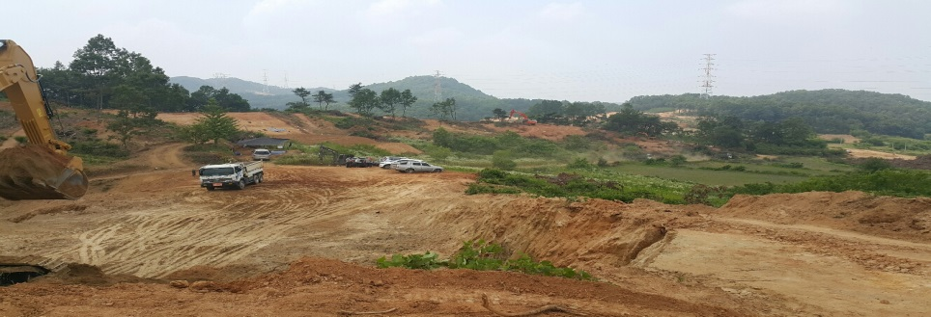

Construction & Civil Eng.
Status of Site (Cultural assets & Site preparation)
Sales contract
(`14.12.26.)
Land compensation
(`15.10.01.)
Expropriation decision
(`16.06.14.)
Site preparation
(`16.06.15.)
Excavation of cultural assets
Acc. & Exp. bldg site('15.12.~'16.09.), Support bldg site('16.06.~'16.11.)
Site preparation :
Acc. & Exp. bldg site ('16.07.~'17.01.), Support bldg site('16.08.~'17.06.)

Slide 15
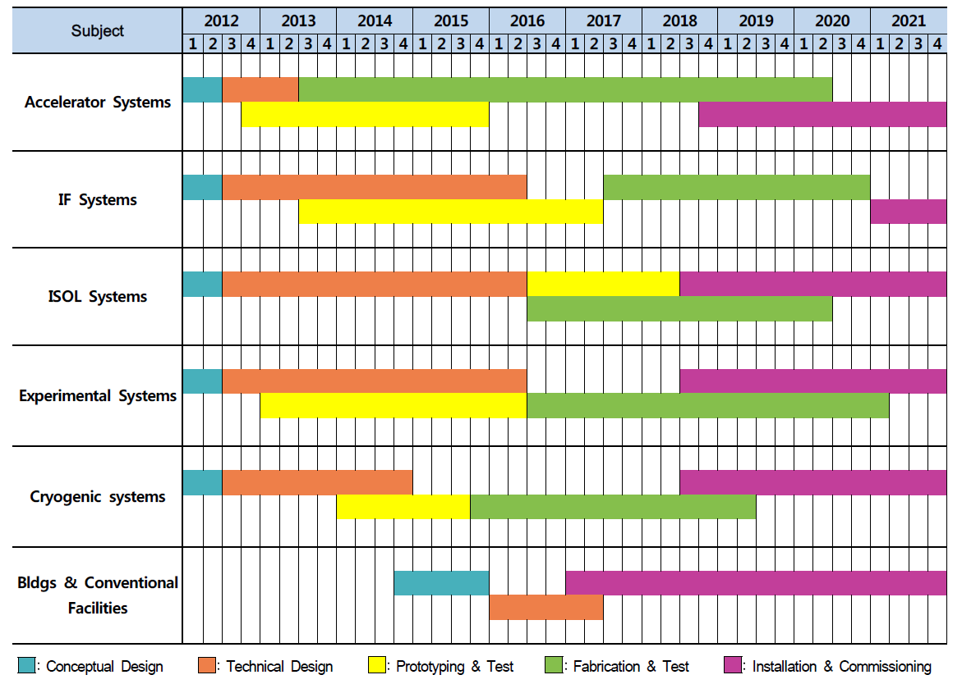
RISP Milestone Schedule
ECR SI Beam
RFQ Beam
SCL Demo Beam
SCL SI Beam
IF RI Beam
ISOL SI Beam
Cyclotron
ISOL RI Beam
DAY-1 Experiment
Start Utility Supply
Begin Construction
Completion

Slide 16
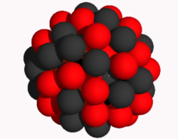
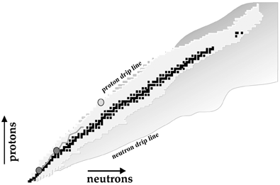
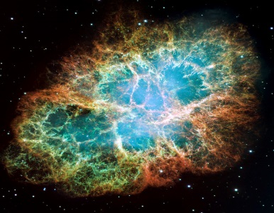
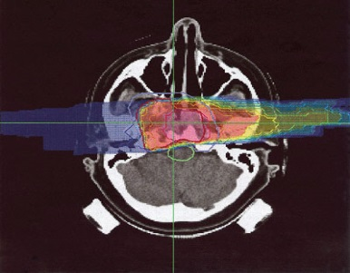
Rare Isotope Science
Nuclear Physics
- Structure of exotic nuclei
- Properties of exotic nuclei: masses, radii, life-time etc
- Search for super heavy elements
- Nuclear theory: nuclear force, nuclear model
Nuclear astrophysics
- Stellar evolution
- Nucleosynthetic processes under stellar environments
- EoS of asymmetric nuclear matter such as neutron stars
Applications
- Bio-medicine
- Material sciences
- National security

Slide 17

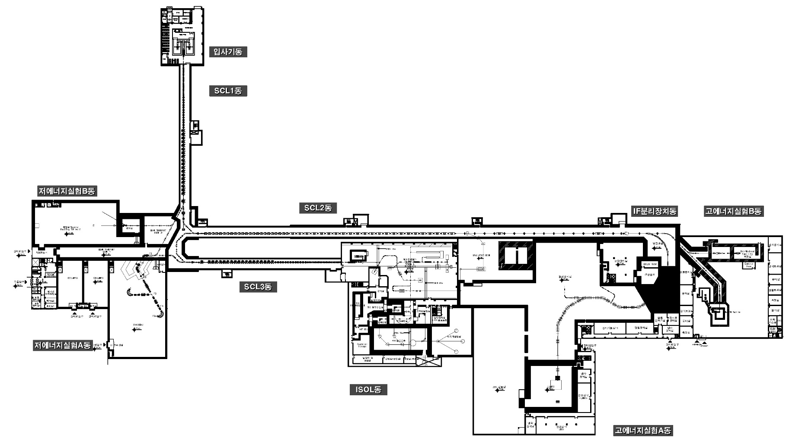


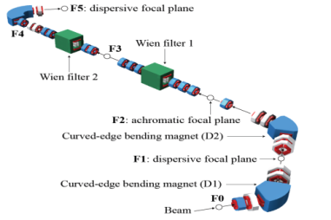

RAON Layout: Experimental system
HPMMS
CLS
Neutron Facility
Bio-medical facility
Low Energy Exp. Bldg
Ultra-low Exp. Bldg
High Energy Exp. Bldg
μSR
KOBRA
LAMPS

Slide 18
Experimental Facilities at RAON
Field | Facility | Exp. hall | Characteristics | Remark
Pure science | Recoil spectrometer – KOBRA | Low E | High resolution, Large acceptance function, RIBs production with in-flight method | Mass resolution; ~ 200 Large acceptance; ~ 80 msr
 | Large acceptance Spectrometer – LAMPS(L&H) | Low & High E (I) | High efficiency for charged particle, n, and γ | TPC ; 3π sr, Neutron wall, Si-CsI array, dipole spectrometer
 | High resolution Spectrometer | High E (I) | High resolution, Precise scattering Measurement to the focal plan, Rotatable | Momentum resolution ; 1.5x10⁴
 | Zero-degree Spectrometer | High E (I) | Charge and mass separation, Good mass resolution | Momentum resolution ; 1200~ 4100
 | High precession mass measurement system | Ultra low E | Penning trap, Multi-reflection Time of flight | Mass resolution ; 10⁻⁵~ 10⁻⁸
 | Collinear laser Spectroscopy | Ultra low E | High Resolution Laser Spectroscopy System | Spectral resolution ; ≤ 100 MHz
Applied science | β-NMR/μ-SR | Low / High E (II) | High intensity ⁸Li & muon production | ⁸Li & muon > 10⁸ pps
 | Bio-medical facility | Low & High E (II) | Irradiation system for stable & radio ion beam | Uniformity ; < 5%
 | Neutron science Facility | Low E | Fast neutron generation & measurement system of fission cross section | Uncertainty ; < a few %
(KOrea Broad acceptance Recoil spectrometer and Apparatus)

Slide 19
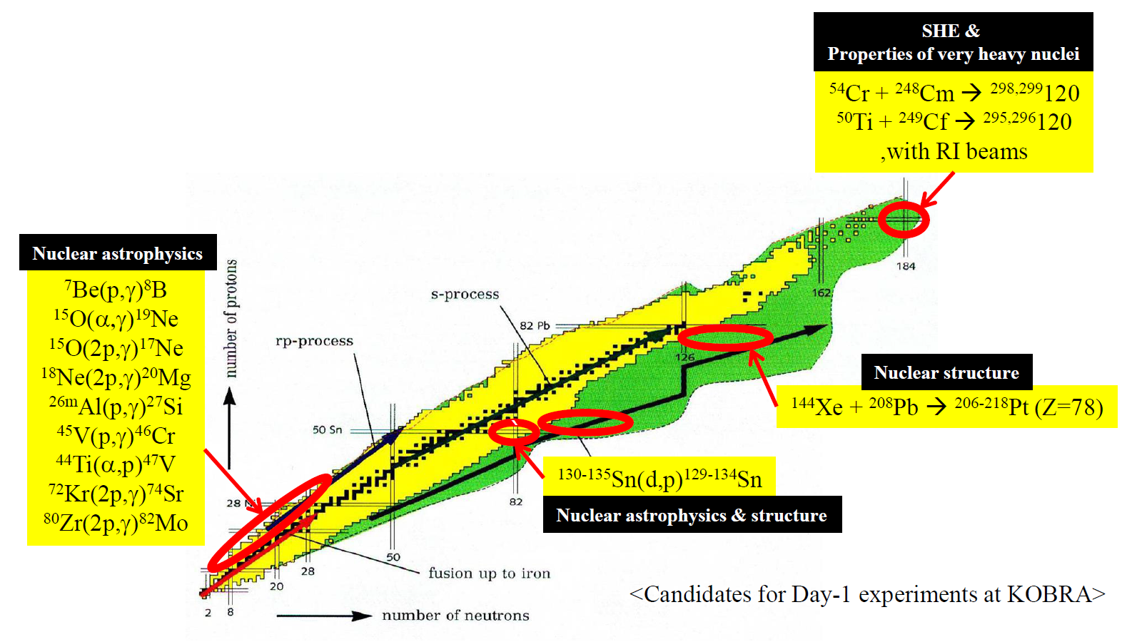
Nuclear Physics at KOBRA
Main Research Subject
Nuclear structure of exotic nuclei
- shell evolution, shape coexistence, isomers, etc
Nuclear reactions
- deep inelastic, multi-nucleon transfer reactions…
Astrophysically important nuclear reactions
from Y. K. Kwon

Slide 20
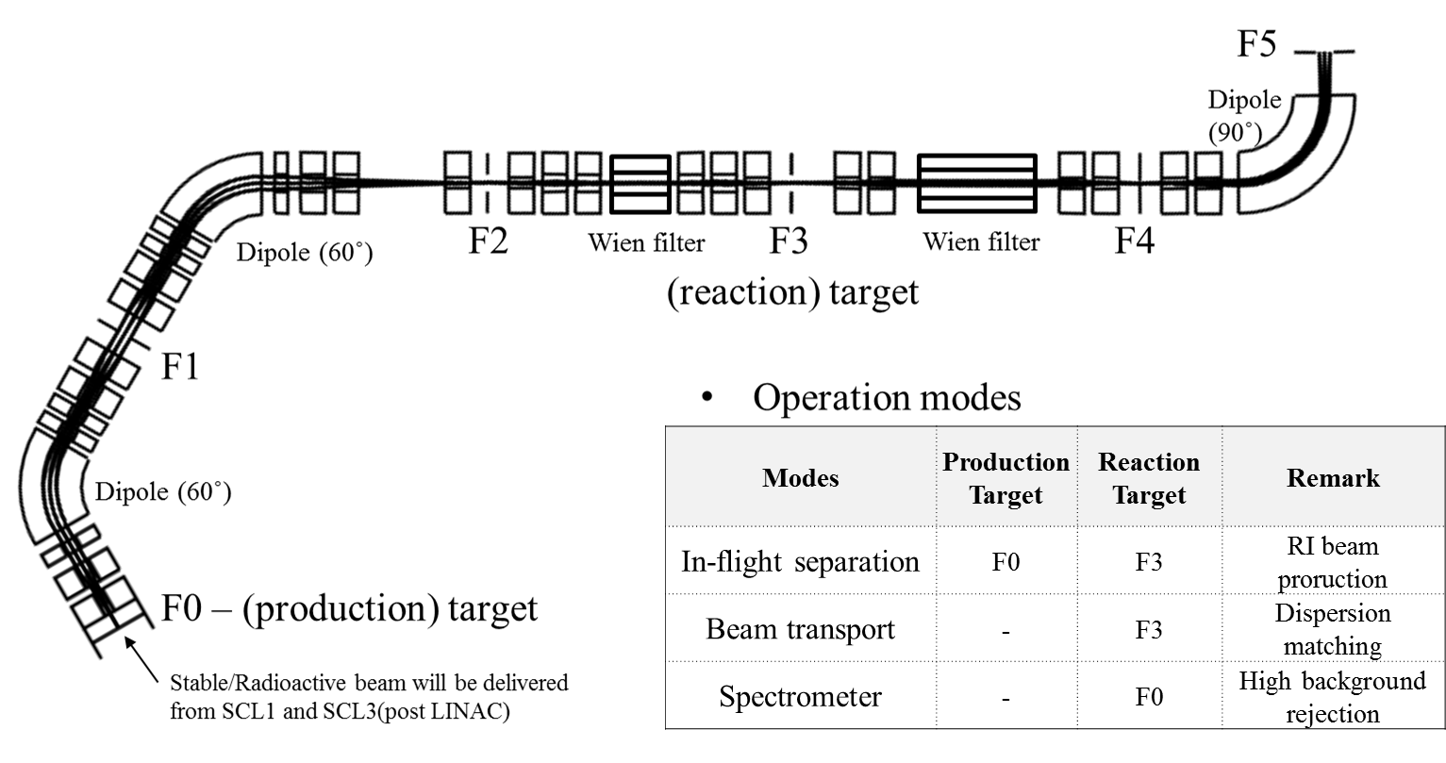
Characteristics of the KOBRA
Versatile two-stage device
RI beams production (stage1)
- low energy in-flight method
- Quasi Projectile Fragmentation
- Polarized RI beam (beam swinger)
High performance spectrometer (stage2)
- Rotatable
- Large acceptance (>50mSr) by movable Q magnets just after F3
- High momentum resolution (p/Δp ~ 10,000) by dispersion matching

Slide 21
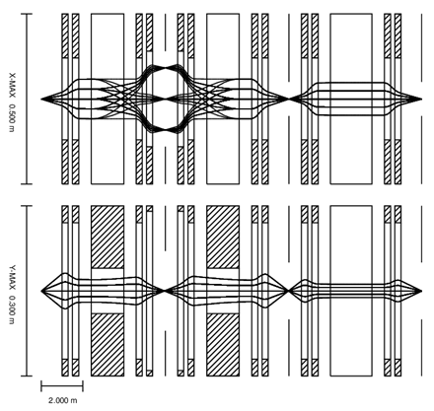
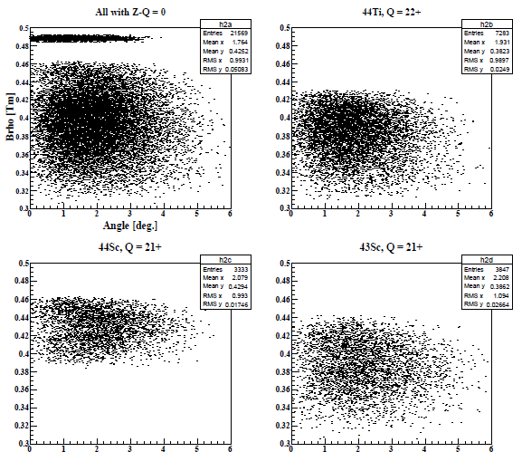
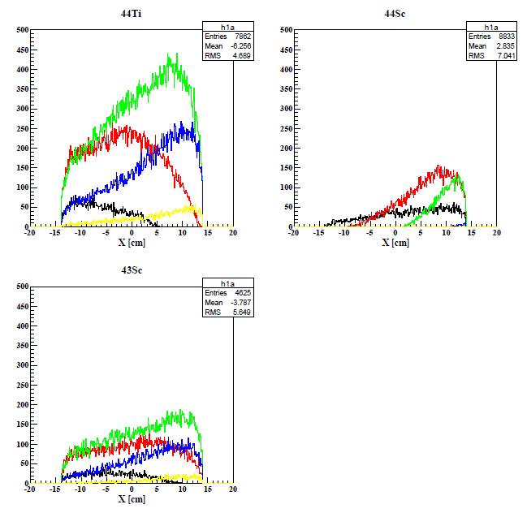
Beam Production (⁴⁴Ti)
⁴²Ca(³He, n)⁴⁴Ti @ E = 5.77 MeV/u
E (⁴²Ca) = 5.77 MeV/u ± 0.1%,
beam size = ± 1 mm,
Δθ = ± 5 mrad,
³He target thickness : 2.4 mg/cm²
F0
D1
F1
D2
F2
Wien Filter 1
F3
⁴²Ca ²⁰⁺
All with Z-Q = 0
⁴⁴Ti ²²⁺
⁴⁴Ti
⁴⁴Sc
⁴⁴Sc ²¹⁺
⁴³Sc ²¹⁺
⁴³Sc
@ F1
Q = Z, Z-1, Z-2, Z-3, Z-4

Slide 22
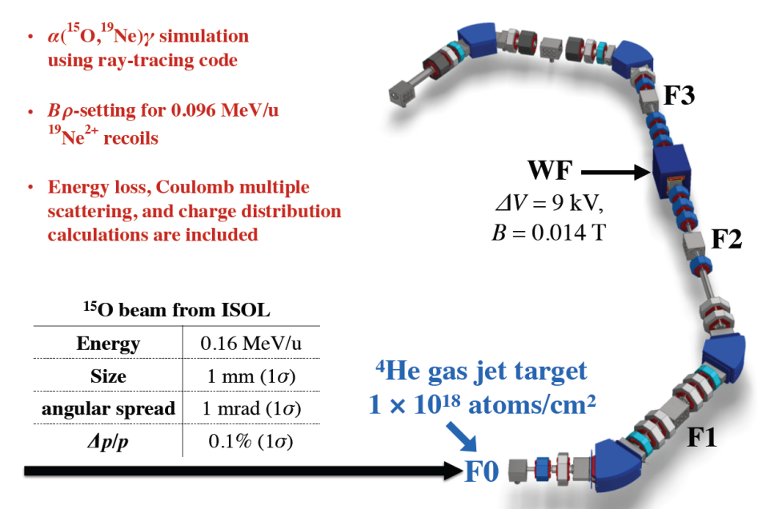
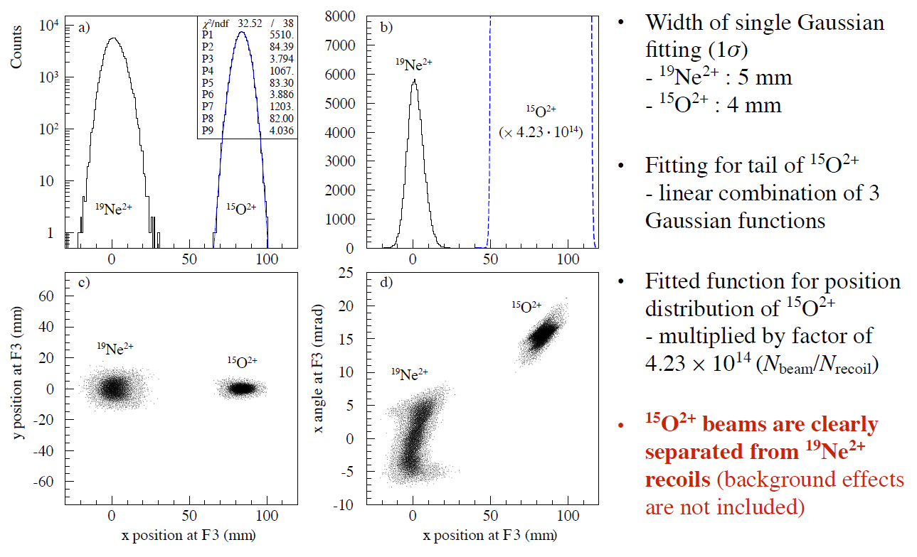
Case study 1: Direct measurement of ¹⁵O(α,γ)¹⁹Ne
Motivation
- ¹⁵O(α,γ)¹⁹Ne reaction
: breakout path from hot-CNO to rp-process
: key reaction to understand nucleosynthesis under explosive stellar environments
Experimental Challenges
- For direct measurement of cross section we need
: ¹⁵O RI beam intensity > 10¹⁰pps , Helium-4 target density > 10¹⁸ atoms/cm²,
recoil detection efficiency > 40% → then ~1 counts/hr
Simulation to check the performance of KOBRA

Slide 23
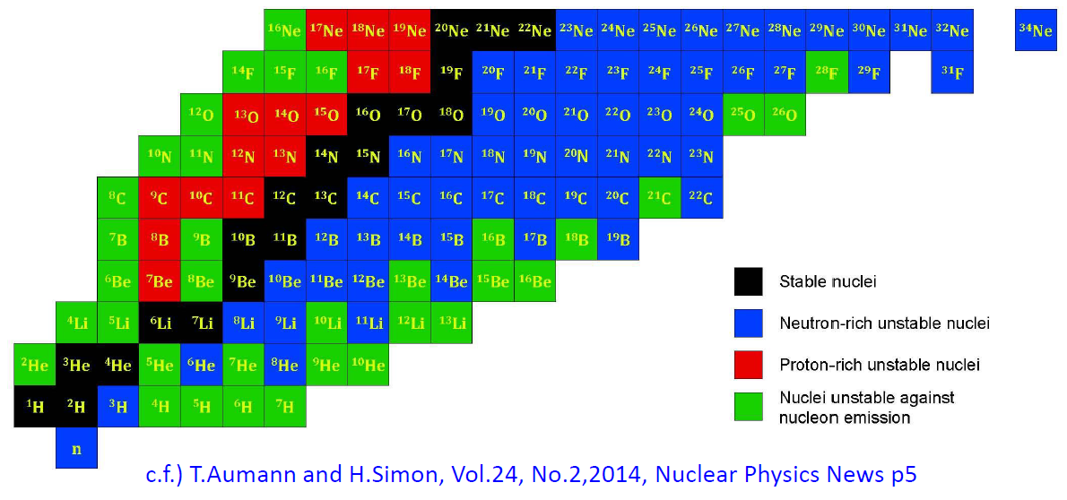
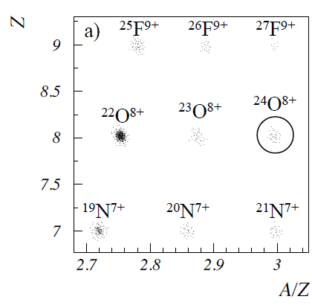
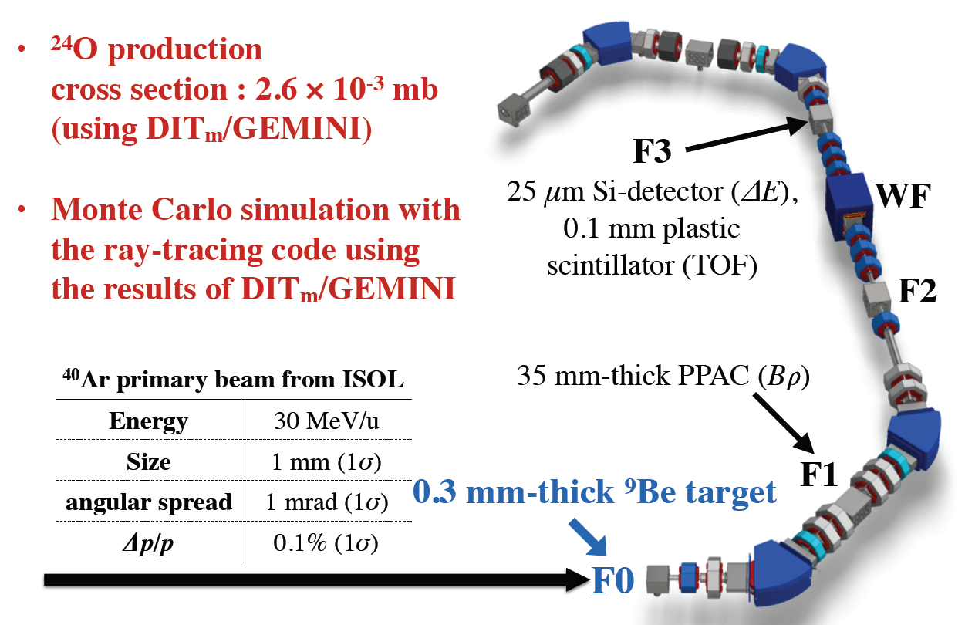
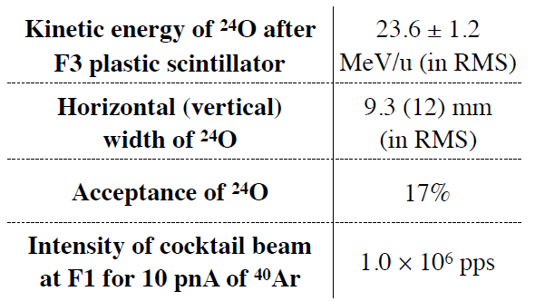
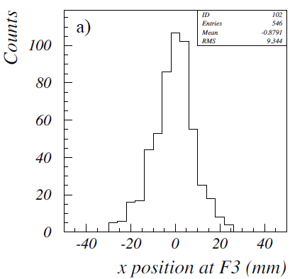

Case study 2: Production of ²⁴O
Motivation
- ²⁴O
: the most n-rich of bound Oxygen isotopes
- RIBs’ production capability of KOBRA,
especially RIBs near p- or n-drip line needs
to be checked
: comparison with other facilities
Simulation to check the performance of KOBRA

Slide 24
Schedule
2017 |  |  |  | 2018 |  |  |  | 2019 |  |  |  | 2020
Q1 | Q2 | Q3 | Q4 | Q1 | Q2 | Q3 | Q4 | Q1 | Q2 | Q3 | Q4 | Q1 | Q2 | Q3 | Q4
 |  | KOBRA stage 1 Manufacturing
 |  |  |  |  |  |  | Delivery/Installation
 |  |  |  |  |  |  |  |  |  |  |  |  | Commissioning
 |  |  |  |  |  |  |  |  |  |  |  |  |  |  | Day-1 Exp.
Completion of construction of Low energy experimental hall A
1st RI beam (ISOL)
Completion of construction of RAON
Present
1st Stable ion beam
Present man power
 | Separator & Spectrometer group (RISP) | Other group (RISP) | Collaboration
Stage 1 design | Dr. K. Tshoo (Old group members: Mr. J. Park Mr. H. Chea, Mr. M.S. Kwag, and Dr. Y. Satou) | Dr. M. Kim (beam dump) Safety Team (Radiation safety) | S. Kubono (RIKEN) S. Kato (Yamagata Univ.) G. Souliotis (Univ. of Athens) G.P.A. Berg (Univ. of Notre Dame) N. Iwasa (Tohoku Univ.) H. Yamaguchi (CNS) K. I. Hahn (Ewha Womans Univ.) K. Chae (SKKU) Y.K. Kim (Hanyang Univ.) S. Choi (SNU) C.S. Lee (CAU)
Science program | Dr. T. Hashimoto with the help of Dr. Yun | Dr. Y. Satou and Dr. H. Ishiyama
KoBRA target |  | Dr. J.Y. Kim and Dr. H.J. Woo
From K.Tshoo @ RIPS 2017/06/29

Slide 25
Outline
Nuclear astrophysics @ RAON
  RAON (the RI accelerator in Korea)
  KoBRA
Nuclear astrophysics @ RIKEN
  Experiments on the rp-process @ RIKEN
  Selected experiments at CNS
Summary

Slide 26
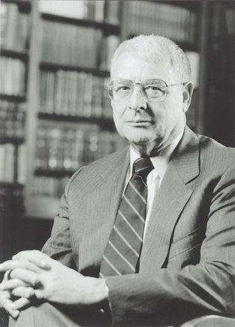
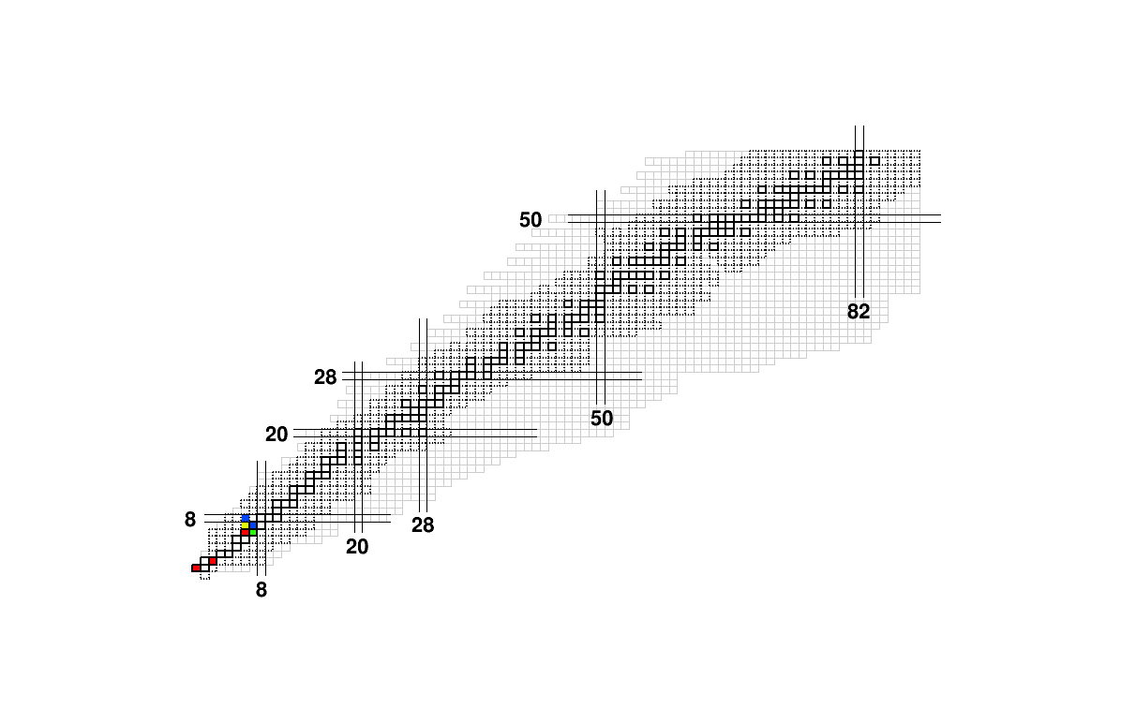
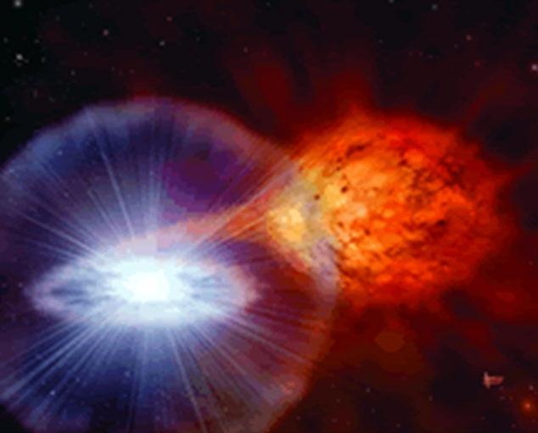

Impact on the studies of nuclear astrophysics
rp-process in X-ray burst
Nuclear inputs:
Masses, Half-lifes,
Reaction rates
Waiting point
⁶⁴Ge,⁶⁸Se,⁷²Kr
R. Giacconi
2002 Nobel奖
X-ray burst
Notes:
X-射线爆是热门话题。已观察到上百个。可帮助我们认识中子结构。
爆发时，中子星吸积H/He，形成高温密环境，导致不可控热核反应，X-射线通量在几秒内突然变化。
该模型涉及大量短寿命原子核质量数量。这些数据的不确定性，影响模型预言的观察量。
精度<100 keV，相当多的核质量不达标。

Slide 27
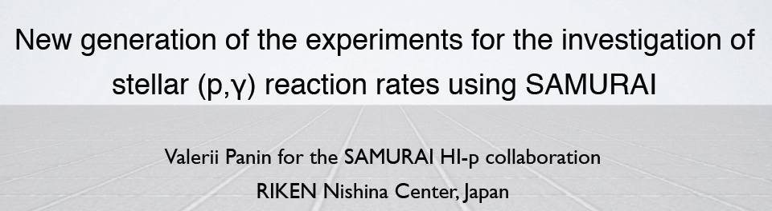
HI-proton Collaboration
T. Motobayashi, T. Uesaka, K. Yoneda, M. Kurokawa, V. Panin, H. Murakami, P. Doornenbal, J. Lee, H. Liu, H. Otsu, Y. Shimizu, H. Sato, T.Isobe, L. Stuhl, Y. Shiga, H.Baba, G. Lorusso, H. Wang,
S. Momiyama, M. Niikura, D. Steppenbeck, R.Taniuchi, H. Sakurai,
T. Kobayashi, N. Iwasa, Y. Togano, N. Aoi,
A. Saastamoinen, R. E. Tribble, C. Bertulani,
L. G. Sobotka, J. Elson, K. Brown, C. Pruitt,
J. C. Blackmon, B. C. Rasco, L. Trache,
K. I. Hahn, D. Kim, A. Parikh,
Á. Horváth, L. Illés, Z. Elekes, Zs. Dombrádi, Zs. Fülöp, G. G. Kiss, Z. Korkulu, A. Krasznahorkay, D. Sohler, Zs. Vajta

Slide 28
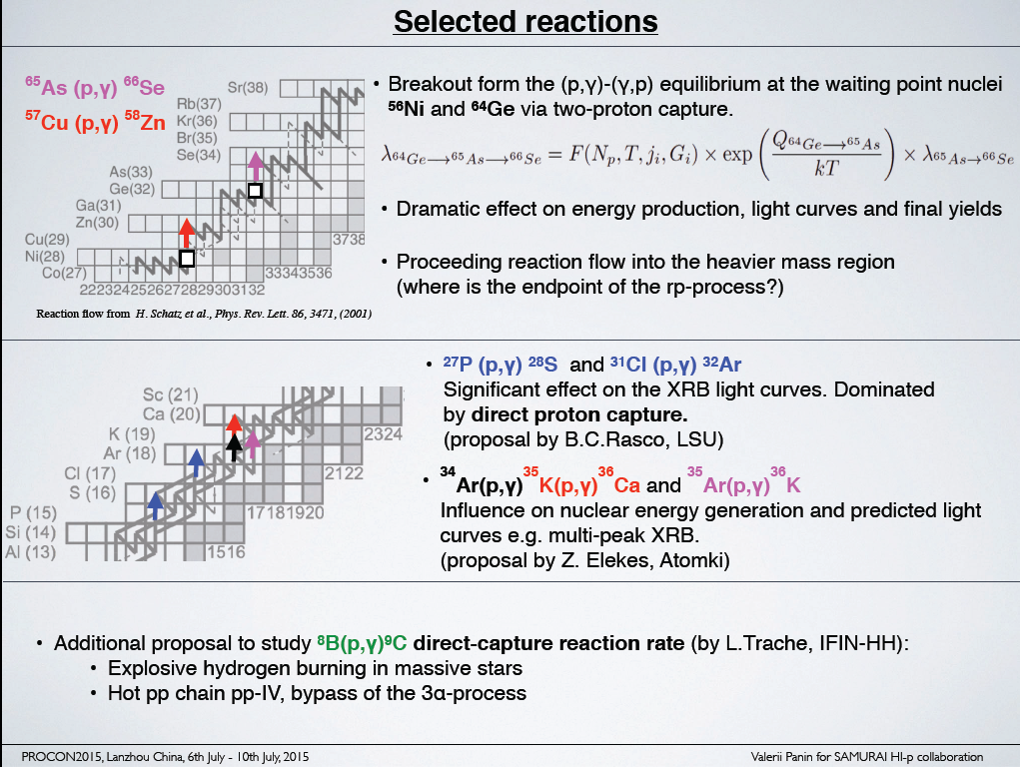

Slide 29
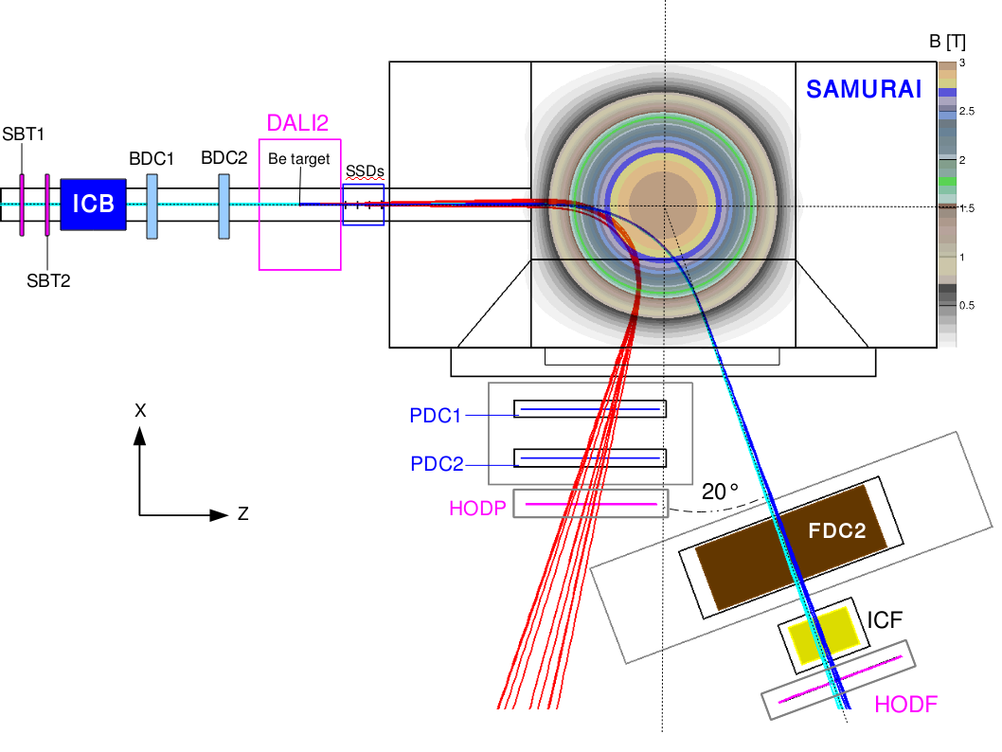
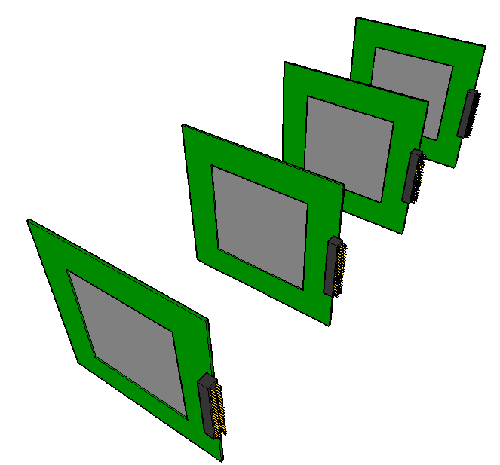
High-resolution mode of the SAMURAI setup
(iron yoke shields the magnetic field)
~10³ pps secondary beams of
⁵⁹Zn and ⁶⁷Se @ 250 MeV/u
2 mrad resolution
Heavy fragments
rail platform
Silicon microstrip trackers
for coincident HI-proton tracking
Strip pitch 684 um
Wide dynamic range 10⁴
Relative HI-p angle
Protons

Slide 30
Z
rp process
²⁴Al
²⁵Al
N
²¹Mg
²²Mg
²³Mg
²⁴Mg
CNO cycle : T₉ < 0.2
HCNO cycle: 0.2 < T₉ < 0.5
rp process : T₉ > 0.5
²⁰Na
²¹Na
²²Na
²³Na
¹⁸Ne
¹⁹Ne
²⁰Ne
²¹Ne
²²Ne
(α, γ)
(α, γ)
¹⁷F
¹⁸F
¹⁹F
(α, p)
¹⁴O
¹⁵O
¹⁶O
¹⁷O
¹⁸O
¹³N
¹⁴N
¹⁵N
Stable
¹²C
¹³C
HCNO cycle
Unstable
CNO cycle
Notes:
Half life of 17F = 64 s, 15O = 122 s; 14O = 70.6 s

Slide 31
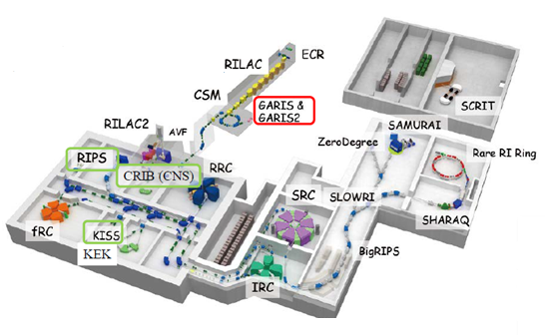
RIKEN/
RI Beam Factory

Slide 32

RIB Experiment at CNS
⁴He+¹⁴O
¹⁴O(α,p)¹⁷F
: Primary target
H_{2,} 400 torr, 80K
¹⁴N beam 8.4 MeV/u
From the AVF cyclotron
: Secondary target.
He gas, 450 torr
detectors
Wien filter
Secondary
¹⁴O (RI) beam
Notes:
14O secondary beam was produced through the well known reaction,14N(p,n)14O.
The energy of the 14N6+ primary beam was 8,4 MeV/u, H2 400 torr, 500 pnA

Slide 33




Slide 34


Slide 35
¹⁸F(p,α)¹⁵O reaction in nova explosion
¹⁷O(p,γ)
¹⁷F(p,γ)¹⁸Ne(e⁺ν_{e})
(p,α)¹⁵O
(p,γ)¹⁹Ne
¹⁸F
τ ~ 2hrs, β⁺-decay
Important positron annihilation source
τ ~ 2hrs, β⁺-decay
¹⁸F(p,a)¹⁵O reaction rate is dominated by
1. 3/2⁻ resonance at E_{cm} = 330keV ⇒ clearly measured.
2. the interference of 3/2⁺ states at E_{cm}= 8 and 38 keV and broad
resonance at E_{cm}= 665 keV ⇒ still controversial !!
Notes:
The emission of gamma rays by novae is dominated by e-e+ annihilation of which main source is from beta decay of 18F.
18F is produced via the 17O(p,g)18F reaction and by beta decay of 18Ne, while it is destroyed by the 18F(p,a)15O and 18F(p,g)19Ne reactions.
18F(p,a)15O rate is dominated by the two known resonances at Ex=6.74 and 7.07 MeV.

Slide 36


None of three states just above the proton threshold are found to be consistent with 3/2+ assignment!
Notes:
By the way, a recent PRL paper shows very different results. This box represents three states just above the proton threshold. But, as you see, any of these states are not consistent with a 3/2+ assignment. So, we need to identify this problem.

Slide 37

We need to decide the resonance energy and J^{π} of important states around the proton threshold for the determination of the reaction rate.
7.07 (3/2+)
6.74 (3/2-)
6.41
¹⁸F+p
3.53
¹⁵O+α
¹⁹Ne
Low alpha threshold energy!
Easy to find the resonances around the proton threshold
via ¹⁵O + α !
Notes:
7MeV 이하 즉, 가모윈도우 내에서 알파위쓰를 직접 측정한 적은 없음. 모두 계산 값.

Slide 38


We performed the ¹⁵O + α experiment in the range
E_{x}=3.53-12.0 MeV in ¹⁹Ne for understanding
the resonances of ¹⁹Ne and their astrophysical implications to
novae and alpha cluster structure of ¹⁹Ne.
⇒These measurements will allow us to measure resonance parameters
such as alpha widths, spins, parities and excitation energies of important
resonance states above the alpha threshold (E_{th}=3.53MeV).
1. First observation of alpha cluster states in ¹⁹Ne
Γ_{w} vs. Γ_{α}
2. Identification of the existence and their effects of 3/2⁺ states around
the proton threshold

Slide 39
NP1412-AVF20R1
Measurement of alpha elastic scattering on ¹⁵O
Kevin Insik Hahn
Beam time : Sep. 20~29, 2015 (9days)
AVF cyclotron,
Primary beam : ¹⁵N⁷⁺, 7.0MeV/u, 600pnA
Primary target : H₂ gas, 600 Torr, (90K)
Secondary beam : ¹⁵O⁸⁺
Secondary target : ⁴He, 660 Torr
Mylar
dE-E detector
(20μm-480μm)
¹⁵O
α,p
PPACa
PPACb
210mm
He gas target
¹⁵O beam
purity : 99.9%
intensity : 6×10⁵ /s
¹⁵O
Preliminary
The experiment was performed successfully, as we identified many resonances of ¹⁹Ne.

Slide 40
Summary
Korea will build the RI beam accelerator facility, called RAON. Integration of ISOL and IF is one of the distinct features of RAON.
KoBRA is one of the first experimental facilities at RAON for nuclear astrophysics and nuclear structure studies using low energy RI beams.
Nuclear astrophysics experiments using RI beams at CNS and RIKEN were measured.
New measurements with RI beams at RIB facilities like RAON and RIBF will give us a deeper understanding of the Universe
  Element abundance, star evolution
  X-ray burst, novae, supernovae
Спасибо за внимание!

Slide 42
Cyclotron+ISOL+SCL3 for LE-Exp.
SIB @ 2020
RIB @ 2021
Uniqueness
in terms of beam energy
(SIB, RIB)
➔Variable
from ~500keV/u
to U-18.5MeV/u
& p-88MeV/u
CLS
High Energy Exp. II
HPMMS
~keV/u
Very-low Energy Exp.
High Energy Exp. I
p, d, Li <P-88MeV/u
Neutron Facility
ISOL
Injector3
Cyclotron
SCL3
> U-18.5MeV/u
Conventional
low-energy
scattering experiments
with high precision
using
RIB & SIB
KOBRA
Low Energy Exp.

Slide 43

RIB energy vs. Intensity
@ LE Halls
by KOBRA
@ VLE hall
By HPMMS & CLS

Slide 44



Layout of RAON
Stable ion beams from SCL1 or SCL3
e.g., < 42 MeV/u ¹²C, < 39 MeV/u for ¹⁸O, ….. <18 MeV/u for ²³⁸U
RI beams from SCL3 with ISOL
Maximum energy: about <18 MeV/u for ¹³²Sn, …
SCL1
Low energy experimental hall
Low energy experimental hall B
SCL2
SCL3
IF facility
Low energy experimental hall A
High energy experimental hall B
ISOL facility
High energy experimental hall A
K.Tshoo @ RIPS 2017/06/29

